Slide 1


Long-term performance studies of RPC detectors operated with eco-friendly gas mixtures at the CERN GIF++ facility
Henrietta Szalai
Supervisors: Beatrice Mandelli and Marcello Abbrescia,
Mattia Verzeroli and Stefania Juks

Slide 2
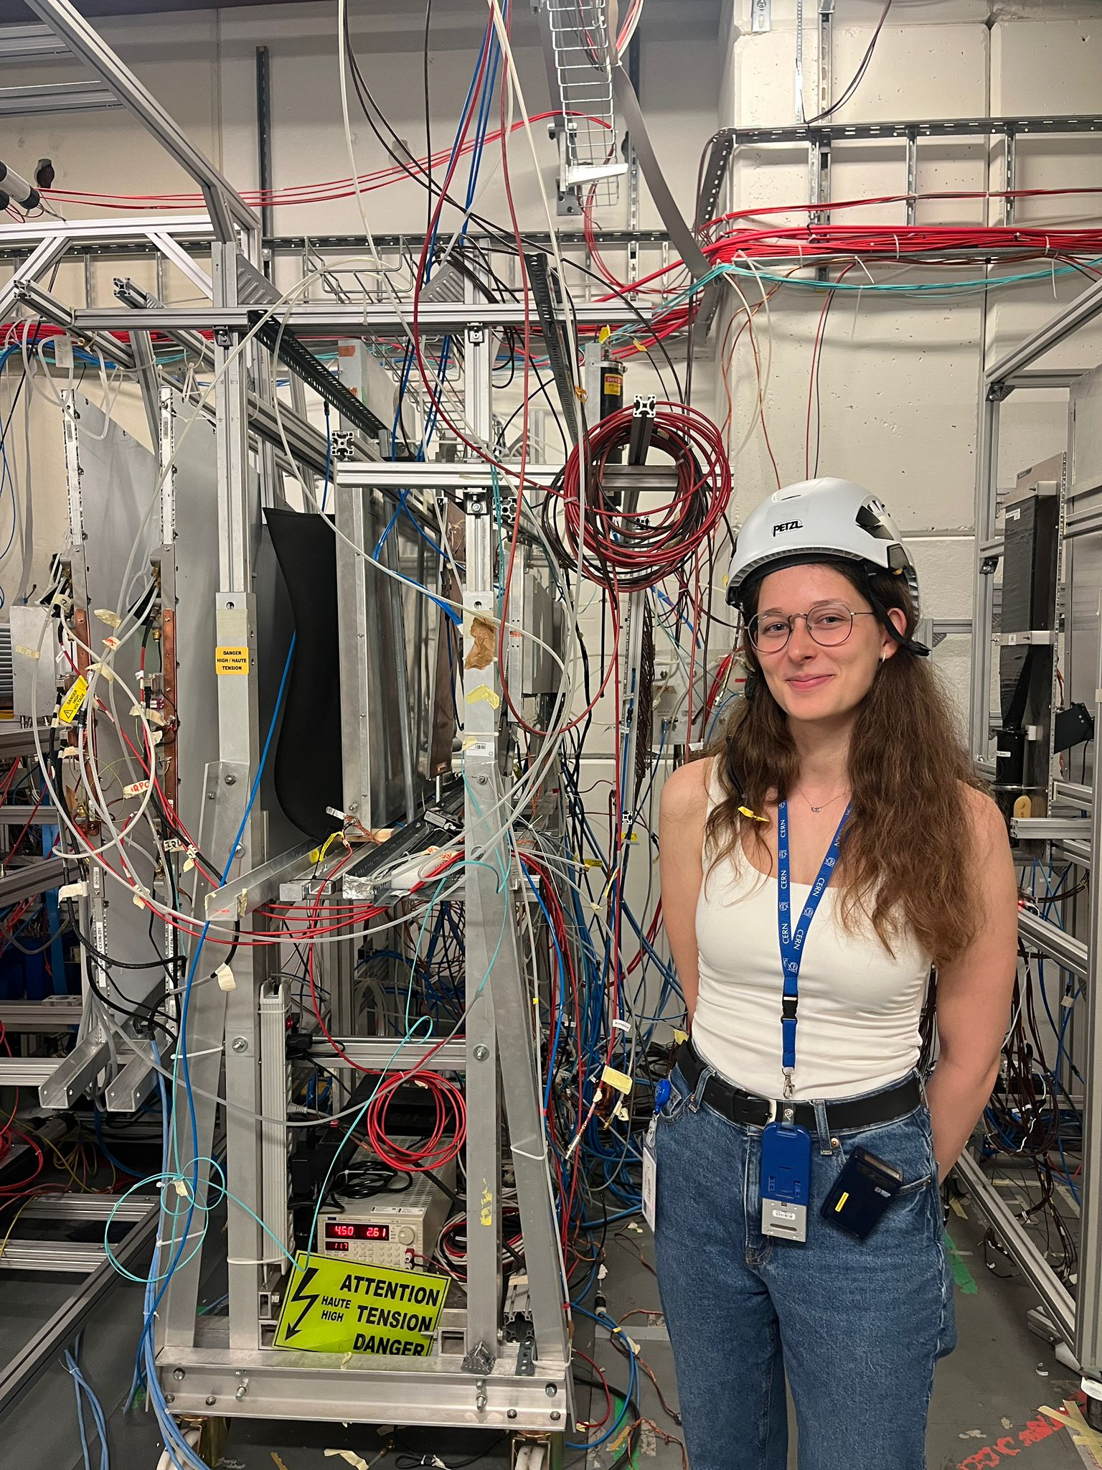

About me
Born and raised in Hungary
Applied Physics and Mathematics in Eindhoven
Internship at HUN-REN Wigner Research Centre for Physics
Hobbies
  Doing sports
  Reading

Slide 3
Dosimeter Calibration
Comparison of the dosimeter fixed on the trolley (visualized on Grafana) and the dosimeter used by ECOGas

Slide 4
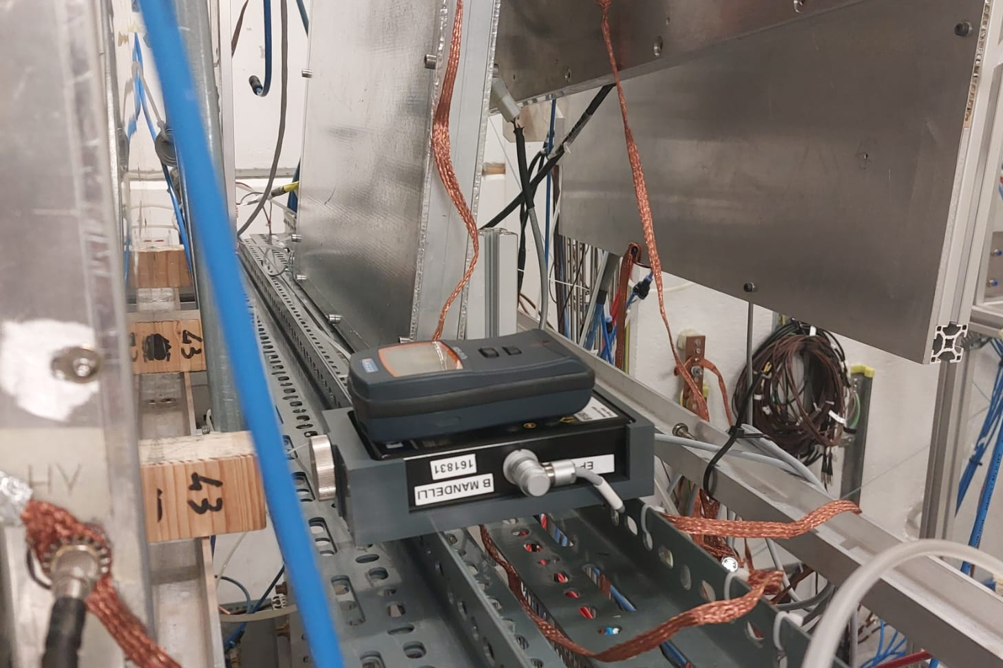
Experimental Setup
Dosimeters on top of each other at GIF++
From low filters (high irradiation) to high filters (low irradiation)
2 minutes measurement with each filter
Notes:
To be updated

Slide 5
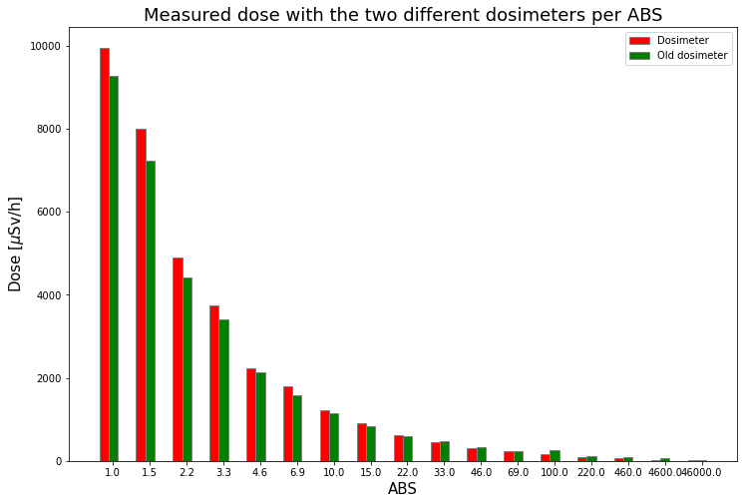
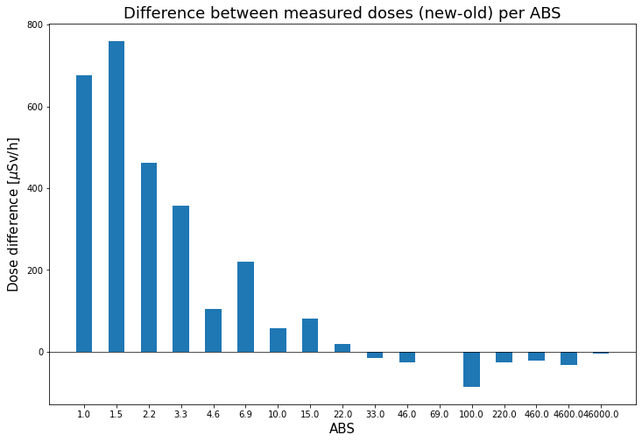
Dosimeter Calibration
Notes:
To be updated

Slide 6
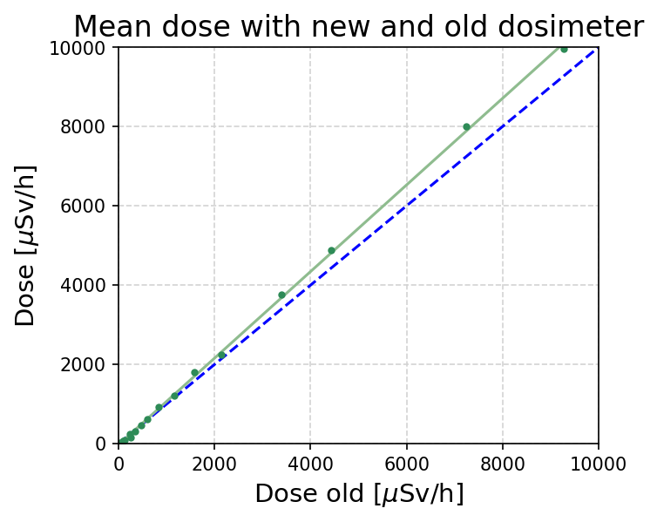

Comparison of the two dosimeters
Data follows approximately linear trend
Bigger difference at higher dose – at lower filters
Linear fit:
$$dose_{new}=1.092 ∙ dose_{old}$$

Slide 7
Aging campaign
Motivation, preliminary results of irradiation campaign in August

Slide 8
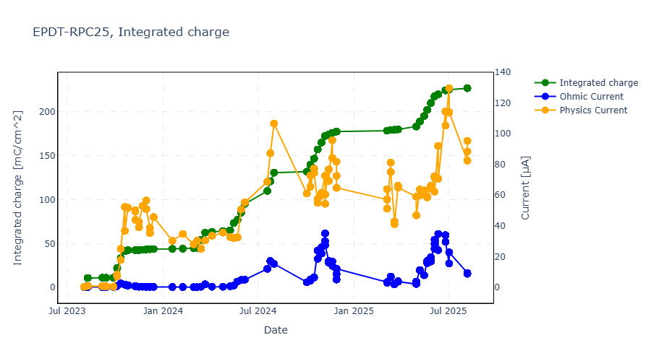
High increase in currents and integrated charge when irradiated
→ irradiation campaign in August
Initial increase
Increase after one month of continuous irradiation
Notes:
Background irradiation is fixed (filter 2.2 300 Hz/cm2)
Even with this we have seen the currents increase, so around 50% efficiency
This is why we take lower irradiation but higher applied voltages

Slide 9
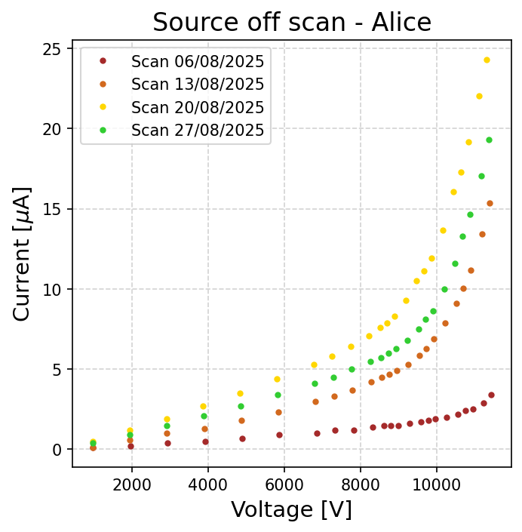
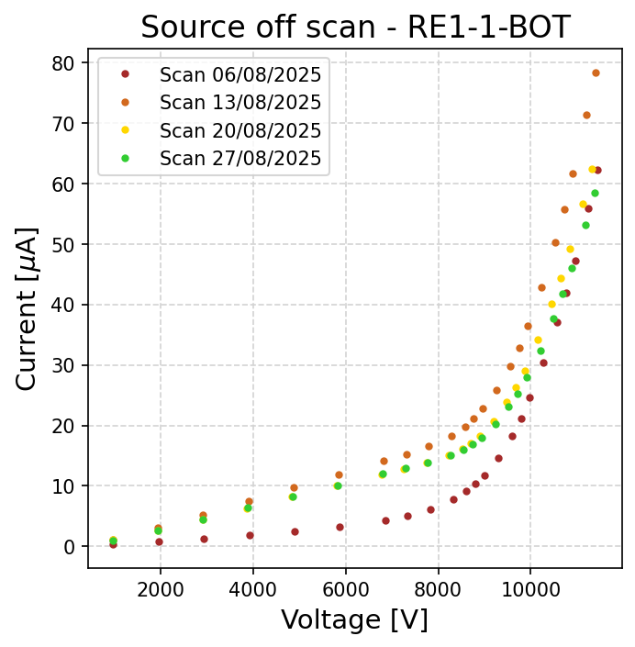
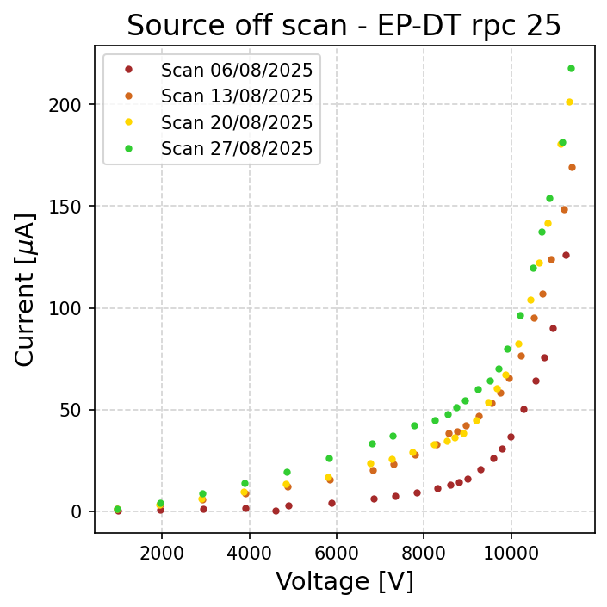
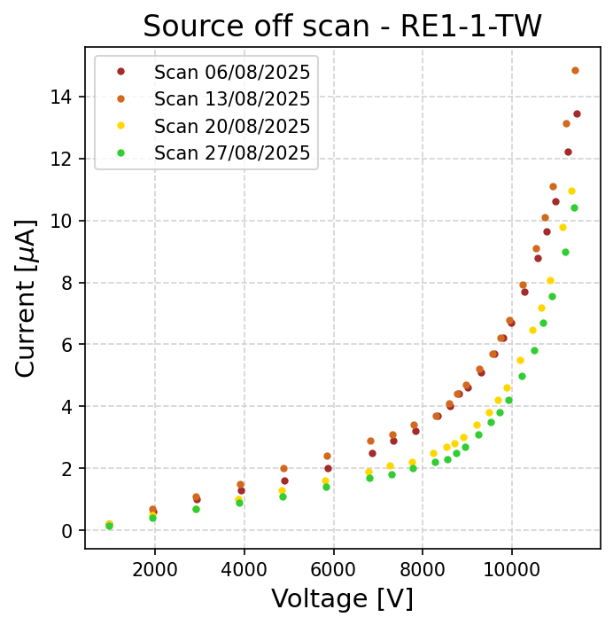
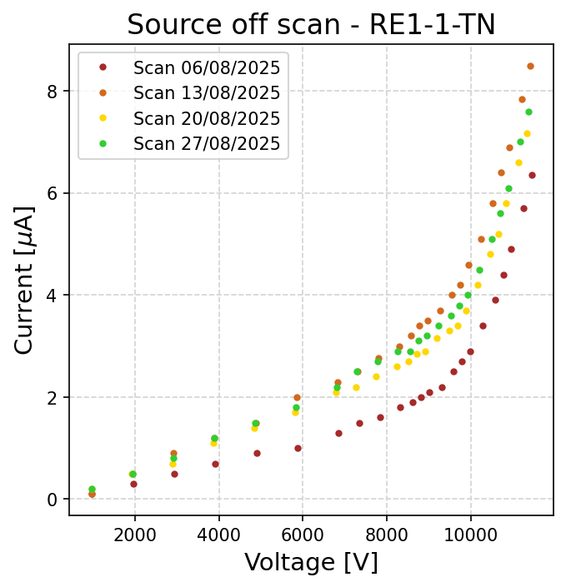
ECO2 current scans in August
Increase in currents after a week of continuous irradiation
New ALICE detector: currents are rapidly rising → under close monitoring
Notes:
This current monitoring is necessary to see how the detector reacts to lower irradiation while keeping it in operation on working point.

Slide 10
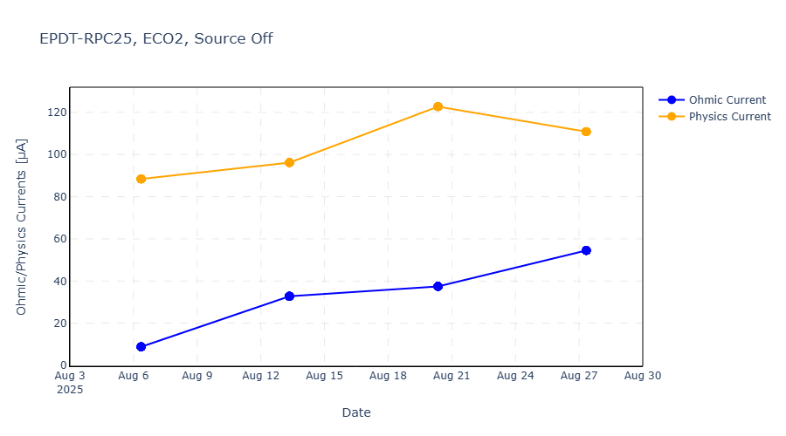
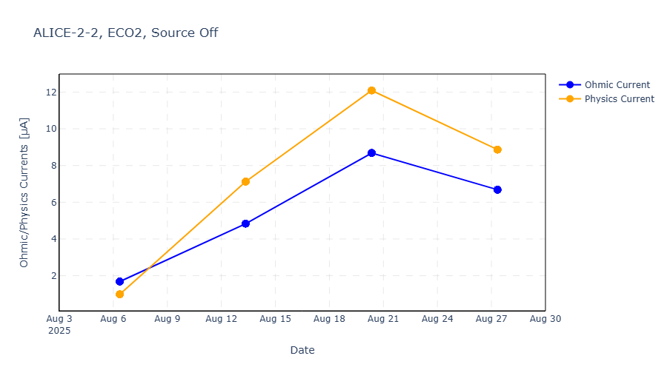
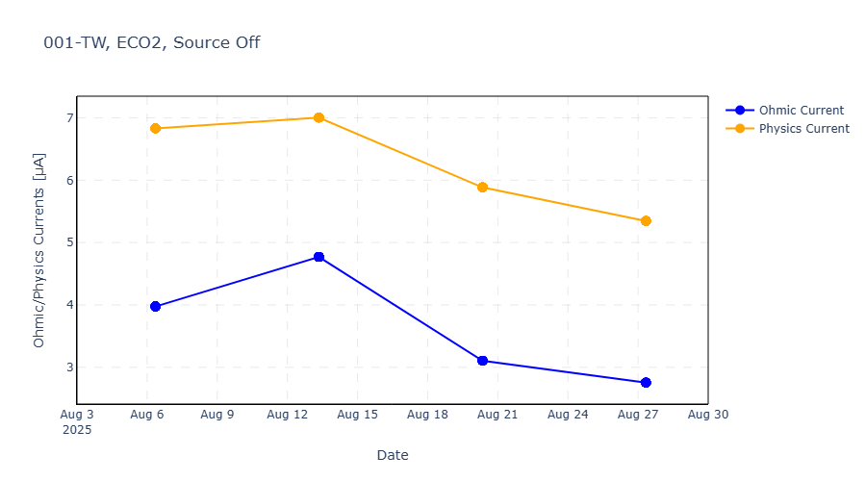
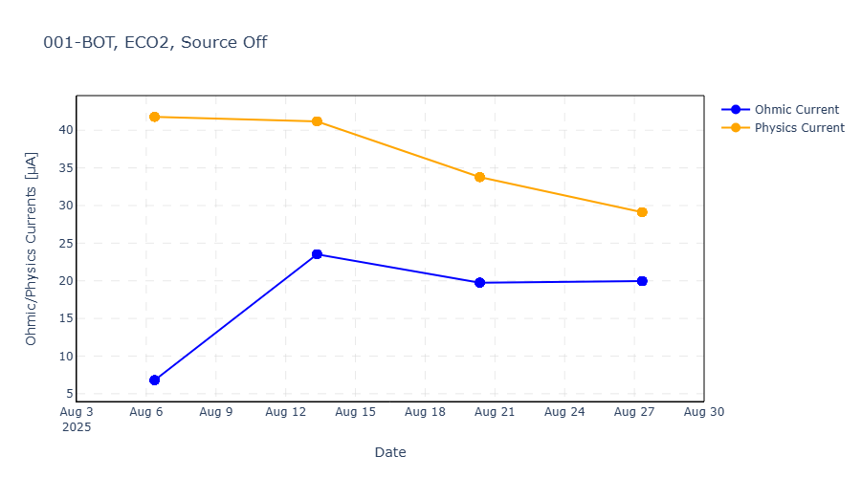
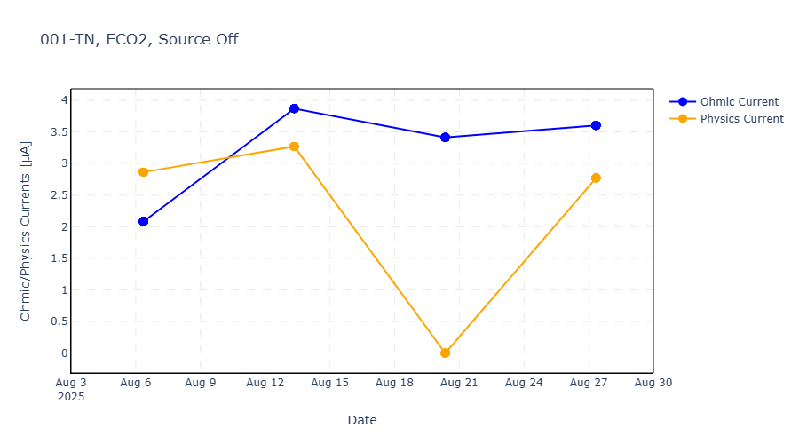
Physics and Ohmic currents at working point
Notes:
This current monitoring is necessary to see how the detector reacts to lower irradiation while keeping it in operation on working point.

Slide 11
ISE Measurements
For rpc6

Slide 12
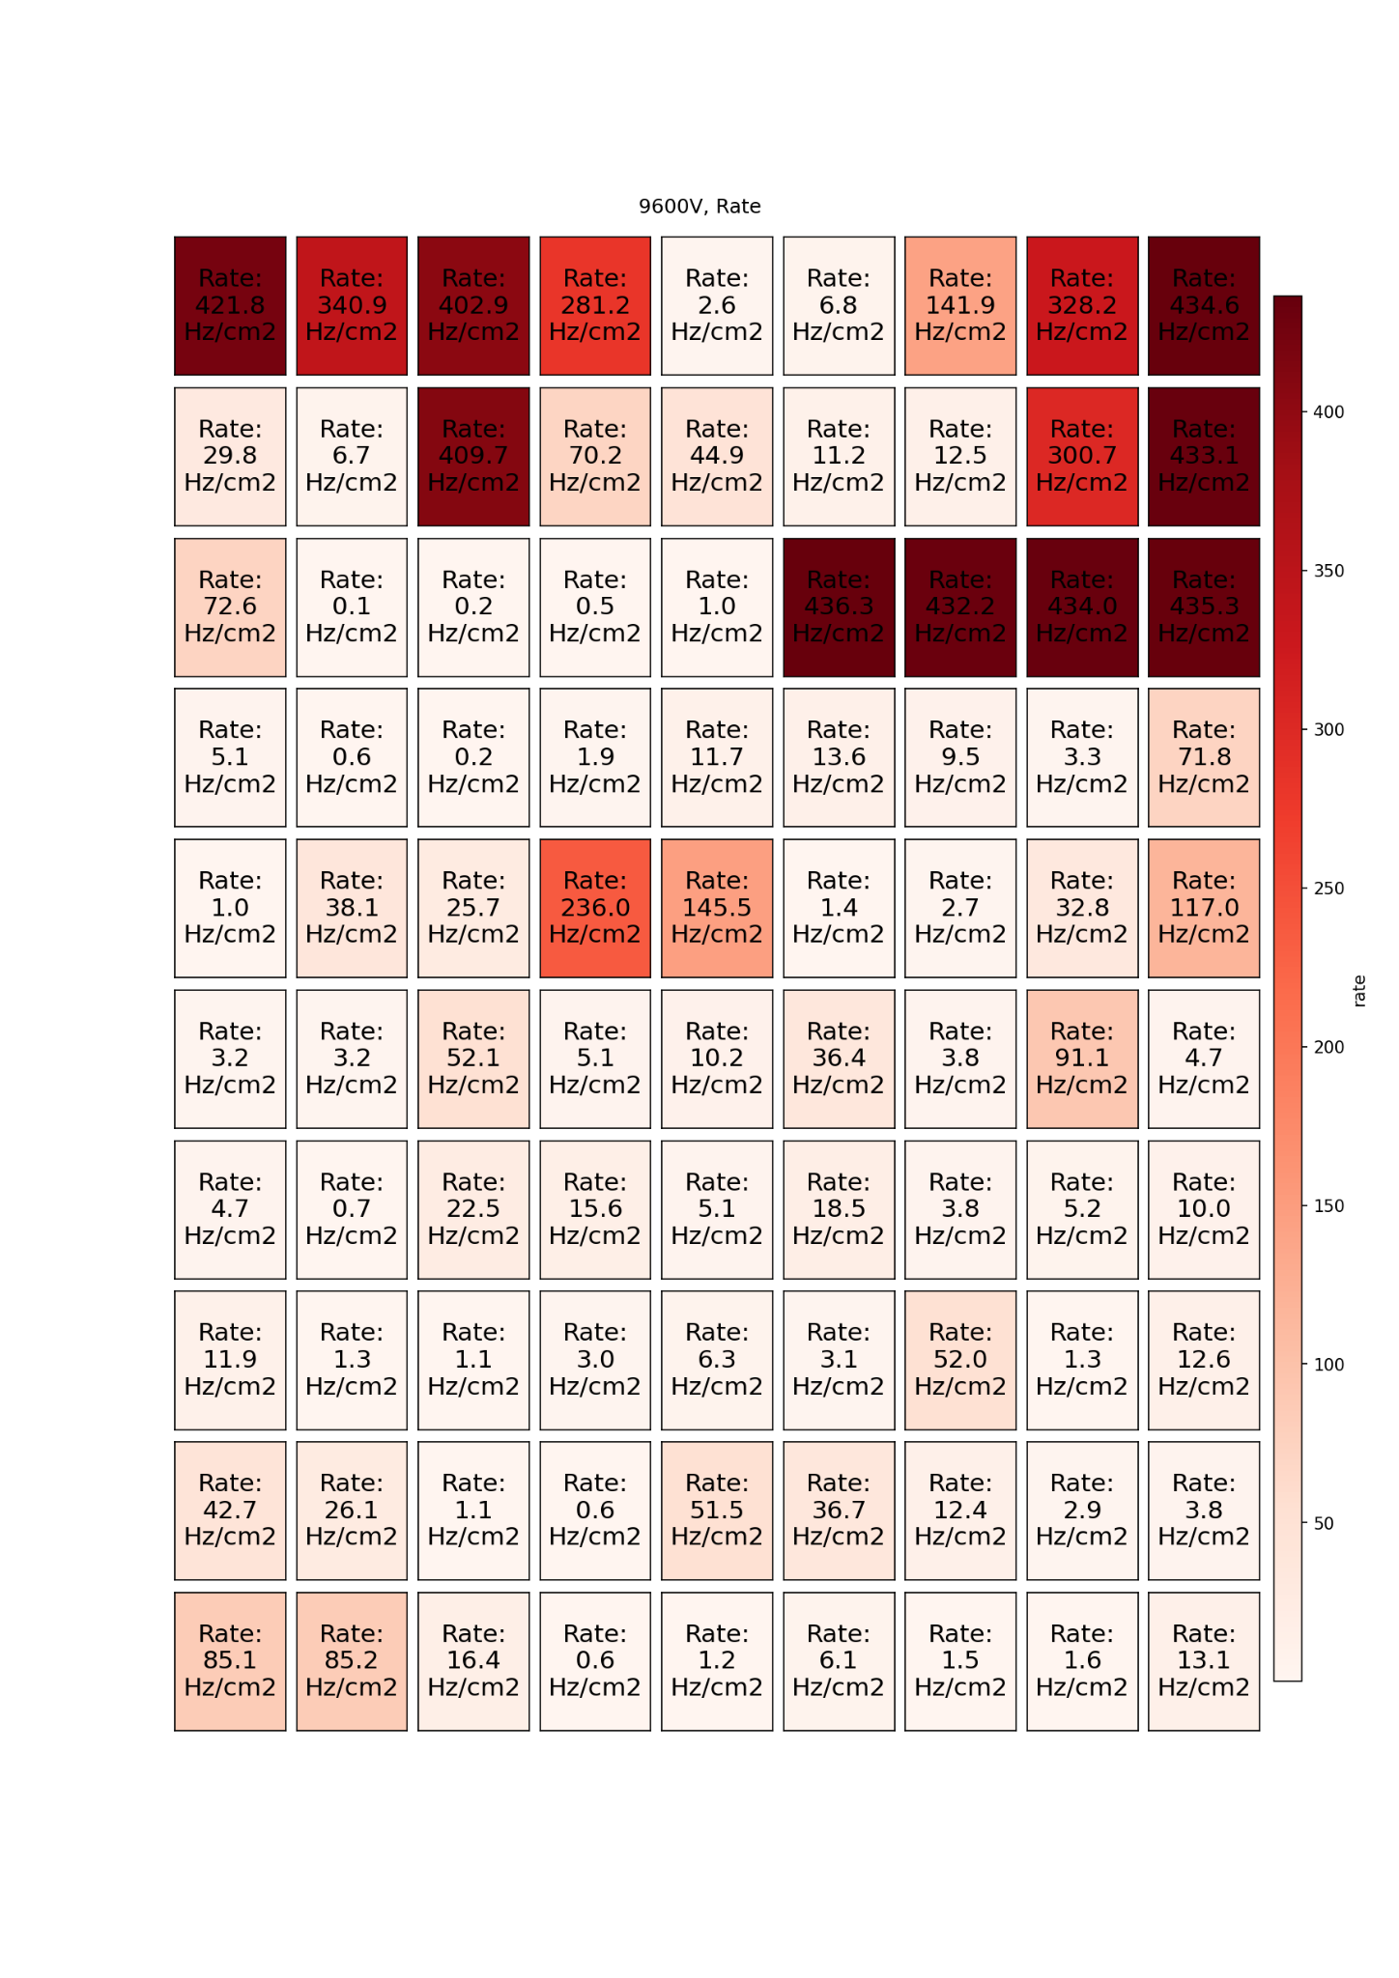
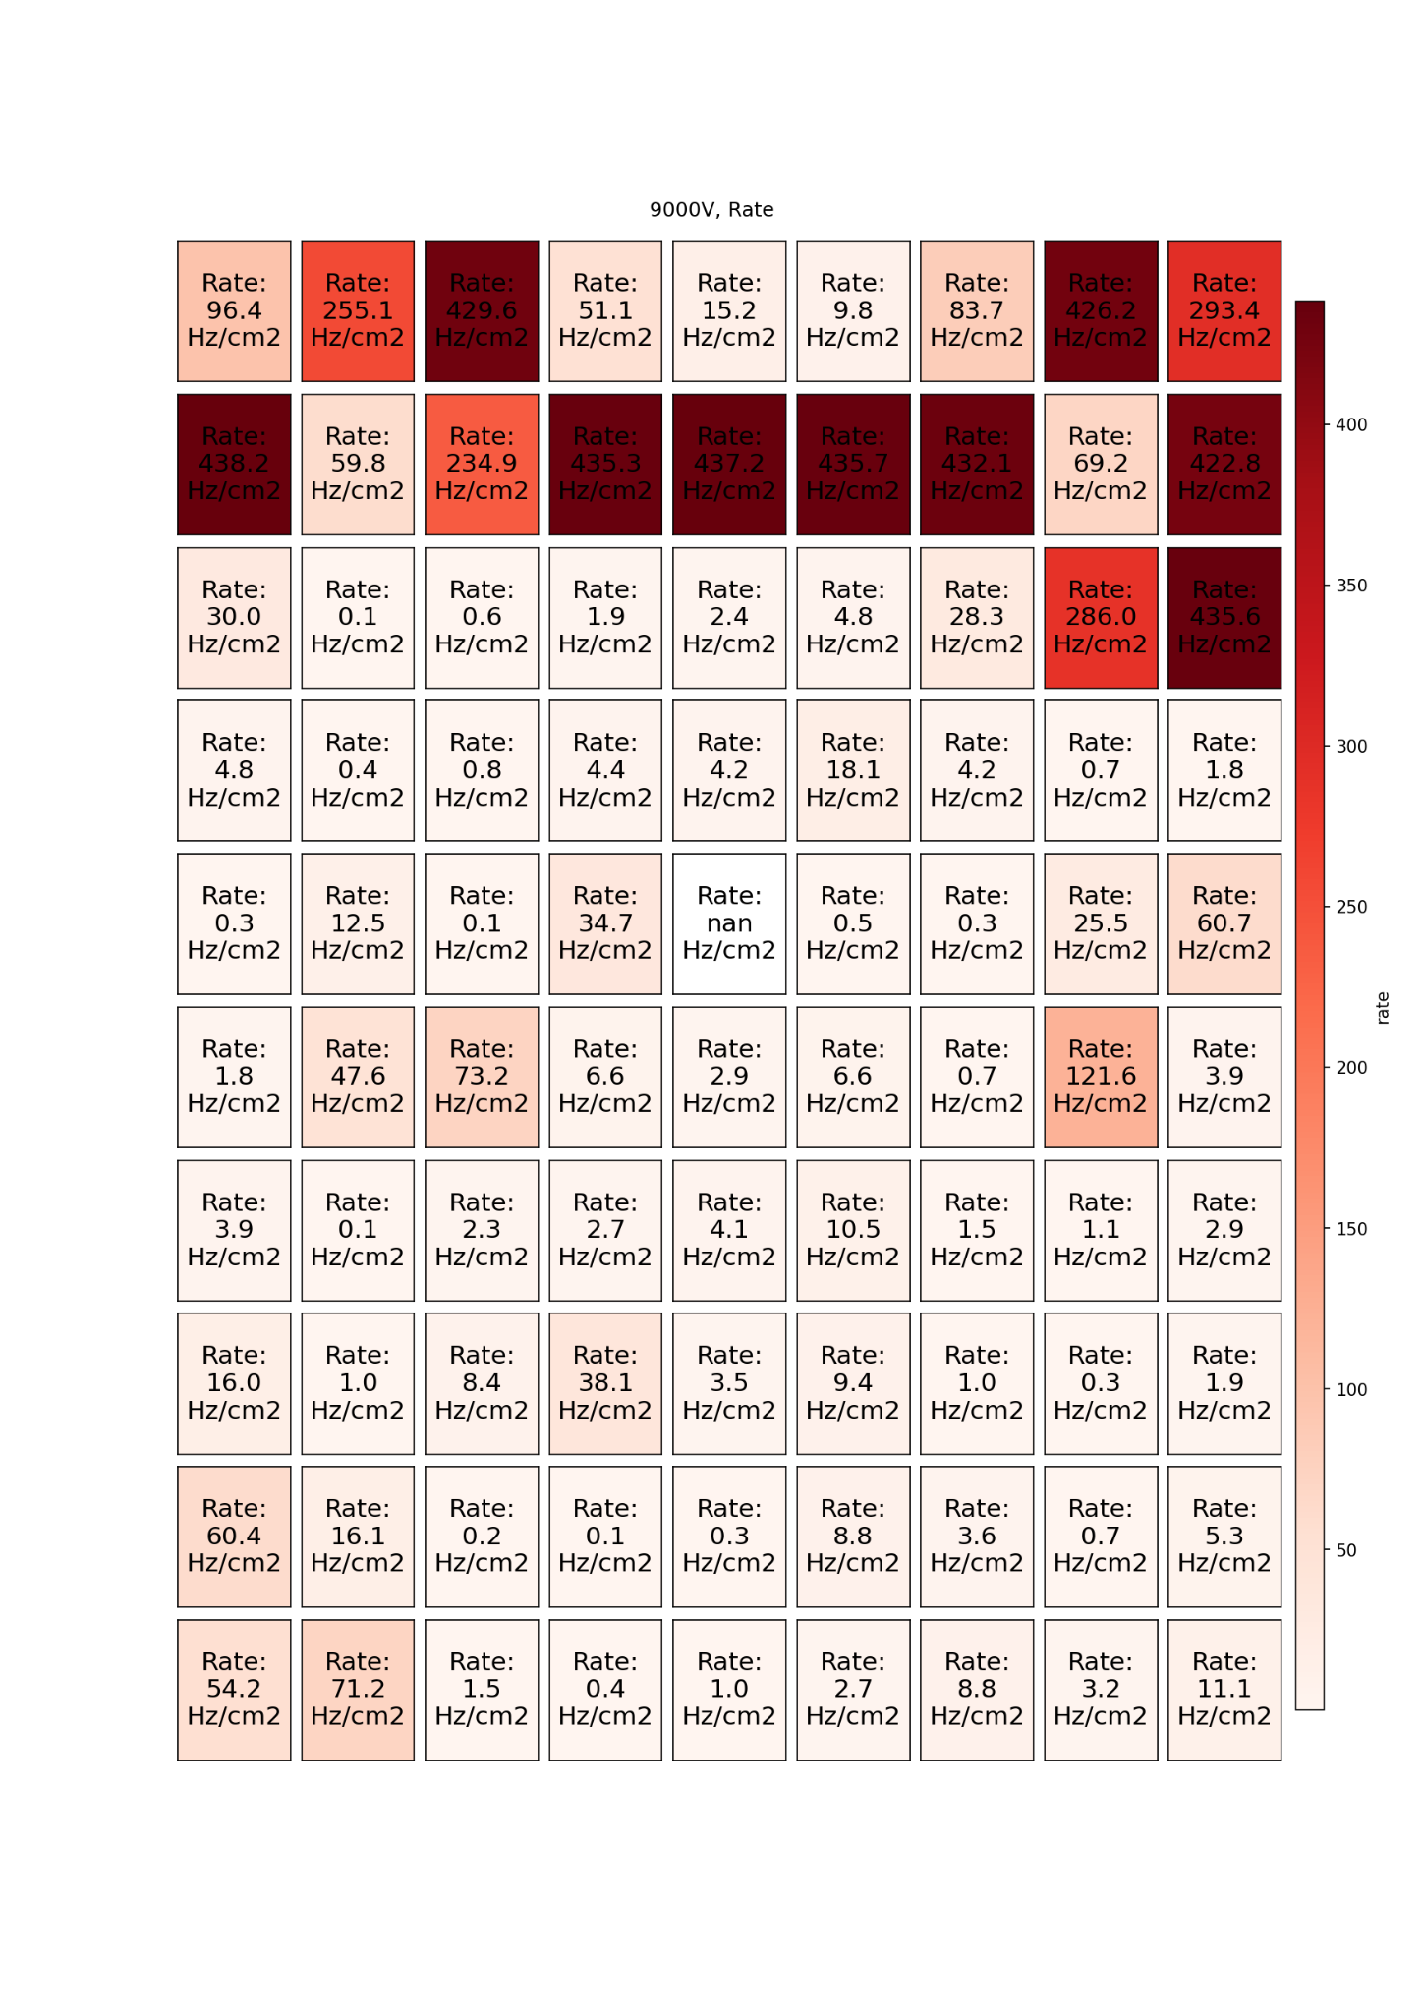
Motivation
Rate gradient
RPC 6 was the previous detector of the EP-DT group for the collaboration
Removed in 2023 due to unstable, high currents
Measurements show that close to the inputs of the detector, the oscilloscope counts more
Options: open right away or do further tests without opening
→ Ion Selective Electrode (ISE) measurement
Rate gradient
9600 V
9000 V
Notes:
]

Slide 13
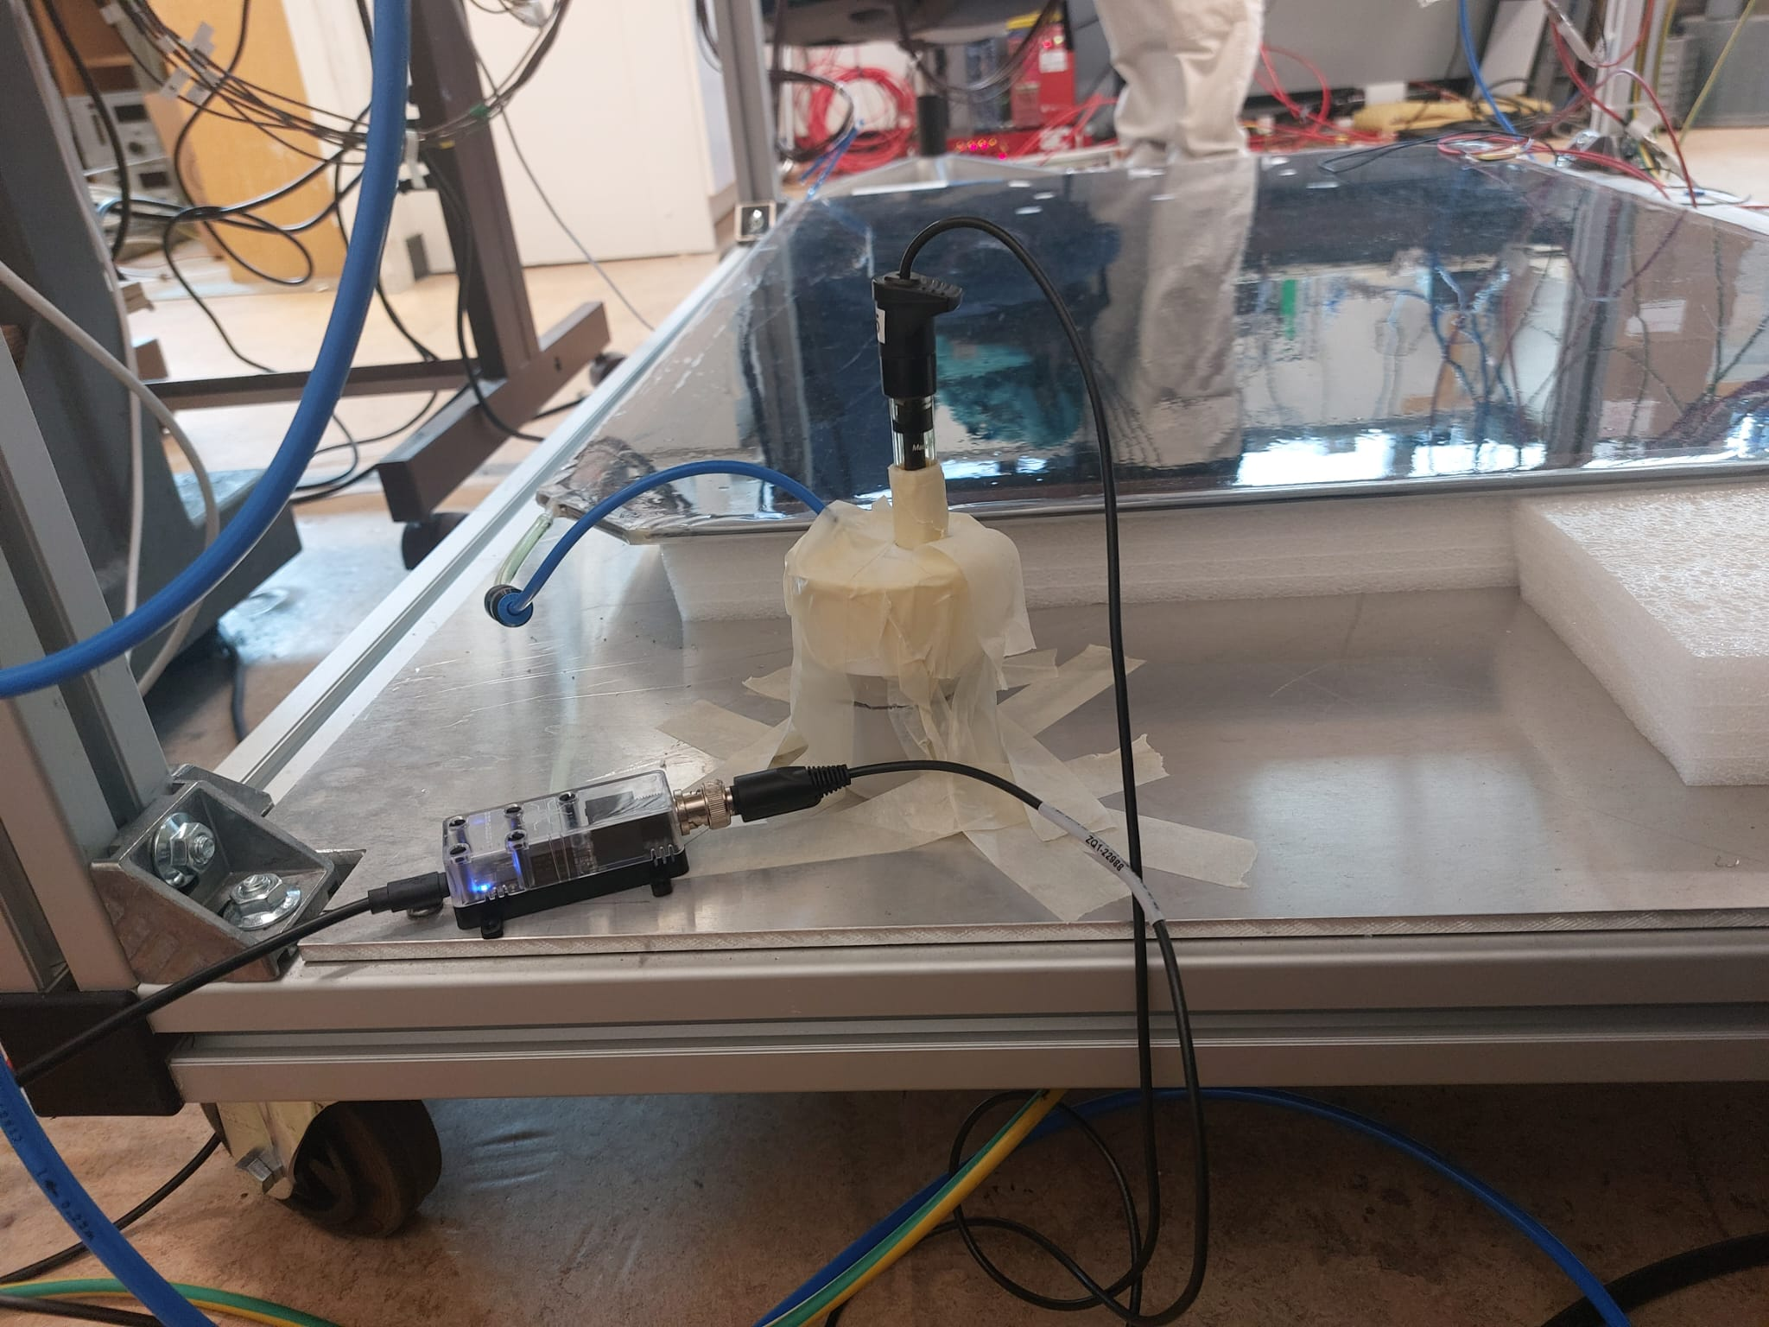
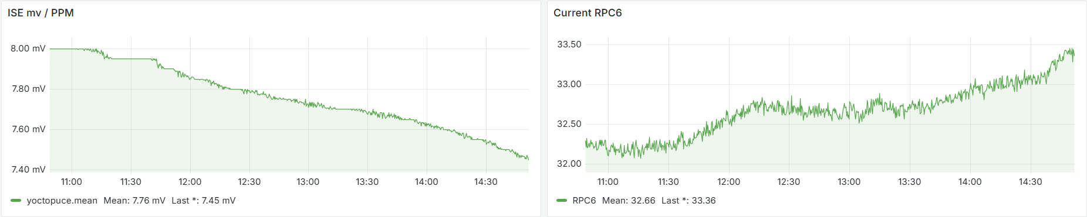
Experimental setup
ISE
Flushing the detector with argon: 1 L/h (rotameter)
30 ml solution
Currents were planned to keep low and stable:
  High voltage kept 2.175 kV
  Current dropped from 45 to 32 μA
RaspberryPI
RPC6
Solution
Computer connection
Notes:
]

Slide 14
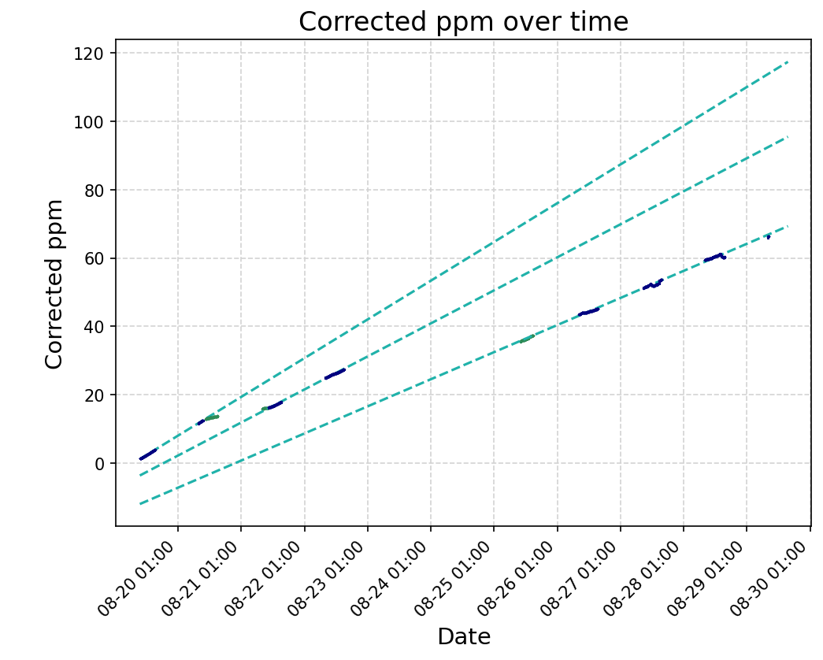
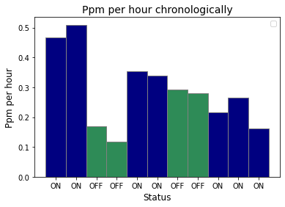
Results
Accumulated ppm follows increasing trend when the detector is on
The amount of ppm per hour slowly decreases in time
Green: measurements taken with detector off
Blue: measurements taken with detector on

Slide 15
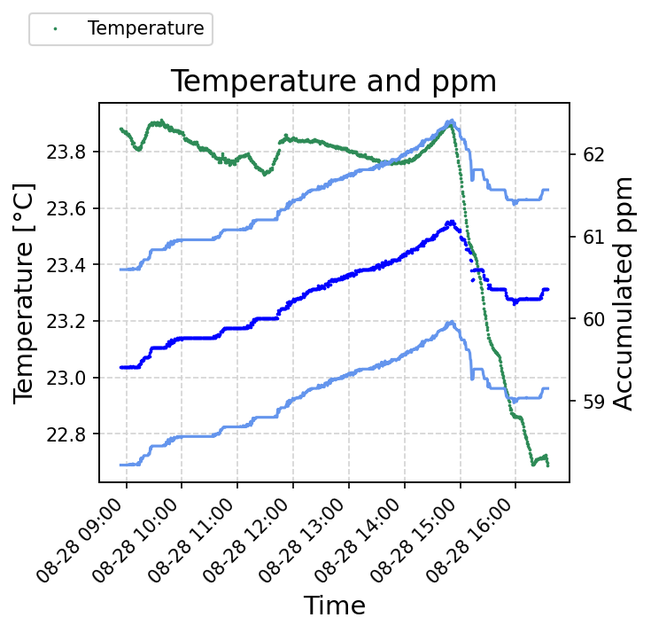
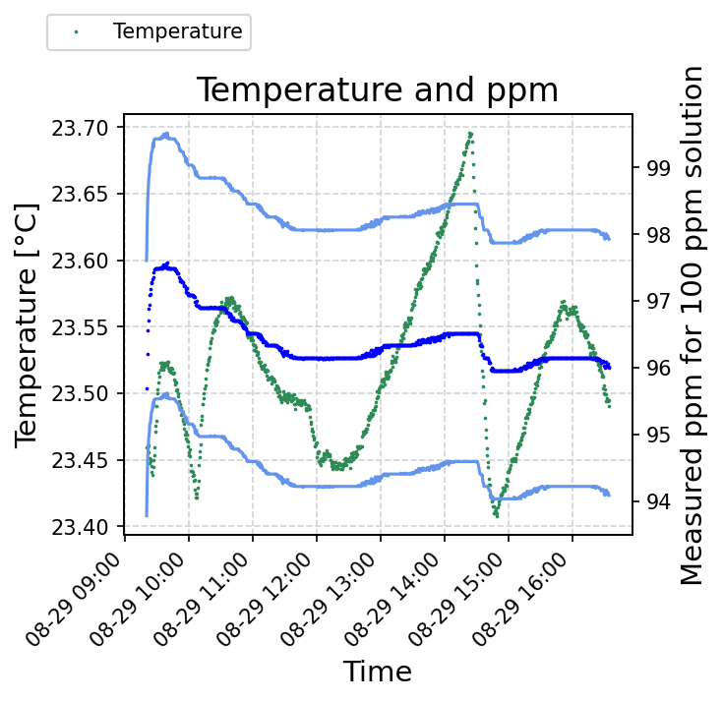
Temperature correction
According to device specifications: 1˚C temperature change can result in 2% error
Fluctuation in ppm production is observed when temperature changes significantly → temperature calibration measurements
Green: temperature
Blue: ppm
Lightblue: error margin

Slide 16
Conclusion
A formula to connect the two used dosimeters was derived from measurement
The detectors in the aging campaign show no significant increase in currents after the first week, which might mean that the earlier increase was caused by too high background irradiation
ISE measurement shows slow decrease in rate of ppm per hour, but further measurements are necessary to correct for temperature changes
My personal experience:
  Test beam data taking and analysis, long-term analysis by comparing this year’s to previous years’ datasets
  Argon scans and comparing resistivity from test beam and argon scan
  August aging campaign: daily monitoring (checklist), source off scans of Wednesdays and data analysis
  ISE measurements and data analysis for it
Notes:
To be updated

Slide 17
Thank you for your attention!

Slide 18
Backup

Slide 19
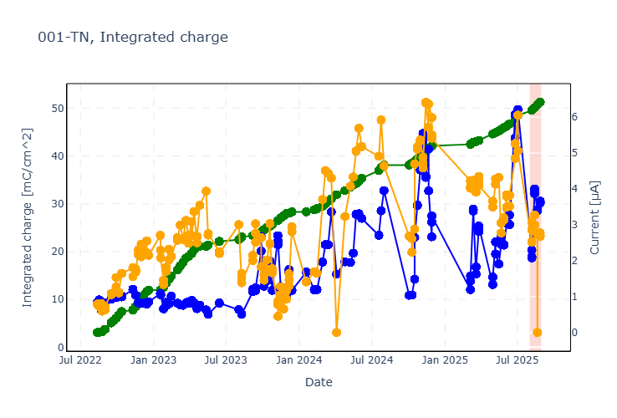
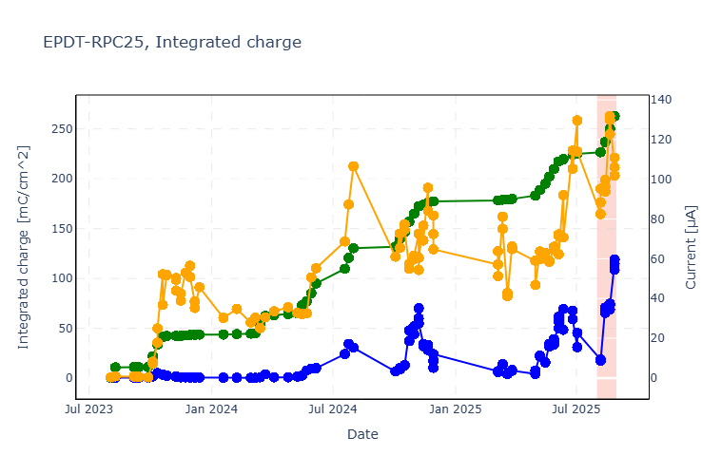
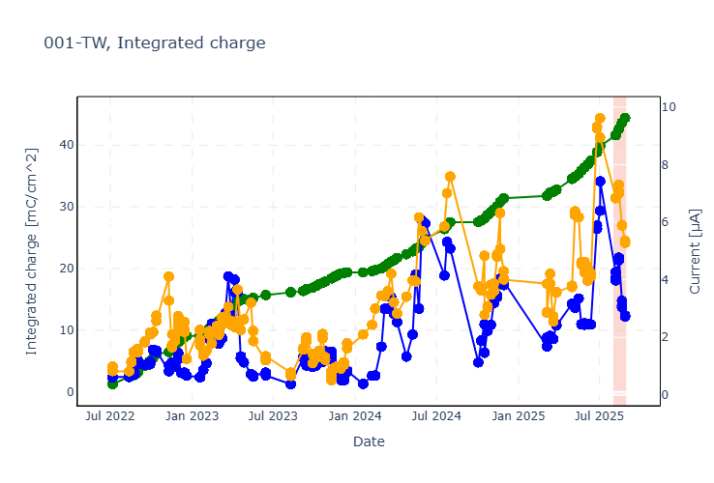
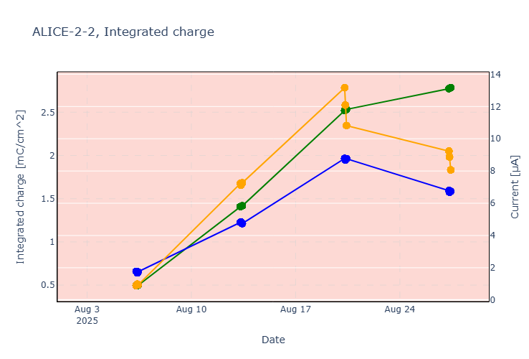
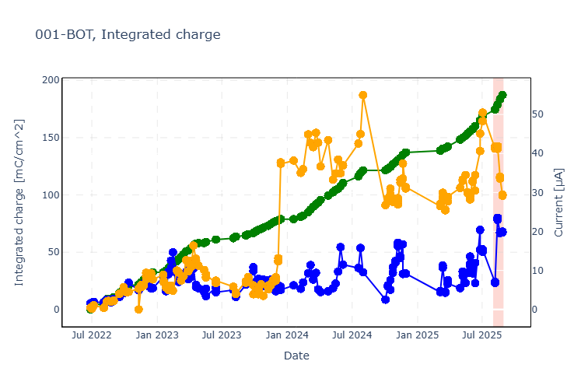
Integrated Charge, Ohmic and Physics Current over Time

Slide 20
Resistivity Measurements
From the test beam data and from argon scans

Slide 21
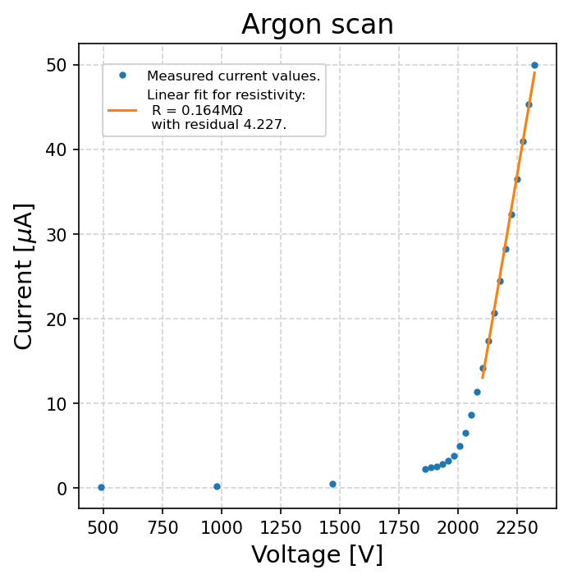

Resistivity measurements
Argon scans
From test beam data:
  Values at 50% efficiency
  $R= \frac{{HV}_{on}−HV_{off}}{I_{on}−I_{off}}$
  Values 2.7-3.7 MΩ
Resistivity
$$ρ=R \frac{length∙width}{height}$$

Slide 22
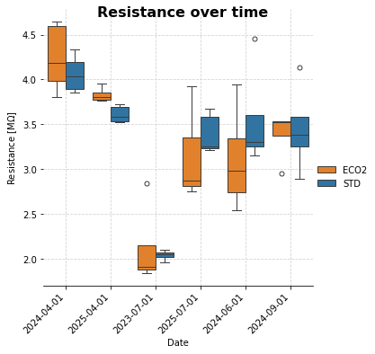
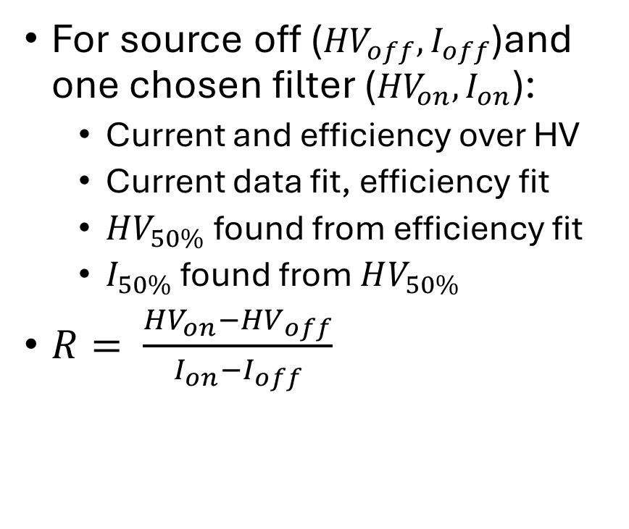
Resistivity Calculation from Test Beam
For source off (${HV}_{off}, I_{off}$)and one chosen filter (${HV}_{on}, I_{on}$):
  Current and efficiency over HV
  Current data fit, efficiency fit
  $HV_{50\%}$ found from efficiency fit
  $I_{50\%}$ found from $HV_{50\%}$
$R= \frac{HV_{on}−{HV}_{off}}{I_{on}−I_{off}}$

Slide 23
The Test Beam
Test beam data analysis, the test beam of July 2025, long-term ageing trends

Slide 24
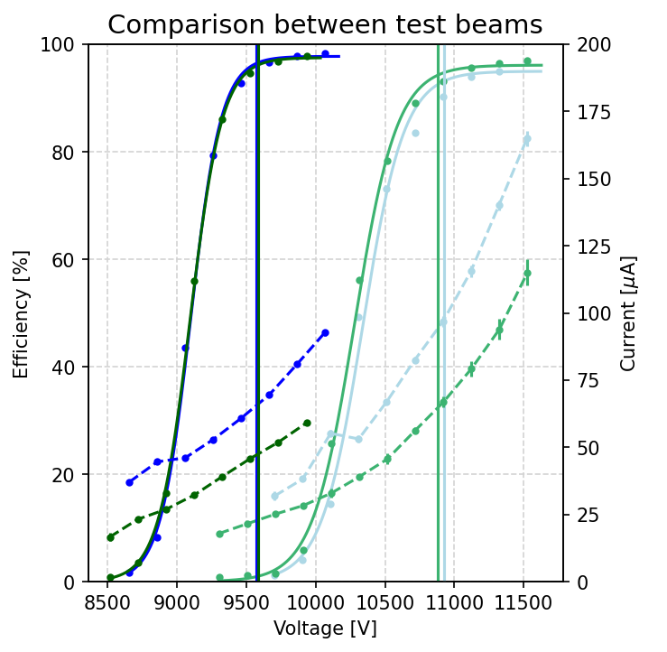
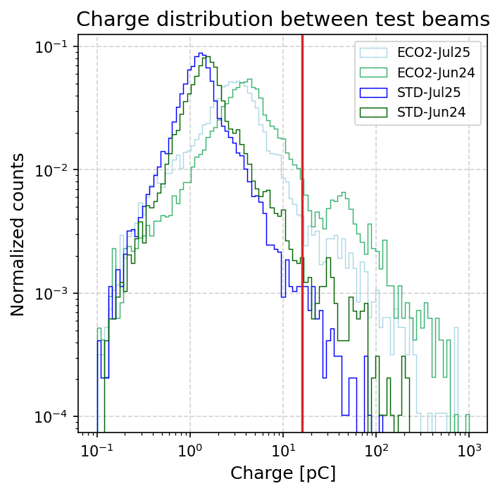
Comparison to Test Beam June 2024
Detector: EP-DT
STD and ECO2
July 2025 and June 2024
Efficiency curve overlaps for STD
Efficiency curve slightly shifted to the right for ECO2
  → Increase in working point
Increase in current compared to a year ago: under investigation
Charges behave as expected
Notes:
Comparison numbers:
Working point
- STD 0.1%
- ECO2 0.4%
Maximum efficiency
- STD 0.3%
- ECO2 1.2%

Slide 25
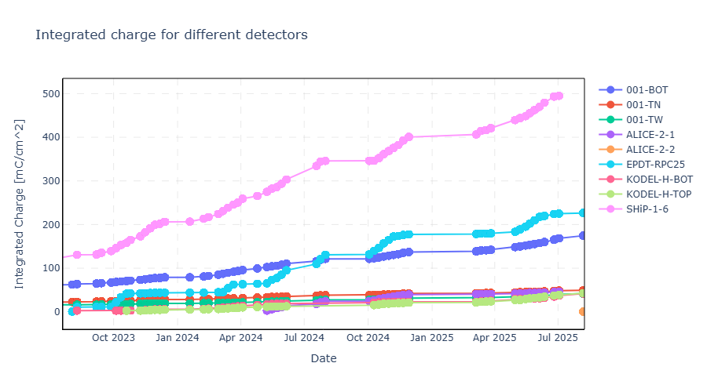
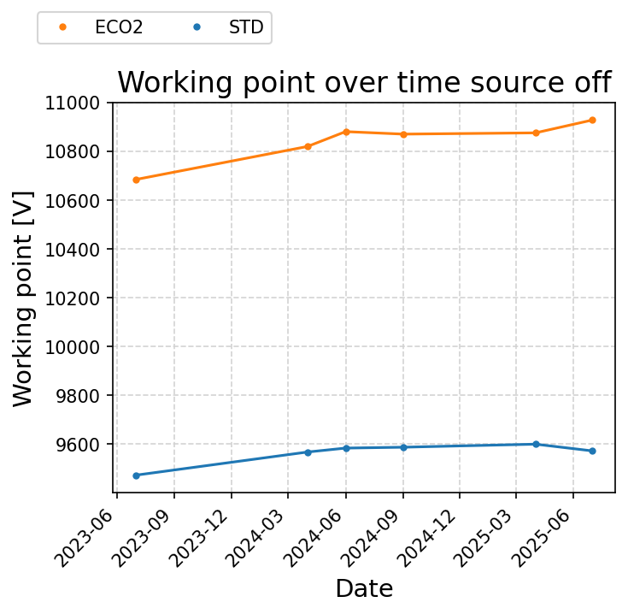
Long-Term Trends
Detectors: all
EP-DT
Integrated charge increases over time
Integrated charge differs per detector
Currently values between 25 and 220 mC/cm²
Working point of EP-DT:
  Initial increase due to the new detector
  Approximately constant after first test beam

Slide 26
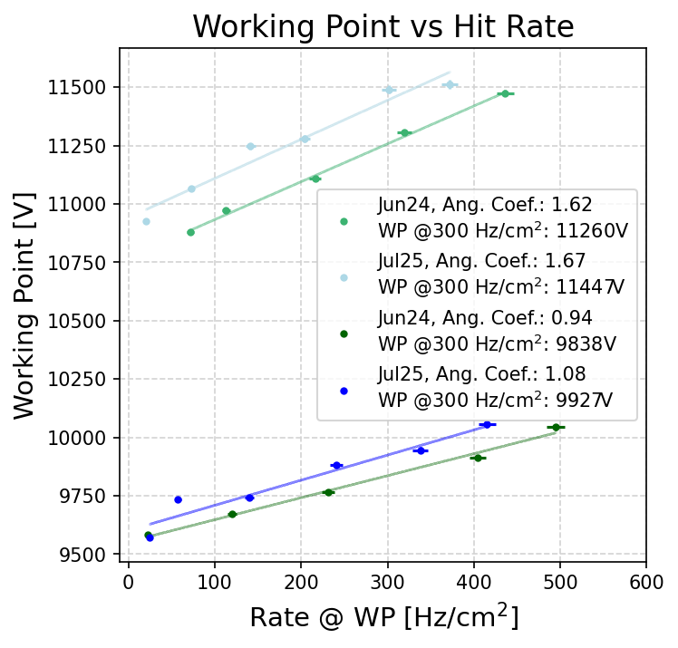
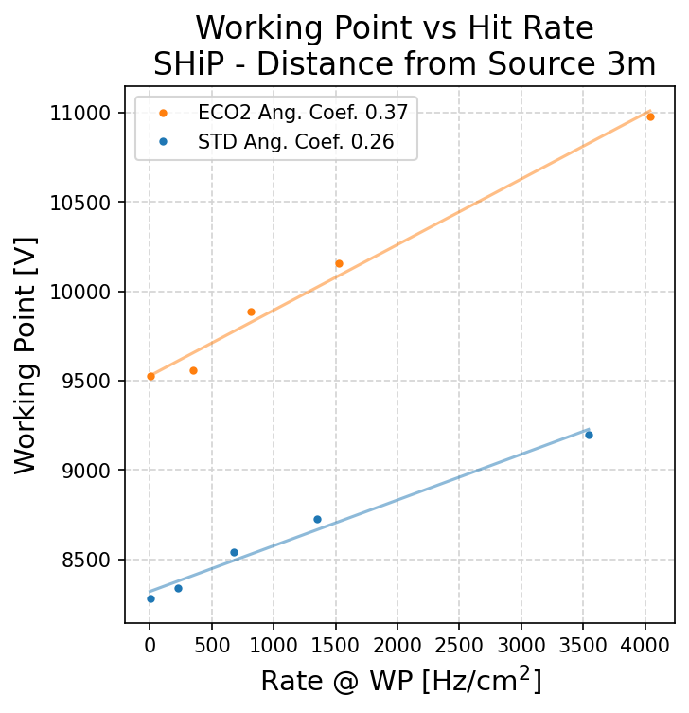
Other Detectors in the Collaboration
Detectors: EP-DT
SHiP
Similar trends can be observed for the SHiP detector
SHiP also analyzed with high hit rates
Notes:
YEAR

Slide 27
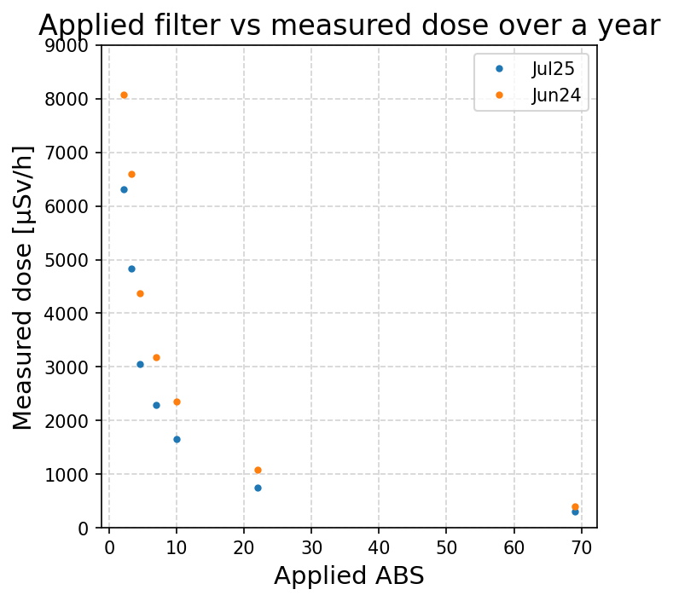
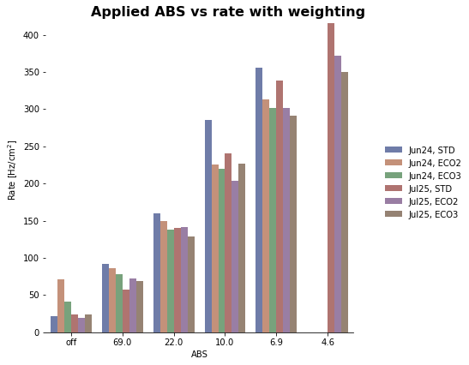
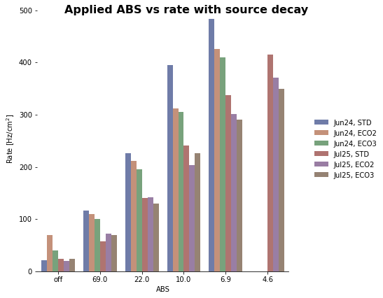
Applied Filter and Hit Rate Comparison 2024 and 2025

Slide 28
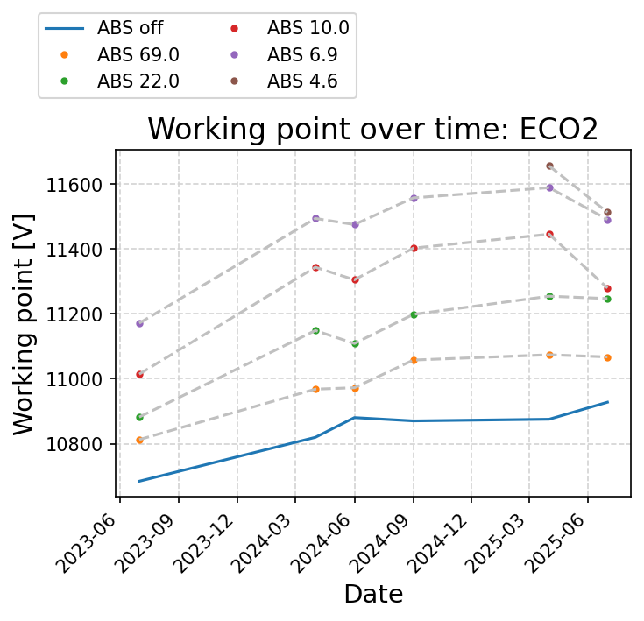
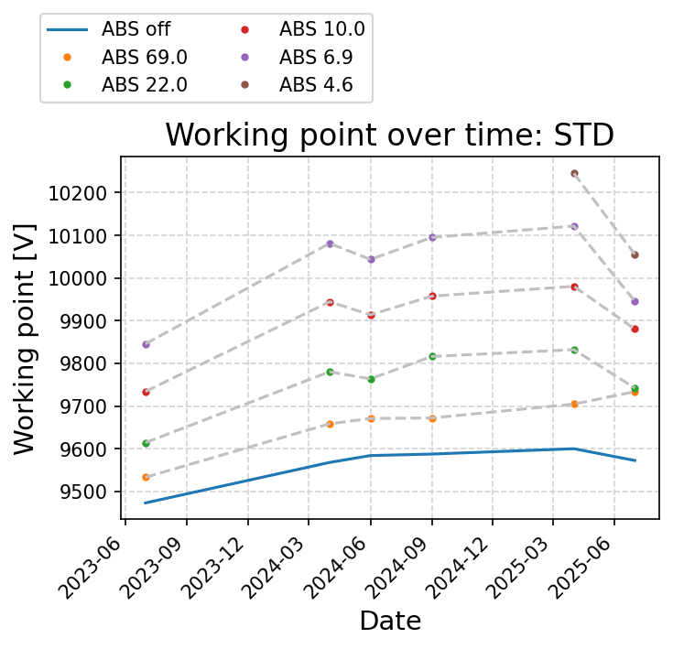
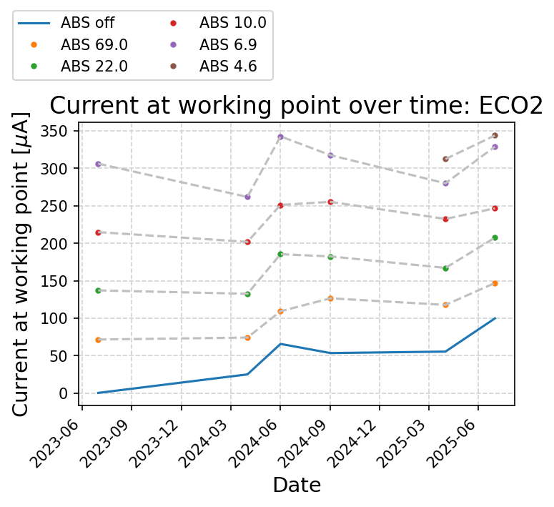
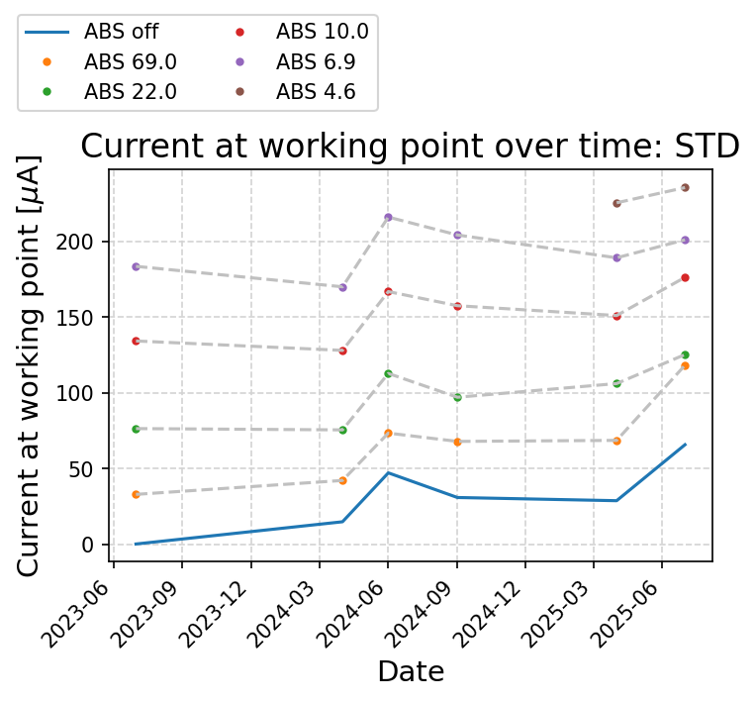
Working Point and Current at Working Point over Time

Slide 29
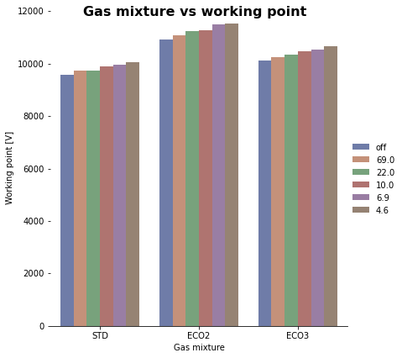
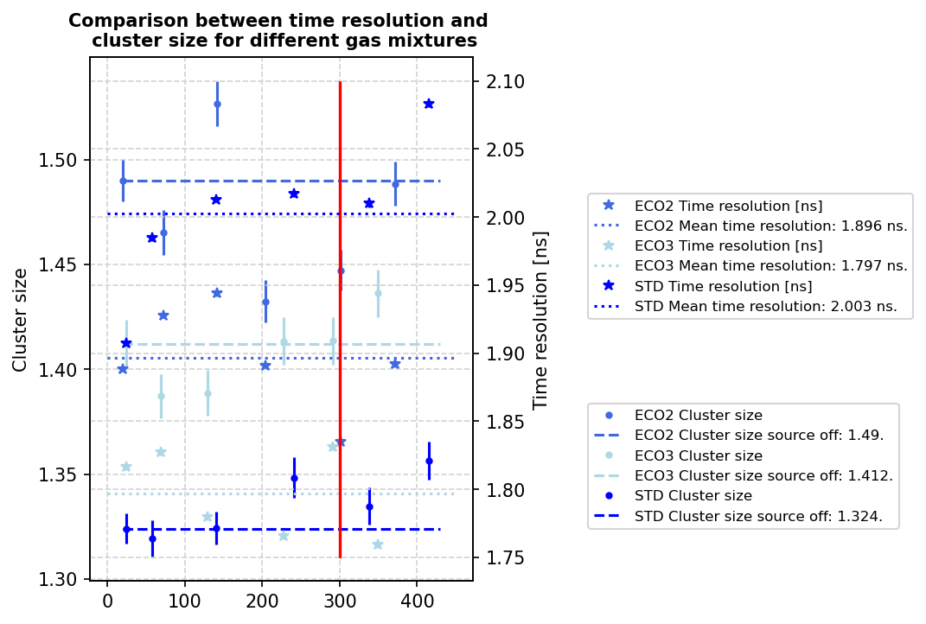
Working Point, Cluster Size and Time Resolution per Hit Rate

Slide 30
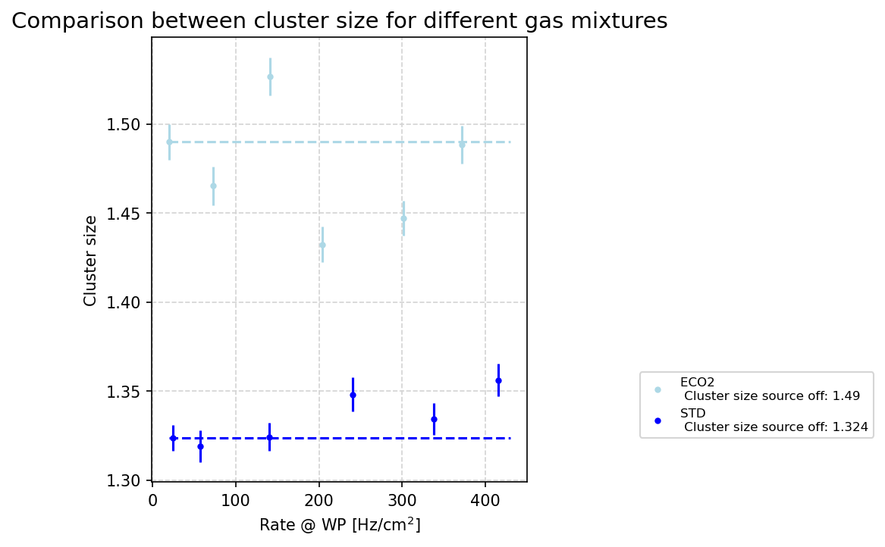

Test beam July 2025: cluster size and time resolution
Cluster size about 1.3 and 1.5 for STD and ECO2, respectively
Mean time resolution is 2 ns and 1.9 ns for STD and ECO2, respectively

Slide 31

Comparison to Test Beam June 2024
Detector: EP-DT
Working point and current increased for 2025
ECO2 requires higher working point and thus higher charges are present
Increase with hit rate is similar over the years

