Slide 1


4th DRD1 collaboration mitting, February 26. 2024. , CERN, Geneva, Switzerland
Institute of General and Physical Chemistry (IGPC), Belgrade, Serbia
Evolution of relevant molecule –ions for gaseous detector operation in the bulk (vacuo) and in the vicinity of copper cathode
People involved : Nebojša Begović (nbegovic@iofh.bg.ac.rs)
Jelena Jovanović (jelena.dragoslav.jovanovic@cern.ch)
Katerina Kuznetsova (ekatarina.kuznetsova@cern.ch)
Predrag Milenović (predrag.milenovic@cern.ch)

Slide 2
4th DRD1 collaboration mitting, February 26. 2024. , CERN, Geneva, Switzerland
Institute of General and Physical Chemistry (IGPC), Belgrade, Serbia
Activities
To be able to face with an important issue of electrode aging in gaseous detectors we applied quantum-chemical calculation (QCC) to get deeper insight into the processes in plasma during the detectors operation, in the bulk (vacuo) and in the vicinity of copper electrode.
In this research we have focused to construction of Potential Energy Surface (PES) for the most comon gaseous species – ions which appear in plasma during gaseous detector operation : CF₃⁺, HFO⁺ and CF₄ ⁺ , and calculate values of activation energies (Ea) for the reaction which take place. For that pourpose QCC, DFT and appropriate basis set have been used.
In regard to that, we compare the calculated values for energy of ongoing processes in vacuo and in the vicinity of copper electrode.

Slide 3
4th DRD1 collaboration mitting, February 26. 2024. , CERN, Geneva, Switzerland
Institute of General and Physical Chemistry (IGPC), Belgrade, Serbia
We construct relaxed PES curves which was obtained by optimizing investigated molecule at every point during his approach to electrode.
We dedicated to simulated copper electrode because it is most frequently used in gaseous detectors.
Motivation
Although thare are a lot of knowledge about molecule-ion decomposition reaction in bulk and plasma, the data about there decomposition in vicinity of electrodes do not existed jet to the best of our knowledge.
Electrodes material can on different way perturb the decomposition reaction of some ions.
Therefore, so we need to know exactly in which way, stabilization or destabilization electrode act on same reactions or some bonds in the investigated ions.
In our opinion, new highlights about the mechanism of bonds stabilization and destabilization for major ions for gaseous detectors (CF4 >, …..) are highly desirable and can lead to solving existing problems and finding new solutions.

Slide 4
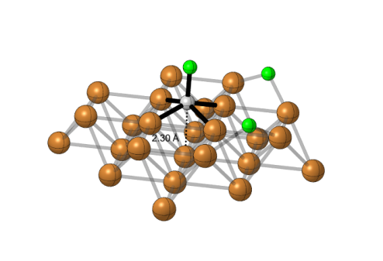
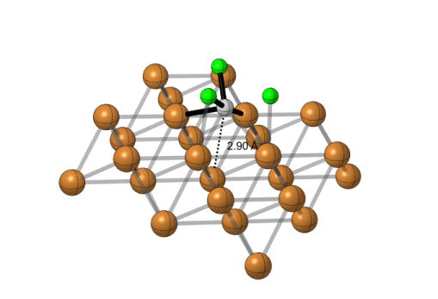
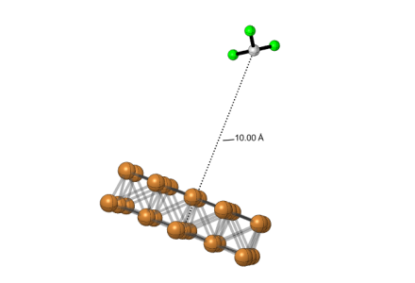
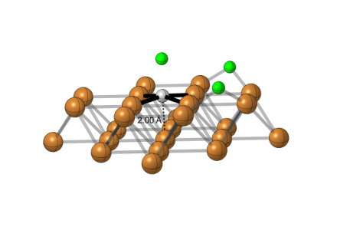
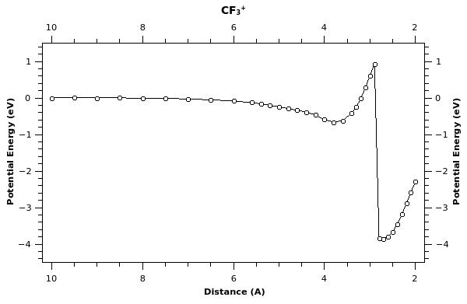
4th DRD1 collaboration mitting, February 26. 2024. , CERN, Geneva, Switzerland
Institute of General and Physical Chemistry (IGPC), Belgrade, Serbia
CF₃⁺ fragmentation near copper electrode

Slide 5
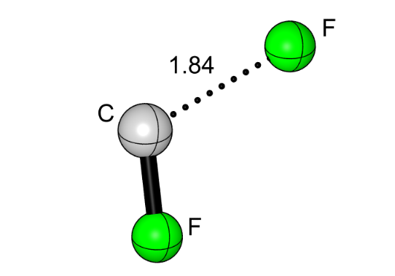
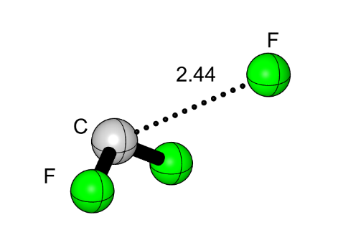
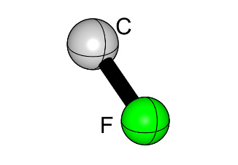
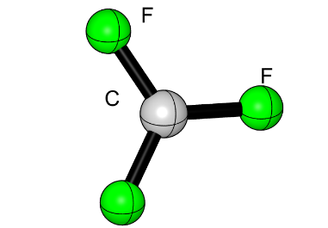
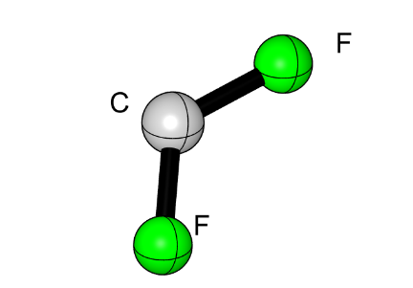
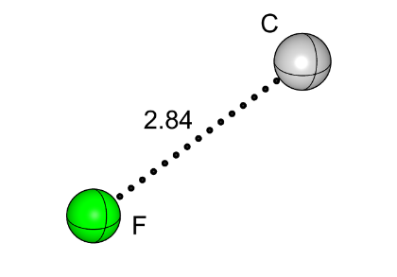
4th DRD1 collaboration mitting, February 26. 2024. , CERN, Geneva, Switzerland
Institute of General and Physical Chemistry (IGPC), Belgrade, Serbia
Energy ( eV) (arb.un.)
17.97
[TS₂]+1s
16.71
. C⁺ + 3 F .
9.25
8.99
[TS₁]+1s
CF⁺ + 2 F .
6.82
[TS₀]+1d
5.90
CF₂⁺ + F .
0.00
.CF₃⁺
CF₃⁺ fragmentation in bulk (vacuo)

Slide 6
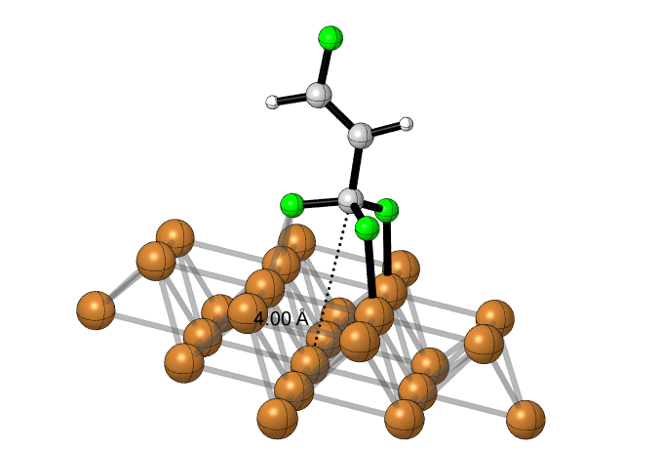
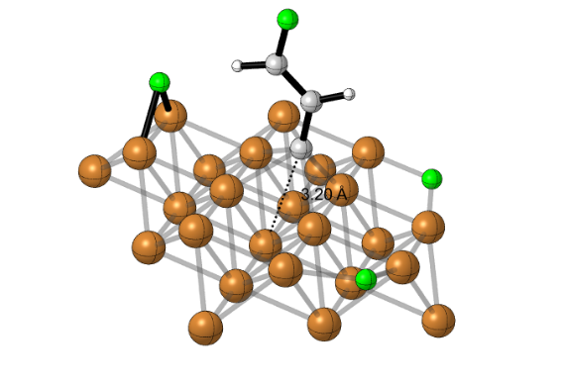
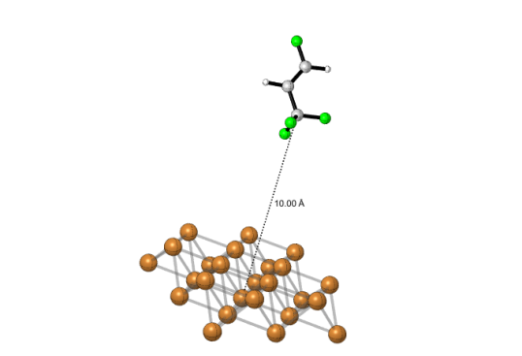
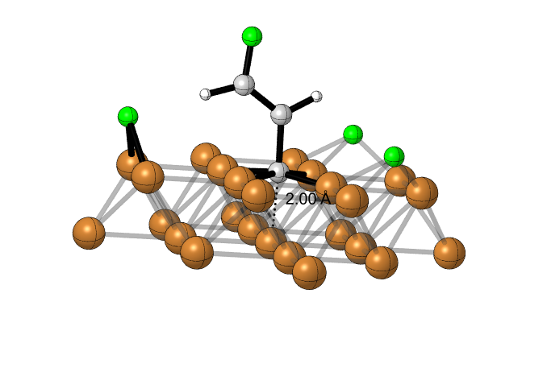
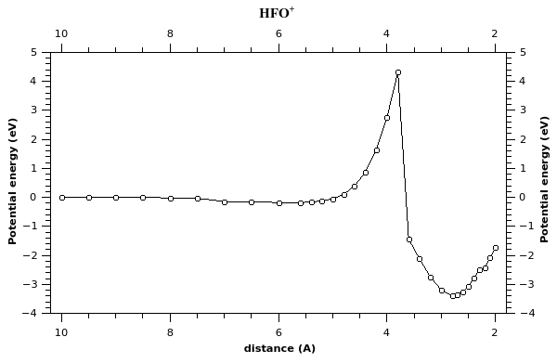
4th DRD1 collaboration mitting, February 26. 2024. , CERN, Geneva, Switzerland
Institute of General and Physical Chemistry (IGPC), Belgrade, Serbia
[.CHF=CH-CF₃]⁺ fragmentation near copper electrode

Slide 7
4th DRD1 collaboration mitting, February 26. 2024. , CERN, Geneva, Switzerland
Institute of General and Physical Chemistry (IGPC), Belgrade, Serbia
Energy eV (arb.un.)
12.10
12.02
[.CHF=CH-CF₃]⁺ fragmentation in bulk (vacuo)
.[TS2]+1s
[HFO3]⁺ + 3F .
7.52
[TS1]+1s
7.22
[CHF=CH-C]⁺
.[HFO2]⁺ + 2F .
1.81
[TS0]+1d
1.54
[HFO1]⁺ + F .
.[CHF=CH-CF]⁺
0.0
.[HFO]⁺
[CHF=CH-CF₂]⁺
.[CHF=CH-CF₃]⁺

Slide 8
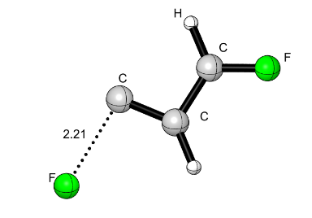
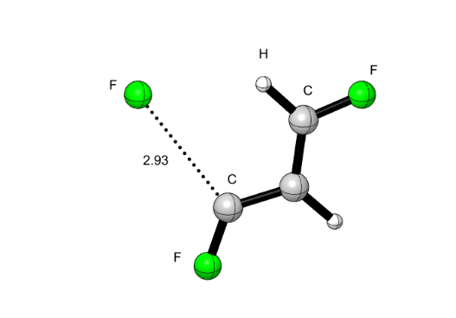
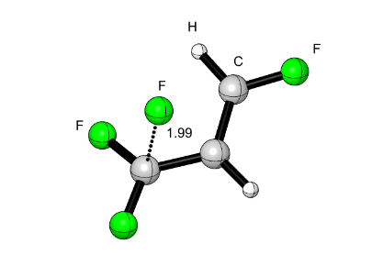
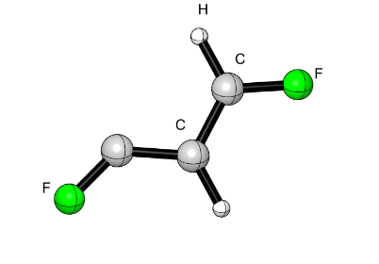
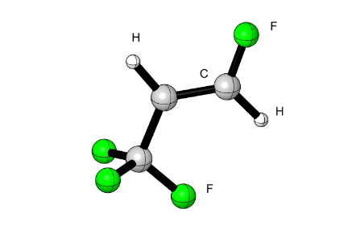
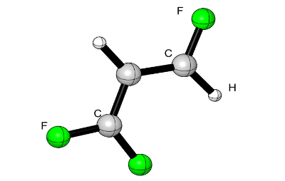
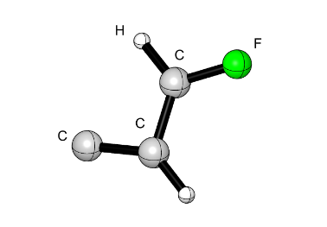
4th DRD1 collaboration mitting, February 26. 2024. , CERN, Geneva, Switzerland
Institute of General and Physical Chemistry (IGPC), Belgrade, Serbia
Energy eV (arb.un.)
12.10
12.02
.[TS2]+1s
[HFO3]⁺ + 3F .
7.52
[TS1]+1s
7.22
.[HFO2]⁺ + 2F .
1.81
[TS0]+1d
1.54
[HFO1]⁺ + F .
0.0
[.CHF=CH-CF₃]⁺ fragmentation in bulk (vacuo)
.[HFO]⁺

Slide 9
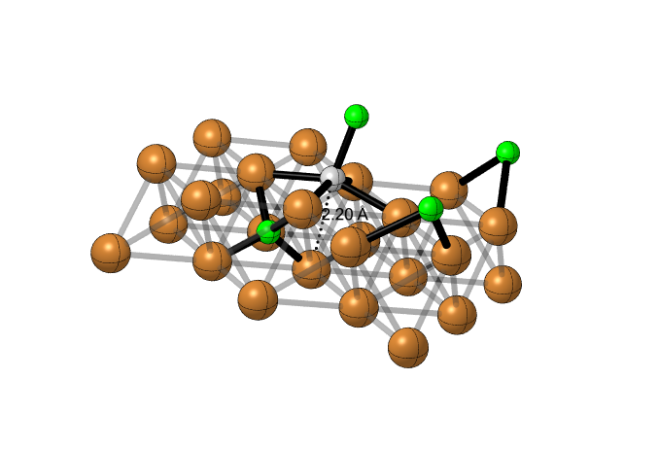
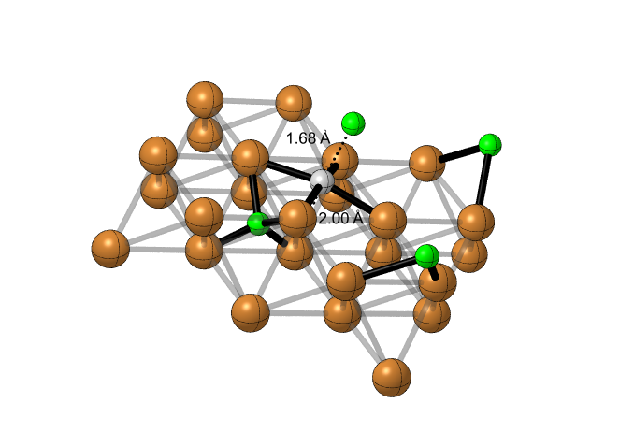
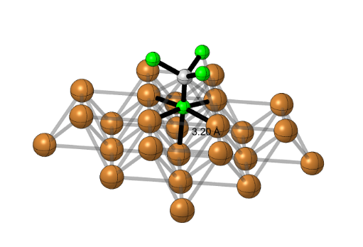
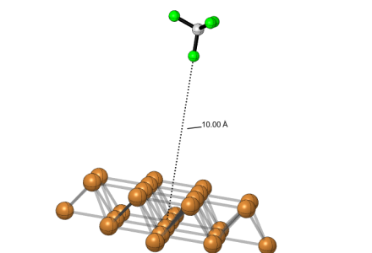
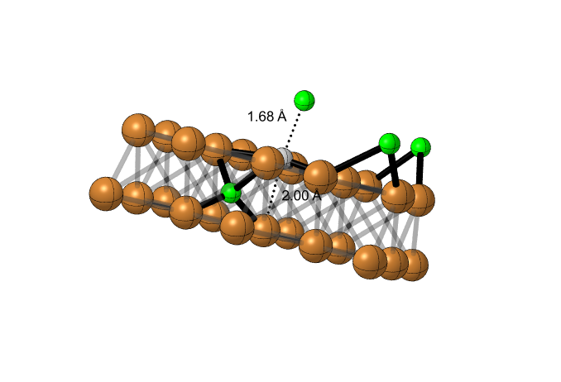
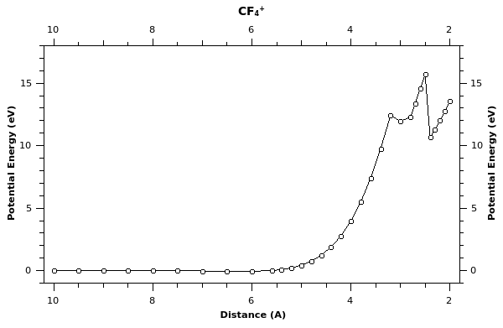
4th DRD1 collaboration mitting, February 26. 2024. , CERN, Geneva, Switzerland
Institute of General and Physical Chemistry (IGPC), Belgrade, Serbia
CF₄⁺ fragmentation near copper electrode

Slide 10




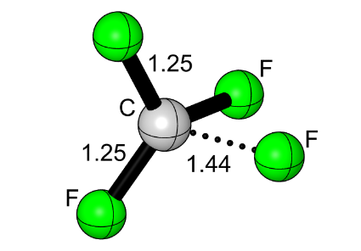
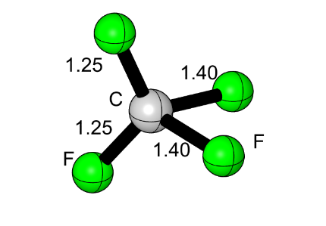
4th DRD1 collaboration mitting, February 26. 2024. , CERN, Geneva, Switzerland
Institute of General and Physical Chemistry (IGPC), Belgrade, Serbia
Energy eV (arb.un.)
7.68
[TS₂]+1s
7.42
5.25
CF⁺ + 3 F .
[TS₁]+1s
4.33
CF₂⁺ + 2 F .
0.01
0.00
.CF₄⁺ fragmentation in bulk (vacuo)
[TS₀]+1d
-1.57
.CF₄⁺
CF₃⁺ + F .

Slide 11
4th DRD1 collaboration mitting, February 26. 2024. , CERN, Geneva, Switzerland
Institute of General and Physical Chemistry (IGPC), Belgrade, Serbia
Conclusion
Copper electrode significantly change the course of investigated reaction in his vicinity for all of investigated species - ions.
Future Perspectives
It will be important for wider scientific community to investigate the effects od different cathode materials on same and other species – ions.

