Slide 1
Sapphire detectors for Luminosity and Beam Profiling(SLBP)
Federico Lasagni Manghi (PI), Marco Bruschi, Pietro Grutta, Mauro Morandin, Antonio Sbrizzi
Strong field QED processes in e-laser collisions are non-linearly highly dependent from the laser intensity, whose online measurement poses several challenges and requirements:
  detector inline with the high-energy high-intensity ɣ beam from the interaction point
  microstrip radiation-hard sapphire-based detector: WP1
Measurement of per-bunch instantaneous luminosity is cornerstone for precision in ATLAS physics
  Beam monitor system (BMA), in radiation-harsh ATLAS forward region (LGADs)
  LGAD performance degradation during Run3 of ~70% per 100/fb-1
  HL-LHC luminosity: 300/fb-1/y.
  Sapphire-based BM detector is proposed: WP2
Artificial sapphire with diamond crystalline lattice(Al2O3):
  + Low cost and arbitrary large size + Insensitivity to visible light + High breakdown field + Low leakage current even after high irradiation + Radiation hardnes
  - High ionization energy - Small charge collection (<15% CCE)
Other possible applications (harsh environments):
  Long-term neutron/gamma flux monitoring in nuclear reactors (w/ CAEN A1425 readout)
  Medical application in e/ɣ irradiation processes (sterilization)
  Dosimetry at high temperatures (i.e., where silicon-based detector have large leakage)

Slide 2
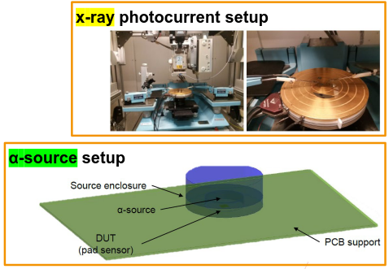
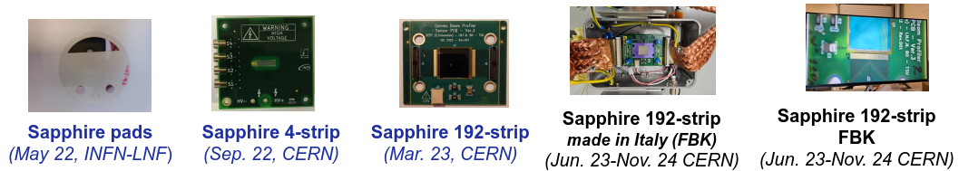
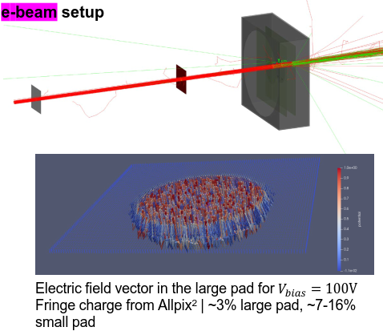
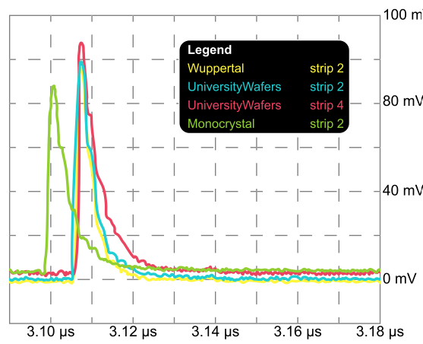
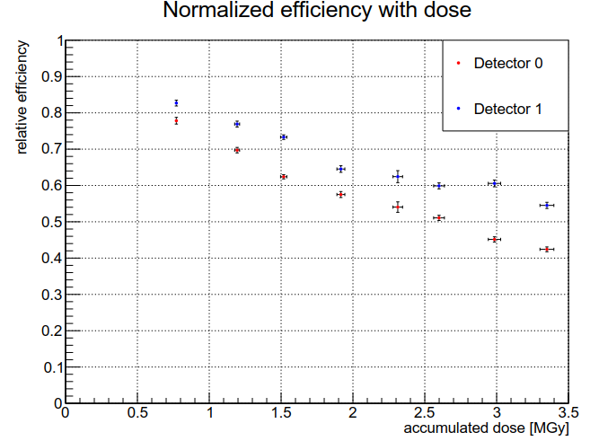
Sapphire R&D
Prototypes manufactured to investigate charge collection properties with x-ray gun, α-source, and e-beam
CCE(-V) + α-source → Negligible hole contribution
Typical CCE 10% for 110 μm at HV bias 6 V μm-1
Signal shape and radiation hardness measured

Slide 3
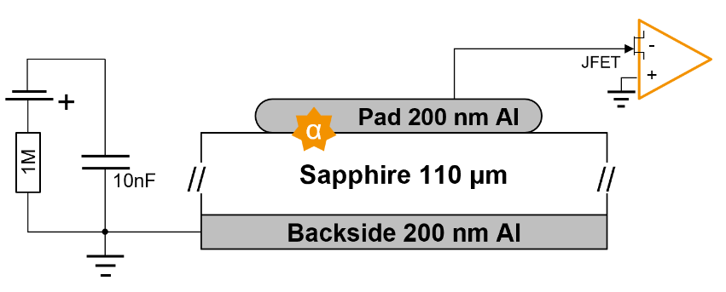
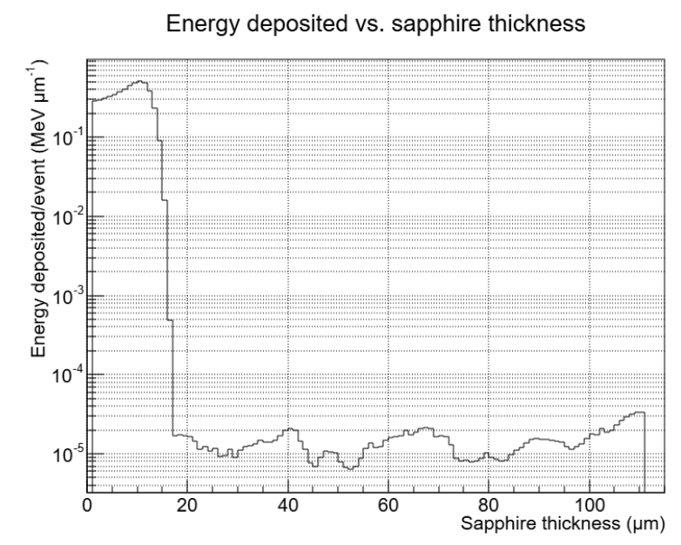
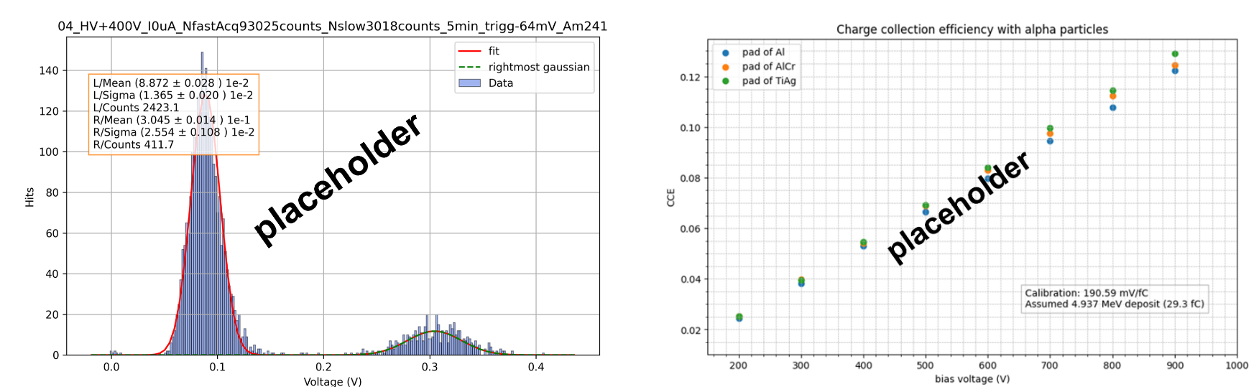
Tests with alpha particles and X-rays
Signal increase linear with HV
  Not confirmed in e- test beams

Slide 4
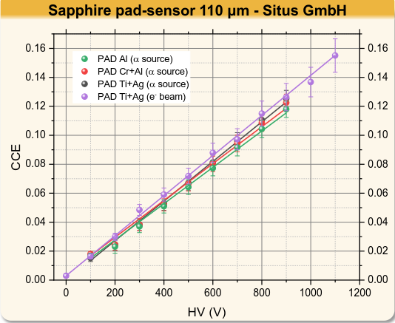
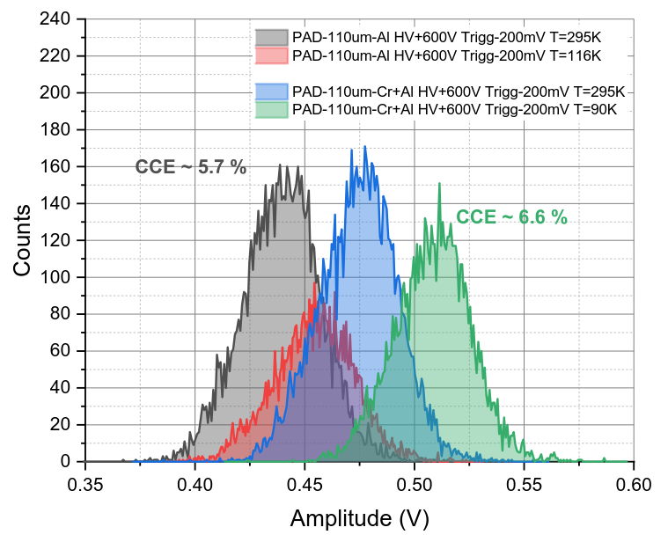
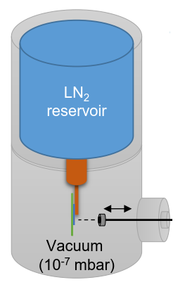
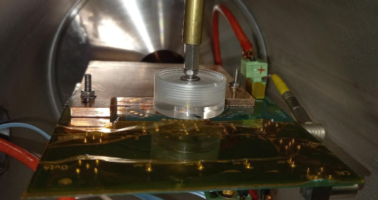
Room temperature CCE α-source (Padua) and e-beam (LNF-INFN)
Multiple sensors types tested at different HV at room T
CCE(V) → extract 𝜇τ-product
CCE(-V) + α-source → Negligible hole contribution
Small charge collection distance with respect to thickness
Typical CCE 15% for 110 μm at 10 V μm-1
Product 𝜇τ 𝑒𝑒 ∈ 1, 3 μm2/V
Two sensors (Al, Cr+Al) tested at cryogenic temperature (90K)
Expected significant increase of charge carriers mobilities at low temperatures.
Only a relative change in CCE was observed

Slide 5
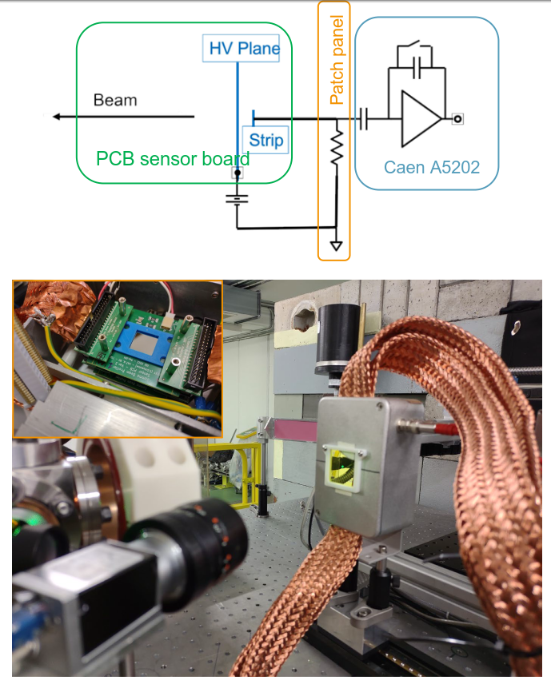
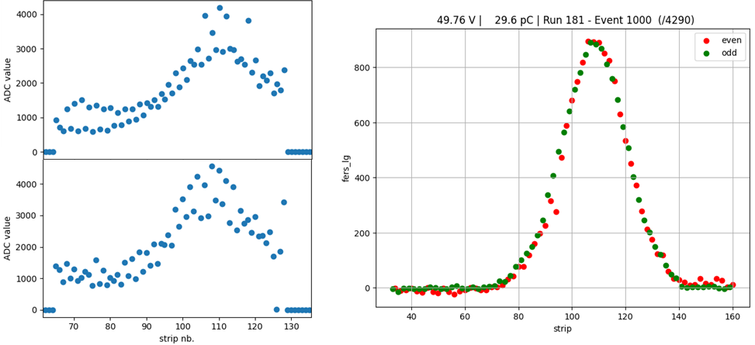
Testbeam setup and results
Detector performance measured in multiple test beams
Micro-coaxial cables led to improvements in the shape reconstruction
Sapphire strips compared to camera setup

Slide 6
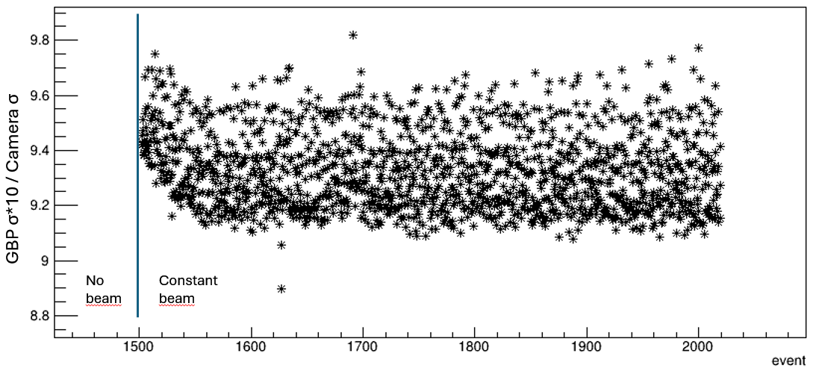
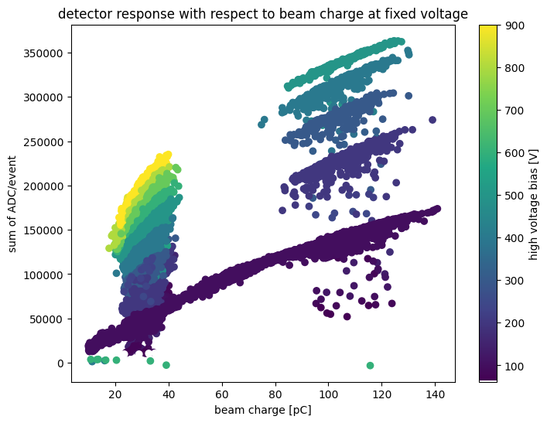
Testbeam open questions
Some effects that need further study observed in testbeams:
Transient effects
  Polarization and charge accumulation
Non-linearity with the beam charge
Non-linearity with the HV
Cross talk effects
  Due to electronics or strip cross-talk?
  Different electronics to reduce the effect

Slide 7

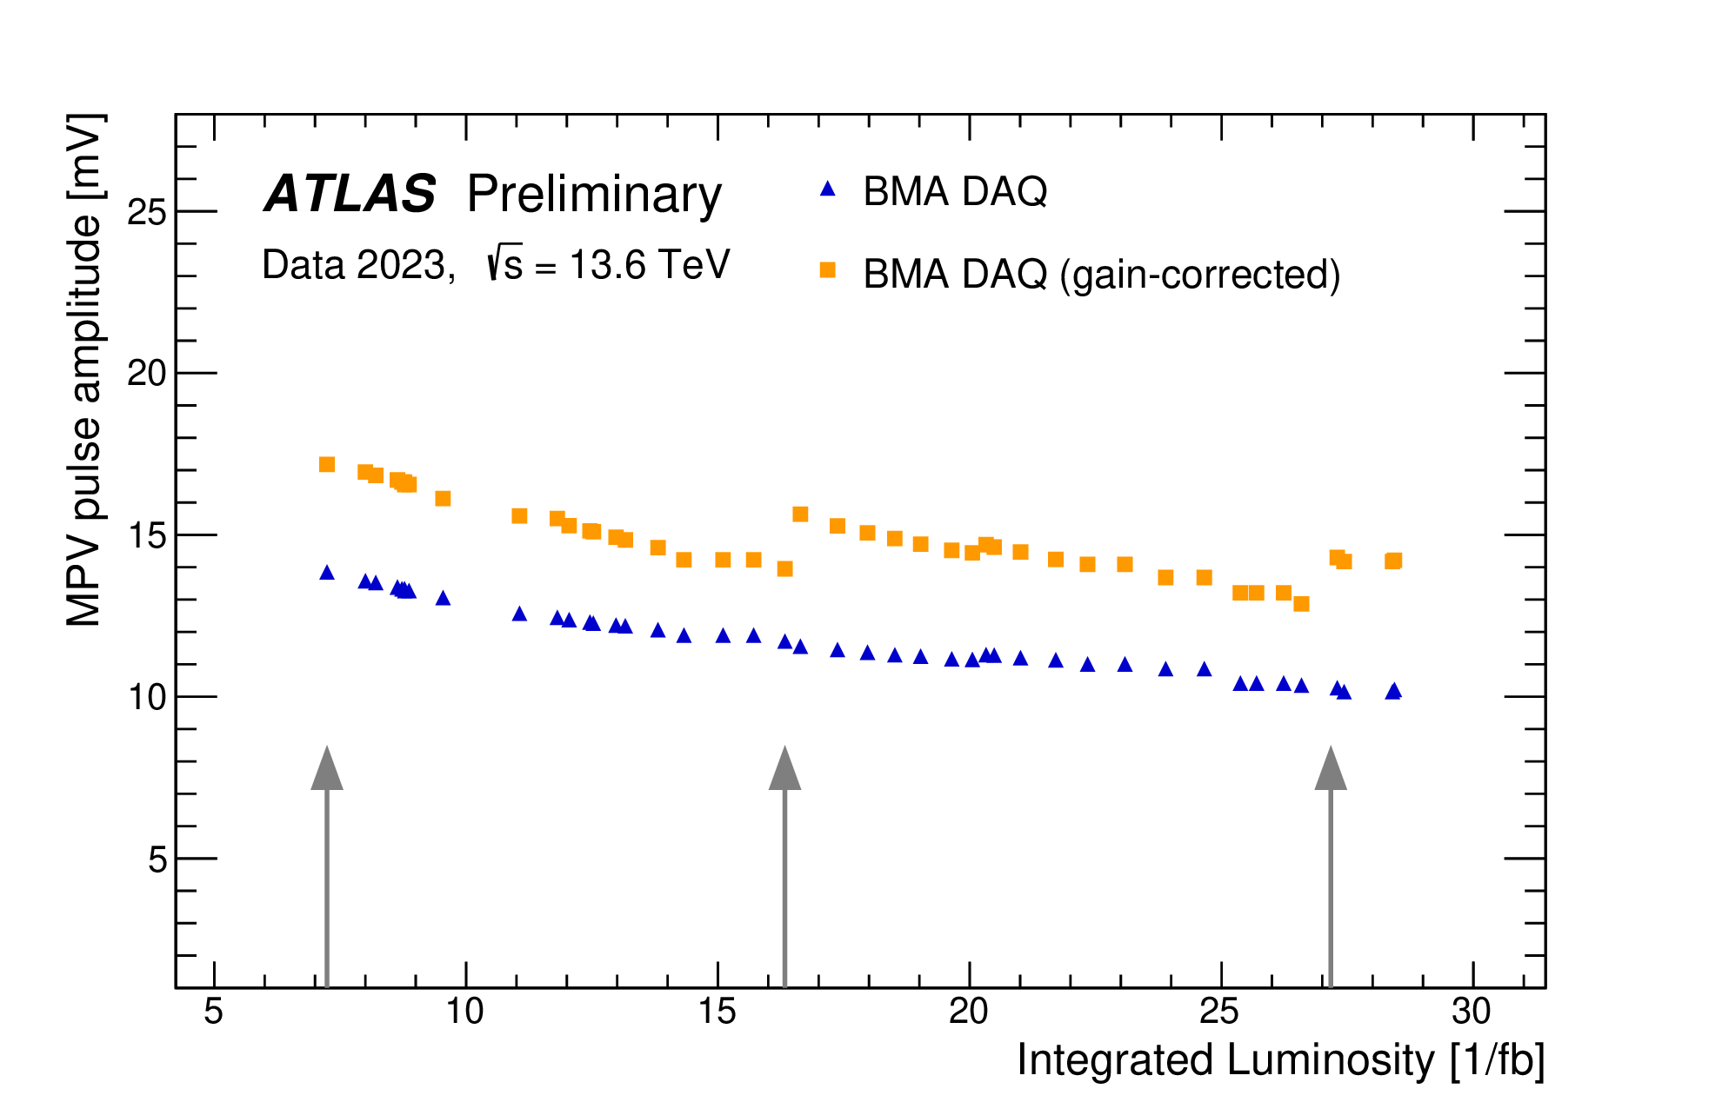
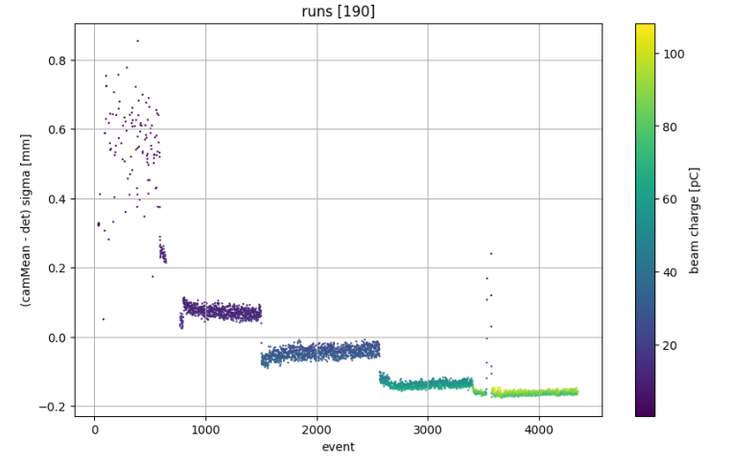
Project Goals and Objectives
WP2: Luminosity Monitoring with Sapphire Detectors
Measure luminosity with <1% stability
→ single MIP peak to monitor degradation
Maintain usable performance at 10^16 neq dose
→ radiation hard detector and electronics (or off-detector)
Objectives
Develop a sapphire pad that, together with a CAEN A1426 preamplifier, allows for single MIP detection (S/N ~10)
Study possible radiation-hard on-detector solutions to reduce migration effects
WP1: Microstrip sapphire detector
for ɣ beam monitoring
Measure laser intensity within O(2.5%)
→ O(μm) spatial resolution for Beam Profiling
SFQED scattering resulting in large variations for
→ signals with high dynamic range
High photon fluence (~10^10 GeV s-1)
→ radiation-hard material
→ strip readout allows to move the electronics readout away from the beam
Need to cover gamma within (20 x 20) mm^2 in XY
→ large size sensing area
Objectives:
Optimise the detector design
  Metalization, pitch, thickness
Understand the anomalies observed in the testbeam campaigns
  Cross talk, polarization, charge dependence, non-liearities

Slide 8
WP1: Microstrip sapphire detector for ɣ beam monitoring
measure the cross-talk of flat flexible cable (FFC) with new interleaved signal-GND topology, compare with micro coaxial (high cost)
redesign the sensor PCB and the patch panel to accommodate for the new solution
procure and manufacture the microstrip sensor
test alternative electronics based on Werooc PsiRoc ASIC
  More linear charge integration expected
assemble the detector setup (sapphire bonding, connections, front-end)
characterize the performance of the optimal system at a beam facility

Slide 9
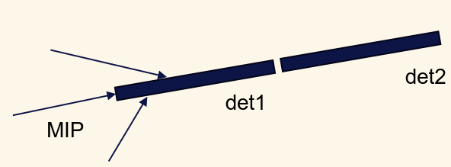
WP2: Luminosity Monitoring with Sapphire Detectors
2026: increse detector charge to work A1426 preamplifier
Design a sapphire pointing detector: 1 x 1 mm^2 cross section, 18 mm long. C = 1.6 pF
  yield: ~22 e⁻/μm, -> ~1.1 e⁻/μm when considering ~5% CCE.
Cut, metalize and assemble the sensor
Test with a source and with CAEN A1426
  with ~2000 e⁻ RMS noise -> S/N > 10
2-sensor coincidence evaluation

Slide 10
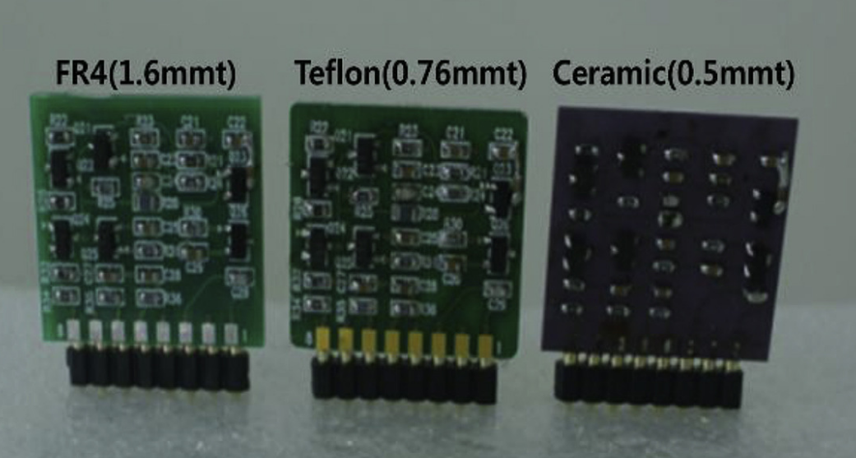
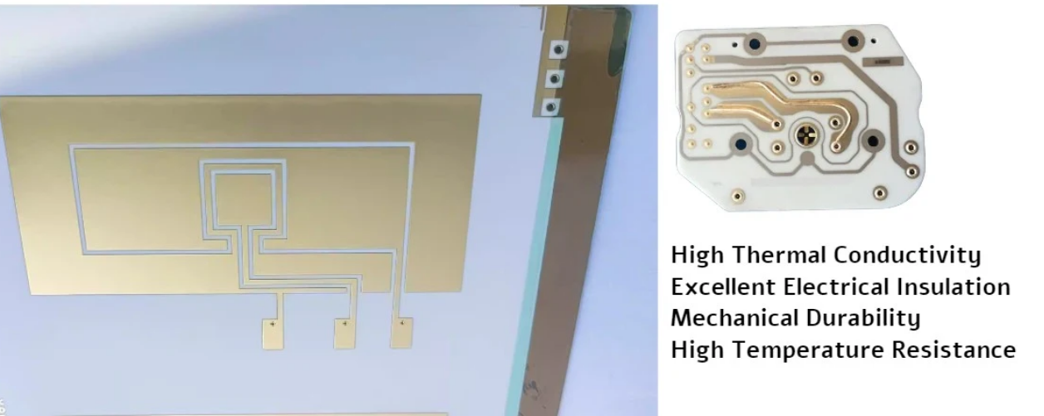
WP2: Integrating detector and FW electronics
Reduce e⁻ RMS noise by preamplifying the signal on-detector
  Smaller detector less prone to migration effects
  Radiation hardness of the amplifying circuit needs to be ensured
Example: Al2O3 (0.5 mm) itself used as a substrate for PCBs
  Excellent temperature, insulation and radiation hardness properties
  Mount radiation-hard discreet components (+self-compensating designs?)
  Explore detector and FE amplification on the same substrate
    https://www.sciencedirect.com/science/article/pii/S1738573319306874?ref=pdf_download&fr=RR-2&rr=9720cf11a90be1f2#bib12
    https://hilelectronic.com/al2o3-pcb/

Slide 11
Person power and requests in 2026
INFN Padova (∑FTE 0.6): M. Morandin (0.4), P. Grutta (0.2)
INFN Bologna (∑FTE 1): M. Bruschi (0.45), F. Lasagni Manghi (0.4, PI), A. Sbrizzi (0.15)
Other collaborators: M. Angelone (ENEA Frascati), D. Trucchi (CNR Montelibretti), M. Pillon (CNR Milano), R. Cardarelli, CAEN
Detector
Travel
no | Entry | Year | Section | Amount [k€] | Note
1 | Sapphire wafer procurement | 2026 | INFN Bologna | 1.5 | WP1, WP2
2 | Pad manufacturing | 2026 | INFN Padova | 0.5 | WP1
3 | PCB design + mechanics | 2026 | INFN Bologna | 3.0 | WP1
4 | Micro-coax. cables + PCB (sensor+patch panel) | 2026 | INFN Padova | 3.0 | WP1 (Sub Iudice)
5 | Sapphire dicing | 2026 | INFN Bologna | 1.0 | WP2
6 | Pad manufacturing | 2026 | INFN Padova | 2.0 | WP2
no | Entry | Year | Section | Amount [k€] | Note
1 | Low intensity test beam | 2026 | INFN Padova | 3 | WP1
2 | Low intensity test beam | 2026 | INFN Bologna | 2 | WP1
3 | Bologna-Padova | 2026 | INFN Bologna | 1 | WP1, WP2
4 | Sapphire characterization (DiaTHEMA lab) | 2026 | INFN Bologna | 5 | WP2
5 | Prototype detector irradiation | 2026 | INFN Bologna | 1 | WP2

Slide 12
Backup

Slide 13
The DiaTHEMA (Diamond, Thermal & Harsh Environment Materials & Applications) Lab
DiaTHEMA Lab has available the following techniques to characterize the defect states within the ultra-wide-bandgap semiconductor and the related junctions with metals:
Dark current-voltage characterization at low bias as a function of temperature (up to 600 °C);
Dark capacitance-voltage characterization as a function of temperature (up to 600 °C) to derive Schottky barrier heights;
Modulated spectral photoconductivity up to 6.5 eV photon energy to derive electronically-active defect states in the ultra-wide-bandgap semiconductor;
X-ray irradiation to derive collection efficiency of charge carriers and detectors’ open-circuit voltage;
Kelvin probe microscopy to visualize work function misalignments (and Schottky barrier heights);
Test devices to measure specific contact resistivities.

Slide 14
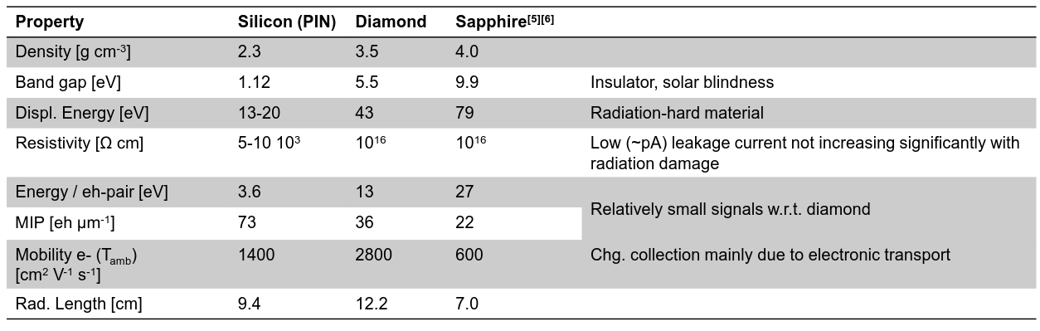
Sapphire properties

