Slide 1
INFN@LECCE
Solar System Object SWG
Status: present results, future and spin-off
SWG LU
AA. Nucita, A. Franco,, F. De Paolis, F. Strafella, S. Sacquegna,E.Orofino, M. D’Elia, E.Portaluti

Slide 2
(B. Carry, et al.): Classification, Morphology and data analysis:
(L. Conversi, M.Lieu, B. Altieri et al.): Deep Leaning
The first attempt to apply CNN to Euclid data with SSOs
(M. Pontinen, M. Granvik et al.): StreakDet and Deep learning
The deep learning pipeline is focused on detecting long asteroid streaks, and it can reach 0.25-05 magnitudes fainter asteroids than StreakDet. The pipeline consists of CNN, RNN, and XGBoost.
(A. Nucita, A. Franco et al.): Euclid: Detecting Solar System objects in Euclid images and classifying them using Kohonen self-organising maps
The SOM method is applied to associate a probability that a given object is a SSO. SOM trained in a un-supervised fashion and by adopting an early stopping criterium in order to classify images with stars, galaxies and SSOs
StreakDet and Deep Learning Pipeline (v > 10 ‘’/h)
SSO-PIPE Deterministic Pipeline (v < 10 ‘’/h)

Slide 3
StreakDet and Deep Learning Pipeline (v > 10 ‘’/h)
The StreakDet (An ESA funded sofware) pipeline consists of three main phases: segmentation, classification, and lastly astrometric and photometric reduction.
Deep learning consists of CNN patter recognition.
Both work on single images.
Current pipeline uses StreakDet
(see next slides for details on PDC results)
The data reduction and detection
methods are embedded into a pipeline
First installed and run
on a INFN server (Italy) using a
Docker image with all the required
Softwares.
From April 2025…
CODE available on ESA-DATALAB
(MILESTONE 2025)

Slide 4
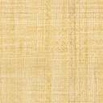
SSO-PIPE Deterministic Pipeline (v < 10 ‘’/h)
StreakDet uses mid outputs from SSO-PIPE ( > 10’’/h)
Astrometry.net
(initial slution)
SExtractor
PSFex
Scamp
(final image
-astro. Corrected)

Slide 5
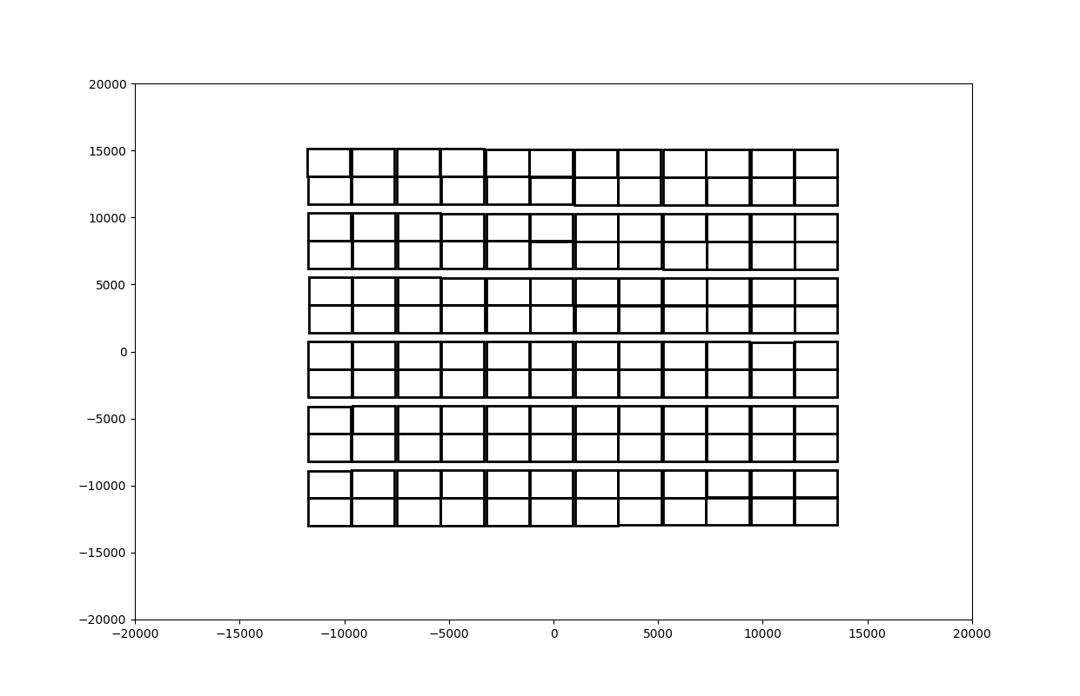
Activity of SWG-SSO in the framework of a pilot study (with CAL field) endorsed by ESA and EC
A golden recipe to solve astrometry and achieve a reasonable good level (and routinely) at quadrant level
Down to \simeq 10 mas (depending on # references)
Reduction done on quadrant level (144 HDUs): bias, flat, mask, prescan/overscan. Output is a 144 HDU mosaic.
A few fundamental keywords copied from 0 header in raw data to any of the other 144 HDUs (RAOBS, DECOB, PA).
A few other keywords generated:
CRVAL1, CRVAL2 (from RAOBS, DECOB),
CDELT1, CDELT2 (from pixel size),
CROTA2 (from PA)
CRPIX (updated to account for cuts on
prescan/overscan regions)
A first guess on quadrant WCS
CD1_1 = CDELT1 * cos (CROTA2)
CD1_2 = -CDELT2 * sin (CROTA2)
CD2_1 = CDELT1 * sin (CROTA2)
CD2_2 = CDELT2 * cos (CROTA2)
3) Run a local installation of astrometry.net along with informationon the VIS Geometry Map). Cdij values are updated by astrometry.net. Downsamplig 5.
Using GAIA DR3, UNWISe and PANSTAR catalogues extracted towards (RAOBS, DECOBS) and extraction radius R=3 degrees. When astrometry fails, CRPIX1,2 kept from the VIS Geometry Map, Cdij kept from the surrounding succesful quadrants.

Slide 6
Calibration field 65536. Astrometry.net + Source-Extractor+PSFEx+SourceExtractor+Scamp

Slide 7
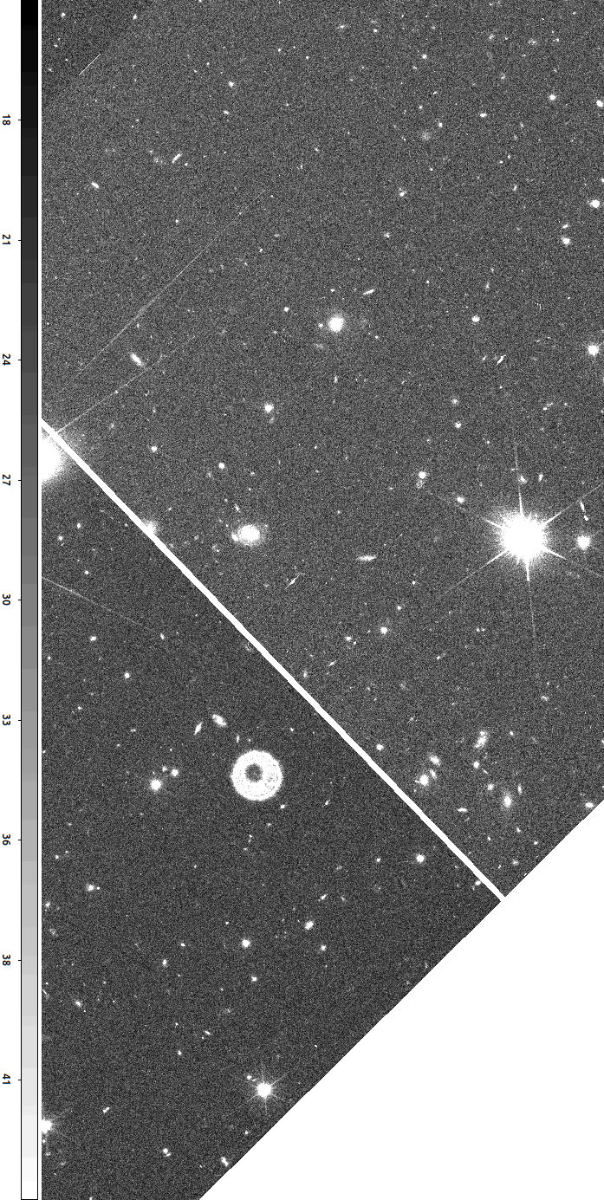
In this example: 20 mas on RA, 40 mas on DEC. By using latest Scamp (which accounts for precession of coordinates) down to 10 mas routinely! Our goal: 0.5’’/h!

Slide 8
SSO finder algorithm to search for slow(< 10 arcsec/h) moving objects in catalogues
Provided that an SSO is detected (Pivot catalogue + N remaining catalogues):
For each pivot source, find if the same source is present (within a given circle with radius given by astrometric precision) in at least M of N-1 catalogues. If true skip this source as a potential SSO
Select in each catalogue, the sources within a given distance from the potential SSOs
Associate sources (same SSO in subsequent catalogues) if the motion appears constant and always in the same direction (but within given errors)
PIVOT: CAT 1
CAT 2
CAT 3
CAT 4
Pivot source i= 45
Pivot source j
100
Pivot source j
10
Pivot source j
200
1200
100
100
23
30
2
3
1233
400

Slide 9
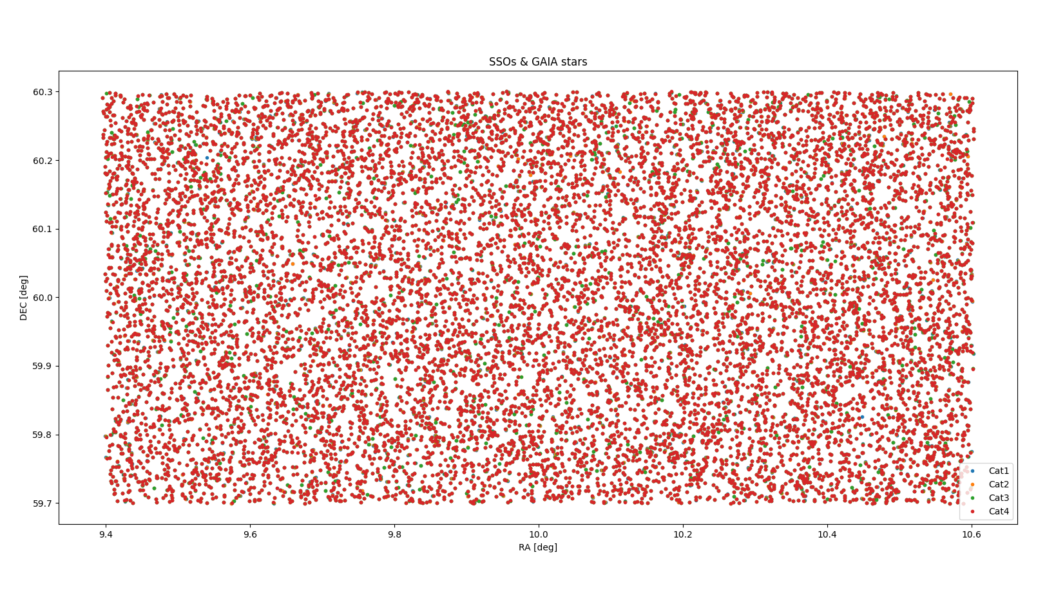
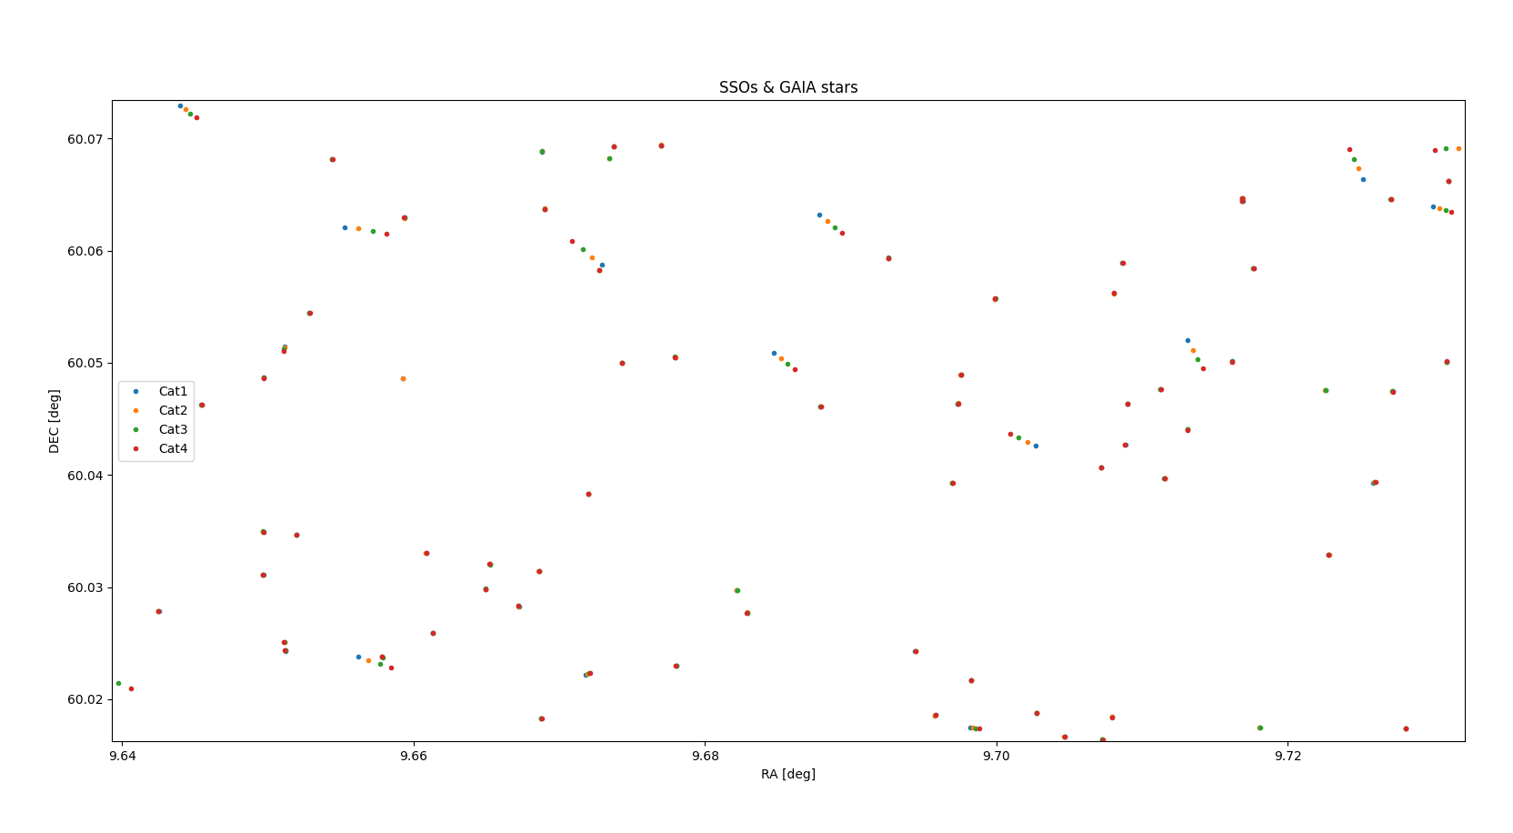
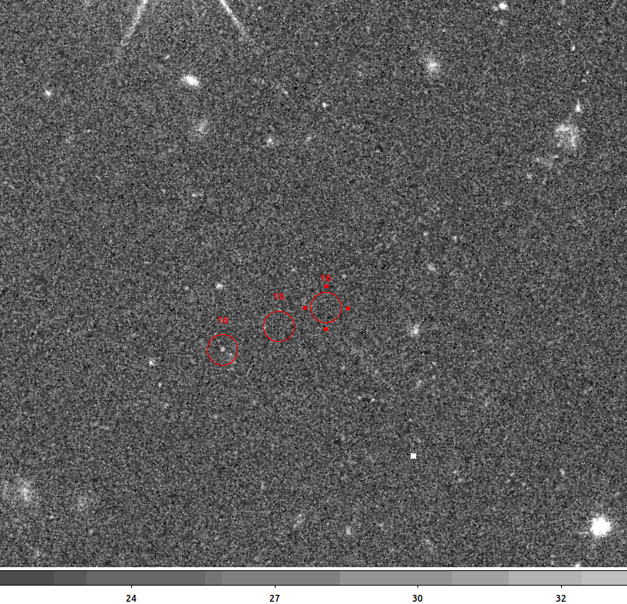
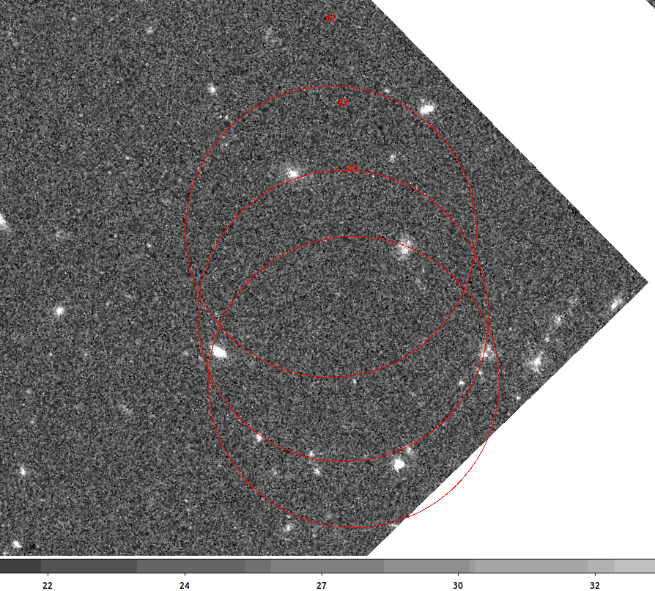
SIMULATIONS of OU-VIS-like catalogues containing SSOs. Detection down to 0.5 arcsec/h
Detection via SSOFinder of SSOs

Slide 10
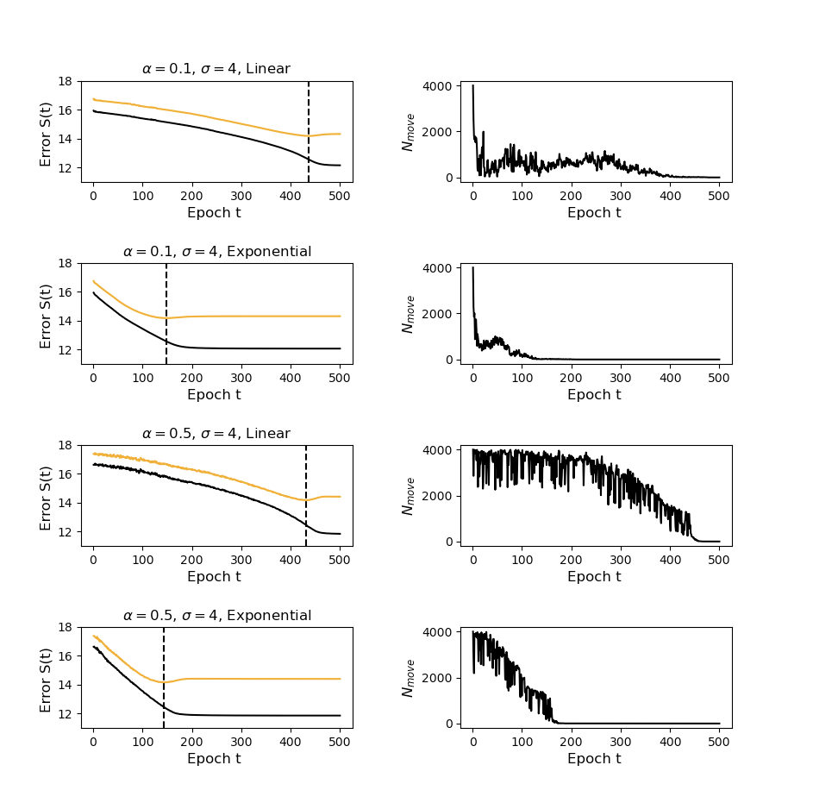
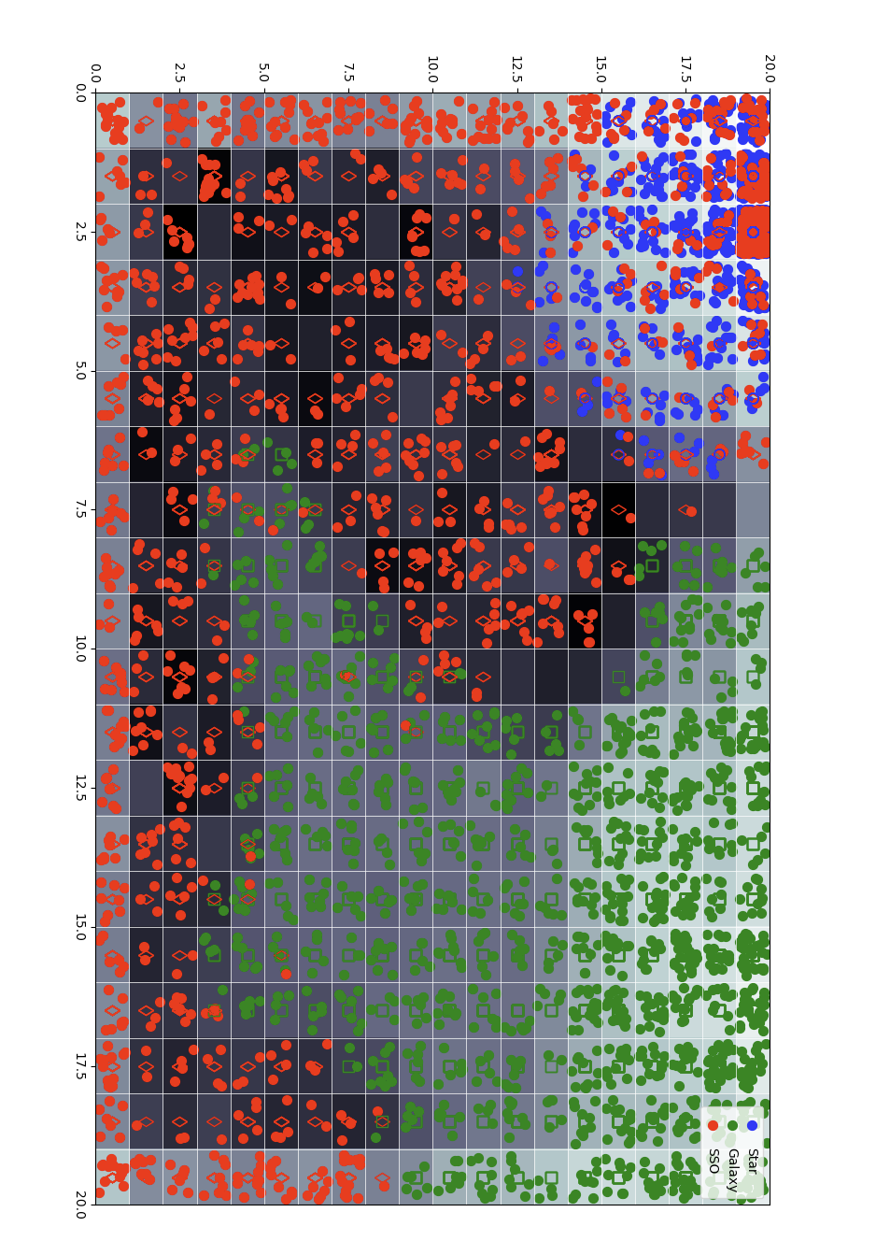
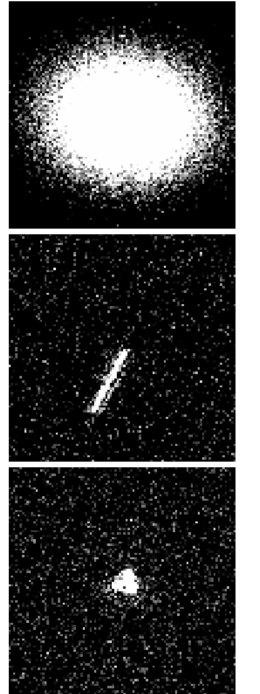
A PREDICTIVE SOM
has been implemented with an early stopping feature thus allowing the net to classify new data.

Slide 11
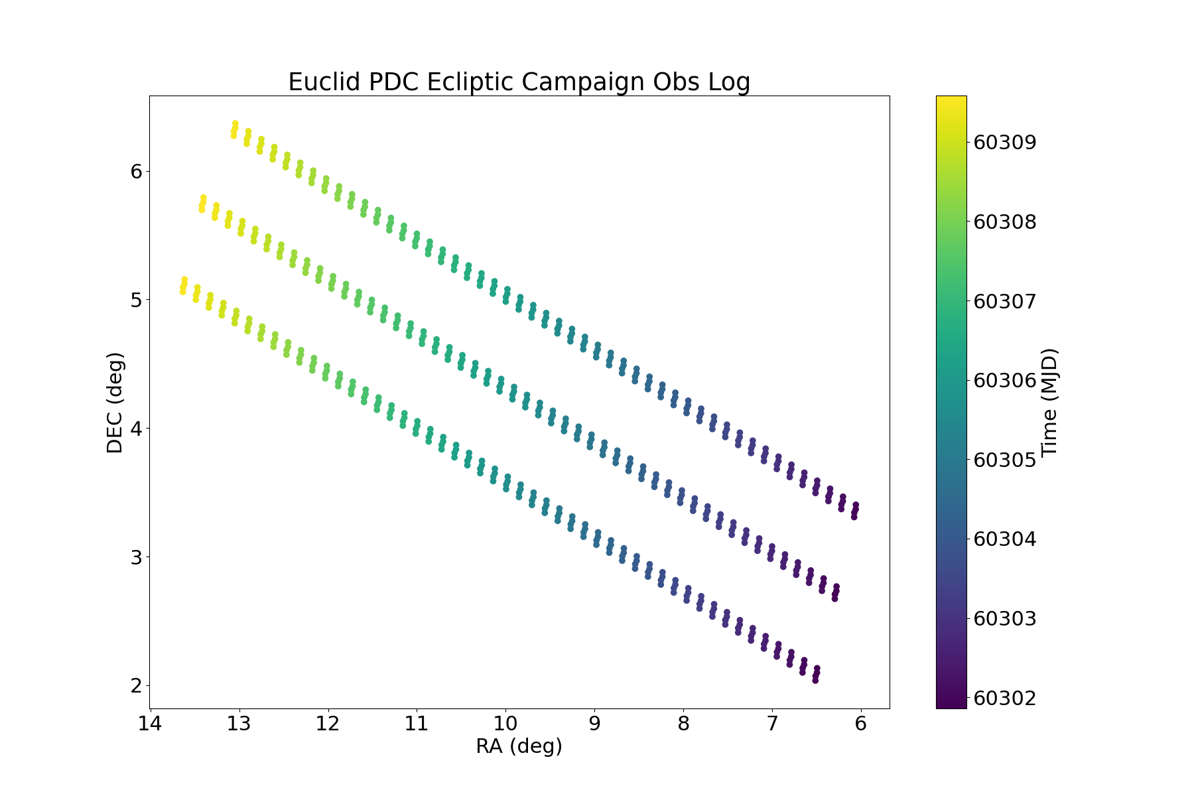
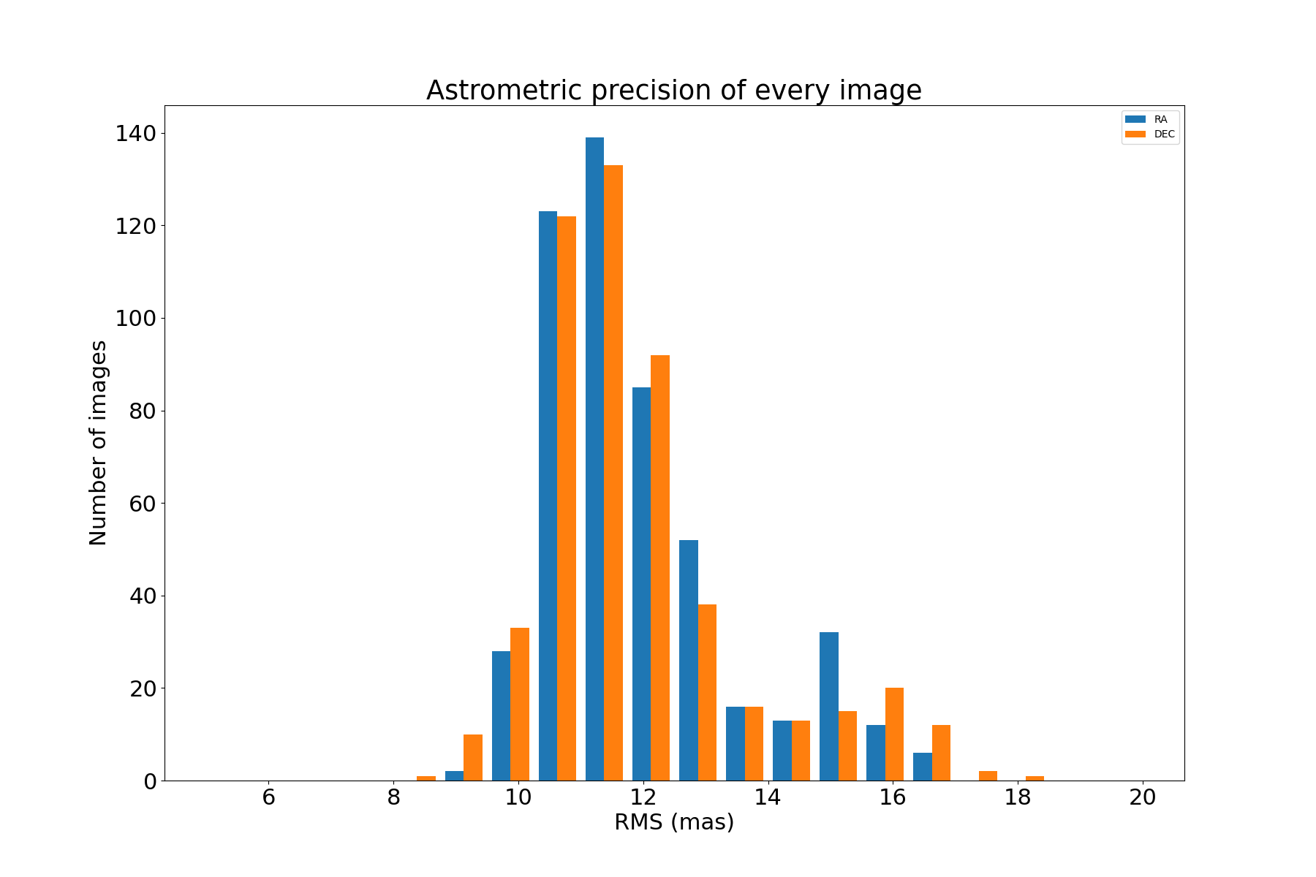
(R. Vavreck, B. Carry, M. Granvik, B. Altieri et al): PDC planning and data acquisition
During the PDC, target fields with ecliptic longitude in range ~6.5 – 14.8 degrees will be observed (Dec 23rd - Dec. 31°)
The patch is fully centered on the ecliptic plane, the height of the patch is ~ 3 x FoV.
MJD from 60301.8 to 60309.58.
OBSID from 66202 to 66350
Analysis of the PDC observation IDs (above) terminated using the described pipeline (Source Extractor, Astrometry.net, Scamp, SSOFinder and StreakDet). We could claim that this pilot study was a success and we continue…
ANALYSIS on a ESA DATALAB (first pilot study on INFN server)
2 PhD students full time (M. Pontinen, S.Sacquegna)
1 Fellow (A. Franco)
Good astrometric correction is a must for SSO studies

Slide 12
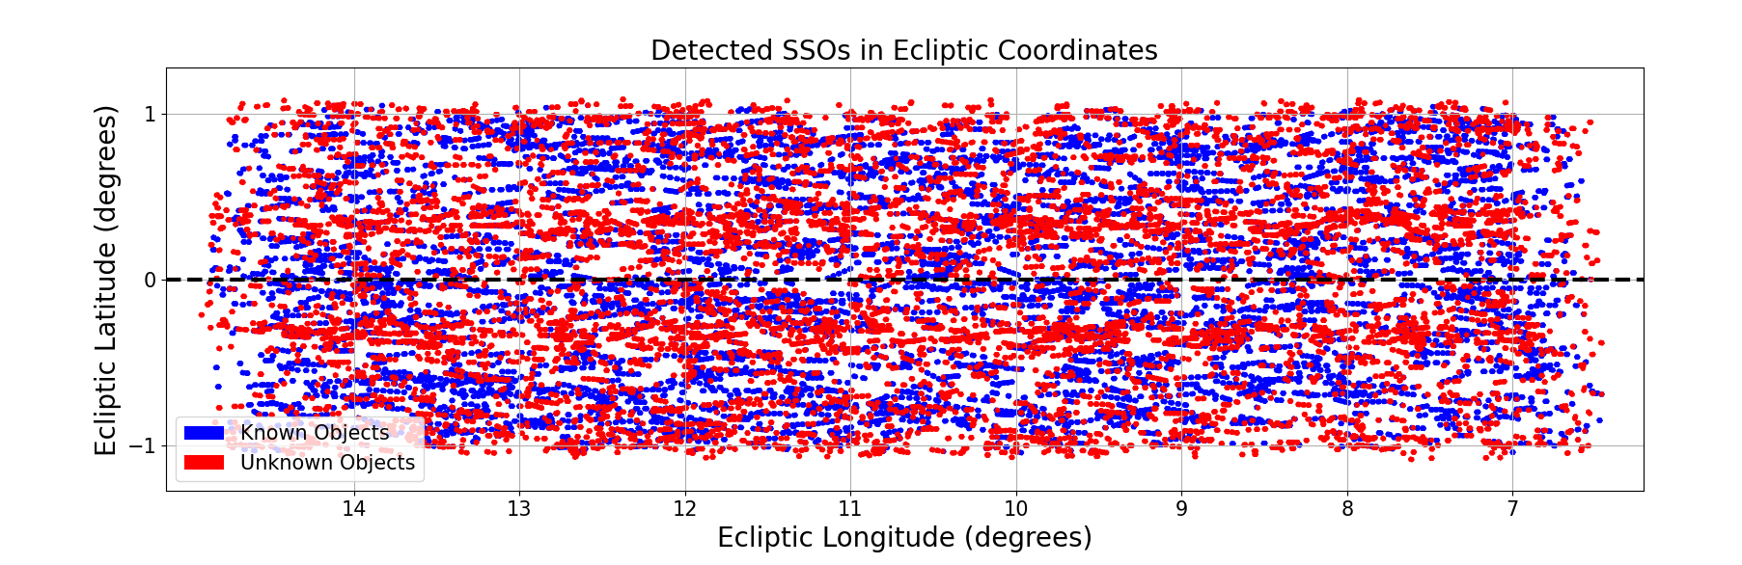
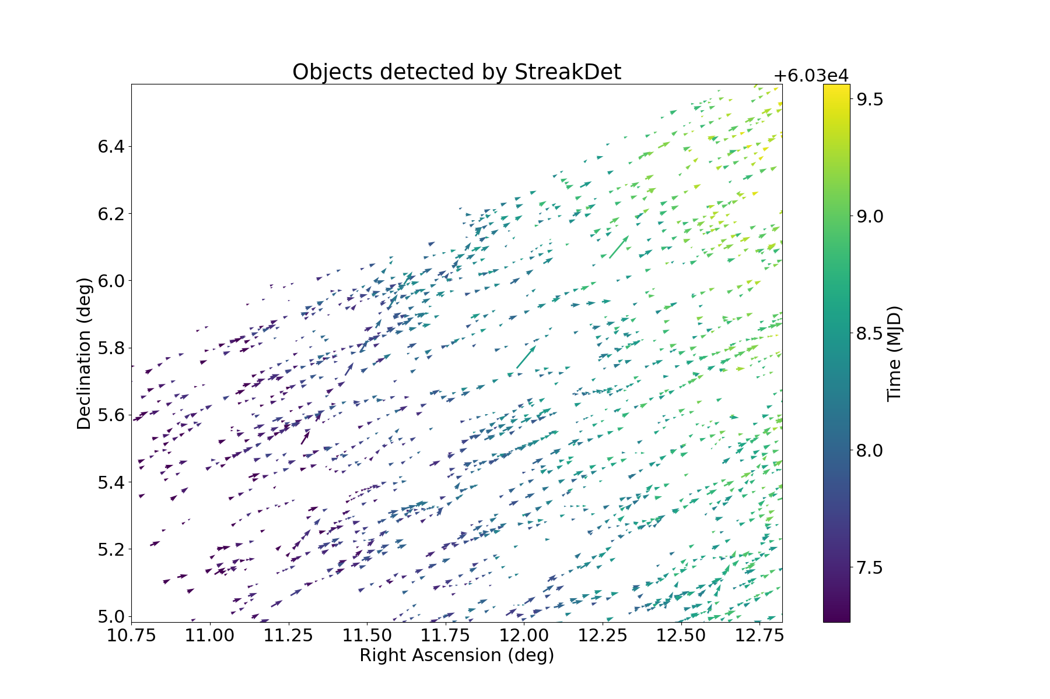
PDC Results
43 179 detected SSO streaks
23 048 (53.4%) matched to 2334 known SSOs: ~10 streaks per SSO
20 131 (46.6%) streaks from unknown objects: ~2000 new SSOs
<1% false-positive rate

Slide 13
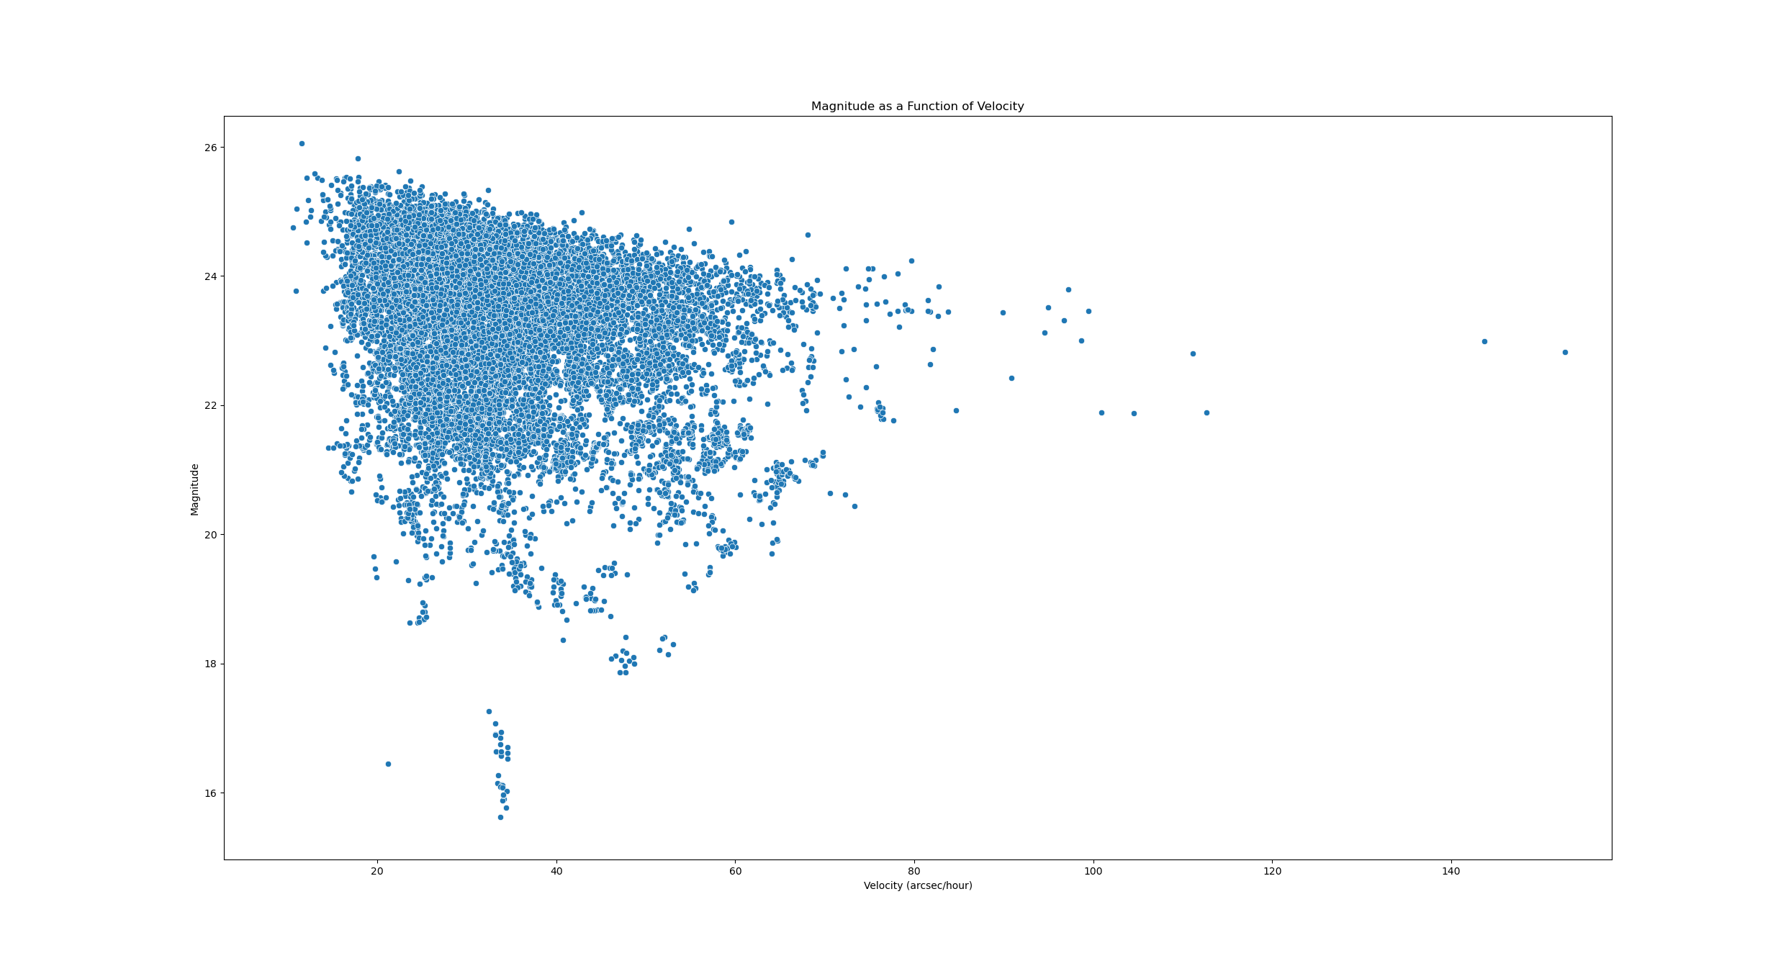
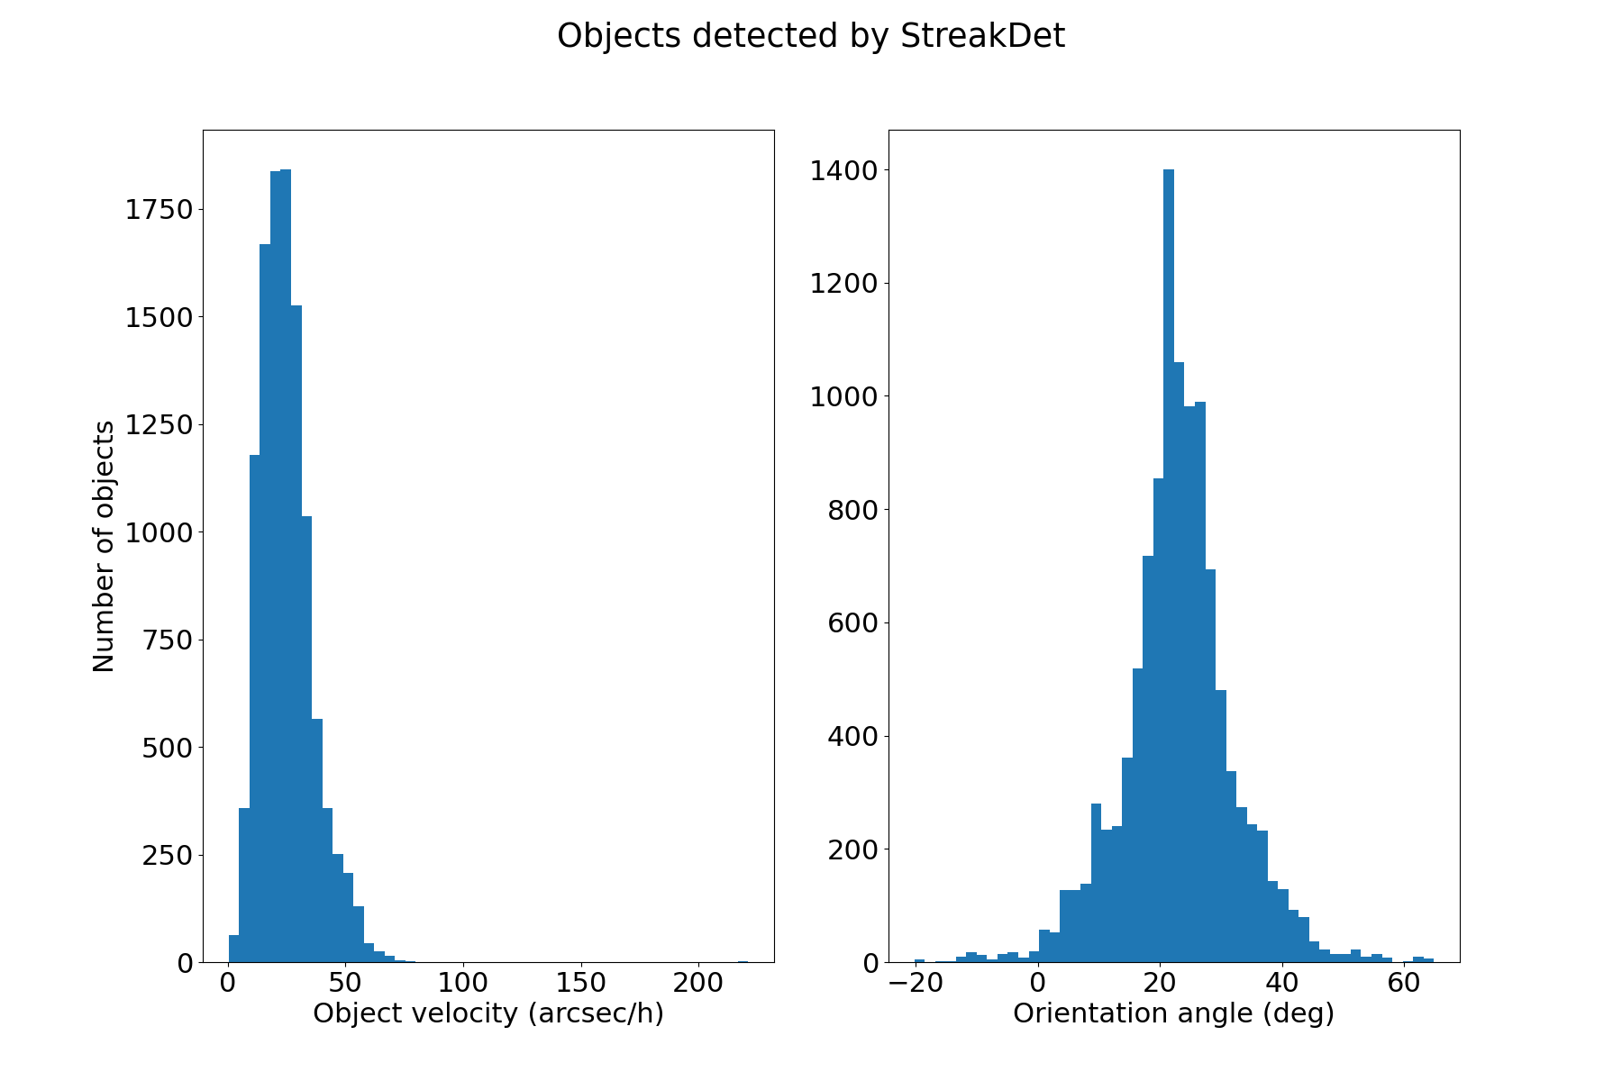
Euclid dection of Solar System Objects during Ecliptic PDC visit
PRELIMINAR
Given the amount of detection, class studies and orbit reconstruction are possible

Slide 14
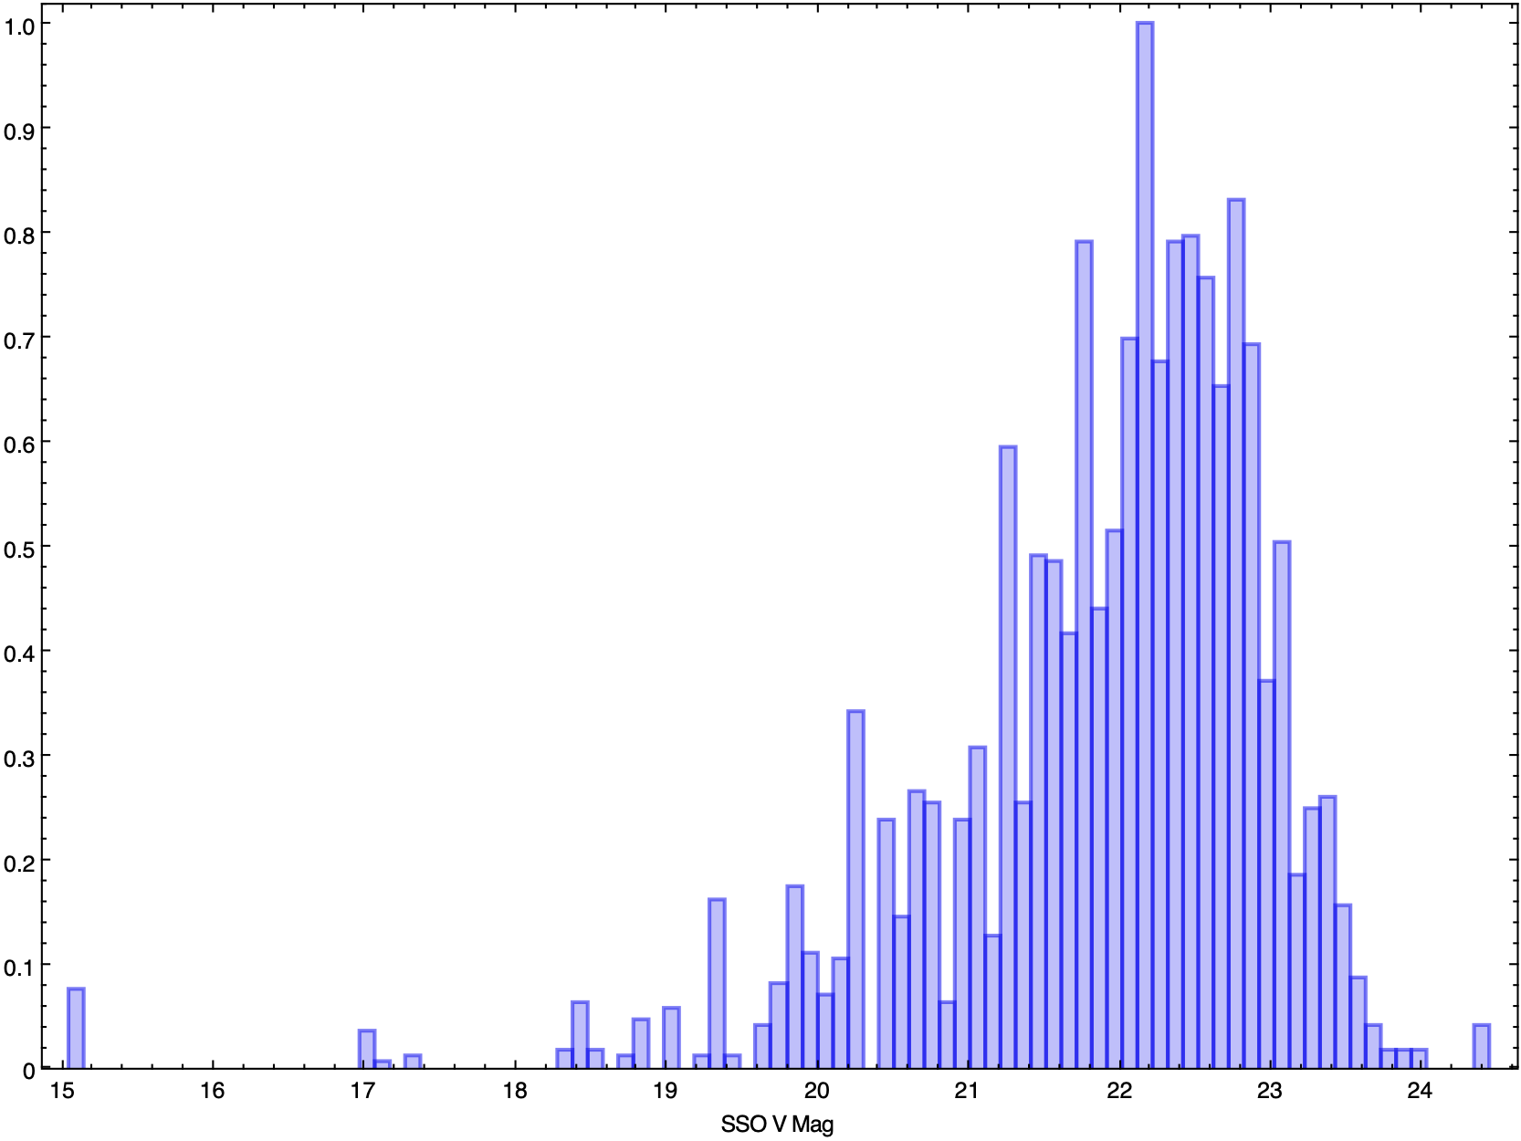
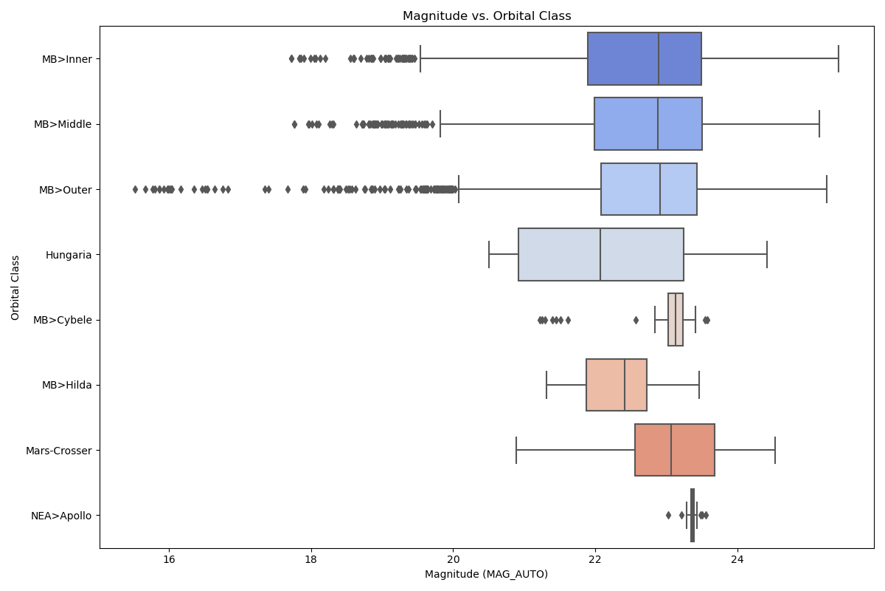
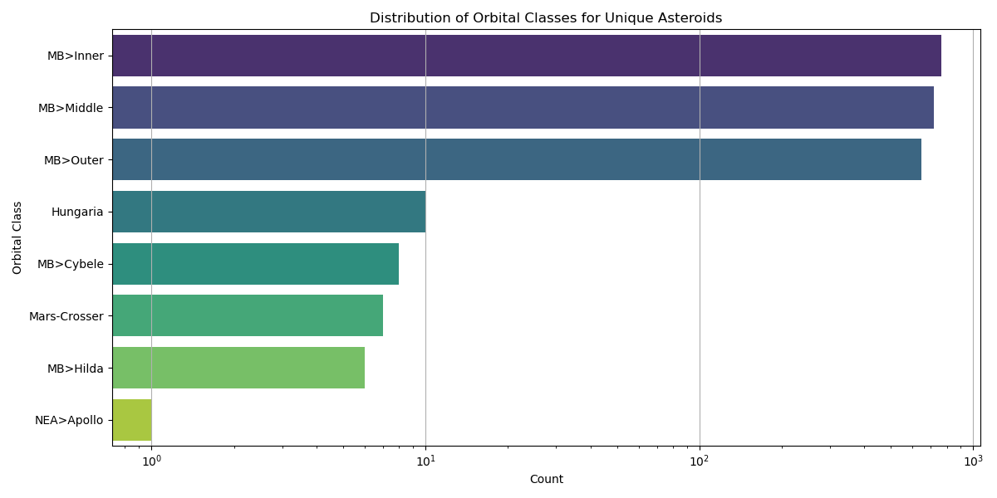
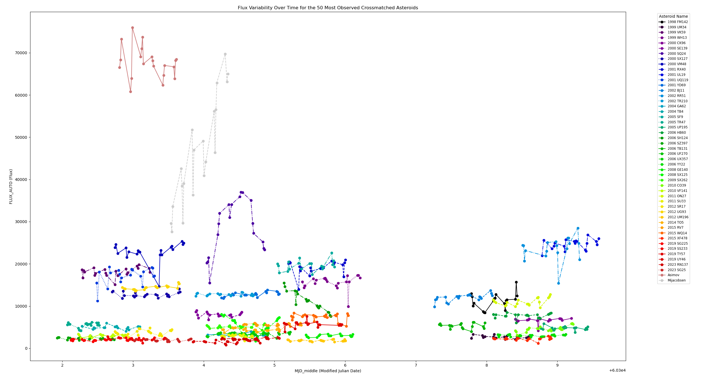
2149 NEEW DETECTIONS DURING PDC!

Slide 15
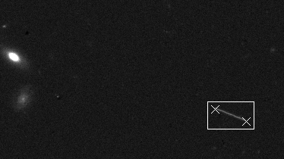
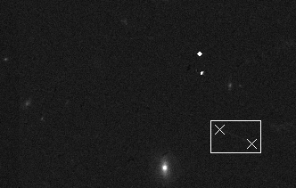
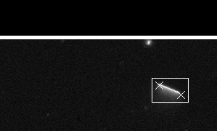
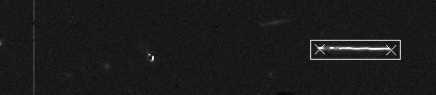
And finally a few SSOs in their appearance in the ESA/Euclid VIS images
Including a new comet at 2-4 UA

Slide 16
Conclusion:
SSO SWG has the capabilities to process data (showed in a pilot study conducted during the PDC campaign towards
the Ecliptic). Pipeline is working on DATALAB.
The team has already published, for the EC, 3 papers on the detection.
The SWG is preparing a set of papers to be submitted to ECEB: results of the PDC Ecliptic campaign for fast and slow SSOs
Present and FUTURE work:
1) Maintenance of the code in DATALAB
2) Timing analysis of the SSO light curves (under progress)
3) In a few weeks the pipeline will start working on the wide survey running on the DATALAB and daily on VIS images
4) Still Under progress: NISP analysis
5) Still Under progress: optimization of a few codes

Slide 17
REMARKS: SPIN OFF
The SGW worked hard on the development of a predictive SOM neural network (learning algorithm easy to be implemented and adapted to GPUs) which is now tested with success on different scenarious (cosmic rays, galaxy redhifts, etc)
Nucita et al., 2025, A&A, Volume 694, A116, Euclid: Detecting Solar System objects in Euclid images and classifying them using Kohonen self-organising maps
CR experiment data
Strong lens images
Redshift estimate via VISTA AB mags
classification and redshift estimate up to z=2.5
Paper about this promising tool to be submitted soon
b) Next Application: EUCLID data
classification of particle
shower extracted features and muon fraction determination.
INFN (work in progress)
classification of the lenses and their recognition in image large catalogues.
(work in progress)

Slide 18
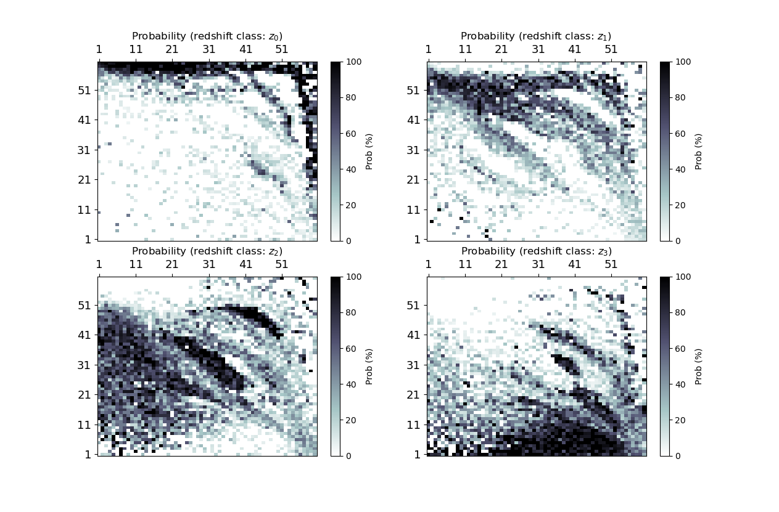
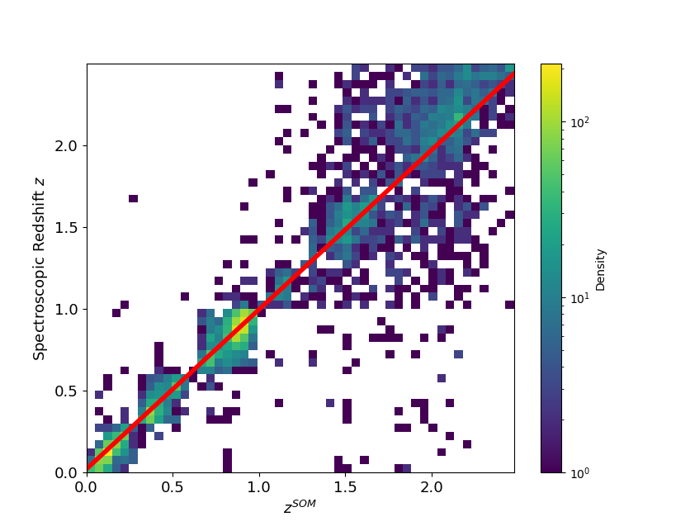
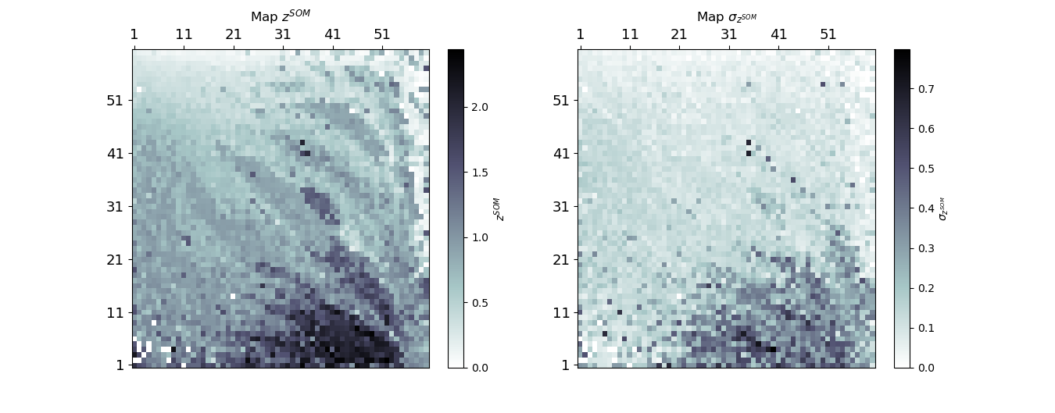
By using COMSOS2020 (VISTA Y, J, H, Ks AB magnitudes of galaxy data-set) the neural network infers the most probable redshift bins to which the objects belong and estimates the redshift from a lattice of z values (and associated errors).
A benchmark for EUCLID where we are going to use I, Y, J, H bands instead.
Z LATTICE

Slide 19
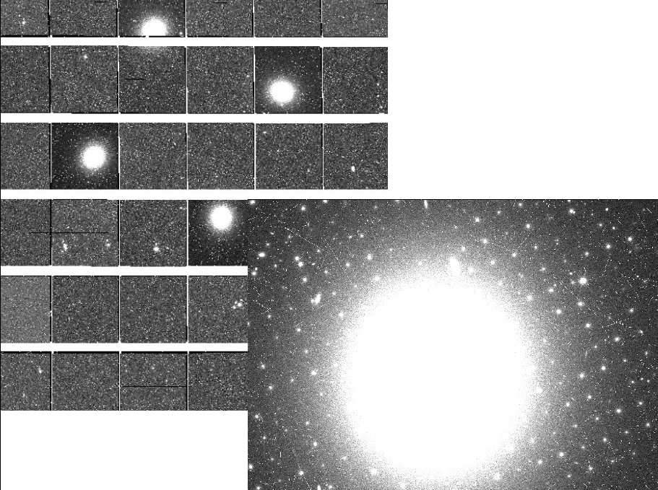
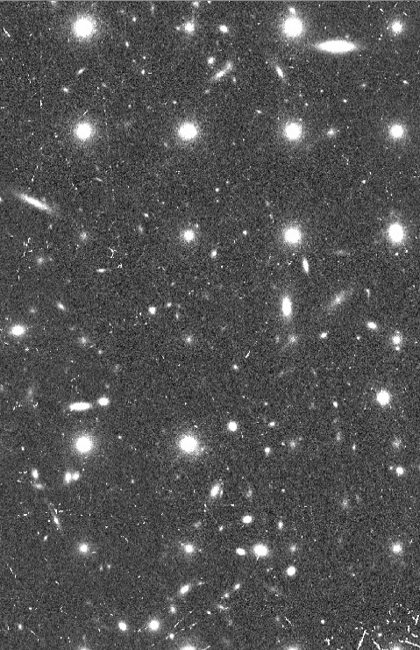
EUCLID: SWG LU
IN SWG LU: SIMULAZIONE DI LSB E GC (nel core team di 2 articoli pubblicati su early release observations): AA. Nucita, A. Franco, F. De Paolis, F. Strafella, E.Orofino

Slide 20
Attività prevista per il 2026
Nel corso dell'anno 2026, il gruppo INFN di Lecce manterrà la leadership del gruppo di ricerca denominato SSO-SWG per la ricerca, classificazione e caratterizzazione degli oggetti del sistema solare osservati dal satellite Euclid.
La migrazione della pipeline di detezione (originariamente installata su un server INFN presso la sezione di Lecce) sui server ESA è stata completata in Aprile 2025 in ritardo rispetto alle previsioni a causa della necessità di implementare la creazione di maschere dei raggi cosmici identificati nelle immagini.
Da Settembre 2025 il gruppo inizierà ad analizzare i dati della wide survey di Euclid. L’attività è prevista continuare per tutto il 2026.
In collaborazione con il gruppo SL-SWG, il gruppo di Lecce applicherà un software di classificazione sviluppato per l'analisi non supervisionata dei dati per la ricerca di lenti gravitazionali forti.
Abbiamo applicato la nostra rete neurale alla stima via MACHINE LEARNING di redshift cosmologici fino a z=2.5 solo attraverso l’analisi di misure fotometriche. Paper in sottomissione su un campione di validazione della survey VISTA. Applicazione nel 2026 a dati Euclid-like o parzialmente mancanti di misure fotometriche.

Slide 21
De Paolis | Francesco | 50%
Franco | Antonio | 0%, borsa PNRR ma lavora sul progetto sinergico
Nucita | Achille | 40%
Orofino | Vincenzo | *
Strafella | Francesco | *
Portaluri | Elisa | 20%, INAF. Tecnologa Osservatorio di Teramo. Distaccata presso il Dipartimento dal Primo Luglio 2025. Nulla osta associatura INFN Lecce per il 2026 in corso
D’Elia | Marcella | 20%
Capitolo | Descrizione | Parziali (K-EUR) | Parziali SJ (K-EUR) | Richieste | SJ
missioni | 4 ke per la partecipazione al prossimo meeting internazionale Euclid (3 persone), 1 ke (s.j) per la partecipazione di 2 persone al prossimo meeting italiano su Euclid. | 4 | 1
materiale | Acquisto 1 laptop per obsolescenza e materiale informatico quali dischi esterni per backup di dati | 2
Totale |  | 6 | 1 | 6 | 1
Si richiede l’intervento del servizio di Calcolo per 2 m/uomo
RESUME:
Richieste 2026: 6k (1k sj)
FTE TOTALI
1.3

