Slide 1
GRAIN
Timeline and goals for 2026
Alessandro MONTANARI and Lea DI NOTO
On behalf of GRAIN Working Group
DUNE ITALIA
Frascati, 11 November 2025

Slide 2
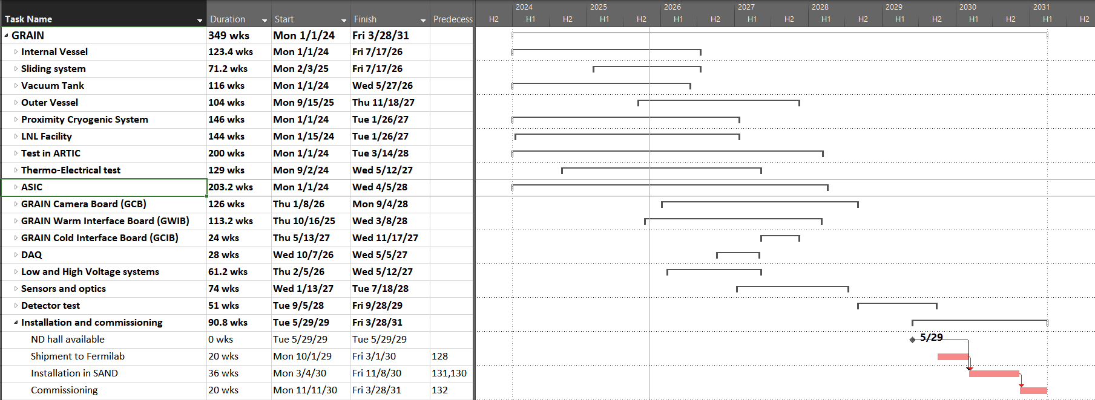
Plans for 2026-2027..or..No pain No GRAIN!
2029
2030
2024
2025
2026
2027
2028
You are here

Slide 3
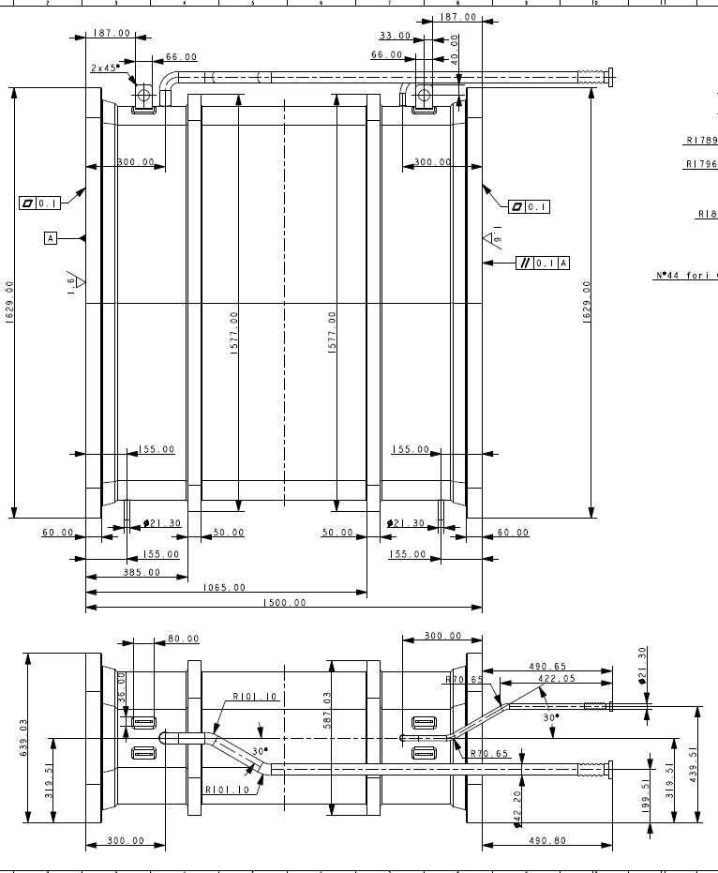
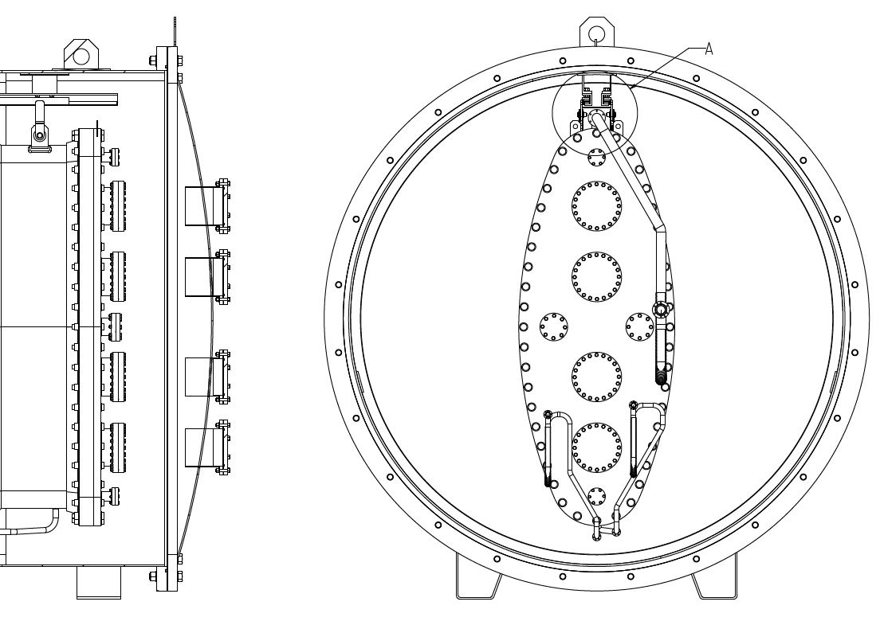
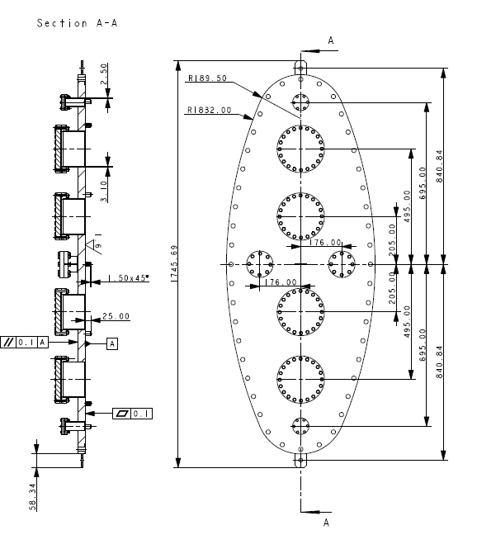
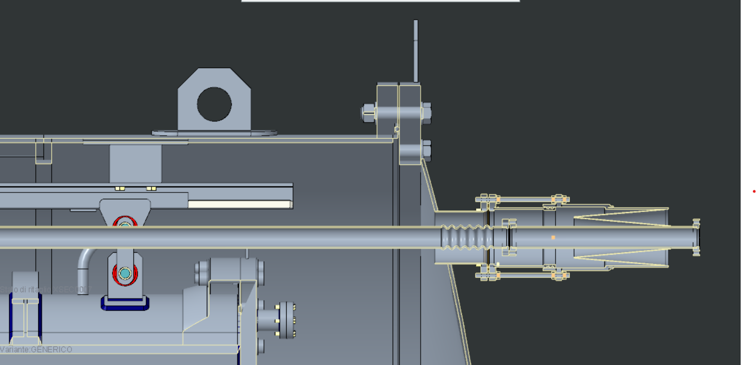
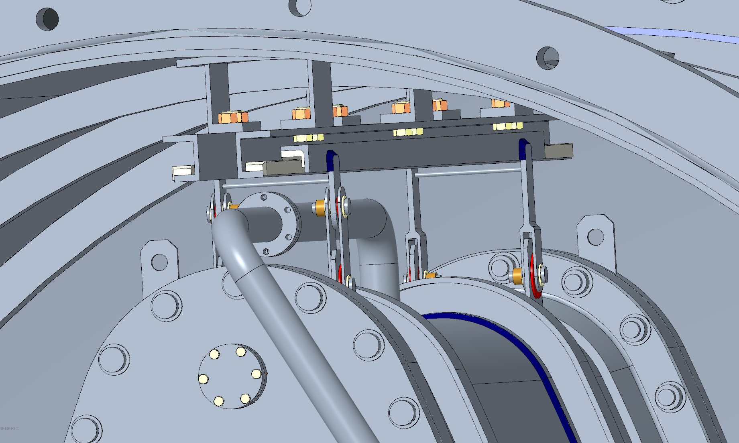
Inner Vessel + Vacuum Tank + Sliding System
(Bologna, LNL, Padova)

Slide 4
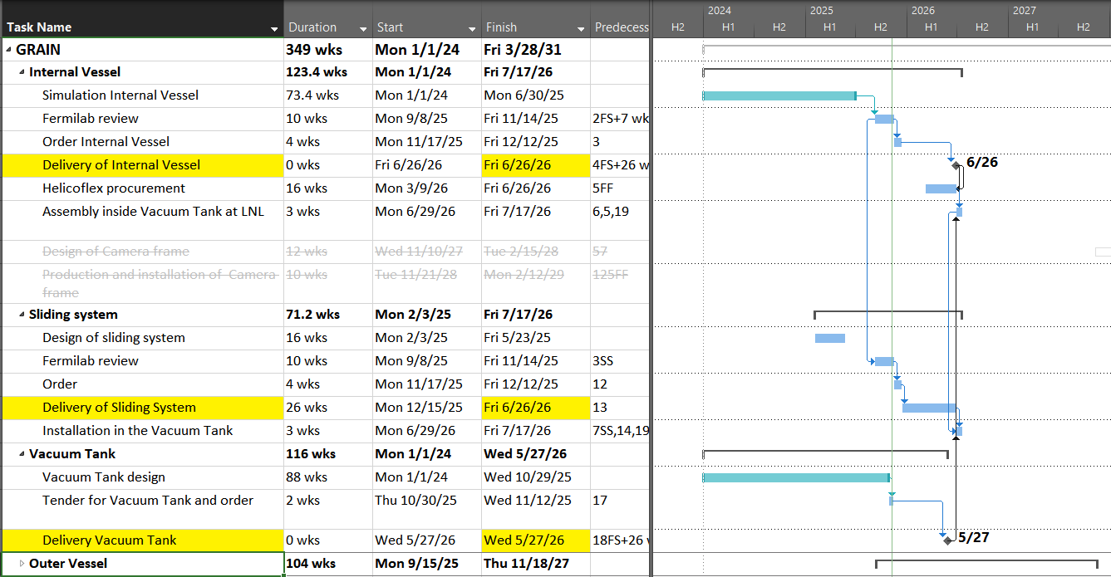
Cryostat

Slide 5
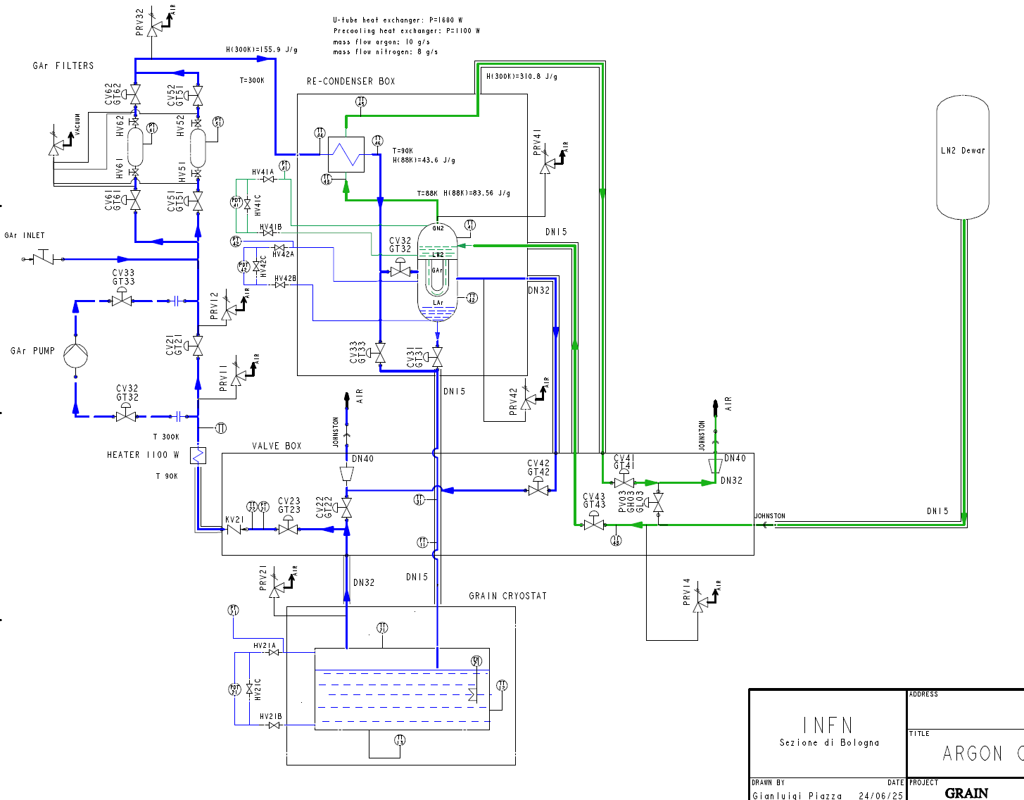
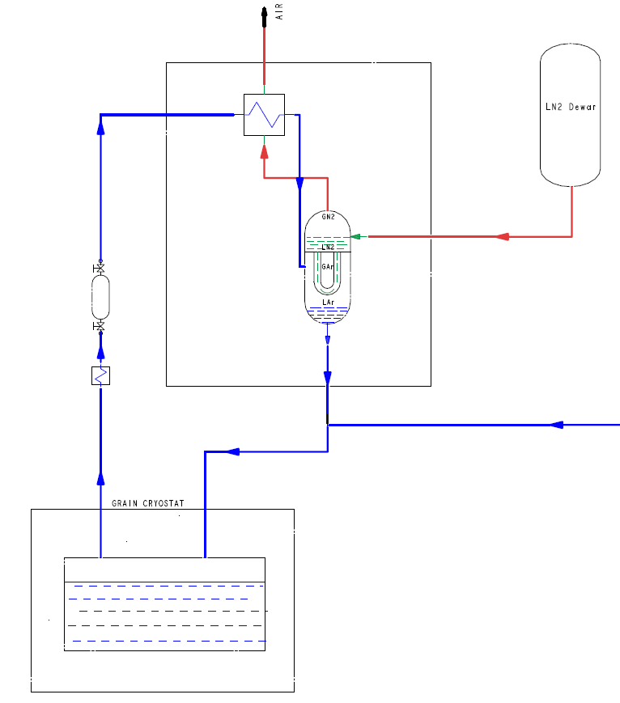
Proximity Cryogenics
(Bologna, LNL, Padova)

Slide 6
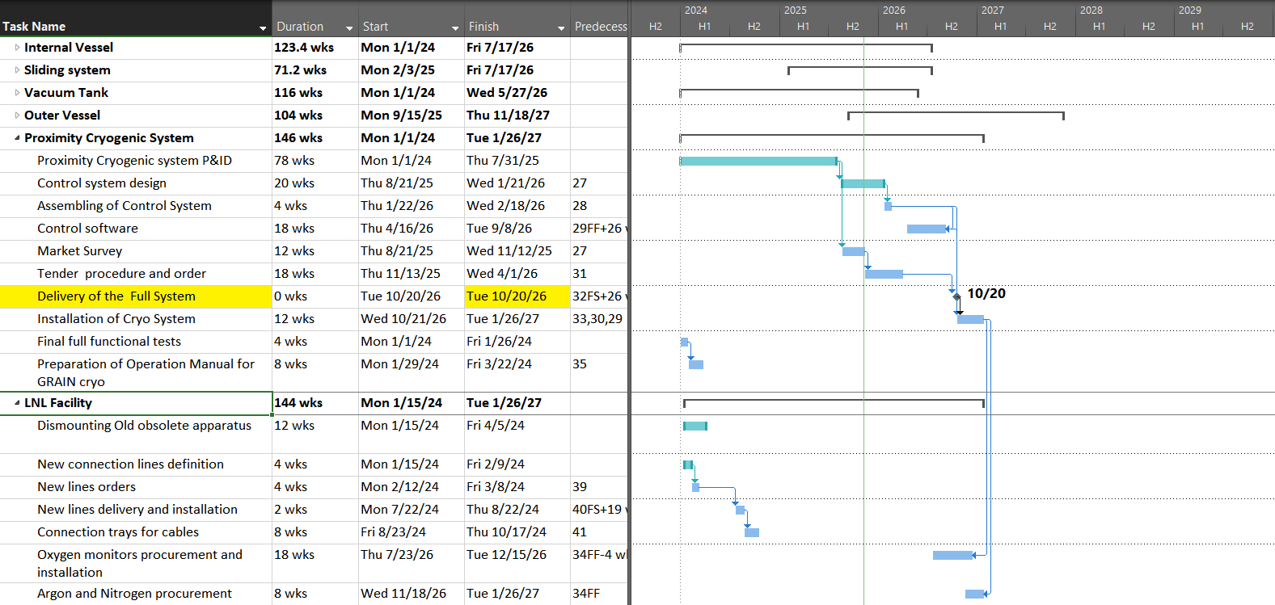
Proximity Cryogenics

Slide 7
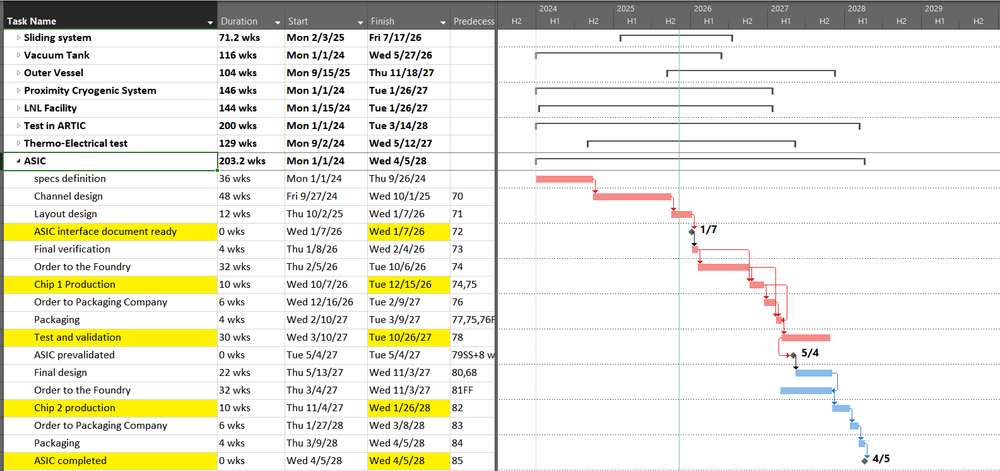
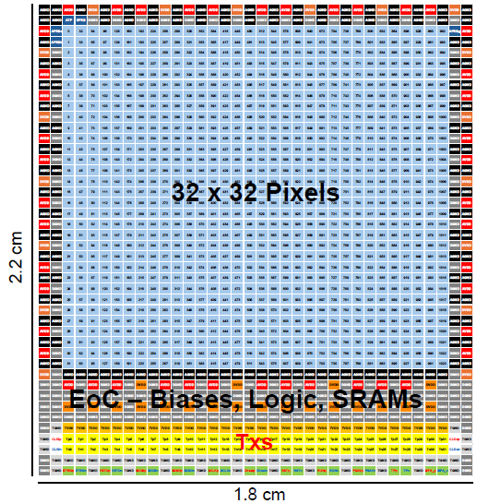
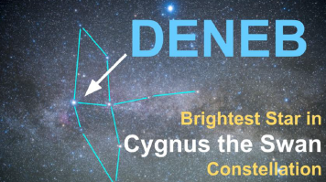
ASIC

Slide 8
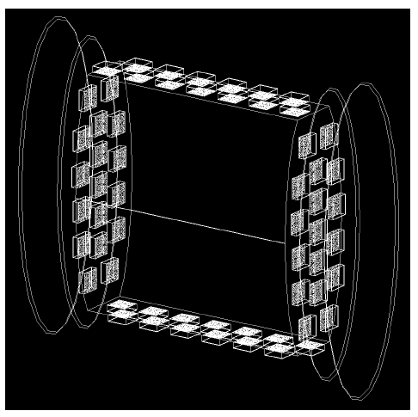
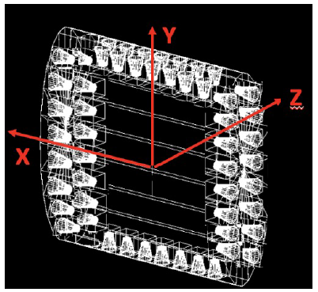
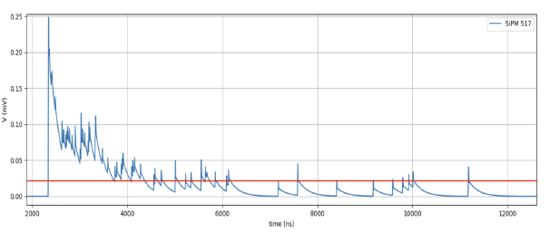
Challenges of Optical readout
Up to 64 «cameras», each with 1024 SiPMs
Complex patterns of signals
Ideally we want the number of photons and their times of arrival on each SiPM
→ a lot of output data produced by many sources
→ high power consumption expected
→ many feedthrough (thermal bridges)
It was clear since the beginning that we needed a new powerful ASIC with 1024 channels (one ASIC per camera)
  → Time of development of such an ASIC is long!! (Torino)

Slide 9
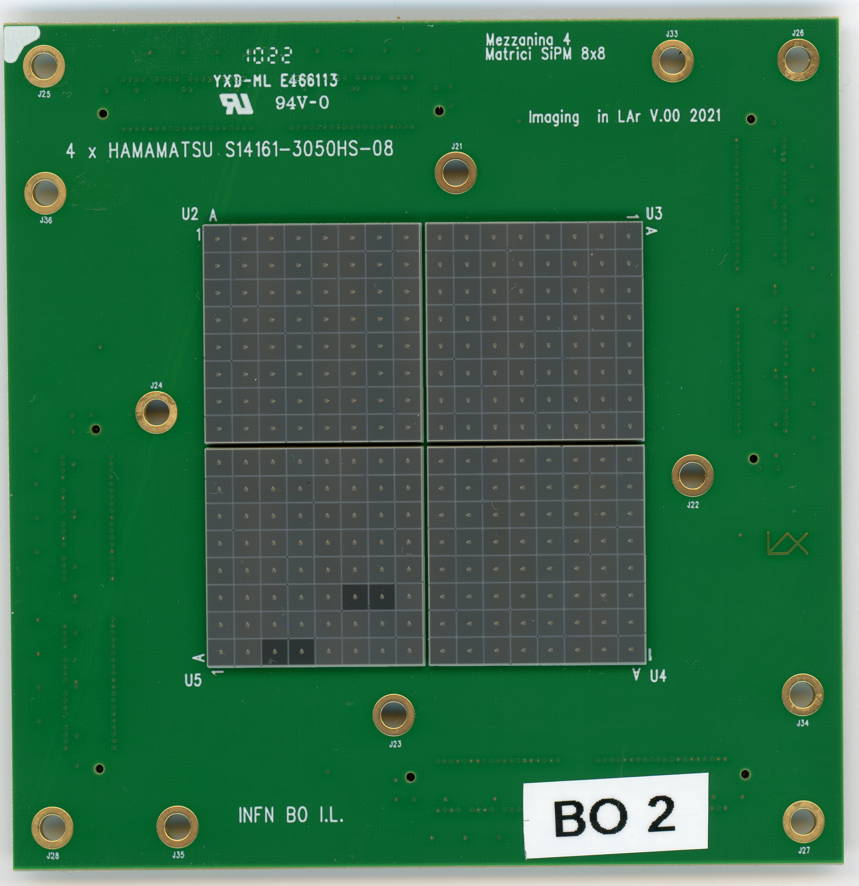
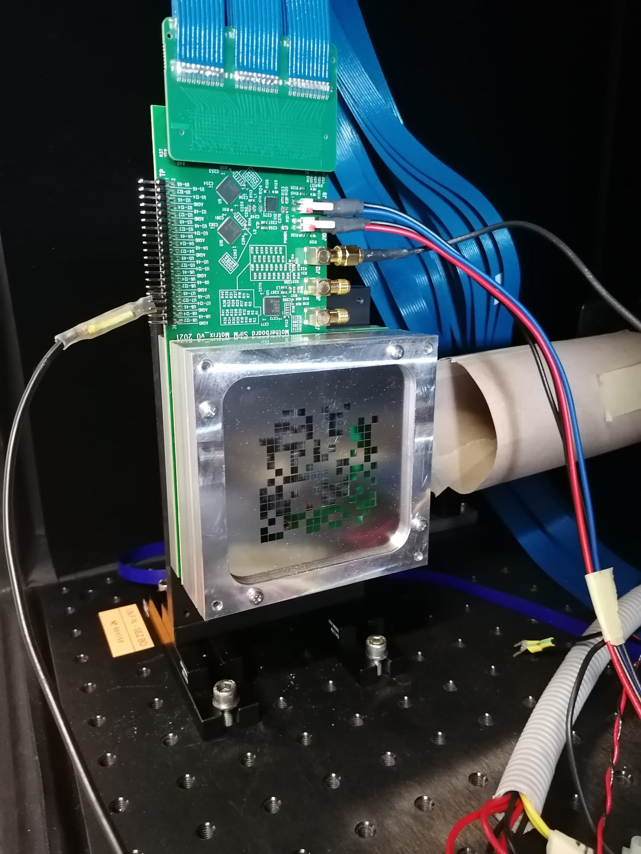
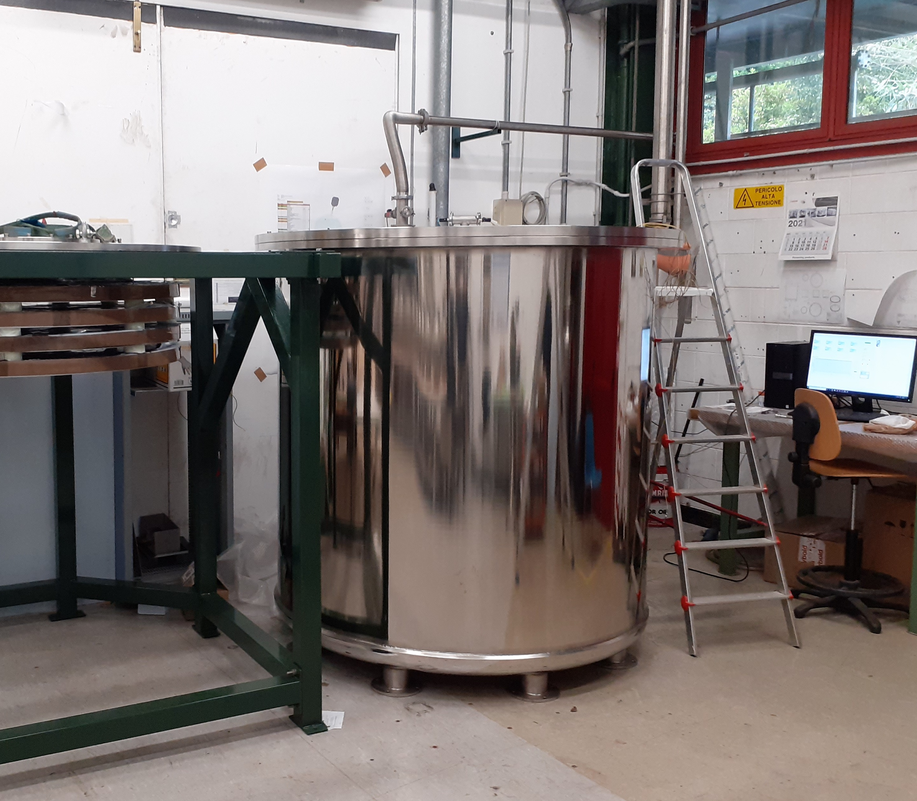
While waiting for the ASIC...
We built 2 camera demonstrators with 256 SiPMs (Bologna)
  Frontend readout by 8 existing ASICs (32 channels)
  Backend readout by FPGA
  Firmware and daq software developed
  It can be coupled to masks or lenses
Test principle in Artic (Liquid Argon facility, Genova)
  with lens (focusing, 1 camera enough)
  with masks (need >= 2 cameras)
Test with cosmics (telescope, Lecce)

Slide 10
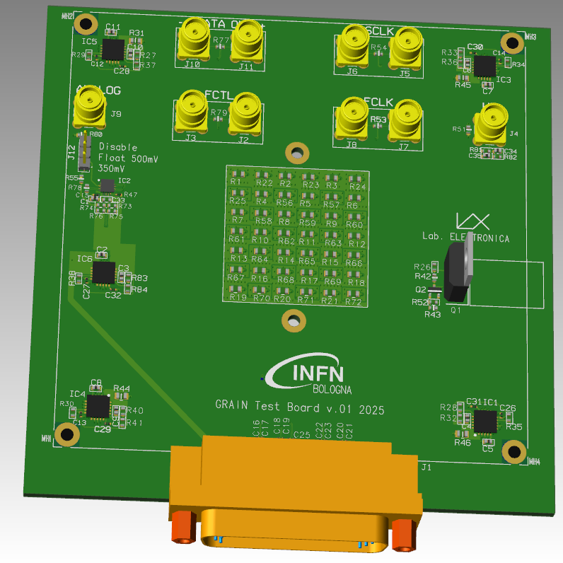
Power consupmtion
Mockup boards are under development (Bologna)
  Same size of final camera boards
  Voltage regulators
  ASIC power dissipation emulated with resistors
Test in Liquid Nitrogen small dewer (Bologna, Genova)
  Voltage regulators cryo operation
  Bubble formation
Test inside Inner Vessel at LNL (Bologna, Padova, Genova)

Slide 11

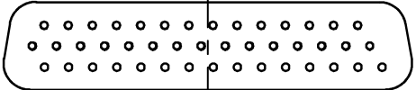
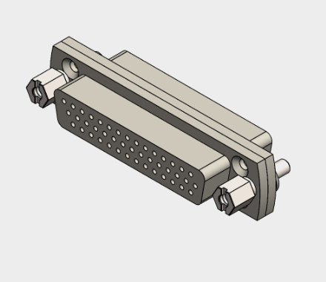
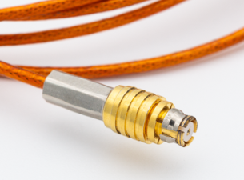
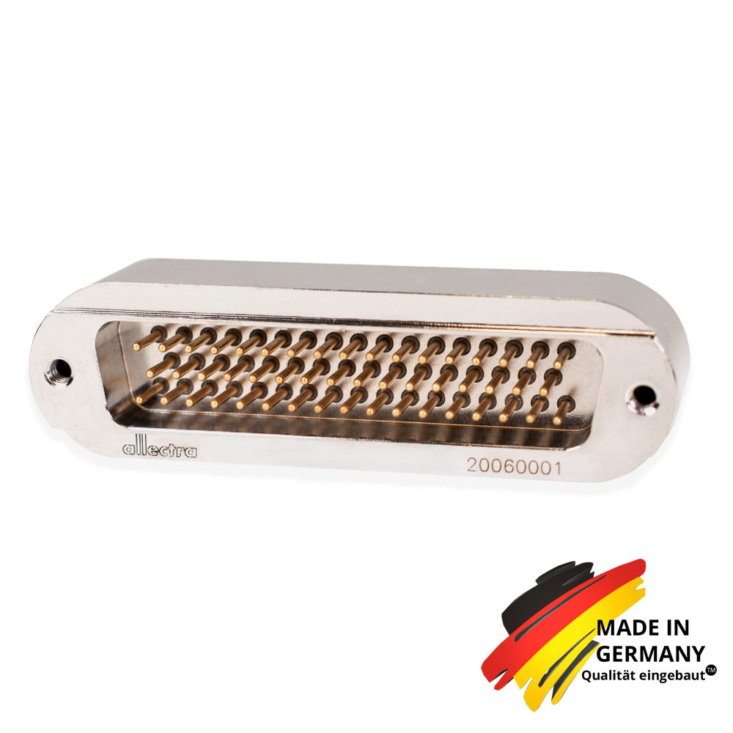
Low voltage and feedthroughs
Electric test of feedthoughs (Bologna)
  Signals integrity (LVDS from ASIC)
  High current power lines
Mockup emulating flanges and interconnections between Inner and Outer vessel (Bologna,..)
  Test cabling layout
  Test integration steps
Define power supplies (for ASIC and SiPMs biasing) (Bologna, Genova)
HC50
HD44
HD44
HD44
HD44
HD44
HD44
HD44
HD44
HC50

Slide 12
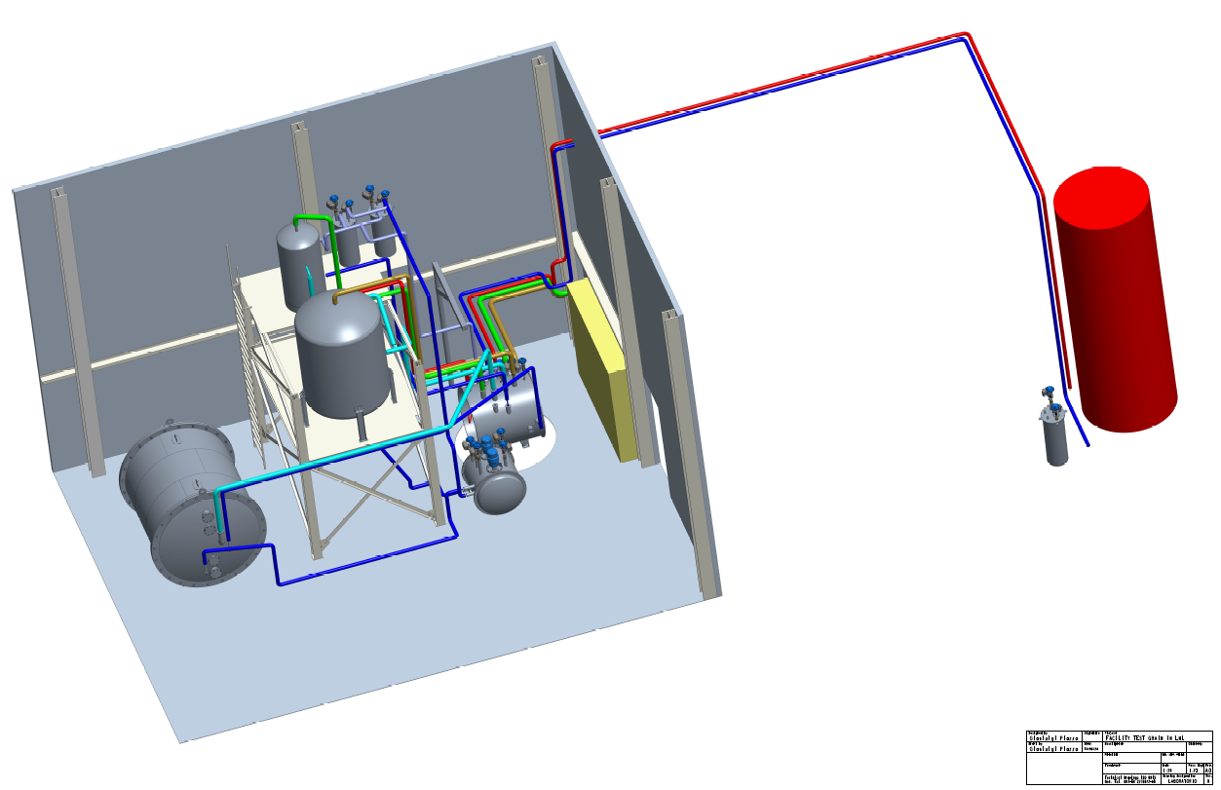
Legnaro facility
Tests in Liquid Argon
  Vacuum tank + Inner Vessel + proximity cryogenics system (LNL, BO, PD, GE)
Test with Mockup boards
Test feedthroughs + cabling
Test Cosmic ray telescope (Lecce)
…………

