Slide 1



Tests on the first prototype of the lens-based optical detector for GRAIN
DUNE-Italia Collaboration Meeting
Frascati, November 11th 2025
Speaker: Francesco Polleri
(on behalf of the Genoa group)

Slide 2
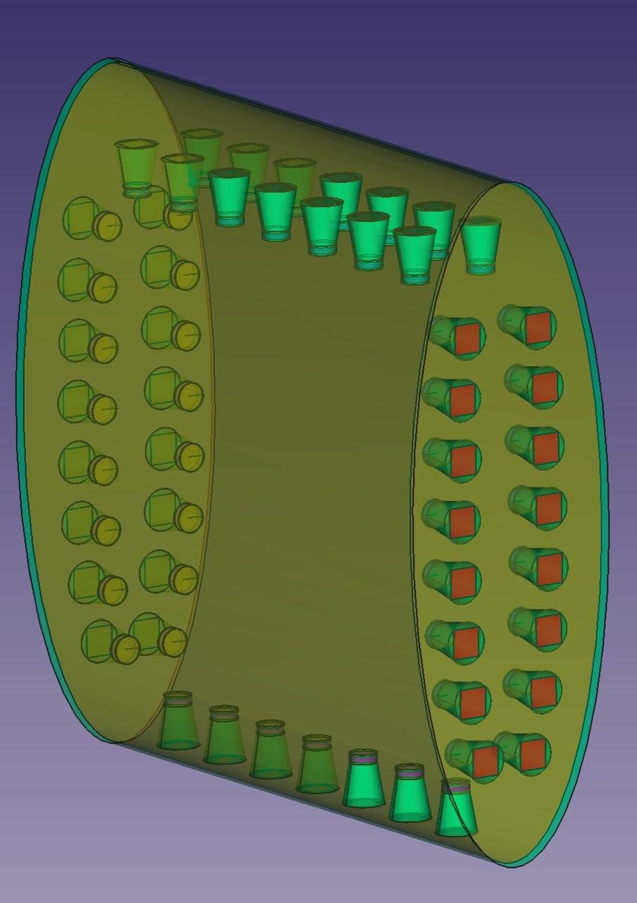
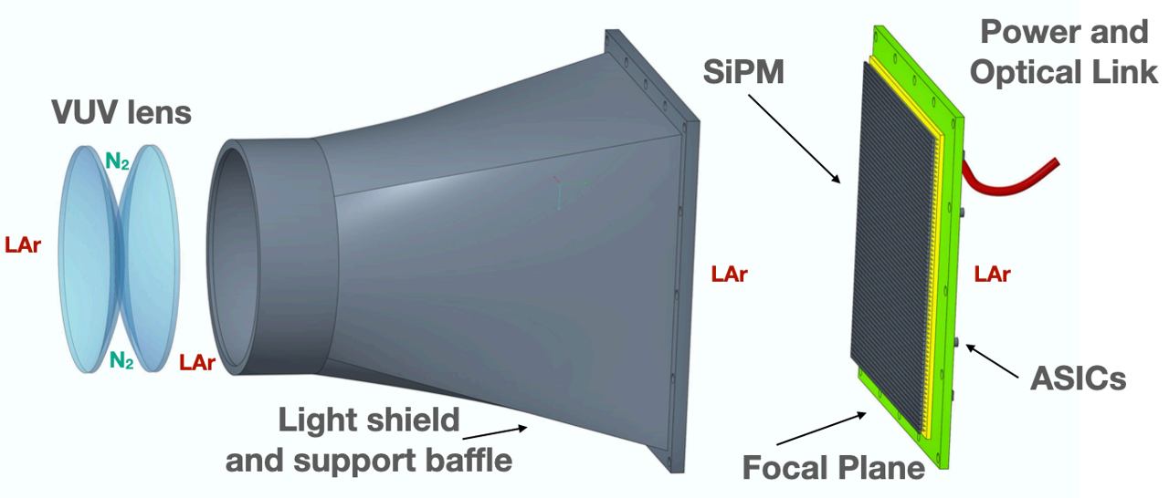
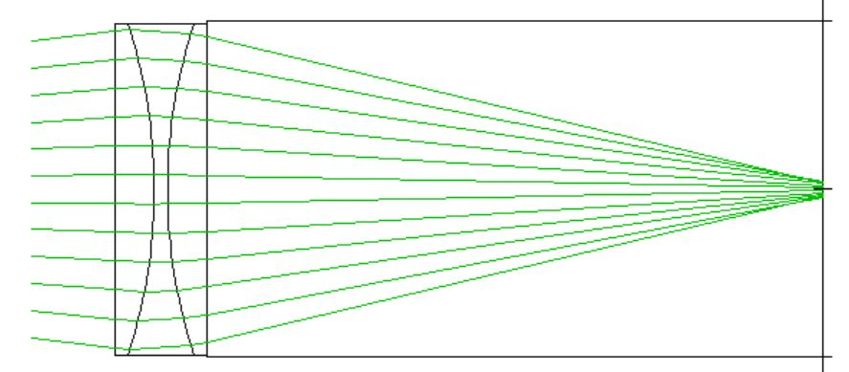
Introduction
For the optical system of GRAIN, one of the two possible options is a lens-based optical detector:
Lenses with good UV light transmission
32x32 (1024 channels) matrix of 2 mm side SiPMs
Dedicated ASIC, specifically developed for GRAIN
Cameras layout in GRAIN
Gas
SiPMs
LAr
LAr
F. Polleri - Tests on the first prototype of the lens-based optical detector for GRAIN DUNE-Italia Collab. Meeting 2025

Slide 3
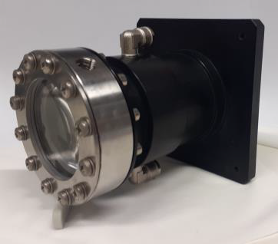
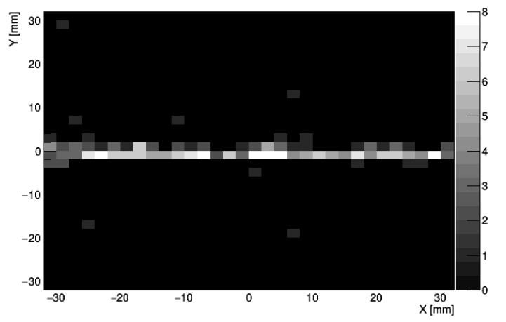
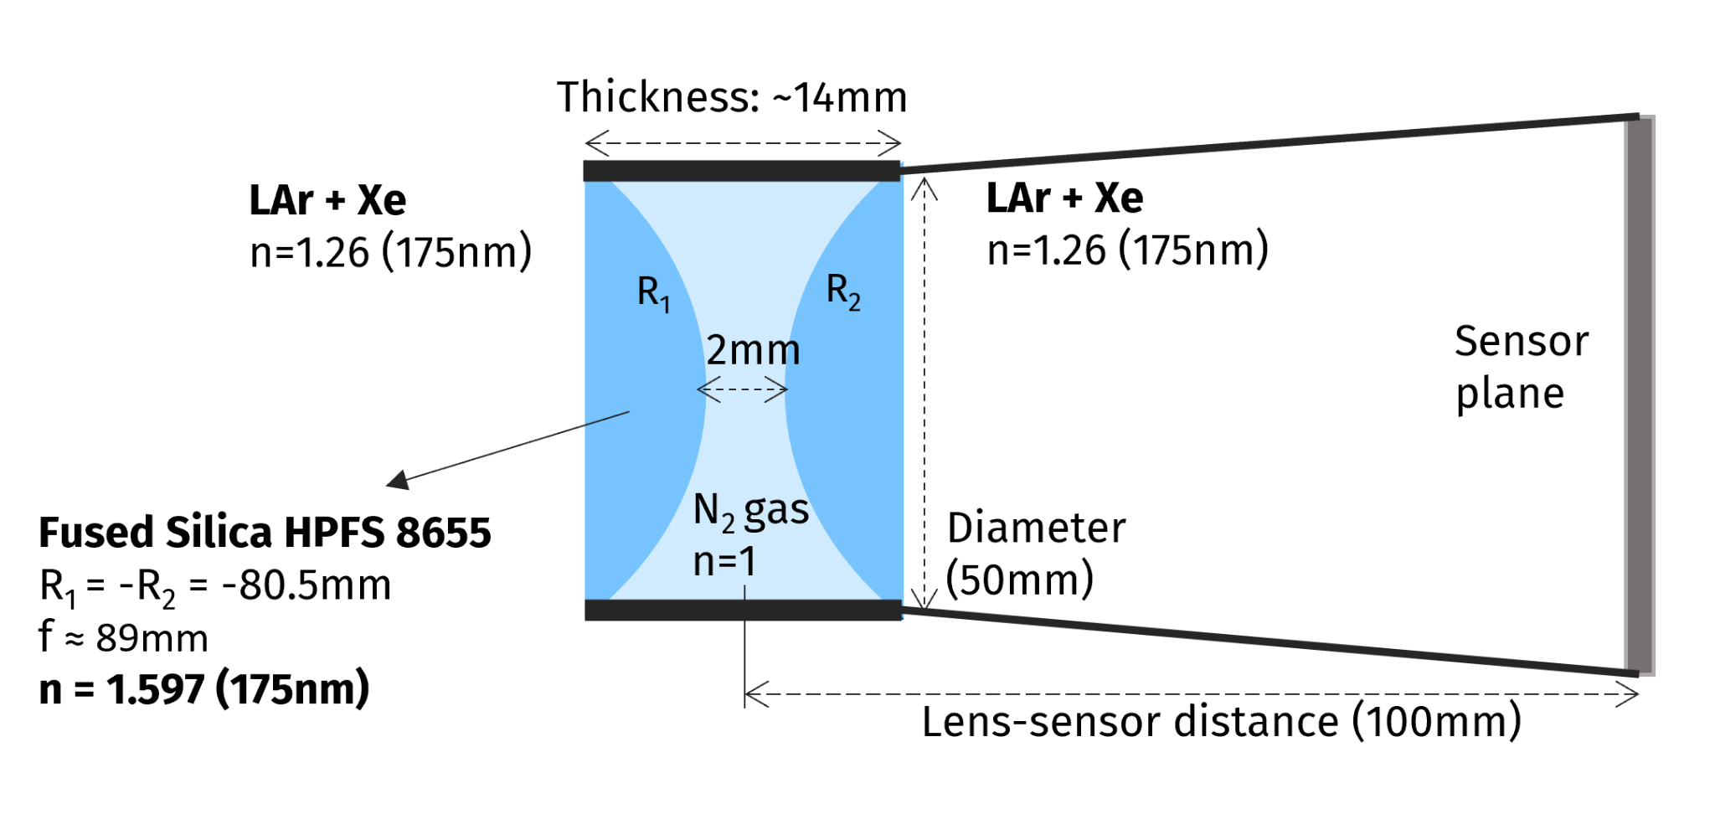
Tested prototype
Pair of bi-convex fused silica lenses with gas between them.
This prototype was designed to operate in LAr doped with xenon gas, allowing the lenses to focus the light emitted by charged particle tracks at distances between 30 and 80 cm.
Diameter: 50 mm
Curvature radius: 80.5 mm
Lens-sensor distance: 10 cm
Track located 50 cm away from the lenses, as reproduced on the SiPMs
F. Polleri - Tests on the first prototype of the lens-based optical detector for GRAIN DUNE-Italia Collab. Meeting 2025

Slide 4
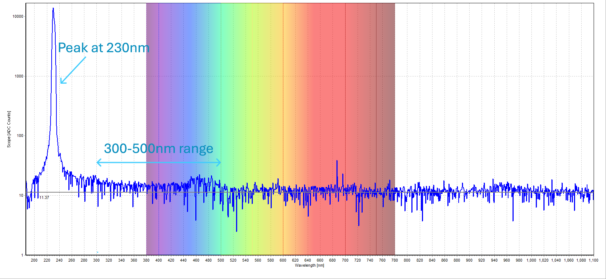
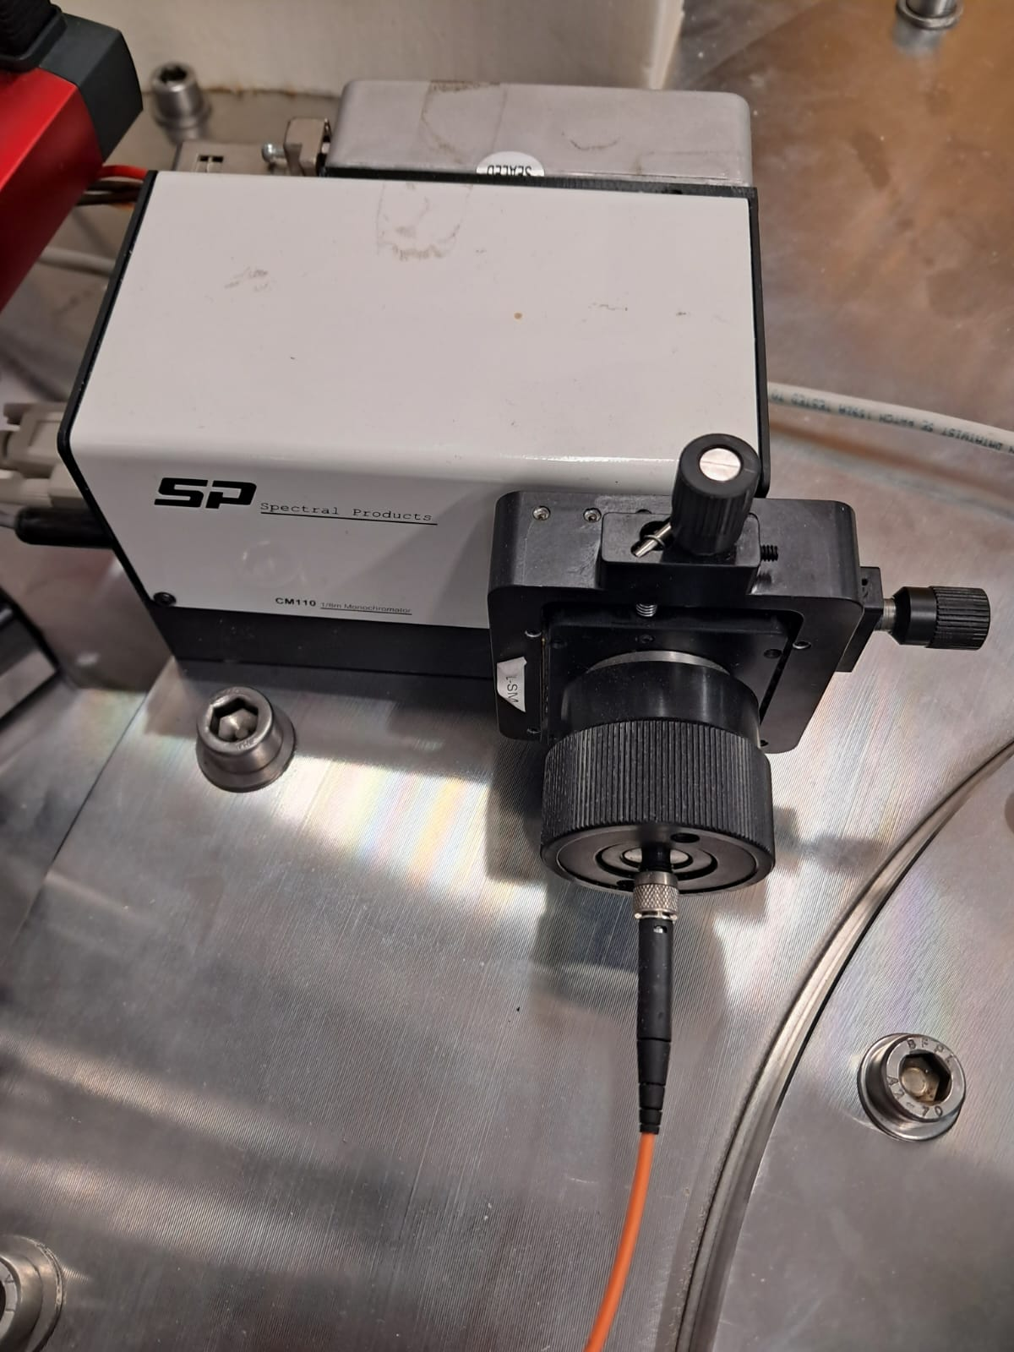
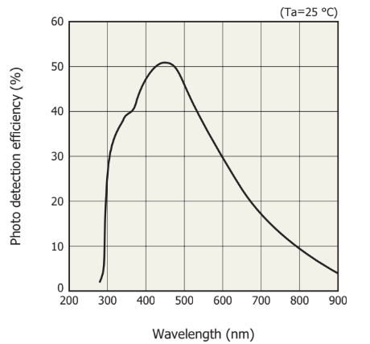
Experimental setup: artificial light source
Counts
Spectrum of the light exiting the optical fiber with the monochromator set to 230 nm.
Xenon lamp
Monochromator
Wavelength [nm]
Datasheet SiPM Hamamatsu S14161
PDE as a function of λ
The light detected by the SiPMs lies in the 300–500 nm range, with maximum intensity at 450 nm.
Optical fiber
Photon Detection Efficiency [%]
Wavelength [nm]
F. Polleri - Tests on the first prototype of the lens-based optical detector for GRAIN DUNE-Italia Collab. Meeting 2025

Slide 5
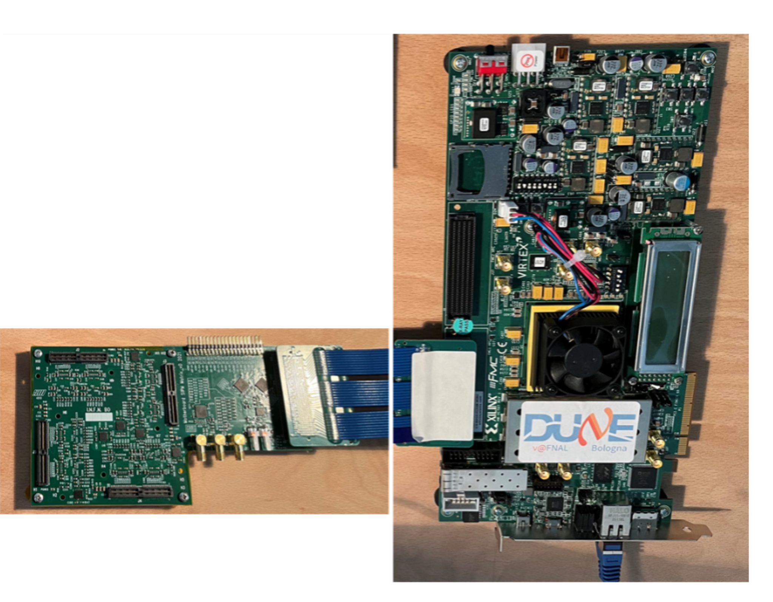
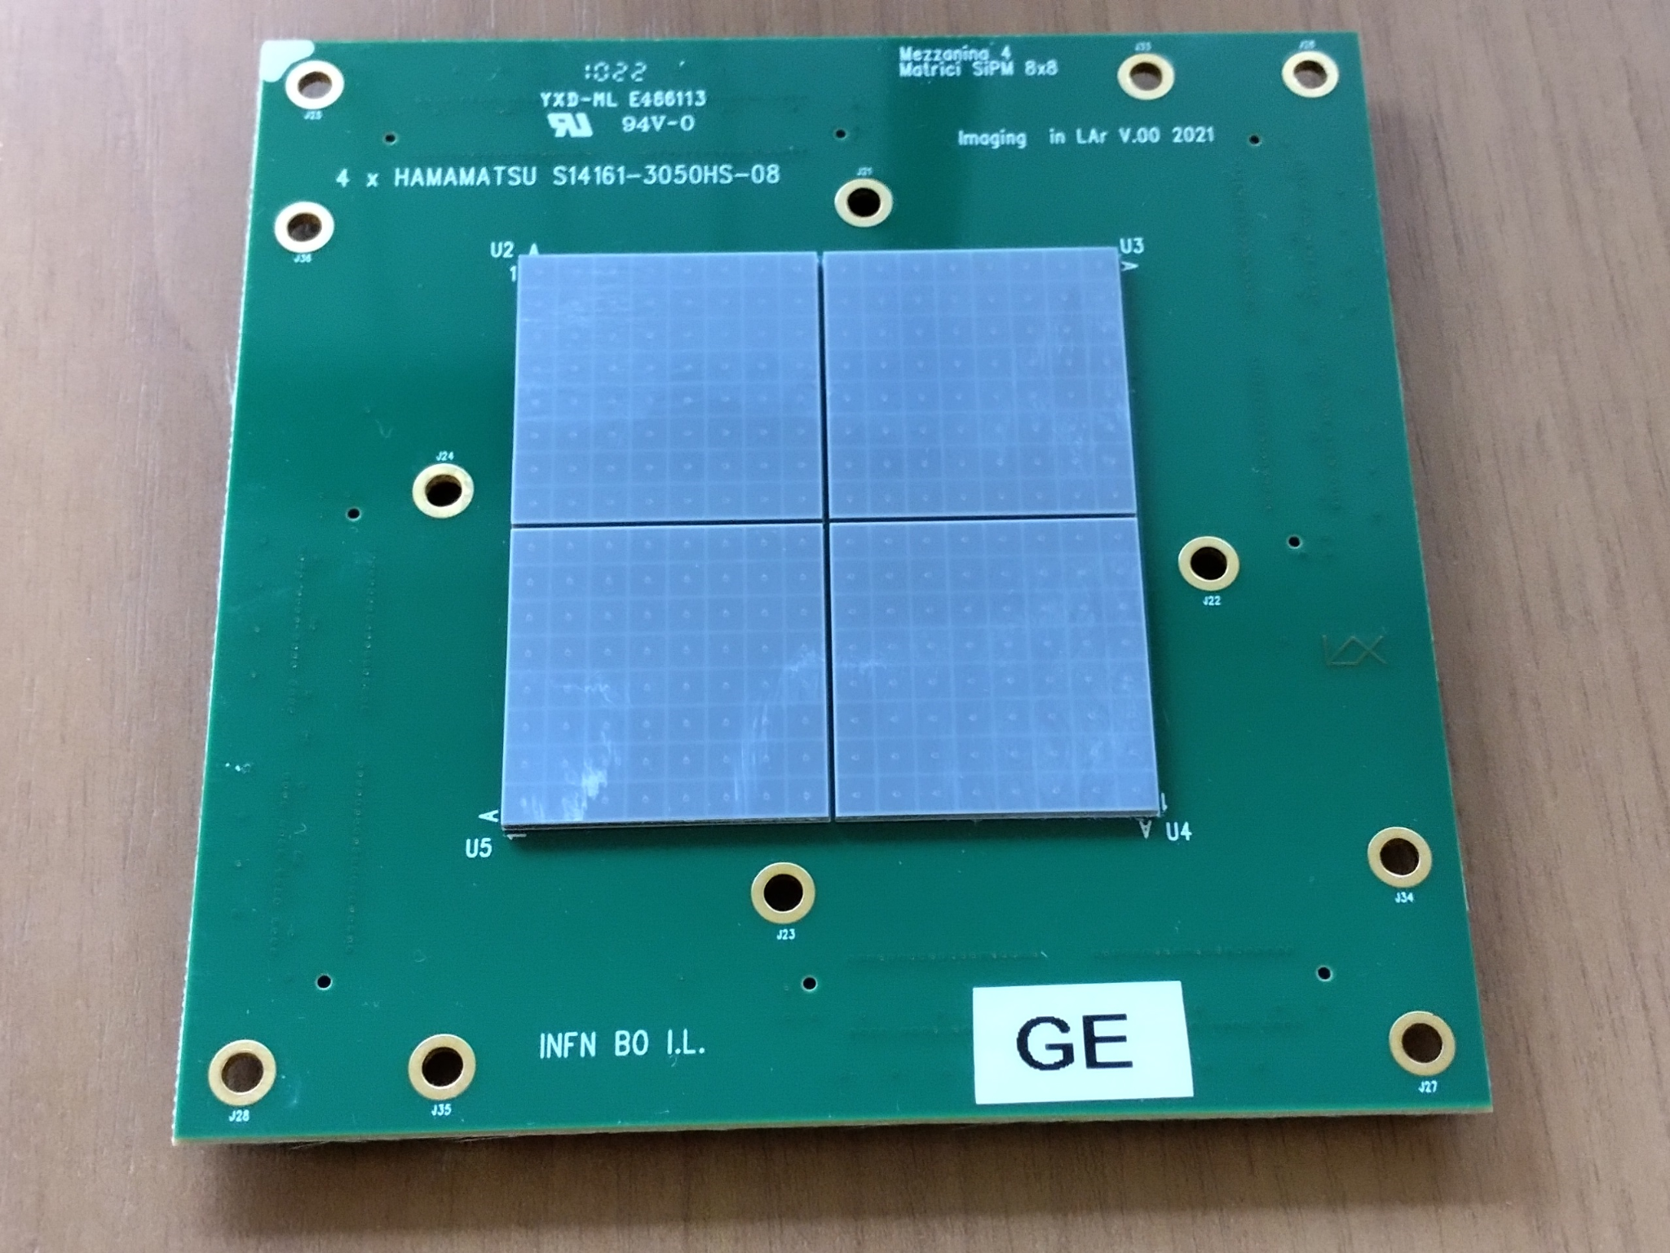
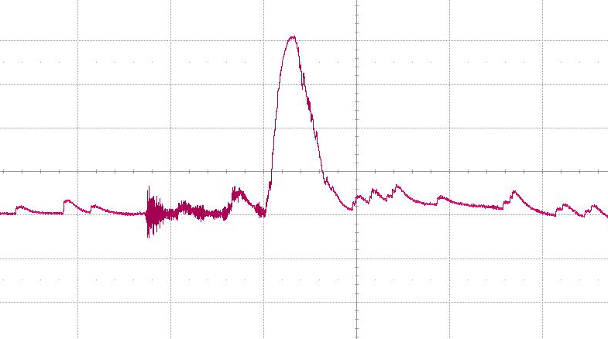
Experimental setup: readout
Designed by Bologna group
The readout consists of:
16 x 16 (256) matrix of 3mm x 3mm SiPMs.
Front-end board equipped with 8 ALCOR ASICs, which for each channel allow to:
- Set threshold, gain and offset
- Measure the Time of Arrival (ToA)
- Measure the Time over Threshold (ToT)
- Generate a Test-Pulse (TP) signal
Each chip allows to observe the analogic signal of two channels.
Acquisition board equipped with an FPGA.
SiPM matrix
FPGA
Front-end board
ToT
ToA
100 mV
Threshold
1 μs
F. Polleri - Tests on the first prototype of the lens-based optical detector for GRAIN DUNE-Italia Collab. Meeting 2025

Slide 6
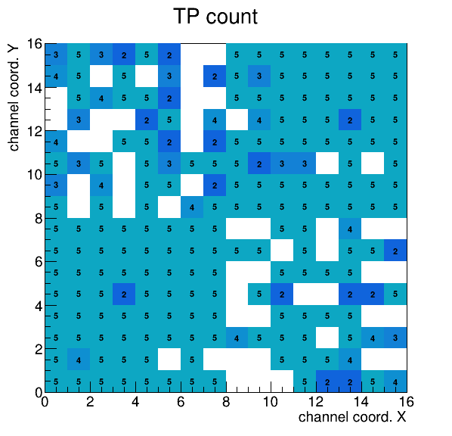
Calibration of the readout with the Test-Pulse
The objective of the tests with the TP was to study the behavior of the readout independently of the SiPMs.
We observed a lack of stability and reproducibility:
performing several measurements under the same conditions may produce varying results such that channels that previously detected a certain number of signals may record a different number.
Another problem was that with a single acquisition many channels do not register any count:
This plot shows the map of the 256 channels that make up the SiPM matrix.
The number of TP signals recorded in a single acquisition is indicated for each channel.
The expected number of TP signals was 5.
Result of a single acquisition
F. Polleri - Tests on the first prototype of the lens-based optical detector for GRAIN DUNE-Italia Collab. Meeting 2025

Slide 7
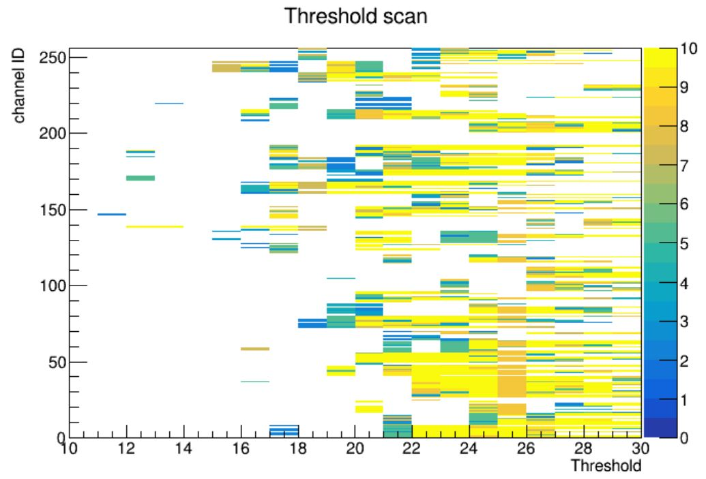
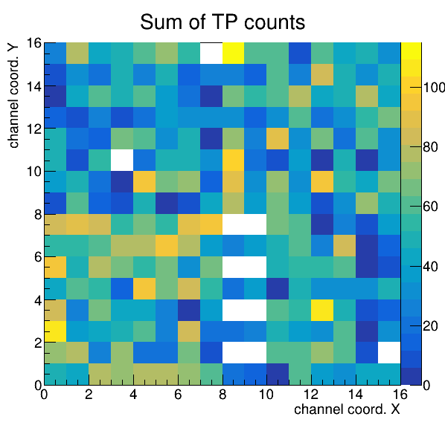
Calibration of the readout with the Test-Pulse
We studied the behavior of the channels as the threshold varies.
We observed that each channel behaves differently precisely because of the instability issues in the electronics.
We therefore defined a procedure based on a “threshold scan”: a series of acquisitions is repeated, changing the threshold value each time and then the obtained results are overlaid.
In this way, almost all channels show at least one count, but this value is no longer a meaningful information.
The threshold scan became the standard procedure we used to acquire the light signals as well.
Overlay of ∼50 acquisitions
F. Polleri - Tests on the first prototype of the lens-based optical detector for GRAIN DUNE-Italia Collab. Meeting 2025

Slide 8
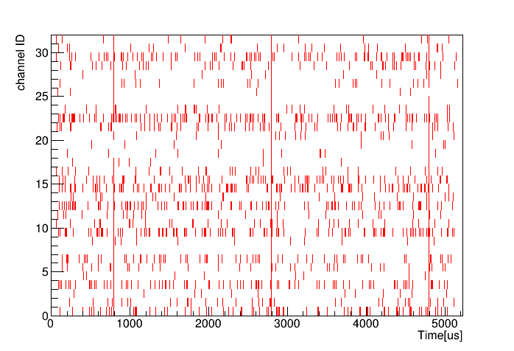
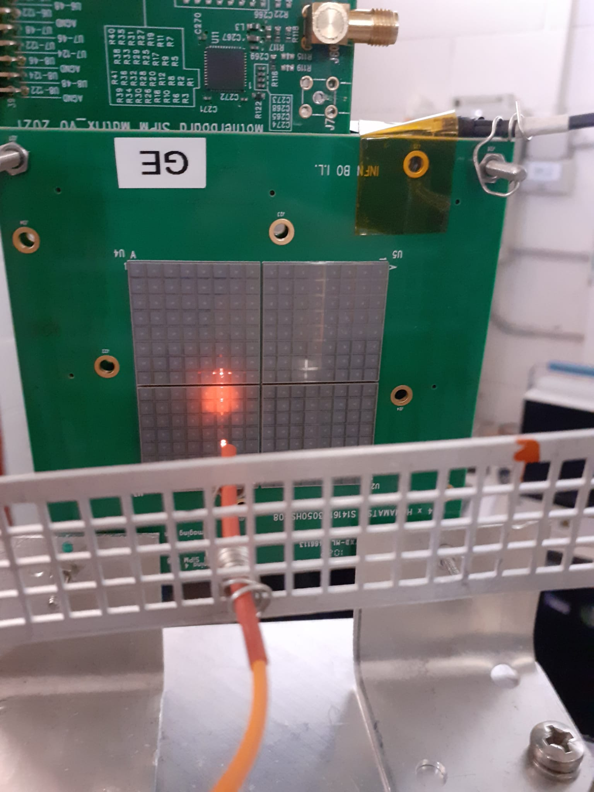
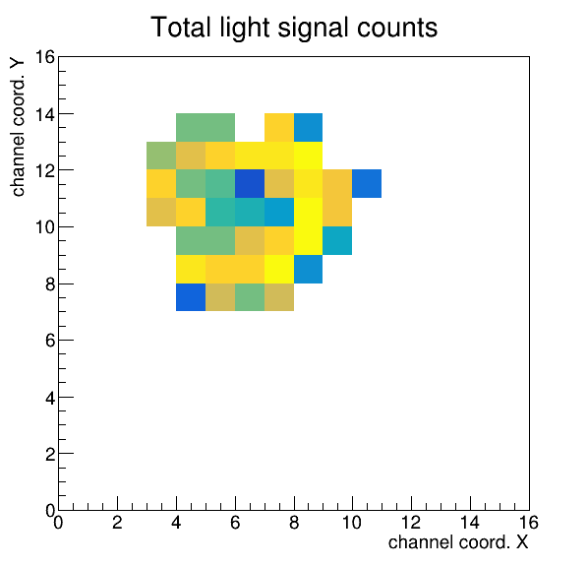
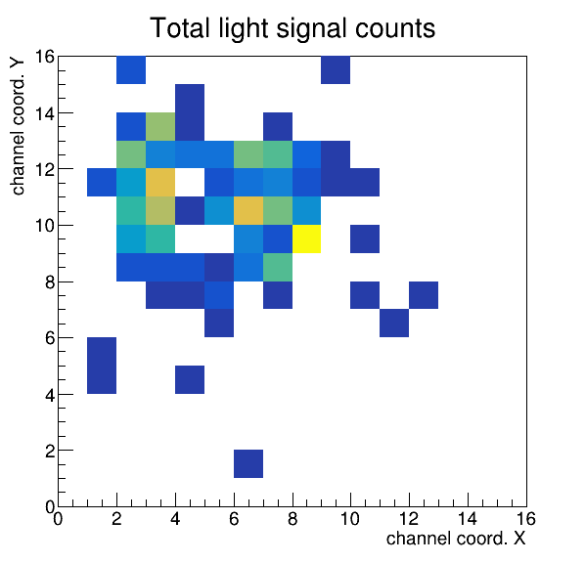
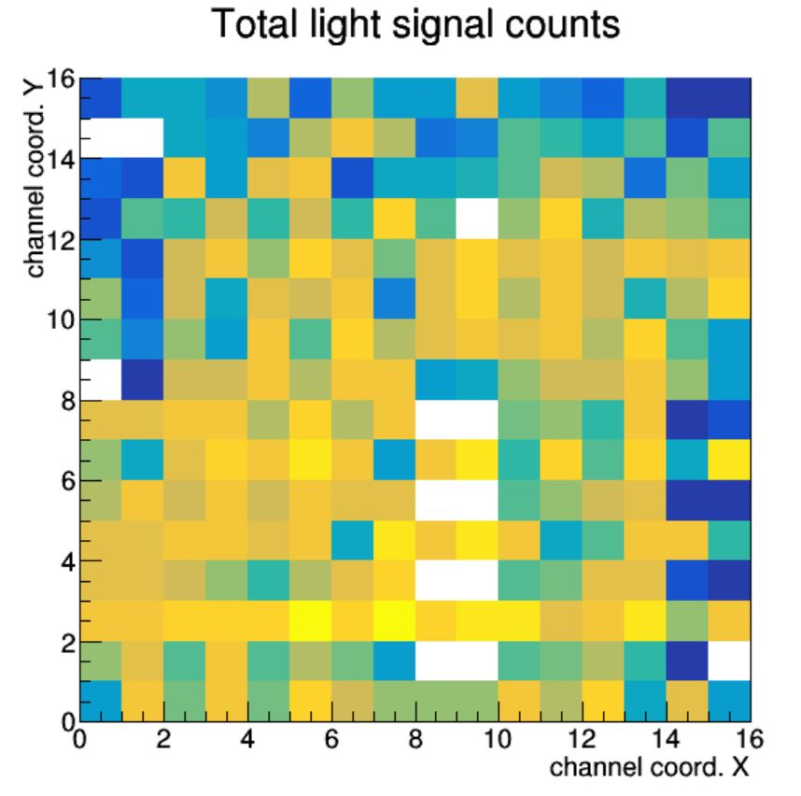
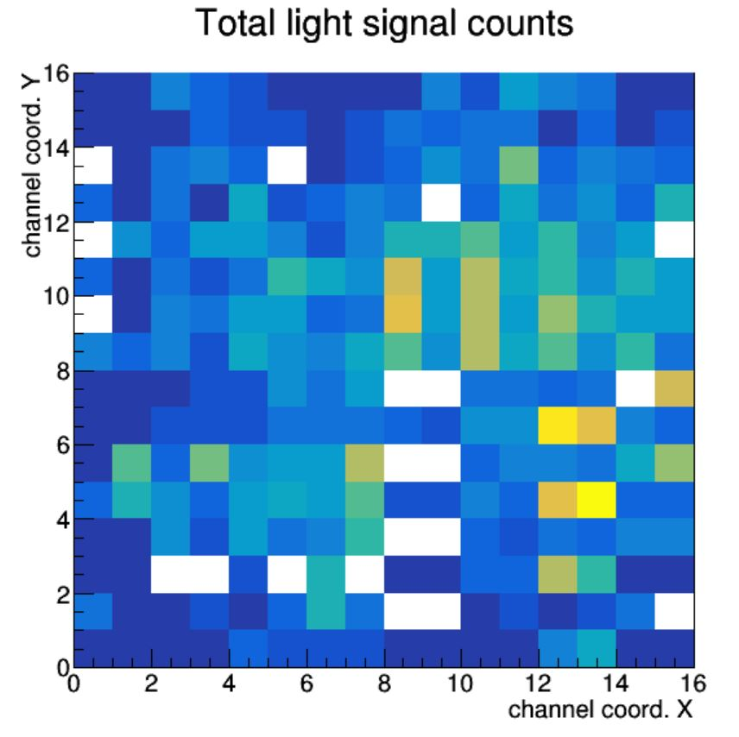
Tests with artificial light source
Picture of the setup with light at 1 cm
Raw data for 32 channels
Room temperature
In liquid nitrogen(77 K)
Light at 1 cm
from SiPMs
Light signal
Light at 10 cm from SiPMs
100 mV
1 μs
“Dark” signal
F. Polleri - Tests on the first prototype of the lens-based optical detector for GRAIN DUNE-Italia Collab. Meeting 2025

Slide 9
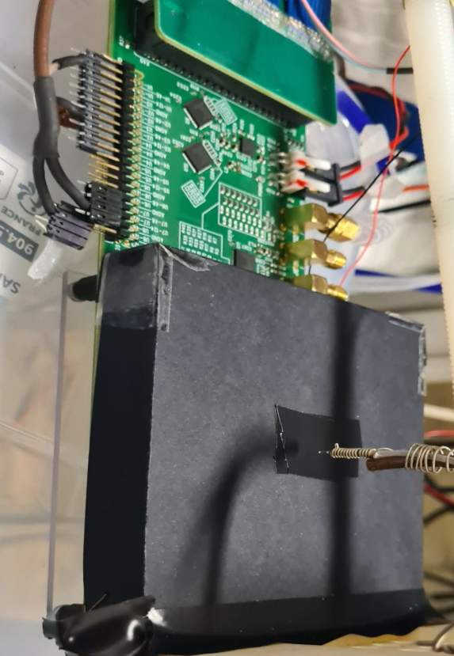
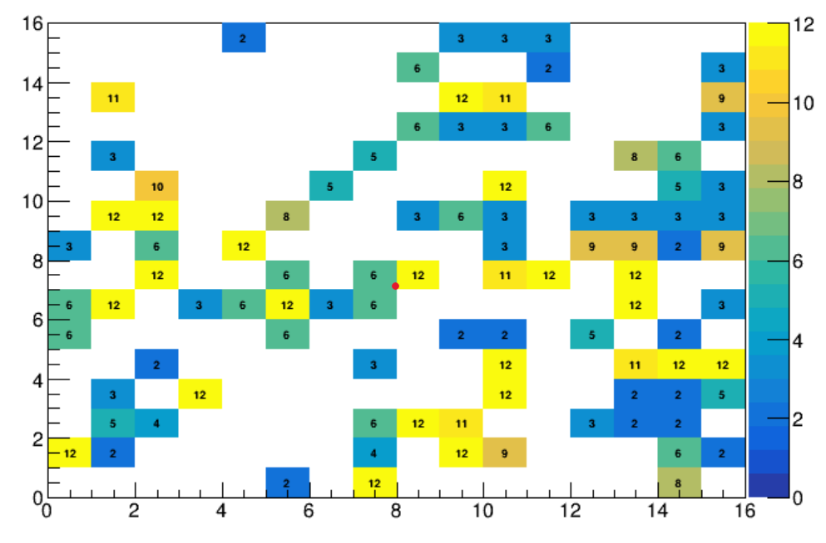
Tests on a TPB coated SiPM matrix
Since the use of TPB on top of the sensors is required, it is necessary to validate a method for depositing it onto the SiPM matrix.
Previously, as a first attempt, a single TPB layer had been deposited over the entire matrix and the result showed a strong cross-talk between the channels.
For these tests, the SiPM matrix was covered with a black cardboard with a small hole (1 mm) in the center.
The illuminated channels were only those in the center, but even the channels further from the center detected light signals.
The hypothesis is that the TPB layer acted as a light guide.
F. Polleri - Tests on the first prototype of the lens-based optical detector for GRAIN DUNE-Italia Collab. Meeting 2025

Slide 10
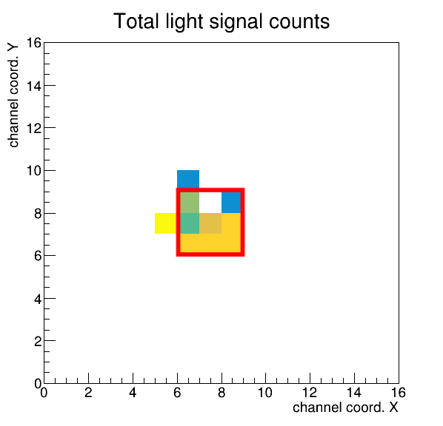
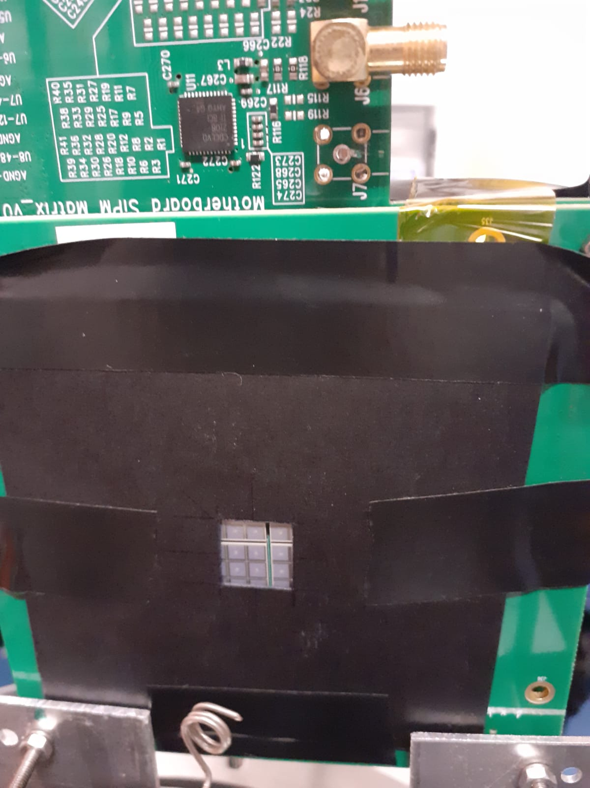
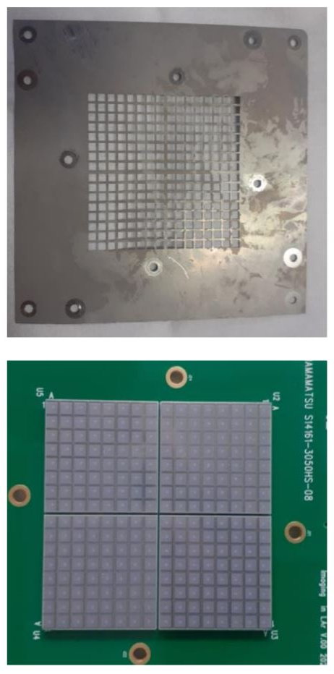
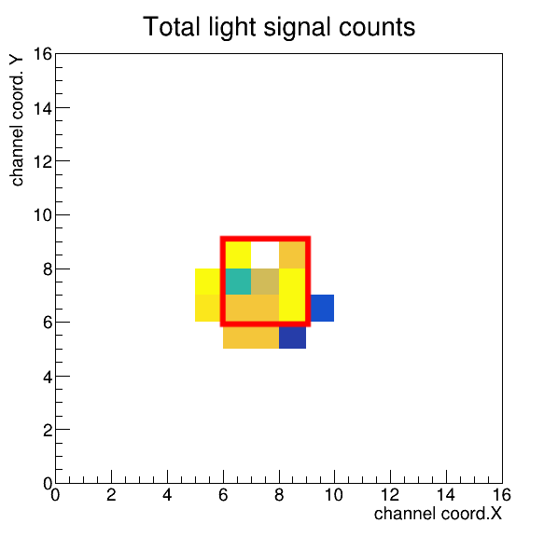
Tests on a TPB coated SiPM matrix with a new deposition method
Thanks to N. Canci (Napoli group)
Grid for TPB deposition
Without TPB
The new deposition method foresees the use of a grid, ensuring that each channel has its own TPB layer, isolated from the adjacent ones.
We carried out a test using a cardboard with a square hole (1 cm), both on the matrix without TPB and on the one with TPB.
Matrix with cardboard with square hole
With TPB
The results obtained with the two matrices are compatible, which demonstrates that, with the new method, there is no longer any cross-talk between the channels.
Moreover, by using a 280 nm LED, we also demonstrated that, thanks to TPB, the SiPMs are able to efficiently detect light with λ < 300 nm.
F. Polleri - Tests on the first prototype of the lens-based optical detector for GRAIN DUNE-Italia Collab. Meeting 2025

Slide 11
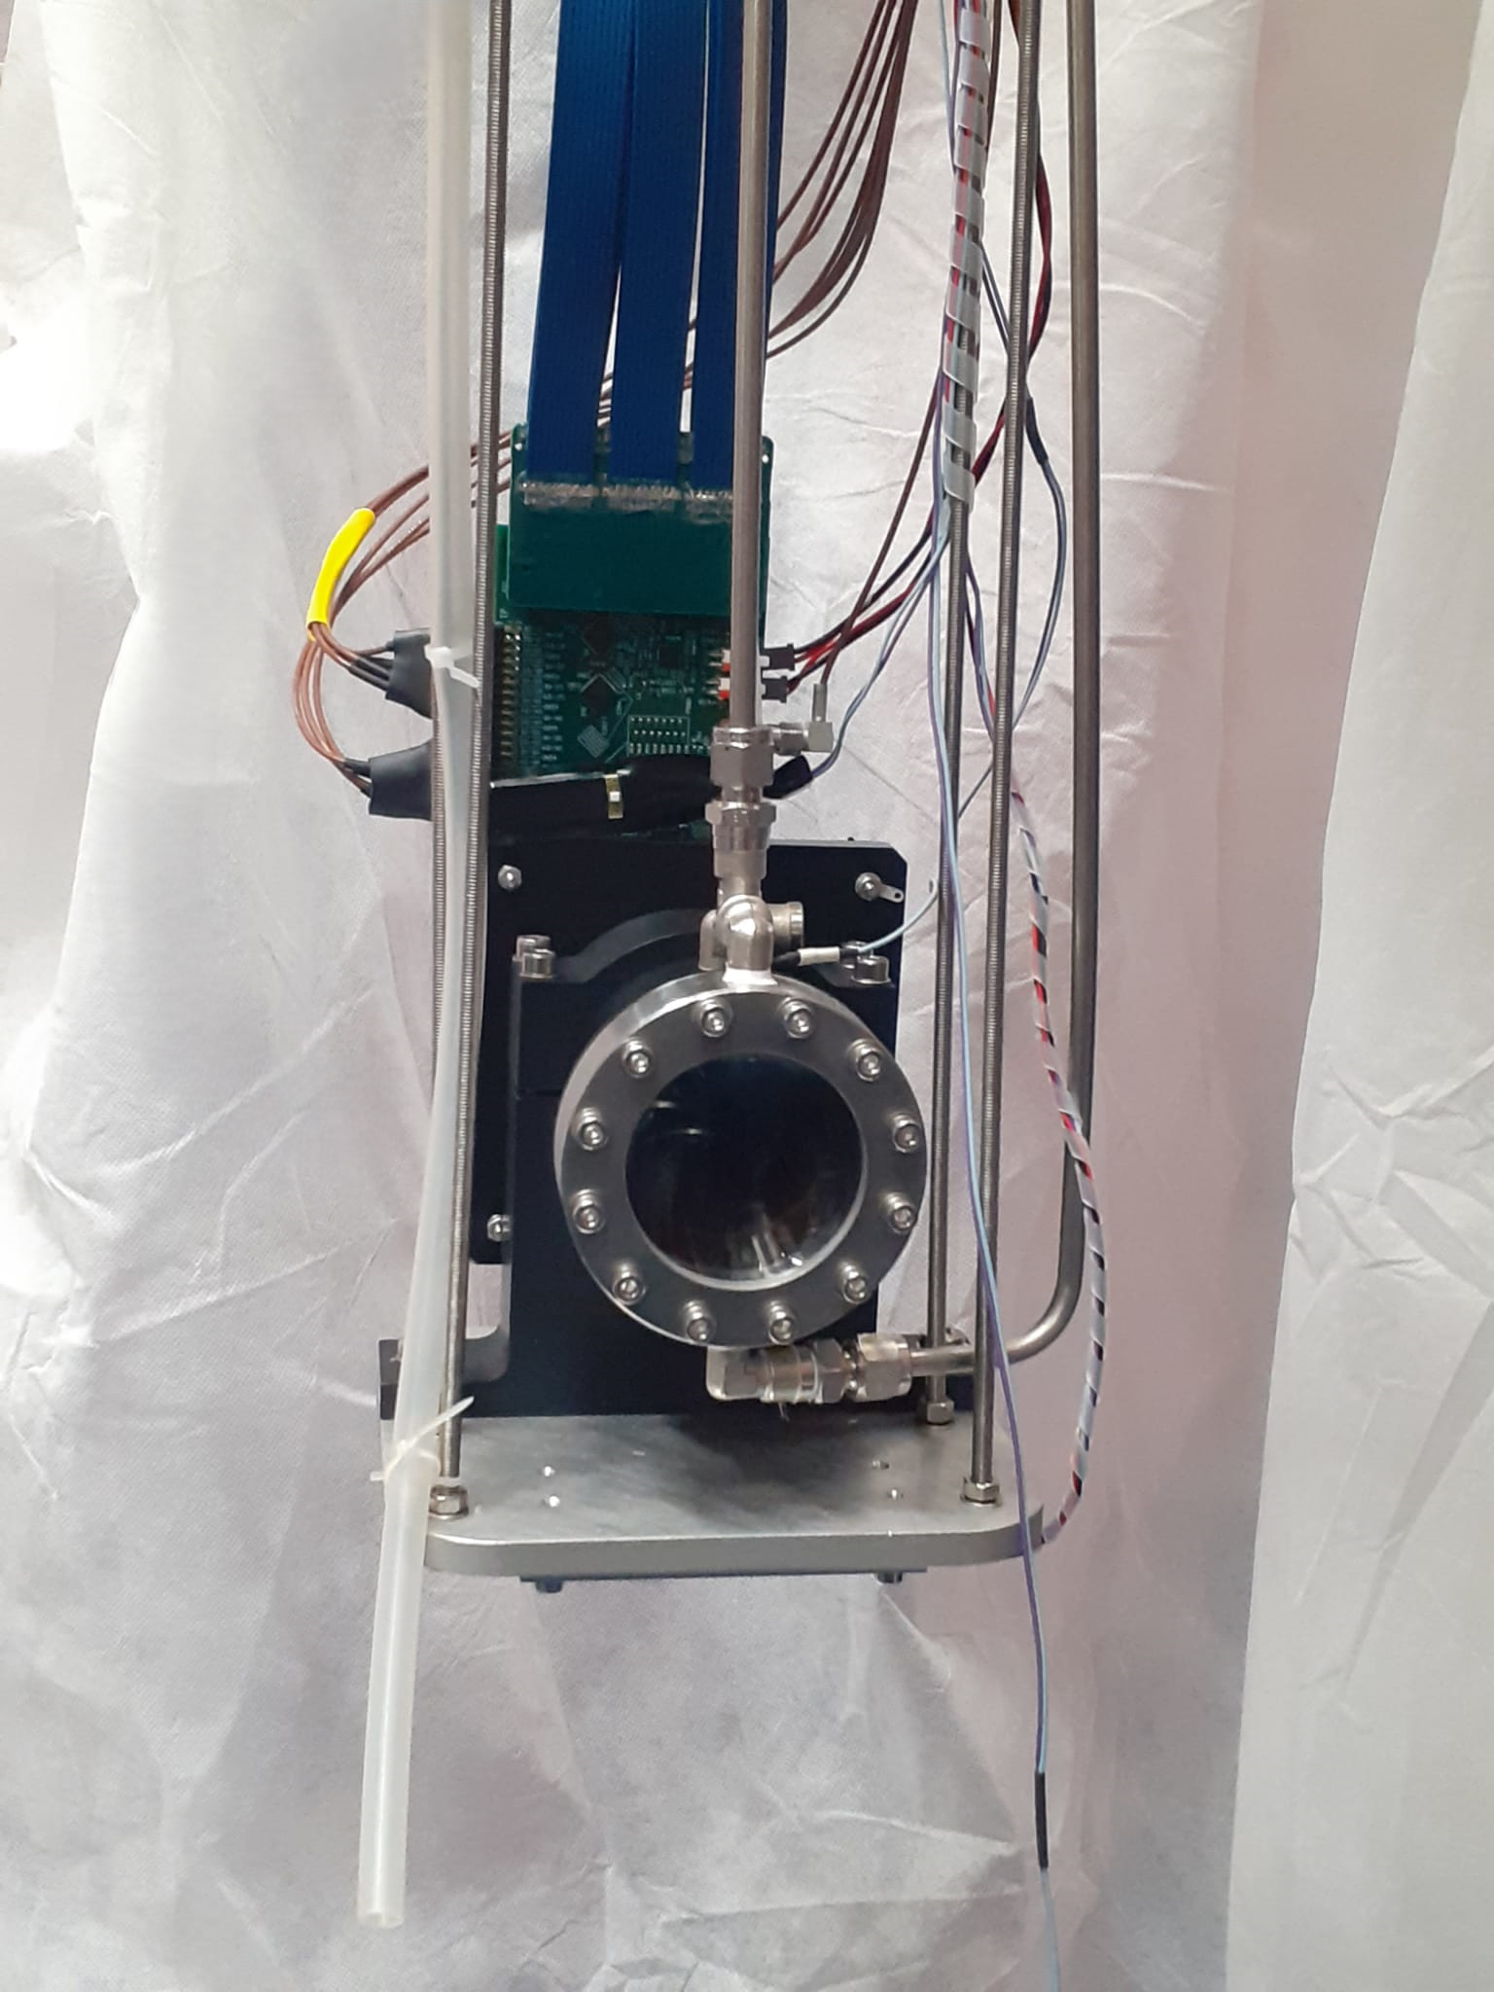
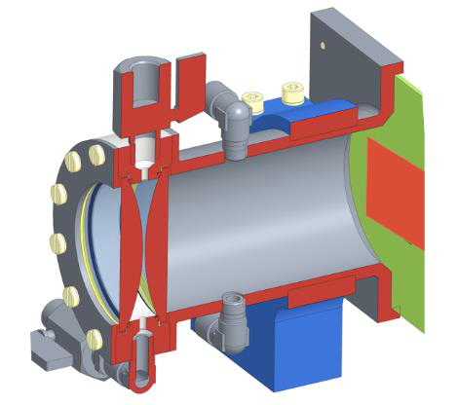
Tests on the prototype: camera assembly
Gas flushing line
Flange with lenses
Front-end board
SiPMs
LAr passage nozzles
Gas flushing line
LAr passage nozzles
The design must be updated since we had some problems with the gas sealing, especially under cryogenic conditions.
F. Polleri - Tests on the first prototype of the lens-based optical detector for GRAIN DUNE-Italia Collab. Meeting 2025

Slide 12
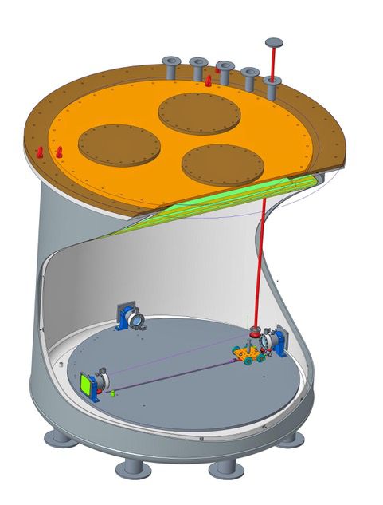
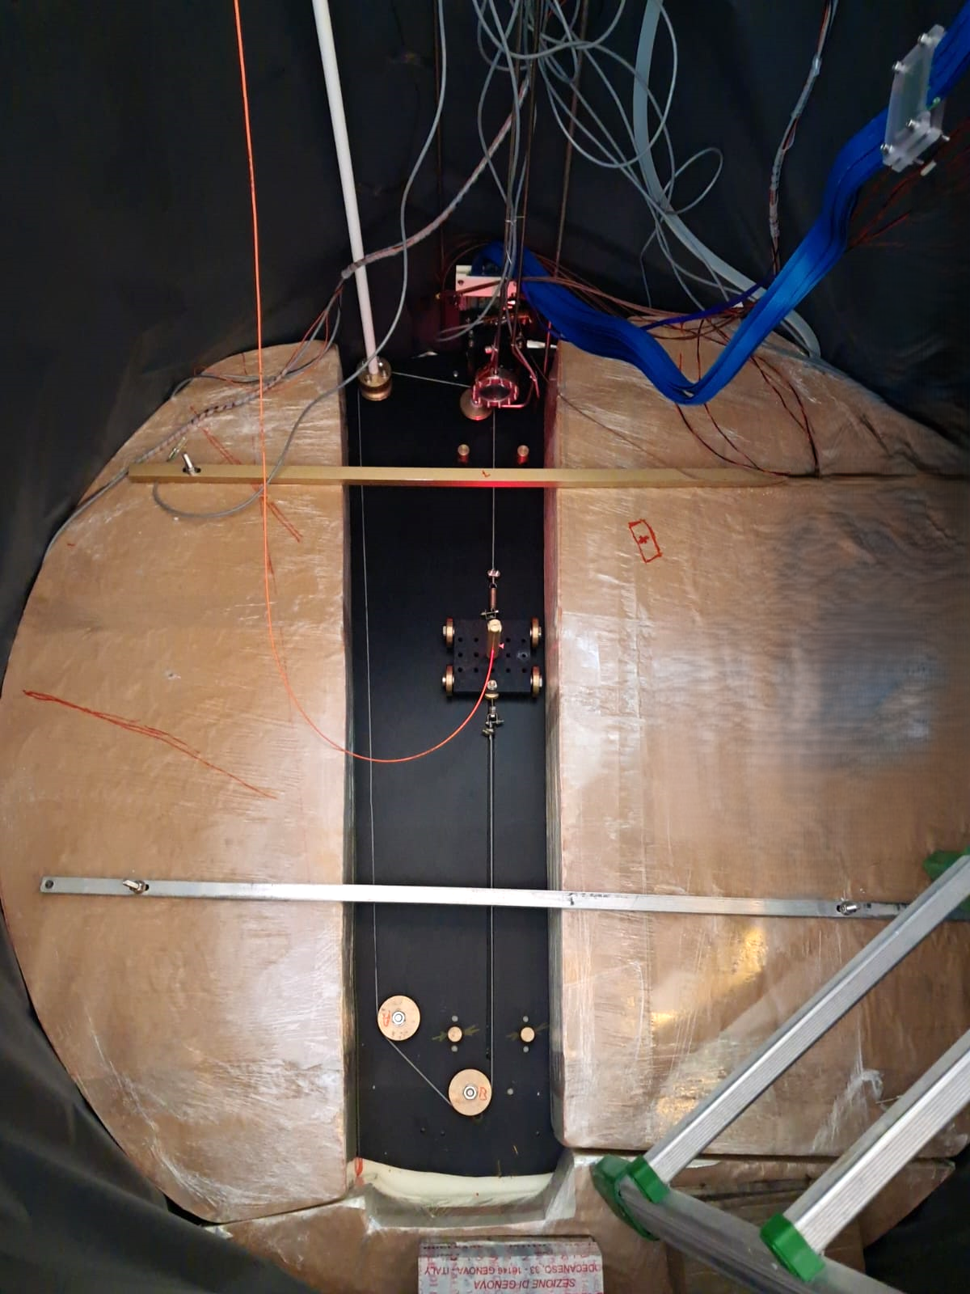
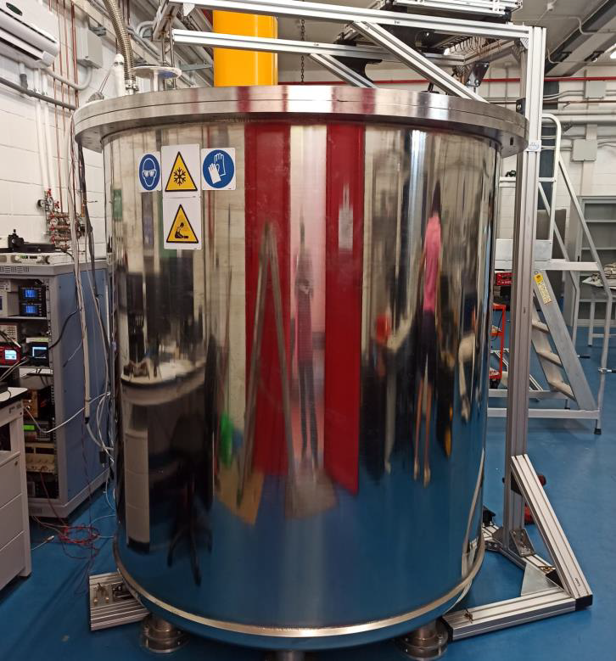

Tests on the prototype: experimental setup in ARTIC (Argon Test Infrastructure)
Pulley
Pulley
Camera
Cart with the optical fiber
Cart with the optical fiber
Camera
We tested the prototype in air and in liquid nitrogen, placing the optical fiber at different distances (15-100 cm) from the lenses.
The precision on the cart position is about 1 cm.
F. Polleri - Tests on the first prototype of the lens-based optical detector for GRAIN DUNE-Italia Collab. Meeting 2025

Slide 13
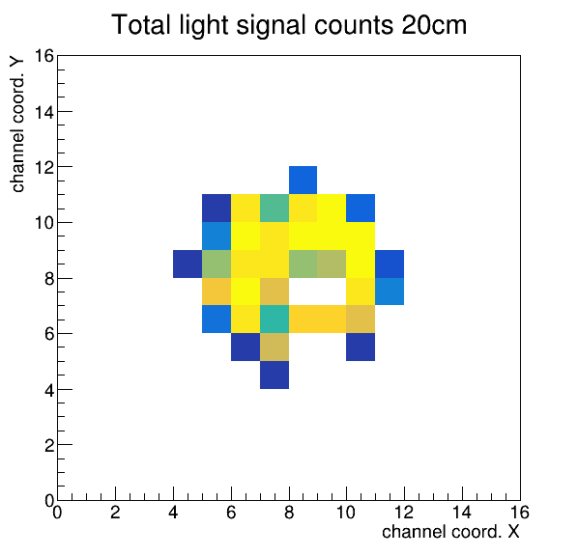
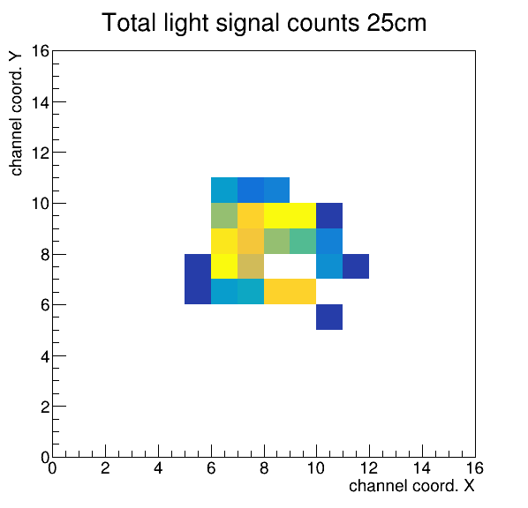
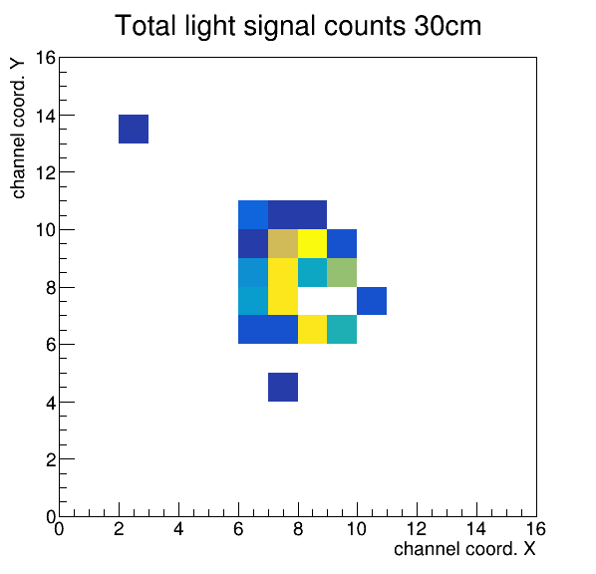
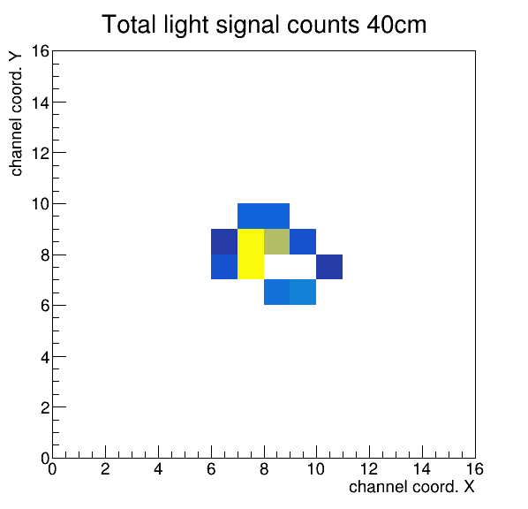
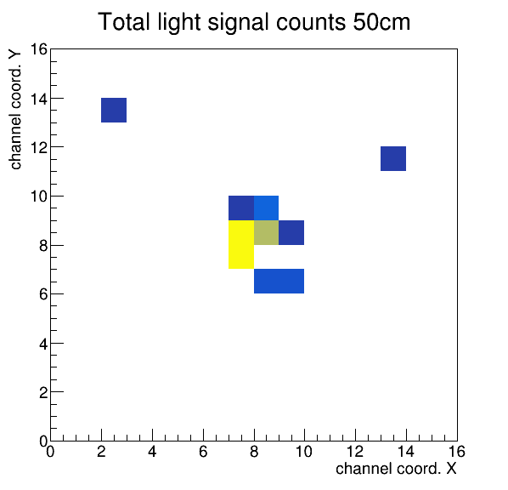
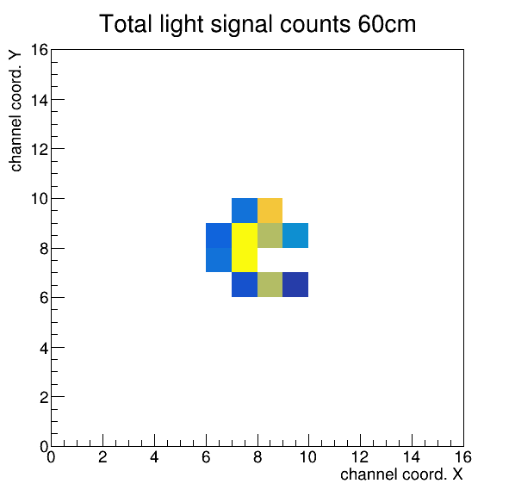
Tests on the prototype : result of the acquisitions in air
Result of the acquisitions made in ARTIC at room temperature (in air) for different values of the distance between the optical fiber and the lenses (a).
Even qualitatively, we can already see the effect of the focusing.
F. Polleri - Tests on the first prototype of the lens-based optical detector for GRAIN DUNE-Italia Collab. Meeting 2025

Slide 14
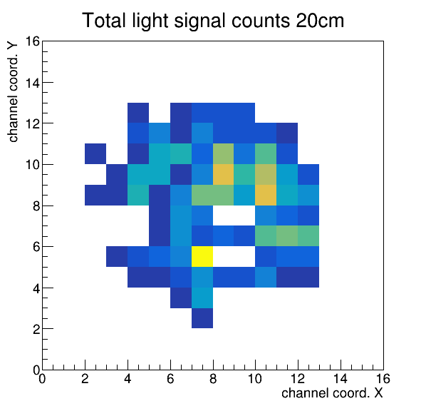
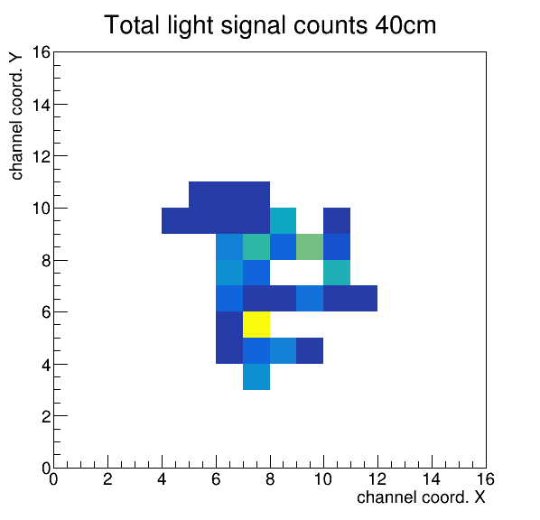
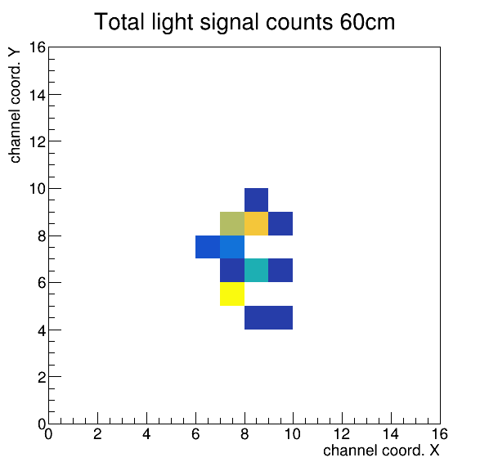
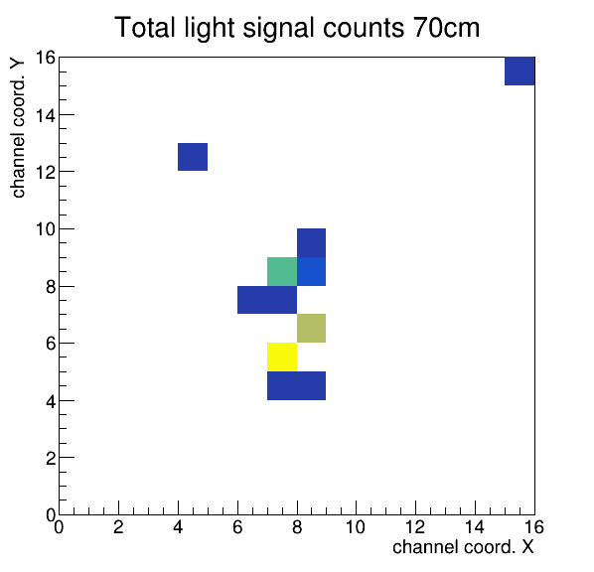
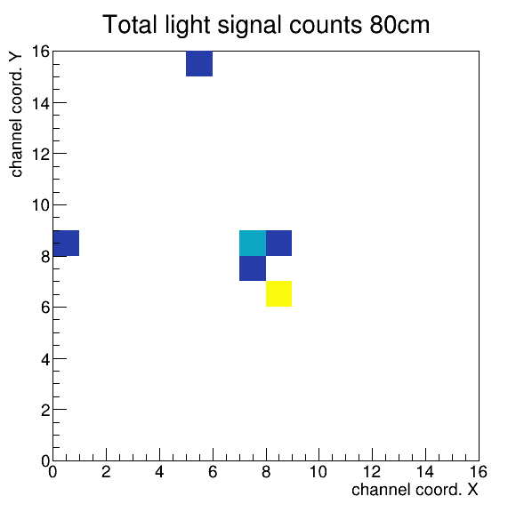
Tests on the prototype: result of the acquisition in liquid nitrogen
Result of the acquisitions made in ARTIC with LN₂ for different values of the distance between the optical fiber and the lenses (a).
In this case as well, we can see the effect of the focusing.
F. Polleri - Tests on the first prototype of the lens-based optical detector for GRAIN DUNE-Italia Collab. Meeting 2025

Slide 15
Analysis and final results: main steps of the analysis
The purpose of the analysis is to compare the data with the expected results, verifying their compatibility.
The expected results are obtained through Monte Carlo simulations performed with Geant4.
The objective is to study the trend of the light spot size, obtained from both the data and the simulations, as a function of the distance between the optical fiber and the lenses (a).
The following steps are required:
Post-process the images, taking into account the reliability of the channels.
Determine the spot size values for both the data and the simulations.
Estimate the uncertainties on the results obtained from the data and the simulations.
Compare the obtained values to verify their compatibility.
F. Polleri - Tests on the first prototype of the lens-based optical detector for GRAIN DUNE-Italia Collab. Meeting 2025

Slide 16
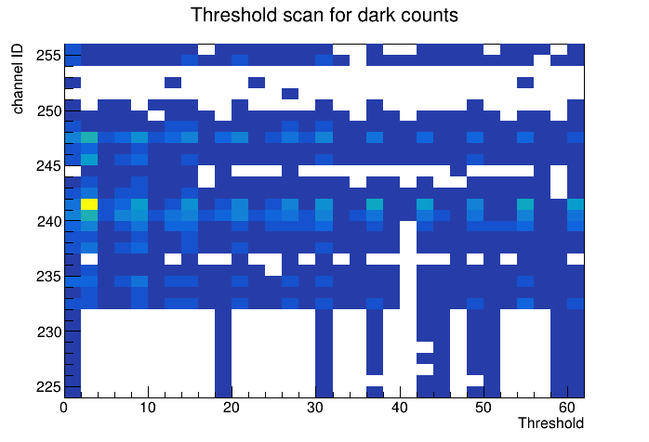
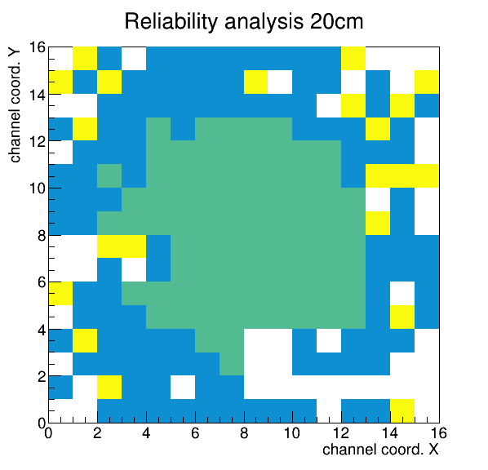
Analysis of channel reliability
This analysis is based on the study of acquired dark counts and aims to identify the channels that have proven to be problematic.
Channels considered unreliable are those that recorded dark counts for:
only a single threshold value, or
a range of threshold values containing significant gaps
Based on this classification and taking into account which channels detected light signals, we applied the following color coding:
Green channel that detected light signals
Blue reliable channel that did not detect light signals
Yellow unreliable channel
White channel that detected neither dark counts nor light signals
F. Polleri - Tests on the first prototype of the lens-based optical detector for GRAIN DUNE-Italia Collab. Meeting 2025

Slide 17
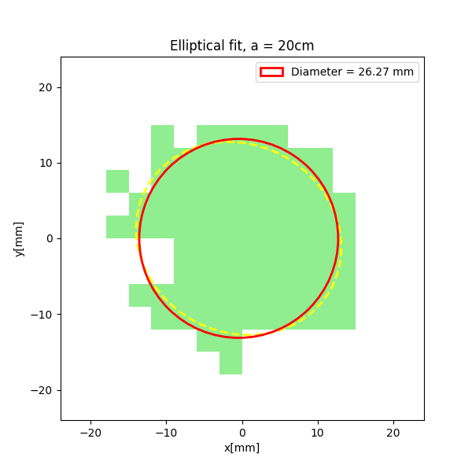
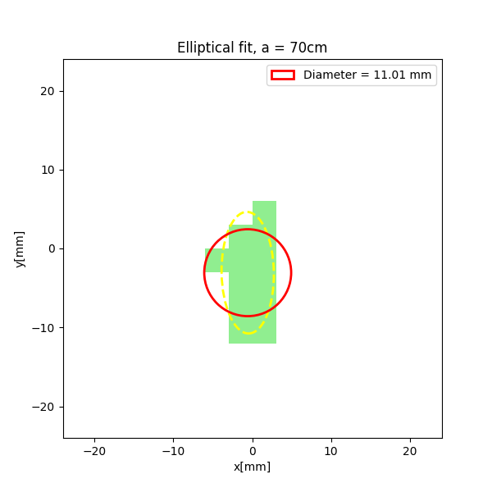
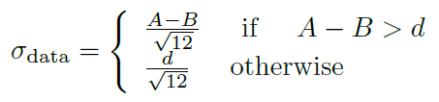
Determination of the spot size
To extract the spot size, we performed an elliptical fit on the green channels identified from the reliability analysis.
The spot diameter is given by the average of the major axis (A) and the minor axis (B) of the ellipse.
Uncertainties related to:
Channel dimension (d = 3 mm)
Fit result (difference between A and B)
F. Polleri - Tests on the first prototype of the lens-based optical detector for GRAIN DUNE-Italia Collab. Meeting 2025

Slide 18
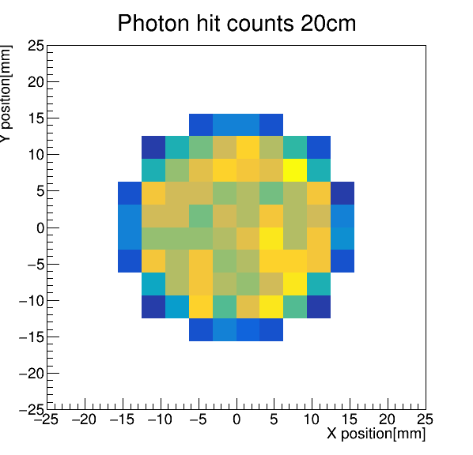
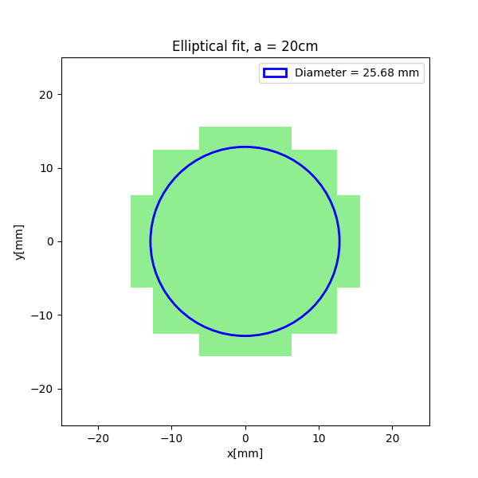
Simulations
To compare the data with the expected results, we carried out a series of MC simulations using Geant4, with the same configuration of the camera and the light source.
For each simulation, we obtained images equivalent to those acquired experimentally and analyzed them using the same fitting procedure applied to the data.
The result of the simulations depends on the following parameters:
Refractive index of liquid nitrogen: n = 1.2015 ± 0.0005
λ : 300-500 nm
Distance between the optical fiber and the lenses (a): uncertainty = 1 cm
The limited knowledge of these parameters introduces uncertainties also in the spot size obtained from the simulations.
F. Polleri - Tests on the first prototype of the lens-based optical detector for GRAIN DUNE-Italia Collab. Meeting 2025

Slide 19







Uncertainties of the simulation results
By varying the refractive index of liquid nitrogen within the range of its uncertainty, we did not observe any change in the light spot size.
To estimate the uncertainty related to the wavelength, for each value of “a” we performed simulations varying λ from 300 to 500 nm. The error is given by:
λ = 300 nm
λ = 500 nm
To account for the error in the position of the optical fiber, for each value of “a” we performed simulations with the optical fiber placed at a+1cm and a-1cm.
The error is given by:
The overall uncertainty is:
a = 19 cm
a = 21 cm
F. Polleri - Tests on the first prototype of the lens-based optical detector for GRAIN DUNE-Italia Collab. Meeting 2025

Slide 20


Data – Simulation comparison
▲ Data ⏺ Simulation
Results comparison in
air: 𝝌²_{air} ≃ 5.47
Results comparison
LN₂: 𝝌²_{nitrogen} ≃ 4.10
Based on the number of points collected in air (6) and in liquid nitrogen (5), the obtained values show good compatibility of the data with the expected results: in both cases P( 𝝌² > 𝝌²_{obs} ) ≃ 0.5
This demonstrate that:
The camera is capable of operating both at room temperature and under cryogenic conditions.
The lenses properly focus the light.
F. Polleri - Tests on the first prototype of the lens-based optical detector for GRAIN DUNE-Italia Collab. Meeting 2025

Slide 21
Conclusions
In summary this is what we have done and achieved:
We characterized and calibrated the acquisition system (SiPM + ASIC)
We validated a new method for the deposition of TPB over the SiPM matrix
We tested in ARTIC the first prototype of the lens-based optical detector of GRAIN and we demonstrated the feasibility of this innovative detector concept
Next steps:
Attempt to improve the acquisition system
Repeat the prototype tests in liquid argon as well (by the end of December)
Tests with TPB (GRAIN condition) and with UV light (200 nm)
Proceed with tests on the other prototypes
Install a purification system in ARTIC in order to observe scintillation light from cosmic rays
F. Polleri - Tests on the first prototype of the lens-based optical detector for GRAIN DUNE-Italia Collab. Meeting 2025

Slide 22

THANK YOU FOR YOUR ATTENTION

Slide 23
Other prototypes
Two types of lens system:
Type A: two plano-convex lenses → gas between the lenses and LAr between the lenses and the SiPM matrix
Type B: single biconvex lens → gas between the lens and the SiPM matrix
There are two options for the lens material:
UV-grade fused silica: Corning@ HPFS 8655 → needs xenon doping for light transmission
MgF₂ →does not need xenon doping
In both configurations, TPB coating on the sensors is currently foreseen.
F. Polleri - Tests on the first prototype of the lens-based optical detector for GRAIN DUNE-Italia Collab. Meeting 2025

Slide 24




Backup: spettro luce

Slide 25


Backup: ALCOR

Slide 26


Backup: procedura di fit
Fit realizzato con utilizzando il metodo cv2.fitEllipse della libreria Python openCV.
Ellisse: Ax² + Bxy + Cy² + Dx + Ey + F = 0 con B² – 4AC < 0
Utilizza le coordinate dei centri dei canali che formano lo spot di luce definendo:
e minimizzando:

Slide 27



Backup: impatto incertezze

Slide 28




Backup: Metrica per analisi compatibilità

