Slide 1
GRAIN simulation and reconstruction with Coded Aperture Masks
V. Cicero, F. Mei
Meeting annuale della collaborazione DUNE-Italia
11/11/2025

Slide 2
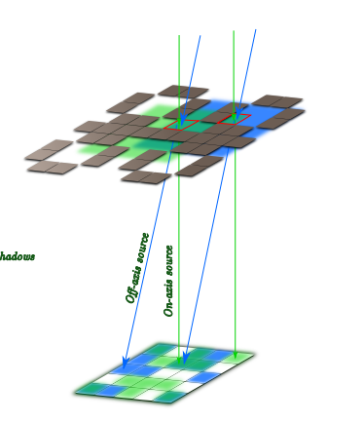
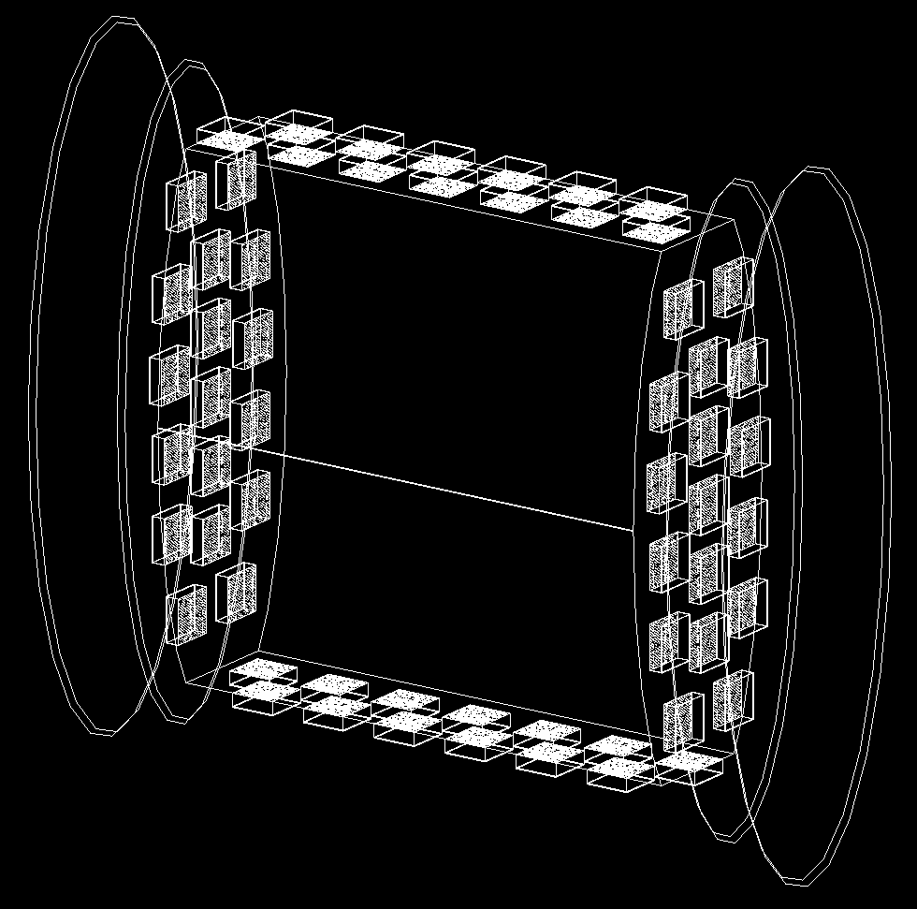
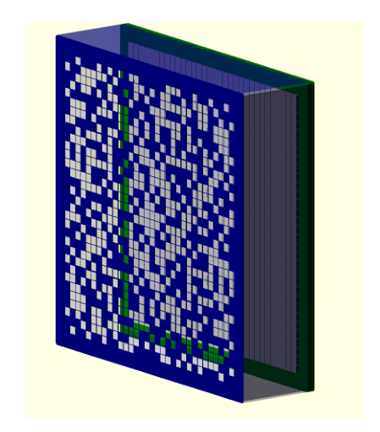
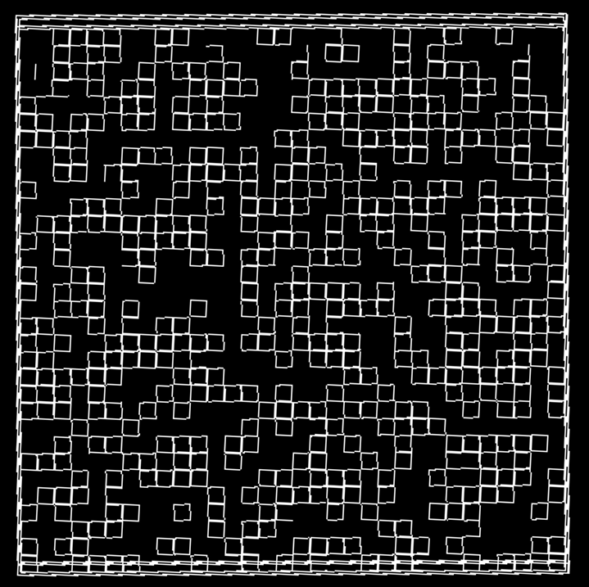
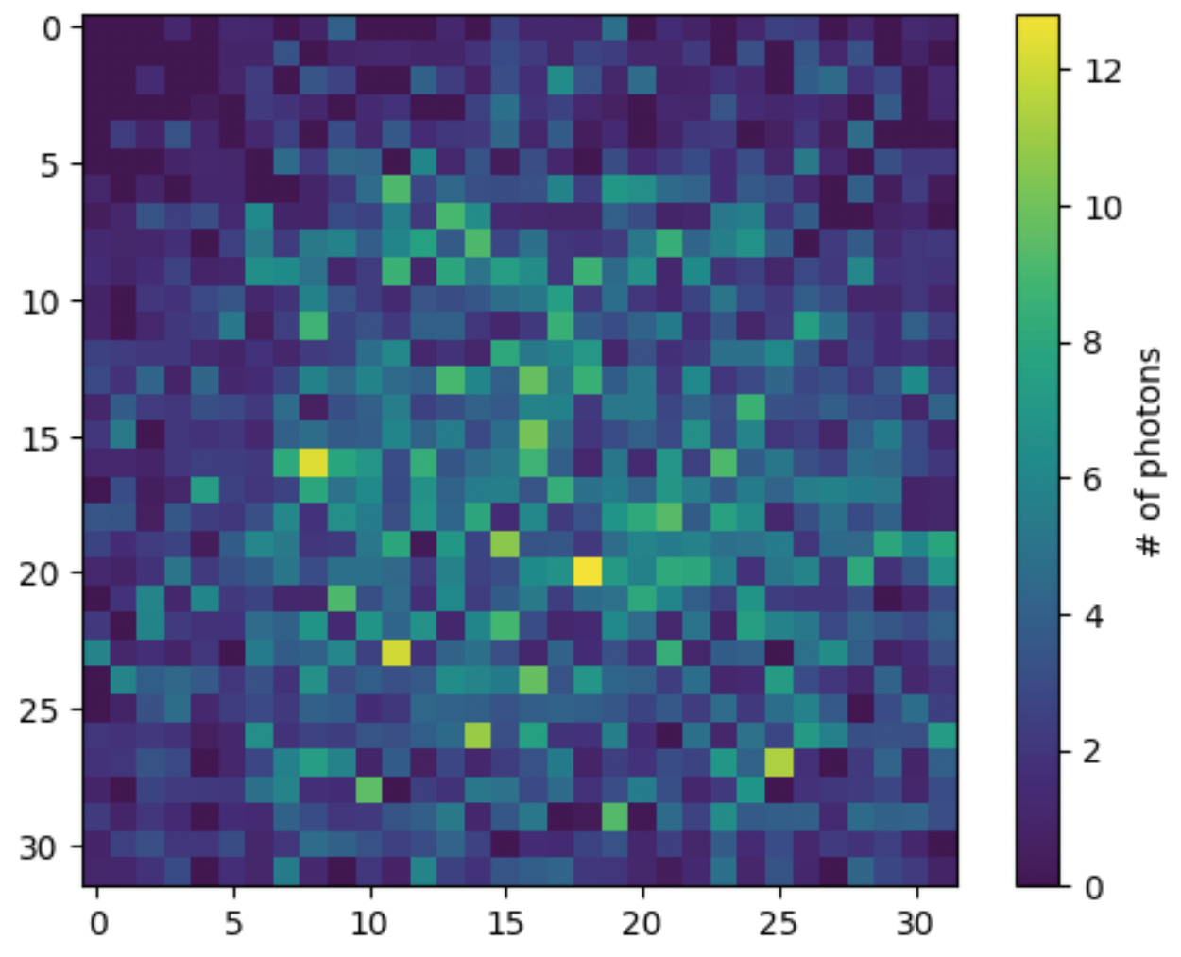
GRAIN Coded Aperture imaging system
Sensor matrix:
  32 x 32 SiPM
  SiPM active area: 3x3 mm²
Coded aperture mask:
  Random uniform pattern of holes
  Holes aligned to SiPMs, area: 3x3 mm²
  Distance from sensors: 3 cm
concept
60 cameras in GRAIN
Mask pattern
Example of detected image

Slide 3
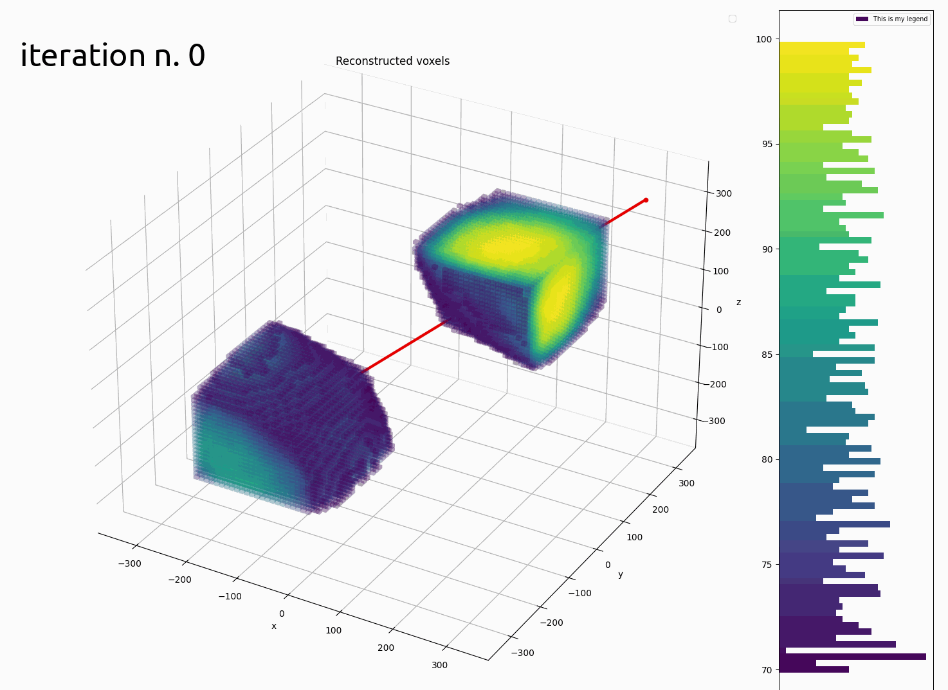
Reconstruction algorithm
Directly reconstructs in 3D dimensions the initial photon source distribution in a segmented volume (voxels)
Combines information of multiple cameras at once
Maximum Likelihood Expectation Maximization (MLEM) algorithm:
  iteratively converges to the photon source distribution that maximizes the likelihood of detecting the observed images
Implemented for execution on GPU
DUNE simulation

Slide 4
Updates from last DUNE italia meeting
(Very) Preliminary tracking performances with simulated CCQE interactions
Porting of simulation software and workflow to new HPC bubbles (TeRABIT)
  Old CNAF HPC cluster was decommissioned in January and the new HPC bubbles were not ready until late July…
  With new NVIDIA H100 GPUs and some small optimizations, the reconstruction time for one event in GRAIN went from 10 minutes to 3
Development of a neural network that uses photons time of arrival to obtain a coarse source distribution as a starting step for the reconstruction algorithm
Implementation of simulation and reconstruction chain into new framework

Slide 5
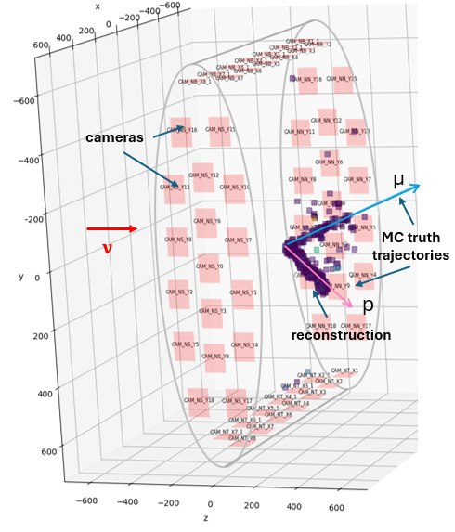


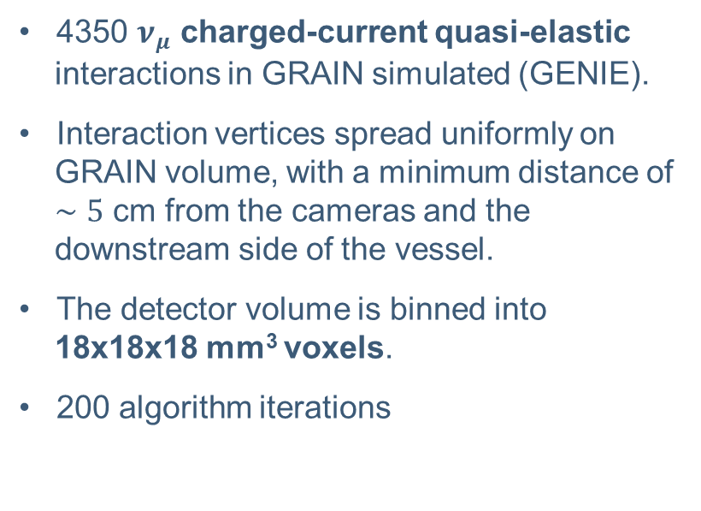
Preliminary tracking performances: simulated sample
4350 $ν_{μ}$ charged-current quasi-elastic interactions in GRAIN simulated (GENIE).
Interaction vertices spread uniformly on GRAIN volume, with a minimum distance of $∼5$ cm from the cameras and the downstream side of the vessel.
The detector volume is binned into 18x18x18 mm³ voxels.
200 algorithm iterations

Slide 6
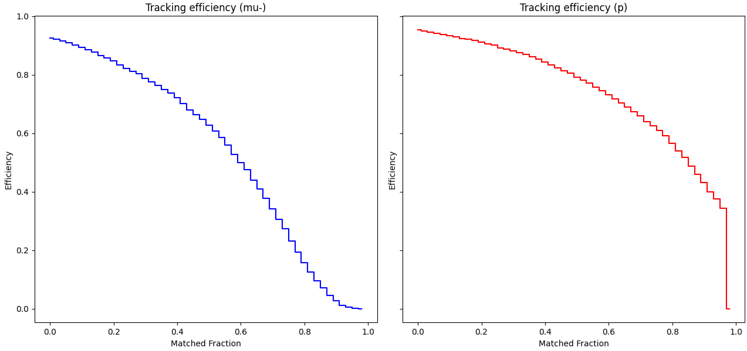
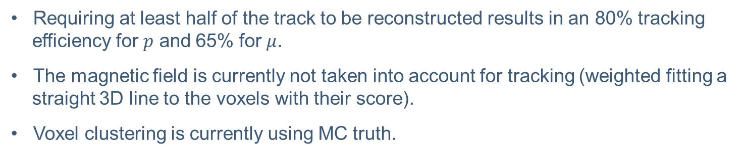
Tracking efficiency
Requiring at least half of the track to be reconstructed results in an 80% tracking efficiency for $p$ and 65% for $μ$.
The magnetic field is currently not taken into account for tracking (weighted fitting a straight 3D line to the voxels with their score).
Voxel clustering is currently using MC truth.

Slide 7
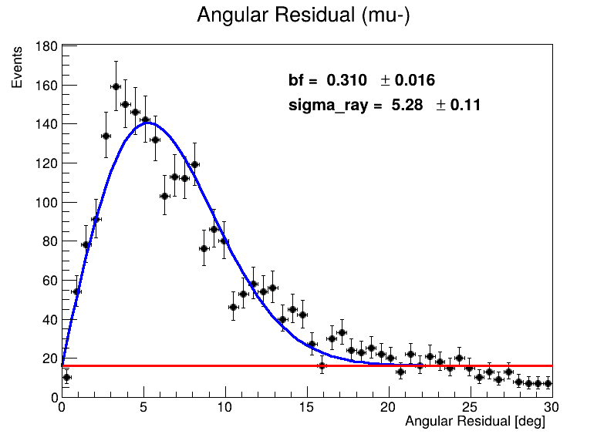
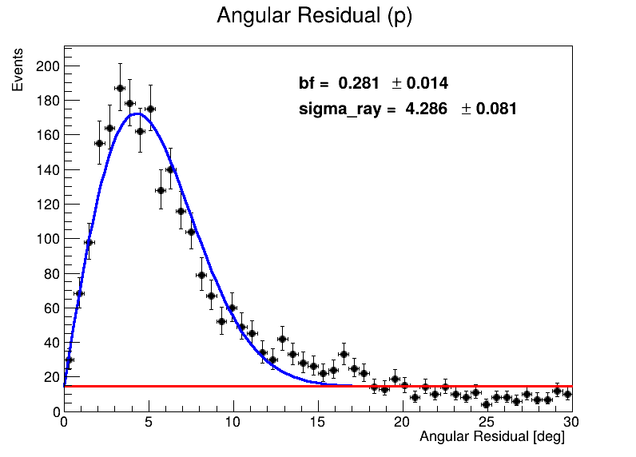
Tracking resolution
Consider the angle between the particle direction at the vertex (MC truth) and the reconstructed direction.
Fitting with a Rayleight distribution + constant background.

Slide 8
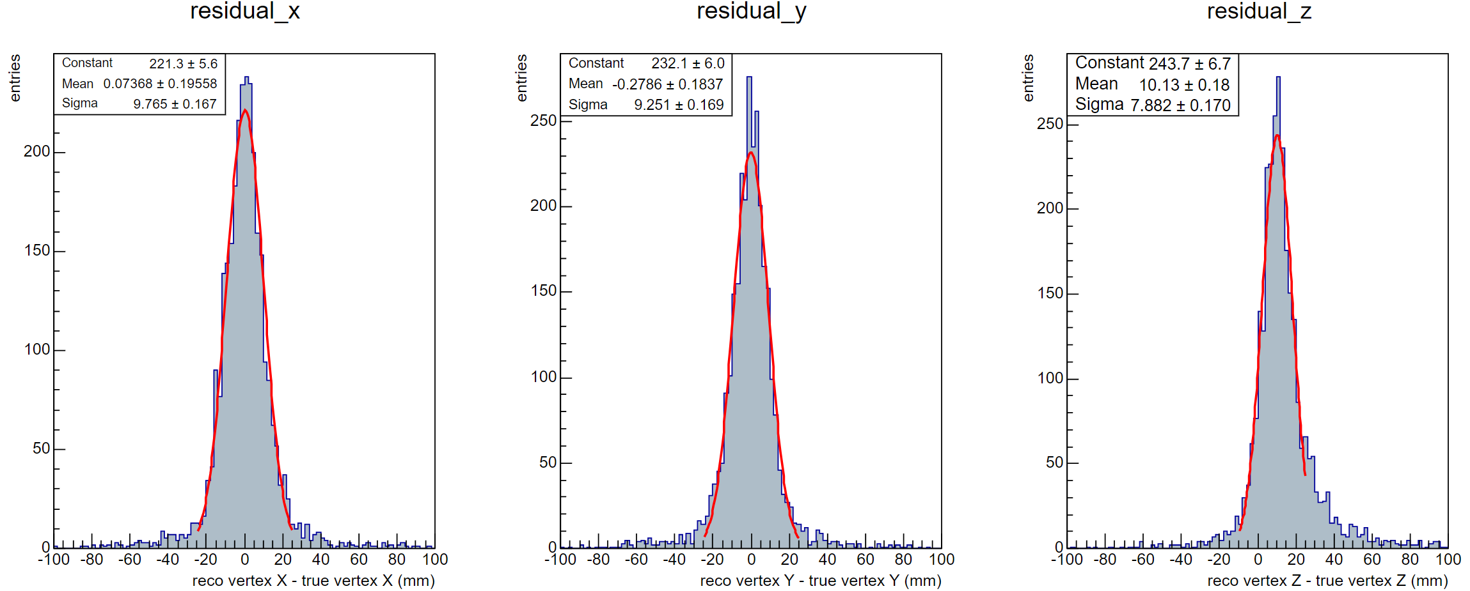
Vertexing resolution
The vertex is the median of the distance between the two best reconstructed tracks (i.e. the closest point to the two tracks).
A Gaussian fit results in a 10 mm vertexing resolution (20 mm considering tails).

Slide 9
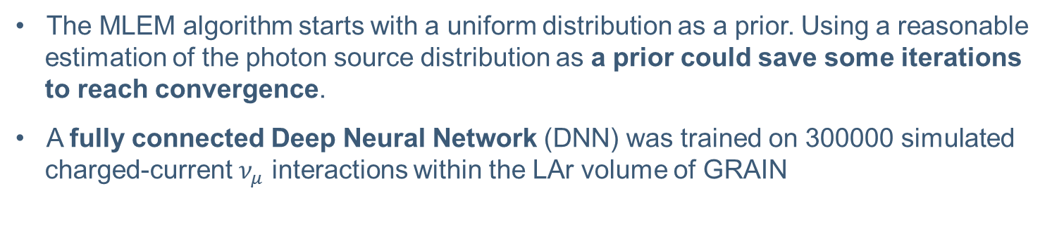
Pre-volumereco
The MLEM algorithm starts with a uniform distribution as a prior. Using a reasonable estimation of the photon source distribution as a prior could save some iterations to reach convergence.
A fully connected Deep Neural Network (DNN) was trained on 300000 simulated charged-current $ν_{μ}$ interactions within the LAr volume of GRAIN
NEW!
Pre-volumereco
Event generation and propagation (GENIE + Geant4)
GRAIN optical scintillation
Detector response
Volumereco
Analysis

Slide 10
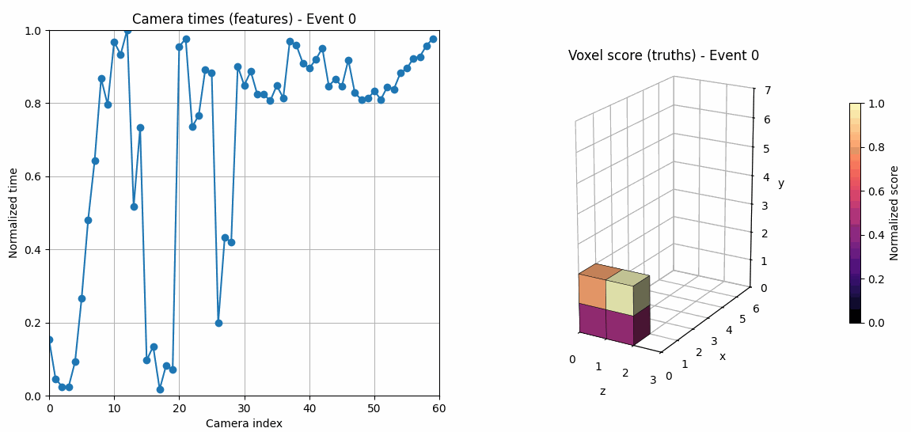
Features and thruths
The average hit times for each camera were used as data features
The Monte Carlo energy deposits, voxelized into 200 mm voxels, were employed as ground truth
Although these voxels are significantly larger than the 18 mm voxels used in the MLEM reconstruction, this coarse resolution provides a sufficiently accurate prior.
F.Mei

Slide 11
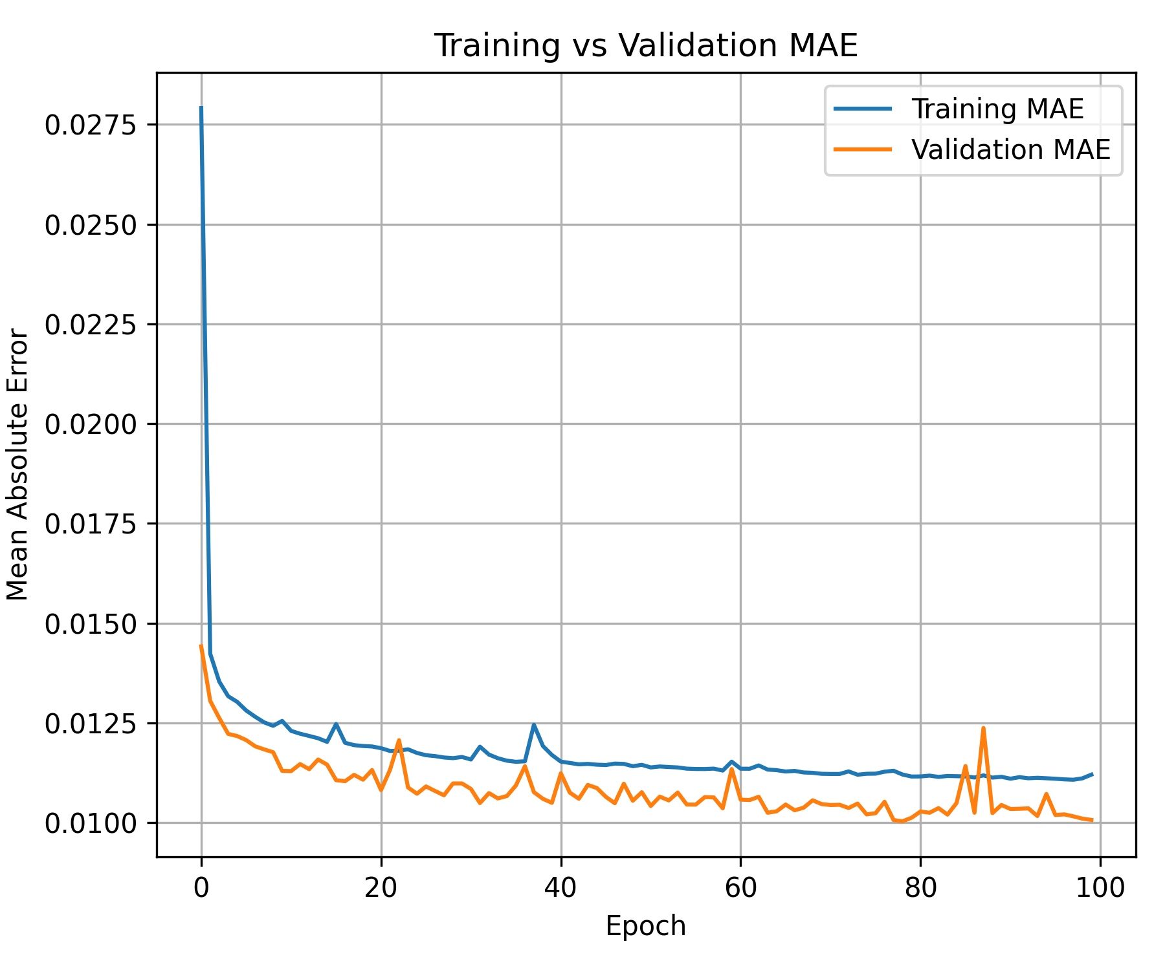
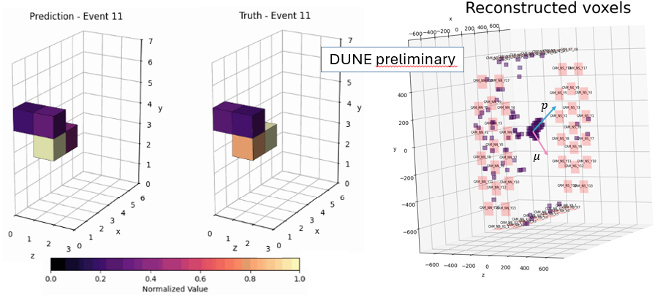
Training
The full dataset was split into 70/15/15 training/validation/test samples.
The DNN hyperparameters were explored and optimized using OPTUNA, resulting in a mean average error (on the normalized voxel score) of 0.01.

Slide 12
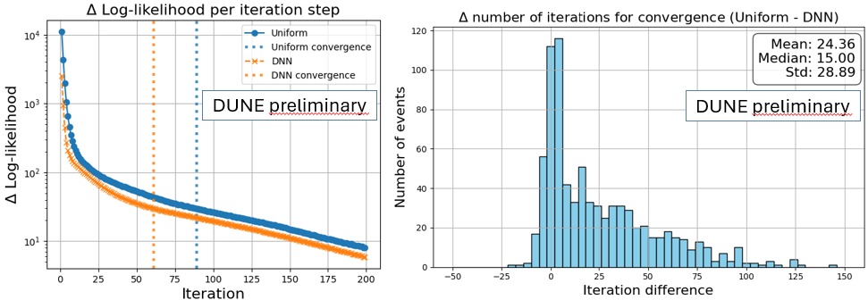
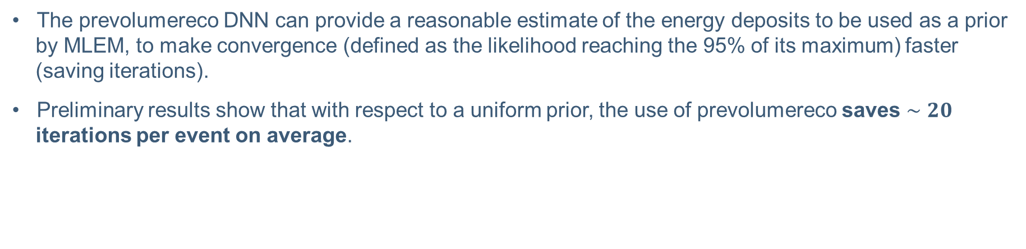
Performance
The prevolumereco DNN can provide a reasonable estimate of the energy deposits to be used as a prior by MLEM, to make convergence (defined as the likelihood reaching the 95% of its maximum) faster (saving iterations).
Preliminary results show that with respect to a uniform prior, the use of prevolumereco saves $∼20$ iterations per event on average.

Slide 13
Conclusions
Preliminary vertexing resolution on small production of CCQE interactions
  ~1 cm st.deviation on residual distribution, consistent with reconstruction voxel size
Improved performances (reconstruction time) of the algorithm
  ML prior on average saves 20 iterations
Working on software implementation in new framework
HPC computing resources are finally operational, we can do larger productions

