Slide 1
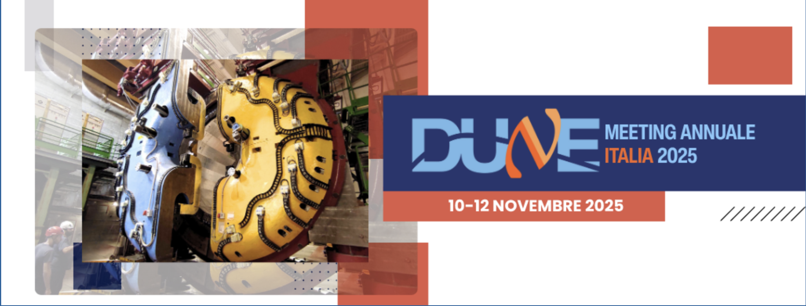
Magnet Test: preparation and compliance

Slide 2
KLOE Magnet test @ LNF and FNAL
Test of the magnet must be performed to put it back to service. It can be divided in two sections:
Warm test
Cold test
Warm test - will check the electrical, mechanical, fluidic and control operational status of all the subsystems at 300 K: vacuum, temperature sensors, pressure sensors, valve leaks, actuators, PS interlocks, heaters, CS etc.
Cold test – will check the previous list at 4.4 K in addition to all the test that must be performed on the PS and the quench detector with the coil energized to a limited current
Tests at LNF will be repeated at FNAL, and both performed in presence of
FNAL representatives as part of training program and compliant hand-off

Slide 3
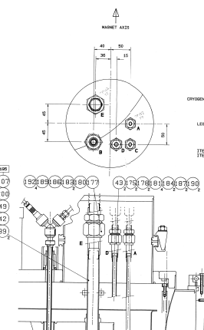
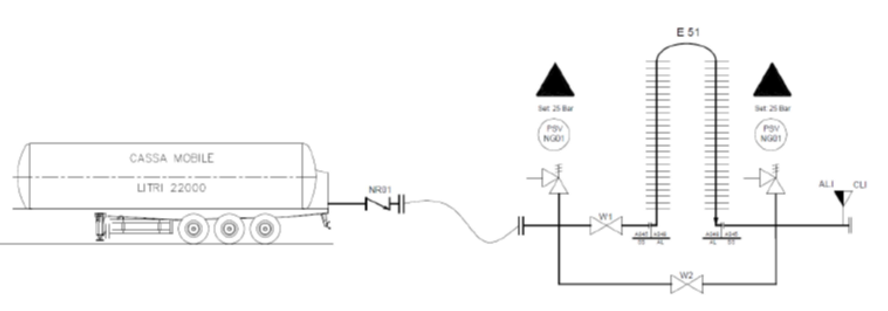
KLOE Magnet cold test @ LNF
Cryo interface
Existing LN2 flexible TL
Existing LN2 tank 3000 lt
LN2 mobile tank + vaporizer
Atm vent
KLOE
Existing LHe dewars 3 x 1000 lt

Slide 4
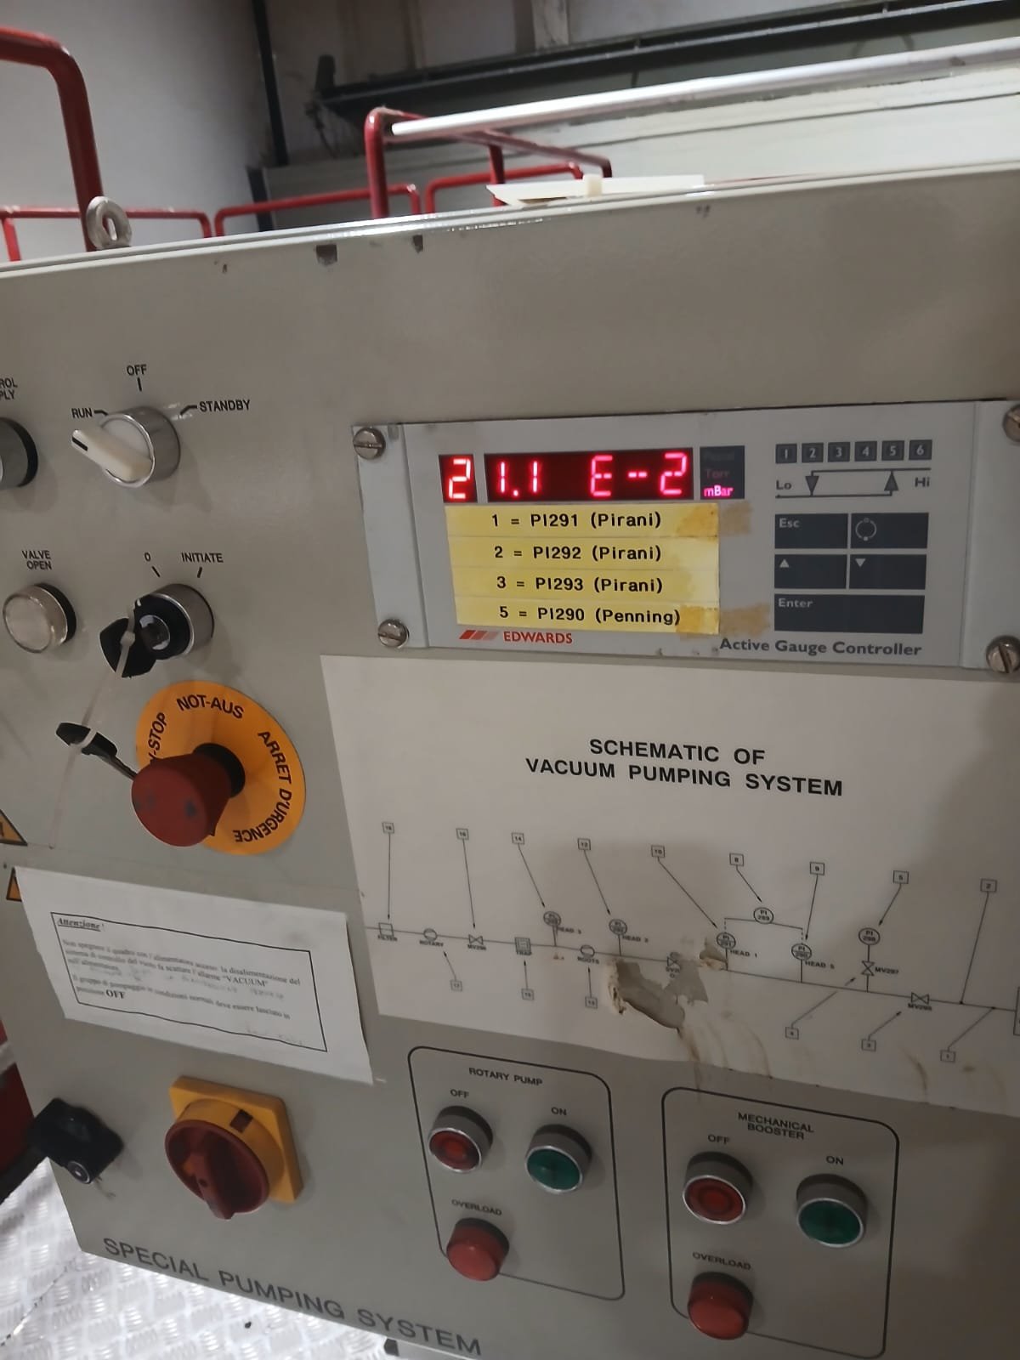
KLOE Magnet Status
Vacuum
the vacuum pumping system has been reconnected to the cryostat, to the CS and to the power line. It is fully operational.
Complete revamping of the pumps will occur after the test at LNF (order already placed)

Slide 5
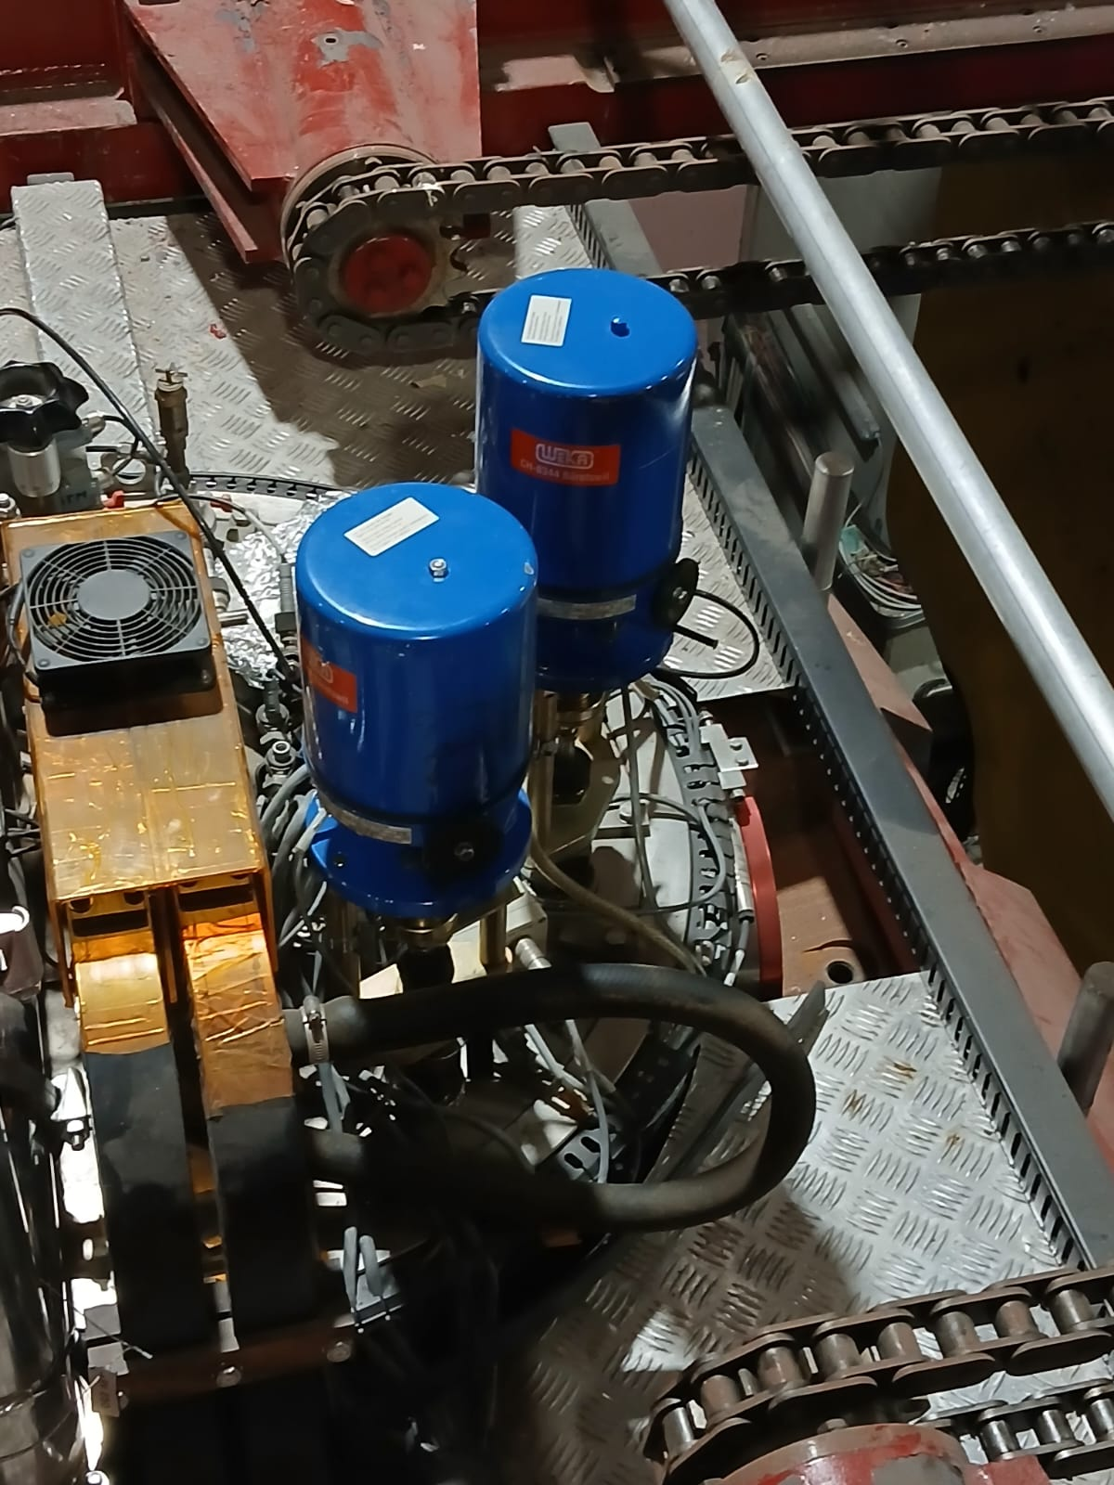
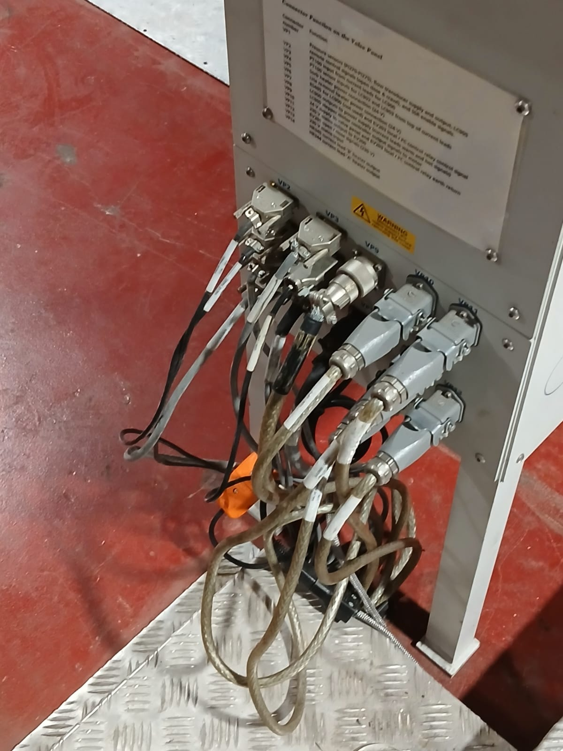
KLOE Magnet Status
Control System
The actuators of Valves EV 200 and EV 201 have been re-assembled
The power and signal interfaces have been reconnected

Slide 6
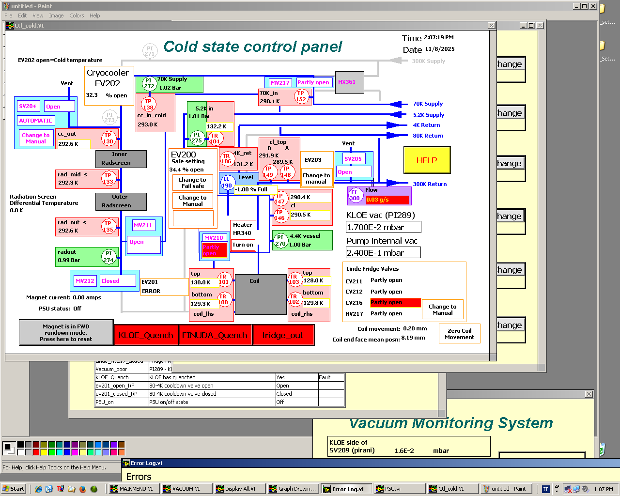
KLOE Magnet Status
Control System

Slide 7
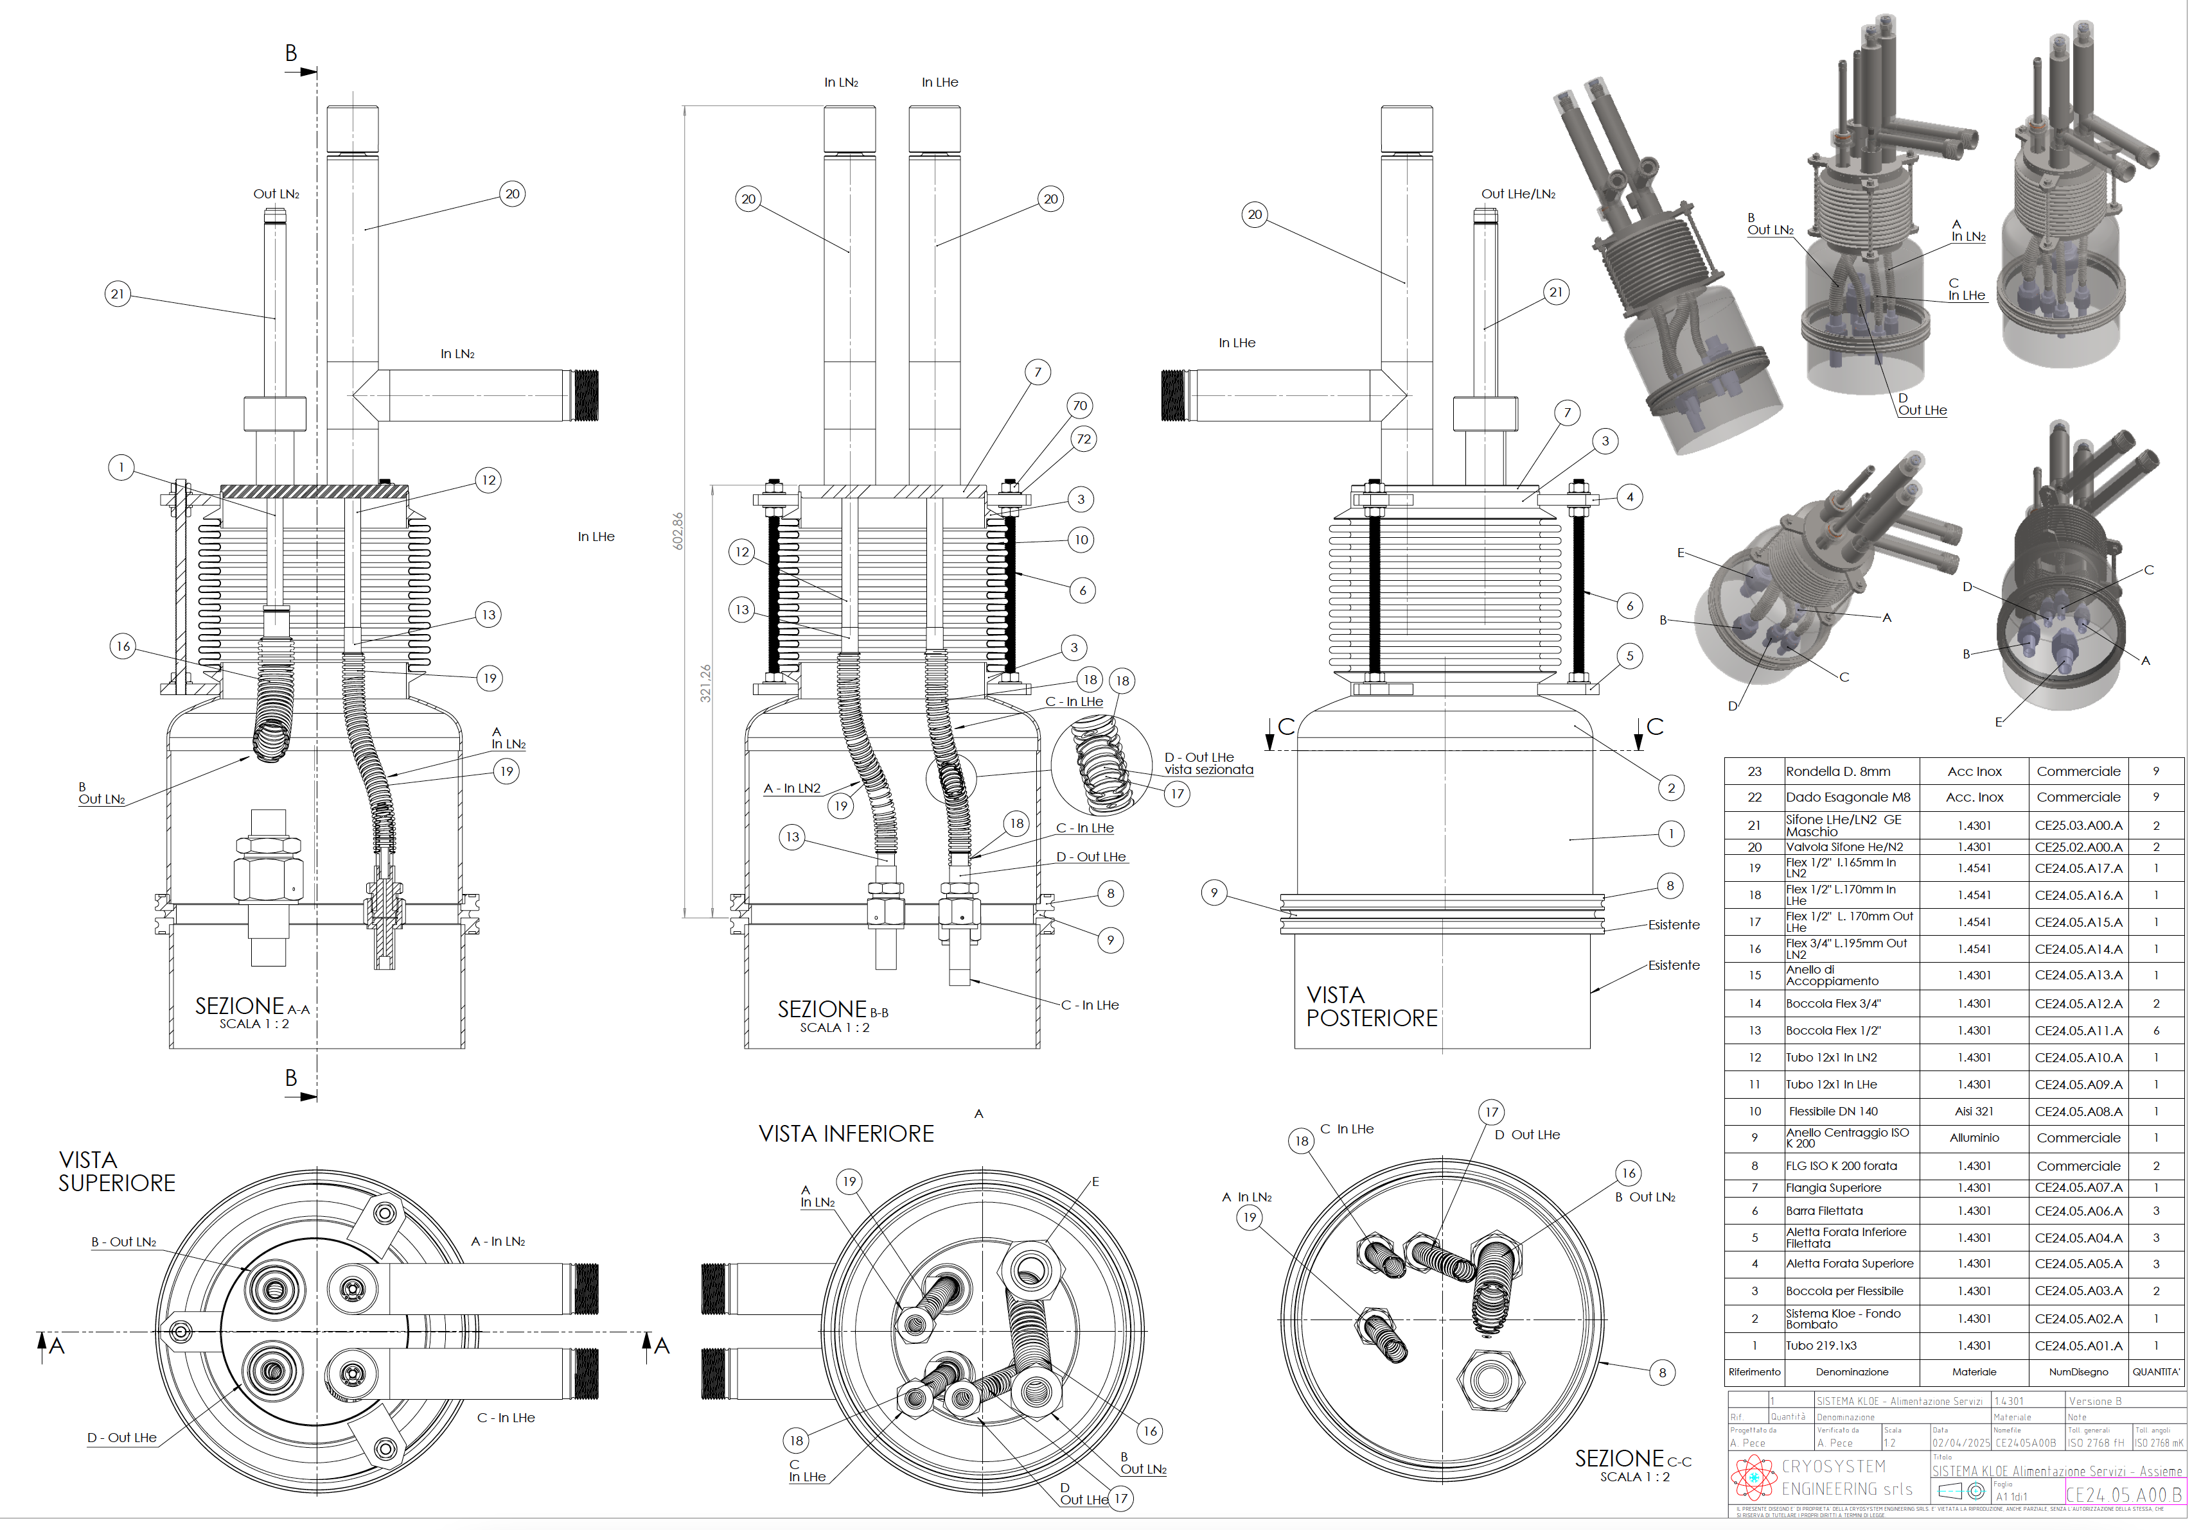
KLOE Magnet Status
Cryogenic interface
Under construction. Delivering date
Nov. 30th

Slide 8
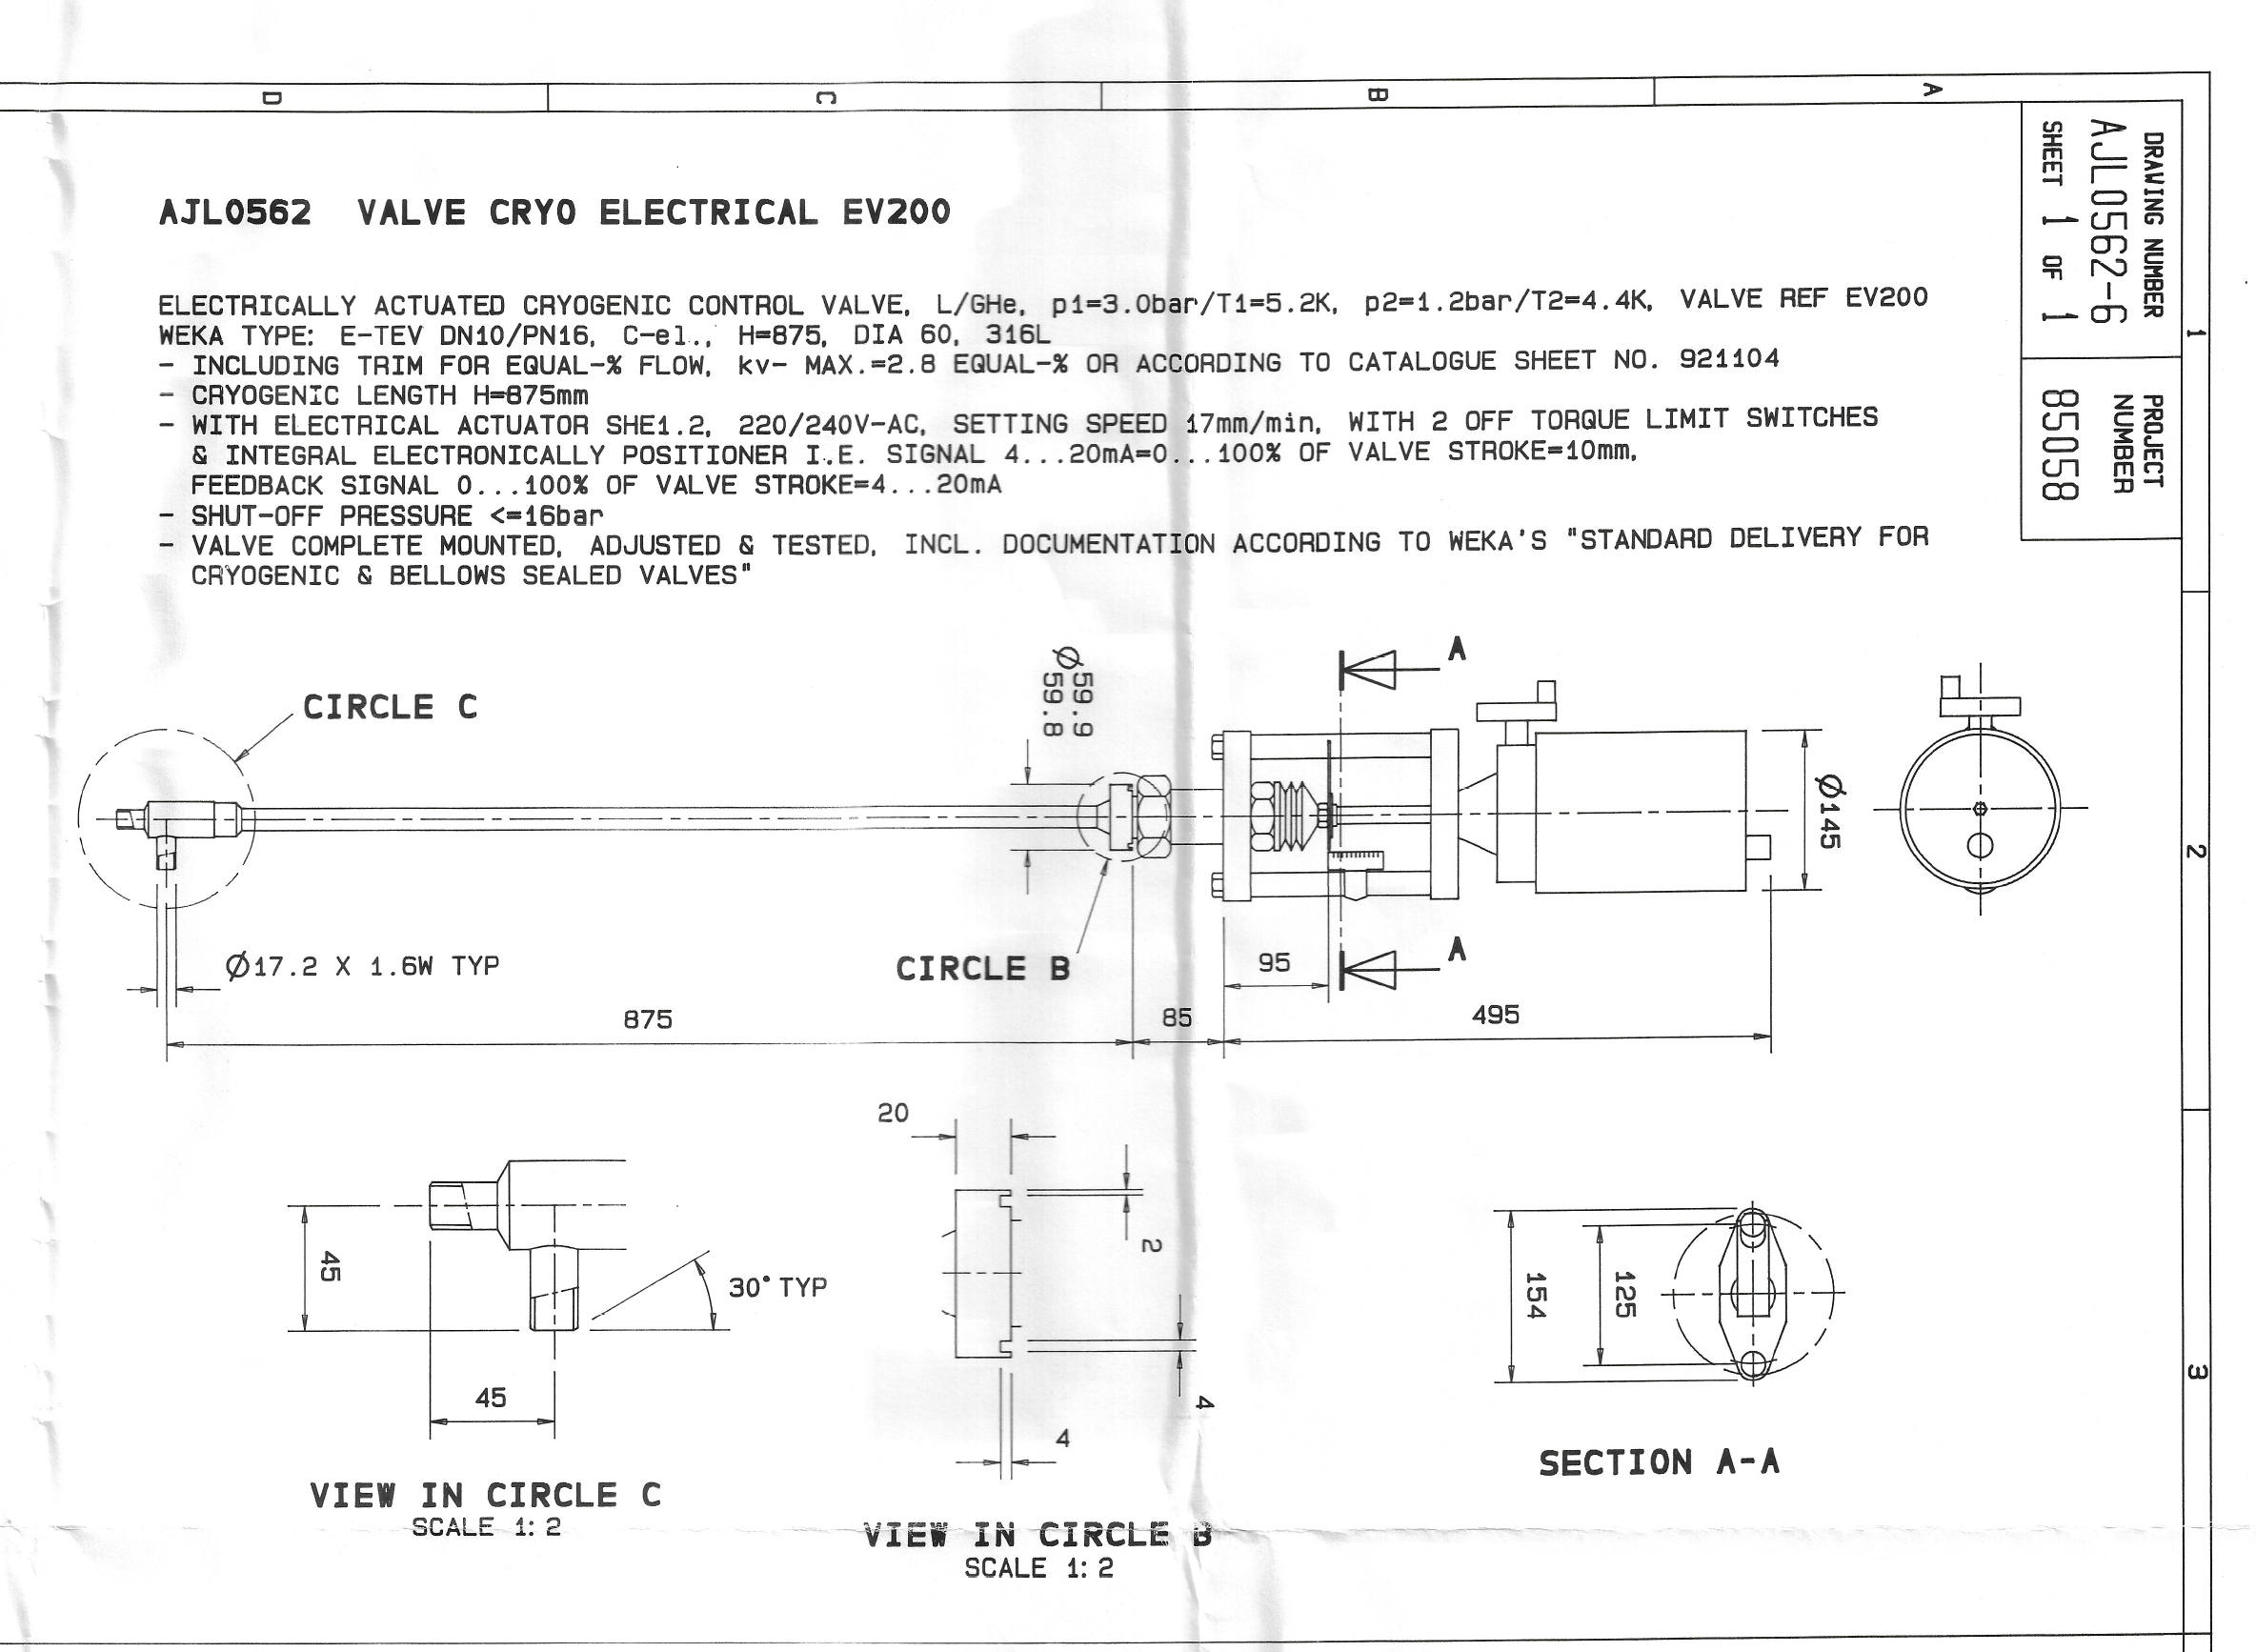
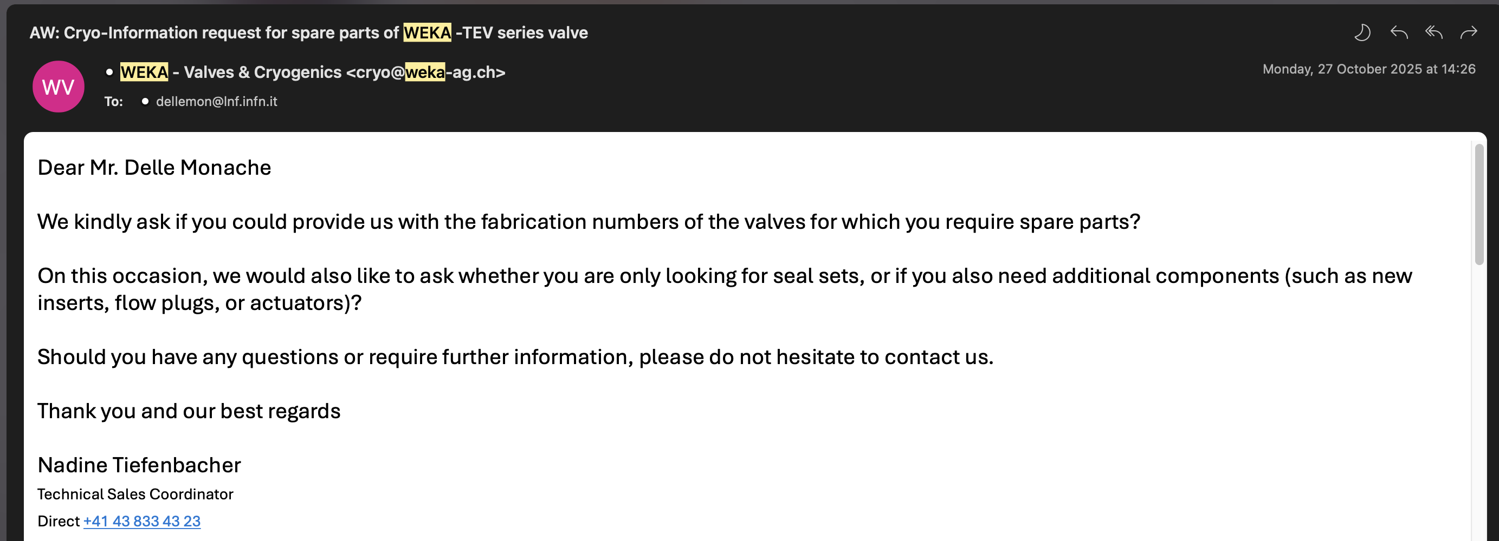
Crio valves maintenance
Spare parts (under procurement)
Seal
Insert (?)
Flow Plug (?)

Slide 9
Procurement
                PO for most part of the HW and services for the cold test has been emitted to the suppliers, in details:
                All the cryo components connecting the LN2 and LHe lines to the magnet turret + exhaust He and N2 lines
                36.000 liters of LN2 + 4/6 weeks of renting LN2 mobile thank + manufacturing of evaporator to control the LN2 T inlet to the magnet
                Interface for the connection of the DAFNE compensator TL to the mobile thank + its redeployment
                LHe awarding contract within 2025.

Slide 10
KLOE Magnet Compliance
KLOE is provided with 150 liters of LHe reservoir aimed to limit its temperature below 20 K in case of a quench, so it must comply FNAL internal regulation for pressure equipment.
In the past, the safety protocol and methodology described in Fermilab ESH Manual allowed Fermilab Director to accept pressure equipment as “exceptional” after the production of an Extended Engineering Note in case of non compliaces.
Recently DOE is reconsidering the methodology for operating FNAL equipment built in periods where ASME and PED code did not require data recording of production processes (e.g. design calcs per ASME, FEA, verification of thicknesses, radiography, additional pressure testing, etc.), so it most likely that FFT “Fitness For Service” methodology will be applied

Slide 11
FFS ASSESMENT(FNAL Project No. 721261)
Purpose:
To assess the fitness-for-service (FFS) of the KLOE pressure equipment for construction and post-construction.
Conclusions:
  1. Construction Conclusion (as per Codes of Fedeal Regulation)
DOE 10CFR851 “Worker Safety and Health Program” Appendix A.4 “Pressure Safety” requires the construction (materials, design, fabrication) of pressure vessels and piping comply with appropriate ASME standards. In the case of the KLOE pressure equipment (vessels and piping) the construction was performed in Europe and the construction records (materials, design, fabrication) are incomplete. Therefore, the pressure equipment construction cannot be demonstrated to be compliant with DOE 10CFR851. Eleven construction verification compensatory measures are recommended, numbered C1 / C11.
  2. Post-construction Conclusion (as per Codes of Fedeal Regulation)
FFS is the assessment of the integrity of the pressure boundary (i.e., prevention of leak or rupture of the pressure boundary) for the remaining service life beyond construction. The FFS assessment consists of Periodic inspection and tests, assessment of damage identified during the inspections and repairs according with proper ASME standards. The KLOE pressure boundary is classified as Medium Risk in Section 5. Five periodic inspection measures are recommended, numbered F1 / F5.

Slide 12
KLOE Magnet FFS
Compensatory measure | Owner/Note
C1 – performing PMI on the SS He vessel, SS piping, AL piping, SS inner and outer vacuum cases. This will determine specific grades of steel or aluminum used for construction. This information will then get crossed checked against the drawings and specifications. If SS grades are of low carbon “L”, then there will be no need to UT check for evidence of intergranular attacks (measure C2). | CND Control (after the test)
C2 – if needed, perform UT check for evidence of intergranular attacks for welds in non-type-L SS material. | CND Control (after the test)
C3 – prepare (as much detailed as possible) isometric drawings for piping anchored to the inlet and outlets of the cooling channels and analyze for max thermal contraction and compliance with B31.3 or EN13480 requirements. | FNAL?
C4 - determine the rate of cool-down and warm-up and predict the number of thermal cycles from past plus a conservative projection of future opera􀀀on. By heat transfer determine the maximum temperature gradient through the wall, from there estimate the through-wall stress and perform a fatigue check for cracking caused by through-wall temperature gradients. | LNF/FNAL
C5 - Estimate the potential for pressure transient up to relief valve set point. If a dynamic pressure rise is credible, apply a dynamic load factor to the pressure rise, and check the stresses in the pipe caused by the total pressure against B31.3 stress limit for occasional loads caused by a pressure surge to relief valve set point. | FNAL? (see KLOE commissioning-acceptance test.pdf for pressure transient up)
C6 – Verify the connection points, sizing, settings of the pressure reliefs and verify that they are adequately set and sized as required by applicable US Codes and Standards, e.g. e.g. ASME B31.3, ASME VIII Div.1, API 520 and CGA S-1.3. | FNAL?

Slide 13
KLOE Magnet FFS
Compensatory measure | Owner/Note
C7 - Perform radiographic examinations ( RT) o r ultrasonic (shear w ave U T) o f t he f ollowing welds: 3 random accessible welds in the SS pipe; 3 random accessible welds in the AL pipe; all accessible bi-metallic SS-AL welds; 3 random accessible locations on the inner and the outer vacuum cases; 3 random accessible locations on the He vessel. Use instructions and requirements per ASME (BPVC Section V and B31.3) or PED (EN13445 and EN13480). If the criteria of ASME B31.3 Chapter VI Para.340 applied, do not permit any incomplete penetration (where B31.3 would permit some) as they may indicate poor argon or helium purging of the first pass of the SS welds and even AL welds. | CND Control (after the test)
C8 – perform a pressure test for each pipe segment using 1.1 x design pressure. This is accomplished by test 1 (see above) or by the test done after cooldown & warmup if any welds require repairs. | Cryosystem
C9 – perform a pressure test for helium vessel using 1.1 x design pressure. This is accomplished by test 1 (see above) or by the test done after cooldown & warmup if any welds require repairs. | Cryosystem
C10 – perform a sensitive leak test for all pressure piping circuits and helium vessel. This is accomplished by test 1 (see above) or by the test done after cooldown & warmup or if any welds require repairs. | Cryosystem
C11 - If the PMI results under C1 are satisfactory (confirming the SS and AL alloys), no need for tensile testing. If the PMI results are not satisfactory, the root cause and extent of the material issue needs to be established, and remediation actions implemented accordingly. | TBD

Slide 14
KLOE Magnet FFS
Periodic inspection | Owner/Notse
F1 - At the first outage, when the He vessel is accessible and at ambient temperature, the same welds as were examined in Section 7.4, should be re-examined using the same technique. Once the results of in-service inspections (NDE) are obtained, they shall be evaluated in accordance with the API 579-1/ASME FFS-1 “Fitness-for-Service” standard. | C1-C2 can be performed only after test at LNF (at the first outage) Welds examination CND Control Results evaluation FNAL
F2 - When the He vessel is accessible and at ambient temperature, the same welds as were examined in Section 7.4, should be re-examined using the same RT technique. | C1- C2 can be performed only after test at LNF (at the first outage) Welds examination CND Control Results evaluation FNAL
F3 - Periodically perform a sensitive leak test, such as He leak test in accordance with ASME Boiler and Pressure Vessel Code Section V Part 10. The periodicity to be established by Fermi Lab depending on the accessibility of the pipes and vessel for leak testing. | FNAL
F4 - Leak tightness and operability of valves should be tested periodically at a scheduled established by Fermi Lab. | FNAL
F5 - Safety relief valves should be tested or replaced periodically as recommended by the valve manufacturer. | FNAL

Slide 15
THANKS
QUESTIONS?

Slide 16
SPARES

Slide 17
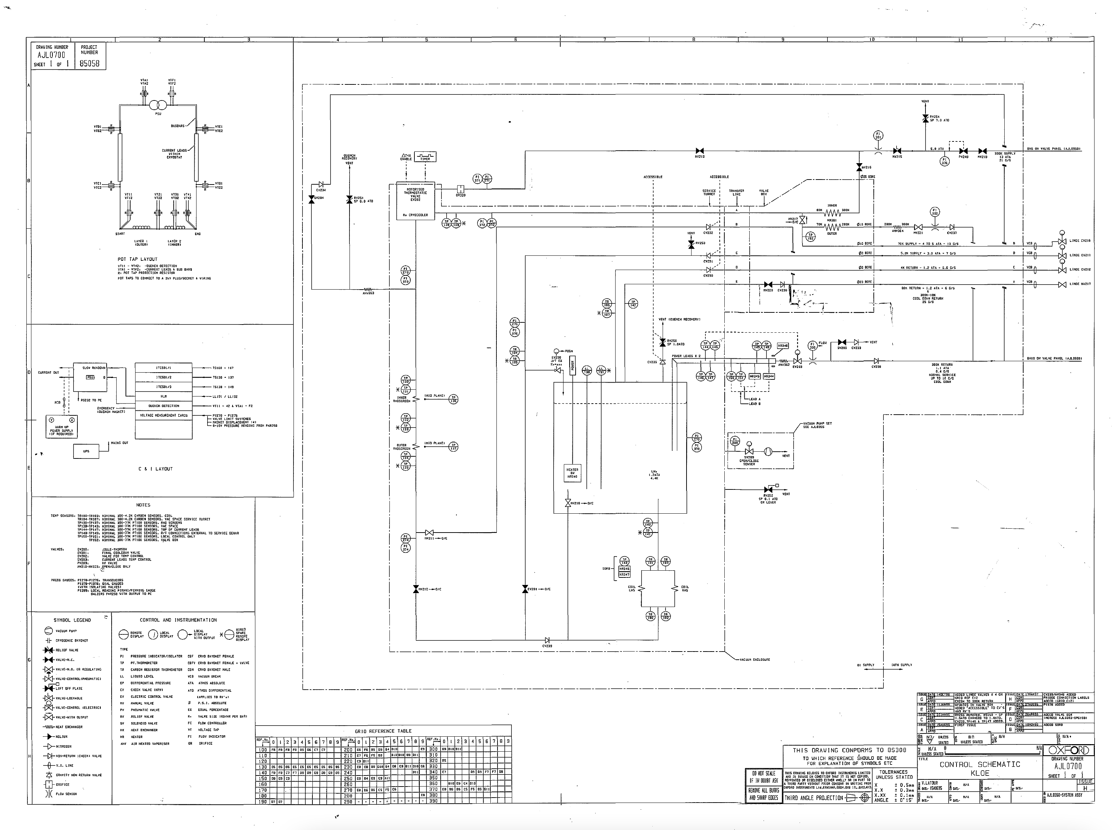
Cool Down 300 – 100 K
N2
N2
N2

Slide 18
Cool Down 100 – 4.4 K
N2
He
N2
He

Slide 19
Magnet @ 4.4 K
N2
He
N2
GHe
He

Slide 20
KLOE Magnet handling: Service Turret Removal
After the tests before the shipment FNAL the service turret must be removed because of the interference with the hall door. The reverse process has been performed by OI in 1997 at magnet delivery. The main operations can be summarized as in the following:
Disconnection of the signal sensors cable (air side)
Removing of the cylindrical shell of the vacuum case
Removing of the MLI
Disconnection of the signal sensors cable (vacuum side)
Disconnection of the coil terminals
Cutting of the 4 cryogenic lines

Slide 21
KLOE Magnet handling: Service Turret Removal
The turret will be reconnected at FNAL and the procedure (to be used in the reverse sequence for the turret removal) is described in the drawing from Oxford Instrument AJL0550 "Service Turret Assy KLOE sheet 1 to 5.
Working Instructions (OI internal procedures) obviously are not available, for this reason due to the nature of this operation INFN will award a contract to ASG Superconductors to perform the entire process of removal and reconnection at FNAL of the service turret.

Slide 22
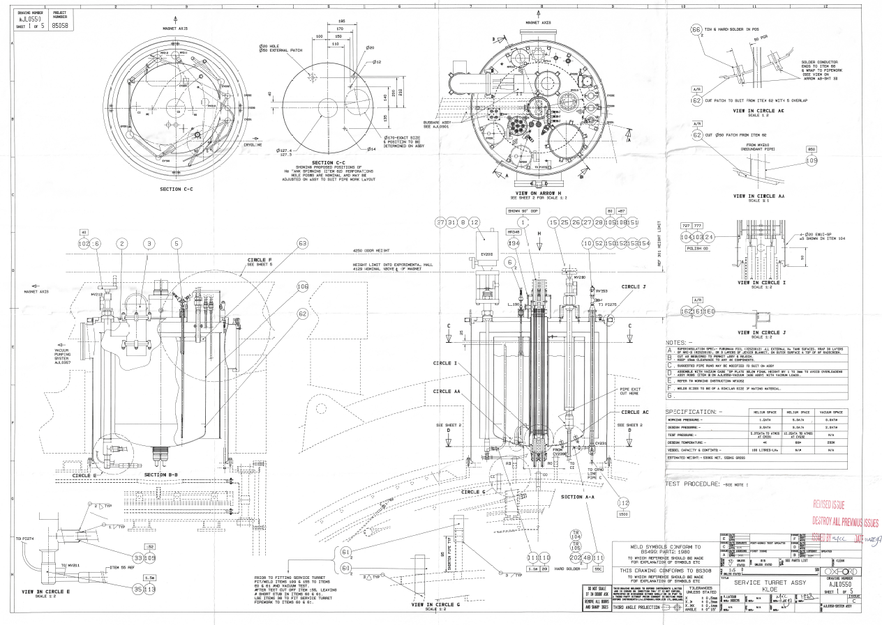
KLOE Magnet handling: Service Turret Removal

Slide 23
KLOE Magnet handling: Service Turret Removal

Slide 24
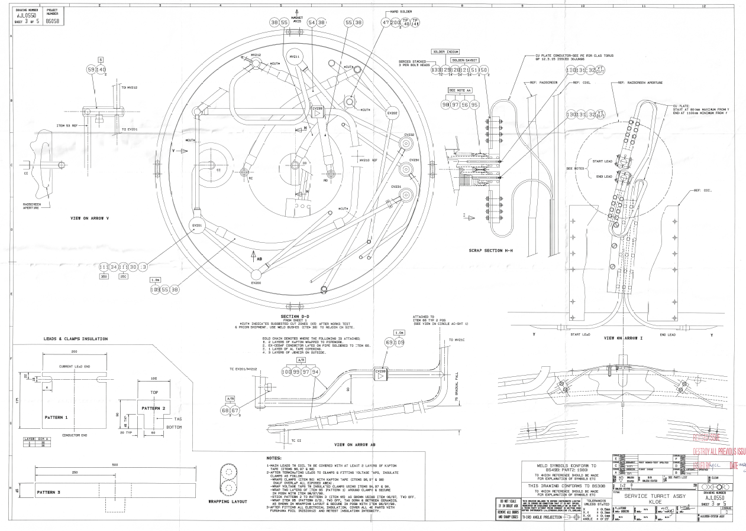
KLOE Magnet handling: Service Turret Removal

Slide 25

KLOE Magnet handling: Service Turret Removal

Slide 26
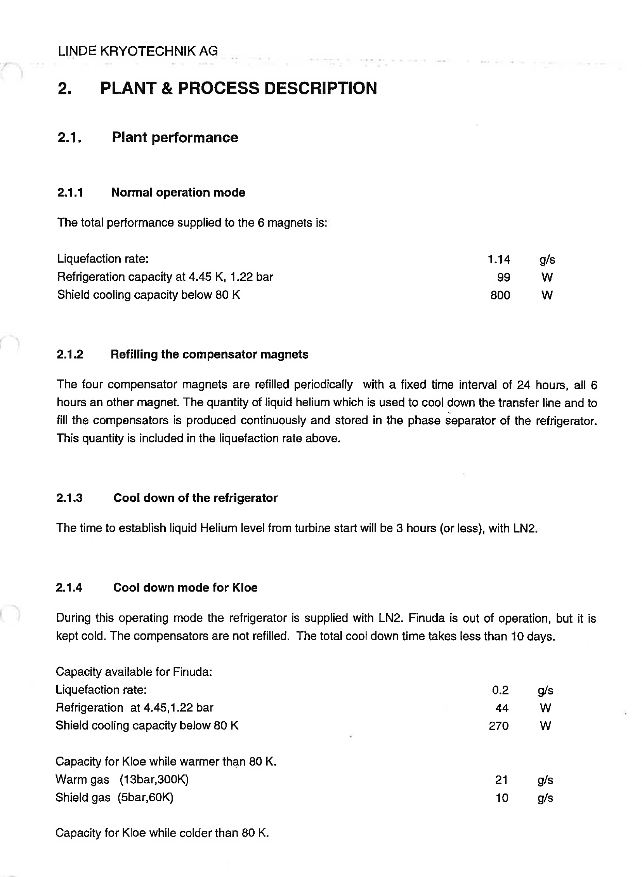
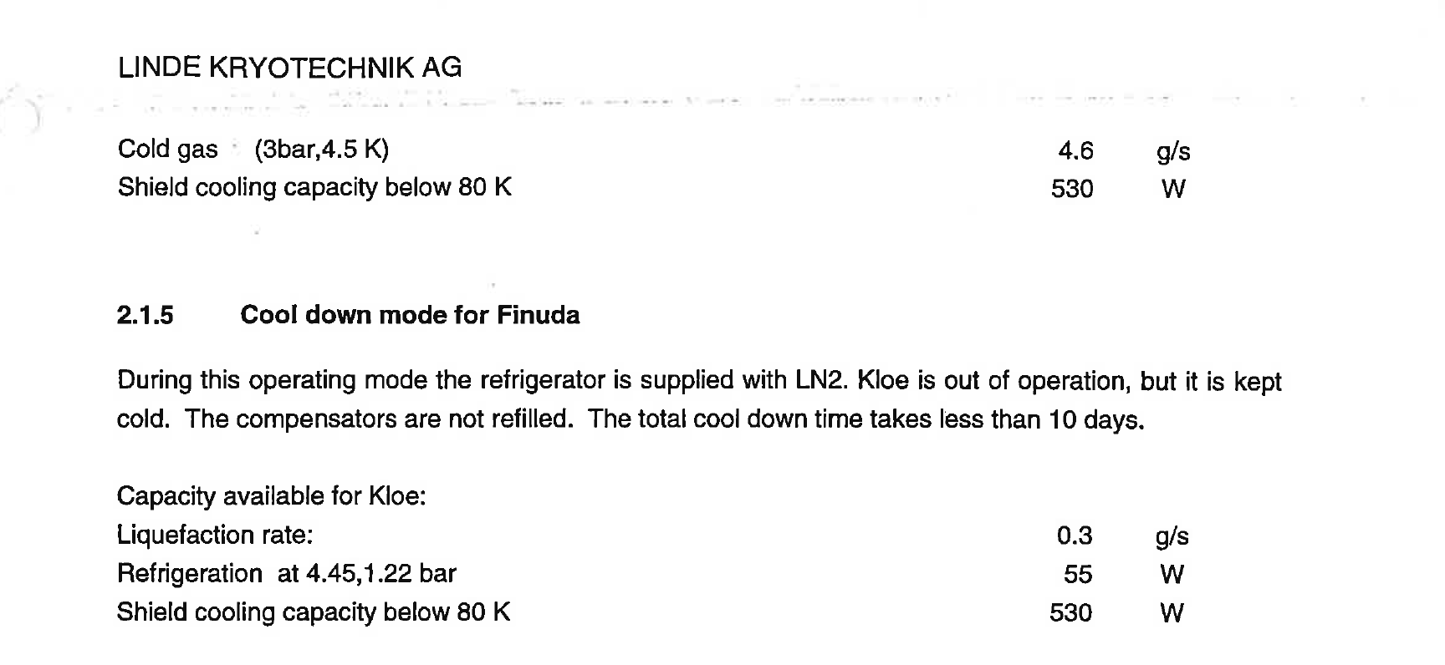
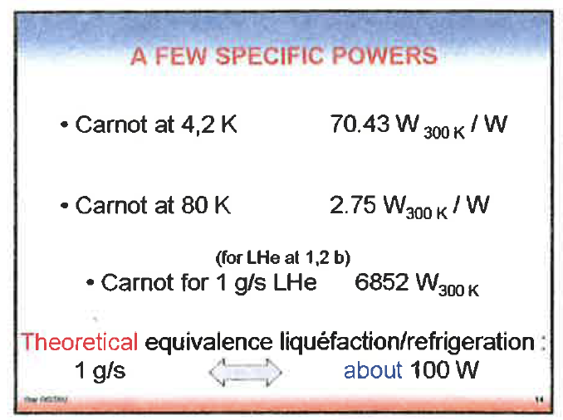
DAFNE Cryo Plant Linde TCF 50
Source | Nominal HL (guarantee) | Measured HL @ 1000 A
Current Leads | 0.6 g/s | 0.12 g/s
coil | 55 W | 27.6 W
Radiation screen | 530 W | 62.6 W
Guy Gistau Bauger

Slide 27
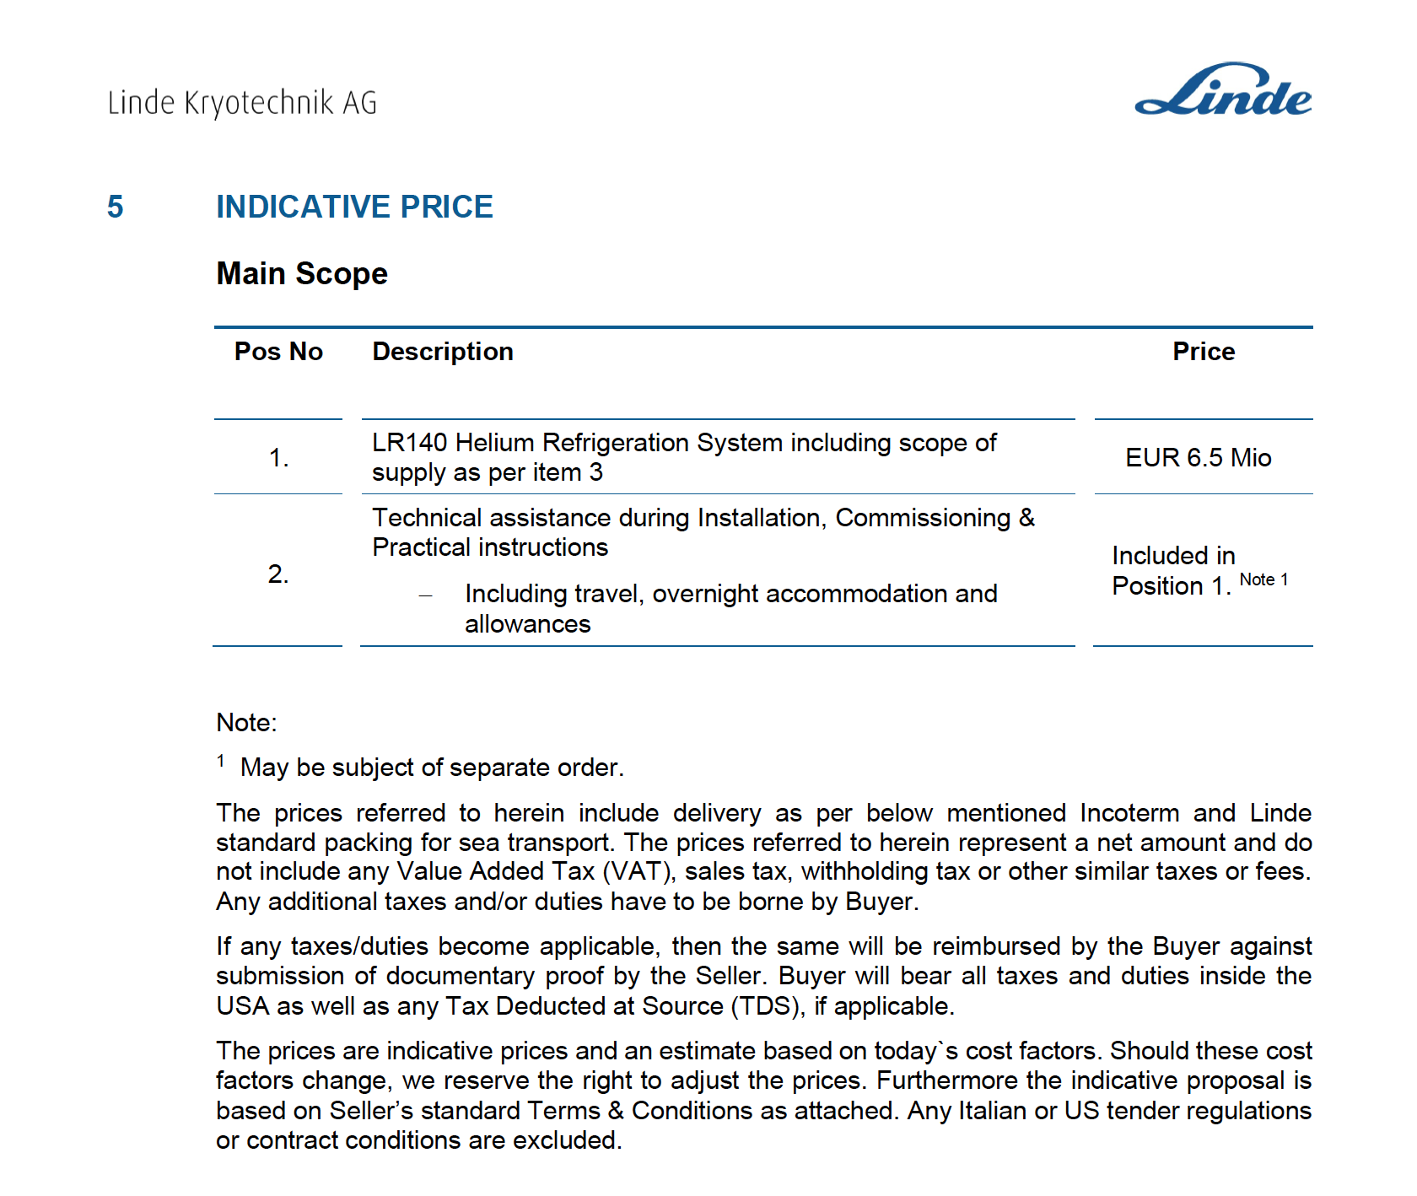
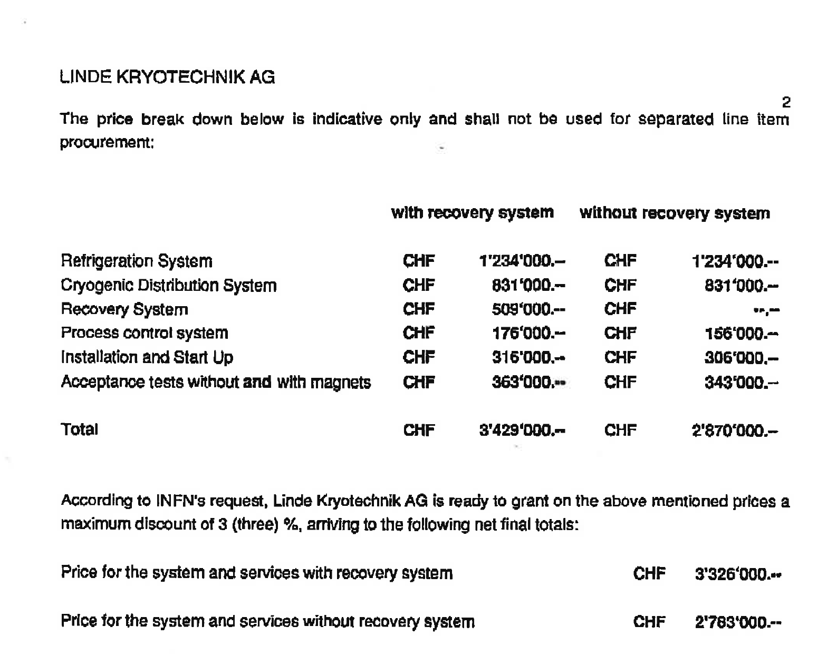
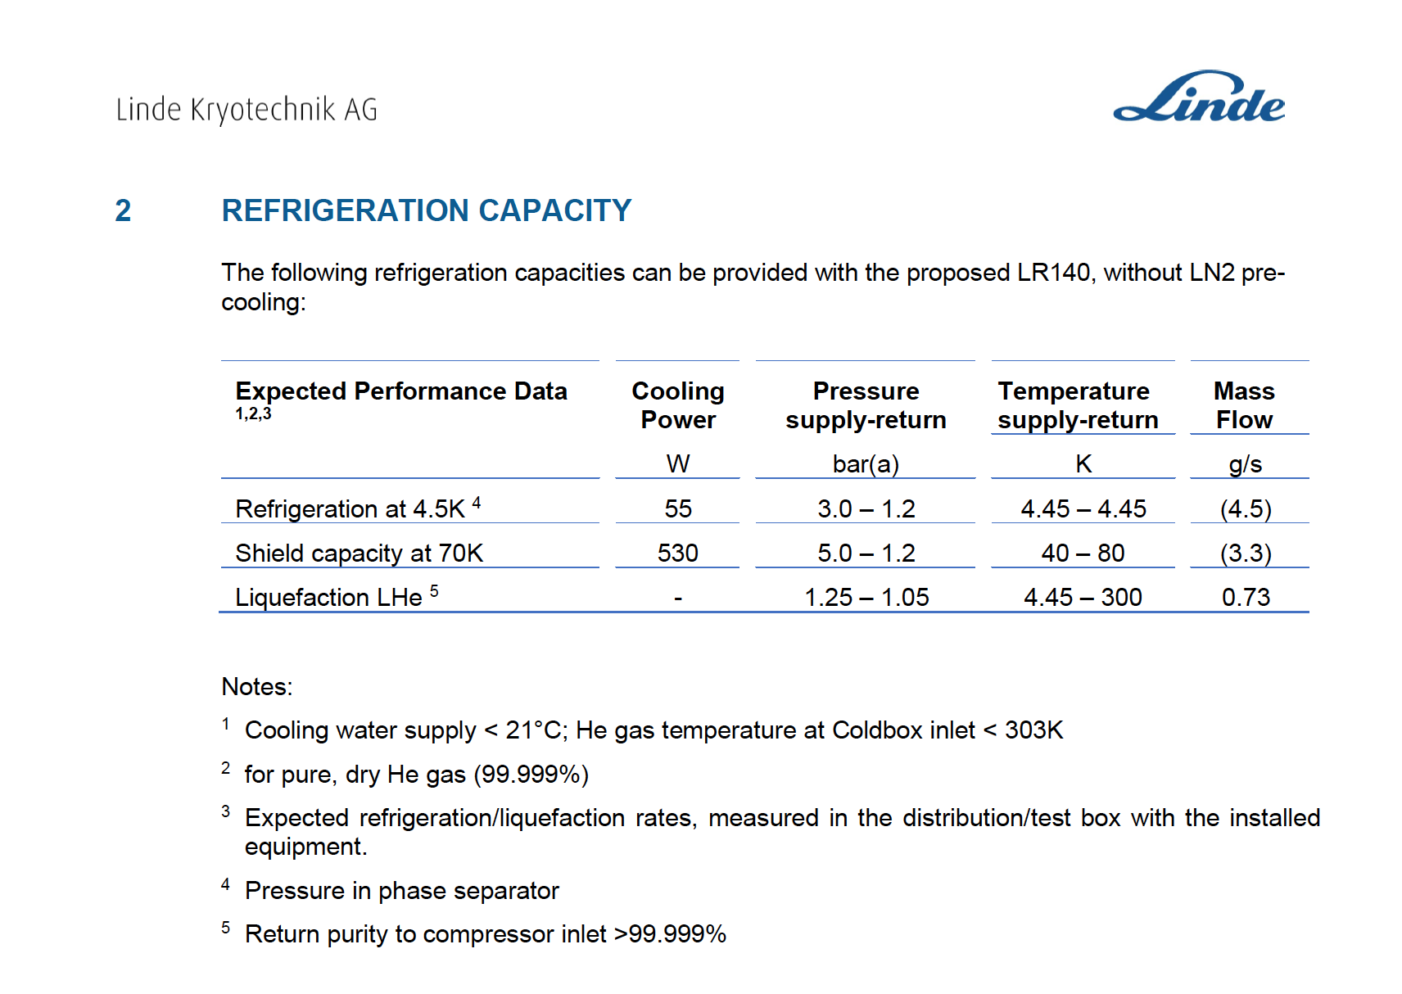
Cryo plant Linde LR 140 vs TCF 50
250 kW
132 kW
3.850.000.000 di Lire in 1995
for a double power plant

Slide 28
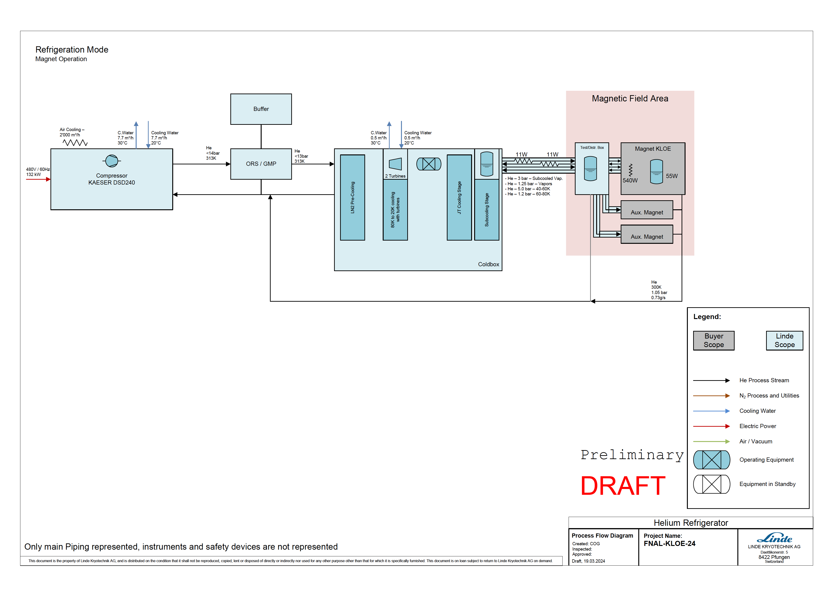
Cryo plant Linde LR 140

