Slide 1




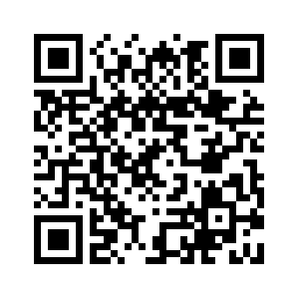

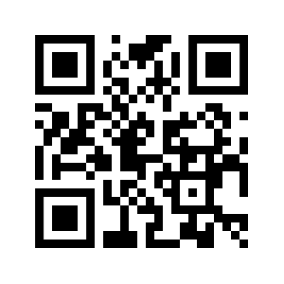
Integrated Waveguide Source of Squeezed Vacuum for Quantum computation and Gravitational-Wave Detection
Hamza Hasnaoui
Hamza.hasnaoui@unitn.it
Integrated Quantum Photonic Laboratory

Slide 2


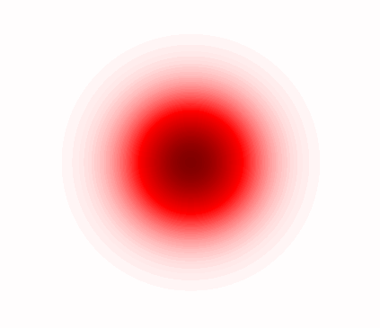

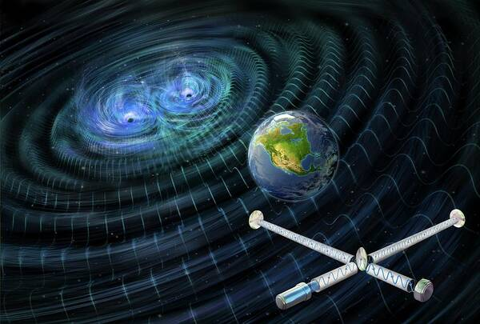

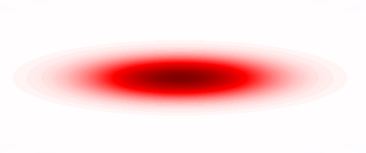









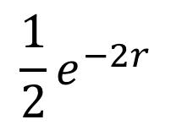



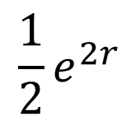

Squeezed state of light
Squeezed states are non-classical states of light that enable measurements below the shot-noise limit, providing a fundamental resource for quantum computing, quantum communication and quantum metrology.
$$p$$
$$E(t)$$
$$\left|\left.0\right\rangle \right.$$
$$1/2$$
$$q$$
$$t$$
$$1/2$$
$$S\left(ξ\right)=exp⁡(ξ{\hat{a}}_{1}^{⟊} {\hat{a}}_{2}^{⟊}−ξ^{∗}{\hat{a}}_{1} {\hat{a}}_{2})\left|\left.0\right\rangle \right.$$
$$p$$
$$E(t)$$
$$\left|\left.Sq\right\rangle =S\left(z\right)\left|\left.0\right\rangle \right.\right.$$
$$\frac{1}{2}e^{−2r}$$
$$q$$
$$t$$
$$\frac{1}{2}e^{2r}$$
1

Slide 3
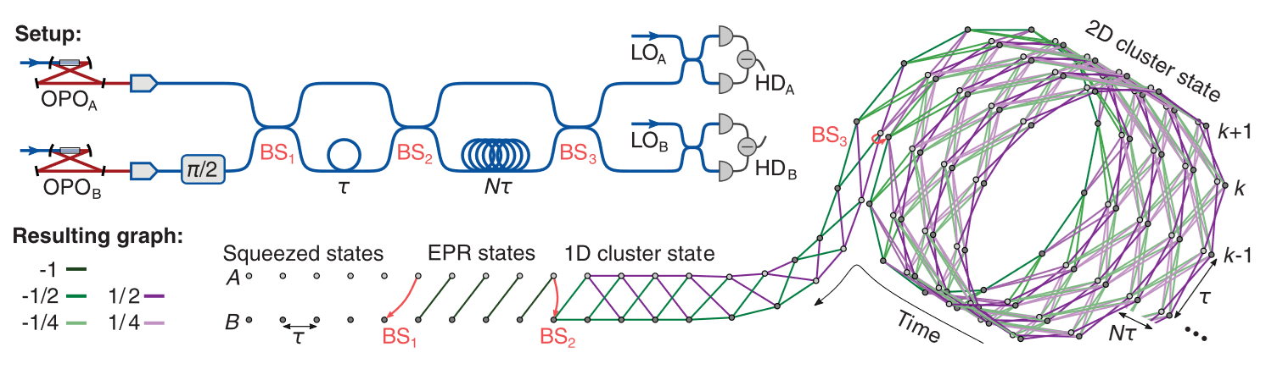
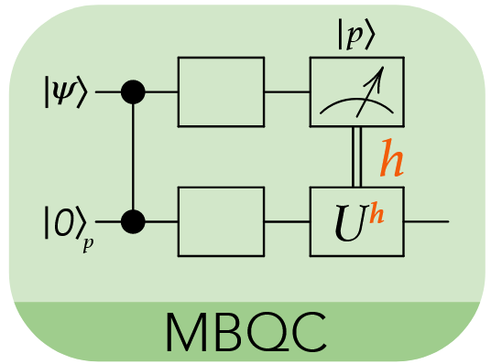
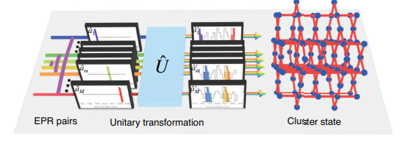
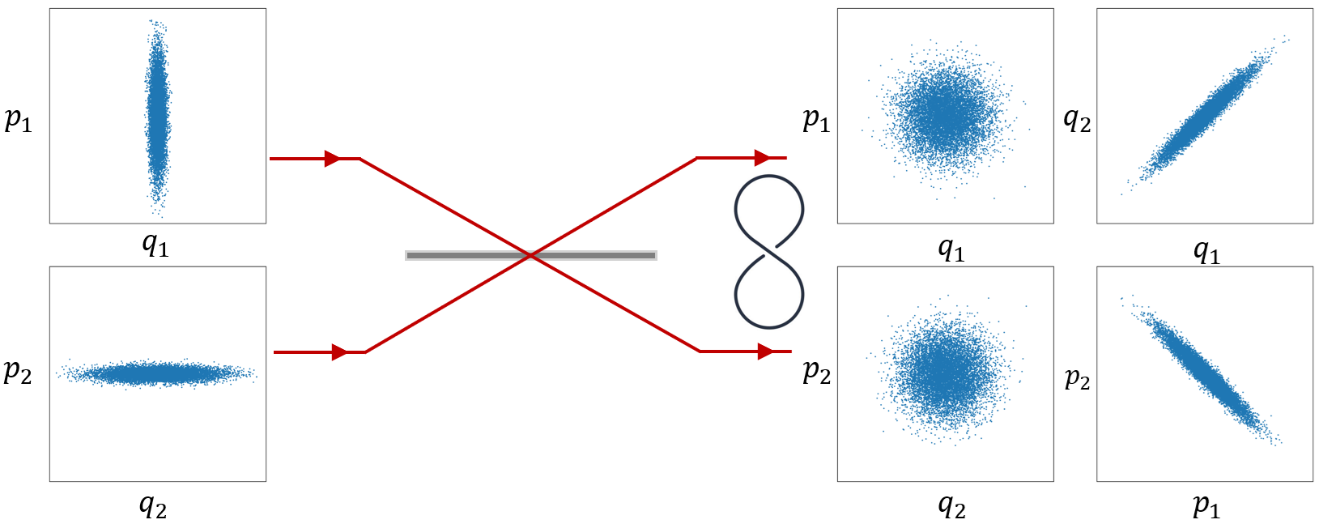
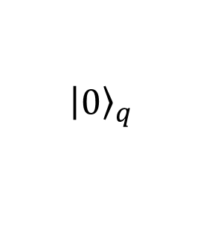
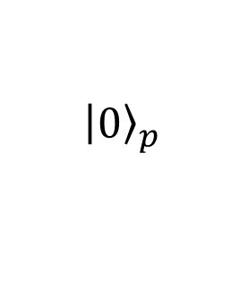
CV-cluster model quantum computation
CV- Measurement based quantum computation (CV-MBQC)
(2019) 2D cluster state (time domain multiplexing)
https://doi.org/10.1126/science.aay4354
$${\left.\left|0\right.\right\rangle }_{q}$$
$${\left.\left|0\right.\right\rangle }_{p}$$
TMSV (EPR) states
(2025) 3D cluster state (time-frequency multiplexing)
https://arxiv.org/abs/2309.05437
2

Slide 4
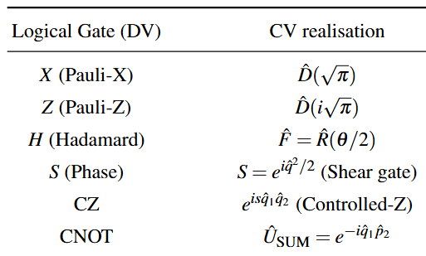
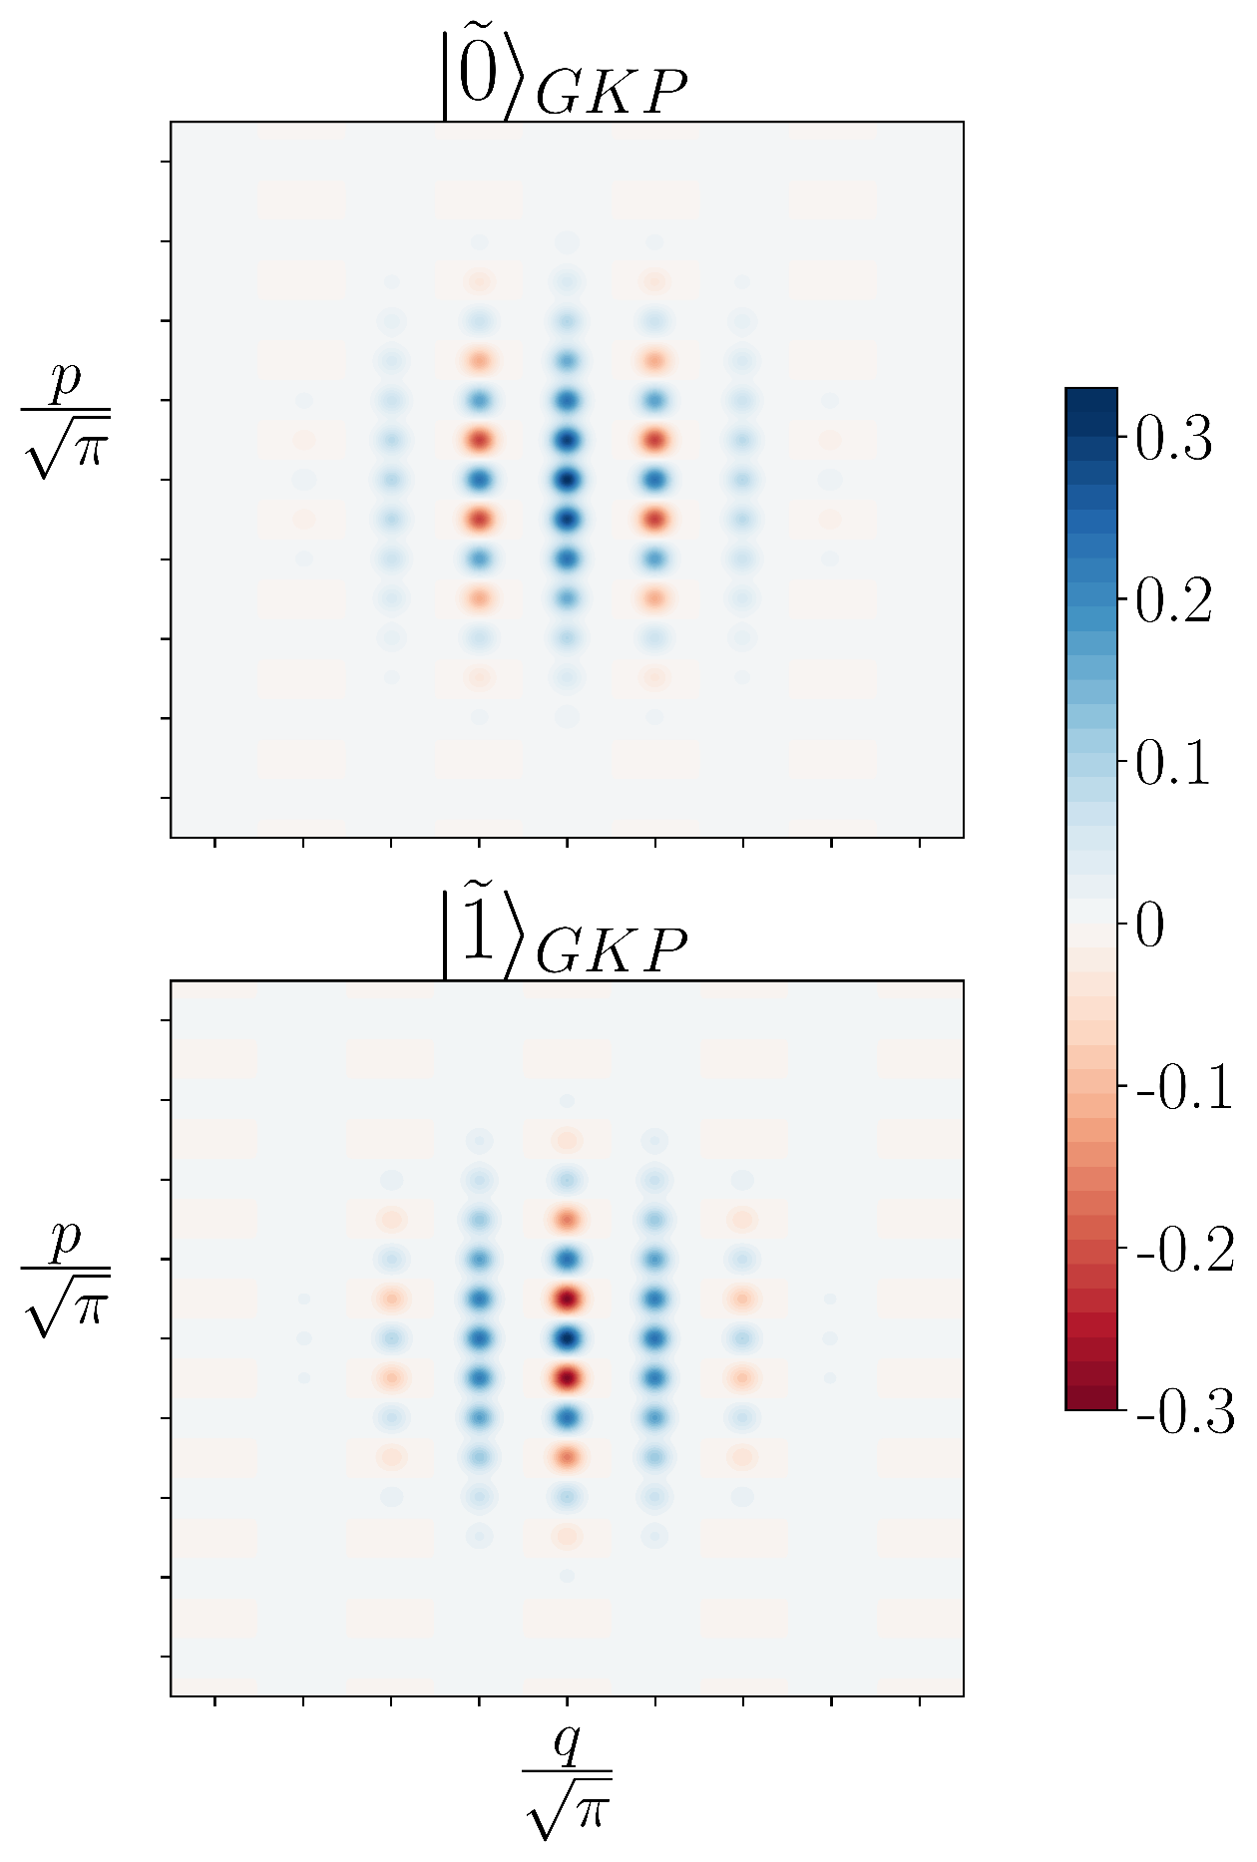
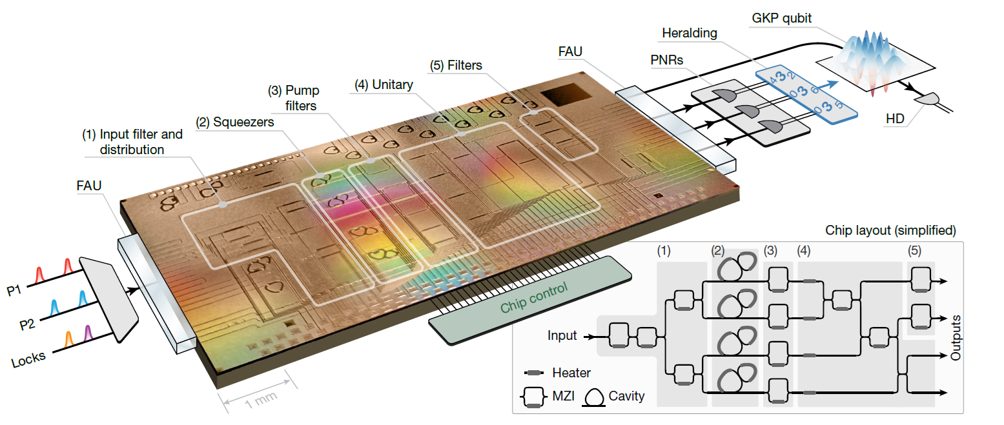
Fault-tolerant quantum computation
Gottesman–Kitaev–Preskill (GKP states)
(2025) https://doi.org/10.1038/s41586-025-09044-5
3

Slide 5
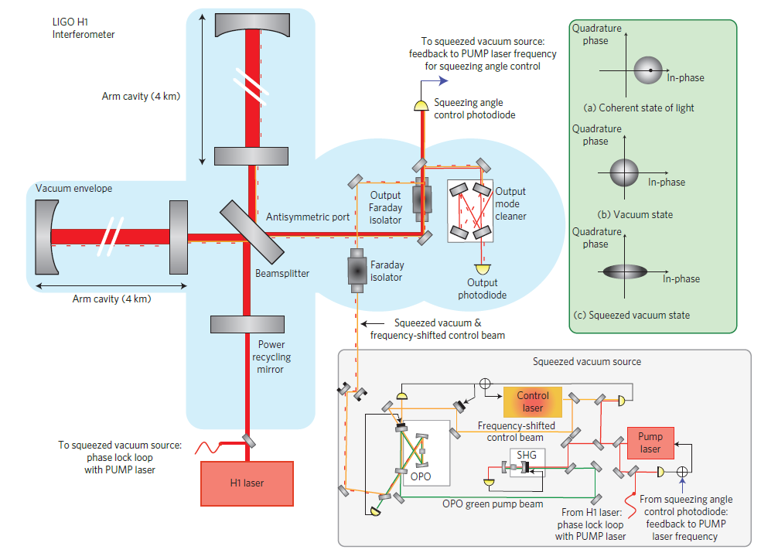
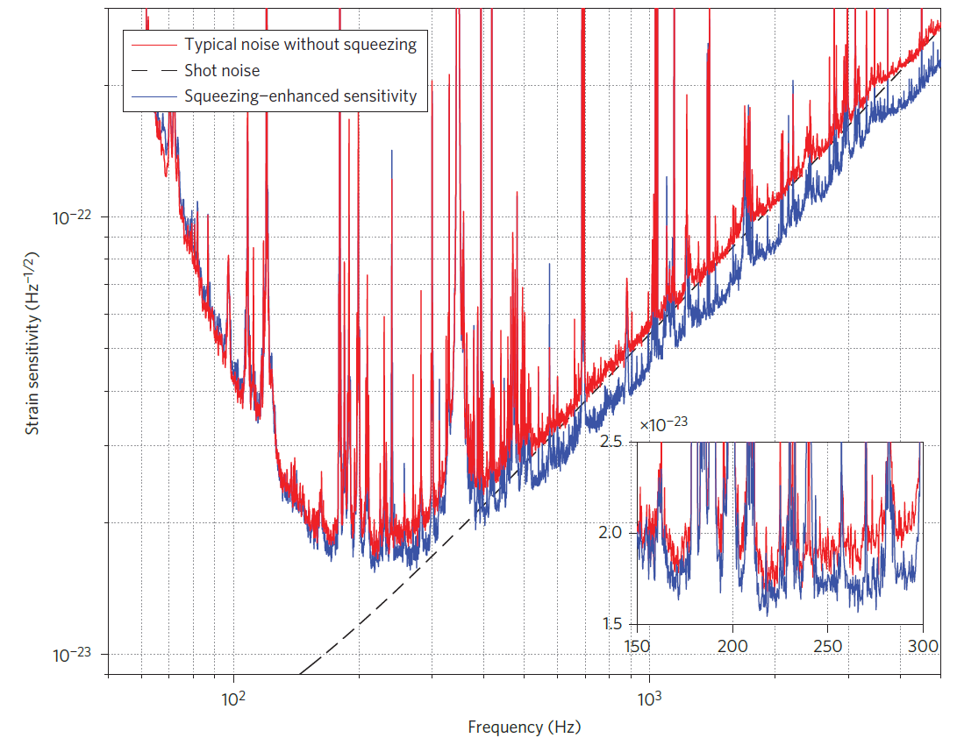
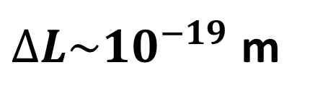
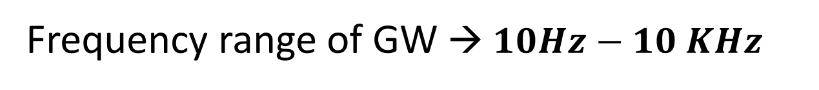
Gravitational wave detection
Quantum noise in interferometric GWD:
shot noise
radiation pressure noise (due to the high power)
$∆L\sim {10}^{−19}$ m
Aasi, J., Abadie, J., Abbott, B. et al. Enhanced sensitivity of the LIGO gravitational wave detector by using squeezed states of light. Nature Photon 7, 613–619 (2013). https://doi.org/10.1038/nphoton.2013.177
Frequency range of GW → $10Hz−10 KHz$
4

Slide 6
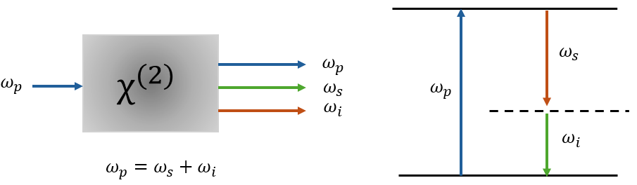
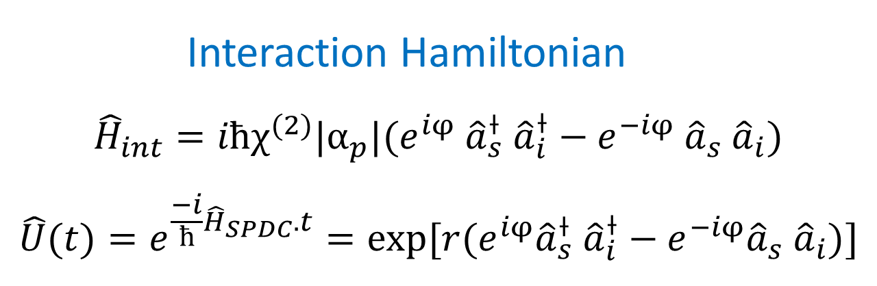
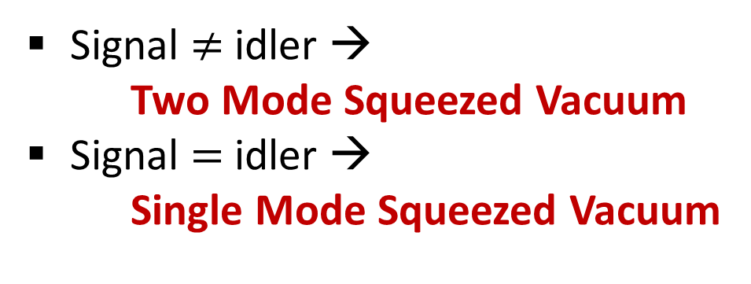
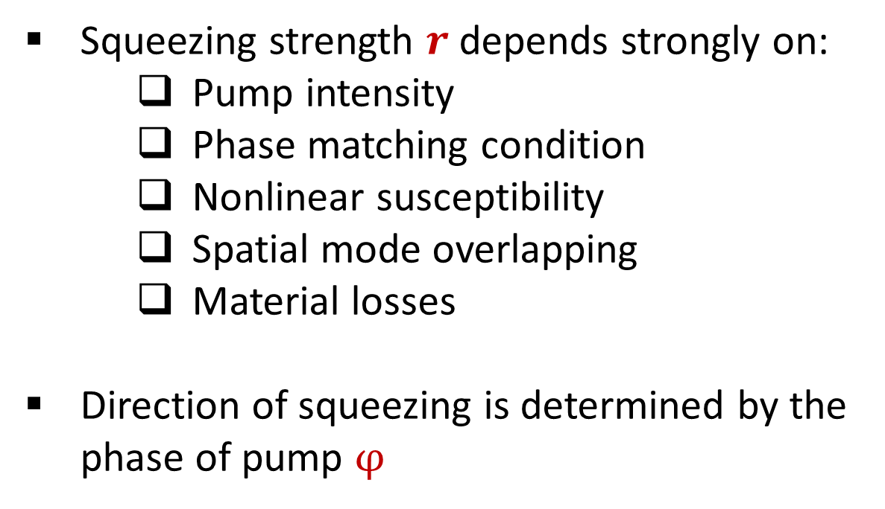
How to generate Squeezed light ?
$χ^{(2)}$ nonlinearities based on SPDC interaction
Signal $≠$ idler →
Two Mode Squeezed Vacuum
Signal $=$ idler →
Single Mode Squeezed Vacuum
Squeezing strength $r$depends strongly on:
Pump intensity
Phase matching condition
Nonlinear susceptibility
Spatial mode overlapping
Material losses
Direction of squeezing is determined by the phase of pump $φ$
Interaction Hamiltonian
${\hat{H}}_{int}=iħχ^{(2)}|α_{p}|{(e}^{iφ}$ ${\hat{a}}_{s}^{⟊}$ ${\hat{a}}_{i}^{⟊}−e^{−iφ}$ ${\hat{a}}_{s}$ ${\hat{a}}_{i})$
$$\hat{U}(t)=e^{\frac{−i}{ħ}{\hat{H}}_{SPDC}.t}=exp[r{(e}^{iφ}{\hat{a}}_{s}^{⟊} {\hat{a}}_{i}^{⟊}−e^{−iφ}{\hat{a}}_{s} {\hat{a}}_{i})]$$
5

Slide 7
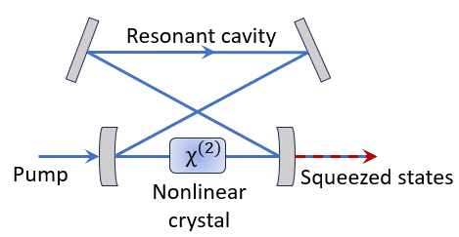
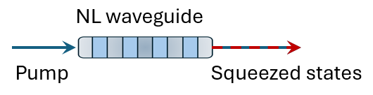

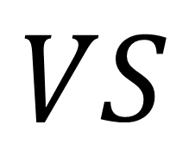
Integrated optical squeezed vacuum sources
Integrated source (Single pass PDC )
Optical parametric oscillator (OPO)
$$VS$$
 | Integrated source | Bulk source
Nonlinear medium | Thin-film LN ,PPLN waveguides | Bulk nonlinear crystals (e.g., PPKTP, PPLN,…)
Nonlinear interaction strength | High (tight optical confinement) | Moderate (limited by beam focusing and crystal length)
Optical losses | Higher propagation and coupling losses | low propagation loss
Squeezing levels | Up to~10 dB https://arxiv.org/abs/2511.15082 2016 | Up to ~15 dB http://dx.doi.org/10.1103/PhysRevLett.117.110801 2025
Bandwidth of squeezing | Broad (typically GHz to THz) | Tens of MHz; (limited by the cavity bandwidth)
Other properties | Compact, High passive stability, hight scalability, | Large setup, sensitive to mechanical vibrations, poor scalability
6

Slide 8
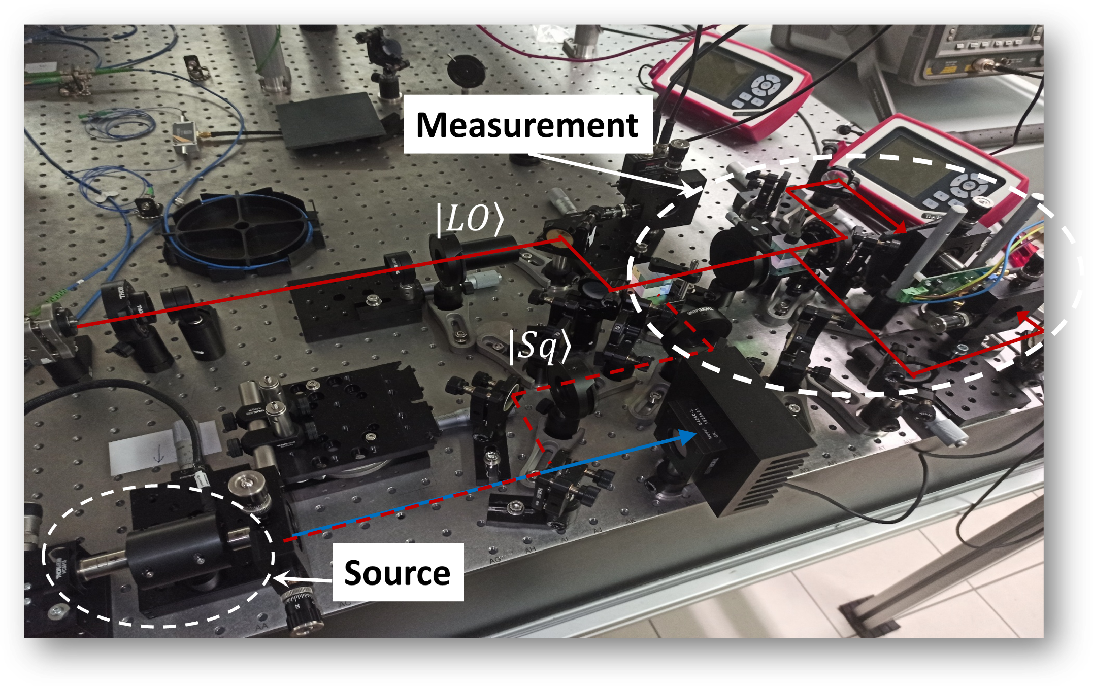
Squeezing experiment @ UNITN
Waveguides
Integrated Quantum Photonic Laboratory
Pump (775 nm)
Local oscillator (1550 nm)
Squeezed vacuum (1550 nm)
7

Slide 9

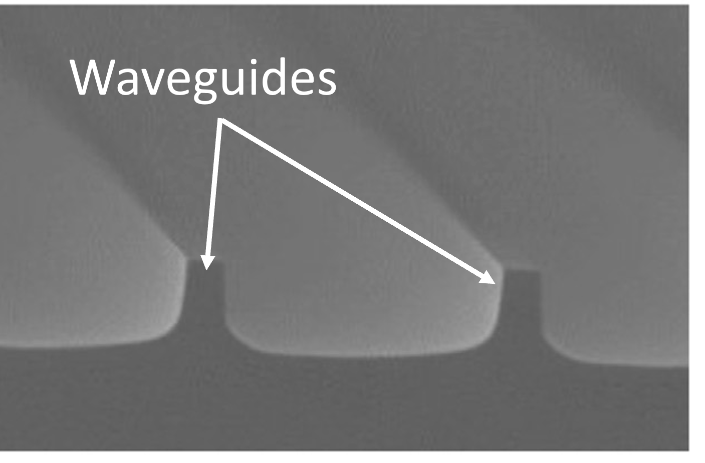
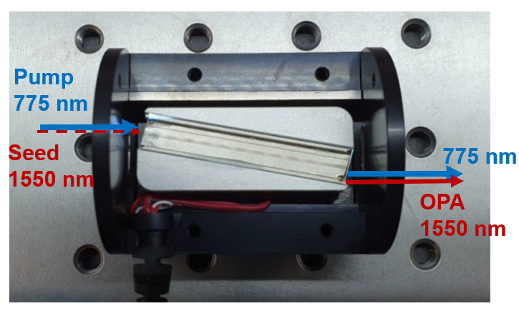
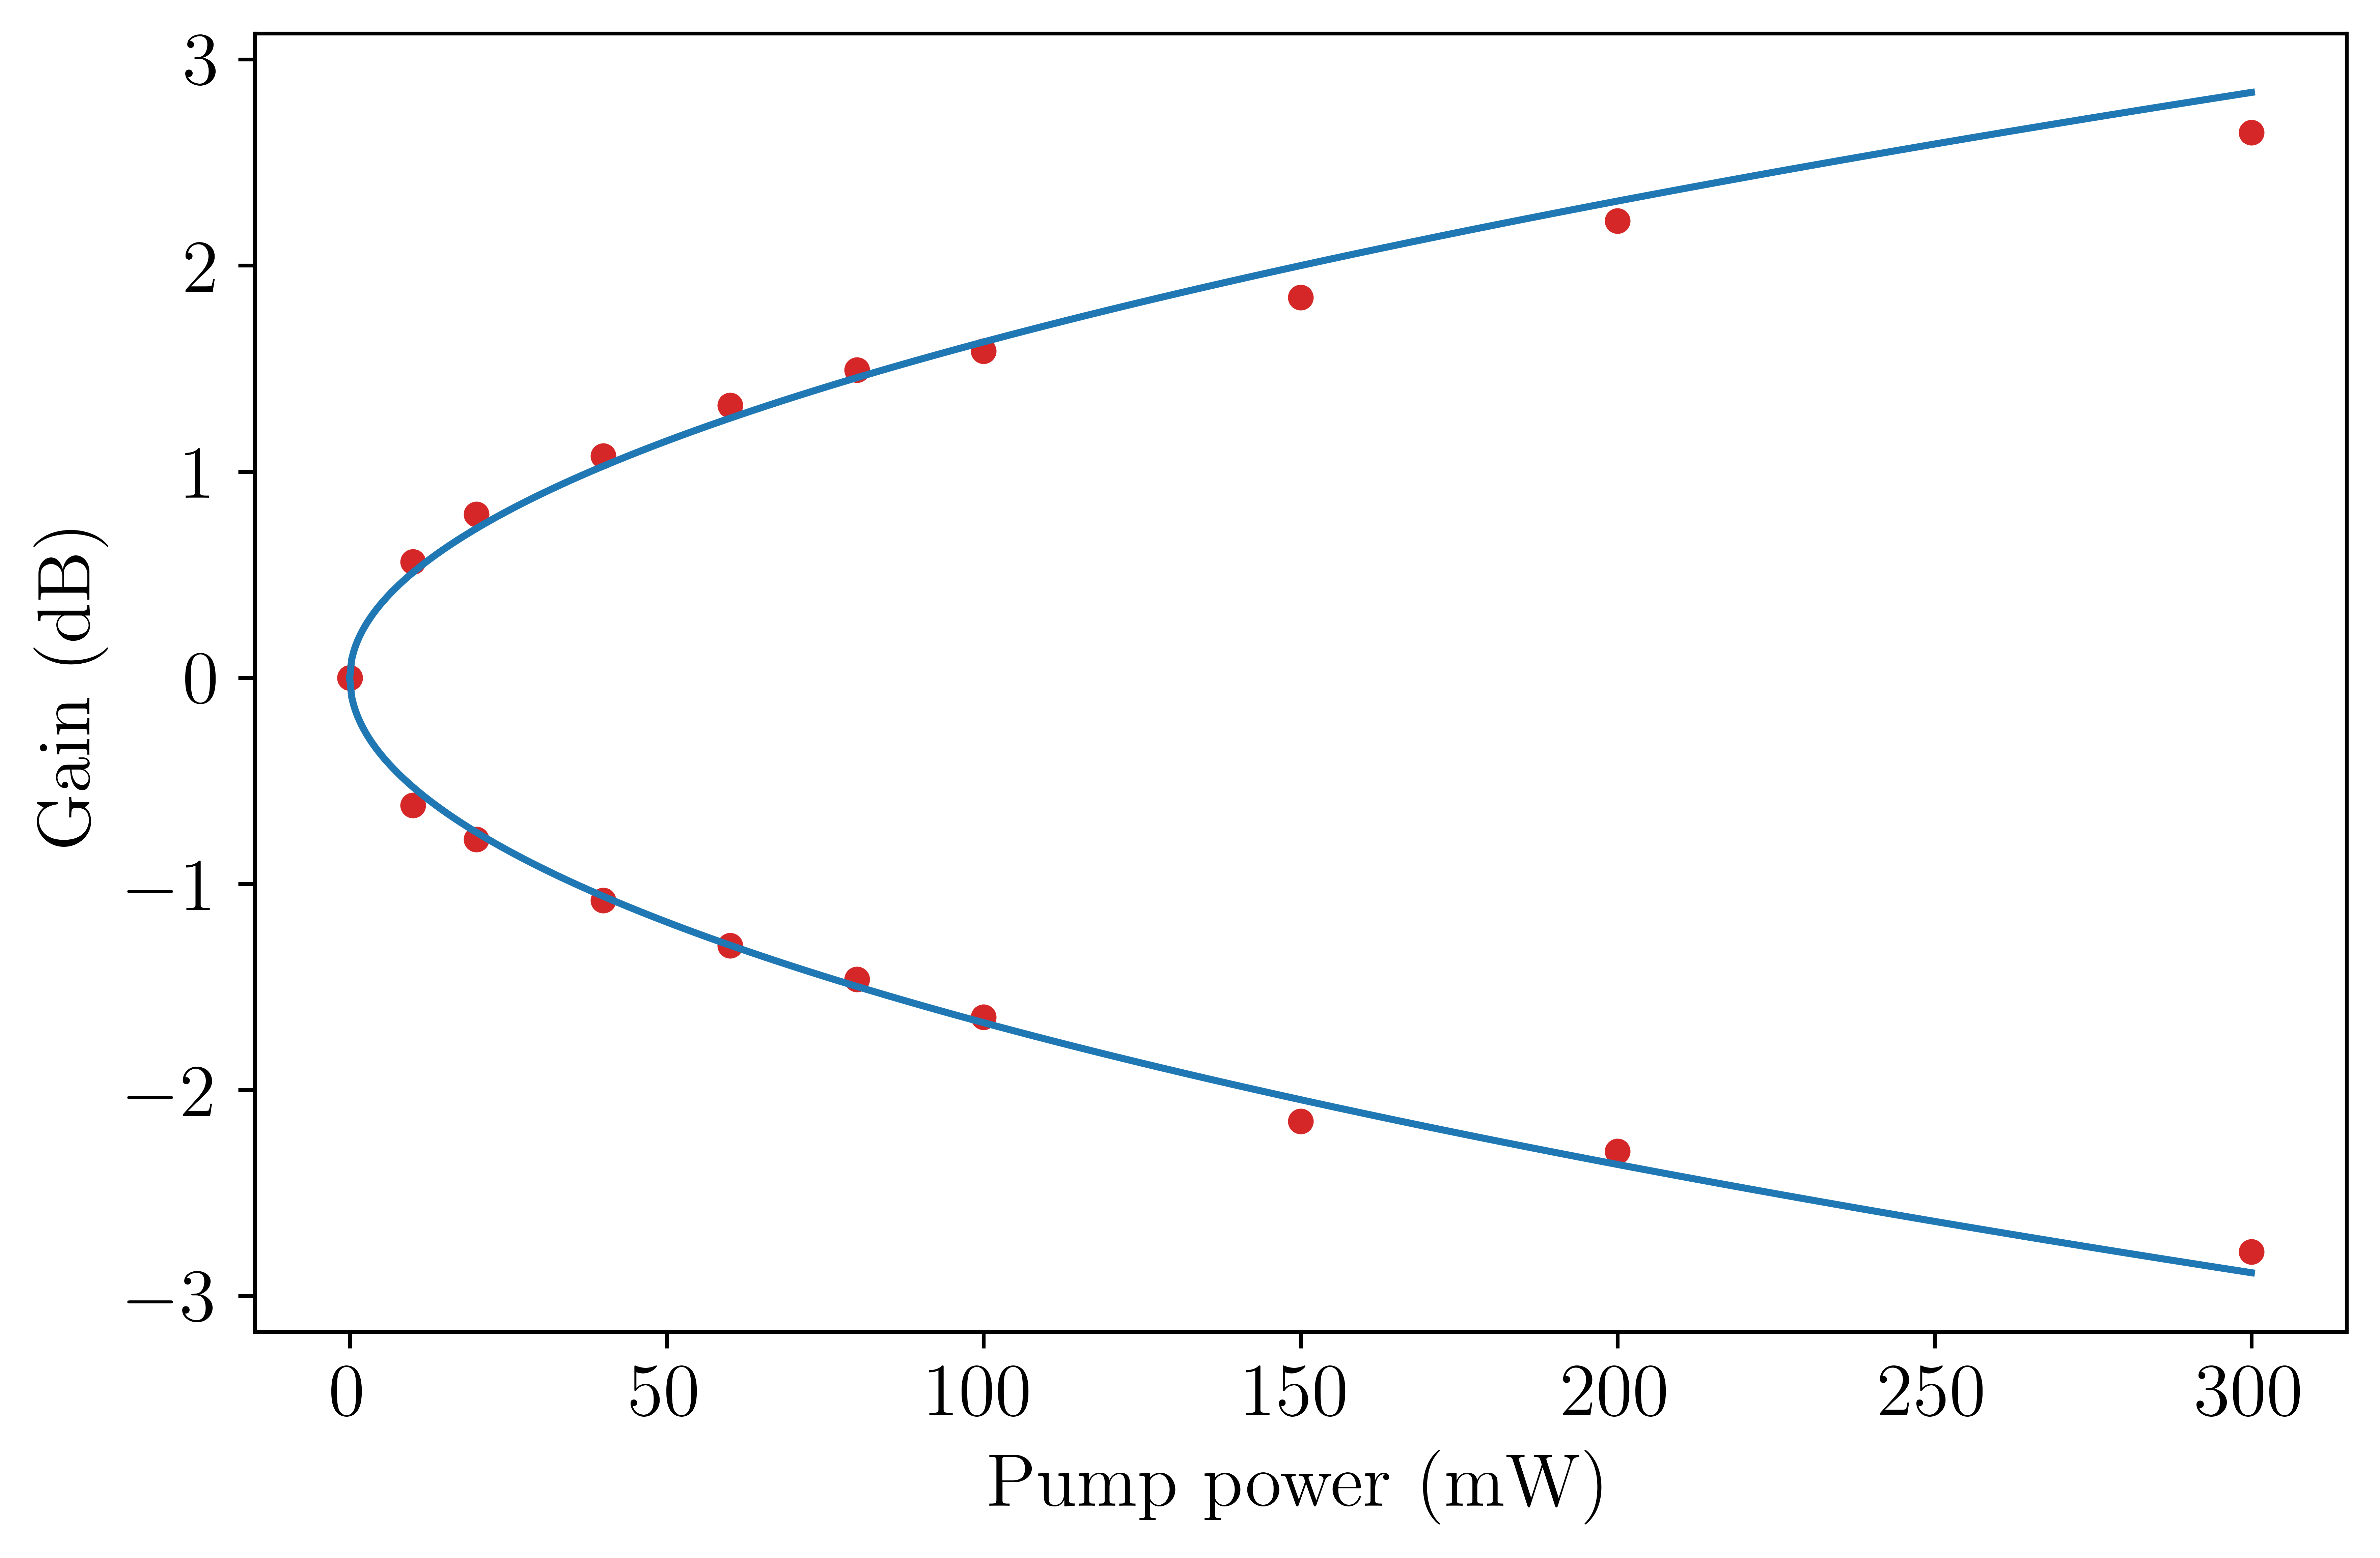
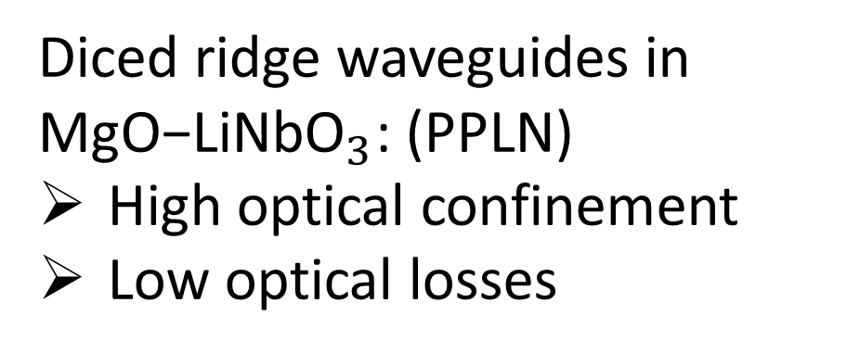
Squeezing source
Diced ridge waveguides in ${\text{MgO}\text{−}\text{LiNbO}}_{3}$: (PPLN)
High optical confinement
Low optical losses
Optical parametric amplification
(OPA)
8

Slide 10
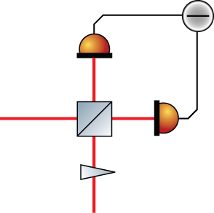
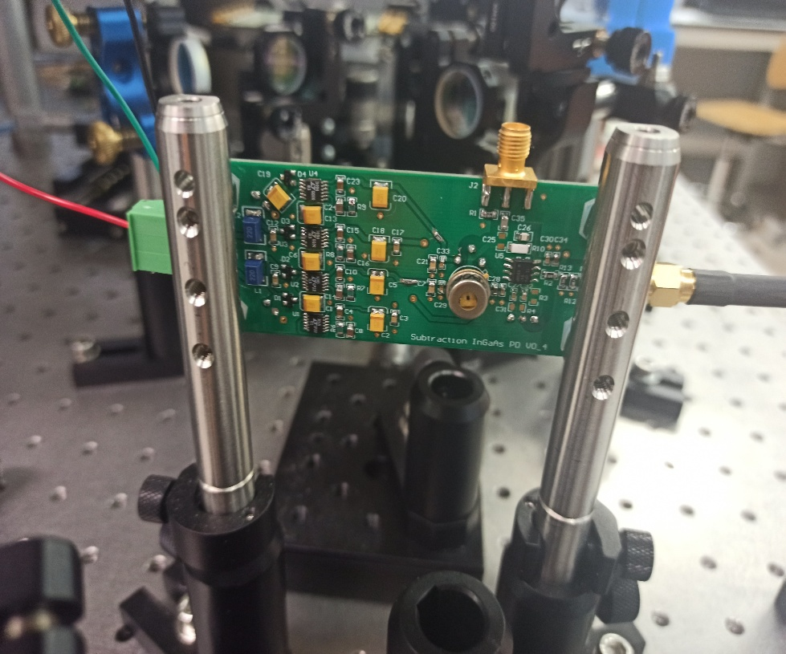

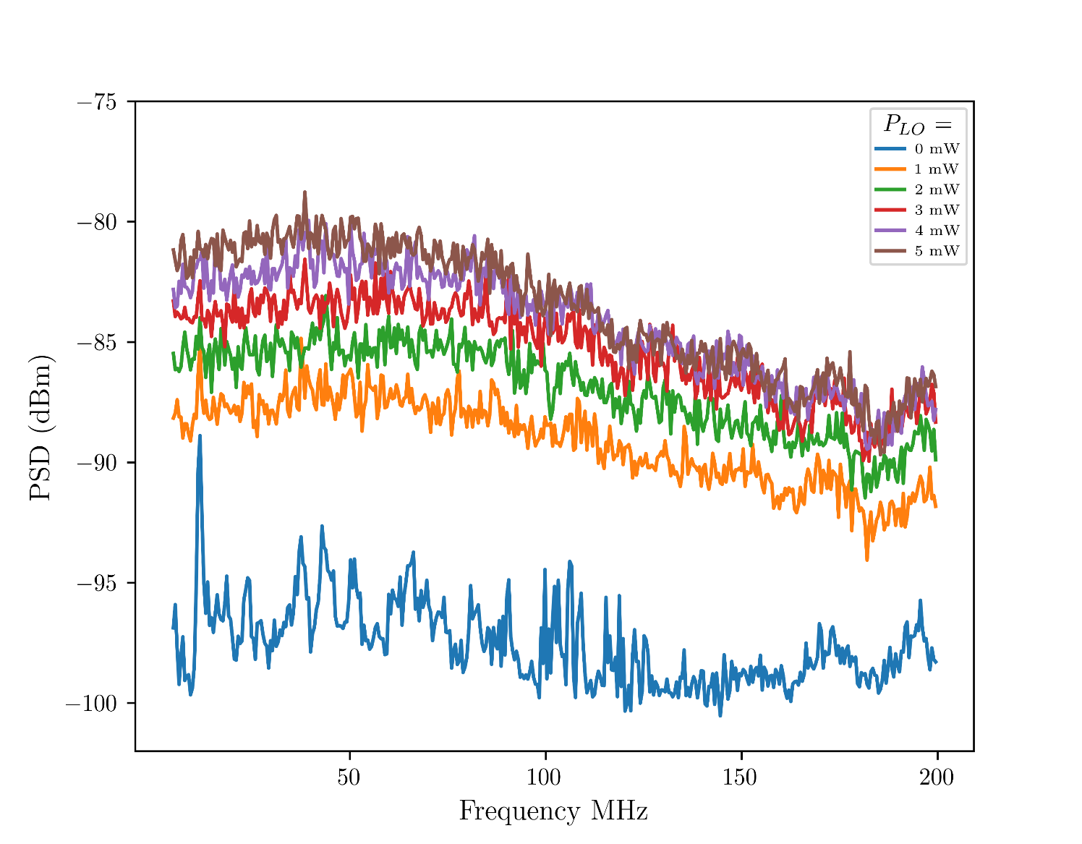
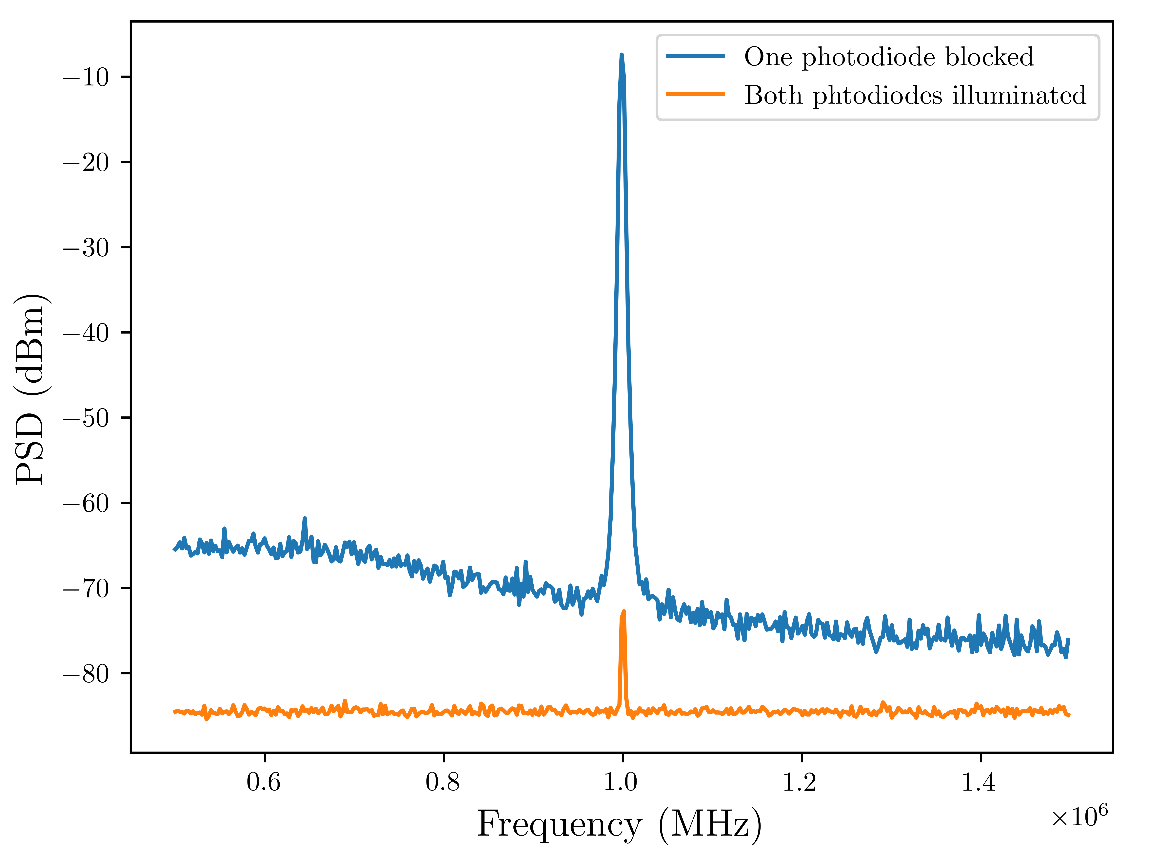

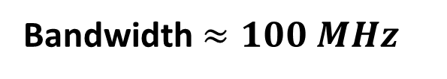
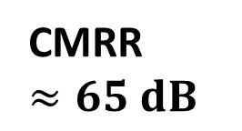
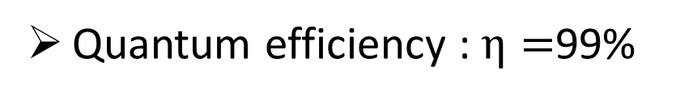



HD, key to observing squeezed states !!
$$\left|\left.sq\right\rangle \right.$$
$$θ$$
Homodyne detector:
$$\left|\left.LO\right\rangle \right.$$
Quantum efficiency : $η=$99%
$$I=∝\sqrt{2}\left|α_{LO}\right|{\hat{q}}_{θ}$$
Bandwidth $≈100 MHz$
CMRR $≈65 dB$
9

Slide 11
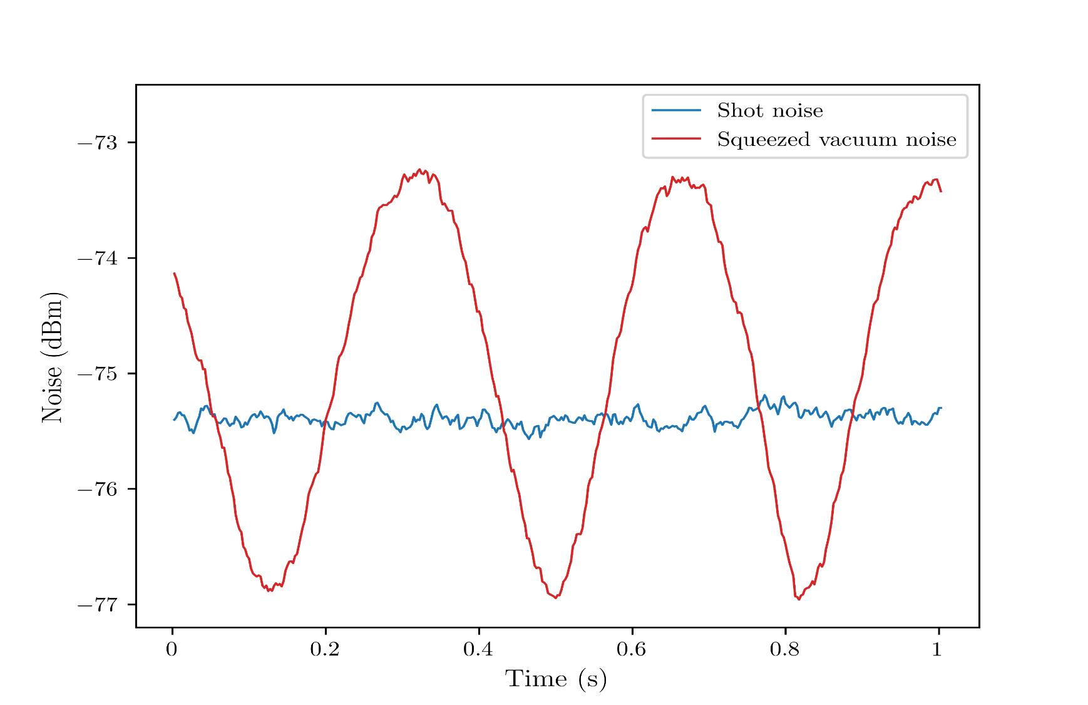
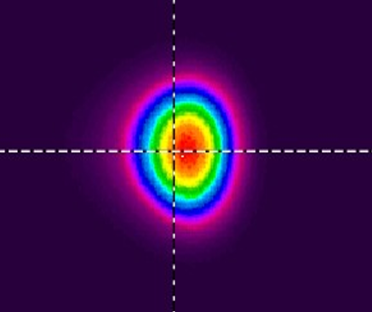
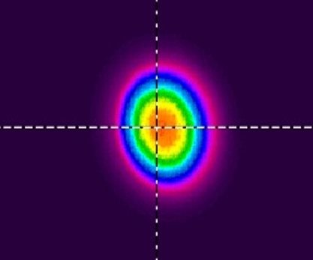
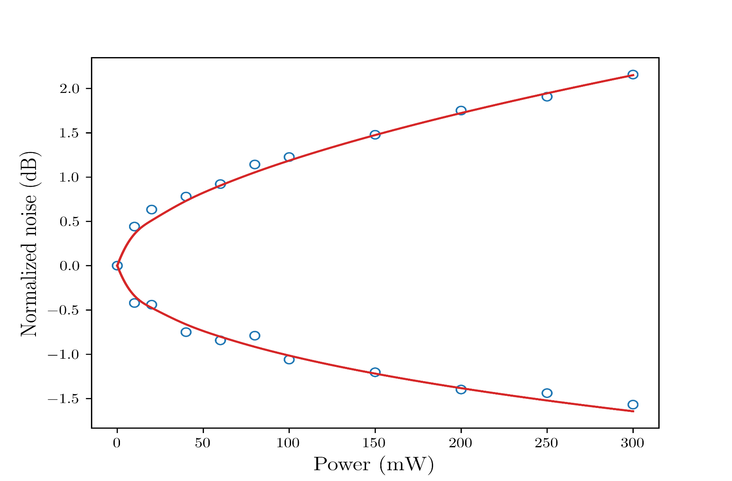
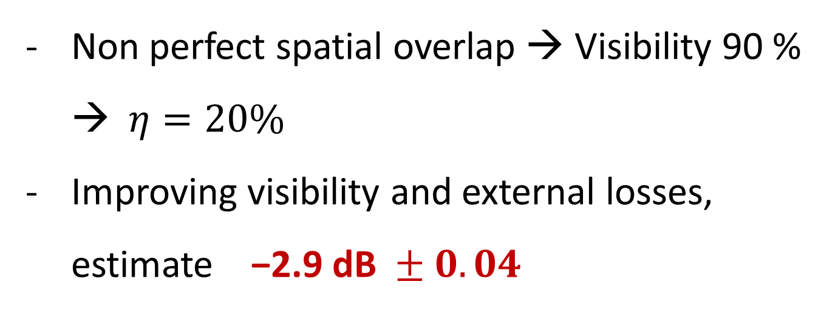

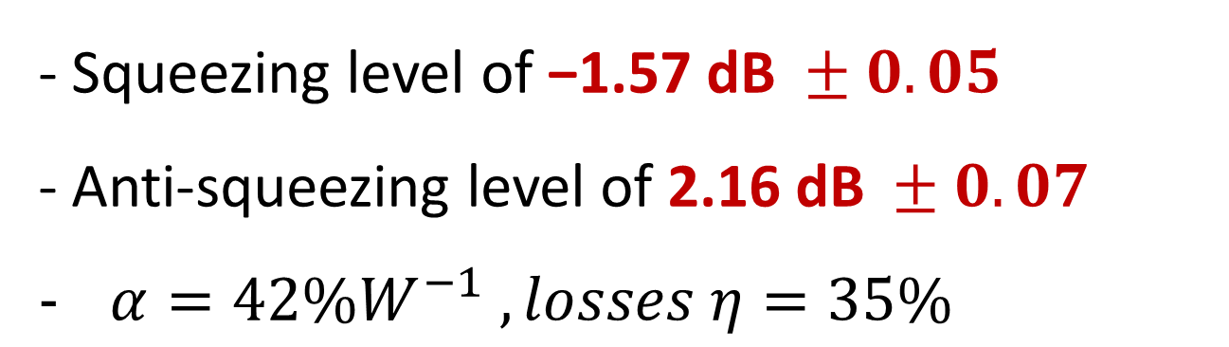
Squeezing measurement
- Squeezing level of $\text{−}\text{1.57 }\text{dB} ±0.05$
- Anti-squeezing level of $\text{2.16 }\text{dB} ±0.07$
$α=42\%W^{−1} , losses η=35\%$
Signal
Local oscillator
Non perfect spatial overlap → Visibility 90 % → $η=20\%$
Improving visibility and external losses, estimate $\text{−}\text{2}\text{.}\text{9} \text{dB} ±0.04$
$$Δ{\hat{q}}^{2}= η+\left(1− η\right)e^{±2\sqrt{αI_{p}}}$$
10

Slide 12
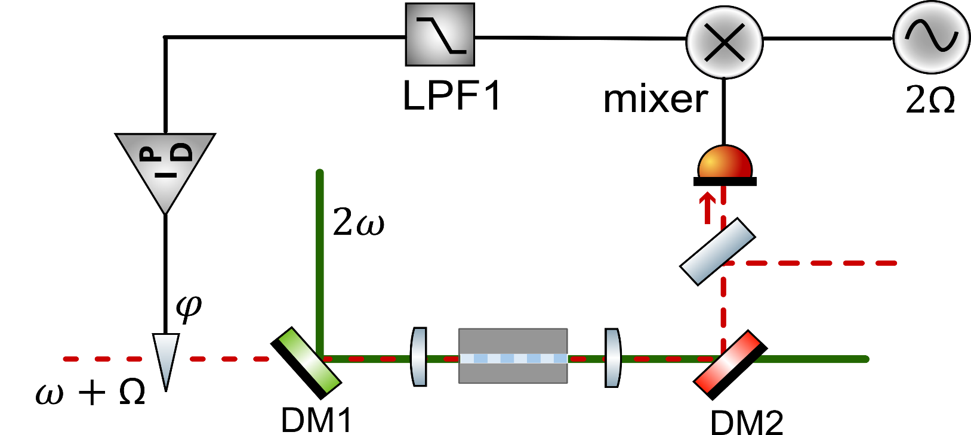




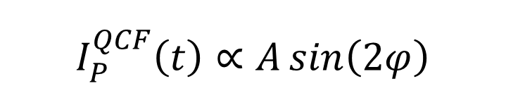


Coherent control
Coherent control is an active techniques to stabilize the phase of the squeezed light and ensure that the measurement is always performed on the quadrature with reduced quantum noise.
Error signal QCF-Pump :
lock-in the phase of the pump (squeezing)
1
$$I_{P}^{QCF}\left(t\right)∝A\sin\left(2φ\right)$$
$$ω−\text{Ω}$$
$$ω+\text{Ω}$$
Demodulation
Pump
1
$$1\%$$
Seed
$$E_{QCF}(t)$$
$E_{QCF}(t)$ : Quadrature Control Field
11

Slide 13





Coherent control
Error signal QCF-LO :
Lock in the relative phase between the squeezed states and local oscillator
2
$$I_{LO}^{QCF}\left(t\right)∝B\sin\left(2φ+θ_{LO}\right)$$
$$ω−\text{Ω}$$
$$ω$$
$$ω+\text{Ω}$$
Demodulation
1
2
12

Slide 14



squeeze lock-in
Zoom-in
Challenging work for low frequencies, due to electronic noise, scattering, environment vibrations
12
13

Slide 15
Future perspective
Developing integrated sources of squeezed vacuum for gravitational wave detection
will significantly reduce costs, improve ease of implementation, and open the door to next generation of GW detectors
Future efforts will emphasize scalable generation of high squeezing, reconfigurable on-chip control, and hybrid integration with non-Gaussian resources, enabling fault-tolerant continuous-variable quantum computing and deployable quantum technologies.
14

Slide 16





Thank you
Acknowledgment
Mirko Lobino Alberto Quaranta Matteo Leonardi Massimo Cazzanelli Hamza Hasnaoui

