Slide 1



PhD Progress Report
“Year 2 Review and Year 3 Plans”
AJAY SHARMA
Technologies for Fundamental Research in Physics and Astrophysics- Electronics curriculum
XXXIX Cycle
Department of Physics and Astronomy "Galileo Galilei"
University Of Padua, Italy
Supervised by
Riccardo Campana
Co-Supervised by
Enrico Virgilli
September 29, 2025

Slide 2


Research Topic and Objectives
The research activity, carried at INAF/OAS Bologna Gamma-Ray Laboratory, is mainly focused on the development of test equipments for new prototypes of front-end electronics (FEE) for Silicon Drift Detectors, in the framework of high-energy astrophysics experiments, and on their experimental characterization.
The test equipment is based on a commercial FPGA board (Xilinx Zynq 7200 platform), that handles the configuration of the FEE ASICs and the event acquisition. Further activity involves laboratory testing of the setup, with and without Silicon detectors, in order to characterise the FEE and the detector performance.
The main topic of the PhD revolve around the LEM-X (PNRR/NRRP EMM project) VEGA-2(NOVA) ASIC, and on the TASTE (ASI ALCOR project, currently in Phase B) front-end ASIC, and their TE testing activities
Ajay Sharma •Unipd Annual Report PhD TFPA-Electronics curriculum

Slide 3
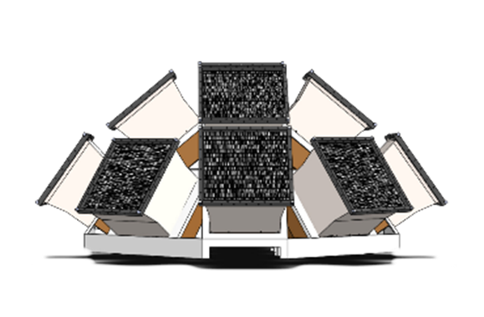
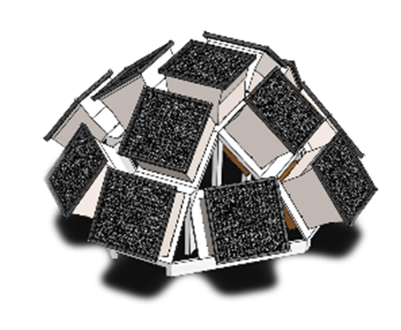
The Lunar Electromagnetic Monitor in X-rays (LEM-X)
The Lunar Electromagnetic Monitor in X-rays (LEM-X) is an All Sky Monitor for the X-ray band (2-50 keV) based on the concept of coded aperture camera, aims at developing a large, permanent X-ray observatory on the Lunar surface.
Each LEM-X camera is equipped with four large-area Silicon Drift Detectors (SDDs) and is capable of monitoring and imaging the high-energy sky in a field-of-view larger than 2 steradians.
The advantages of this design are: high sensitivity, high level of maturity, compact and modular design, and high level of redundancy.
The design of the FEE ASICs for the SDDs rely on the heritage of the VEGA, LYRA and ORION ASICs developed by PoliMI and UniPV in the framework of the ReDSoX collaboration
Ajay Sharma •Unipd Annual Report PhD TFPA-Electronics curriculum

Slide 4

TASTE (Terrain Analyser and Sample Tester Explorer)
Mission to Deimos to investigate the origin and evolution of Martian moons → link to Mars and terrestrial planet formation.
Mission Architecture: 3U lander + Optical camera + X/Gamma-ray spectrometer (HERMES heritage)
Scientific objectives
Global morphology and shape model.
Elemental abundance mapping.
Landing site morphology & texture.
Organic content detection.
Surface composition analysis.
Ajay Sharma •Unipd Annual Report PhD TFPA-Electronics curriculum

Slide 5
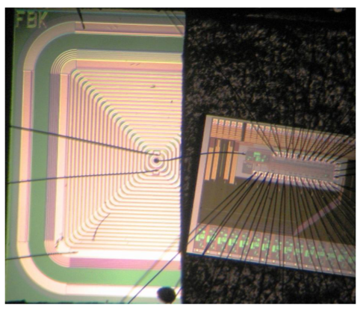
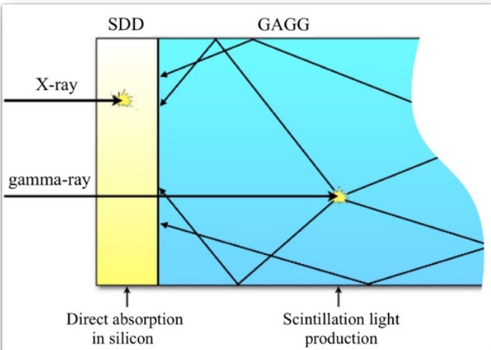
LEM-X vs TASTE: Scientific Goals & Methods
LEM-X | TASTE
Wide-field X-ray observatory for multi-messenger astronomy. All-sky X-ray monitoring (2–50 keV) from the lunar surface | Focused planetary mission for moon formation origin via surface composition. Direct elemental abundance measurements with X-ray fluorescence & gamma-ray spectroscopy in a single, integrated instrument (Siswich architecture)
Different instruments, different scientific goals
→ one detector technology (SDD)
High performance, low noise FEE ASIC Heritage
VEGA
(LOFT)
LYRA
(HERMES)
NOVA
aka VEGA2
(LEM-X)
LYRA2
(TASTE)
2014 JINST 9 C03036 (http://iopscience.iop.org/1748-0221/9/03/C03036)
Ajay Sharma •Unipd Annual Report PhD TFPA-Electronics curriculum

Slide 6
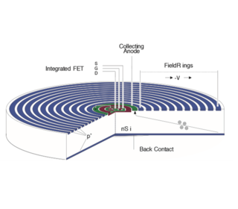
Why SDDs? Common Detector Technology for LEM-X & TASTE
Why SDDs?
• Low noise: Tiny anode → very low capacitance (few fF).
• High sensitivity: Excellent energy resolution across 2–50 keV.
• Fast timing: Short drift paths allow fast charge collection.
• Versatility: Suitable for both photon spectroscopy (X-rays) and scintillator readout.
Applications
• LEM-X: Fast timing for GRB/transient detection.
• TASTE: High resolution for surface elemental abundance measurements.
Alternative silicon detectors (why not)
• PIN diodes: Higher capacitance → noisier.
• CCDs: High resolution but slow readout.
• Microstrip detectors: Larger capacitance, not optimal for spectroscopy.
Ajay Sharma •Unipd Annual Report PhD TFPA-Electronics curriculum

Slide 7
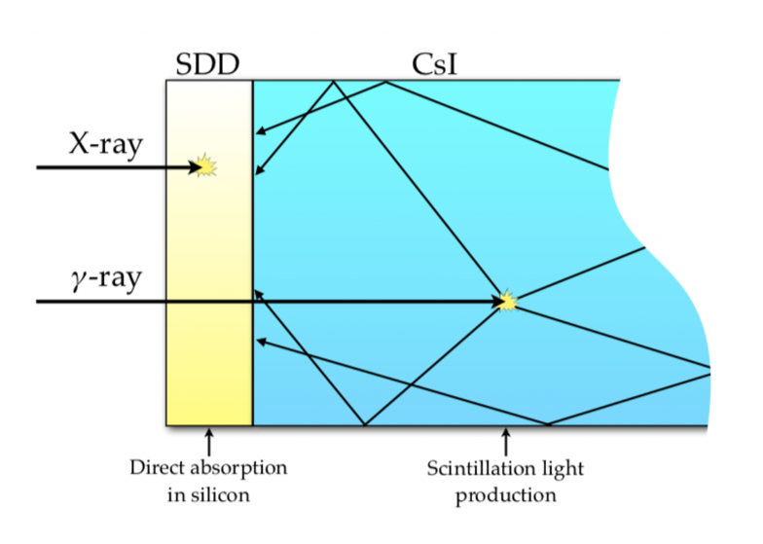
Siswich Concept in TASTE: Dual-SDD + Scintillator
Architecture
• Each scintillator crystal (GAGG:Ce) is coupled to two SDDs.
• X-rays: absorbed directly in one SDD → single-sided event.
• Gamma-rays: absorbed in scintillator → scintillation light detected by both SDDs.
Working Principle
• X-ray identification: One-sided SDD signal.
• Gamma-ray identification: Coincidence in both SDDs.
• Energy measurement:
• - X-rays: electron-hole pairs in SDD → high resolution.
• - γ-rays: light yield of scintillator → reconstructed spectrum.
Advantages
• Single integrated instrument for both X-rays and γ-rays.
• Compact, efficient → ideal for CubeSat/lander constraints.
• Builds on heritage from HERMES Pathfinder.
Ajay Sharma •Unipd Annual Report PhD TFPA-Electronics curriculum

Slide 8
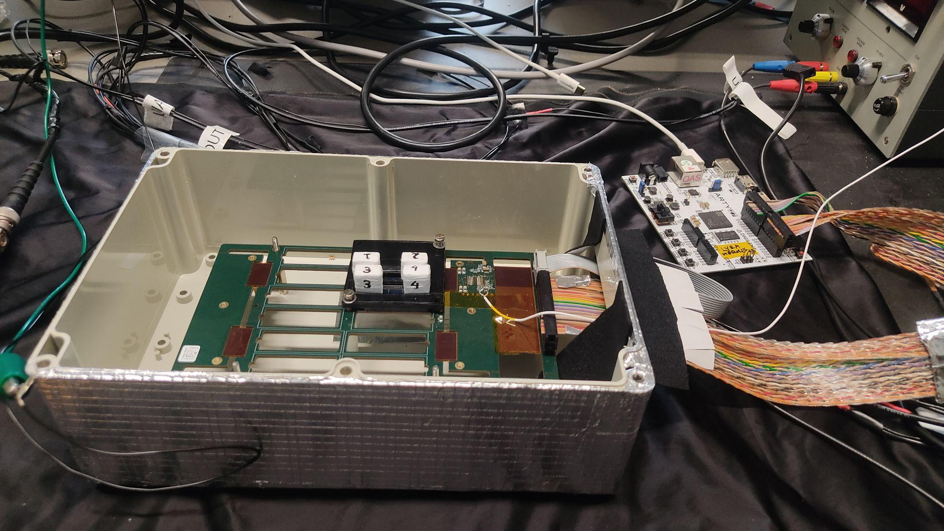
Year 1 Activities & Achievements
7-month visa delay, reached Italy only in June 2024 → limited lab time.
Work Completed:
Hands-on testing of an HERMES prototype (LYRA ASIC + scintillator + SDD) in the framework of the SISCO (Siswich Instrument Spectral Calibration Optimization) project (INAF mini-grant)
Calibrated the LYRA ASIC board, started multi-temperature acquisition.
Status:Analysis of SISCO experimental data is ongoing. Results not finalized yet → work in progress
Scientific Dissemination: Poster presented at RSN5 – 2° Forum della Ricerca Sperimentale e Tecnologica in INAF (Oct 1–3, 2024).
Ajay Sharma •Unipd Annual Report PhD TFPA-Electronics curriculum

Slide 9
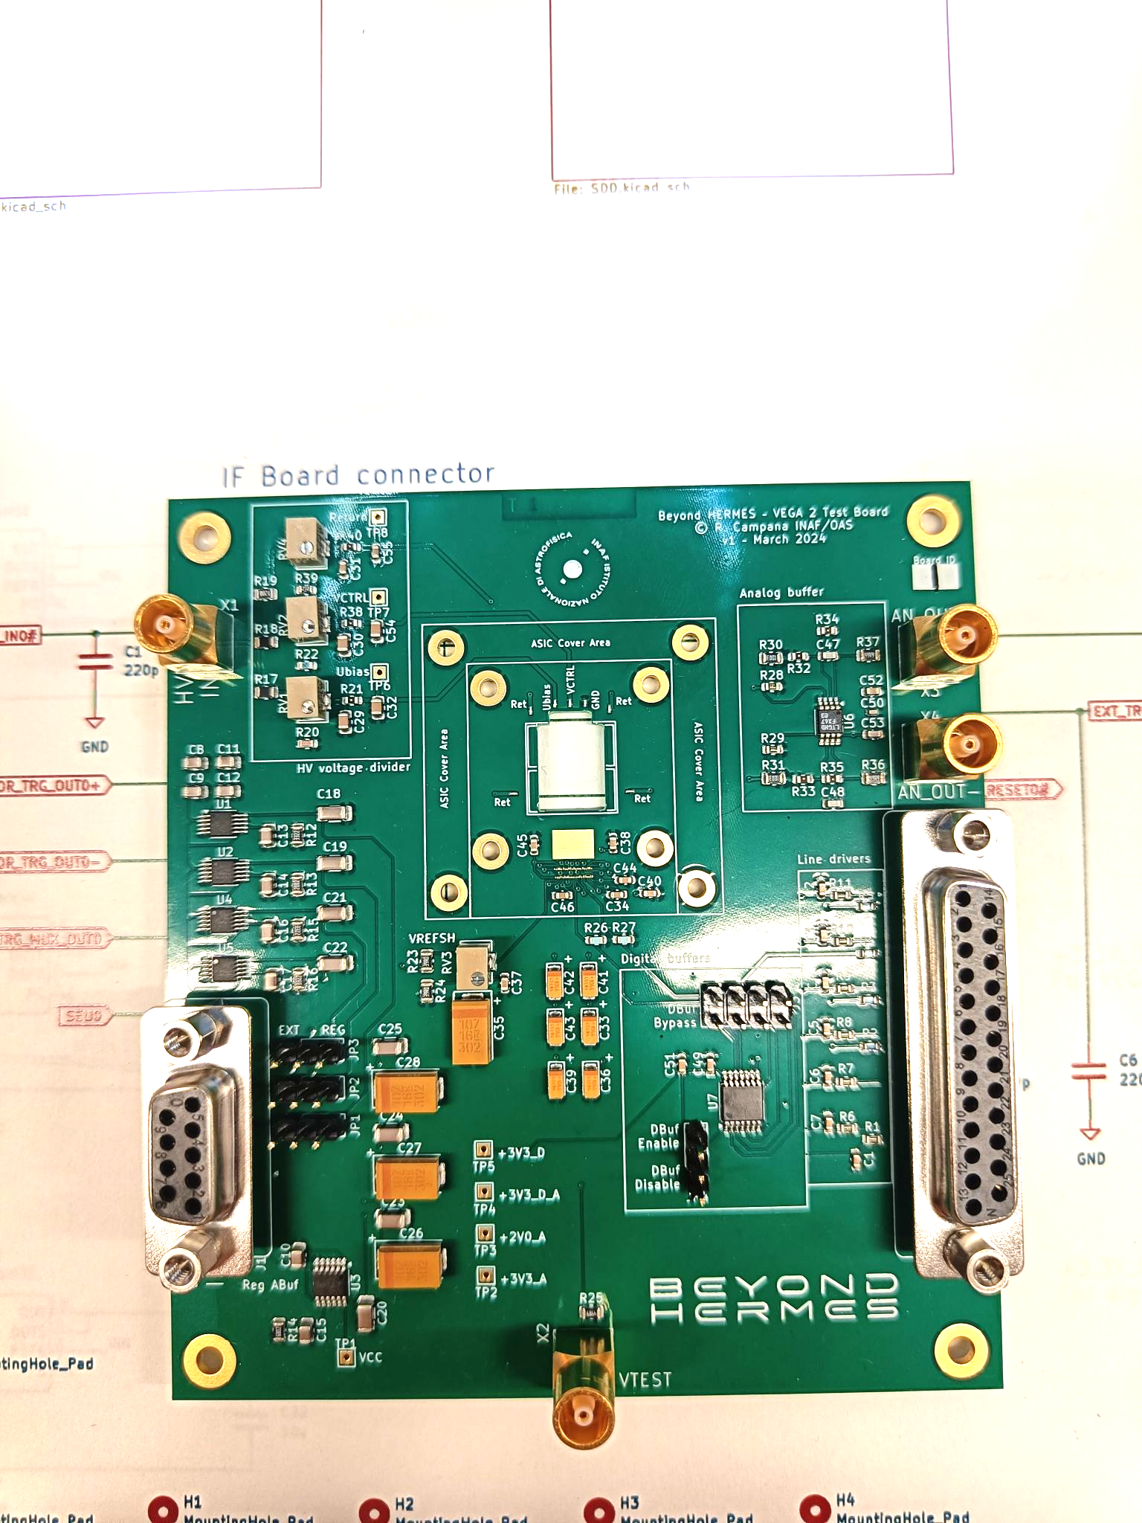
Year 2 Work Overview
VEGA2 (NOVA) Breadboard
NOVA is a new front-end ASIC developed by PoliMI/UniPV for the read-out of the Silicon Drift Detectors of the LEM-X experiment, building on the heritage of the VEGA and LYRA ASICs.
A test board for characterization of this ASIC for a TASTE-like application (with a siswich architecture, SDD+scintillator) has been developed in the framework of the Beyond HERMES project (INAF Ricerca Fondamentale 2022 grant)
Ajay Sharma •Unipd Annual Report PhD TFPA-Electronics curriculum

Slide 10
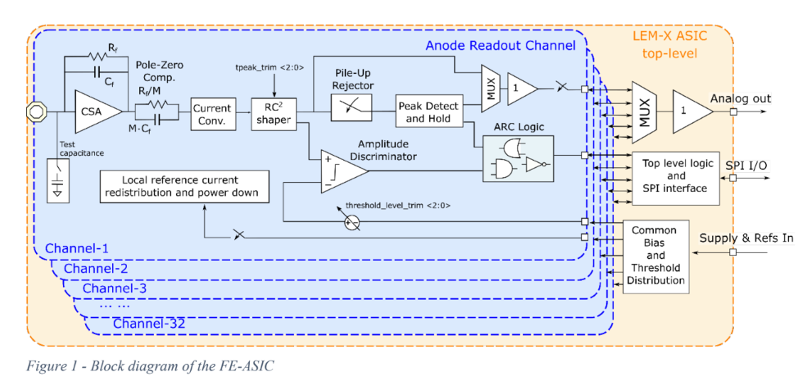
Year 2 Work Overview
VEGA2 (NOVA) FUNCTIONAL DESCRIPTION
Ajay Sharma •Unipd Annual Report PhD TFPA-Electronics curriculum

Slide 11
Year 2 Work Overview
VEGA2 (NOVA) FUNCTIONAL DESCRIPTION
Signal Processing
CSA: Converts a charge impulse to a voltage step
Shaper: Filters the noise and shapes the signal, optimize the timing.
Pile-up Rejection: Handles the overlapping signals.
Amplitude Discriminator: Rejects any signal below threshold.
Peak detection and Hold: Stores the maximum signal amplitude.
Top - Level Circuitry
Multiplexes the output from all the 32 channels
Supplies references and threshold.
Handles the communication via SPI/AXI.
Ajay Sharma •Unipd Annual Report PhD TFPA-Electronics curriculum

Slide 12
Year 2 Work Overview
VEGA2 (NOVA) Breadboard Characterization and test
Aim: To verify the VEGA2 breadboard setup against the proposed design requirements for functionality, performance, and integration with detectors.
Board preparation & power setup.
Analog and stretcher chain characterization.
Noise vs shaping time measurements.
Dynamic range evaluation.
SDD bonding & scintillator integration
At every stage of experimental activities:
FPGA Firmware optimization and debugging
Verification of correct ASIC configuration and event acquisition
Test Equipment client software and analysis software development
Ajay Sharma •Unipd Annual Report PhD TFPA-Electronics curriculum
Ajay Sharma •Unipd Annual Report PhD TFPA-Electronics curriculum
Ajay Sharma •Unipd Annual Report PhD TFPA-Electronics curriculum

Slide 13
Year 2 Work Overview
VEGA2 (NOVA) Breadboard Characterization and test
Board preparation & power setup.
Ajay Sharma •Unipd Annual Report PhD TFPA-Electronics curriculum
Ajay Sharma •Unipd Annual Report PhD TFPA-Electronics curriculum
Ajay Sharma •Unipd Annual Report PhD TFPA-Electronics curriculum

Slide 14
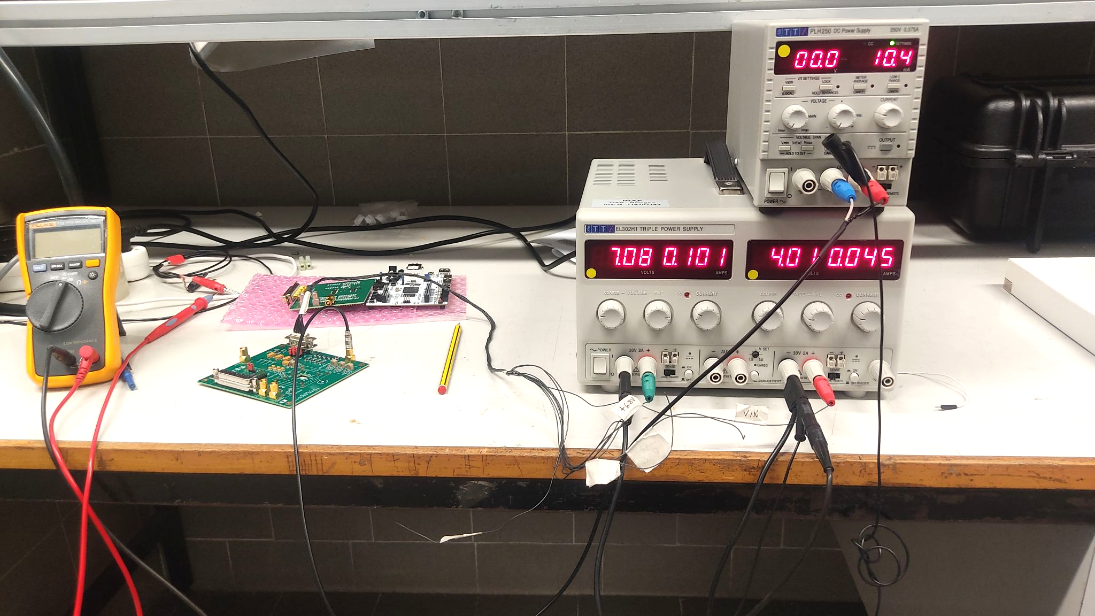
Year 2 Work Overview
VEGA2 (NOVA) Breadboard Characterization and test
Board preparation & power setup.
Ajay Sharma •Unipd Annual Report PhD TFPA-Electronics curriculum
Ajay Sharma •Unipd Annual Report PhD TFPA-Electronics curriculum
Ajay Sharma •Unipd Annual Report PhD TFPA-Electronics curriculum

Slide 15
Year 2 Work Overview
VEGA2 (NOVA) Breadboard Characterization and test
Board preparation & power setup.
Analog chain characterization.
Measurement of Rise time & amplitude across all 32 channels at different shaping times.
Ajay Sharma •Unipd Annual Report PhD TFPA-Electronics curriculum
Ajay Sharma •Unipd Annual Report PhD TFPA-Electronics curriculum

Slide 16
Year 2 Work Overview
VEGA2 (NOVA) Breadboard Characterization and test
Board preparation & power setup.
Analog chain characterization.
Measurement of Rise time & amplitude across all 32 channels at different shaping times.
Good uniformity across channels.
Linearity with input pulse maintained.
Dispersion < 3%.
Ajay Sharma •Unipd Annual Report PhD TFPA-Electronics curriculum
Ajay Sharma •Unipd Annual Report PhD TFPA-Electronics curriculum
Ajay Sharma •Unipd Annual Report PhD TFPA-Electronics curriculum
Ajay Sharma •Unipd Annual Report PhD TFPA-Electronics curriculum
Ajay Sharma •Unipd Annual Report PhD TFPA-Electronics curriculum

Slide 17
Year 2 Work Overview
VEGA2 (NOVA) Breadboard Characterization and test
Board preparation & power setup.
Analog and stretcher chain characterization.
Noise vs shaping time measurements.
Ajay Sharma •Unipd Annual Report PhD TFPA-Electronics curriculum
Ajay Sharma •Unipd Annual Report PhD TFPA-Electronics curriculum
Ajay Sharma •Unipd Annual Report PhD TFPA-Electronics curriculum

Slide 18
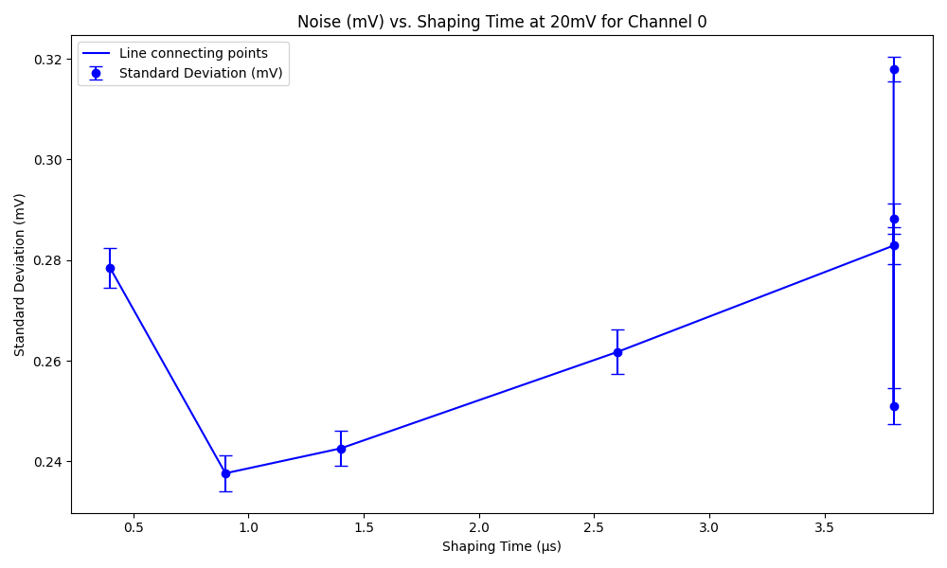
Year 2 Work Overview
VEGA2 (NOVA) Breadboard Characterization and test
Board preparation & power setup.
Analog and stretcher chain characterization.
Noise vs shaping time measurements.
Ajay Sharma •Unipd Annual Report PhD TFPA-Electronics curriculum
Ajay Sharma •Unipd Annual Report PhD TFPA-Electronics curriculum
Ajay Sharma •Unipd Annual Report PhD TFPA-Electronics curriculum

Slide 19
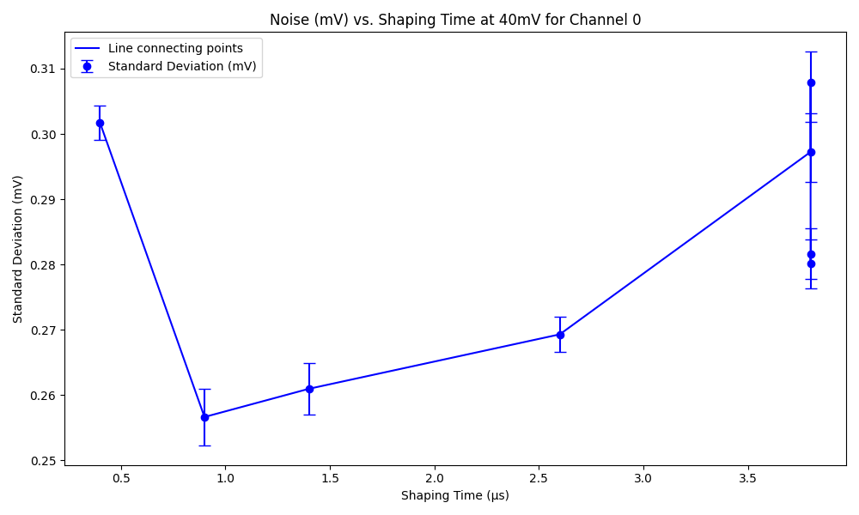
Year 2 Work Overview
VEGA2 (NOVA) Breadboard Characterization and test
Board preparation & power setup.
Analog and stretcher chain characterization.
Noise vs shaping time measurements.
The expected U-shaped trend is observed, where noise initially decreases due to reduced thermal (series) noise but increases at longer shaping times due to the dominance of parallel noise from leakage currents and low-frequency noise sources within the ASIC itself.
Ajay Sharma •Unipd Annual Report PhD TFPA-Electronics curriculum
Ajay Sharma •Unipd Annual Report PhD TFPA-Electronics curriculum
Ajay Sharma •Unipd Annual Report PhD TFPA-Electronics curriculum

Slide 20
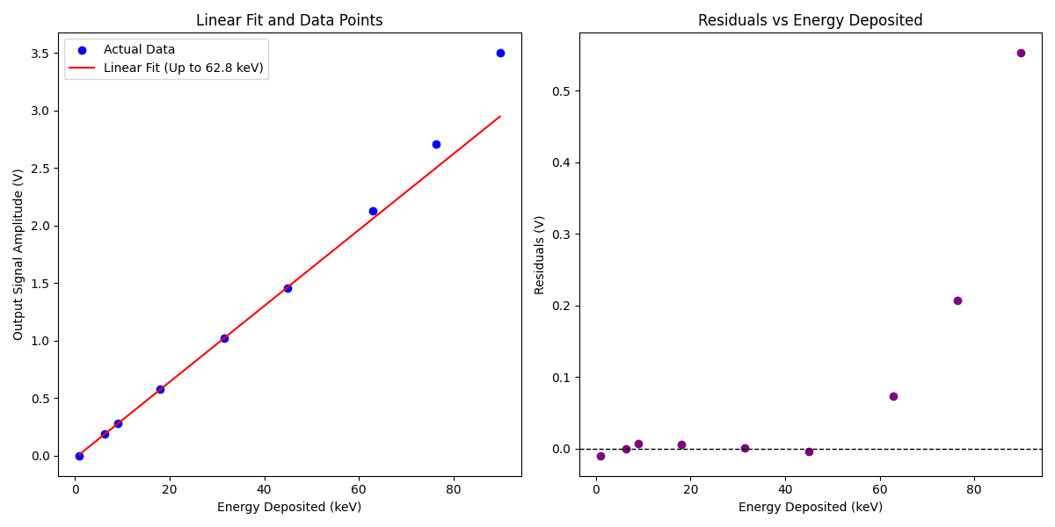
Year 2 Work Overview
VEGA2 (NOVA) Breadboard Characterization and test
Board preparation & power setup.
Analog and stretcher chain characterization.
Noise vs shaping time measurements.
Dynamic range evaluation.
Ajay Sharma •Unipd Annual Report PhD TFPA-Electronics curriculum
Ajay Sharma •Unipd Annual Report PhD TFPA-Electronics curriculum

Slide 21
Year 2 Work Overview
VEGA2 (NOVA) Breadboard Characterization and test
Board preparation & power setup.
Analog and stretcher chain characterization.
Noise vs shaping time measurements.
Dynamic range evaluation.
The ASIC response remained linear up to ~63 keV (140 mV input). Beyond this, nonlinearities were observed (almost satisfying the requirement of linearity up to 70 keV)
Ajay Sharma •Unipd Annual Report PhD TFPA-Electronics curriculum
Ajay Sharma •Unipd Annual Report PhD TFPA-Electronics curriculum
Ajay Sharma •Unipd Annual Report PhD TFPA-Electronics curriculum

Slide 22
Year 2 Work Overview
VEGA2 (NOVA) Breadboard Characterization and test
Board preparation & power setup.
Analog and stretcher chain characterization.
Noise vs shaping time measurements.
Dynamic range evaluation.
SDD bonding & scintillator integration
Ajay Sharma •Unipd Annual Report PhD TFPA-Electronics curriculum

Slide 23

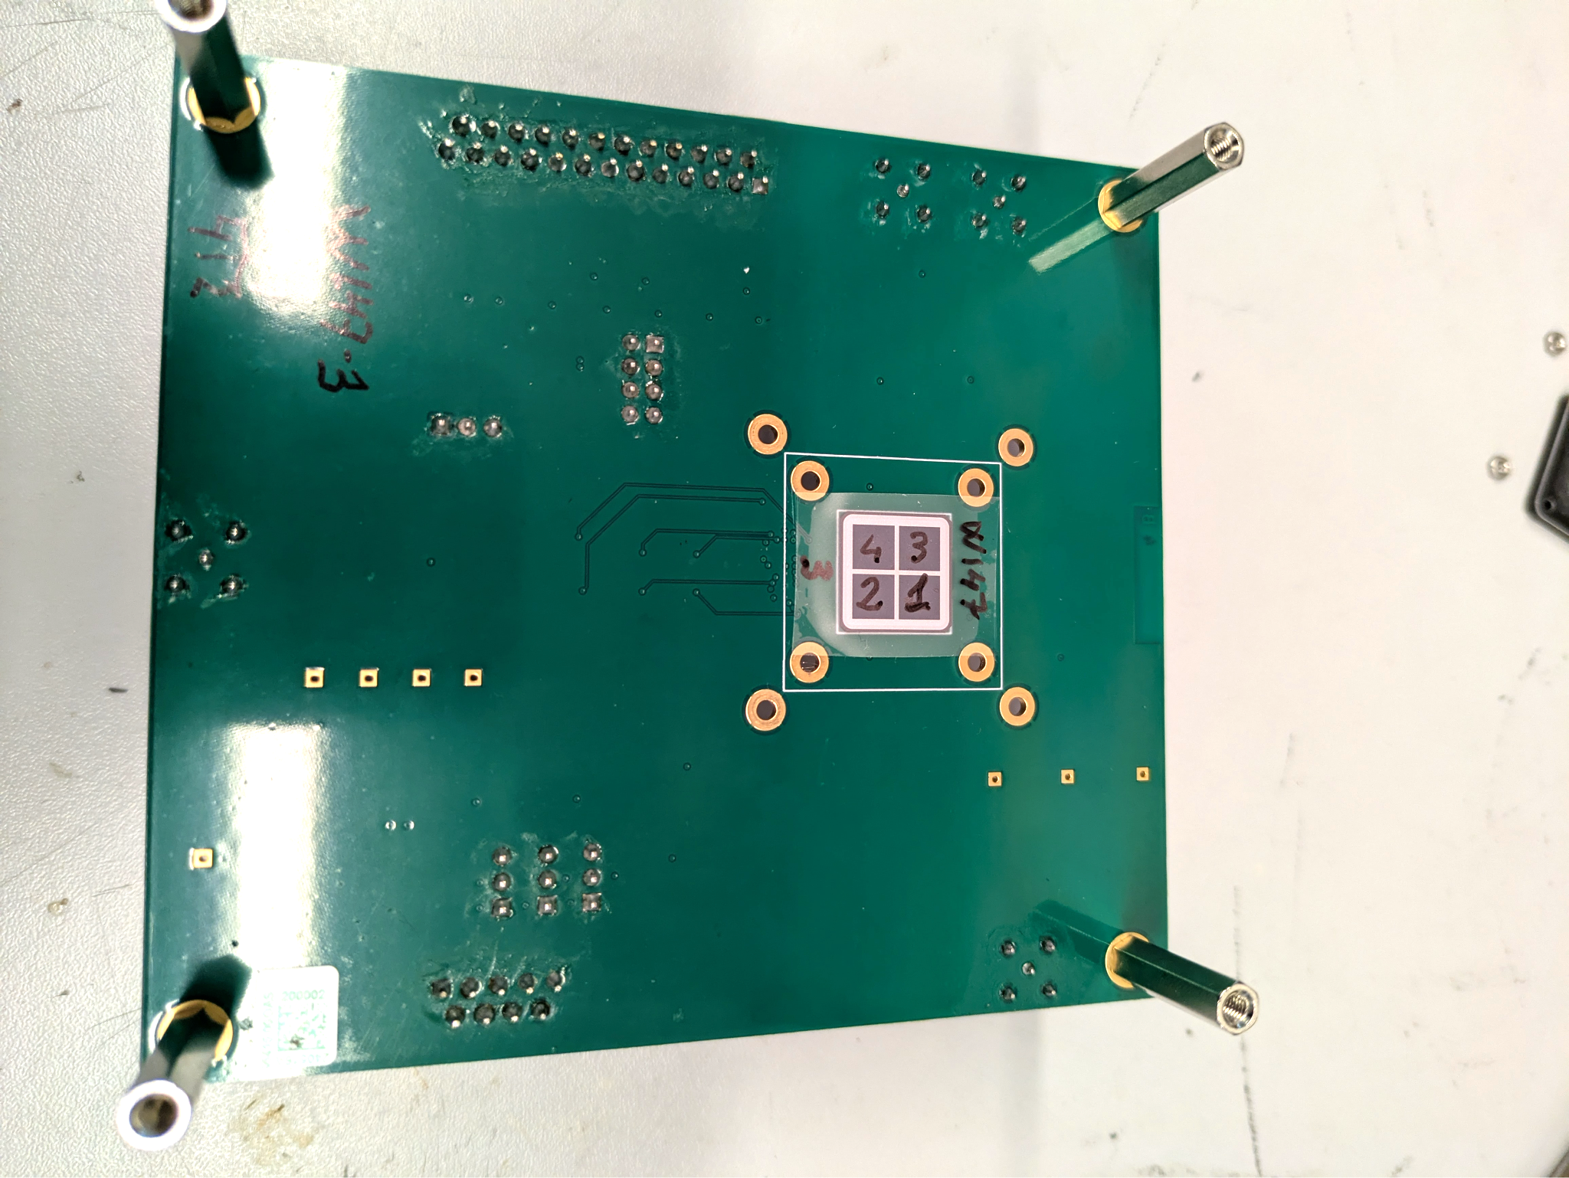
Year 2 Work Overview
VEGA2 (NOVA) Breadboard Characterization and test
SDD bonding & scintillator integration
Bonded with FBK-fabricated SDDs.
Ajay Sharma •Unipd Annual Report PhD TFPA-Electronics curriculum

Slide 24
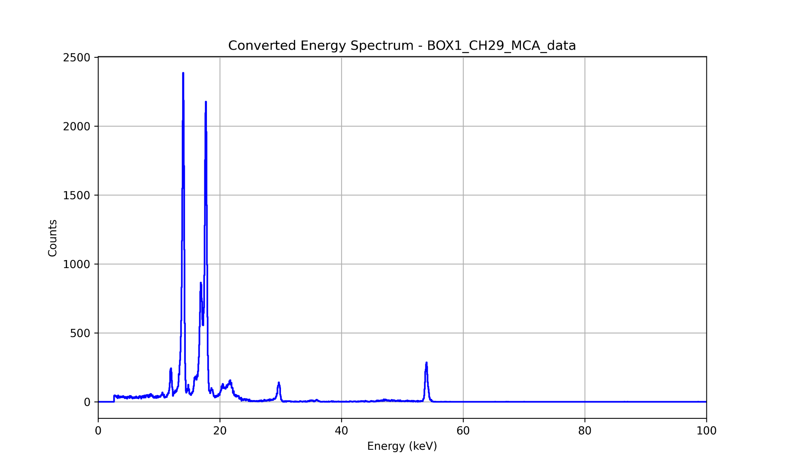
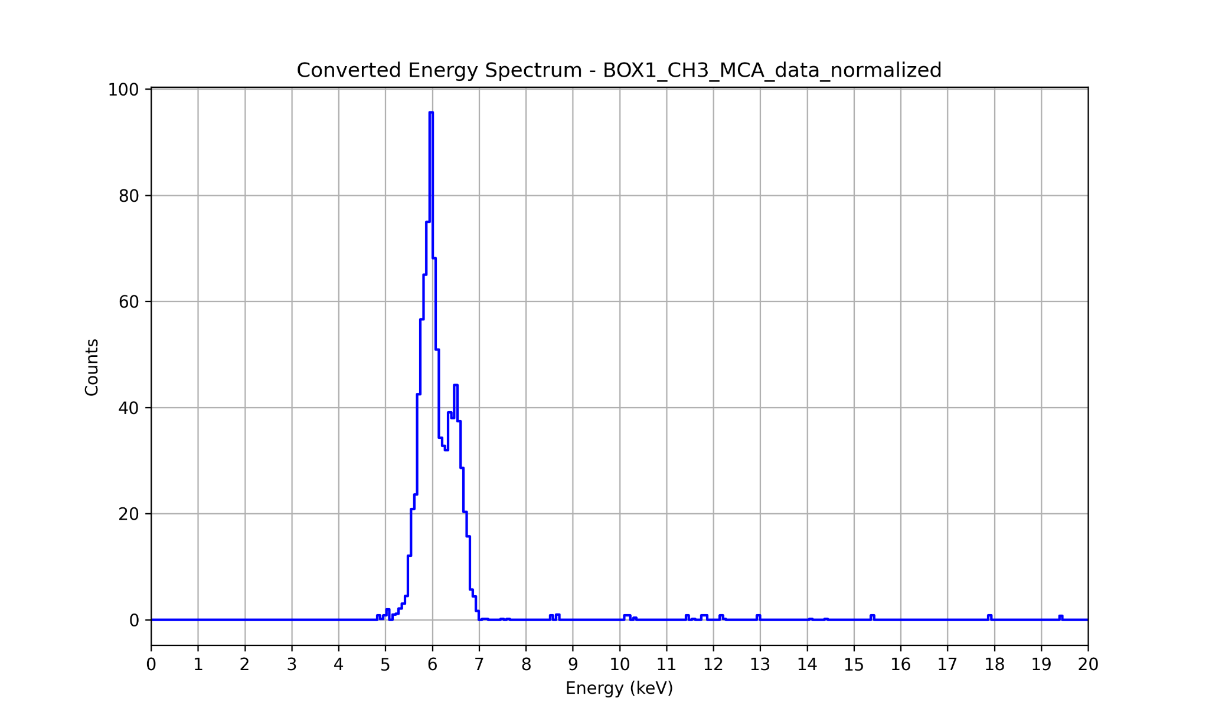
Year 2 Work Overview
VEGA2 (NOVA) Breadboard Characterization and test
SDD bonding & scintillator integration
Bonded with FBK-fabricated SDDs.
Calibration with X-ray sources (Am-241 and Fe-55).
Ajay Sharma •Unipd Annual Report PhD TFPA-Electronics curriculum

Slide 25
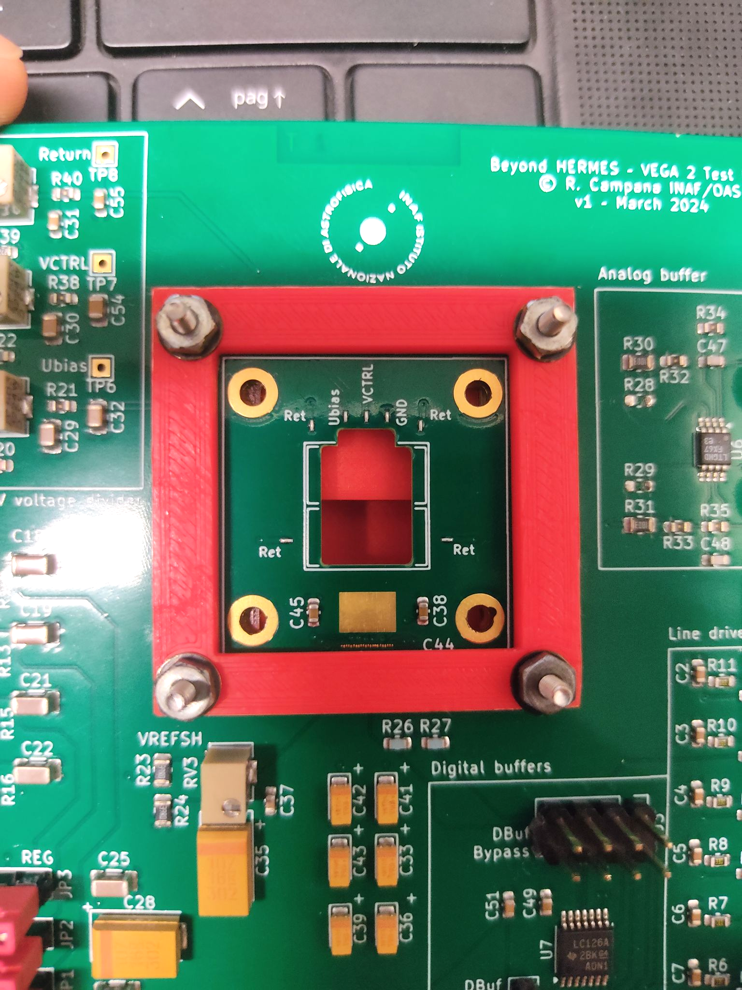
Year 2 Work Overview
VEGA2 (NOVA) Breadboard Characterization and test
SDD bonding & scintillator integration
Bonded with FBK-fabricated SDDs.
Calibration with X-ray sources (Am-241 and Fe-55).
Covers & Scintillator Holders designed with
OpenSCAD for ASIC protection
and 3-D printed
Ajay Sharma •Unipd Annual Report PhD TFPA-Electronics curriculum

Slide 26
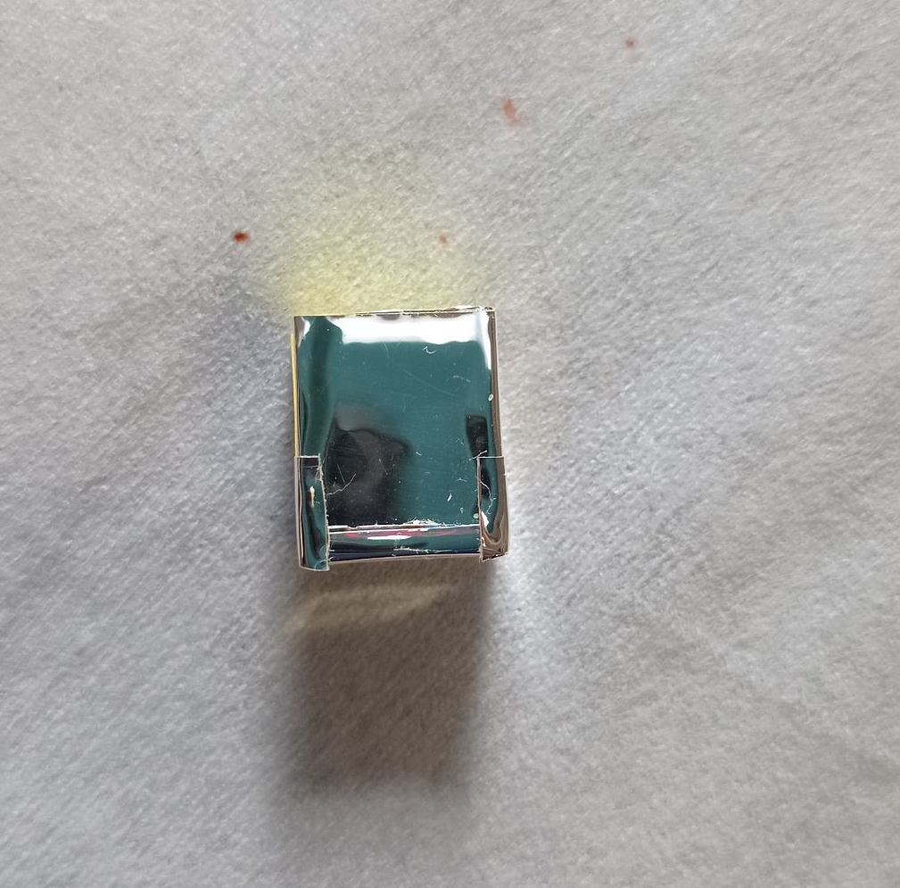
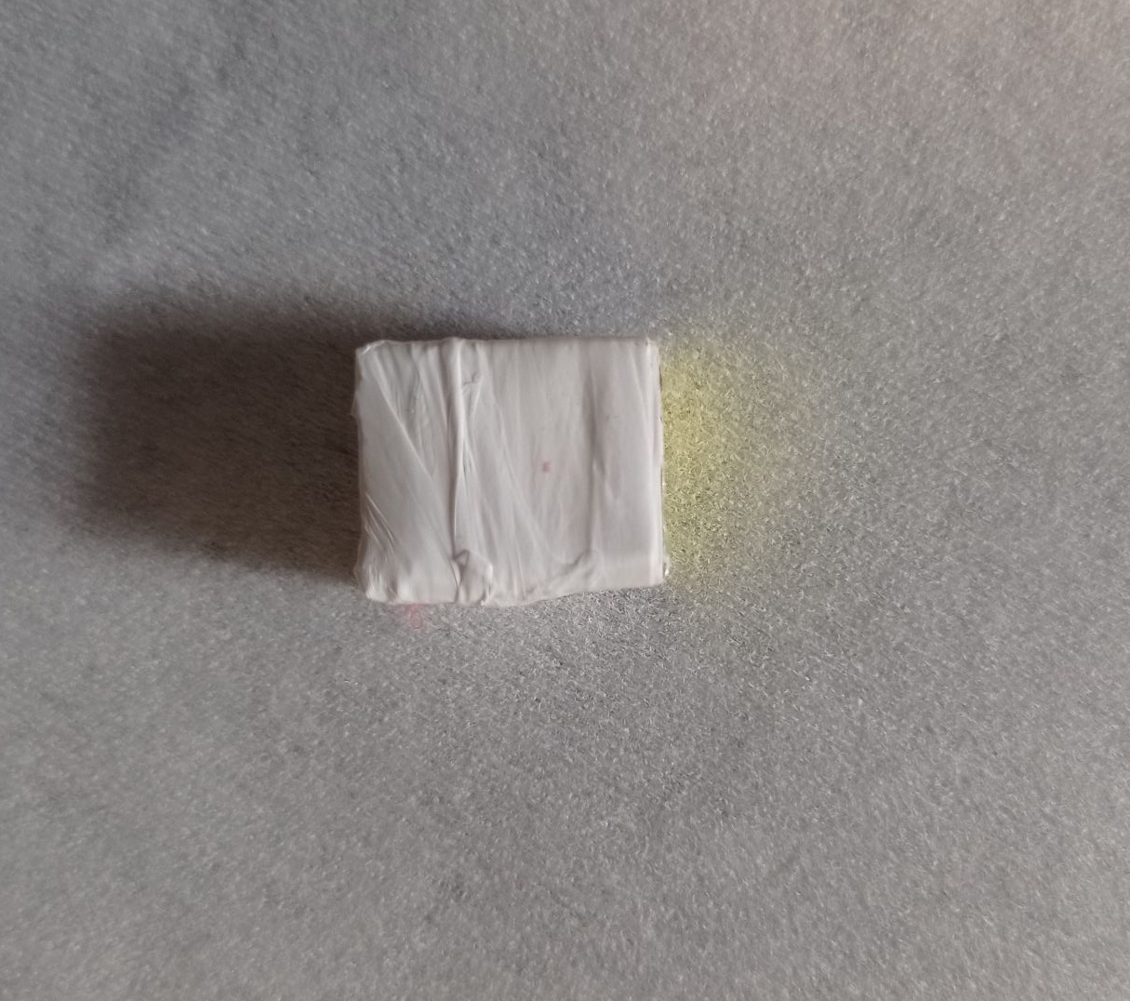
Year 2 Work Overview
VEGA2 (NOVA) Breadboard Characterization and test
SDD bonding & scintillator integration
Preliminary Scintillator Testing
GAGG:Ce Crystal wrapped with VM2000 reflector + Teflon → improved light containment.
Ajay Sharma •Unipd Annual Report PhD TFPA-Electronics curriculum

Slide 27
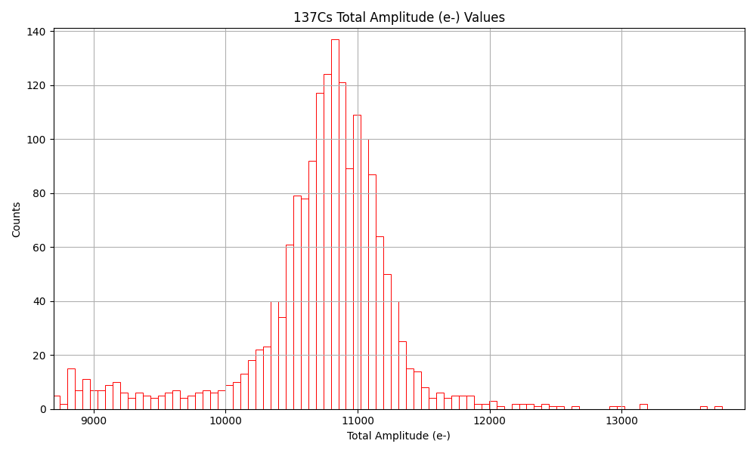
Year 2 Work Overview
VEGA2 (NOVA) Breadboard Characterization and test
SDD bonding & scintillator integration
Preliminary Scintillator Testing
GAGG:Ce Crystal wrapped with VM2000 reflector + Teflon → improved light containment.
Preliminary light yield ≈ 16 e⁻/keV.
Ajay Sharma •Unipd Annual Report PhD TFPA-Electronics curriculum

Slide 28
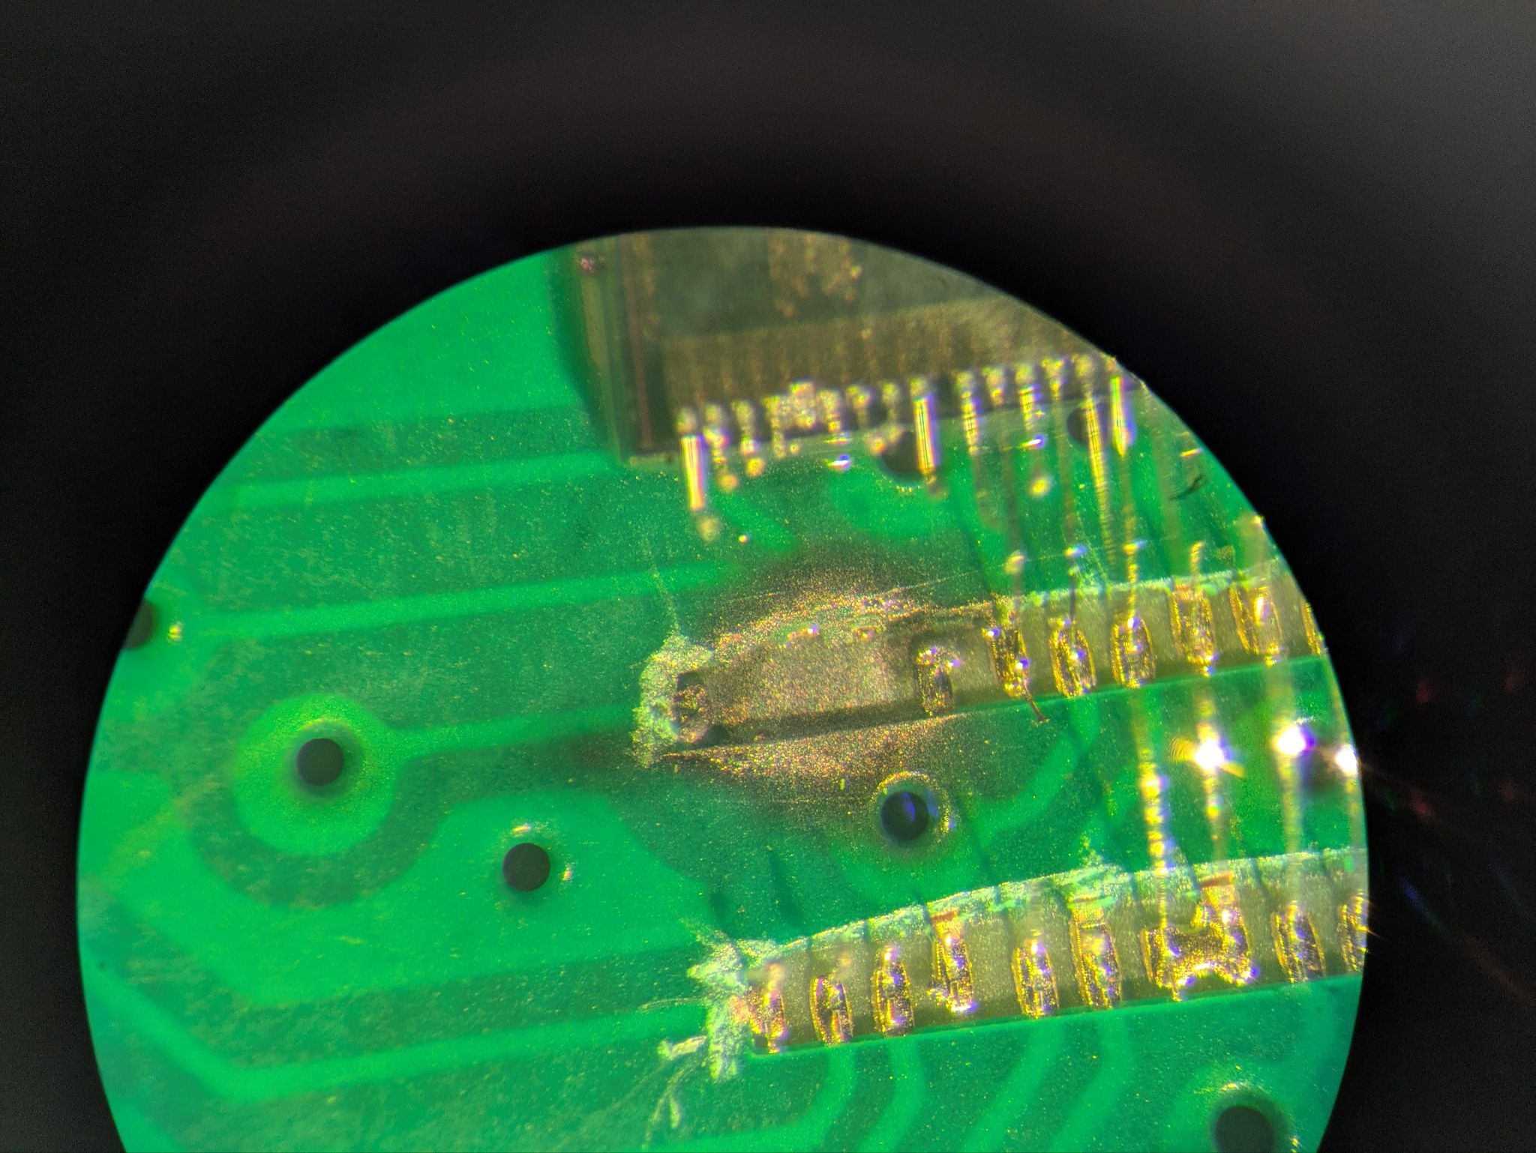
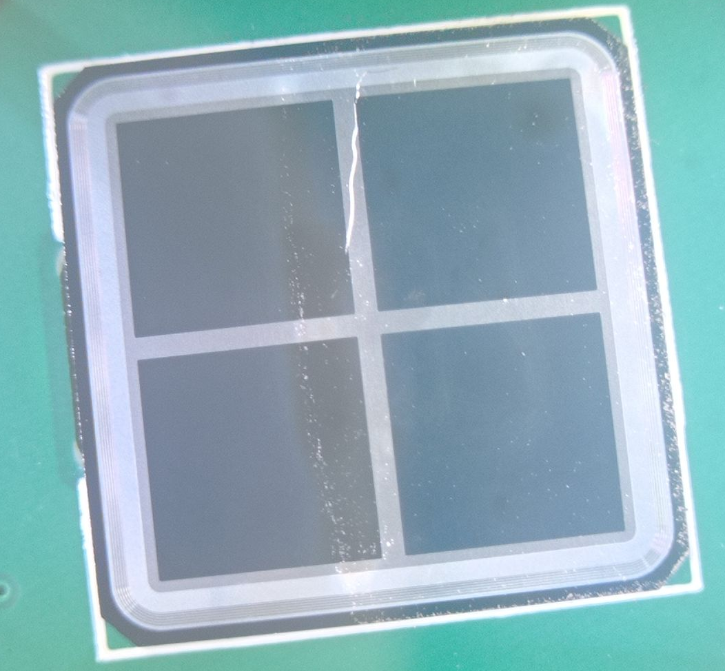
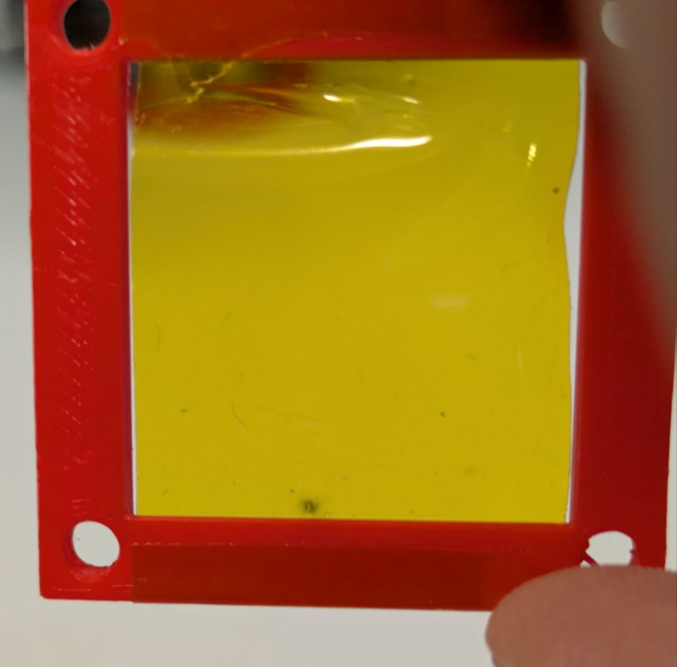
Challenges & Mitigations
Board #2 failed with a short-circuit:
Identified reason was the Kapton ASIC protective cover too close (< 4mm) causing the wire bonds to touch.
SDD cracking:
Mechanical stress from the cover during scintillator assembly led to SDD cracking.
A redesigned cover and improved assembly procedure has been implemented to avoid future damage.
Ajay Sharma •Unipd Annual Report PhD TFPA-Electronics curriculum

Slide 29
Publication Activities
List of published papers/proceedings
P. Calabretto, ..., A Sharma et al., “Advanced readout logic for the XGIS instrument: discriminating X-ray and gamma-ray photons from background and particles”, Particles, submitted (2025) [peer-reviewed proceeding of the ASAPP2025 conference]
F. Ceraudo, ..., A. Sharma et al., “The LEM-X all-sky monitor: first results of the detector prototype” Particles, in preparation (2025) [peer-reviewed proceeding of the ASAPP2025 conference]
G. Della Casa, ..., A. Sharma et al., “The Large Area Detector for future spectral-timing space missions” Particles, in preparation (2025) [peer-reviewed proceeding of the ASAPP2025 conference]
A. Sharma et al. “Design and development of a test equipment for Silicon Drift Detectors” (in preparation)
Ajay Sharma •Unipd Annual Report PhD TFPA-Electronics curriculum

Slide 30
Courses and Training Activities
High Energy Particle Detectors in Space (2,5 CFUs)
Gaseous Detectors for Experimental Particle Physics (2,5 CFUs)
Design of Readout IC for Particle Detectors (2,5 CFUs)
Programmable system on Chip(SoC) for data acquisition and processing (4 CFUs)
Fundamental of FPGA-based digital design (2.5 CFUs)
ADDITIONAL TRANSVERSAL/SOFT SKILLS COURSES
Educational and training course on “Radiation protection in workplaces”
Italian Language Course PRE-A1
Ajay Sharma •Unipd Annual Report PhD TFPA-Electronics curriculum

Slide 31
CONFERENCES, SEMINARS, SCHOOLS
Workshop on Electronics for physics experiments and applications INFN Turin
from 5th - 7th March 2025
Gran Sasso Hands-on 2025 - PhD summer school on experimental astroparticle physics
from 8th-18th September 2025
Ajay Sharma •Unipd Annual Report PhD TFPA-Electronics curriculum

Slide 32
Research Activities (3rd Year)
The main objectives of this year are to continue the front-end electronics ASIC board ongoing testing, calibration, and system integration in the framework of the Beyond HERMES, LEM-X and TASTE projects.
An initial standalone characterization of the ASIC with and without Silicon Drift Detectors has been completed, with a methodical evaluation of all electrical and logical functionalities, verifying the compliance of the ASIC design with the scientific requirements.
Ajay Sharma •Unipd Annual Report PhD TFPA-Electronics curriculum

Slide 33
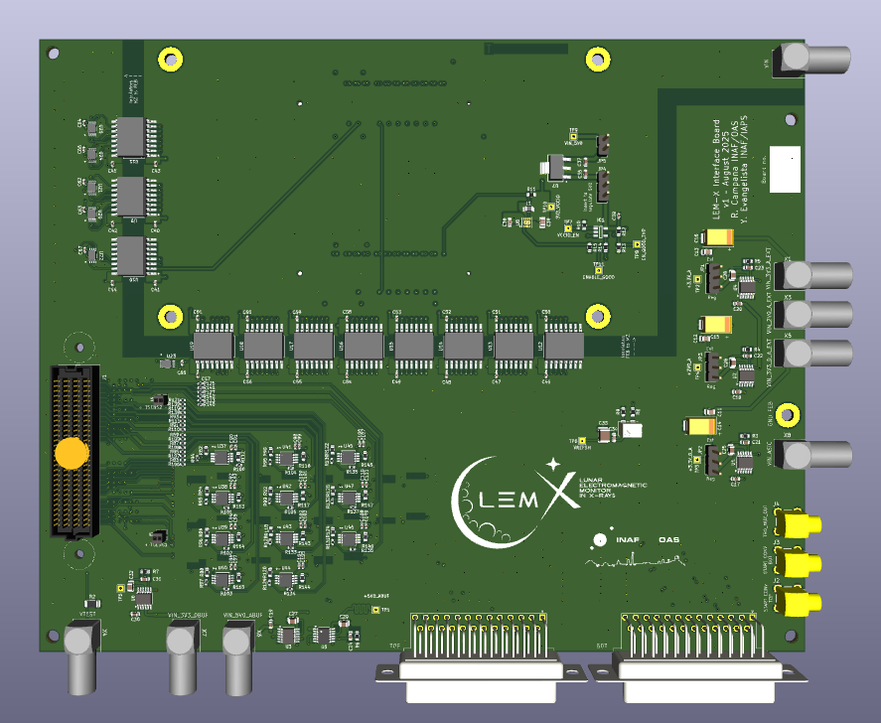
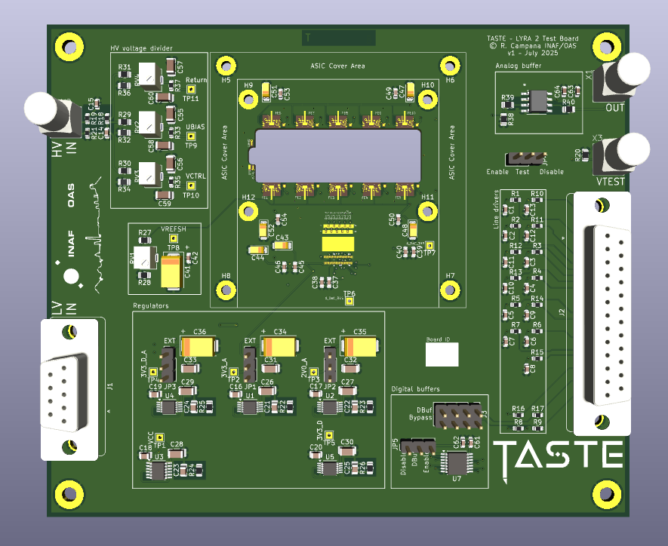
Research Activities (3rd Year)
The third year activity will focus on:
Final characterization of Beyond HERMES prototype breadboards.
Characterization of a fully-representative TASTE prototype board with an improved ASIC (LYRA2) version (test equipment development, experimental characterization of FEE and detector)
Development of the test equipment for the final LEM-X focal plane boards (22x NOVA version 2 ASICs!) and experimental testing at INAF/IAPS Rome
LEM-X interface board to be delivered in October, 2025
TASTE prototype board to be delivered in November, 2025
Significant restructuring of the TE FPGA architecture is required
Ajay Sharma •Unipd Annual Report PhD TFPA-Electronics curriculum

Slide 34
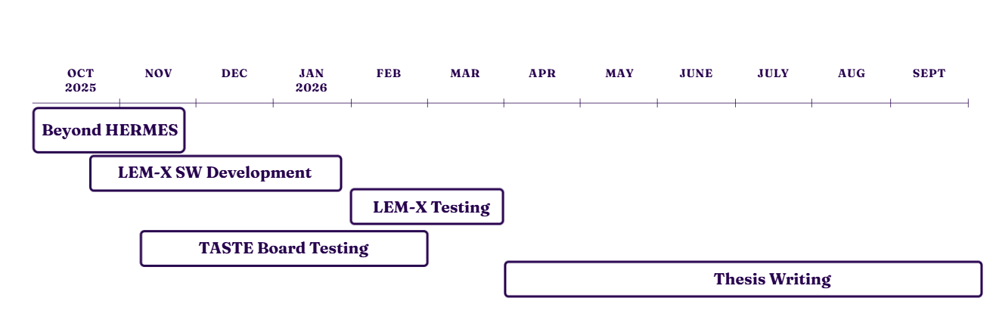
Research activities - Timeline
Ajay Sharma •Unipd Annual Report PhD TFPA-Electronics curriculum

Slide 35
Thank you for your attention!!
Ajay Sharma •Unipd Annual Report PhD TFPA-Electronics curriculum

Slide 36
Backup Slides
Ajay Sharma •Unipd Annual Report PhD TFPA-Electronics curriculum

Slide 37
Design Requirements vs Logbook Results
Parameter | Design Requirement | Result Achieved
ENC | ~10–20 e⁻ rms | 16.9 e⁻ rms
Dynamic Range | Upto ~ 70 keV | Linear upto ~ 63 keV ; nonlinearity beyond
Peaking times | Selectable: 0.4, 0.9, 1.4, 2.6, 3.8 µs | All 5 peaking time tested. Measured: 0.56 µs (τ0), 3.19 µs(τ7)
Amplitude discriminator | Configurable per channel | Verified in multi-channel runs
PSRR(-3.3 V analog) | ~36db @ 10 kHz | Stable operation (No oscillation and no unexpected peak); Noise Vs τ also matches expected value
Ajay Sharma •Unipd Annual Report PhD TFPA-Electronics curriculum

Slide 38
Requirements → Setup → Measurements → Analysis → Results
Define Requirements
(from Design Report)
Prepare
Hardware
Setup
Measurement Campaign
Data Analysis
Results
Ajay Sharma •Unipd Annual Report PhD TFPA-Electronics curriculum

Slide 39
Ajay Sharma •Unipd Annual Report PhD TFPA-Electronics curriculum

