Slide 1




New Optical and RF Over Fiber Technologies for New Generation Radio Telescopes
PhD TFPA - Technologies for Fundamental research in Physics and Astronomy
Cycle and a.a.: 39th cycle /2024-2025
Scholarship No#23
Student: Maida Anwar
Supervisor: Federico Perini INAF
Co-supervisor: Jacopo Nanni UNIBO

Slide 2
Courses for 2nd Year
Timeline of 2nd year
Timeline | Courses | Credit Hour | Status
Sep-Dec, 2024 | High Frequency Electronic Circuits M | 7.5 | Exam Passed in Jan (addendum left)
Sep-Dec, 2024 | Laboratory of Microwave Photonics T | 4 | Exam Passed in Jan (addendum left)
8-9April, 2025 | Fundamental system engineering and project management for large scientific projects | 1.5 | Exam passed
Courses for 1st Year
Timeline | Courses | Credit Hour | Status
Feb-June,2024 | Optical Fiber System M | 7.5 | Exam Passed

Slide 3
Timeline of 2nd year
Conferences, Seminars
TECH-FPA PhD Retreat 2025, February 17 - 21, 2025, Gran Sasso National Laboratory (LNGS), Assergi (L'Aquila)
Sixth Workshop on Millimetre Astronomy in Italy, 3 June 2025, Bologna
Towards high - performance mm - VLBI science operations with multi-band receivers, Bologna (Italy), 28-31 October 2025
Schools
SPEcialized Training in Technologies for Radio Astronomy, September 15 to 19, 2025, INAF Radioastronomical Station of Medicina (Bologna)
The Bianca Garilli School, Scientific Communication in Astronomy , 3rd edition October 12-17, 2025, Bertinoro, Bologna

Slide 4
Timeline of 2nd year
Conferences, Seminars
TECH-FPA PhD Retreat 2025, February 17 - 21, 2025, Gran Sasso National Laboratory (LNGS), Assergi (L'Aquila)
Sixth Workshop on Millimetre Astronomy in Italy, 3 June 2025, Bologna
Towards high - performance mm - VLBI science operations with multi-band receivers, Bologna (Italy), 28-31 October 2025
Schools
SPEcialized Training in Technologies for Radio Astronomy, September 15 to 19, 2025, INAF Radioastronomical Station of Medicina (Bologna) https://sites.google.com/inaf.it/scuola-gianni-tofani-2025/spettra-2025?authuser=0%20)%20.
The Bianca Garilli School, Scientific Communication in Astronomy , 3rd edition October 12-17, 2025, Bertinoro, Bologna https://andymelandri.wixsite.com/scia2025 (a school recognized for PhD and postdoctoral students)

Slide 5
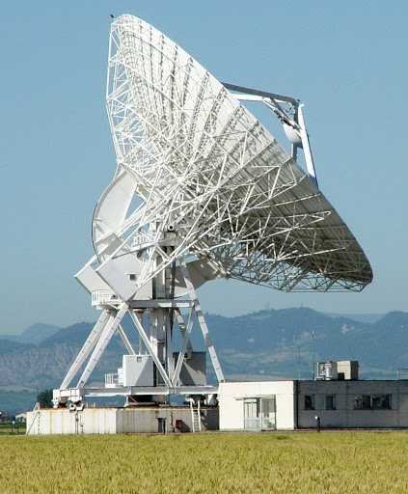
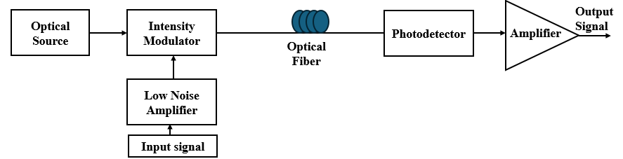
Research Topic and Objectives
Design and Realization of wide band (1-18GHz) radio over fiber systems for the IF downlinks of INAF VLBI antennas (Medicina and Noto)
  Starting point:
  The current optical link purchased for SRT (Sardinia Radio Telescope)
  Direction of research: Improvement of the dynamic range from architectural and component perspective
RoF link
Intrinsic optical link
OTX
ORX
RoF block diagram

Slide 6
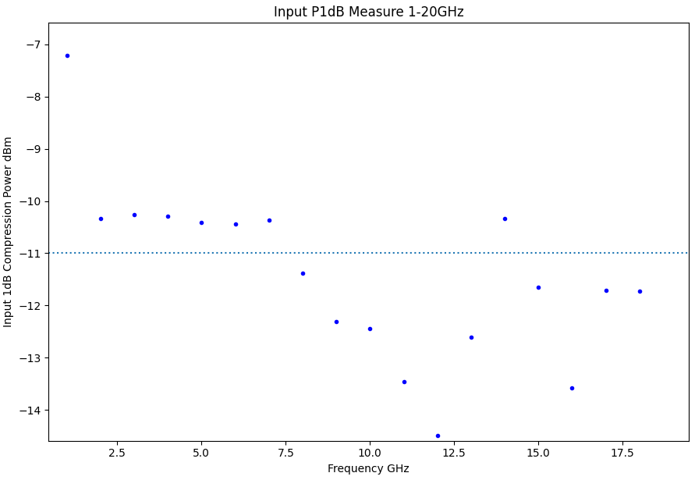
Requirements of current optical link purchased for SRT
➔ SRT links meet all specs except input P1dB
Parameter | Value | Unit
Frequency band | 1-18 | GHz
Gain(mean value in band) | 14±2.5 | dB
Gain Smoothness | ±1 (on 2GHz bandwidth) | dB
Input Return Loss | >10 | dB
Output Return Loss | >10 | dB
Input P1dB* | >-11 (-6) | dBm
Input IP3 | >-11 | dBm
Input IP2 | >-11 | dBm
NF | <6 | dB
Cost | <17.5 | K€
Example of Input P1dB measurement of SRT link no. 1
* -6 dBm was the original specification which has been relaxed to
-11dBm because the spec was not reachable with COST system

Slide 7
Second-Year Research Activities
Development of a MATLAB model for wideband intrinsic optical link (laser, MZM, wideband PD) RoF link
Laboratory measurements at low frequencies (900 MHz) to validate the model.
Simulation of intrinsic optical link based on several combination of commercial components
Identified and implemented suitable pre-/post-amplifiers to satisfy full link requirements
Market research of commercial components (laser, MZM, wideband PD)

Slide 8
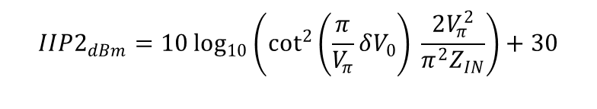

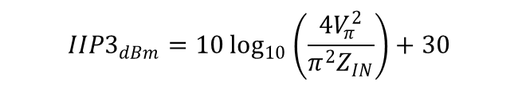
Gain expression in linear region (both MZM and PD)
$$G_{RF,lin}(f_{RF})=\frac{1}{4}Z_{L}Z_{IN}{\left(i_{out,0,mid}\frac{π}{V_{π,RF}(f_{RF})}\right)}^{2}\cos^{2}\left(\frac{π}{Vπ}{δV}_{0}\right)H_{PD}(f_{RF}), where i_{out,0,mid}=\frac{RP_{o,out,max,MZM}}{2A_{0}}$$
Noise
$N_{out}\left(f_{RF}\right)=N_{Laser_{\frac{1}{Hz}}}\left(f_{RF}\right)$+ $N_{{shot}_{\frac{1}{Hz}}}\left(f_{RF}\right)$+ $N_{th_{1/Hz} =}$
$={\frac{1}{4}Z}_{L}RINH_{PD}(f_{RF}){\left[\frac{RP_{0,max}}{2A_{0}} \left(1−\sin\left(\frac{π}{V_{π}}δV_{0}\right)\right)\right]}^{2}$ + ${\frac{1}{4} Z}_{L}2q\frac{RP_{0,max}}{2A_{0}}H_{PD}(f_{RF})\left(1−\sin\left(\frac{π}{V_{π}}δV_{0}\right)\right)$ + $KT$
Input P1dB
$$P_{RF,1dB}≃{0.3}^{2}⋅\frac{V_{π}^{2}}{2Z_{IN}}$$
IIP3
$$IIP3_{dBm}=10\log_{10}\left(\frac{4V_{π}^{2}}{π^{2}Z_{IN}}\right)+30$$
IIP2
$$IIP2_{dBm}=10\log_{10}\left(\cot^{2}\left(\frac{π}{V_{π}}δV_{0}\right) \frac{2V_{π}^{2}}{π^{2}Z_{IN}}\right)+30$$

Slide 9
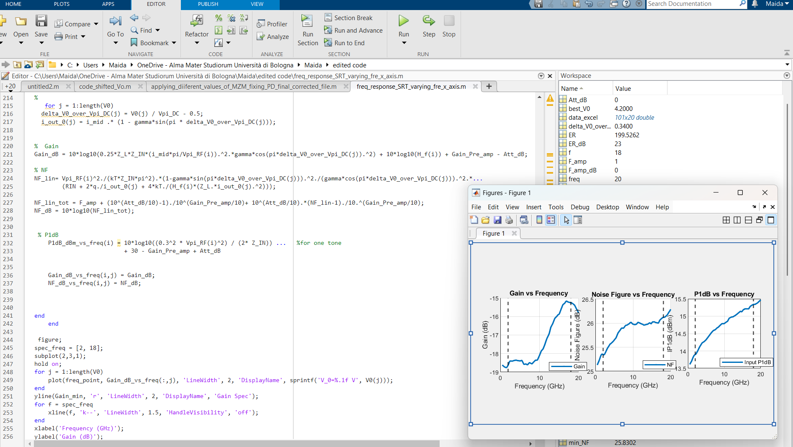
MATLAB Code with Results

Slide 10
Second-Year Research Activities
Development of a MATLAB model for wideband intrinsic optical link (laser, MZM, wideband PD) RoF link
Laboratory measurements at low frequencies (900 MHz) to validate the model.
Simulation of intrinsic optical link based on several combination of commercial components
Identified and implemented suitable pre-/post-amplifiers to satisfy full link requirements.
Market research of commercial components (laser, MZM, wideband PD)

Slide 11
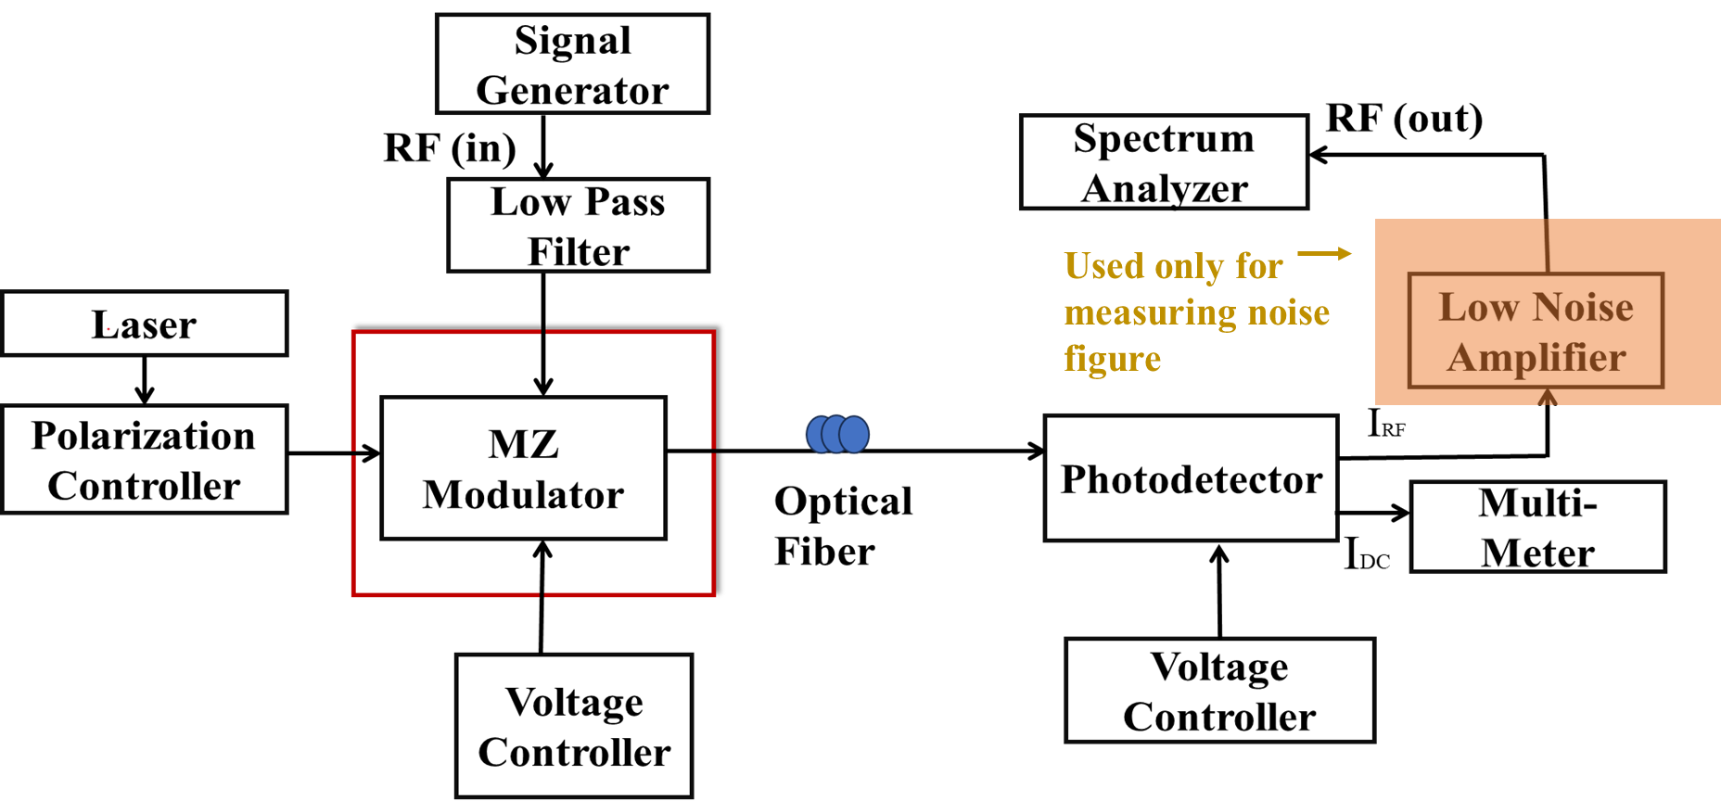
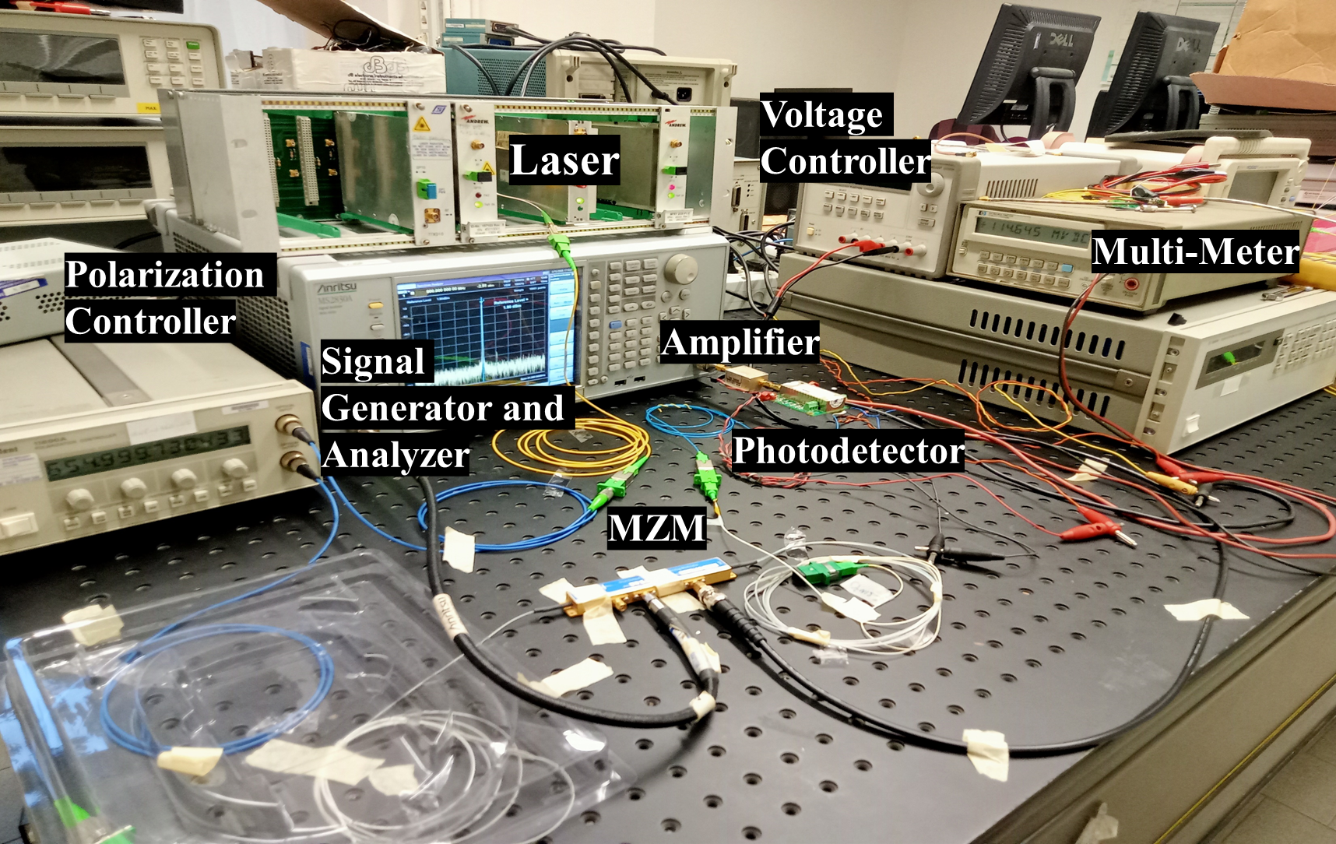
Characterization of Analogue RoF Link based on
MZM and Comparison with Numerical Simulation
Parameters:
Laser Power= 10dBm
MZM Vpi = 8V
Amplifier Gain= 30dB
Photodiode Responsivity = 1 A/W
Operating frequency = 900 MHz
Low noise Amplifier use for measuring noise figure only
Block diagram of analogue RoF link
Experimental setup in UNIBO
Preliminary performance: simulation matches experiment well at low frequencies.
High-frequency measurements will be performed once the component arrives

Slide 12
Second-Year Research Activities
Development of a MATLAB model for wideband intrinsic optical link (laser, MZM, wideband PD) RoF link
Laboratory measurements at low frequencies (900 MHz) to validate the model.
Simulation of intrinsic optical link based on several combination of commercial components
Identified and implemented suitable pre-/post-amplifiers to satisfy full link requirements
Market research of commercial components of intrinsic link (Laser, MZM, wideband PD)

Slide 13
Block diagram
Intrinsic Optical link
Optical Source
Intensity Modulator
Photodetector
Optical Fiber
Low Noise Amplifier
Post-Amplifier
RF Input
RF Output
Objective: Select an optical link from available market components

Slide 14
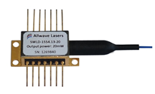
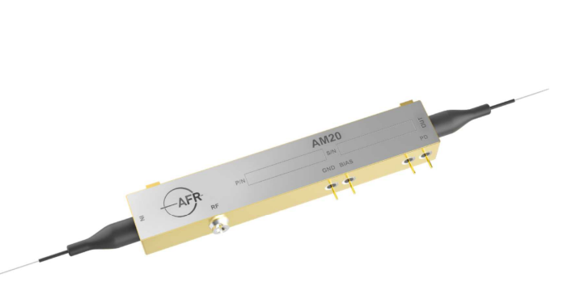
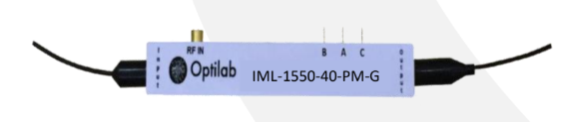
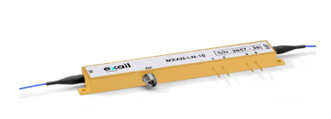
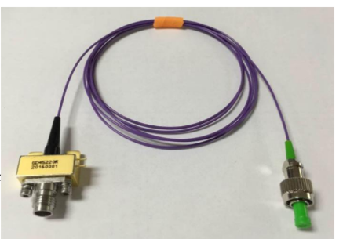
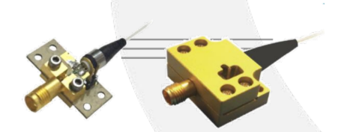
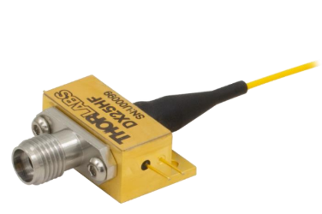
Market research of commercial components for intrinsic link and extraction of S21 parameter
➔Use the same laser as in the SRT for all combinations, with a low relative intensity noise (RIN ≤ –160 dB/Hz).
➔Identify commercially available components (MZM and PD) through market research.
➔Extract S21 parameters (full frequency response) to be used into the MATLAB model, including Vπ and insertion loss (IL) for MZM and responsivity (R) for PD, from datasheets and test reports using MATLAB tool- Grabit.
Component | Companies & Product no. | Components Picture
Laser | Allwave Lasers SWLD927080-22-01-PM
MZM | AFR AM-20
MZM | Optilab IML-1550-40-PM-G
MZM | Exail MXAN-LN 1550
PD | WESTMAG GD45220R
PD | Optilab PD30
PD | Thorlabs DX25H
List of components identified through market research

Slide 15
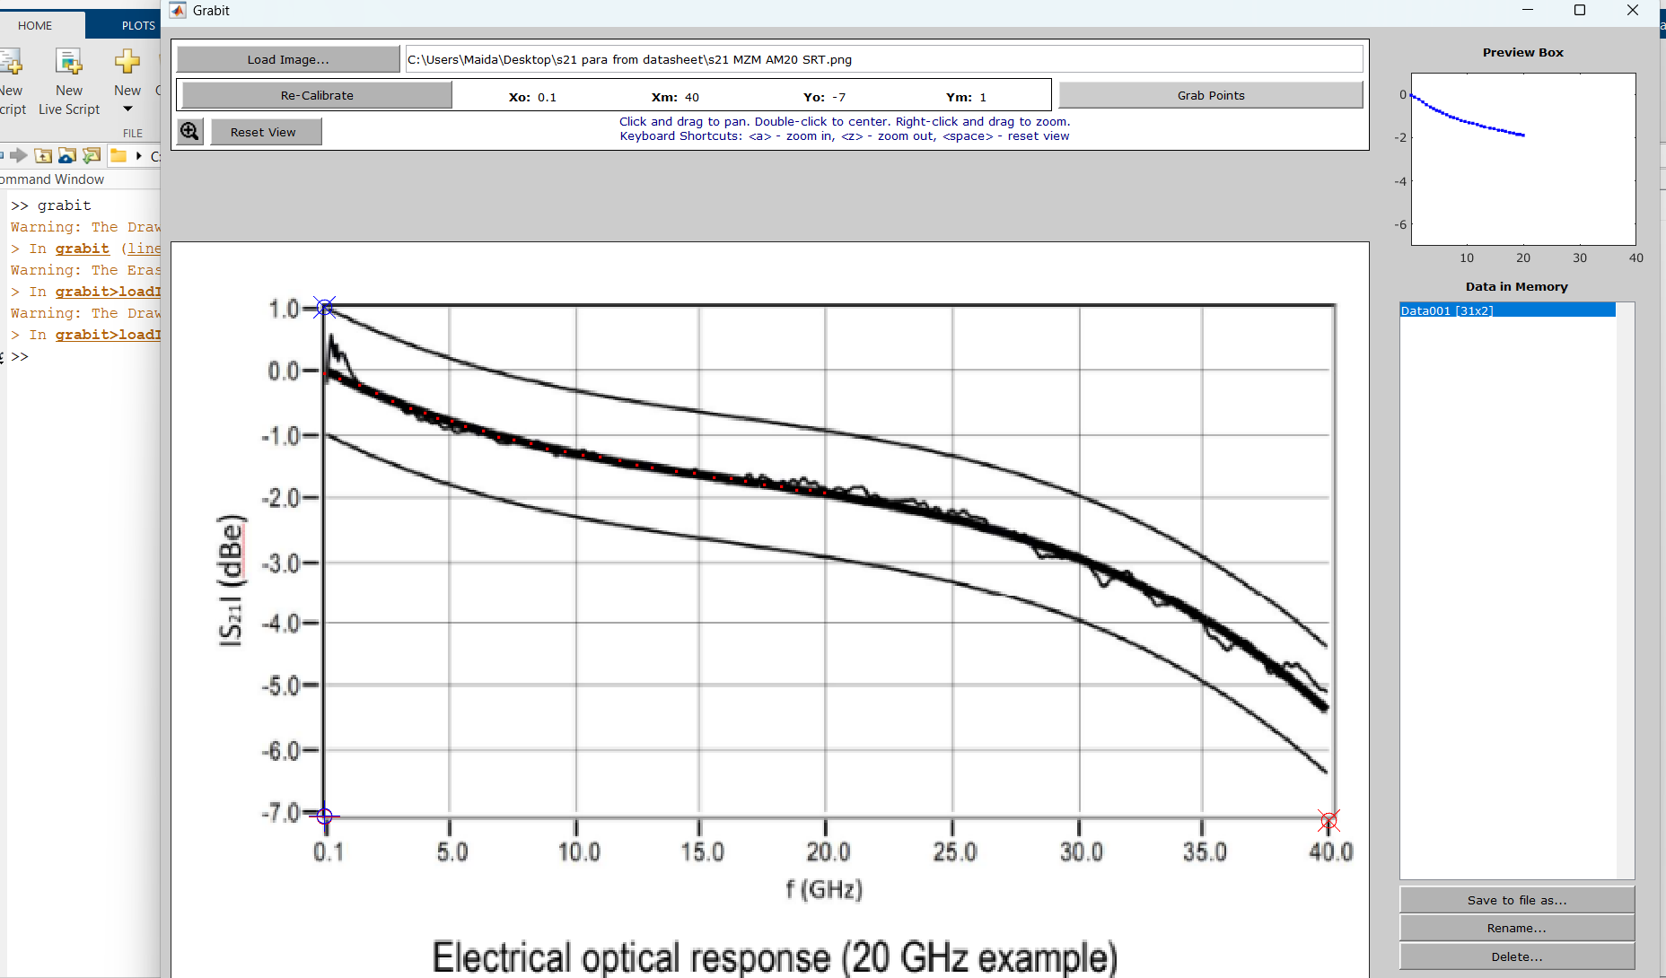
Example of Data Extraction Process with MATLAB Tool- Grabit of MZM AFR AM20-XT

Slide 16
Second-Year Research Activities
Development of a MATLAB model for wideband intrinsic optical link (laser, MZM, wideband PD) RoF link
Laboratory measurements at low frequencies (900 MHz) to validate the model.
Simulation of intrinsic optical link based on several combination of commercial components
Identified and implemented suitable pre-/post-amplifiers to satisfy full link requirements
Market research of commercial components intrinsic link (laser, MZM, wideband PD)

Slide 17










1 – AFR AM-20 WESTMAG GD45220R(SRT)
$V_{π,DC}$ = 5 V
IL = 3.3dB
R = 0.8 A/W
2 – AFR AM-20 WESTMAG GD45220R
$V_{π,DC}$ = 5 V
IL = 3.3dB
R = 0.8 A/W
3 - AFR AM-20 Thorlabs DX25H
$V_{π,DC}$ = 5 V
IL = 3.3dB
R = 0.45 A/W
4 - AFR AM-20 Optilab PD30
$V_{π,DC}$ = 5 V
IL = 3.3dB
R = 0.85 A/W
5 -optilab IML-1550-40-PM-G WESTMAG GD45220R
$V_{π,DC}$ = 2.5 V
IL = 4 dB typ
R = 0.8 A/W
6 - optilab IML-1550-40-PM-G Thorlabs DX25H
$V_{π,DC}$ = 2.5 V
IL = 4dB typ
R = 0.45 A/W
7 - Optilab IML-1550-40-PM-G Optilab PD30
$V_{π,DC}$ = 2.5 V
IL = 4dB typ
R = 0.85A/W
8 - Exail MXAN-LN 1550 WESTMAG GD45220R
$V_{π,DC}$ = 6.5V
IL = 3.5dB typ
R = 0.8 A/W
9 - Exail MXAN-LN 1550 Thorlabs DX25H
$V_{π,DC}$ = 6.5 V
IL = 3.5dB typ
R = 0.45 A/W
10 - Exail MXAN-LN 1550 Optilab PD30
$V_{π,DC}$ = 6.5 V
IL = 3.5dB typ
R = 0.8 5A/W

Slide 18






Best Combination
1 – AFR AM-20 WESTMAG GD45220R(SRT)
$V_{π,DC}$ = 5 V
IL = 3.3dB
R = 0.8 A/W
2 - AFR AM-20 Thorlabs DX25H
$V_{π,DC}$ = 5 V
IL = 3.3dB
R = 0.45 A/W
3 - AFR AM-20 Optilab PD30
$V_{π,DC}$ = 5 V
IL = 3.3dB
R = 0.85 A/W
4 -optilab IML-1550-40-PM-G WESTMAG GD45220R
$V_{π,DC}$ = 2.5 V
IL = 4 dB typ
R = 0.8 A/W
5 - optilab IML-1550-40-PM-G Thorlabs DX25H
$V_{π,DC}$ = 2.5 V
IL = 4dB typ
R = 0.45 A/W
7 - Optilab IML-1550-40-PM-G Optilab PD30
$V_{π,DC}$ = 2.5 V
IL = 4dB typ
R = 0.85A/W
7 - Exail MXAN-LN 1550 WESTMAG GD45220R
$V_{π,DC}$ = 6.5V
IL = 3.5dB typ
R = 0.8 A/W
8 - Exail MXAN-LN 1550 Thorlabs DX25H
$V_{π,DC}$ = 6.5 V
IL = 3.5dB typ
R = 0.45 A/W
9 - Exail MXAN-LN 1550 Optilab PD30
$V_{π,DC}$ = 6.5 V
IL = 3.5dB typ
R = 0.8 5A/W

Slide 19
Second-Year Research Activities
Development of a MATLAB model for wideband intrinsic optical link (laser, MZM, wideband PD) RoF link
Laboratory measurements at low frequencies (900 MHz) to validate the model.
Simulation of intrinsic optical link based on several combination of commercial components
Identified and implemented suitable pre-/post-amplifiers to satisfy full link requirements
Market research of commercial components intrinsic link (laser, MZM, wideband PD)

Slide 20
Block diagram
Intrinsic Optical link
Optical Source
Intensity Modulator
Photodetector
Optical Fiber
Low Noise Amplifier
Post-Amplifier
RF Input
RF Output
Full link analysis → suitable pre-/post-amplifiers identified from the market for chosen optical Link

Slide 21
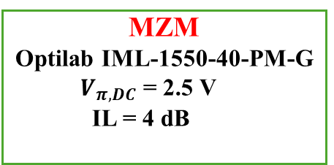
Full Link Simulation using Commercial Components
Intrinsic Optical link
Laser
Allwave Lasers
SWLD927080-22-01-PM
Rin ≤ -160 dB/Hz
MZM
Optilab IML-1550-40-PM-G
$V_{π,DC}$ = 2.5 V
IL = 4 dB
PD
Optilab PD-30
R = 0.85 A/W
Post-Amp
R00M30GSM
(RF Lambda)
Pre-Amp
ZVE-0234LNX-K+ (Mini-Circuit)
Extensive market research and simulations performed
Pre- and post-amplifiers selected based on chosen optical link
Results closest to required specifications
Attenuator
12 dB
RF Input
RF Output

Slide 22
Best Compromise of Full Link Simulation with Commercial Components so far
NF at lower and higher frequencies fails to meet specifications.
Next step: optimization/customization of pre- and post-amplifiers.

Slide 23
Future Plan
3rd Year
1-8 Month
Full and deep measurement characterization of the SRT RoF links in the lab to validate the MATLAB code at high frequency.
Check and refresh the RF specifications after new receiver installation on Medicina (first light mid October 2025)
Validate chosen components (MZM &PD) through lab measurements
Testing of a different architecture, e.g., a balanced photodetector, is planned
Prototype of the wideband 18GHz link
8-12 Month
Thesis writing and preparation for submission
One journal paper submission e.g., Journal of Astronomical Telescopes, Instruments, and Systems
Conferences and Workshops
Planned presentation of current work at the workshop “Towards High-Performance mm-VLBI Science Operations with Multi-Band Receivers” (Bologna, Italy, 28–31 October 2025
SPIE Astronomical Telescopes + Instrumentation 5 - 10 July 2026 Copenhagen, Denmark
Italian Conference on Optics and Photonics June 15 – 17, L’Aquila, Italy

Slide 24
Thank you

