Slide 1








Introduction to JUNO/TAO, My Contributions and Research Activities
Presented by: Ammad Ul Islam
For: Admission to the III year
Supervisor: Dr. Andrea Fabbri
Co-Supervisor: Dr. Fabrizio Petrucci

Slide 2
INTRODUCTION
Taishan Antineutrino Observatory (TAO), a satellite experiment of JUNO.
Taishan Nuclear Power Plant, 30 –35 m from one of the 4.6 GW the reactor cores
Measure reactor neutrino spectrum
Ton scale Gd-doped Liquid Scintillator (Gd-LS)
Full coverage of SiPM
Operate at -50 ℃ (reduce SiPM dark noise)
Water tanks and plastic scintillator for shielding
Water Tank (WT)
1.2 m thickness of water Cherenkov detector
300, 3 inch PMTs, same with sPMT in JUNO
GdLS→Acrylicvessel →SiPM/support → Tank→ Insulation → 1.2 m water or HDPE shielding
Reference: TAO CDR arXiv:2005.08745

Slide 3
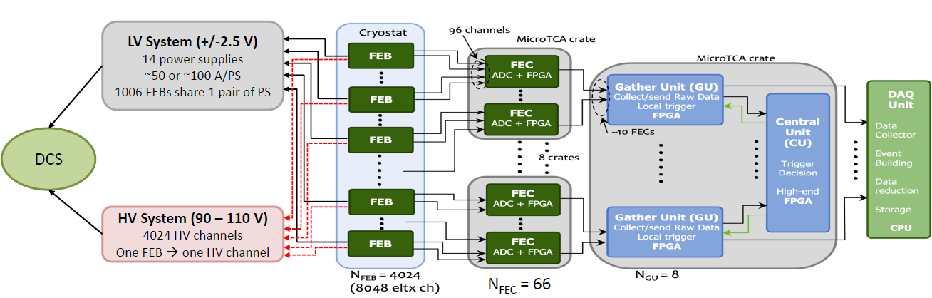
TAO Electronics
Key features (refer to CDR):
8048 readout channels, 12.5 cm2/ch
Timing resolution: ~1ns

Slide 4
TAO Electronics Scheme
FEB
2 channel 1 tiles
Total 8048 channels
Tile and FEB are connected
Analog signals from FEB will be transferred to FEC via differential pairs, 3-4 m inside the SS tank, ~10 m outside the tank
FEC
ADC is on FEC, used to digitize analog signals from FEB
FPGA & Power boards in MicroTCA.4 crate
Q/T information is extracted with FPGA (waveform analysis)

Slide 5
Study Abroad at TNNP/IHEP
The Language Barrier
Working in a Controlled Environment
Working Underground in a Noisy Environment
Safety, Access, and Logistical Hurdles
System Integration and Interdependence
Custom/Prototype Hardware
Troubleshooting Unforeseen Failures

Slide 6
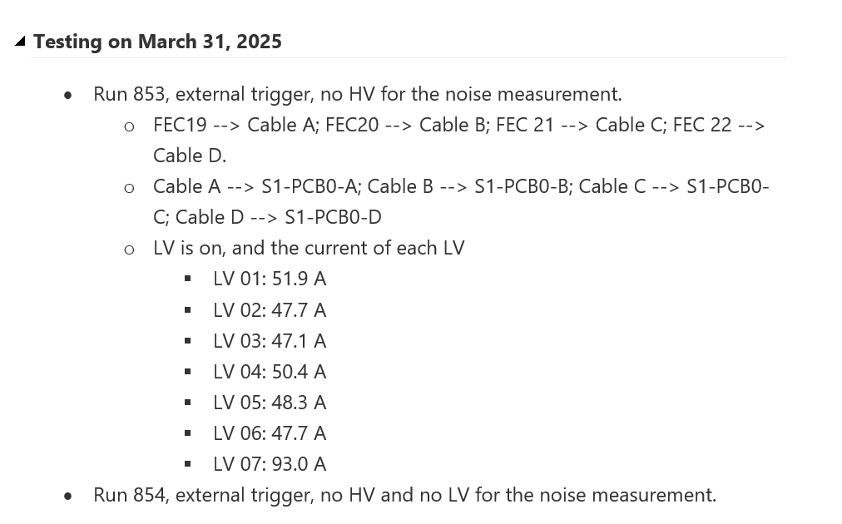
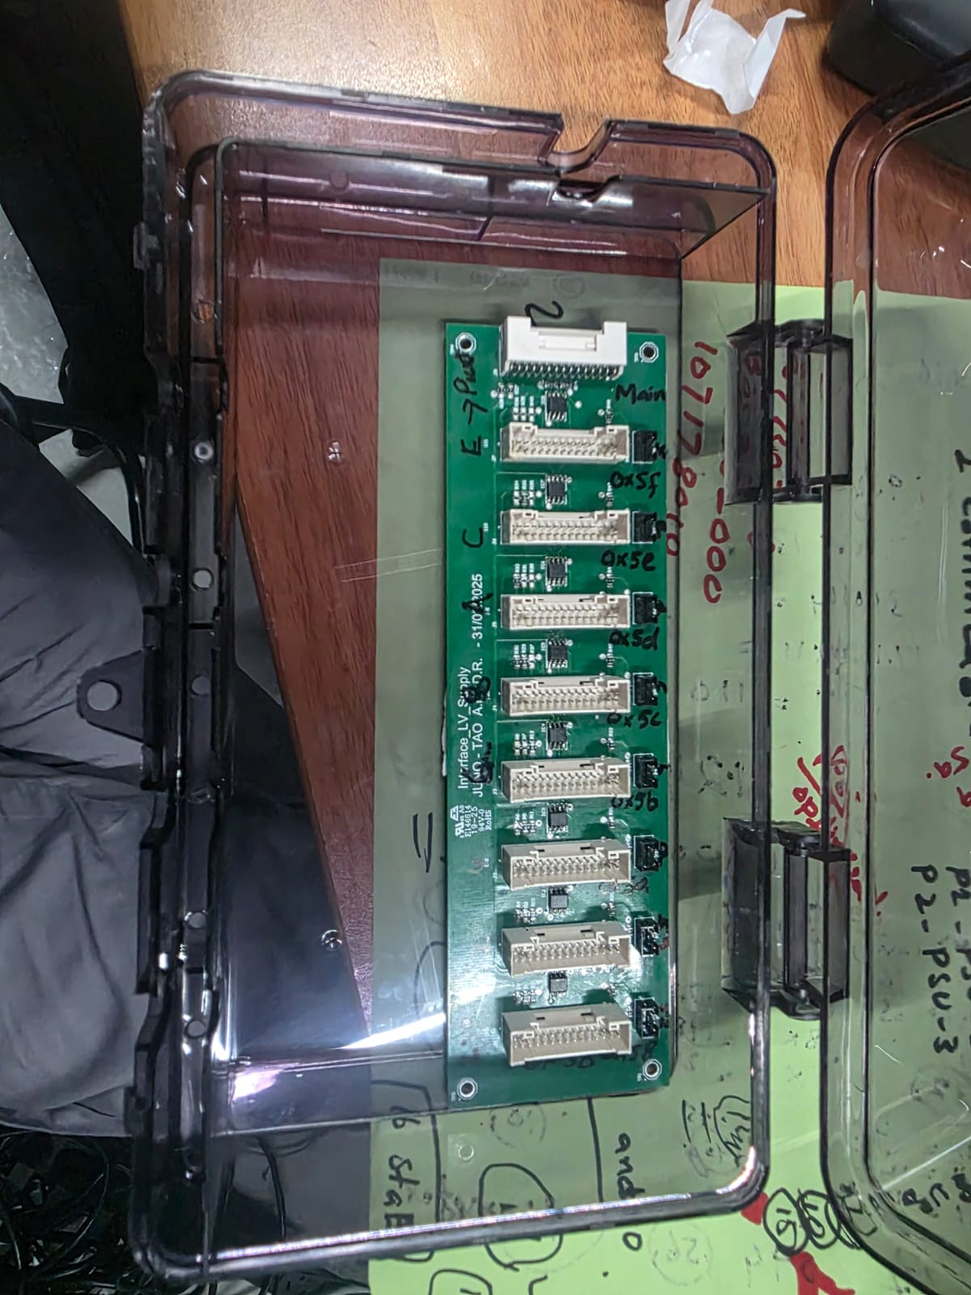
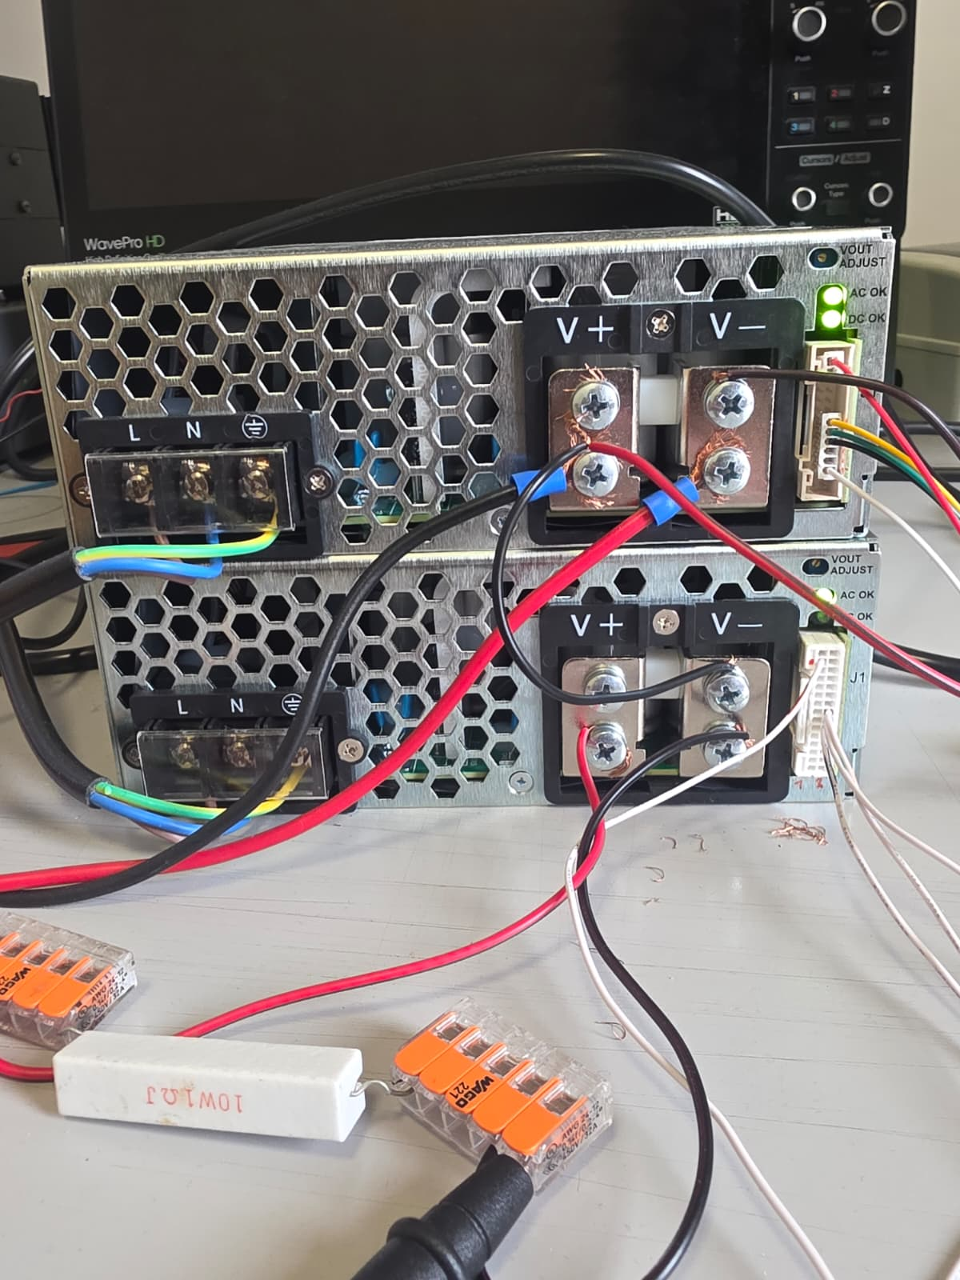
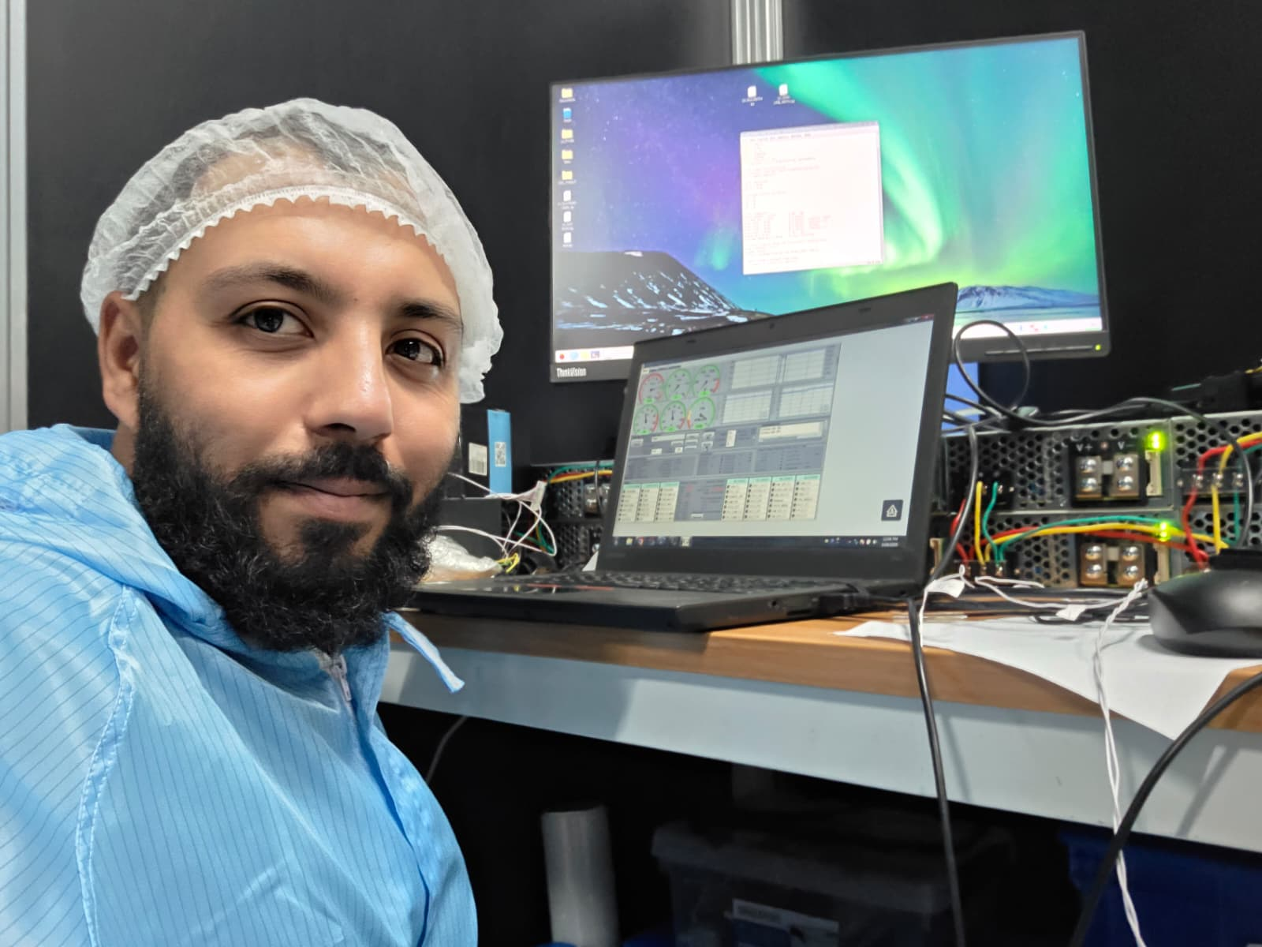
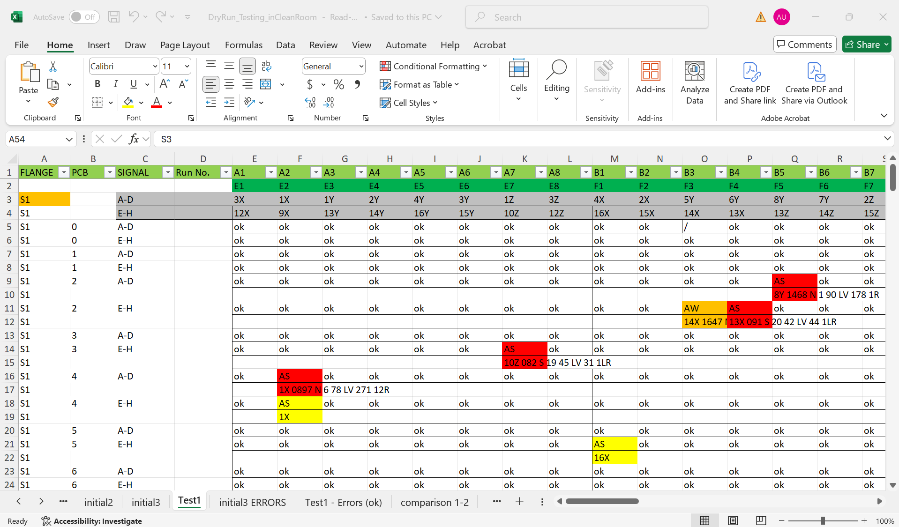
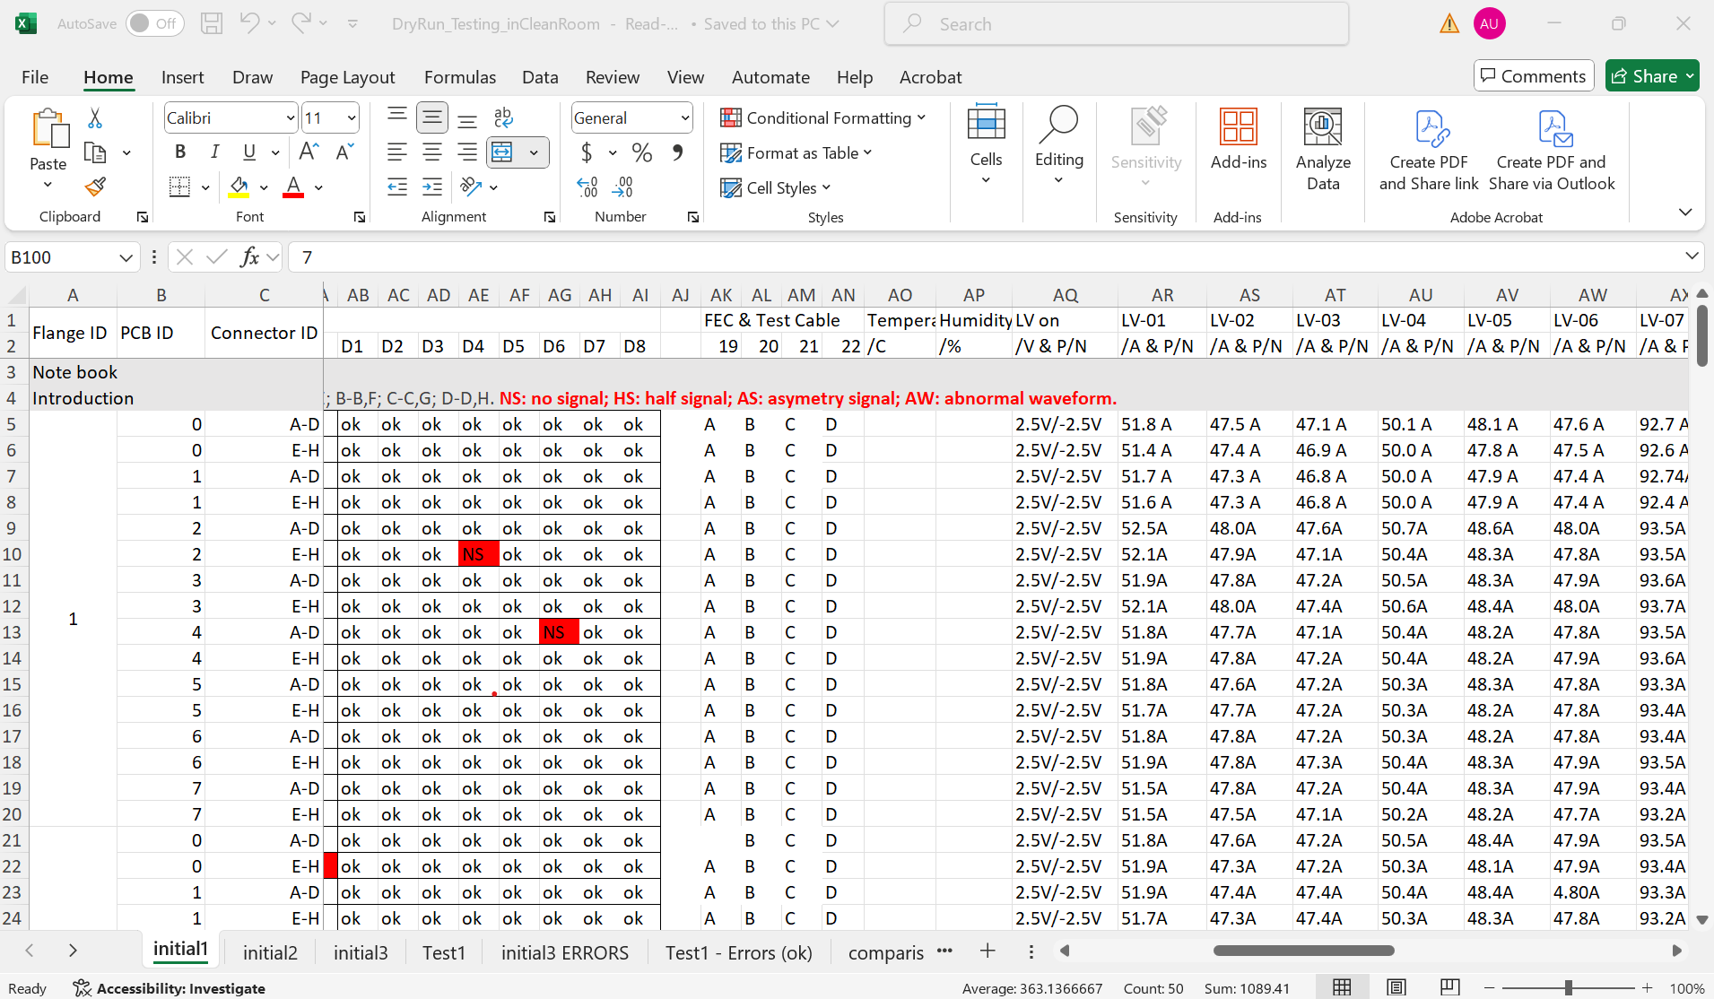
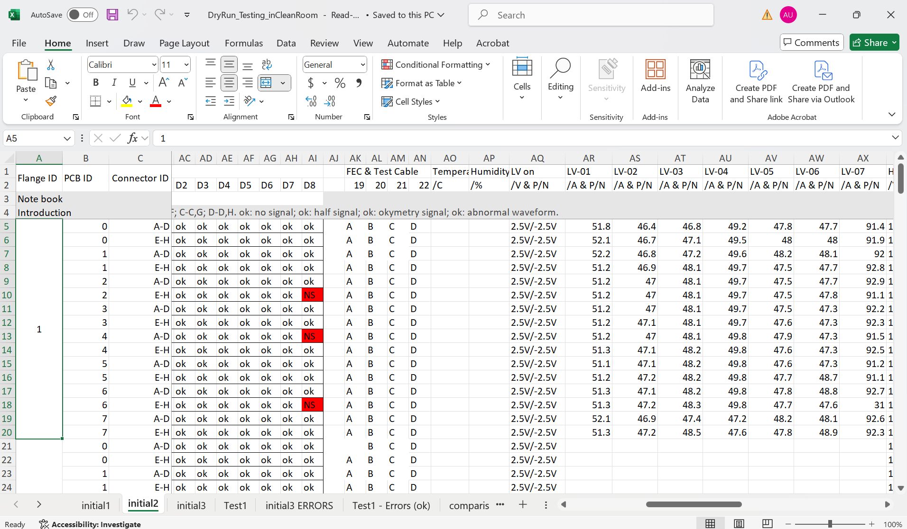
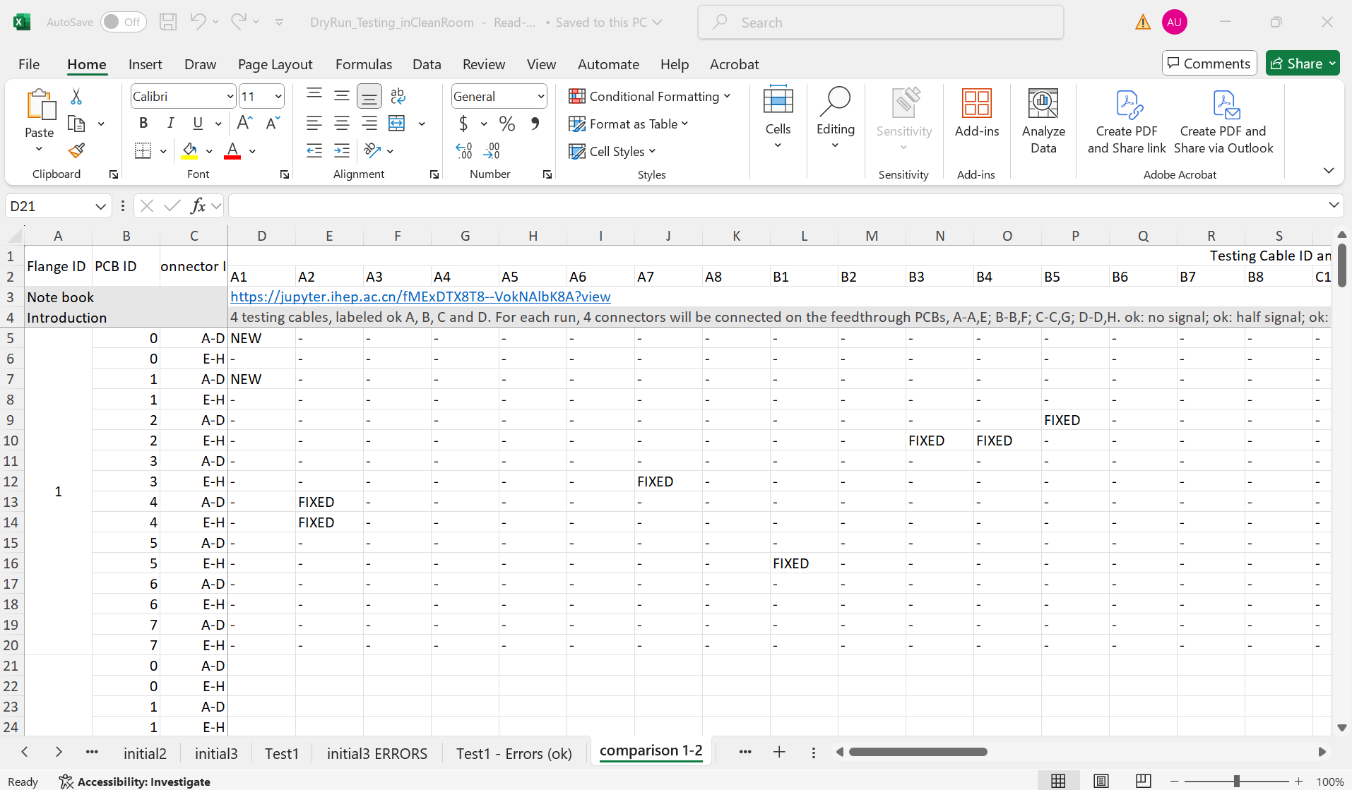
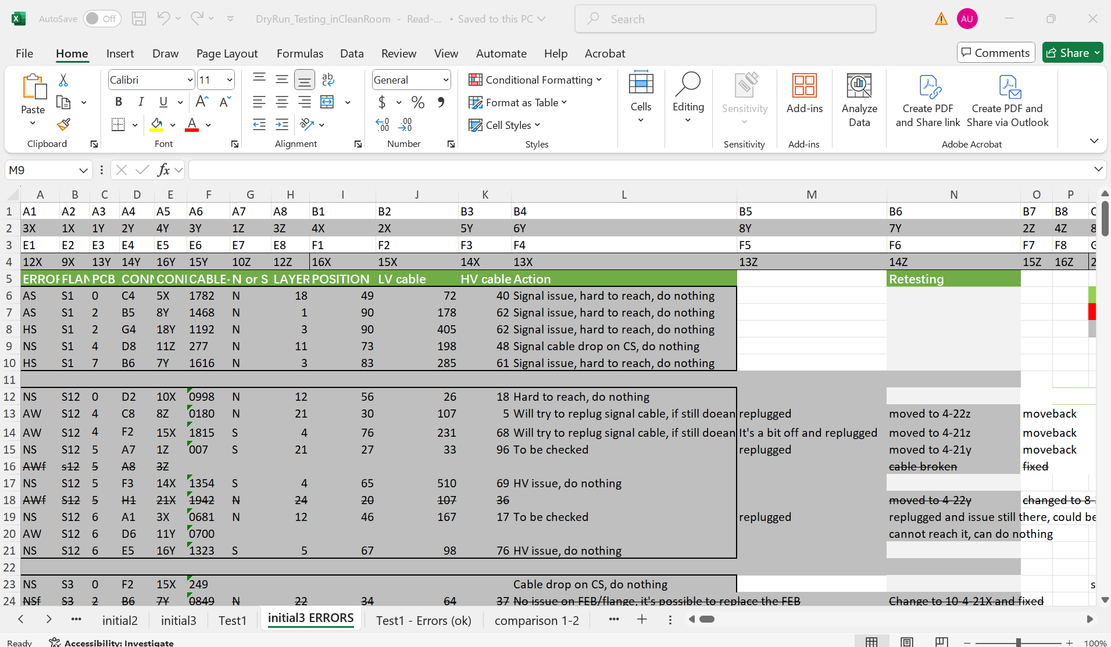
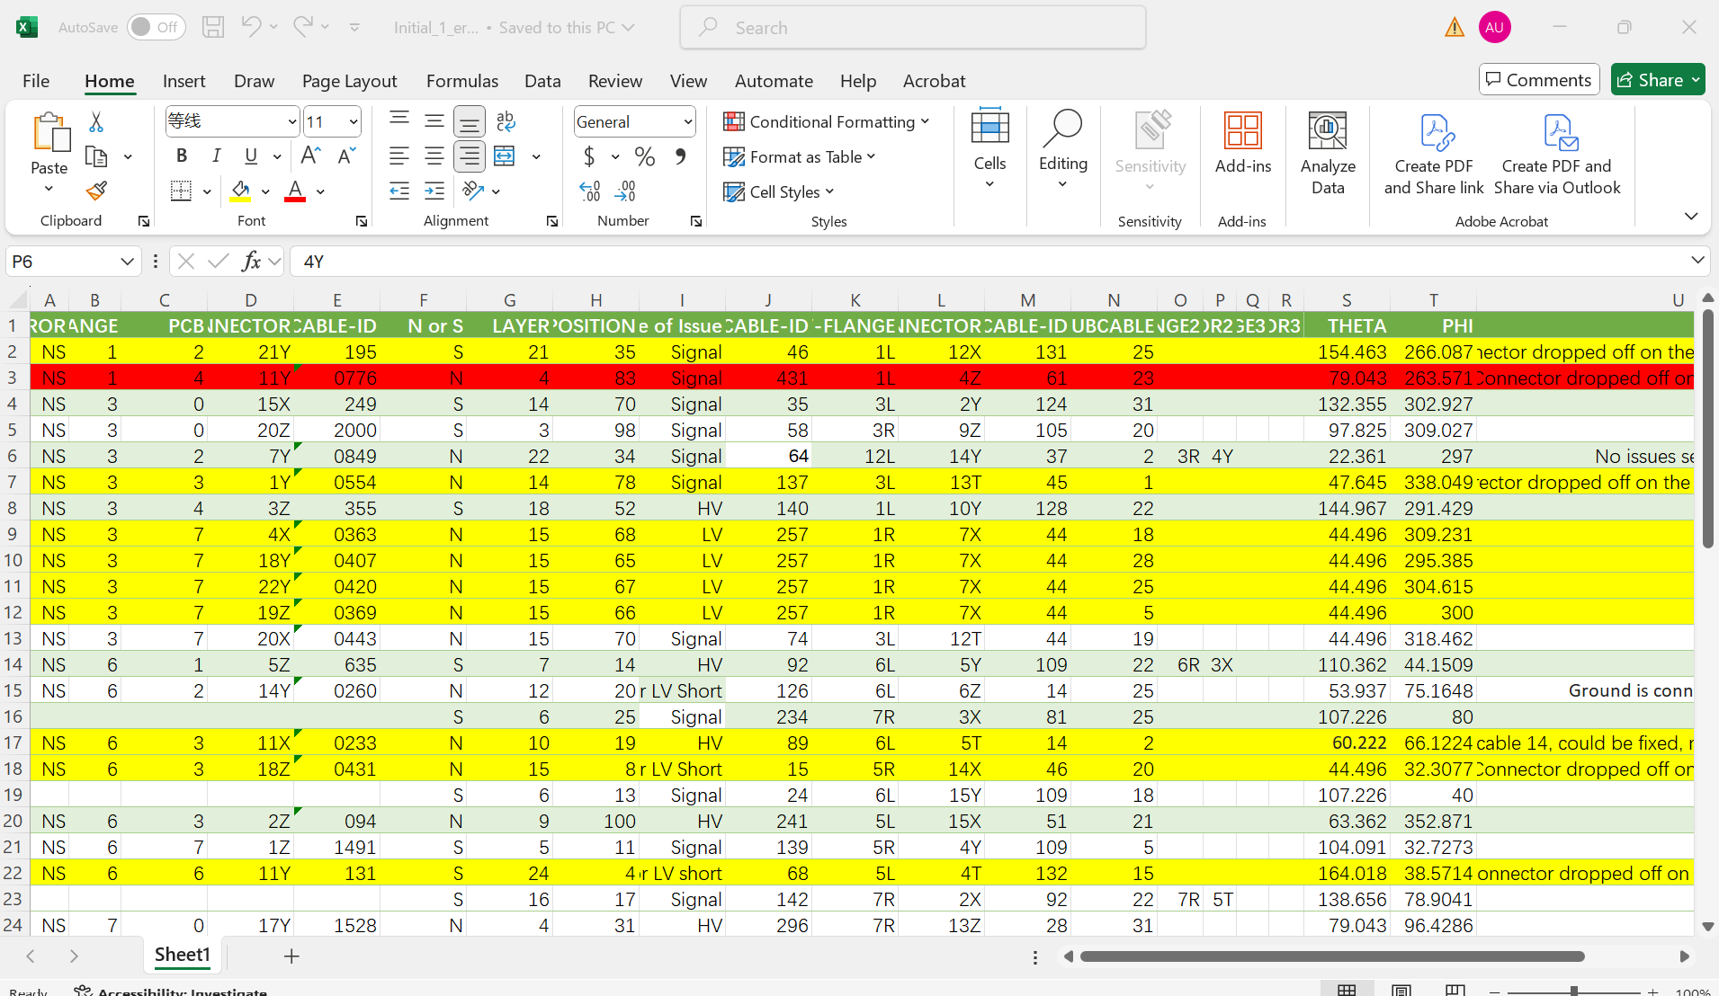
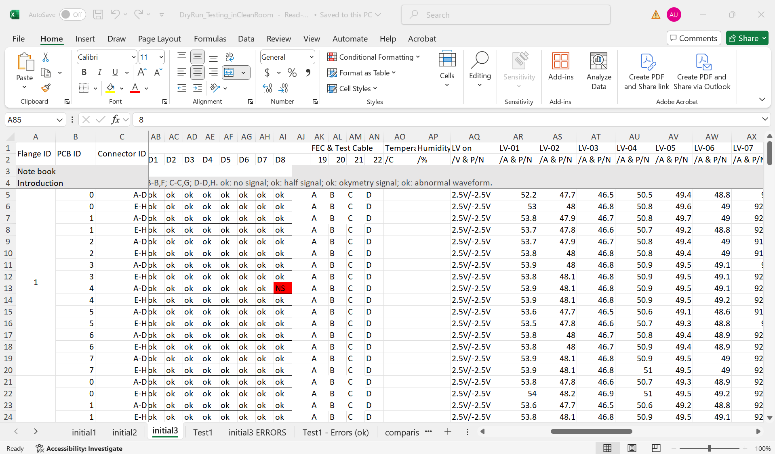
My Contribution
PS Testing, Configuration, Pair Testing
Interface Board Issue
Cabling of LV to all flanges
Testing Dryrun initial 1
Troubleshooting of Faulty Channels
DryRun Initial test 2
Troubleshooting
Dryrun Initial Test 3
Troubleshooting of faulty channels
Documentation of all Initials and Troubleshooting
Water
Water
Notes:
Final Signal Cable Mapping [Final one] - HedgeDoc

Slide 7
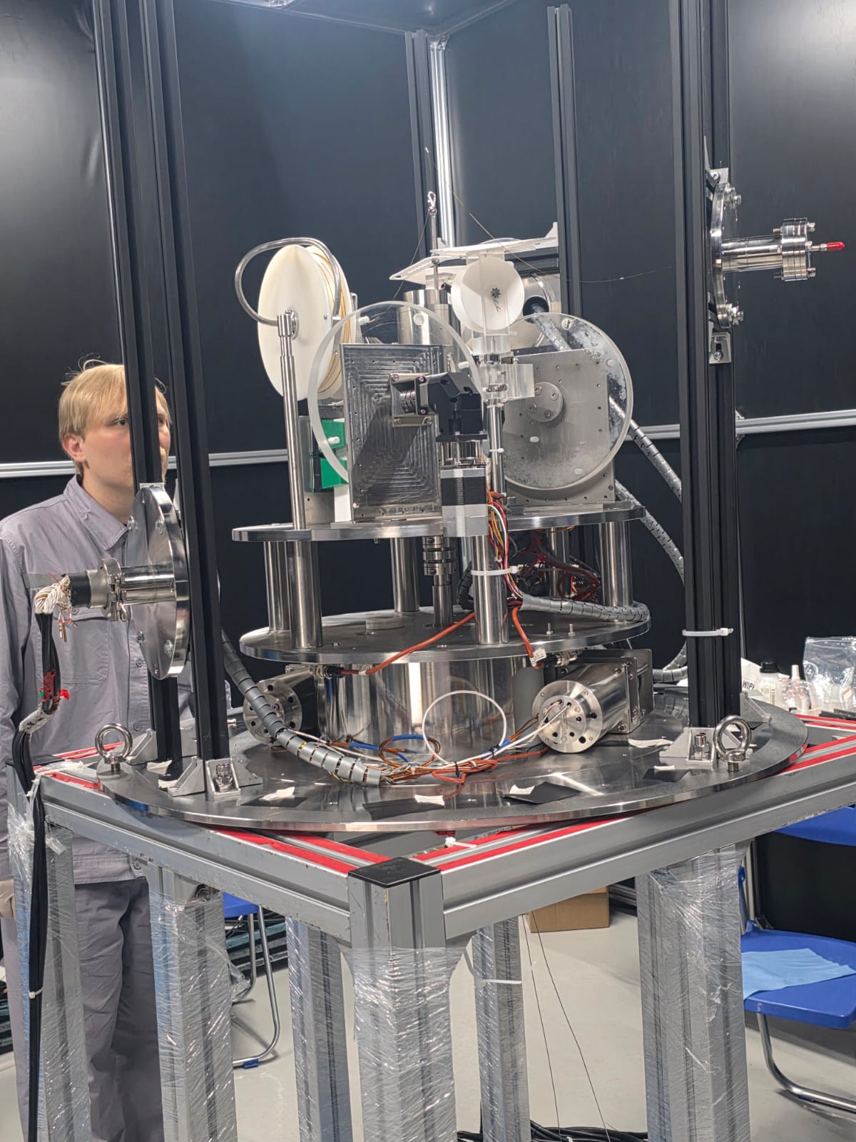
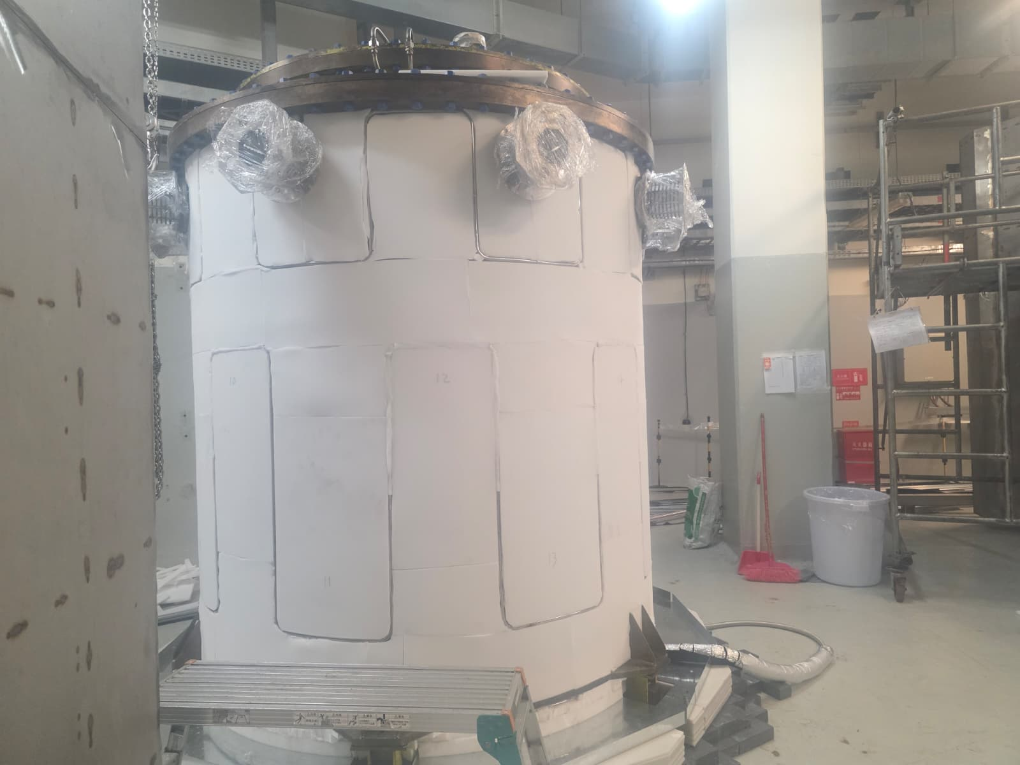
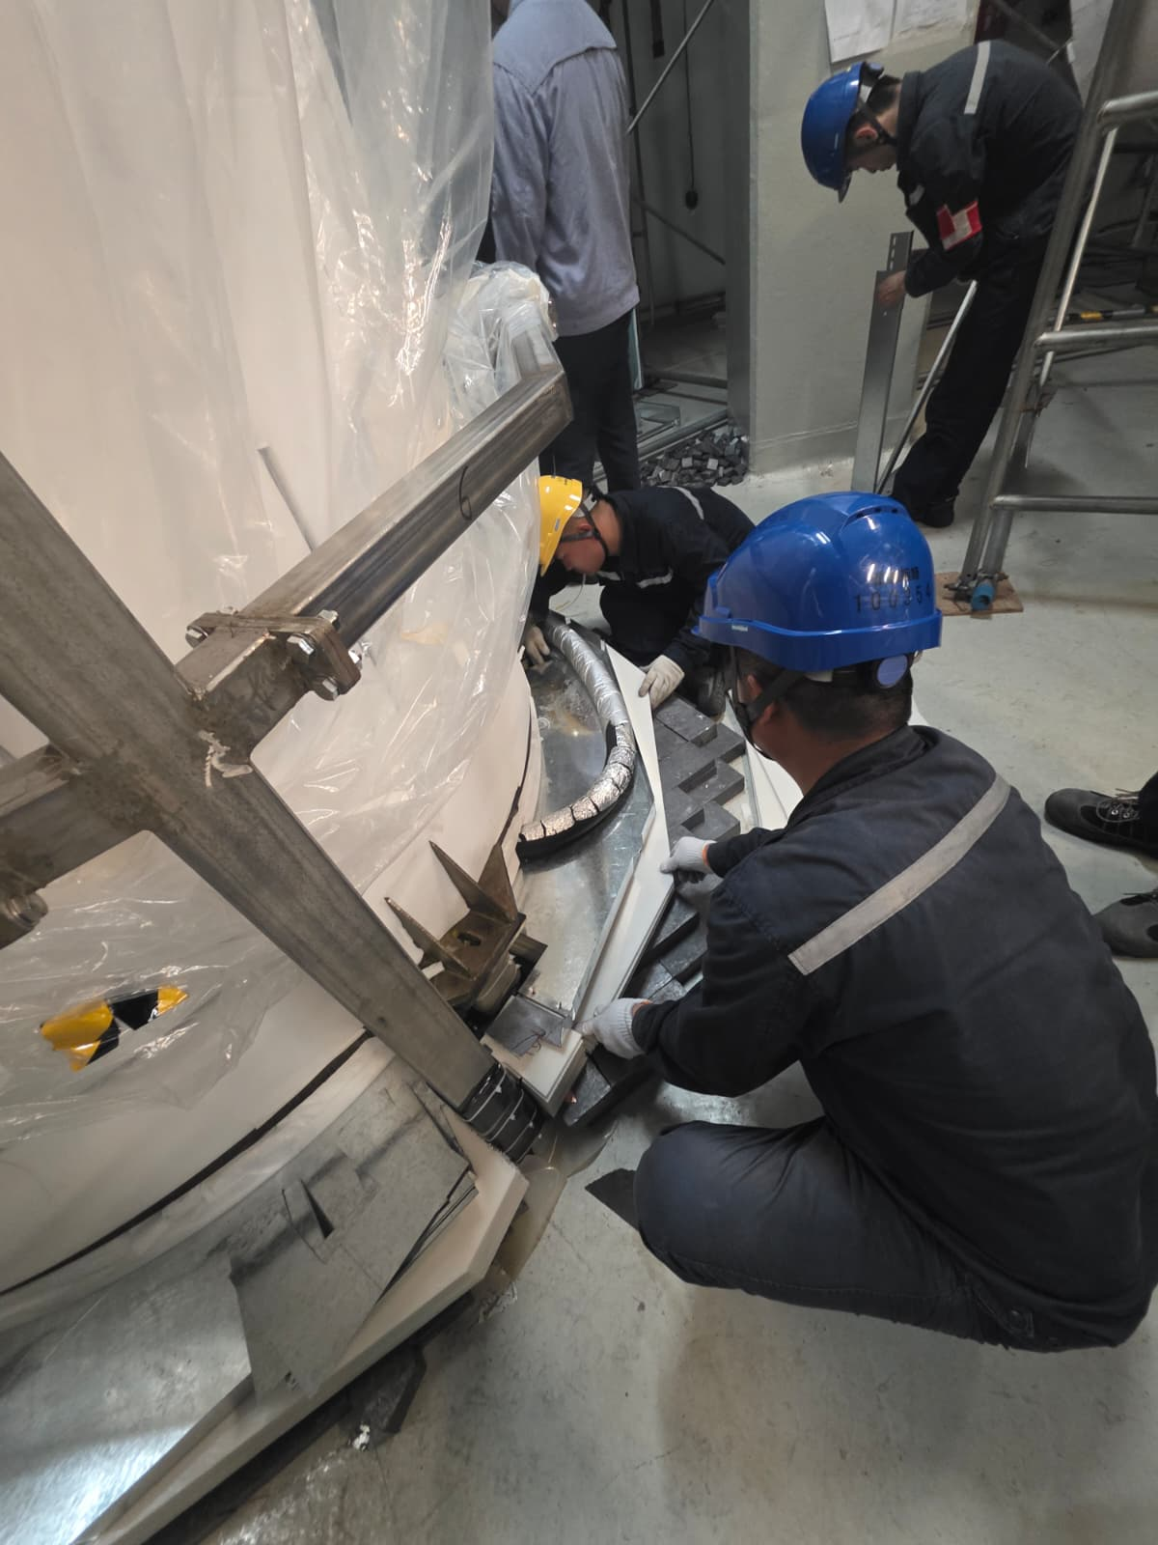
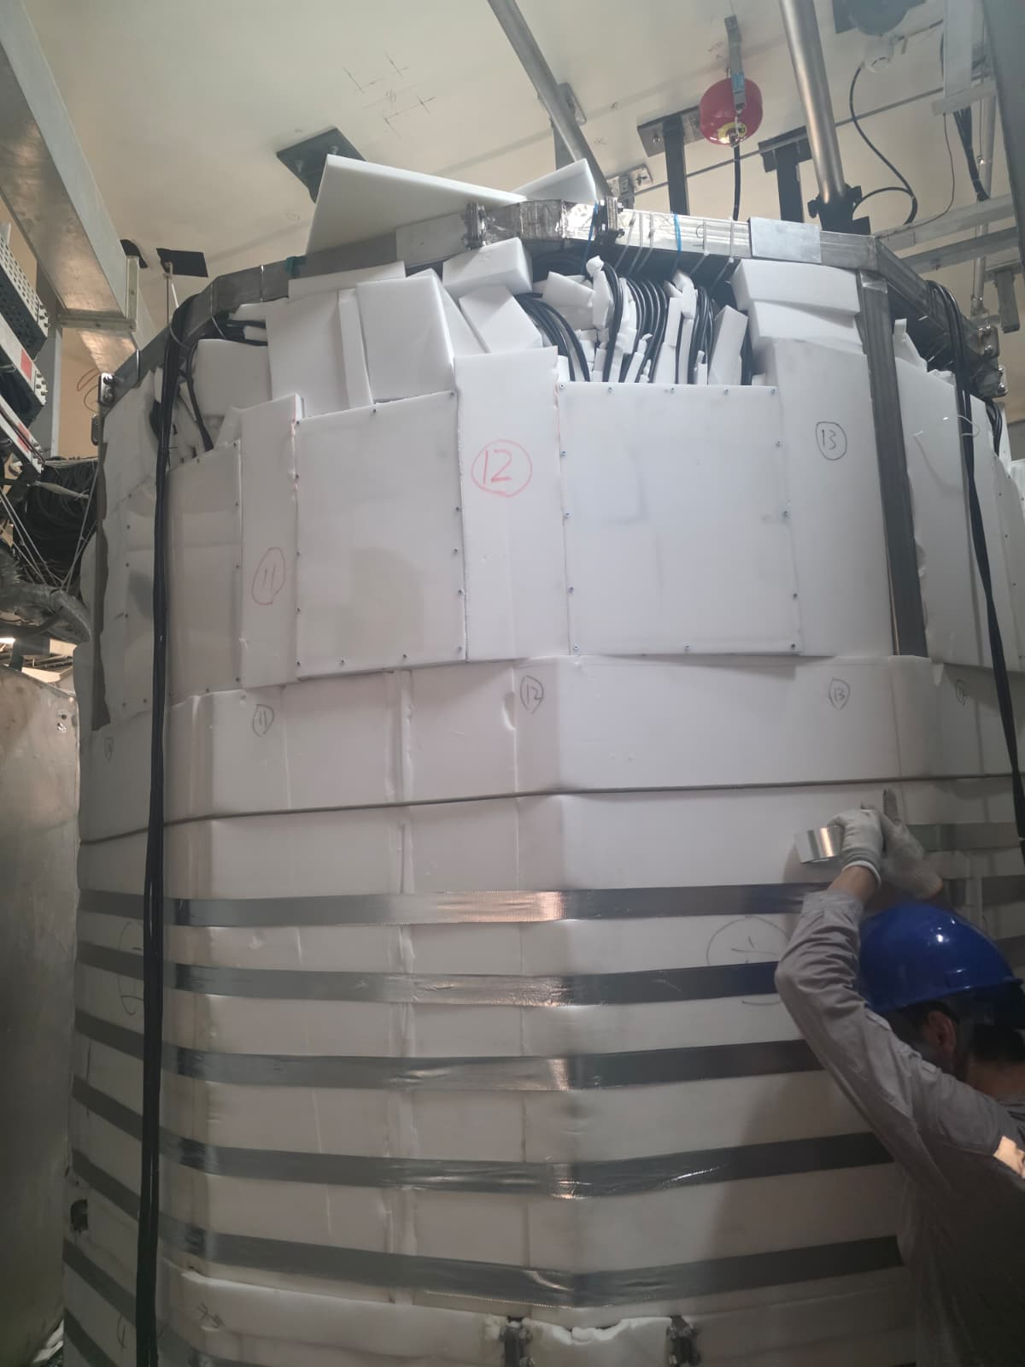
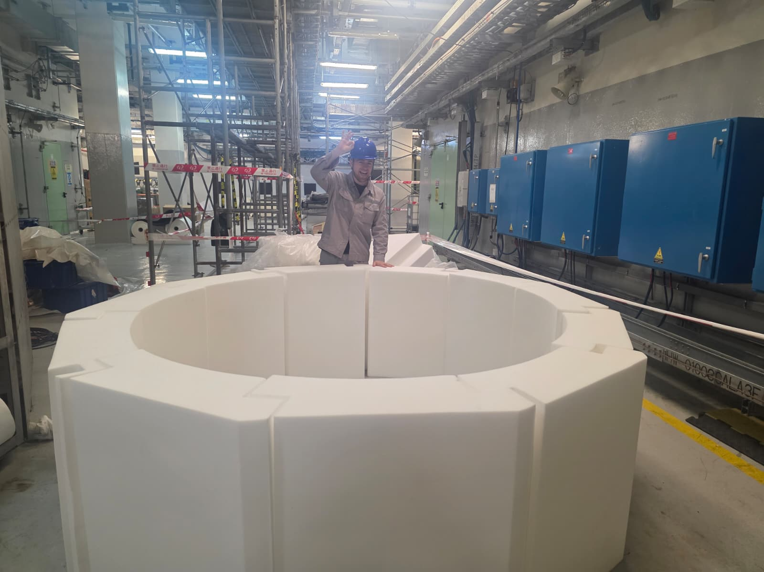
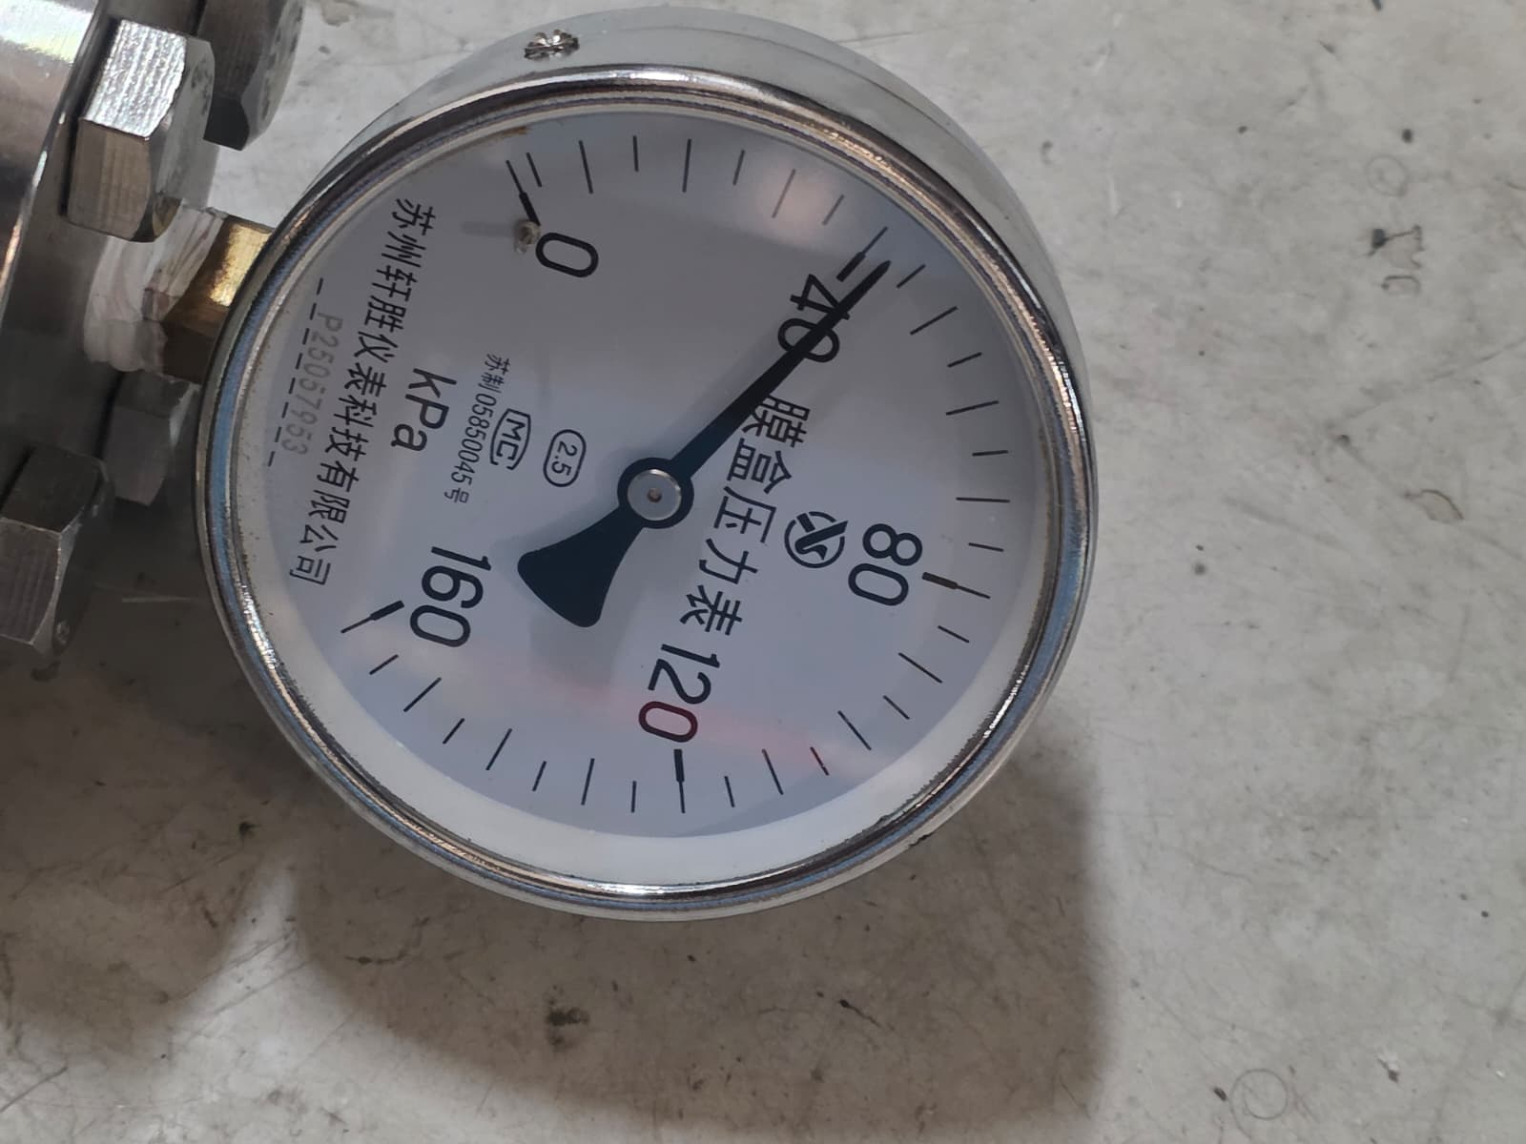
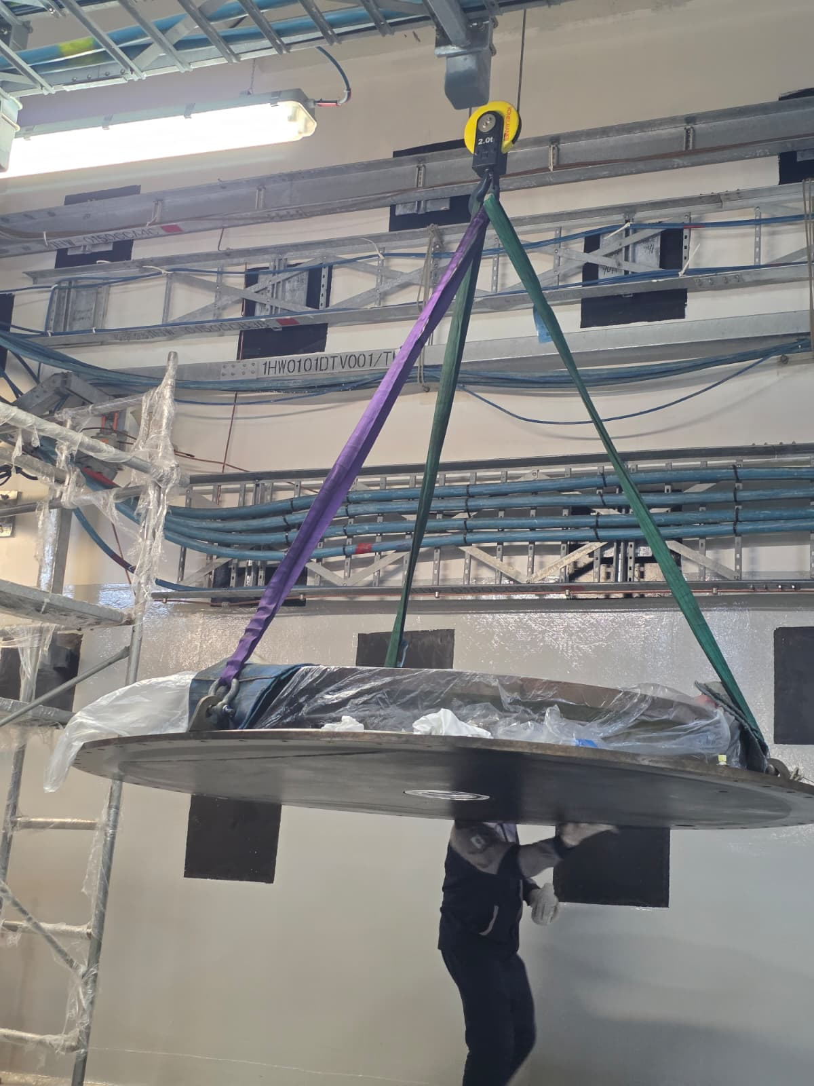
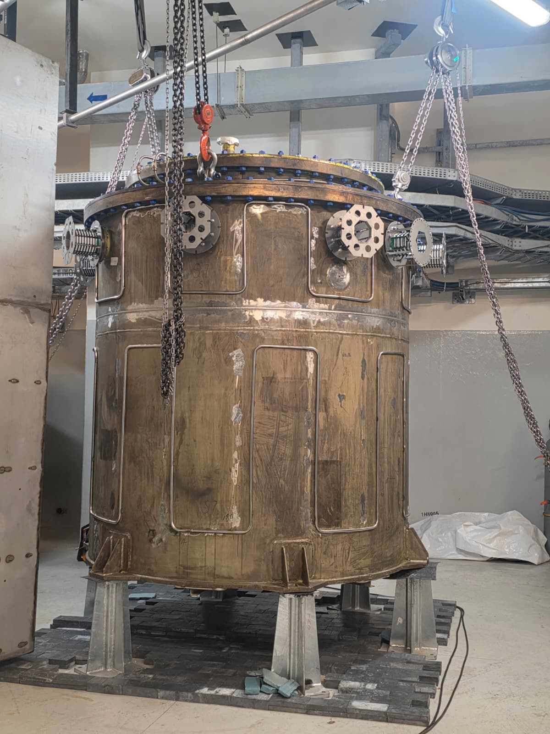
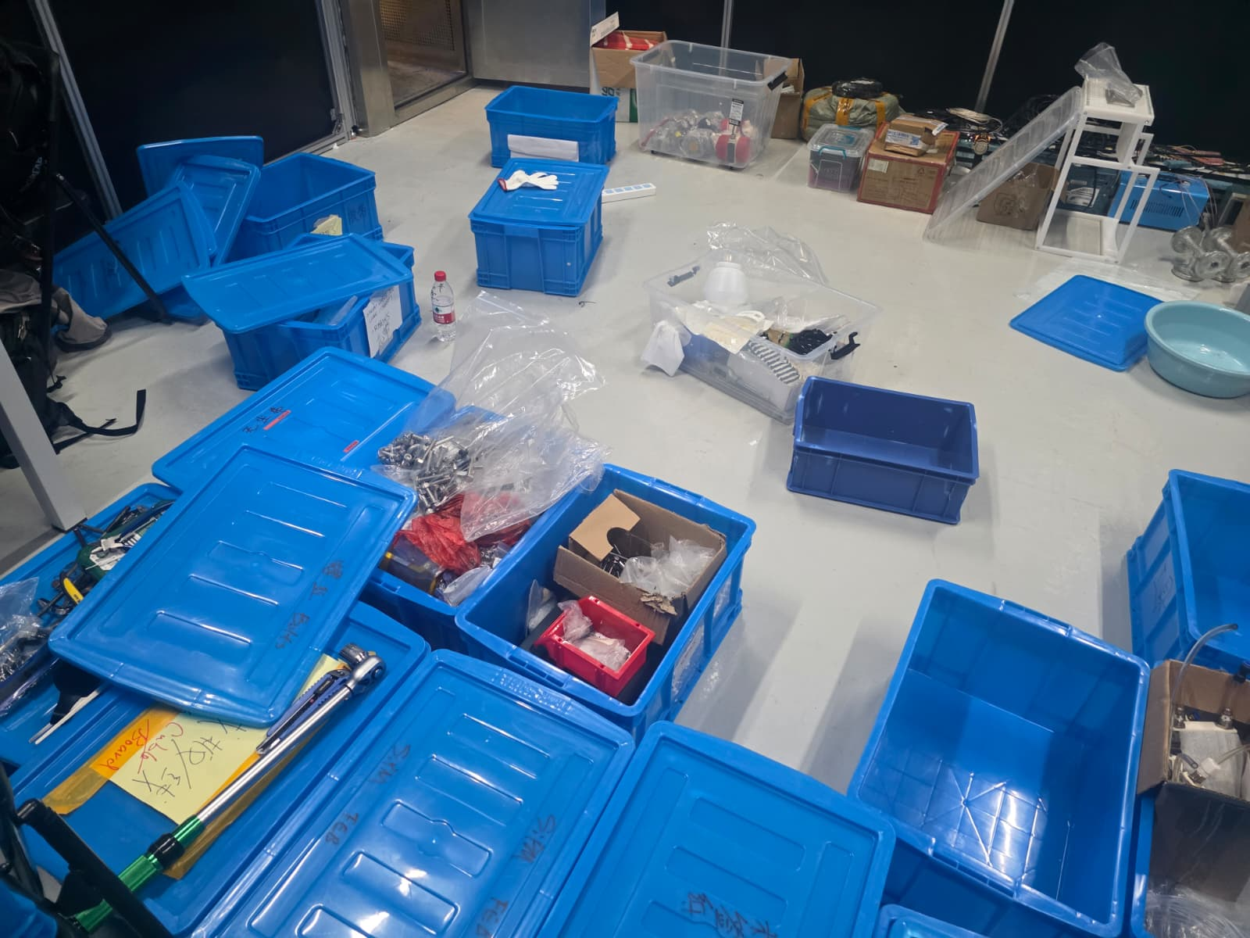
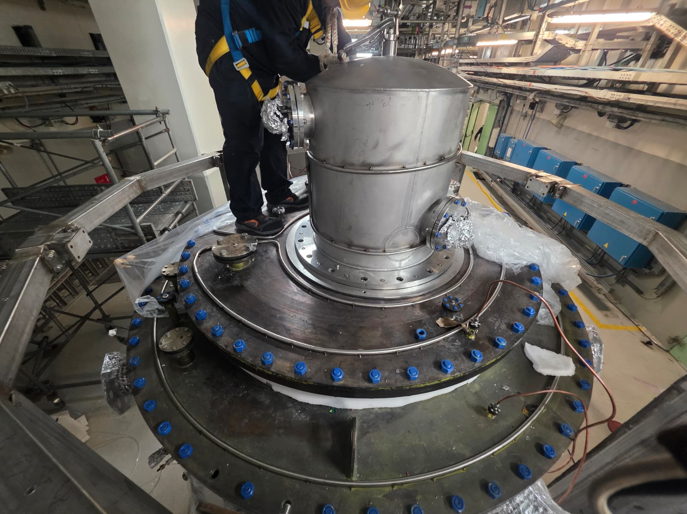
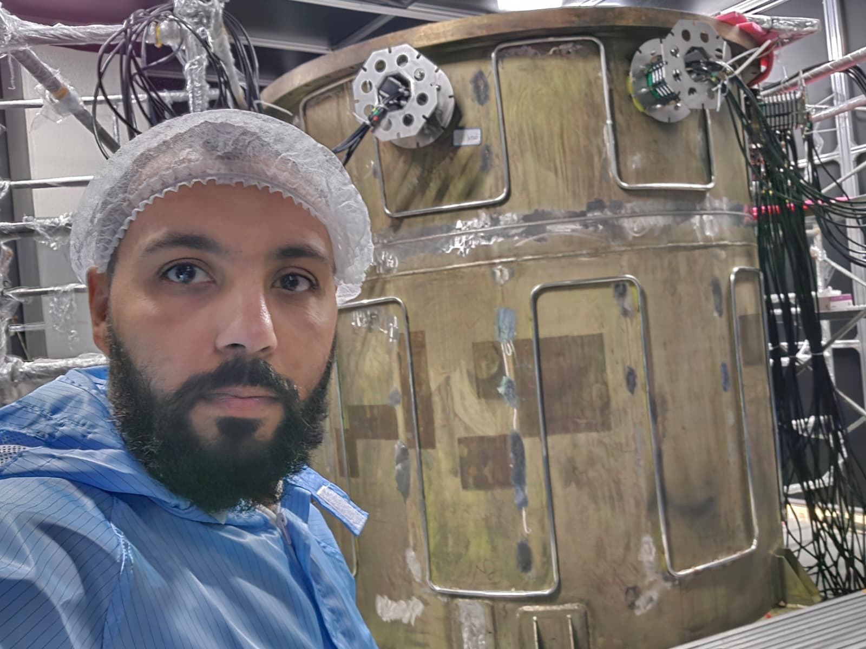
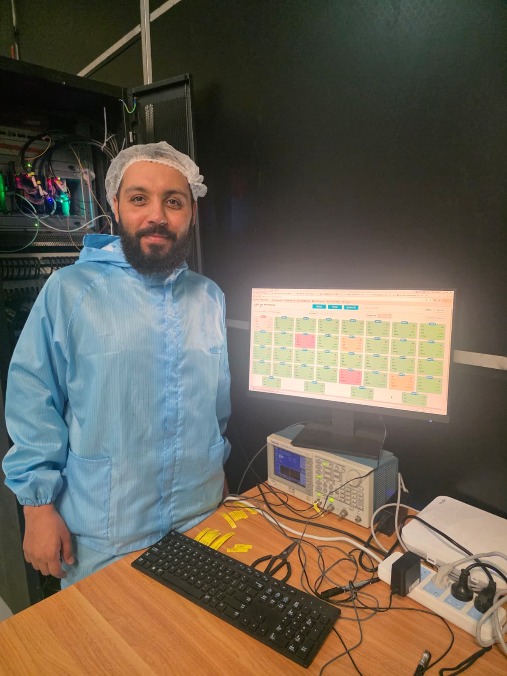
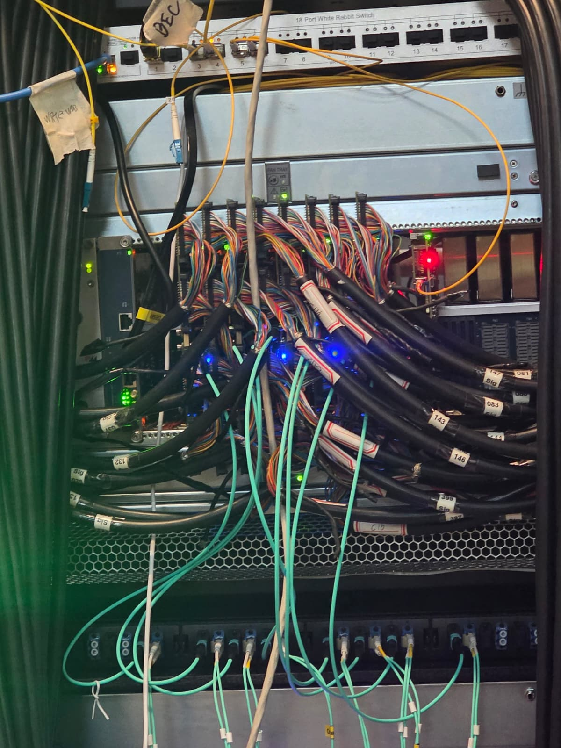
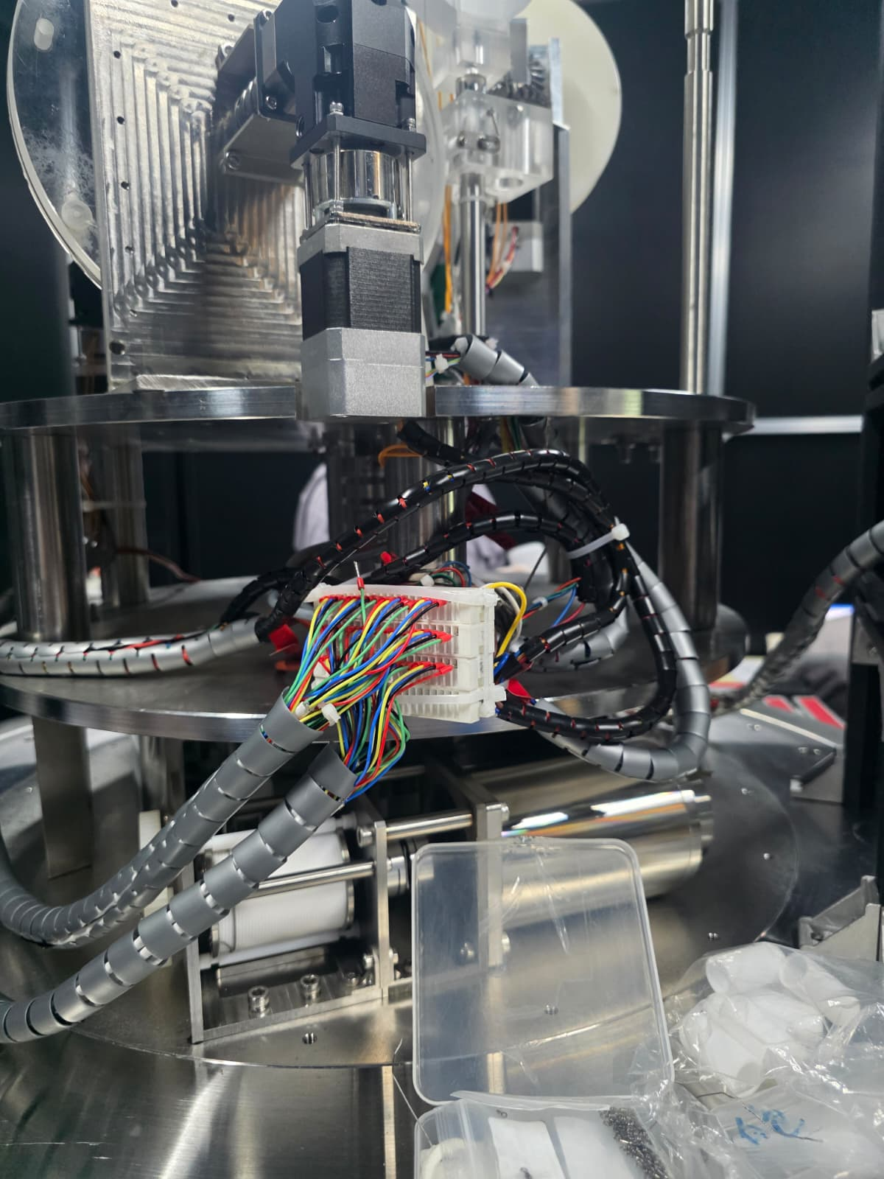
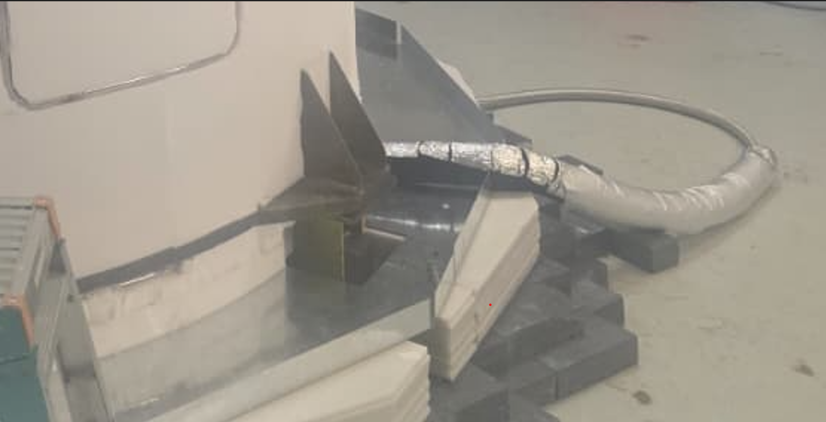
My Contribution
Dementaling of LV, HV and Signal Cables
Cleaning of the tank and Internal parts with ethanol
Shifting and setting of new Cleanroom
Bottom Shielding with Lead
HDPE bottom
ACU(Automatic Calibration Unit)
Cable Loop Systems(CLS)
Air Purging
Thermal Insulation
HDPE
Water
Water

Slide 8
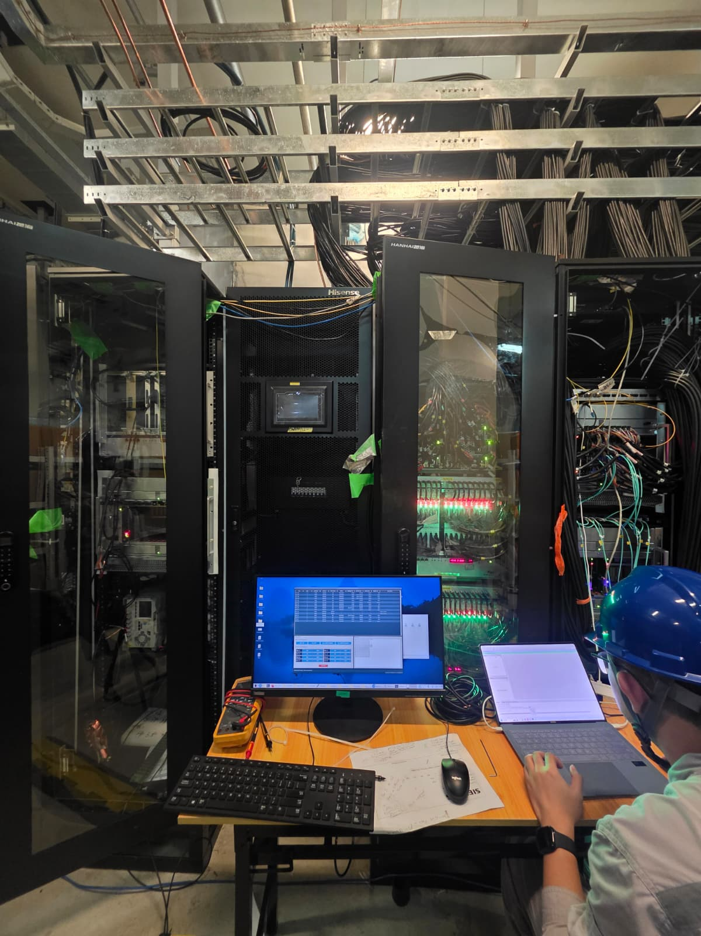
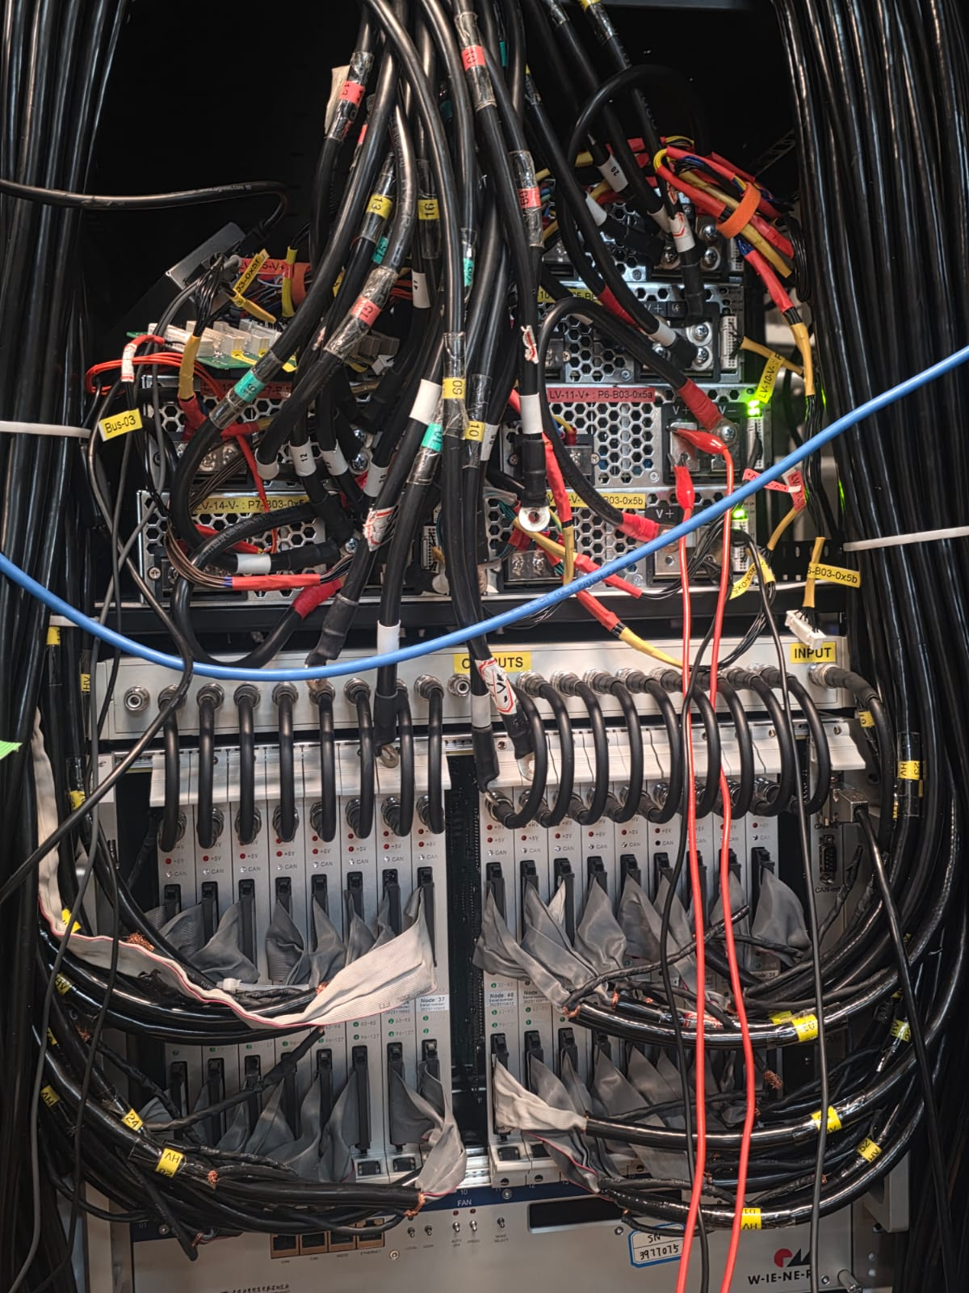
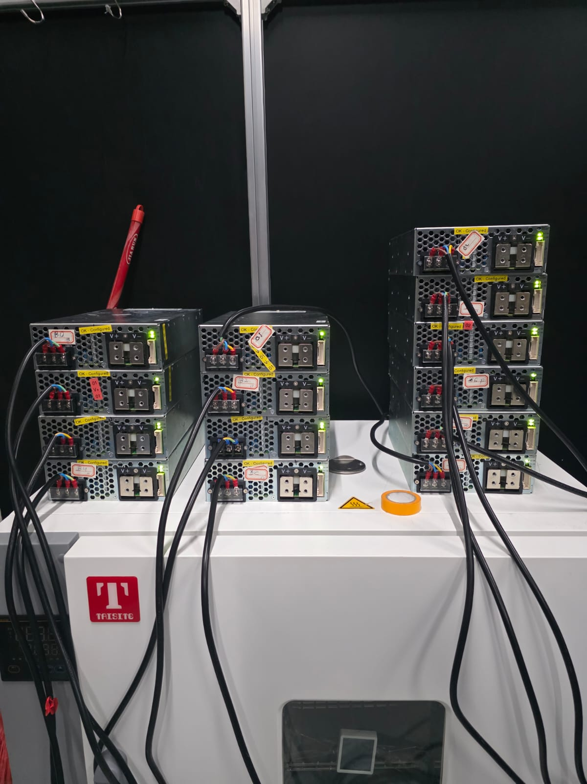
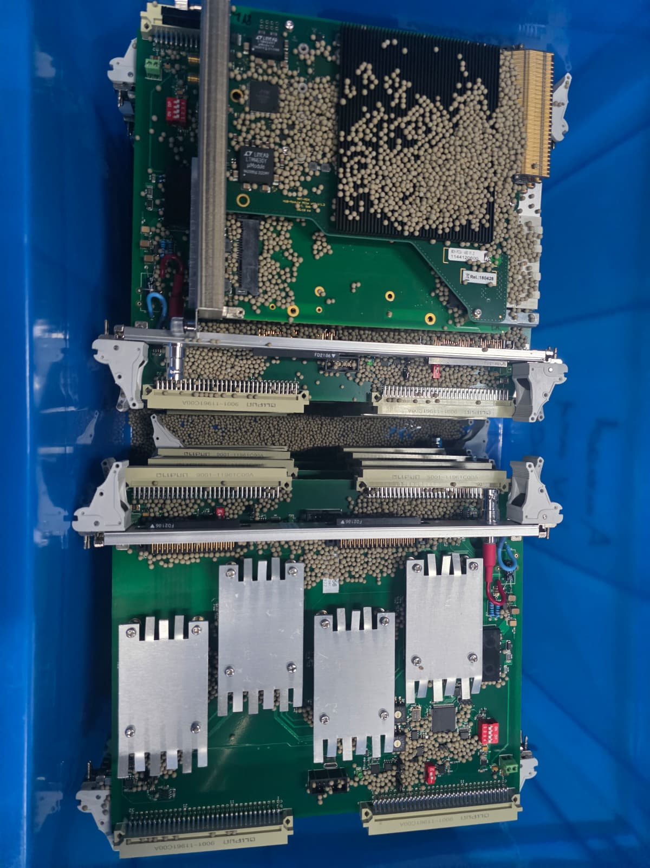
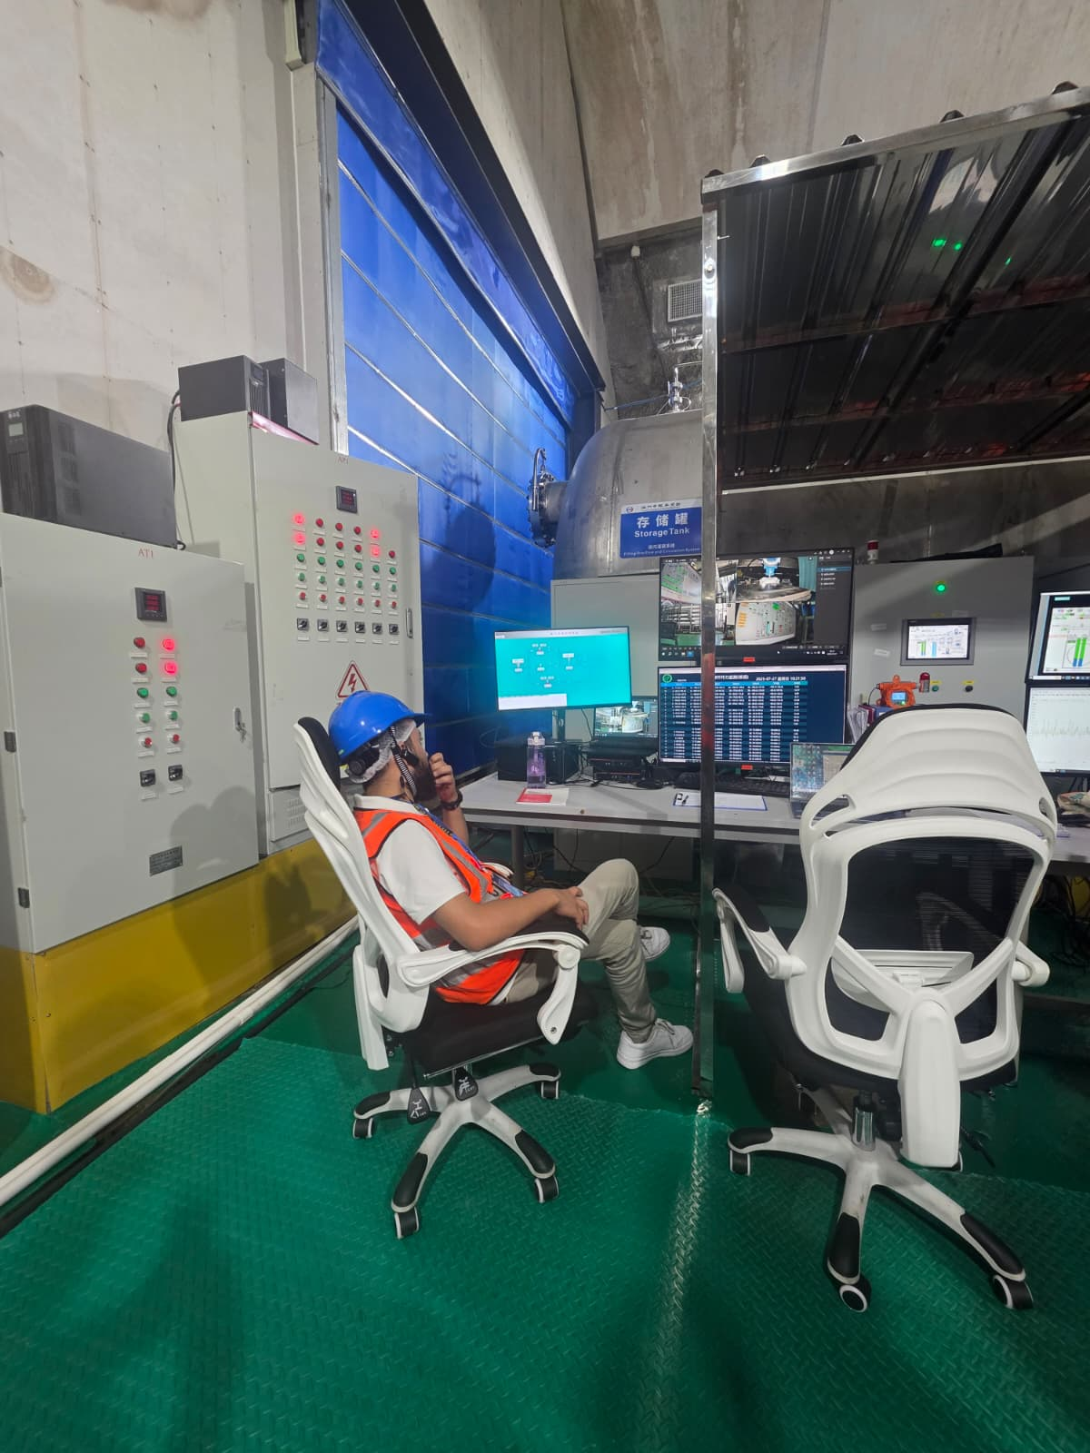
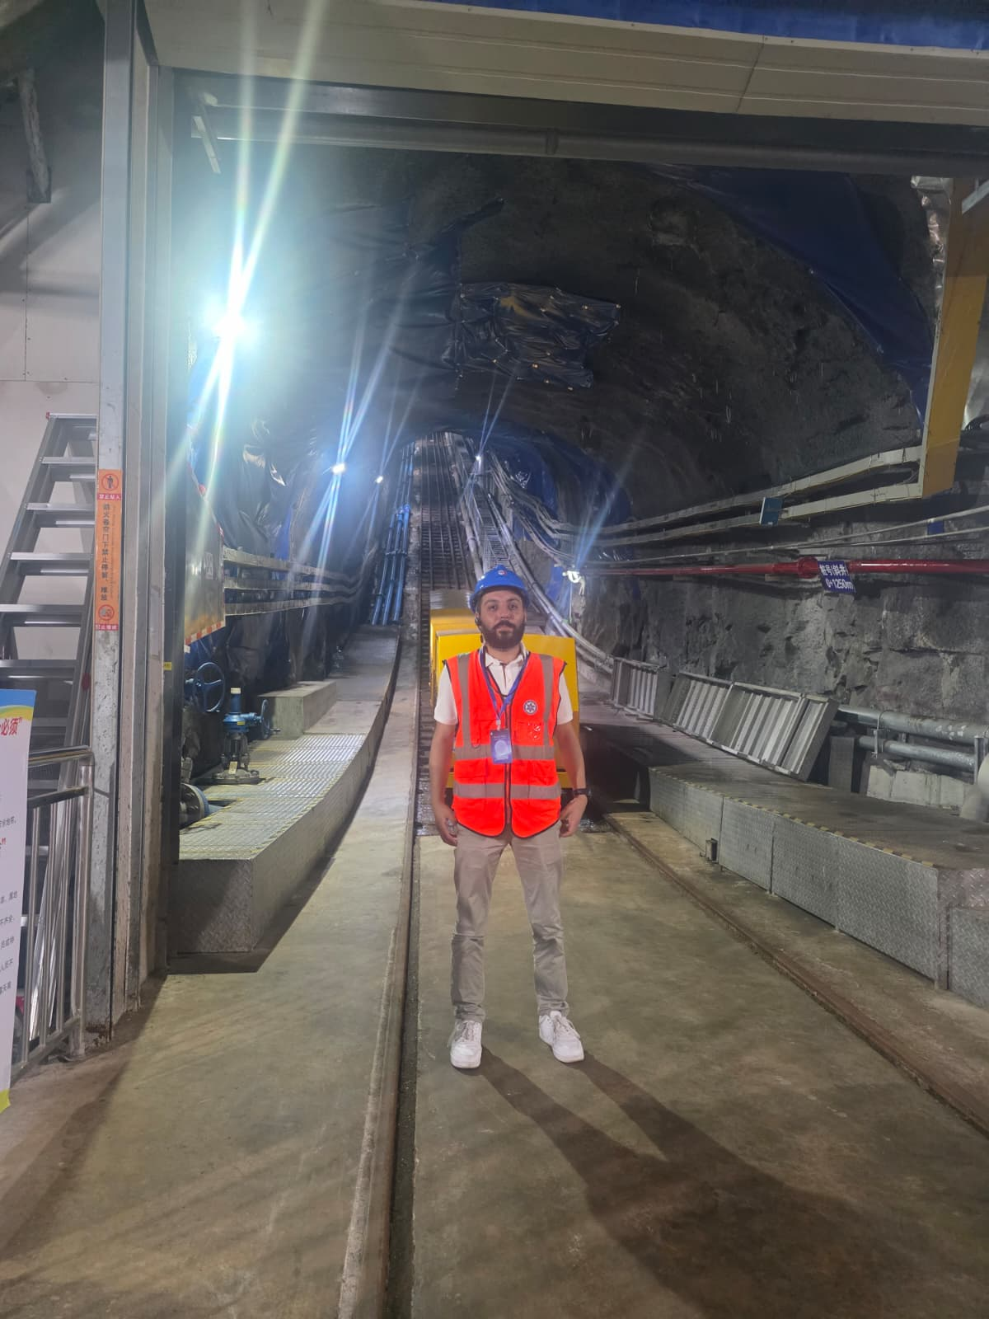
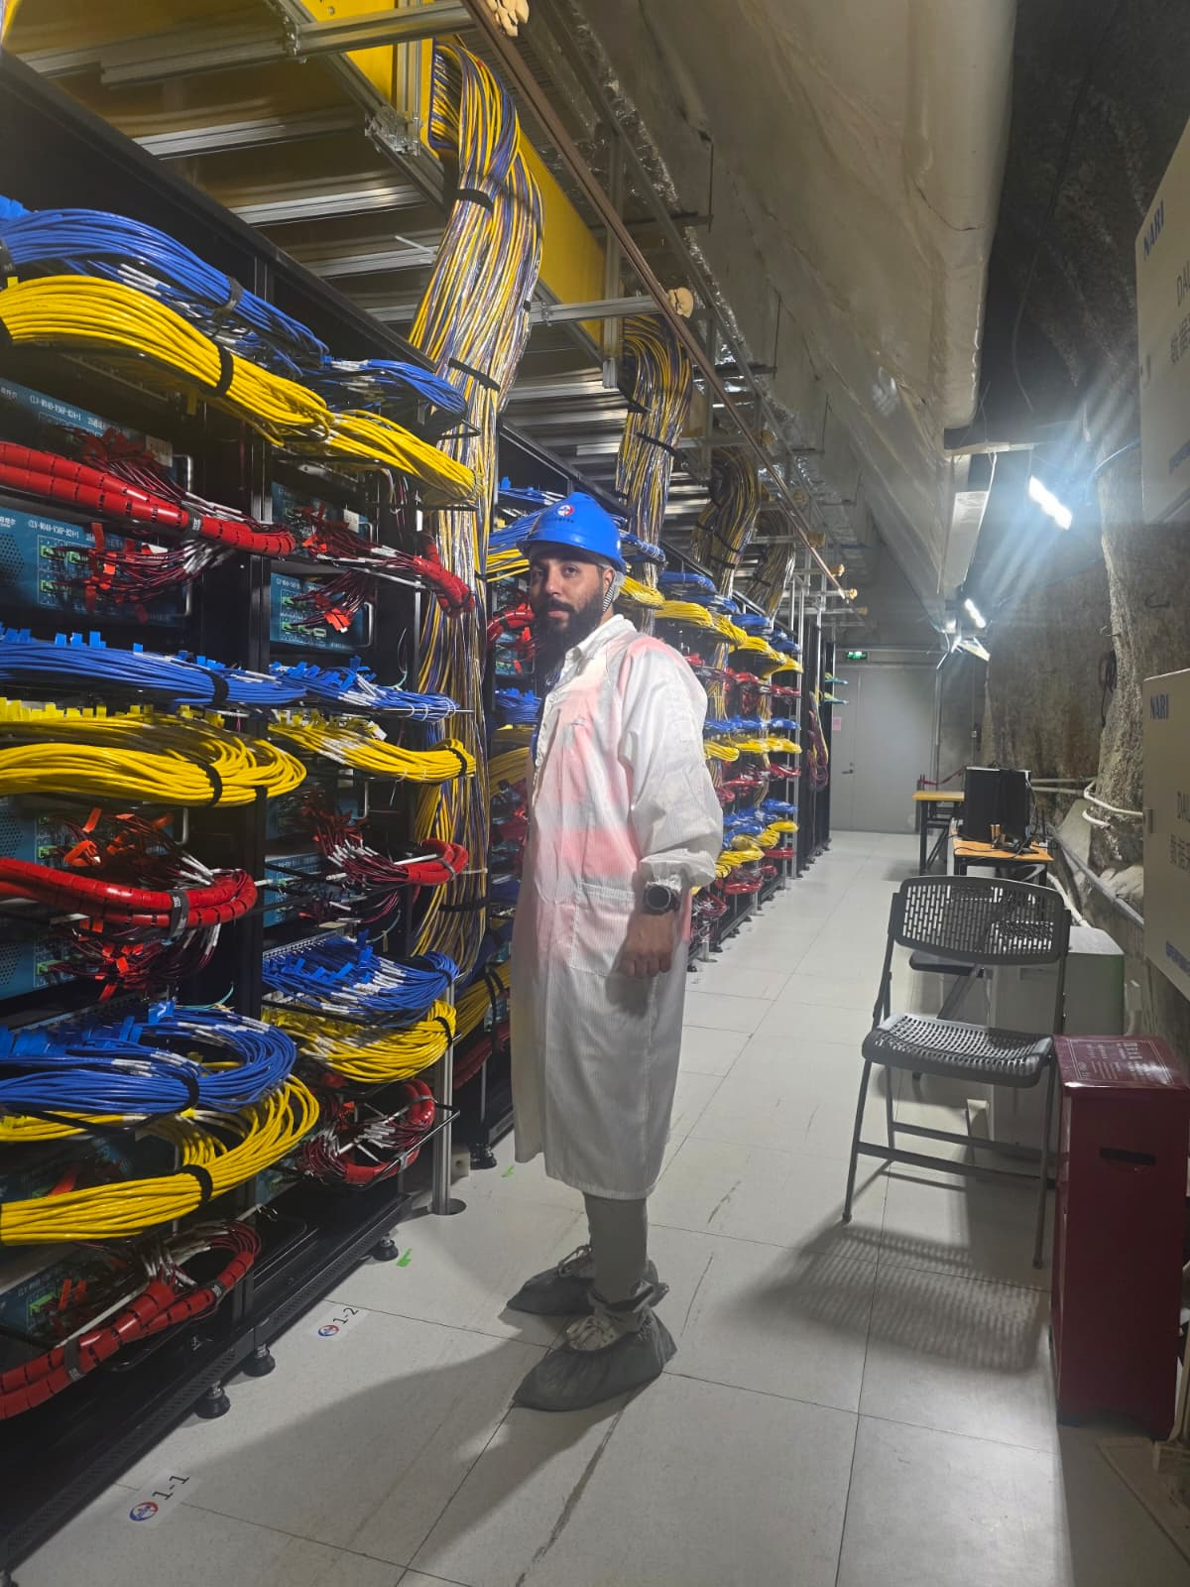
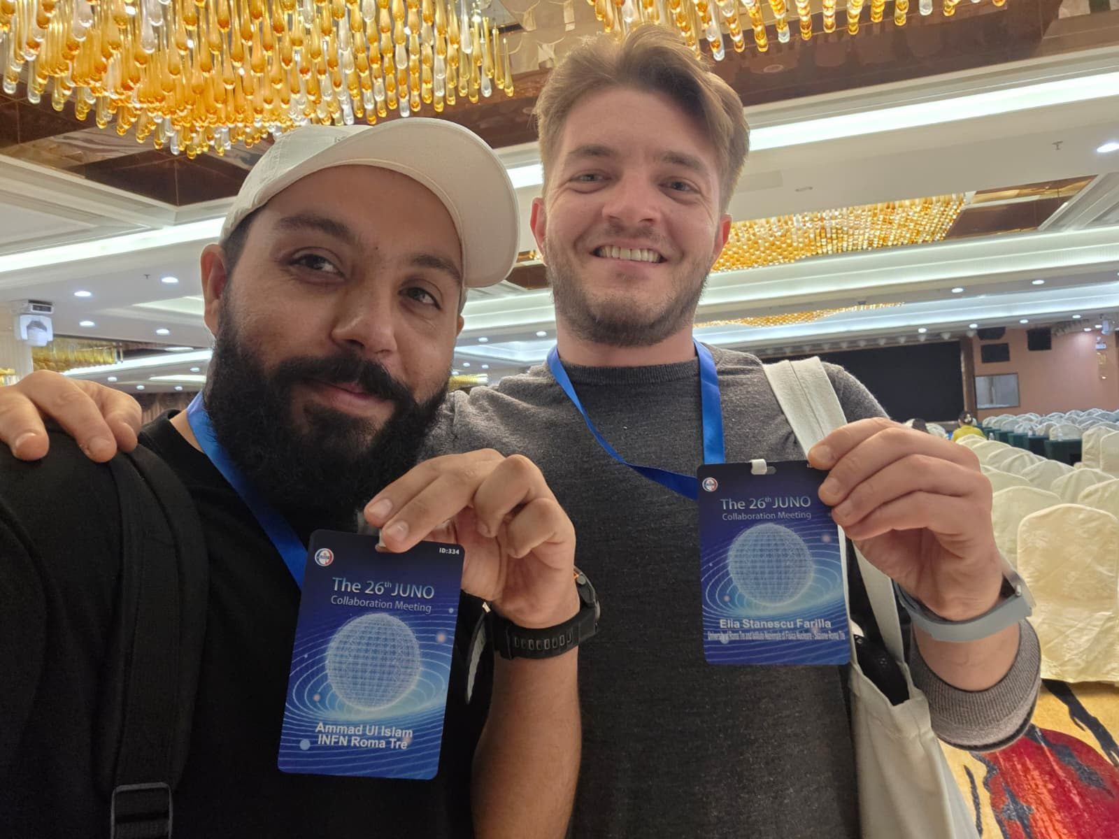

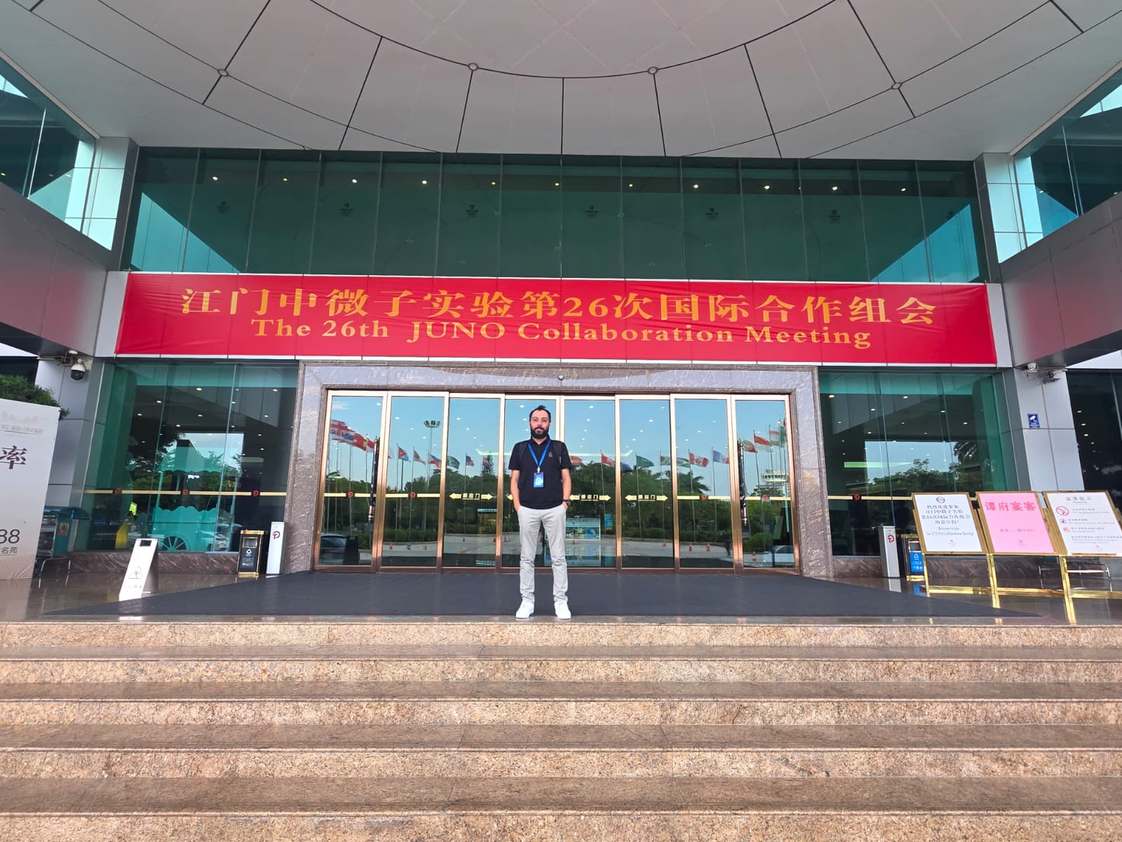
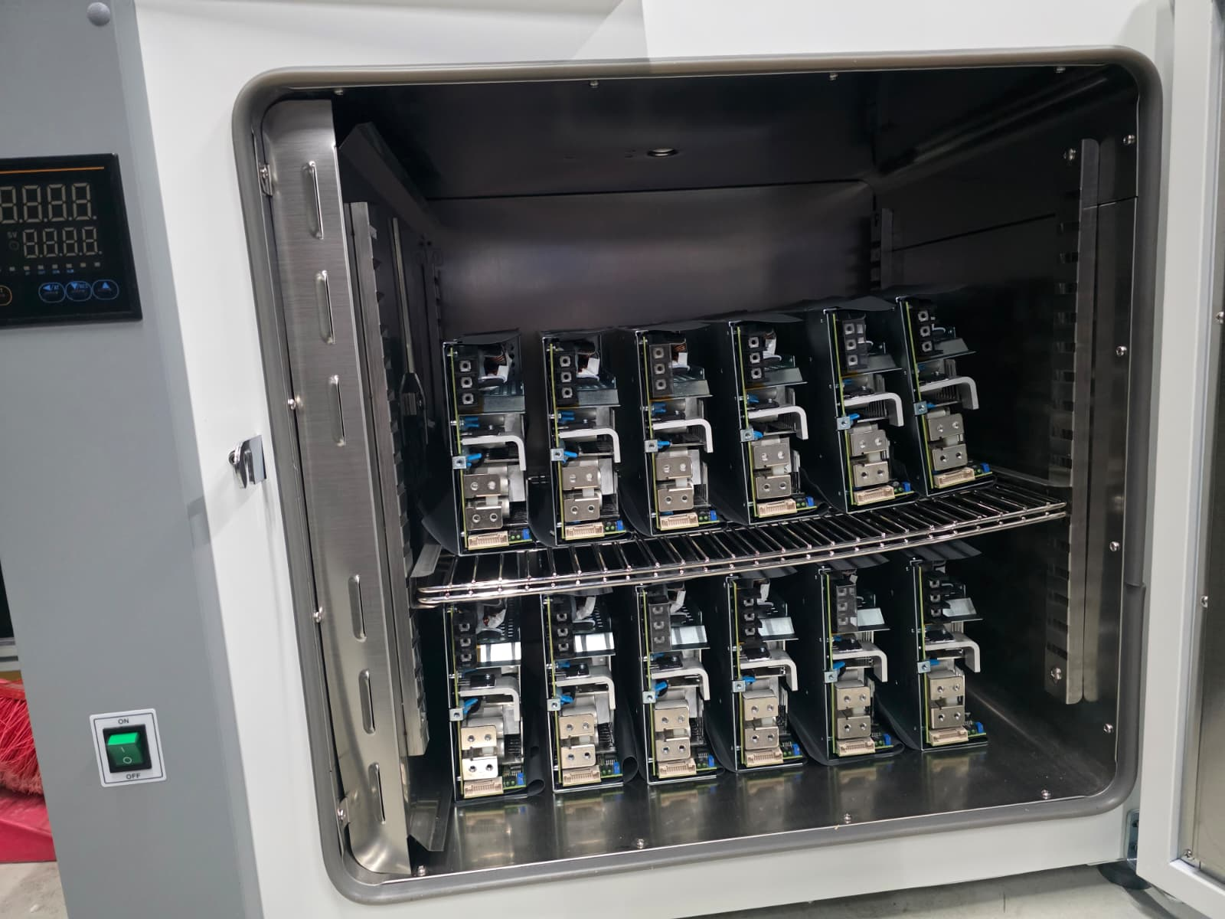
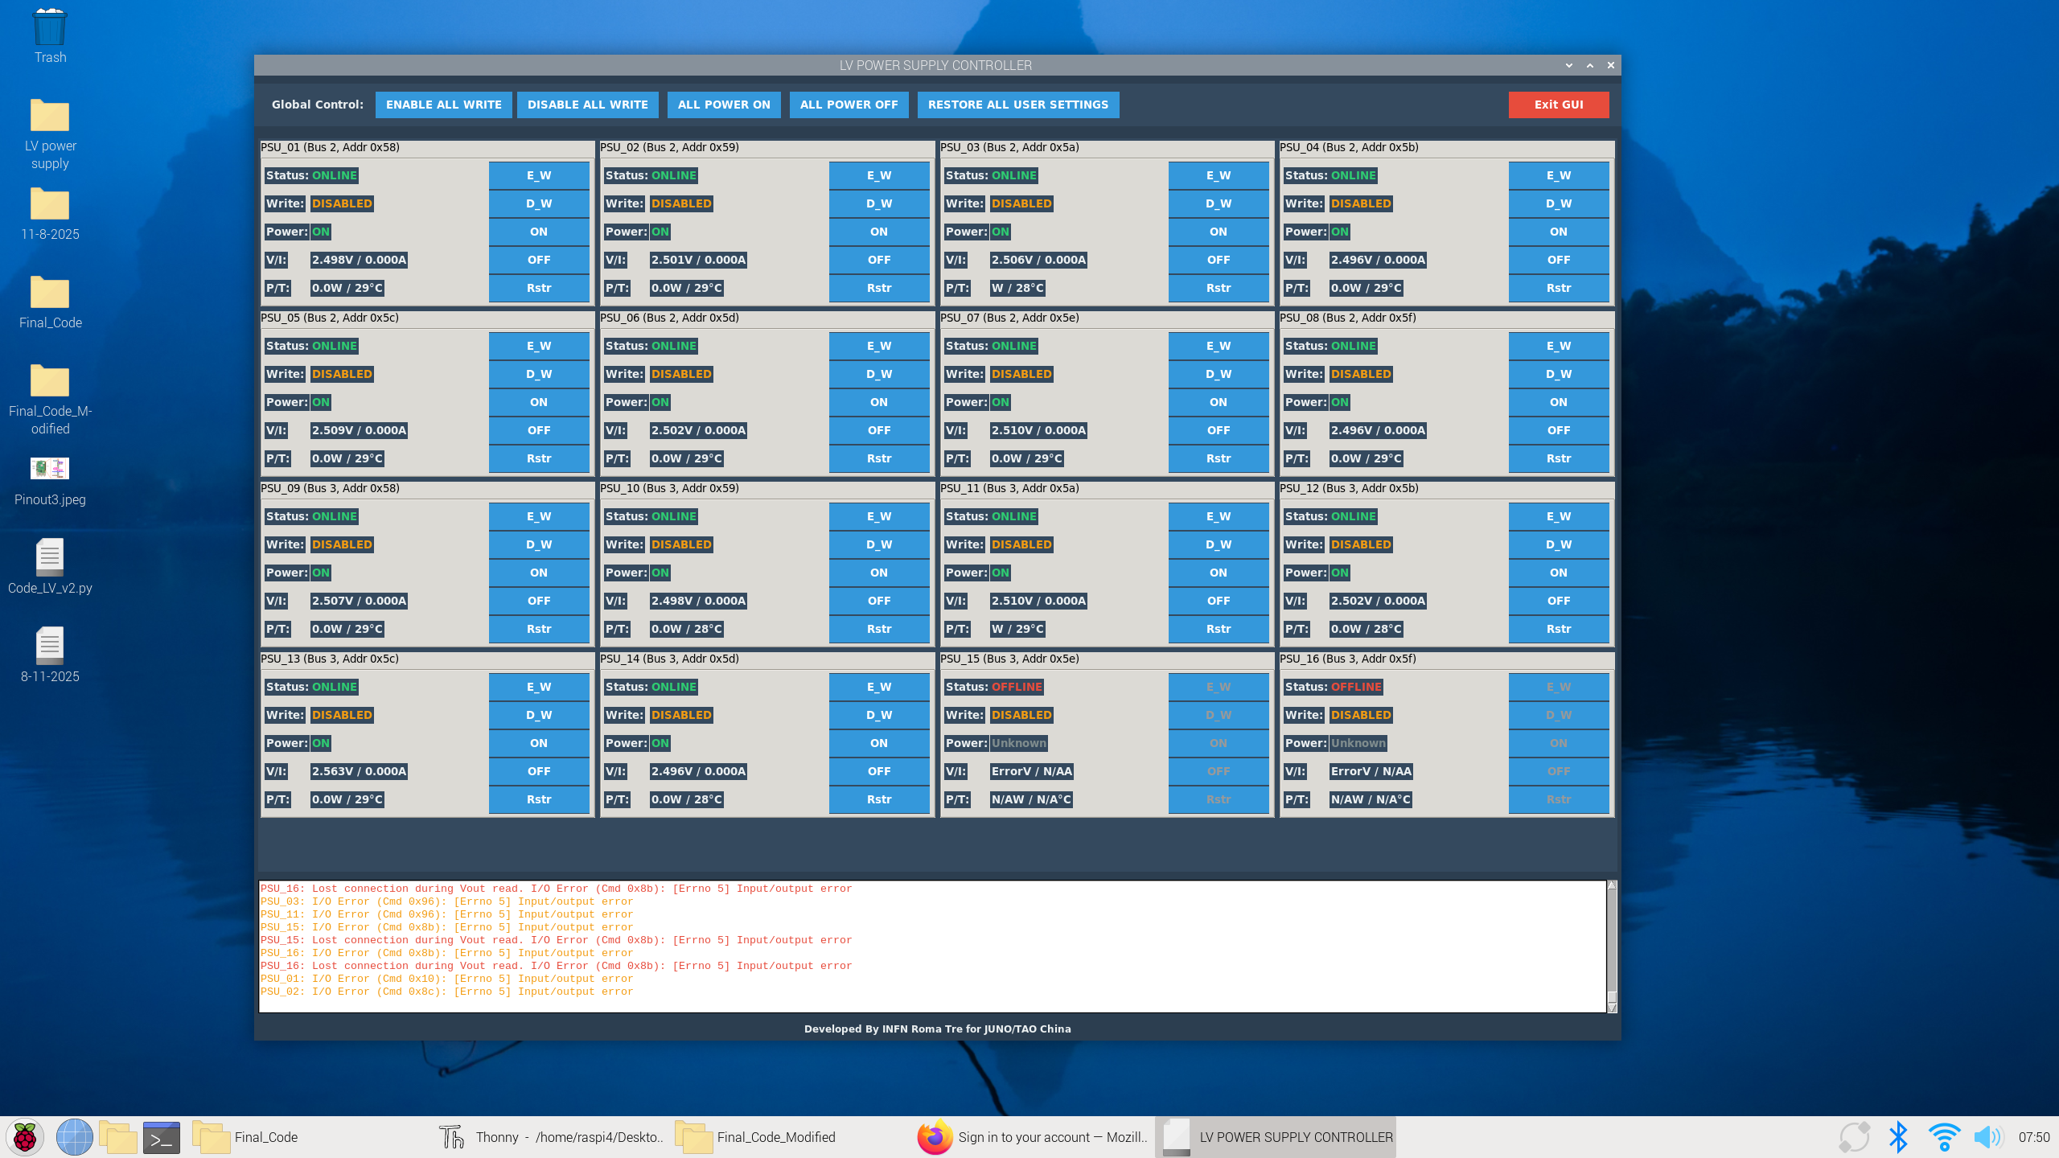
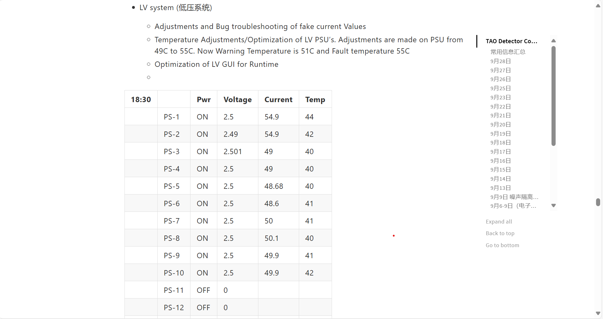
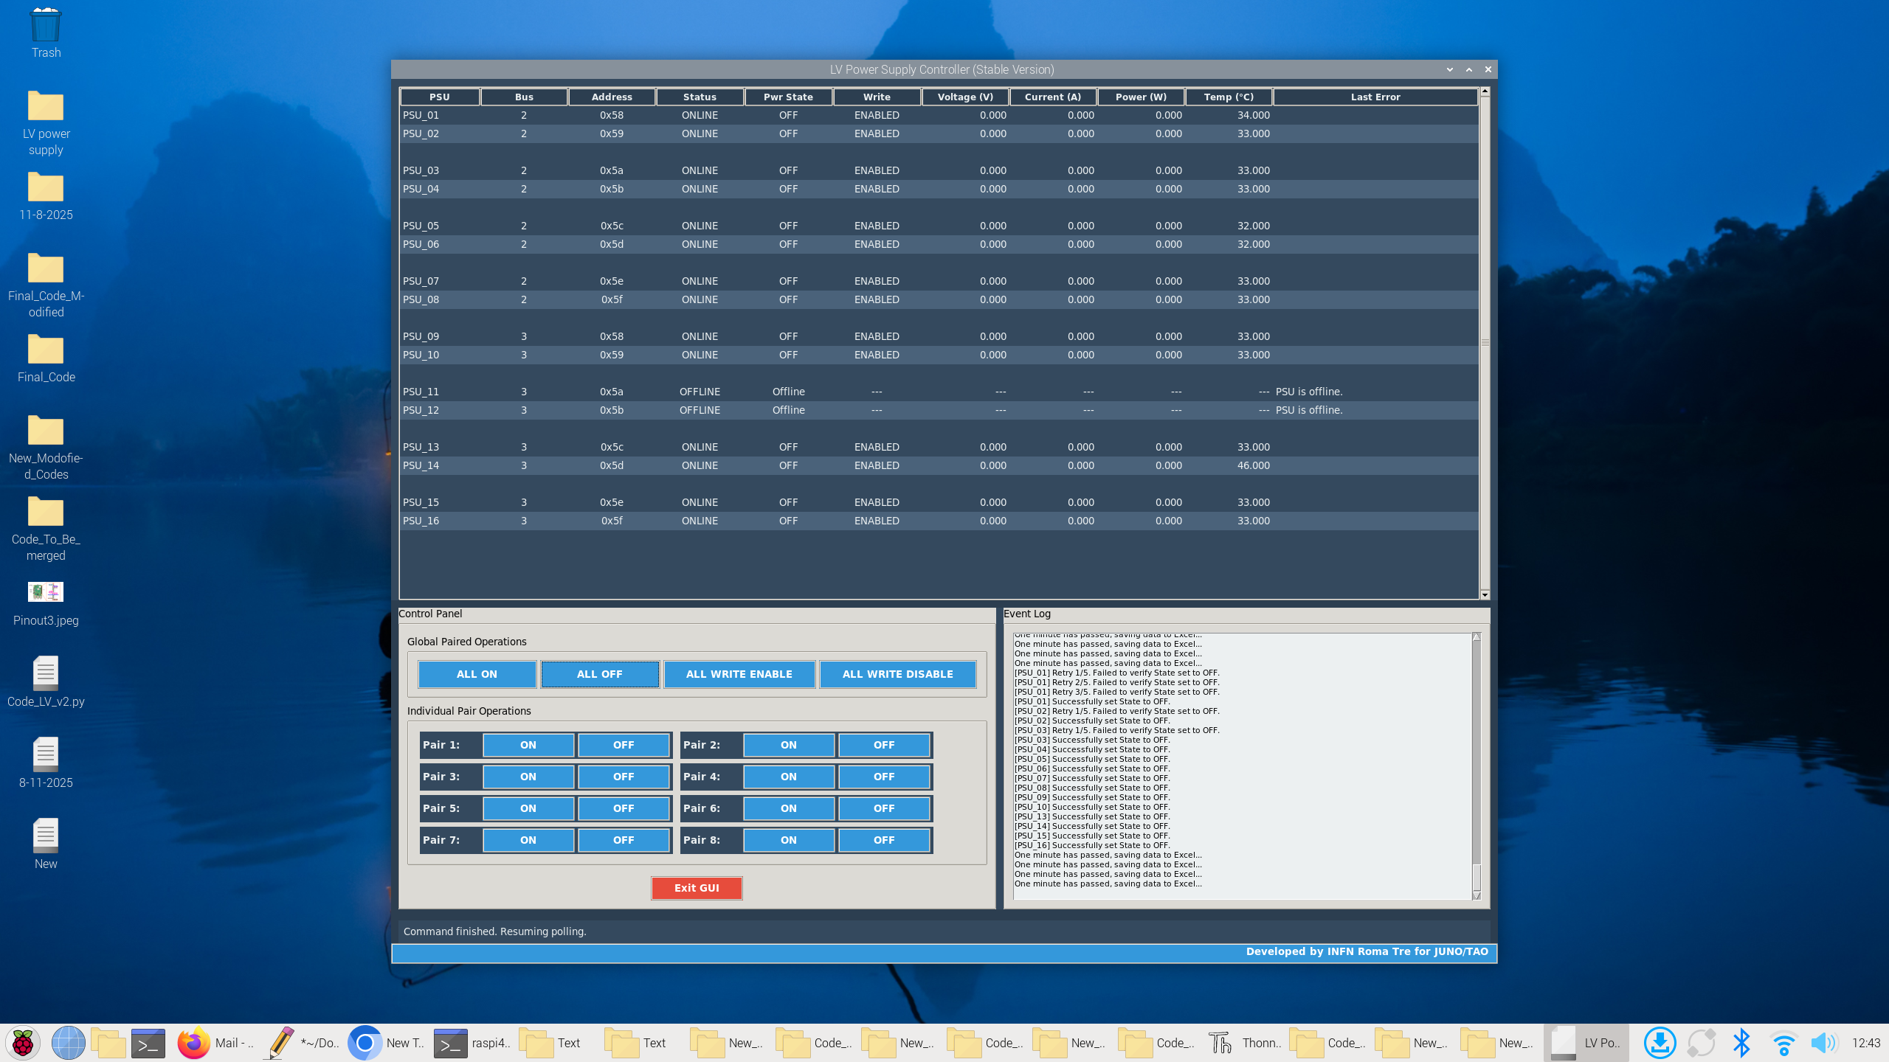
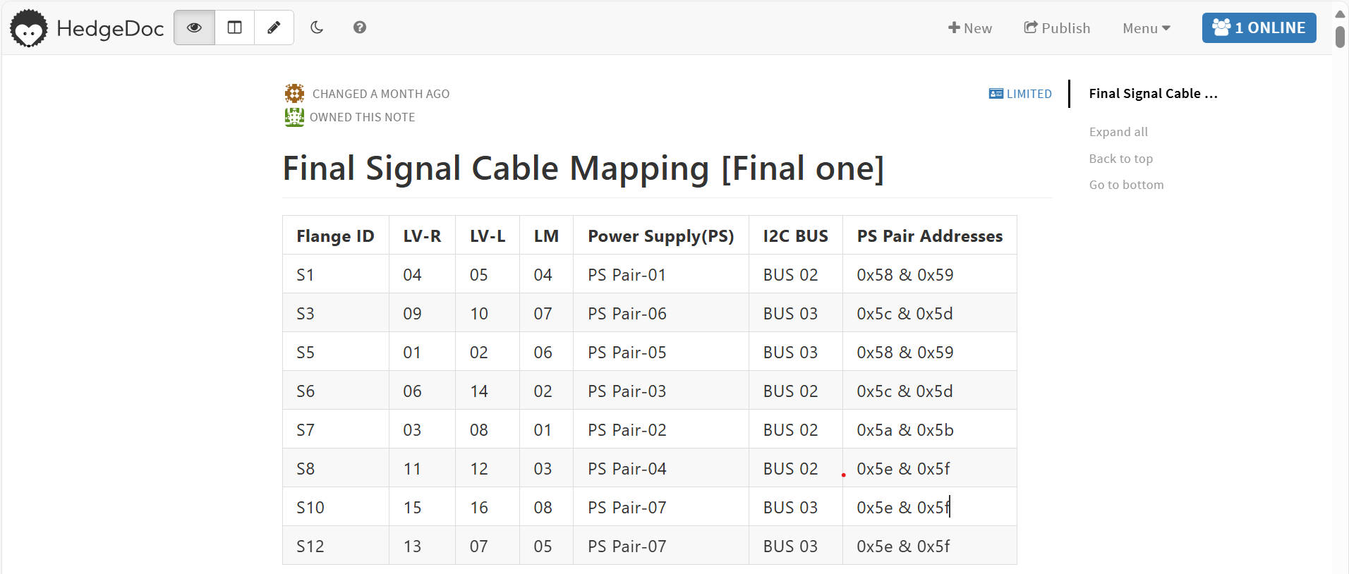
My Contribution
Troubleshooting Resistance Issue
JUNO Workshop
Collaboration Meeting
Resistance Testing
GUI development for LV
Water Leakage Issue
Dismanteling Everything From Racks
Flange Boxes
Putting Everything on Racks
Commissioning
Water
Water

Slide 9
Current Status of TAO
Installation work almost done
CD installation done
LS filling was done on Aug. 30
Started cooling on Sep. 2, now at ~-50
TVT installation done
WT filling done
Detector Commissioning
TAO Goals Achieved
Reconstruction algorithm works with reasonable accuracy
Backgrounds are understood
Detector response is understood, and energy response is obtained
First IBD signals are obtained by analyzing the commissioning data
Notes:
European community for future accelatror

Slide 10
Remaining Tasks
Delivery remaining ADC boards [Rome Tre]
Overshoot optimization, Sep. 15 Guofu Cao + 1 PhD from NJU
LV control software improvement, [Rome Tre]
Grounding, Sep. 11 Guofu Cao]
1 mTCA crate commissioning (~1300 channels), Sep. 11 Sep. 22 [Elec. + TDAQ]
Cabling in cabinets, Sep. 22 Jie Zhang +
Q/T algorithm optimization based on waveform data, < Sep. 22 Guofu Cao, Jiayang Xu]
Firmware, < Oct. 13 Fengfan Yang]
Address issues found during the commissioning
Smooth data flow from FEC to TDAQ
Implement optimized Q/T algorithm, reasonable Q/T accuracy
Firmware for TVT
Complete the full detector commissioning and performance optimization, < Oct. 27
Notes:
European community for future accelatror

Slide 11
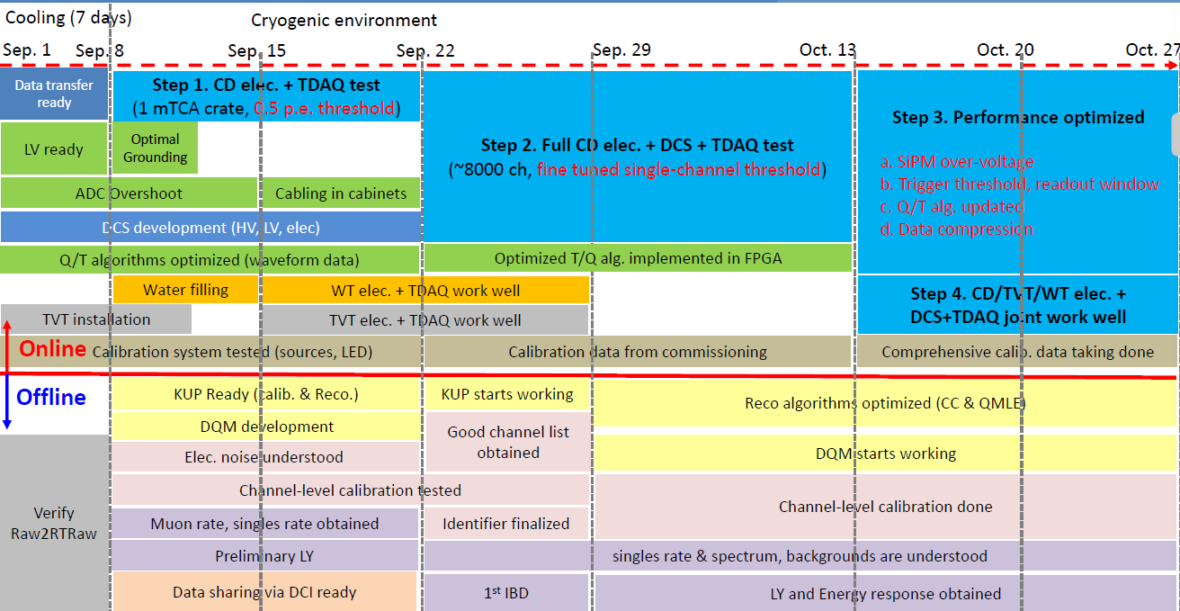
Roma Tre Tasks
Delivery remaining ADC boards [Rome Tre]
Testing and Troubleshooting of the LV issues with proposed solutions at INFN Roma Tre
Setup LV system controls to DCS(Remote Control is already implemented)
Notes:
European community for future accelatror

Slide 12
Courses and Conferences
Courses
Programmable System on Chip (SoC) for Data Acquisition and Processing(Passed)
High Energy Particle Physics Detectors in Space(Passed)
Management of Scientific Projects(Passed)
Machine Learning For Physics(Project in Development)
Advanced scientific Programming in MATLAB(Attended)
Conferences and Workshops
The 26th JUNO Collaboration Meeting, Kaiping, China
JUNO Analysis Workshop, Dongguan University of Technology(DGUT) July 2025
PhD meeting at the Gran Sasso National Laboratories February 2025: Poster Presentation
2nd ECFA-INFN Early Career Researchers Meeting, 2024
Notes:
European community for future accelatror

Slide 13
Publications
Published
As Corresponding Author: “Real-Time Monitoring and Control of Renewable Energy Systems Using Wireless Telecommunication and Signal Processing Techniques for Smart Grids with Energy Storage”, Spectrum of Engineering Sciences (2025)
In Writeup
Development and Performance of Silicon Photomultipliers Readout System and Front-End Electronics for Reactor Neutrino Detection at the JUNO-TAO Experiment (writeup)
Talks
TAO LV System Talk in TAO Meeting
Notes:
European community for future accelatror

Slide 14
Planning for III Year
Final Version of GUI for LV and its Deployment on DCS
Optimization of Noise Issues on I2C of LV System
Data Analysis and Pre-processing:
Analyze the real-time data acquired from the TAO which is expected to be available at the end the year.
Cleaning, pre-processing, and organizing
AI Algorithm Development:
Develop and train the AI-based pattern recognition technique.
Machine learning model, optimizing its architecture, and training
FPGA Implementation:
AI model will be developed on an FPGA(KU15P).
System Validation and Benchmarking:
Benchmarking the speed, accuracy, and efficiency of proposed method against traditional methods.
Thesis Writing:
Writing the thesis, systematically documenting the research methodology, results, and conclusions.
Water
Water

Slide 15
THANK
YOU

Slide 16
Supporting Slides

Slide 17
Electronics Update

Slide 18
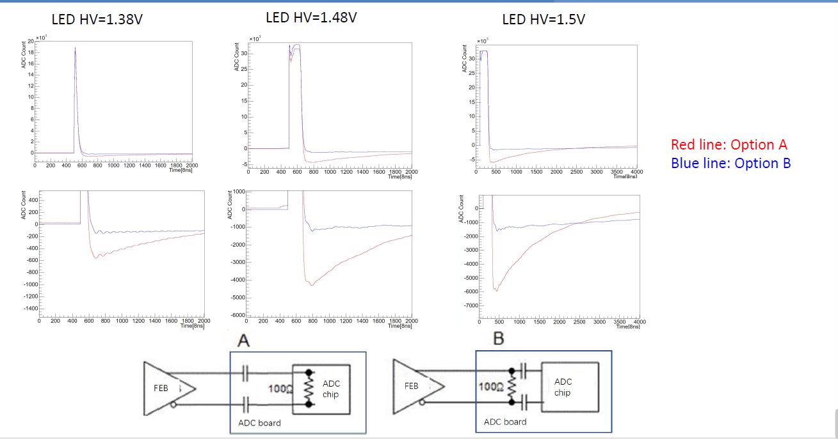
Over shoot

Slide 19
Pending Actitivies since last meeting
Low Voltage Control system
Splitter boards give some insulation issues when several PSU are connected
ADC Production
It was scheduled during the last spring

Slide 20
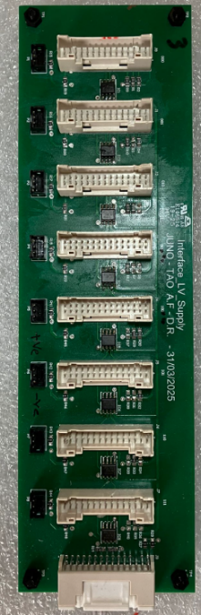
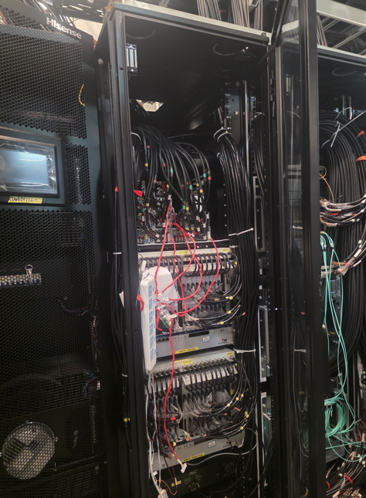
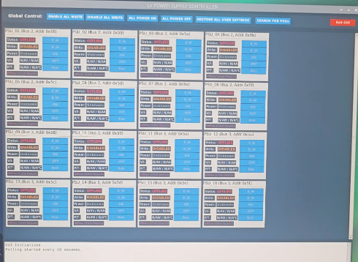
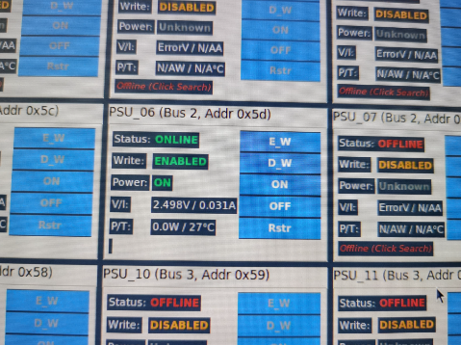
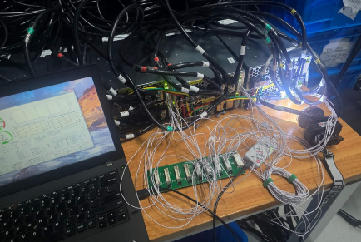
LV system
A second version of the splitter board is currently running @ NPP. All the insulation issues are solved.
The control software for the LV system is currently under final deployment by Ammad directly at NPP.
It will be included in the DCS software in the next weeks.

Slide 21
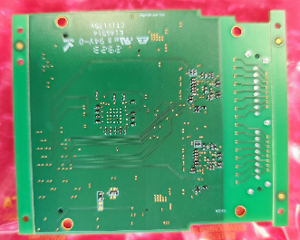
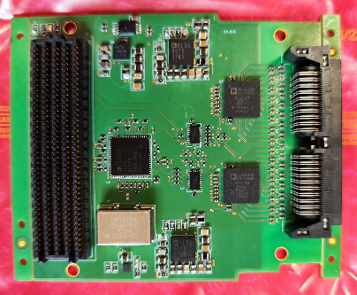

ADC Board
Production done at the end of May
Voltage Regulators
E²PROM
AD9083 (16 channel each)
PLL
Input connector
FPGA Connector
Level shifters

Slide 22


Test Procedure
#32
Test JIG
Test JIG generates 32 signals that feed all the ADC board input.
Signal amplitudes can scan the input dynamics starting from below half of a single p.e. up to ~300 p.e.

Slide 23



QA / QC results

Slide 24

QA / QC results
Several boards (~ 100) didn’t pass the first steps of the QA / QC:
odd resistance values on the DC/DC outputs.
Reduced voltages on the ADC pins also with the right resistance values.
Data cannot be acquired by the DAQ system (discontinuous transfer or totally absent)
After several iteration with the assembly company we found there was a big issue with the soldering oven,
the temperature was not homogeneus during the process and was below the soldering threshold on some of
boards.

Slide 25



QA / QC results

Slide 26
Current activities
Currently ~16 boards were recovered.
Fifty-four reworked boards will be delivered next Wednesday, we will be able to test them the day after and ship them as soon as possible.
We have 6 board in China right now, thanks to Fabrizio, to test the same reworking there trying to speed up the process.
The last board batch should be ready for mid-september (take into account italian company summer break.)

Slide 27
Physics Requirments
Requirements➢ENC < 0.1 p.e.
Negligible impacts on energy resolution and allowed us to perform photon counting
ASIC Readout Scheme
Discrete Readout Scheme

Slide 28
Timing Resoultion
Requirements: 1 ns
It’s not essential to have a ~ns level timing resolution for PSD
However, a good timing resolution (~1 ns) can help to improve the resolution of reconstructed position
ASIC scheme
200 ps TDC bin size, timing resolution of SPE is under investigation
Discrete scheme
~1.5 ns at 1 p.e., measured with a 6 x 6 mm square SiPM
ASIC
Discrete

Slide 29
Energy Non Linearity
ASIC scheme:
The large non-linearity is expected for KLauSchip, which is similar with that in DYB.
The non-linearity based on charge depends on event positions, but this dependence can be significantly reduced by using p.e.counting, which is one of main features of SiPMs.
Can be corrected during energy calibration.
Discrete scheme:
No electronics non-linearity is expected for discrete readout.

Slide 30

Pulse Shape Discrimination(PSD)
Due to fine granularity of ASIC readout scheme, it shows very powerful PSD discrimination➢
The sensitivity of mass ordering determination is improved with Δχ2increased by 0.05 (Doc-6568) (JUNO budget ~300 M$ for Δχ2= 9, so Δχ2= 0.05 is corresponding to 1.7 M$)
The potential risks on fast neutron background are almost eliminated
If the number of channels in discreate readout scheme is increased by a factor of 2, the similar PSD power with ASIC one can also be achieved
ASIC
ASIC
Discrete
IBD Efficiency 100%
Discrete

Slide 31

Muon Induced Fast Neutron Findings
The spallation neutron from muon can mimic IBD signal.
Fast neutron
High energy neutron deposited energy(proton recoil)+neutron capture
Double neutron:
Two neutron capture
Using about 22days’ data
Muon
Muon
Water

Slide 32

Event Selection
In the real case, the fast-n background is an untagged muon-induced background.
Here use the tagged WP muon to study the fast-n properity.
The preminary trigger select WP muon(nHit>450);
CD muon [-20us,20us](total PE>40000);
Select WP only event(no CD muon)
Cut:
After muon:[0, 500]us, find the CD event；
Sub-event PE>3000
Muon
Water
Outside from the veto
Water
[0,500us] sub-event mulitiplicity

Slide 33

Sub event Time vs Charge after WP-only muons
Since select the WP-only muon:
Still see before 60μs, there were a lot of events;
Caused by the flasher/PMT after pulse?
Sub-events time:
Prompt Time，the time of first signal after muon
Delayed Time，the time of second signal after muon
The time of third signal after muon
Time n：The time of (n+1)th signal after muon
Water

Slide 34
Fast-neutron/Double neutron Finding
For sub-event
Add Cut :[0,500us], sub-event multiplicity =2;
Fast neutrons:
Multiplicity =2;
Prompt signal : within <2us after WP-only
Delay signal: [60,500]us, neutron capture signal
Double neutron
Prompt(neutron capture), [60,500]us
Delay(neutron capture), [60,500]us
Water
Water

Slide 35




Sub-event multiplicity =2 event feature
– Time distribution of prompt signals
– Time distribution of delayed signals
– Time timediff distribution
Water
There is a distinct pulse between 0 and 60 microseconds
The Event generated by the inherent properties of the PMT
Water

Slide 36




Time vs Charge without Cut
Water
Water

