Slide 1




Design and Characterization of a Data Acquisition System for High-Energy Physics with Ethernet-based Communication
PhD Student: Fatima Bzeih
Supervisor: Prof. Paolo Musico, Prof. Paolo Gastaldo, Prof. Saverio Minotuli
University of Genoa and Padua / INFN Genoa
16 September 2025

Slide 2
Outline
Introduction
Main Objective and Motivation
System Block Diagram
FPGA in High Energy Physics DAQ
FPGA Architecture
Genoa Laboratory Testbench
Work Accomplished So Far
Courses and Conferences
Publications
Abroad Stay
Current and Future Work
Overall Planning
Conclusion

Slide 3

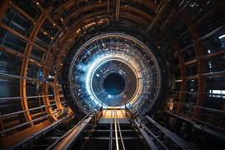
Introduction
High-Energy Physics Experiments
  Large-scale scientific investigations that use particle accelerators and advanced detectors to explore the fundamental building blocks of matter and the forces governing them.
Data Acquisition (DAQ)
  The process of collecting, digitizing, and transmitting detector signals in real time to enable meaningful physics analysis.

Slide 4
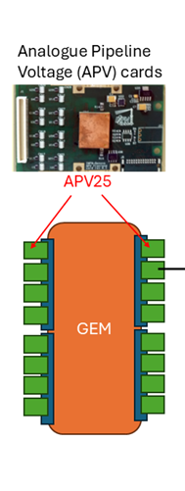
Introduction
Detection with Gas Electron Multiplier GEM Detectors
  Ionization: A charged particle passing through the detector ionizes the argon gas, creating electron-ion pairs.
  Multiplication: The electrons are accelerated by the electric field in the GEM foils, causing further ionizations and producing a cascade of electrons.
  Collection: The multiplied electrons are collected, generating a detectable signal.
  The gas mixture is 70% Argon (Ar) and 30% Carbon dioxide (CO₂).
Amplification with APV25 front-end electronics card
    Signal Amplification
    Signal Shaping

Slide 5
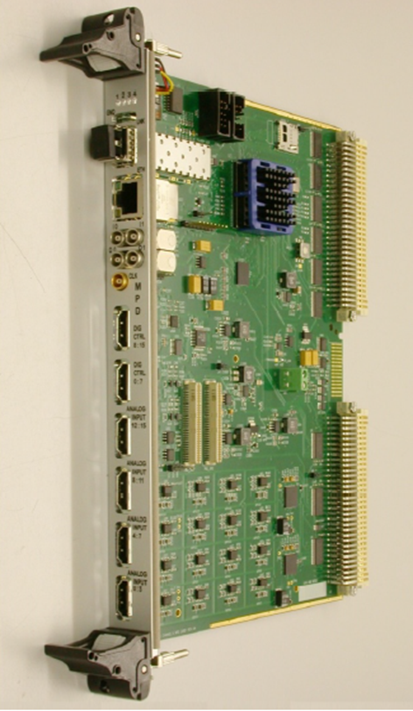
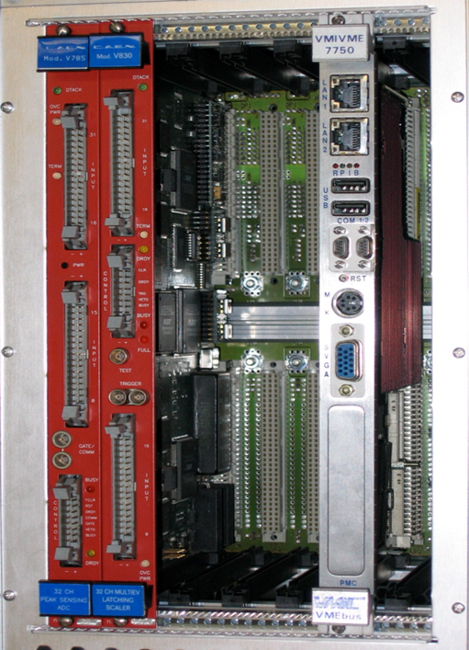
Introduction
MPD
Digitization with Multi-Purpose Digitizer (MPD)
  Convert the analog signals from APV into digital data, preparing it for further processing and transmission.
  There is an Existing MPD board that operates with VME.
Data Transmission with VME
  VME Bus: A parallel bus system that allows for high-speed data transfer between modules.
VME

Slide 6
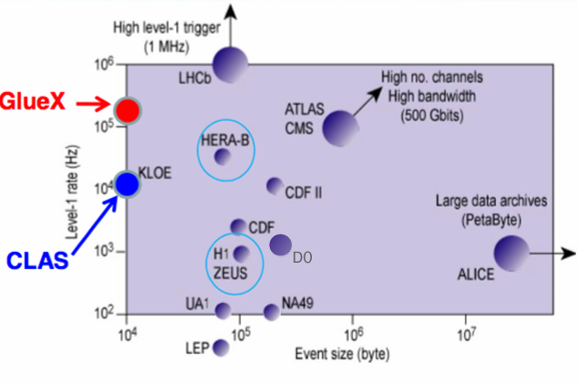
Introduction
  Look at historical triggers and data rates.
    At JLab – mid 1990s CLAS, 2 kHz and 10-15 MB/s
      mid 2000s - 20 kHz and 50 MB/s
      mid 2010’s
        HPS, 50 kHz and 100 MB/s
    FRIB - odd assortment of experiments with varying rates
      GRETA 4000 channel gamma detector with 120 MB/s per channel. (2025 timescale).
  Looking at the historical trends, the highest trigger rate experiments increase the rate by a factor of 10 every 10 years.

Slide 7
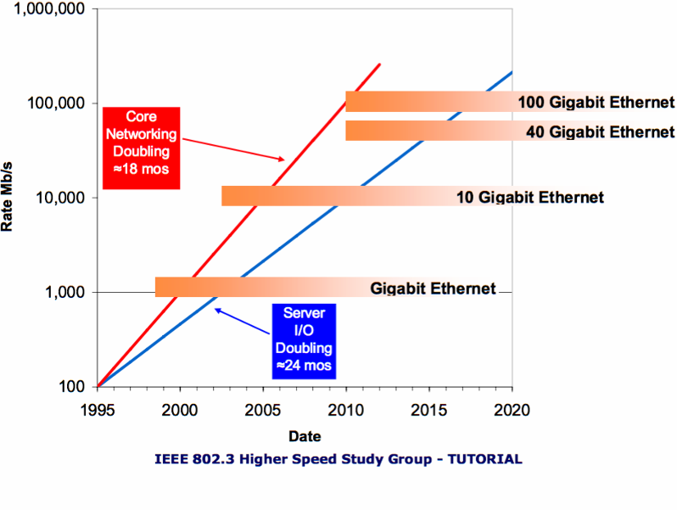
Introduction
VME Limitations
  The data transfer rate was 40MB/s for the original VME bus.
  VME320 has a burst transfer rate up to 320 MB/s.
  In practice, the sustained rate is only 150–200 MB/s, which is the real bottleneck for experiments with high rates.”
Network and Server I/O Trends
  Network speed has historically doubled every ~18 months.
  Server I/O performance has doubled every ~24 months.
  10 Gb/s Ethernet appeared in the mid-2000s but only became widely affordable around 2010, coinciding with server I/O capabilities catching up.

Slide 8

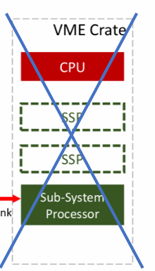
Main Objective and Motivation
Motivation
VME Limitations
  The maximum speed of the Advanced VME320 is around 150–200 MB/s sustained.
  Expensive.
Ethernet
  Higher data transfer rate.
  Ease and flexibility of implementation.
  Stability.
  Cost
  Speed.
  Accessibility
Main Objective
Transitioning from Traditional Industrial Bus Architecture VME to Network-Based DAQ System Ethernet.

Slide 9
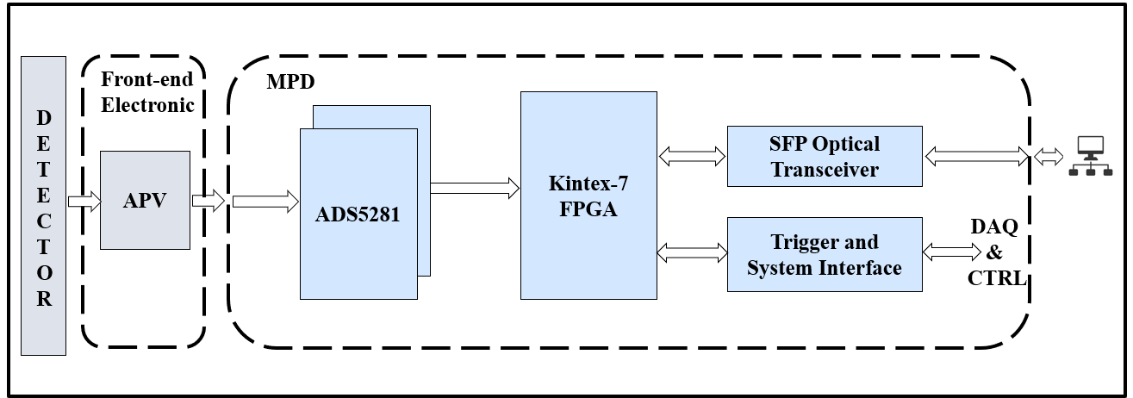
System Block Diagram

Slide 10
FPGA in High Energy Physics DAQ
Importance of FPGA in High-Energy Physics DAQ
Reconfigurable hardware
Parallel processing
Low latency
High throughput
On-chip integration combines deserialization, signal processing, and network interfaces in a single device.
Cost & power efficiency are more flexible and energy-efficient than building custom ASICs.
Future-proof: firmware can be upgraded as experimental requirements evolve.

Slide 11
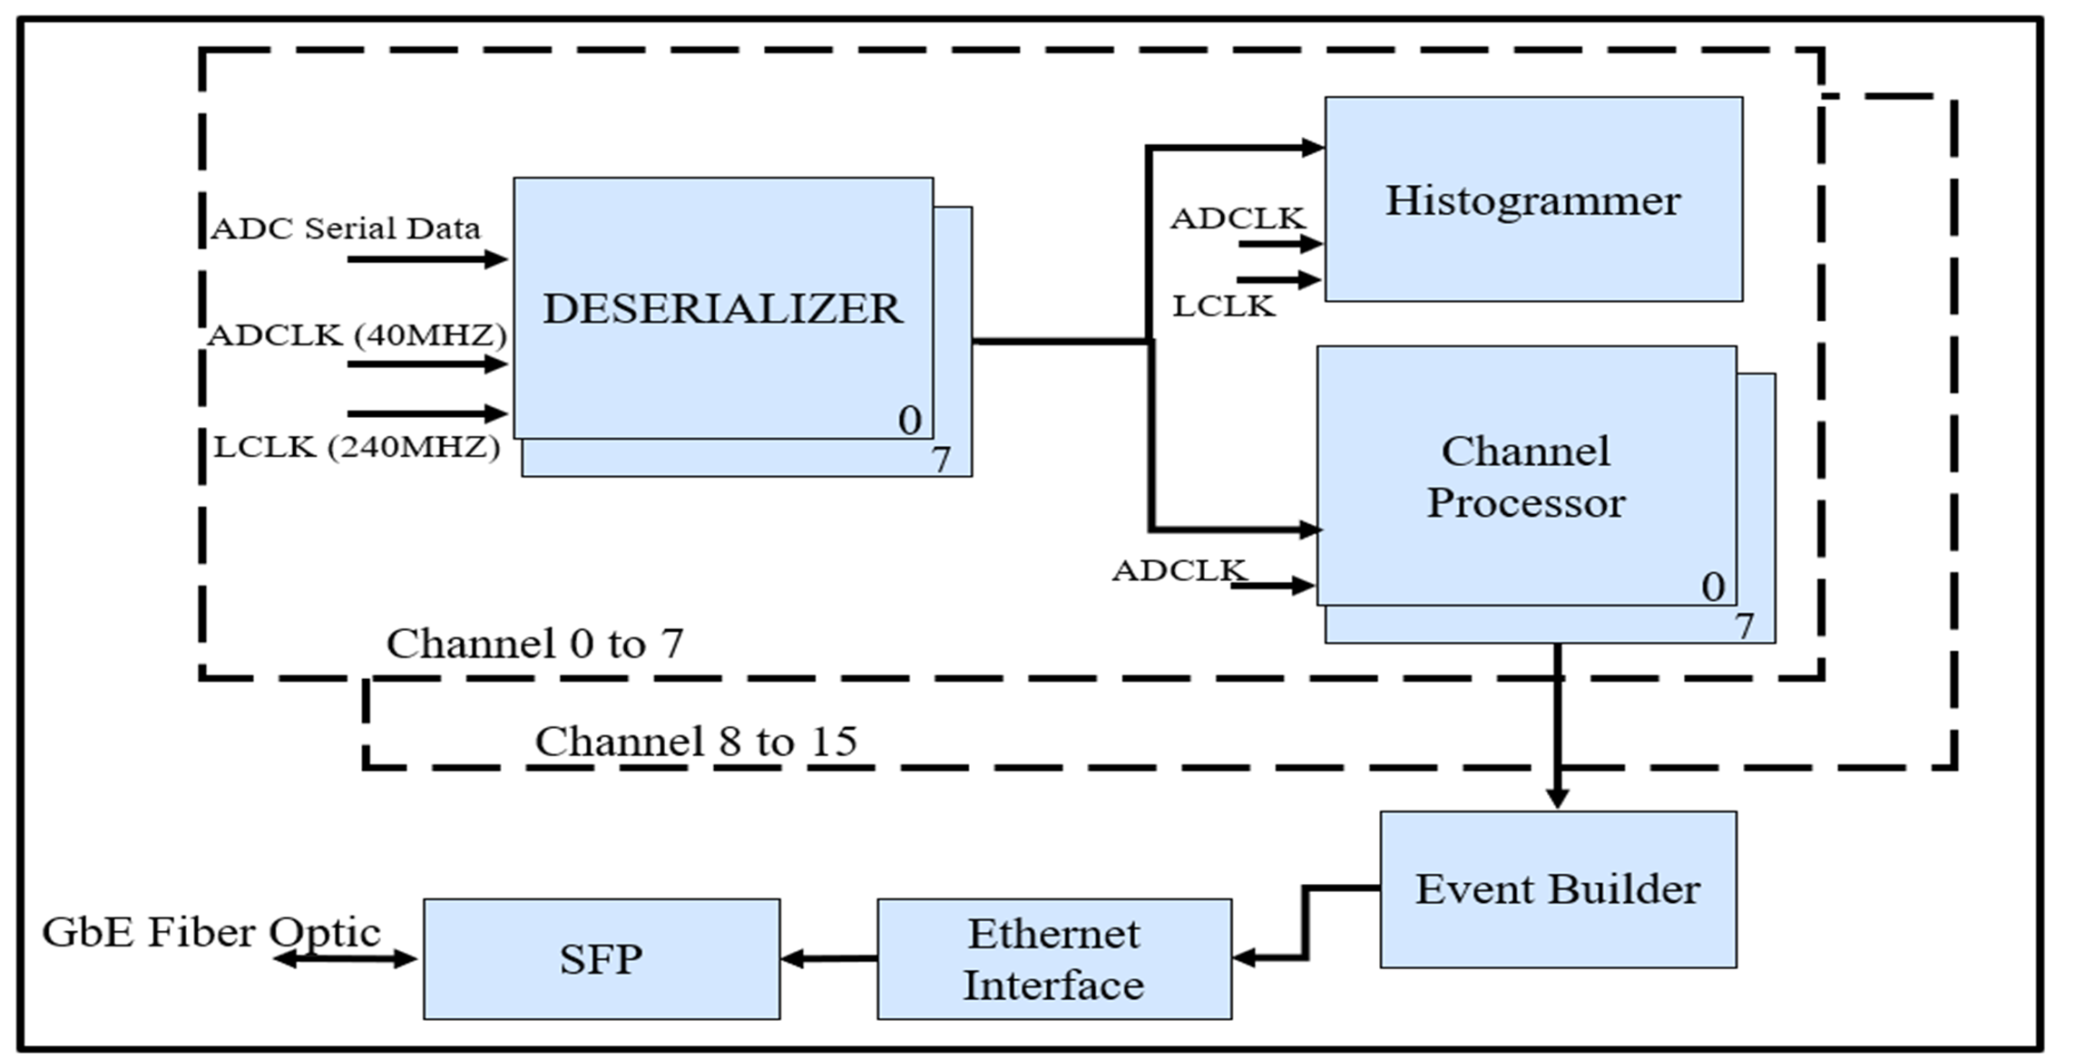
FPGA Architecture

Slide 12
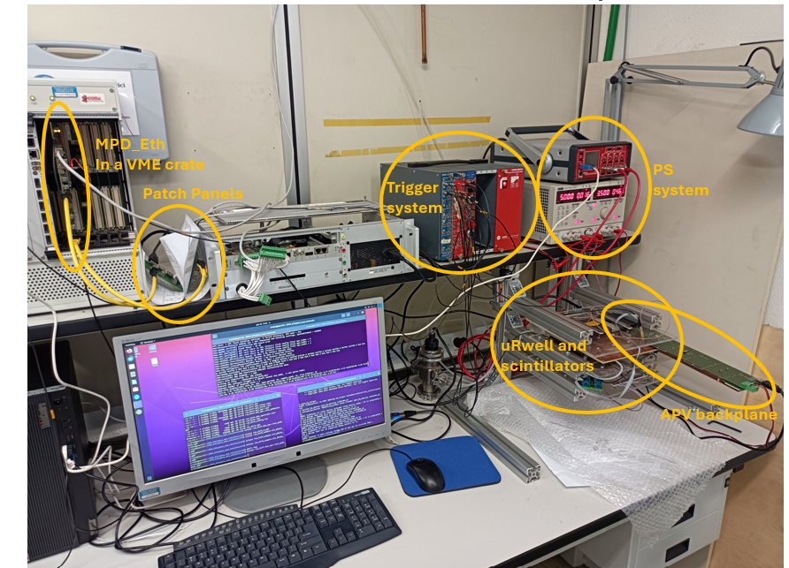
Genoa Laboratory Testbench

Slide 13
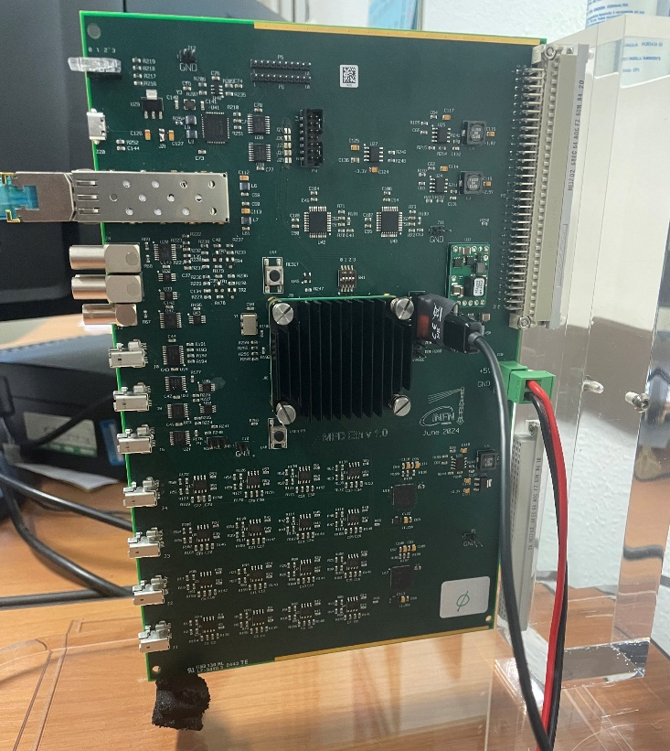
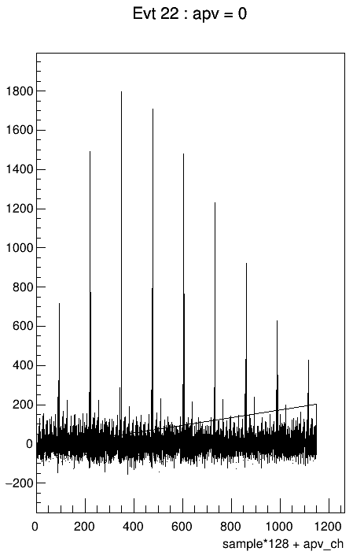
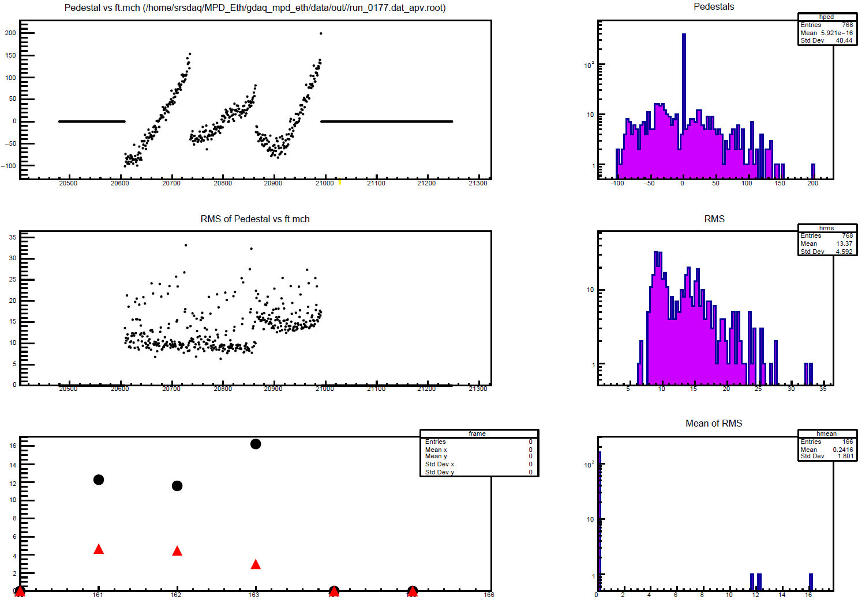
Work Accomplished So Far
Prototype Development & Validation
Prototype MPD board tested and validated.
1G Ethernet connection successfully established.
Real detector readout with µ-RWELL + APV25 (cosmic particles).
Data Transfer & Throughput
  Memory-mapped TCP interface: 30 MB/s sustained over 1G link..
  Achieved 100 MB/s throughput with synthetic FPGA data (upper 1G limit).
High-Speed Link Testing (10 G)
  10 G Ethernet transceiver tested using IBERT (Integrated Bit Error Ratio Tester) in Vivado.

Slide 14

Courses and Conferences
  PhD Retreat – Gran Sasso National Laboratories, February 2025
  Poster presentation on Design and Characterization of a DAQ Board for High-Energy Physics with 1G/10G Ethernet Connectivity.
  Two Weeks Jlab Visit- June 2025
  Test the MPD board with a real Detector.
  NEWCAS 2025 – Paris, June 2025
  Poster presented in the Young Professional Session based on the abstract submission.
Course Title | Credits | Status
Machine Learning programming in physics | 2.5 | Passed
Gaseous detector for experimental particle physics | 2.5 | Passed
Design of readout integrated circuits for particle detector | 2.5 | Passed
Advanced FPGA design and design management techniques | 2.5 | Finishes before the end of September 2025

Slide 15
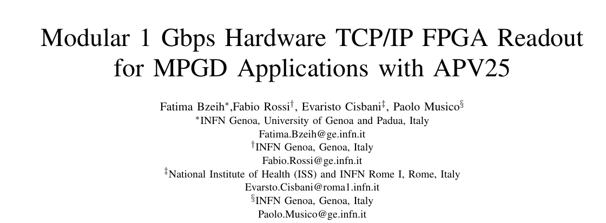
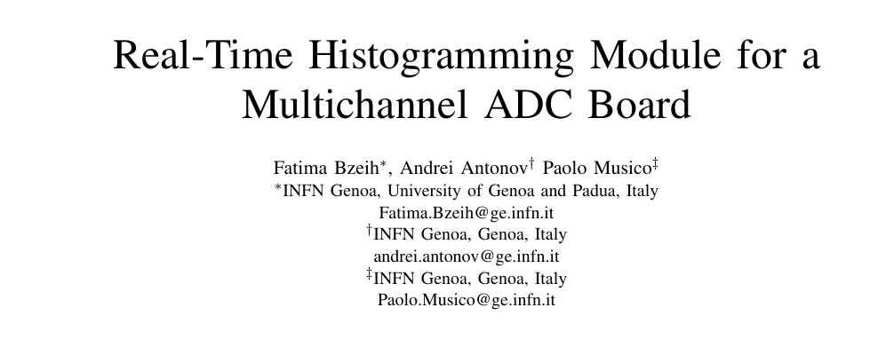
Publications
  NEWCAS 2025 – Paris, June 2025
  Poster presented in the Young Professional Session based on the abstract submission.
  PRIME 2025 – Taormina, September 2025 (upcoming)
  Accepted paper on Real-Time Histogramming Module for a Multichannel ADC Board (oral presentation scheduled).
  ICECS 2025 – Morocco, November 2025 (upcoming)
  Accepted paper on Modular 1 Gbps Hardware TCP/IP FPGA Readout for MPGD Applications with APV25 (oral presentation scheduled).
  Journal paper on the 1G Ethernet system, the target venues are like IEEE Transactions on Nuclear Science (TNS) or Nuclear Instruments and Methods in Physics Research (NIM).

Slide 16
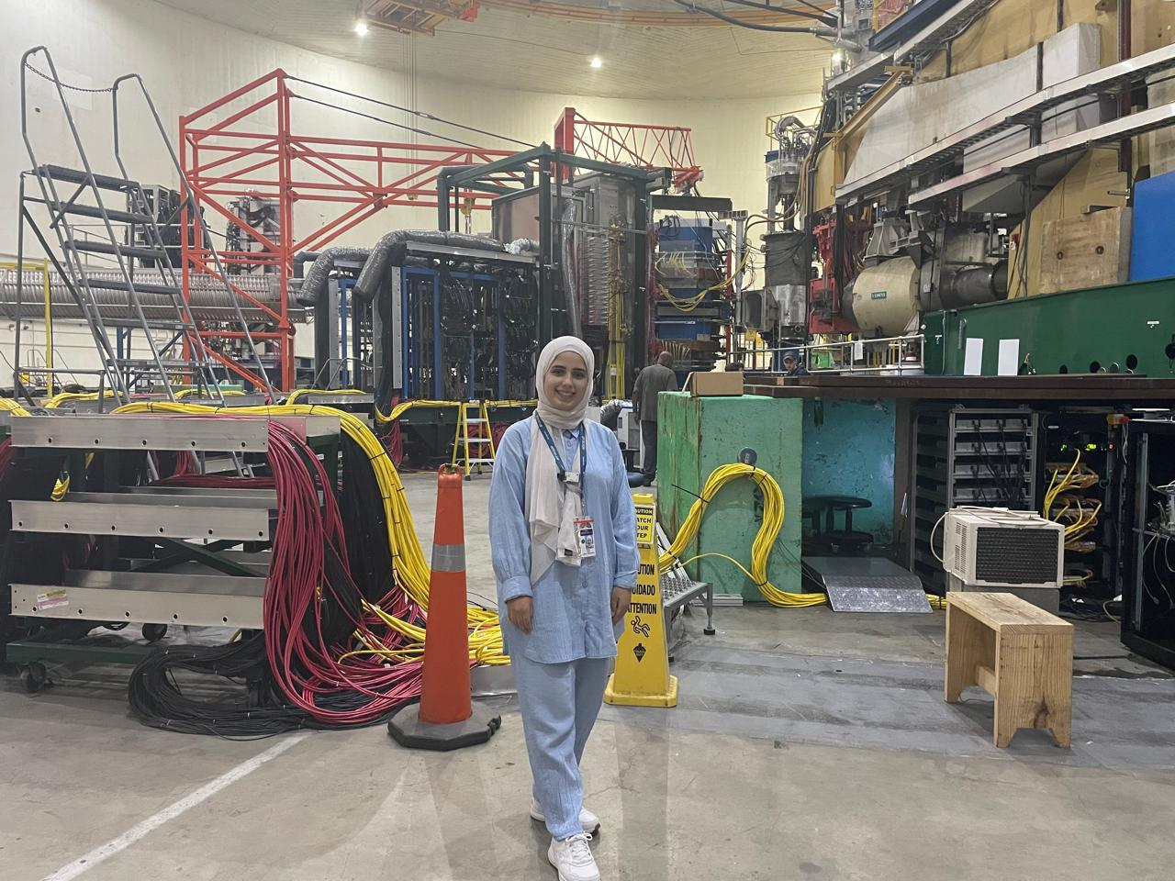
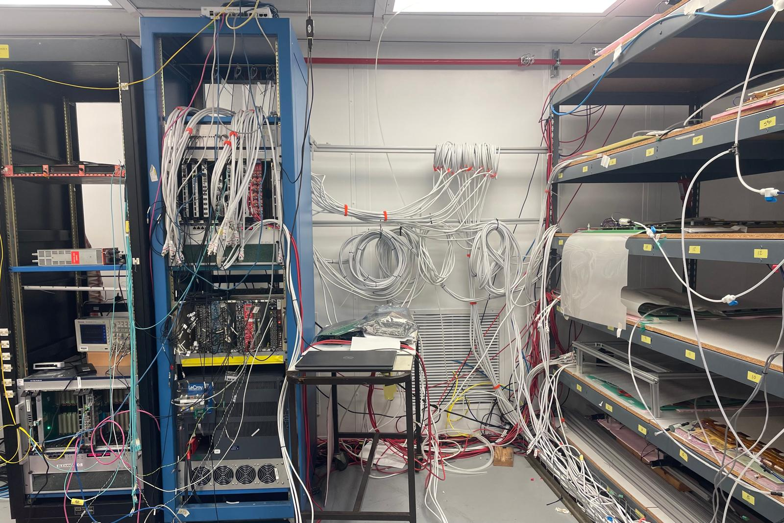
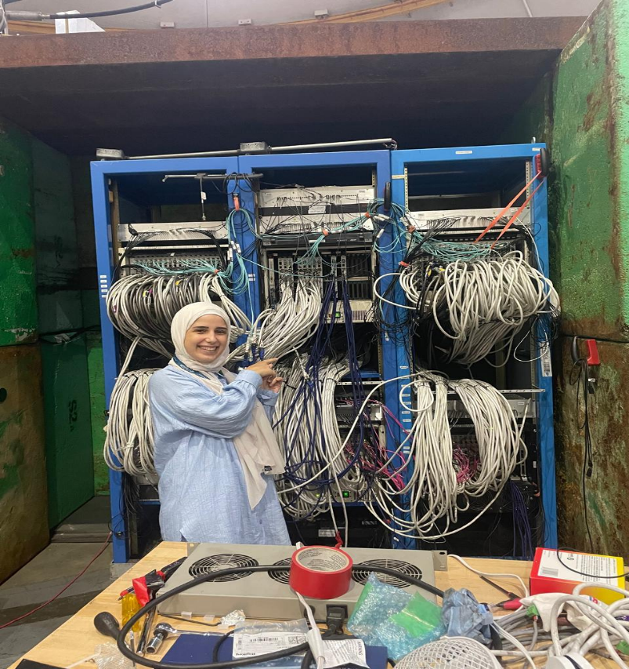
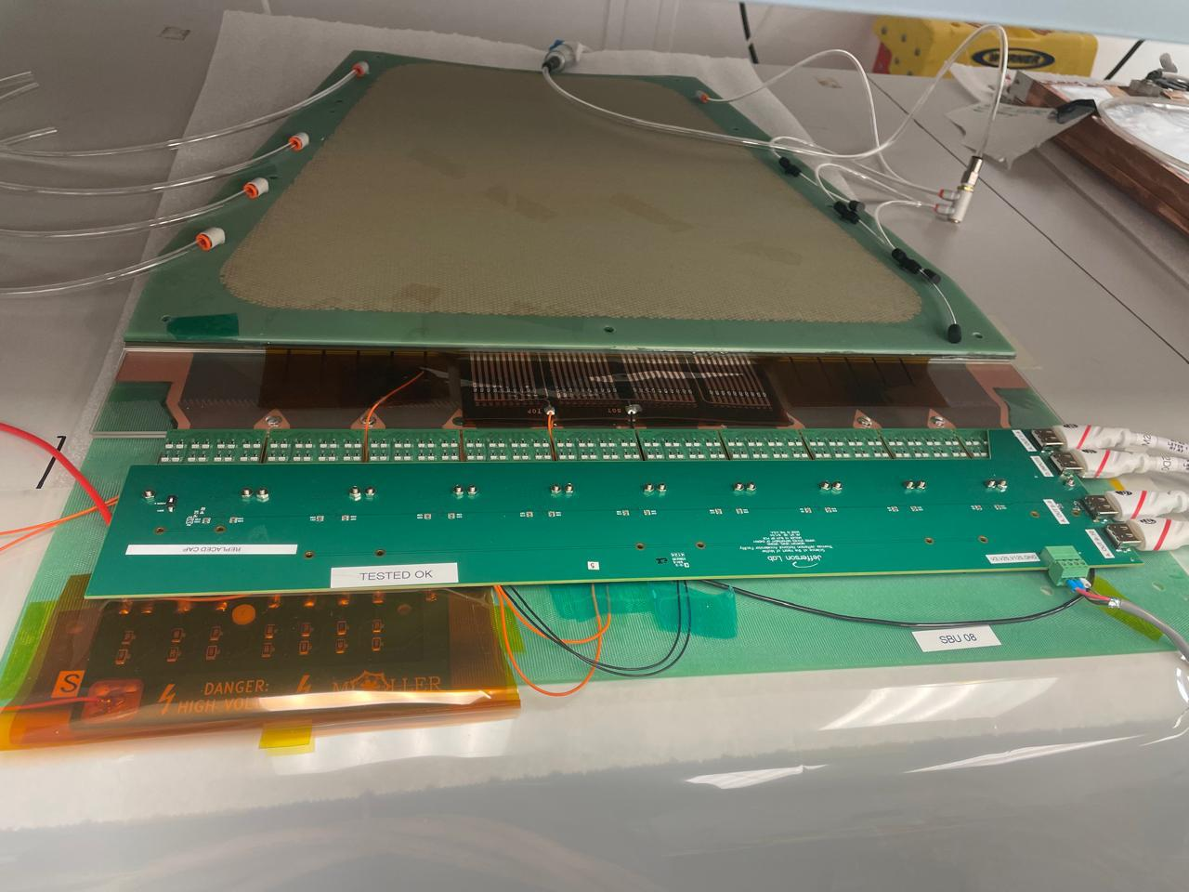
Abroad Stay
Abroad Research Stay (Jefferson Lab, USA)
First stay: June 5 – 19, 2025 (Jefferson Lab, Newport News, VA, USA).
Second stay: August 20 – October 25, 2025 (65 days).
Total period at JLab: 80 days (over 2 months).
Abroad Research Stay (Jefferson Lab, USA)
Working with the team on installation of the MOLLER experiment in Hall A.
Possible use of our MPD boards (up to 80) with 10G Ethernet in this experiment.
Abroad stay organized and financially supported by supervisor Prof. Musico and partner institutions.
Final decision pending whether the 6-month abroad period will be completed at JLab or partially at a European facility (due to high living costs in the USA).

Slide 17
Current and Future Work
  Current Work
    Abroad stay at Jefferson Lab until the end of October 2025.
    In parallel: Writing a journal paper on the 1G Ethernet DAQ system.
Future Work
  10G Ethernet implementation: complete development and perform testing.
  Abroad stay to finalize the remaining mobility period (at JLab or European facility).
  Finalize thesis work and prepare for defense.
  Continue publications based on results (1G system, 10G upgrade, DAQ applications).
  Participate in summer school(s) to strengthen knowledge and networking.

Slide 18
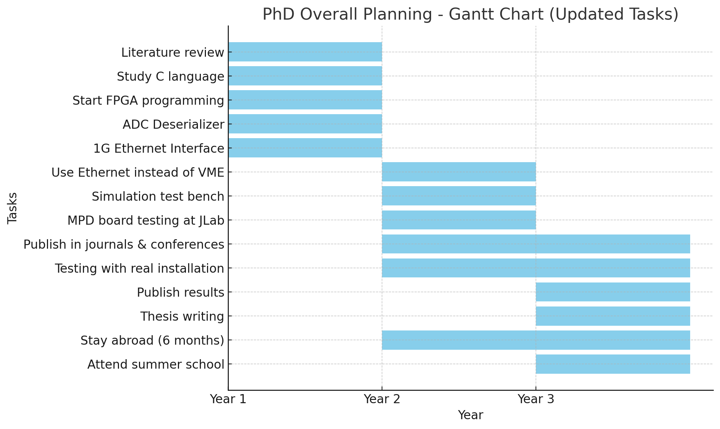
Overall Planning

Slide 19
Conclusion
PhD project is on track for timely completion.
Achieved 1G Ethernet DAQ implementation.
Current focus: Abroad stay at Jefferson Lab.
  10G Ethernet upgrade.
Publications in preparation (IEEE TNS, etc.).
Confident to complete thesis and defend on time.

Slide 20
Thank you

