Slide 1



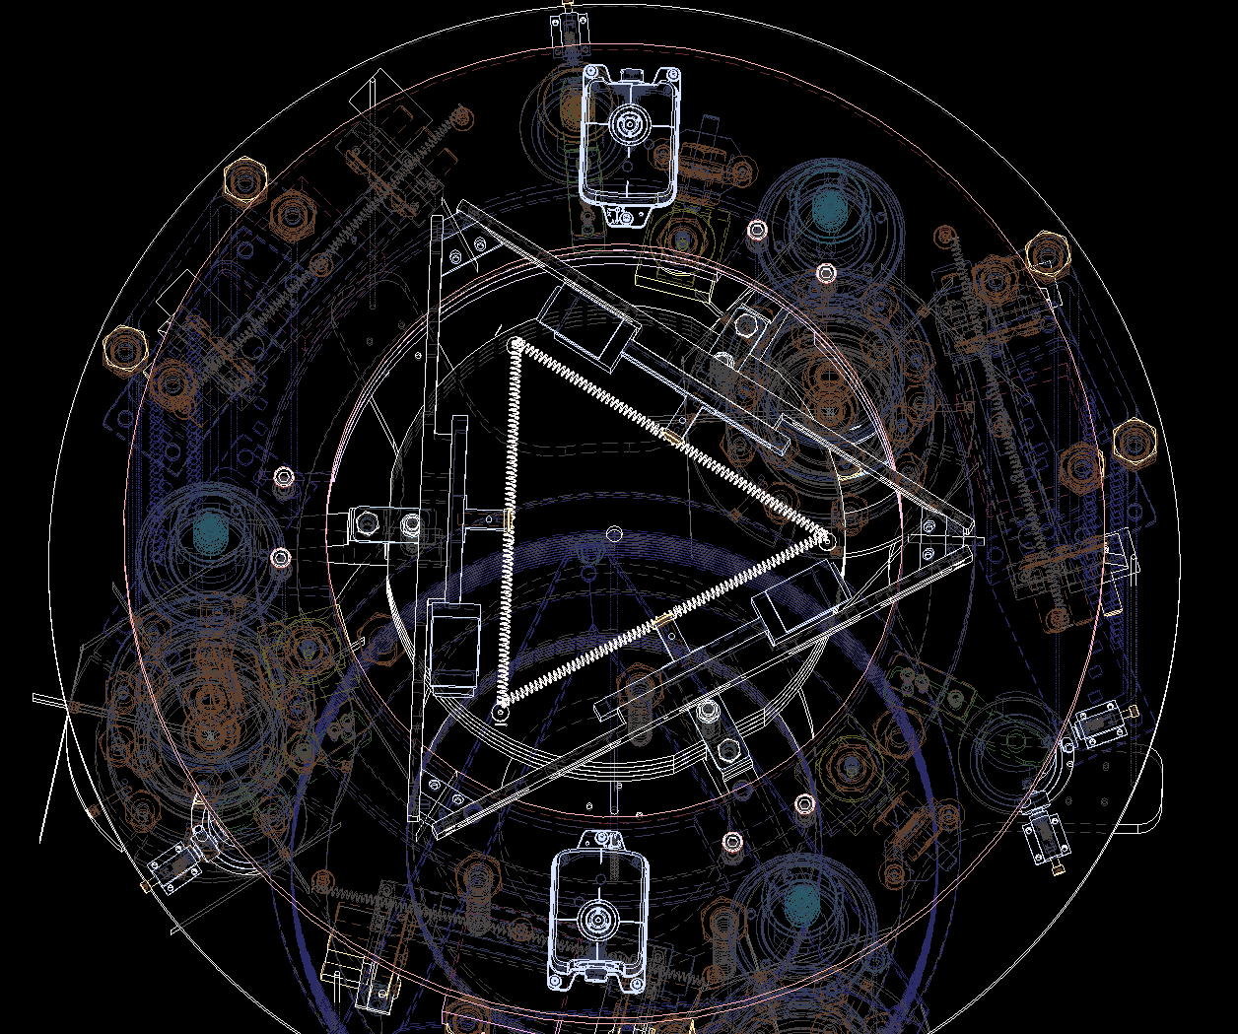
DEVELOPMENT OF MECHANICAL SYSTEMS FOR VIBRATION ISOLATION IN GRAVITATIONAL WAVE DETECTORS AND OTHER FUNDAMENTAL PHYSICS EXPERIMENTS
First year final presentation
Ph.D Candidate: Moreno Nacca
Supervisor: Prof. Luca Esposito (UNINA - DICMaPI)
Cosupervisor: Eng. Alcide Bertocco (INFN – Napoli)
Host Istitution: INFN - Napoli
XL Cicle

Slide 2
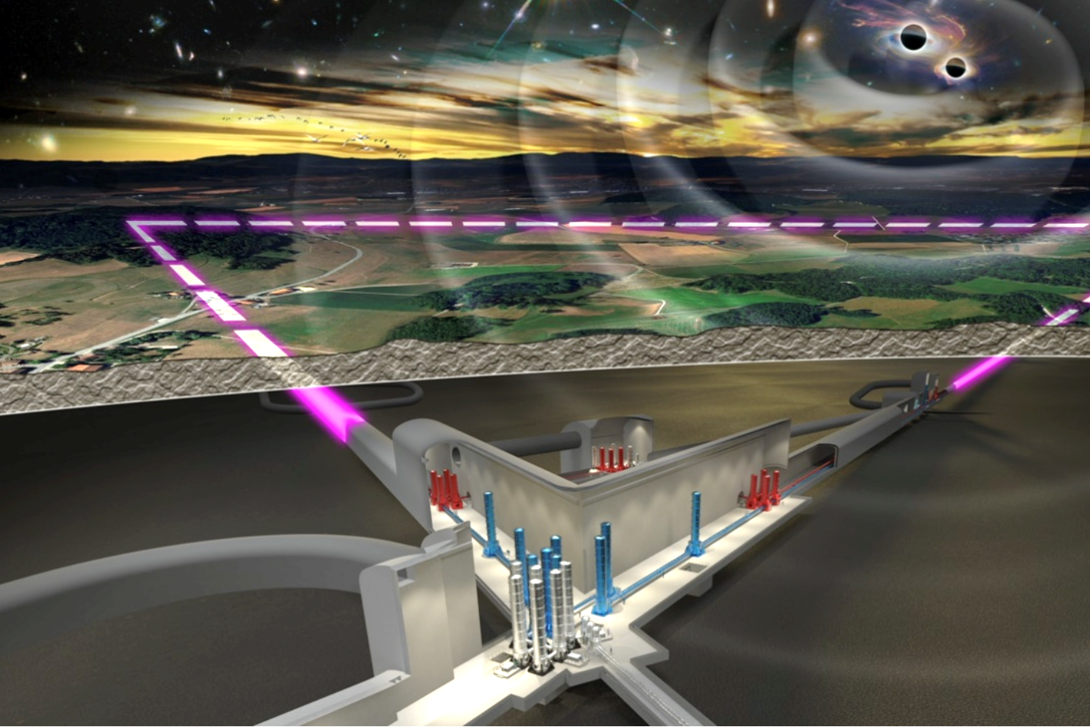

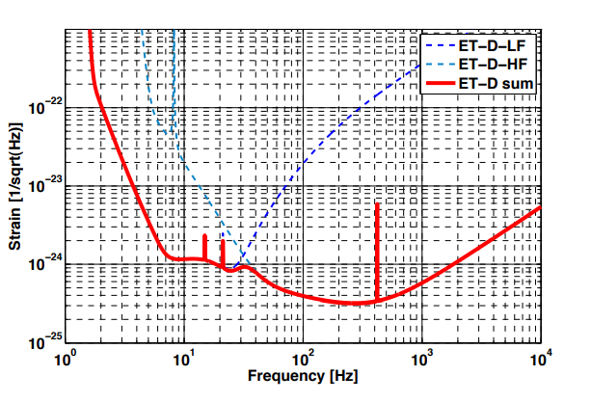
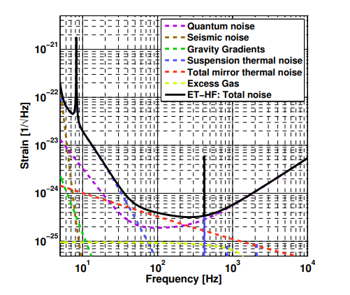
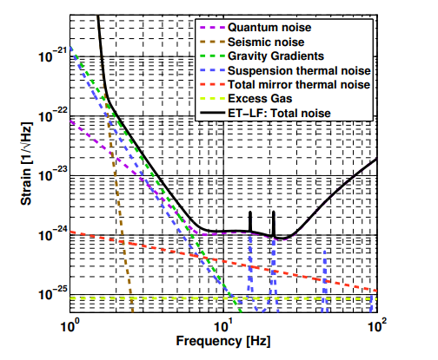
Einstein Telescope overview
Einstein Telescope represent the third generation of gravitational wave detectors
ET will be built in «triangle» configuration
«Xylophone» design: two detectors in the same spot, one for LF (underground) and the other for HF
LF detector: 1.5Hz to 30Hz
HF detector: 30 Hz to 10kHz
[1]Einstein gravitational wave Telescope Conceptual Design Study (2011)

Slide 3
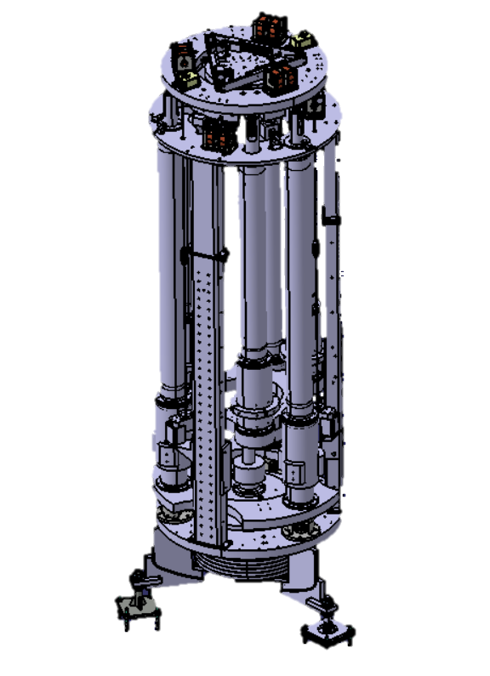
Introduction
“Cost analysis shows that tunnels, shafts and caverns constitute the main cost drivers for the Einstein Telescope
project. It is obvious that the cost of underground construction is site dependent and contains large uncertainties
at this stage of the project”
Why?
“[…]a SA 17-m high with six magnetic anti-spring filters […] represents the reference solution for ET-LF interferometer.”
“Einstein Telescope will have a total of 9 underground caverns. Each corner station will have a large cylindrical
underground cavern with a diameter of about 65 m and a height of 30 m.”
How could we solve this problem?
A system shorter than a SuperAttenuator but with the same (or even better) seismic attenuation level would represent a huge advantage in terms of costs and feasibility for the Einstein Telescope.
Source: «Einstein gravitational wave Telescope conceptual design study (2011)»

Slide 4
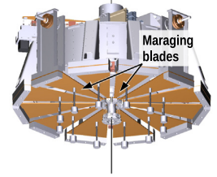
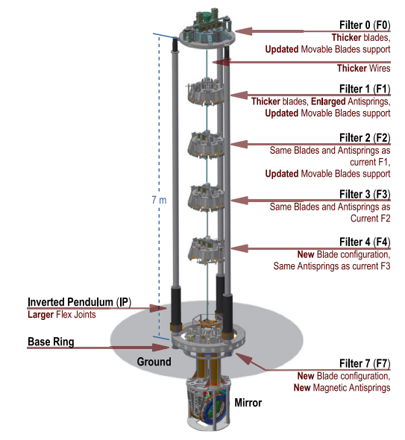
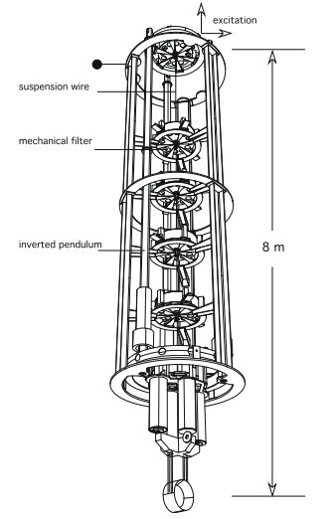
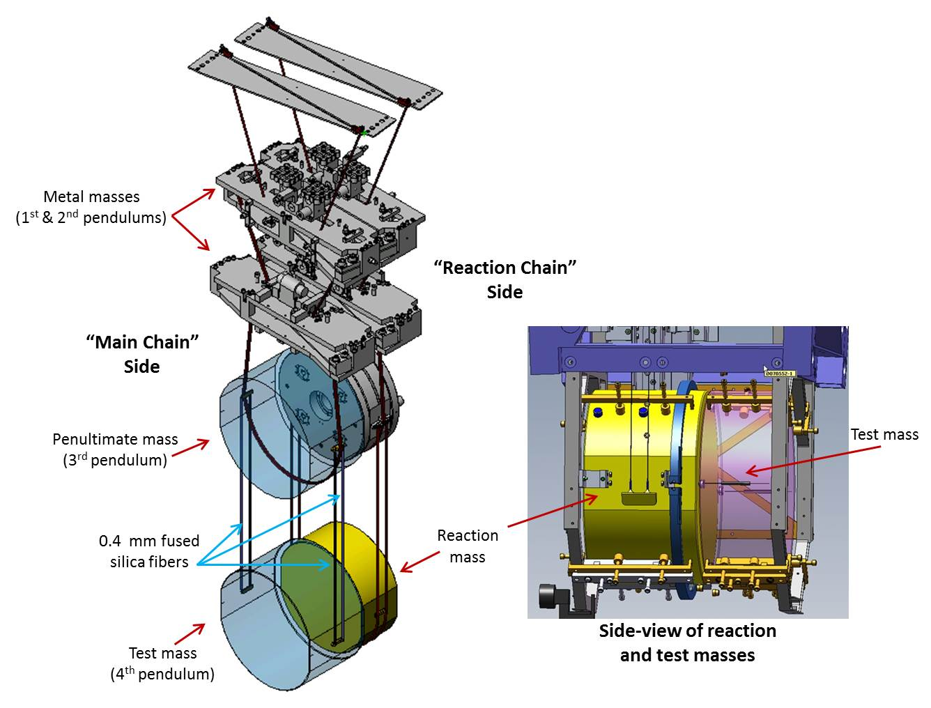
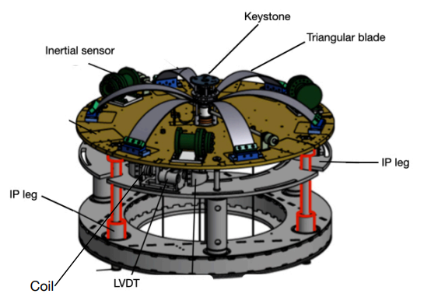
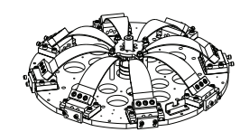
State-of-art solutions in the field of mechanical isolation for gravitational waves detectors
Magnetic AntiSpring(MAS) schematic[7]
LIGO suspension[8]
Geometric Anti Spring (GAS) schematic[6]
SuperAttenuator (SA) schematic[4]
KAGRA pre-isolation stage
[4] F. Acernese et al. / Astroparticle Physics 33 (2010) 182–189
[5] A. Basti, V. Boschi, P. Chessa et al. Nuclear Inst. and Methods in Physics Research, A 1048 (2023) 168021
[6] M.G. Beker et al. / Physics Procedia 37 ( 2012 ) 1389 – 1397
[7] A. Basti, V. Boschi, P. Chessa et al. Nuclear Inst. and Methods in Physics Research, A 1048 (2023) 168021
[8] https://www.ligo.caltech.edu/page/vibration-isolation
SuperAttenuator (SA) detailed representation[5]

Slide 5
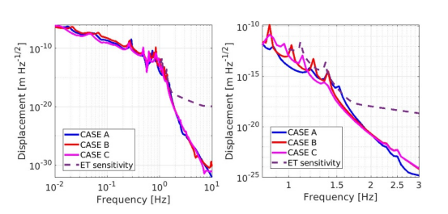
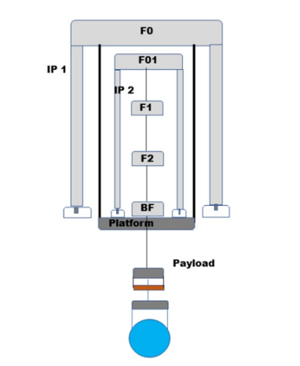
Research topic & Objectives
In collaboration with INFN-Naples, we are exploring an alternative solution to the AdV+ SA. Our proposal for the NewGeneration SuperAttenuator (NGSA) is based on a Nested Inverted Pendulum (NIP). The NGSA NIP will perform passive and active damping of the mechanical vibration.
Longitudinal transfer function
Tilt transfer function
The simulation was performed using OCTOPUS. In CASE C, a 10m NIP was simulated, with mechanical filtering performances in line with ET requirements[2].
Nested Inverted Pendulum (NIP) schematic[2]
[2] A Bertocco et al 2024 New Generation of Superattenuator for Einstein Telescope: preliminary studies Class. Quantum Grav. 41 117004

Slide 6
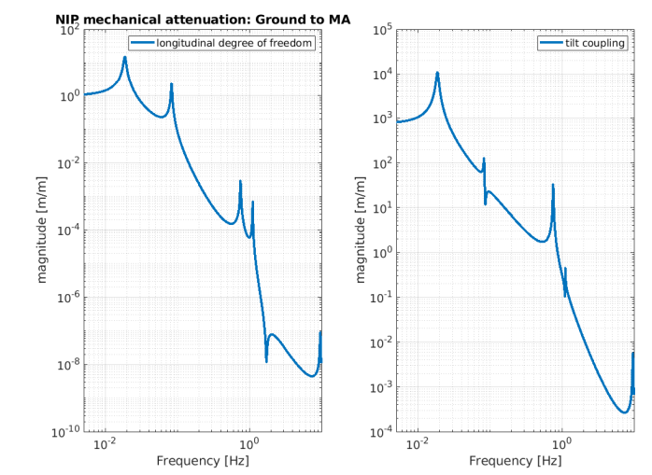
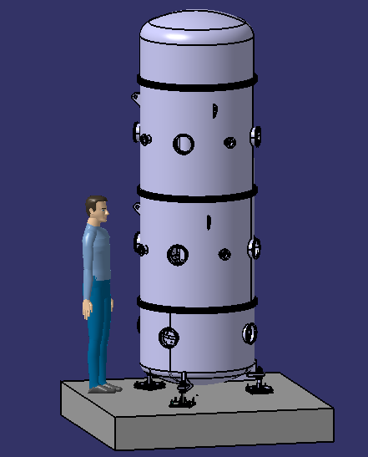
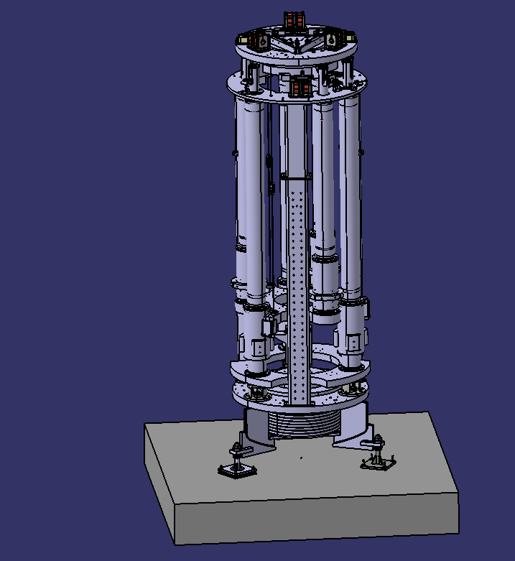
Research topic & Objectives
The performances of a solution based on NIP must be validated experimentally. To achieve the experimental validation, we are building a 1:2 scale prototype in the PLaNET laboratory in Naples.
Simulation with OCTOPUS of the mechanical attenuation expected from the scaled NIP[3]
3D model of the NIP prototype
(w/ vacuum chamber)
3D model of the NIP prototype
(w/o vacuum chamber)
[3] Trozzo, L.; Bertocco, A.; Bruno, M.; De Rosa, R.; Di Fiore, L.; D’Urso, D.; Frasconi, F.; Gennai, A.; Lucchesi, L.; Nacca, M.; et al. A Nested Inverted Pendulum as a Possible Pre-Isolator for the ET-LF Seismic Isolation System. Galaxies 2025, 13, 21. https://doi.org/10.3390/galaxies13020021

Slide 7
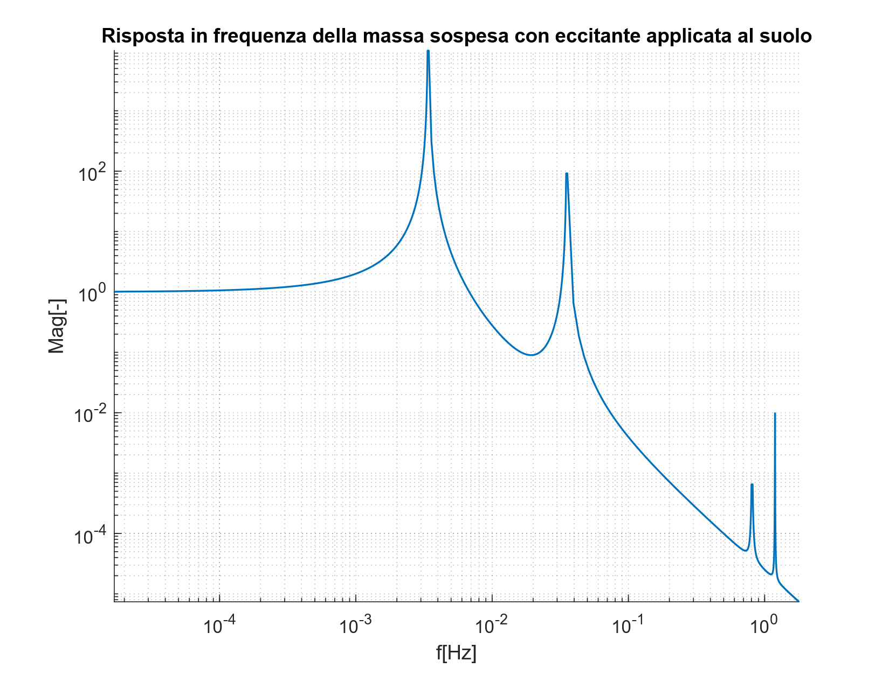
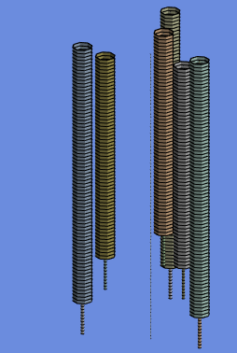
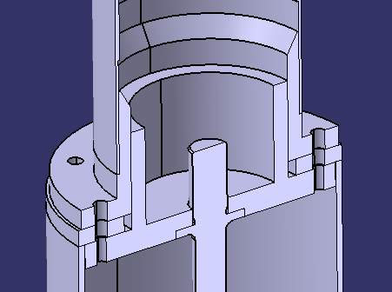
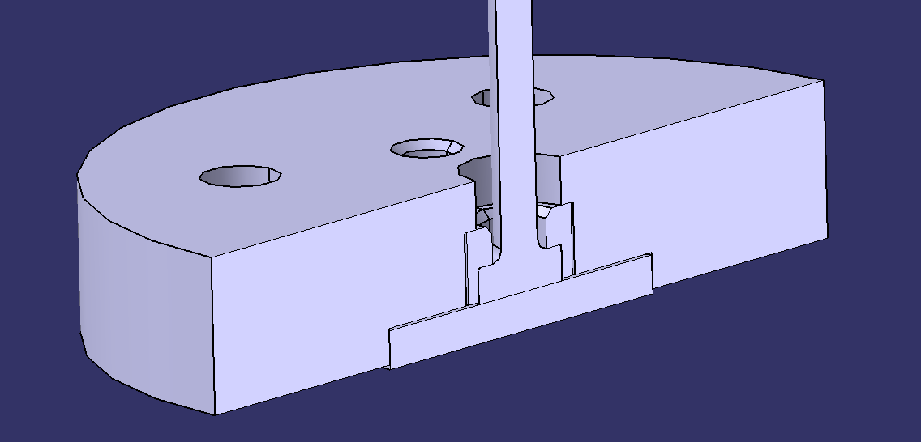

Research topic & Objectives
A simplified model of the NIP dynamics has been developed and compared with results obtained with ANSYS.
In this model:
Effects of gravity are neglected
Damping is neglected
Only the longitudinal TFs have been considered for now
ANSYS | Analytical model
3.39e-003Hz 3.46e-002Hz 0.80Hz 1.16Hz | 3.4e-003Hz 3.53e-002Hz 8.08e-001Hz 1.19Hz
$$\left[M\right]\underline{\ddot{x}}+\left[K\right]\underline{x}=\underline{0}$$
K is the stiffness matrix. To proper modelling the elements of the K-matrix an in-depth study of the connections between the components of the NIP was necessary.

Slide 8
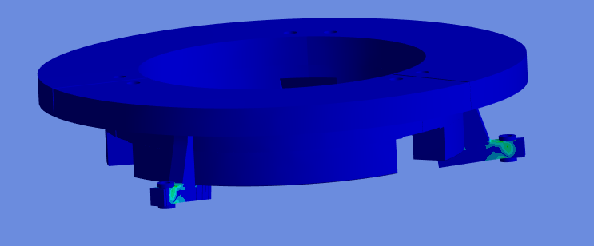
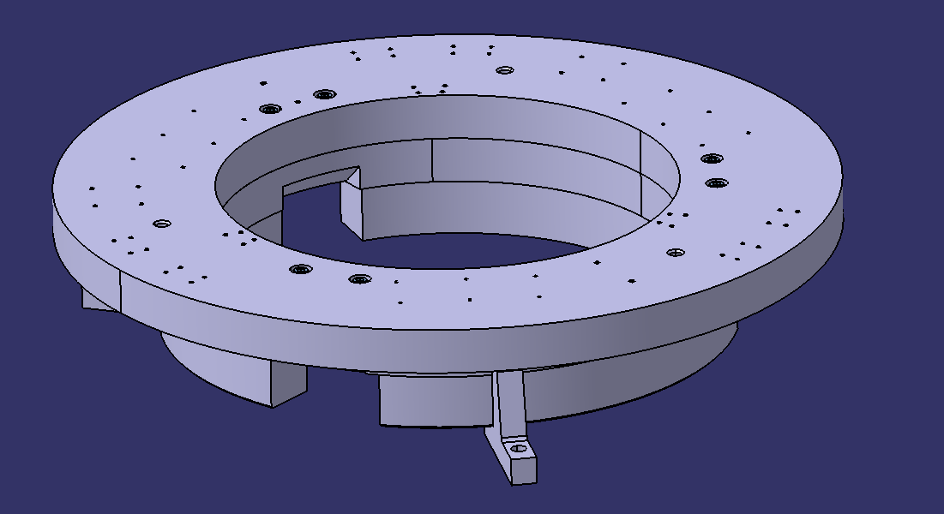
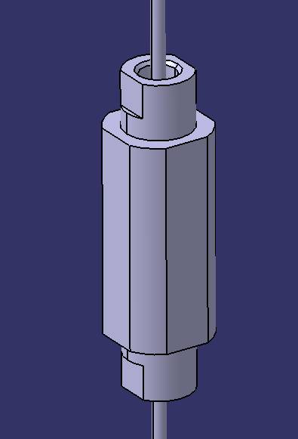
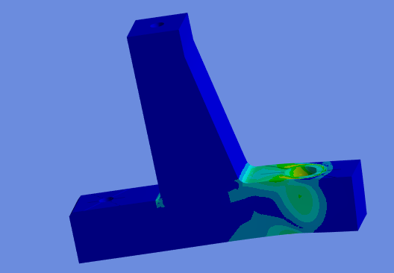
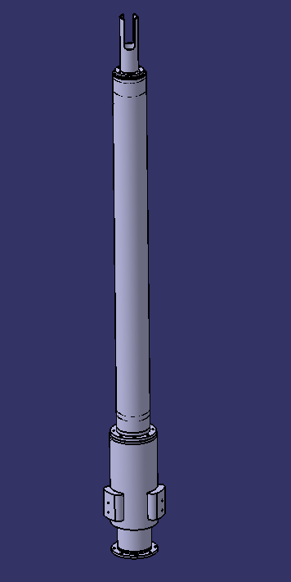
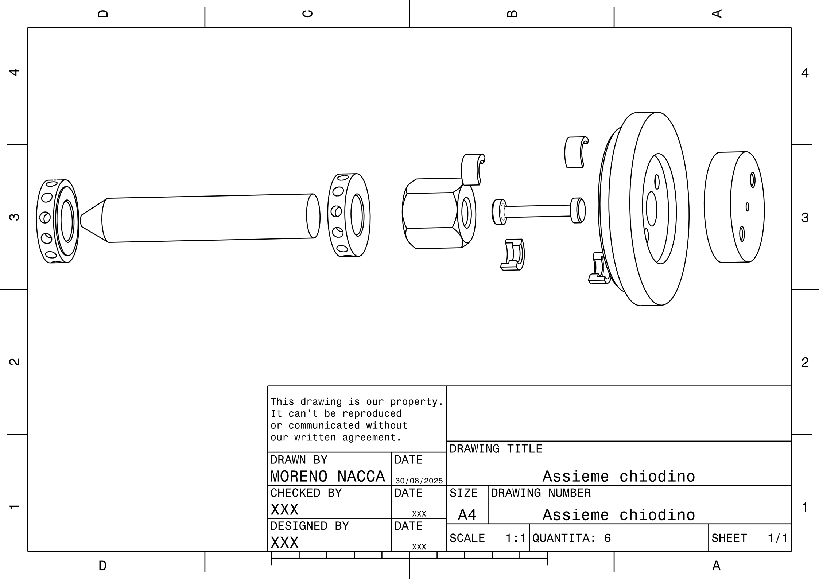
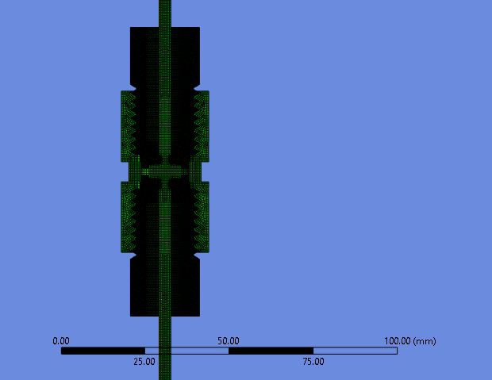
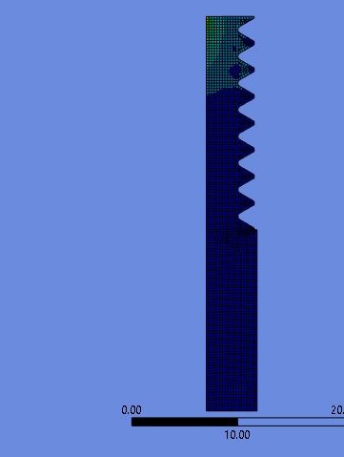
Research activities – Design

Slide 9
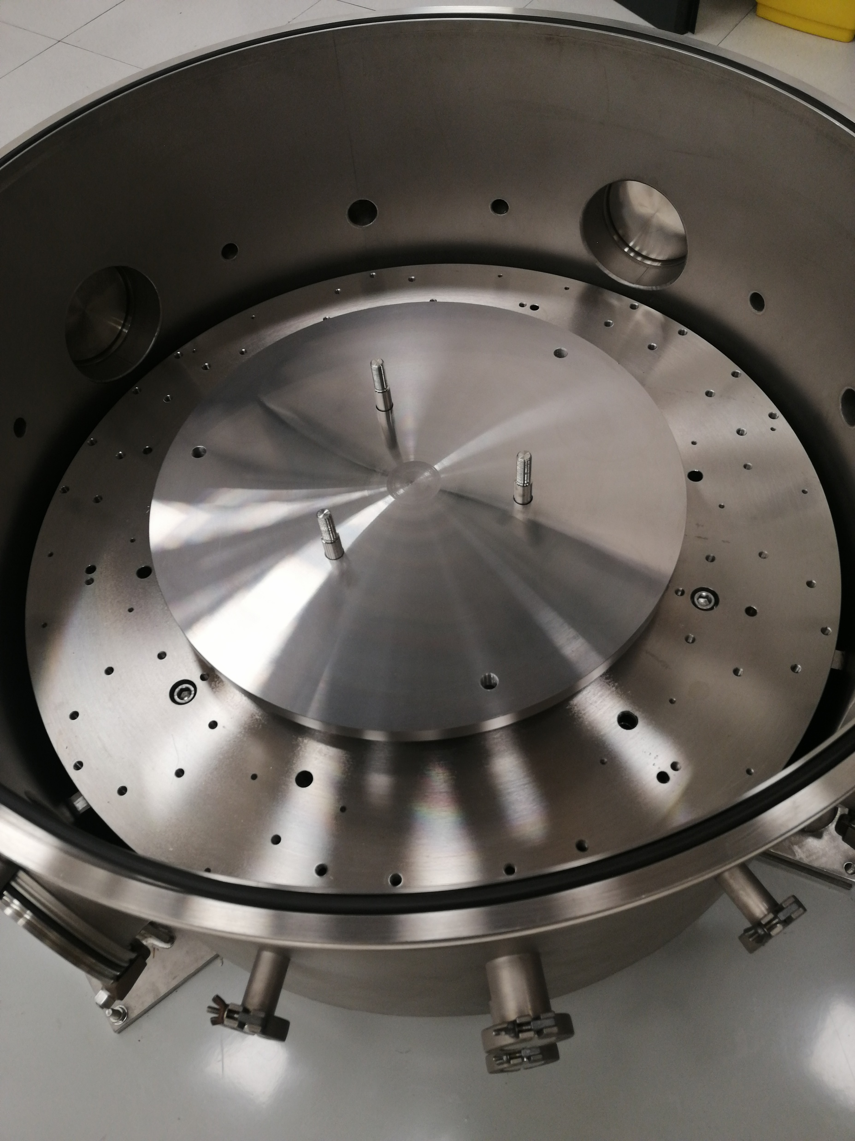
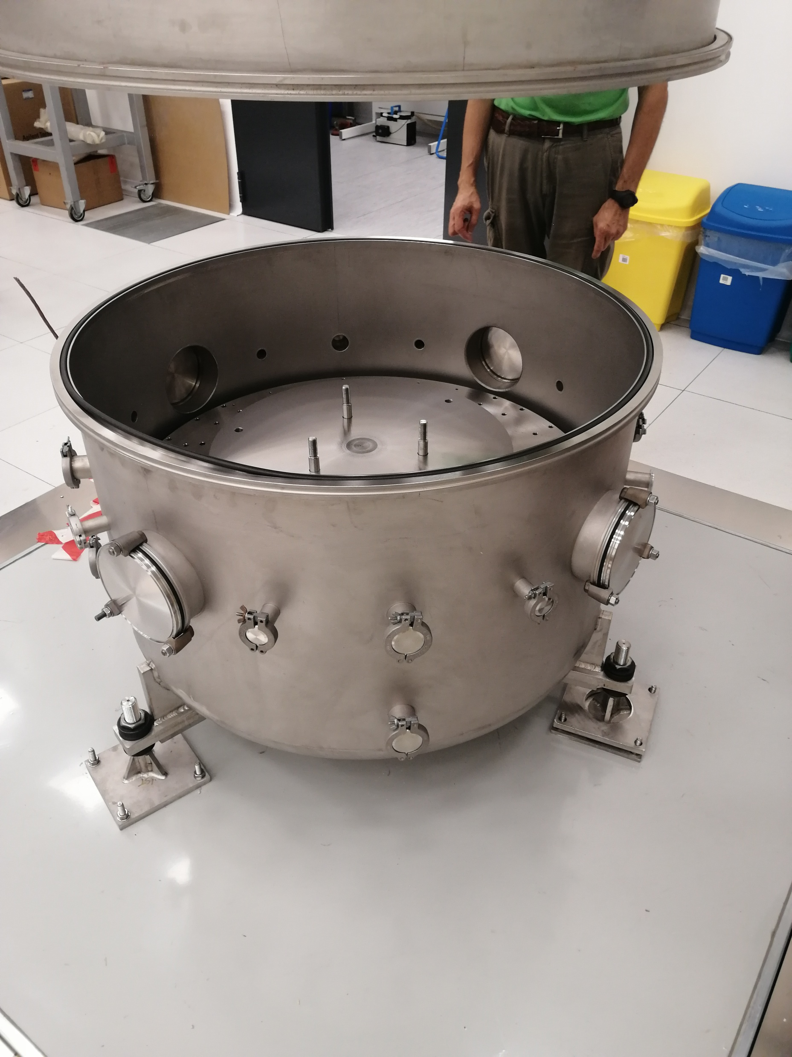
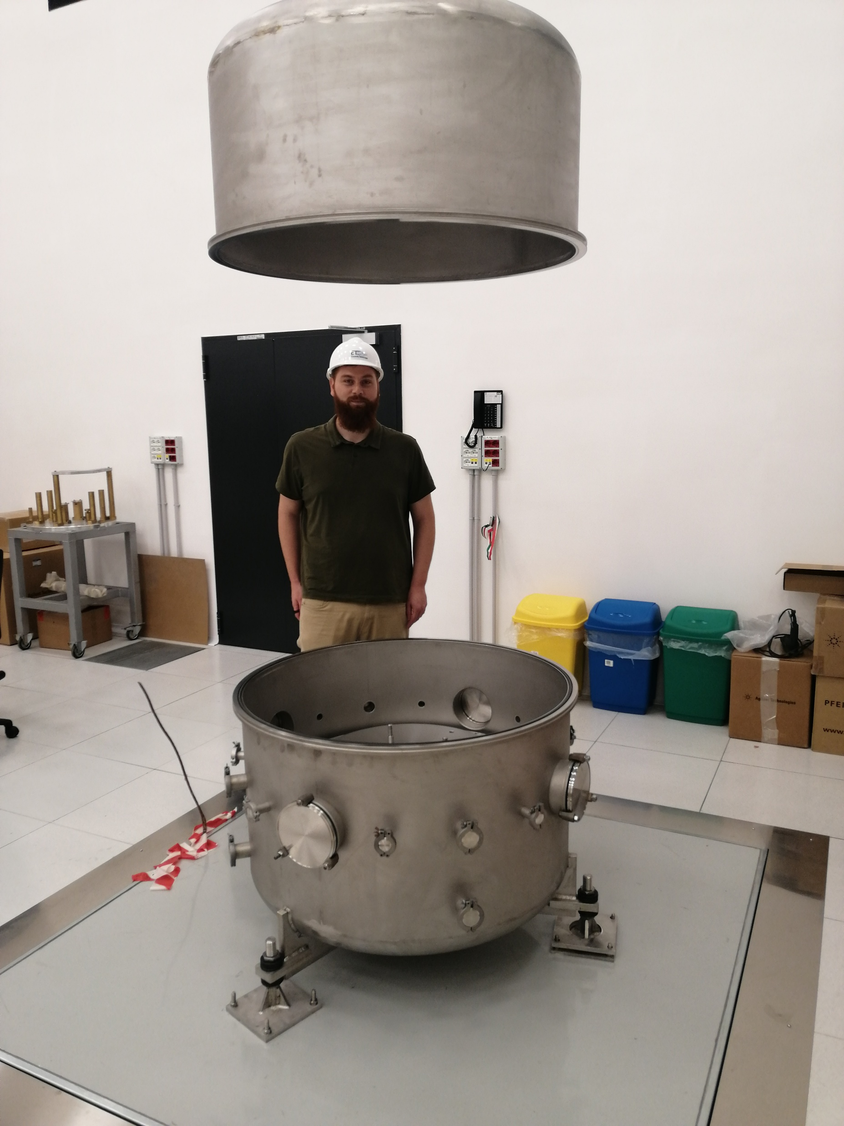
Research activities – Preassembly

Slide 10
Research activities - Papers
[1] A Nested Inverted Pendulum as a Possible Pre-Isolator for the ET-LF Seismic Isolation System
(https://doi.org/10.3390/galaxies13020021)
[2] Enhanced Weibull Formulation for Capturing Fatigue Life Scatter in AM Alloys Supported by Fractographic Analysis (presented to 5th International Symposium on Fatigue Design and Material Defects (FDMD), under review)

Slide 11
Overall planning
First year:
Study of the state-of-art solutions in the field of mechanical isolation for gravitational waves detectors (like SuperAttenuator in AdV+)
Study the mechanical isolation performances required for ET-LF
Study the state-of-art simulation tools (e.g. OCTOPUS)
Study the mechanics of an innovative solution for the New Generation SuperAttenuator (NGSA) based on a Nested Inverted Pendulum (NIP)
Start the design of subassemblies required for a proof-of-concept of the NIP
Pre-assembly the NIP
Development of a FEM model and a simplified analytical model of NIP dynamics
Second year:
Complete the design of the NIP
Assembly the NIP
Study the state-of-art simulation tools (e.g. OCTOPUS)
Improving OCTOPUS
Prepare to collect data
Collect and elaborate data
Experimentally exploring the NIP mechanical stability near to its limit
Partecipate to a Ph.D school
Third year:
Collect and elaborate data
Design further components if needed
Prepare for defence

Slide 12

Training activities - Courses
Course name | CFU | Status
STATISTICAL PROCESS MONITORING OF COMPLEX ENGINEERING DATA | 3 | Passed
Analysis and Modelling of the Additive Manufacturing | 2 | Passed
Generative Design for smart Additive Manufactruing | 3 | Passed
All models are Uncertain | 3 | Passed
Materials at elevated temperatures, creep modeling and simulation | 1.5 | September-December
Random Excitation and response of structures | 3 | September
Required CFUs | 10
Acquired CFUs | 11

Slide 13
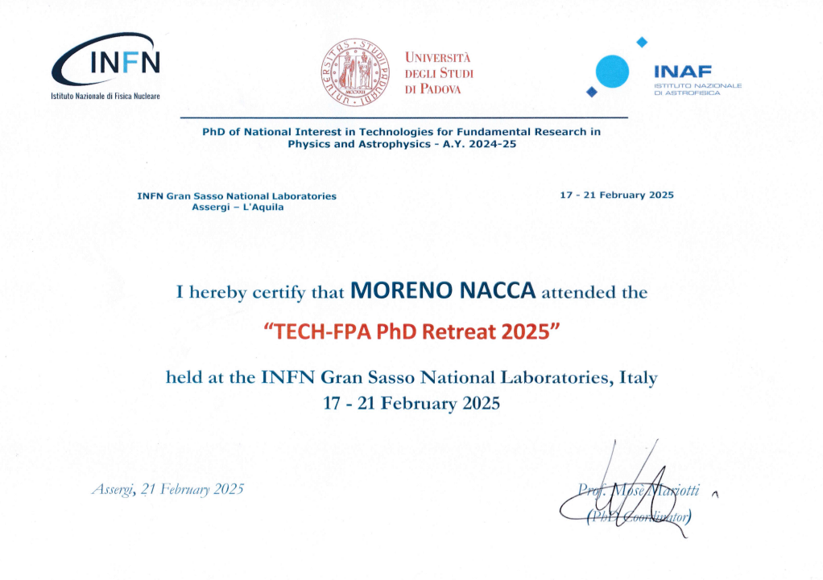
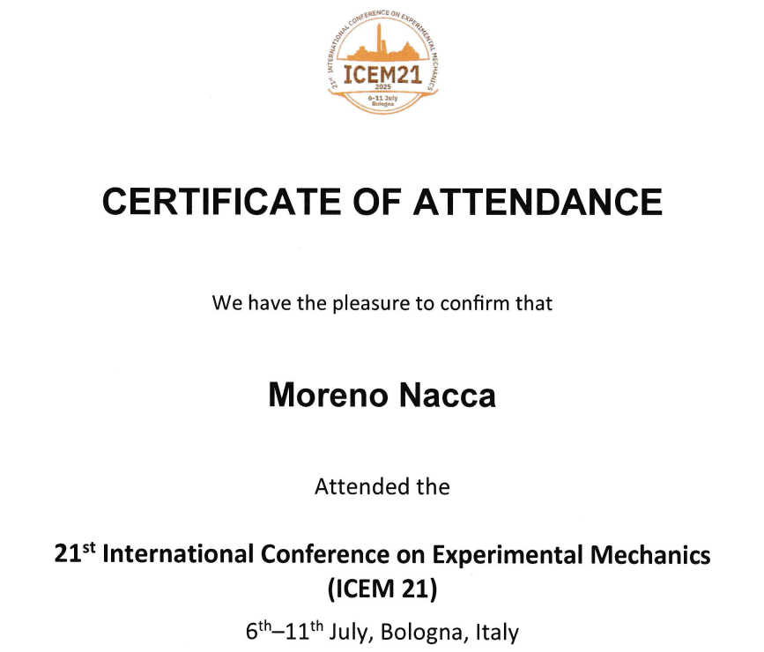
Training activities – Ph.D schools & Conferences
Schools
Why «Not attended yet»?
School name | Status
CERN Accelerator School (CAS) | Not attended yet
Associazione Italiana per l'Analisi delle Sollecitazioni (AIAS) Summer school | Not attended yet
The topics this year didn’t fit enough with my research activities, so I decided to wait for the next year’s edition. Meanwhile, I’m looking for other options, just in case even the 2026 edition of these two schools won’t be aligned with my research.
Required schools | 1
Attended schools | 0
Conferences
(audience)

Slide 14
Thank you for your attention

