Slide 1
PhD Program of National Interest in
“Technologies for fundamental research in Physics and Astrophysics”
Development, design and testing of metallic components for high-temperature nuclear physics applications produced using additive manufacturing technologies
Supervisor : Prof. Mattia Manzolaro
Co-supervisor: Dott. Michele Ballan
Annual Report 2024/2025
Giacomo Voltan
Padova, 23/09/2025

Slide 2
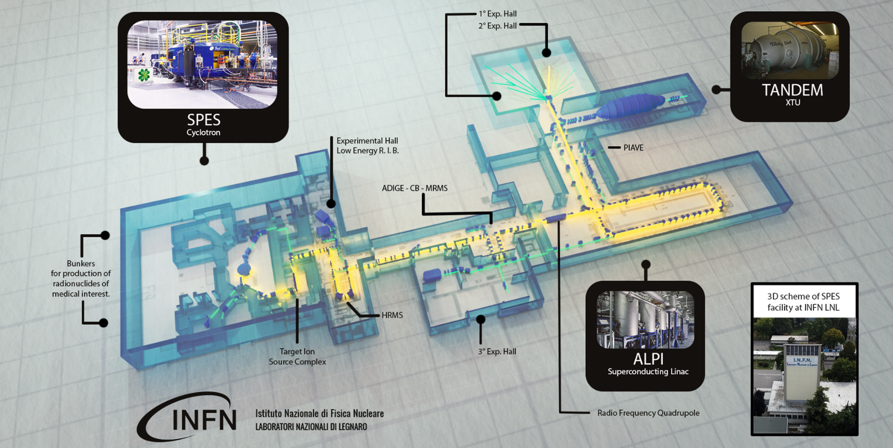
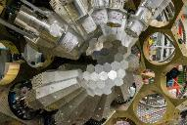

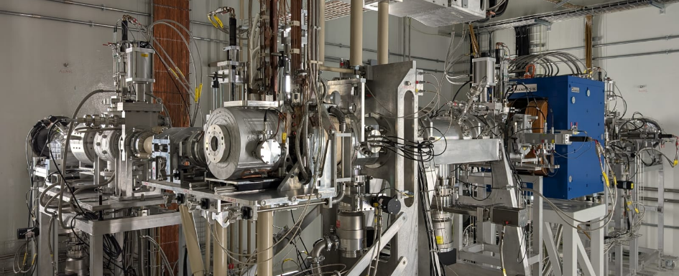

The framework: SPES at LNL

Slide 3
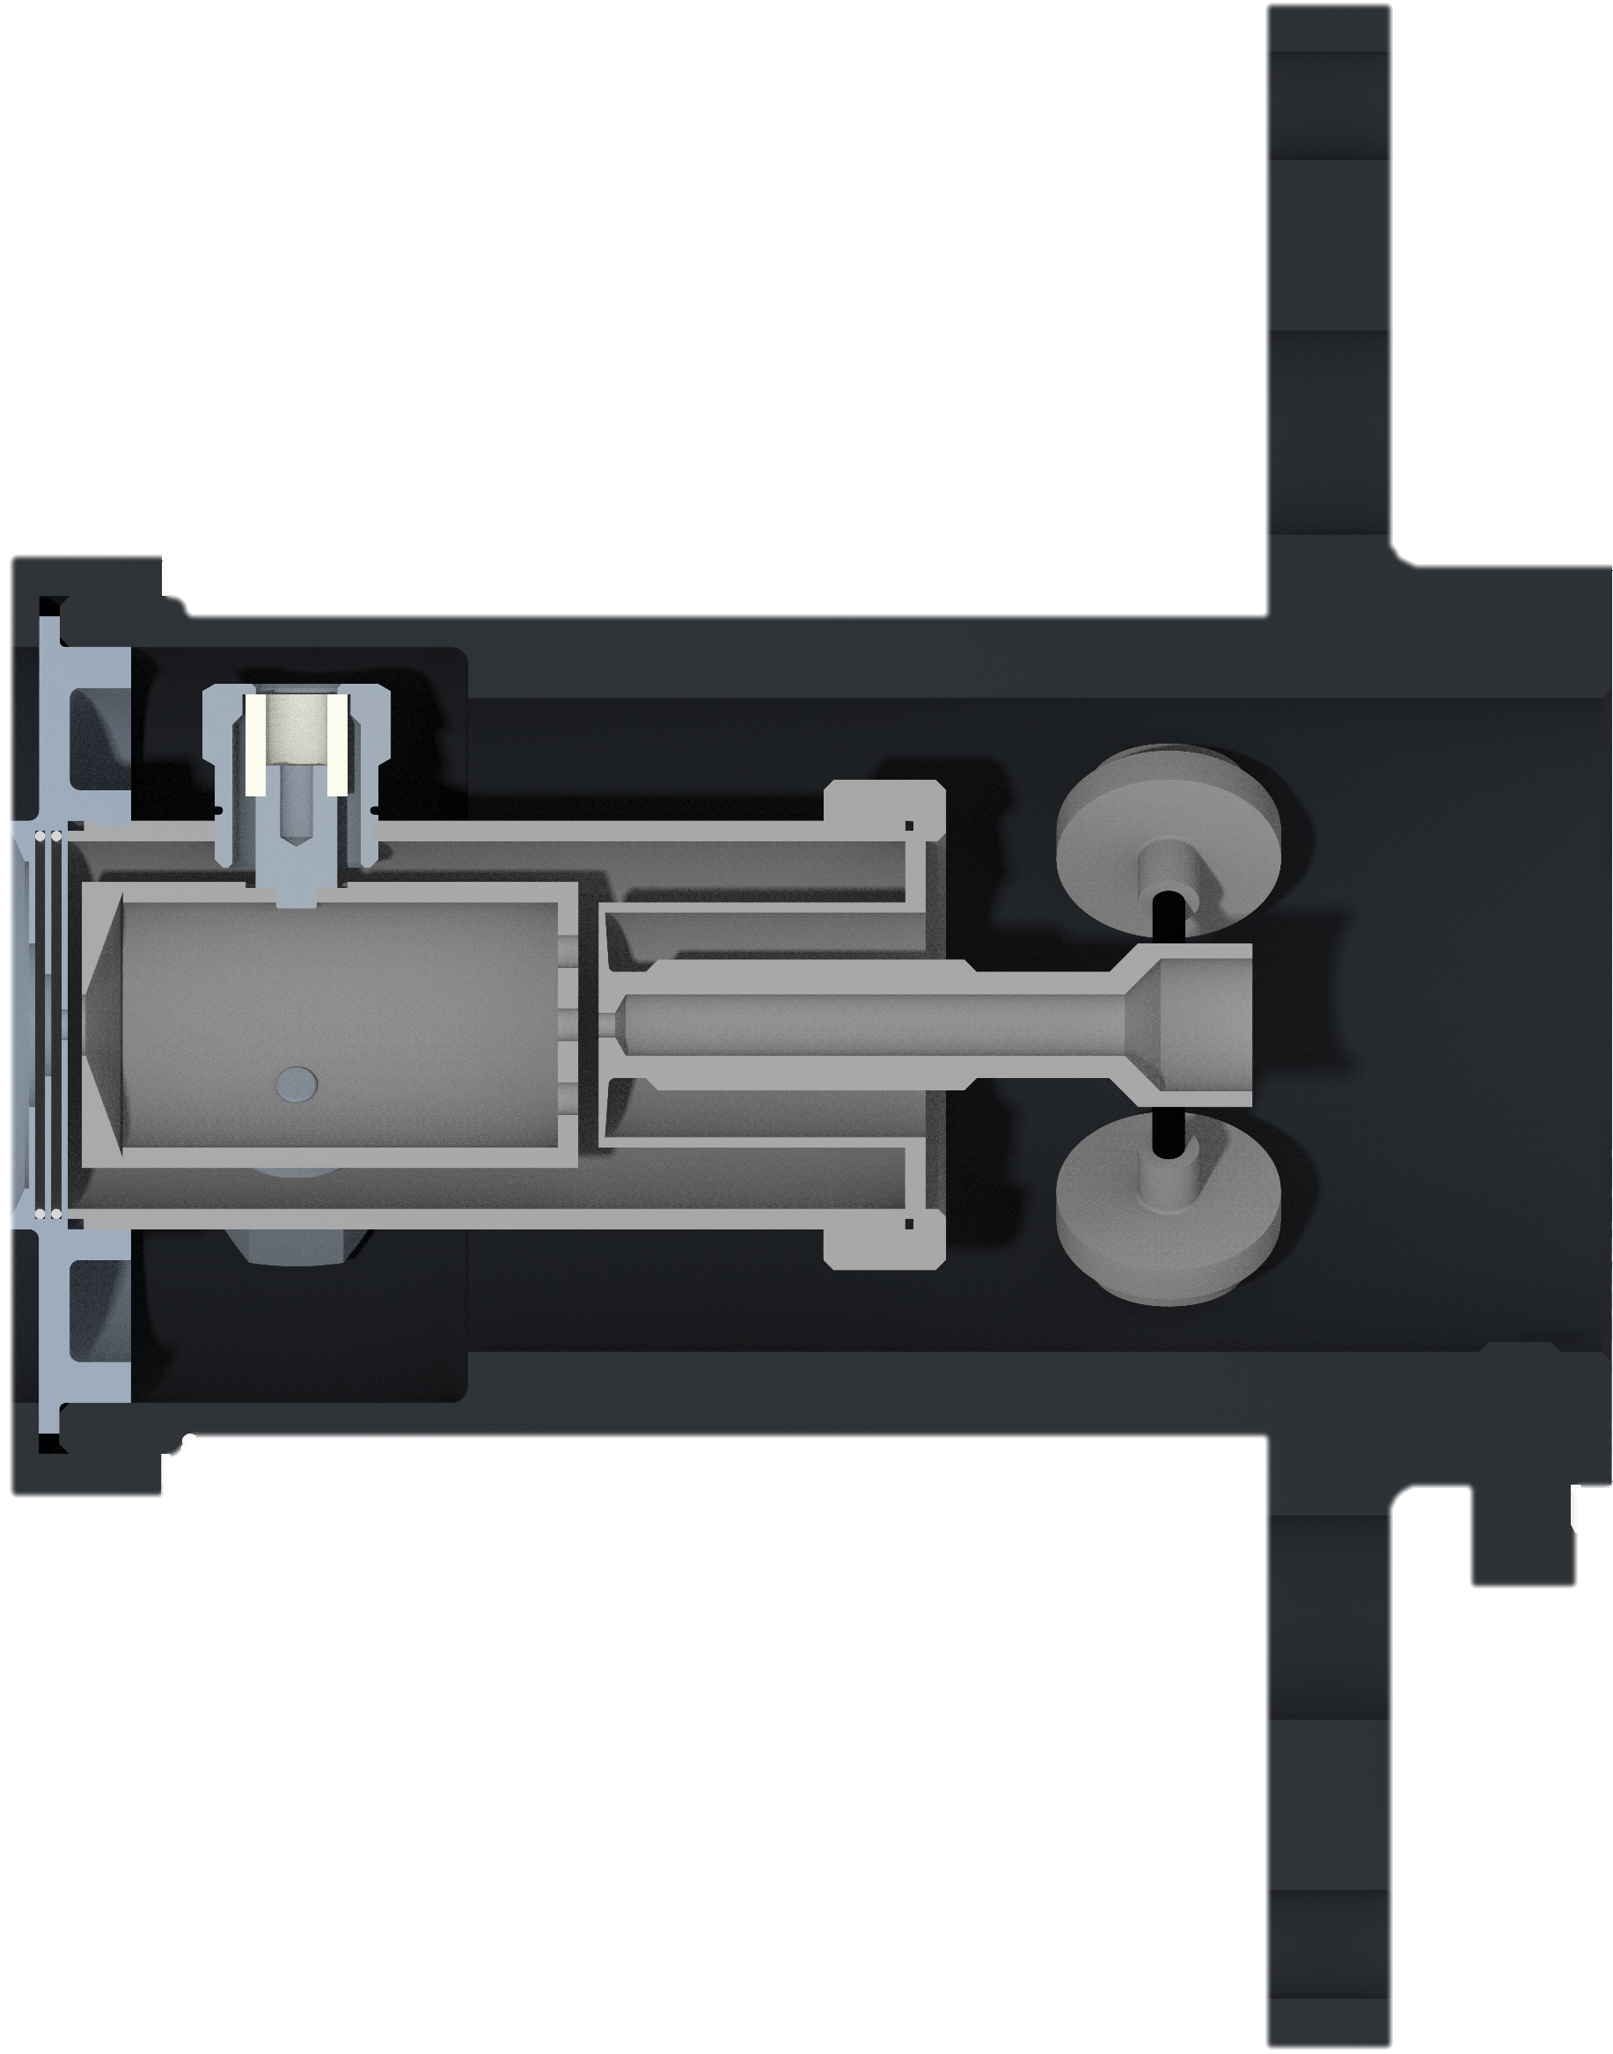
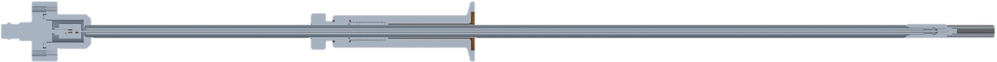
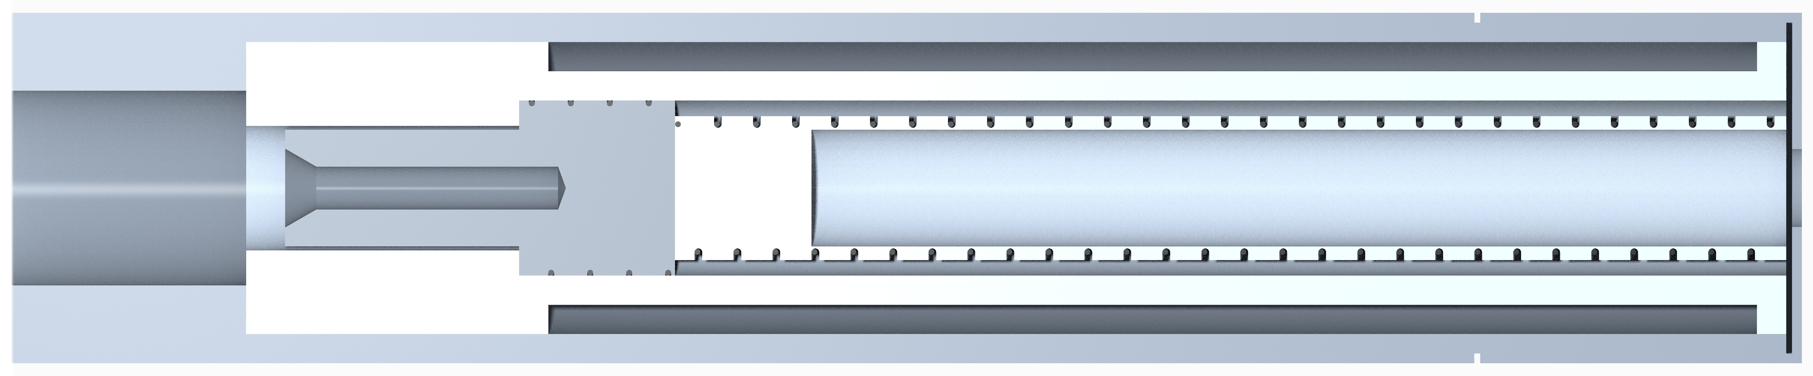
Research project and objectives
ISOL machine - TIS Complex
ADIGE and ECR Ion Source (PIAVE)
FEBIAD Ion Source used for the production of Radioactive Ion Beams
Injection system used to produce Ion Beams from Solid Elements
Discharge Chamber
(Ta)
3x Anode Support System
(Ta, Al₂O₃)
4x Cathode Centering Pins
(Ta, Al₂O₃)
Housing
(Graphite)
Current connector
Alignment system
Heating rod
Oven
Insulators (Al₂O₃)
Crucible (Al₂O₃)
Heating Coil (W)
Extraction disks
(Ta)
Grid (Mo)
Frontal Surface (Ta)
Flange (Ta)
Outlet (Mo)
Plasma Chamber (Ta/Mo)
Screw (Mo)
Oven body (Ta)
Oven head (AISI304)
Anode
Main Body (Ta)
Cathode

Slide 4
Research project and objectives
FEBIAD Ion Source used for the production of Radioactive Ion Beams
Injection system used to produce Ion Beams from Solid Elements
Investigate the influence of several factors on the FEBIAD performances exploiting LPBF advantages
Study the oven to identify its limitations, then develop a new design possibly using LPBF technology
Design of innovative anode-cathode interfaces
Development and validation of a Finite Element Model
Development of a new FEBIAD geometry through LPBF
Development of procedures for the high temperature characterization
Study the influence of the cathode surface finishing
Development a new oven design to improve its stability
Study the influence of the anode grid transparency
Evaluation of innovative oven design possibly using new materials
Evaluation of the possible improvements of using different materials
Study of new experimental procedures to measure T<800°C

Slide 5
Research project and objectives
Investigate the influence of several factors on the FEBIAD performances exploiting LPBF advantages
Study the oven to identify its limitations, then develop a new design possibly using LPBF technology
Study the influence of the cathode surface finishing and anode grid transparency (new LPBF designs)
Definition and validation of the oven Finite Element Model
Design and development of innovative anode-cathode interfaces (e.g. conical, spherical)
Development of procedures for the high temperature characterization to identify the current design limitations
2024-2025
Design and development of a new complete FEBIAD geometry through LPBF
Improvement of the actual oven design
Evaluate new experimental procedures to measure T<800 °C
Evaluate the possible improvements of using different materials (e.g. TaW alloy)
Production and characterization of the new design
Production and complete characterization of:
The innovative LPBF FEBIAD geometry
The new anode-cathode interfaces with standard FEBIAD geometry
(High temperature tests, thermionic emission tests and ionization efficiency measurements with stable elements)
2025-2026
Evaluate innovative oven design possibly using new materials or LPBF technology (evaluation of operating temperature, potential reaction..)
Possible production and characterization of the innovative geometry
2026-2027

Slide 6


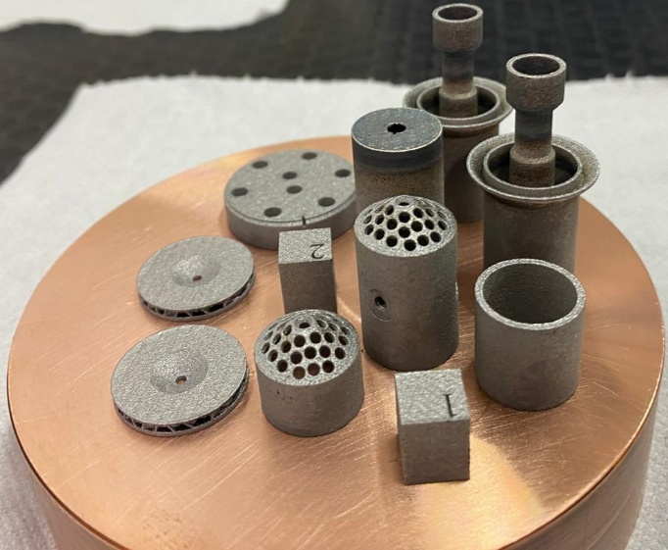
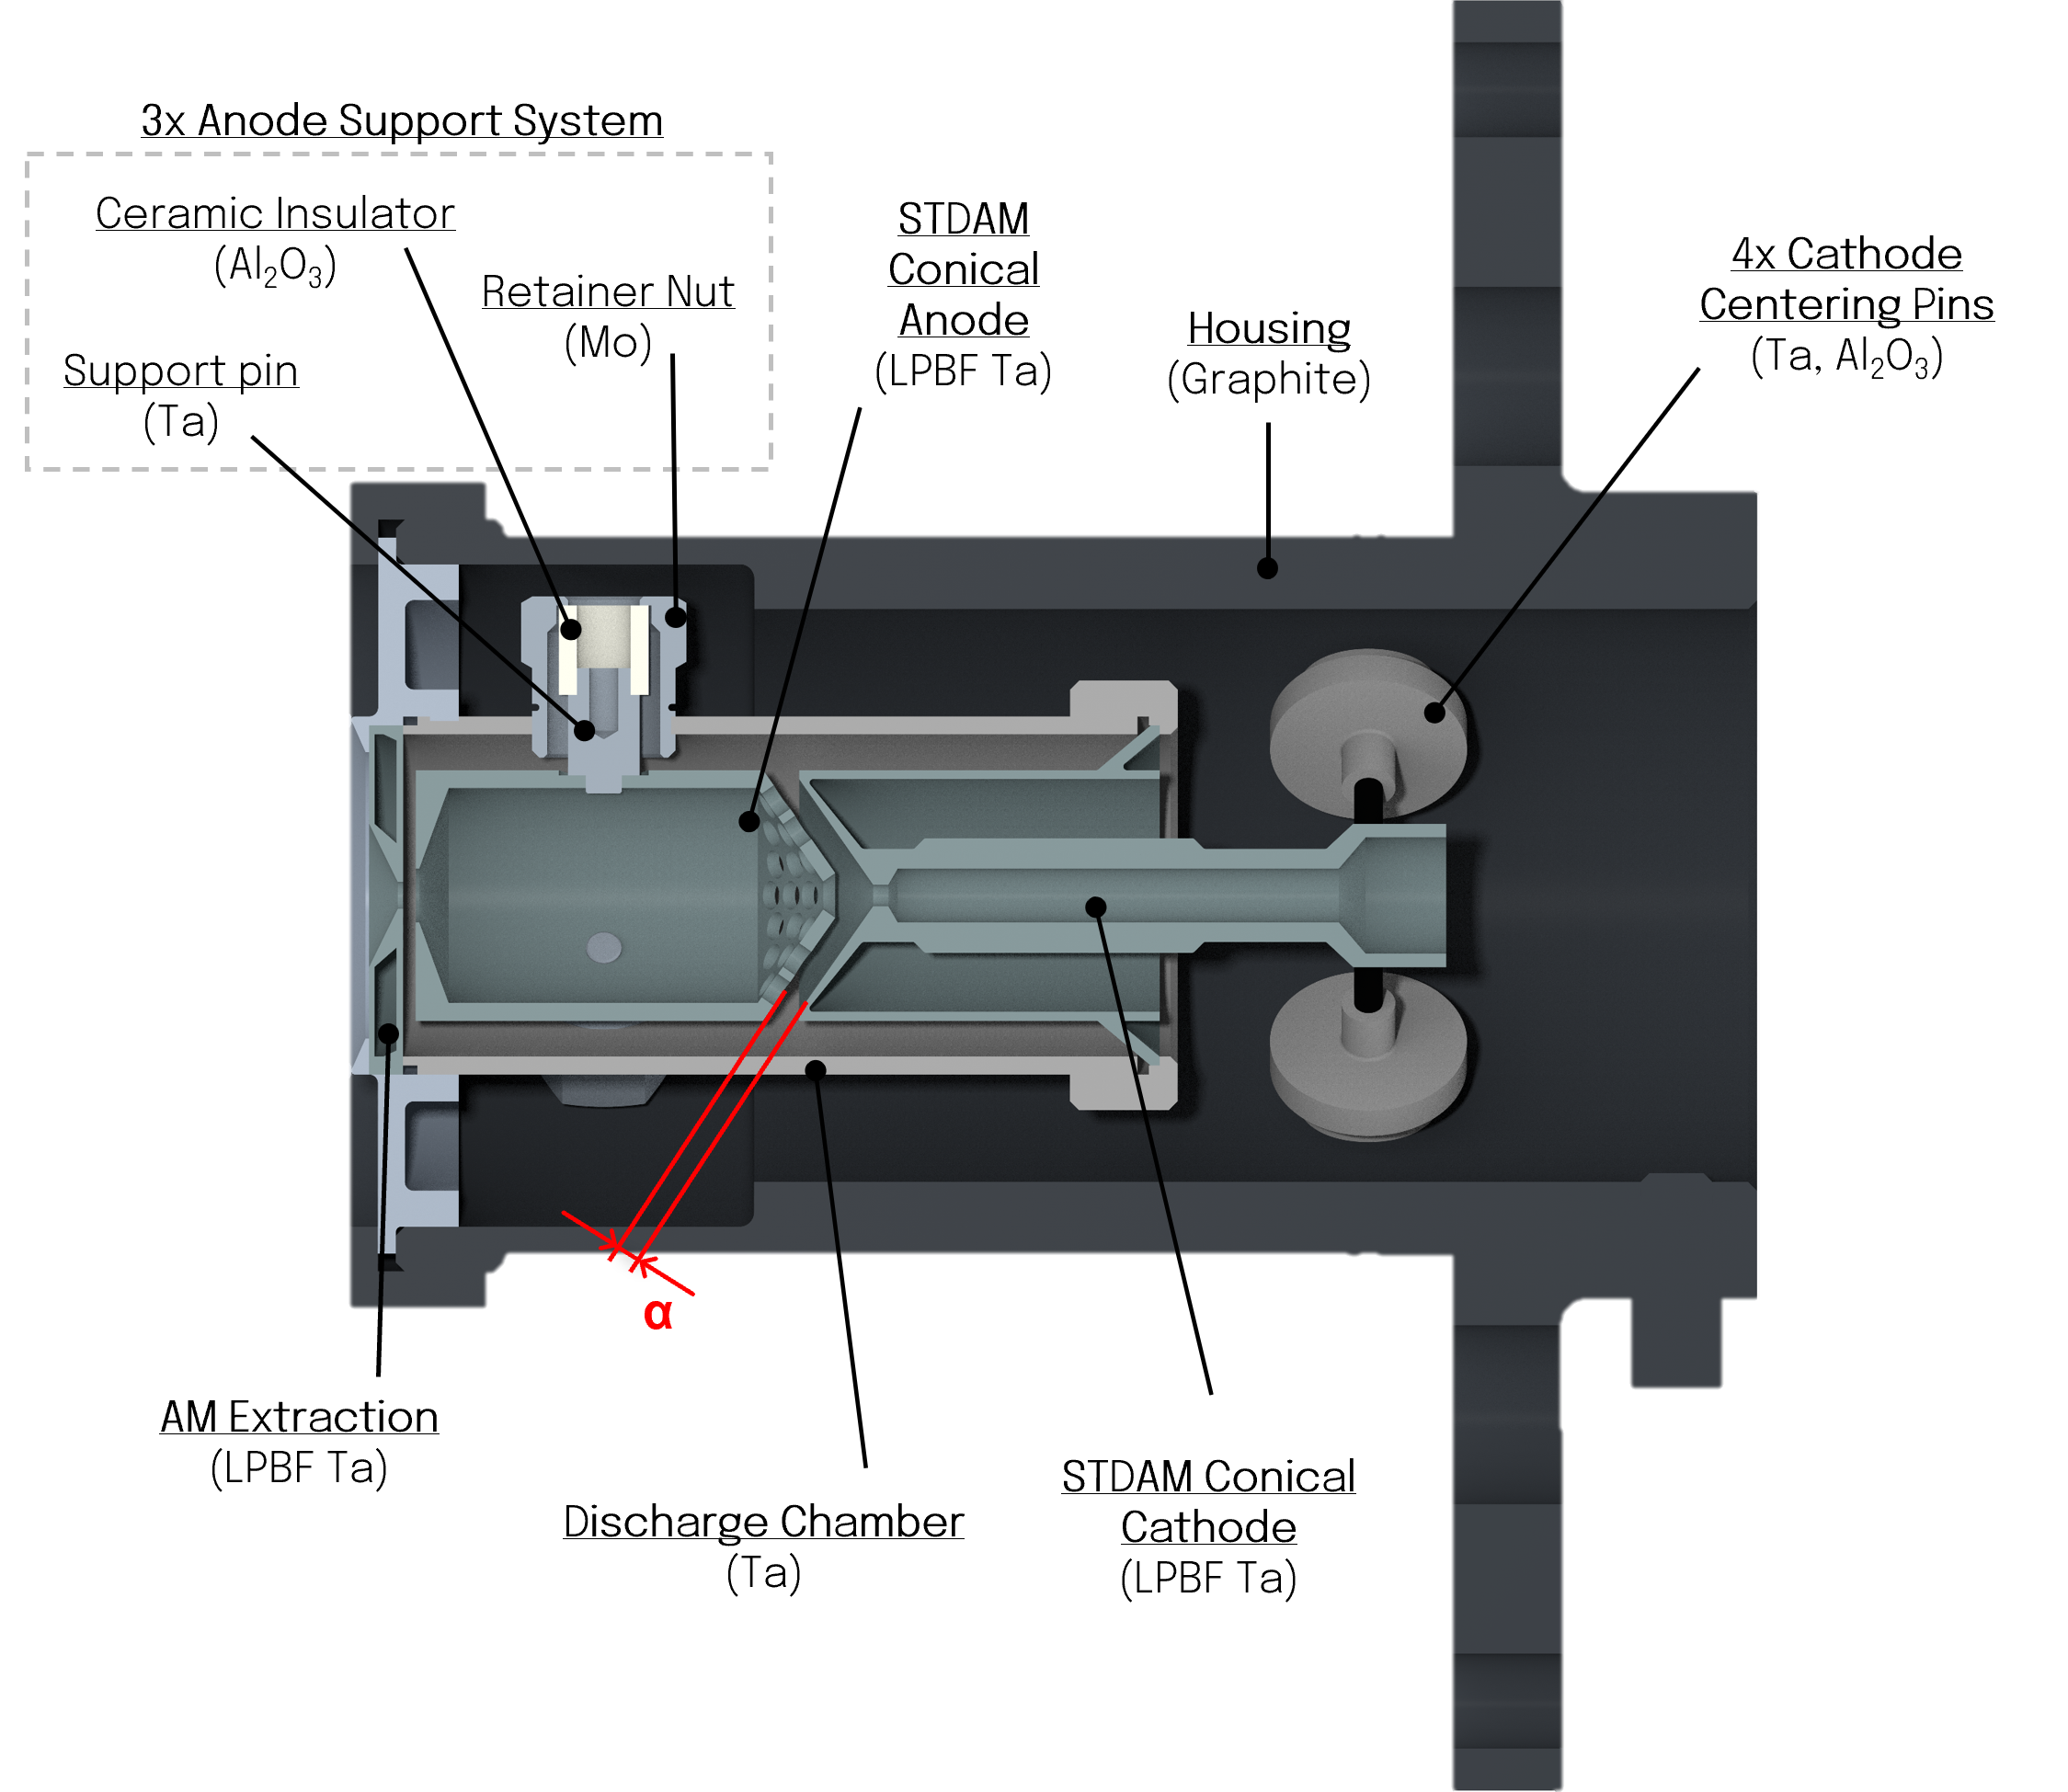
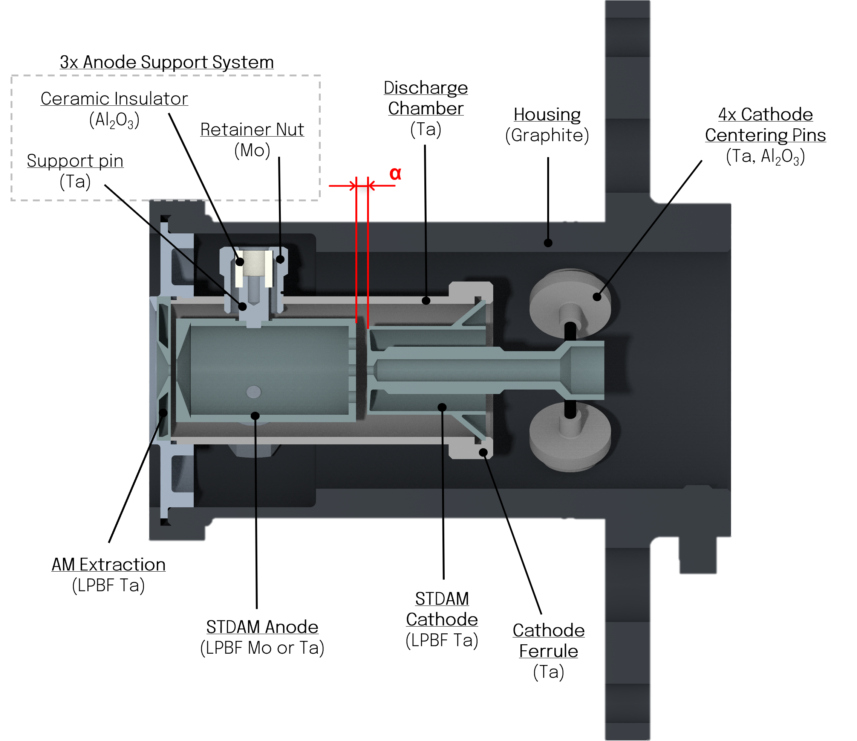
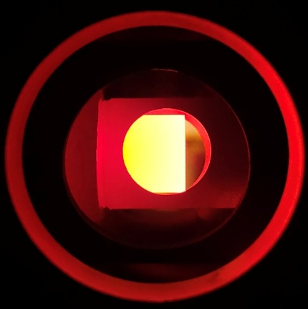
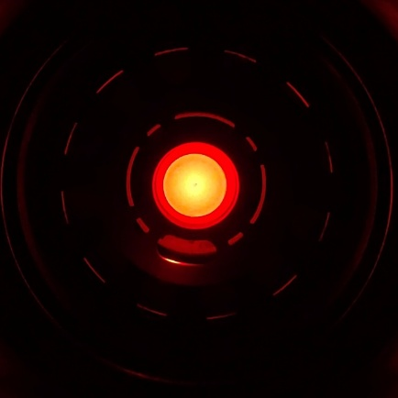
FEBIAD Ion Source
Design of innovative anode-cathode interface
First design: conical interface with 35° angle
Production by means of LPBF of the first prototype, ready for:
High temperature characterization
Thermionic emission measurement
Ionization efficiency tests with stable beams (noble gases)
High temperature characterization of the conical cathode
Lateral Surface Temperature
Frontal Surface Temperature

Slide 7
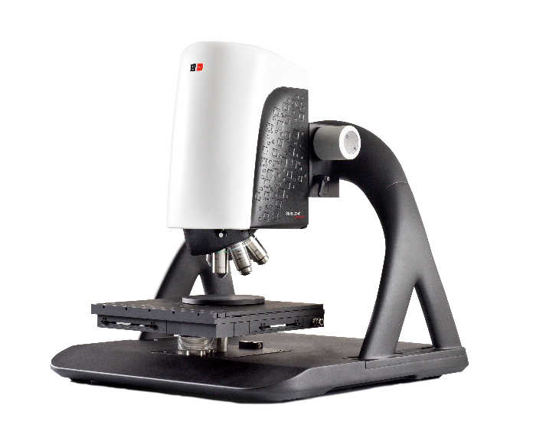
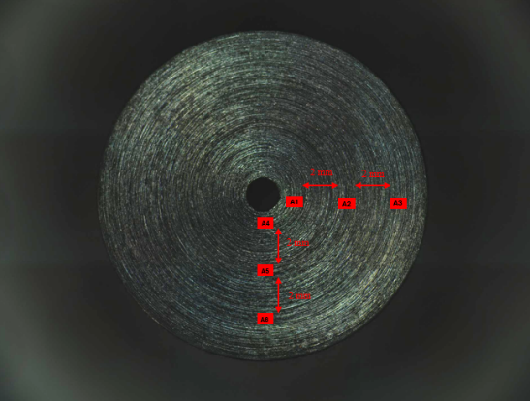
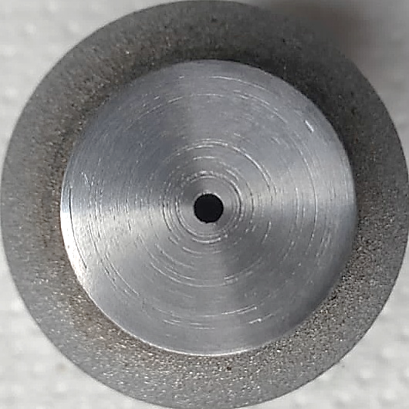
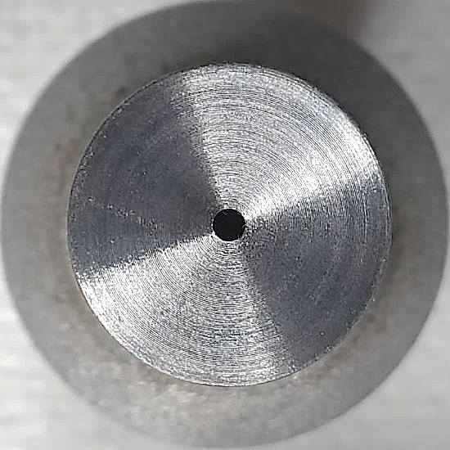
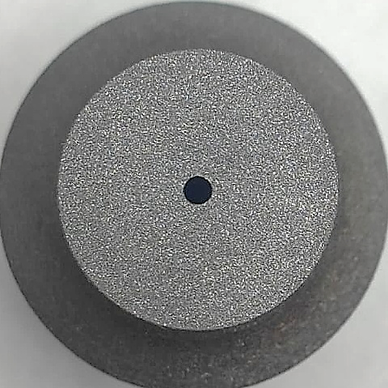
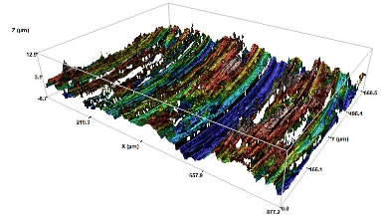
The FEBIAD Ion Source
Influence of the cathode surface finishing
Production of Standard LPBF cathodes and subsequent mechanical operation to have three different frontal surface finishing
Frontal Surface finishing characterization using an Optical Profiler
Polished
Turned
3D Optical Profiler Sensofar Neox
Study the parameters that can have an influence on the thermionic emission
Sandblasted
Polished
Turned
Sandblasted

Slide 8
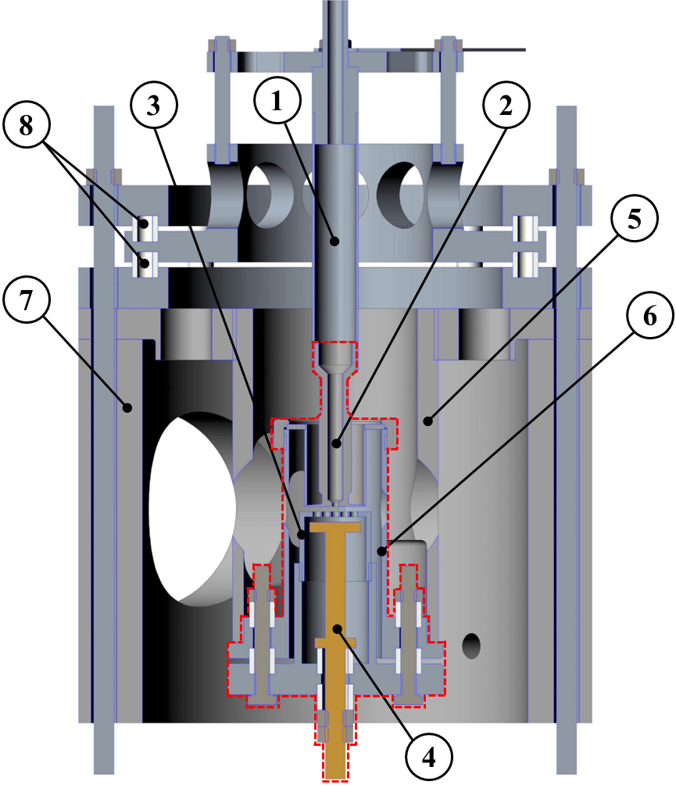
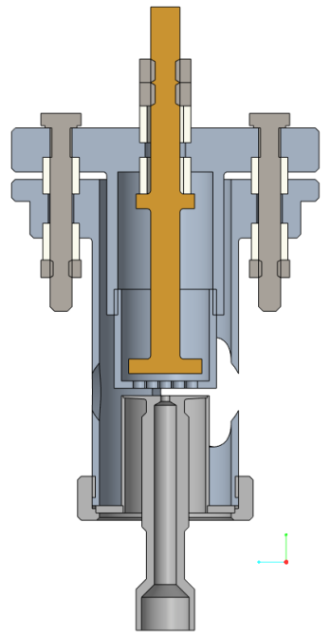
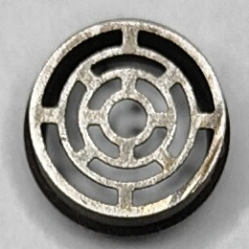
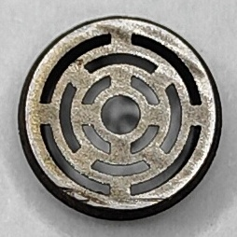
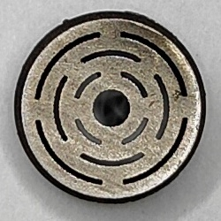
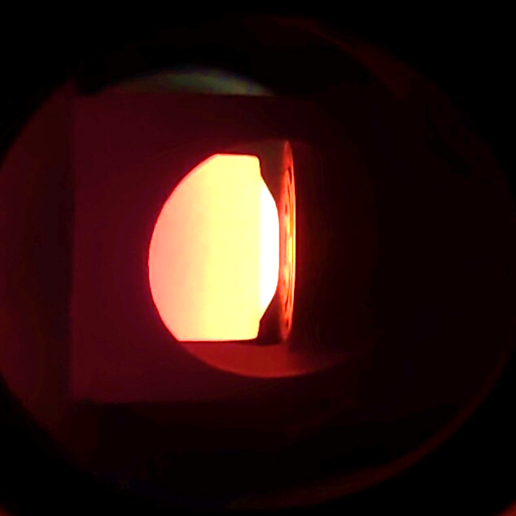

The FEBIAD Ion Source
Influence of the anode grid transparency
_{i(t)}
Production of new grid geometries by means of LPBF with different transparency
-
-
-
-
-
-
-
-
-
-
-
-
-
-
Transparency: 50%
Transparency: 33%
Transparency: 20%
150 V
150 V
(1) Transfer line
(2) Cathode
(3) Anode
(4) Probe
(5) Housing support
(6) Extraction chamber
(7) Support Box
(8) Insulators
Anode 33% during thermionic emission test

Slide 9
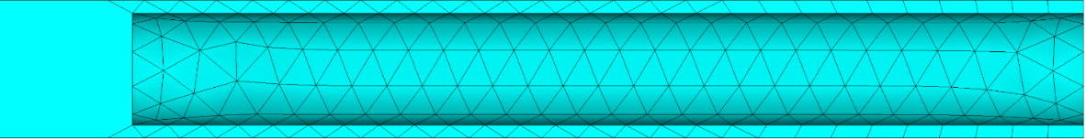
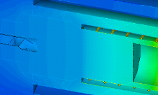
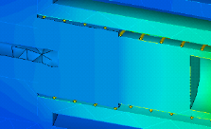
The ECR Ion Source
Definition of a Finite Element Model
Thermal-electric simulation of the oven by means of ANSYS® MAPDL software
Insulators (Al₂O₃)
Crucible (Al₂O₃)
Heating Coil (W)
Screw (Mo)
Oven body (Ta)
Oven head (AISI304)
Model #1
Temperature profile along the alumina crucible at different levels of supplied current
Model #2

Slide 10
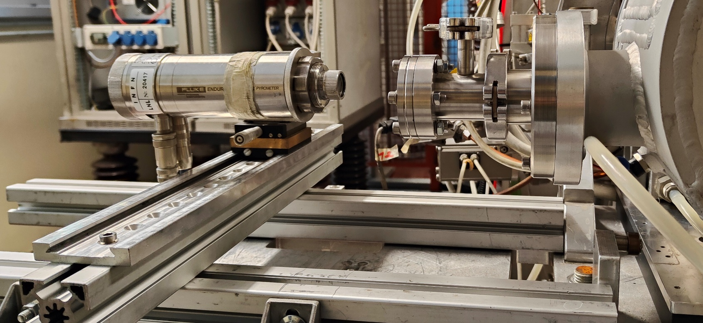
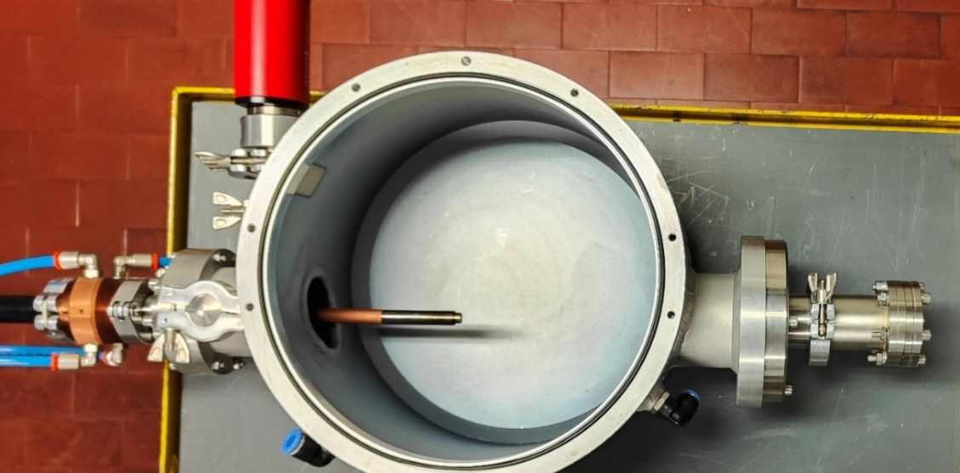
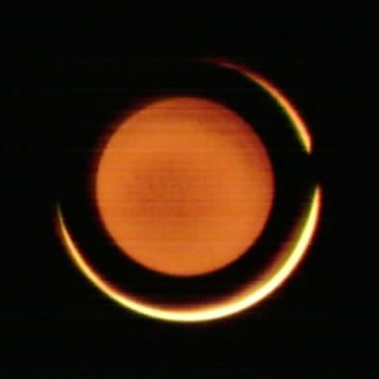
The ECR Ion Source
High temperature characterization
1.20A
1.30A
1.40A
1.50A
Observation Window
Observation Window
Endurance tests highlighted the instabilities of the oven and confirmed the strong gradient present in the crucible
Redesign strongly recommended!
Oven during high temperature test,
the red line identify the pyrometer spot

Slide 11
Educational activities
Courses, exams and other training activities
Vacuum Technologies
Completed in June 2025
Physics, Technology and Applications of Linear Accelerators
Ongoing
COURSES
Optimization Methods for Mechanical Design
Expected in Mar 2026
Python for Numerical Heat Transfer Modelling and Building Physics
Expected in Mar 2026
School
To be defined
Expected in 2026
Abroad period
Experimental campaign at ISOLDE (CERN)
Expected in Fall 2026
OTHER
Co-supervisor of two Master’s Thesis
To be defended in Oct. 2025

Slide 12



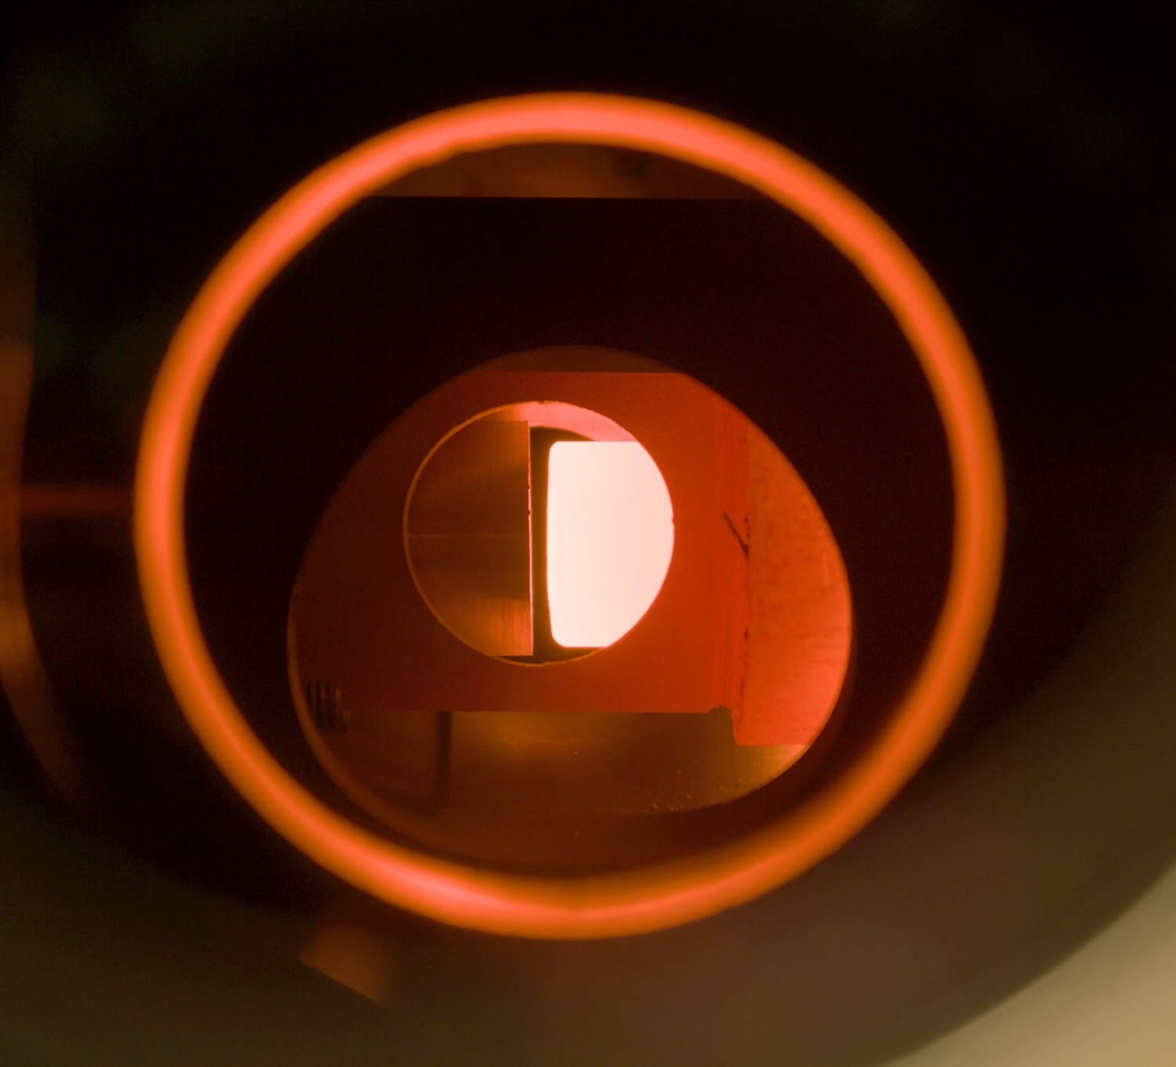
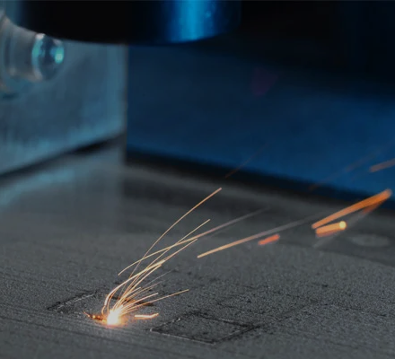
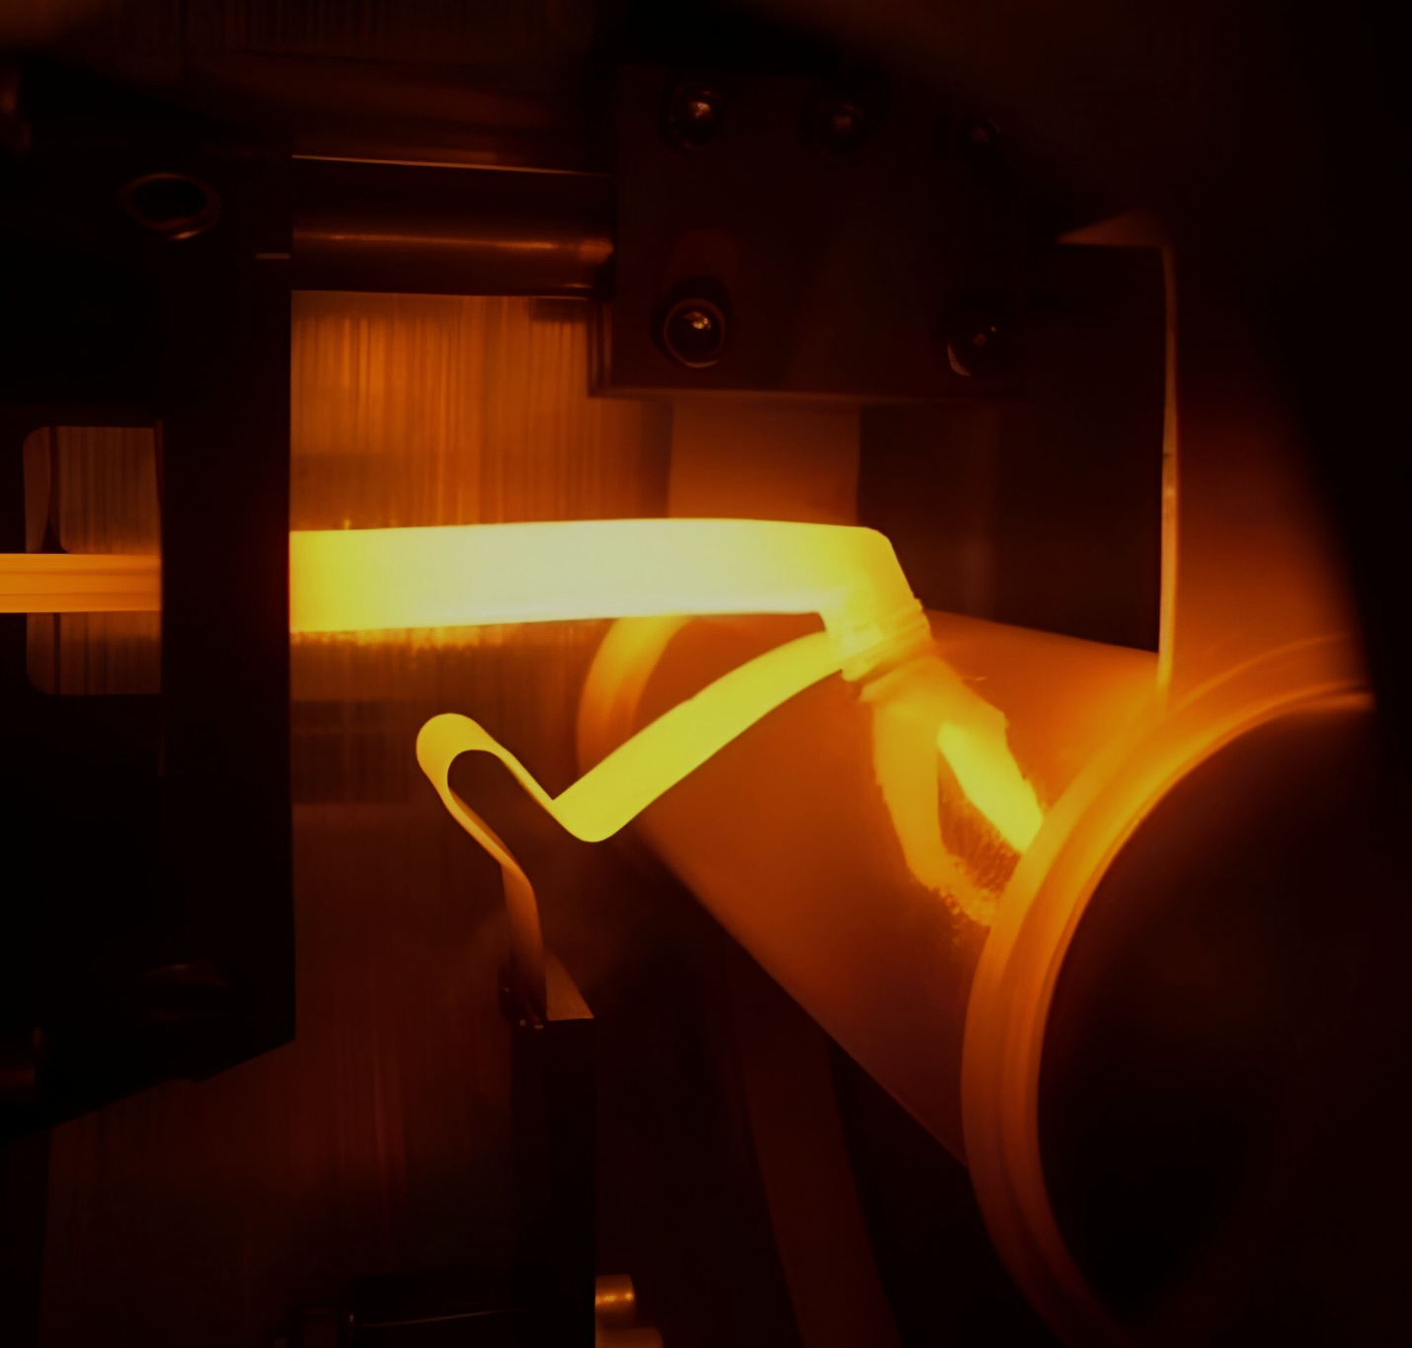
Thank you for your attention!

