Slide 1

Admission to second year
Technologies for fundamental research in phisycs and astrophisycs
Alberto Barci
A.Y. 2024-2025

Slide 2
Development and Characterization of Innovative Additively Manufactured Metal Alloys for High and Ultra-High Temperature Applications
PhD Program: Tecnologie Per La Ricerca Fondamentale In Fisica E Astrofisica (TFPA)
CURRICULUM: Meccanica
UNIVERSITY/RESEARCH CENTRE: Università degli Studi di Padova (DFA) / INFN sezione di Padova
PhD STUDENT: Alberto Barci
SUPERVISOR: Prof. Massimo Pellizari
Dr. Pietro Rebesan

Slide 3
Courses, exams and schools
PhD courses completed:
Analysis and Modelling of the Additive Manufacturing (12 hours)
Generative Design for Smart Additive Manufacturing (12 hours)
Coupled electrical-thermal-structural finite element analyses (10 hours)
Powder Flowability (course of DII department) (10 hours)
Summer school:
SEAMAC International Summer school: additive manufacturing, from powder to final parts with a smooth surface, 29.06 – 05.07.2025, Ljubljana
Advanced Course on "Metal Additive Manufacturing: Fundamentals, Modeling, Materials, and Implementation“, 22.09 – 26.09.2025, remotely
Additional activity:
Attendance -Phd Academic English – January-February 2025

Slide 4



Research introduction
Context
Part of the HISOL_NEXT project (CSN V) for next-generation ISOL sources (SPES facility, INFN Legnaro).
Focus on additively manufactured refractory metals for very high-T applications (2000÷2200 °C).
Materials studied
Pure Tantalum (Ta)
Ta-10W alloy
Refractory High Entropy Alloy (RHEA) - TaWCrV
Objectives
Evaluate printability via LPBF.
Optimize process parameters (P, v, etc.).
Material characterization: physical, thermal, electrical, and mechanical properties evaluation

Slide 5
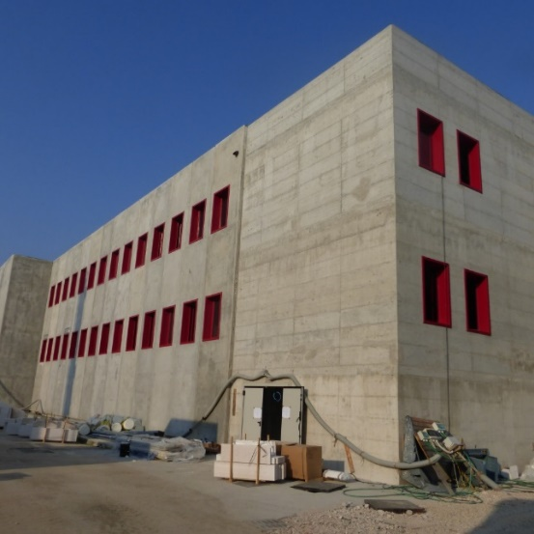
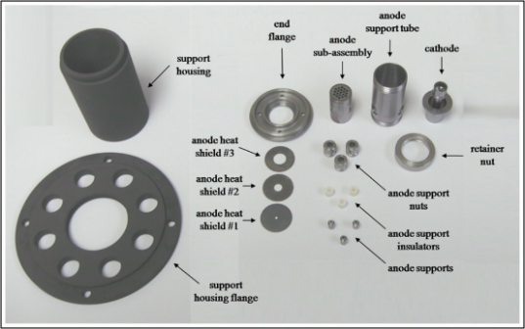
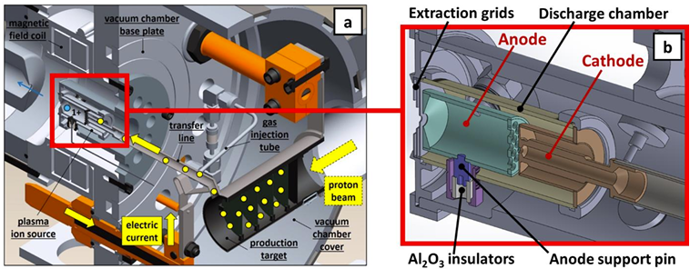
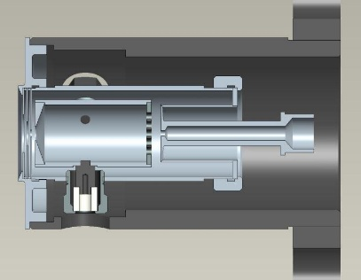
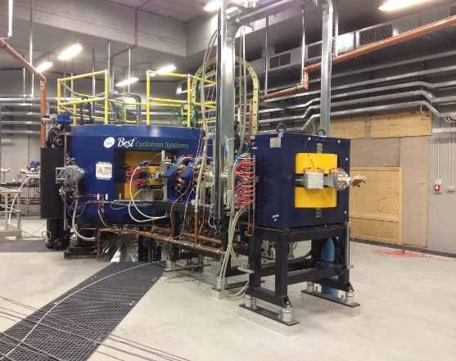
PhD project context: SPES project
Selective Production of Exotic Species
Proton Beam
Target
Transfer Line
Ione source
Radioactive Beam
SPES building
(a) CAD model section view of The SPES Target Ion Source (TIS) system; (b) magnification of the FEBIAD Ion Source of the system.
Cyclotron

Slide 6
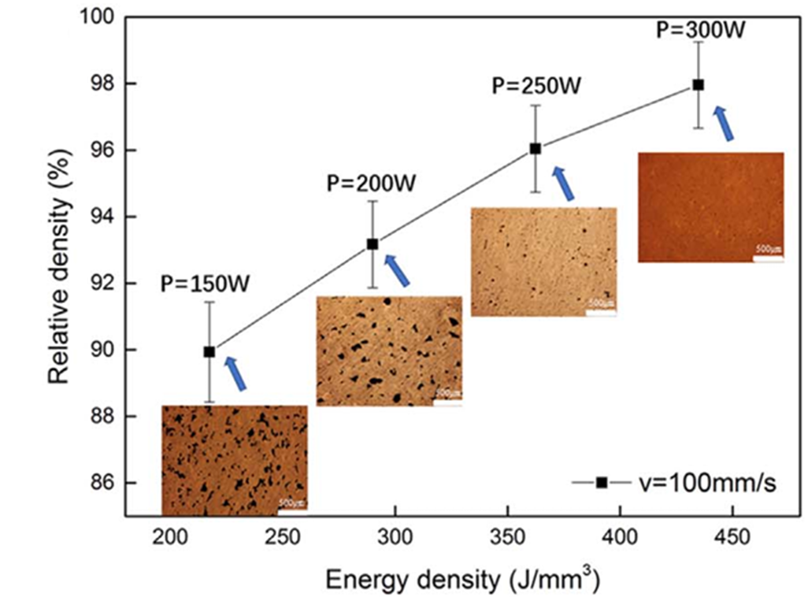




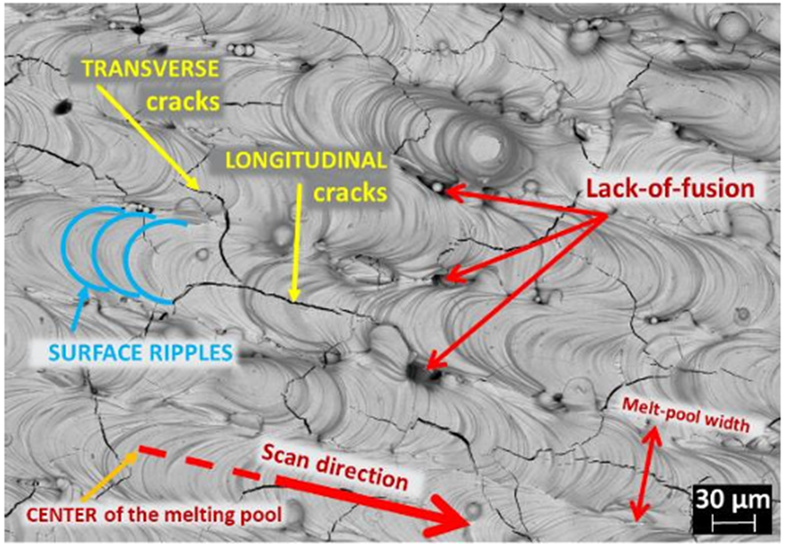


Current state of research / 1
Pure tantalum:
Literature:
Many examples of 3D printing of pure Ta by LPBF
Parameters:
Many examples of 3D printing of pure Ta by LPBF
Results:
Very high densities, up to 99.9%.
Gaps:
No research on thermal and electrical characterization
https://doi.org/10.1016/j.jmatprotec.2003.11.051
Pure tungsten:
Literature:
Many examples of 3D printing of pure W by LPBF
High Melting Temperature (3410°C)
High Thermal Conductivity (~174 W/m*K)
Brittleness at Room Temperature
Very difficult to print without cracks
https://doi.org/10.1007/s40195-018-0752-2

Slide 7

Properties:
Excellent corrosion/oxidation resistance
High mechanical strength
High-temperature stability; suitable for extreme enviroment
Ta-10W:
90 wt.% Ta, 10 wt.% W
Solid solution strengthening from W
RHEAs:
Multicomponent design (high configurational entropy)
Better radiation resistance (low embrittlement)
Our alloy TaWCrV:
Ta 35-40 %wt.
W 35-40 %wt.
Cr 12-17 %wt.
V 8-13 %wt.
Literature:
Only one study published as of 2025
Literature:
The composition was newly developed for this application
Few studies, mostly with low Ta/W content

Slide 8
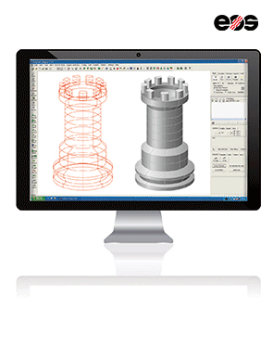
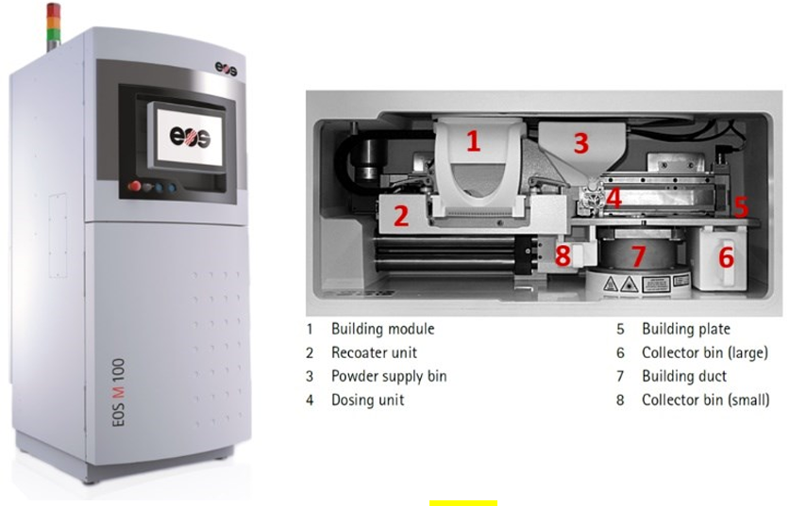
3D Printing - LPBF
Laser
Ta powder
Layer thickness
Ta block
Eos M100 printer used in this research (left);
view of the interior (right)
Main characteristics
Powder bed
Laser scanning
Layer-by-layer build
Solid part formation
Controlled environment
Main parameters:
Laser power
Laser speed
Layer thickness
Hatch spacing
Tantalum
Ta-10W

Slide 9
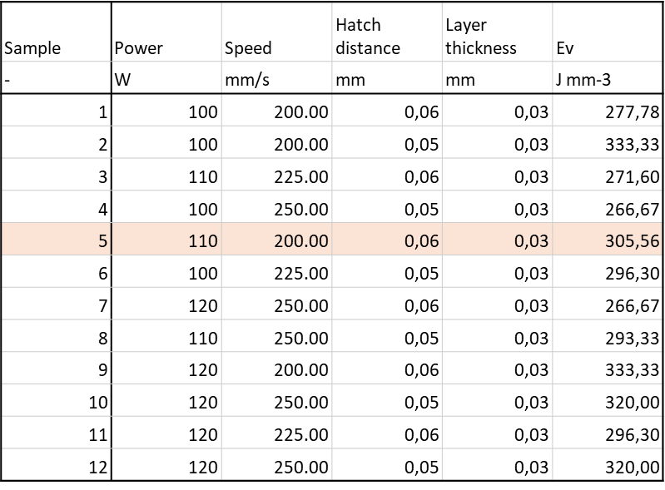
Ta – The first LPBF samples
Cubes 8 mm side
It is the simplest geometry for controlling parameters
Measurement of relative density
Detection of defects (porosity)
Best parameters from previous experiences
For both cubes and SSTs, the parameters were varied around these reference values.
Singles Scan Tracks (SST)
8 mm long
Single laser lines produced on solid blocks
Used to test if power & speed ensure stable melting
Help define the suitable process window
Power | Speed
W | mm/s
95 – 125 | 100 - 350

Slide 10
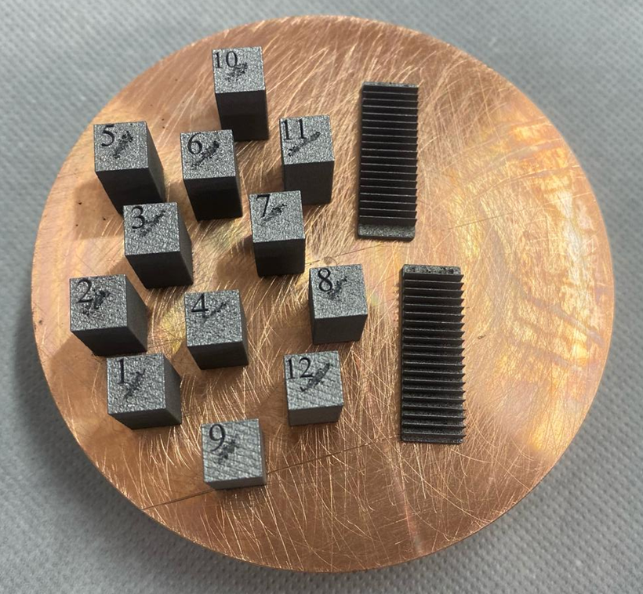
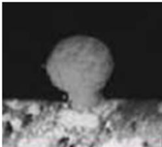
Ta – The first LPBF samples
Figure: Cubes and Single Track (SST) Ta samples
Figure: SST Ta samples (SEM)
No adhesion issues on the Cu platform.
SSTs: the tracks shape becomes irregular as laser power and scan speed increase + Balling

Slide 11
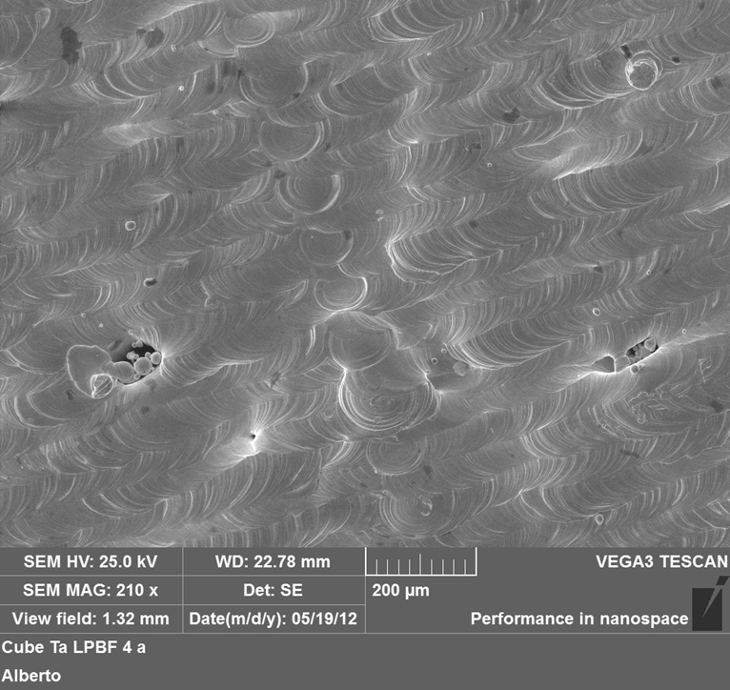
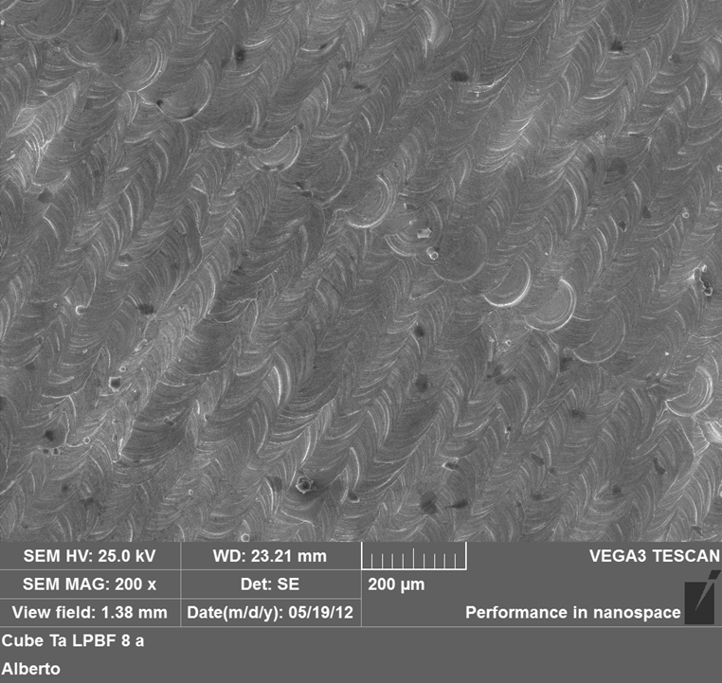
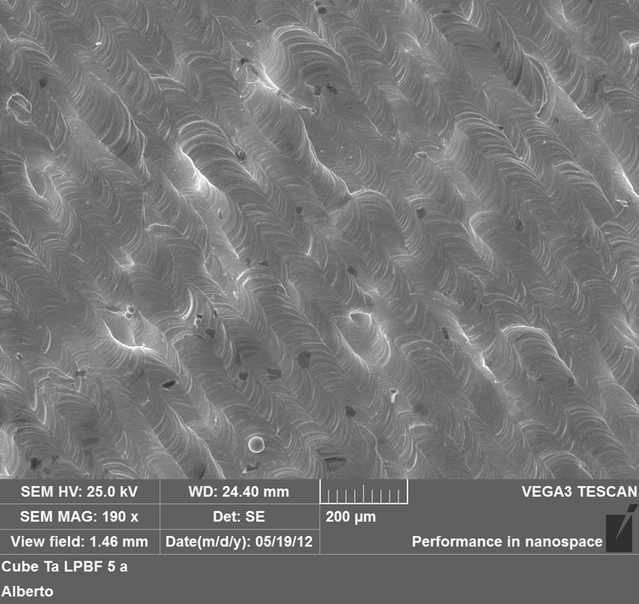
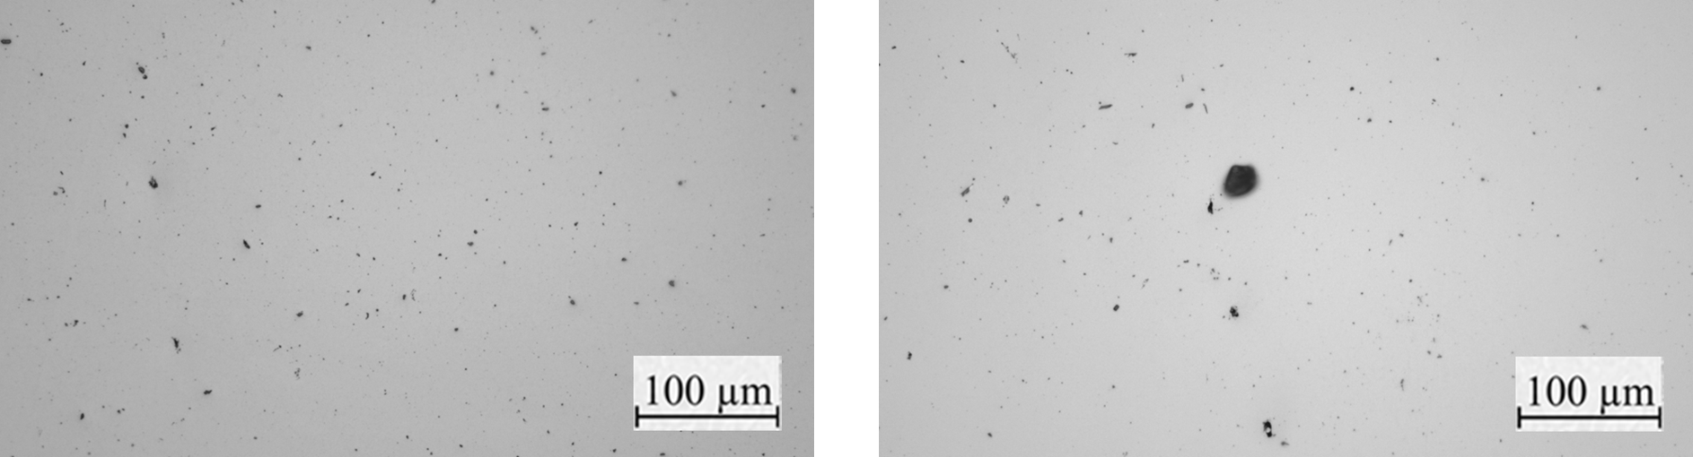
Ta – LOM and SEM analysis
Ed<290 J/mm^{3,} RD=98.56 %
Ed=290-320 J/mm³, RD=98.88 %
Ed>320 J/mm³, RD=98.81 %
No porosity or defects on the top surface
Ed: 293.33 J/mm³, Laser power: 110 W, Scanning speed: 250 mm/s, RD=98.88%
Widespread porosity, probably due to the presence of impurities in the powder.
Maximum RD~98.8%

Slide 12
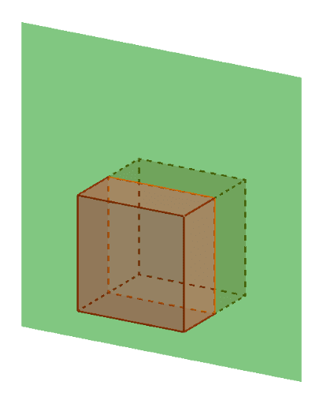
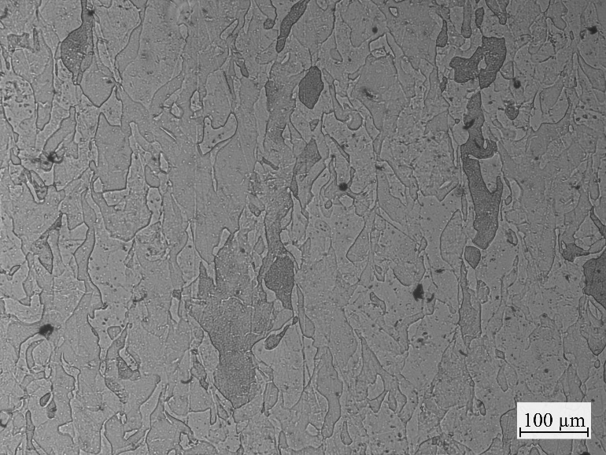
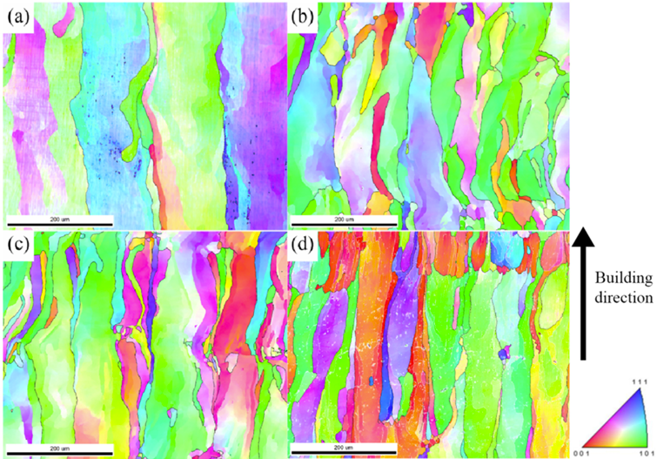
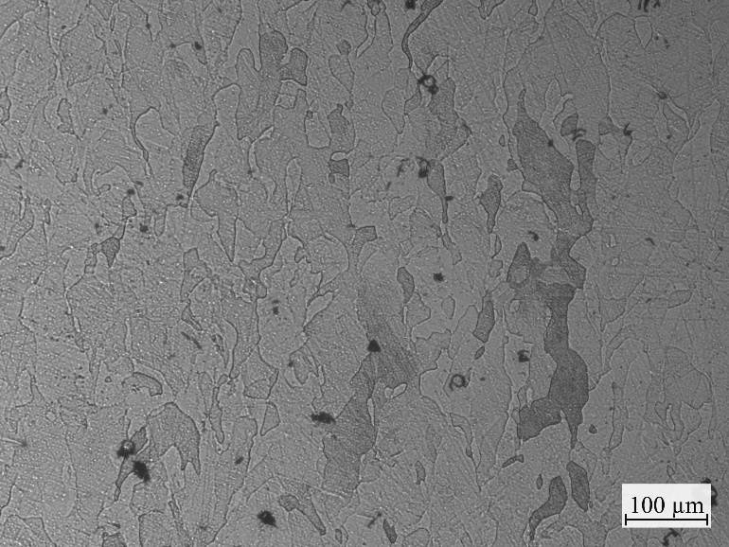
Ta samples - microstructure
Build direction (BD)
Top surface
VED: 271.60 J/mm3;
Laser power: 110 W;
Scan speed: 225 mm/s;
Relative density: 98.58%
VED: 289.96 J/mm3
Laser power: 120 W
Scan speed: 230 mm/s
Relative density: 98.55%
Examples of EBSD images of grains
https://doi.org/10.1016/j.ijrmhm.2022.105882

Slide 13
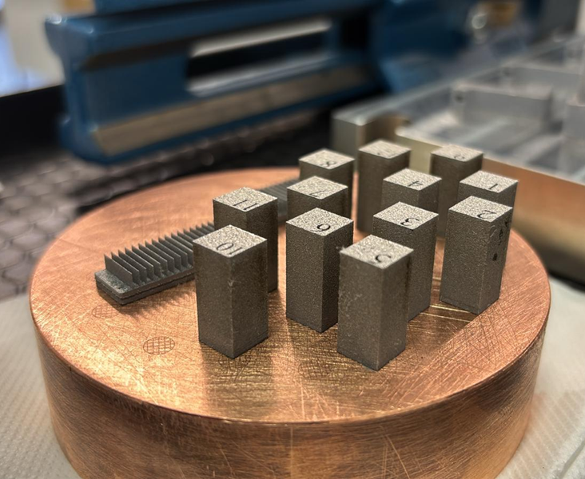
Ta-10W samples
Figure: Cubes and Single Track (SST) Ta-10W samples
Figure: SST Ta-10W samples (SEM)
The first printing attempts directly on the copper support were stopped after only about 20 layers.
The printing was successful by first creating a 1 mm layer of pure Tantalum and then printing the Ta-10W on top of it.

Slide 14
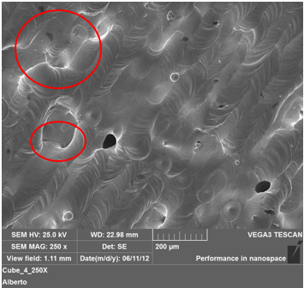
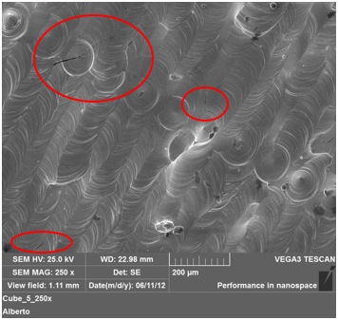
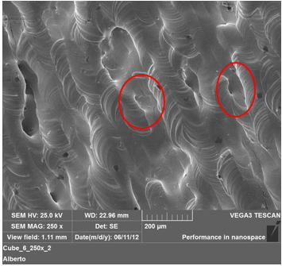
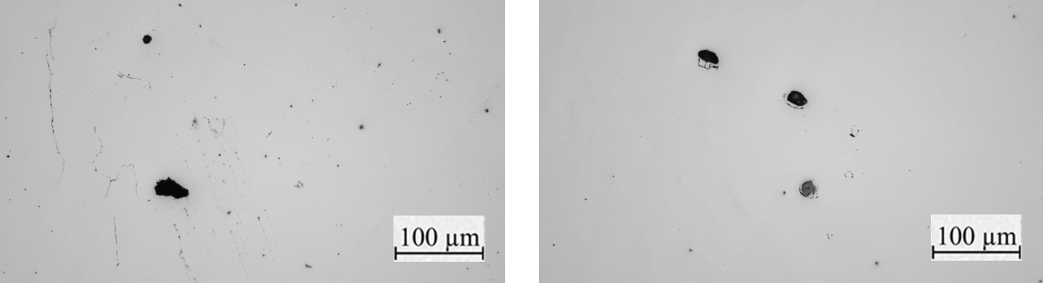
Ta-10W – LOM and SEM
Ed<290 J/mm³, RD=94.4%
Ed=290-320 J/mm³, RD=96.79%
Ed>320 J/mm³, dr=93.32%
Surface:
Cracks
Porosity
Energy density: 300.00 J/mm³; Laser power: 90 W; Scanning speed: 200 mm/s; RD: 96.52%
Large pores and cracks, probably due to inadequate melting and cooling processes.
Maximum relative density ~97%

Slide 15
Second year activity
Conclusion of Metallographic Characterization of Tantalum
Optimization of Ta-10W parameters
Study of Mechanical Properties of Ta-10W
Study of Thermal and Electrical Properties of Ta-10W

Slide 16
Plan of activities
 | Year 1 |  |  |  | Year 2 |  |  |  | Year 3
 | Q1 | Q2 | Q3 | Q4 | Q1 | Q2 | Q3 | Q4 | Q1 | Q2 | Q3 | Q4
Bibliography research
Tantalum printing and characterization
Ta-10W printing optimization
Ta-10W thermal and electrical characterization
TaWCrV printing optimization
TaWCrV thermal and electrical characterization

Slide 17
Thank you for your attention

