Slide 1


TECH-PFA PhD Program
Admission to II year presentation
Multi-parametric thermal-mechanical modeling and analysis of high order active mirrors for space telescopes
23 September 2025
Candidate: Chiara Scandaglia
Supervisors: Runa Briguglio, Marco Xompero
INAF - O.A. Arcetri
XL Cycle

Slide 2
  Educational requirements
Attended courses
  Adaptive Optics for Astronomy I - Dr. Carmelo Arcidiacono - Passed
  Adaptive Optics for Astronomy II - Dr. Kalyan Radhakrishnan - Attended
  Fundamentals of system engineering and project management for large scientific projects - Dr. Marco Xompero and Dr. Runa Briguglio - Passed
  Coupled electrical-thermal-structural Finite Element Analyses - Dr. Michele Ballan, Prof. Giovanni Meneghetti and Prof. Mattia Manzolaro - Passed
  Methodologies and techniques for the analysis of experimental data - Prof. Alexis Pompili - Attended
  Random excitations and response of structures - Prof. Giuseppe Petrone and Prof. Francesco Franco - Ongoing lectures
12 total credits (10 credits required from educational obligations)
Missing exams will be taken by the end of 2025

Slide 3
  Educational requirements
Planned schools and conferences
  Workshop on Innovative Technologies for Space Optics (WITSO) 2025 - ESA/ESTEC, Noordwijk, The Netherlands - 13-17 October 2025 - Workshop - Poster accepted
  SPIE Astronomical Telescopes + Instrumentation 2026 - Copenhagen, Denmark - 5-10 July 2026 - Conference
  Observing with Adaptive Optics 2026 - Observatoire de Haute-Provence, Saint-Michel-l'Observatoire, France - October 2026 - School
A period of study and research abroad during the second year is foreseen, but not yet defined. The ESA OSIP program is one of the proposed options.

Slide 4
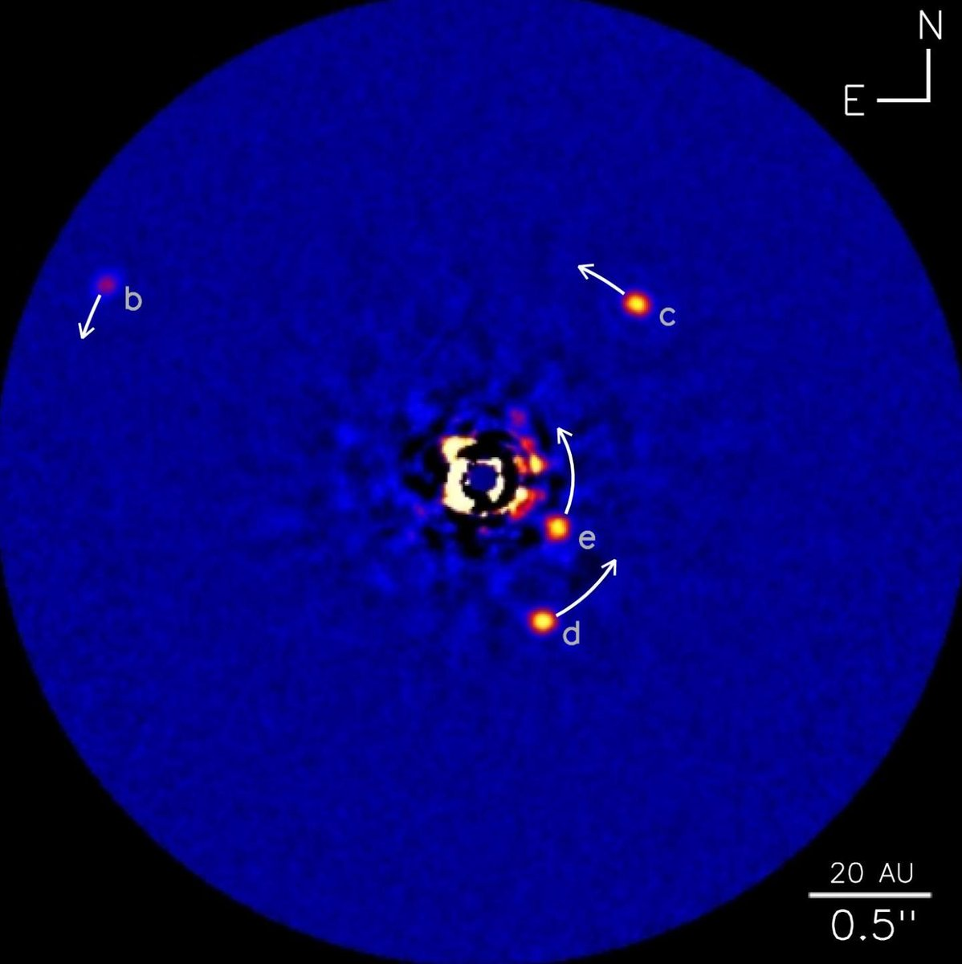
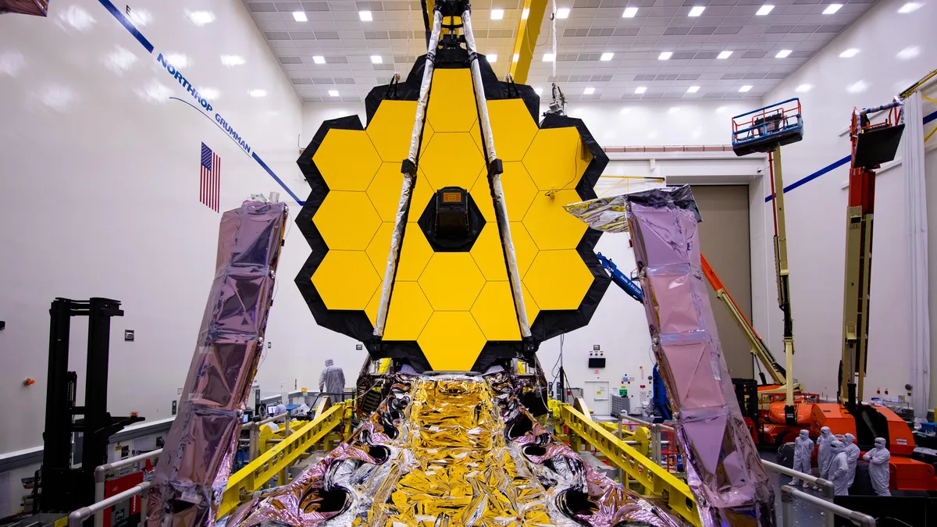
  Scientific context
SCIENCE CASES
REQUIREMENTS
TECHNOLOGIES
Earth-like exoplanets
characterization
Cosmological structures
observation
High resolution
High contrast
Ultra-stable wavefront
Risks and costs mitigation
  Large primary apertures
  Deformable mirrors (w/ contactless actuators)
  Wavefront sensors
  Active optics control loops

Slide 5
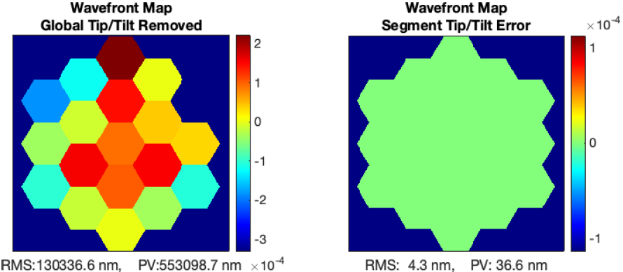
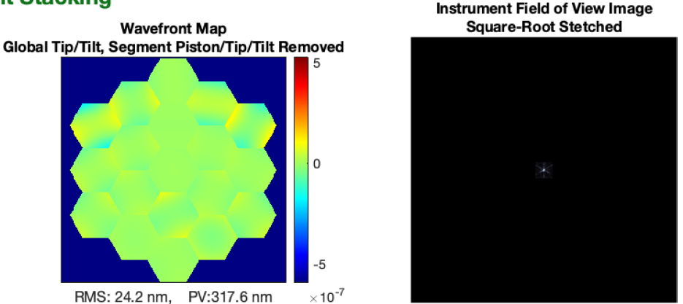
  Why adaptive optics in space?
Features
  Stable wavefront control
  Large primary aperture achievable
    and correction directly on the primary
  Support vibration rejection through the use of particular actuators (e.g. voice coil)
    Decoupling from the mirror
    Use of lighter materials -> mass reduction
    Looser tolerances
  Thermal load deformation correction
  High contrast imaging (e.g. if combined with
coronagraph instruments)
Challenging topics
  New studies on adaptation of ground-based technologies in the space context
  New mission profiles taking into account deformable mirrors
  Cost effectiveness assessment

Slide 6
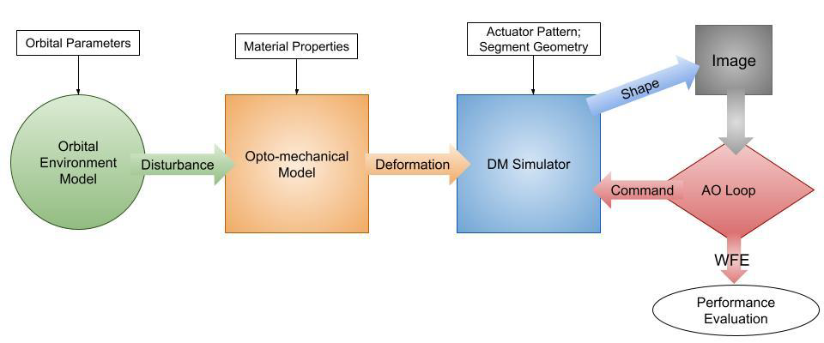
  Main research activity
  An active mirror system parametric integrated model
In what does it consists?
Telescope opto-mechanical model
  w/ variable mirror configuration parameters
Thermal-mechanical simulator
  w/ variable orbital environment parameters
Calculate deformations and displacements
Compute wavefront correction
Estimate mirror performance (fitting error)
Set trade-offs and optimize
  mission profiles
  mirror configurations
Evaluate the system behaviour in different scenarios (i.e. costs)
TO
Leading question: with regard to typical space mission profiles, costs and requirements, what could make this technology more attractive than others?
You are here
Part of the ULAOPS project, funded by ASI and in collaboration with PoliMi and industrial partners

Slide 7
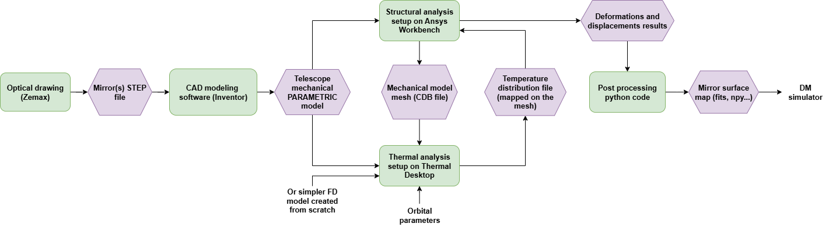
  Simulation pipeline
Simulation train meant to be as automatized as possible, to autonomously switch between the environmental condition and mirror configuration parameters and re-run the analysis

Slide 8
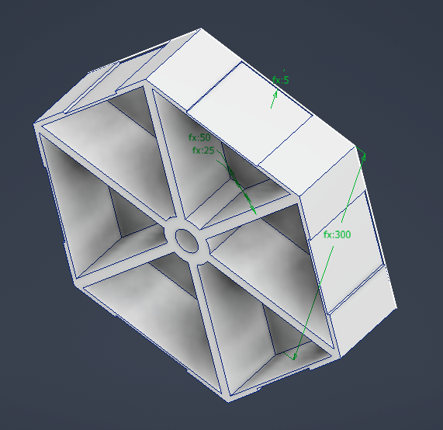
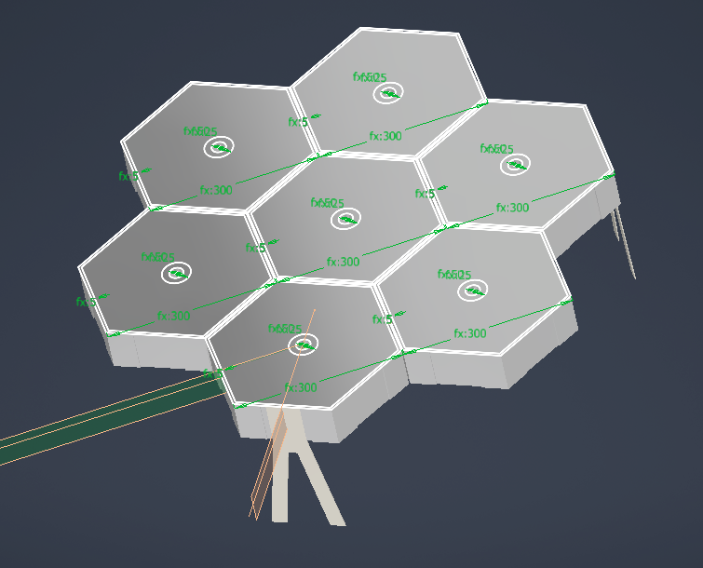
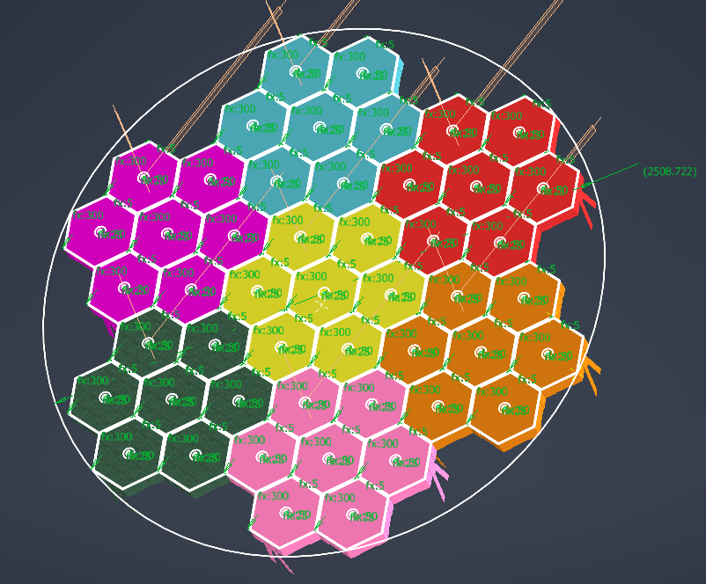
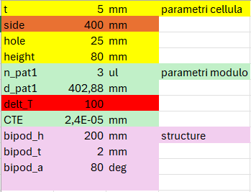
  First implementations: structural parametric model
Single actuator cell model
Deformable mirror segment (module) support model with 7 actuator cells
Configuration parameters
Deformable mirror support model with 7 modules

Slide 9
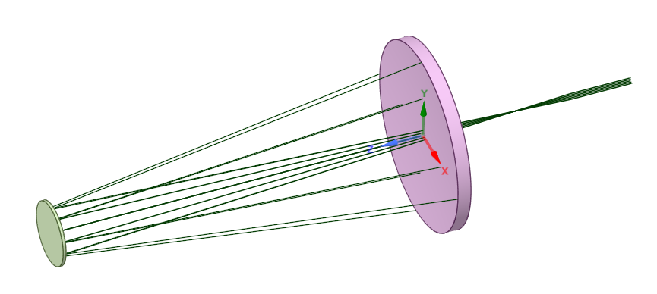
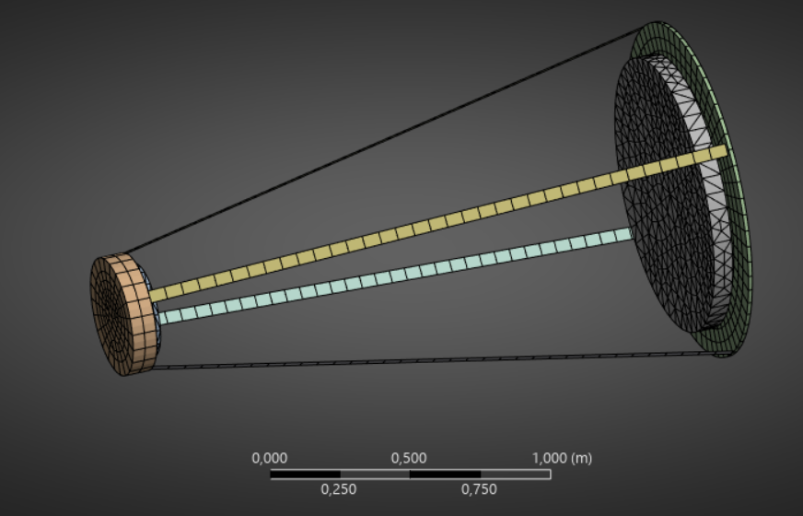
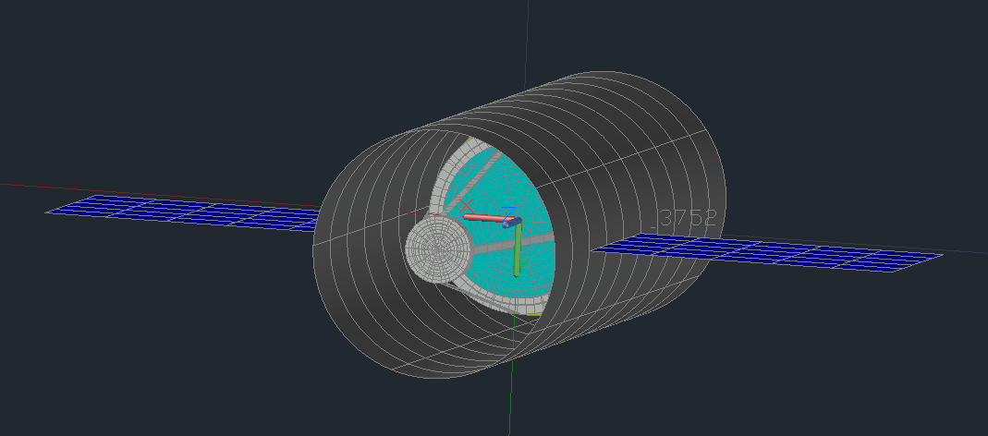
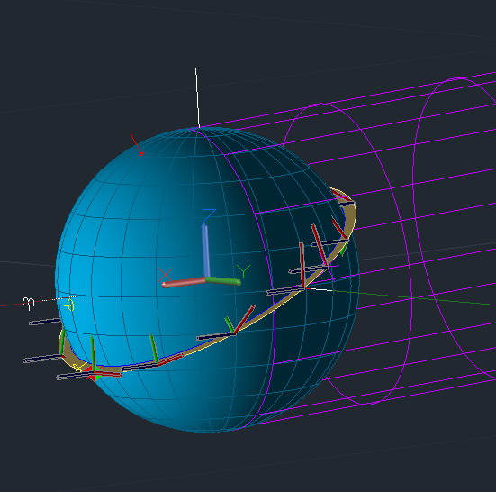
  First implementations: thermal inputs on FEM model
Telescope dummy mechanical model + mesh
Telescope optical drawing
Telescope thermal model (inside a dummy spacecraft for thermal boundary conditions)
Selected orbit

Slide 10
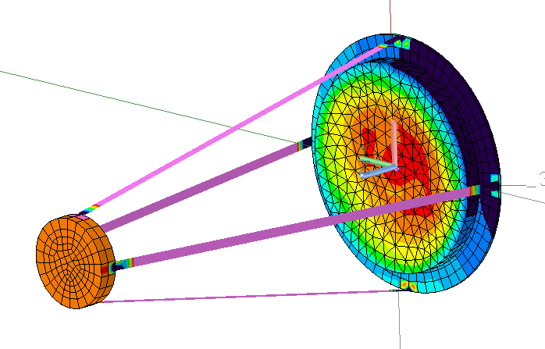
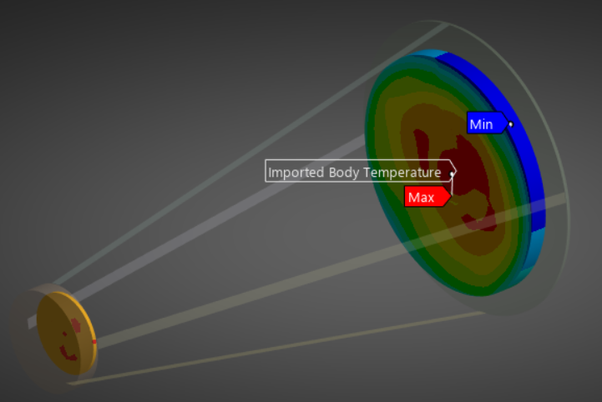
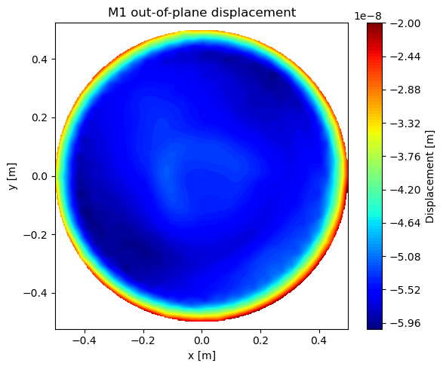
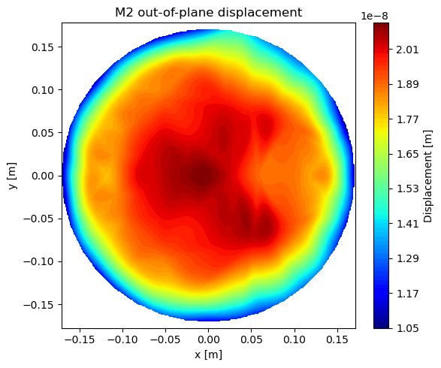
  First implementations: thermal inputs on FEM model
FEM mesh imported in the telescope thermal model and temperature distribution mapped onto it
Imported temperature distribution in the Ansys Mechanical model
Out-of-plane displacements (WFE from deformations) calculated by Ansys and exported as python maps

Slide 11
  First implementations: thermal inputs on FEM model
FEM mesh imported in the telescope thermal model and temperature distribution mapped onto it
Imported temperature distribution in the Ansys Mechanical model
Out-of-plane displacements (WFE from deformations) calculated by Ansys and exported as python maps
DM correction loop
+sensitivity matrix∙displacement vector

Slide 12
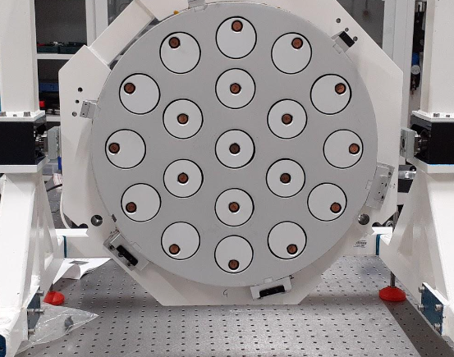
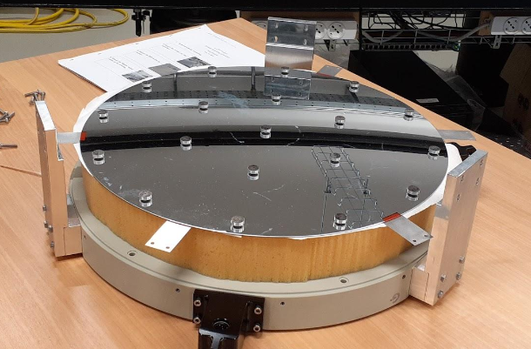
  Other activities: introducing LATT
Deformable segment of a primary mirror prototype
40 cm thin Zerodur deformable shell (mirror)
Aluminium honeycomb reference body (support)
Low mass density
19 voice-coil actuators and 19 capacitive sensors (contactless technology)
  When set, the shell floats at a given gap from the reference body
  Decoupling between mirror and support!

Slide 13
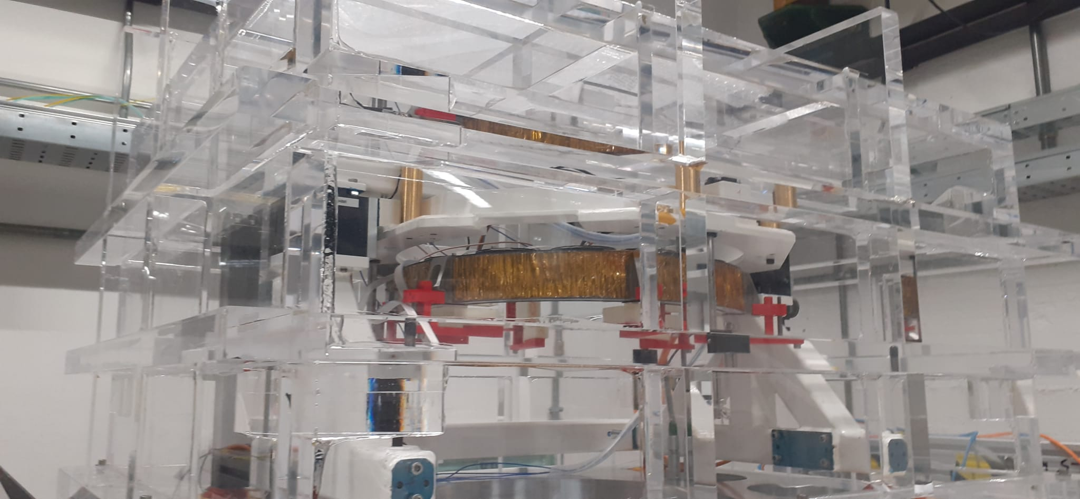
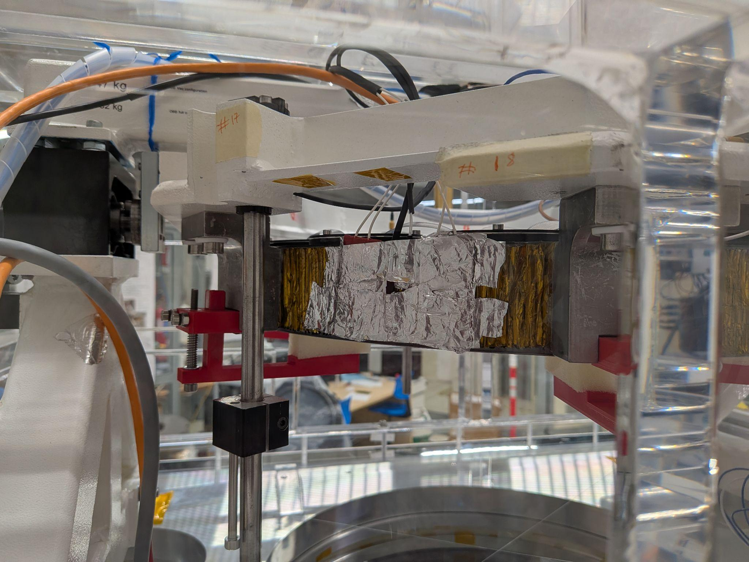
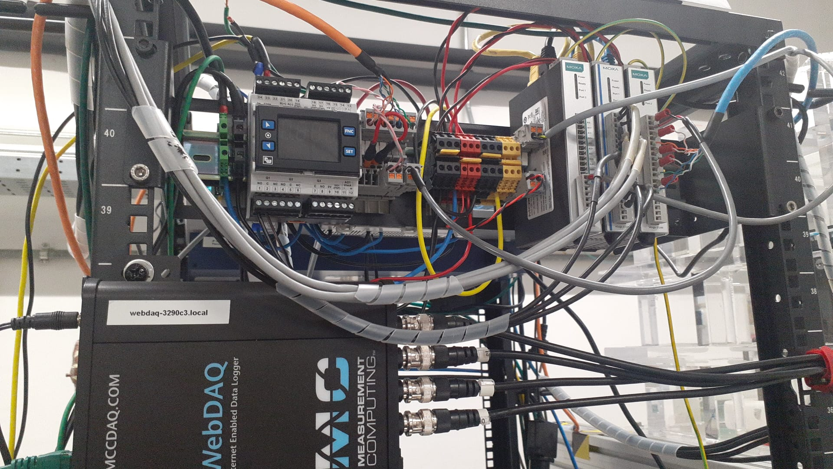
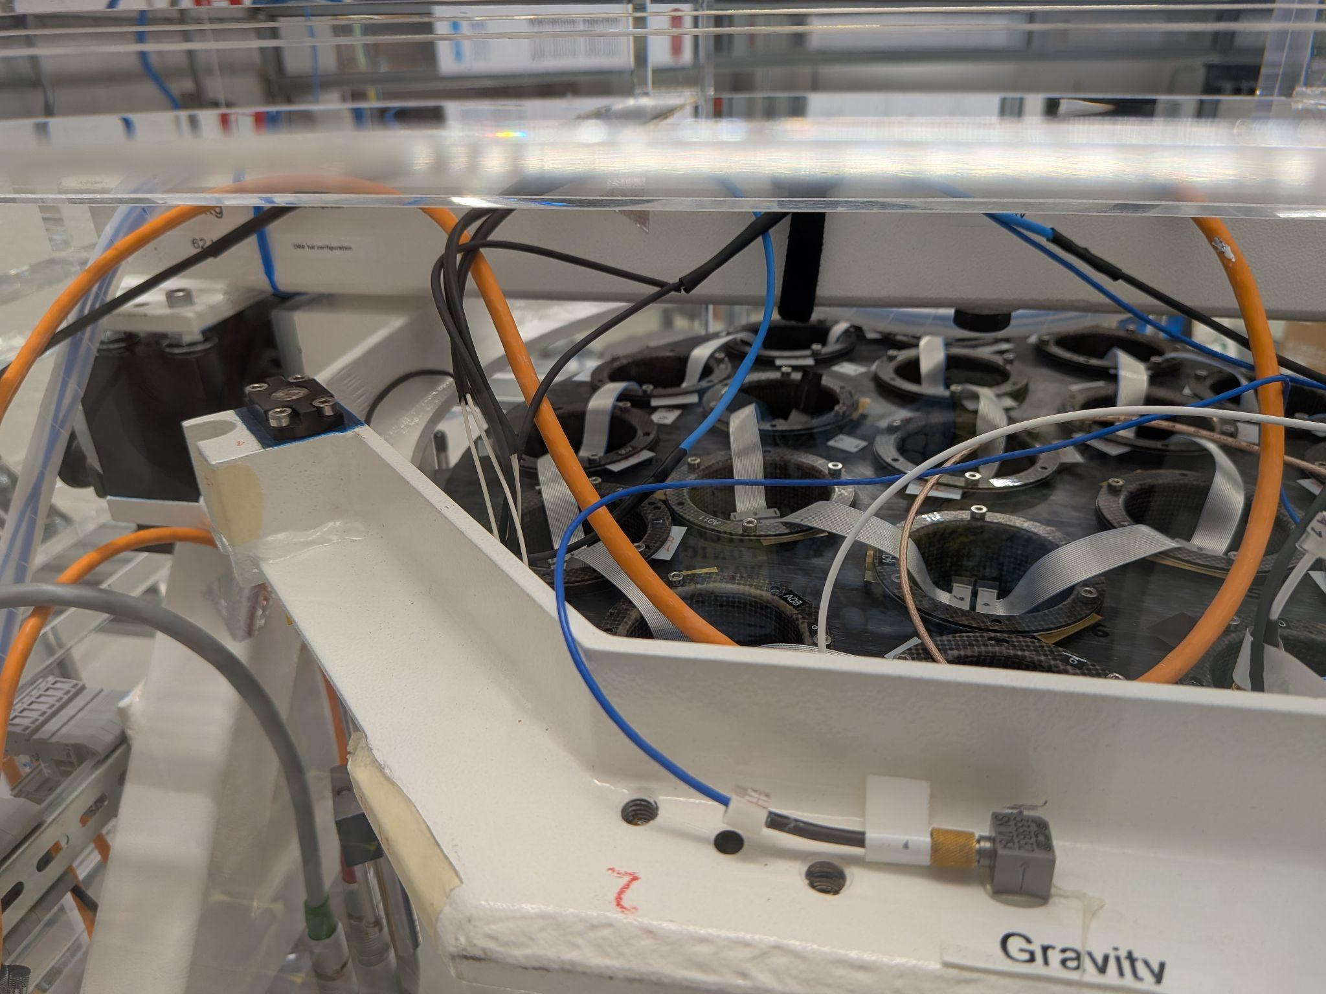
  Other activities: LATT thermal tests
Vacuum chamber
Reference body
Heaters placed on reference body
Mirror shell
Goal: assess effects of reference body deformations and resulting actuator commands on mirror correction
Thermostat
Connectors
Sensed temperature dataloggers
Reference body back w/ actuator electronics
Notes:
Thermal tests in vacuum chamber to assess the deformations of the reference body and how they propagate to the mirror shell
Objective: verify how the mirror deformations are the result of an ‘incorrect’ actuator command, caused by the greater distance measured by the capacitive sensors due to the reference body thermal deformations
Being the deformations caused by an actuator command, an equal and opposite command would be sufficient to restore the shell original surface: corrections with zero fitting error

Slide 14
  Roadmap for the next years
WITSO
KM1
KM2
SPIE
KM3
KM4
2025
2026
2027
 | Q4 | Q1 | Q2 | Q3 | Q4 | Q1 | Q2 | Q3
Opto-mechanical model finalization
Python automatization architecture finalization
Simulations on actual model and performance evaluation
Laboratory activities
Thesis writing
MILESTONES
WITSO @ ESA - Simulation scheme finalized
KM1 - Model completed
KM2 - Architecture code completed
SPIE @ Copenhagen - Paper ready
KM3 - Activities completed
KM4 - Thesis completed

Slide 15
  THANK YOU FOR YOUR ATTENTION!

