Slide 1



The Plasma Electrolytic Polishing (PEP) for SRF Cavities and its Extension to Additively Manufactured (AM) Components
Research Topic:
The PhD of National Interest in Technologies for Fundamental Research in Physics and Astrophysics
Ezeaba Tochukwu Emmanuel UNIPD, Padova 23/09/2025

Slide 2
Programme Objectives:
1
To validate plasma electrolytic polishing (PEP) as a surface treatment for superconducting Radio-frequency (SRF) cavities and additively manufactured (AM) components.
To establish optimized PEP protocols that mitigate surface roughness and improve accelerator performance.
To support the next generation of AM-featured particle accelerators by providing more efficient, cost-effective, and scalable surface-finishing techniques.
2
3
Ezeaba Tochukwu Emmanuel UNIPD, Padova 23/09/2025

Slide 3
Three-Year PhD Plan
Year 1 – Foundations & Experiments:
H1:
Literature Review: Comprehensive study of SRF surface treatment methods, PEP fundamentals, and additive manufacturing in accelerators.
Training: Courses, lab safety, cleanroom protocols, and theoretical skill-building (electrochemistry, surface characterization).
Practical Training: PEP setup at INFN, electrolytes preparation, and benchmark against known standards.
H2:
Preliminary Experiments: Application of PEP to SRF 6 GHz cavities, small Cu samples and coupons (both conventional and AM), and surface morphology characterization (roughness).
Scaling: Successful scaling from 6 GHz to 1.3 GHz SRF Cavity in collaboration with CERN and KEK.
Dissemination: Presentation of findings at workshops/conferences (e.g., AM4Linacs, SRF’25).
Ezeaba Tochukwu Emmanuel UNIPD, Padova 23/09/2025

Slide 4
Three-Year PhD Plan
Year 2 – Abroad & Company Research Placements:
H1: CERN, Geneva, Switzerland
Learn CERN protocols for surface treatment of SRF cavities.
Gain hands-on experience with surface characterization techniques.
Study PEP, Chemical Polishing (CP), and Electrochemical Polishing (EP) applications as practiced at CERN.
Explore surface treatment of materials not yet treated or covered at INFN.
Exchange knowledge and compare polishing methodologies between CERN and INFN.
H2: WEAL 3T SYSTEMS S.r.l, Torino, Italy
Gain experience in system and part design for additively manufactured components.
Learn advanced post-processing methods, including:
De-powdering of AM parts
High-powered ultrasound cleaning
Chemical milling treatments
Study their approaches to the post-processing of AM channels and complex geometries.
Contribute expertise in Plasma Electrolytic Polishing (PEP) to support and enhance their surface treatment workflow.
Ezeaba Tochukwu Emmanuel UNIPD, Padova 23/09/2025

Slide 5
Three-Year PhD Plan
Year 3 – Final Validation & Thesis Writing:
H1:
Optimization Studies:
Refine material-specific electrolyte choice and process, especially for AM components.
Address uniformity and energy consumption minimization, possibly through pulse PEP, DC-to-AC, etc.
Integration:
Compare PEP with existing treatments (EP, CP), summarize advantages/limitations.
Final Validation:
Repeat performance tests of 1.3 GHz SRF cavity at cryogenic conditions (1.8 K).
Demonstrate reproducibility and scalability of PEP from 6 GHz to 1.3 GHz SRF cavity and beyond.
H2:
Thesis Preparation:
Draft thesis chapters alongside results.
Submit publications in journals.
Completion:
Finalize and submit my thesis.
Ezeaba Tochukwu Emmanuel UNIPD, Padova 29/09/2025

Slide 6
Courses taken & passed
Schools/Workshop Attended
Science Communication and Knowledge Valorization: Practices & Tools (2 CFU) – March 2025
Analysis and Modelling of Additive Manufacturing (2 CFU) – April 2025
Advanced scientific Programming (6 CFU) – May 2025
Vacuum Technologies (2 CFU) – June 2025
Italian Language Course – A2 – August 2025
Italian Language Course – B1 – Sept. 2025
PhD Meeting of Gran Sasso – Feb. 2025
iSAS Conference at INFN, Legnaro – April 2025
Summer School at the University of Slovenia, Slovenia – July 2025
International Conference on AM4Linacs at Goethe University, Frankfurt, Germany – Aug. 2025
Challenges with AM
Courses to be taken
Entrepreneurship and Startup (14th Jan. – 26th Feb. 2026)
Italian Language Course – B2
Ezeaba Tochukwu Emmanuel UNIPD, Padova 23/09/2025

Slide 7
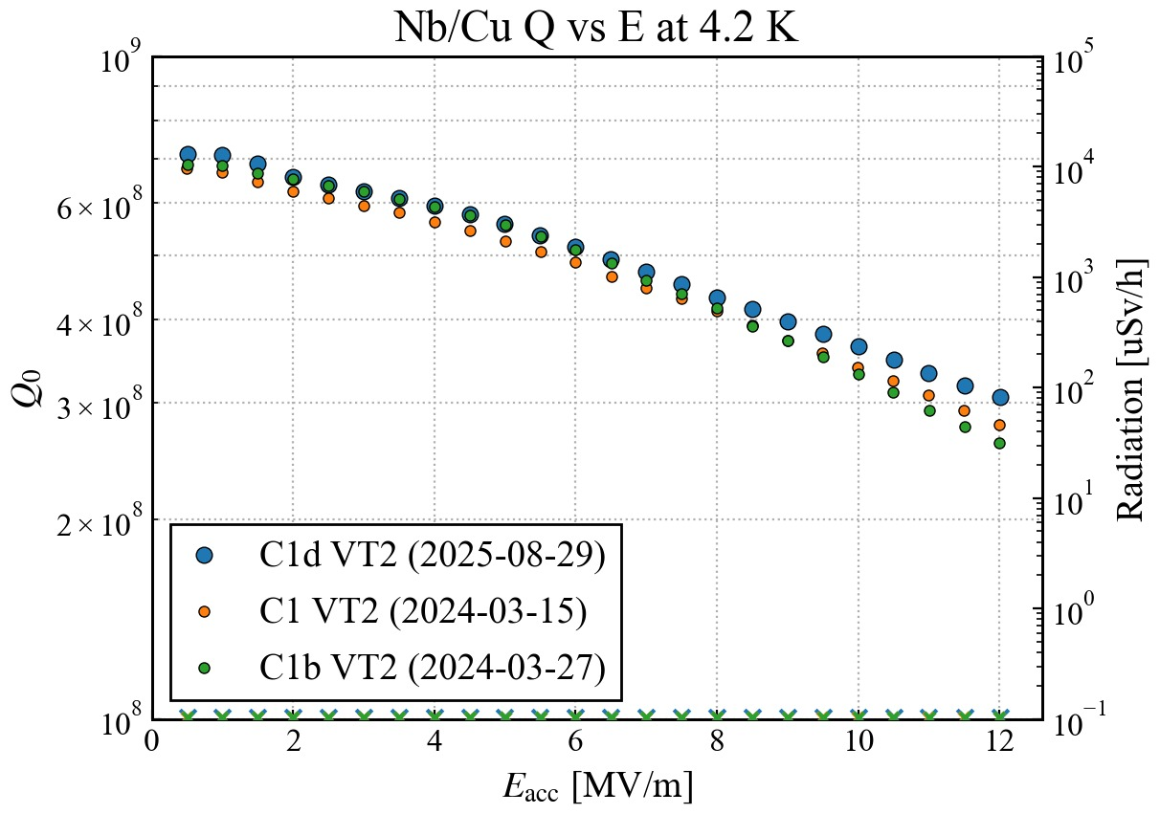
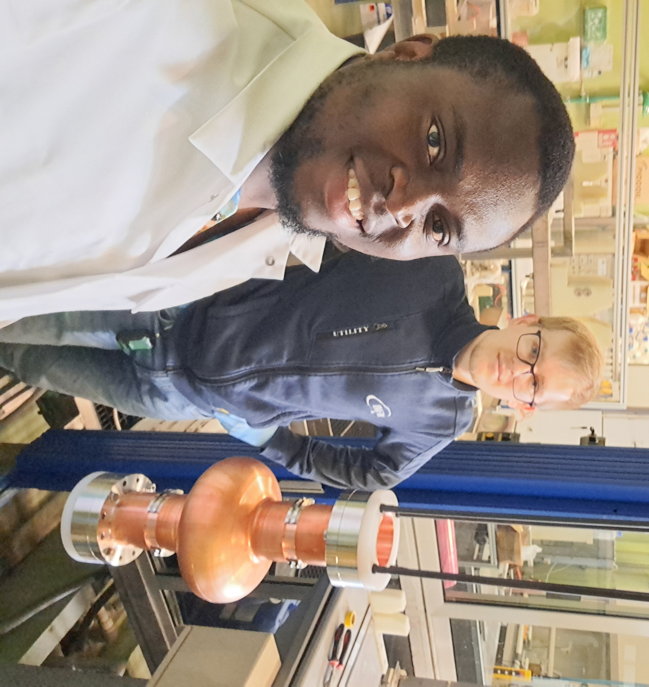
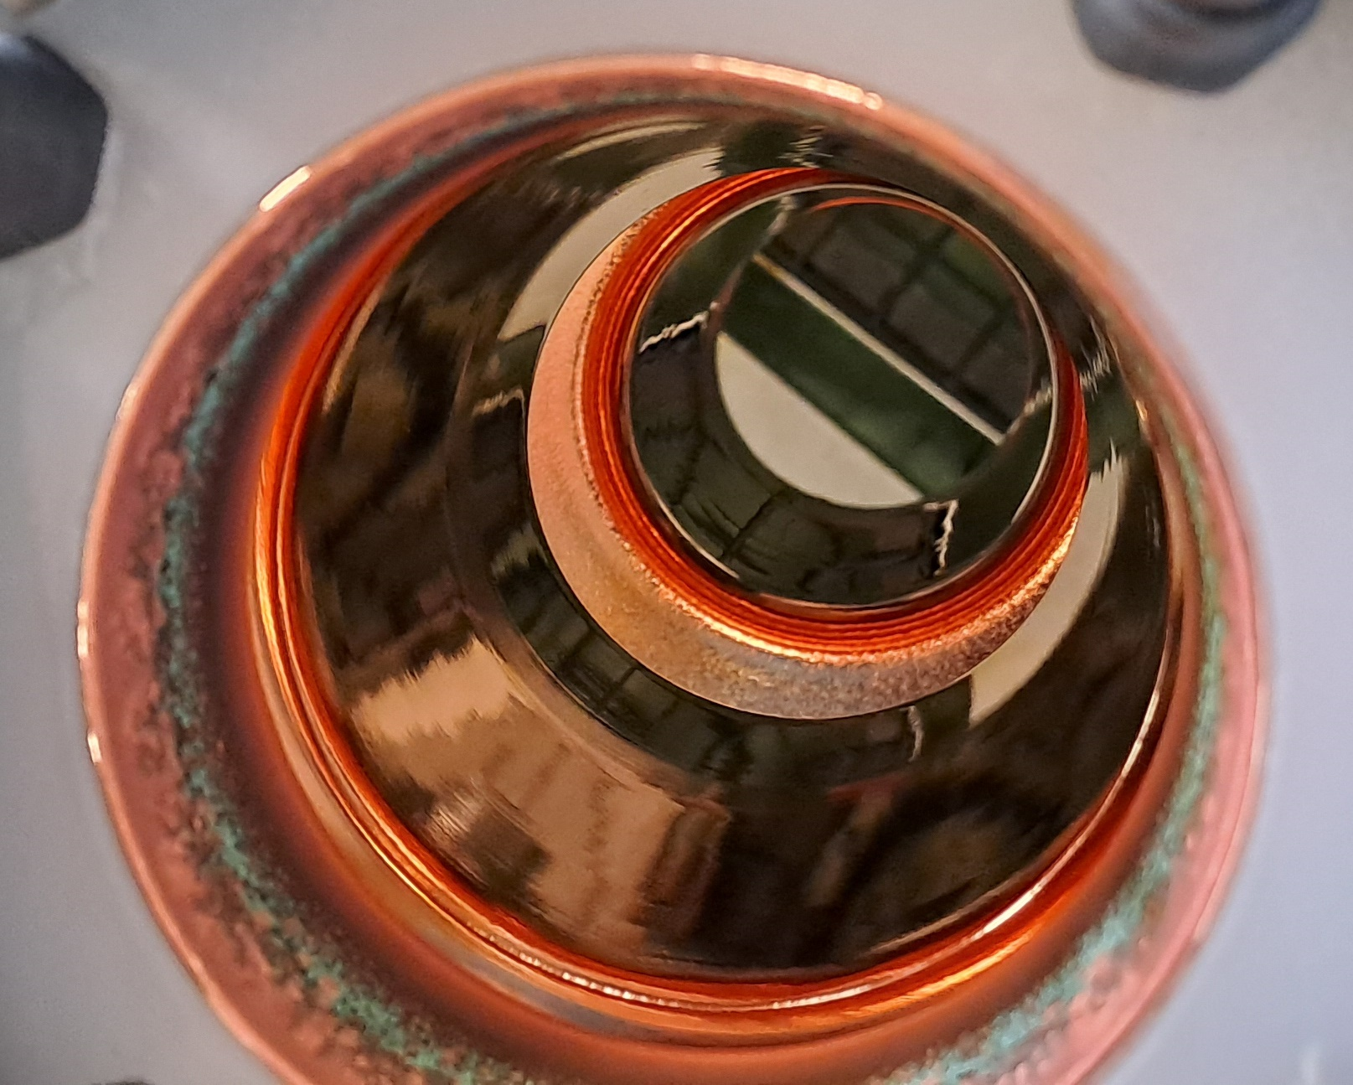
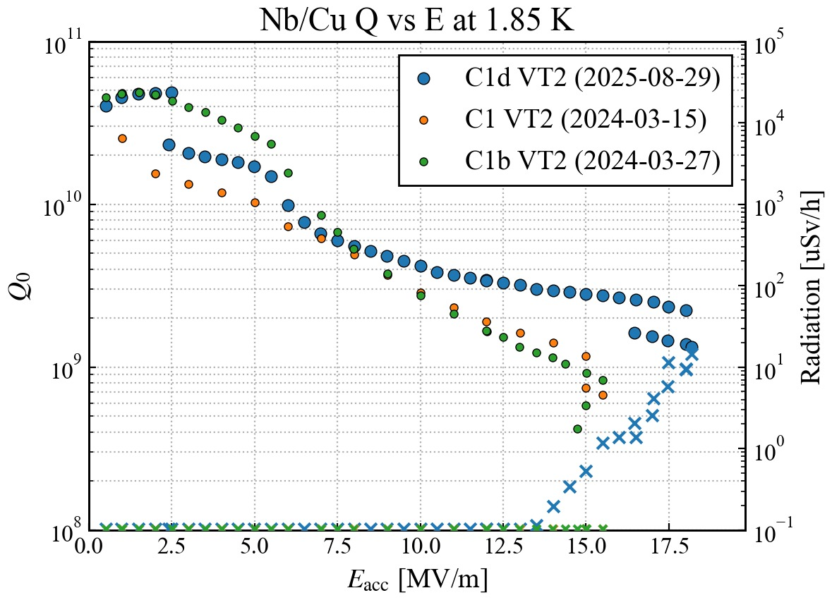
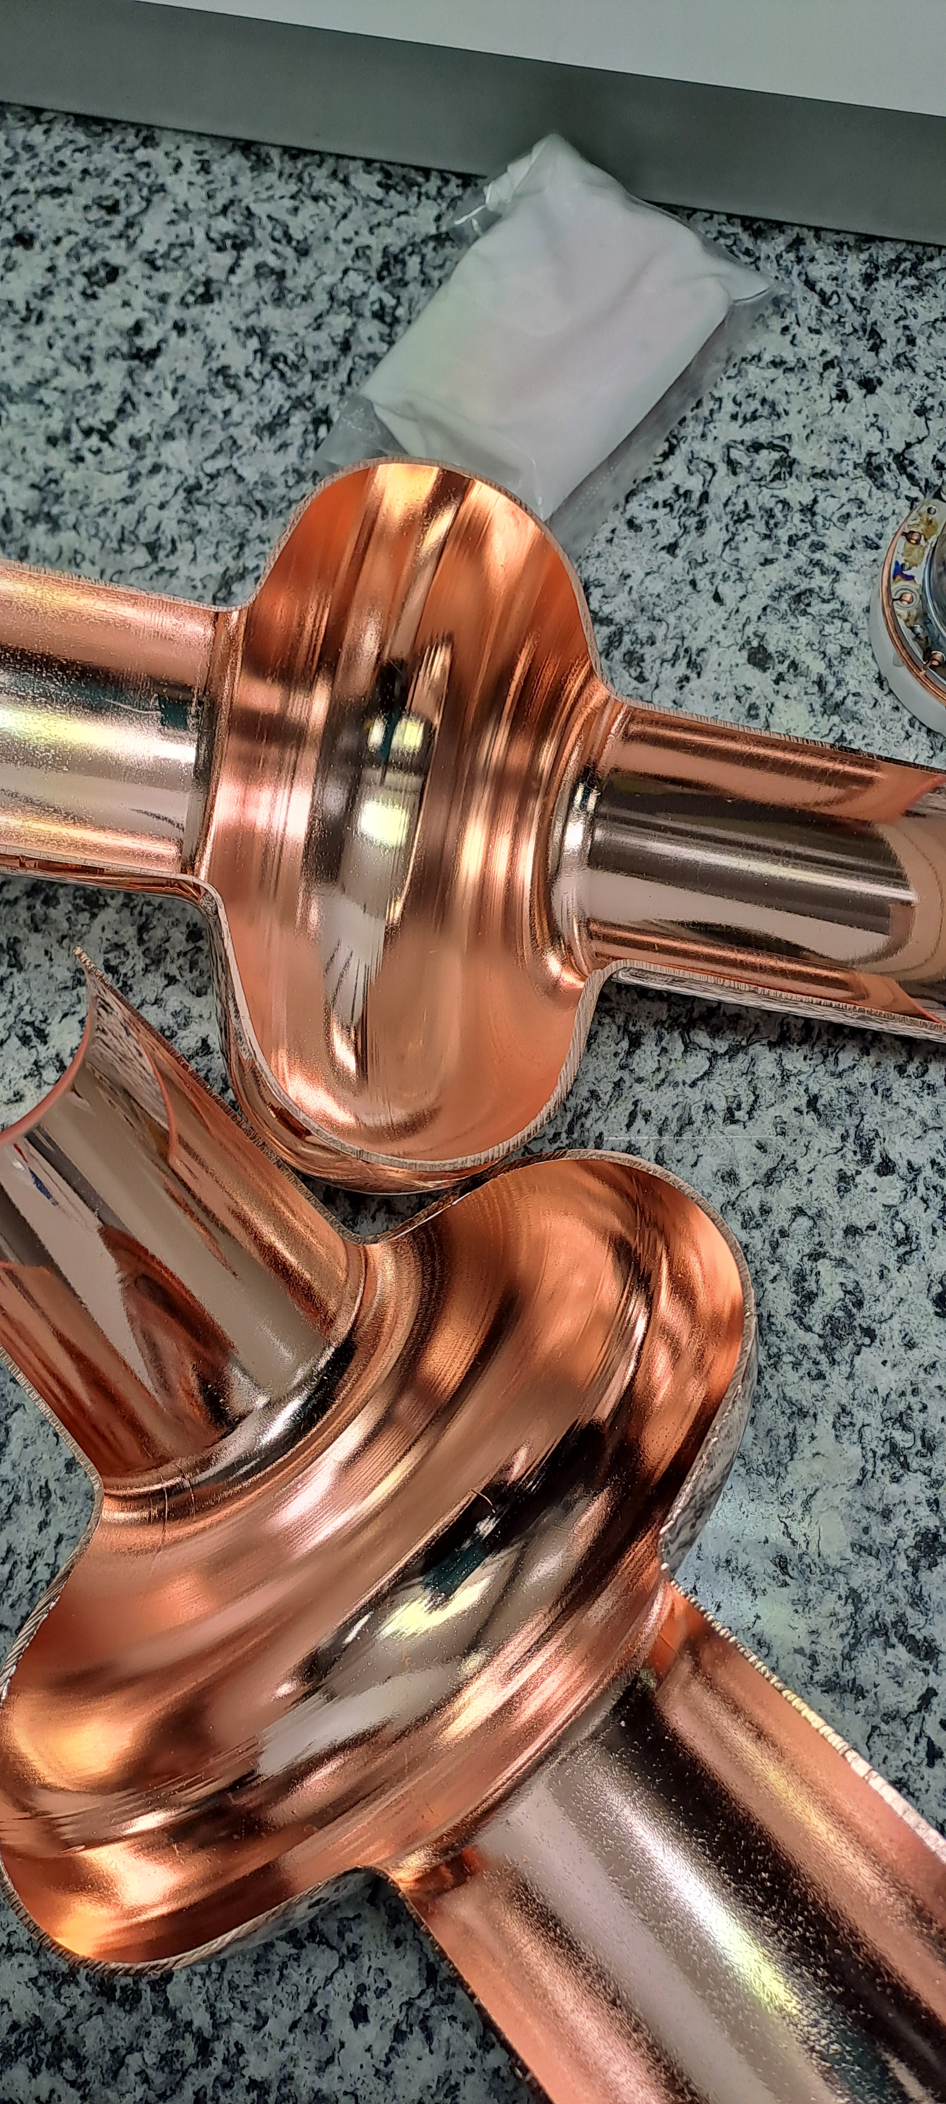
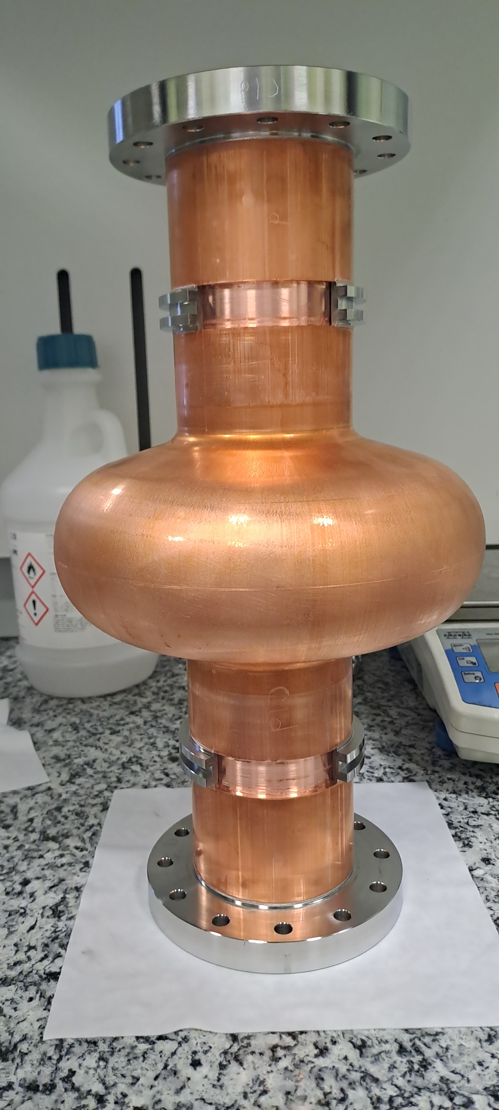
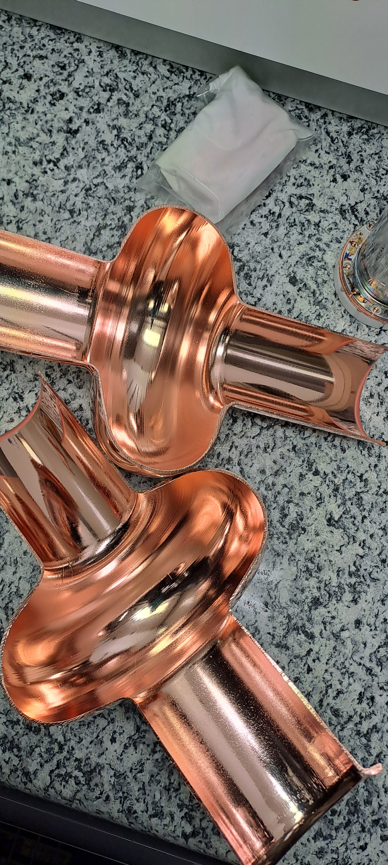
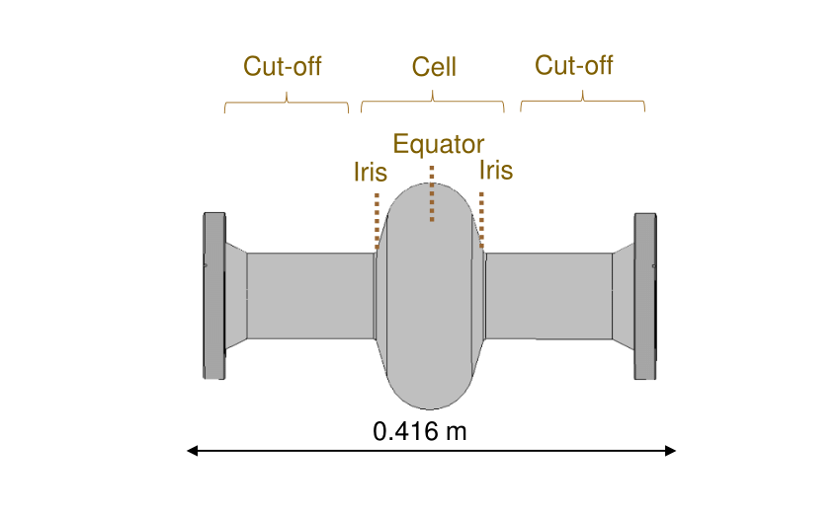
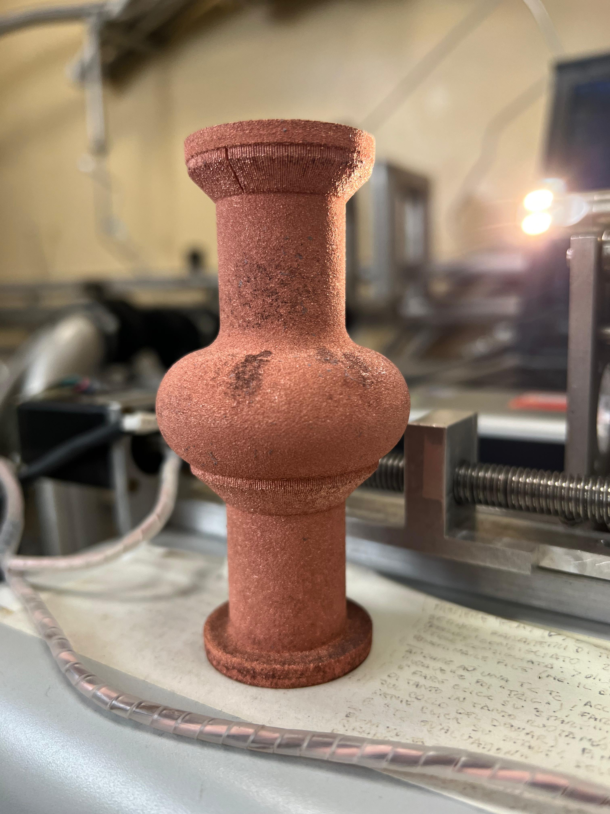
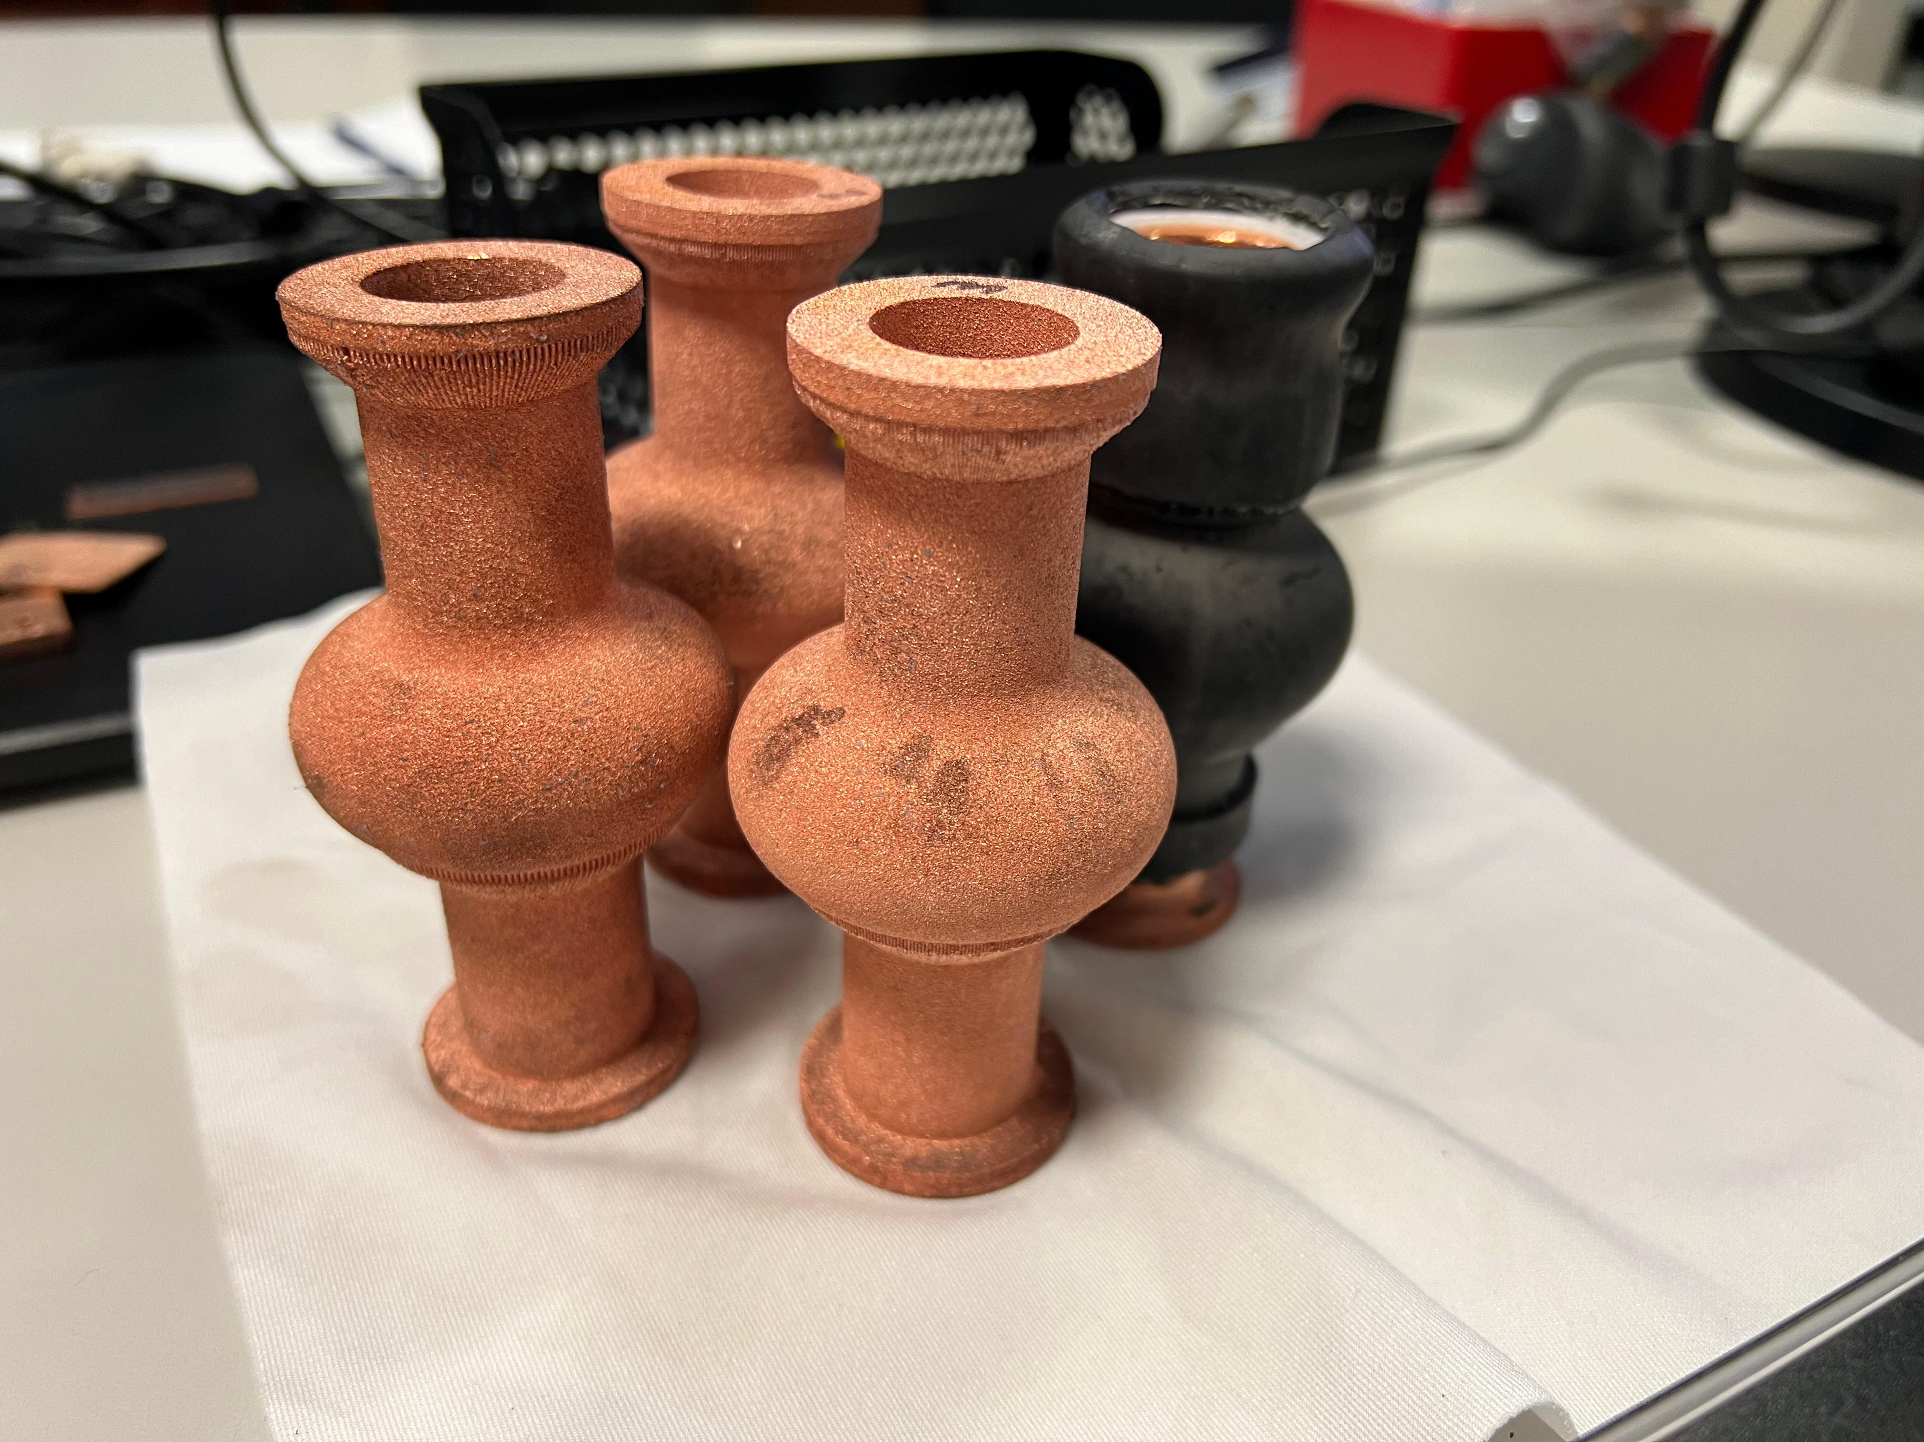
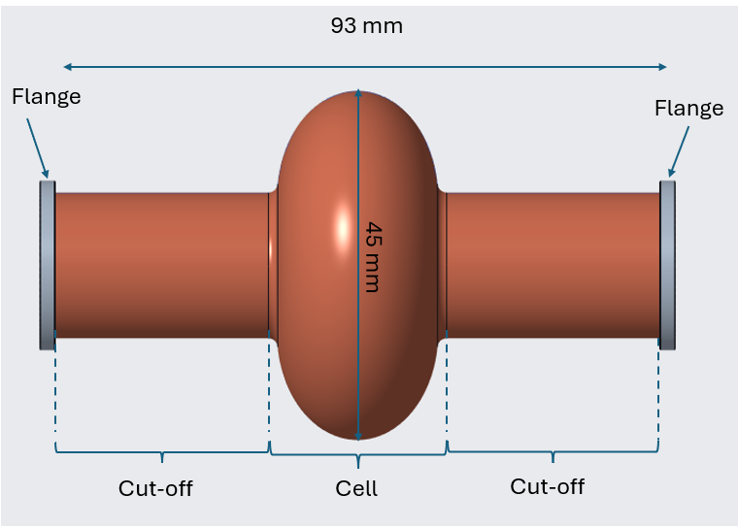
Research Activities Carried Out So Far:
Scale-up: PEP of Hydroformed 1.3 GHz Cavity
Challenges with AM
Ezeaba Tochukwu Emmanuel UNIPD, Padova 23/09/2025

Slide 8
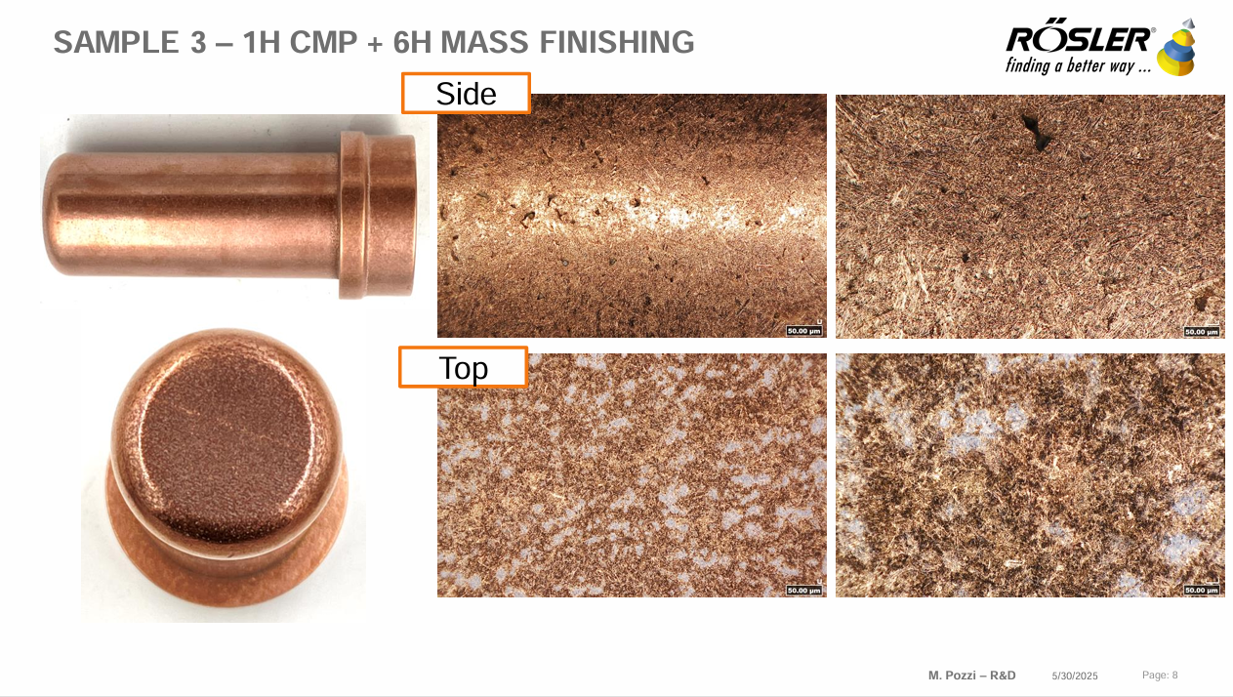




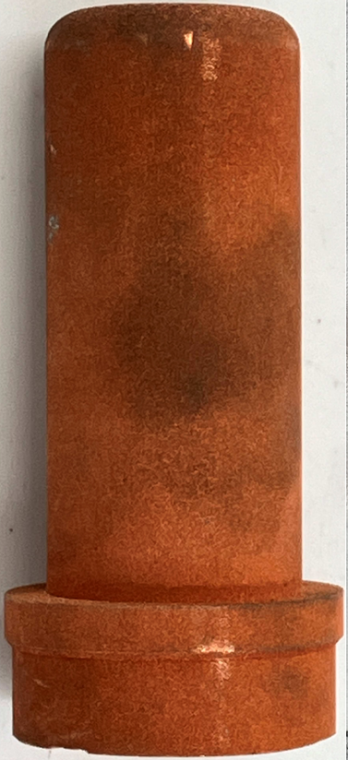
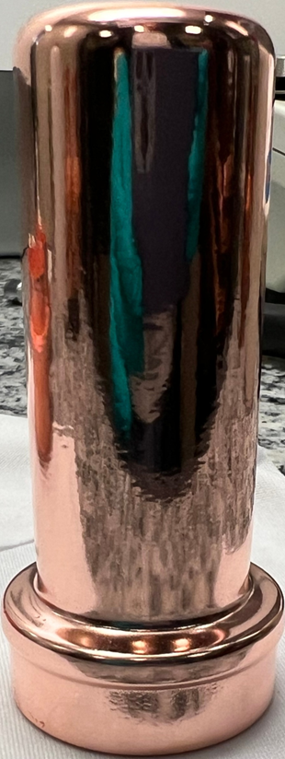
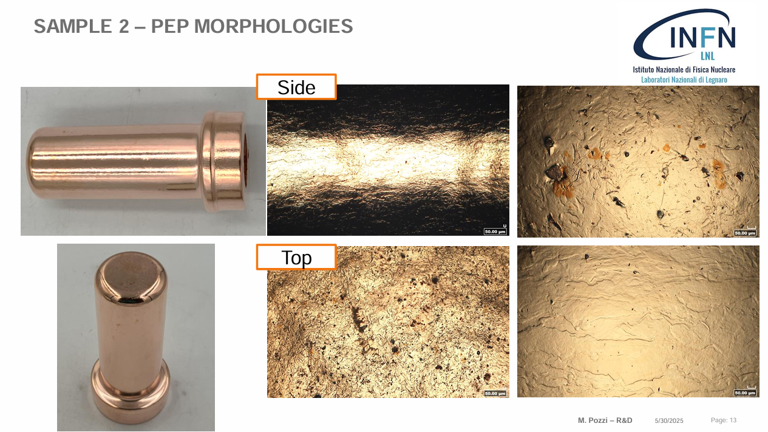
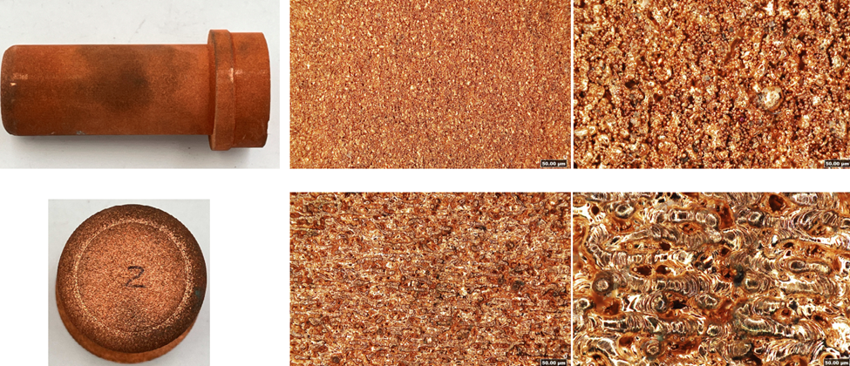

AM4Linacs
Sa 0.76 µm
Sa 2.22 µm
1 Hr. PEP
50 µm
Sa 19.31 µm
Sa 0.70 µm
Sa 31.48 µm
Sa 0.71 µm
Measurements by Rösler Italiana s.r.l
Ezeaba Tochukwu Emmanuel UNIPD, Padova 23/09/2025
50 µm

Slide 9

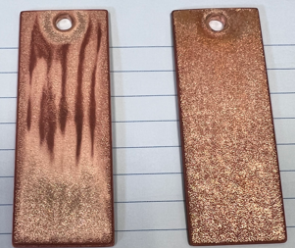
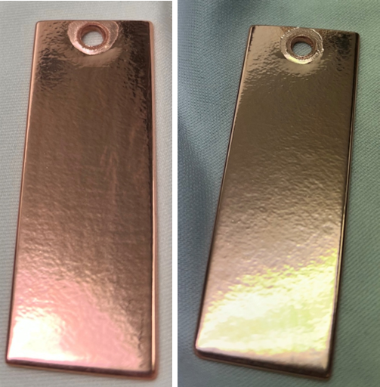
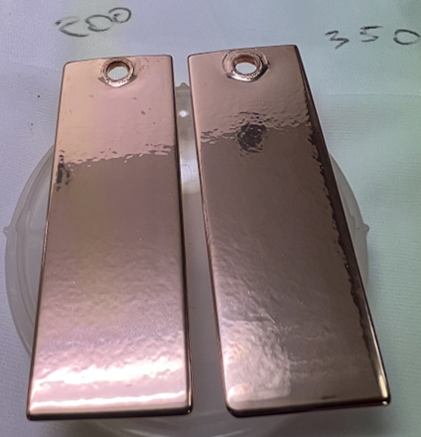
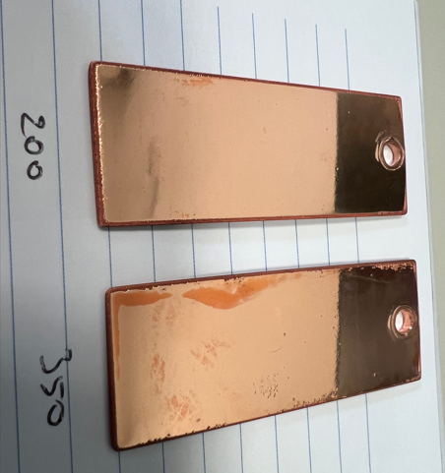
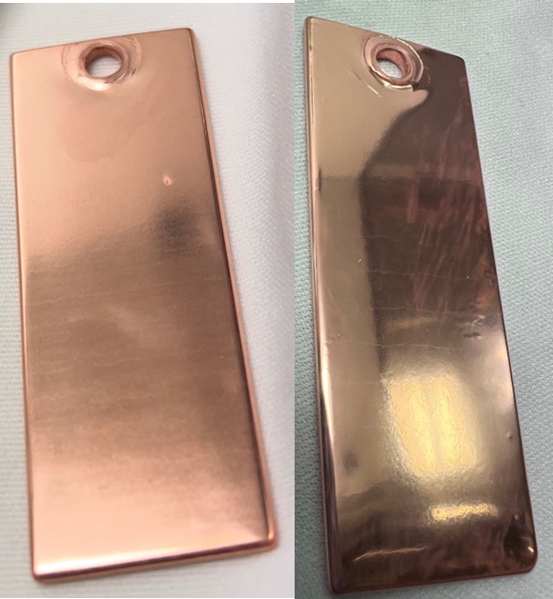
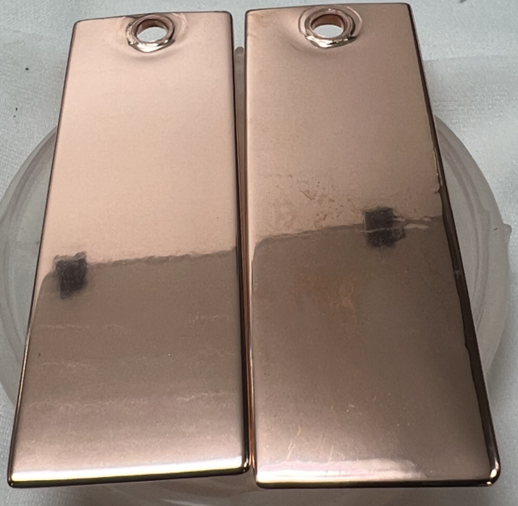
SUBU_5
MCS_4
SUBU_5
200°C
350°C
200°C
350°C
200°C
350°C
Smoothened surface
As-sprayed surface
PEP1 (10 min) PEP2 (+20 min) PEP3 (+5 min)
Ezeaba Tochukwu Emmanuel UNIPD, Padova 23/09/2025

Slide 10
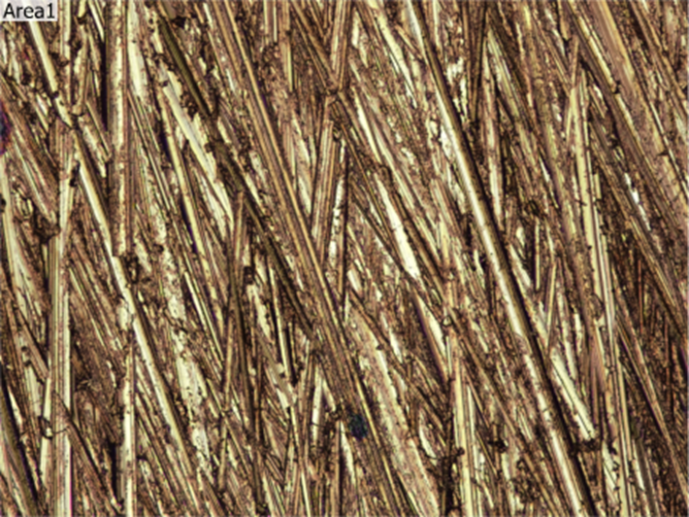
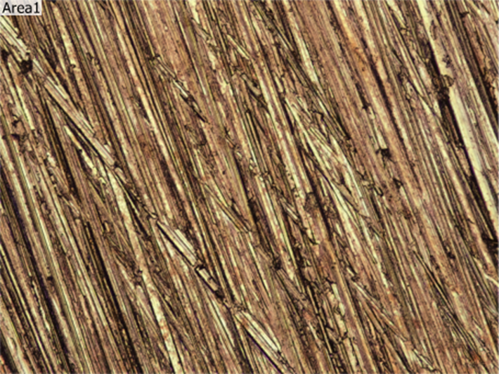
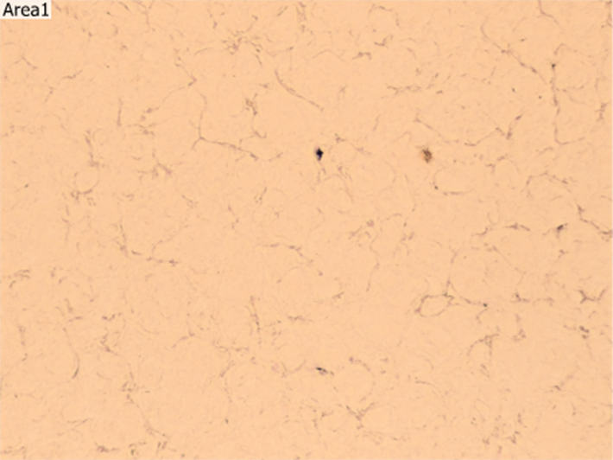
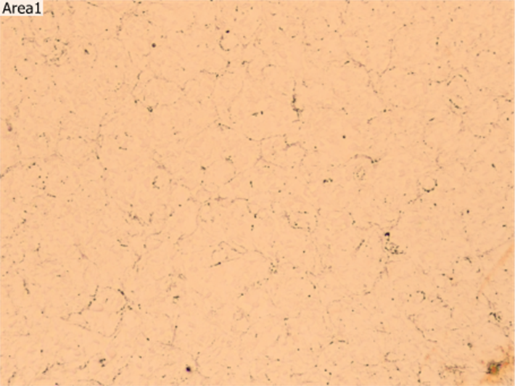
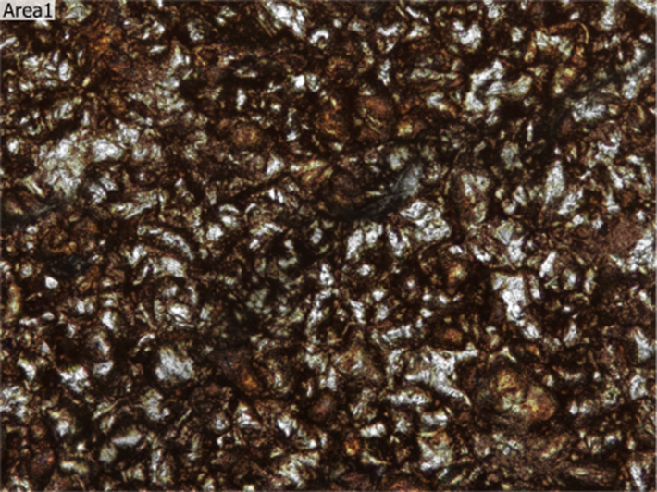
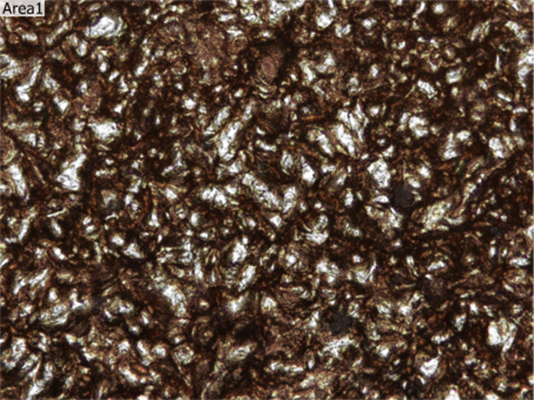
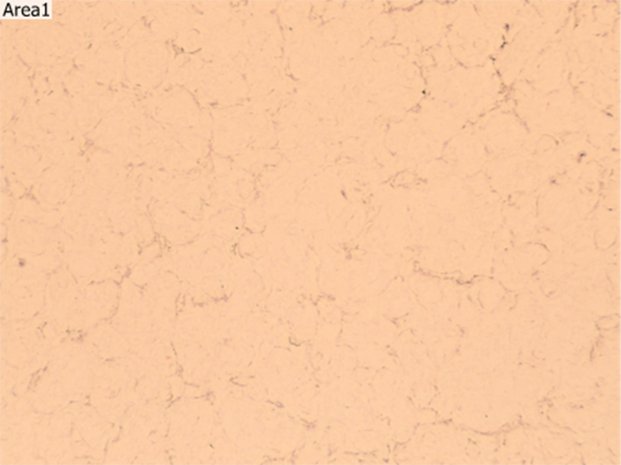
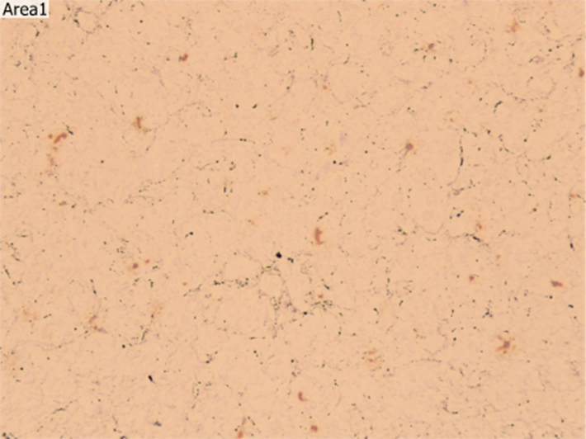
Initial
Final
200°C
350°C
200°C
350°C
Smoothened Surface
As-sprayed Surface
Sa = 1.142µm
Sa = 1.003µm
Sa = 0.077µm
Sa = 0.095µm
Sa = 6.317µm
Sa = 6.893µm
Sa = 0.074µm
Sa = 0.094µm
Ezeaba Tochukwu Emmanuel UNIPD, Padova 23/09/2025
50µm

Slide 11
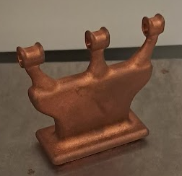
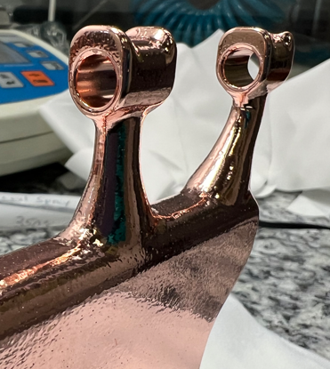
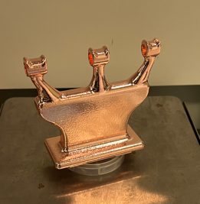
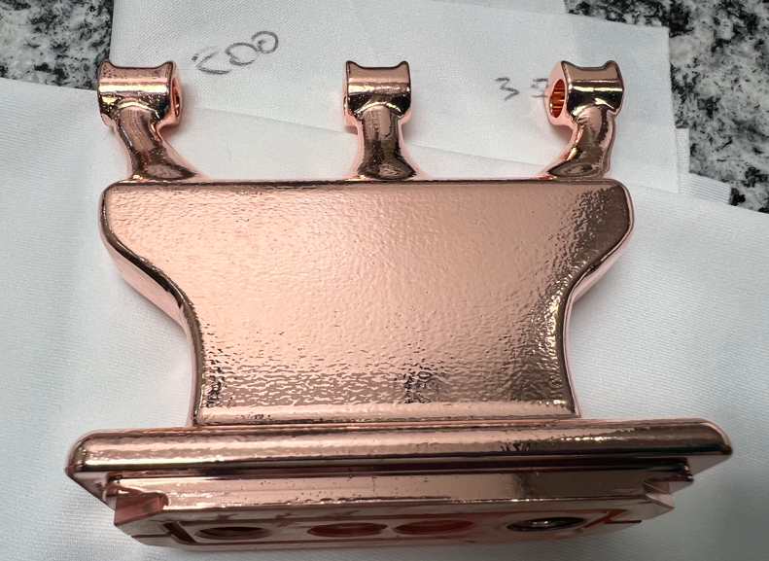

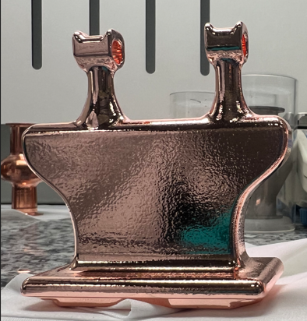
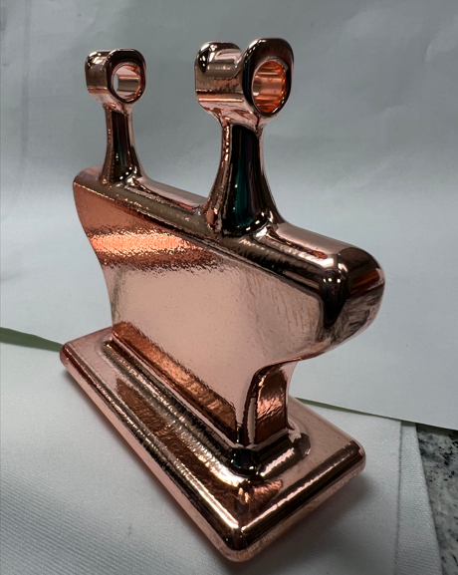
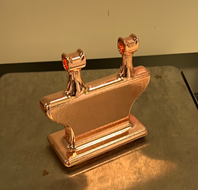
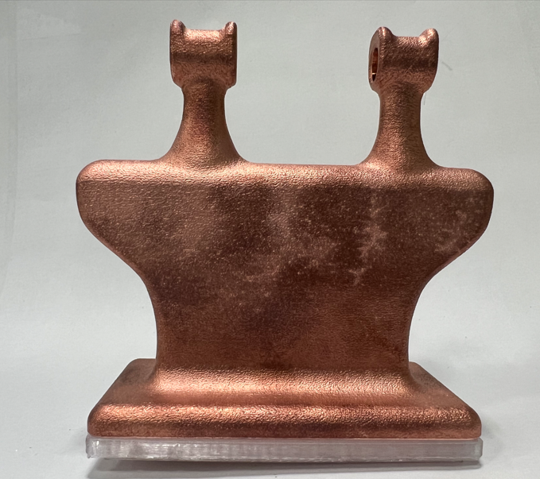
SUBU_5
15 min
Sa = 0.08 µm
DT3
MCS_4
30 min
Sa = 0.10 µm
Sa = 1.24 µm
DT2
Ezeaba Tochukwu Emmanuel UNIPD, Padova 23/09/2025

Slide 12
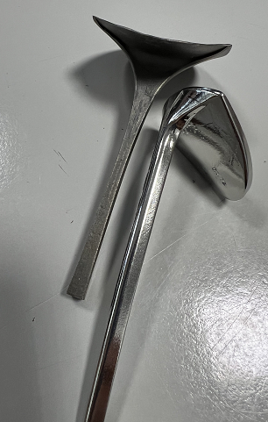
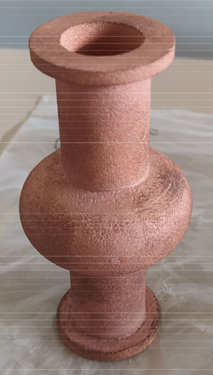
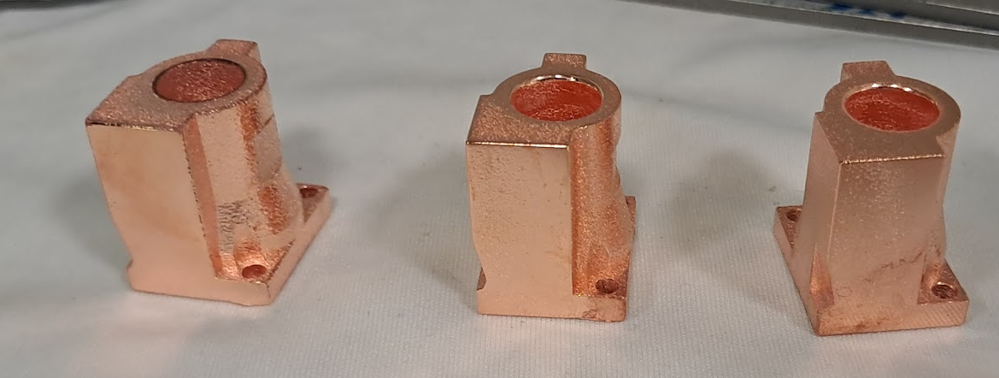
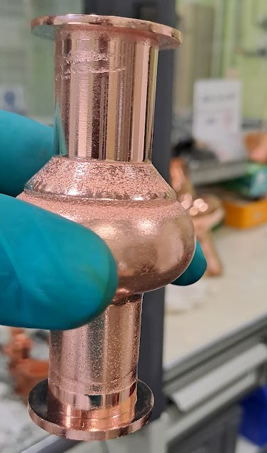
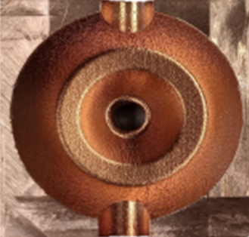
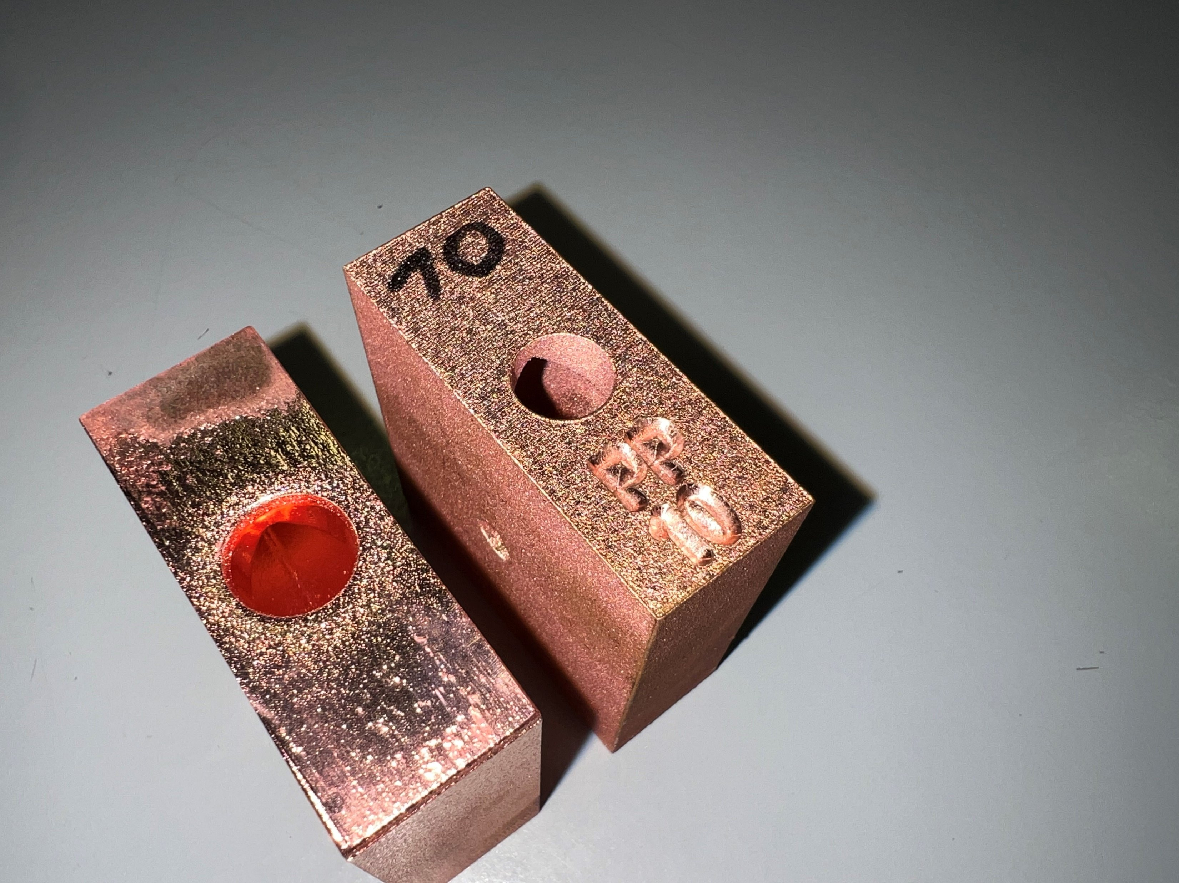
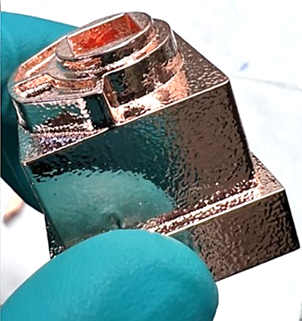
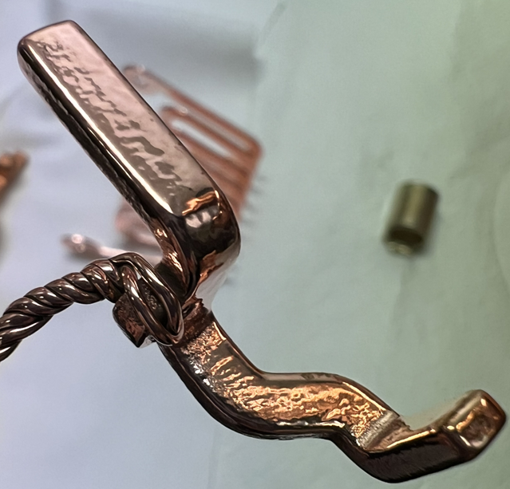
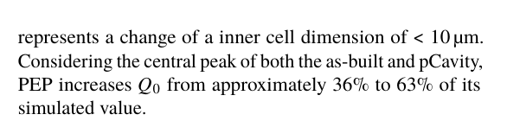
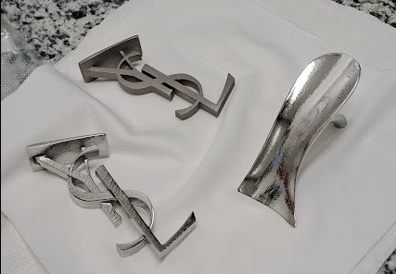
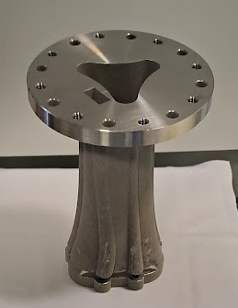
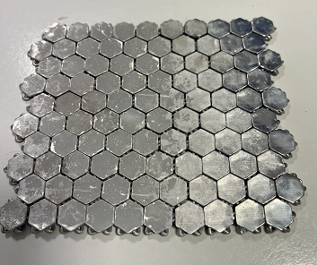




Metal Injection Molding
doi: 10.18429/JACoW-IPAC25-THPB052
Ezeaba Tochukwu Emmanuel UNIPD, Padova 23/09/2025
CuCr1Zr (X-Band RF Cavity)
Binder Jetting

Slide 13
THANK
YOU
FOR
YOUR
ATTENTION!
Ezeaba Tochukwu Emmanuel UNIPD, Padova 23/09/2025

