Slide 1
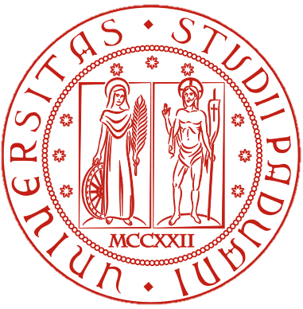

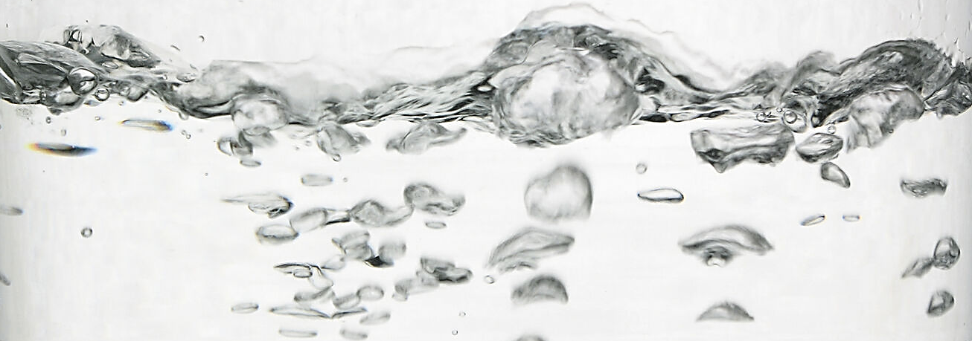
TFPA PhD SECOND YEAR - FINAL REPORT
MULTIPHYSICS DESIGN STRATEGIES FOR HEAT TRANSFER ENHANCEMENT USING ADDITIVE MANUFACTURING.
CURRICULUM: Mechanics
UNIVERSITY/ RESEARCH CENTRE:
University of Padua (DFA)/ PD-INFN.
PhD STUDENT: Francesca Valentini
SUPERVISOR: Prof. Simone Mancin
CO-SUPERVISOR: Ing. Adriano Pepato

Slide 2
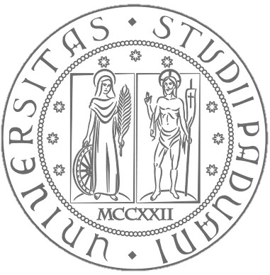
RESEARCH TOPIC AND OBJECTIVES
Development and optimization of components for thermal control in the field of nuclear fusion and fundamental research in Physics and Astrophysics through metal additive manufacturing
Develop innovative thermal design that exploits additive manufacturing flexibility.
Use of simulation tools and optimization algorithms to reinvent components.
Experimentally validate the proposed design.
Steam generator for molten salts (LoCoMoSa project):
Design and test a steam generator to be produced by additive manufacturing that can:
Maximize the heat transfer efficiency.
Validate simulations through experiments on a small and a full-scale prototype.
Optimization algorithms, simulations and additive manufacturing:
Apply optimization methods or additive manufacturing structure for improved thermal performance in:
Numerical and experimental integration:
Calibrate models against experiments to ensure reliability.
Safely operate in challenging conditions.
Heat transfer surfaces,
Cooling channels.

Slide 3
PROJECT PLANNING
FIRST YEAR: Literature research & Preliminary studies
Performed an extensive literature review on high-temperature steam generators, boiling heat transfer, and topology optimization methods.
Learning how to perform simulations and conduct experimental validation.
SECOND YEAR: Modeling, Optimization & Experimental Setup
Explore design solutions for novel steam generator, including the use of additive manufacturing tailored geometries to:
Ensure a safe and efficient operation of the steam generator
Enhance heat transfer.
Design and build an experimental setup to validate numerical simulations and optimization approaches.
THIRD YEAR: Integration & Application
Perform experiments on the topology optimized geometries.
Finalize the design of the steam generator for LoCoMoSa project
Extended TO methodologies beyond the steam generator, applying topology optimization and heat transfer models to more AM-based thermal management components.
Experimental testing on cooling channels (extraction grid for nuclear fusion application) and PCM filled heat sink for high power industries.
2023-2024
2024-2025
2025-2026

Slide 4
COURSES, EXAMS, AND OTHER TRAINING ACTIVITIES (E.G. SCHOOLS)
COURSES, EXAMS, AND OTHER TRAINING ACTIVITIES (E.G. SCHOOLS)
2023-2024
Thermo-fluid dynamic sin 3D printed channels |TFPA - 1CFU
Coupled electrical-thermal-structural Finite Element Analyses |UNIPD (DII) - 1,5 CFU
Experimental measurements in thermal fluid dynamics |UNIPD (DII) - 3,5 CFU
2024-2025
Life Cycle Assessment of Energy Systems: fundamentals and applications |UNIPD (DII) - 3CFU
Python for numerical heat transfer modeling and building physics (3 CFU) |UNIPD (DII) - 3CFU
Generative Design for Smart Additive Manufacturing |UNINA - 3CFU
SCHOOL
Summer School Metal Additive Manufacturing, AssociazioneItalianadi MetallurgiaAIM, Bertinoro-30 June, 1-2-3 July 2024

Slide 5

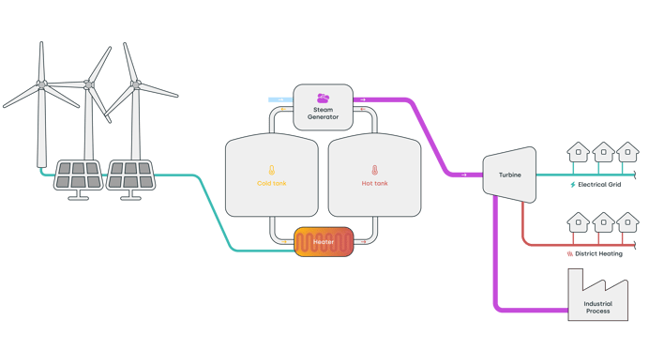

SECOND YEAR ACTIVITY
Project LoCoMoSa:
Low-Cost Molten Salt Thermal Energy Storage for Industrial Processes
Objective: Deliver industrial heat at 120-450 °C through the use of a low cost molten salt.
Low-Cost Molten Salt

Slide 6
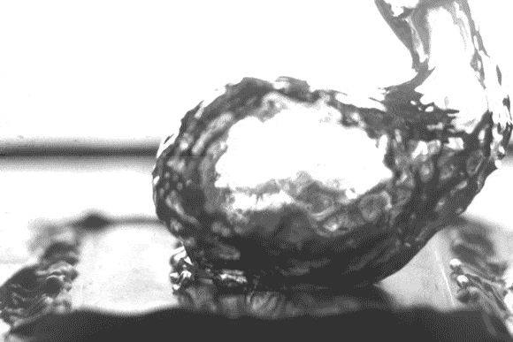
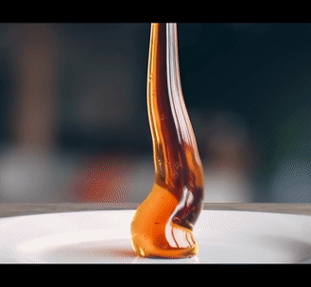


SECOND YEAR ACTIVITY
Possible transition to instable film boiling condition.
At high temperature driving force the steam forms a vapour blanket
Low heat transfer efficiency of the molten salt.
High viscosity molten salt slowly flows in the SG tubes

Slide 7
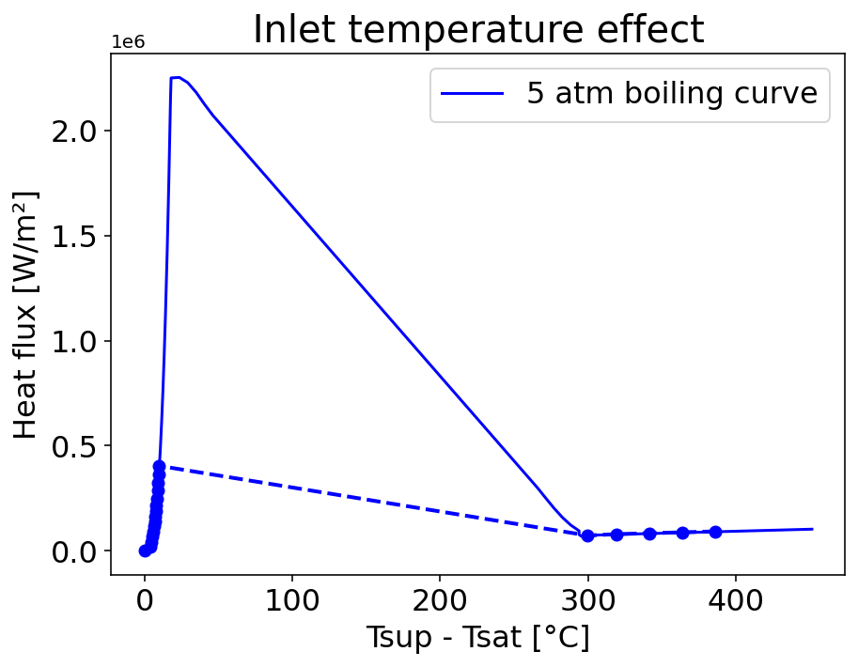
NOVEL CONCEPT OVERVIEW
Concept idea: introduce a thermal regulation layer to controll the surface temperature of the tube and avoid dangerous transition
Three layers:
Tube side: molten salt,
Shell side: Saturated water
Intermediate layer: thermal regulation layer.
A layer with flowing gasses and surface area enhancement:
Corrosion control inert gass (N2 or Ar)
Steam: recirculated to provide controlled superheating
Thermal control parameter is the additional area
Visual rapresentation
Goal: avoid the jump!

Slide 8





NOVEL CONCEPT OVERVIEW
$$\dot{Q_{BOIL}}$$
TSAT
Concept idea: introduce a thermal regulation layer to controll the surface temperature of the tube and avoid dangerous transition
RBOIL,i
Three layers:
Tube side: molten salt,
Shell side: Saturated water
Intermediate layer: thermal regulation layer.
A layer with flowing gasses and surface area enhancement:
Corrosion control inert gass (N2 or Ar)
Steam: recirculated to provide controlled superheating
Thermal control parameter is the additional area
RWALL2,i
RGASS2,i
$$\dot{Q_{GAS}}$$
$$\dot{m_{GAS}}$$
RGASS1,i
RWALL1,i
RSALT,i
$$\dot{m_{SALT}}$$
TSALT,i
$$\dot{Q_{SALT}}$$

Slide 9

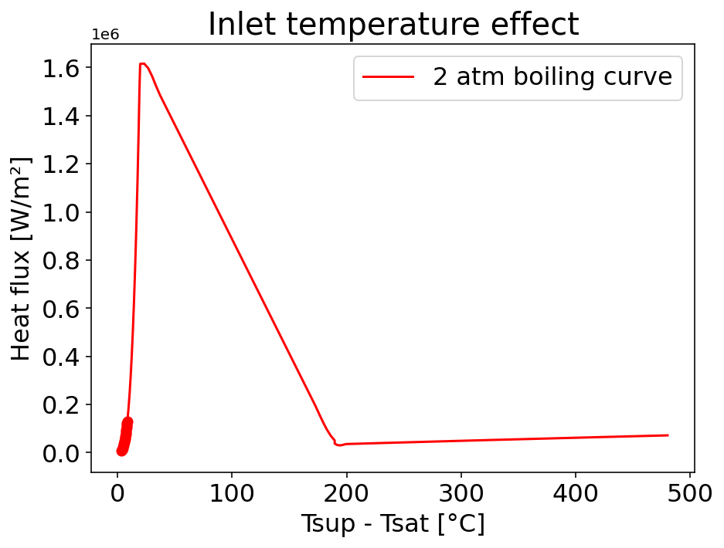
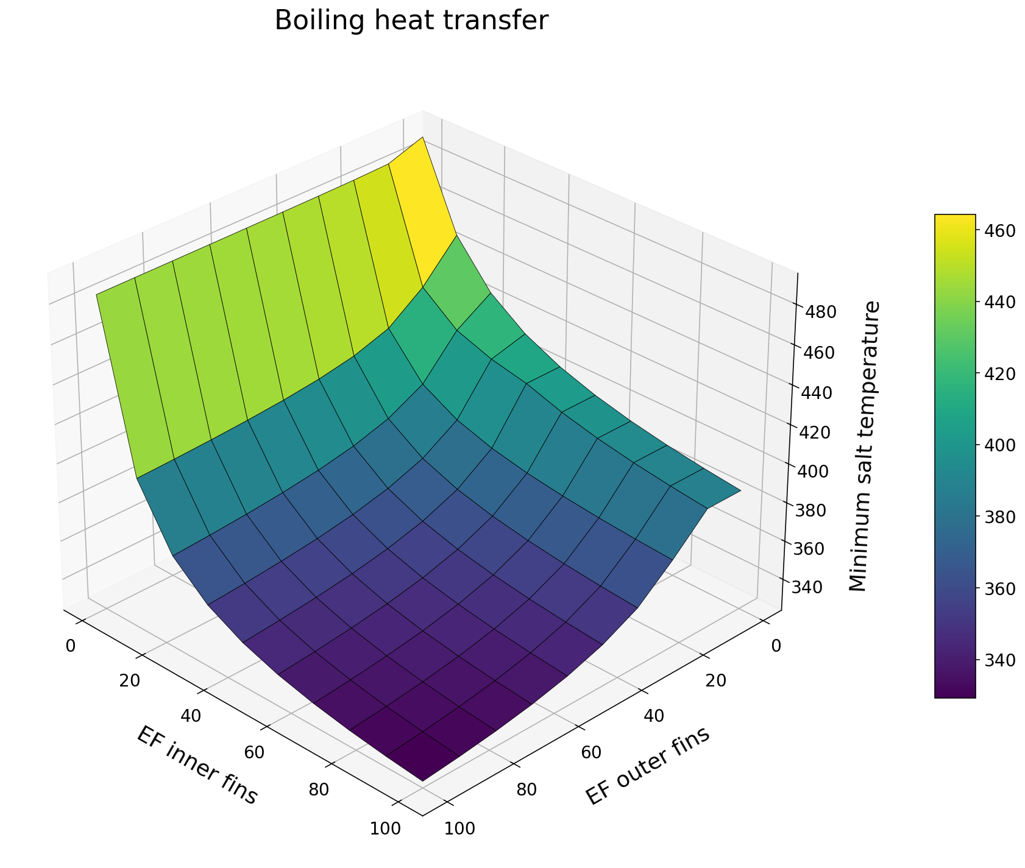
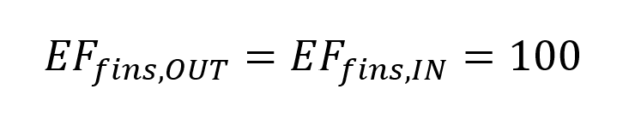
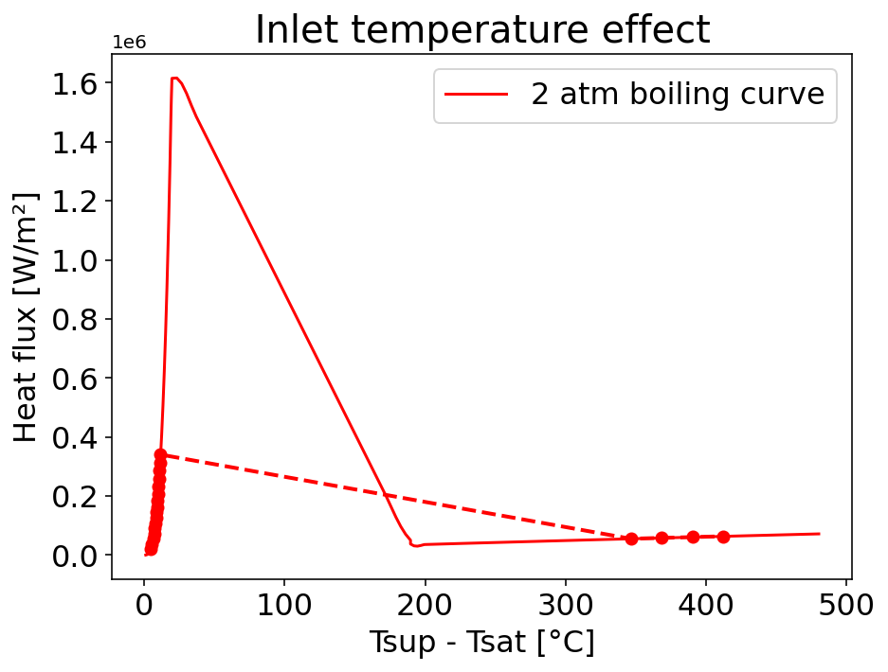
NOVEL CONCEPT RESULTS
By tailoring the efficiency factor one can:
Find a set of parameters that avoid the film boiling transition.
Sustain acceptable heat transfer.
More fins inside
More fins outside

Slide 10
SECOND YEAR ACTIVITY
Possible transition to instable film boiling condition.
At high temperature driving force the steam forms a vapour blanket
Low heat transfer efficiency of the molten salt.
High viscosity molten salt slowly flows in the SG tubes

Slide 11
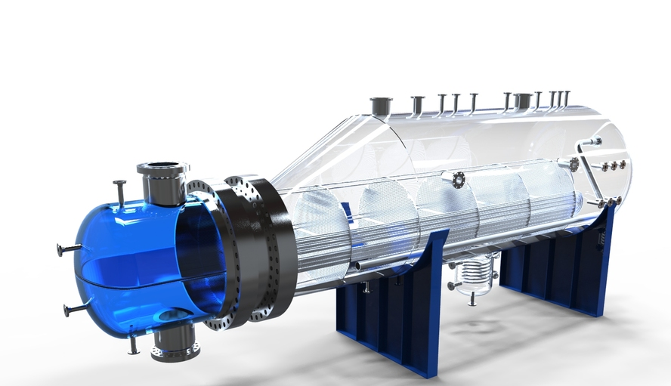
TOPOLOGY OPTIMIZED FINNED TUBE
The idea is to enhance heat transfer using TO fins in the inner side of the tube.
It will improve laminar flow.
With TO fins

Slide 12
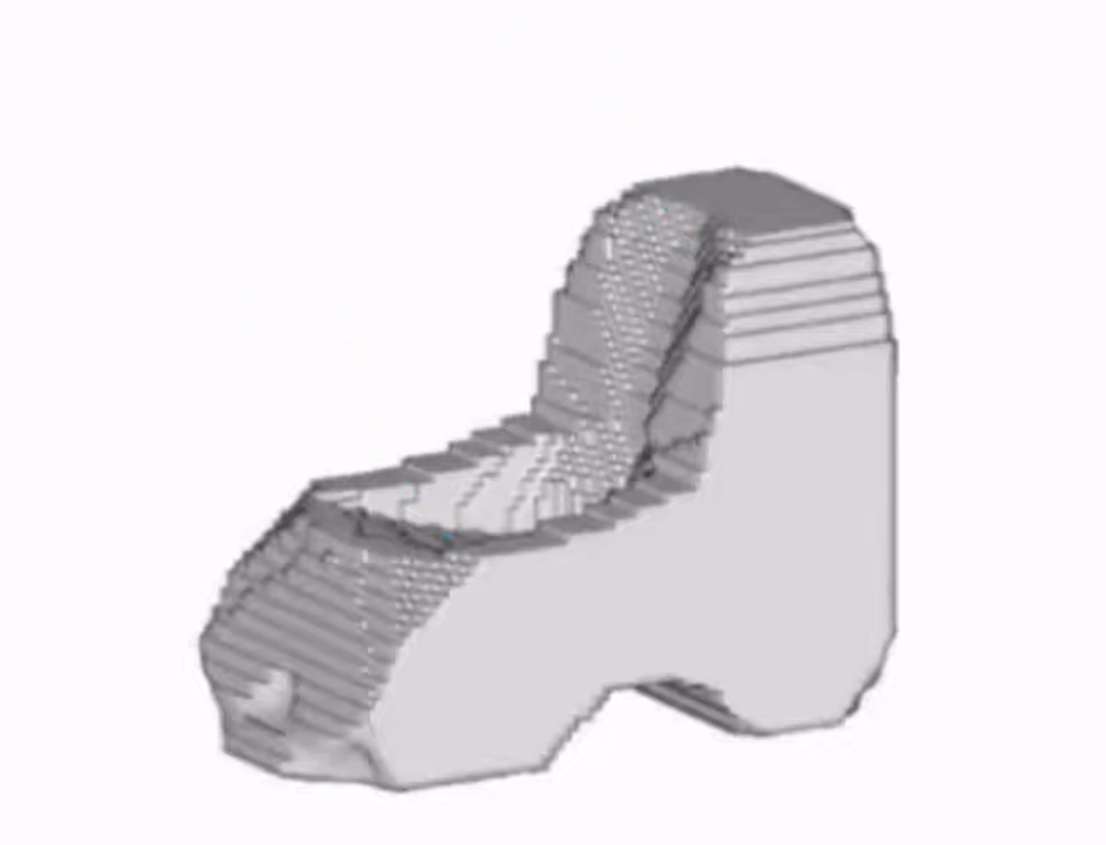
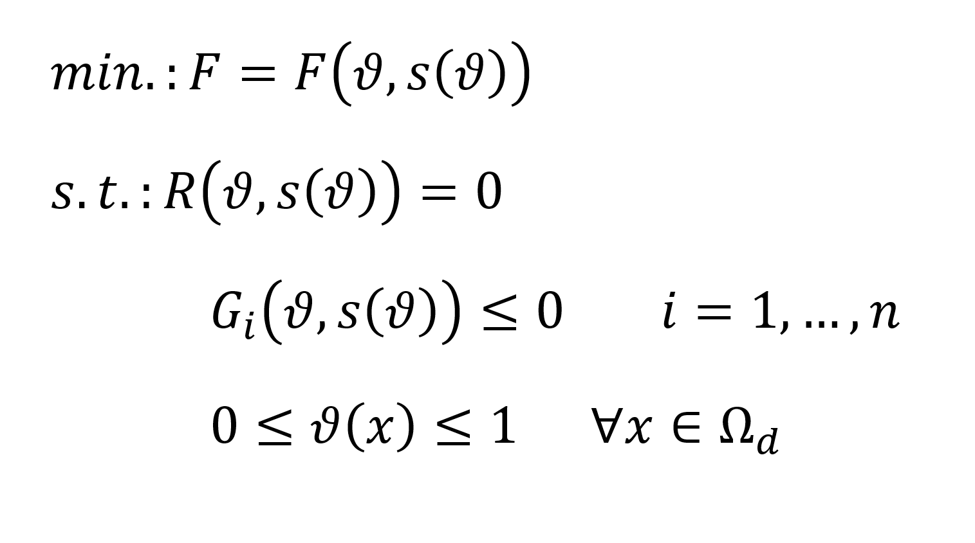
TOPOLOGY OPTIMIZED FINNED TUBE
"Topology Optimization is a computational design method that determines the best way to distribute material within a defined space to meet performance goals under given constraints."

Slide 13
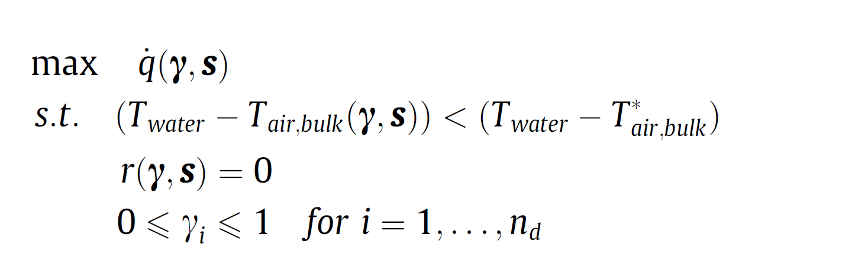
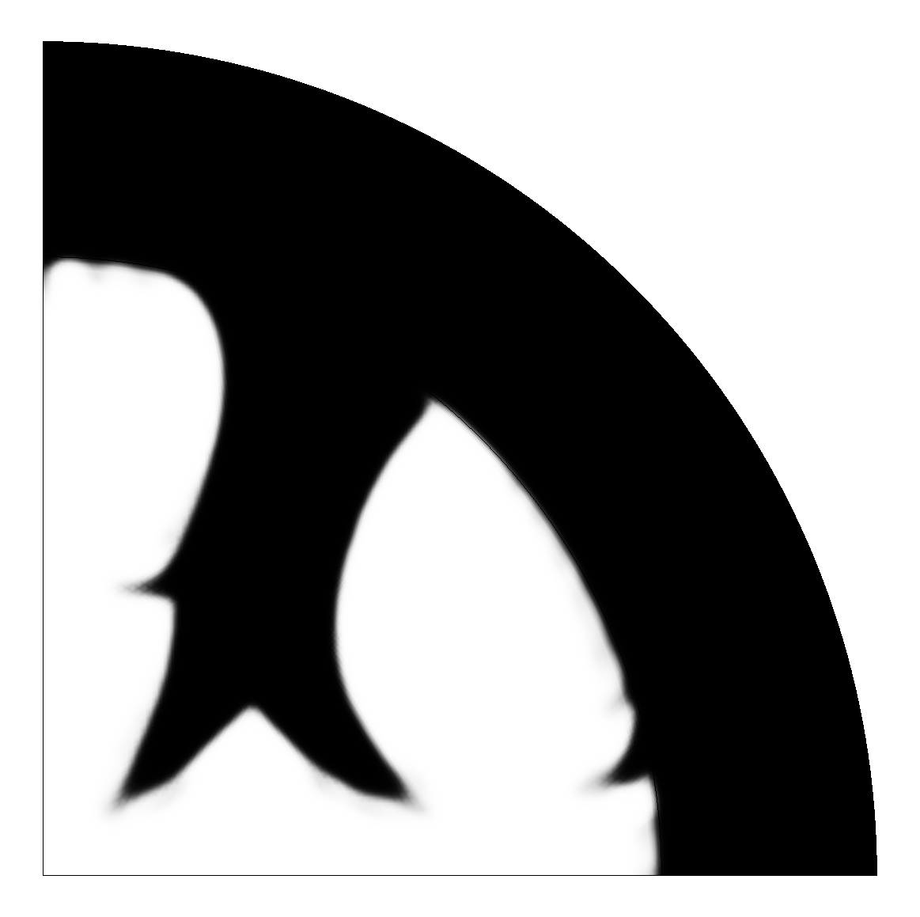
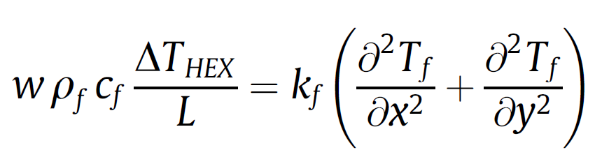
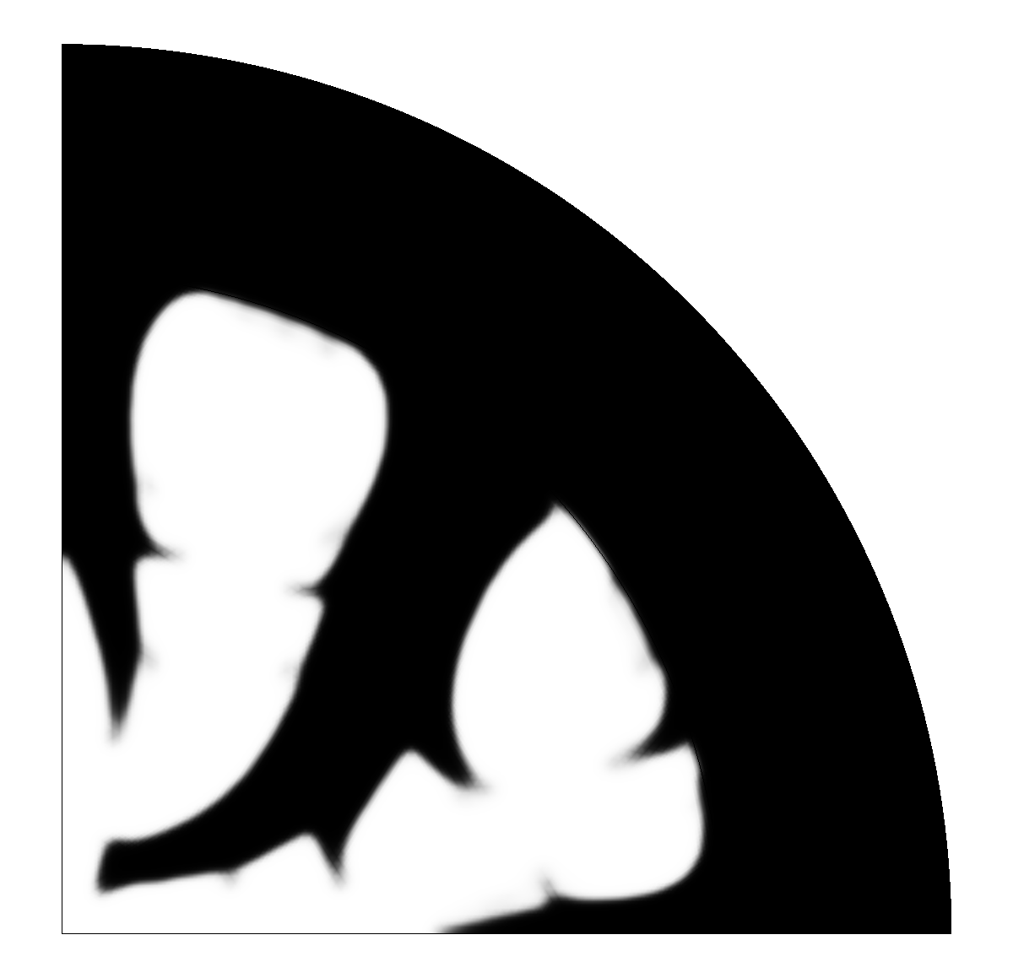

TOPOLOGY OPTIMIZED FINNED TUBE
"Topology Optimization is a computational design method that determines the best way to distribute material within a defined space to meet performance goals under given constraints."

Slide 14
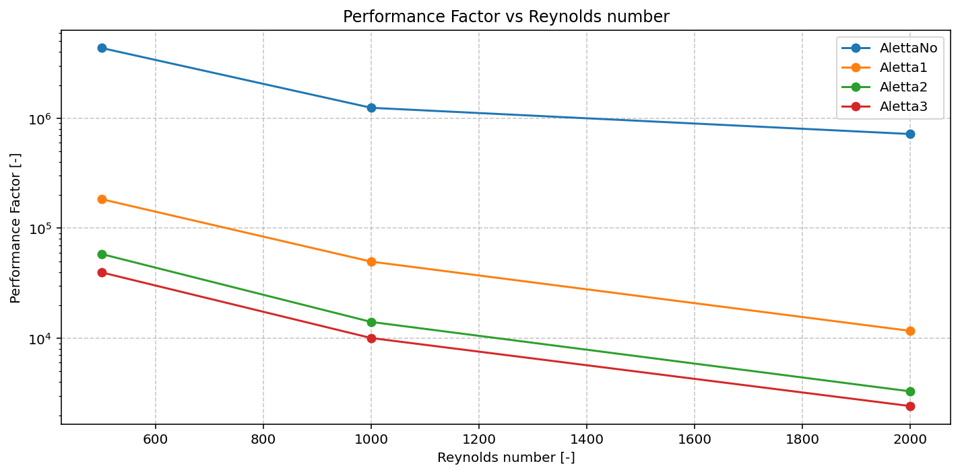
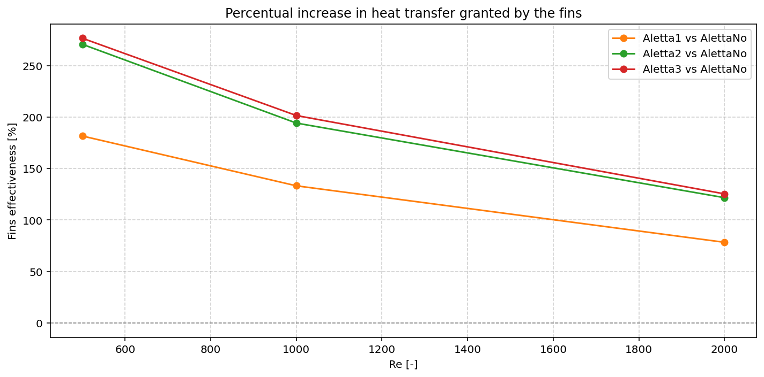
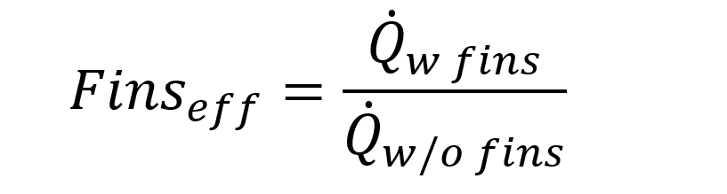
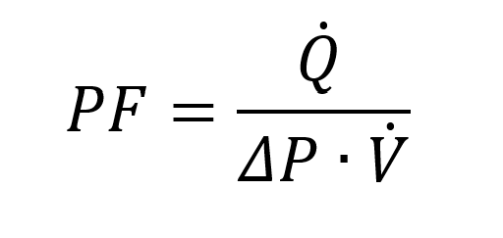
TOPOLOGY OPTIMIZED FINNED TUBE
The introduction of topology optimized fins can:
Increase heat transfer by a great amount, with a fin effectiveness up to 270%!
Trade-off analysis: fins increase efficiency but also introduce pressure drop

Slide 15
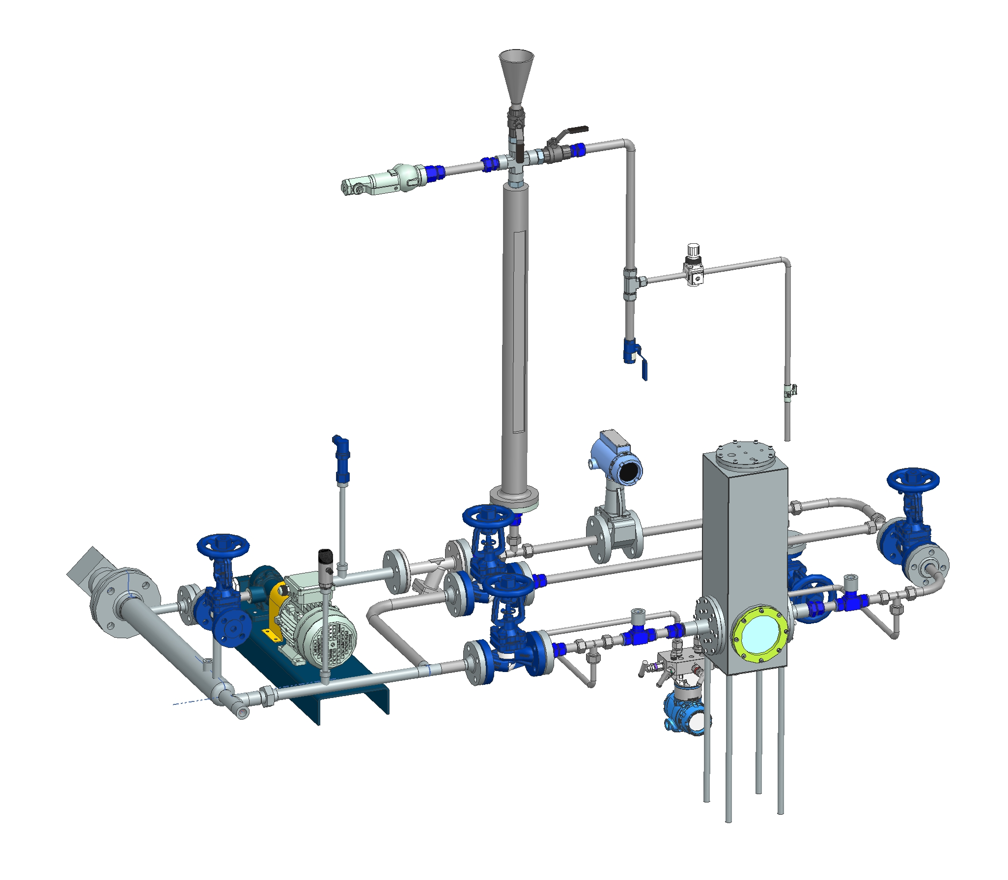
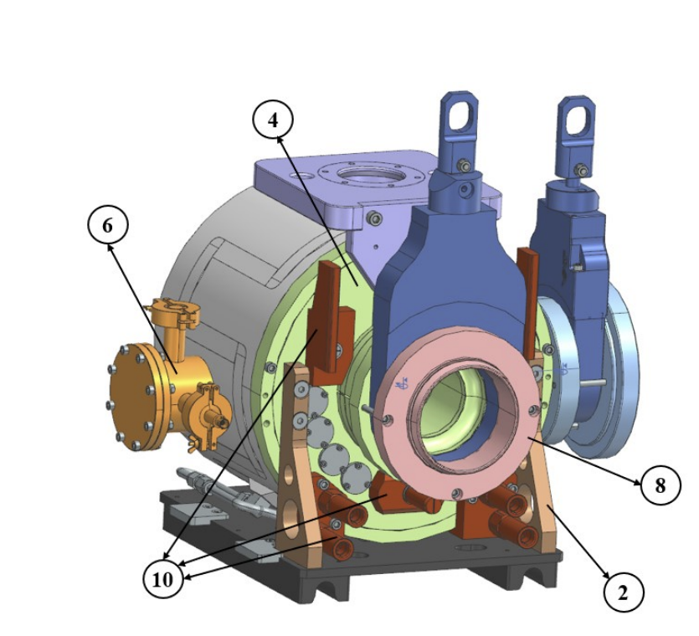
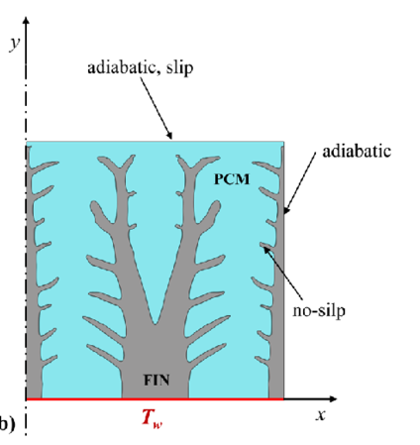
THIRD YEAR ACTIVITIES
Have the experimental validation of the finned surface performance in a custom built hydraulic loop.
Apply the knowledge gained on topology optimization to more case studies in the field of fundamental physics.

Slide 16
THANK YOU! ANY QUESTIONS?

