Slide 1


PhD Progress Report
“Year 1 Review and Year 2 Plans”
AMBRESH MAHANARAYAN MISHRA
Technologies for Fundamental Research in Physics and Astrophysics- Computing curriculum
XL Cycle
Supervisor :
Daniele Gardiol, Dario Barghini
October 02, 2025
October 02, 2025 Annual Report 1

Slide 2

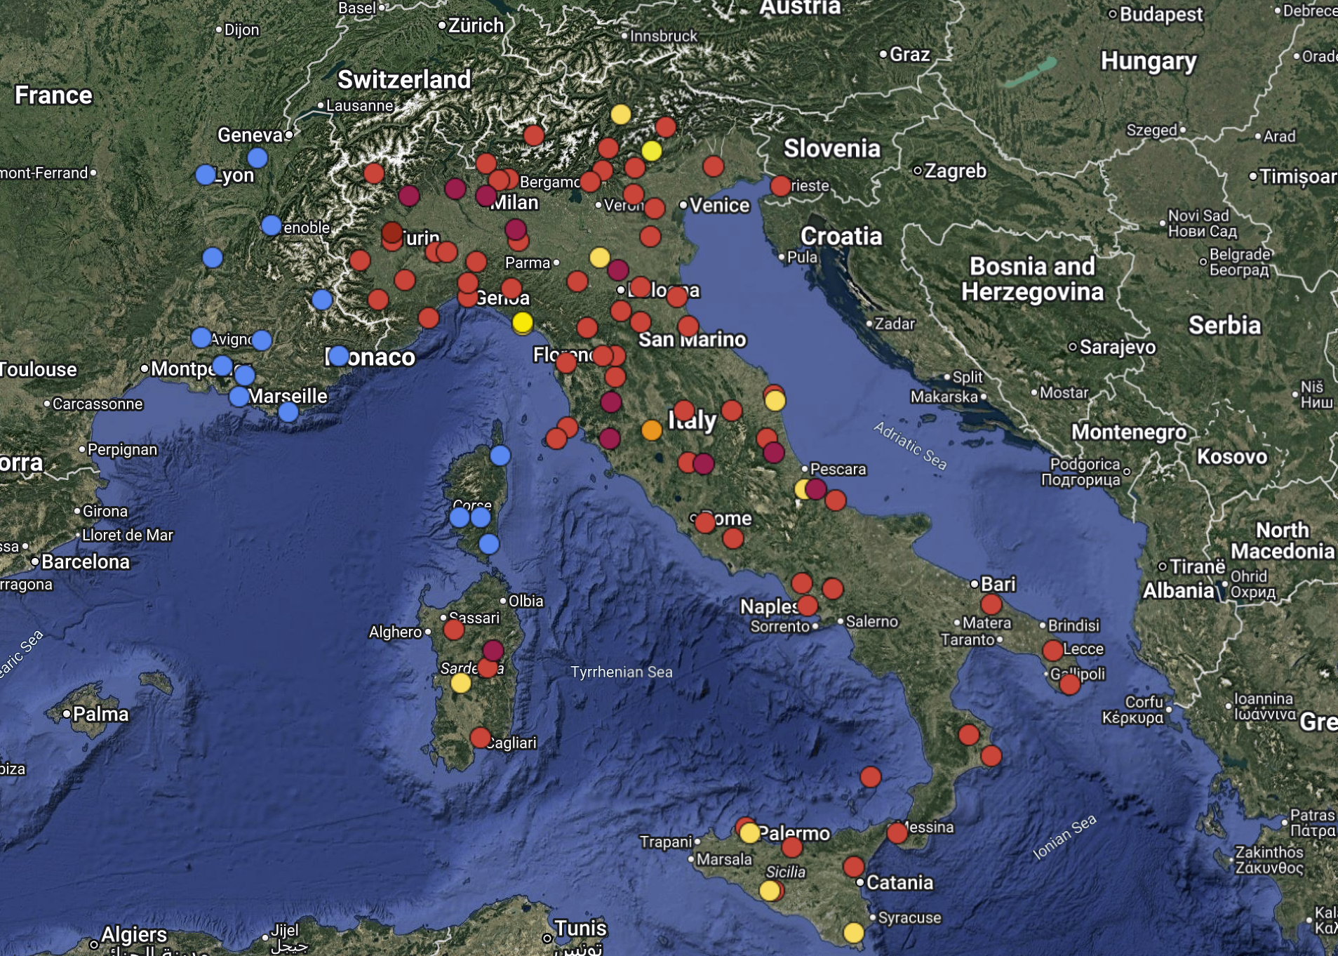
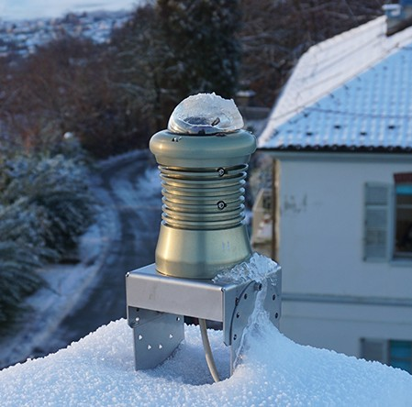
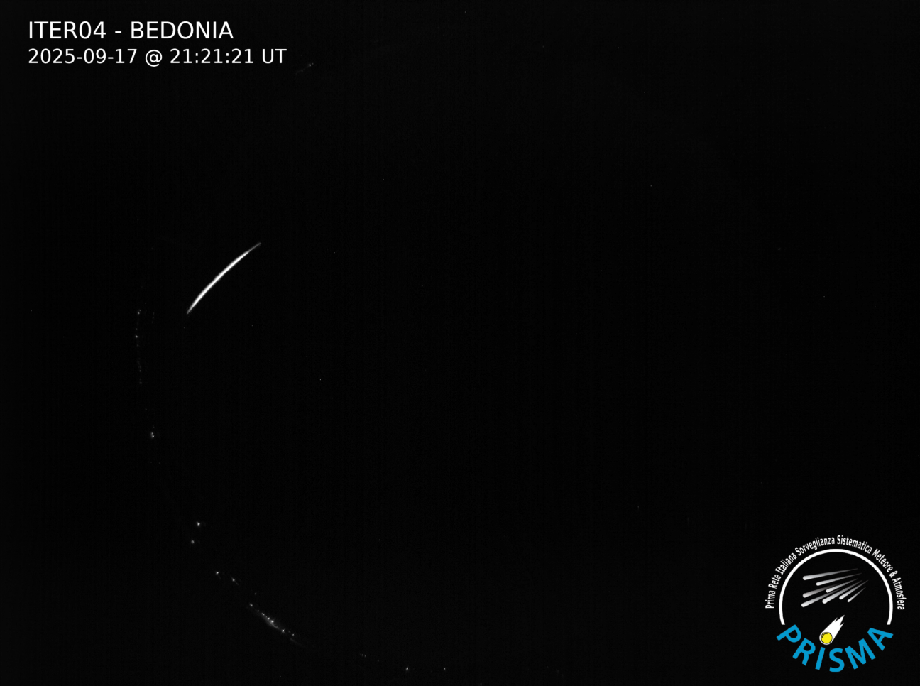
What is Prisma?
October 02, 2025 Annual Report 2

Slide 3
Research Topic and Objectives
Research Topic: Development of advanced technologies for multi-platform meteor observation from ground and space.
Objectives:
Combine multi-technique observations (e.g. optical imaging,infra-sound, seismic detections, space-based data) into a coherent framework.
Develop methodologies for identifying meteor signals in seismic and infrasound data.
Implement an Integrated Alert System (IAS) to collect and correlate data across optical, seismic, and infrasound networks.
Design and maintain data models to enable systematic multi-messenger analysis of fireballs.
Support PRISMA optical network through integration, validation, and maintenance.
Integrate space-based observations (e.g., Mini-EUSO, ESA Lightning Imager) into the fireball monitoring infrastructure.
October 02, 2025 Annual Report 3

Slide 4
1. Calibration of all-sky cameras
Configuring and Calibrating PRISMA cameras
Acquired hands on skills in PRISMA camera configuration and calibration
Stations I worked on : FRCA20 (Nice), FRCA21 (Fréjus), FRCA22 (Vinon), DEBY20 (Münsterschwarzach), DEBW21 (Weinheim), DEBW22 (Crailsheim), GREV21 (Avlonari), ITAB03 (Teramo), ITUM03 (Cesi)
these are the some old cameras that Configure and calibrated : ITUM01, ITER07, ITPI02, ITTO04, ITTO01, ITLO03, ITER10, ITTO02, ITER04, ITTO05
October 02, 2025 Annual Report 4

Slide 5
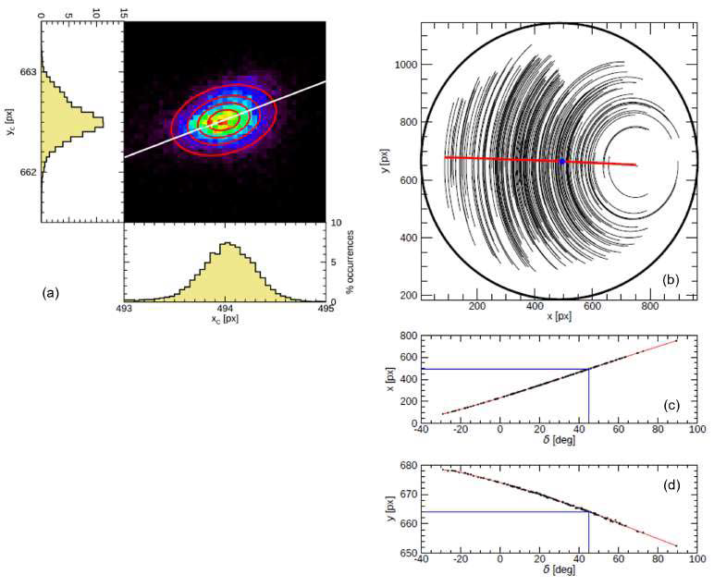
Configuring and Calibrating PRISMA cameras
2.Source identification and catalogue correlation
3.Determination of the astrometric solution
October 02, 2025 Annual Report 5

Slide 6
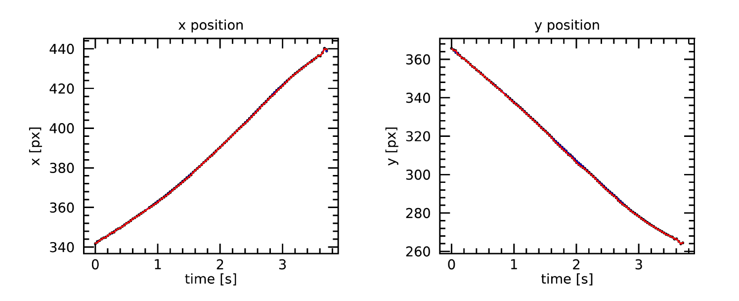
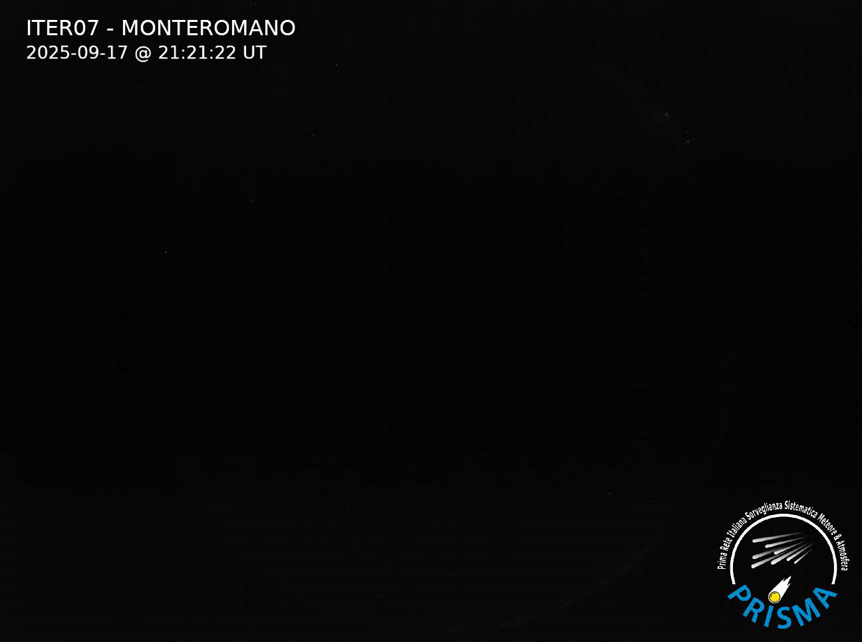
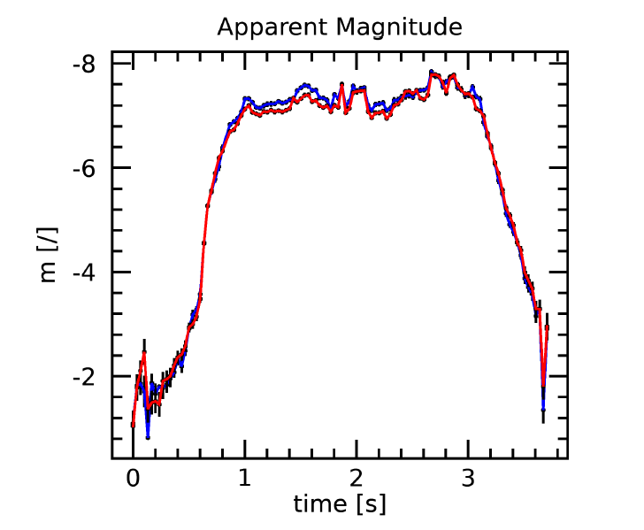
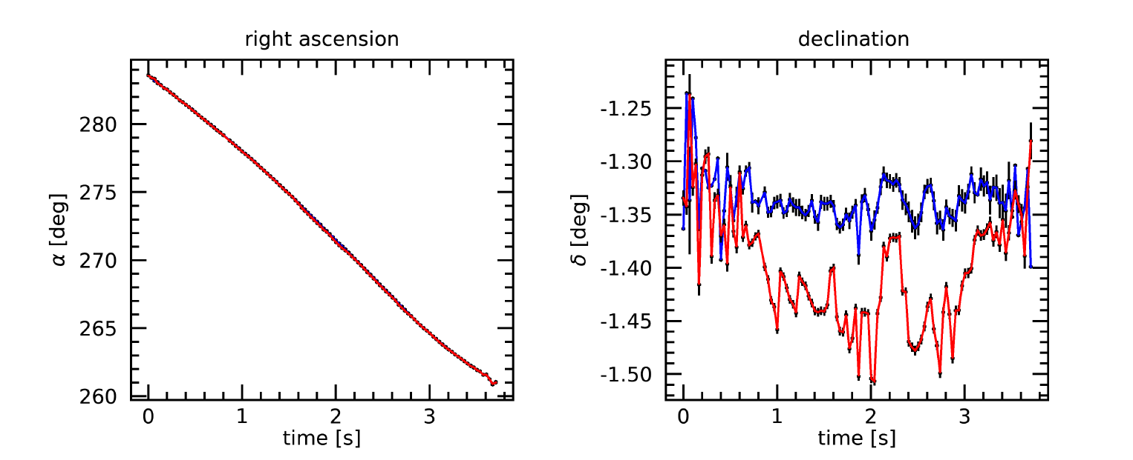
Analysis of PRISMA events
During this year, I also processed several meteor events.
Following event is one of the brightest and recent, on September 17, 2025, at 21:21:22 UT. And detected by 10 cameras in our network.
1.Astrometric and photometric processing
October 02, 2025 Annual Report 6

Slide 7
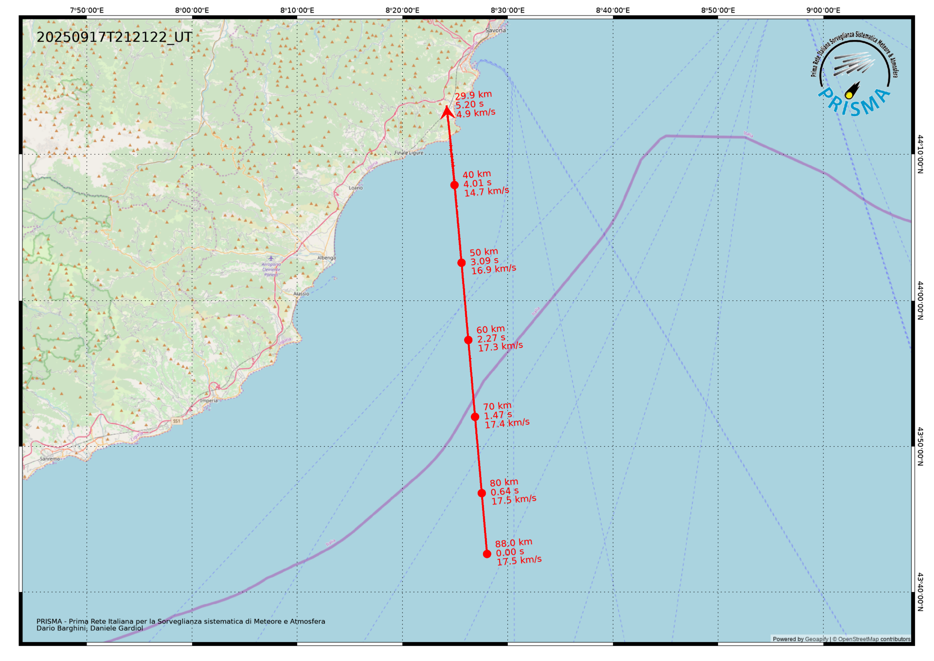
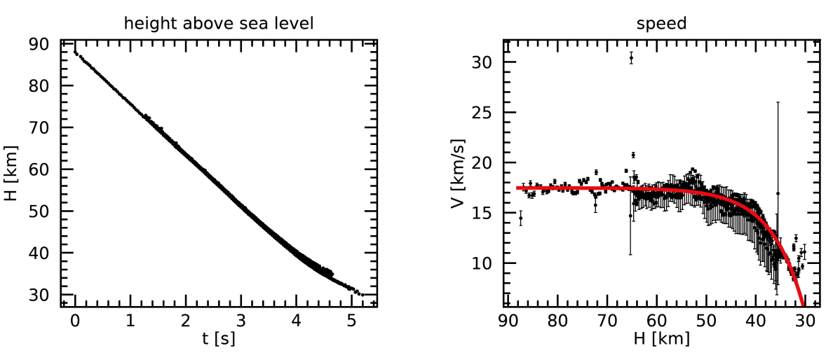
Analysis of PRISMA events
2. Calculating Trajectory
October 02, 2025 Annual Report 7

Slide 8
Analysis of PRISMA events
3. Dynamic model:
Parameter | Initial Values | Final Values
Time of flight [s] | 5.2 ± 0.04
Velocity [km/s] | 17.43 ± 0.08 | 5.33 ± 0.17
Mass [kg] | 3.58 ± 1.26 | 0.012 ± 0.005
Energy [J] | (5.44 ± 1.91) × 10⁸
Initial height [km] | 87.76 ± 0.03 | 30.75 ± 0.07
Trajectory inclination [deg] | 44.86 ± 0.11
Latitude | 43° 42′ 35.1″ N | 44° 13′ 16.1″ N
Longitude | 8° 27′ 57.2″ E | 8° 24′ 5.0″ E
October 02, 2025 Annual Report 8

Slide 9
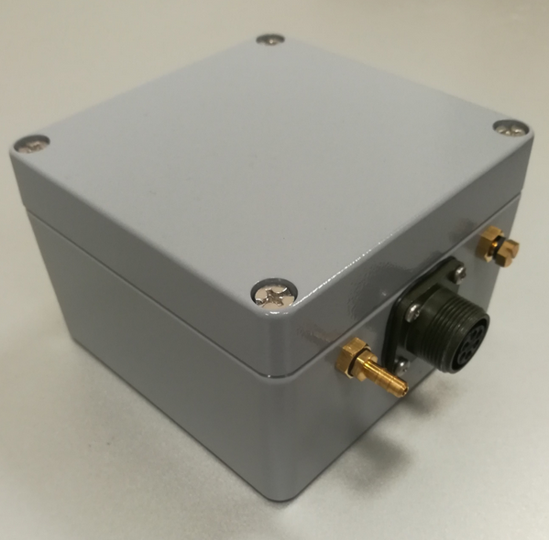
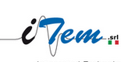
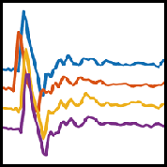
Infrasonic Array
Source
Infrasonic signal
Array analysis also allows us to discriminate coherent signal from noise
Reference : “G. Belli et al., Integrated analysis based on all-sky cameras and infrasonic array for the characterisation of small fireballs events, SnT 2023, 19-23 June 2023, Vienna”
Infasonic array analysis: Infrasonic is typically recorded not with a single sensor but via an infrasonic array, which offers many advantages.
October 02, 2025 Annual Report 9

Slide 10
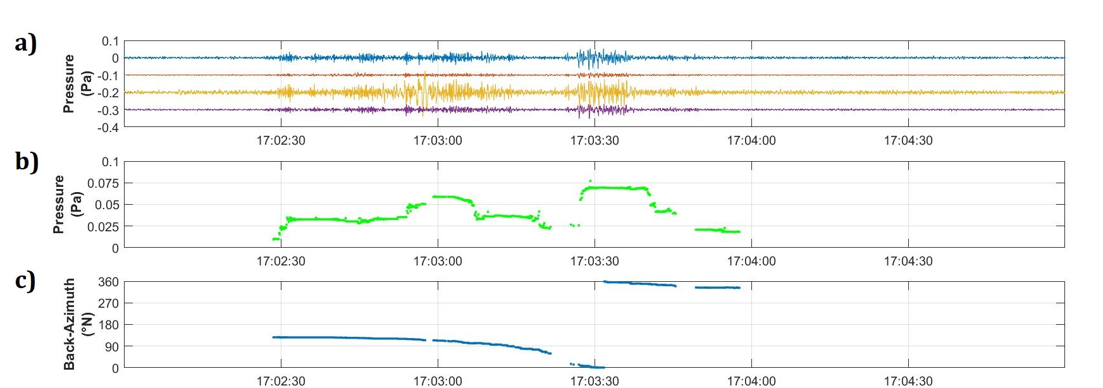
Aircraft signals in Infrasound data
Reference : “G. Belli et al., Integrated analysis based on all-sky cameras and infrasonic array for the characterisation of small fireballs events, SnT 2023, 19-23 June 2023, Vienna”
October 02, 2025 Annual Report 10

Slide 11
Meteor signals in Infrasound data
In 2018, a total of 150 confirmed meteor events were recorded by the PRISMA optical network.
Out of these, 15 events were also detected by the infrasound network.
I processed all the 150 events and performed analysis on 135 non-infrasound events and 15 infrasound events.
October 02, 2025 Annual Report 11

Slide 12
October 02, 2025 Annual Report 12

Slide 13
The research activity for the second year
Definition, implementation and validation of methods to identify meteor signals in seismic and infrasound data
Implementation of an Integrated Alert System (IAS) able to identify and collect data from optical, seismic and infrasound networks
Integration, validation and maintenance of the PRISMA optical nodes and infrastructure as a part of the multi-messenger fireball network
October 02, 2025 Annual Report 13

Slide 14
Courses : 1. Advanced scientific programming in Matlab - Passed (credits - 6) 2. Big Data Analysis in Python - Passed (credits - 2.5) 3. Adaptive Optics For Astronomy - Pending (credits - 1.5) 4. Machine Learning For Physics - Pending (credits - 3) Schools : 1. Francesco Lucchin - Asiago 2025: From the solar system to high redshift galaxies May 26-31, 2025 2. Scientific Communication in Astronomy School – 3rd edition – Bertinoro October 12-17, 2025
List of attended courses and schools
October 02, 2025 Annual Report 14

Slide 15
Thank you for your attention!!
October 02, 2025 Annual Report 15

