Slide 1


Progress Report for Admission to the 3rd Year of PhD Course Technologies for Fundamental Research in Physics and Astrophysics
By Neeraj Yadav
Supervisor: Dr. Stefano Bagnasco (INFN)

Slide 2
Research Objective and Research Activities Carried Out So Far
Research topic: Advanced computing systems for Gravitational wave (GW) research.
With the objective of developing interdisciplinary expertise bridging advanced
computing and GW astronomy
Research carried out so far:
Development of Low Latency Alert Infrastructure (LLAI) monitoring dashboard using Prometheus and Grafana (completed)
Near face on systems systematic study: Inspiral-Merger-Ringdown consistency test (IMRCT) (on-going)
Comparison and evaluation of scientific workflow management tools: Snakemake, Nextflow, Pegasus and REANA (on-going)

Slide 3
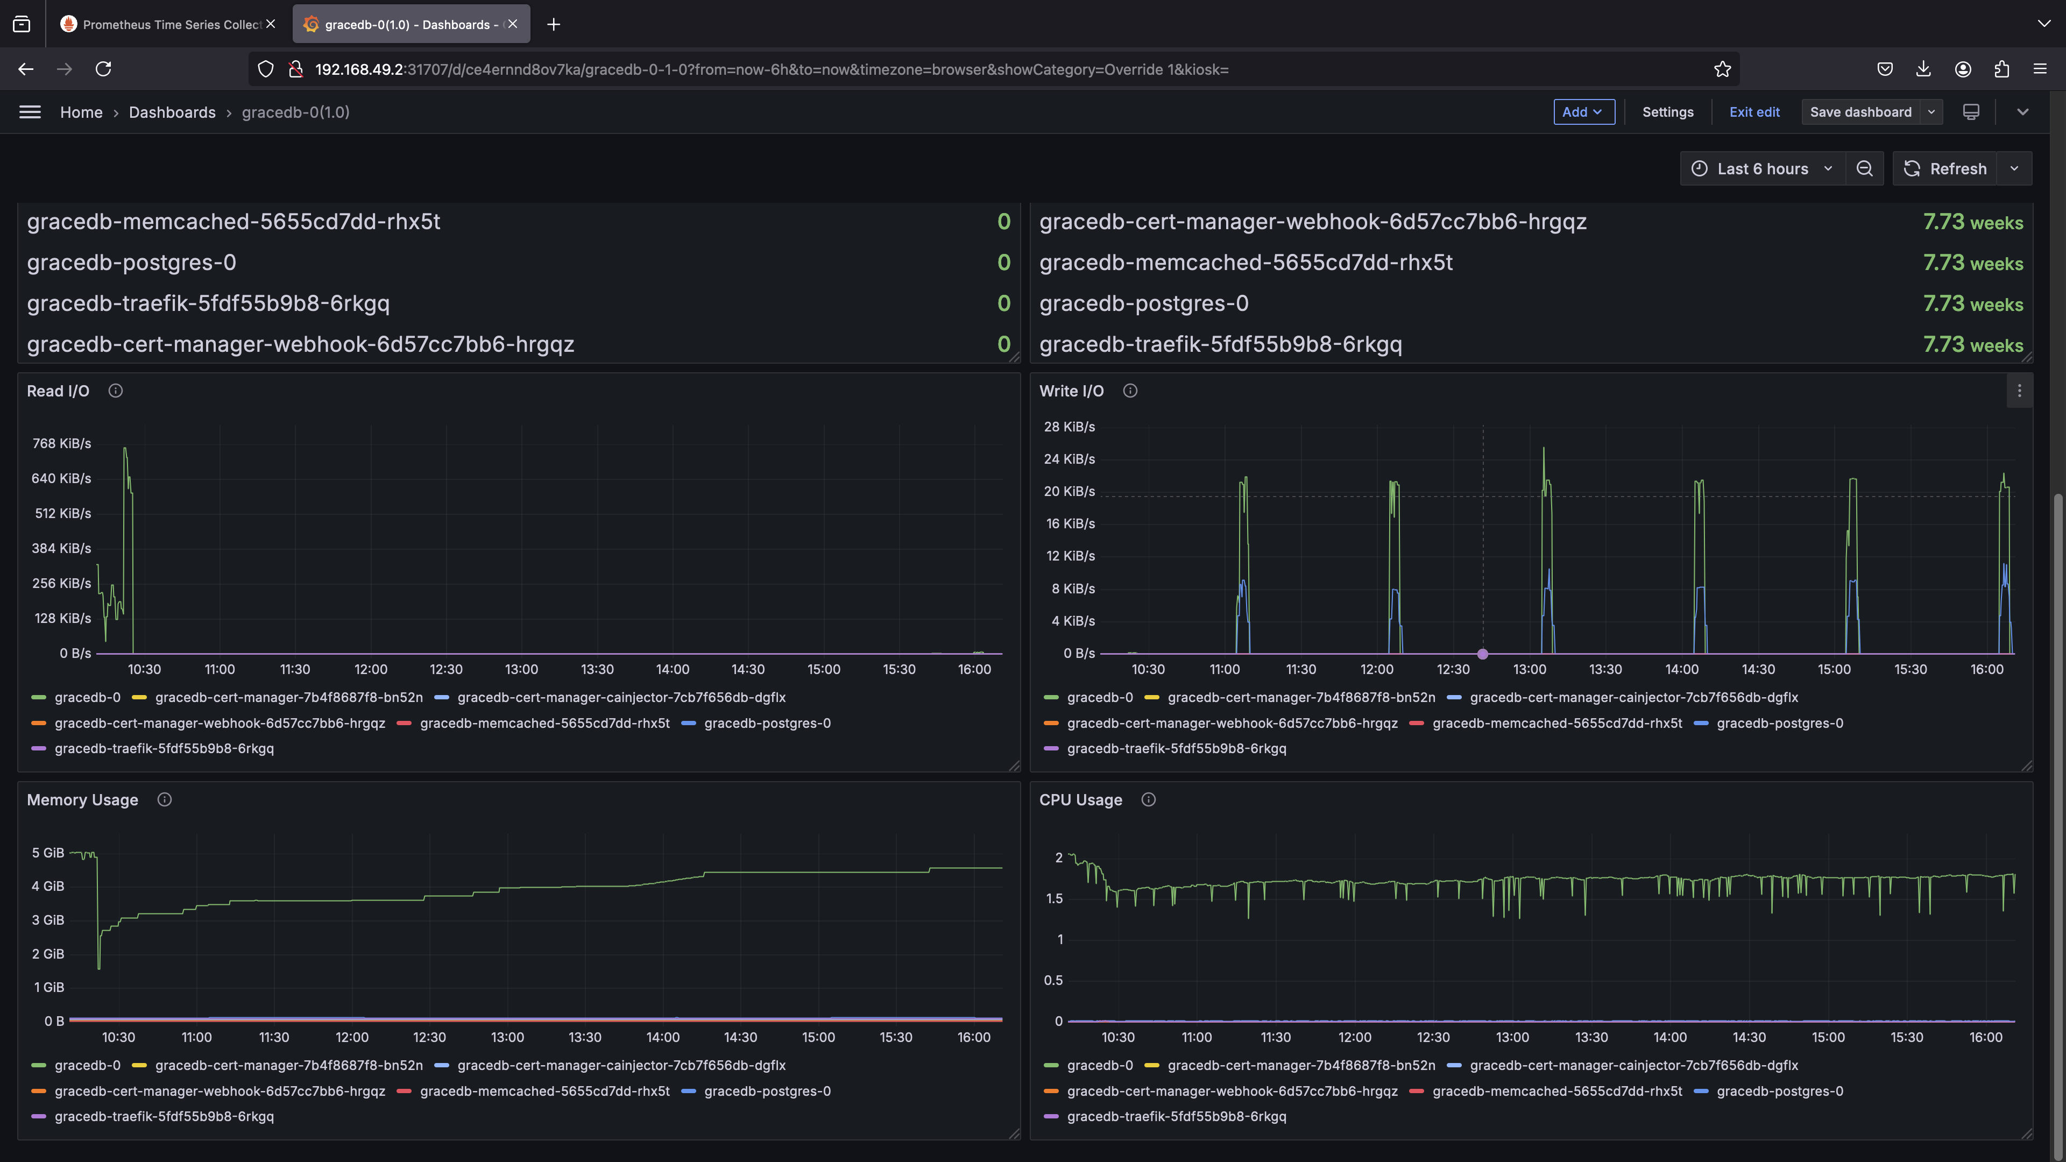
Low Latency Alert Infrastructure Monitoring Dashboard
This dashboard monitors the performance of different components of low-latency infrastructure like gwcelery, gracedb

Slide 4
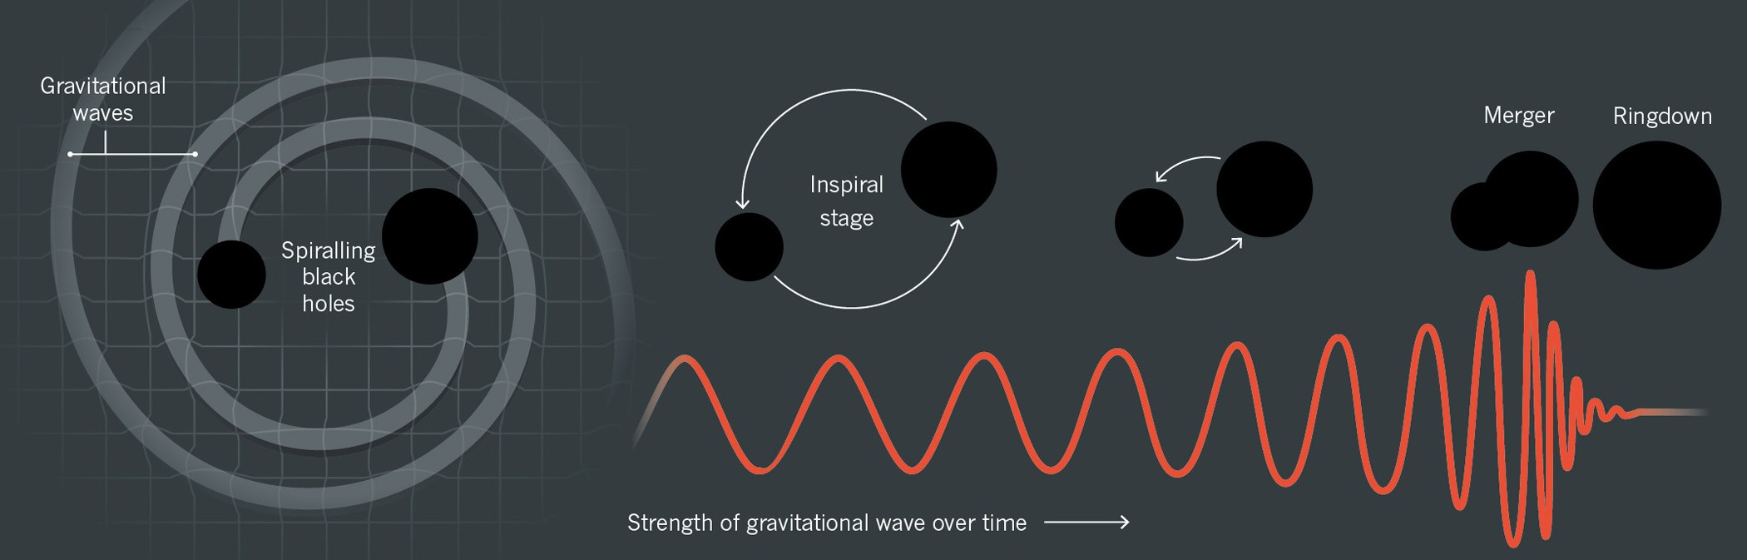
Inspiral-Merger-Ringdown Consistency Test (IMRCT)
As a part of the TGR (Testing General Relativity) group of the Ligo-Virgo-Kagra (LVK) collobaration, I am involved in the IMRCT study
It is a null test of GR used in Gravitational Wave (GW) astronomy
A null test is designed such that, if the theory being tested is correct, the result should be zero (or within expected noise)
It checks whether the inspiral and merger-ringdown parts of the GW signal from a binary black hole (BBH) coalescence are mutually consistent with each other under the assumption that the sources are described by GR
From the inspiral phase, we estimate the final black hole’s mass and spin predicted by GR
From the merger-ringdown phase, we again independently estimate the remnant’s mass and spin
If GR is correct, both estimates of the final mass and spin must agree

Slide 5
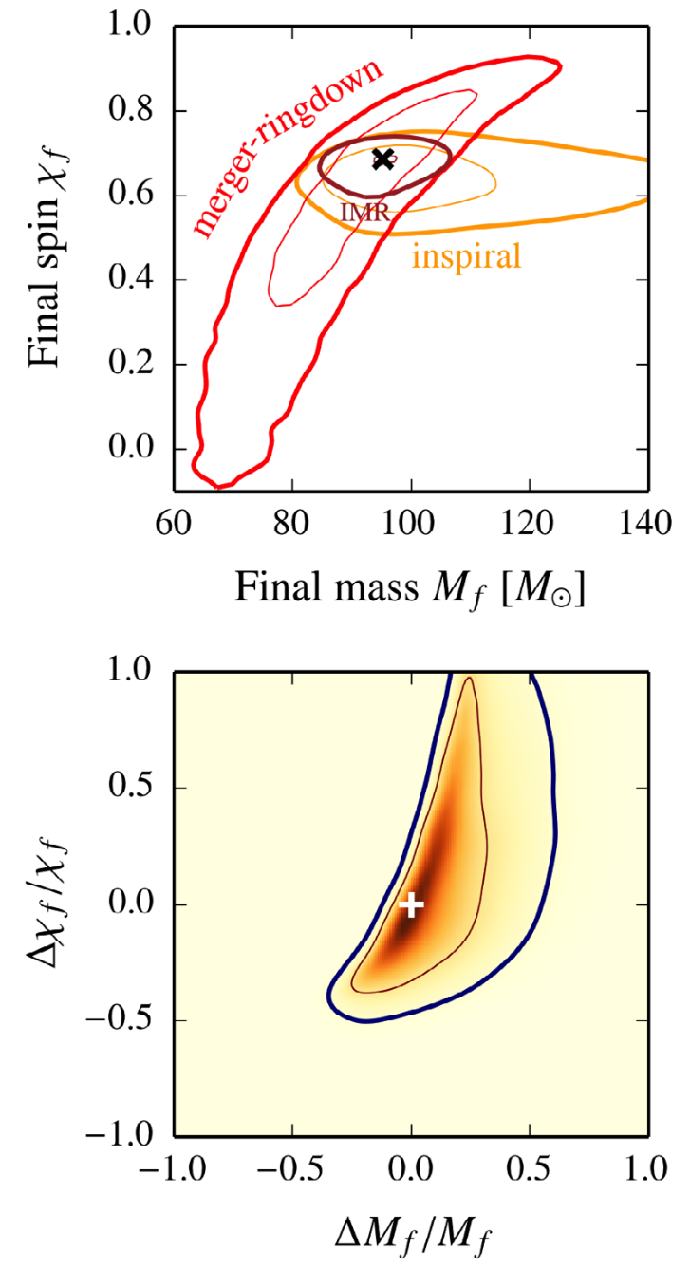
Biases in Inspiral-Merger-Ringdown Consistency Test
This study explores the biases in IMRCT observed for systems with near-face-on inclinations, unequal masses, and highly misaligned spins
With bias: Even if GR is perfectly correct, the measured difference between inspiral and merger-ringdown remnant properties is not centred at zero. So, the test may falsely suggest a deviation from GR
A preliminary investigation suggests that these biases occur due to volumetric prior on the luminosity distance
Presently, we are in the last phase of the work. Final test analysis jobs are going on. After they are finished, we will run about 50-100 parameter estimation (PE) jobs
These jobs are computationally intensive, but we hope to finish most of the work by the end of this year
A publication is also expected
IMR consistency test on a simulated GR event (50 M⊙+50 M⊙, SNR = 25)
showing credible regions for final mass/spin and posteriors for deviation parameters

Slide 6
Comparison and Evaluation of Scientific Workflow Management Tools
This work is connected to the Einstein Telescope (ET) gravitational-wave observatory, specifically with its Computing and Data Model
The ET computing domain can be divided into three main areas: online, low-latency, and offline
The offline domain encompasses tasks such as detailed data analysis, deep searches, and high-precision parameter estimation
The overarching objective of this work is to evaluate a selection of workflow management tools, offering the ET collaboration potential candidates for adoption
Such a tool would serve as a user-facing interface, supporting the activities outlined above

Slide 7




Comparison and Evaluation of Scientific Workflow Management Tools
A scientific workflow management tool is a specialized software system designed to automate, manage, and track complex scientific computational processes, often referred to as workflows or pipelines. It helps researcher:
Define a series of computational steps
Orchestrate the execution of these tasks in a specific order, managing data flow and control flow
Manage the input and output data
Utilize diverse computational resources (local machines, clusters, cloud platforms)
Track the execution history, parameters, and provenance of each run, ensuring reproducibility
Visualize the workflow structure and execution status
Handle errors and manage failures gracefully
In short, it acts as a digital lab assistant for computational scientists, taking care of the logistical complexities of running sophisticated analyses
I have selected 4 such tools: Snakemake, Nextflow, Pegasus and REANA

Slide 8
Linking the IMRCT Study and the Workflow Study
The aim is to evalute the workflow tools and compare them on different metrics like core functionality, user experience and integration with other tools amongst many
As a practical test case, I have chosen the IMRCT study
Broadly, the IMRCT study can be broken into 3 steps
Step 1 involves creating an injection file, which contains values of parametrs that describes the BBH system, values like masses, spins and luminosity distance etc
Step 2 involves processing this injection file based on some conditions. Step 2 is made up of 4 sub steps
Step 3 is launching the parameter estimation jobs
Overall, it involves handling scripts, jupyter notebooks and data files

Slide 9
What Have I done and What Will I Do Next?
Codified what I have done manually in the form of a workflow for Snakemake, Nextflow and Pegasus
Next, containerize everything to test the portability. Had partial success in the past
Test the fault tolerance, error handling and debugging capabilities of these tools by artificially introducing problems
For the IMRCT study, I am using the CIT and the OSG sites. For the worfklow study, plan is to use the geographically distributed computing resources through user interface at CNAF
Basically, provide a comprehensive view of what each tool has to offer

Slide 10
Planning for the 3rd Year
Finish the IMRCT study
Finish the workflow project well in advance, followed by post work. This may include consulting collaboration members to identify the most common challenges they encounter and subsequently evaluating which tool provides the most effective solutions
As a precursor to the above idea, I am preparing an ET data analysis tutorial that demonstrates the use of Snakemake, to be presented at the 4th Einstein Telescope Annual Meeting in Croatia (10–14 November 2025)
Planning to do an internship period abroad either in University of Geneva or UC Louvain
Start writing my thesis well in time so that I can submit timely

Slide 11
Courses and Conferences
Courses attended and final exam completed:
Advanced Scientific Computing in MATLAB (4 CFU)
Deep Networks and Structured Learning (2 CFU)
Machine Learning for Physics (3 CFU)
Soft Skills: How to Deliver Effective Presentations (3 CFU)
Conferences attended:
Einstein Telescope symposium XIV, May 6th to 10th 2024, Maastricht, Netherlands
XV Einstein Telescope Symposium, 26-30 May, 2025, Bologna, Italy
Schools attended:
SOSC 2024 Sixth International School on Open Science Cloud, Dec 2 – 6, 2024. University of Bologna, Department of Physics and Astronomy
CINECA Summer HPC School for Heterogeneous Computing 2025, June 30th to July 11th, 2025
Therefore, I have fulfilled all the "Educational Obligations of the PhD student" as mentioned in PhD TFPA: Regulations for training activities

