Slide 1



Analysis of astrophysical phenomena using efficient and parallelized models on HPC computing systems.
Saim Ali Supervisor: Fabio Vitello
University of Padova Co-supervisor: Eva Sciacca
INAF Catania
PhD course of National Interest in Technologies for Fundamental Research in Physics and Astrophysics

Slide 2
Outlines
Introduction
Tool
Objectives and Motivation
Current Work
Results / Benchmarking
Challenges faced
Courses attended
School/Workshop
Conclusion
Notes:
Utilizzare sempre i modelli di elenco forniti dal programma, quindi non realizzare elenchi solamente inserendo trattini, numeri o punti, affinché una sintesi vocale possa leggerli in ordine e proprio come elenchi.

Slide 3
Introduction
The research is focusing on efficiently processing and analyzing large astrophysical datasets.
The cosmological simulations and Astrophysics generates massive datasets from simulations like the DEMNUni suite, which model the universe's evolution.
A single-threaded process struggles with massive datasets due to speed and memory limitations.
Focused on creating innovative solutions using different algorithms for processing large datasets and accelerating computation and AI libraries.

Slide 4
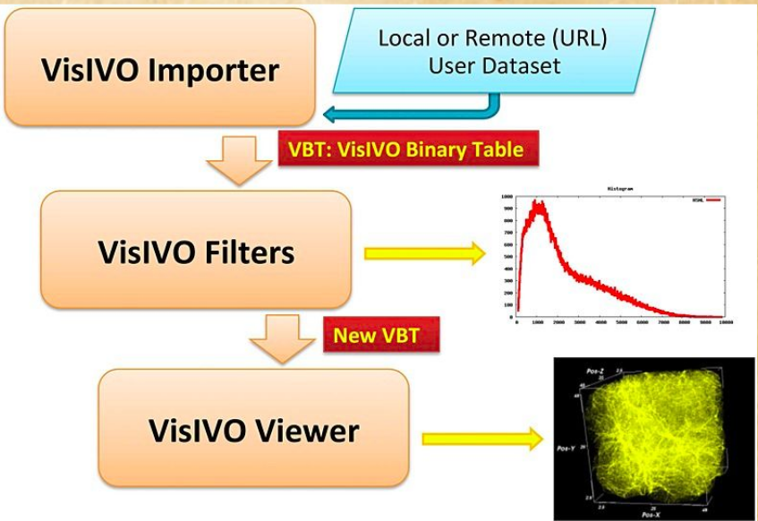
Tool:
VisIVO Server: An open-source platform for data analysis and scientific visualization, designed for the fast rendering of 3D views of astrophysical datasets.
VisIVO Importer, Converts user datasets
into a simple data format used by VisIVO
Filter
VisIVO Filter, a collection of data
processing modules that construct data
tables from the tables produced by VisIVO
Importer
VisIVO Viewer, generates 3D
visualizations of astrophysical datasets.

Slide 5
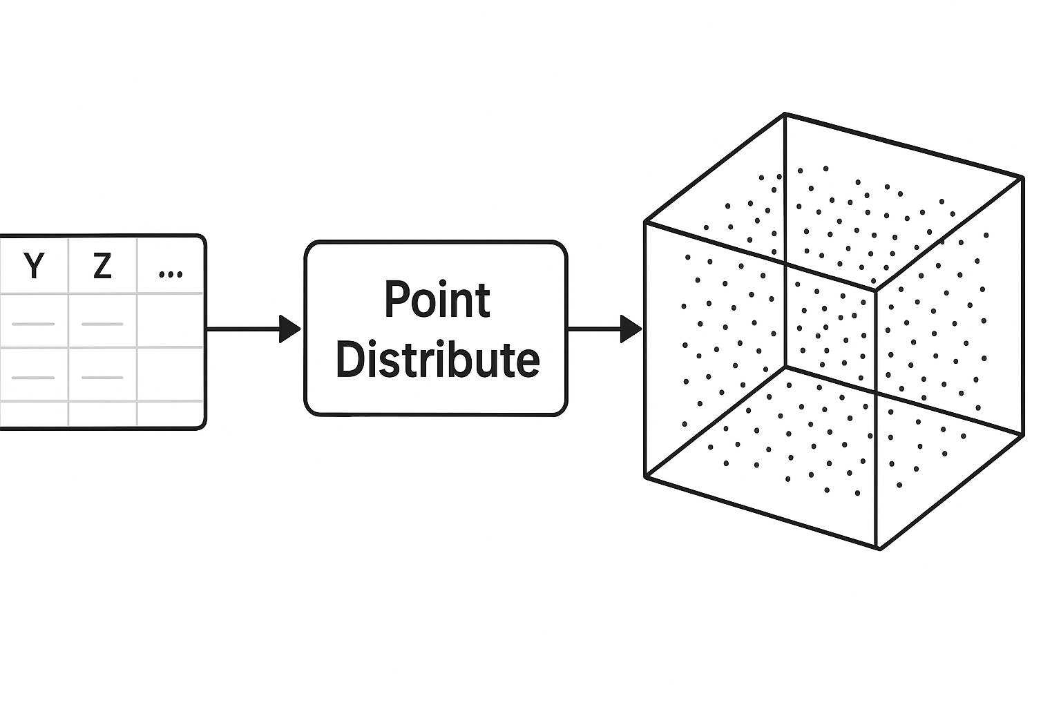
Point Distribute Filter
The VisIVO Server provides a variety of filters, with my research focusing on the Point Distribute Filter.
This filter generates a table representing a volume derived from selected fields of the input data table used to generate a volume (a 3D distribution
of points).
Point Distribution using the
NGP (Nearest Grid Point),
CIC (Cloud-In-Cell, default),
TSC (Triangular Shaped Cloud)
algorithms.

Slide 6
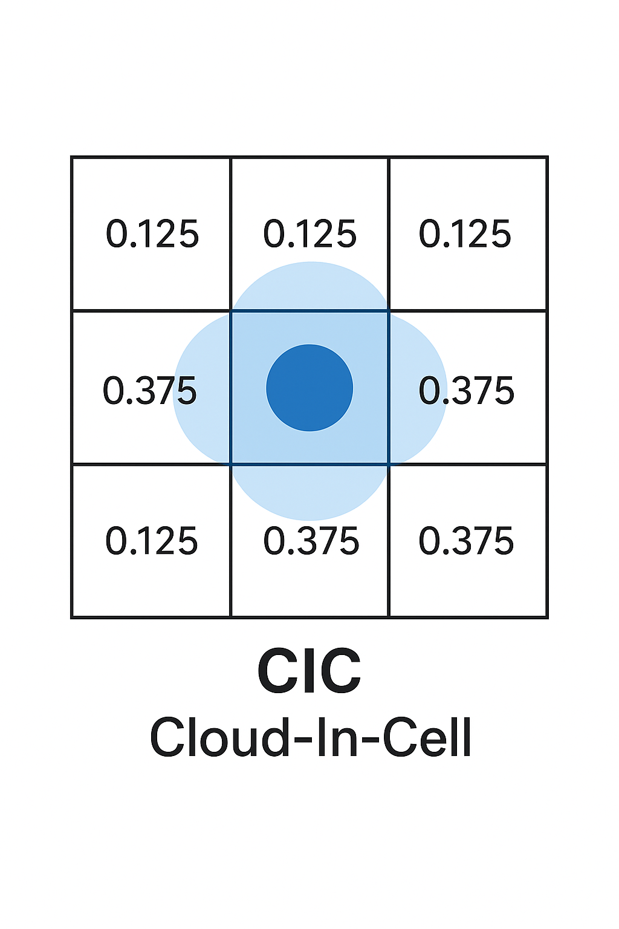
CIC (Clouds-in-cells) algorithm
A popular technique in computational astrophysics and particle physics for assigning values from discrete particles to a grid, and vice versa.
Overview of the CIC Algorithm
Grid Initialization:
Particle Assignment:
Weight Calculation:
1D Interpolation:
Mass Distribution:

Slide 7
Objectives and Motivation
The aim is to design and develop efficient and parallelized models for big data analysis, leveraging advanced visualization techniques and algorithmic solutions on modern HPC computing systems.
Parallel computing using MPI, openMP and openACC overcomes this with dividing the task into multi processing and multi threading.
The data should be taken in chunks efficiently.
The code must accomplishes reasonable scalability with an increasing number of MPI processes.
To solve the more complex problems by overcoming single-machine memory and time constraints.

Slide 8
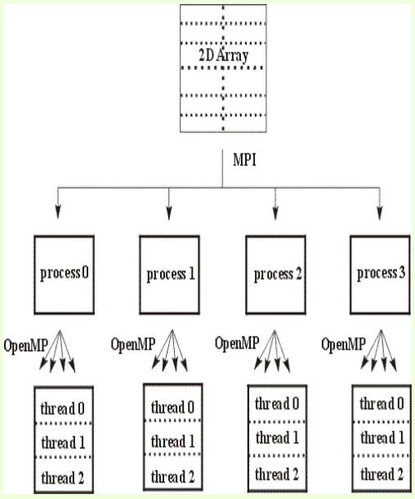
Parallel implementation file:///home/saim/Pictures/Screenshots/Screenshot%20From%202025-09-30%2014-05-08.png
Current Work

Slide 9
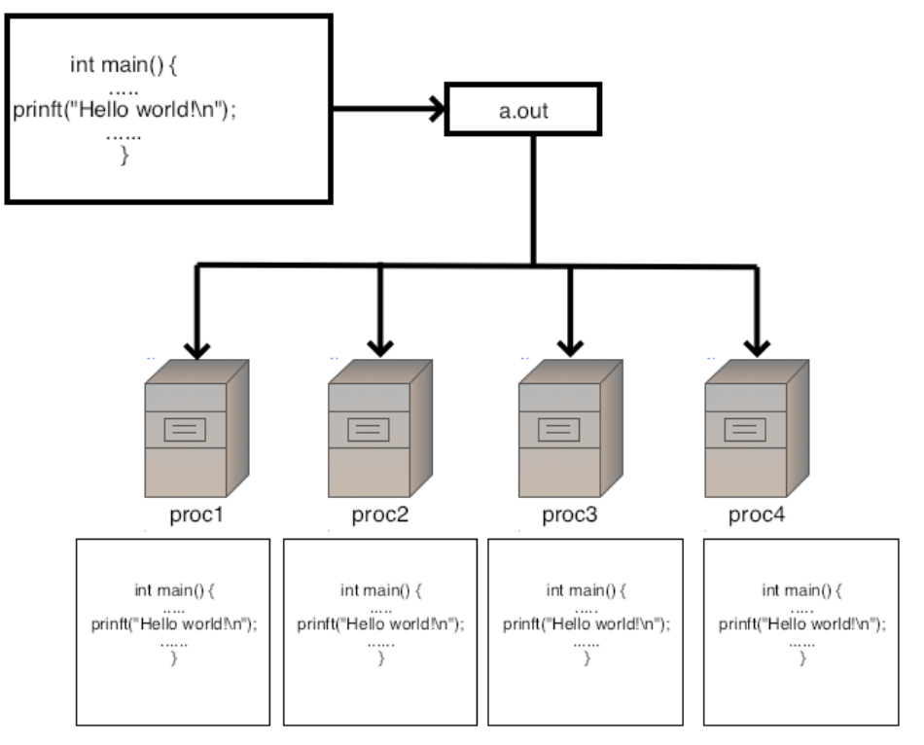
Data Distribution with MPI (Feb to April 2025)
The parallelization with MPI is designed as a highly effective distributed reading model, where multiple processes simultaneously read their own non overlapping chunks of data.
This implementation strategically
centralizes initial checks and data
distribution on Rank 0 to ensure
consistency and efficiency in a
distributed memory environment.
MPI_Barrier calls are used to synchronize processes, ensuring that all MPI ranks reach (parameter checks, filename distribution, or table validation) before moving to the next phase of computation.

Slide 10
Data Reduction (may to june2025):
The code achieves reduction or summation by using MPI_Reduce calls only once after thread level reduction is completed by each process.
Following the main computational loop, each process gathers the results from its local threads, summing contributions there into a single, contiguous buffer.
This operation aggregates the contributions from all processes into a single, final result on the root process, which is then used to update the main data structure.
Finally the results are read and written with getcolumn() and putcolumn() functions in to the output table, then we can visualize it, and check the exicution scalability.

Slide 11
Parallel Processing with OpenMP (july to august 2025):
The data is first divided among multiple MPI processes, where each process is assigned a unique chunk of data to read and process (start_chunk to end_chunk).
Inside each MPI process, the #pragma omp parallel for directive is defined to further parallelize the main computation loop into multithreading.
This directive tells the OpenMP runtime to distribute the iterations of the for loop among the available threads.
The OpenMP parallelization is implemented within the if(m_cic) block, leveraging shared-memory parallelism to accelerate the computation by utilizing the multiple cores of a modern CPU.

Slide 12
OpenAcc (Open Accelerators)(sep to oct 2025):
By replacing OpenMP with OpenACC pragmas #pragma acc parallel, computations can be executed on the GPUs.
I Installed the OpenAcc on my Personal Computer and I am working on the implementation of the code as I have not yet acheived the scalability of the code with openACC.
At the end of my 2nd year I will be able to achieve the required optimal scalabilty.

Slide 13
Benchmarking:
I have tested code with binary data file of 50 as well as 100 million records data points with the parallel version of the code with different number of processes and multi threading.
The code scalability is not optimal with the number of increasing processes and threads ,but It however accomplishes reasonable scalability with an increasing number of MPI processes .
I am still working on the scalability of the code, and hopefully i will acheive the optimal threshold soon.

Slide 14
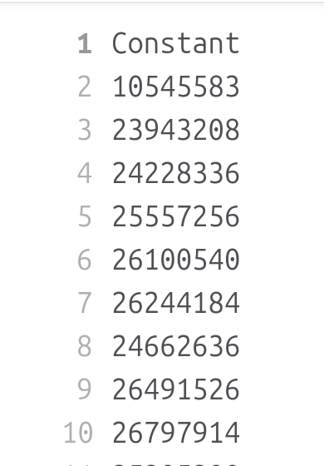
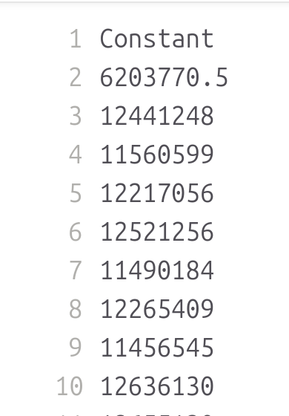
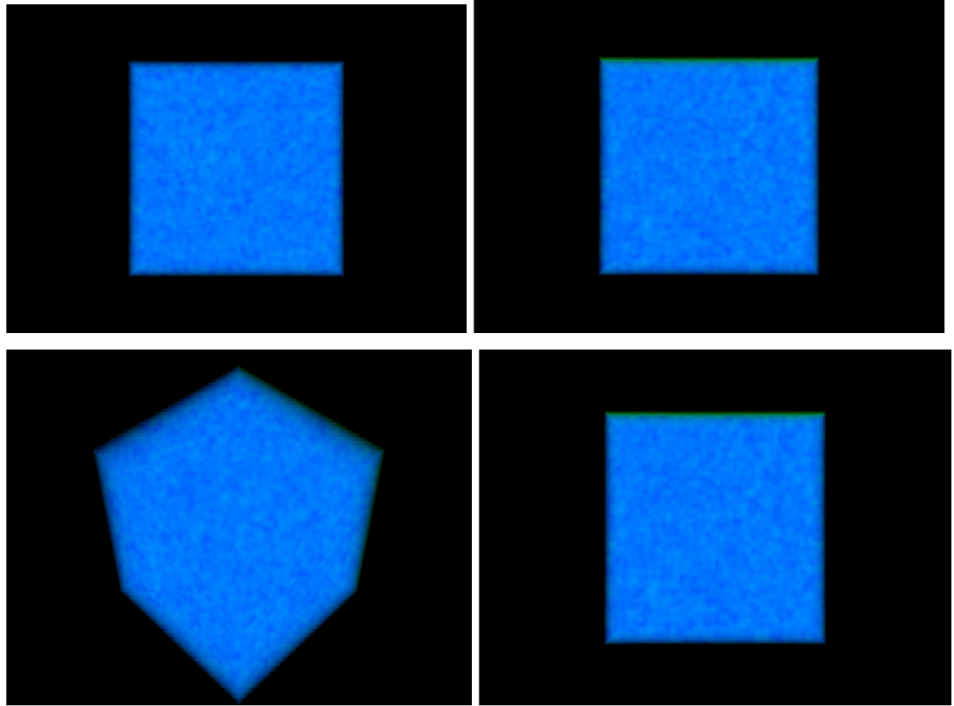
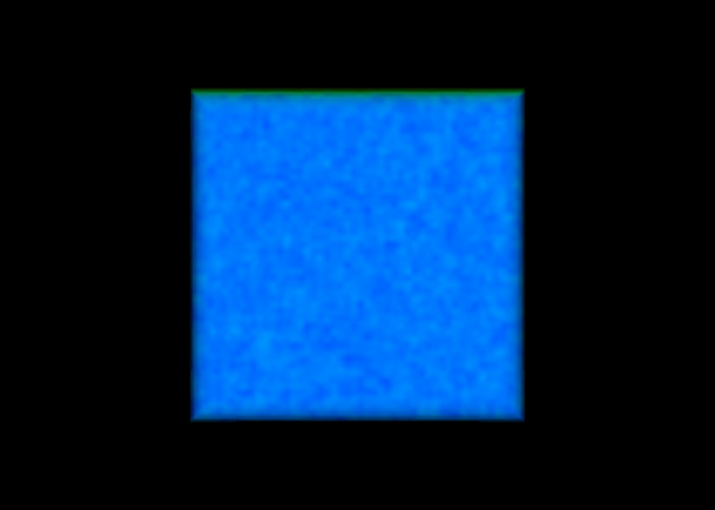



Visualization of serial version:
# of MPI Processes: 1 Output tables
# of OMP Threads per Proc: 1
Execution time: 6.1681 seconds

Slide 15
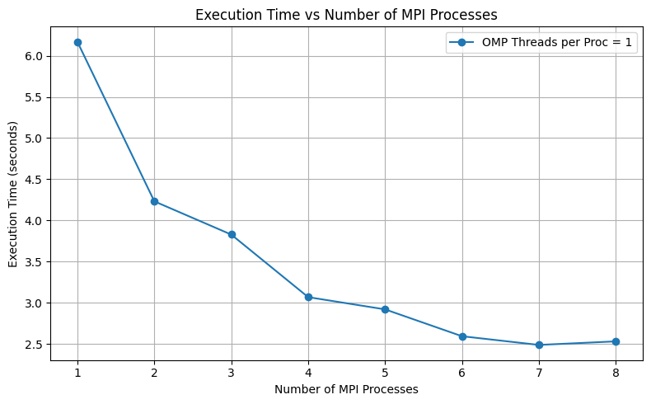
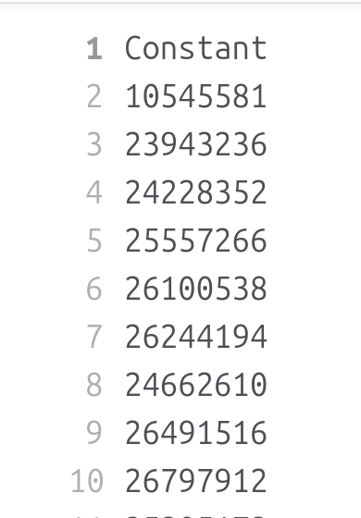
Visualization of Parallel version of the code
# of MPI Processes: 1
# of OMP Threads per Proc: 1
Execution time: 6.1681 seconds
# of MPI Processes: 2
# of OMP Threads per Proc: 1
Execution time: 4.23294 seconds
# of MPI Processes: 3
# of OMP Threads per Proc: 1
Execution time: 3.82985 seconds
# of MPI Processes: 4
# of OMP Threads per Proc: 1
Execution time: 3.07075 seconds
# of MPI Processes: 5
# of OMP Threads per Proc: 1
Execution time: 2.92222 seconds
# of MPI Processes: 6
# of OMP Threads per Proc: 1
Execution time: 2.59645 seconds
# of MPI Processes: 7
# of OMP Threads per Proc: 1
Execution time: 2.49096 seconds
# of MPI Processes: 8
# of OMP Threads per Proc: 1
Execution time: 2.53409 seconds

Slide 16
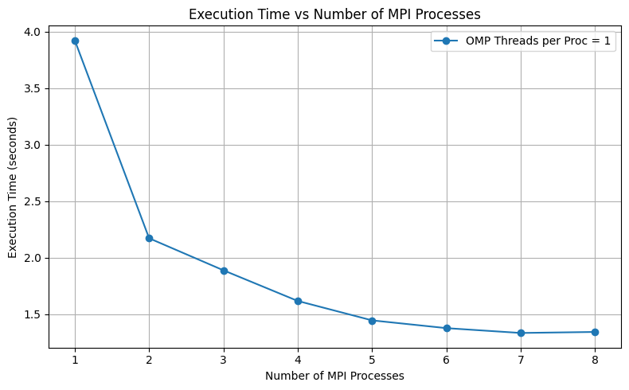
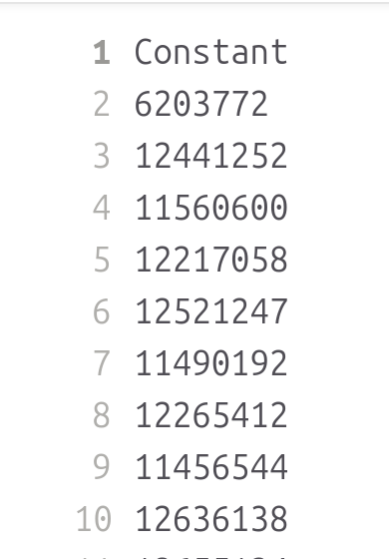
Visualization of Parallel version of the code (with different no of proc)
# of MPI Processes: 1
# of OMP Threads per Proc: 1
Execution time: 3.9233 seconds
# of MPI Processes: 2
# of OMP Threads per Proc: 1
Execution time: 2.17271 seconds
# of MPI Processes: 3
# of OMP Threads per Proc: 1
Execution time: 1.88934 seconds
# of MPI Processes: 4
# of OMP Threads per Proc: 1
Execution time: 1.61807 seconds
# of MPI Processes: 5
# of OMP Threads per Proc: 1
Execution time: 1.44635 seconds
# of MPI Processes: 6
# of OMP Threads per Proc: 1
Execution time: 1.3777 seconds
# of MPI Processes: 7
# of OMP Threads per Proc: 1
Execution time: 1.33492 seconds
# of MPI Processes: 8
# of OMP Threads per Proc: 1
Execution time: 1.34393 seconds

Slide 17
Planning for III Year
Implementation of the OpenACC:
The openACC implemntation can be done at the beginning.
Full functional code:
Acheving the scalability of the code with MPI, openMP and openACC with full functional code at the beginning of the III year.
Continue Research and Benchmarking:
Benchmarking the speedup, accuracy, and efficiency of the code.
Thesis Writing / Publications:
  Writing the thesis, systematically documenting the research methodology, results, and conclusions.

Slide 18
Challenges faced
Hybrid model with MPI and openMP ►first implements MPI and then openMP.
Block-reading logic ► distributed reading model with each process reading data independently.
Chunk mechanism challenge ► every process only read its own chunk of data.
Duplication in a parallel environment, parse parameters, filename and create a VSTable object ►validated parameters from Rank 0 to all other processes.
The Scalability of the execution time for MPI, openMP, and openACC, which is yet not achieved with high scale ►still i am working on it to get good scalability.​

Slide 19
Courses attended/School/Workshop
1. Machine learning for Physics, 3 CREDITS Exam done
2. High energy physics detectors in space, 2,5 CREDITS Exam done
3. Deep network and structure learning 2 CREDITS Exam done
4. Machine learning programming for Physics, 3 CREDITS Exam done
1.​ Course on computing and HPC for Astronomy and Astrophysics (Bol 24).
2.​ TECH-FPA PhD Retreat 2025​ (LNGS) Physics (INFN) L'Aquila.
3.​ INAF Workshop on Astro Statistic 2024​ INAF Catania.
4.​ Parallel Programming with MPI and OpenMP Universität Mainz, Germany.
5.​ Italian Language and Culture Course - A2, 2024/2025​ University of Catania, ItalStra.

Slide 20
Conclusion
VisIVO Server is a suite of software tools for creating customized views of 3D renderings from astrophysical data tables.
Point Distribute Filter generates a table representing a volume derived from selected fields of the input table.
Parallelized the CIC algorithm for efficient data distribution and interpolation by mapping positions, computing weights, and distributing density across grid points.
Data Distribution and Reduction by MPI_reduce calls on each grid point.
Parallel Processing with OpenMP using #pragma omp parallel for.
By replacing OpenMP with OpenACC pragmas #pragma acc parallel.

Slide 21
Thank you for your attention.

Slide 22
Backup slides

Slide 23
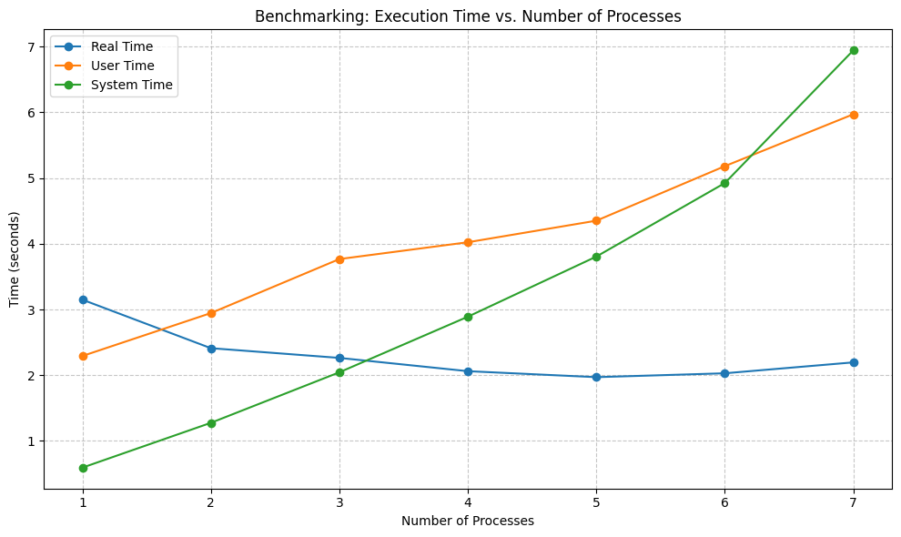
The execution time for one process:
real 0m3.150s
user 0m2.293s
sys 0m0.594s
The execution time for two processes:
real 0m2.412s
user 0m2.946s
sys 0m1.276s
The execution time for 3 processes:
real 0m2.264s
user 0m3.768s
sys 0m2.045s
The execution time for 4 processes:
real 0m2.062s
user 0m4.024s
sys 0m2.891s
The execution time for 5 processes:
real 0m1.971s
user 0m4.352s
sys 0m3.806s
The execution time for 6 processes:
real 0m2.030s
user 0m5.182s
sys 0m4.925s
The execution time for 7 processes:
real 0m2.196s
user 0m5.972s
sys 0m6.945s
sys 0m11.526s

Slide 24
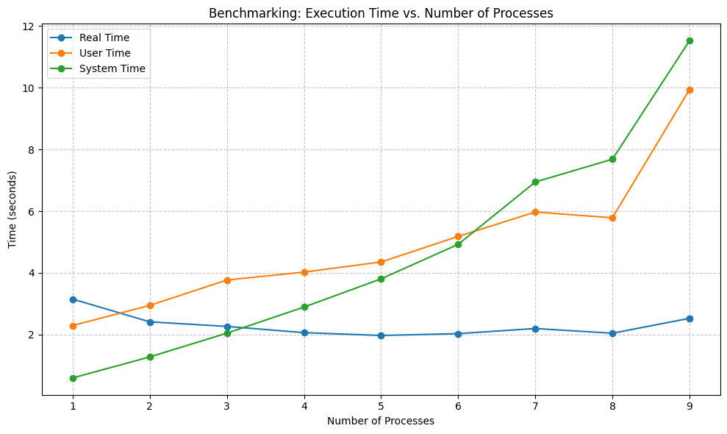
The execution time for 1 processes:
real 0m4.887s
user 0m3.664s
sys 0m0.979s
The execution time for 2 processes:
real 0m3.734s
user 0m4.907s
sys 0m1.971s
The execution time for 3 processes:
real 0m3.457s
user 0m6.208s
sys 0m3.193s
The execution time for 4 processes:
real 0m3.150s
user 0m7.069s
sys 0m4.185s
The execution time for 5 processes:
real 0m2.863s
user 0m7.287s
sys 0m5.371s
The execution time for 6 processes:
real 0m2.914s
user 0m8.314s
sys 0m7.202s

