Slide 1


Ph.D. Second Year Progress report
Surface Impedance of Superconductors Under Conditions of
Interest for Fundamental Physics
Measurements and Methods
Curriculum: Elettrotecnica ed Elettrotecnica per Acceleratori
Student: Gaurav Rajesh Mota, gauravrajesh.mota@studenti.unipd.it Advisor: Prof. Nicola Pompeo, University Roma Tre, nicola.pompeo@uniroma3.it
Co-advisor: Prof. Enrico Silva, University Roma Tre, enrico.silva@uniroma3.it
CryoEQS Lab,
Head: Nicola Pompeo
Cryogenics and Electrodynamics of Quantum solids
and Superconductors Laboratory
EleMeas Lab,
Head: Enrico Silva
Electrical, magnetic and electrodynamic
Measurements Laboratory

Slide 2
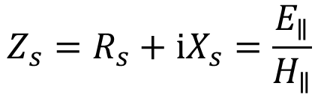

AIM
Agenda
Study of Surface Impedance$Z_{s}$ of super conductors in High Magnetic fields.
Motivation
High field Super conductivity
Experimental Techniques
Research activities
School & Course
$$Z_{s}=R_{s}+iX_{s}=\frac{E_{∥}}{H_{∥}}$$

Slide 3
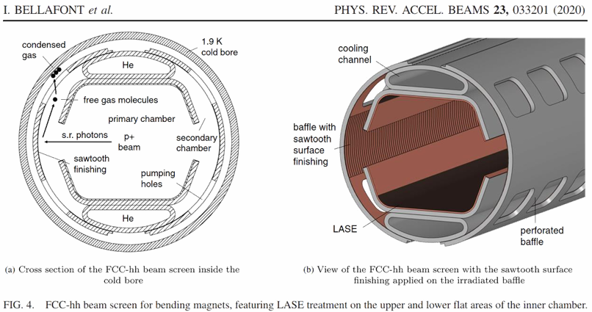
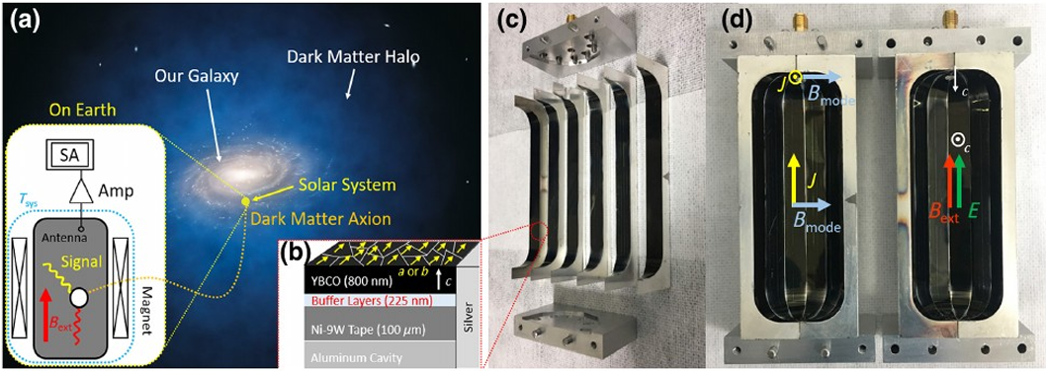
Motivation
The FCC-hh beam screen
Haloscopes for Axions

Slide 4
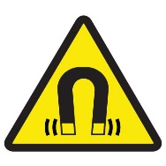

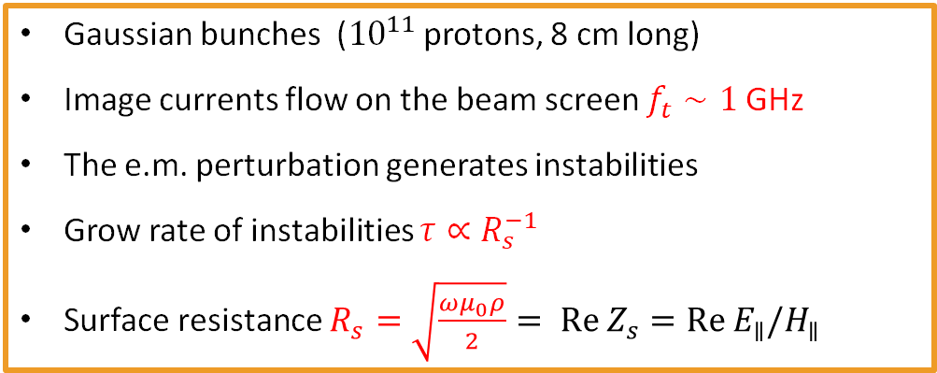

FCC Beam screen
Particle bunch
Beam screen
$$16 T$$
Image current
With copper - at 50 K ; beam lost after 25 turns
Gaussian bunches (${10}^{11}$ protons, 8 cm long)
Image currents flow on the beam screen $f_{t}∼1$GHz
The e.m. perturbation generates instabilities
Grow rate of instabilities $τ∝R_{s}^{−1}$
Surface resistance $R_{s}=\sqrt{\frac{ωμ_{0}ρ}{2}}= Re Z_{s}=Re{ E}_{∥}/H_{∥}$
We need materials with lower $R_{s}$
High Temperature Superconductor (HTS)! (High frequency, fields, temperature)?
S. Calatroni, IEEE Trans. Appl. Supercond., 26(3), 2016

Slide 5
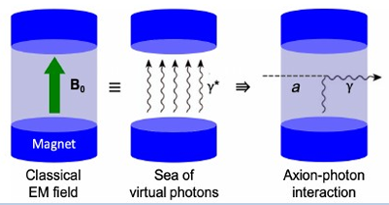

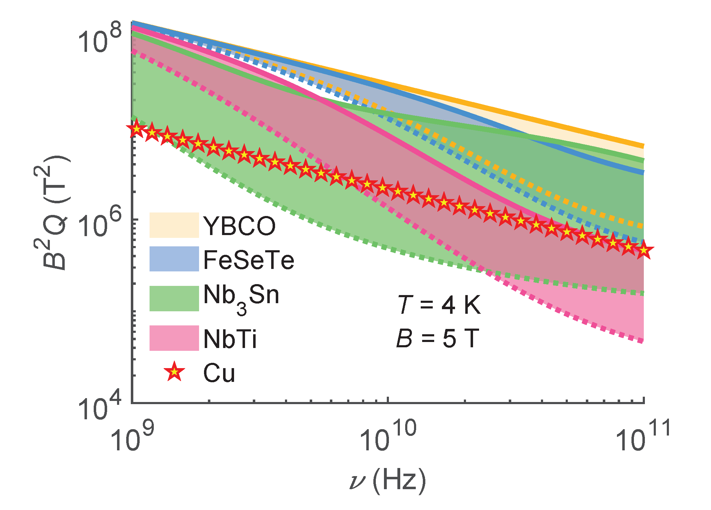


The search for Axions
(QCD) Axions:
– Peccei-Quinn proposed solution for Strong CP problem
– Candidate for (at least a part of) Cold Dark Matter
Detection scheme
– Axion photon photon-coupling:
${(g}_{αγγ}$: axion-photon coupling)
– Conversion in microwave photon collected in a high-Q cavity
→ haloscopes for the detection of galactic halo axions
Signal power: $P_{α→γγ}∝ \left(B^{2}VQ\right)\left(g_{αγγ}^{2} ρ_{a}ν\right)$
Alimenti, A.; Torokhtii, K.; Di Gioacchino, D.; Gatti, C.; Silva, E.; Pompeo N., Instruments 2022, 6, 1.

Slide 6
Electrodynamics of High Field
Super Conductivity

Slide 7

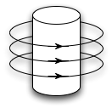
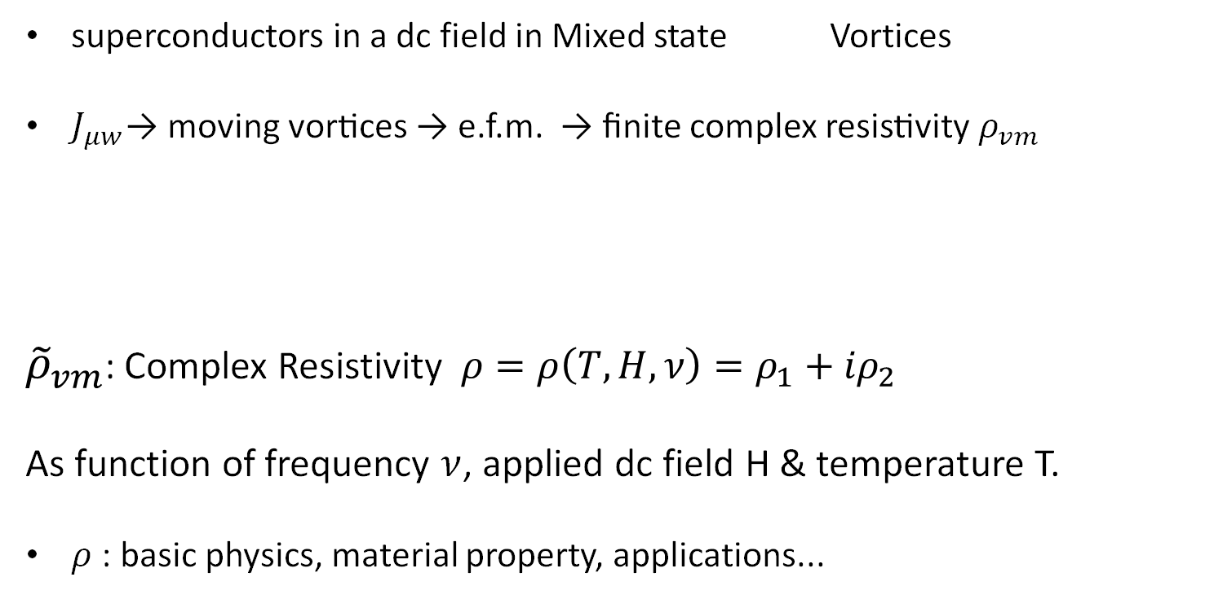
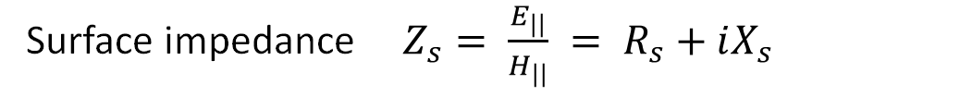

Vortex Motion
Surface impedance $Z_{s}= \frac{E_{||}}{H_{||}} = R_{s}+iX_{s}$
superconductors in a dc field in Mixed state Vortices
$J_{μw}$→ moving vortices → e.f.m. → finite complex resistivity $ρ_{vm}$
${\tilde{ρ}}_{vm}$: Complex Resistivity $ρ=ρ\left(T,H,ν\right)={ρ_{1}+iρ}_{2}$
As function of frequency $ν$, applied dc field H & temperature T.
$ρ$: basic physics, material property, applications...
microwave
e.m. field
$$Z_{s}=\sqrt{iωμ_{0}{λ_{L}}^{2}+{\tilde{ρ}}_{vm}}$$
F
Jmw

Slide 8
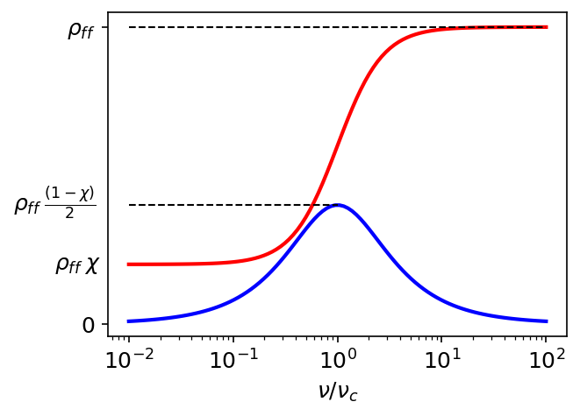

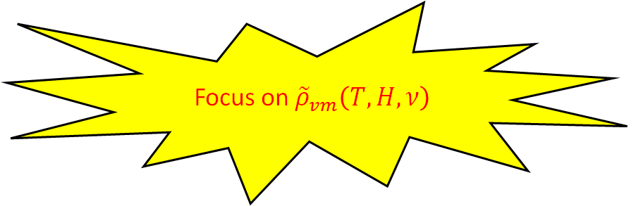
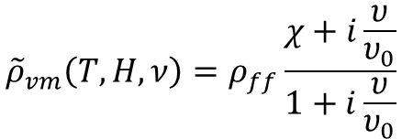
${\tilde{ρ}}_{vm}$ Frequency Dependence
Frequency dependence of vortex motion : many models, one equation
$${\tilde{ρ}}_{vm}\left(T,H,ν\right)=ρ_{ff}\frac{χ+i\frac{υ}{υ_{0}}}{1+i\frac{υ}{υ_{0}}}$$
pinning
flow
&creep
Focus on ${\tilde{ρ}}_{vm}\left(T,H,ν\right)$
Re(ρ_{vm})
Im(ρ_{vm})
NEED FOR WIDEBAND EXPERIMENTAL TECHNIQUES
Pompeo, Silva, Phys. Rev. 78, 094503 (2008)

Slide 9
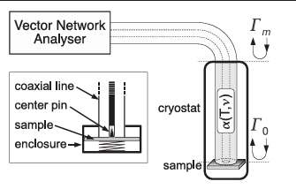
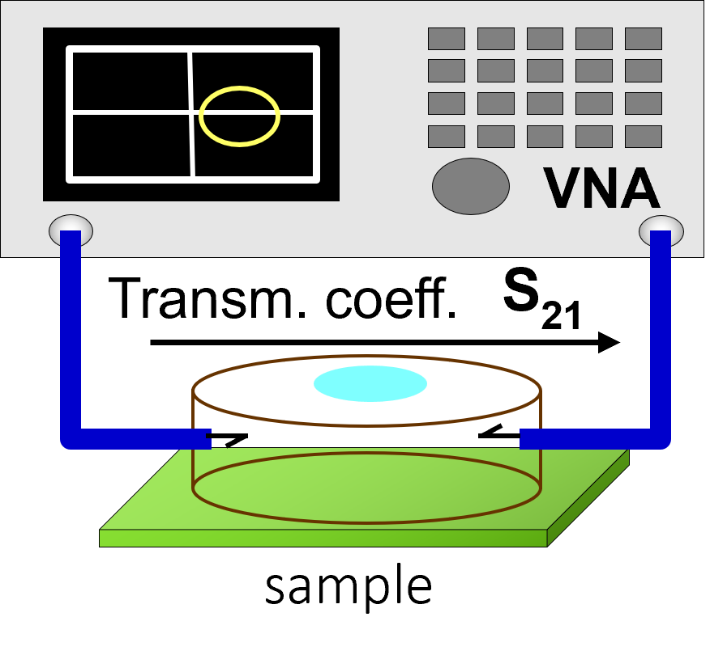
Wide Band Measurement Techniques
Dielectric-loaded resonator
Corbino disk

Slide 10
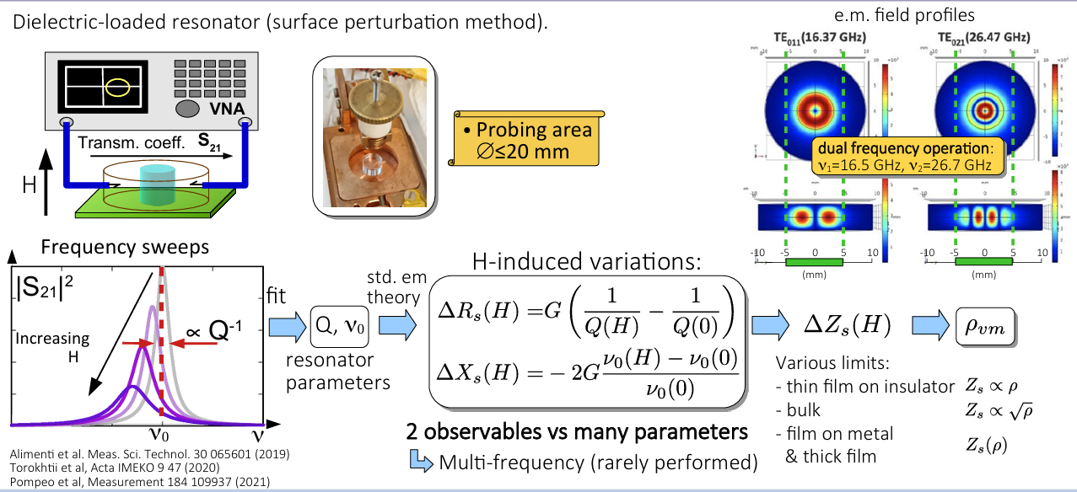
Dielectric-Load Resonator

Slide 11
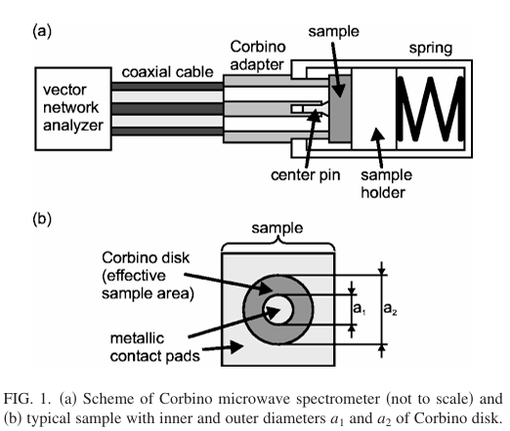
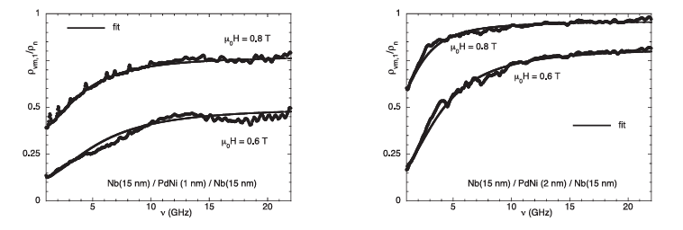
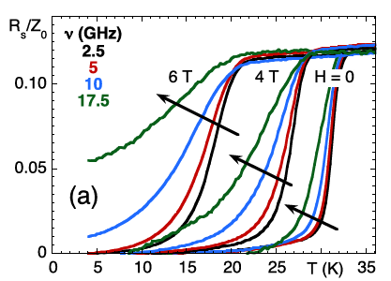



Corbino Disk Measurements
$$S_{11m}$$
The $s_{11}$can be determined by impedance of the sample by following relation
$s_{11m}=\frac{Z_{L}−Z_{0}}{Z_{L}+Z_{0}}$
where $Z_{0}$is impedance of the coaxial line (std: 50$Ω$)
$Z_{L}=\frac{ln\left({a_{2}}/{a_{1}}\right)}{2πdσ}$
Where d is thickness of the sample , $σ$ is complex conductivity
and $a_{1}$, $a_{2}$are inner and outer diameter of the corbino disk.
$$S_{11a}$$
E. Silva, N. pompeo et al Supercond. Sci. Technol. 24 (2011) 024018
Rs/Z0 in the superconducting MgB2 thin film

Slide 12
Current Research Activities

Slide 13
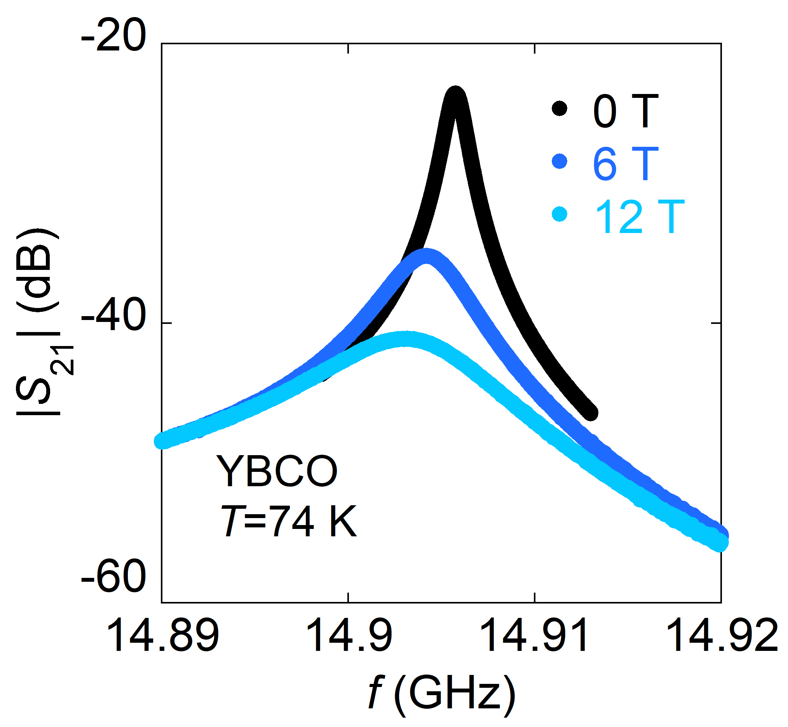
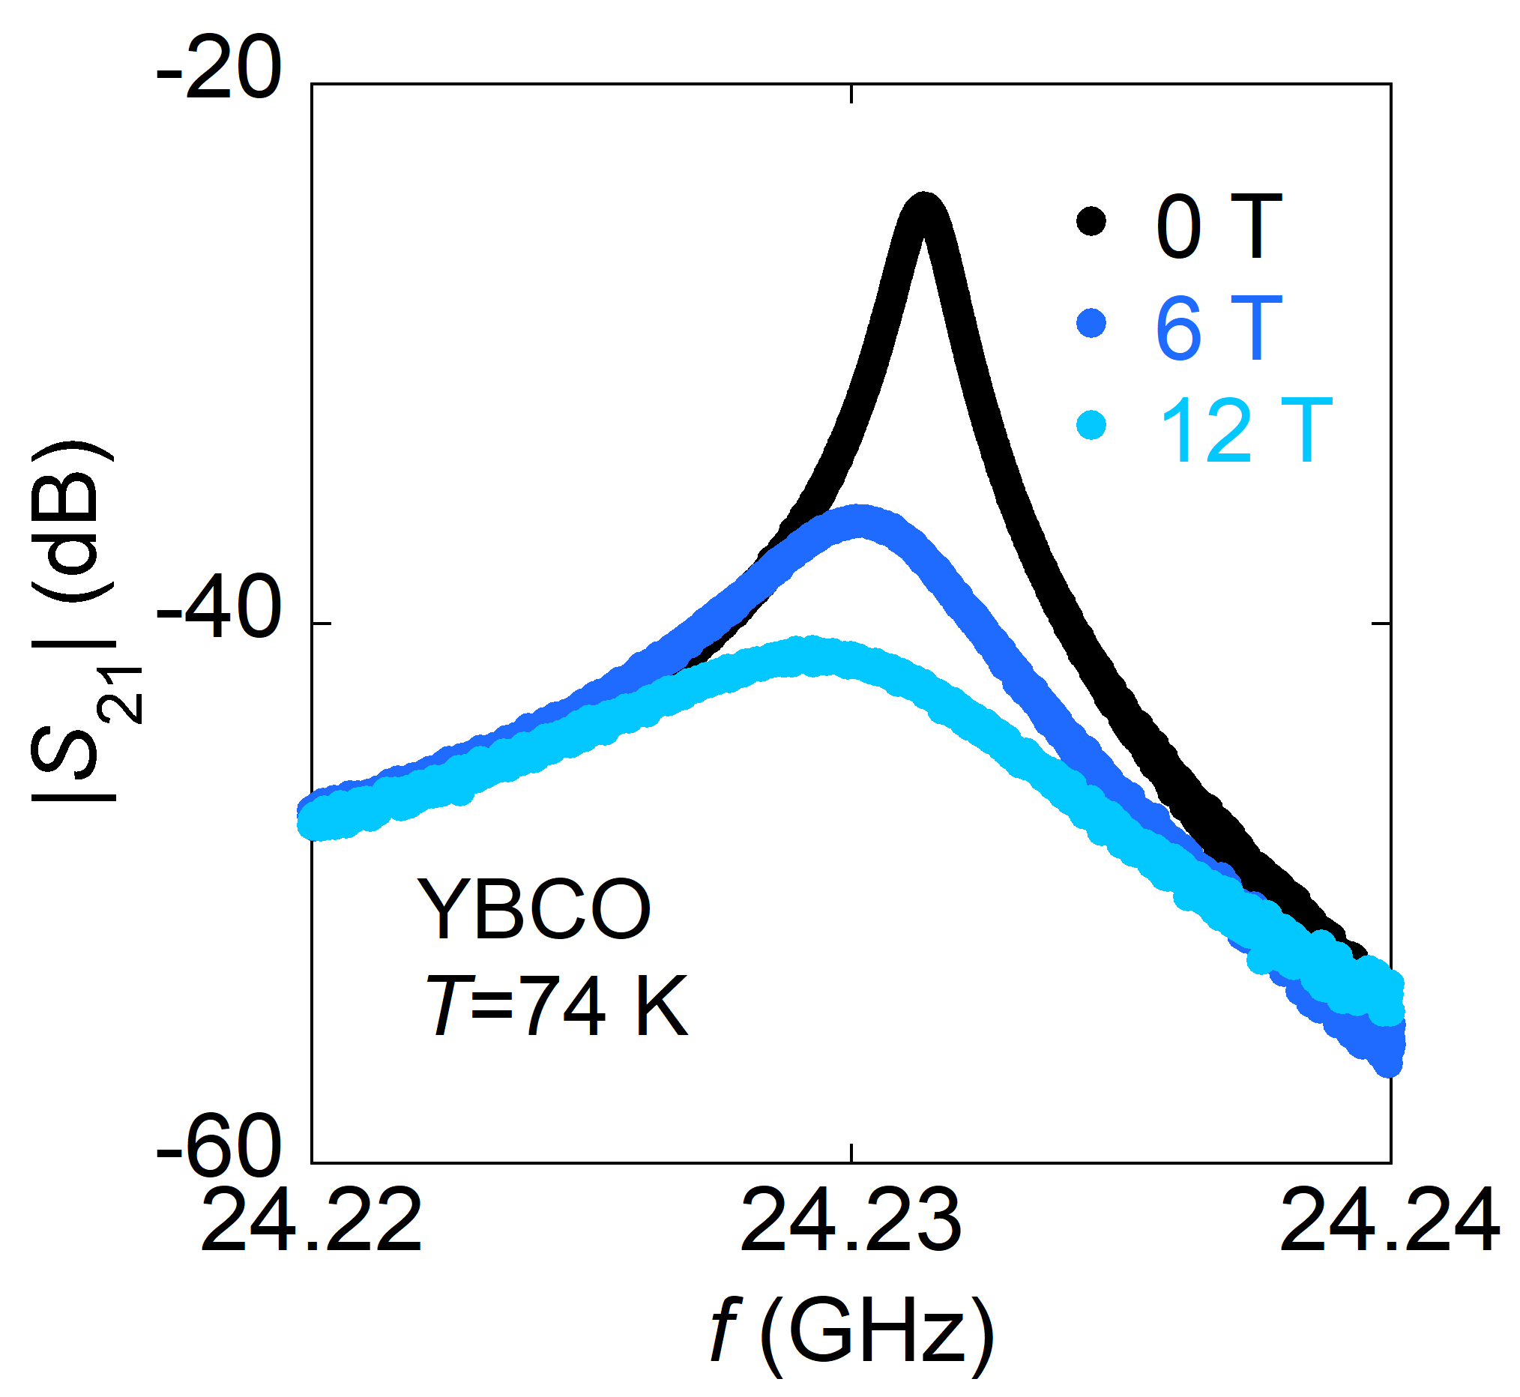
DR: Measurement and Data Analysis
TE₀₁₁ - mode
TE₀₂₁ - mode

Slide 14
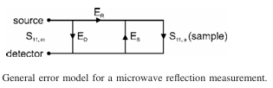


Line calibration
Calibration of coaxial line under cryo temp and magnetic fields
$S_{11,m}=E_{D}+\frac{E_{R}S_{11,a}}{1−E_{S}S_{11,a}}$
$S_{11,m}$ : measured reflection coefficient
${ S}_{11,a}$ : actual reflection coefficient
$E_{D},E_{R},E_{S}$ : Error parameters Determine with 3 measures with std.
$E_{D}$ : signal reaches the detector directly without interacting with the sample
$E_{R}$ : damping and phase shift in the transmission line
$E_{S}$ :signal coming from the sample is reflected again and adds to the signal
approaching the sample
# standard calibration procedure not feasible with cryostat
Need for proper calibration suitable in the required conditions.
$$S_{11m}$$
$$S_{11a}$$
E. Silva, N. pompeo et al Supercond. Sci. Technol. 24 (2011) 024018
14

Slide 15
Calibration scheme used wide
Method | Advantages | Limitations | Used For
OSL (Open-Short-Load) (Scheffler & Dressel, RSI 2005) | Simple, standard method Compatible with Corbino | Sensitive to parasitic effect Connector repeatability 4 days for one set of mes. | Broadband Corbino thin-film superconductors
DBC (Data-Based Calibration) (Wang et al., arXiv 2021) | No physical standards needed Works in dilution fridges | Requires reproducible data Sensitive to modelling errors | Cryogenic setups with limited access
TRL + Cryo Switches (Anlage Lab, RSI 2013) | In-situ calibration Reduces thermal drift | Expensive switches Complex integration | Multi-port precision superconducting devices
Superconducting Normal-State Ref. (Zingler et al., arXiv 2018) | Eliminates geometry mismatch Material-specific | Only works if Tc well-defined | Thin films with sharp superconducting transitions

Slide 16
Motivation & Methodology
Vector Network analyzer
RF cables affect measurement accuracy:
– Phase delay
– Insertion/return loss
– Connector repeatability
Even 'identical' cables may differ due to manufacturing tolerances.
Goal: check if cables are interchangeable in calibration chain.
1-port OSL calibration performed for cable.
4 identical cables tested on two VNA channels (CH1 & CH2).
For each cable: extract error parameters and apply correction
Calibration std. OSL
Temp
sensors
Reference plane
Corbino cell
2
VNA
Standards and DUT
1
Calibration performed
(Cable –end to end )

Slide 17
Cable 1 CH 1

Slide 18
Comparison of Error para. for all cables

Slide 19
Cross Characterization
VNA Cal
Model Cal
Selected EP
Random selection of EP
Applying error parameters from one cable to DUT data measured with another test's transferability of calibration.
Selected EP - Selecting error parameters of different cable which show similar behaviour that as od the cable measuring DUT
Any divergence shows sensitivity to cable-specific effects.
Correction did not work; it means cables are not effectively interchangeable.

Slide 20
Motivation to changed Approach
Vector Network analyzer
4-Cable Calibration Issues:
- Each cable introduces unique insertion loss and phase delay.
- Calibration is time-consuming and requires repetition for each cable.
- Not interchangeable: error correction not transferable.
Microwave Switch (MM5230-03NDB-TR) Advantages:
- MEMS switch with ultra-low insertion loss (~0.3 dB) up to 26.5 GHz.
- Enables repeatable, automated calibration with fixed reference plane.
- Switching time ~20 µs, >3 billion cycle lifetime.
- Potentially suitable for cryogenic environments and compact integration.
Outcome: Improved calibration stability, reduced human error, and faster experimental cycles.
Microwave switch
Circuit board
Calibration std. OSL
Temp
sensors
Corbino cell

Slide 21
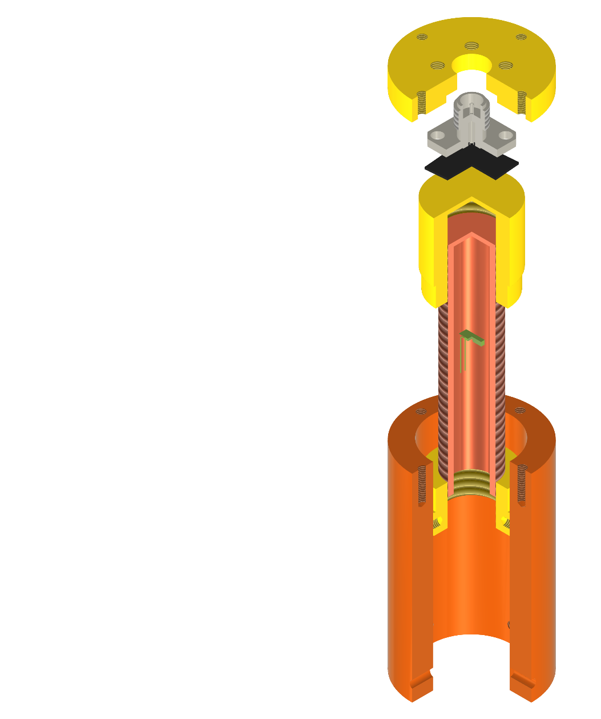
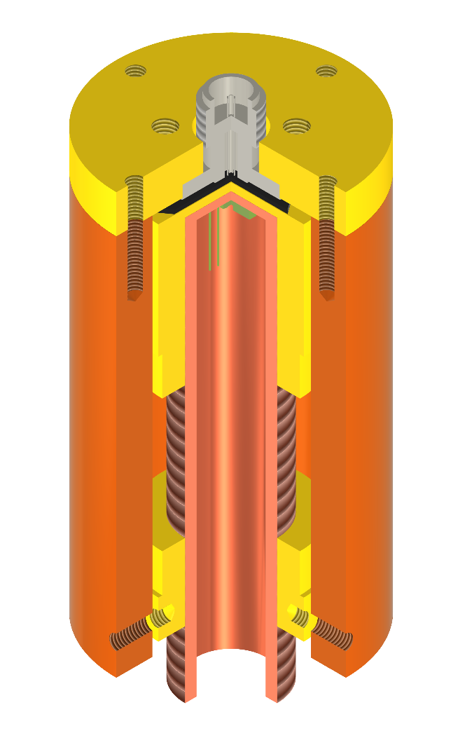
Corbino Disk Cell Design old
Top cover
Female 4-Hole Flange Launcher
Design Requirements @cryo T and High H
Mech. Stabilities
Size of magnet bore
Size of samples
Contact btw coaxial line & sample
Stable thermalization (Heaters and T sensors)
Superconducting sample
Sample holder
Temp sensor
central screw to ensure good contact b/n sample and launcher
Bottom support

Slide 22
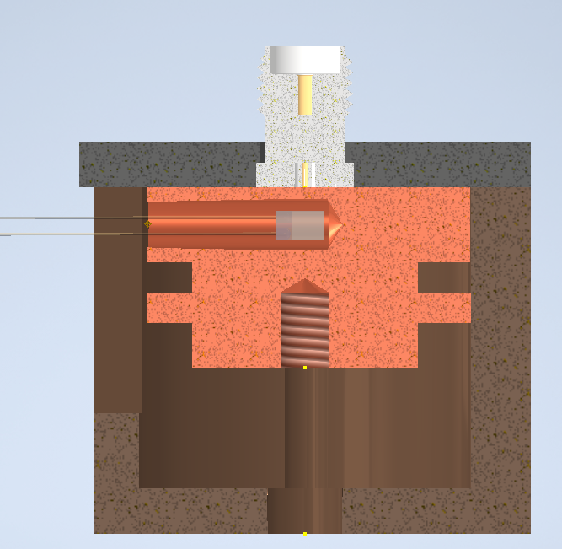
Updated Corbino Disk Cell Design
“The redesign aims to reduce thermal drift, improve contact repeatability, and enable integration of microwave switching circuit for using single cable from VNA to the circuit board.
Vector Network analyzer
Female 4-Hole
Flange Launcher
Top cover
Microwave switch
Superconducting sample
Circuit board
Temp sensor
Calibration std. OSL
Slot for adding heating coil
Temp
sensors
Sample holder
central spring to ensure good contact b/n sample and launcher
Corbino cell
central screw to extract sample holder

Slide 23
Electrical Characterization of Ti Thin Film
using Van der Pauw Method

Slide 24
Introduction
Thin metal films (like Ti) are crucial in electronics, superconductivity studies, and as reference standards.
Titanium films can act as resistive standards, contact layers, or be tested as candidate calibration loads.
The d.c. electrical resistivity tells us about the film’s quality, morphology, and suitability for applications.
Unlike simple 2-probe methods, Van der Pauw is geometry-independent and reduces contact resistance effects

Slide 25
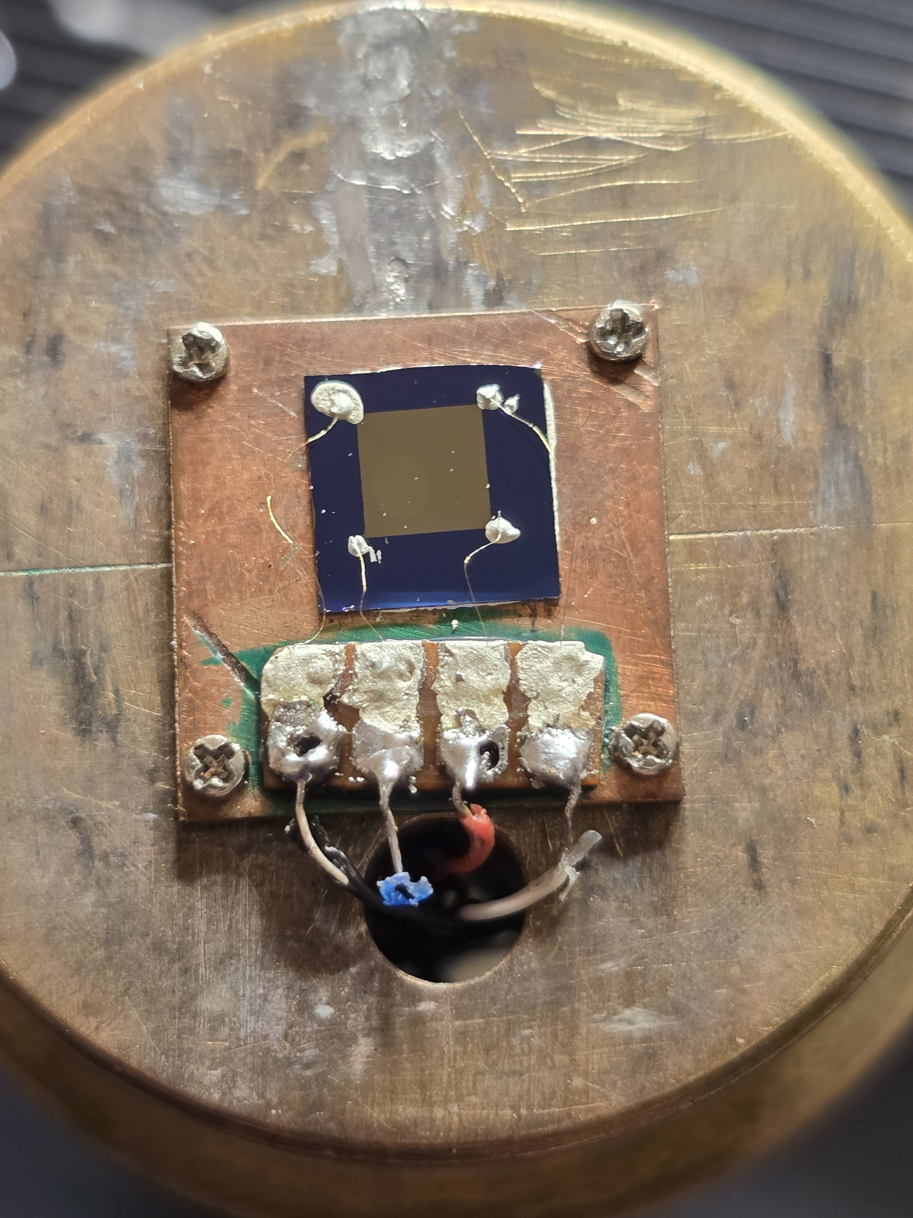
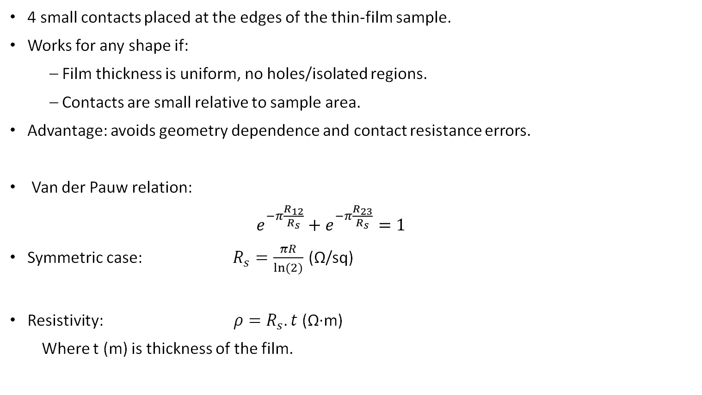
Theory
4 small contacts placed at the edges of the thin-film sample.
Works for any shape if:
– Film thickness is uniform, no holes/isolated regions.
– Contacts are small relative to sample area.
Advantage: avoids geometry dependence and contact resistance errors.
Van der Pauw relation:
$e^{−π\frac{R_{12}}{R_{s}}}+e^{−π\frac{R_{23}}{R_{s}}}=1$
Symmetric case: $R_{s}=\frac{πR}{ln⁡(2)}$ (Ω/sq)
Resistivity: $ρ=R_{s}.t$ (Ω·m)
Where t (m) is thickness of the film.

Slide 26
Sample Details
Material: Titanium thin film deposited on silicon substrate(500um).
Thickness TI films : 50 nm & 100 nm.
Deposition method: sputtering .
Geometry: Square (4mm*4mm)
Contact pads (0.5mm*0.5mm)(of Ti)
Contact pads: Four small contacts at corners A, B, C, D (with silver paste).
Contact pads
Sample

Slide 27
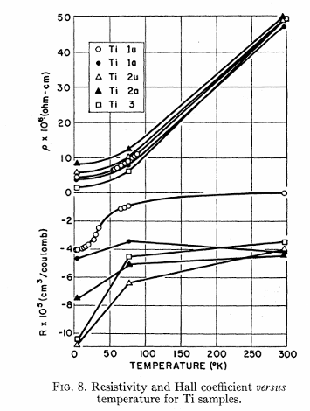
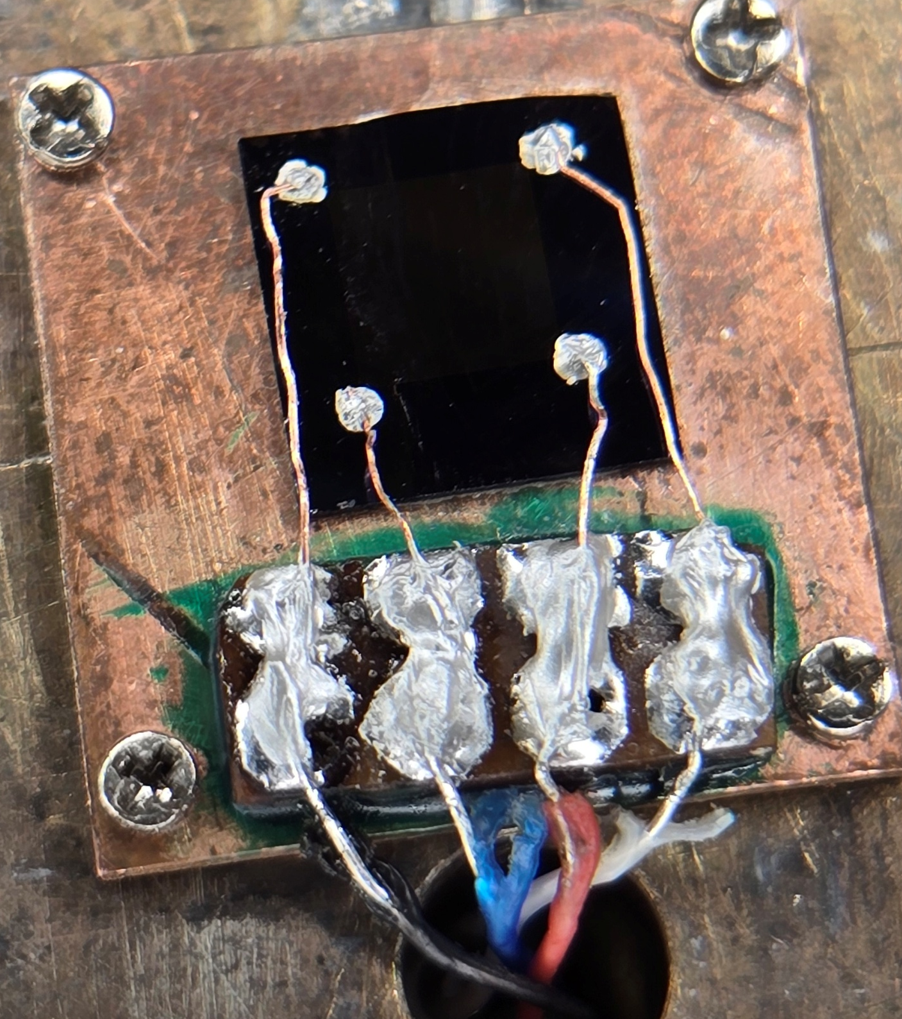
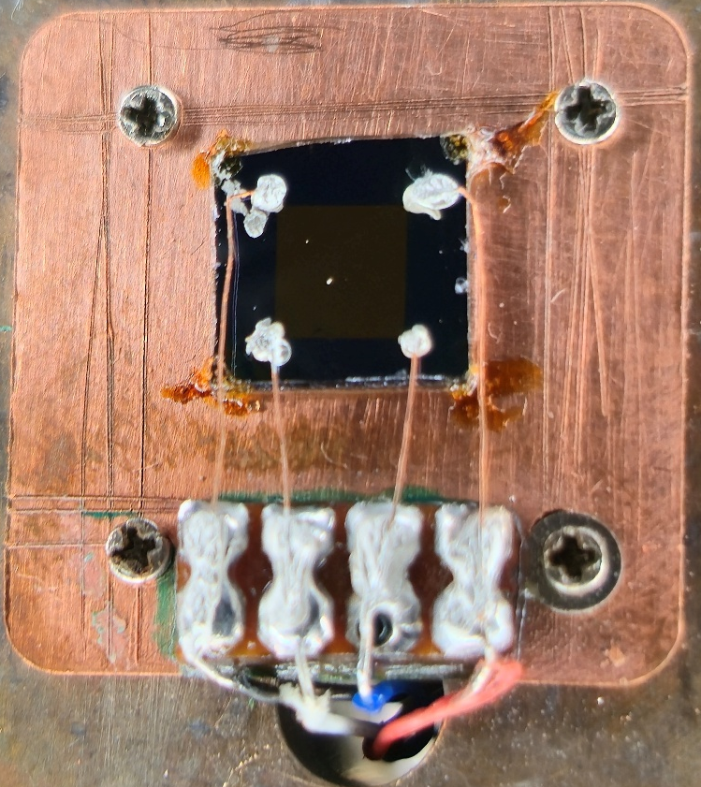
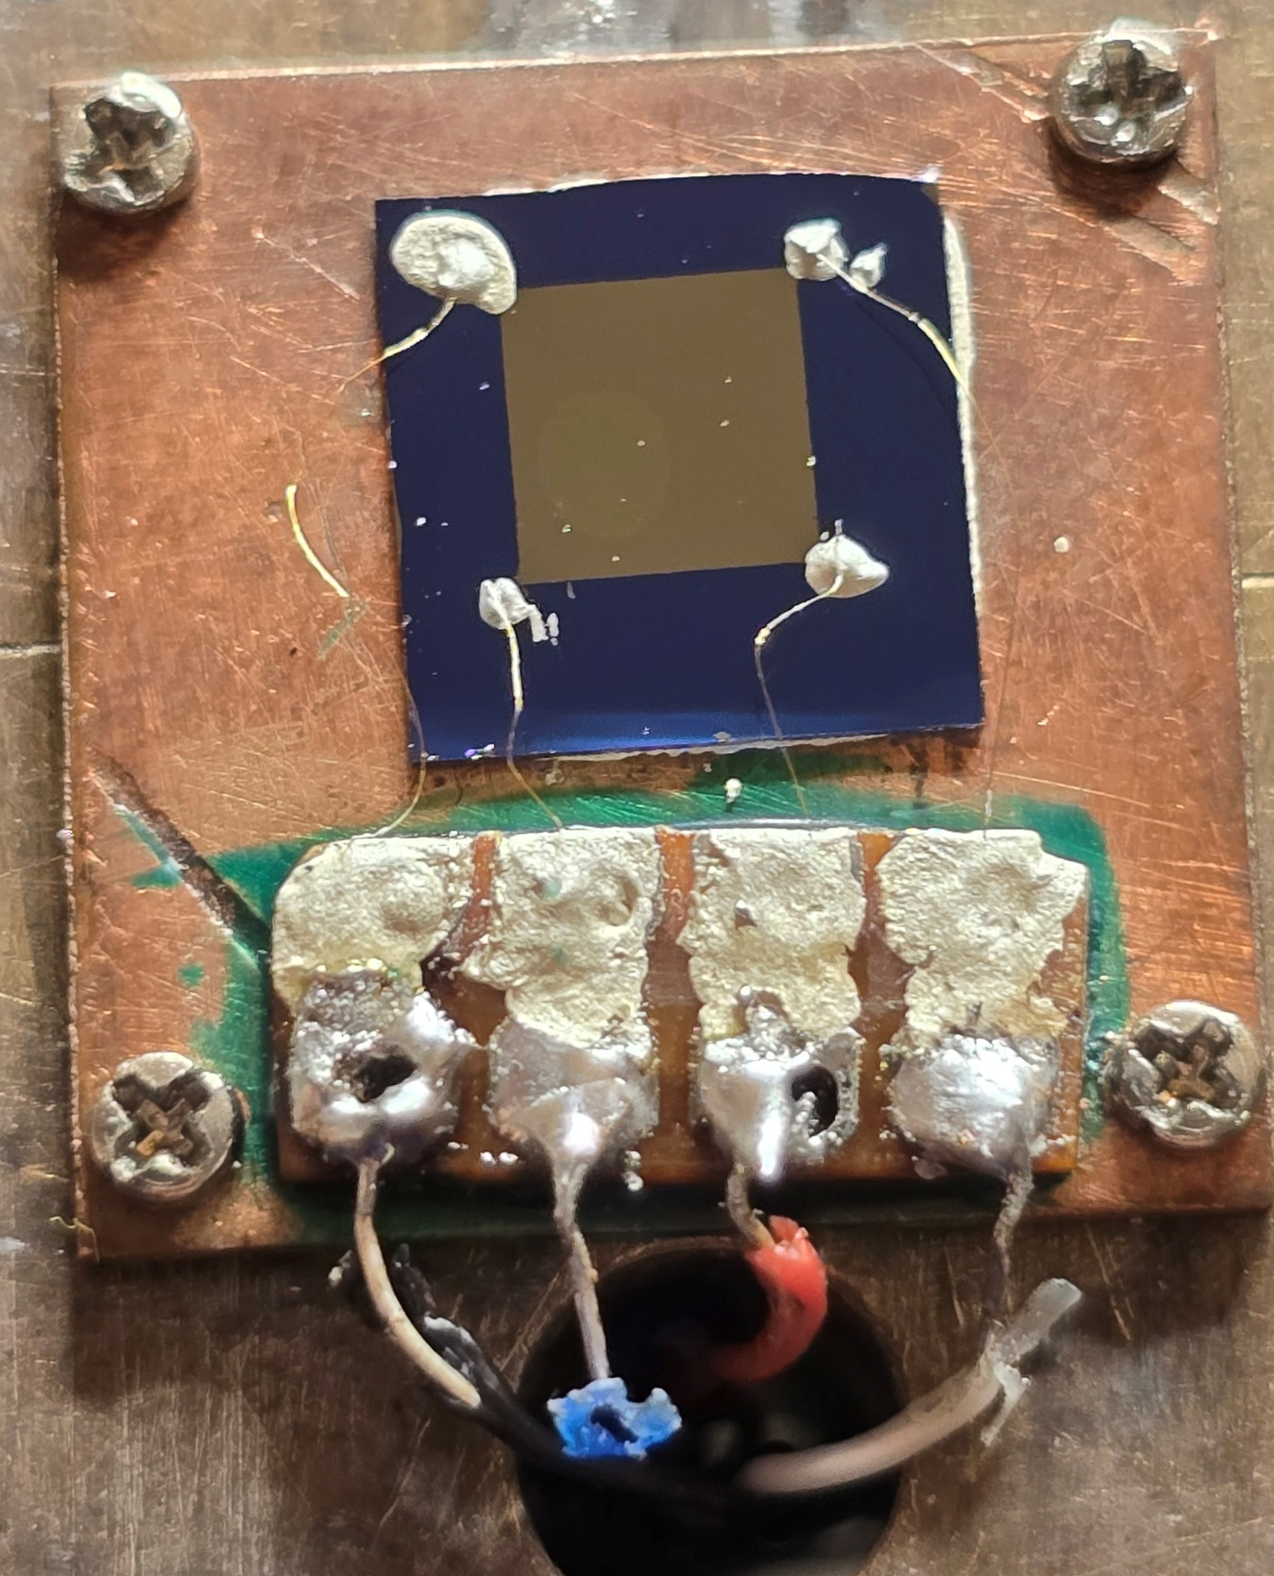
Results
Ti film 50 nm
Rs(T) exhibit not metallic behaviour, but reminiscent of semiconductors
Is the Si substrate probed in the measurement?
New set of dielectrics to be precured and tested.
T.G. Berlincourt Phys. Rev. 114, 969 (1959)
Ti film 100 nm
1st measurements
New connections made with contact pads
Sample isolated from sample holder using a Teflon sheet

Slide 28
Conclusion & Future Work
4-cable calibration tests showed that cables are not effectively interchangeable → error correction not transferable.
Redesign Corbino disk cell with integrated microwave switch for automated, repeatable calibration.
Next steps: • Test switch-based calibration in cryogenic setup. • Begin systematic measurements of Ti films on new set of dielectrics to be used for calibration loads .
Final goal: link experimental results with vortex dynamics models, providing reliable broadband impedance data for superconductors under relevant physical conditions.

Slide 29
School and Course
Joint Universities Accelerator School 2025 (9 CFU).
Course 2: The Technology & Applications of Particle Accelerators (118h15)
Attended full curriculum Lectures (71h15), Seminars (9h), Workshops (21h), Visits (17h)
Advance scientific programming in Matlab (6 CFU)

Slide 30
Thank you
GAURAV RAJESH MOTA

