Slide 1



ANNUAL REPORT 1st YEAR PHD PROGRAM
ARBAB IMTIAZ
40th Cycle, 2024/2025
Supervisor: Alberto Aloisio
Co-supervisor: Pierluigi Casolaro

Slide 2
OUTLINE
Research topic and objectives of my PhD program
What is impedance spectroscopy and why it matters for sensors characterization
Analysis of radiation effects on sensors and electronics with impedance spectroscopy
Courses, exams, papers, conferences and schools
Overall planning of my 3-years doctoral program
Research activities carried out so far and those planned for the future

Slide 3
RESEARCH TOPICS AND OBJECTIVES
Thesis title (tentative):
”Characterization of sensors with Impedance Spectroscopy (IS) techniques and noise analysis”
The project aims to:
study and characterize solid-state sensors with IS and low-noise analysis techniques
use such techniques to study how radiation affects the electrical properties of sensors
improve sensor performance through in-depth electrical characterization

Slide 4
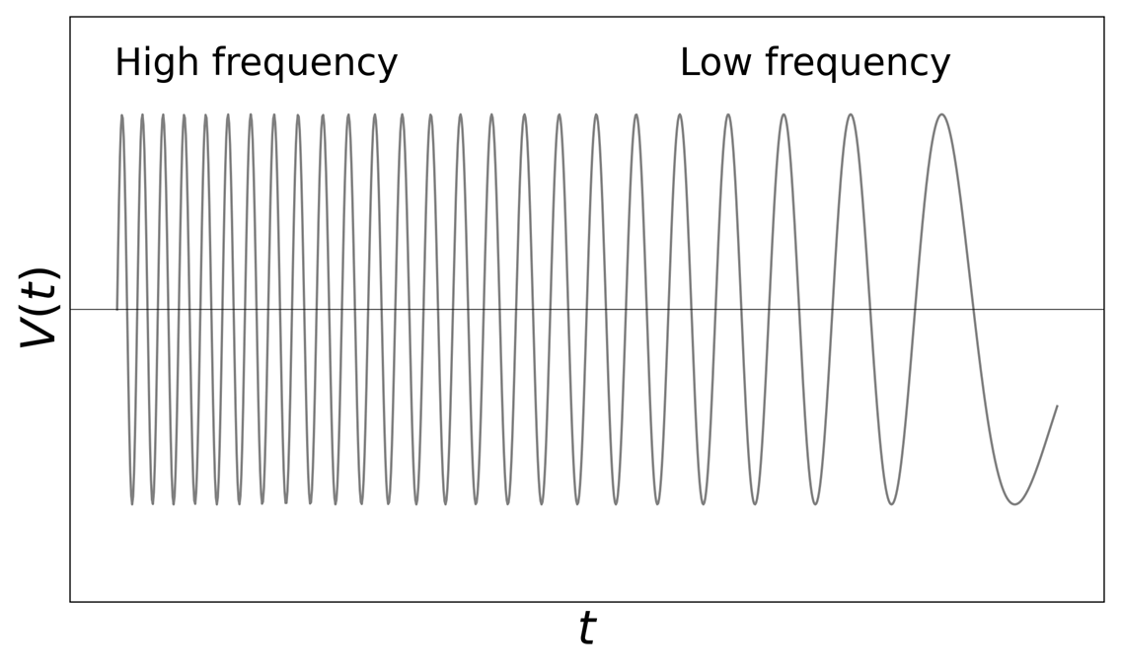
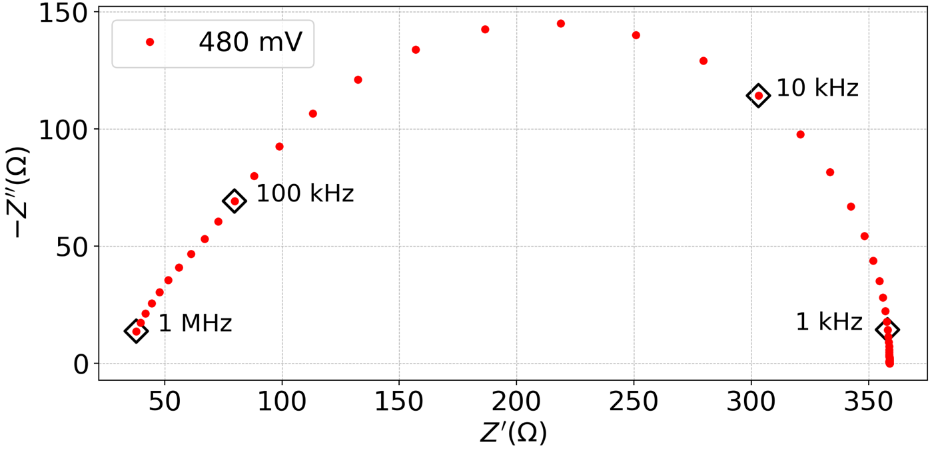
IMPEDANCE SPECTROSCOPY (1/2)
IS is a non-destructive technique that probes the electrical response of a system using small AC signals over a wide frequency range (typically mHz–MHz) applied on a constant bias level
The impedance response is analyzed with Bode and Nyquist plots
Fitting data to equivalent circuits reveals physical parameters as resistance, capacitance, inductance, and time constants, providing insights into charge carrier dynamics
IS is widely used in electrochemistry (batteries, fuel cells, solar cells, corrosion studies, etc.) and I aim to apply it for the characterization of solid-state sensors
Nyquist plot of a 1N4007 commercial diode biased at 480 mV
Small AC signal applied to the DUT

Slide 5
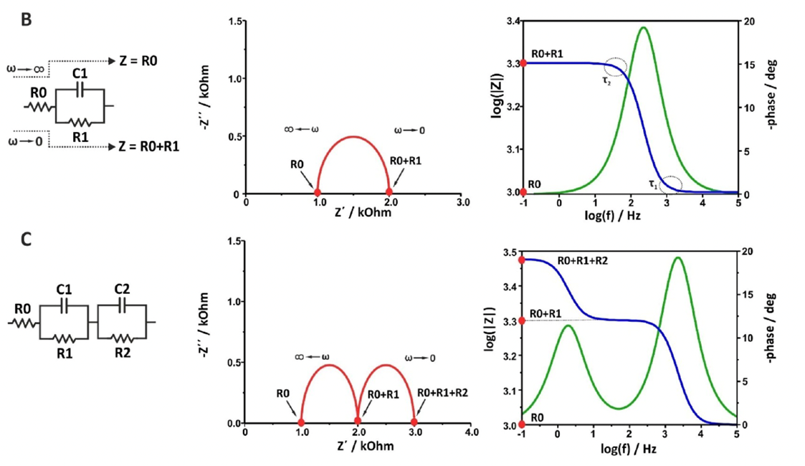
IMPEDANCE SPECTROSCOPY (2/2)
EQ. CIRCUIT
Nyquist plot
Bode plot
Review the literature on the topic: tutorial (2023)
An RC parallel network with a series resistance gives a semicircle
Two RC parallel networks with a series resistance give two semicircles

Slide 6
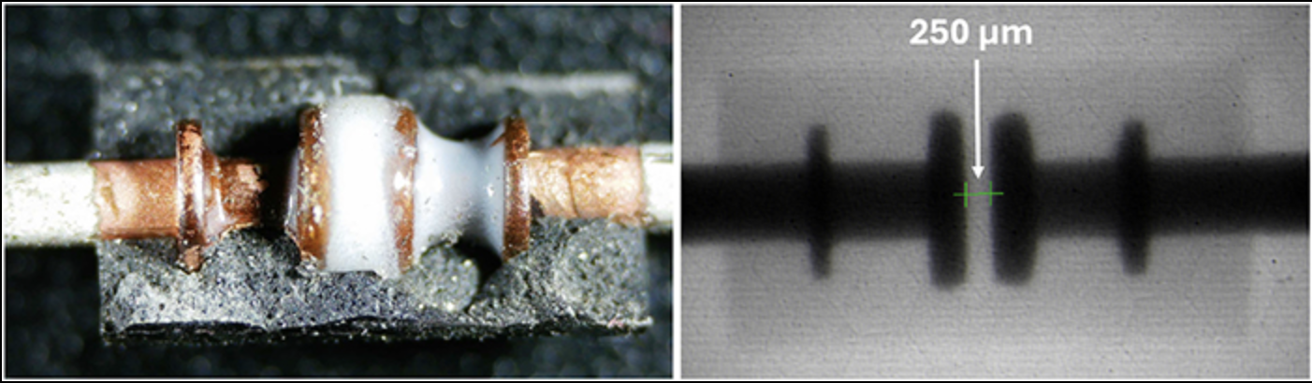
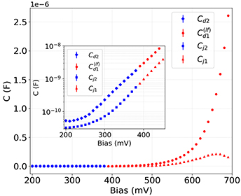
IMPEDANCE SPECTROSCOPY APPLIED TO A Si pn diode
J. Appl. Phys. 136, 115702 (2024)
Review the literature on the topic: paper (2024) from our group on IS analysis of a Si pn diode
Through IS analysis → disentangle the contributions of depletion and diffusion capacitance in forward bias

Slide 7
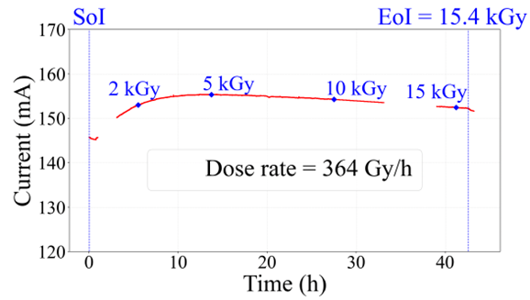
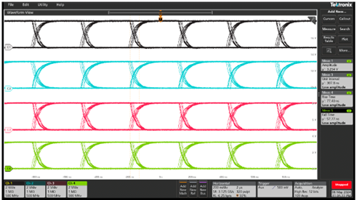
IS ANALYSIS OF RADIATION EFFECTS ON ELECTRONICS WITH IS (1/2)
TID test at CERN CC60 facility (10 TBq ⁶⁰Co gamma source) on LVDS receivers used for HEP applications
Measurements of the current drawn by LVDS receivers, and key waveform parameters such as amplitude, rise time and fall time, showed very small differences before and after irradiation

Slide 8
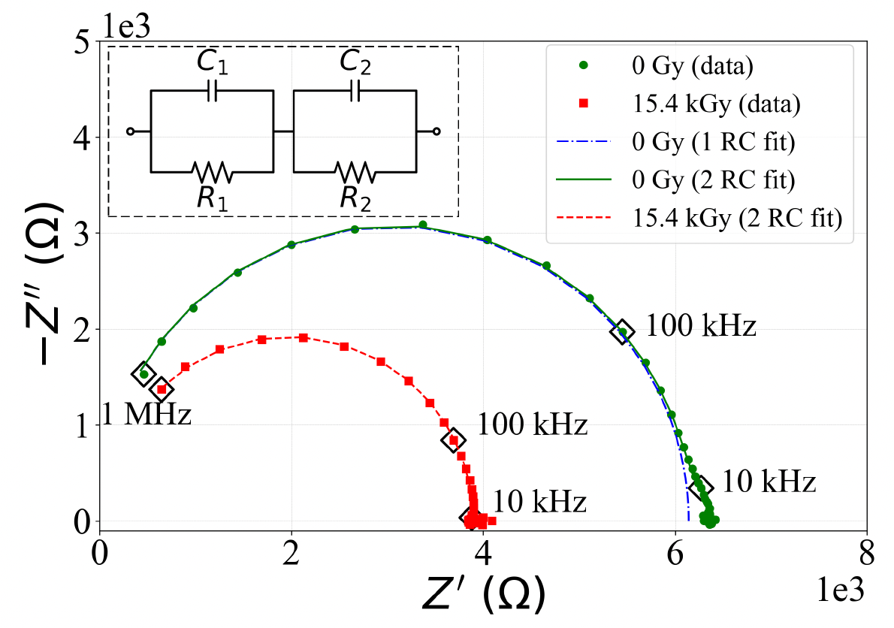
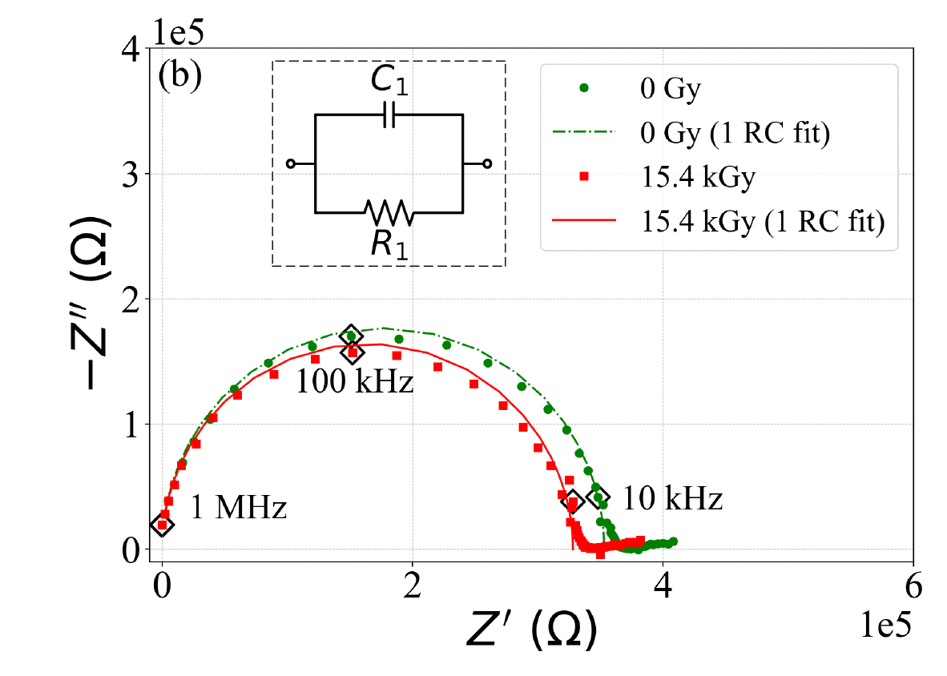
IS ANALYSIS OF RADIATION EFFECTS ON ELECTRONICS WITH IS (2/2)
IS analysis on different device sections identified rad-induced changes that are difficult to detect with traditional methods
POWER RAIL NETWORK
INPUT NETWORK

Slide 9

COURSES AND EXAMS
Cabling and Shielding for Low Noise Application (1.25 CFU)
Lecturer: Prof. Alberto Aloisio
Exam passed
2. Cosmic Radiation and Radiation Hardness Assurance (2 CFU)
Lecturer: Dr. Pierluigi Casolaro
Exam passed
3. Electronic System in High Energy Physics (4 CFU)
Lecturer: Prof. Adriano Lai
Exam passed
4. Solid State Detector (2 CFU)
Lecturer: Prof. Donato Creanza
Lectures completed, exam to do
5. Radiation Matter Interaction (2 CFU)
Lecturer: Prof. Raffaella Radogna
Course not yet started
Training activities (non academic courses):
Italian language Course-intensive and communicative
Delivered by CLA Univ. of Padua
Started in October 2025
2. Cyber Security-Basic
Mandatory course delivered by INFN for IT security

Slide 10
PAPERS, CONFERENCES, AND SCHOOLS
PAPERS
Pierluigi Casolaro, Vincenzo Izzo, Riccardo Vari, Mila D’Angelantonio, Antonio Vanzanella, Claudio Principe, Arbab Imtiaz, Alberto Aloisio, 60 Co gamma irradiation effects on Low- Voltage Differential Signaling (LVDS) receviers: analysis with impedance spectroscopy (Under review by Radiation Physics and Chemistry)
CONFERENCES
Arbab Imtiaz, Vincenzo Izzo, Riccardo Vari, Antonio Vanzanella, Claudio Principe, Pierluigi Casolaro, Alberto Aloisio, “Investigating Total Ionizing Dose Effects on LVDS Receivers with Impedance Spectroscopy”. RAD 13th Conference 2025. (Poster presentation by A. Imtiaz)
Pierluigi Casolaro, Vincenzo Izzo, Riccardo Vari, Antonio Vanzanella, Claudio Principe, Arbab Imtiaz, Alberto Aloisio, “Frequency-domain analysis of ⁶⁰Co radiation effects on silicon pn and pin photodiodes”. (Accepted as horal presentation to 2025 IEEE NSS MIC RTSD)
Pierluigi Casolaro , Vincenzo Izzo, Riccardo Vari, Claudio Principe, Antonio Vanzanella, Paolo, Di Meo, Antonio Anastasio, Arbab Imtiaz, and Alberto Aloisio“, Analysis of radiation effects in trigger front-end electronics with impedance spectroscopy”. (Submitted to TIPP2026)
P. Casolaro, V. Izzo, R. Vari, A. Vanzanella, C. Principe, A. Imtiaz and A Aloisio, TID reliability of voltage translators for the ATLAS muon trigger system (Accepted as poster presentation by TWEPP)
Pierluigi Casolaro, Vincenzo Izzo, Riccardo Vari, Mila D’Angelantonio, Antonio Vanzanella, Claudio Principe, Arbab Imtiaz, Alberto Aloisio, Investigating radiation effects on LSF0102 level shifters (Horal presentation at ANIMMA 2025)
SCHOOLS
Participated remotely and presented my project during the online PhD meeting at Gran Sasso Laboratories, School
FUTURE EVENTS
First Bulletin: International Workshop on Photon-Detectors, 3–5 Dec, Bologna, Italy
Bi-National Conference on Detectors R&D 18-20 Nov 2025, LPNHE Paris

Slide 11
OVERALL PLANNING OF 3 YEARS
1st YEAR
Literature Review
Getting involved in lab activities
Courses, exams, and workshops
2nd YEAR
Courses, exams, and workshops
Taking measurements, coding and data analysis
Period abroad (UniBern? CERN? tbd)
Publication(s)
3rd YEAR
Data analysis
Writing PhD thesis and publication(s)
Final presentation

Slide 12
Research activities carried out so far and those planned for the future
I studied literature on my research topic
I got involved in lab activities and started presenting results (poster at RAD conf.)
For the future, I plan to study the application of IS and low-frequency noise analysis techniques (the latter not yet studied) on the characterization of pn and pin junctions, as well as electronics
Also, future research activities involve the study of radiation effects on the above-mentioned class of sensors with both techniques (IS and low-frequency noise analysis techniques )

Slide 13
THANK YOU VERY MUCH FOR YOUR KIND ATTENTION

