Slide 1


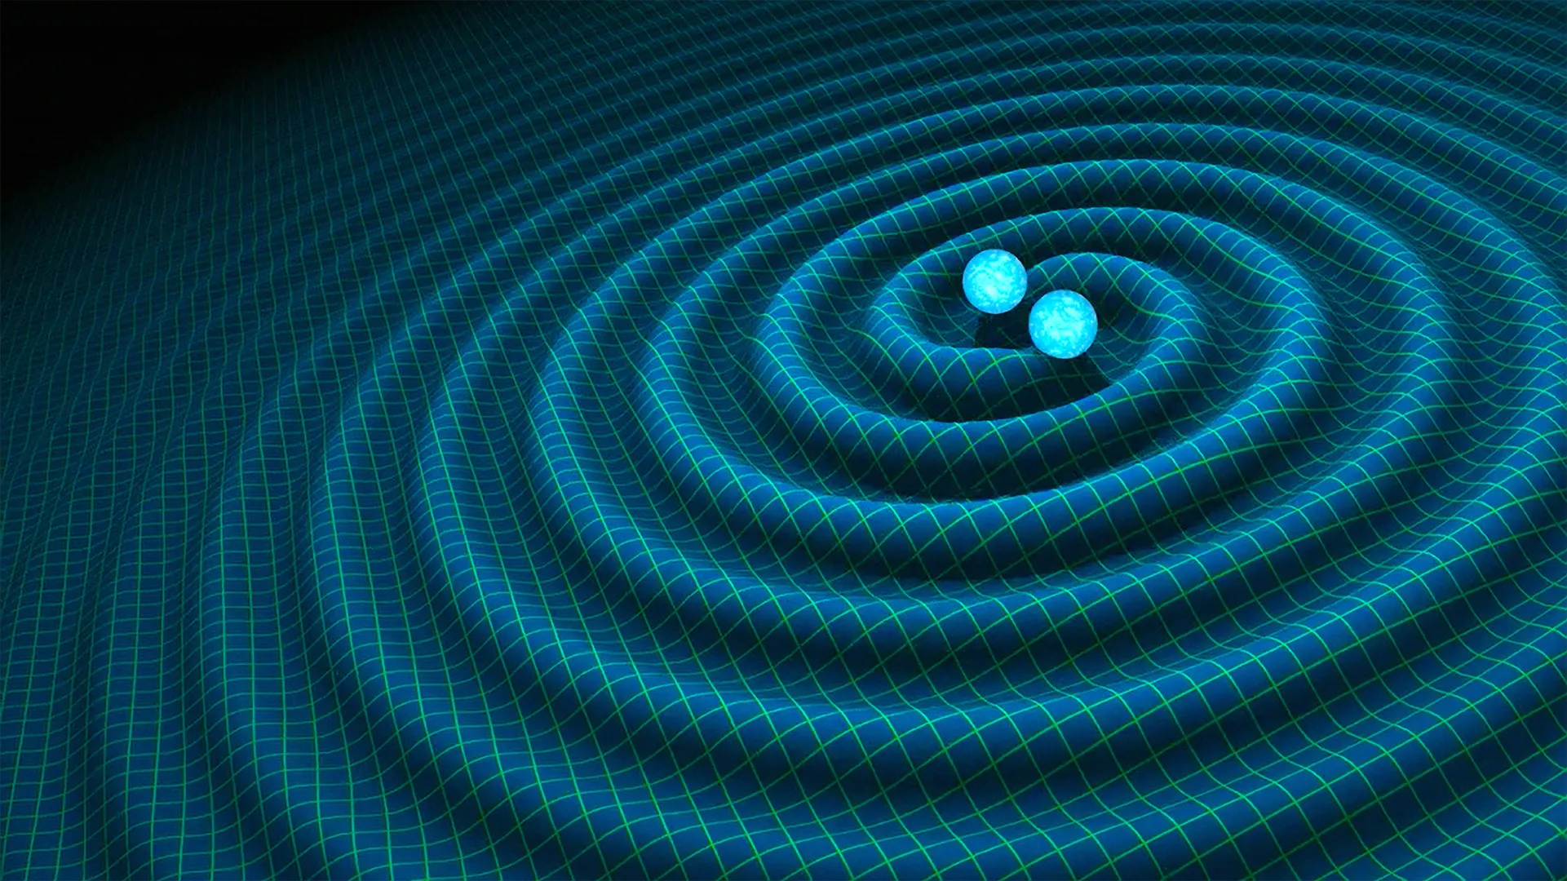
Progress Report on 1st year-
University of Padova, University of Cagliari Supervisor- Francesco Quochi
Presented by- Prajkta Nehete PhD in Technologies for Physics and Astrophysics
Curriculum- Detectors, optics and lasers

Slide 2
Research project and objectives
Objectives-
To deposit thin films made from various materials that minimize thermal noise and maximize reflectivity.
Characterize the films to get the optical properties
Study the thermo-optical effects of these thin films
Evaluation of the overall or in situ performance of the films
Project Title-
Optics and thermo-optics of dielectric coatings for gravitational wave interferometer.
1

Slide 3
Background
1916-
Einstein predicted GW
1974- Hulse and Taylor discovered binary pulsar
1992: LIGO Project Founded
2000s: Initial LIGO & Virgo
New generation of detector
Upgrades and more detection of GW
2015: Advanced LIGO Detection
2

Slide 4
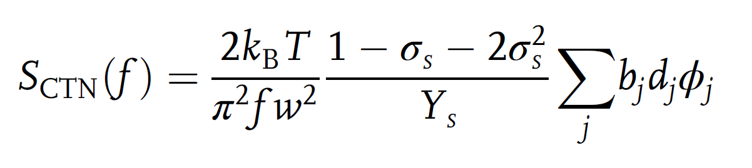
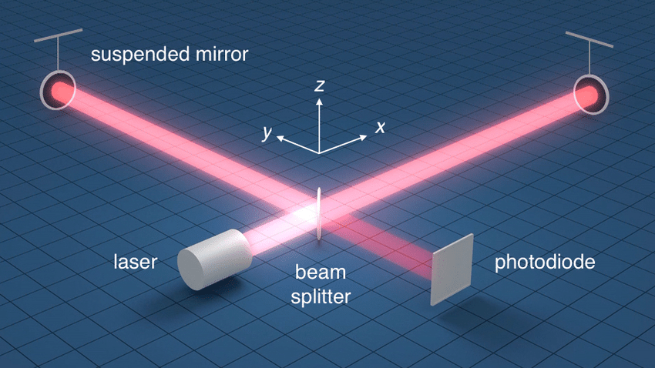
Focus
Gravitational wave detectors limitations – - Thermal noise
- Coating materials – Mechanical loss
Limits the sensitivity of the detector
3

Slide 5
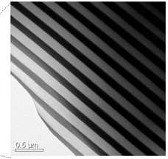
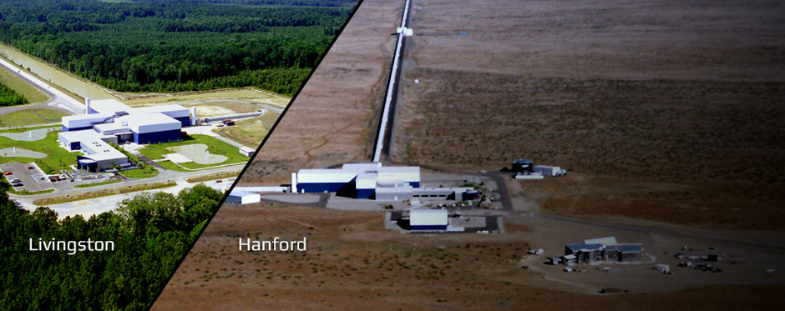
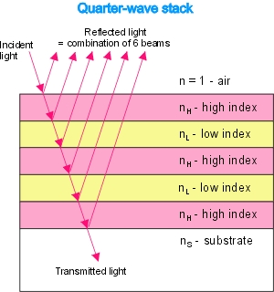
Current Gravitational Wave Detectors
4 Km arms
Bragg reflector coating- To increase reflectivity
IBS System- Low scattering loss
Materials- TiO₂(25%):Ta₂O₅ and SiO₂
Thickness- 5.9μm
Annealing - 500°C for 10H –For absorption
Limitation- Mechanical loss in Tantala layers, Thermal noise – still critical in advanced detectors
4

Slide 6
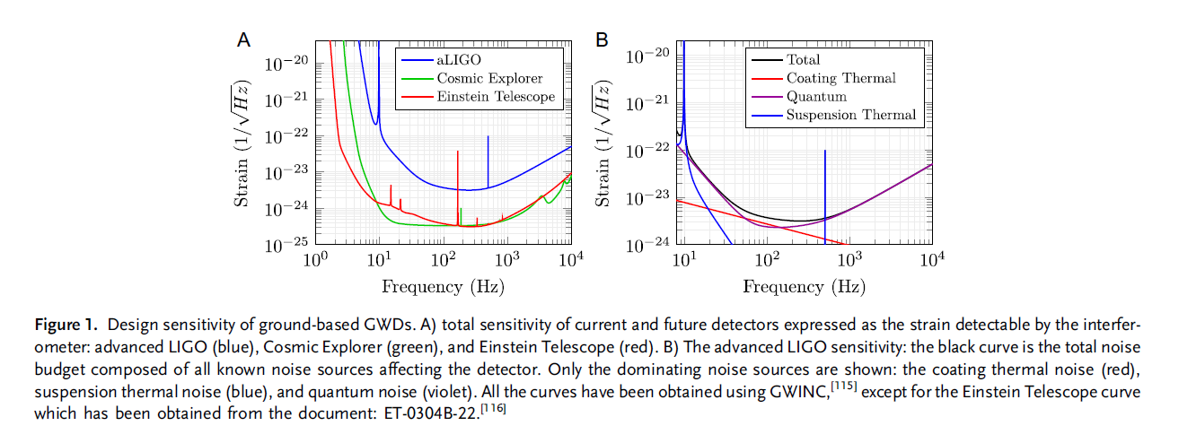
Sensitivity and Noise curves
5

Slide 7
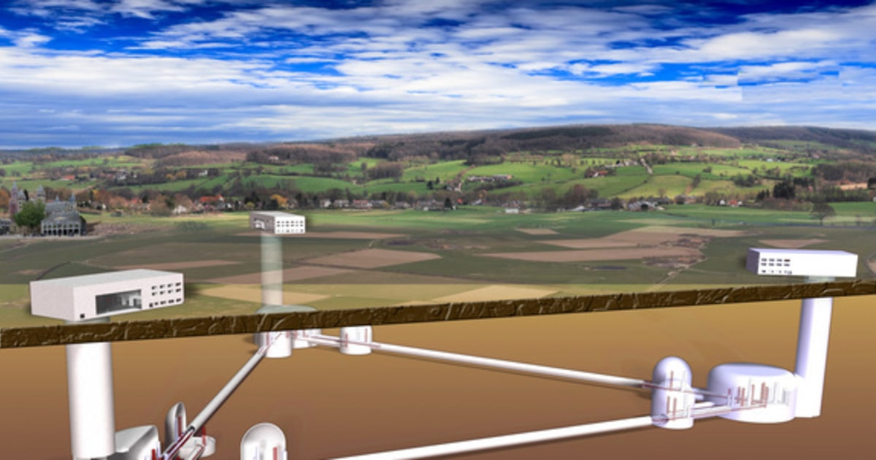
Einstein Telescope-
Underground
10-15 Km arms
RT and Cryogenic temperature (10-20K)
Increased Operating frequency band- 1064nm- 2100nm
Coatings with lower optical absorption – few parts per million (10¯⁶)
Aim- One order of magnitude higher sensitivity
6

Slide 8
Training and lab work-
Electrical Measurements
Atomic Force Microscopy
- Topography - KPFM Measurements - Conductive Measurements
Evaporator
Spectroscopic Ellipsometer
7

Slide 9
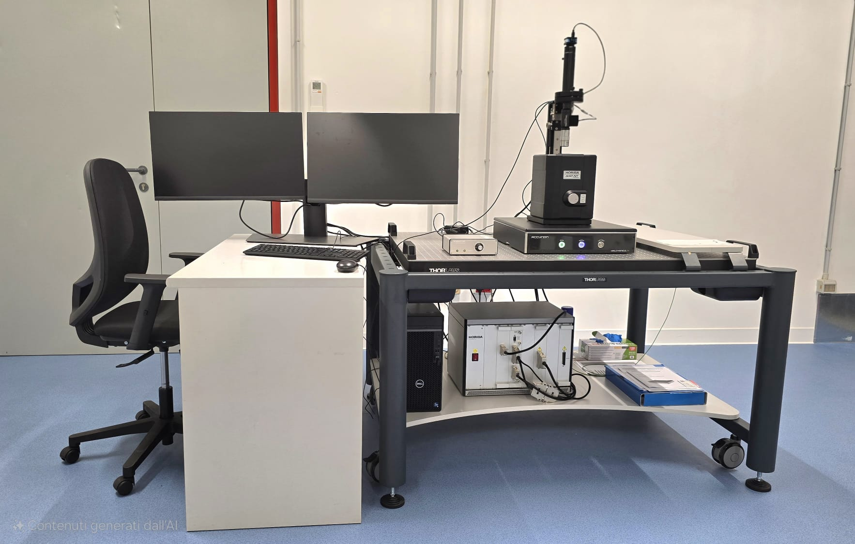
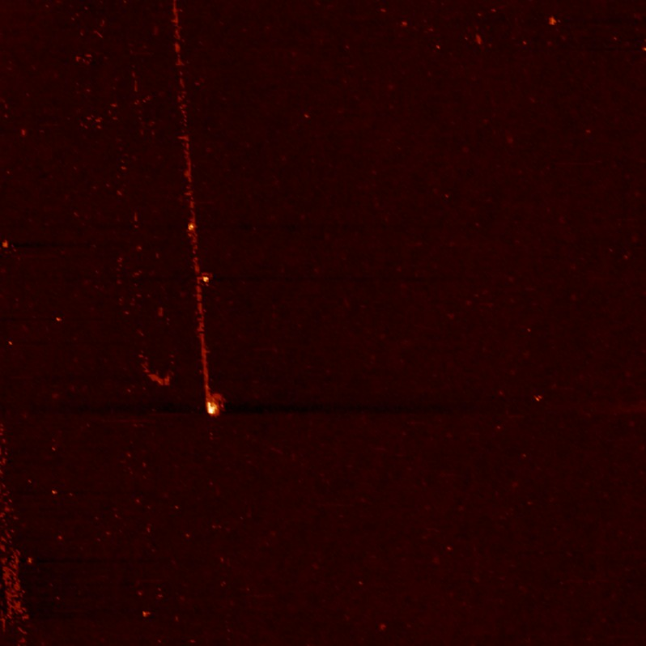
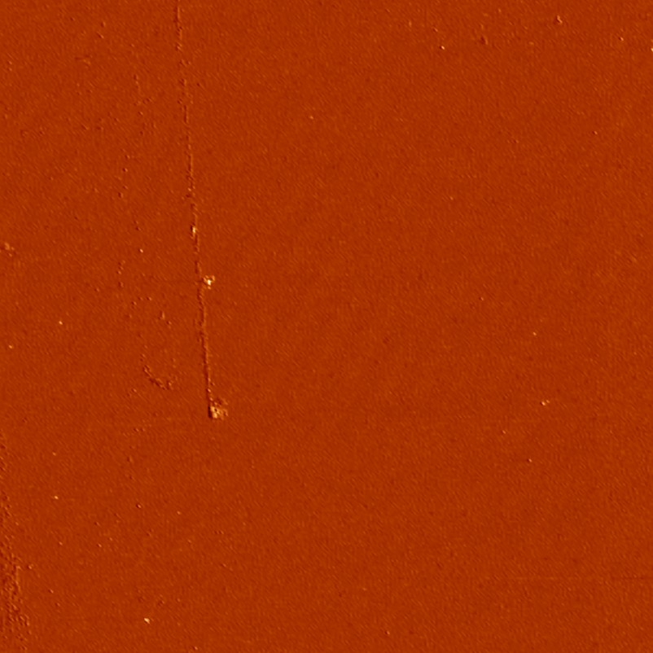
AFM setup for surface characterization
Troubleshooting testing with standard reference samples
Collaboration with the group to characterise perovskite samples.
Surface characterization for SiO₂ thin film
8

Slide 10
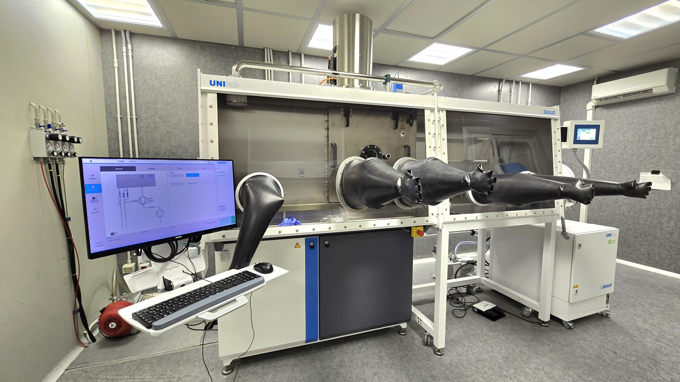
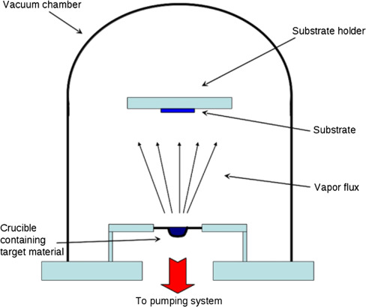
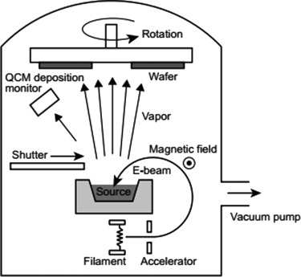
Evaporator with Glovebox -
LTE and THE
E-Beam
9

Slide 11
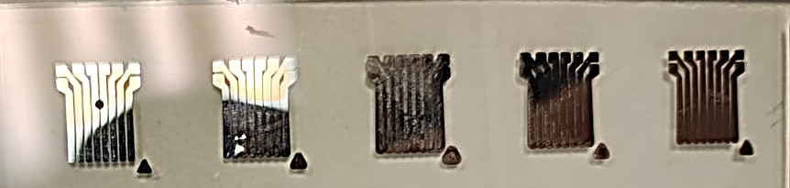
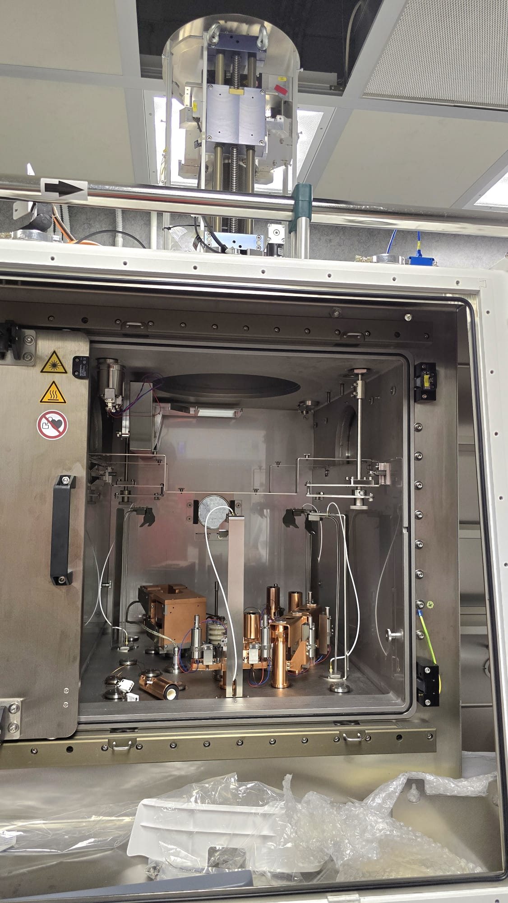
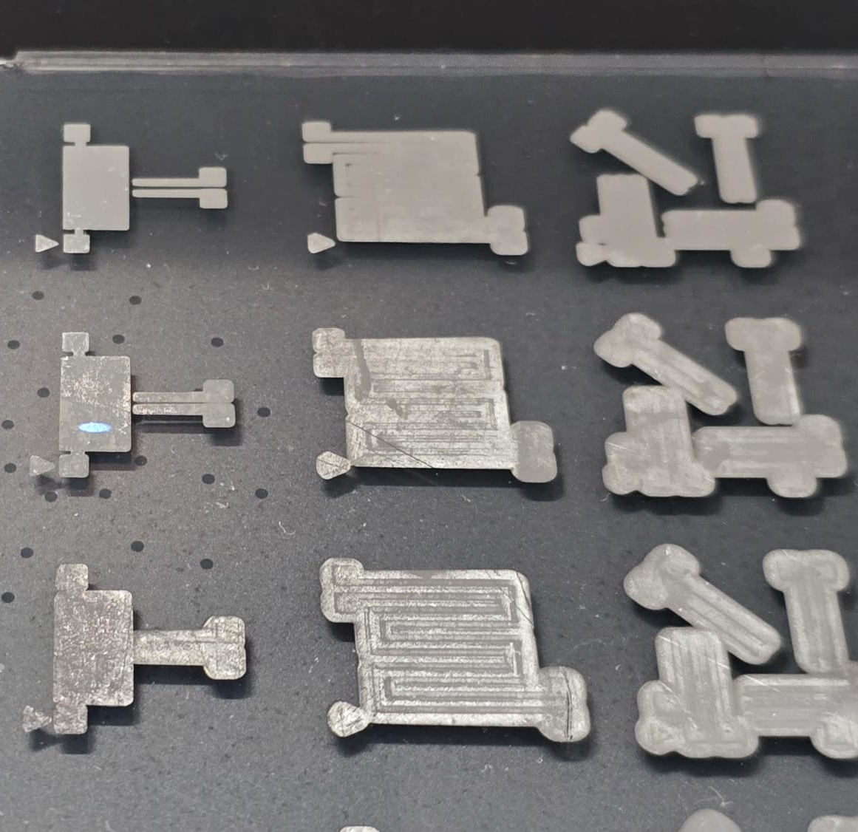
Inside structure of Evaporator
Sources- E-beam, LTE, THE
Trial Al contacts deposition with E-beam
10

Slide 12
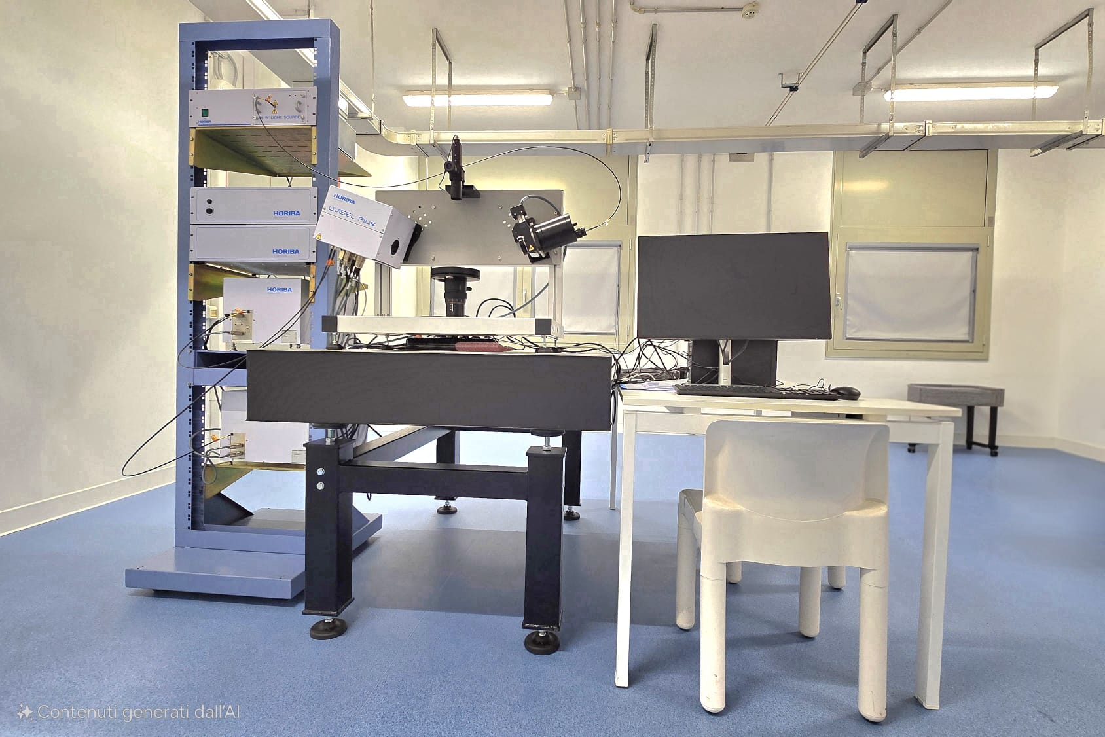
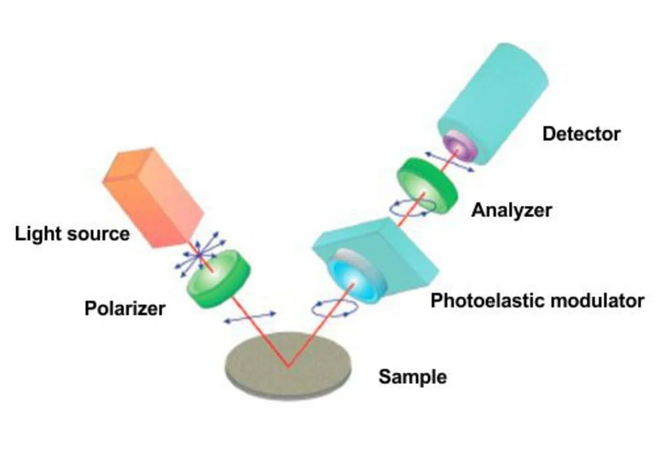
Ellipsometer
Troubleshooting tests with different types of materials that were available
Exploring different fitting and modelling options
11

Slide 13
Oxides fit
85nm SiO₂ on c-Si
300nm SiO ₂ on c-Si
12

Slide 14
10
Results for the Ellipsometry fit on Metals
Deposited Al contacts
30nm Gold on Glass
Si100 Wafer
13

Slide 15
Ongoing and Future work –
1. Deposition of the standard (Ta₂O₅ and SiO₂) coatings for the interferometer.
2. Characterization of the coatings.
3. Necessary optimization of the coatings
14

Slide 16
Courses and Summer school-
1. Scientific programming MATLAB – Passed (credits – 6)
2. Machine Learning for Physics – Exam pending
Courses need to be attended –
1. Radiation matter interaction - Enrolled
2. Semiconductor Light Sources for Engineers
Summer school attended- 2025 Characterization of Materials Summer School. 2nd September 2025 to 5th September 2025.
15

Slide 17
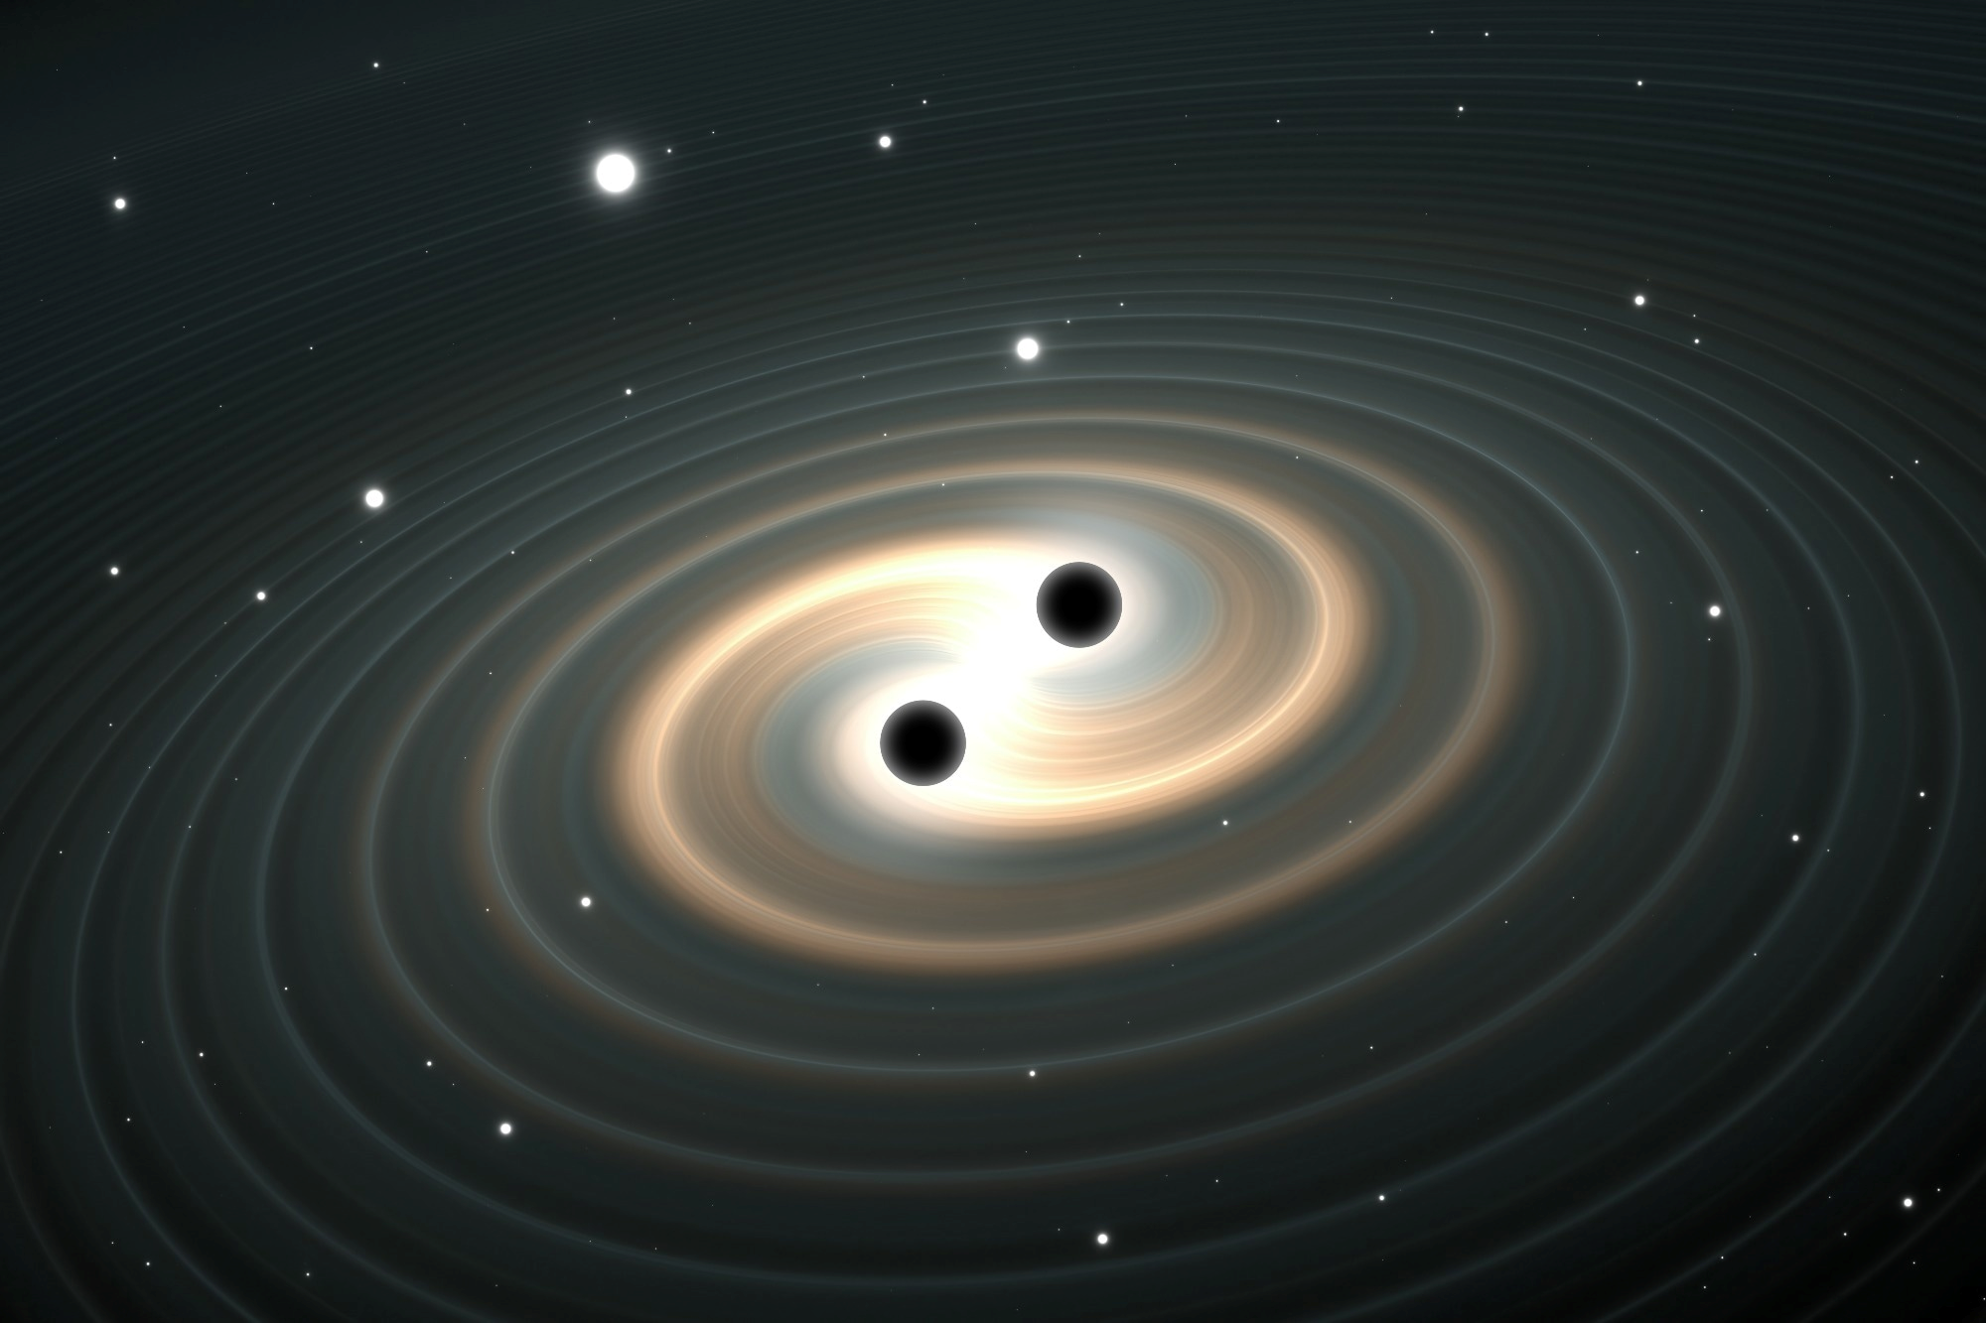
Thank You!!

Slide 18
Summer school-
2025 Characterization of Materials Summer School.
2nd September 2025 to 5th September 2025.
Method | Application
TEM & Microanalysis | See atoms and defects
XPS | Check surface elements and bonds
X-ray/Neutron Diffraction | Find crystal structure
SEM, EDX | Look at surface and elements
STM | See atoms on surfaces
AFM | Map surface shape at nanoscale
Nanoindentation | Test hardness and stiffness
Visco-Elastic Characterisation | Study soft/stretchy materials
Rheology | Measure flow of liquids/gels
Tribology | Test friction and wear
Corrosion | Study rusting/degradation
Scratch | Check coating strength

