Slide 1


Progress Report for Admission to the 2nd Year of PhD course
Sami Ullah Khan

Slide 2

Index
Research topic and objectives
First year research activities
Research activities planned
Courses and conferences

Slide 3
Research topic and objectives
Research topic:
Development and characterization of CMOS sensors for X-ray imaging in space and medical applications
Objectives:
Design and optimize CMOS sensor-based setups for advanced X-ray imaging, with a focus on Phase Contrast Imaging (PCI).
Characterize sensor performance under both soft and hard X-ray irradiation, assessing sensitivity, resolution, and stability.
Develop and implement self-calibration techniques to improve signal uniformity and ensure reliable, high-quality imaging.
Validate applications of CMOS sensors in space, medical, and industrial environments, highlighting their versatility and robustness.

Slide 4
Conducted X-ray imaging experiments using the ARCADIA MD3 sensor.
Used a (Mo) X-ray tube and (Si) crystal to observe Kα₁ and Kα₂ diffraction peaks.
Analyzed cluster size distributions to study charge sharing and event localization.
Performed additional tests with Bremsstrahlung and soft X-rays.
Evaluated detector sensitivity and spatial resolution under varying energy conditions.
Research activities carried out so far

Slide 5
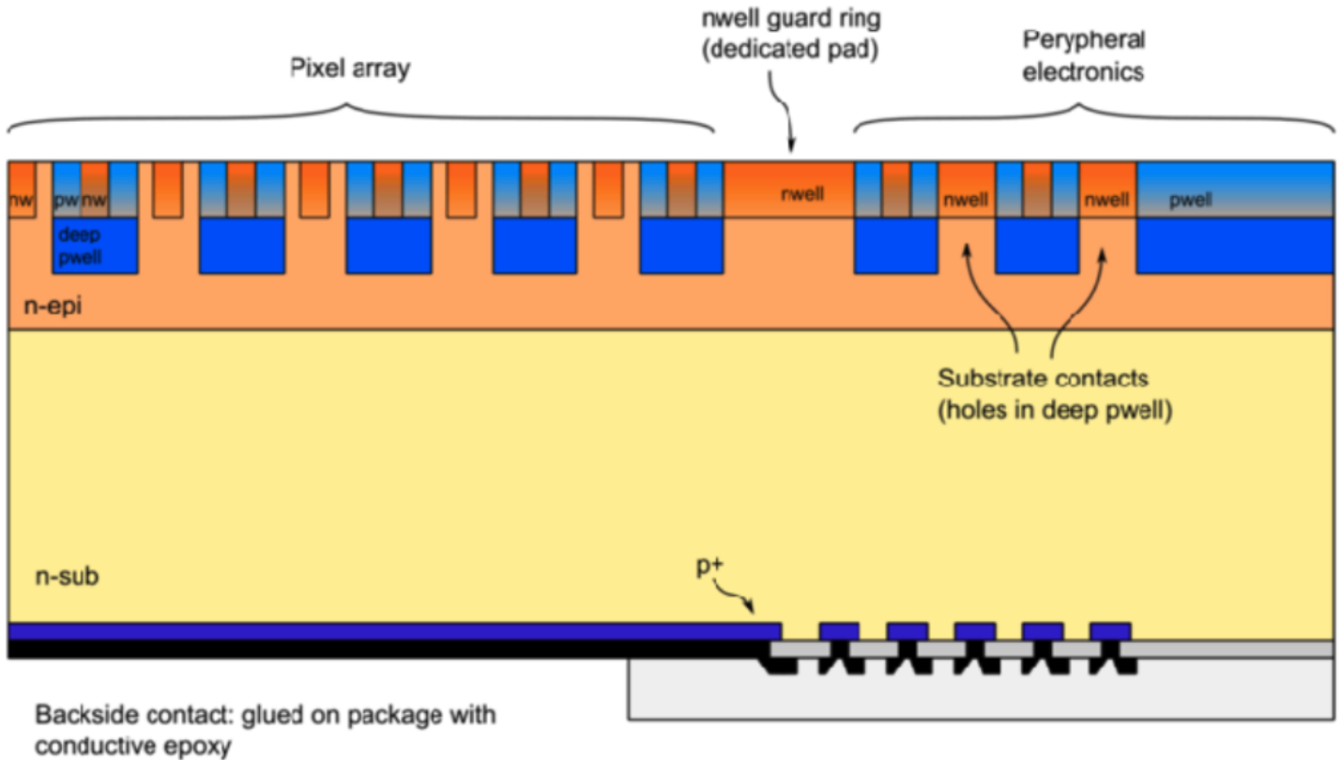
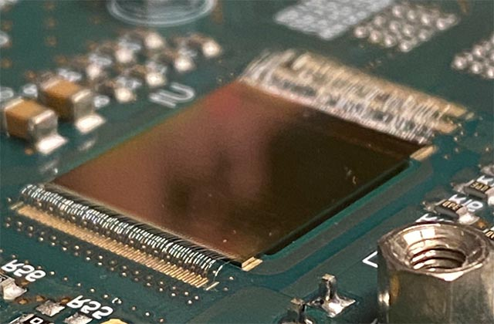
ARCADIA MD3 – Pixel Sensor
Architecture:
Pixel size: 25 × 25 μm², 512 × 512 matrix → 1.28 × 1.28 cm² active area.
Active thickness: Fully depleted, 50–500 μm (tunable).
Structure: 16 sections (32 × 512 each), clock-less for ultra-low power.
Performance:
Spatial resolution: < 5 μm.
Detection efficiency: > 99% at operational settings.
Uniform threshold & very low noise across the matrix.
Operational Modes:
High rate: Up to 100 MHz/cm² (simulated), 17–30 mW/cm².
Low rate: < 10 mW/cm² (measured) → ideal for power-limited systems.
Technology & Robustness:
Process: 110 nm CMOS, quad-well, high-resistivity bulk.
Radiation hardness: 1 Mrad.
Scalability: Modular design supports stitching for larger areas.
RCADIA fully depleted CMOS MAPS development with LFoundry 110 nm CIS. Frontiers in Sensors, 6:1603755. doi:10.3389/fsens.2025.1603755.

Slide 6
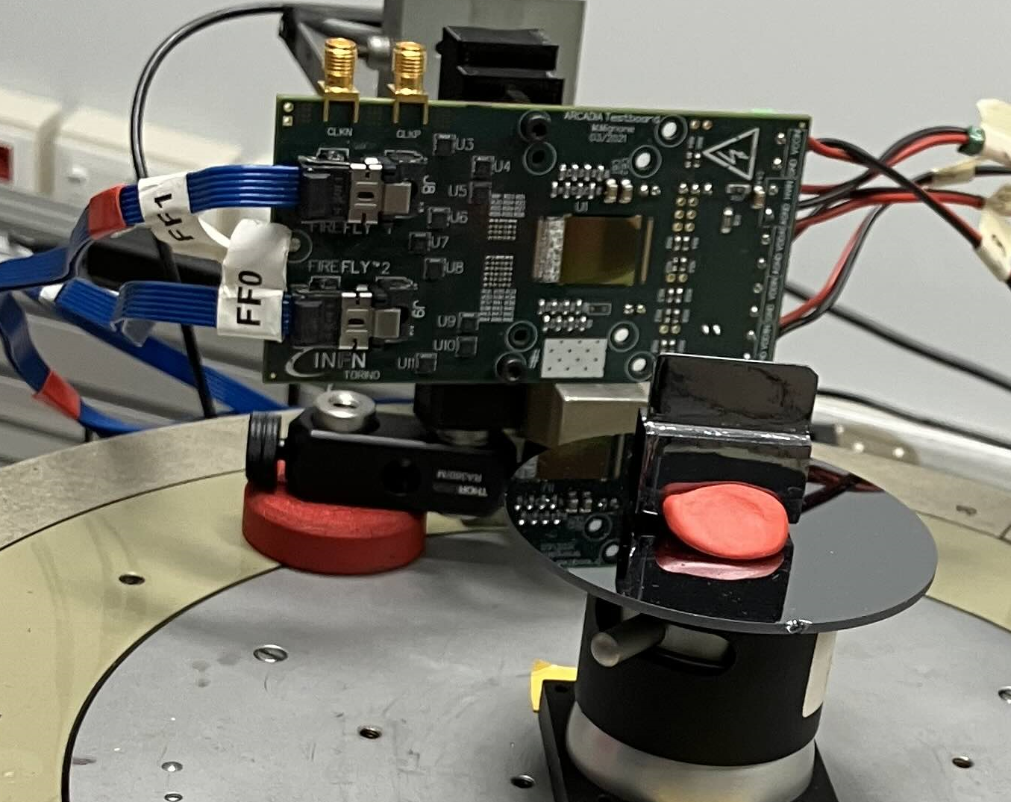
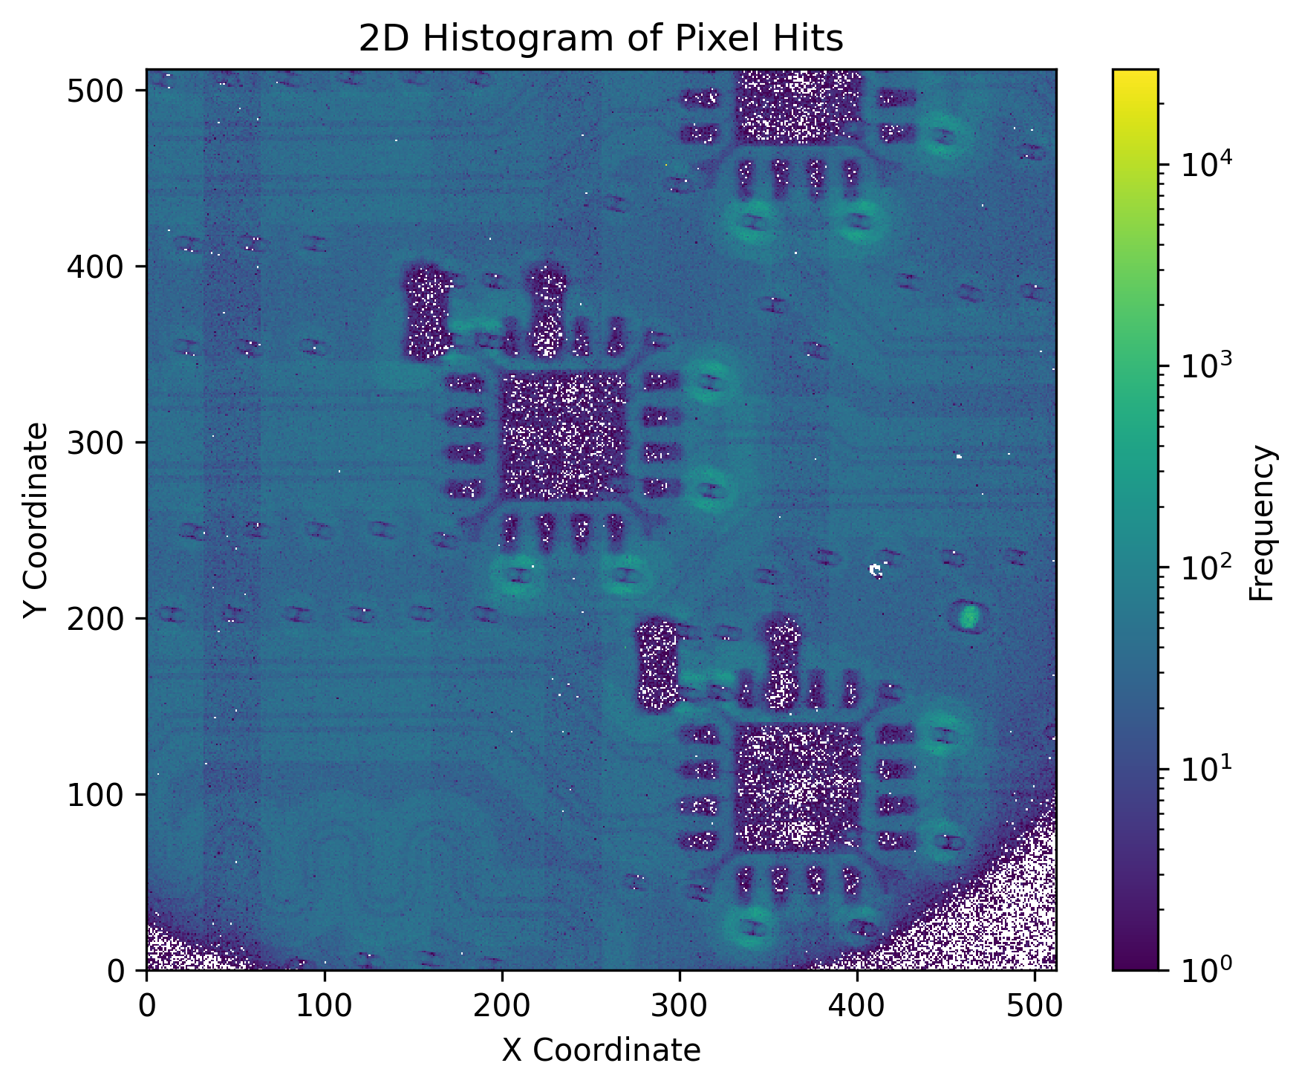
1° year research activities
Study with X-rays
X-ray Source: Molybdenum (Mo) filament tube
Monochromator: Silicon (220) crystal (d = 192 pm) for energy selection
Purpose: Crystal selects a specific X-ray energy for precise measurements
Application: Enables monochromatic beam for accurate detector testing
Hard X-ray Beamline Setup for Detector Testing

Slide 7
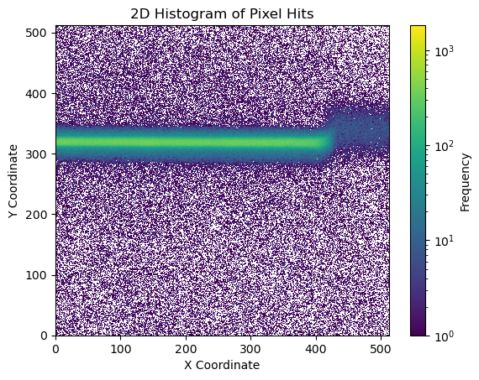
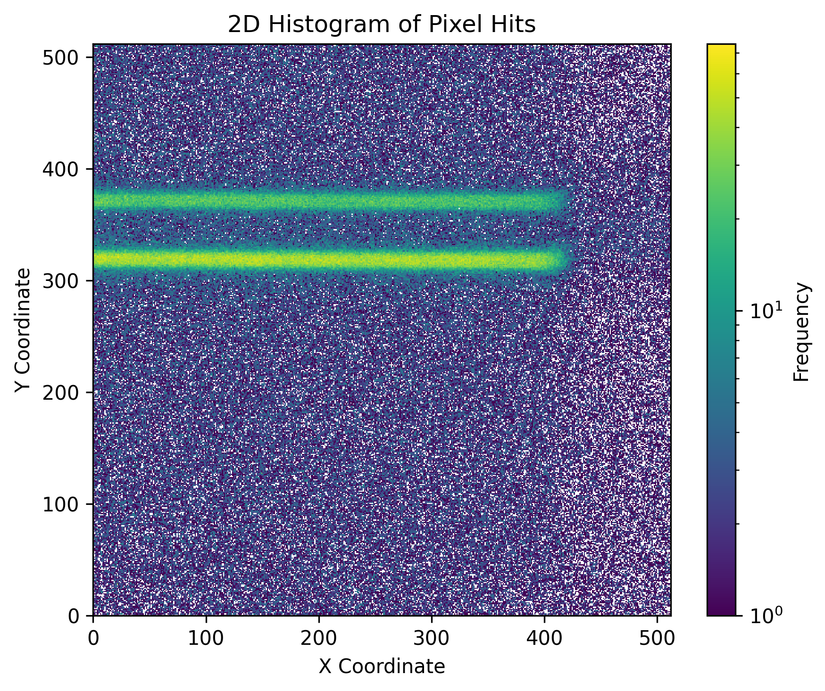
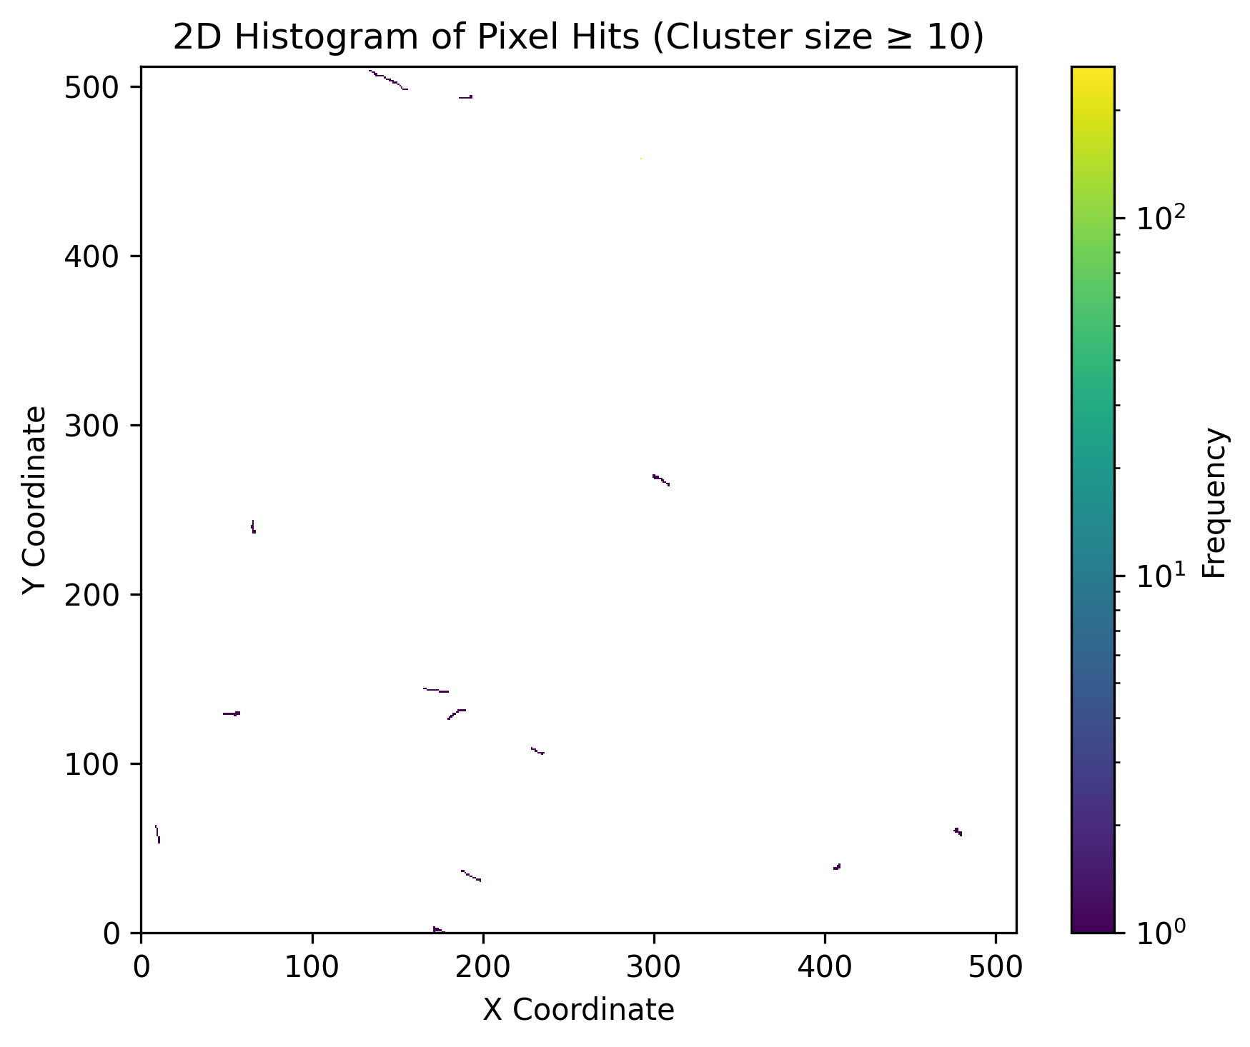
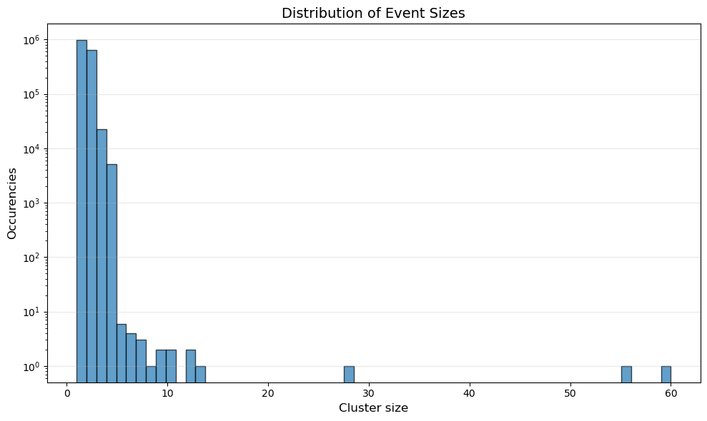
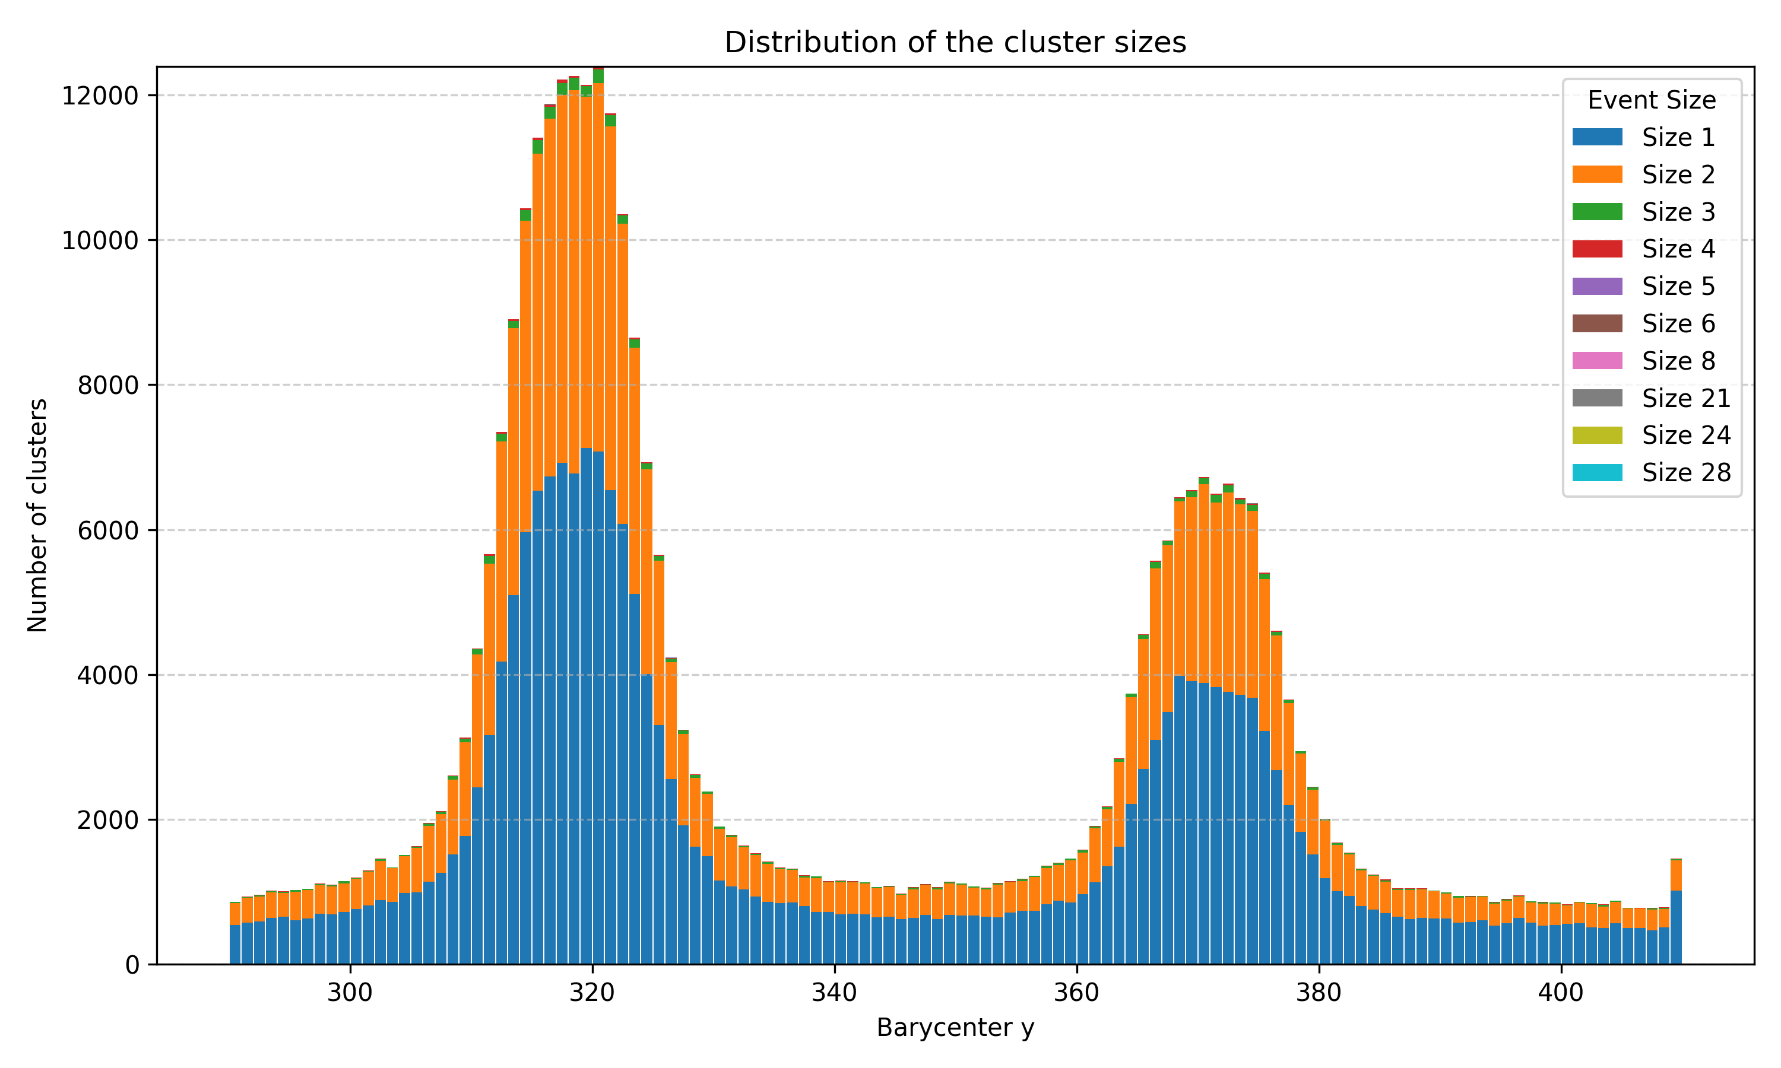
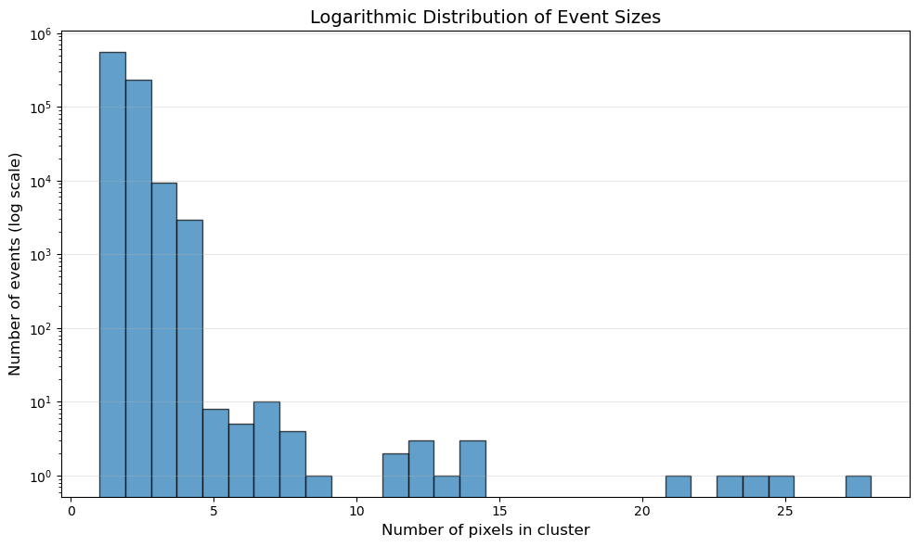
Detection of Mo Kα1 and Kα2 Lines with ARCADIA
ARCADIA successfully detected the Mo Kα1 (17.479 keV) and Kα2 (17.374 keV) lines.
Measurements performed from the top view confirmed the system’s energy selection capability.
Lead slit (14 × 0.1 mm) at pipe aperture
No lead slit at the aperture
Bragg angle: 10,6°
D=1.31 ± 0.08 mm

Slide 8
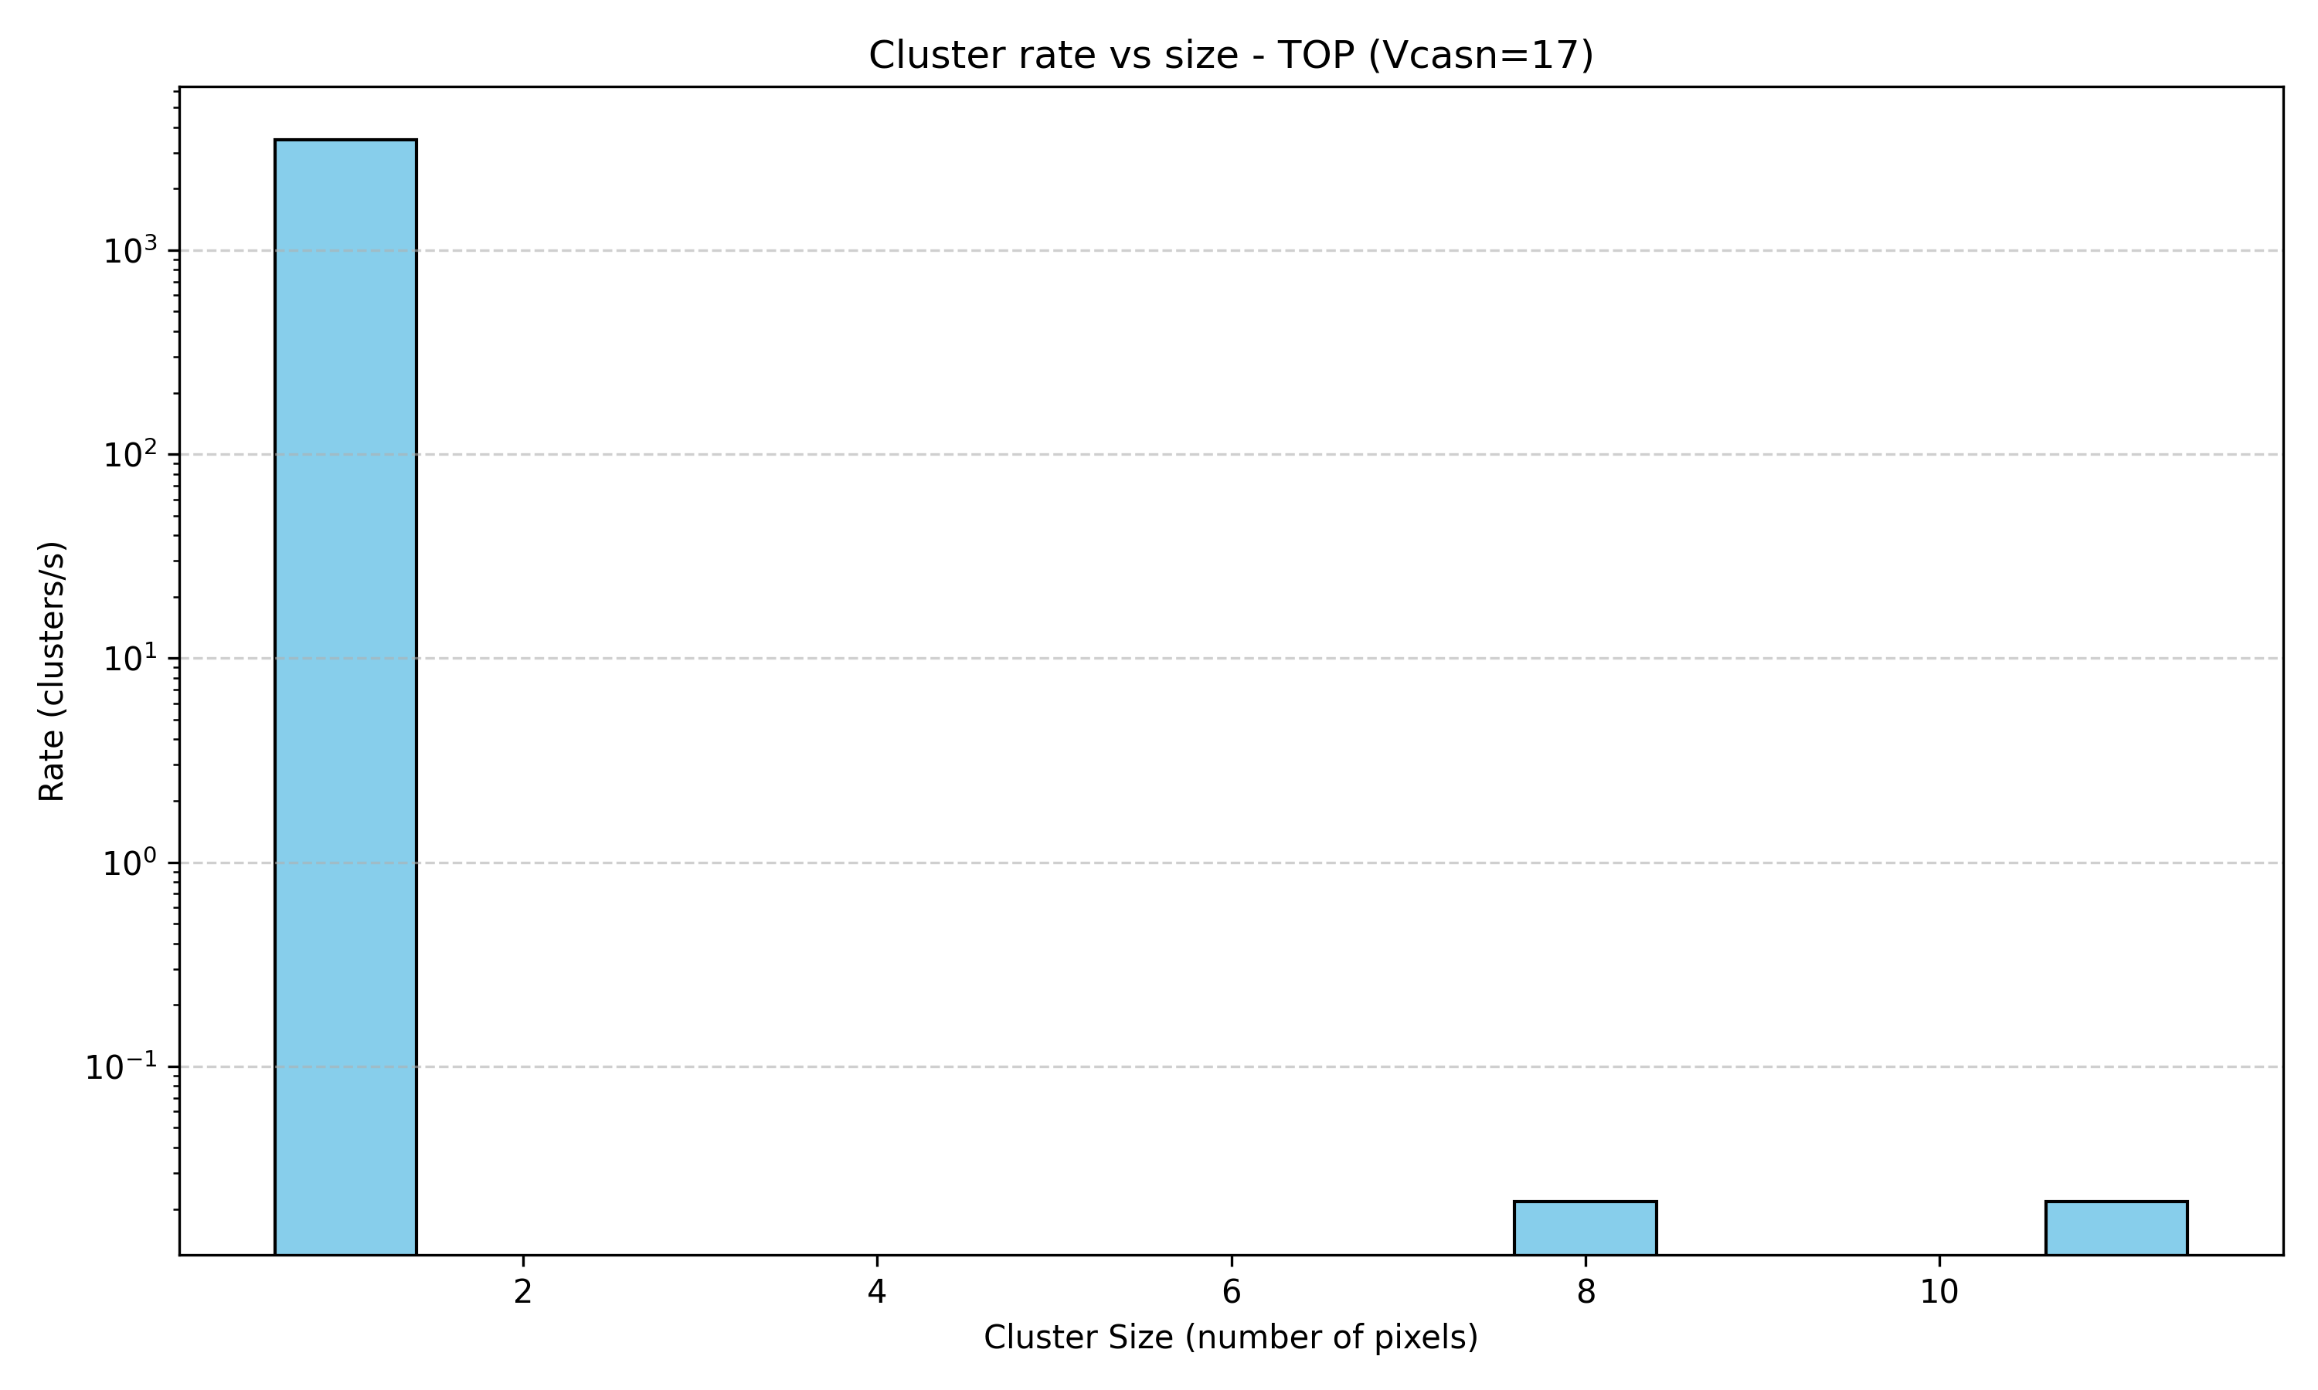
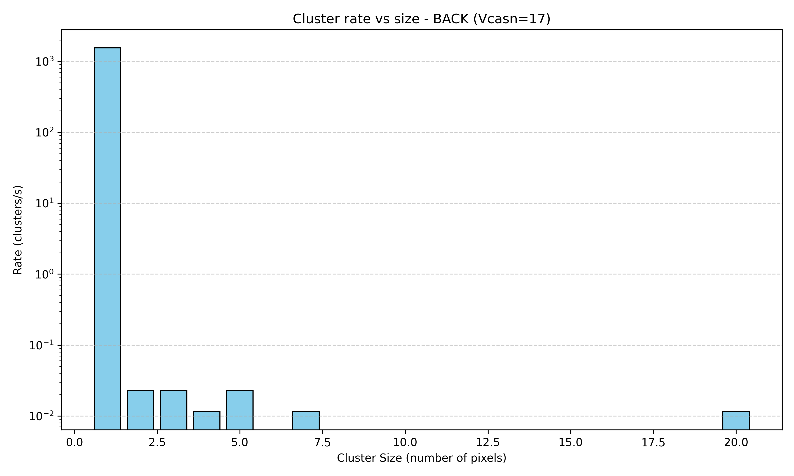
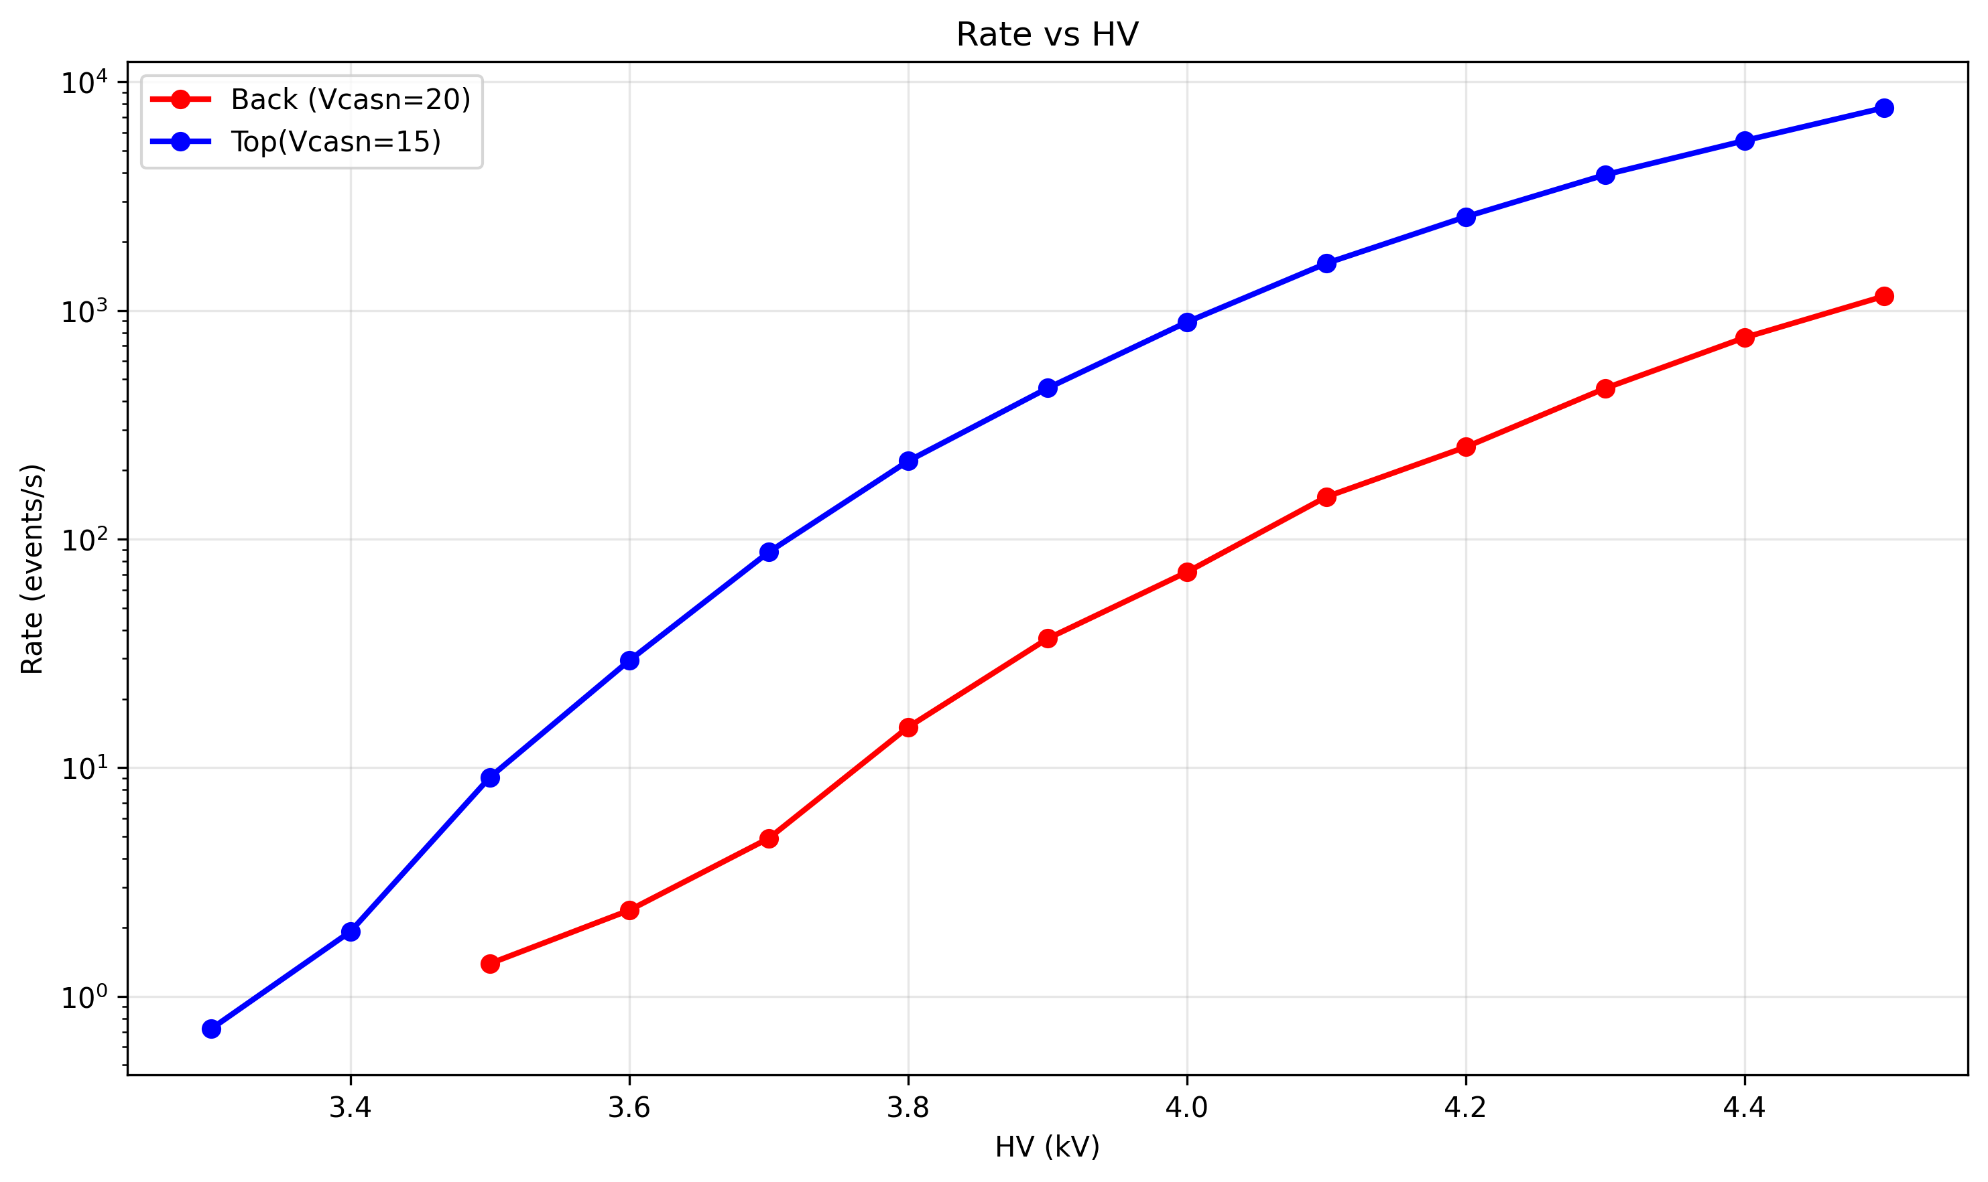
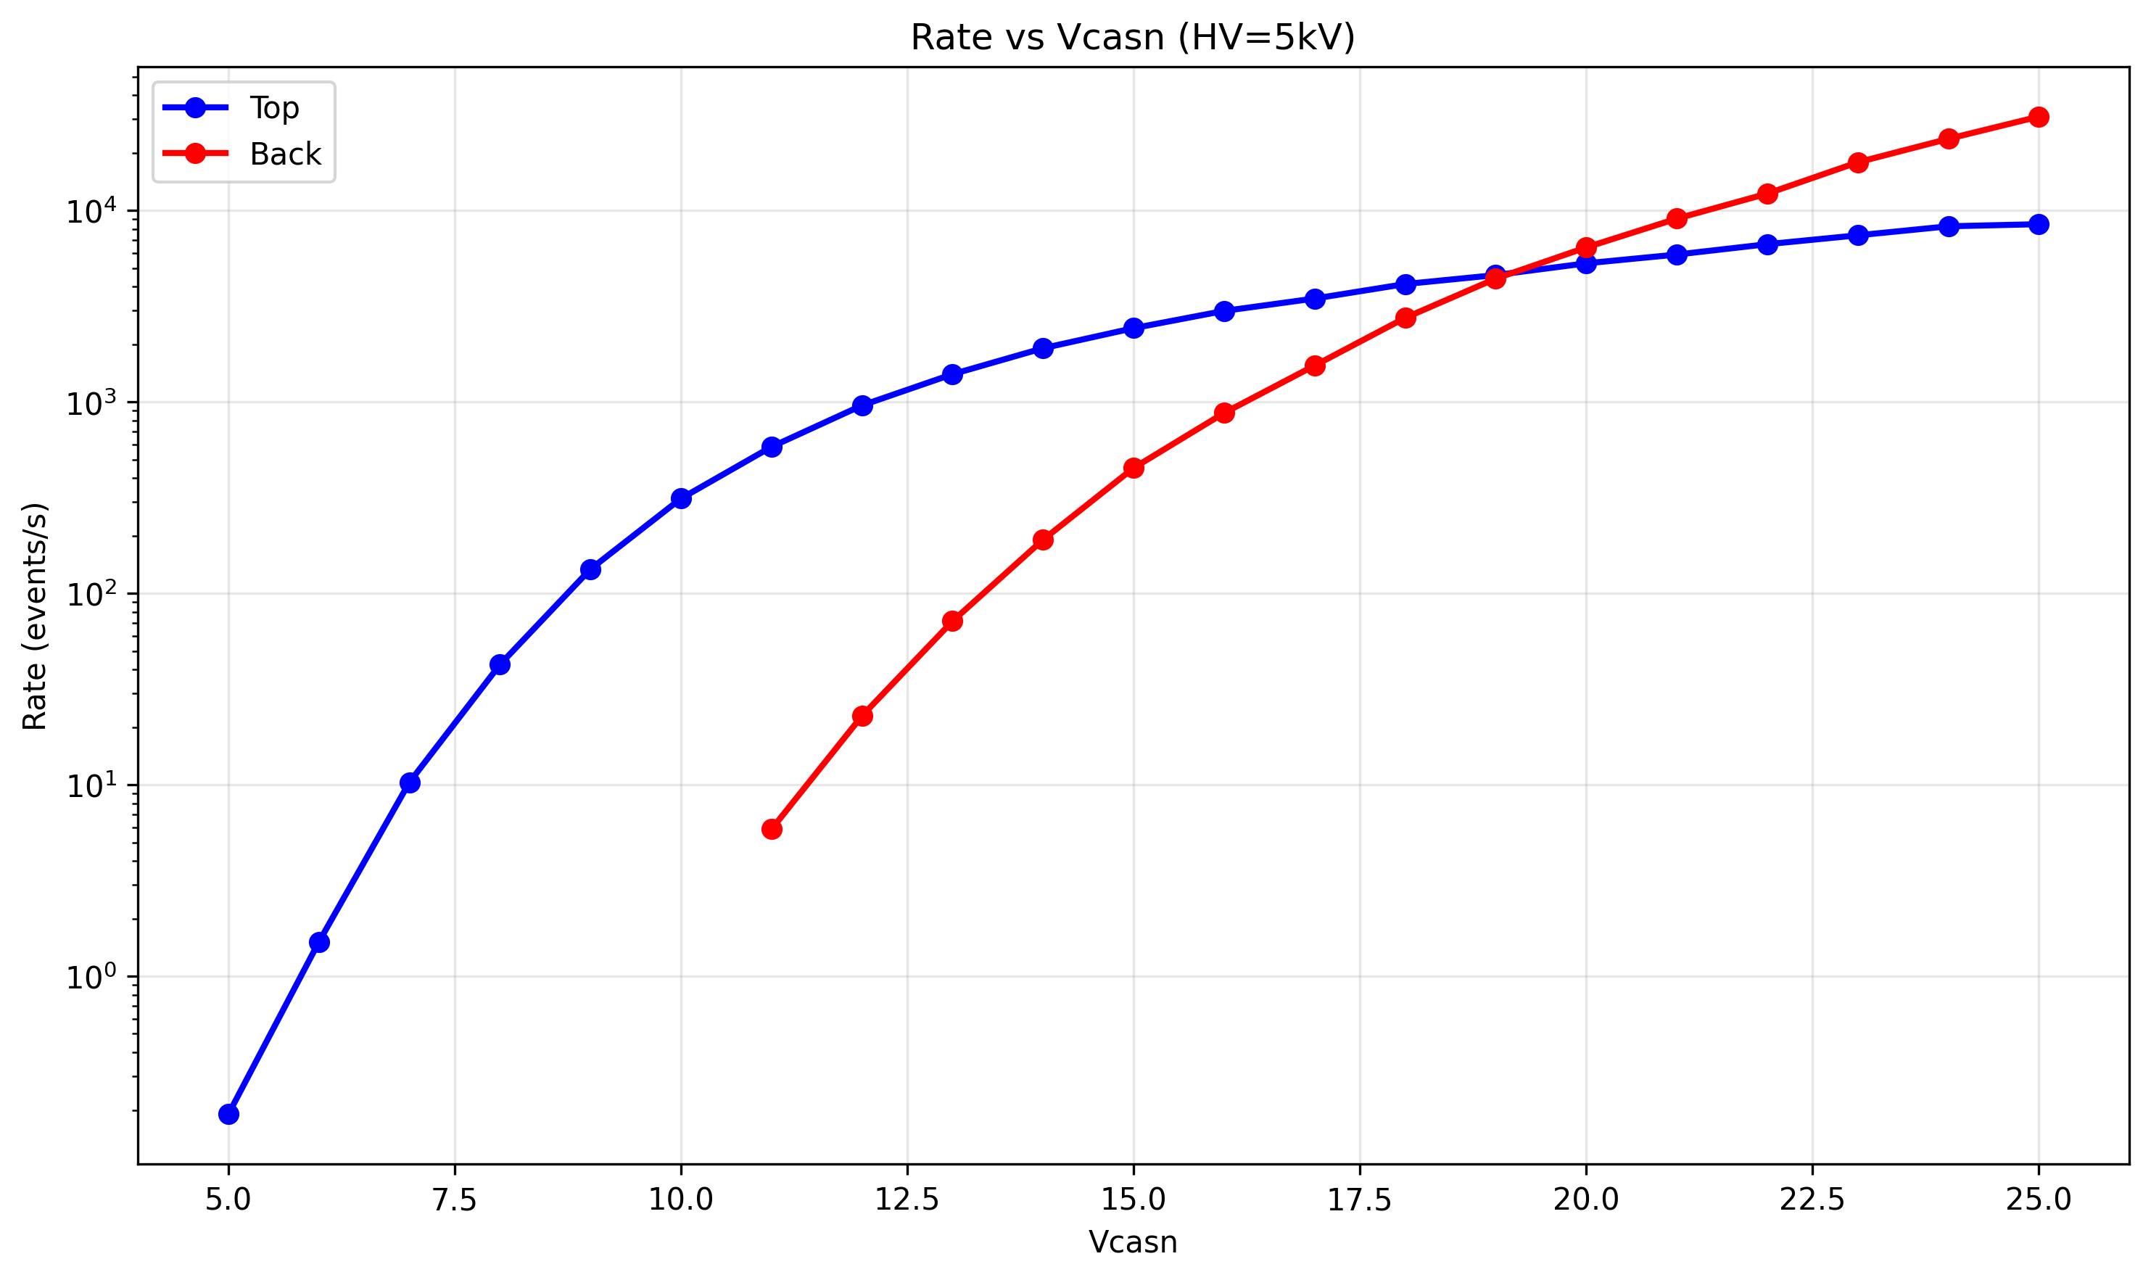
Cluster Behaviour: Top vs. Back
With soft X-rays
Tube voltage: <35 kV
1 mm Al filter in front of aperture
No crystal
ARCADIA’s response to soft X-rays was compared for Top and Back illumination (Vcasn=17).
Finding: Most clusters are size 1 in both cases.
Cluster rate increases with tube voltage and Vcasn: • Higher rate from Top side • Plateau observed for Top at high Vcasn
Conclusion: Top illumination yields higher rates; clusters are mostly size 1 in both cases.

Slide 9
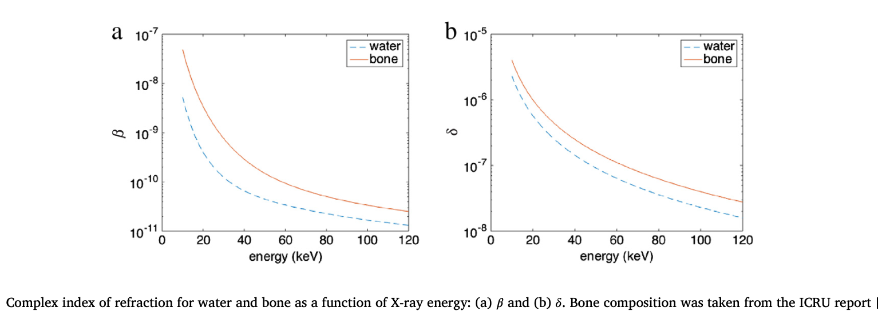
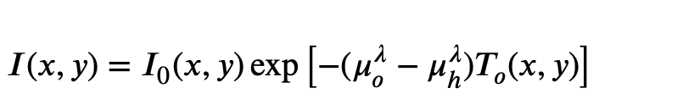
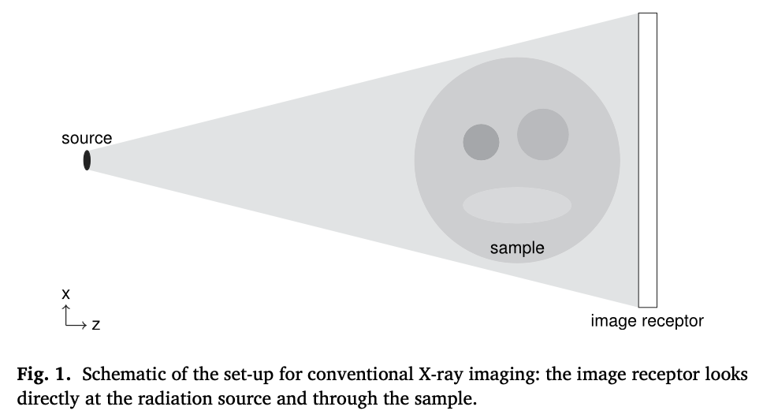
Planned Work: X-ray Phase Contrast Imaging with Arcadia MD3
Absorption Imaging:
Based on Beer–Lambert law:
μ: absorption property of material
Phase-Contrast Imaging:
Uses X-ray phase shifts to improve contrast
Refractive index: n=1−δ+iβ
δ → control phase shift;
β → control absorption.
At medical/engineering X-ray energies: δ ≫ β
Highlights low-contrast structures clearly
(Endrizzi, M., 2018. X-ray phase-contrast imaging. Nucl. Instrum. Methods Phys. Res. A, 878, pp.88–98.)

Slide 10
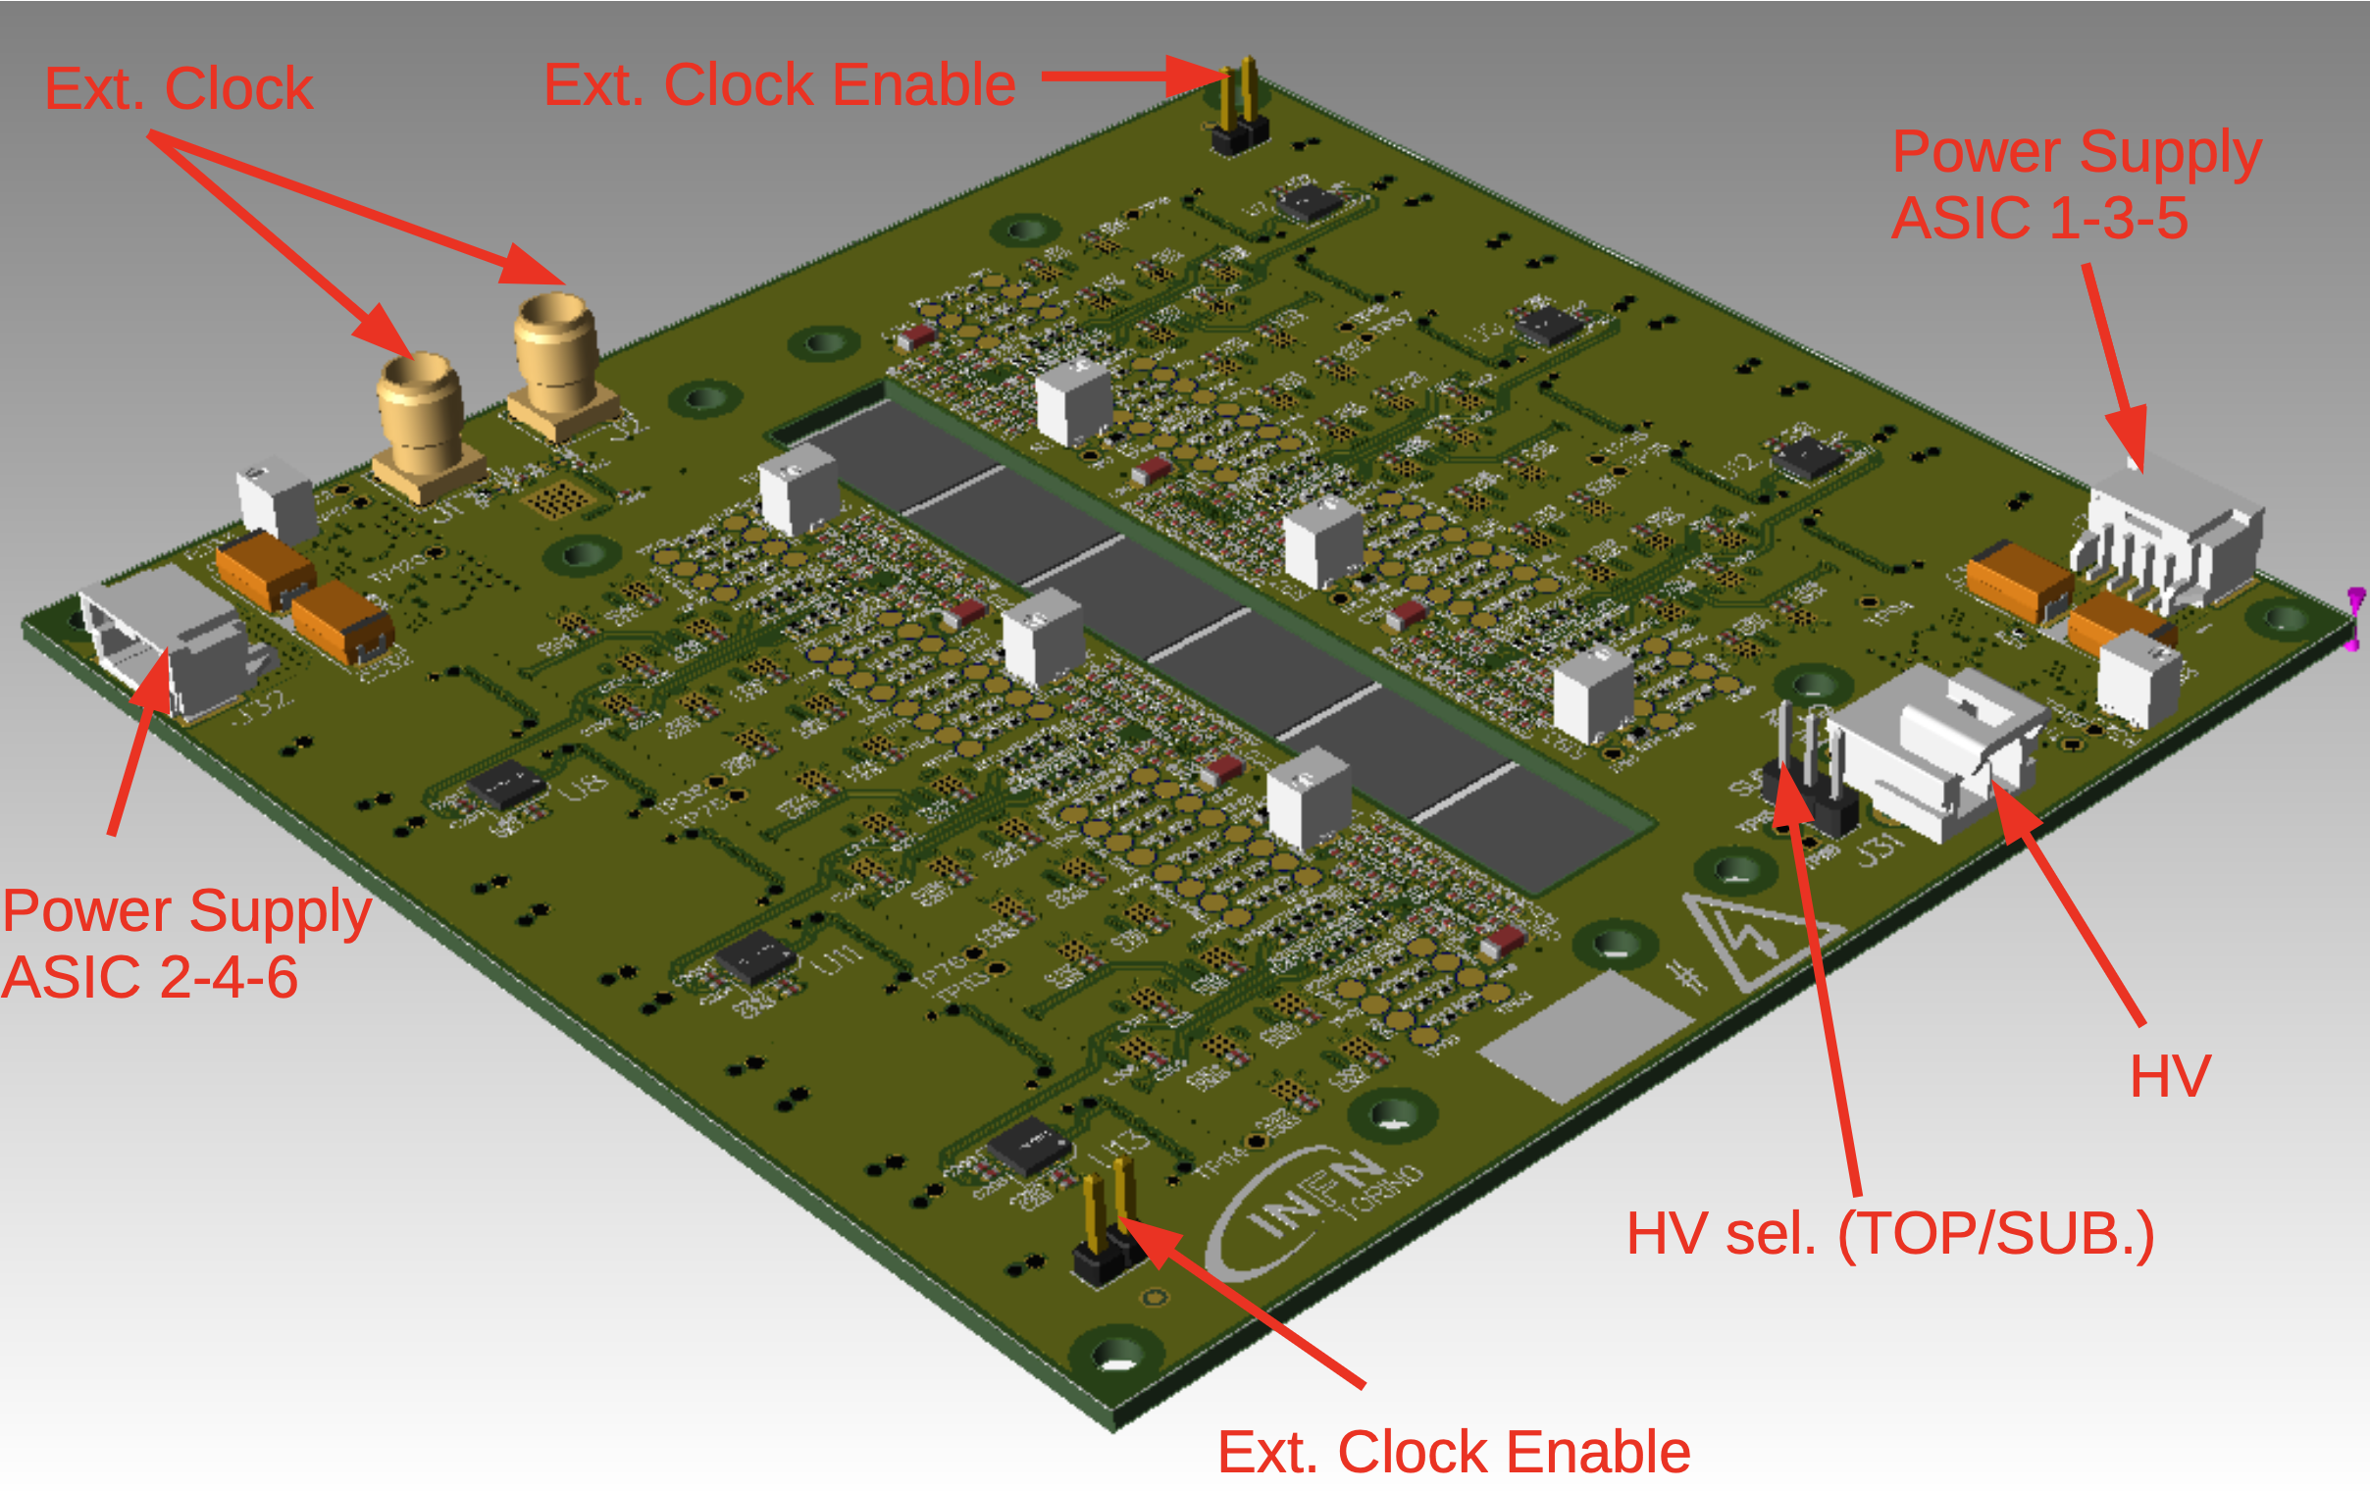
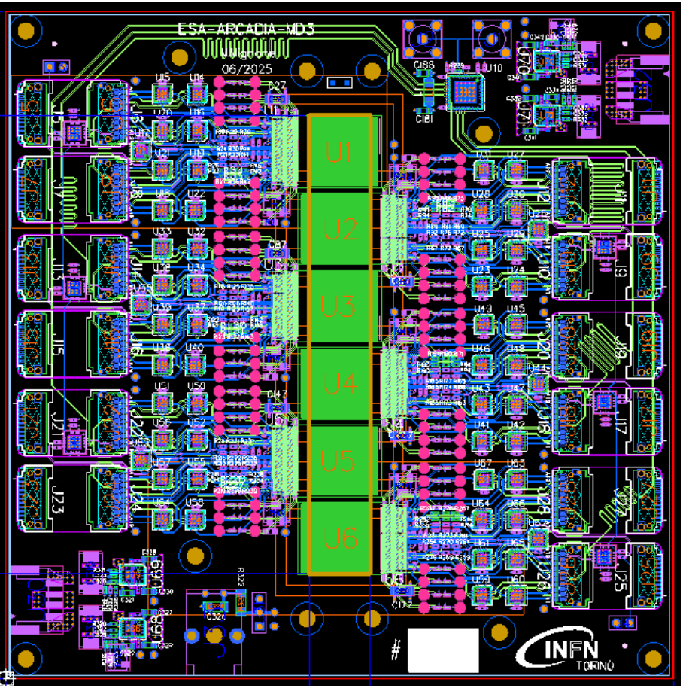
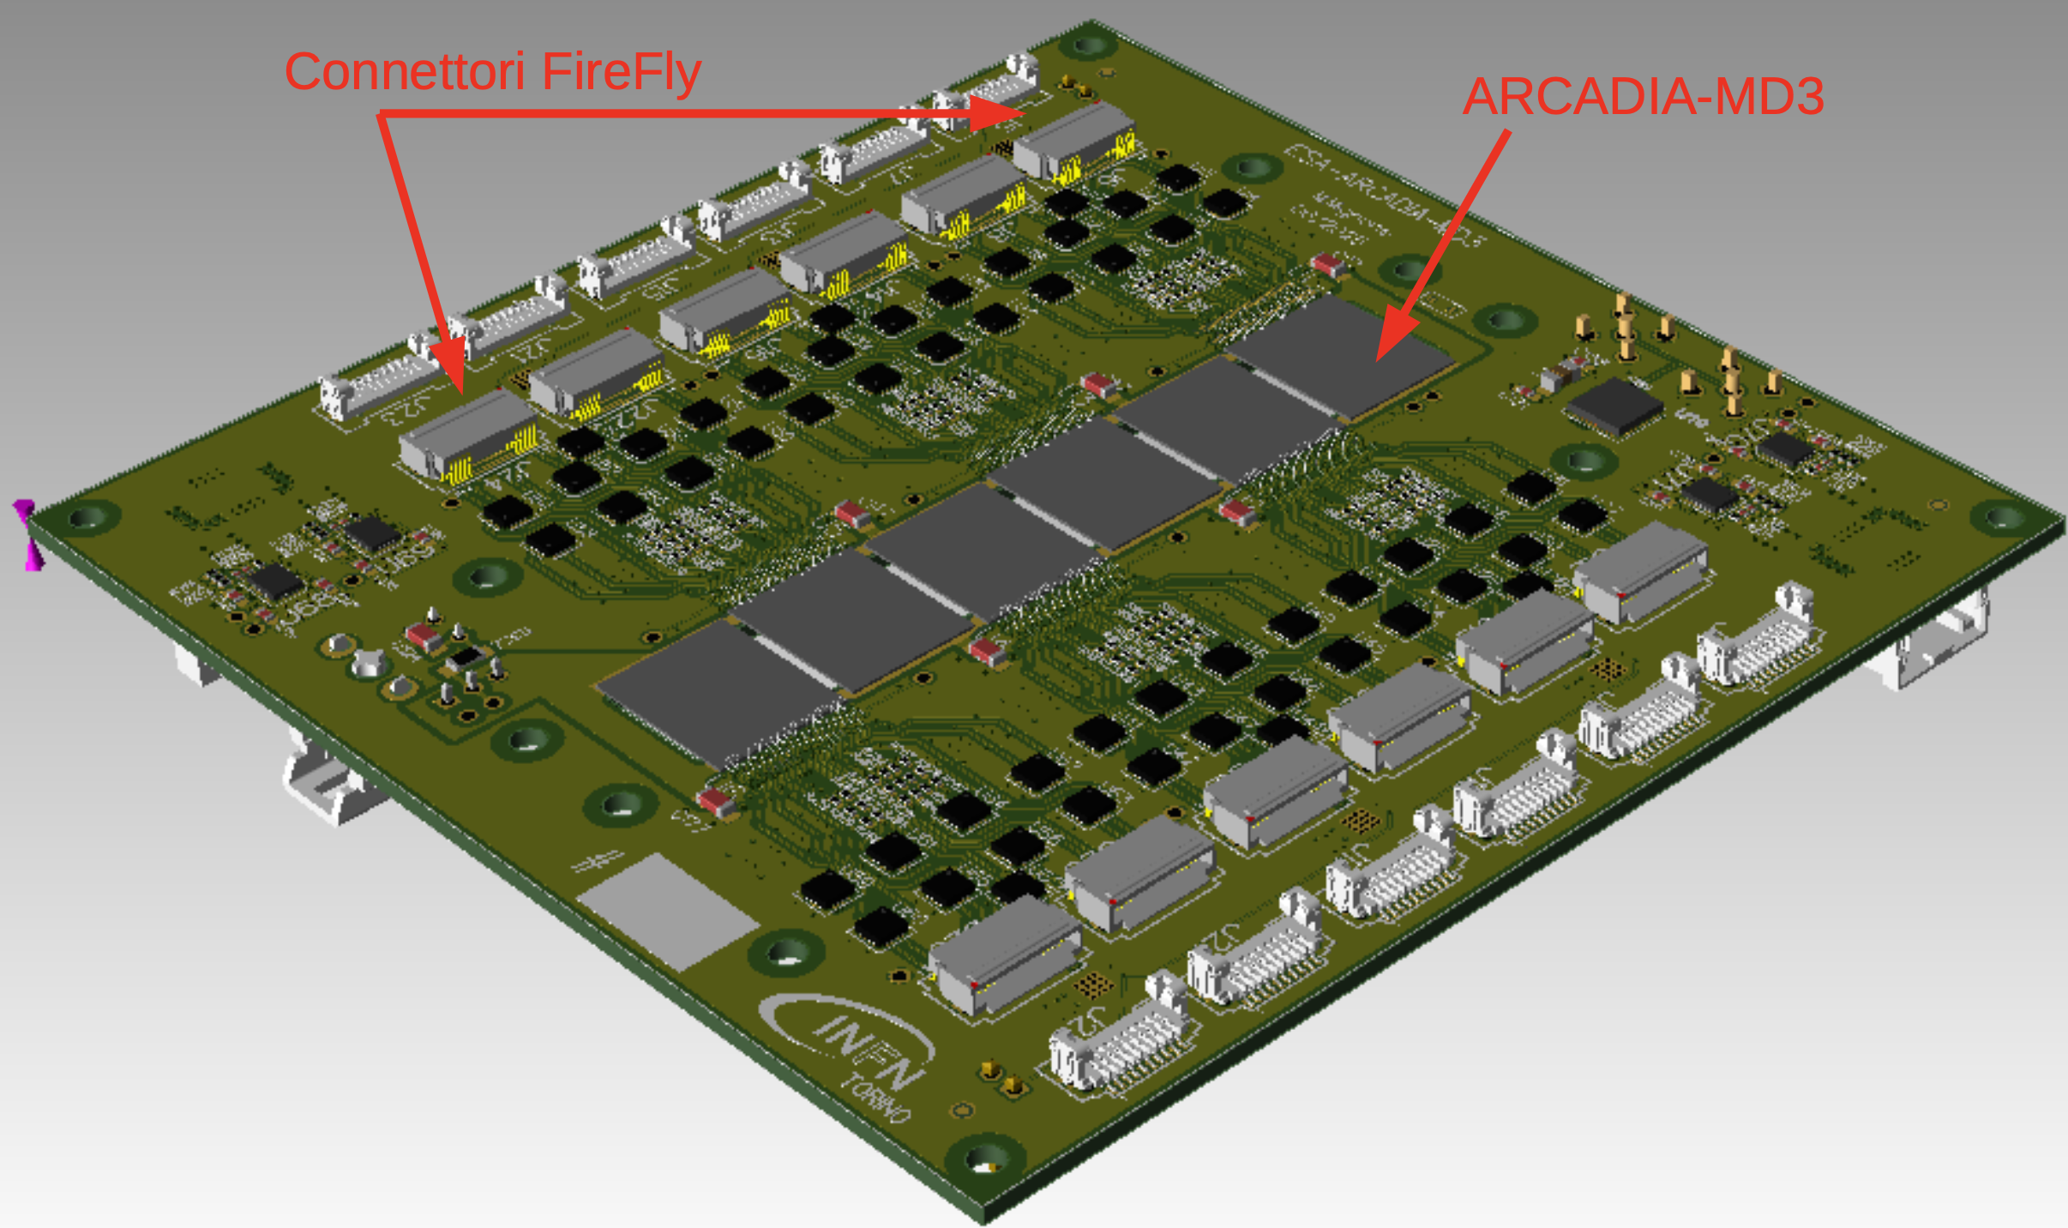
ARCADIA-MD3 PCB Layout & Features
Dimensions: 124.46 × 124.46 mm
8-layer PCB design
DE104 PCB laminate made of standard FR4 material
6 ARCADIA ASICs integrated
12 FireFly connectors for ASIC readout
External clock option for synchronizing multiple boards
Clock skew across 6 ASICs: < 50 ps
Top view
Bottom view

Slide 11
Overall planning for 3-year period
Year 1 – Coursework and Experimental Setup
Completion of core PhD courses and technical training workshops
Setup of laboratory infrastructure and experimental test benches
Initial characterization of ARCADIA MD3 sensors
Study of charge collection, cluster formation, and calibration techniques
Year 2 – Development of X-ray Phase Contrast Imaging
Design and implementation of an X-ray phase contrast imaging setup using ARCADIA MD3 sensors
Exploration of phase-sensitive techniques to enhance image contrast in low-absorption regions
Execution of both soft and hard X-ray experiments
Integration of self-calibration algorithms to improve signal stability and spatial resolution
Year 3 – Data Analysis, Publications, and Thesis Submission
Detailed analysis of experimental results and comparison of imaging modalities
Final optimization of detector performance under varied X-ray conditions
Preparation and submission of peer-reviewed journal publications
Completion and defense of the PhD thesis, summarizing the innovative contributions to CMOS-based X-ray imaging

Slide 12
Courses and Schools
Courses attended:
“Programmable system on chip (SOCs) ” (4 CFU, exam passed)
“Microelectronics of radiation detector II ” (3 CFU, exam passed)
“Design of readout integrated circuits for particle detectors ” (2.5 CFU, exam passed)
“Introductory course to VHDL and HLS programming” (5 CFU, exam passed)
“Fundamental of FPGA based digital design” (2.5 CFU, exam remaining)
Course to be attended:
“Advanced course to FPGA programming” (3 CFU)
School and workshops to be attended:
Excellence in Detector and Instrumentation Technologies (EDIT), 3-13 March, CERN, Switzerland
7th international workshop on new photon detectors, 3-5 December 2025

Slide 14
Backup slides

Slide 15
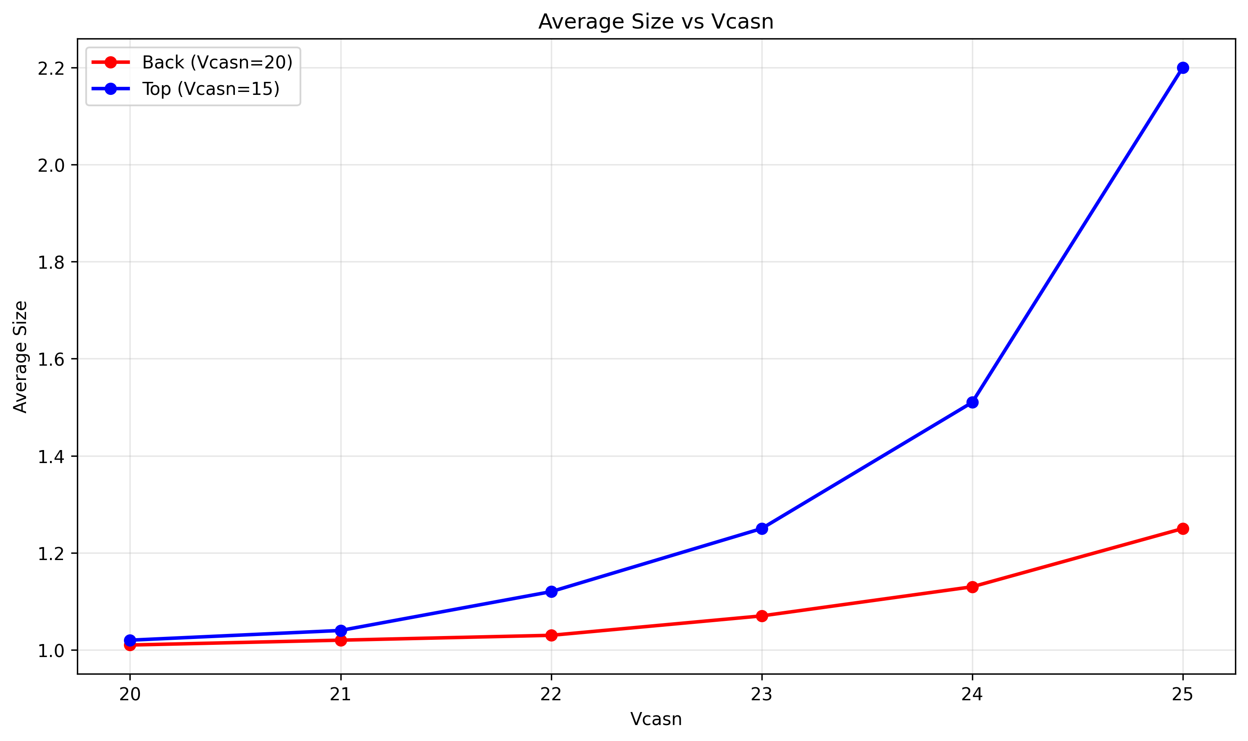
Noise Analysis: Top vs Back illumination
Noise studied by scanning different Vcasn values for Top and Back illumination.
• Two clustering approaches:
– With inertia = 4
– Ignoring pixel position (same timestamp = same cluster)
• Noise observed for Vcasn > 20 in both configurations.

