Slide 1




NIT R&D and
Data Takings: an overview
A. Alexandrov, V. Boccia, N. D’Ambrosio, G. De Lellis, G. Galati, A. Lauria, S. Masci, M.C. Montesi, V. Tioukov
Università di Napoli “Federico II”, INFN Napoli
Università di Bari “Aldo Moro”, INFN Bari
Laboratori Nazionali del Gran Sasso
DAMON Meeting, 1 August 2025

Slide 2
Outline
Overview of NIT related activities in Japan (January 2025 – March 2025)
Current status on NIT sensitization, development and production
First look at the measurements at 200 MeV (Nagoya 03/2025)
First look at the carbon measurements at CNAO (11/2024)
Ideas for future measurements
Conclusions and outlooks
Vincenzo Boccia

Slide 3



Upcoming NIT Measurements in Japan
Many activities planned from ~ January 2025 to March 2025
Machine time booked at Nagoya proton therapy center (3 exposure slots are expected to be available)
Define optimal sensitization and support material (overlap with 2024 CNAO campaign?)
  Use of alternative plastic materials like PMMA (first checks show promising optical properties)
  Testing reversal development for NIT (70 nm) to improve contrast
Physics measurement: expose a NIT brick to protons to reconstruct vertices
Work to be done between Nagoya and Toho (Vincenzo, Giuliana + T. Naka, T. Asada)
From XVII FOOT General Meeting
$$400 μm$$

Slide 4
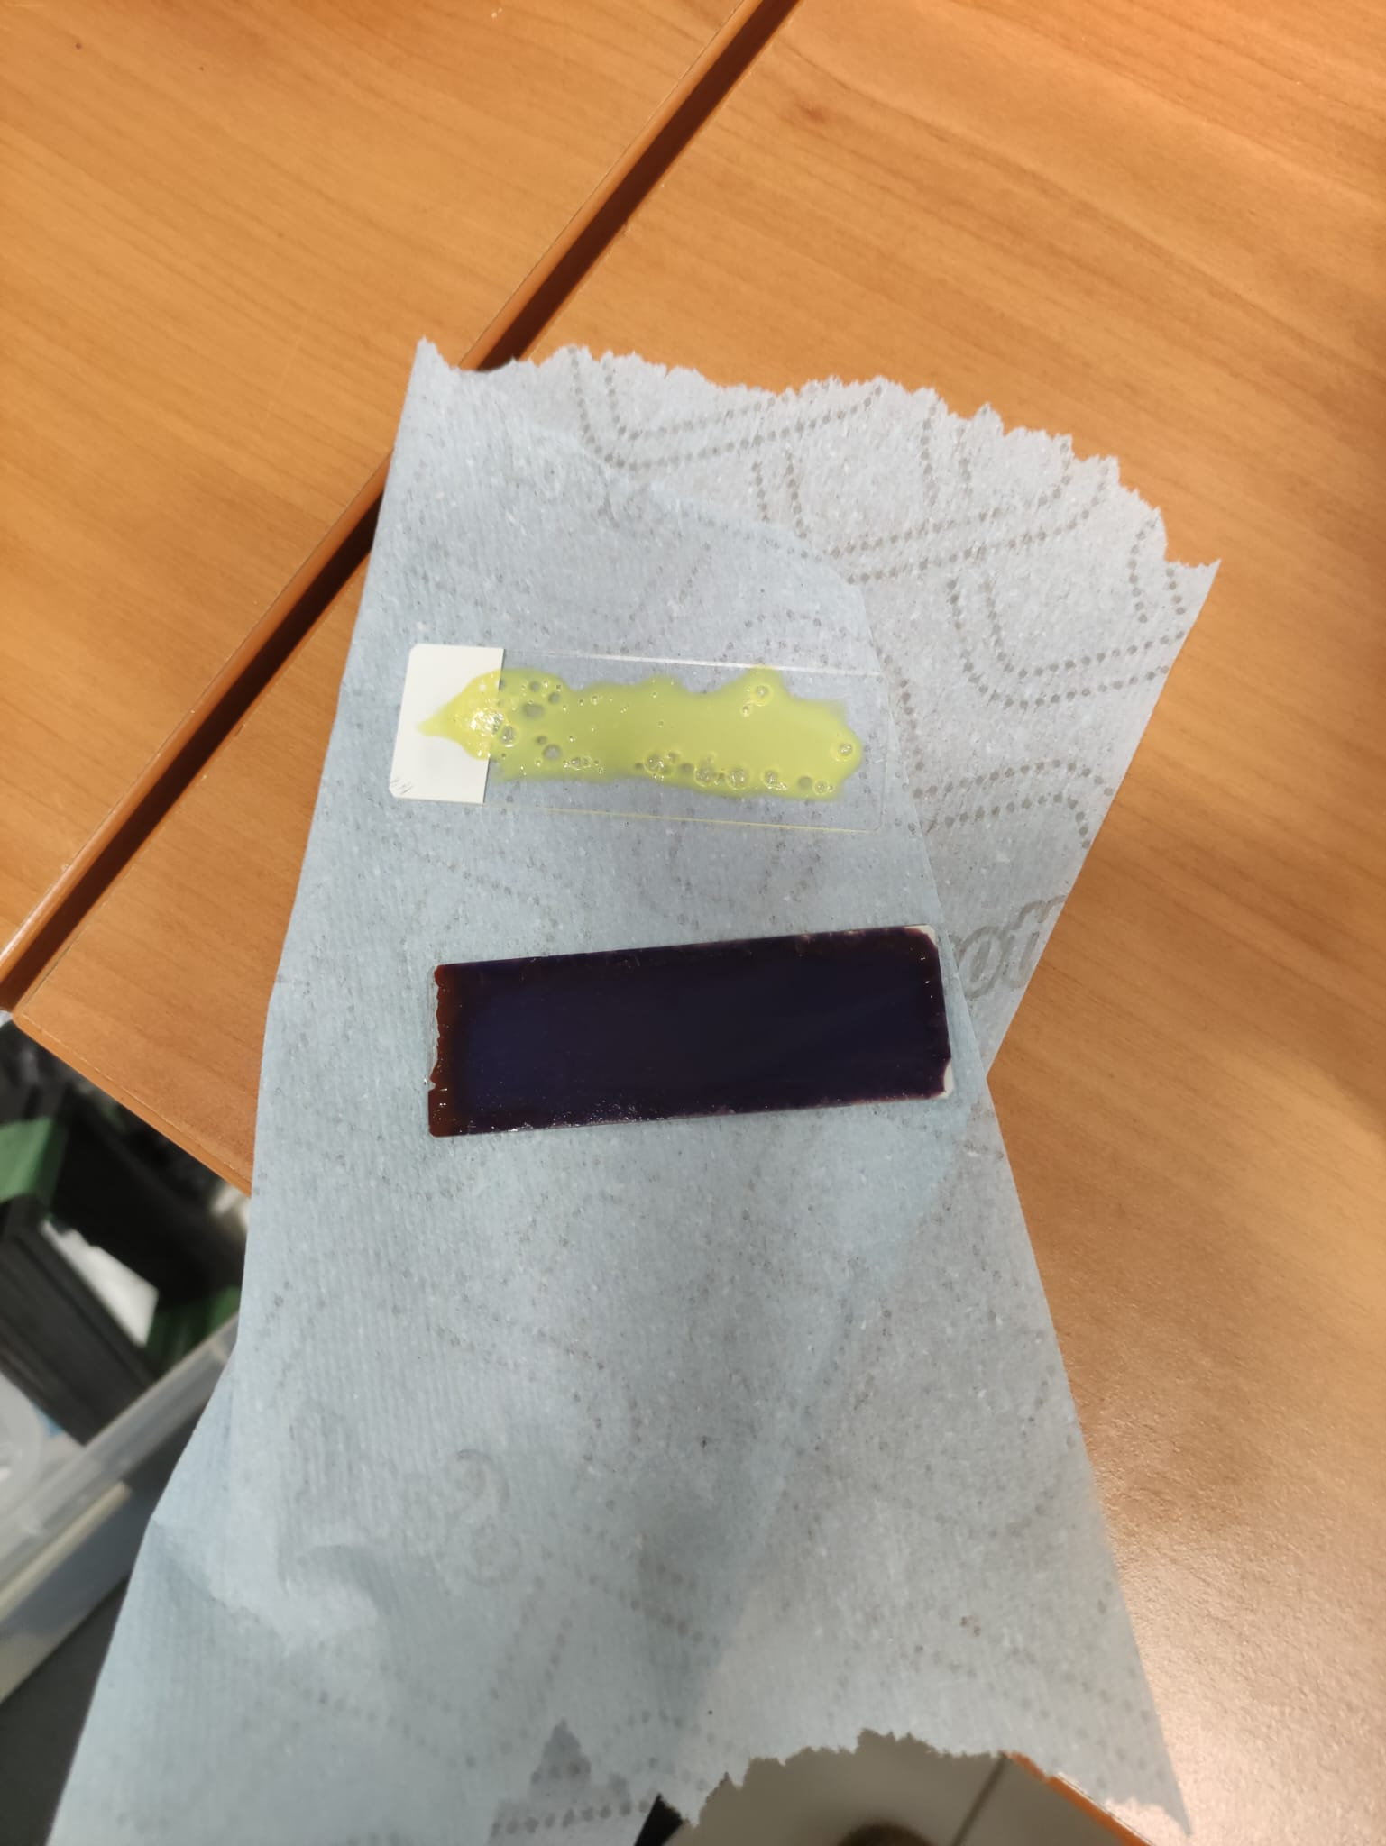
Background
NIT R&D has been focused on improving two main aspects: emulsion gel sensitivity to primary protons and optical properties of the plastic support
NIT emulsions have shown low sensitivity to protons in the past (except for energies lower than ~15 MeV)
New chemical sensitization approaches: sulphur-plus-gold (Au-S) and triethanolamine (TEA) were tested in LNGS (end of 2024) with promising results
PMMA a promising candidate for thin plastic support
Unsensitized vs TEA sensitized
Vincenzo Boccia

Slide 5
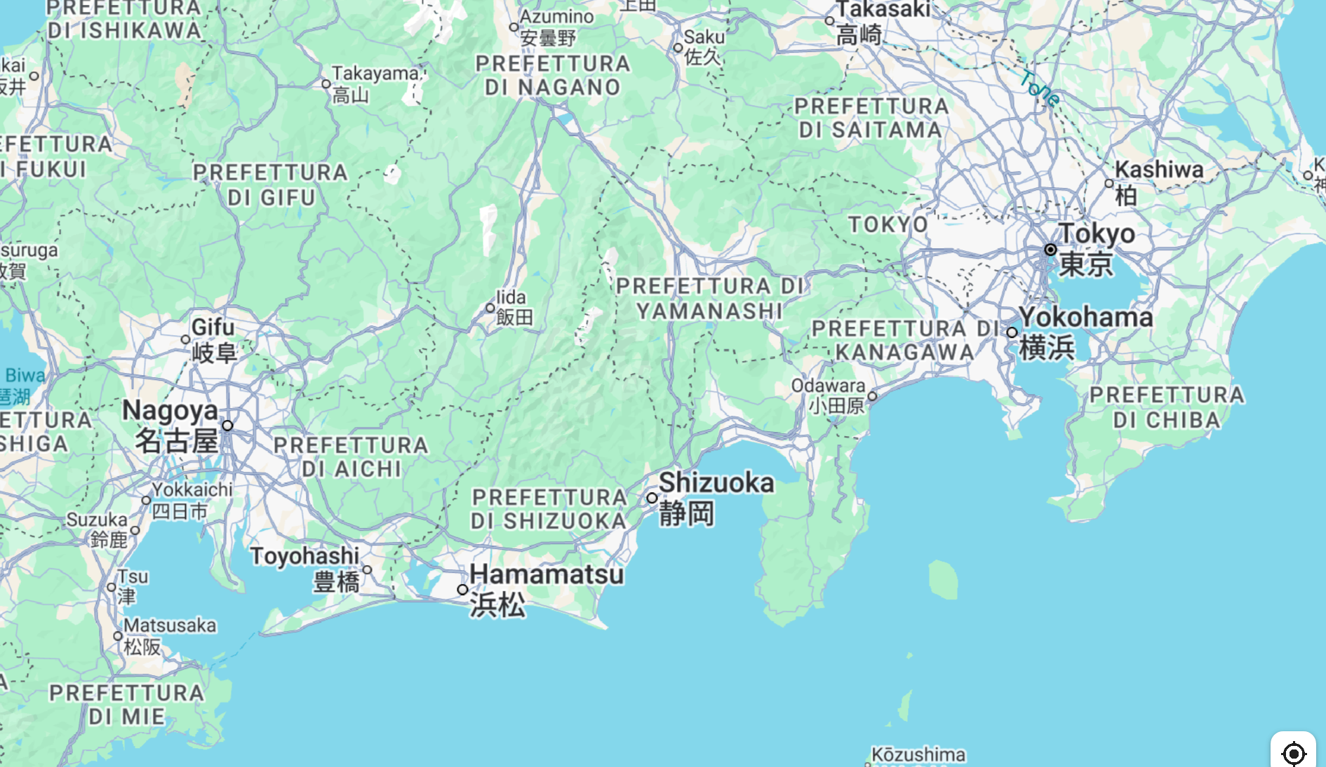


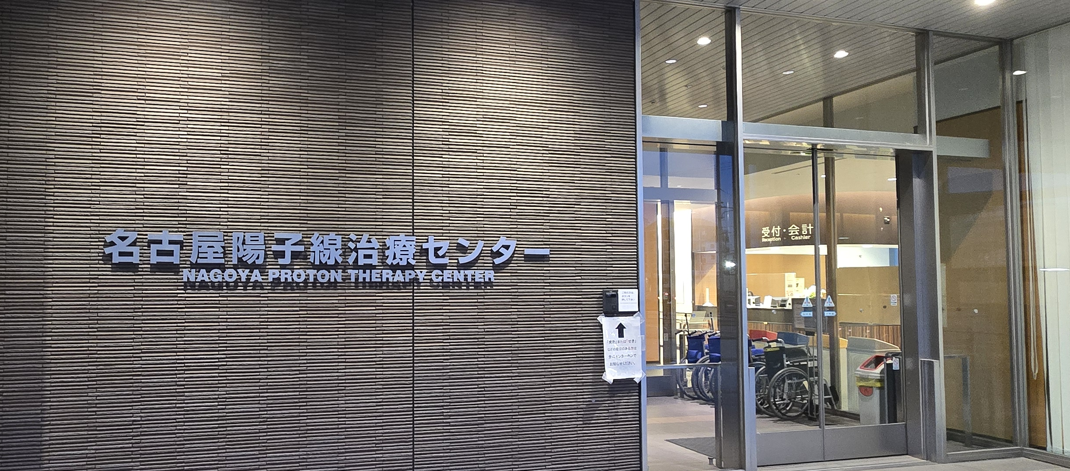
Overview of Activities in Japan
Three data takings at the Nagoya proton therapy center (January – March 2025)
Production of samples between Toho university (Narashino, near Tokyo) and Nagoya university
Main improvements
  New chemical development («reversal»)
  Characterization of grain density as a function of proton energy
  Successful usage of PMMA base (improved contrast and significant reduction of artifacts)
Physics measurements
  Target fragmentation with protons at 70 MeV (PS base and reversal development)
  Target fragmentation with protons at 200 MeV (PMMA base, MAA and reversal developments)
Vincenzo Boccia

Slide 6
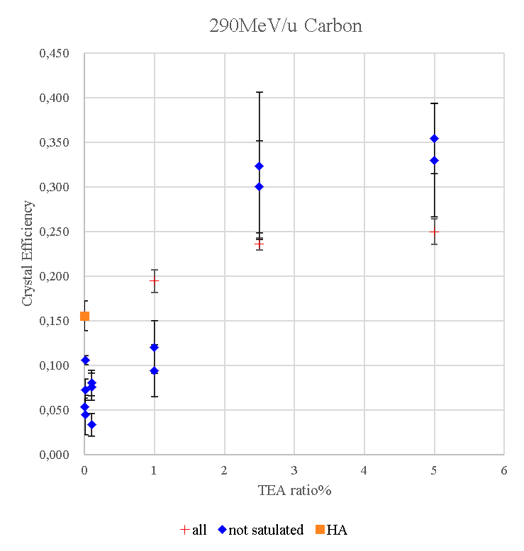



NIT Sensitization: Current Status
Previous tests performed in LNGS had shown Triethanolamine (TEA) to be a promising candidate to increase crystal sensitivity in NIT emulsions
The analysis of horizontal exposures to 290 MeV/n $^{12}C$ ions at HIMAC (T. Asada, T.Naka, December 2024) showed little to no increase in sensitivity for concentrations larger than 25 g/L of TEA
Using larger concentrations is difficult because of changes in the mechanical properties of the emulsion gel
HA
Images and plot by T. Asada
TEA 2.5%
not saturated
20 $μm$
Vincenzo Boccia

Slide 7
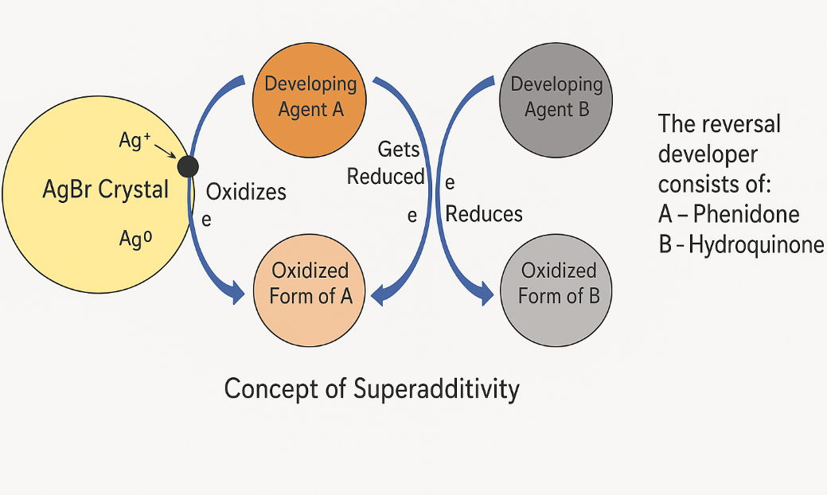
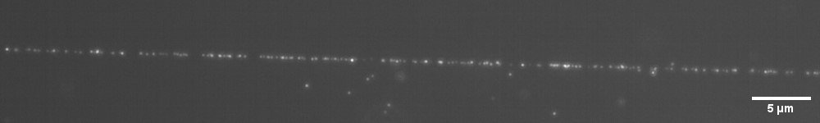
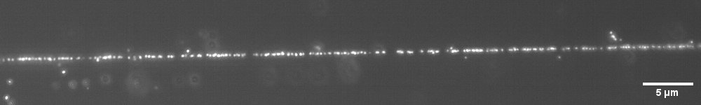
Reversal Development
Standard NIT development is performed with the MAA developer, based on Metol and Ascorbic Acid
  The main drawback of this developer is low brightness of the developed grains
Reversal development has been designed to increase grain brightness
  More aggressive development containing phenidone and hydroquinone, which melt the AgBr crystals to stimulate larger filament growth, resulting in a much larger brightness
At this time it has been tested and is being optimized for 70 nm NIT
  One drawback: larger filaments exhibit weaker plasmon resonance!
Images by
K. Someya
MAA
290 MeV/n Carbon ions
Reversal
Vincenzo Boccia

Slide 8
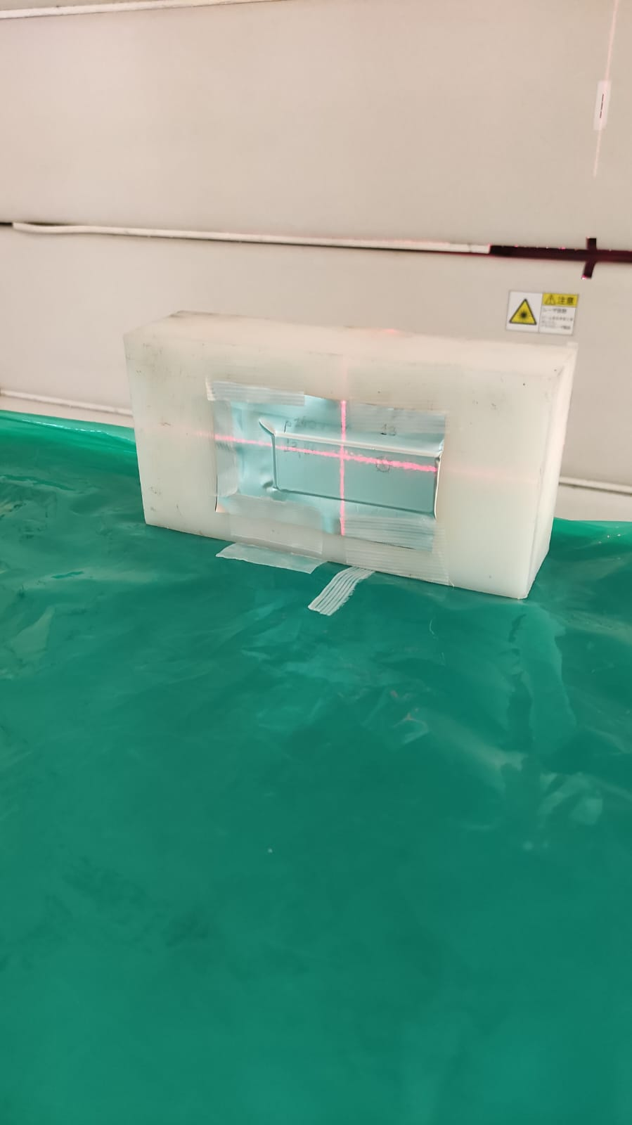
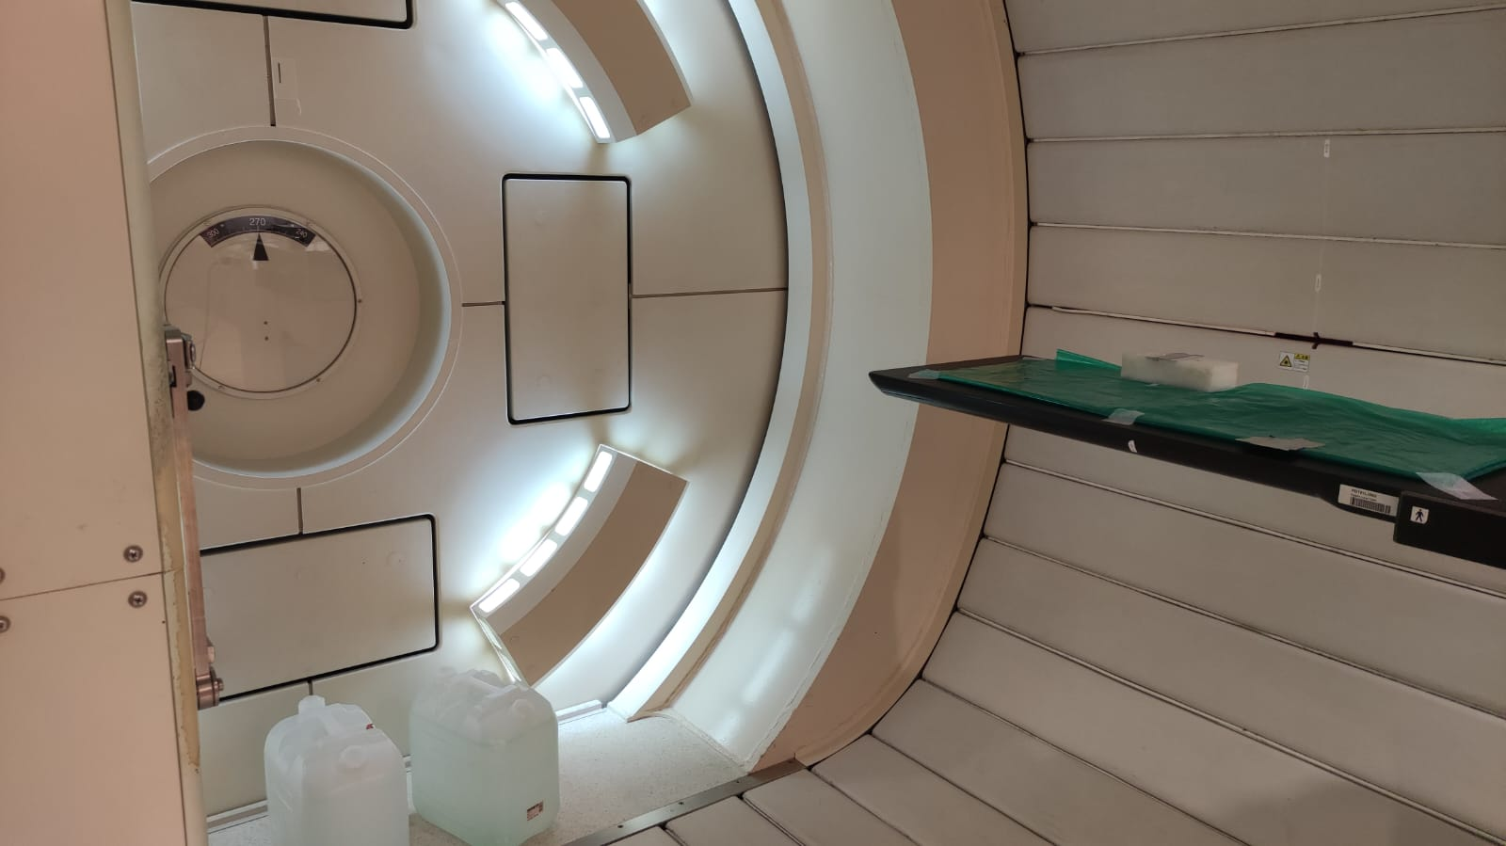
First exposure at Nagoya Proton Therapy Center
Characterize NIT response to protons at different energies, when using 2.5% TEA and reversal development
Test proton tracking efficiency with vertical exposures
NIT (70 nm)
OPERA (200 nm)
Horizontal exposures to measure proton sensitivity at different energies
Vertical exposures:
proton tracking
Vincenzo Boccia

Slide 9
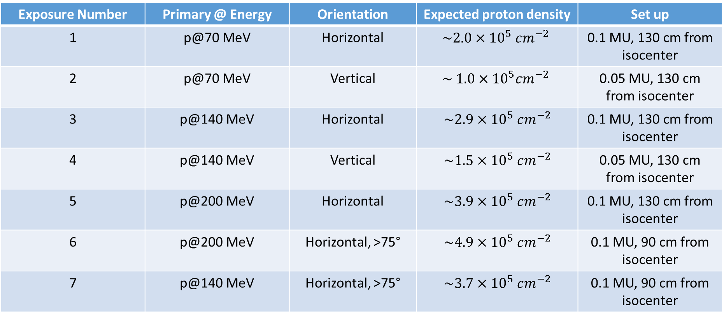
Exposure Summary
Emulsion batches: FAN161gf, FAN162fg
All samples were produced on slide glasses (すべてのサンプルはスライドガラス上で作製されました。)
NIT (70 nm)
OPERA (200 nm)
Exposure Number | Primary @ Energy | Orientation | Expected proton density | Set up
1 | p@70 MeV | Horizontal | $$\sim 2.0×{10}^{5} cm^{−2}$$ | 0.1 MU, 130 cm from isocenter
2 | p@70 MeV | Vertical | $$\sim 1.0×{10}^{5}cm^{−2}$$ | 0.05 MU, 130 cm from isocenter
3 | p@140 MeV | Horizontal | $$\sim 2.9×{10}^{5} cm^{−2}$$ | 0.1 MU, 130 cm from isocenter
4 | p@140 MeV | Vertical | $$\sim 1.5×{10}^{5} cm^{−2}$$ | 0.05 MU, 130 cm from isocenter
5 | p@200 MeV | Horizontal | $$\sim 3.9×{10}^{5} cm^{−2}$$ | 0.1 MU, 130 cm from isocenter
6 | p@200 MeV | Horizontal, >75° | $$\sim 4.9×{10}^{5} cm^{−2}$$ | 0.1 MU, 90 cm from isocenter
7 | p@140 MeV | Horizontal, >75° | $$\sim 3.7×{10}^{5} cm^{−2}$$ | 0.1 MU, 90 cm from isocenter

Slide 10
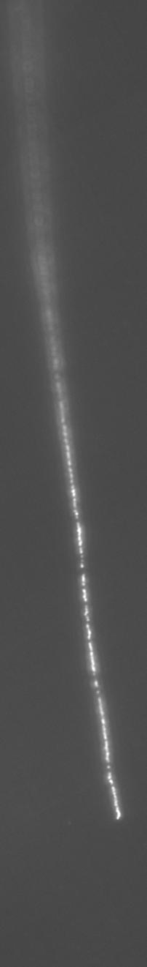
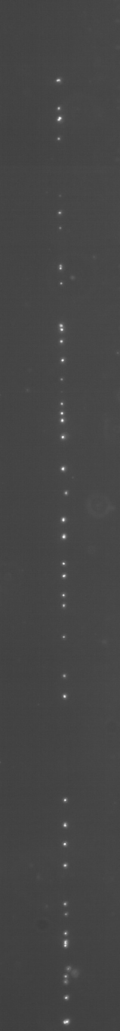
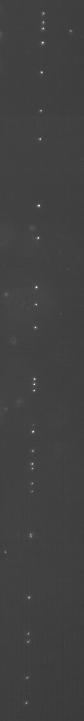
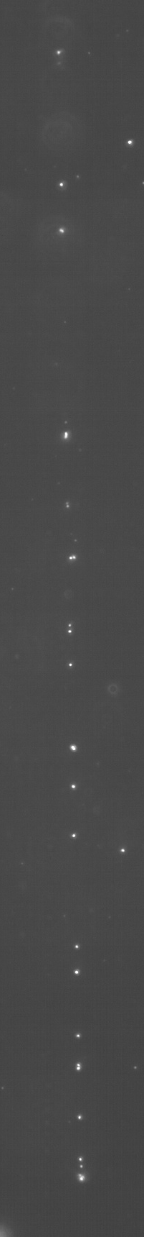
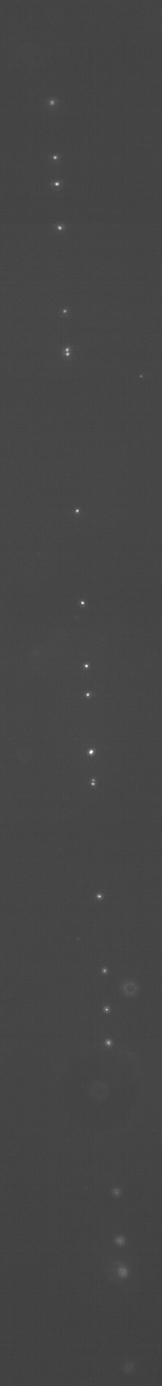





Proton Beam
NIT (70 nm)
OPERA (200 nm)
TEA (2.5%) REVERSAL
End of range
$$\sim 26 MeV$$
$$\sim 68 MeV$$
$$\sim 96 MeV$$
$$\sim 126 MeV$$
$$\sim 179 MeV$$
Proton Energy
Vincenzo Boccia

Slide 11
Grain Density Calibration
Proton energy loss in the emulsion layer was simulated with Geant4
Grain density was measured manually after choosing 10 proton tracks at different «depths», corresponding to different proton energies (the uncertainty on the energy has been neglected)
Small sensitivity increase when the temperature is larger than 75°: not significant enough to justify the added complexity!
Physics point of view: possible to identify protons and measure their energy (and separate them from helium tracks)
NIT (70 nm)
OPERA (200 nm)
Vincenzo Boccia

Slide 12
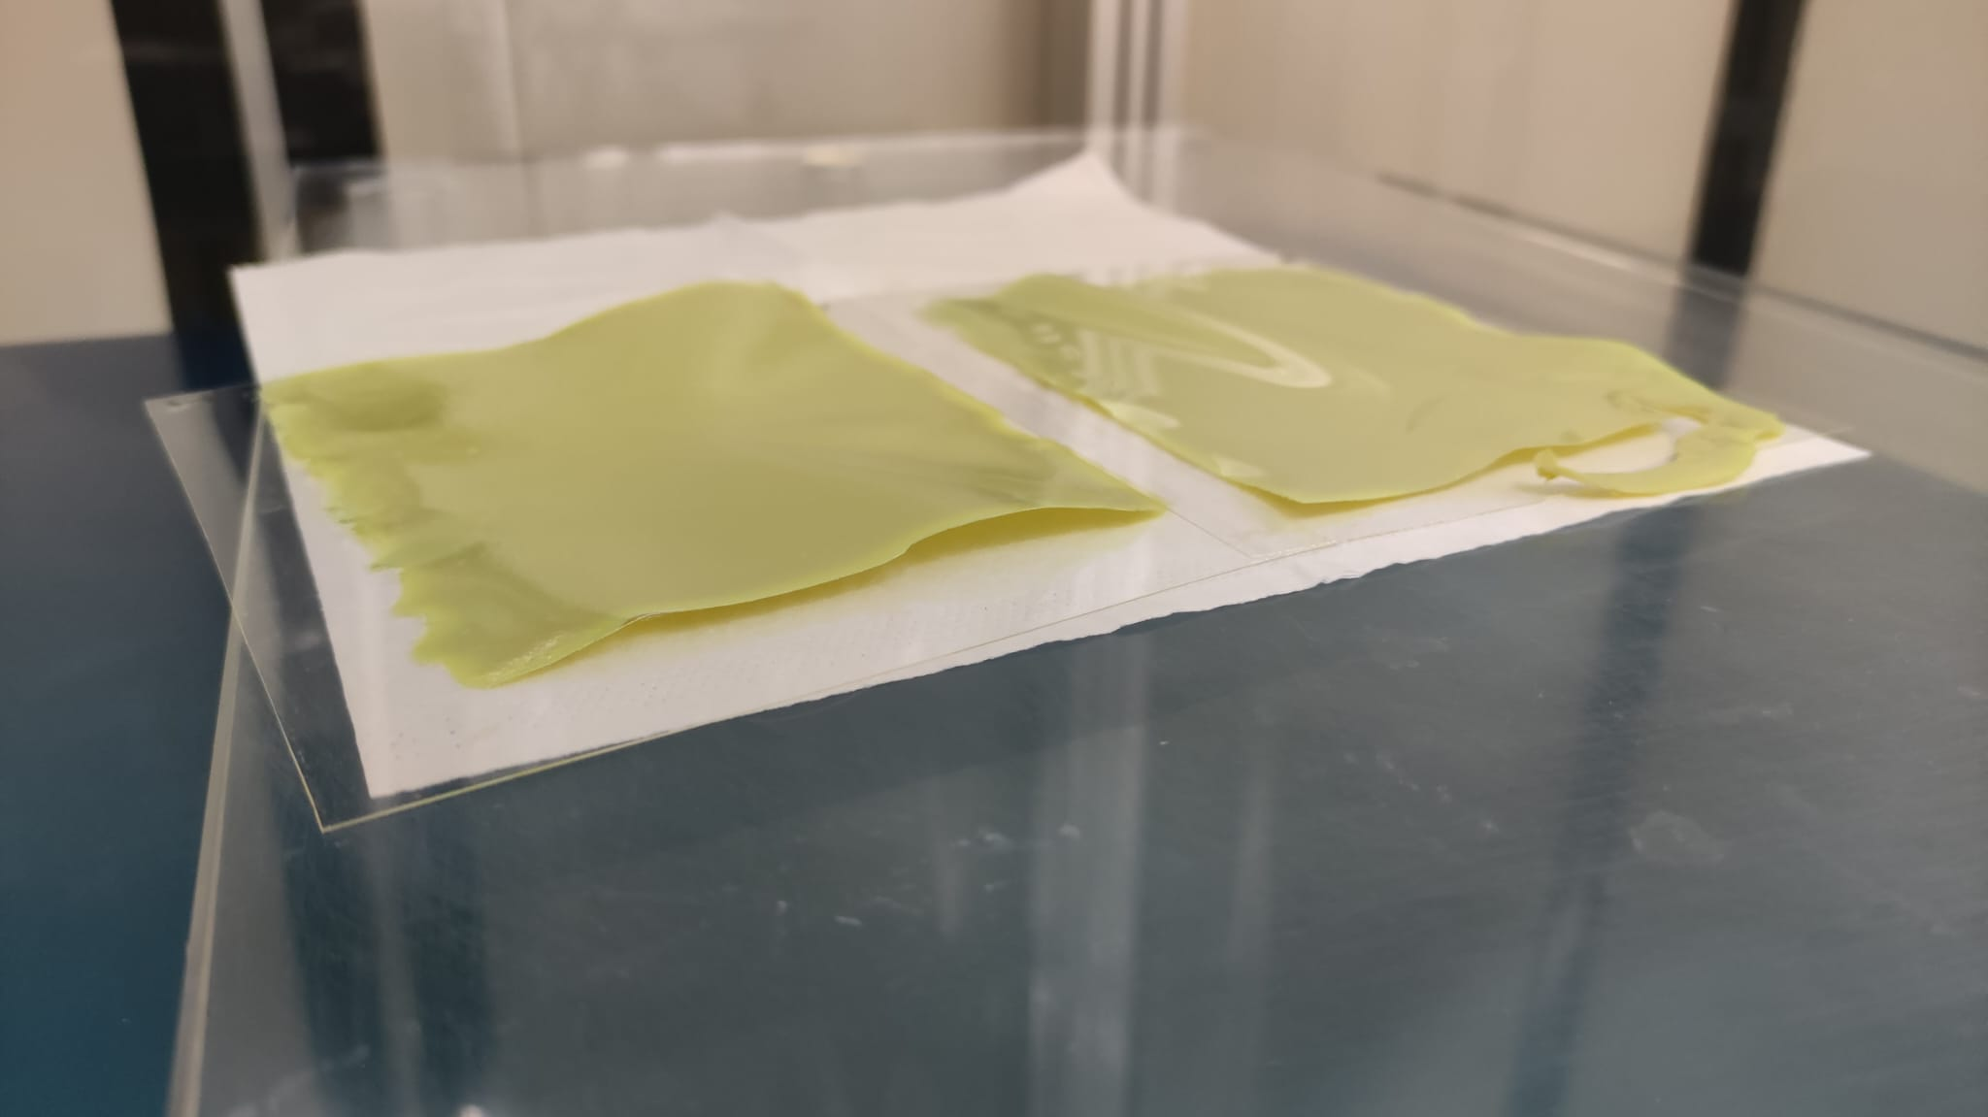
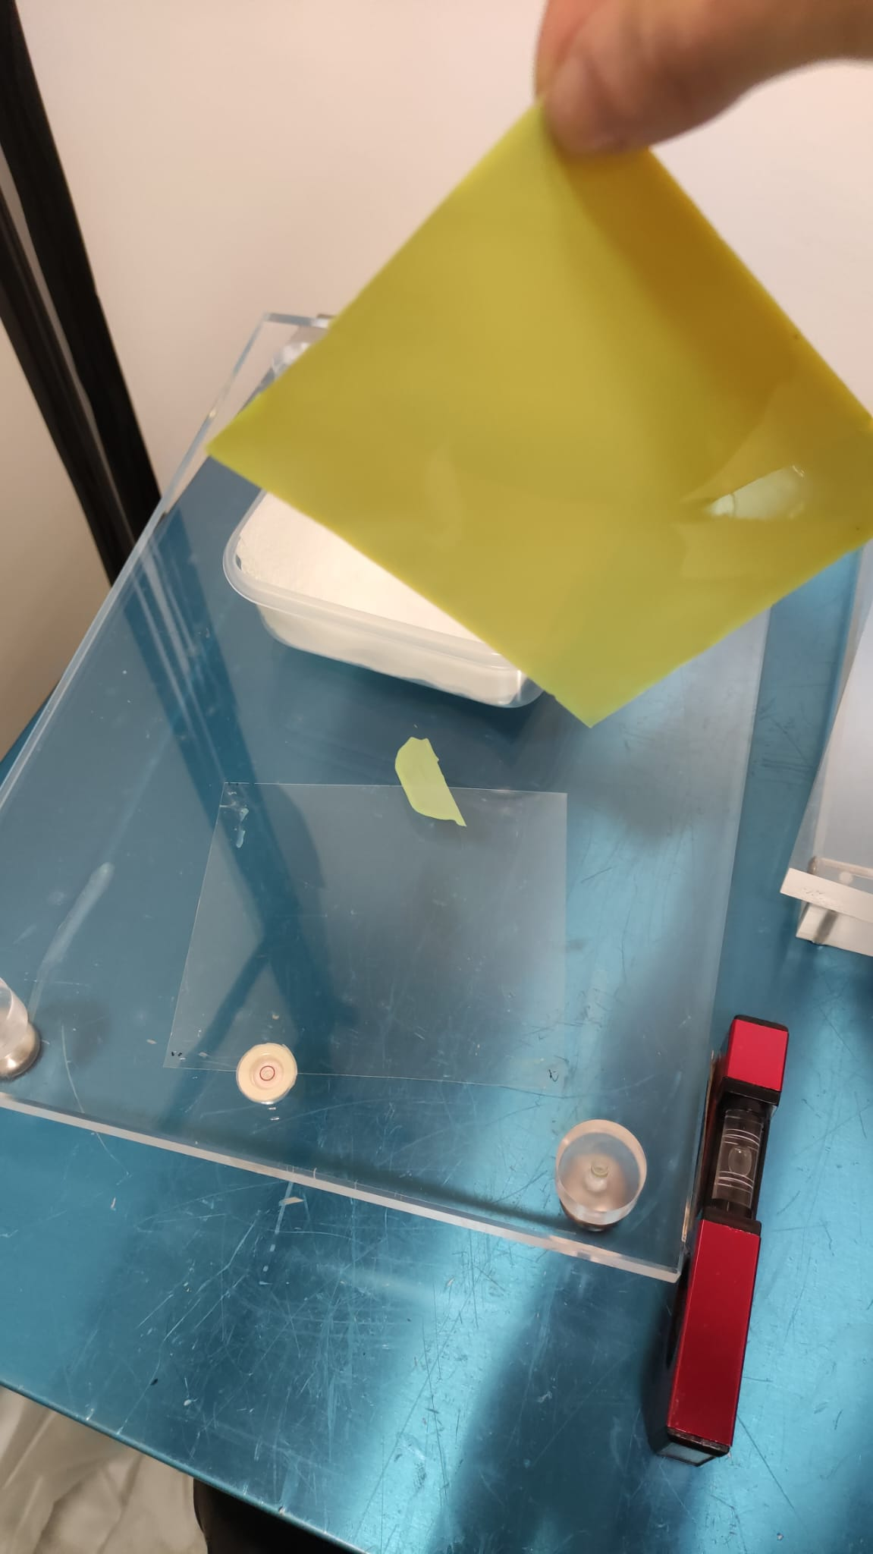
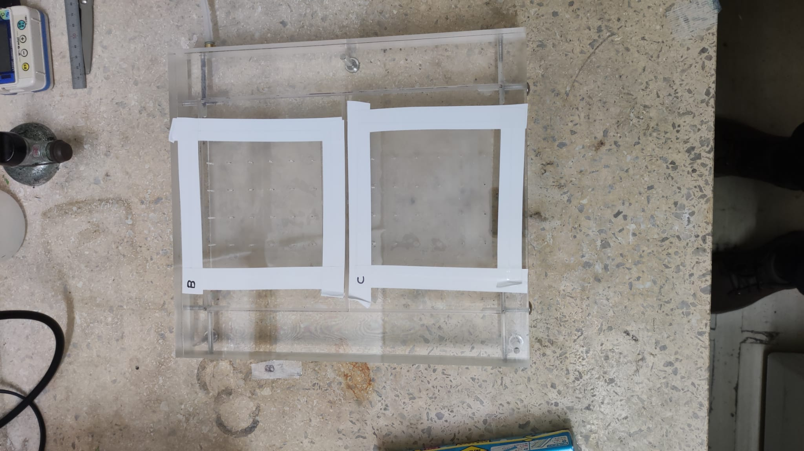

PMMA Pouring Tests
In order to do pouring, it is necessary to treat the PMMA plastic with a corona discharge machine, before applying an Under Coat (UC)
First, we tested pouring with a thin (200 $μm$) PMMA base in Nagoya and standard UC, with poor results: NIT detached from the plastic after removing the tape!
A second test at Toho university has shown that the issue was low humidity ($\sim$ 40% in Nagoya vs $\sim 65\%$ in Toho)
The second pouring test was more successful but the samples detached from the plastic after the final protection coating
NIT (70 nm)
OPERA (200 nm)
Vincenzo Boccia - MAECI-MOFFIITS Meeting, 27 May 2025

Slide 13
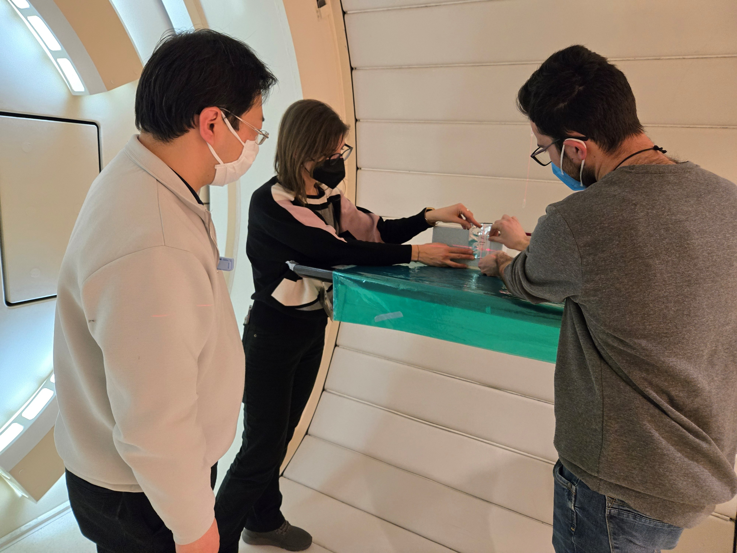
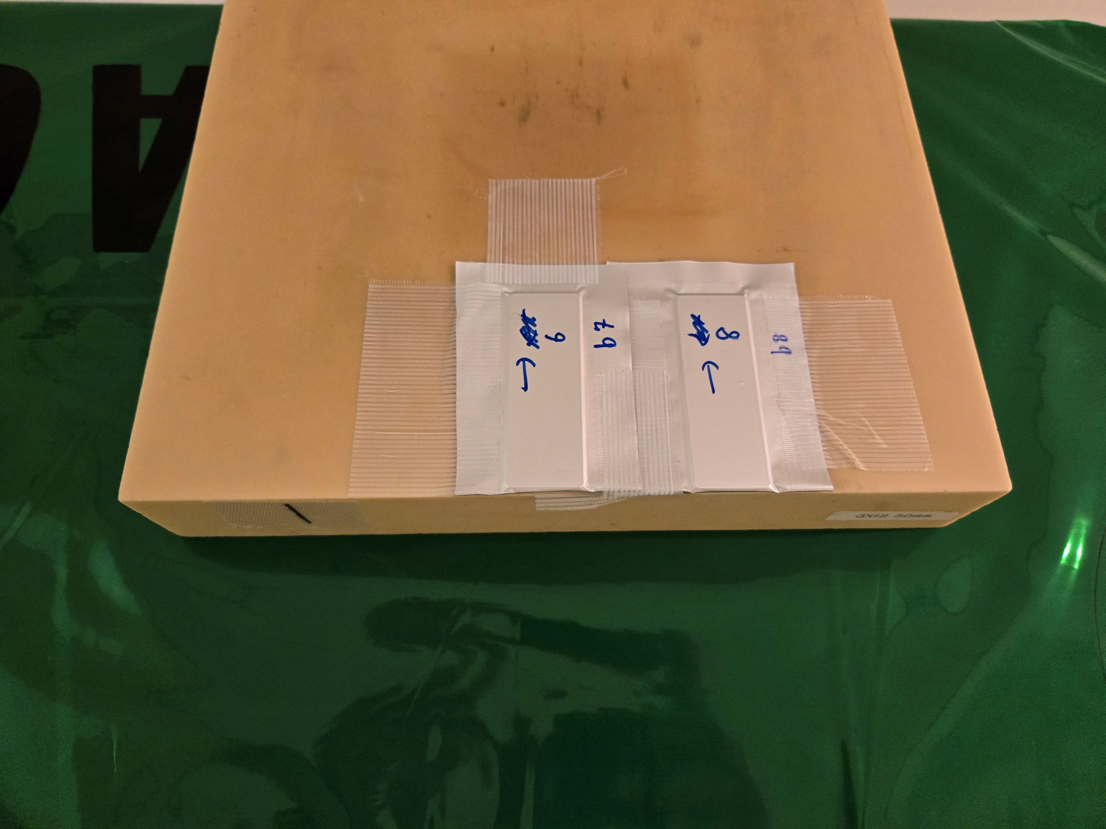
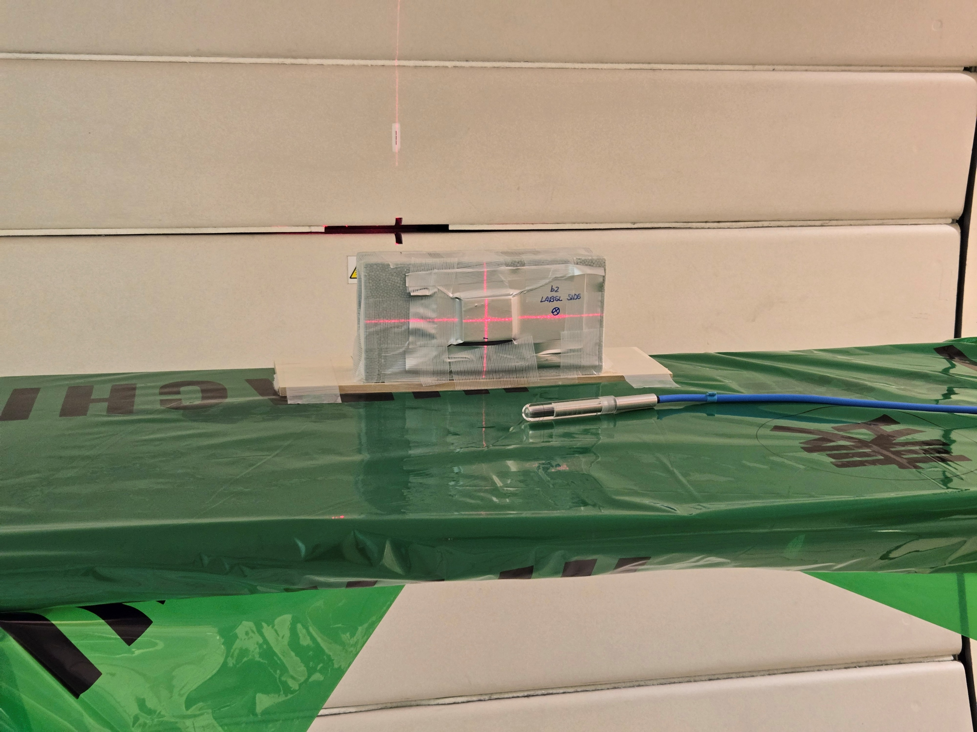
Second exposure
Measure the primary proton density and the repeatibility when close to zero Machine Units (down to 0.025 MU)
  OPERA-like emulsion gel poured on slide glasses and exposed vertically
Test the repeatability of the grain density calibration by using a different emulsion batch
Test different development parameters
Perform a first physics measurement in «conservative» conditions
NIT (70 nm)
OPERA (200 nm)
Horizontal exposures: repeat grain density calibration
First Physics Measurement (70 MeV protons)
Vincenzo Boccia

Slide 14
Grain Density Calibration repeatability
The results of the second measurement were compatible with the previous one within the margin of error, demonstrating the robustness of this result
NIT (70 nm)
OPERA (200 nm)
Proton Beam
TEA (2.5%) REVERSAL
Vincenzo Boccia

Slide 15
Tuning the development parameters
Reversal development was tested with different temperatures and development times
A small increase of grain density was observed when developing at 10° for 10 minutes. However this condition also led to an increase in fog density
OPERA (200 nm)
NIT (70 nm)
Proton Beam
TEA (2.5%) REVERSAL
Vincenzo Boccia

Slide 16
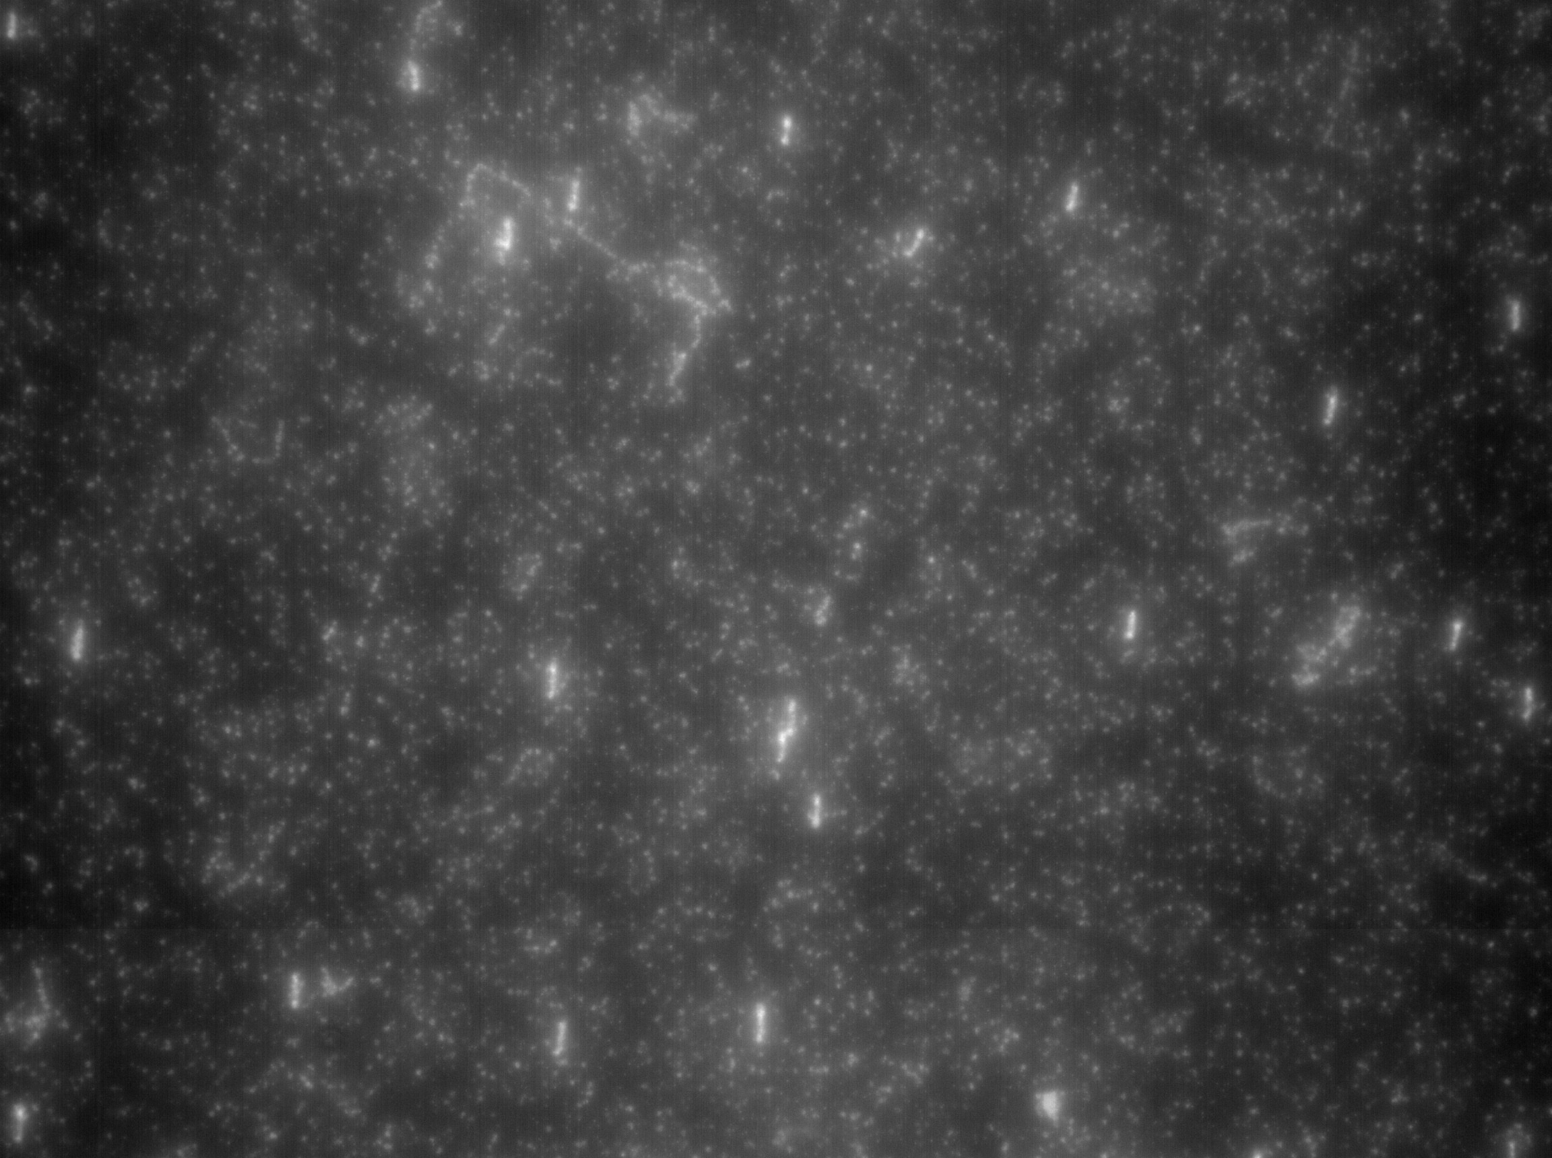


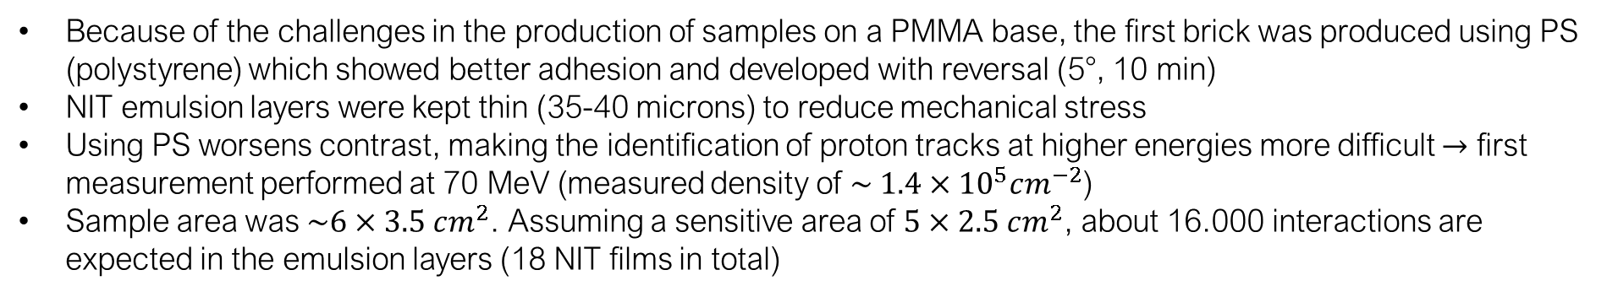
First Physics Measurement
Because of the challenges in the production of samples on a PMMA base, the first brick was produced using PS (polystyrene) which showed better adhesion and developed with reversal (5°, 10 min)
NIT emulsion layers were kept thin (35-40 microns) to reduce mechanical stress
Using PS worsens contrast, making the identification of proton tracks at higher energies more difficult $→$ first measurement performed at 70 MeV (measured density of $\sim 1.4×{10}^{5}cm^{−2}$)
Sample area was $\sim 6×3.5 cm^{2}$. Assuming a sensitive area of $5×2.5 cm^{2}$, about 16.000 interactions are expected in the emulsion layers (18 NIT films in total)
NIT (70 nm)
OPERA (200 nm)
NIT sensitive layer
AgBr(I) crystals dispersed in organic gelatine (H, C, O, N)
Plastic Support
Polystyrene (H, C, O)
Proton
...
$$\sim 200 μm$$
$$\sim 80 μm$$
OPERA sensitive layer
Used for monitoring
OPERA layer used as beam monitor
Vincenzo Boccia

Slide 17
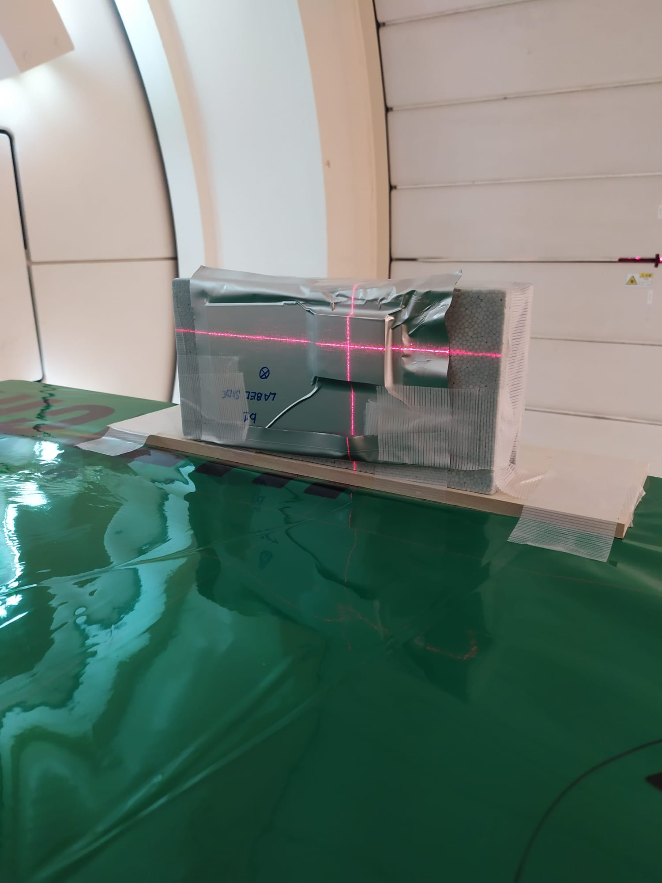
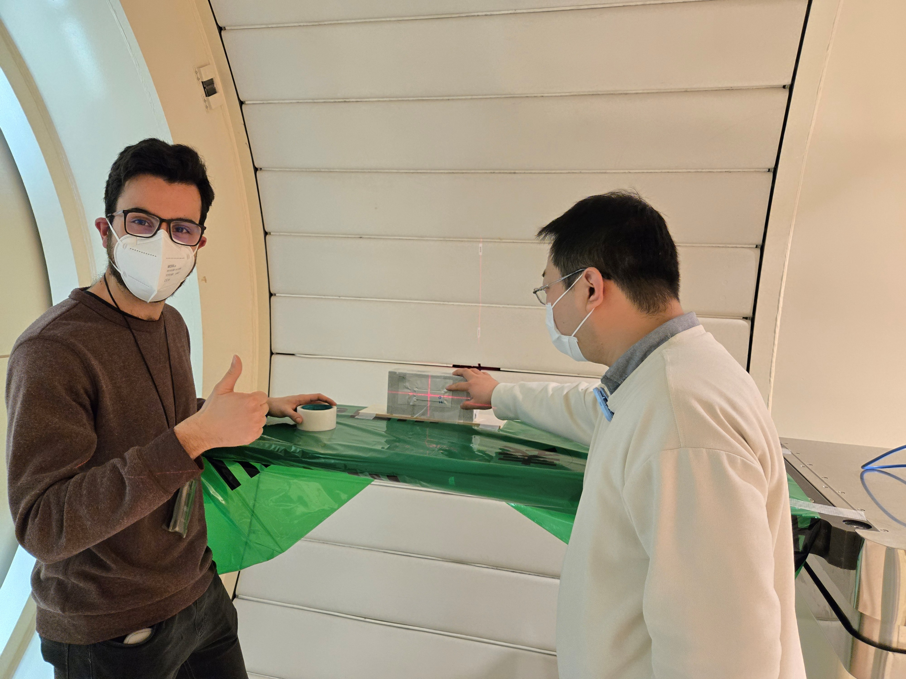
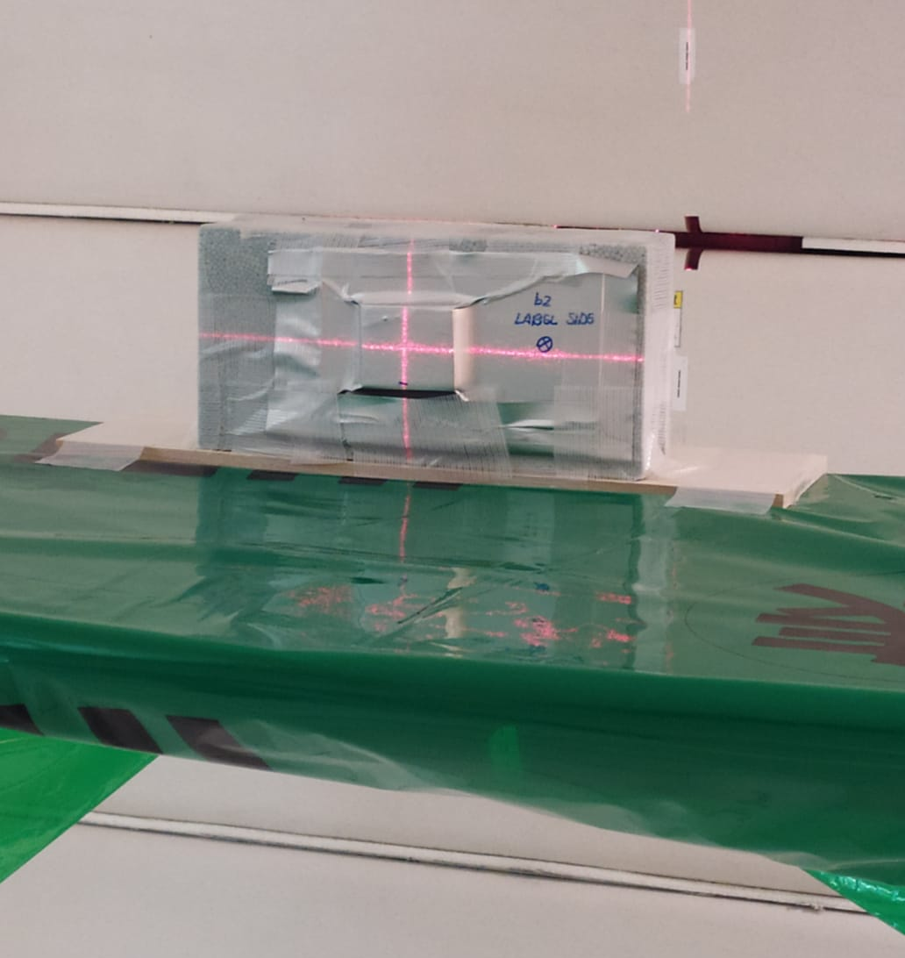

Final Exposure in Nagoya
Several pouring tests were performed with PMMA: finally, the use of an Under Coat solution containing Chromium lead to the first successful samples $→$possible to use PMMA
Data takings performed with protons at 200 MeV
NIT (70 nm)
OPERA (200 nm)
b1: 200 MeV protons + Reversal
b2: 200 MeV protons + MAA
Vincenzo Boccia

Slide 18
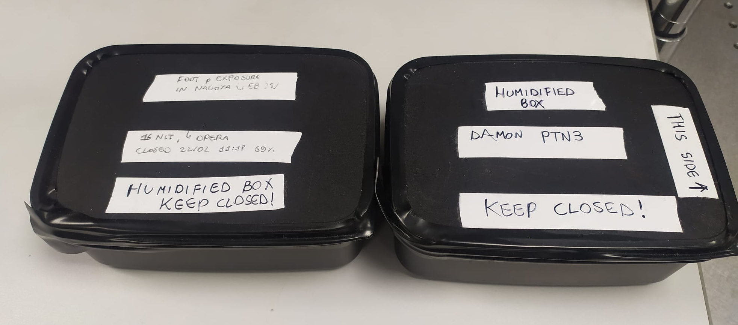

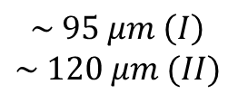

Physics Measurements at 200 MeV
For the final exposure (primary protons at 200 MeV), we produced two NIT bricks
  The first brick (3 OPERA-PS + 12 NIT-PMMA + 3 OPERA-PS) has been developed with MAA and it has been exposed to $\sim 5×{10}^{5}$ protons $cm^{−2}$. Its goal is to study the heavier fragments with the plasmon analysis, disregarding secondary protons (very faint with MAA). Unfortunately, about half of the films in this brick were damaged (detaching) immediately before development
  The second brick (3 OPERA-PS + 20 NIT-PMMA + 3 OPERA-PS) has been developed with reversal and it has been exposed to $\sim 1×{10}^{5}$ protons $cm^{−2}$. The higher grain brightness should enable the reconstruction of secondary protons
All bricks were transported back to Italy in sealed boxes with a NaBr saturated solution to keep humidity stable
NIT sensitive layer
AgBr(I) crystals dispersed in organic gelatine (H, C, O, N)
NIT (70 nm)
OPERA (200 nm)
Plastic Support
PMMA (H, C, O)
...
$$\sim 200 μm$$
$$\sim 95 μm \left(I\right)$$
$$\sim 120 μm (II)$$
OPERA sensitive layer
Used for monitoring
Vincenzo Boccia

Slide 19
Physics Measurements at 200 MeV: First Look
Importance of humidified environment for these samples (show some log)
Good condition of PMMA -> optical success take picture and compare it to previous slides about PS
1 typical view from P02 and primary proton tracks (reversal brick)
1 example of vertex + first secondary proton with estimate of energy based on grain density
Gold nano particles for reference system -> a first look
Vincenzo Boccia - MAECI-MOFFIITS Meeting, 26-28 May 2025

Slide 20
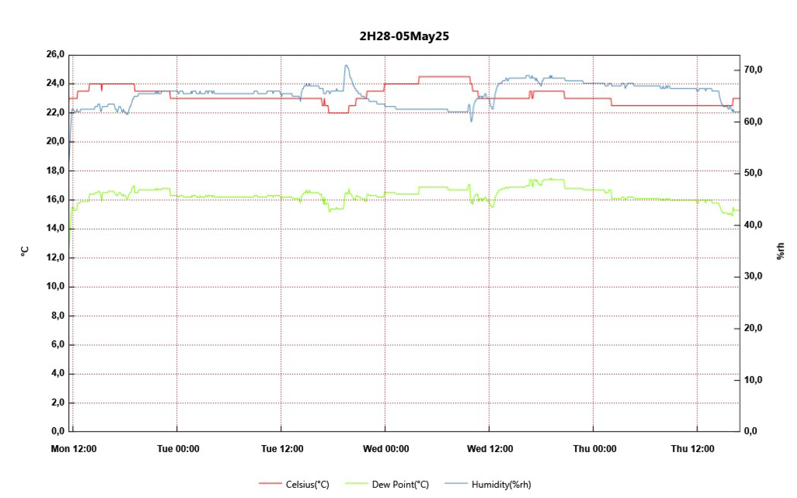
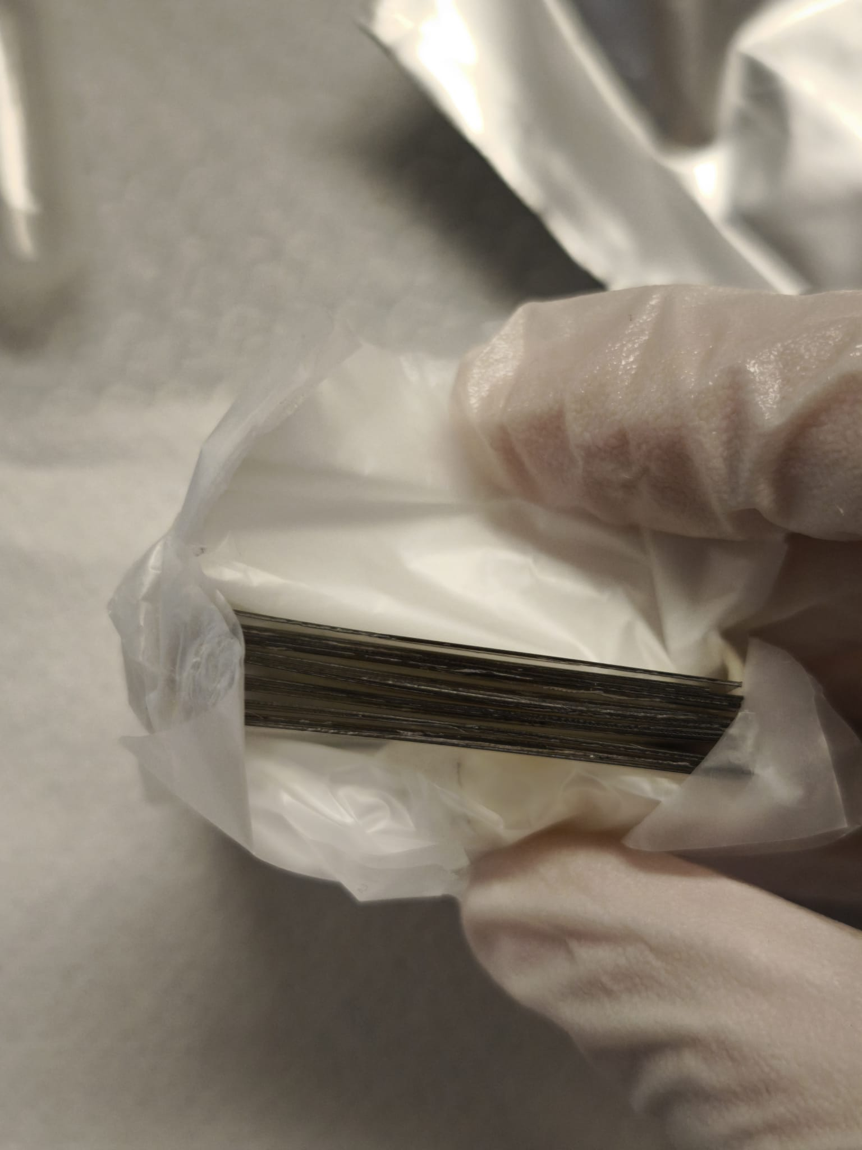
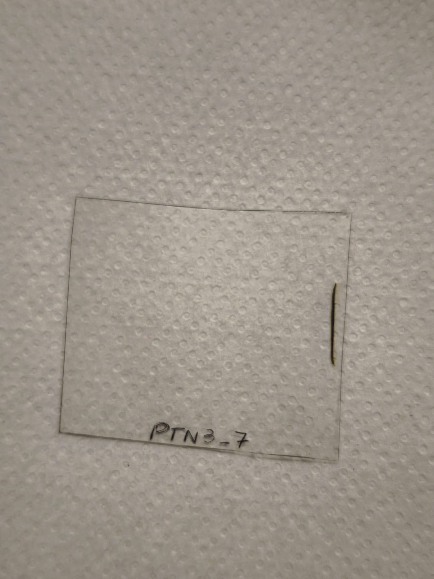
Measurements at 200 MeV: First Look (1)
In order to prevent detaching from the plastic support it was important to set up a humidified environment in the scanning room (target relative humidity is at least 60%)
Good news: no PMMA sample was damaged during transportation from Japan to Italy!
Vincenzo Boccia

Slide 21
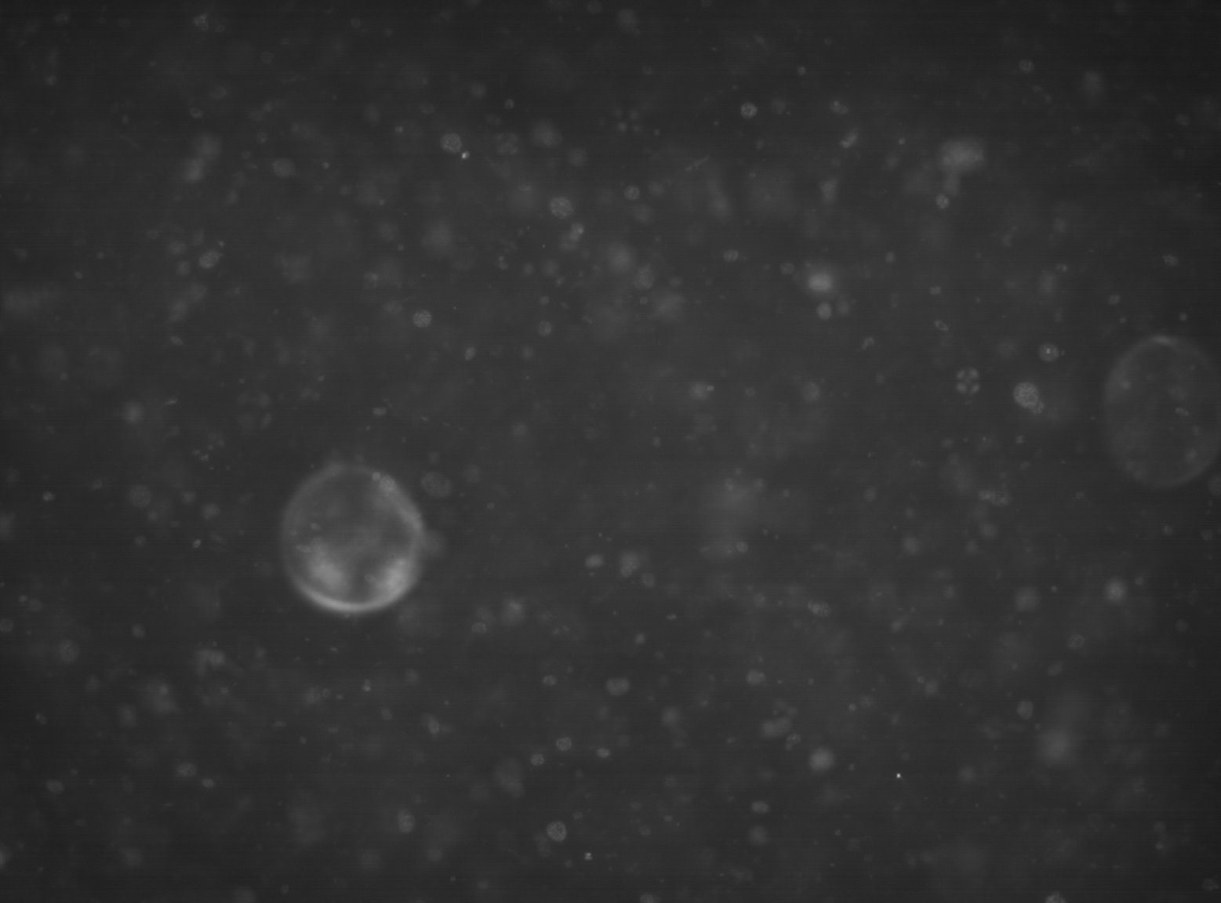

Measurements at 200 MeV: First Look (2)
PMMA offers significantly better optical properties for scanning with epi-illuminated microscopes: no fake clusters are reconstructed inside the plastic support
The absence of diffusion artifacts (as well as the large number of visible grains!) will make automatic surface finding easier
Plastic
inhomogeneity
Light Source
PS Base
PMMA Base
Vincenzo Boccia

Slide 22
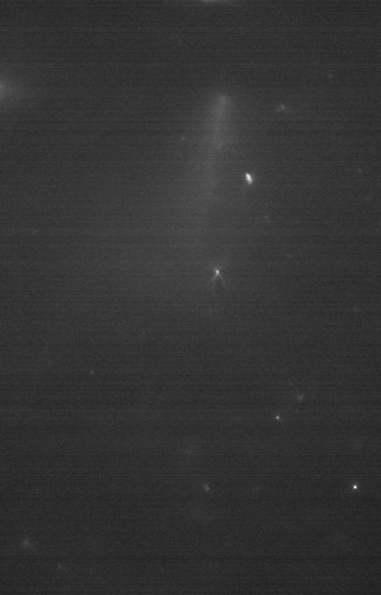
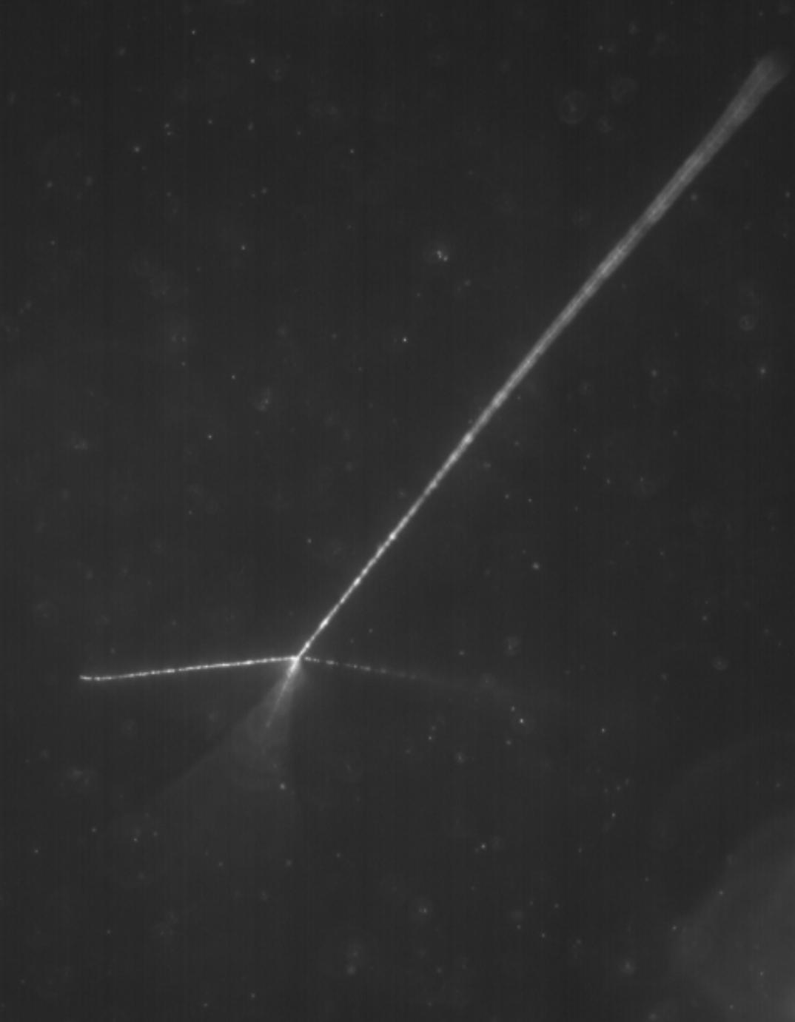



Measurements at 200 MeV: First Look (3)
Scanning tests are on-going: optimization of scanning and reconstruction parameters is needed
Automatic scanning and reconstruction of long secondary tracks: primary protons are visible but difficult to track (low grain density)
Secondary proton tracks are also visible
On-going: optimization of vertex reconstruction algorithms
$$\sim 80 μm$$
$$\sim 210 μm$$
Estimated grain density $0.19±0.05 μm^{−1}$
Corresponding proton kinetic energy between $\sim$90 and 115 MeV
Vincenzo Boccia

Slide 23
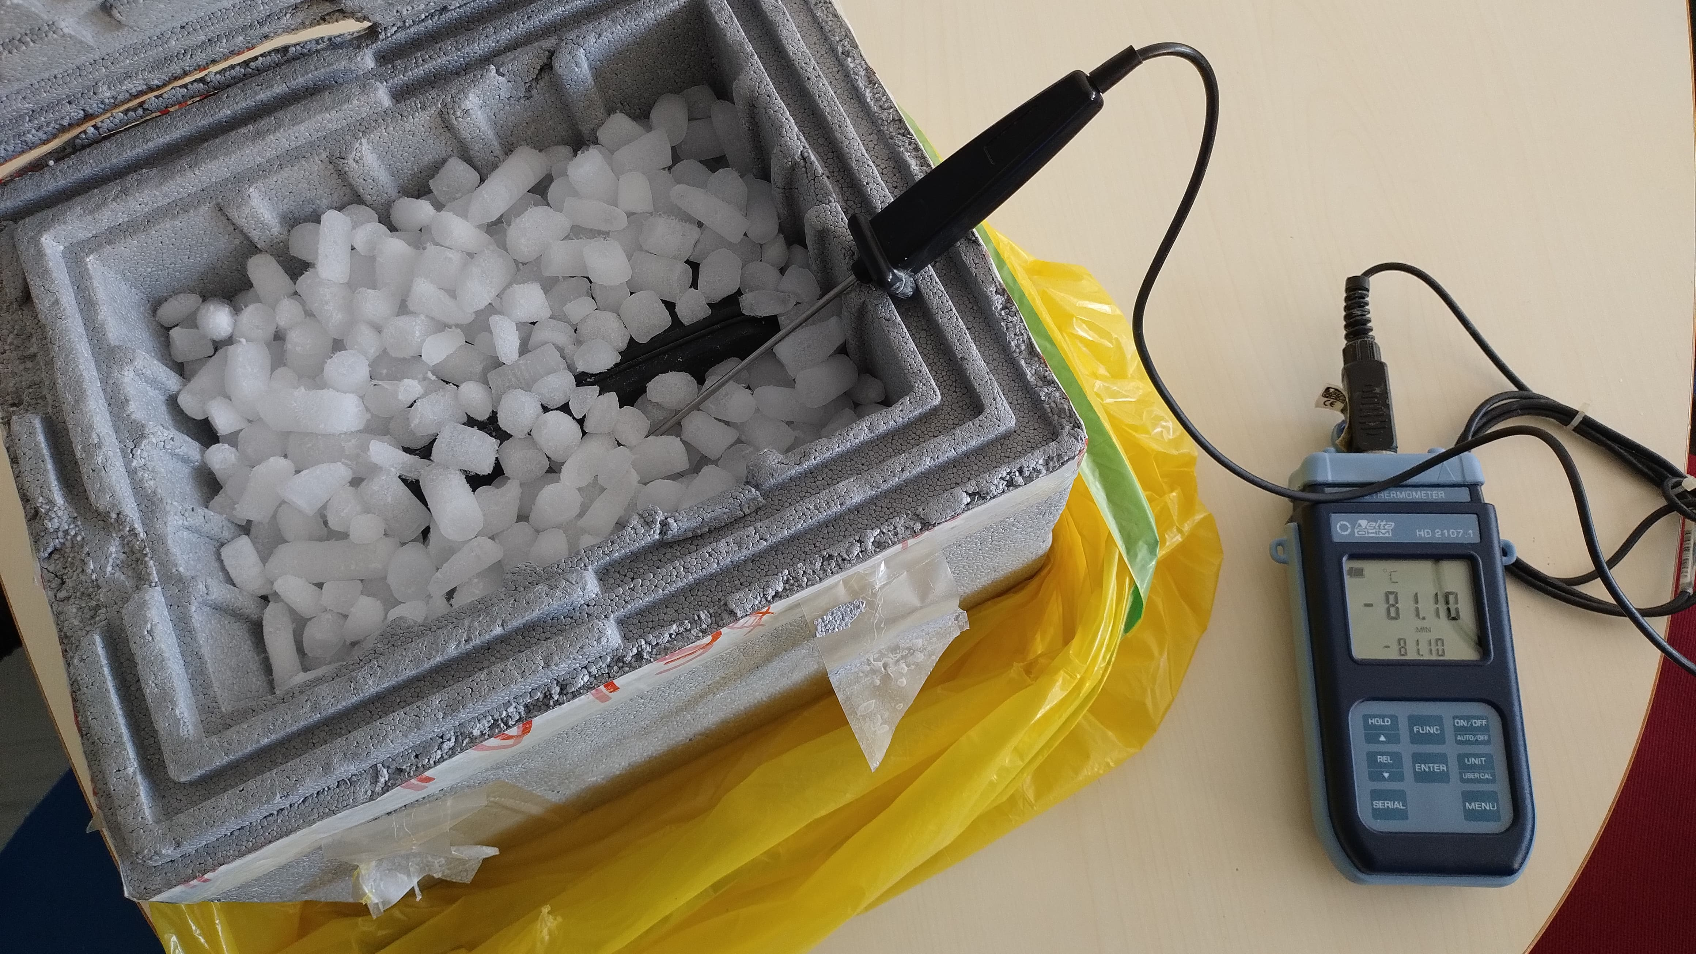
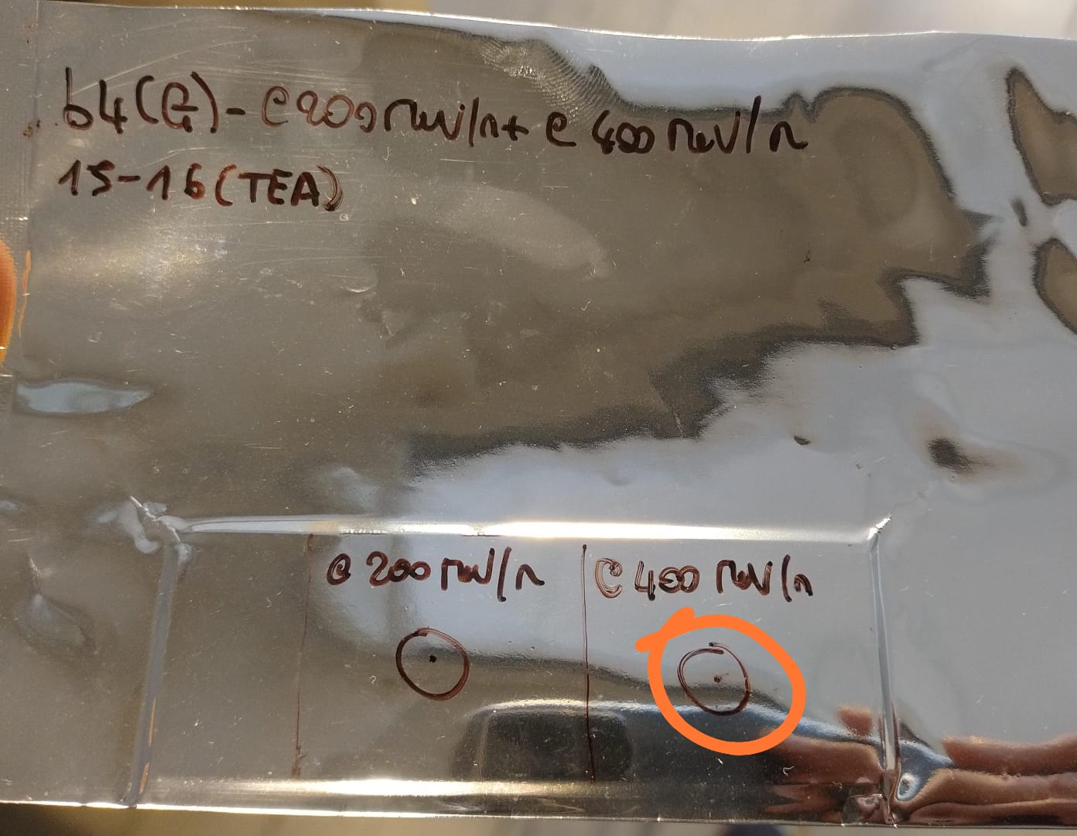
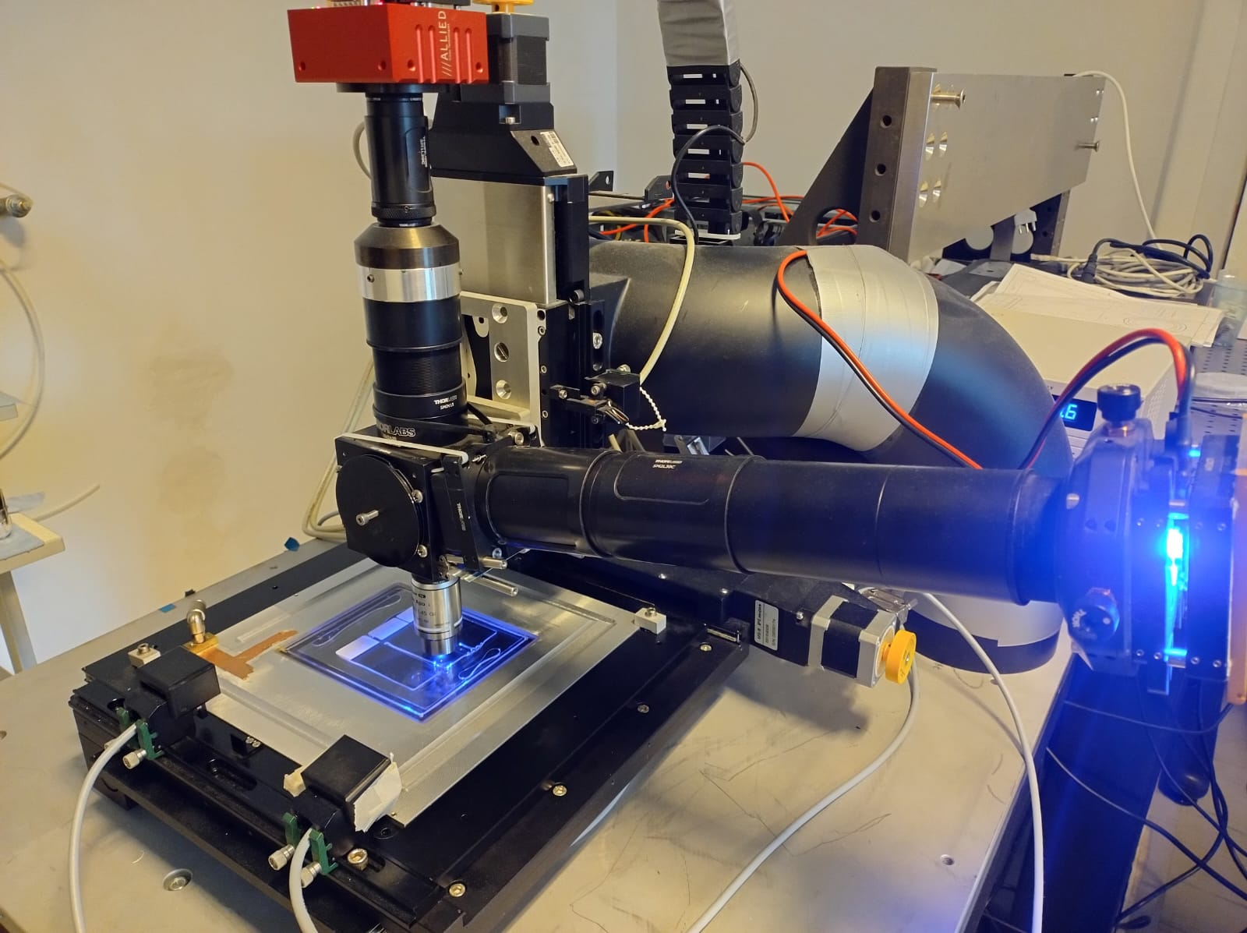

Update on CNAO 2024 (1)
NIT samples were released from CNAO on the 19th of March 2025, about 4 months after their exposure $→$ significant fading expected
These samples have been developed at LNGS (Giuliana, Simone) shortly after arrival
Currently we are checking the slide glasses exposed to carbon beams (200 MeV/n and 400 MeV/n), which should be less prone to fading
First scanning tests performed: difficult to identify carbon tracks with LNGS system
Vincenzo Boccia

Slide 24
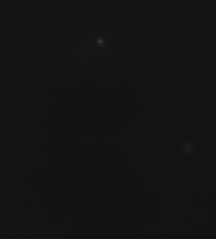
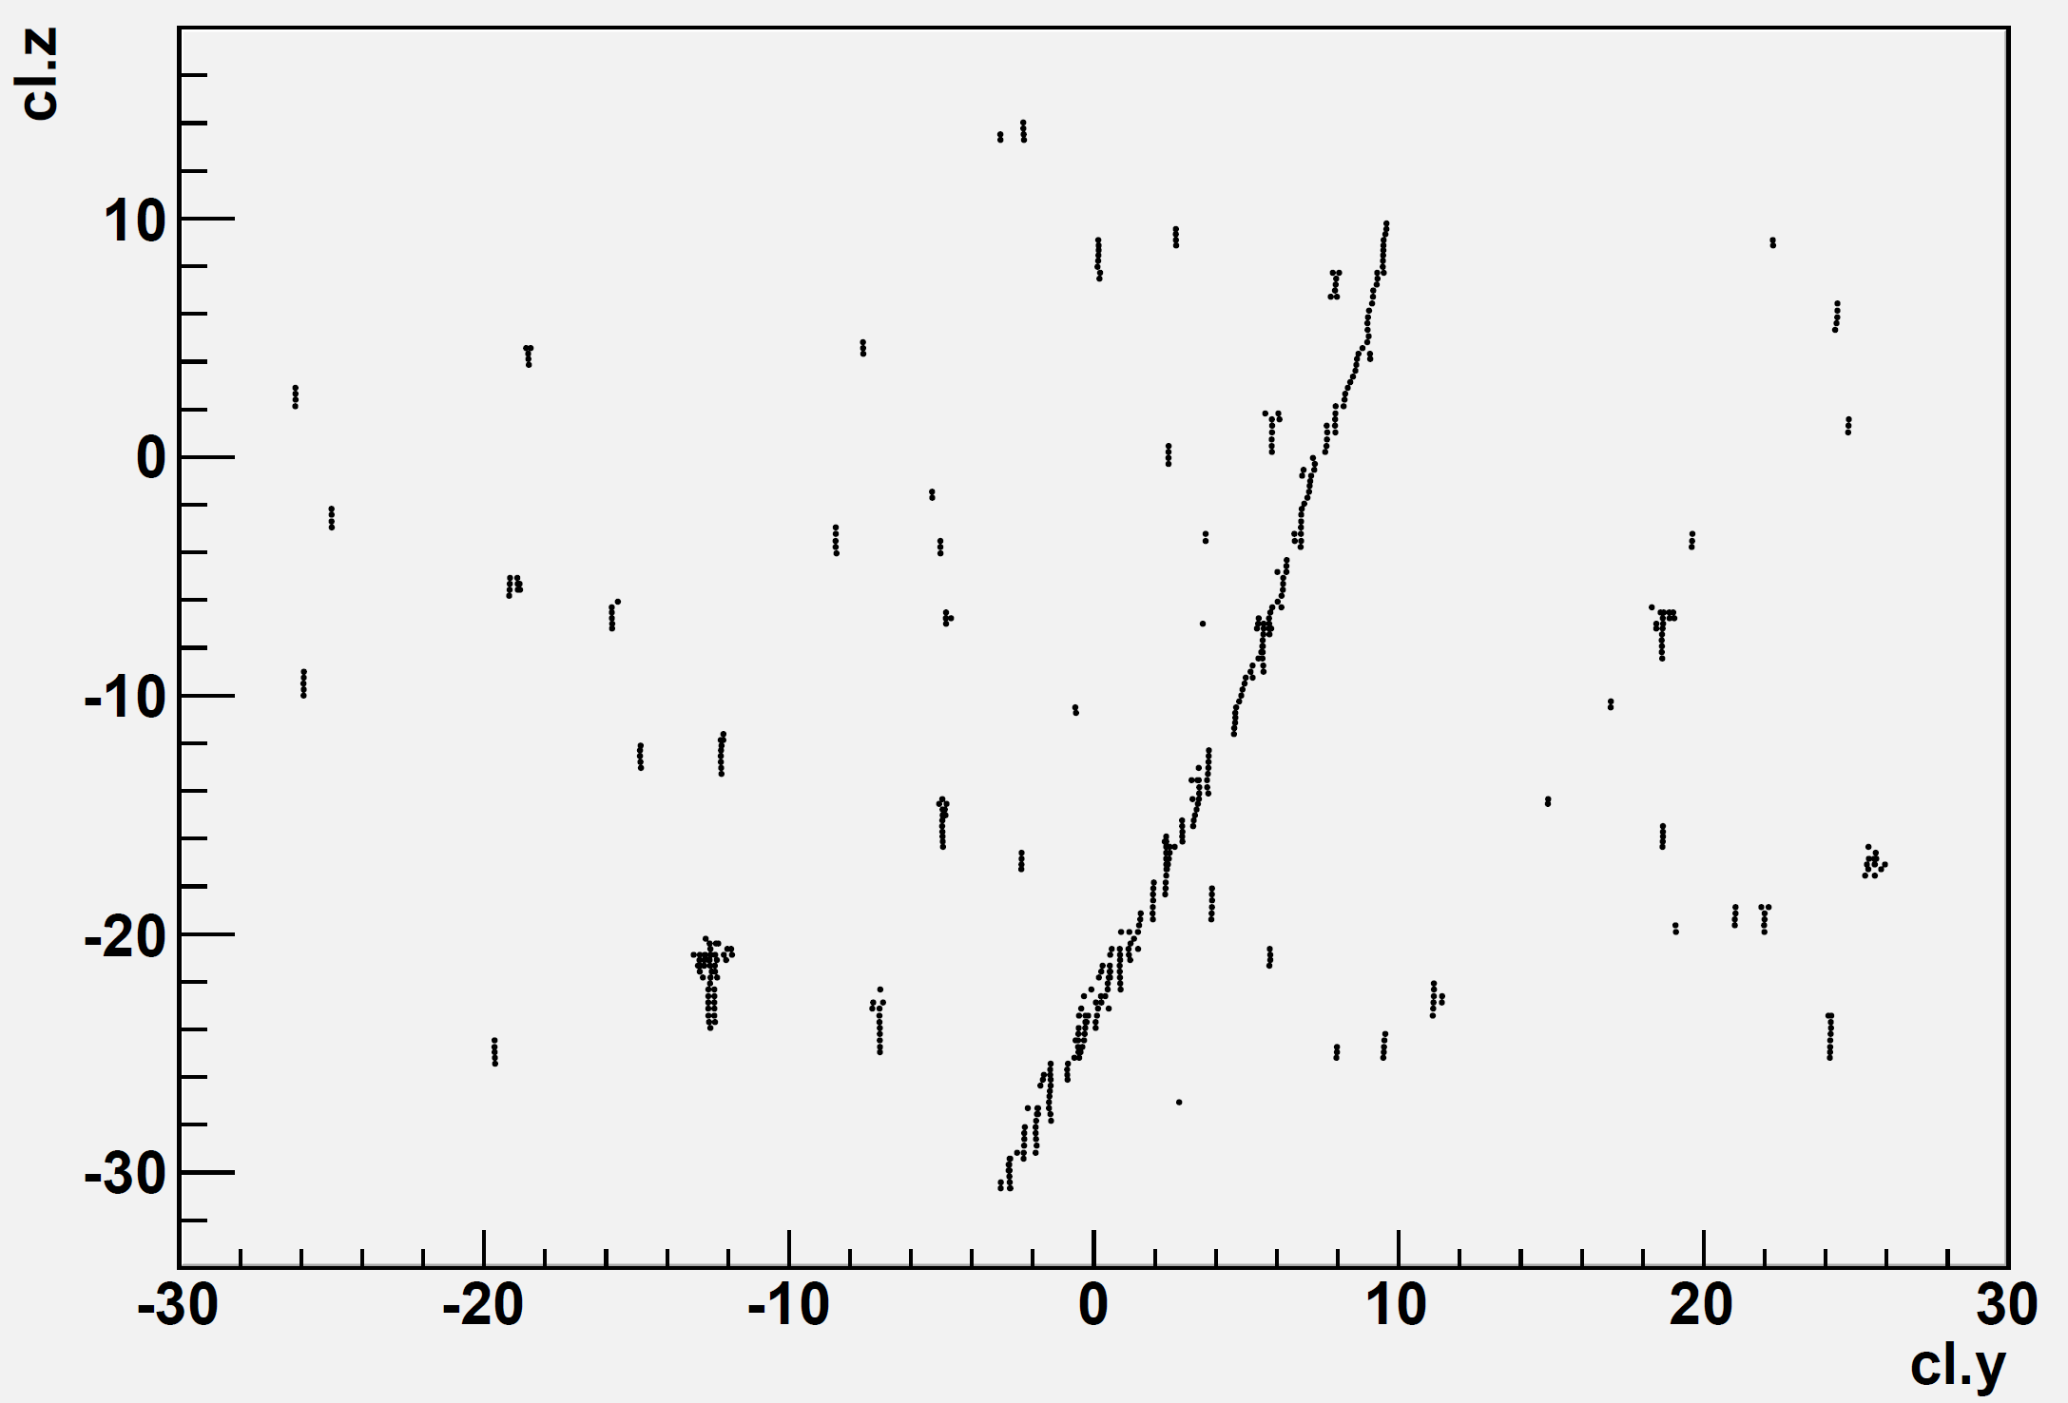
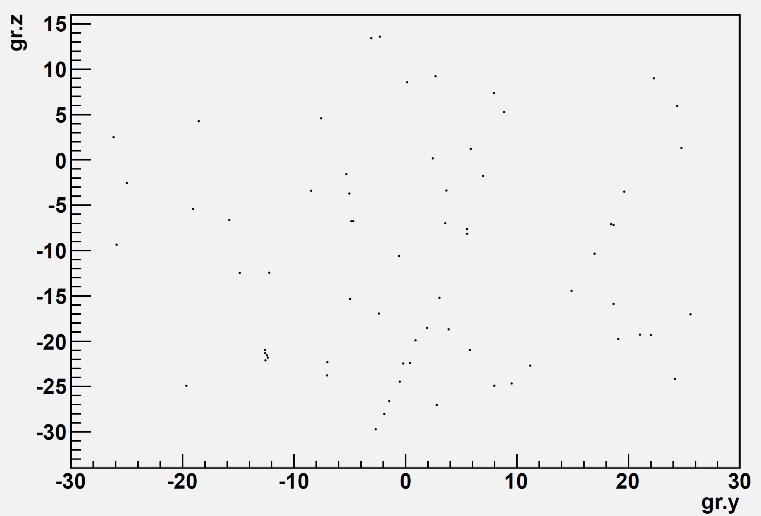

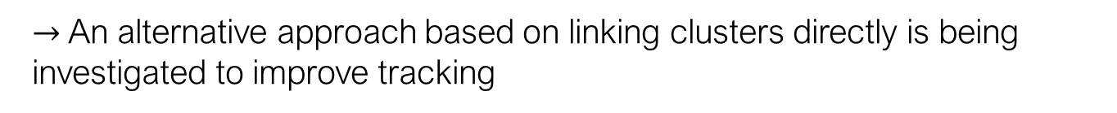
Update on CNAO 2024 (2)
The first scans performed at LNGS showed poor performance of the algorithm for grain reconstruction
This is likely due to the absence of a limit on the extension of each grain along the Z axis
Reconstructed Clusters
Reconstructed Grains
$$\sim 9 μm$$
Images by S. Masci
$→$An alternative approach based on linking clusters directly is being investigated to improve tracking
Vincenzo Boccia

Slide 25


Ideas for future measurements
The next time slot will be available at CNAO at the end of 2025
  Physics data taking to collect more statistics by repeating previous measurements (similar setups to final exposure in Nagoya, but finer control on number of primary particles)
  Test beam to further optimize PMMA pouring / reversal development recipe
  Test beam to study Super Resolution efficiency when reversal development is combined with 70 nm crystals (concerns about magnitude of plasmon resonance with increasing grain size)
Likely that the emulsions will be kept in a freezer after the exposure at CNAO (last time they were released 4 months later)
$$?$$

Slide 26
Outlooks
First look at Japan data (200 MeV protons on PMMA NIT)
  Noticeable improvement in automatic surface finding thanks to PMMA base
  TEA sensitization and reversal development enabled the first detection of a secondary proton with NIT at energies larger than ~15 MeV
A lot of scanning and analysis to be done!
  Protons @70 MeV (on PS)
  Protons @200 MeV (on PMMA, reversal + MAA)
  Carbon @200 MeV/n and 400 MeV/n (slide glasses to improve tracking)
  Unfortunately, not possible for the moment in Napoli
Early results from Japan exposures to be published
  Technical paper about NIT R&D (TEA sensitization, reversal development) -> topic for the next contribution

Slide 27
Thank you!

