Slide 1




Plan for a technical publication
A. Alexandrov, V. Boccia, N. D’Ambrosio, G. De Lellis, G. Galati, A. Lauria, S. Masci, M.C. Montesi, V. Tioukov
Università di Napoli “Federico II”, INFN Napoli
Università di Bari “Aldo Moro”, INFN Bari
Laboratori Nazionali del Gran Sasso

Slide 2
The idea
Write a technical publication with the latest advancements related to NIT chemical sensitization and development
  TEA sensitization and response to protons
  Reversal development
Target journal: JINST
Main results to be published: characterization of proton grain density as a function of its energy in TEA sensitized NIT emulsions (70-80 nm crystals)

Slide 3
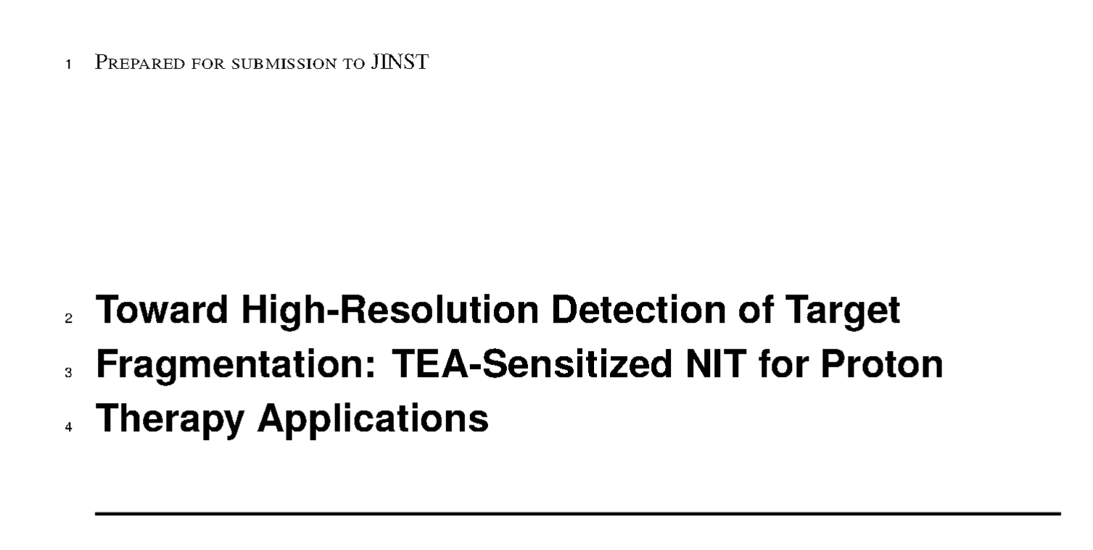
Paper Title
Suggestions welcome!
Should it be more general (no direct reference to proton therapy)?

Slide 4
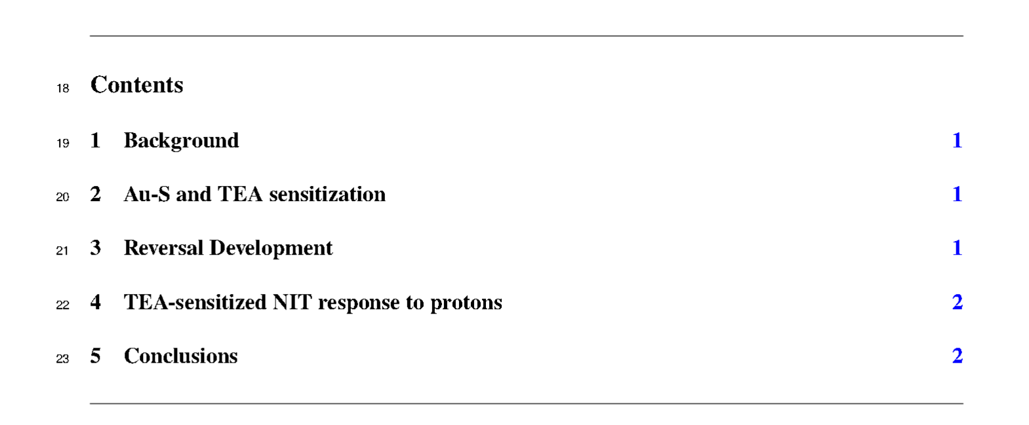
Paper Structure

Slide 5
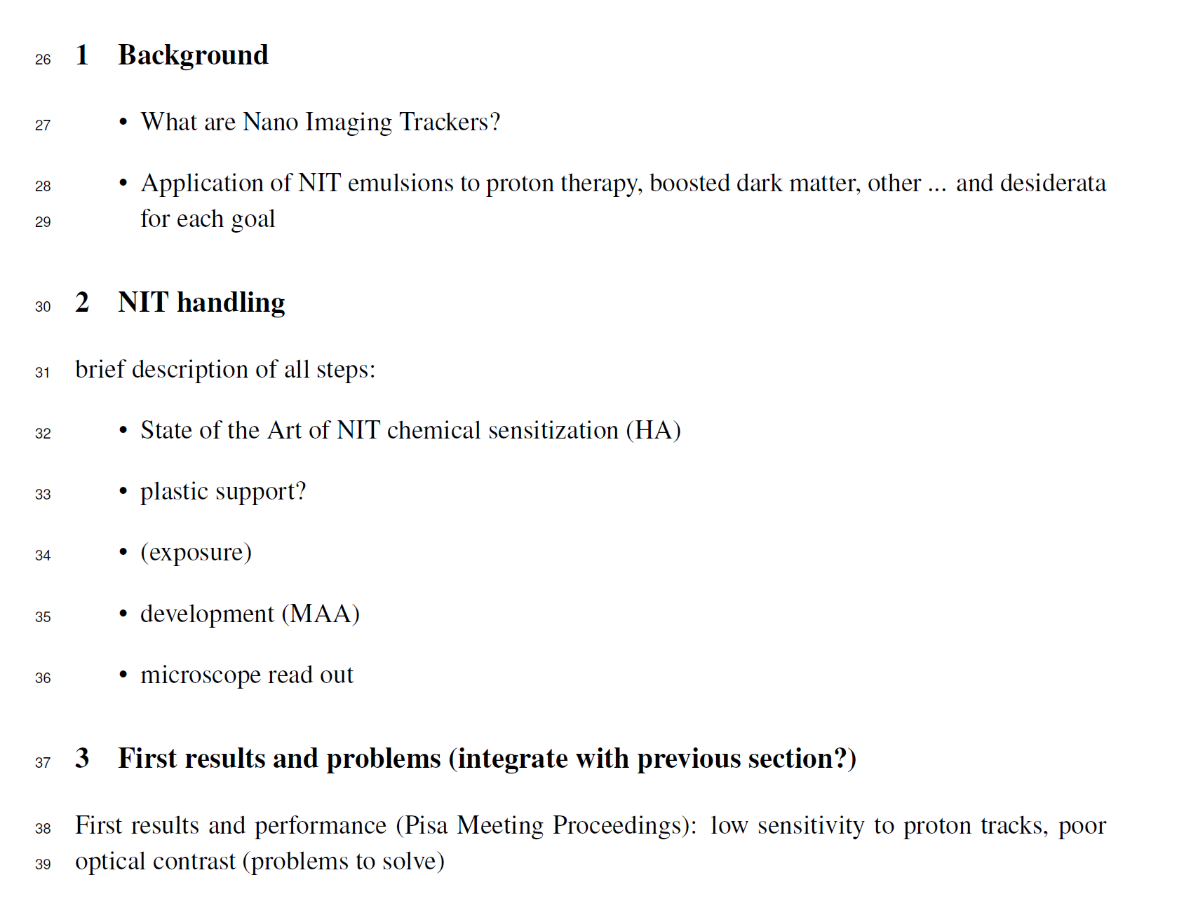
Paper Structure

Slide 6

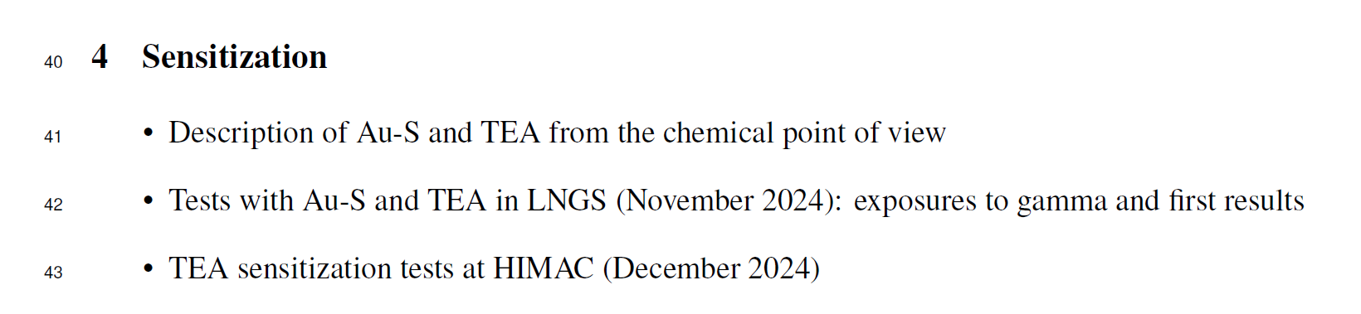

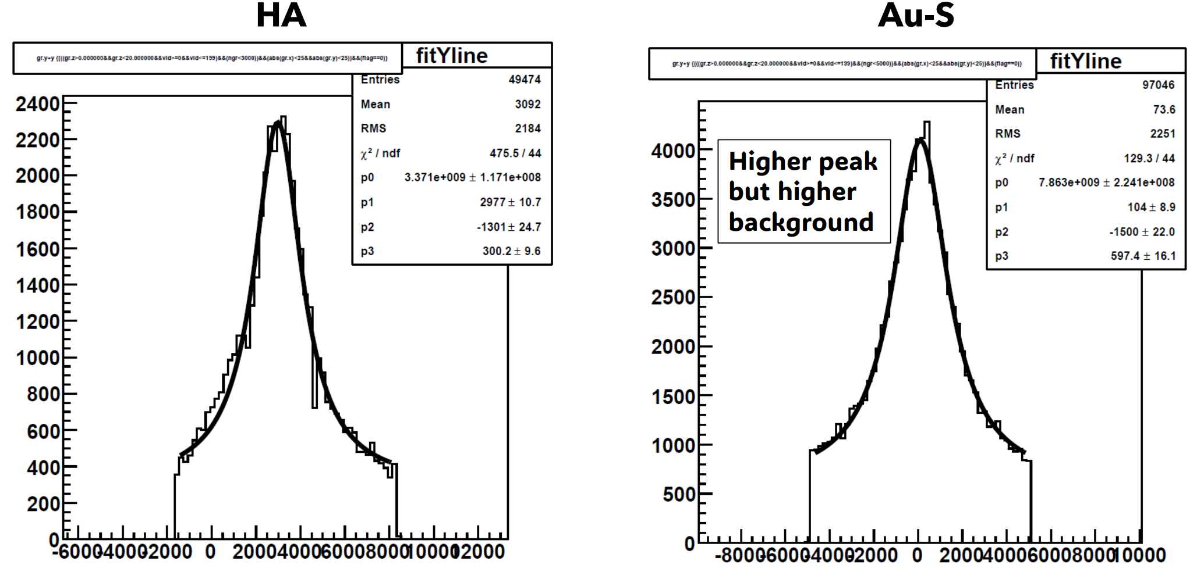
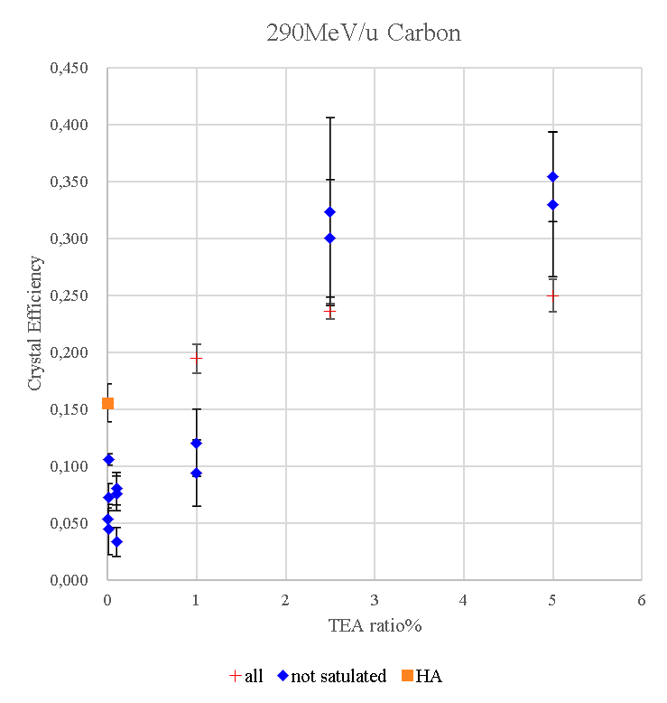
Paper Structure (2)
HA
TEA 2.5%
20 $μm$

Slide 7
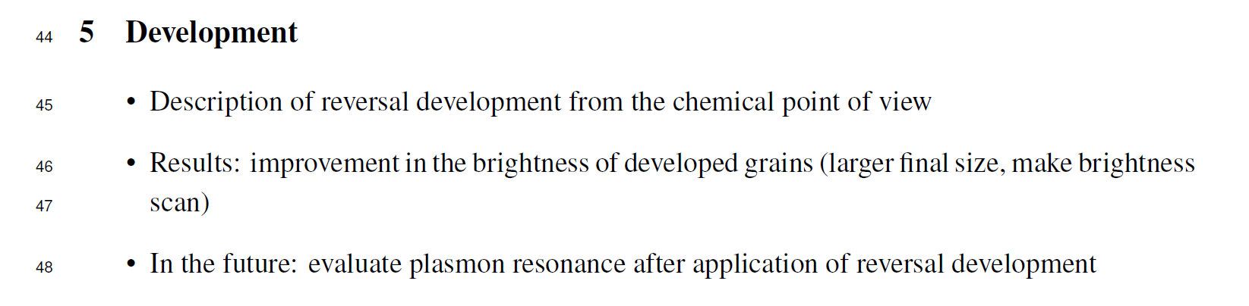
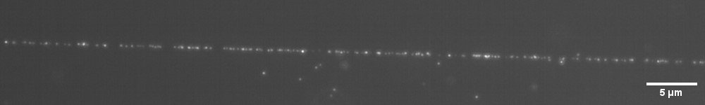
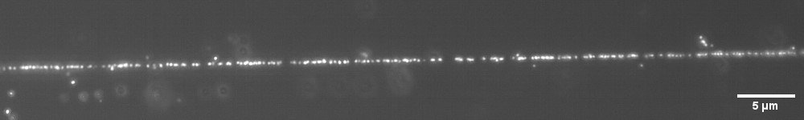
Paper Structure (3)
290 MeV/n Carbon ions
MAA
To add: brightness distribution MAA vs reversal
Reversal

Slide 8
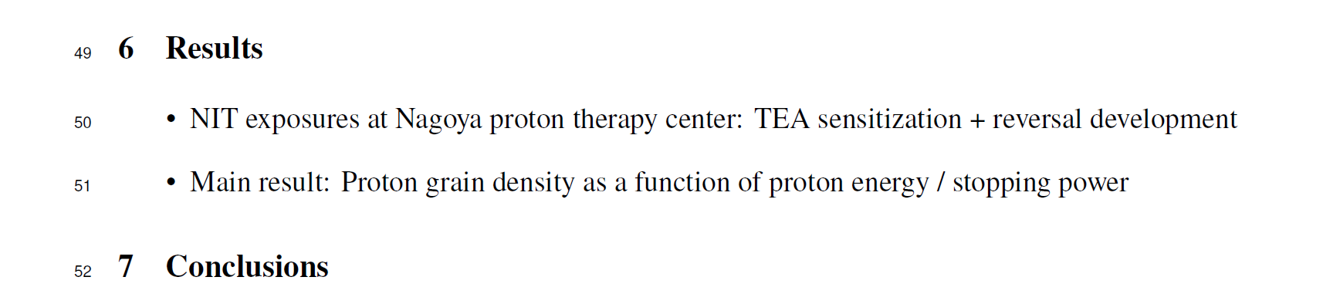
Paper Structure (3)

Slide 9
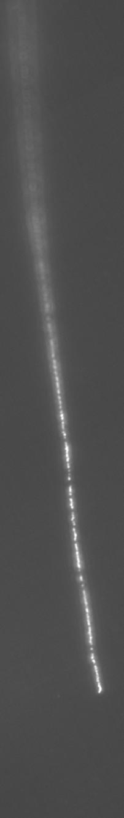
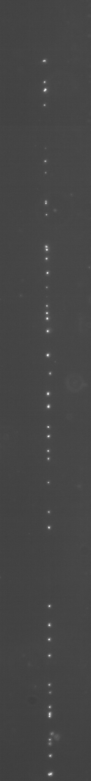
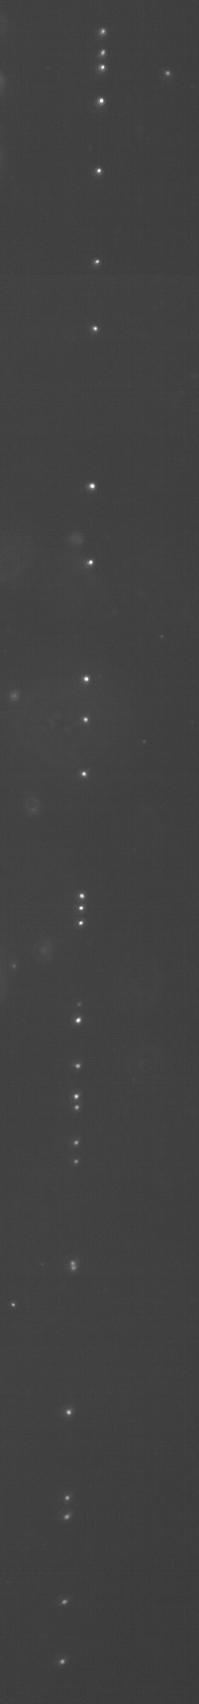
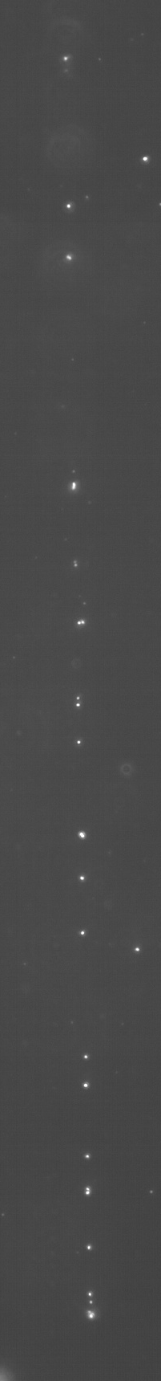
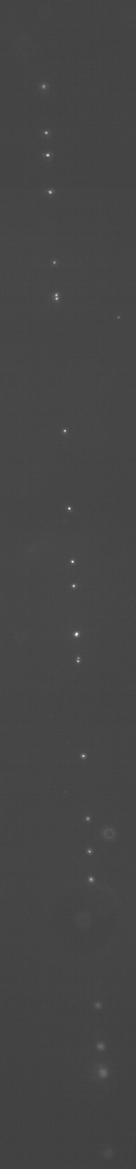
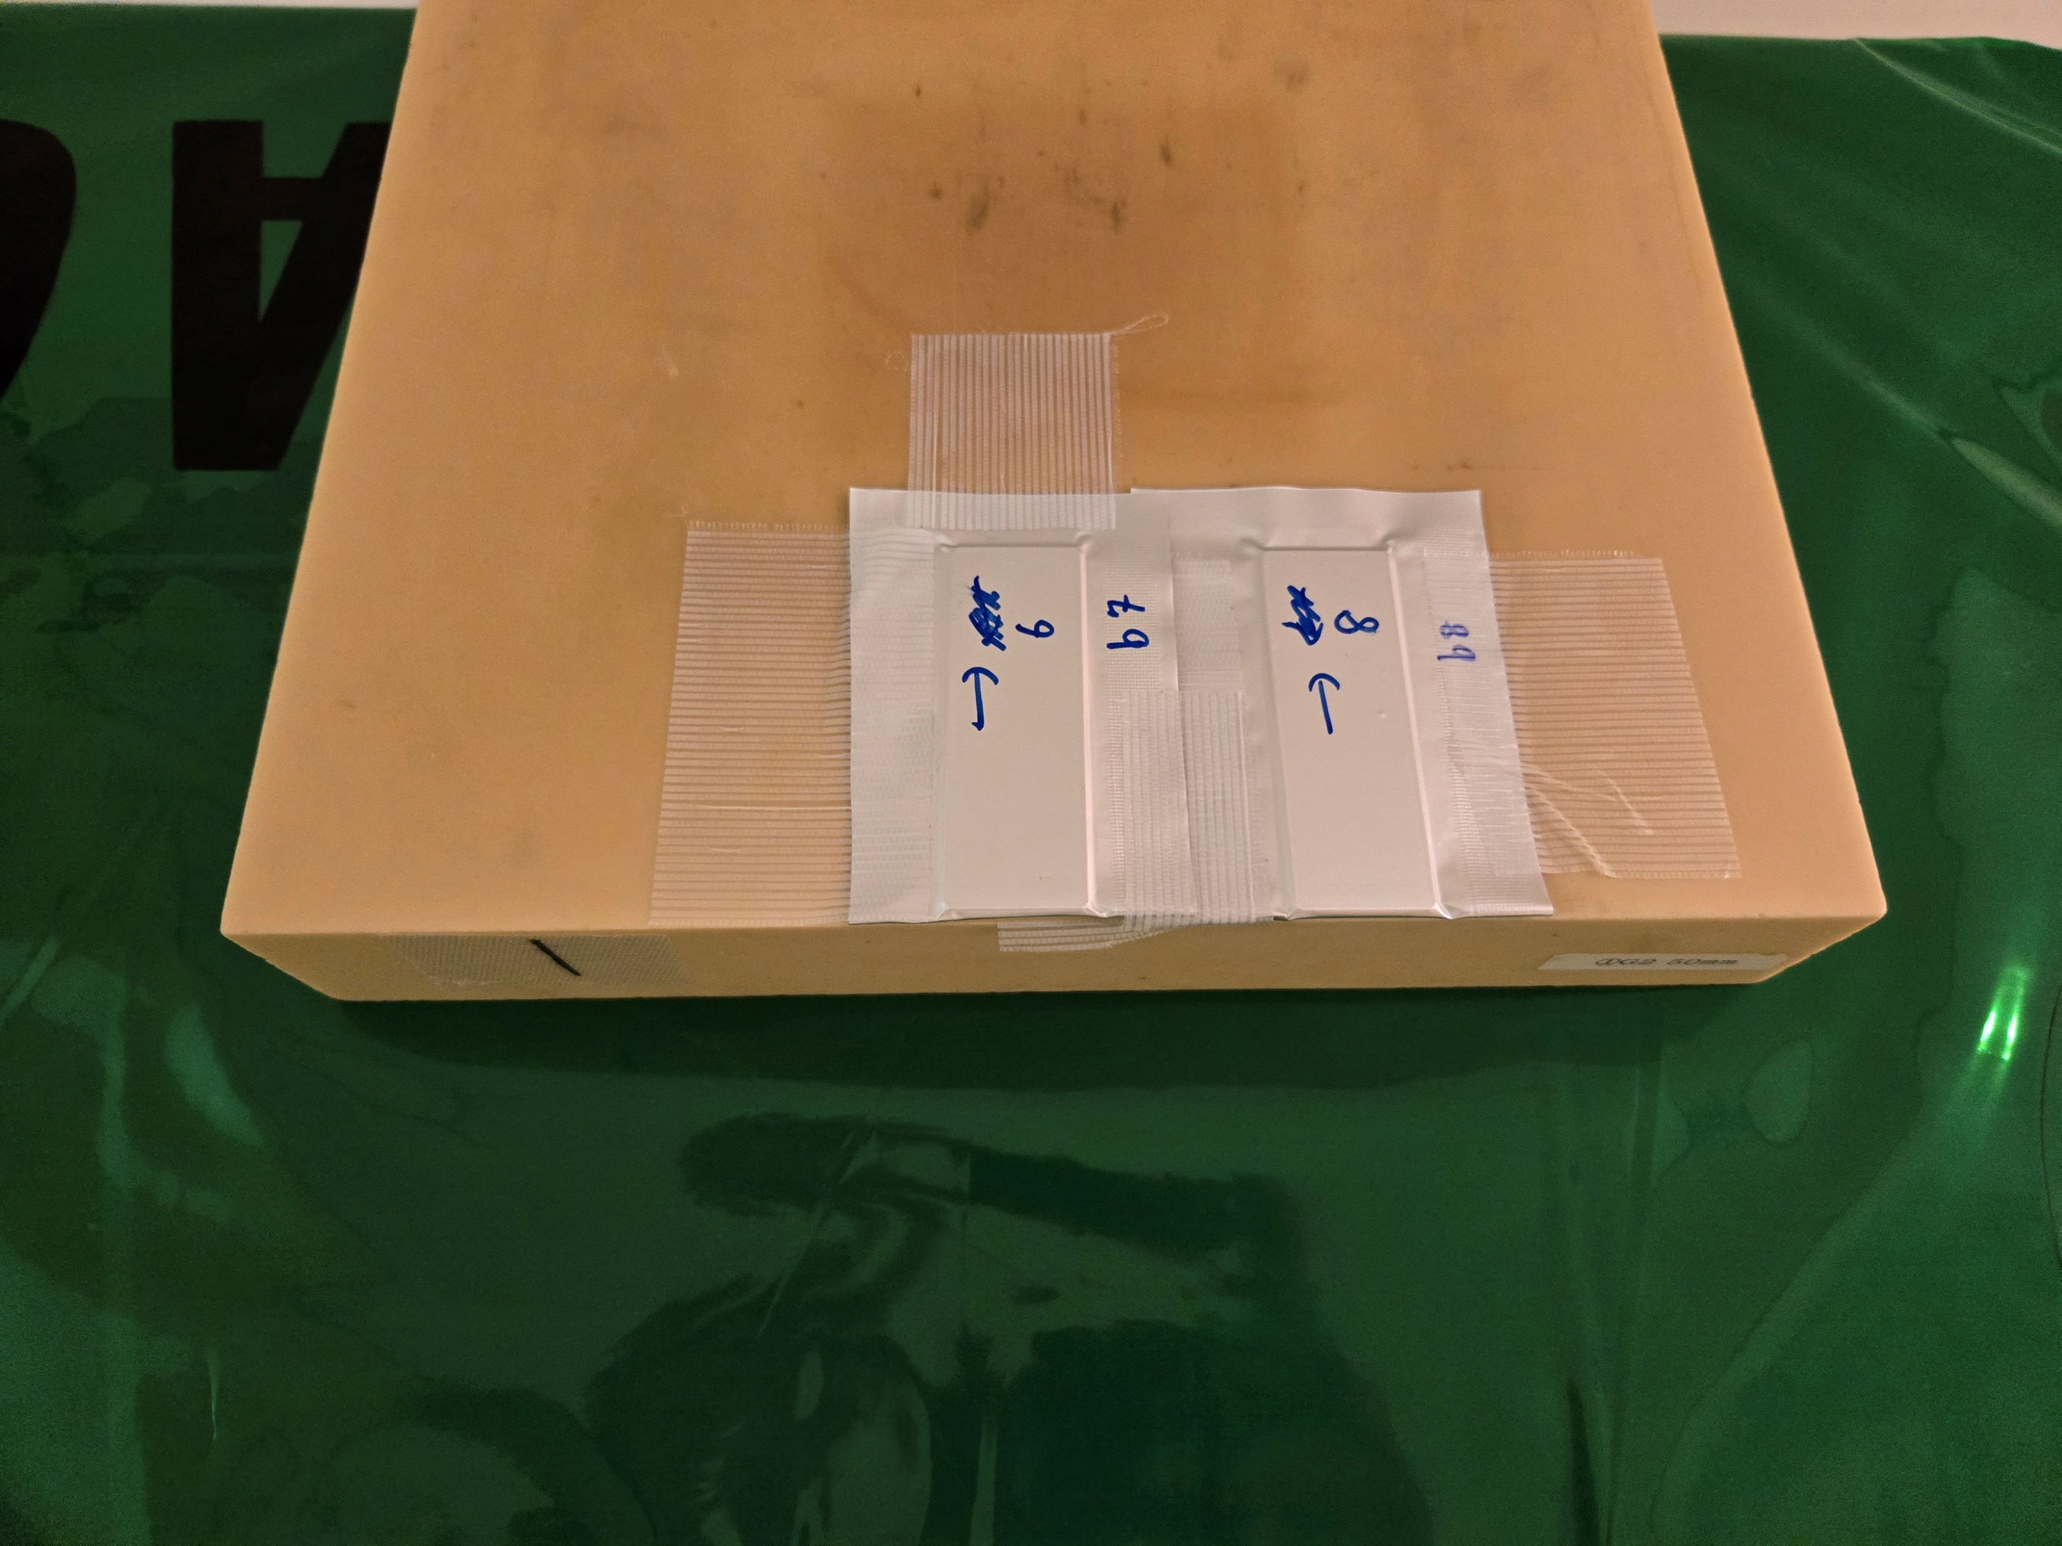





Horizontal Exposures To Protons
Proton Beam
NIT (70 nm)
TEA (2.5%) REVERSAL
End of range
$$\sim 26 MeV$$
$$\sim 68 MeV$$
$$\sim 96 MeV$$
$$\sim 126 MeV$$
$$\sim 179 MeV$$
Proton Energy

Slide 10
Main Results: Proton Grain Density

Slide 11
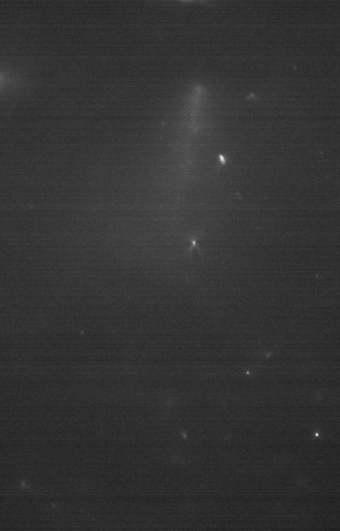


Possible “Extras”
$$\sim 80 μm$$
Estimated grain density $0.19±0.05 μm^{−1}$
Corresponding proton kinetic energy between $\sim$90 and 115 MeV

Slide 12
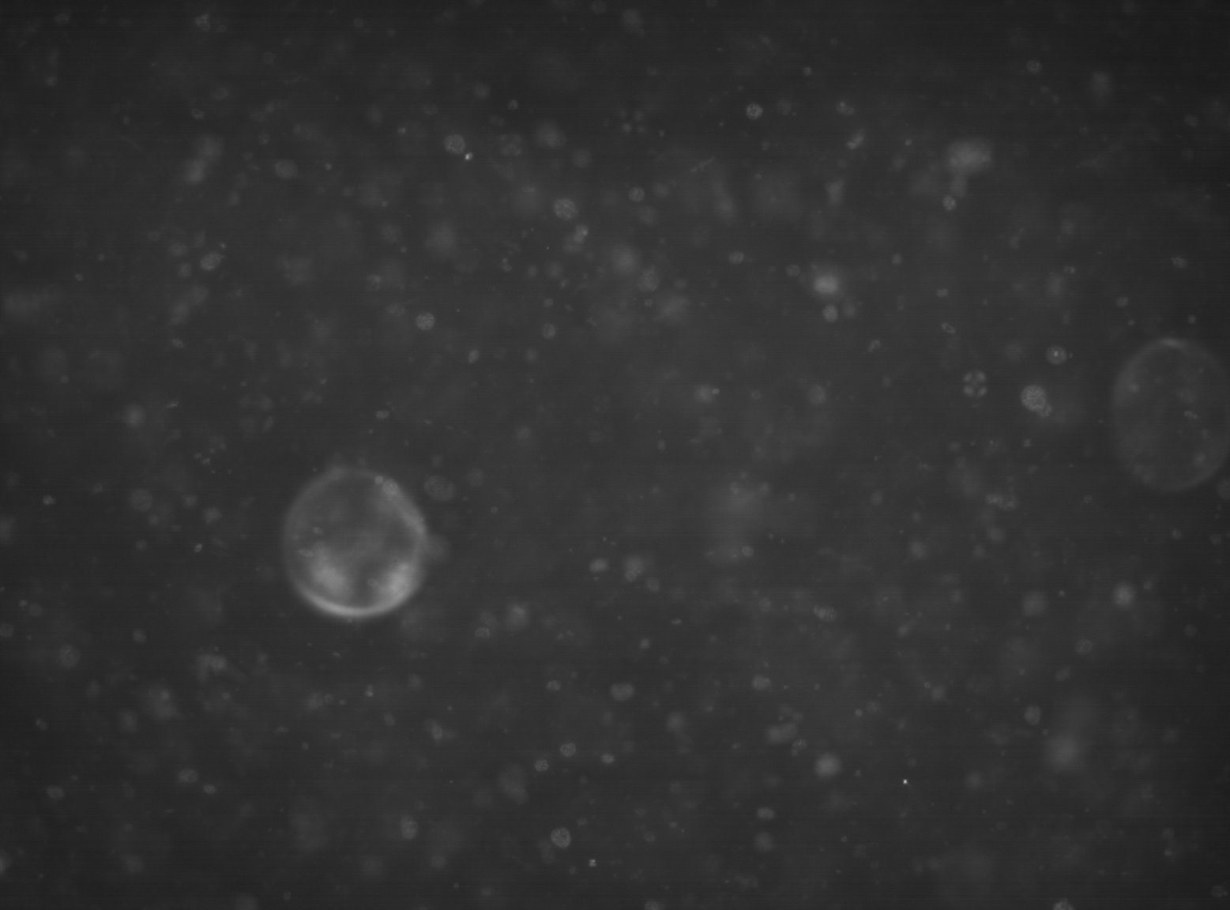

Possible “Extras”
PS Base
PMMA Base

Slide 13
Thank you!

