Slide 1



X-ray Irradiation Effects on ASAP110LF Chip
F. Shojaei & L. Ratti
ASPIDES meeting
July 30, 2025

Slide 2
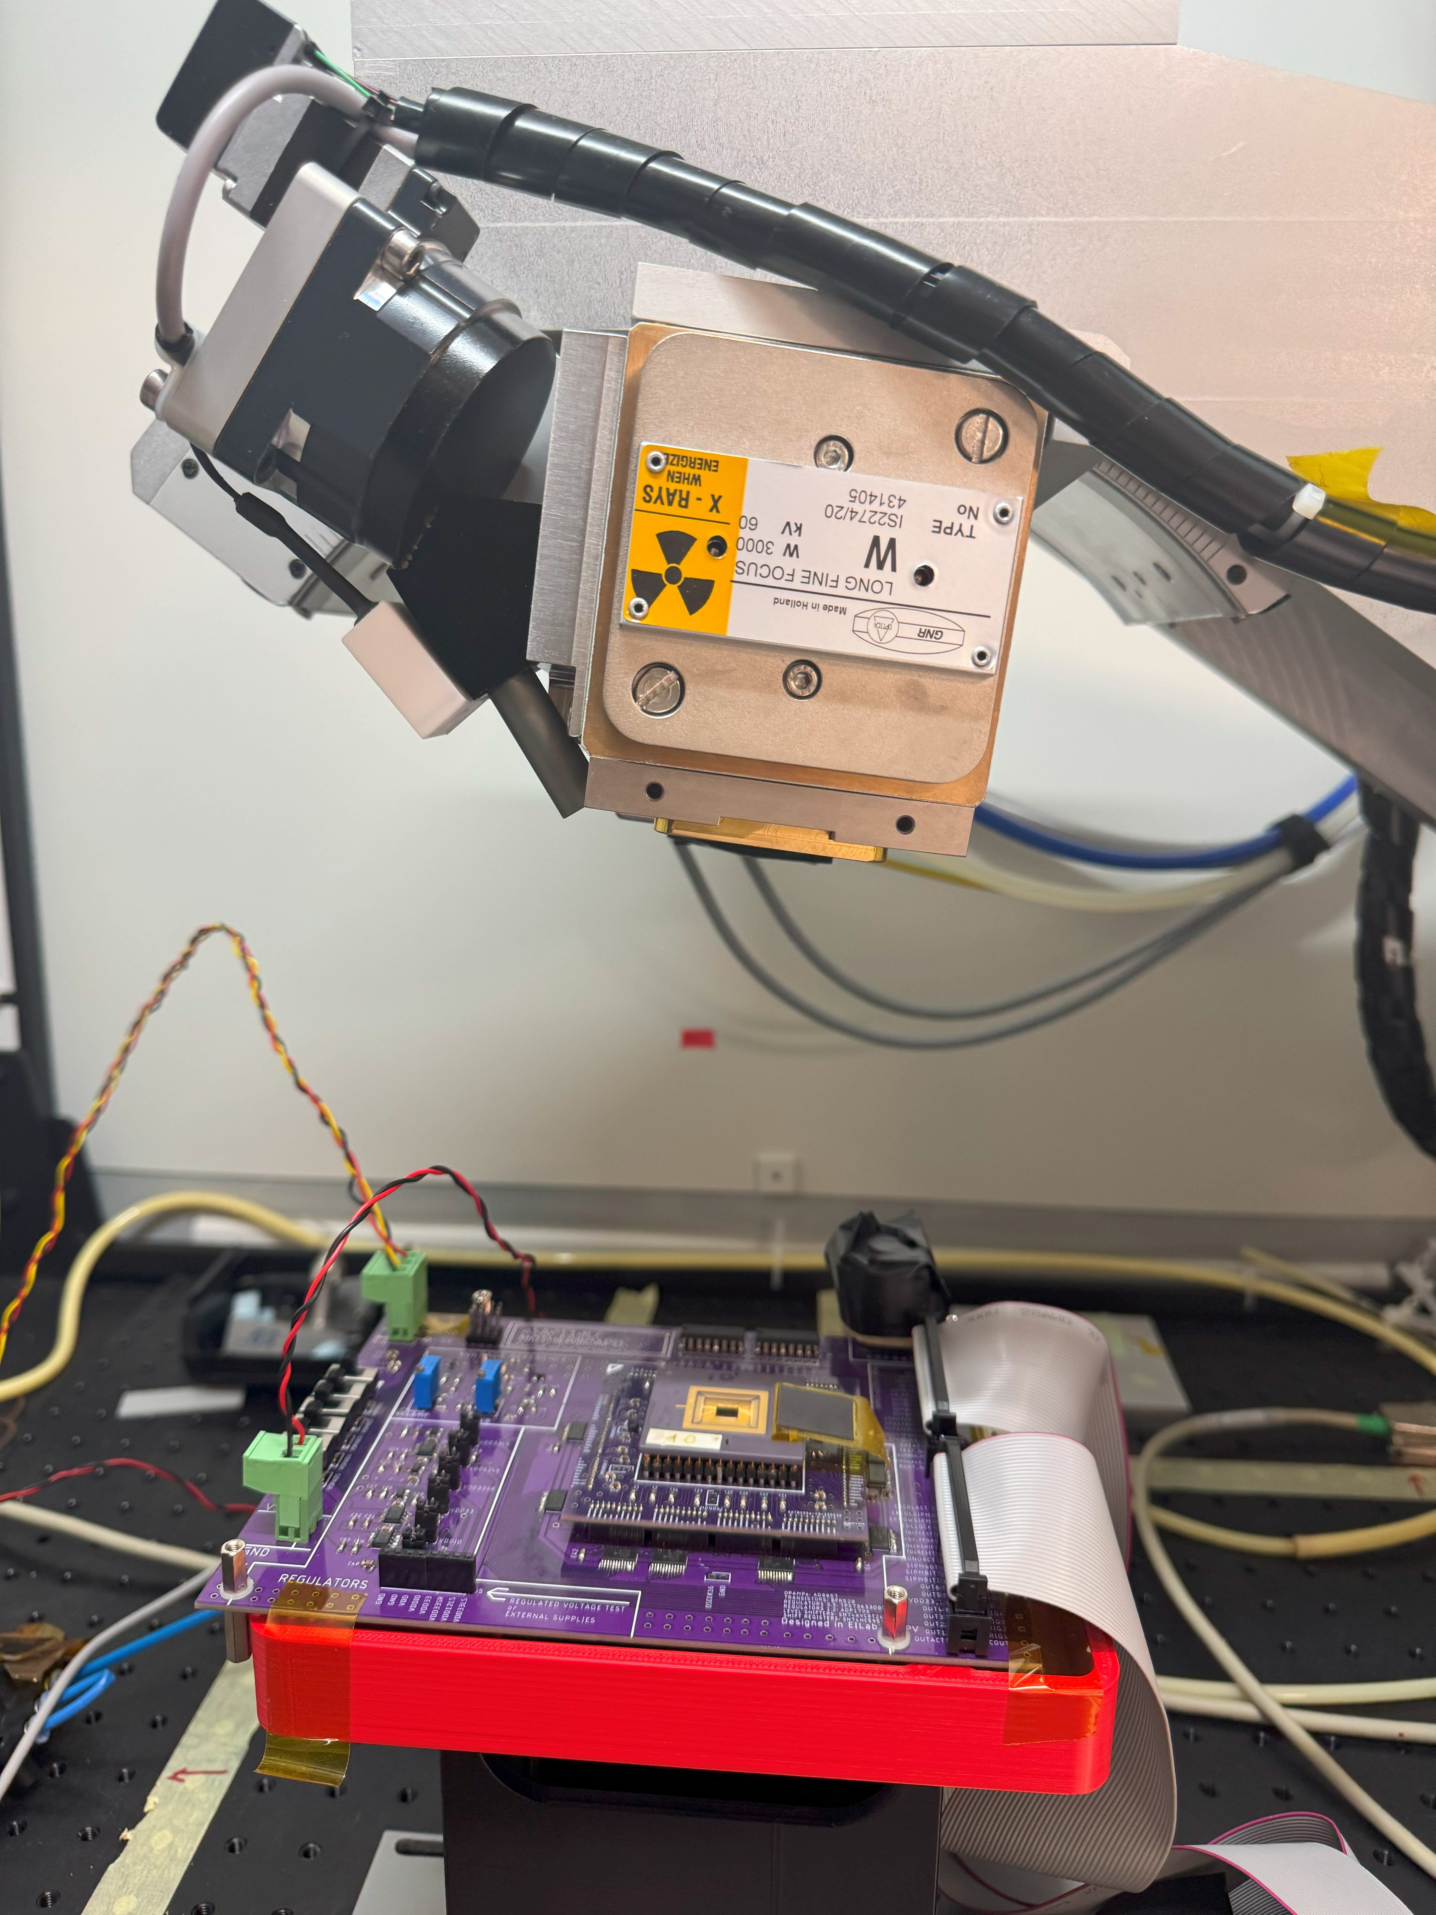
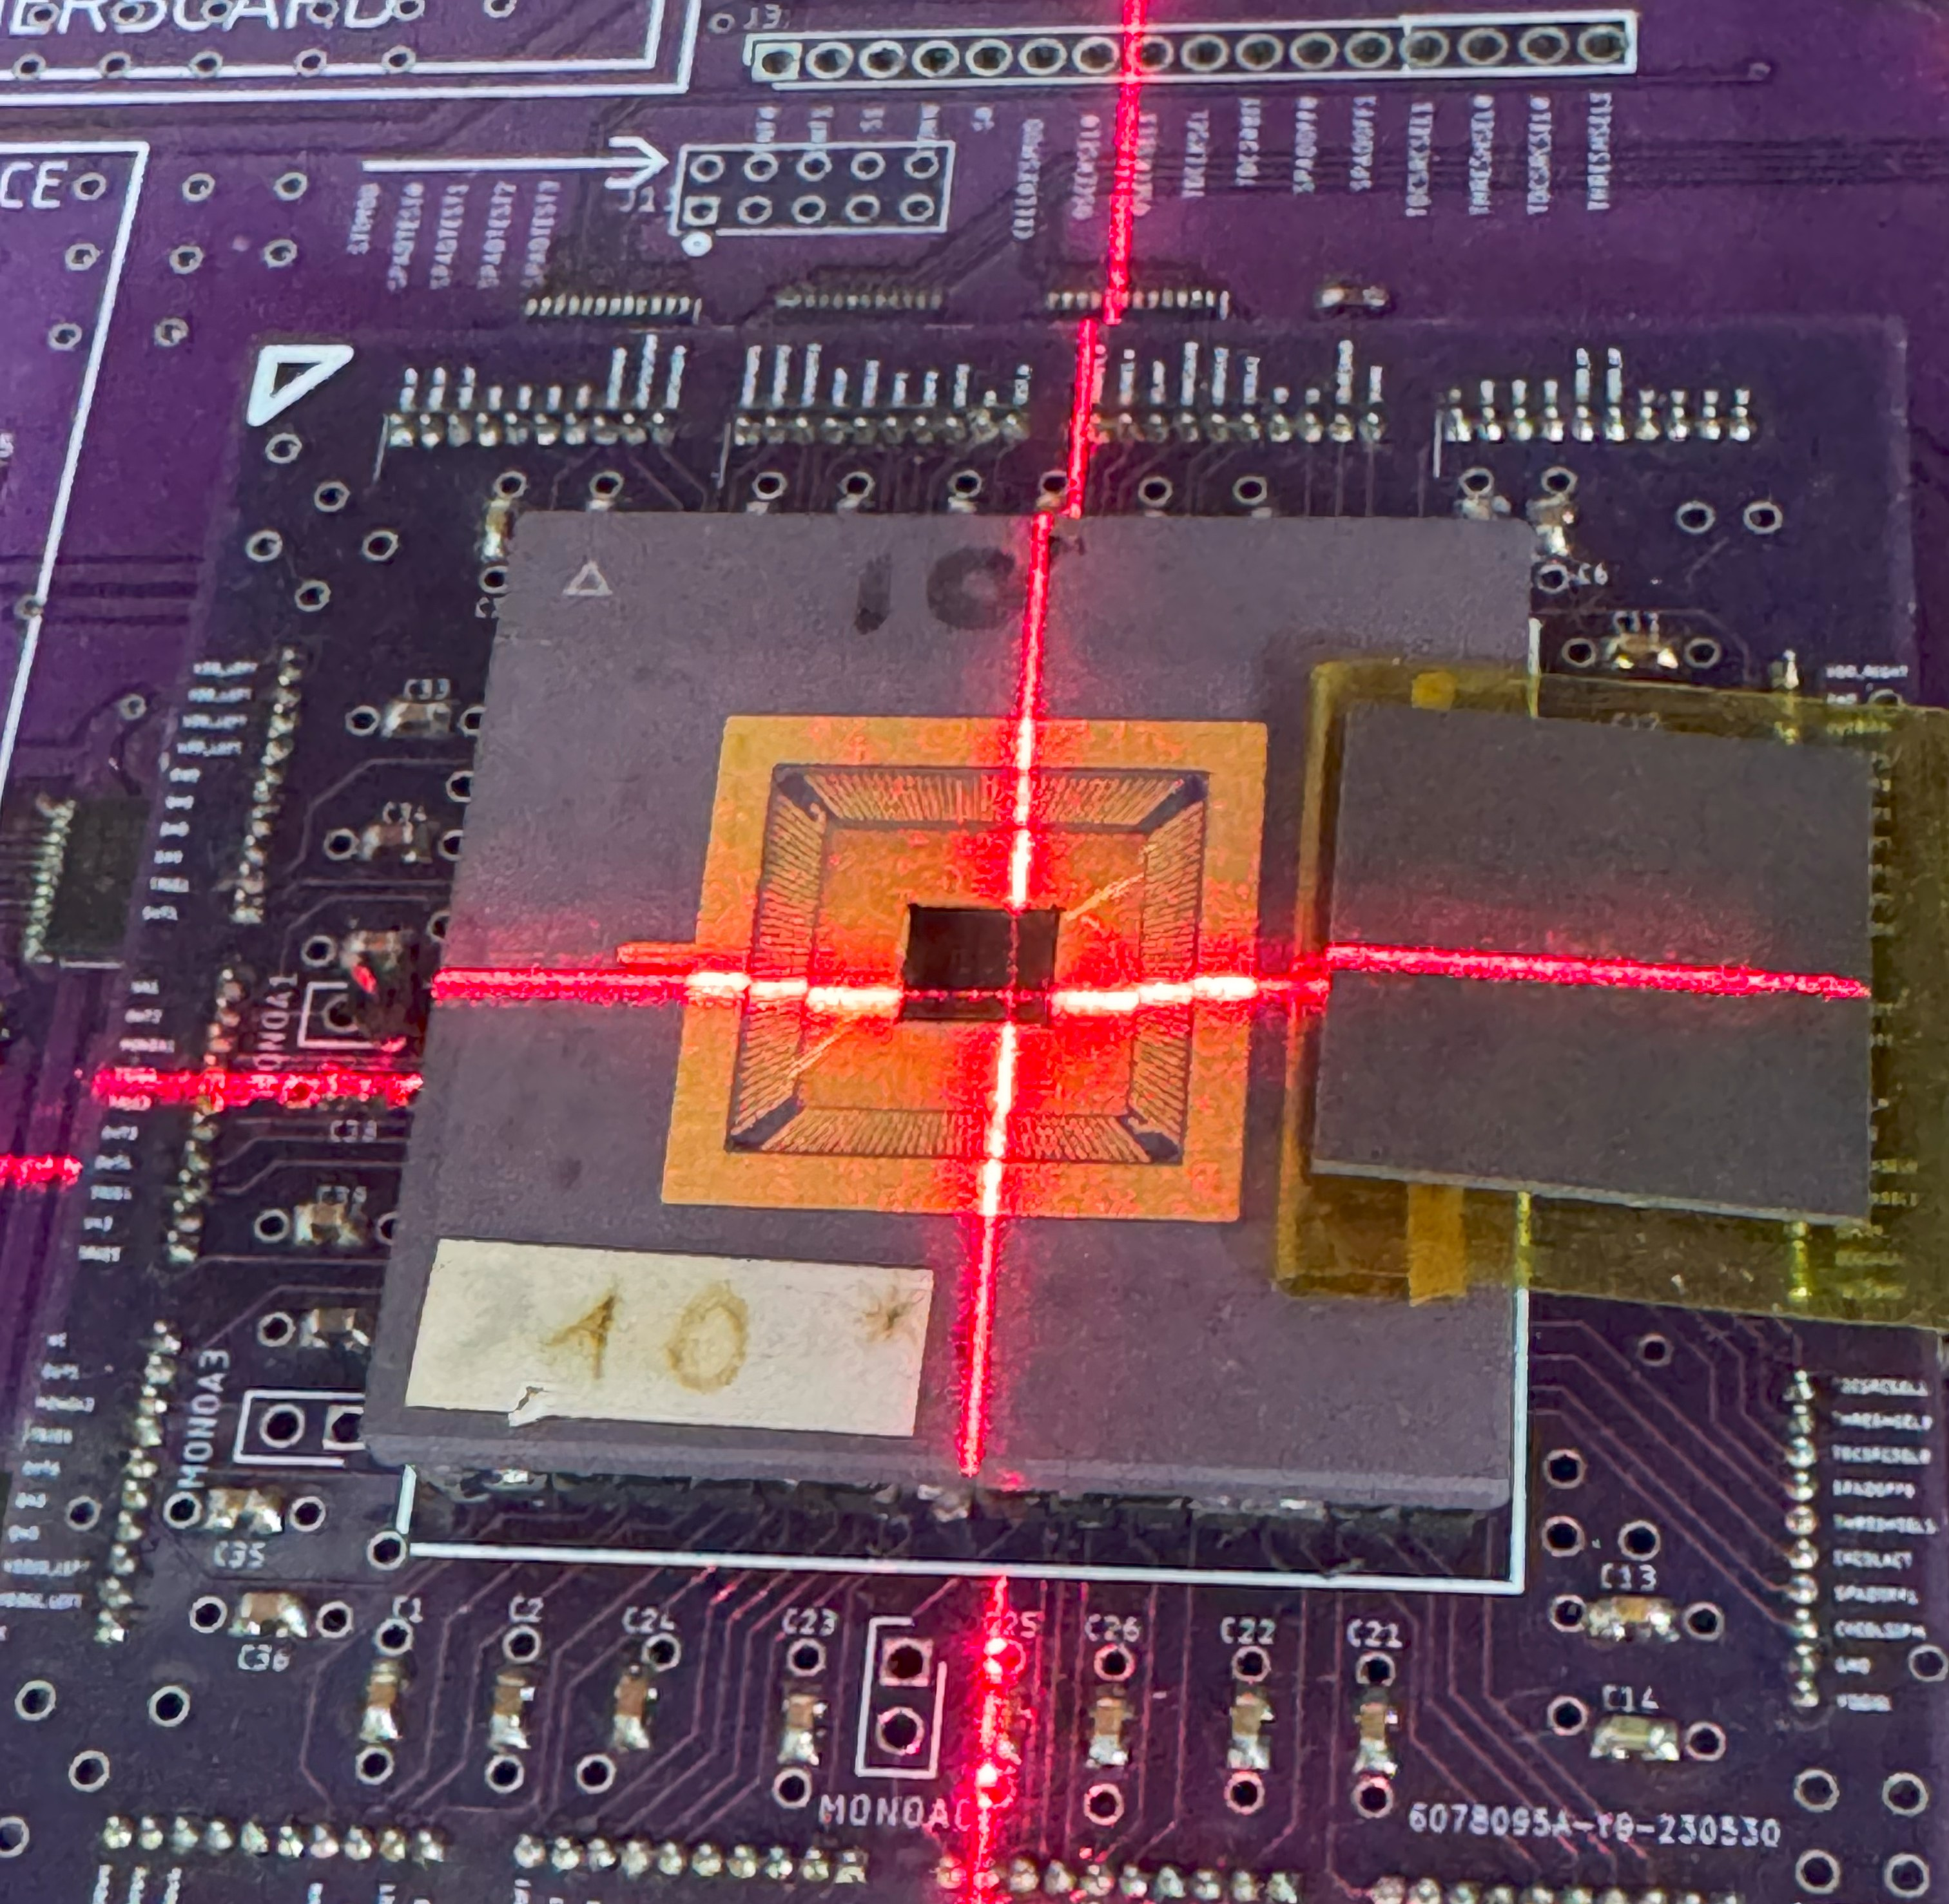
Irradiation Setup
Step | TID[Mrad] | TID Rate [Mrad/h] | Integrated TID [Mrad] | Time [h]
1 | 0.10 | 0.690 | 0.10 | 0.14
2 | 0.20 | 0.690 | 0.30 | 0.29
3 | 0.70 | 0.690 | 1 | 1.01
4.a | 1.04 | 0.690 | 2.03 | 1.50
4.b | 0.97 | 0.690 | 3 | 1.40
5.a | 5.97 | 0.483 | 8.96 | 12.35
5.b | 1.04 | 0.690 | 10 | 1.50
X-ray Source
56.5 mm
A laser source was used to align the X-ray beam with the center of the DUT. However, the laser cross is offset by approximately 1 mm in both the horizontal and vertical directions relative to the actual beam center. This offset has been taken into account.
SPADs are biased at 17 V during irradiation.
The chip was kept at ambient temperature between steps and placed in the refrigerator only after the final step.

Slide 3
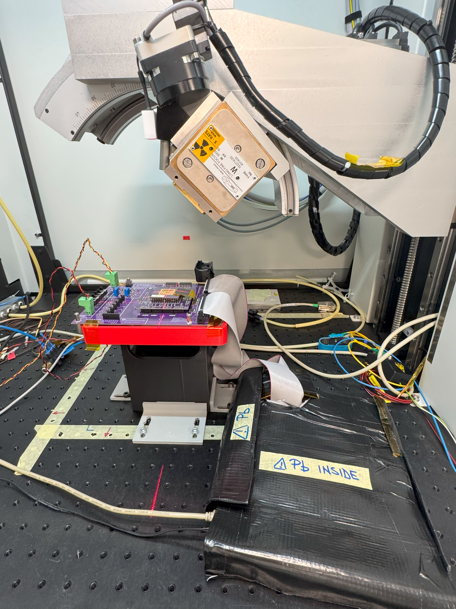
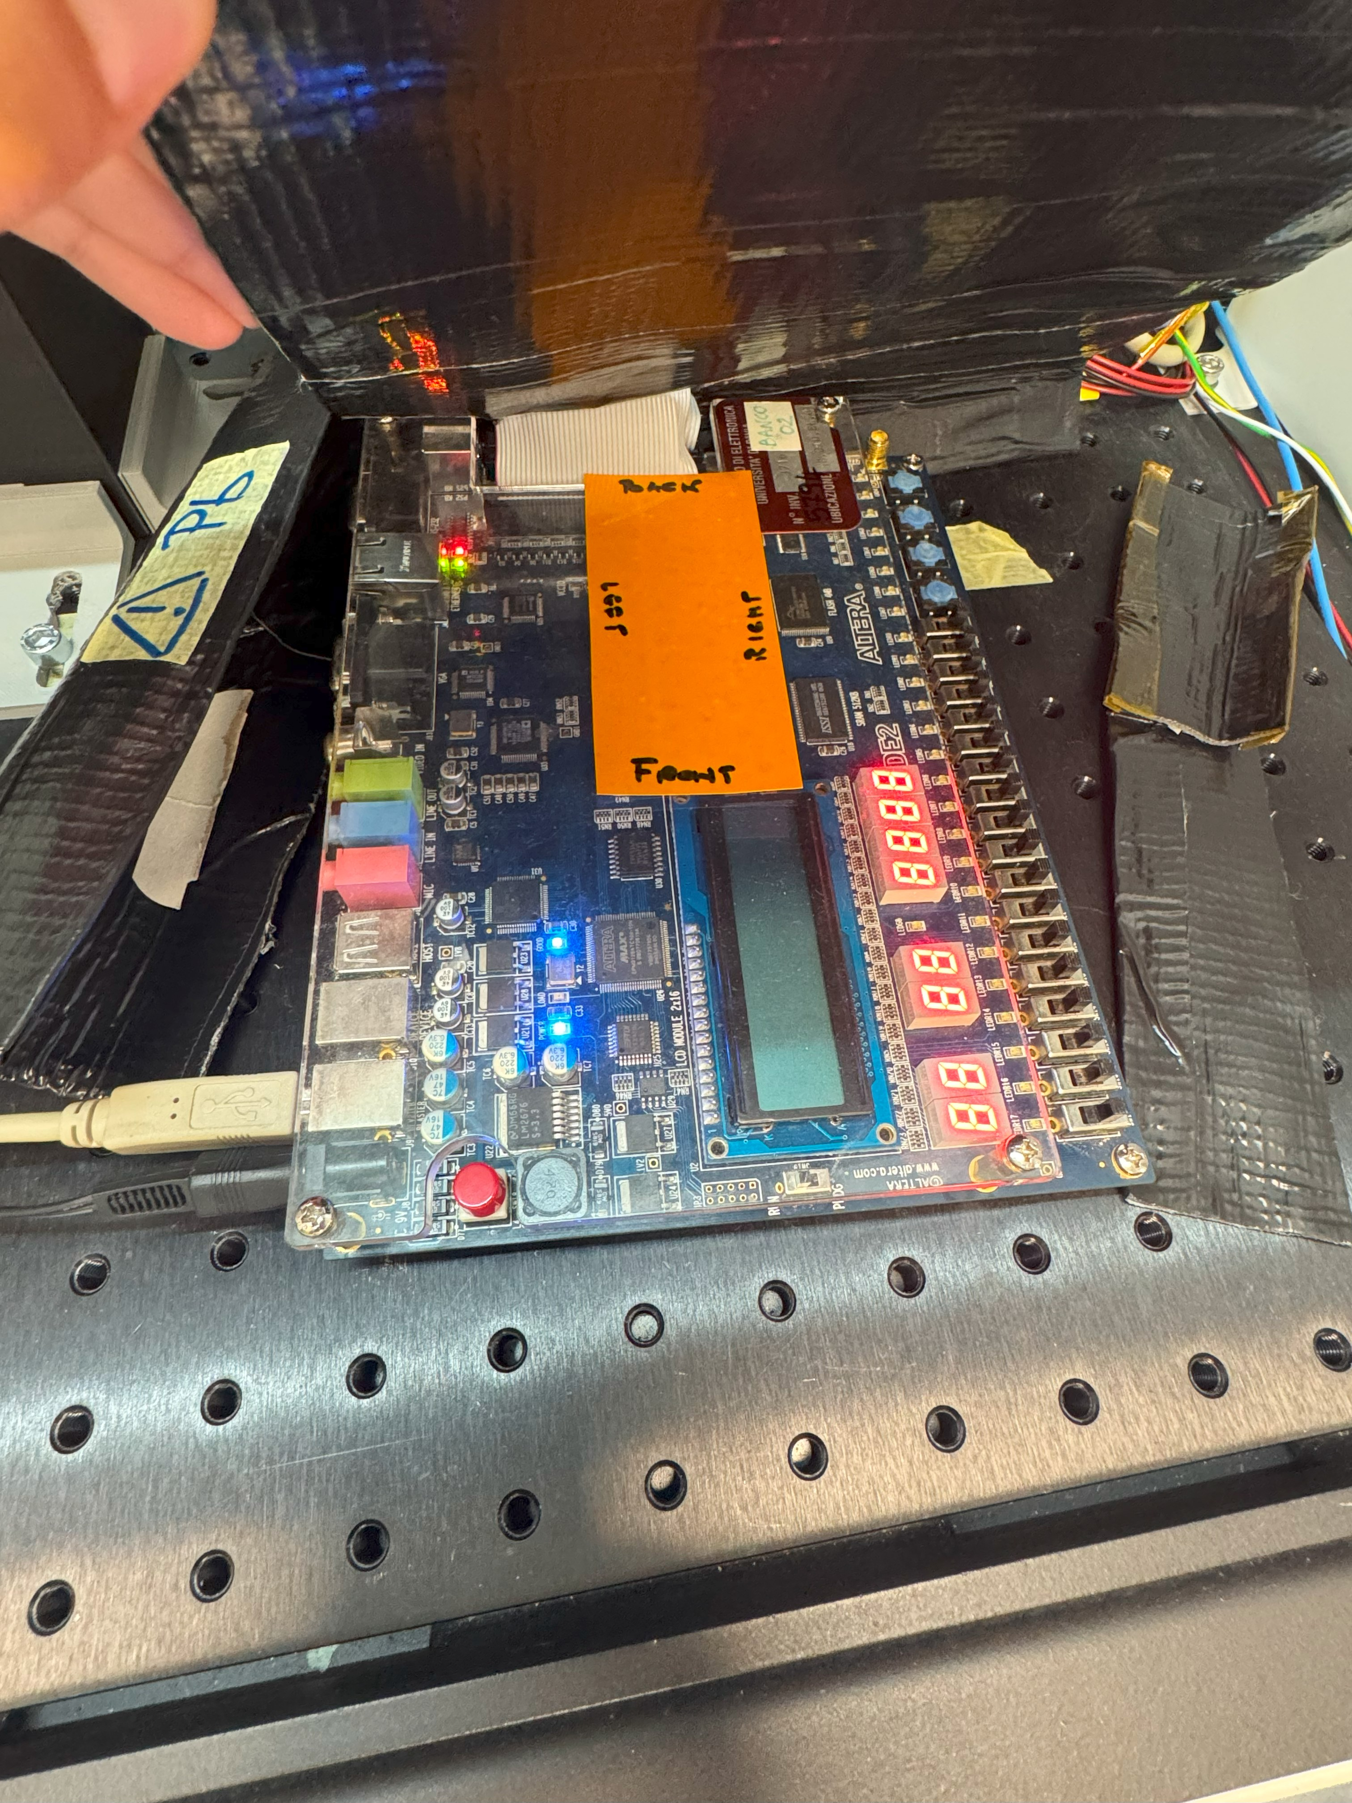
Irradiation Setup
The FPGA was shielded with a lead (Pb) cover to protect it from irradiation.
A sensitive film was placed beneath the shielding and inspected after each irradiation step to ensure that no irradiation reached the FPGA.
Pb Shielding
Sensitive Film

Slide 4
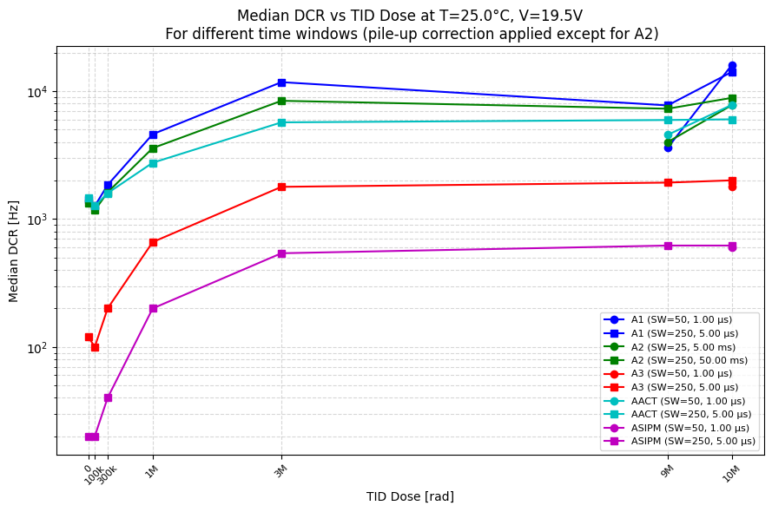
Median DCR vs Total Dose
For array A2, saturated pixels and those in row 2 are excluded from the median calculation.
After a TID dose of 9Mrad, DCR was measured for A1 and AACT using two different small windows (1 μs and 5 μs) and for A2 using two different total time windows (5 ms and 50 ms).
The lower median DCR values observed with the shorter time windows across all three arrays may be due to annealing effects, as those measurements were taken approximately four hours after irradiation ended, whereas the others were performed only about one hour post-irradiation.

Slide 5
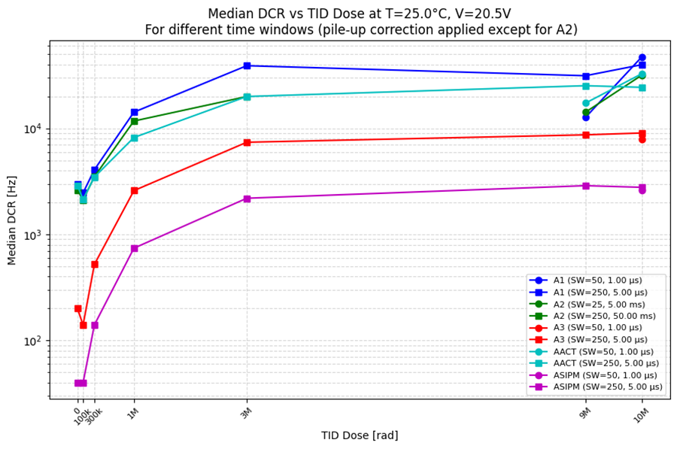
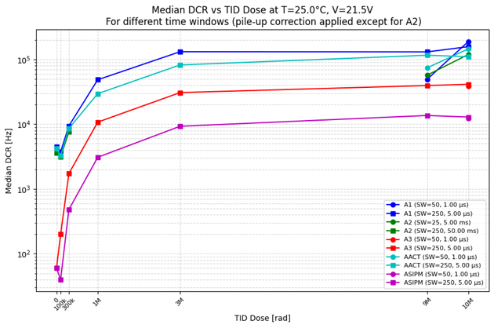
Median DCR vs Total Dose

Slide 6
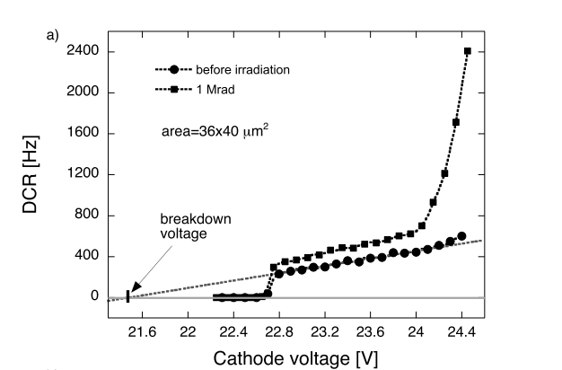
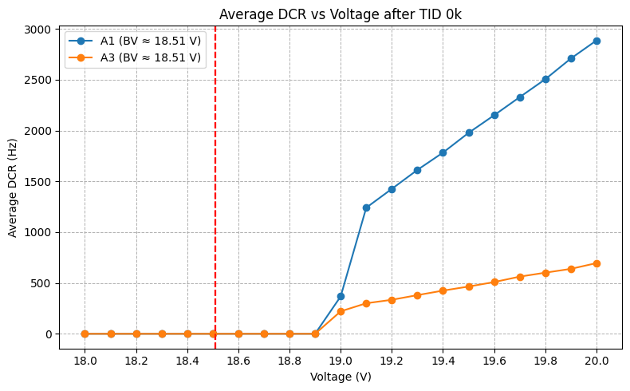
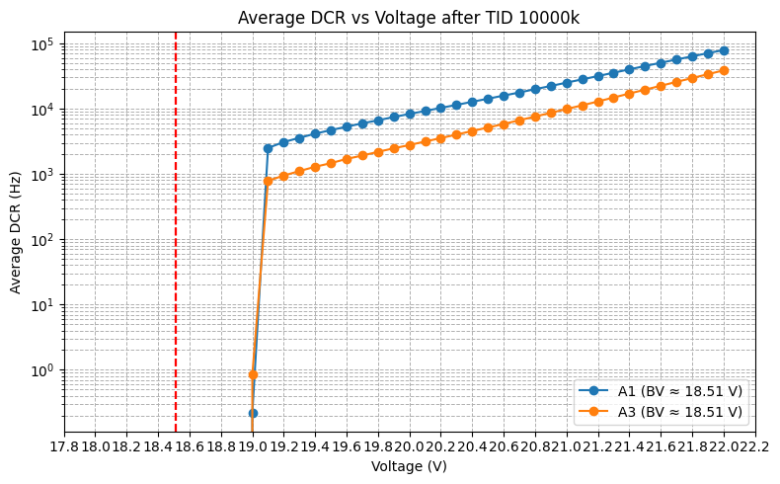
Breakdown Voltage
L. Ratti et al., "Dark Count Rate Degradation in CMOS SPADs Exposed to X-Rays and Neutrons," in IEEE Transactions on Nuclear Science, vol. 66, no. 2, pp. 567-574, Feb. 2019, doi: 10.1109/TNS.2019.2893233.
No change in breakdown voltage is observed before and after irradiation.
The guard ring does not experience breakdown with this technology and SPAD structure.

Slide 7
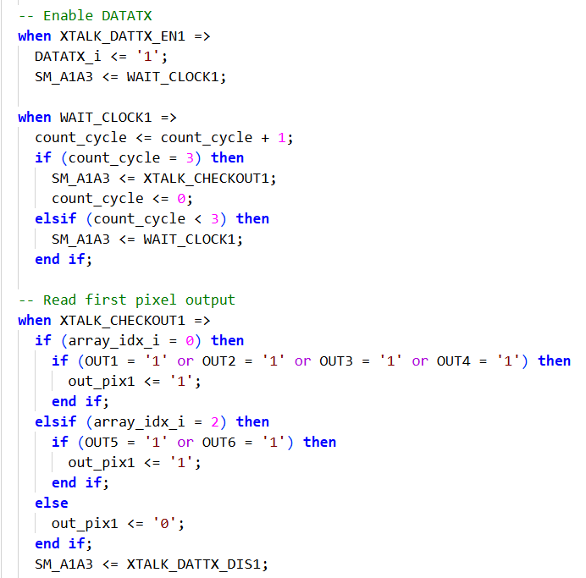
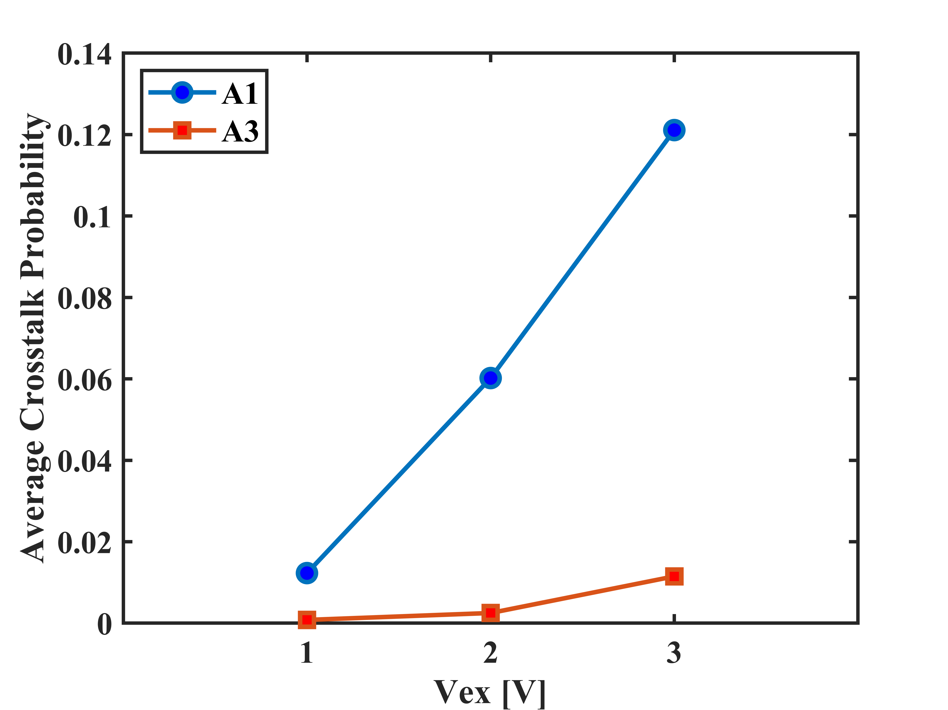
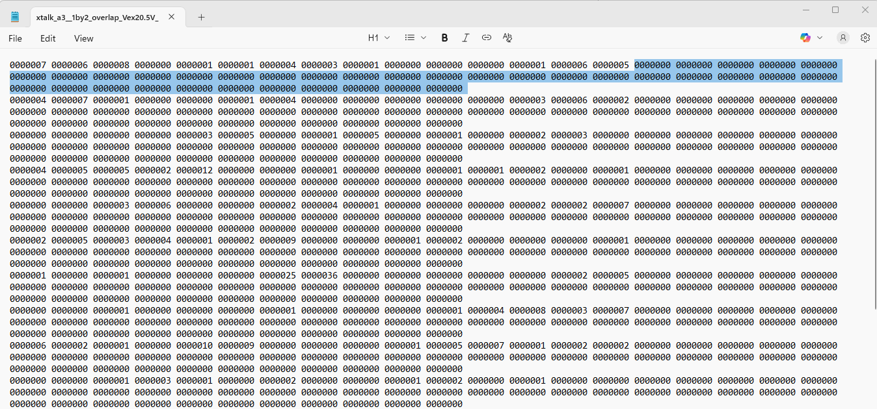
Crosstalk Before Irradiation
Obtained with previous firmware
Introduce a delay block between enabling DATATX and checking OUTx pads.
Coincidences are observed up to a specific column, after which all values drop to zero. This pattern is consistent across all rows.

Slide 8
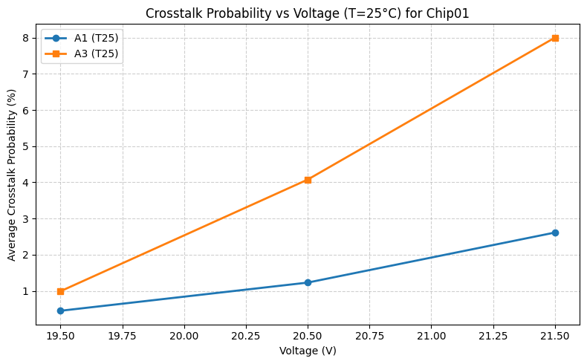
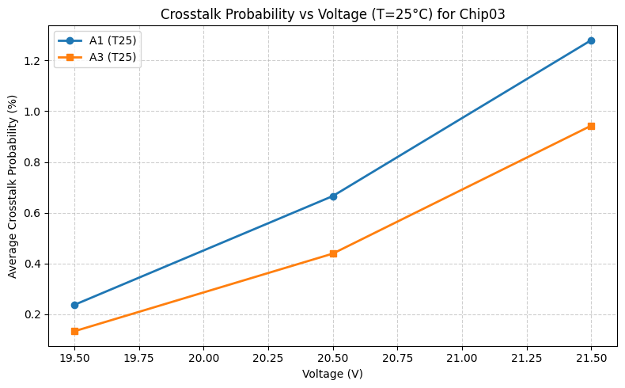
Crosstalk Before Irradiation

Slide 9
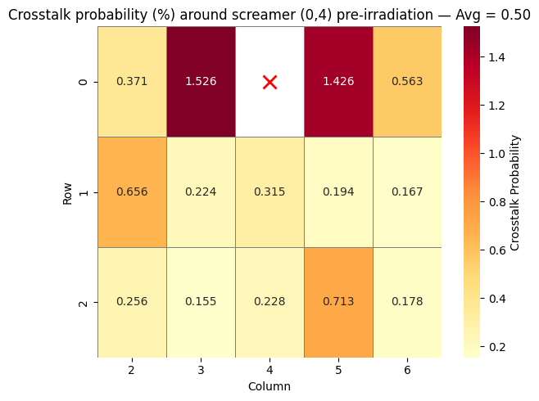
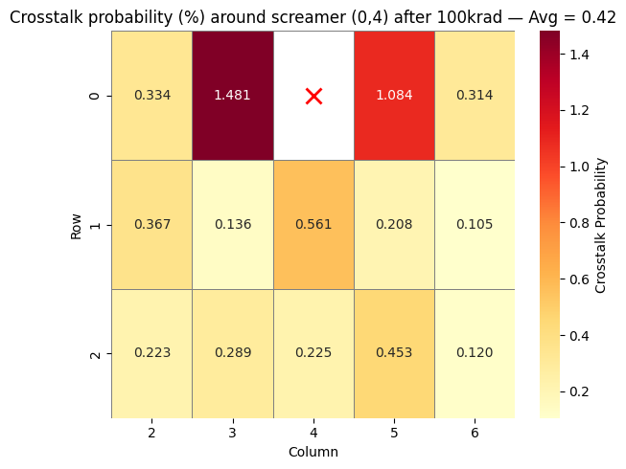
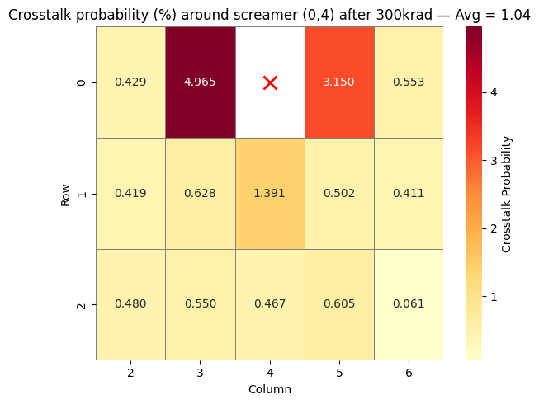
Crosstalk After Irradiation with version 1, array A1

Slide 10
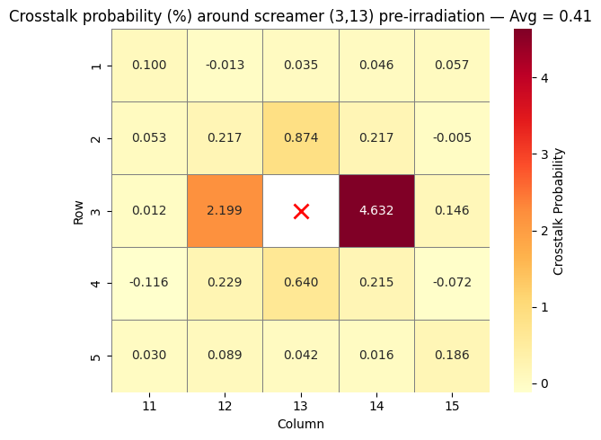
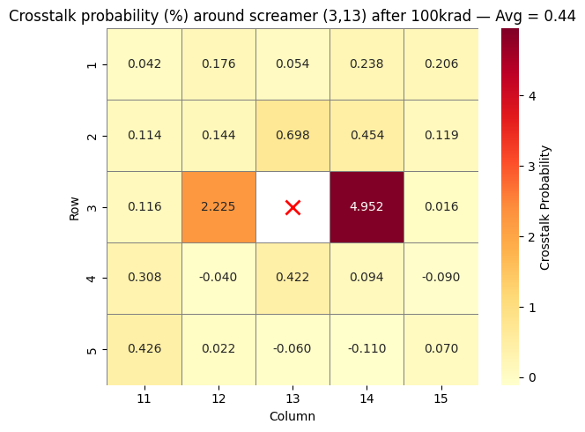
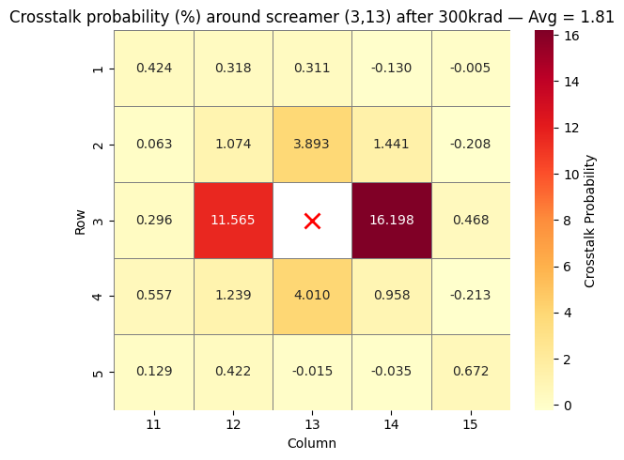
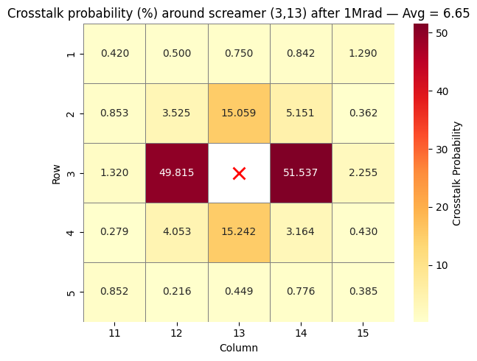
Crosstalk After Irradiation with version 1, array A3

Slide 11
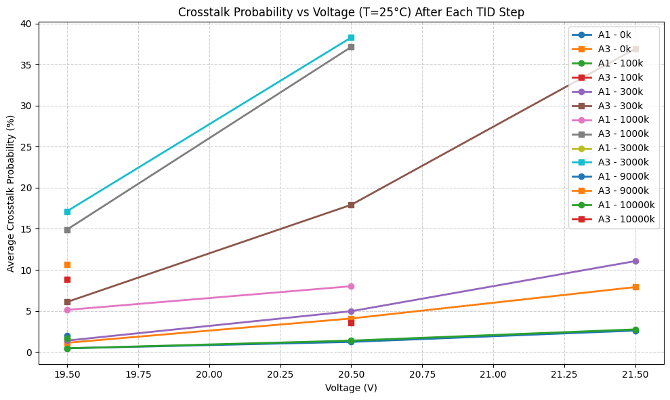
Crosstalk After Irradiation with version 2
A1, 19.5 V
TID Dose [krad] | Average Crosstalk Probability (%)
0 | 0.44
100 | 0.44
300 | 1.38
1000 | 5.12
3000 | 1.65
9000 | 1.98
10000 | 1.68
A3, 19.5 V
TID Dose [krad] | Average Crosstalk Probability (%)
0 | 1.25
100 | -
300 | 6.08
1000 | 14.90
3000 | 17.13
9000 | 10.63
10000 | 8.88

Slide 12
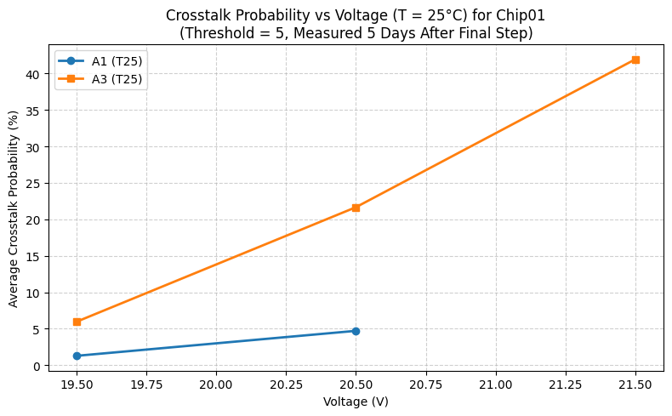
Crosstalk After Irradiation with version 2, 5 days after 10Mrad TID
A1, 19.5 V
TID Dose [krad] | Average Crosstalk Probability (%)
0 | 0.44
100 | 0.44
300 | 1.38
1000 | 5.12
3000 | 1.65
9000 | 1.98
10000 | 1.68
A3, 19.5 V
TID Dose [krad] | Average Crosstalk Probability (%)
0 | 1.25
100 | -
300 | 6.08
1000 | 14.90
3000 | 17.13
9000 | 10.63
10000 | 8.88

Slide 13
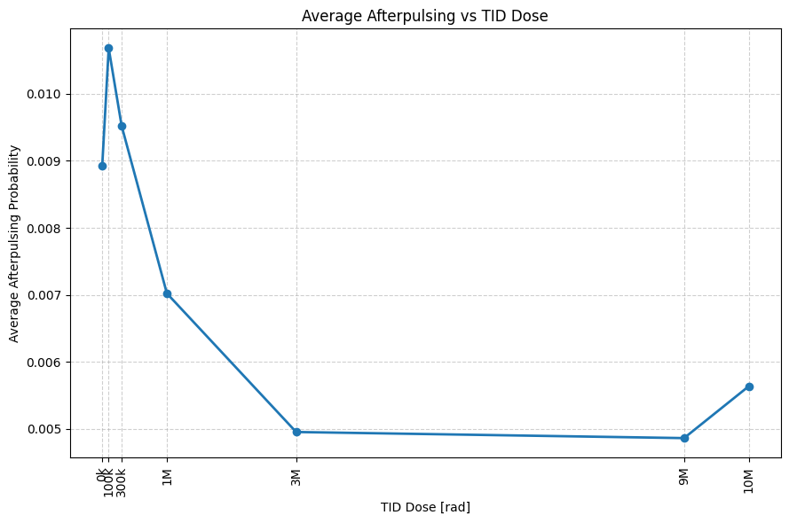
Afterpulsing vs TID Dose

Slide 14
Thank You

