Slide 1
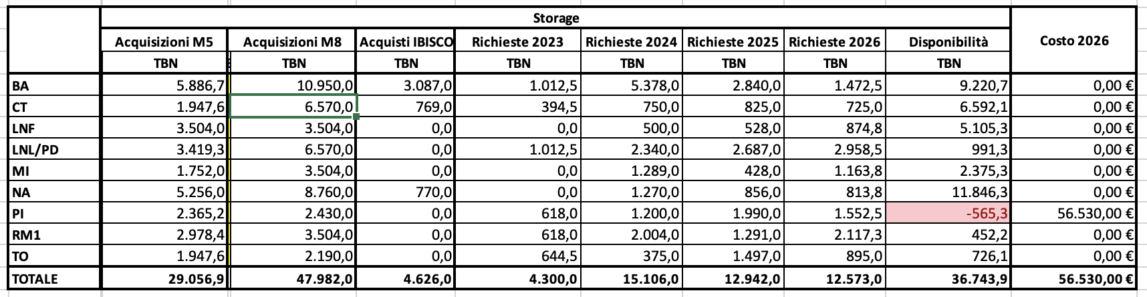
Risorse ICSC (pledged) Tier2
Storage

Slide 2
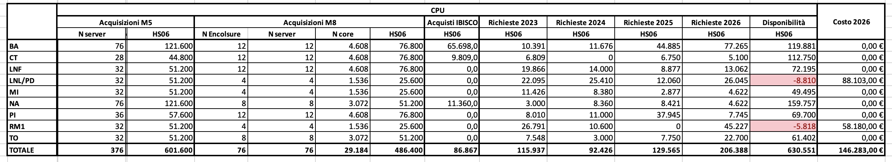
Risorse ICSC (pledged) Tier2
CPU

Slide 3
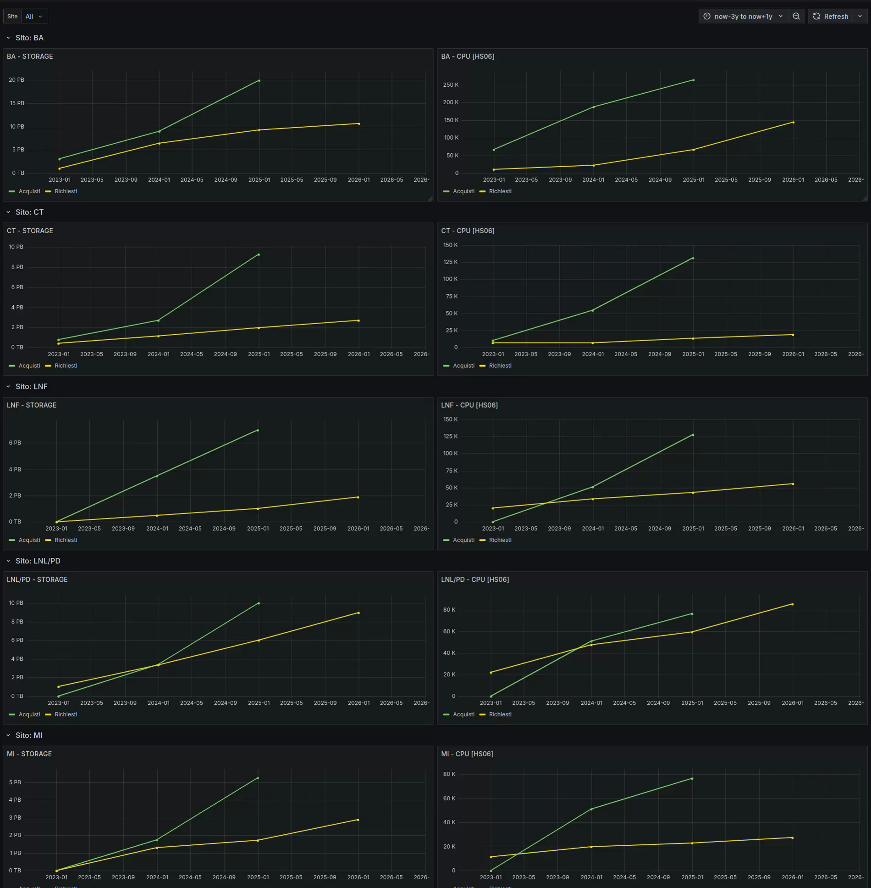
Monitoring delle risorse dei Tier2

Slide 4
Terabit “HPC Bubbles”
Nodi con solo fondi Terabit per sito
 | Nodo CPU | Nodo GPU | Nodo FPGA Xilinx | Nodo FPGA Terasic | Nodi Cloud storage
BA | 0 | 4 | 0 | 0 | 18
CNAF | 16 | 21 | 2 | 2 | 36
MIB | 0 | 0 | 2 | 2 | 0
NA | 10 | 0 | 2 | 0 | 0
PD | 6 | 6 | 0 | 0 | 0
PI | 8 | 0 | 0 | 0 | 0
RM1 | 8 | 0 | 0 | 0 | 0
TO | 6 | 6 | 0 | 0 | 0
TOTALE | 54 | 37 | 6 | 4 | 54
Core: 10.4 kcore fisici
Circa 34 HS/core
GPU: 148 NVIDIA H100
5.0PFLOPS FP64
40 FPGA
21 PB RAW
InfiniBAnd 400Gbs

