Slide 1


A short workshop on ET cryostat design
E. Majorana
28/07/2025

Slide 2
Items touched in this meeting in red blocks
Payload Cooling hardware cond.+rad.
Single/Double cavern
VAC tank preliminary design
Cryostat design
iteration 1
OTS, ITS, IITS+CPay
Cooling modelling
Cryostat parameters
iteration 2
Previous Payload design experience
alternative solution/tuning (Cryostat/CPAY)
Design VS Payload installation/operation
CRITICAL
Feasible change proposal
OK?
Cryostat parameters
iteration 3
Significant amendments in
OTS, ITS, IITS design
CRITICAL
YES
Cryostat refinement
and tuning
Cryostat
parameters
iteration 4
Executive drawings

Slide 3
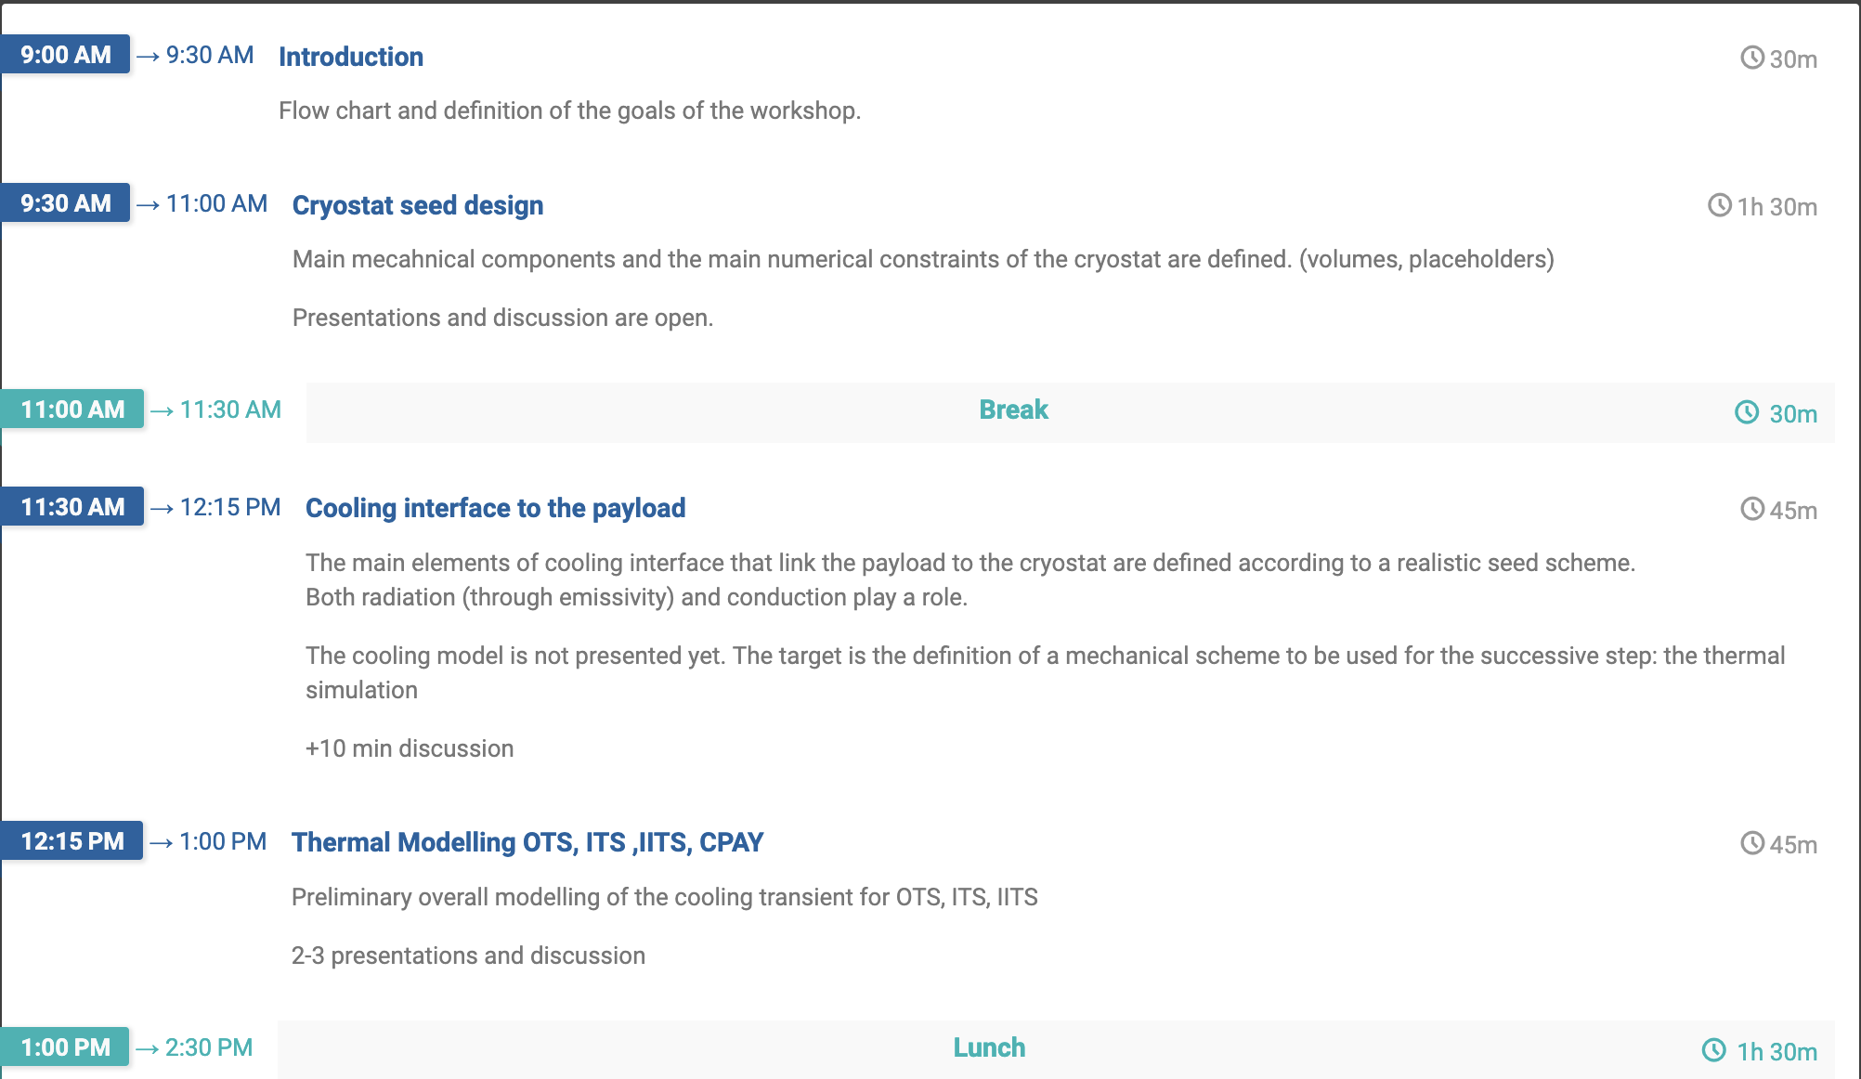
28/7

Slide 4
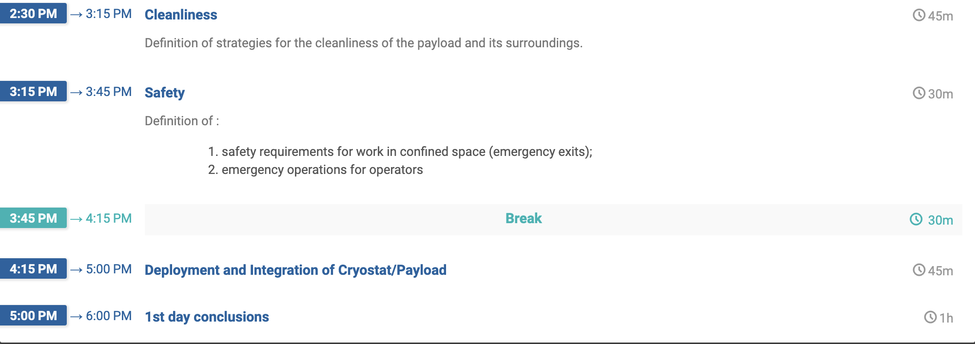
28/7

Slide 5
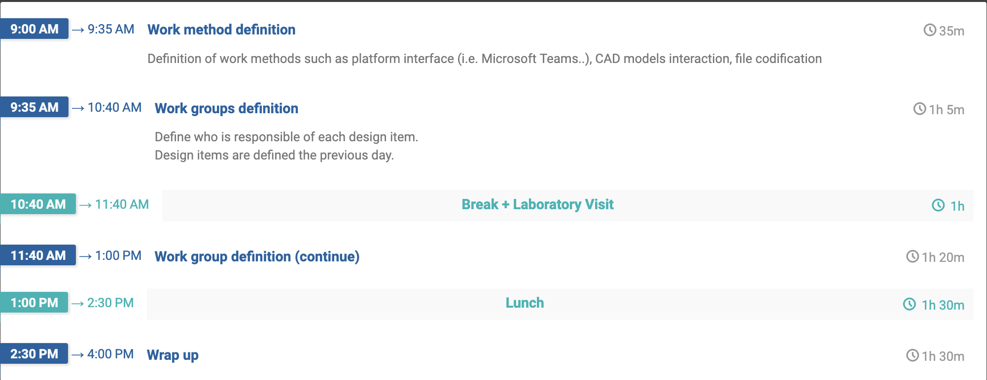
29/7
Targets

