Slide 1
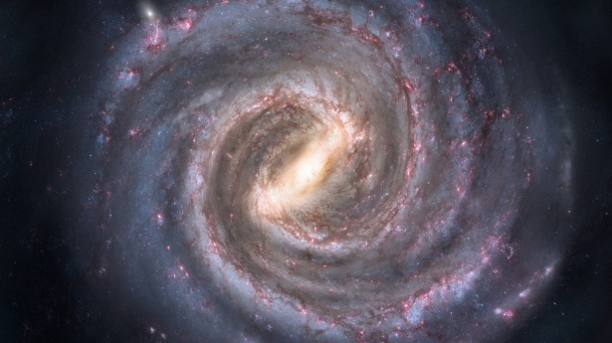
REFRACTED GRAVITY
Classical theory
Based on
Matsakos, Diaferio (2016)
Sanna, Matsakos, Diaferio (2023)
Gervani, Diaferio, Pace, Sanna (in preparation)

Slide 2
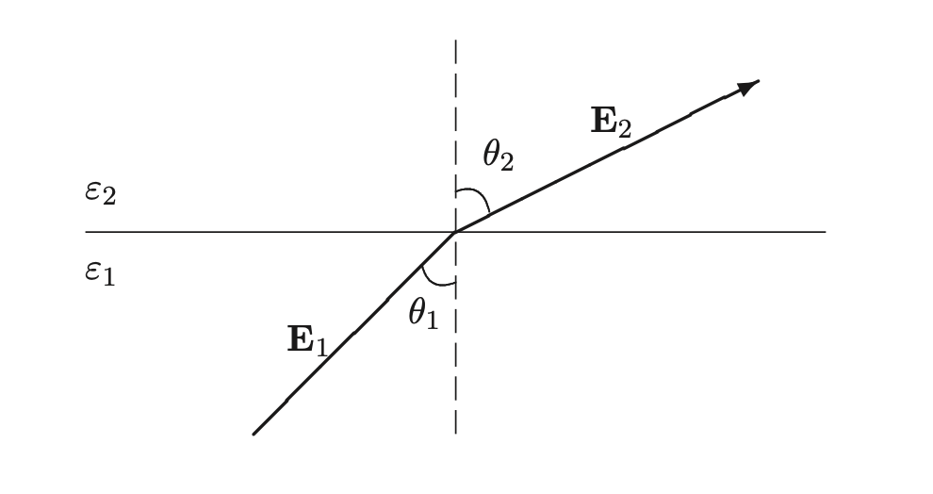

The electrodynamical analogy
redirection of field lines;
amplification of the Newtonian field
similar to AQUAL [1], but with an important difference:
[1] Bekenstein & Milgrom (1984)
1

Slide 3
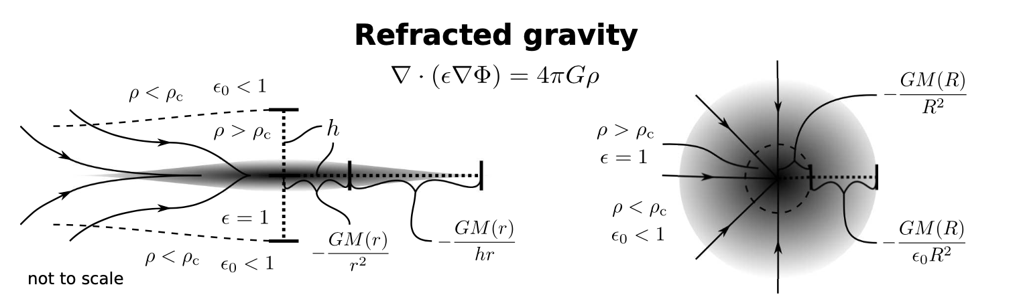
Qualitative behaviour
Flat systems: redirection of field lines boosts the gravitational force along the disk plane, changing its radial dependence. At large radii:
Spherical systems: since and are parallel, the field is still radial, but amplified by a factor .
2

Slide 4
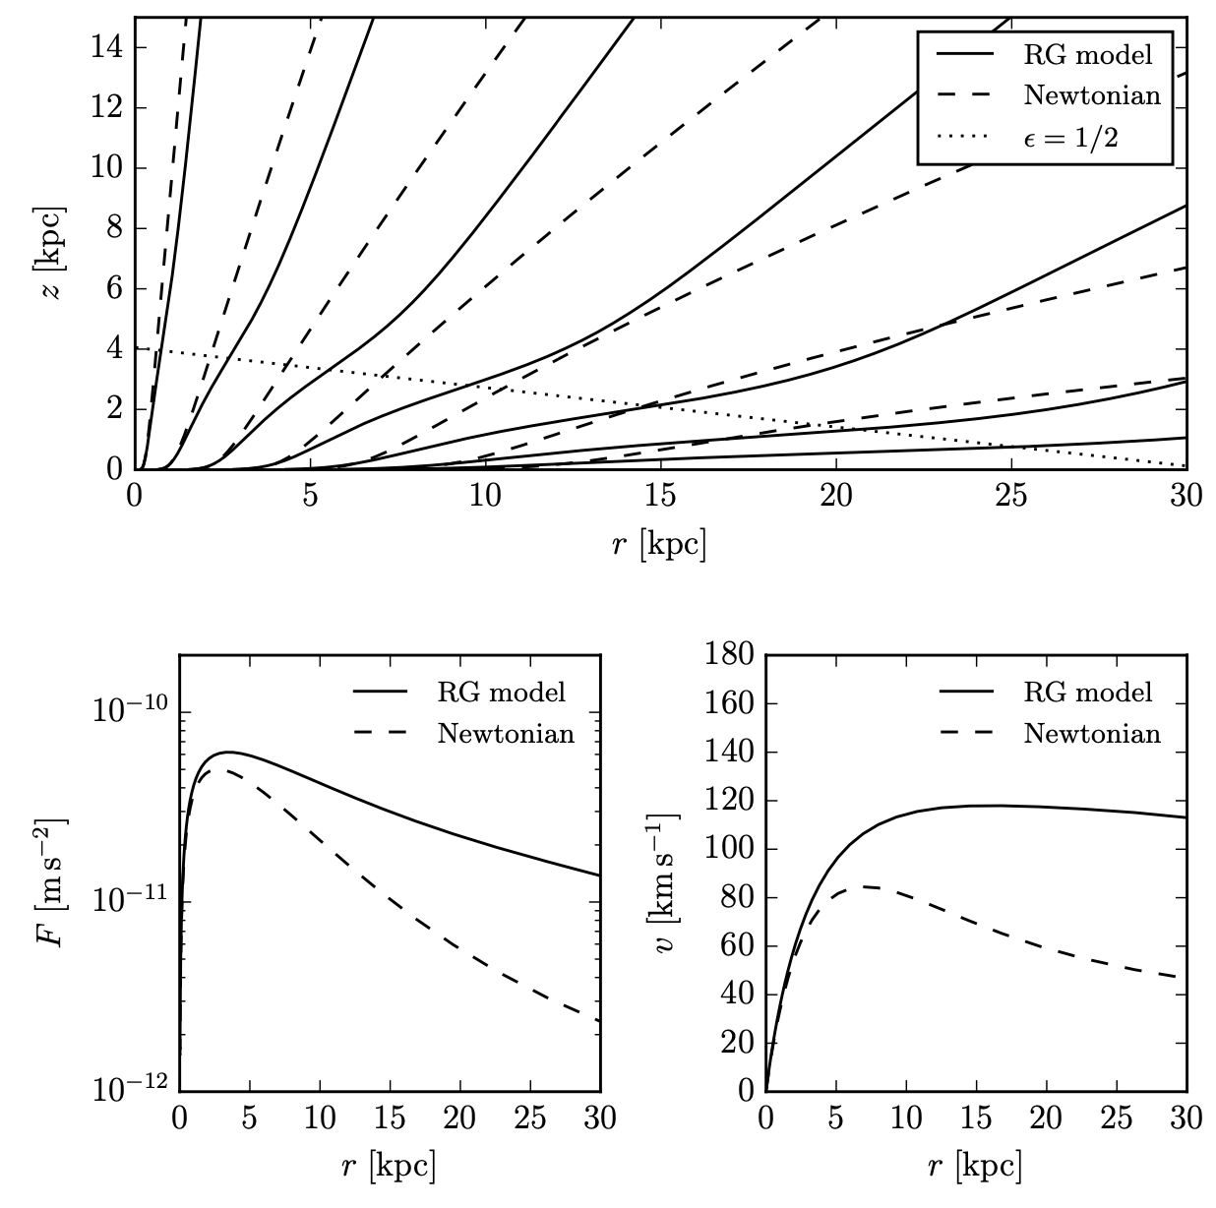
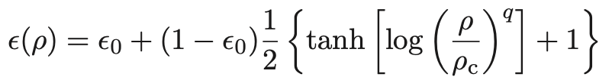
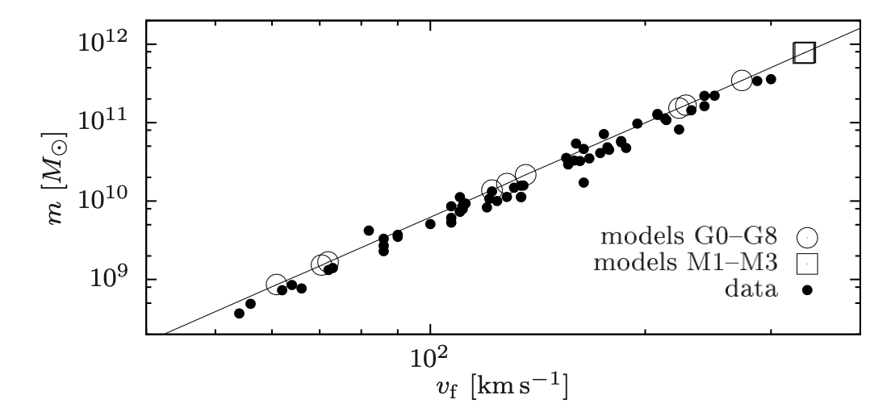
MOND-like predictions of RG
Realiastic model of the disk and permittivity:
Flat rotation curves:
Tully-Fisher relation [2]:
[2] Tully & Fisher (1977)
3

Slide 5
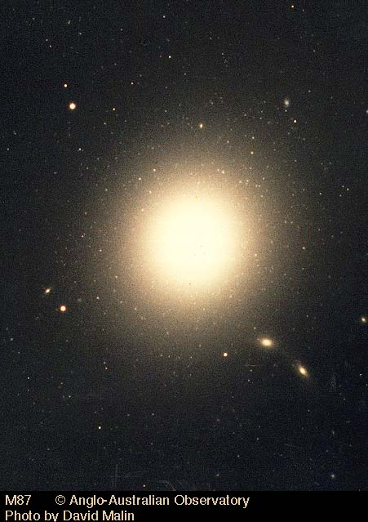
OBSERVATIONAL TESTS

Slide 6
Disk galaxies: rotation curves
Reference [3] tested RG predictions on a sample of 30 disk galaxies from the DMS catalogue. This is done mainly by solving the RG equation (modified Poisson) and to give a model estimate of the velocity profile:
Poisson solver
Model and data are compared with a MCMC Metropolis-Hastings method to yield the best estimates of the five parameters of the model : .
The permittivity parameters are all compatible with each other, suggesting a possible universality of the permittivity function.
[3] Cesare et al. (2020)
4

Slide 7
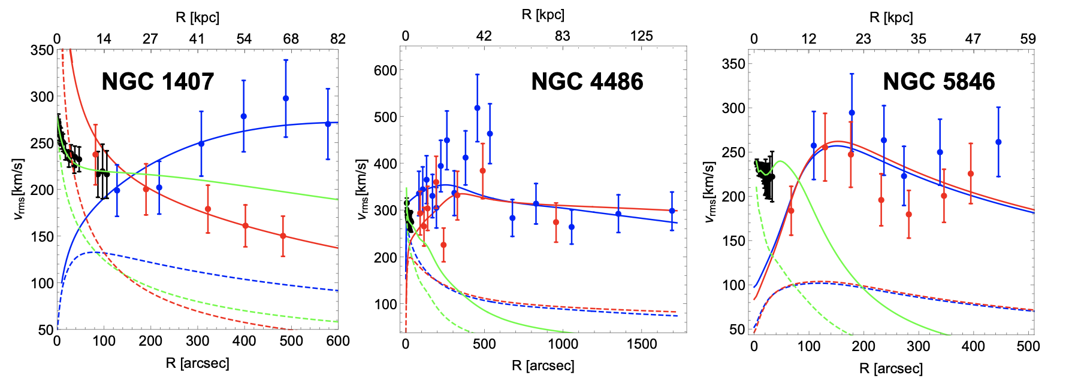
E0 galaxies
Reference [5] investigated whether RG can model the dynamics of the outer regions of 3 E0 galaxies, using the motion of stars, red globular clusters and blue globular clusters. The model has 4 parameters common to all sources, , and three orbital anisotropy parameters, one for each family, .
Overall RG proves able to descrive the dynamics of the three systems. Permittivity parameters are all compatible with each other and with those estimated from DMS galaxies.
[5] Cesare et al. (2022)
5

Slide 8
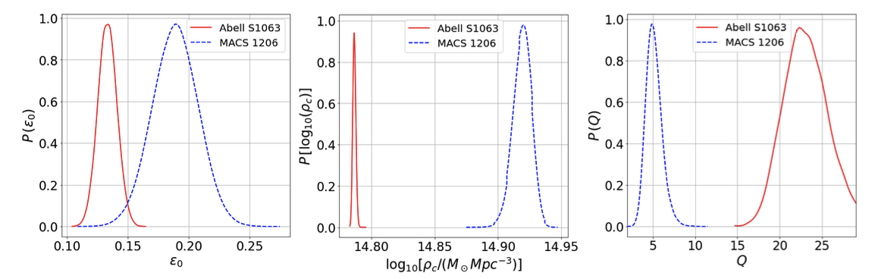
Galaxy clusters
Reference [6] tried to constrain the RG parameters from the dynamics of 2 galaxy clusters. This is done by solving the stationary spherical Jeans equation (assuming dynamical relaxation and spherical symmetry) both for stars in the Brightest Cluster galaxy (BCG) and for galaxies in the cluster:
.
RG predictions are in good agreement with the observed VDP. However, best fit parameters for the two clusters are not compatible with each other nor with those found by [3] and [6], possibly due to the failure of the assumptions: clusters may be not perfectly spherical and/or not isolated.
[6] Pizzuti et al. (2024)
6

Slide 9
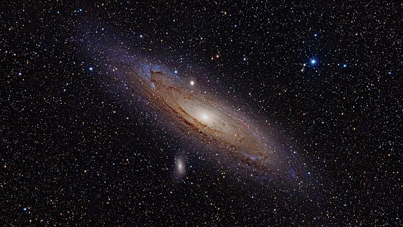
REFRACTED GRAVITY
Covariant formulation

Slide 10
Brans-Dicke theory
To do cosmology in RG we need a covariant formulation. A possibility is the scalar-tensor theory [7]
Covariant Refracted Gravity (CRG) is set by . This yields equations of motion
(*)
(**)
[7] Quiros et al. (2016)
7

Slide 11
Weak-field limit of CRG
in
Expanding around the Minkowski metric,
the (00) component of the field equation (*) reduces to : we recover classical RG if we identify . In the simple case of a spherical source at large distances
We observe the natural emergence of an acceleration scale: if , the accelaration dependece on r reduces to that at small radii (rescaled Newtonian); if instead it will deviate from the Newtonian accelaration.
8

Slide 12
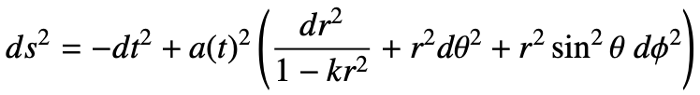
Cosmology in CRG
in
In a homogeneous and isotrpic universe with the FLRW metric and a pressureless (baryonic) perfect fluid
equation (*) and equation (**) yield
which can be integrated to yield the explicit evolution of the Hubble rate. This integration gives a bound:
9

Slide 13
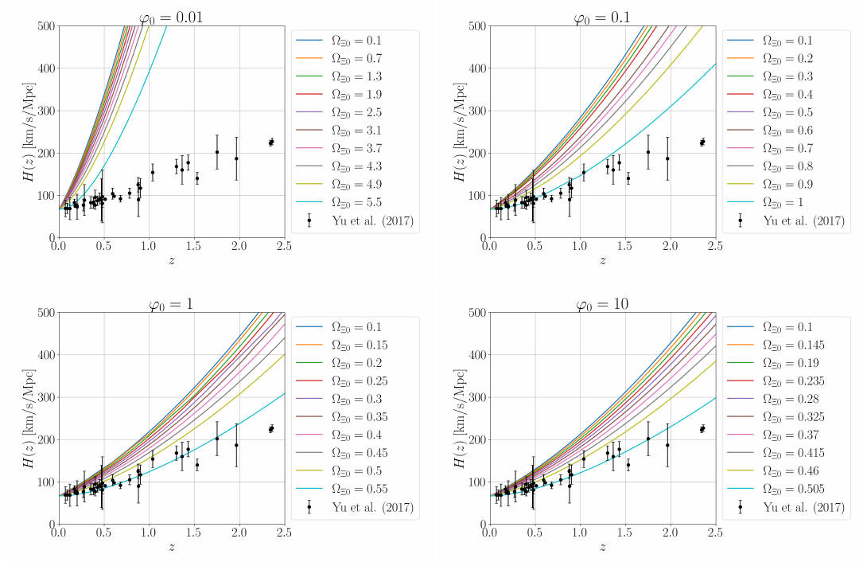
Background evolution: H(z) fit
in
Our model has two free parameters:
We compare our numerical/analytical results to available data points for H(z) for different values of them.
Values of the scalar field above unity seem clearly favored.
10

Slide 14
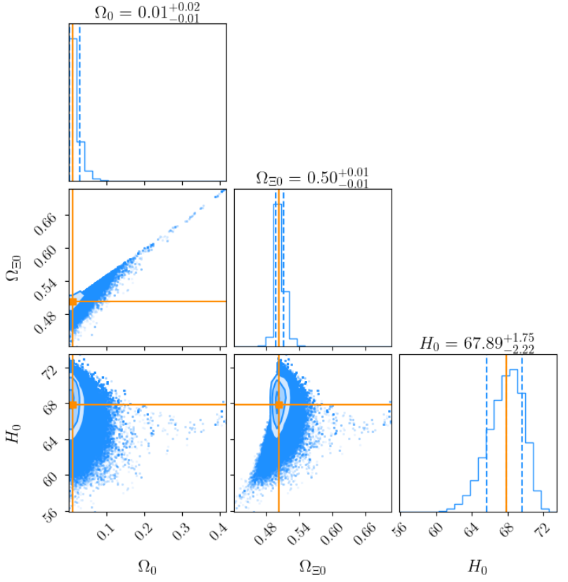
Background evolution: H(z) fit
in
A full MCMC analysis yields the best-fit values for .
The posterior favors pairs saturating the theoretical bound,
and the preferred values are
11

Slide 15

Linear perturbation theory
in
To study structure formation in RG, we develop the linear perturbation theory in Brans-Dicke gravity.
12

Slide 16
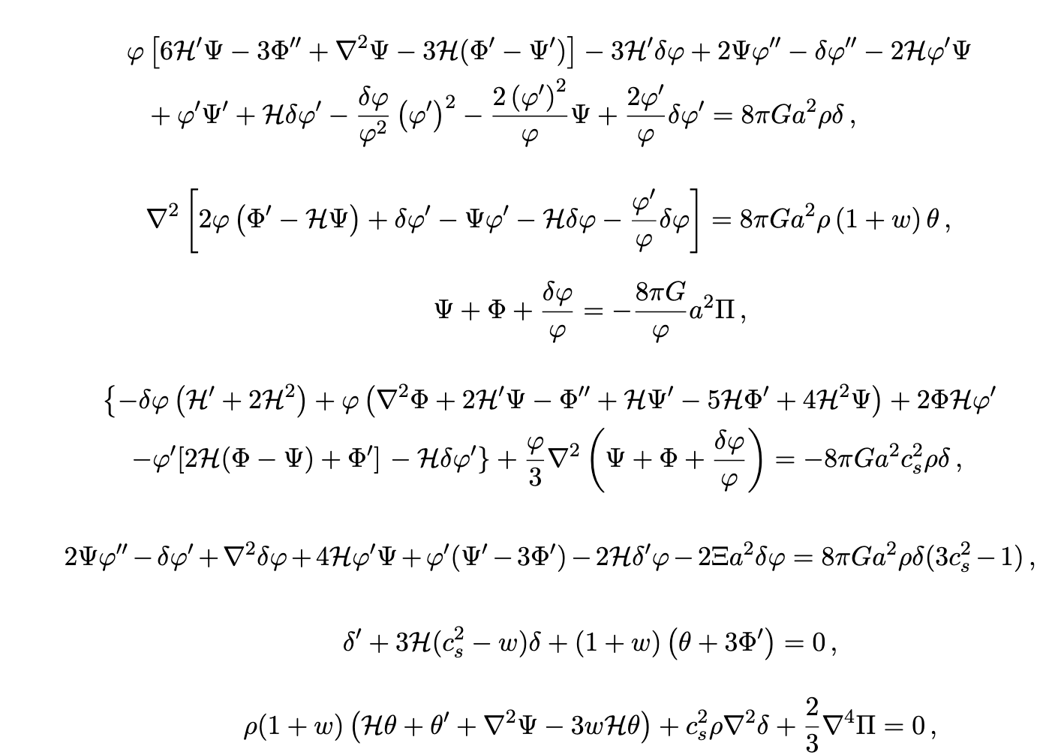
Linear perturbation theory
in
To study structure formation in RG, we develop the linear perturbation theory in Brans-Dicke gravity.
We obtain the perturbed Einstein and Klein-Gordon equations, as well as the perturbed continuity equation.
12

Slide 17
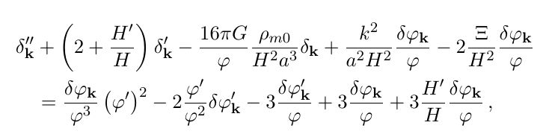
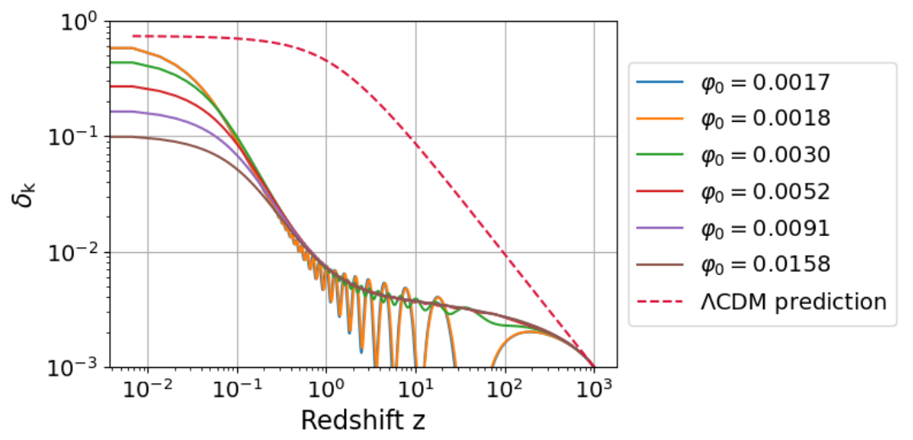
Linear perturbation theory
in
Through some manipulations we arrive at the growth factor equation
which can be numerically integrated.
Structure formation is heavily delayed with
respect to the LCDM case.
13

Slide 18
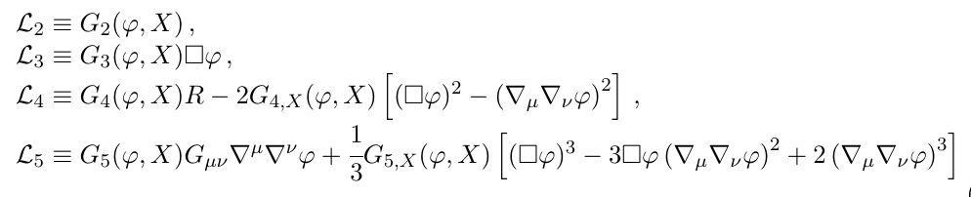
Future prospects
in
Currently working on more general theories than the Brans-Dicke theory: Horndeski theories are
What conditions must we impose to re-obtain RG in the weak field limit?
14

Slide 19
Thank you for your attention

