Slide 1
DPDF Meeting
July 22

Slide 2
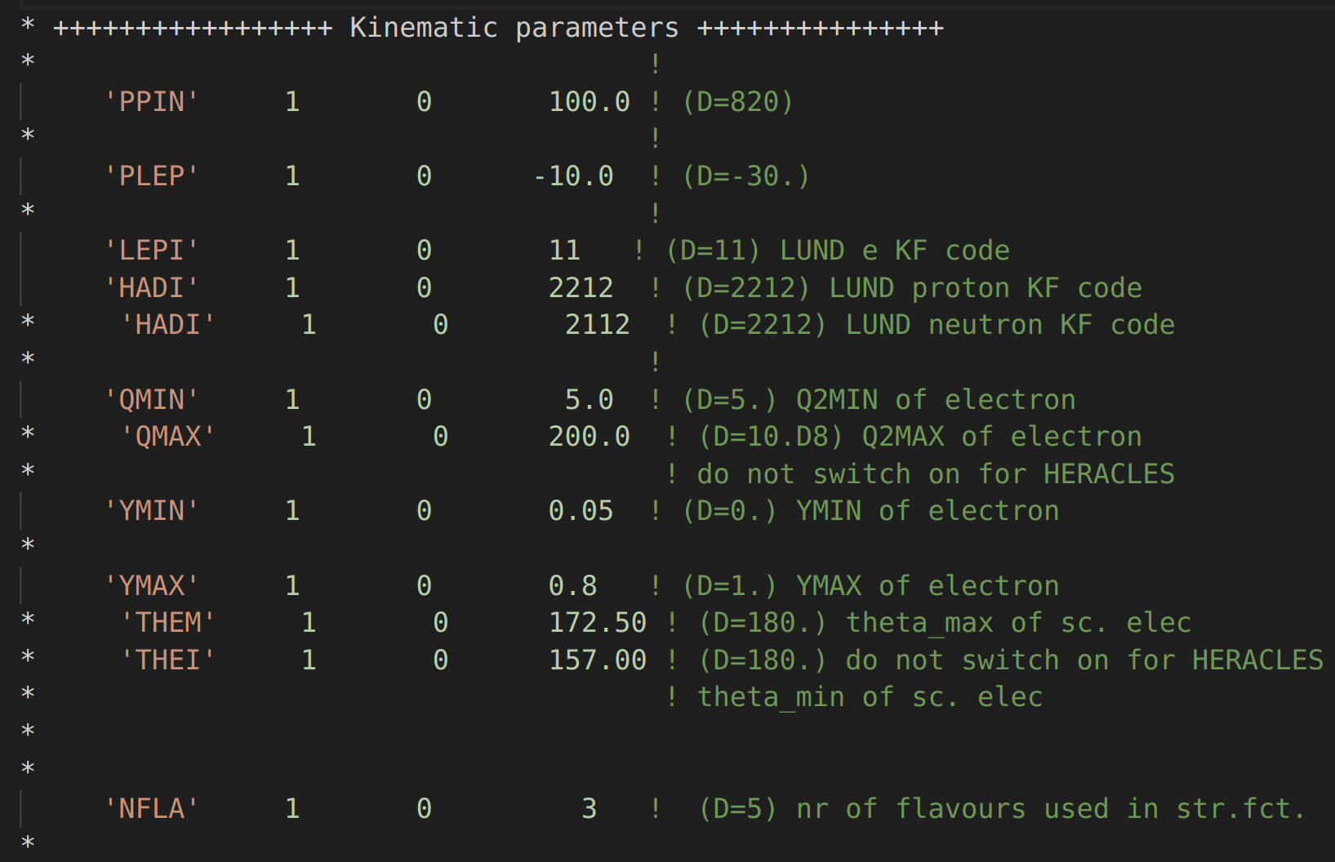
Steering card
IFPS = 3 initial and final state PS
Parameters Identified for QED Radiation:
INT3, LPIN (initial/final state radiation, leptonic radiation)

Slide 3
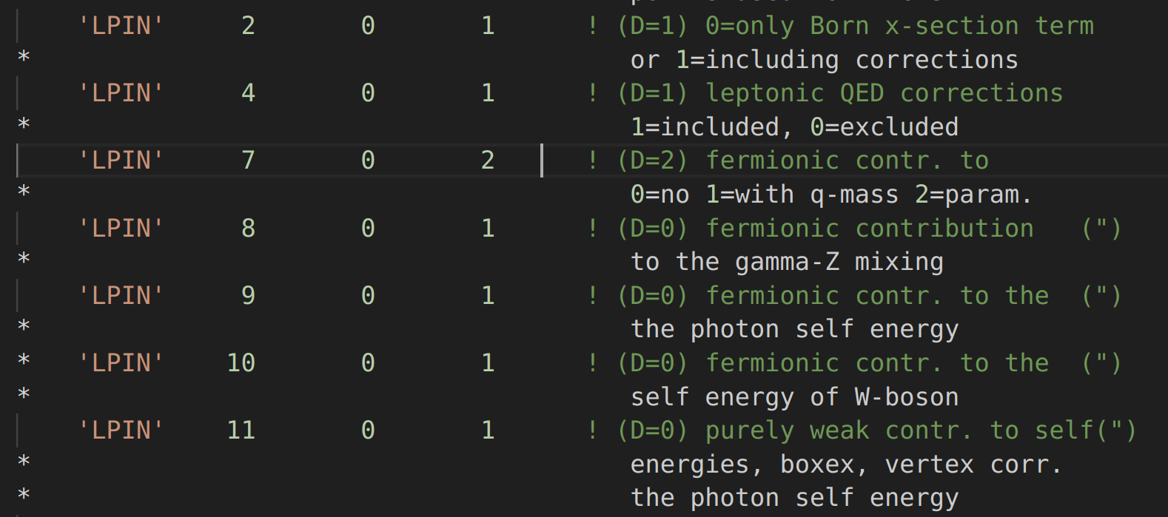
Radiative QED corrections

Slide 4
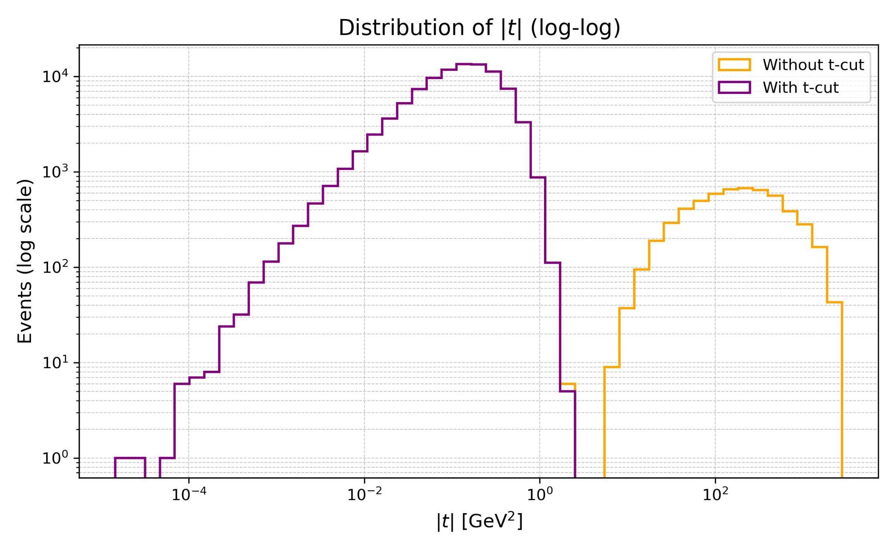
Plot of |t| with and w/o |t| cut

Slide 5
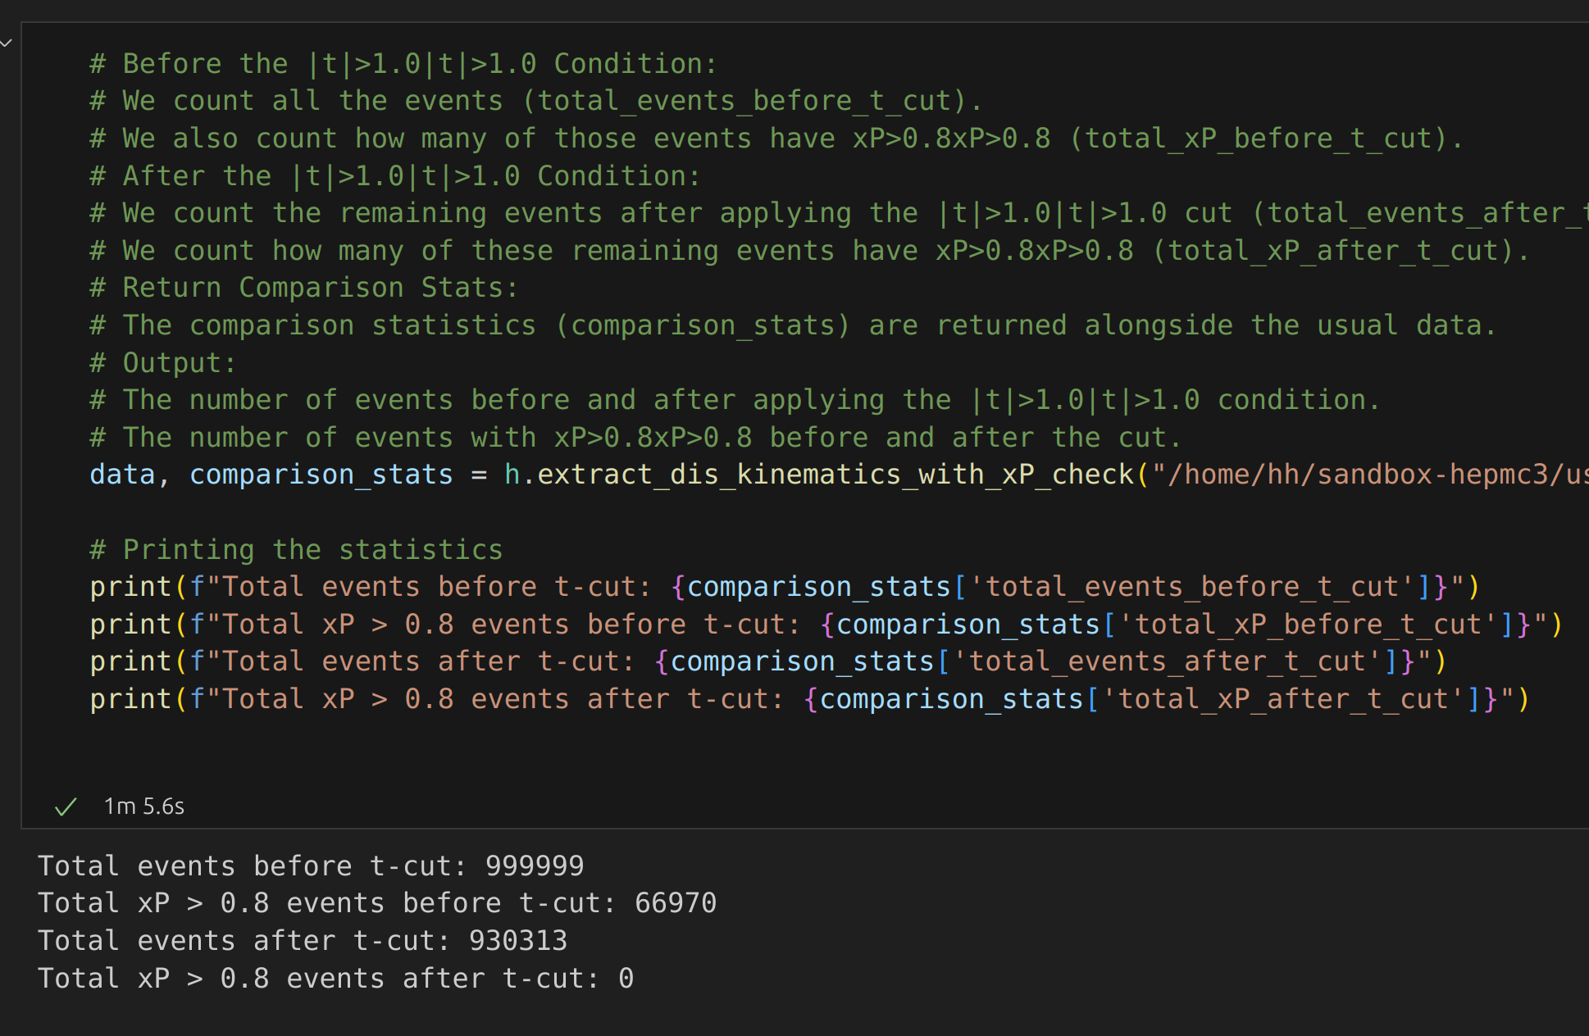
How many events do we lose with |t| cut? Less than 1%
999999-930313=69686
69686-66970=2716 per mil

Slide 6
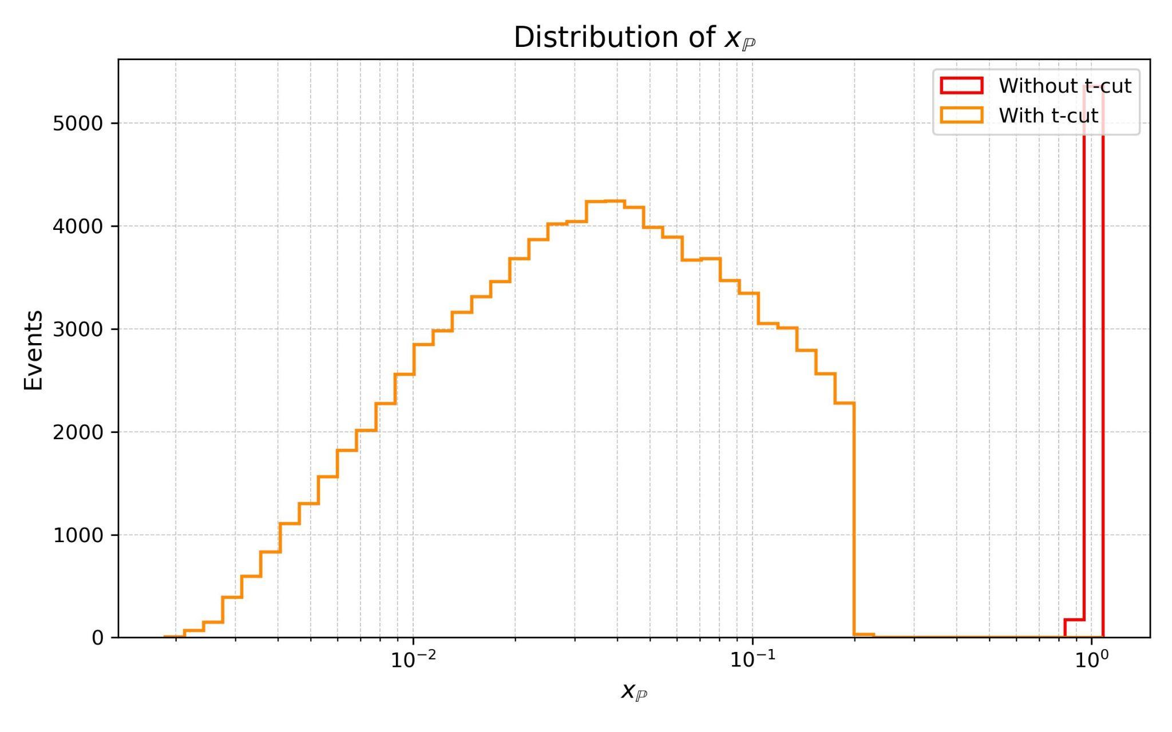
Why do we see a gap in xPom hist?
It seems that all the large xP as well as gap are gone with |t| cut.

Slide 7
communications
Discussed Limitations of eicrecon Electron Finder for HepMC Events
Reviewed Possibility of Identifying Scattered Electron via Parentage in HepMC:
However, in the provided events, the electrons and the other particles show an "Originating Vertex ID" of 0 and an "End Vertex ID" of 0. This means they are not explicitly connected to any detailed interaction or decay vertices within the record.

Slide 8
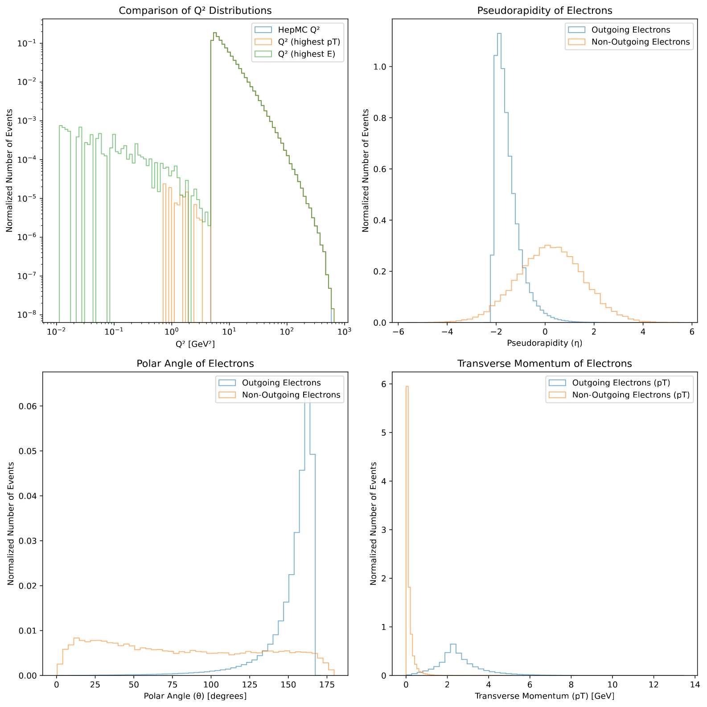
Outgoing electrons

Slide 9
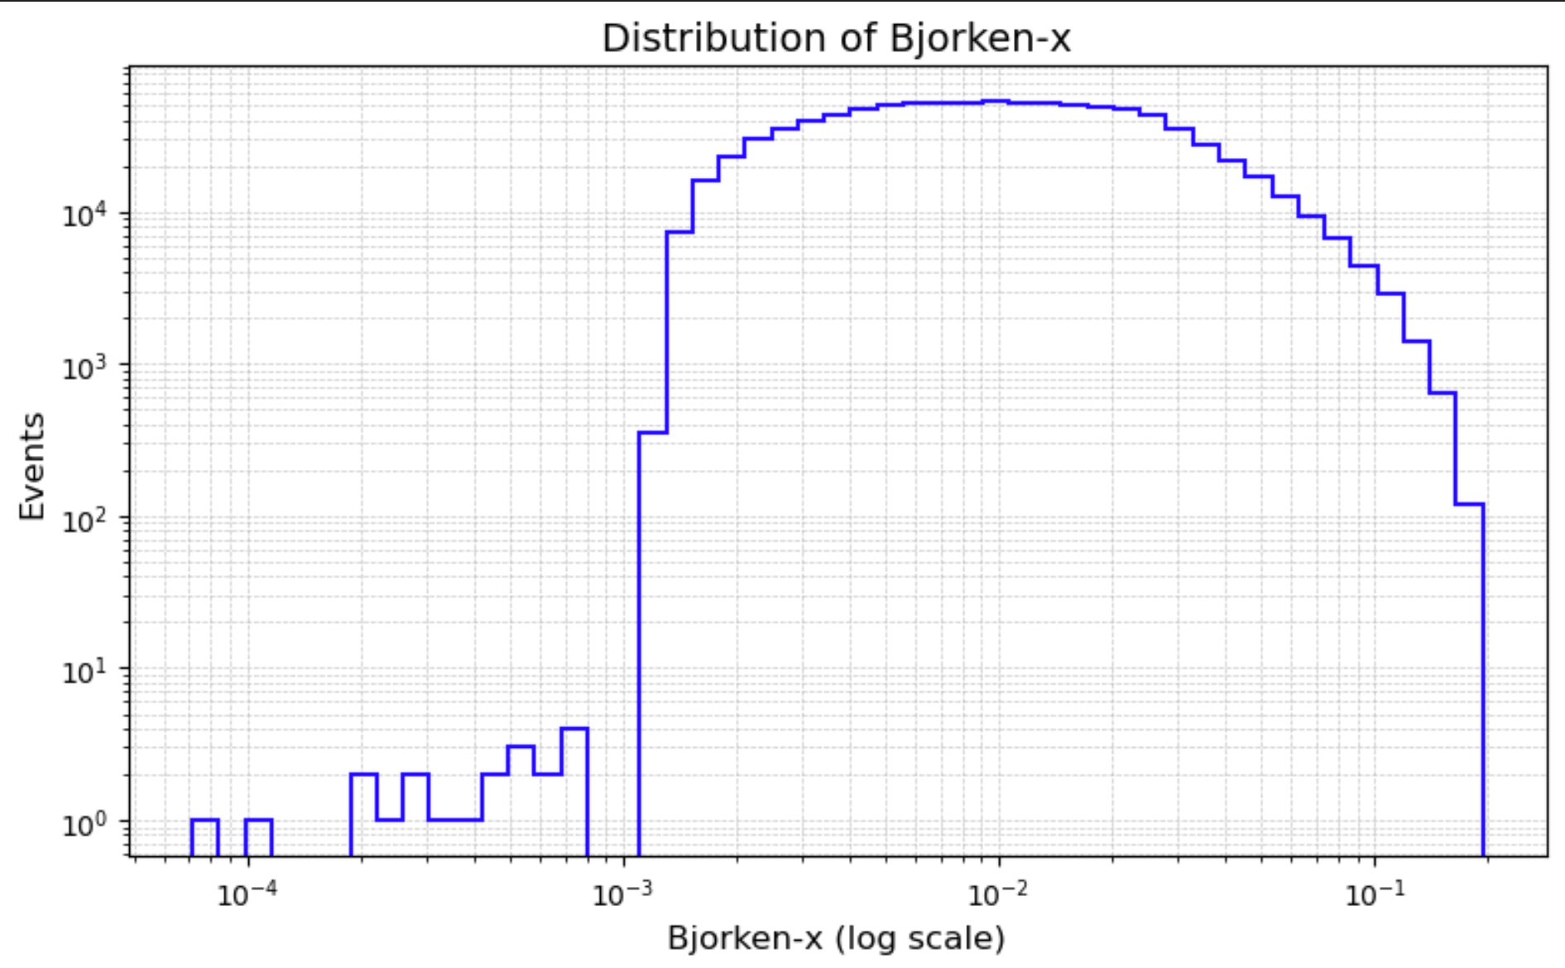
New plots - w/ Rad., no YMAX, no QMAX, w/ |t| cut and pT for outgoing electrons

Slide 10
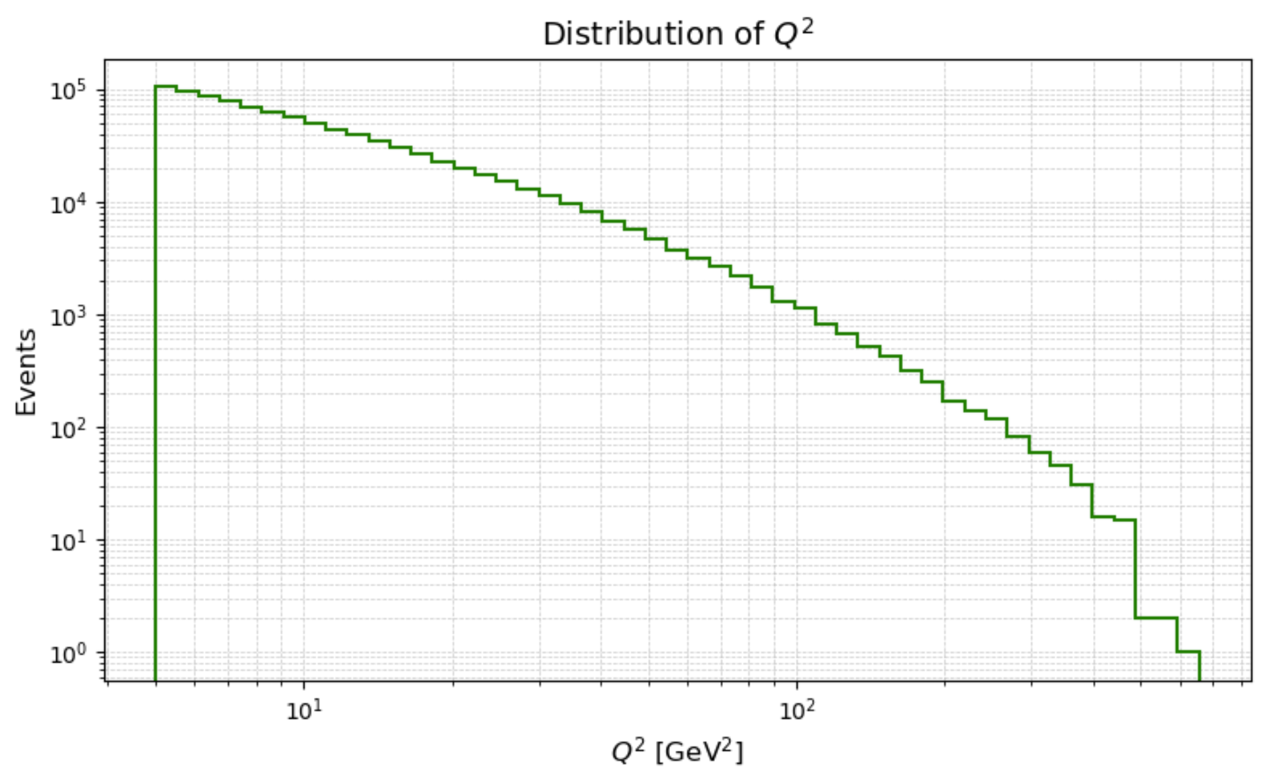
New plots
Q2 now extends to larger values and decays (no sudden drop)

Slide 11
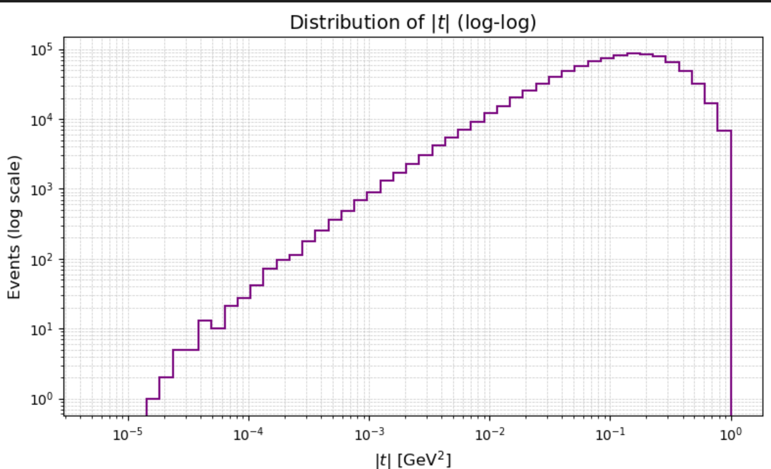
|t| hist

Slide 12
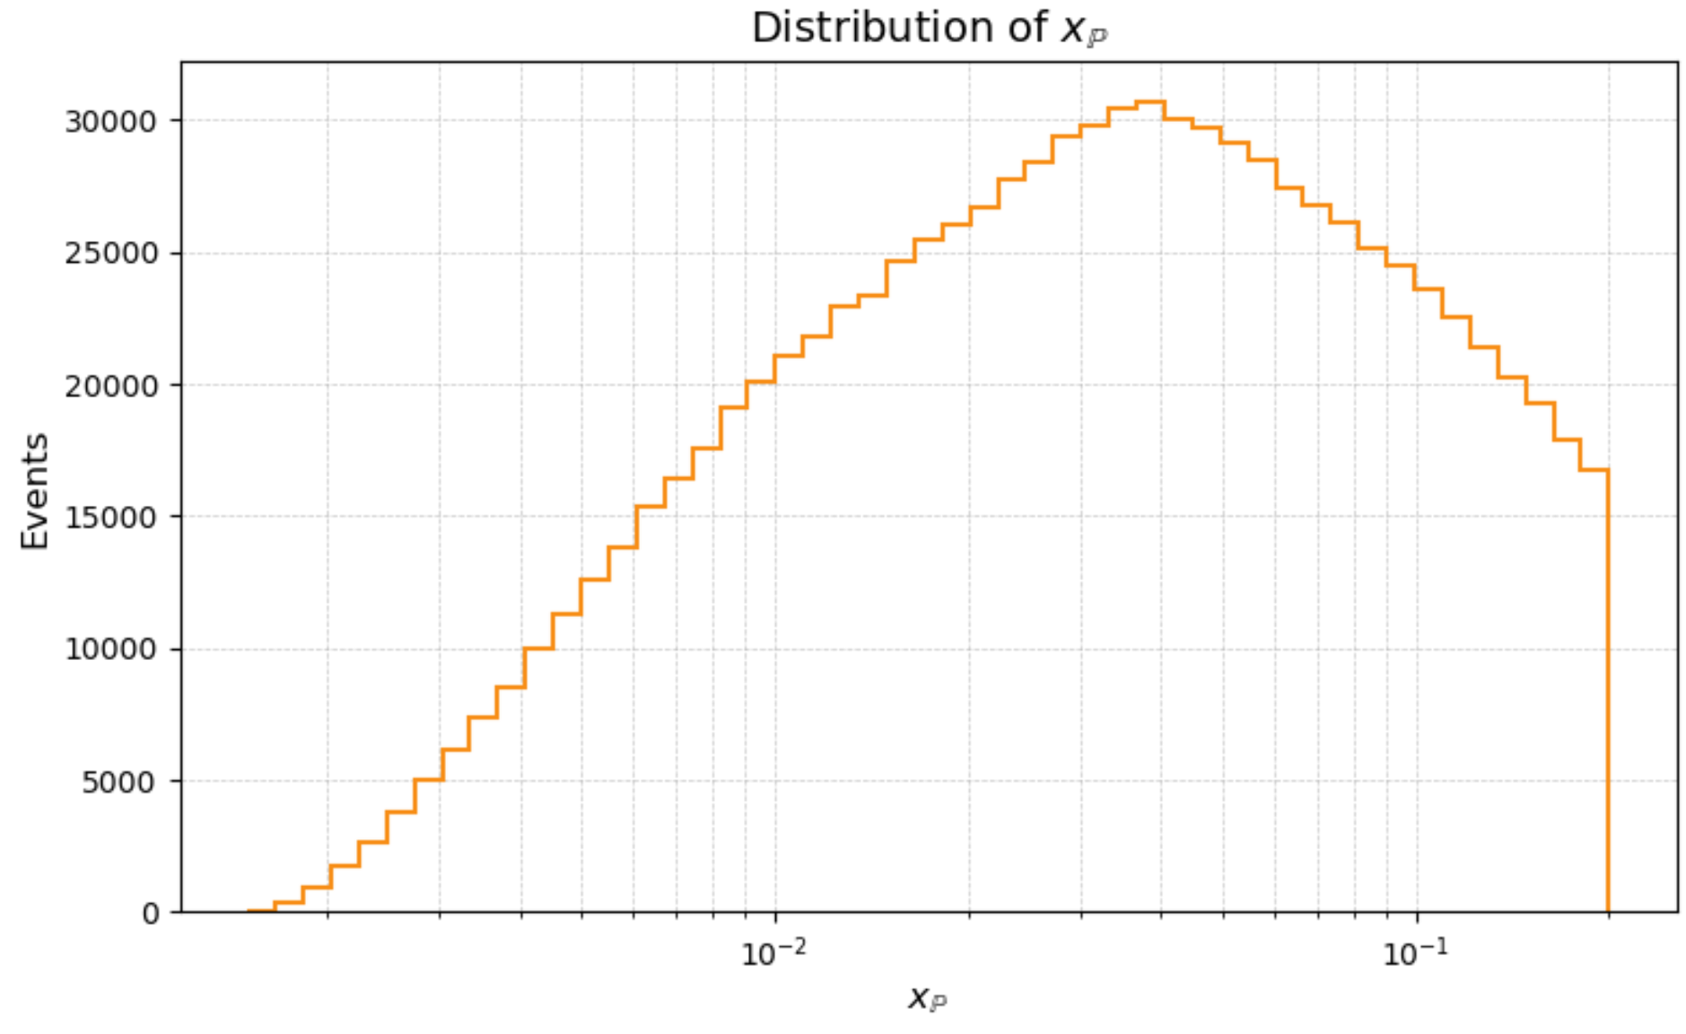
xP hist
No xP~1 peak with |t| cut

Slide 13
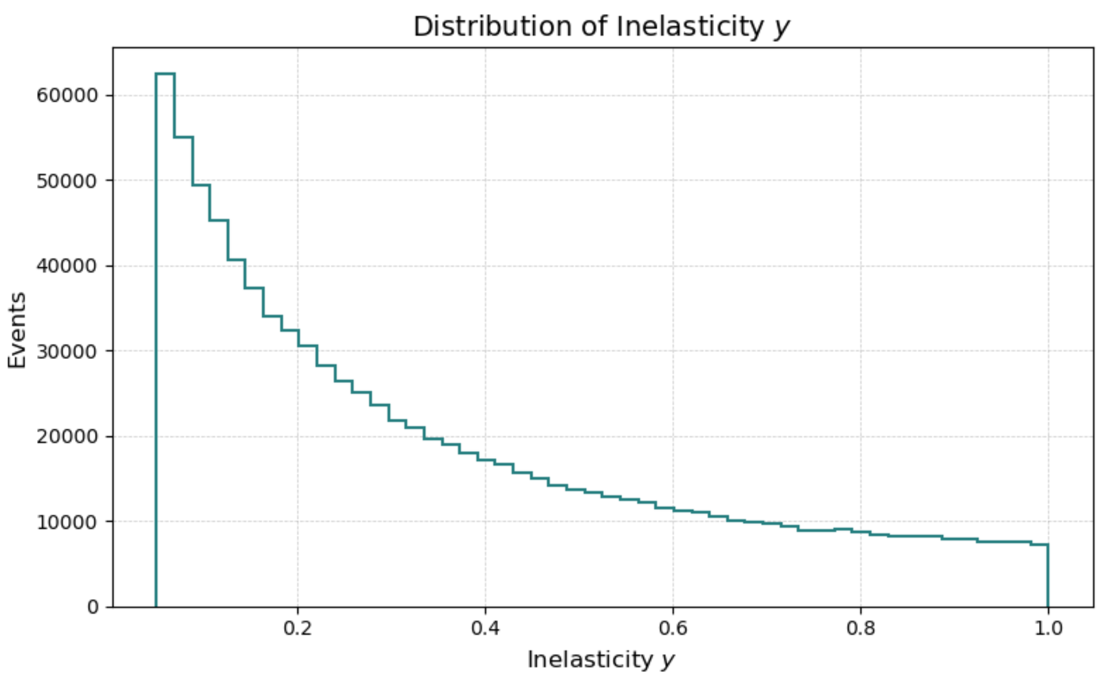
Inelasticity hist
No peak at y~1 after proper electron identification
No gap in the dist. Without YMAX setting

Slide 14
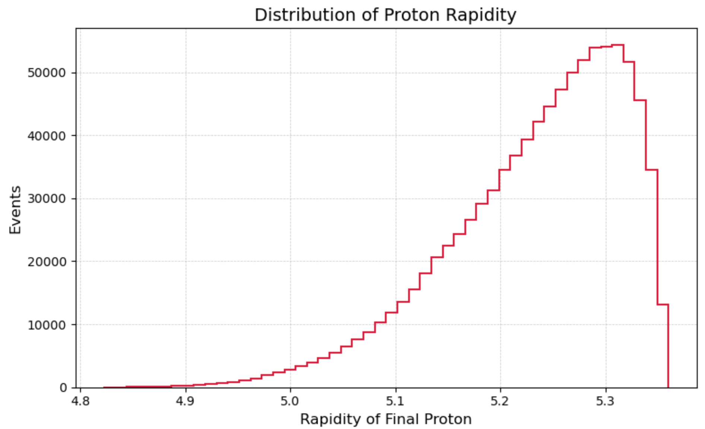
Proton rapidity

Slide 15
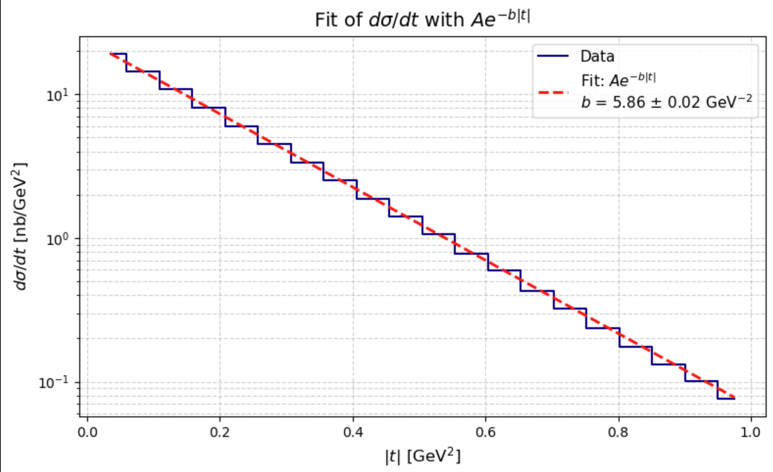

Slide 16
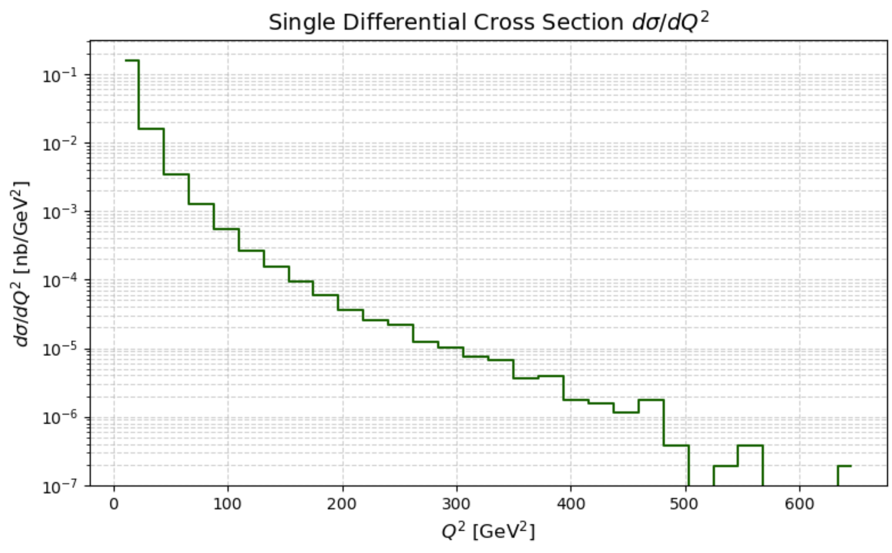

Slide 17
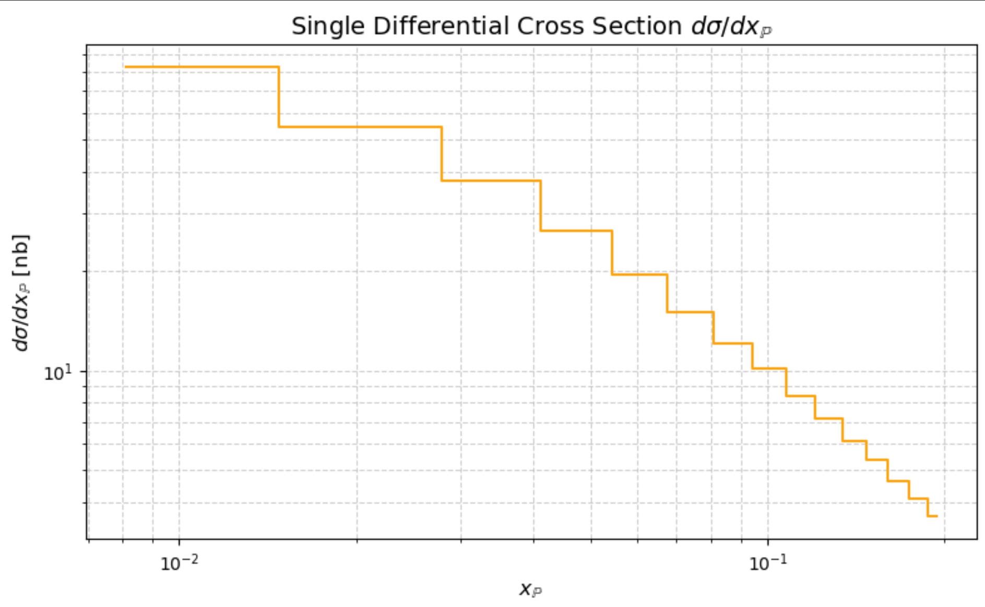

Slide 18
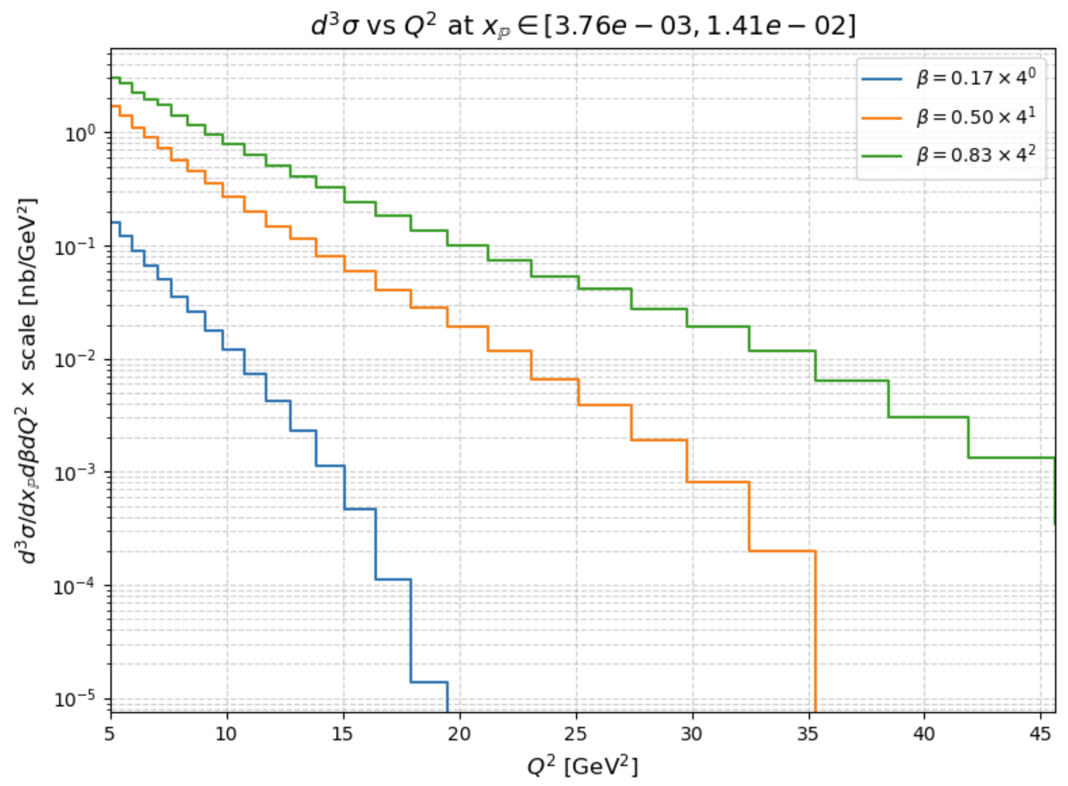
Triple diff. Cross section

