Slide 1


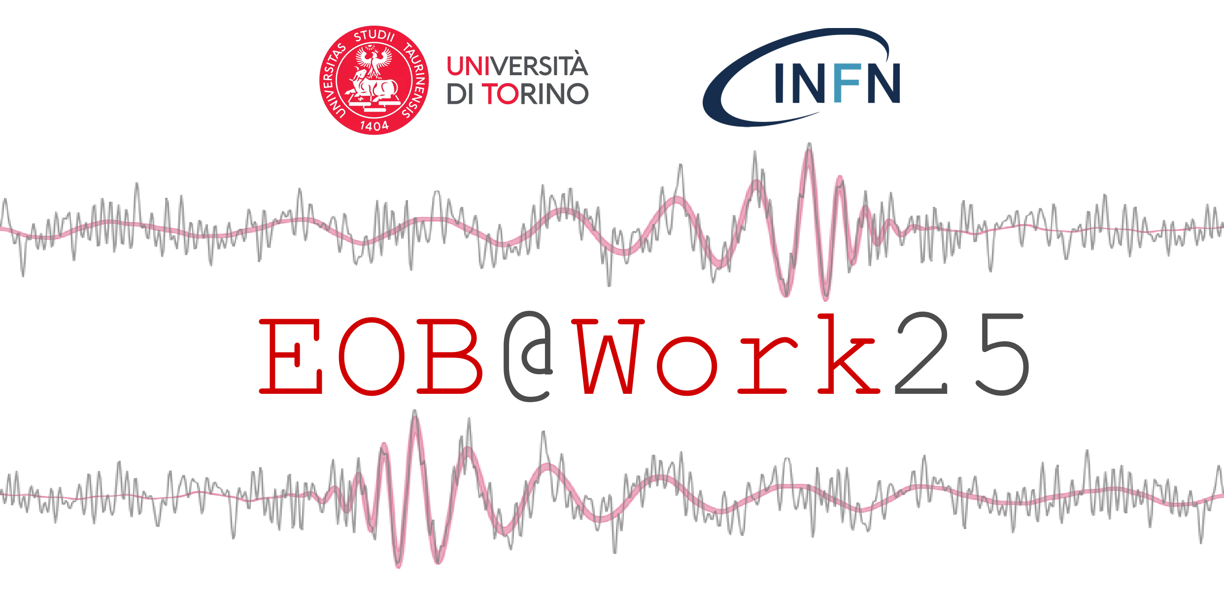

Covariant and Gauge-Invariant Metric-based Gravitational-waves Extraction in Numerical Relativity
arXiv:2508.03799
Joan Fontbuté,
Sebastiano Bernuzzi, Simone Albanesi, David Radice, Alireza Rashti, William Cook, Boris Daszuta & Alessandro Nagar

Slide 2
Context and motivation
Study systematics effects in numerical waveforms specially for problems in which ψ₄ integration is a main source of uncertainty.
The performance of coordinate-independent metric-based extraction have not yet been studied in detail.
GW multipole data (RWZ) offer a way to investigate GW extraction at null infinity based on hyperboloidal foliations.
~30 years since the first Gauge-invariant metric-based gravitational wave (GW) extraction algorithm! [Abrahams+, Camarda+, Pazos+…]
  Perturbation theory of spherically symmetric spacetimes (Regge-Wheeler-Zerilli- Moncrief).

Slide 3
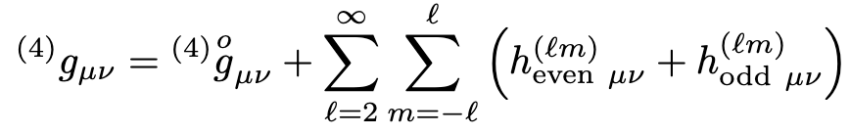
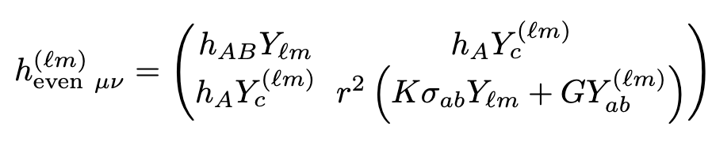
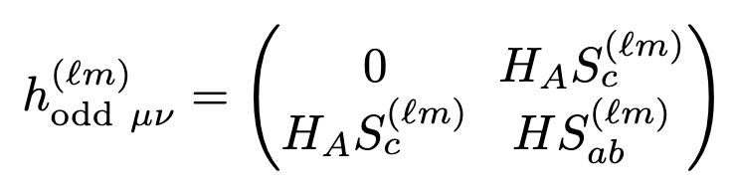
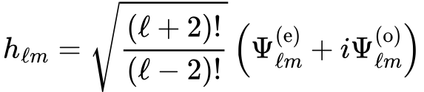
Algorithm structure
Interpolation of the (3+1) metric onto the extraction spheres and define the Schwarzschild (areal) radius of the spacetime.
Identify the background 2-metric.
Compute the even/odd multipoles by projecting the (3+1) metric onto the correspondent scalar/vector/ tensor spherical harmonics.
Build the gauge-invariant multipoles that are used in the even/odd master functions.
A,B = 0,1 a,b = 2,3

Slide 4
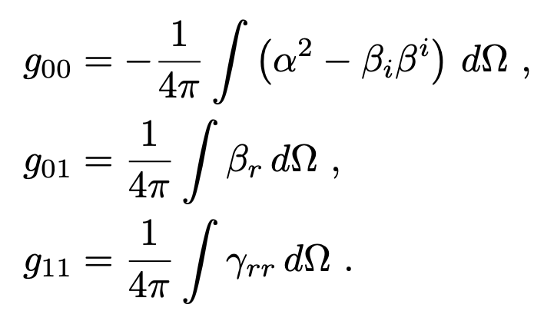

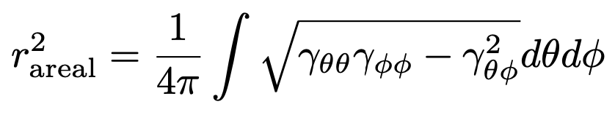



1. Interpolation + Areal radius
2. Background 2-metric
Interpolation of the (3+1) metric components (and derivatives) from the cartesian grid onto the extraction spheres.
Transform to:
Define the areal radius e.g.
+ inverse metric and derivatives.
Define:
Transform to:
Compute the (inverse) Jacobian and Hessian of the transformation.
Compute 1st and 2nd time derivative of the Areal radius + 1st time derivative of the (inverse) Jacobian.

Slide 5
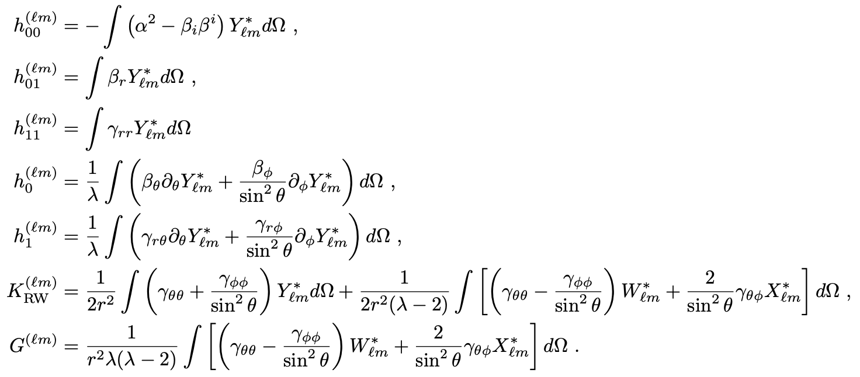
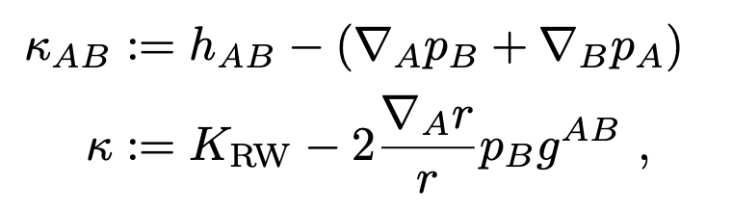
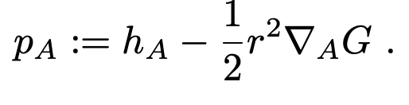
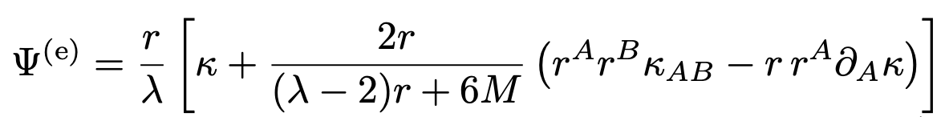
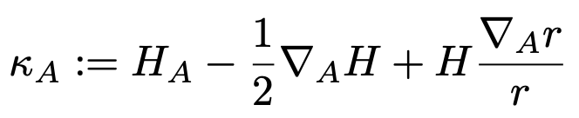



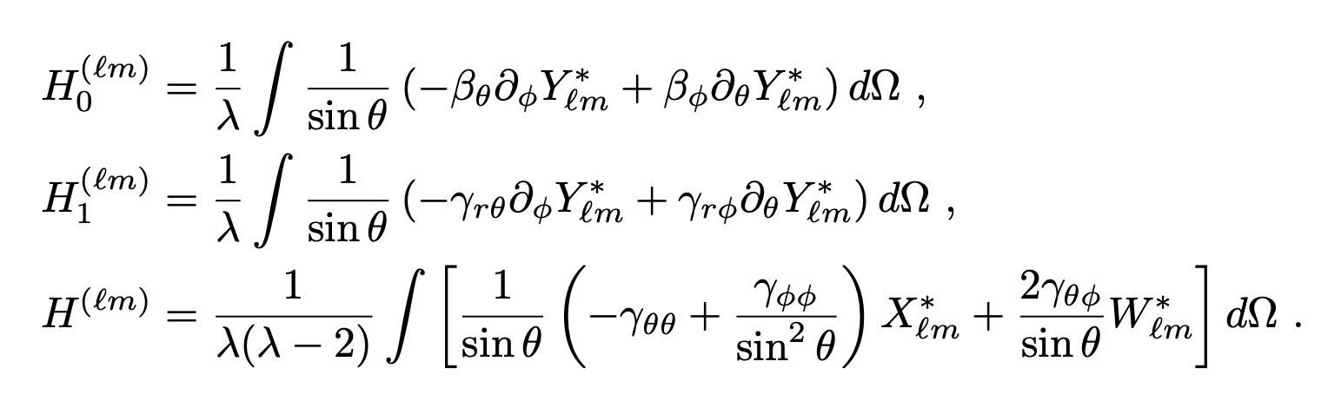
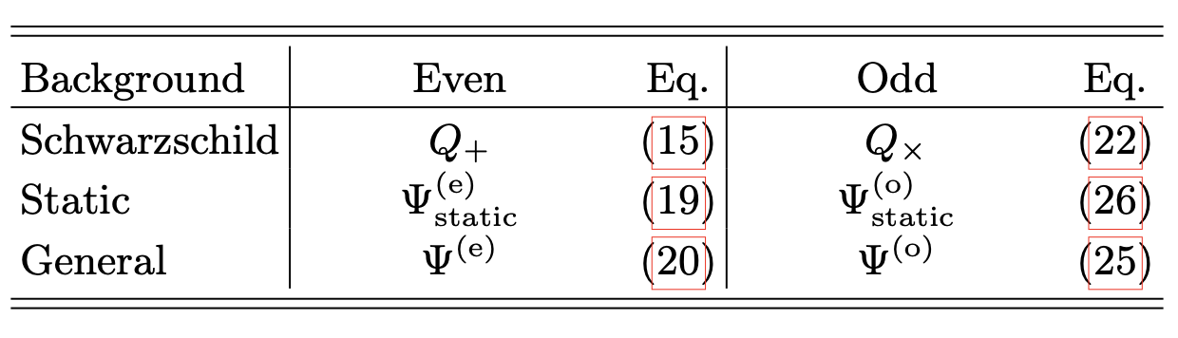
3. Even/odd Multipoles computation
4. Even/odd Master Functions

Slide 6
Simulations
NR code GR-Athena++.
We extract the Weyl scalar, CCE (PittNull) and metric waves (all master functions) for comparison.
Set of problems:
  TOV spacetime: even/odd perturbation of a static NS. [Baiotti+]
  RNS spacetime: gravitational collapse of a rotating NS.
  BBH spacetime: quasi-circular merger / dynamical capture / (scattering).
  BNS spacetime.

Slide 7
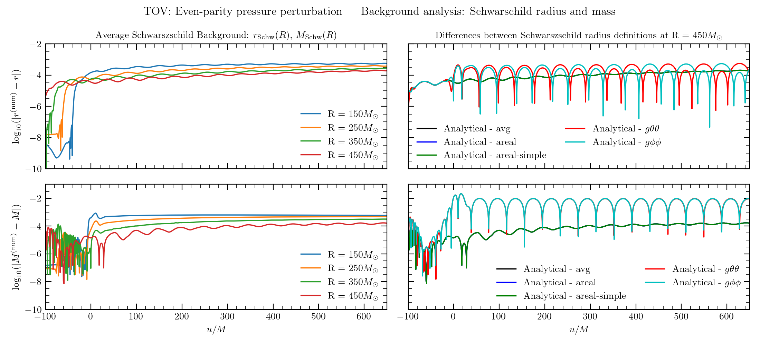

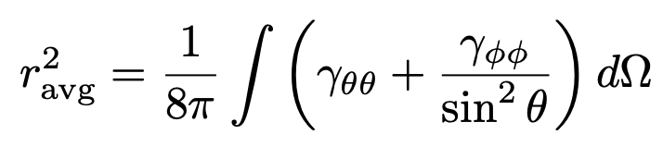
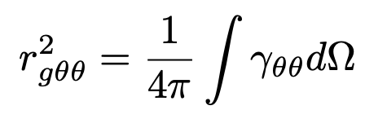
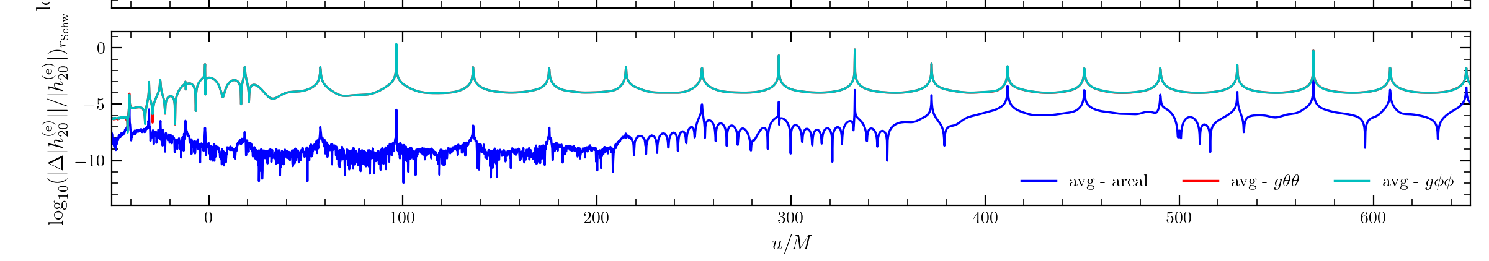
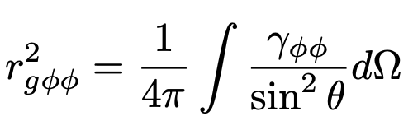
TOV spacetime: diagnostics

Slide 8
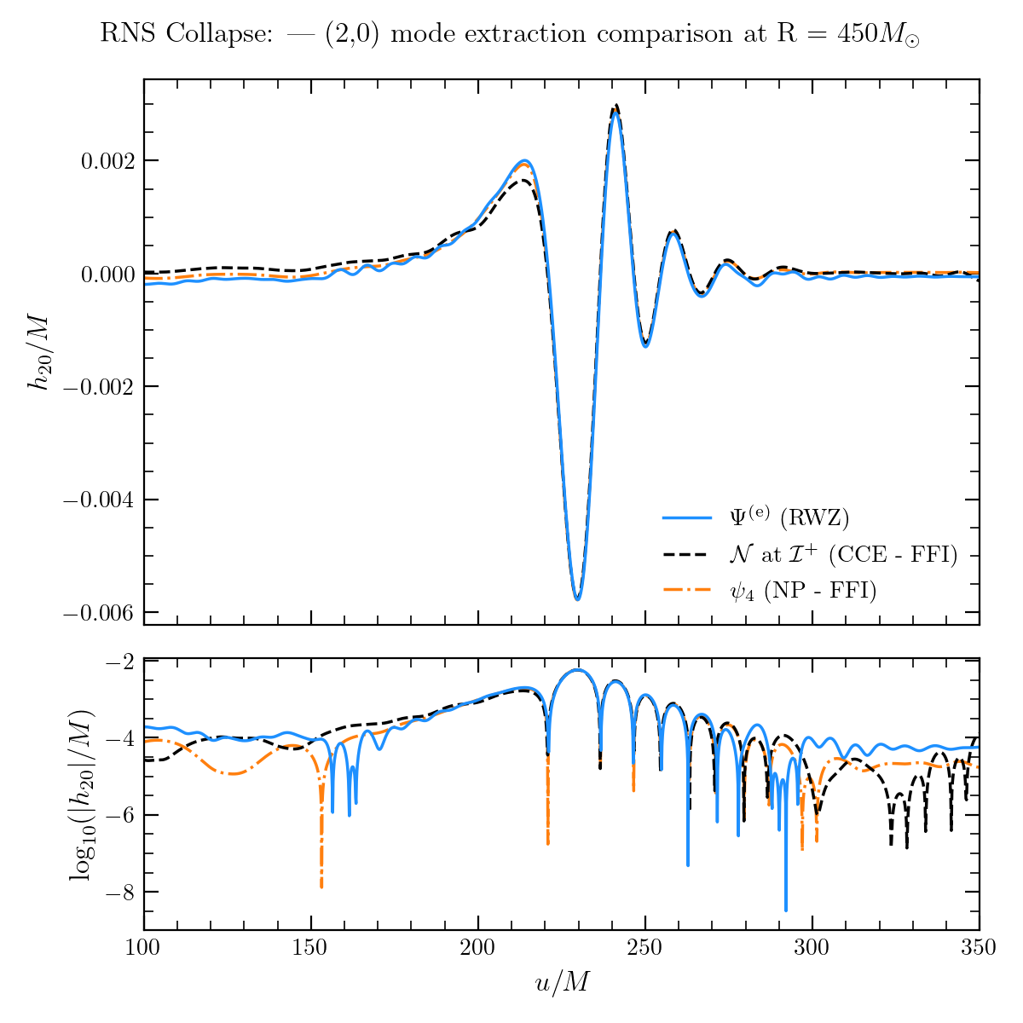
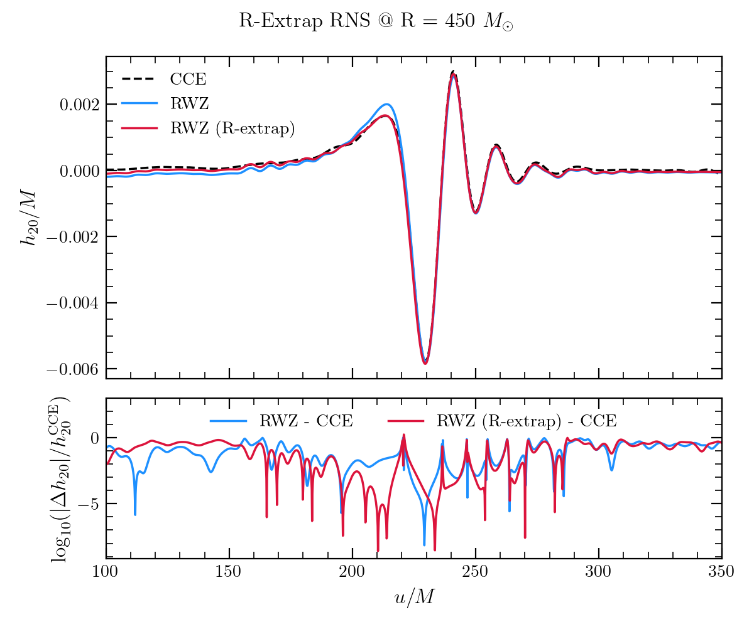
RNS spacetime
[Nakano+]

Slide 9
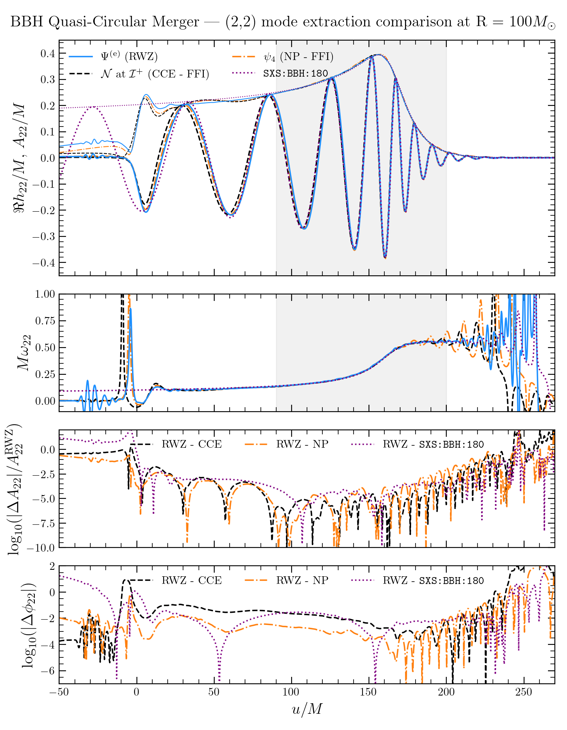
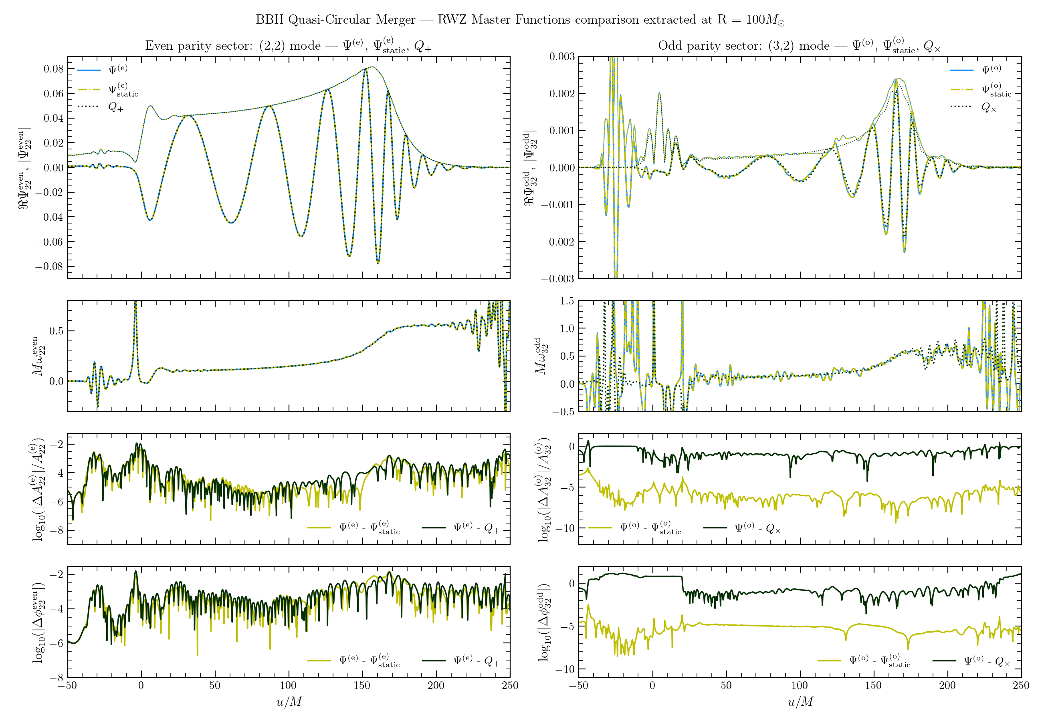
BBH spacetime: Quasi-Circular merger

Slide 10
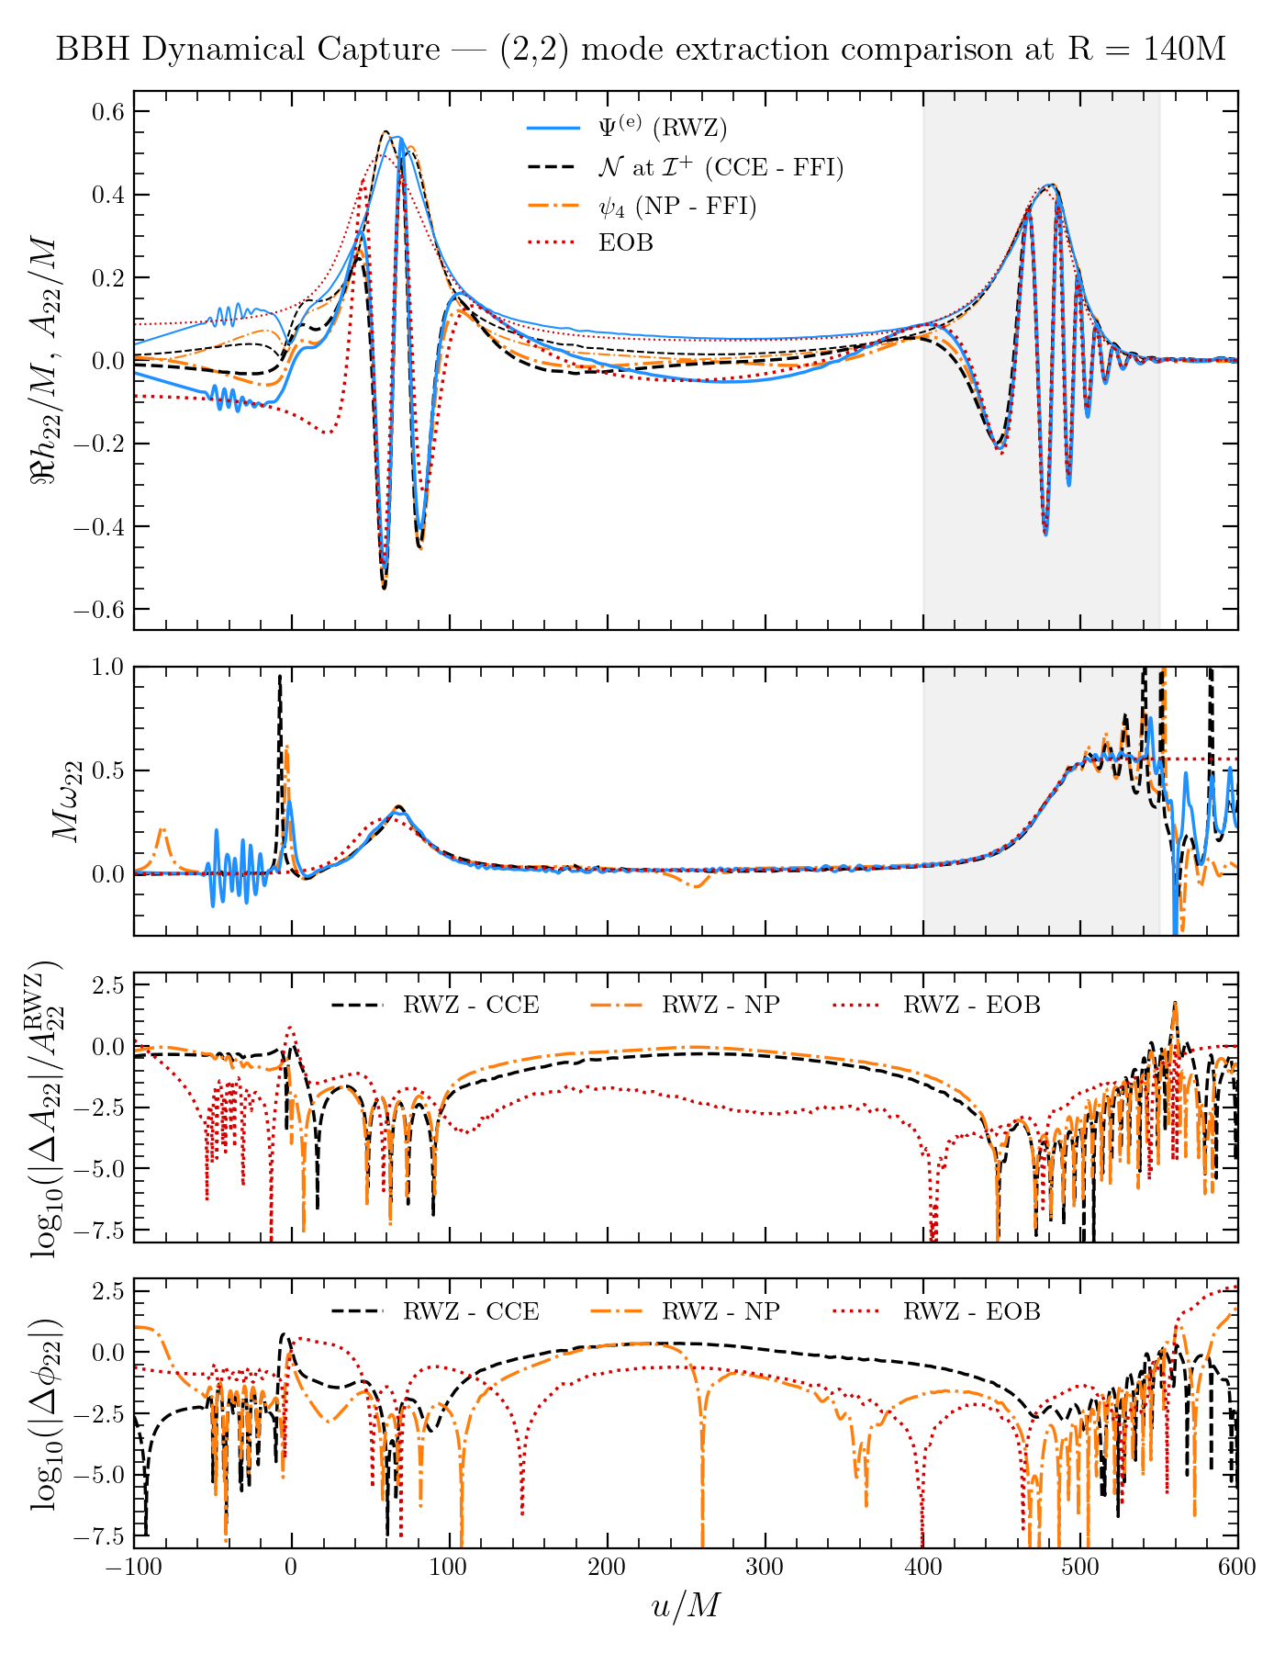
BBH spacetime: Dynamical capture

Slide 11
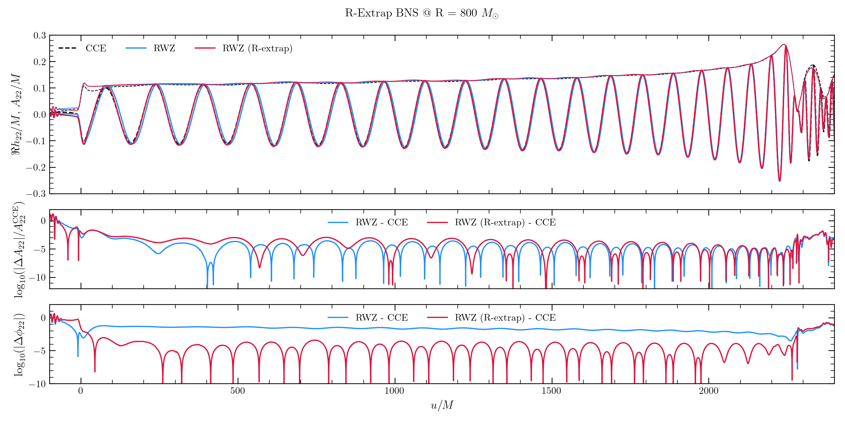
BNS spacetime

Slide 12
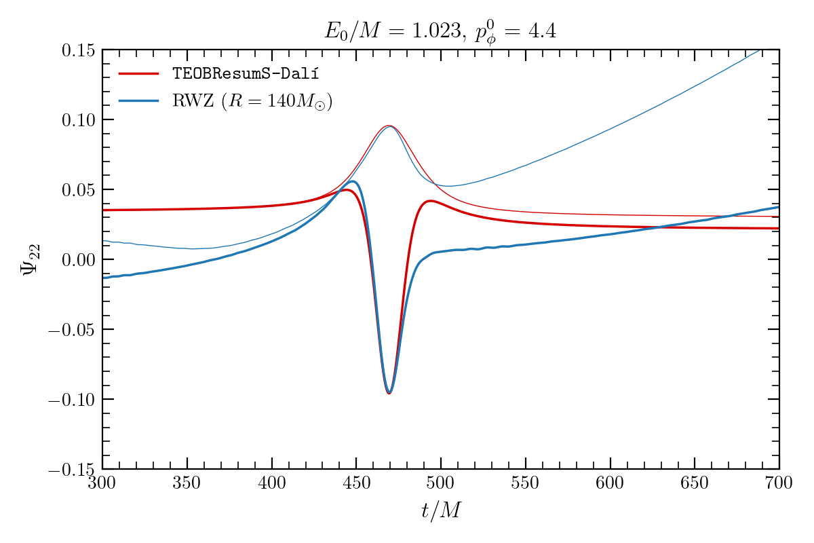
How does the RWZ perform for scatterings?
Not good for box-in-box type of grids…
Heads up to upcoming
work by the SXS group…
[Rüter+]

Slide 13
RWZ as input for hyperboloidal null extrapolation
arXiv:2508.05743
NR RWZ wvf injected as ingoing boundary data at the extraction distance.
Solve the 1+1 RWZ equation in the wave zone using hyperboloidal slices.
Faster than CCE.
Comparable phase and amplitude differences with CCE.
Cannot capture non-linear effects in wave propagation.

Slide 14
Summary
Metric waveforms extracted are of comparable quality to curvature waveforms extracted at the same finite radius.
The different choices of the Areal radius are all found robust as they introduce uncertainties typically smaller than the choice of finite extraction radius.
In binary problems, odd master function in general coordinates is affected by the Gauge choice inducing extra noise compared to Schwarzschild.
We compared simple extrapolated metric waveforms against hyperboloidal extrapolation as well as CCE.

