Slide 1


RESUMMING PM AND PN GRAVITATIONAL
WAVEFORM EXPANSIONS
EOB@work25: 10 years of gravitational wave detection (Turin University)
Andrea Cipriani
Based on
2502.20881 with G. Di Russo, F. Fucito, J.F. Morales, H. Poghosyan, R. Poghossian
In preparation with A. Nagar, F. Fucito, J.F. Morales

Slide 2


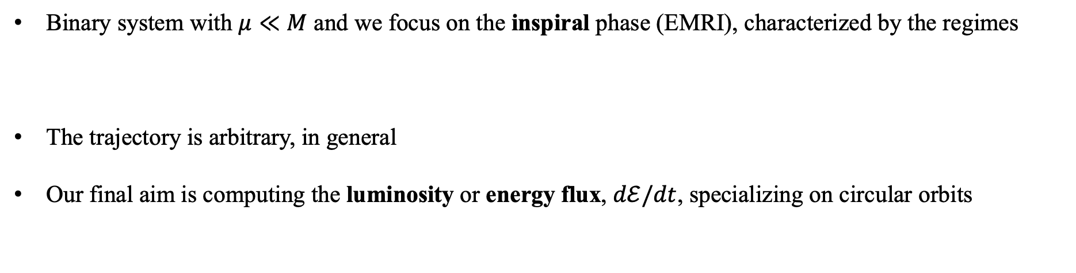

INTRODUCTION
$μ$
M
Binary system with $μ≪M$ and we focus on the inspiral phase (EMRI), characterized by the regimes
The trajectory is arbitrary, in general
Our final aim is computing the luminosity or energy flux, $dℰ/dt$, specializing on circular orbits
$$r≫2 M, ω r≪1$$

Slide 3
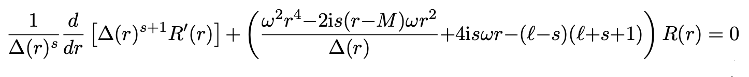
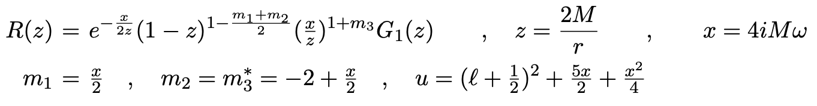
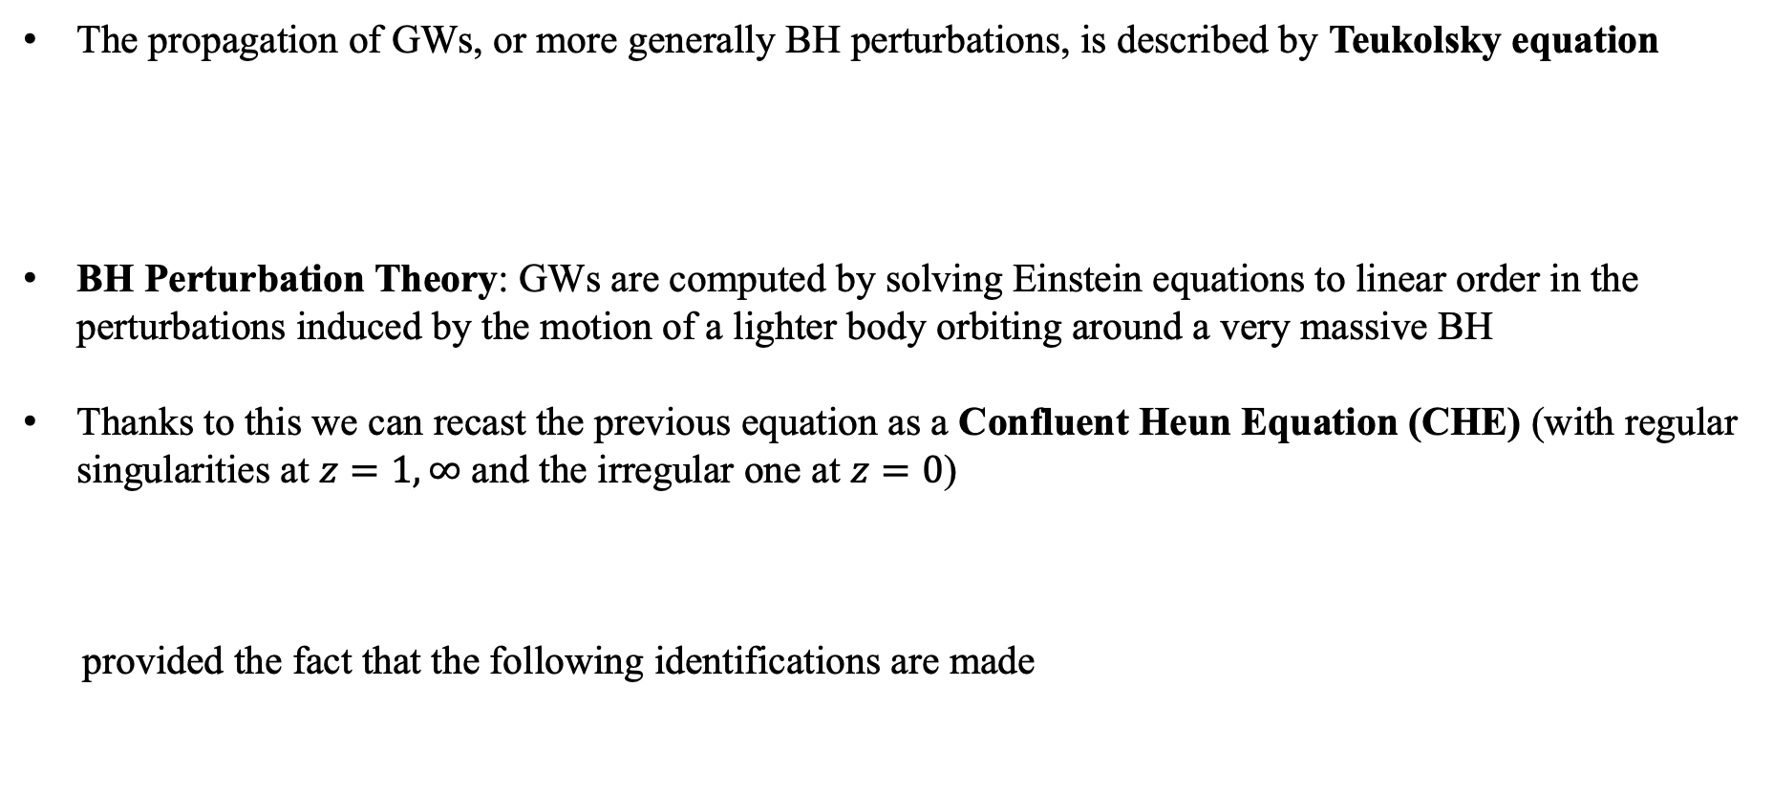
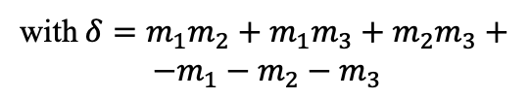

BH PERTURBATION THEORY
The propagation of GWs, or more generally BH perturbations, is described by Teukolsky equation
BH Perturbation Theory: GWs are computed by solving Einstein equations to linear order in the perturbations induced by the motion of a lighter body orbiting around a very massive BH
Thanks to this we can recast the previous equation as a Confluent Heun Equation (CHE) (with regular singularities at $z=1,∞$ and the irregular one at $z=0$)
provided the fact that the following identifications are made
with $Δ\left(r\right)=r\left(r−2M\right), s=−2$
with $δ=m_{1}m_{2}+m_{1}m_{3}+m_{2}m_{3}+$
$$−m_{1}−m_{2}−m_{3}$$

Slide 4
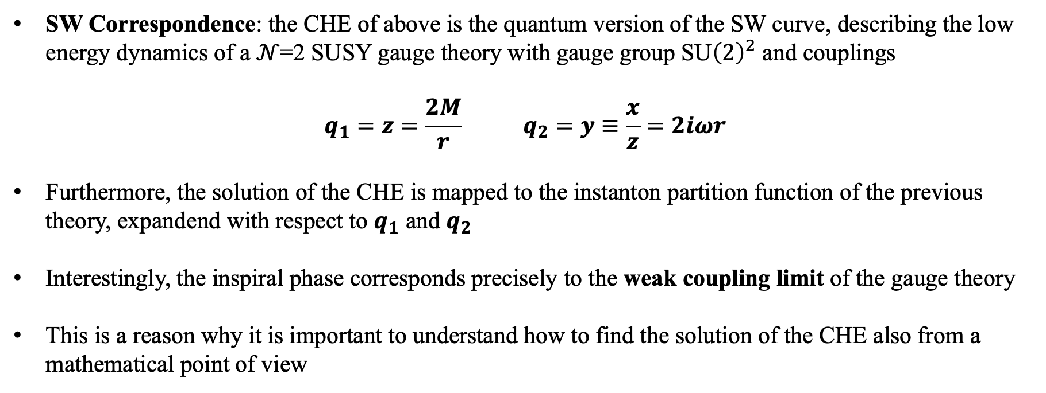
SEIBERG-WITTEN (SW) CORRESPONDENCE
SW Correspondence: the CHE of above is the quantum version of the SW curve, describing the low energy dynamics of a 𝒩=2 SUSY gauge theory with gauge group SU${\left(2\right)}^{2}$ and couplings
$$q_{1}=z=\frac{2M}{r} q_{2}=y≡\frac{x}{z}=2iωr$$
Furthermore, the solution of the CHE is mapped to the instanton partition function of the previous theory, expandend with respect to $q_{1}$ and $q_{2}$
Interestingly, the inspiral phase corresponds precisely to the weak coupling limit of the gauge theory
This is a reason why it is important to understand how to find the solution of the CHE also from a mathematical point of view

Slide 5
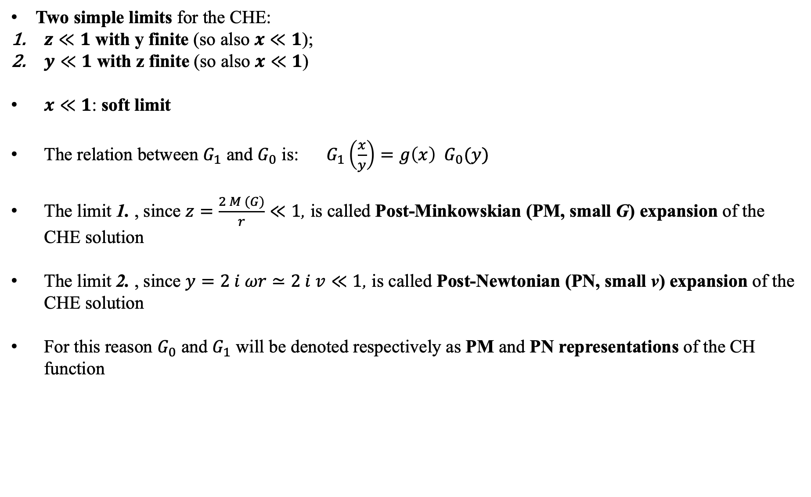
PM & PN REPRESENTATIONS OF CH FUNCTION
Two simple limits for the CHE:
$z≪1$ with y finite (so also $x≪1$);
$y≪1$ with z finite (so also $x≪1$)
$x≪1$: soft limit
The relation between $G_{1}$ and $G_{0}$ is: $G_{1}\left(\frac{x}{y}\right)=g\left(x\right) G_{0}(y)$
The limit 1. , since $z=\frac{2 M (G)}{r}≪1$, is called Post-Minkowskian (PM, small G) expansion of the CHE solution
The limit 2. , since $y=2 i ωr≃2 i v≪1$, is called Post-Newtonian (PN, small v) expansion of the CHE solution
For this reason $G_{0}$ and $G_{1}$ will be denoted respectively as PM and PN representations of the CH function

Slide 6
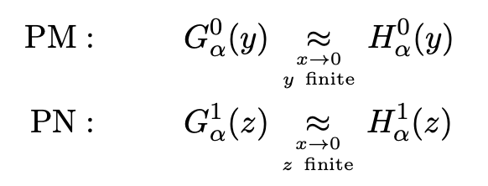
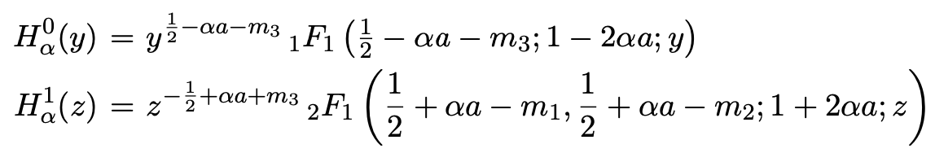
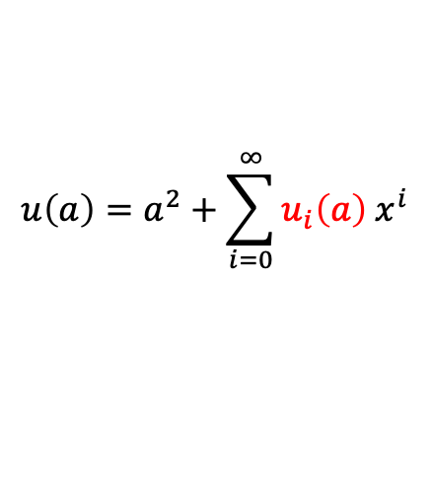

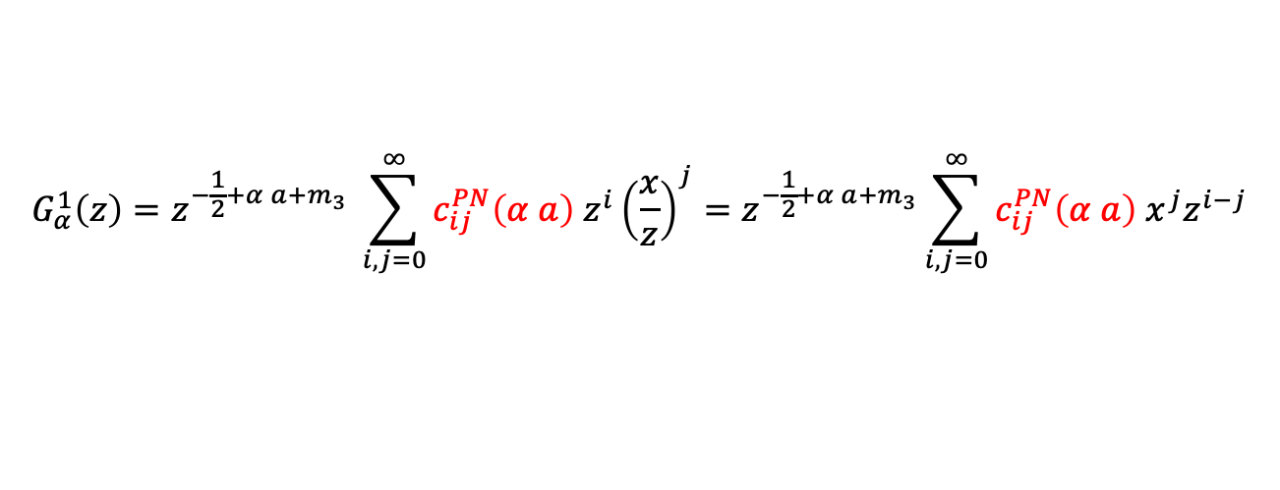
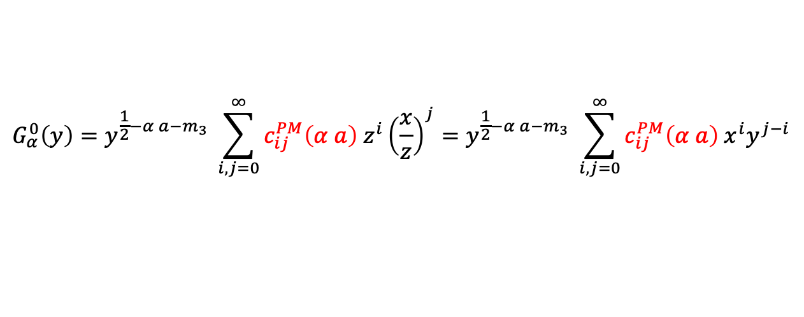
NEAR ZONE REGION
In the two limits of before, the CHE reduces to hypergeometric equation with solutions given by
where $α= ±$ denotes the two independent solutions and $a=a(u)$.
Near zone: region where the two limits overlap, i.e. where both z and y are small
Here the two solutions can be written as double series, which is the exact form of them
All the coefficients can be determined recursively order by order in x.
Proportionality relation between the independent solutions: $G_{α}^{1}\left(z\right)=g_{α}\left(x\right) G_{α}^{0}\left(\frac{x}{z}\right)$
$$G_{α}^{0}\left(y\right)=y^{\frac{1}{2}−α a−m_{3}} \sum_{i,j=0}^{∞}{c_{ij}^{PM}\left(α a\right) z^{i}{\left(\frac{x}{z}\right)}^{j}}=y^{\frac{1}{2}−α a−m_{3}} \sum_{i,j=0}^{∞}{c_{ij}^{PM}\left(α a\right) x^{i}y^{j−i}}$$
$$u\left(a\right)=a^{2}+\sum_{i=0}^{∞}{u_{i}\left(a\right) x^{i}}$$
$$G_{α}^{1}\left(z\right)=z^{−\frac{1}{2}+α a+m_{3}} \sum_{i,j=0}^{∞}{c_{ij}^{PN}\left(α a\right) z^{i}{\left(\frac{x}{z}\right)}^{j}}=z^{−\frac{1}{2}+α a+m_{3}}\sum_{i,j=0}^{∞}{c_{ij}^{PN}\left(α a\right) x^{j}z^{i−j}}$$

Slide 7
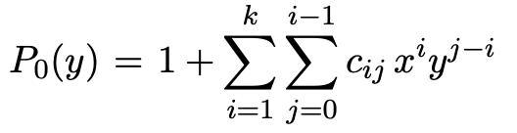
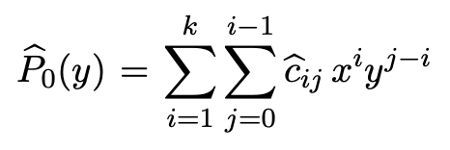

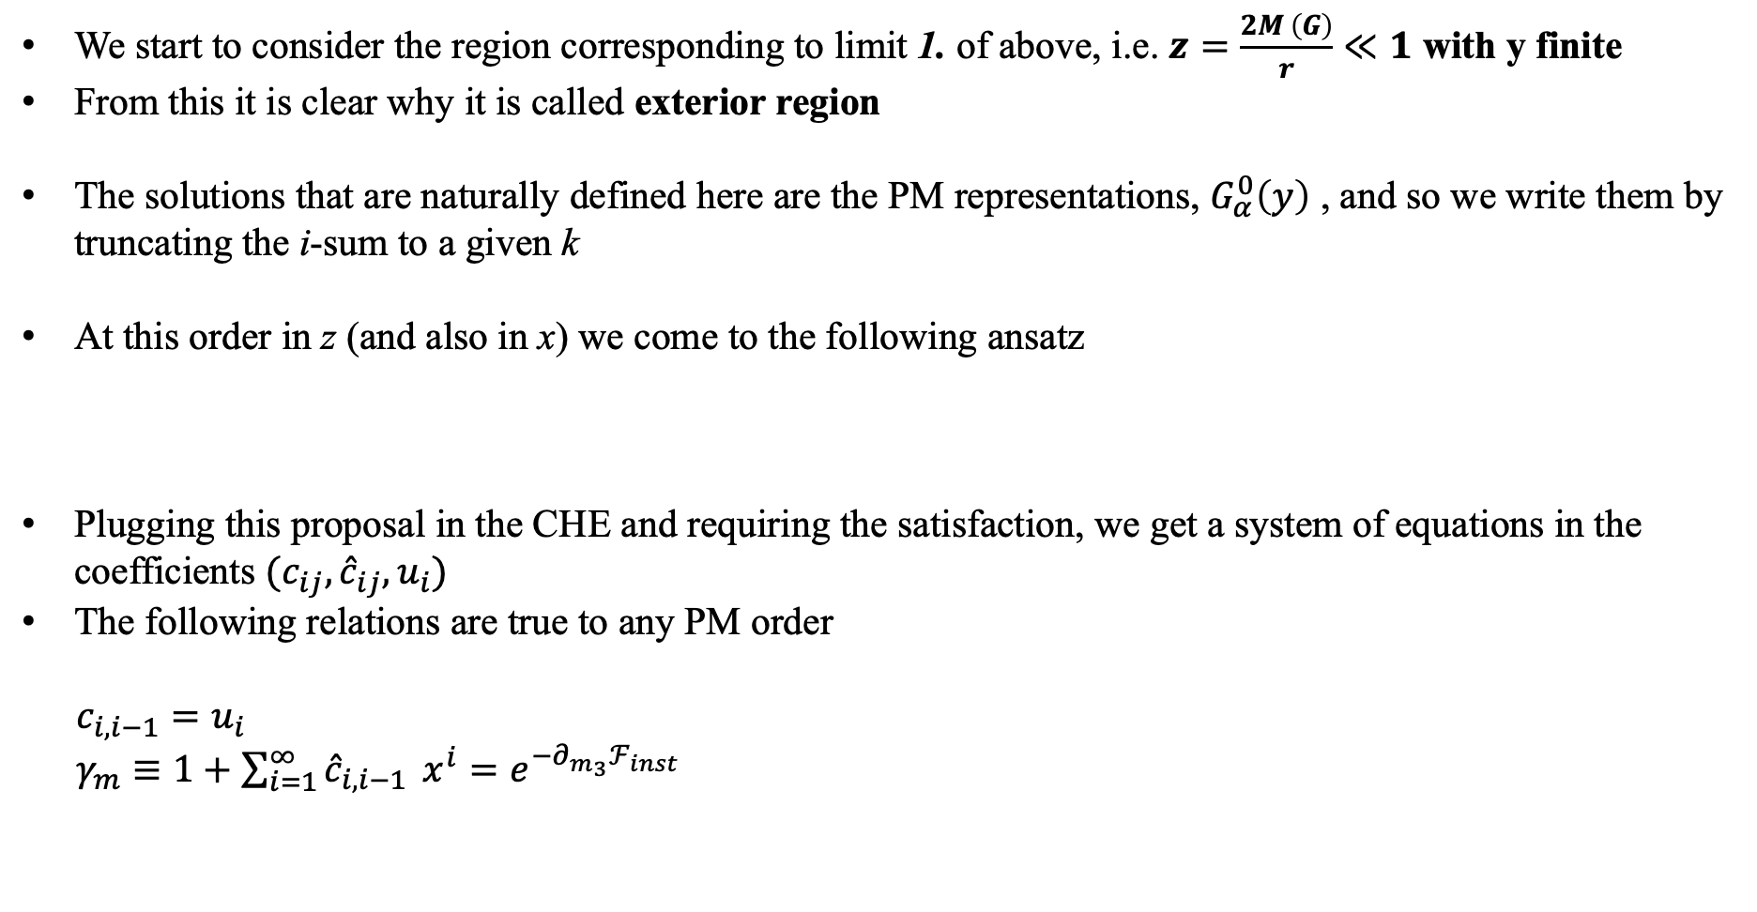
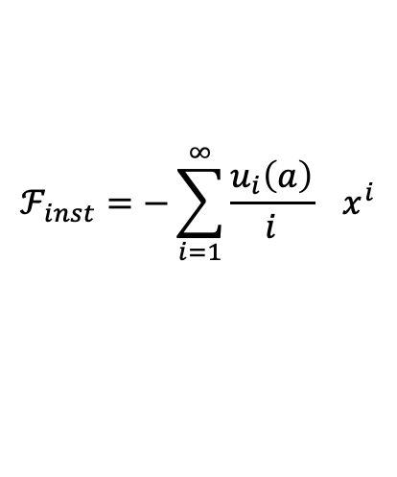
PM APPROXIMATION: EXTERIOR REGION
We start to consider the region corresponding to limit 1. of above, i.e. $z=\frac{2M \left(G\right)}{r}≪1$ with y finite
From this it is clear why it is called exterior region
The solutions that are naturally defined here are the PM representations, $G_{α}^{0}\left(y\right)$ , and so we write them by truncating the i-sum to a given k
At this order in z (and also in x) we come to the following ansatz
Plugging this proposal in the CHE and requiring the satisfaction, we get a system of equations in the coefficients $(c_{ij},{\hat{c}}_{ij},u_{i})$
The following relations are true to any PM order
$c_{i,i−1}=u_{i}$
$γ_{m}≡1+\sum_{i=1}^{∞}{{\hat{c}}_{i,i−1}} x^{i}=e^{−∂_{m_{3}}ℱ_{inst} }$
with
$$ℱ_{inst}=−\sum_{i=1}^{∞}{\frac{u_{i}\left(a\right)}{i}} x^{i}$$
with

Slide 8
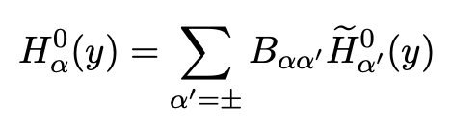
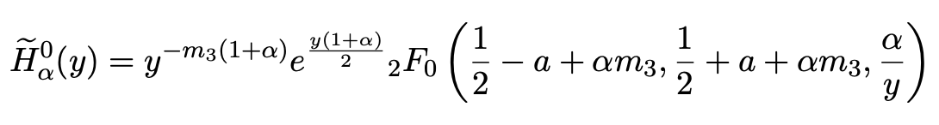
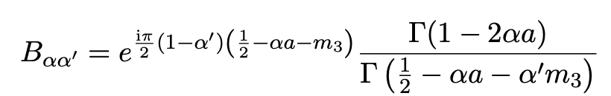
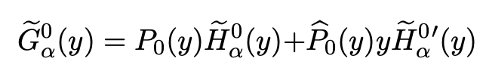
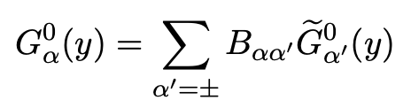
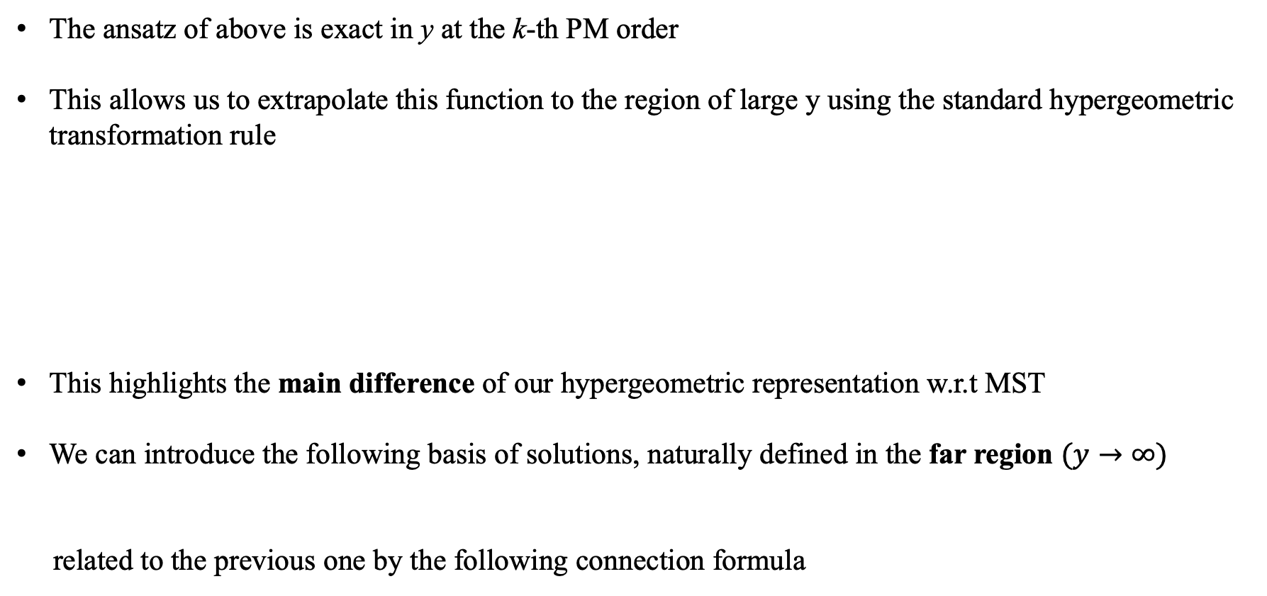
CONNECTION FORMULAE AND FAR REGION
The ansatz of above is exact in y at the k-th PM order
This allows us to extrapolate this function to the region of large y using the standard hypergeometric transformation rule
This highlights the main difference of our hypergeometric representation w.r.t MST
We can introduce the following basis of solutions, naturally defined in the far region $(y→∞)$
related to the previous one by the following connection formula

Slide 9

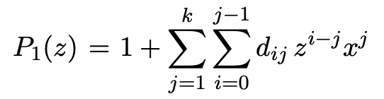
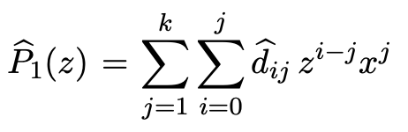
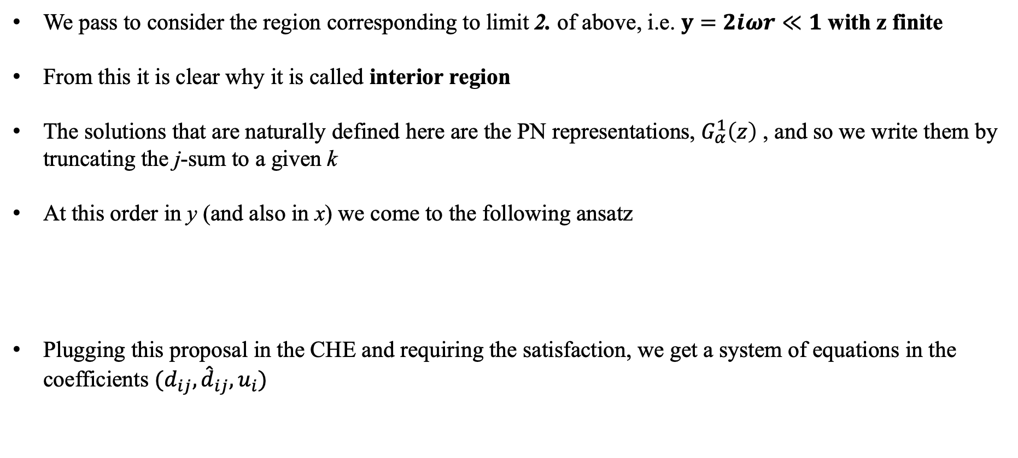
PN APPROXIMATION: INTERIOR REGION
We pass to consider the region corresponding to limit 2. of above, i.e. $y=2iωr≪1$ with z finite
From this it is clear why it is called interior region
The solutions that are naturally defined here are the PN representations, $G_{α}^{1}\left(z\right)$ , and so we write them by truncating the j-sum to a given k
At this order in y (and also in x) we come to the following ansatz
Plugging this proposal in the CHE and requiring the satisfaction, we get a system of equations in the coefficients $(d_{ij},{\hat{d}}_{ij},u_{i})$
with

Slide 10
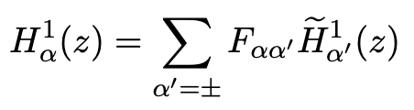
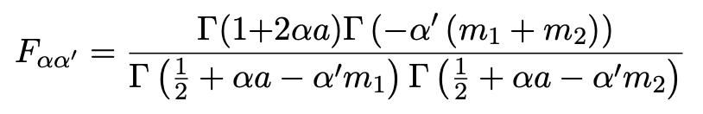
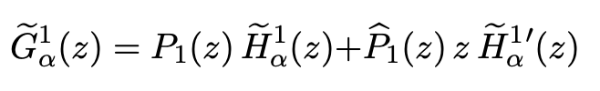
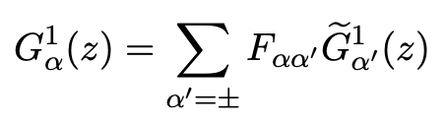
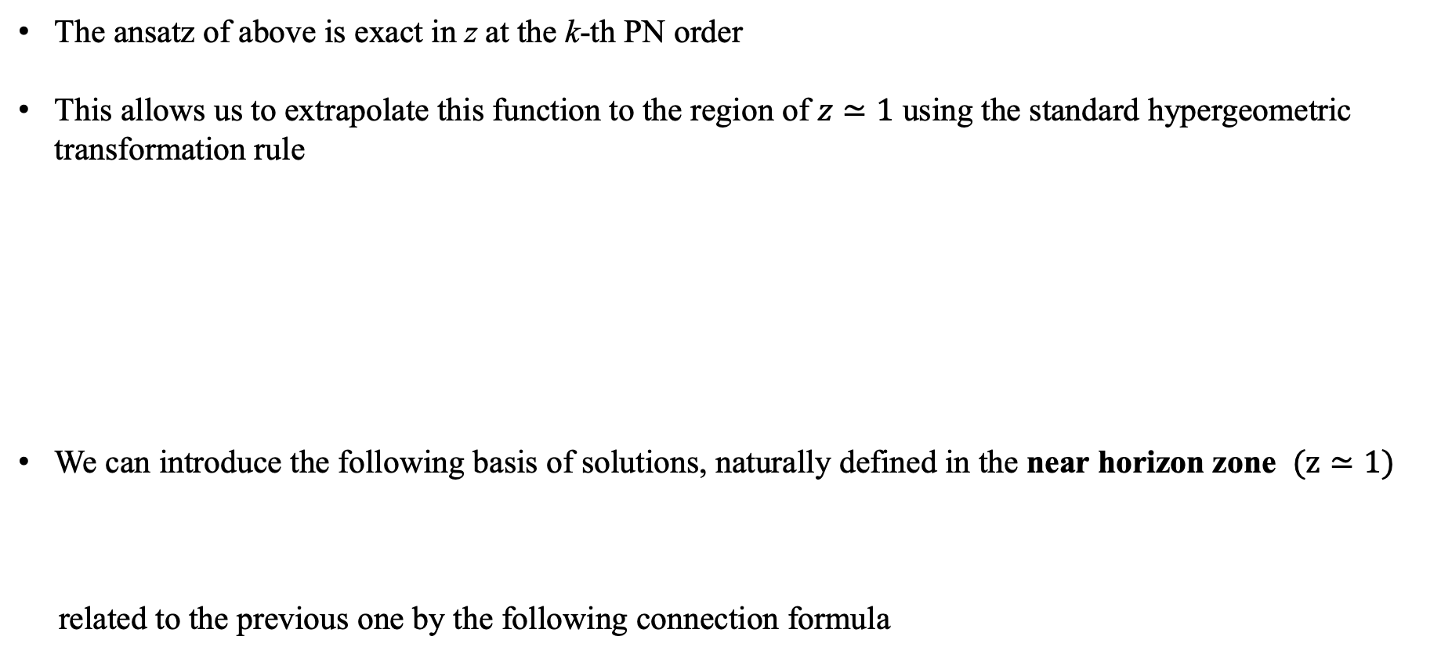
CONNECTION FORMULAE AND NEAR HORIZON ZONE
The ansatz of above is exact in z at the k-th PN order
This allows us to extrapolate this function to the region of $z≃1$ using the standard hypergeometric transformation rule
We can introduce the following basis of solutions, naturally defined in the near horizon zone $(z≃1)$
related to the previous one by the following connection formula

Slide 11
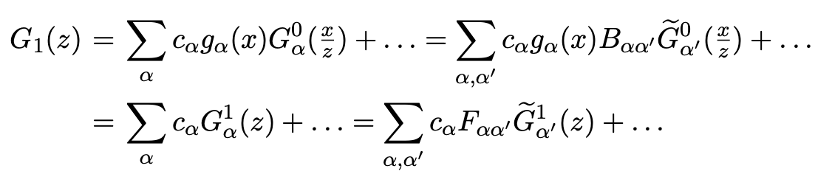
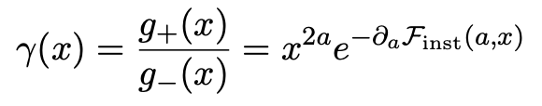

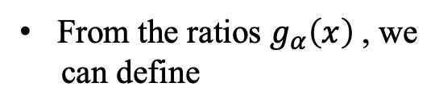
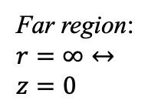

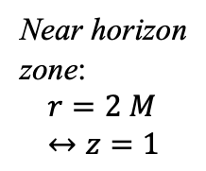

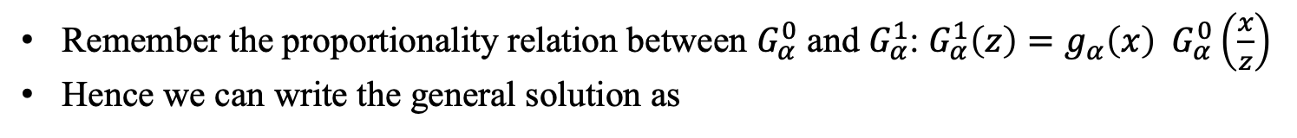





SUMMARY PICTURE
Near horizon
zone:
$$r=2 M↔z=1$$
Internal zone: $y≪1, z$ finite
Near zone: $z,y≪1$
External zone: z$≪1, y$ finite
Far region: $r=∞↔z=0$
$${\tilde{G}}_{α}^{1}$$
$${\tilde{G}}_{α}^{0}$$
$$G_{α}^{1}$$
$$G_{α}^{0}$$
Connection formulae
Connection formulae
Remember the proportionality relation between $G_{α}^{0}$ and $G_{α}^{1}$: $G_{α}^{1}\left(z\right)=g_{α}\left(x\right) G_{α}^{0}\left(\frac{x}{z}\right)$
Hence we can write the general solution as
From the ratios $g_{α}\left(x\right)$, we
can define
$$γ_{inst}(a,x)$$

Slide 12
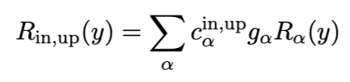
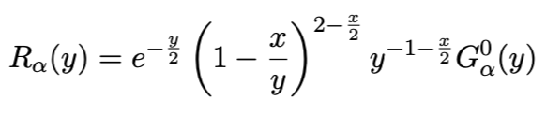
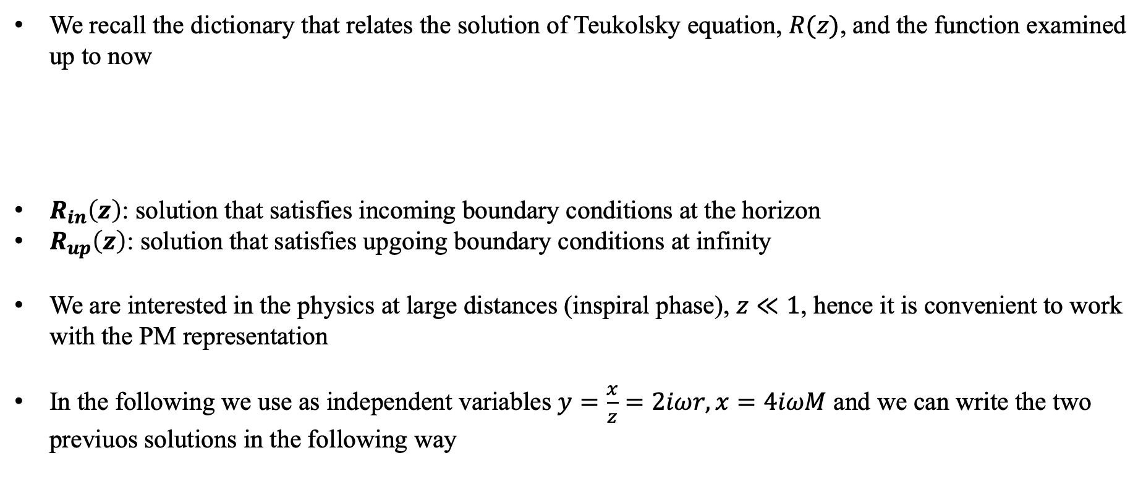
SOLUTIONS TO TEUKOLSKY EQUATION
We recall the dictionary that relates the solution of Teukolsky equation, $R(z)$, and the function examined up to now
$R_{in}\left(z\right)$: solution that satisfies incoming boundary conditions at the horizon
$R_{up}\left(z\right)$: solution that satisfies upgoing boundary conditions at infinity
We are interested in the physics at large distances (inspiral phase), $z≪1$, hence it is convenient to work with the PM representation
In the following we use as independent variables $y=\frac{x}{z}=2iωr, x=4iωM$ and we can write the two previuos solutions in the following way
with

Slide 13
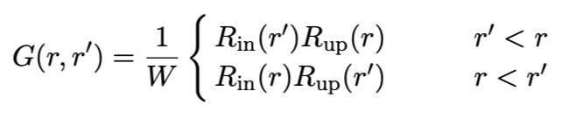
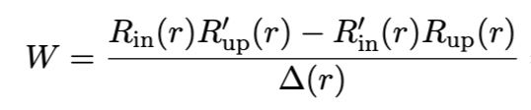
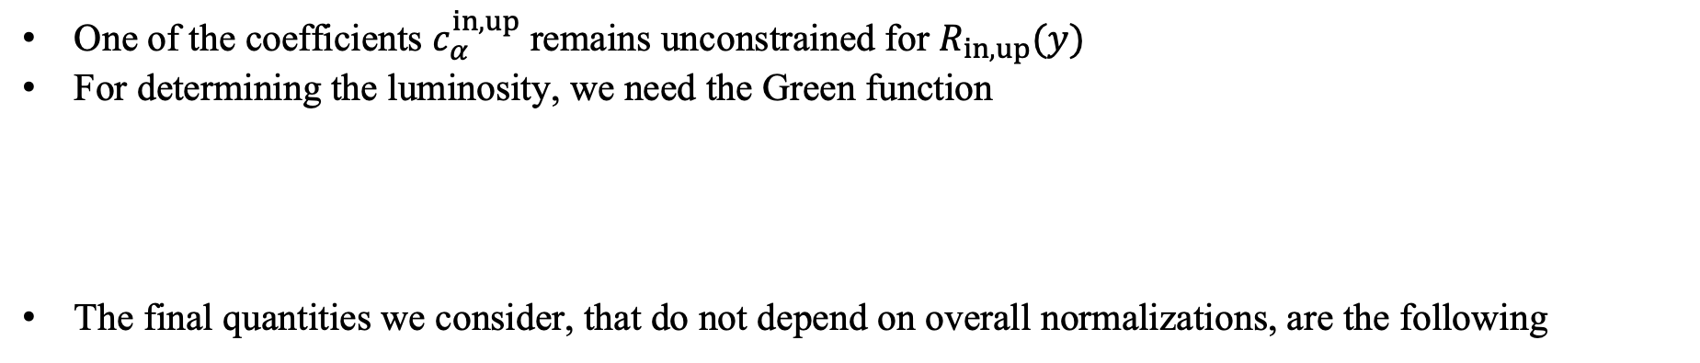
SOLUTIONS TO TEUKOLSKY EQUATION
with
One of the coefficients $c_{α}^{in,up}$ remains unconstrained for $R_{in,up}(y)$
For determining the luminosity, we need the Green function
The final quantities we consider, that do not depend on overall normalizations, are the following
where

Slide 14
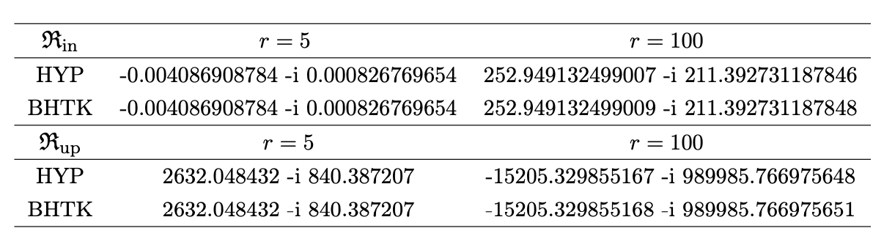
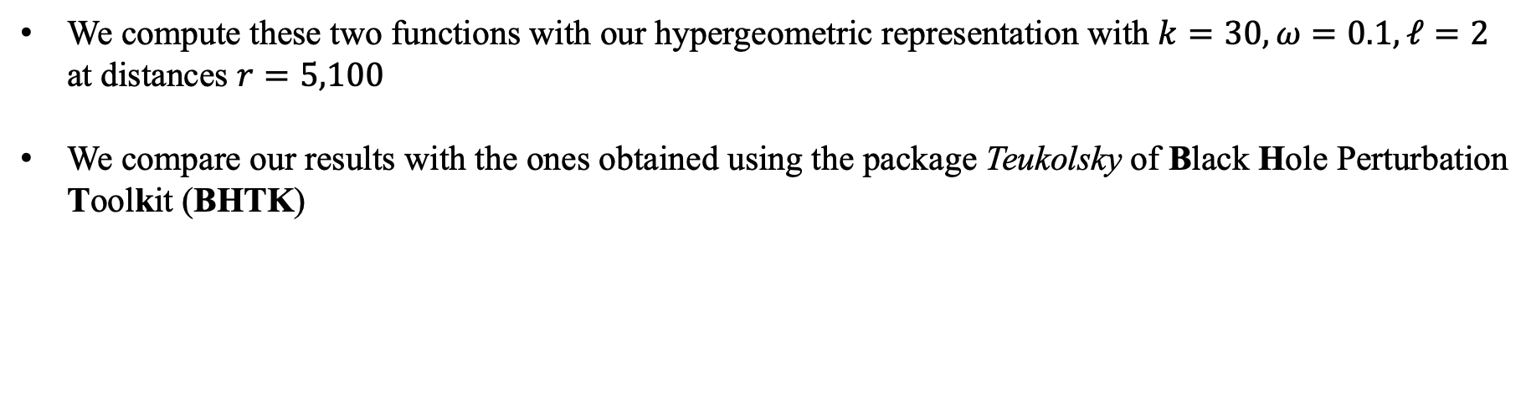

RESULTS FOR $ℜ_{in}$ AND $ℜ_{up}$
We compute these two functions with our hypergeometric representation with $k=30, ω=0.1, ℓ=2$ at distances $r=5,100$
We compare our results with the ones obtained using the package Teukolsky of Black Hole Perturbation Toolkit (BHTK)

Slide 15
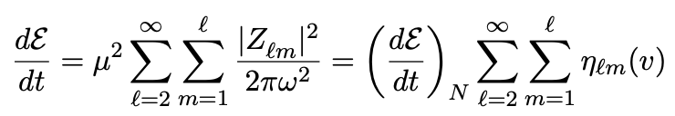
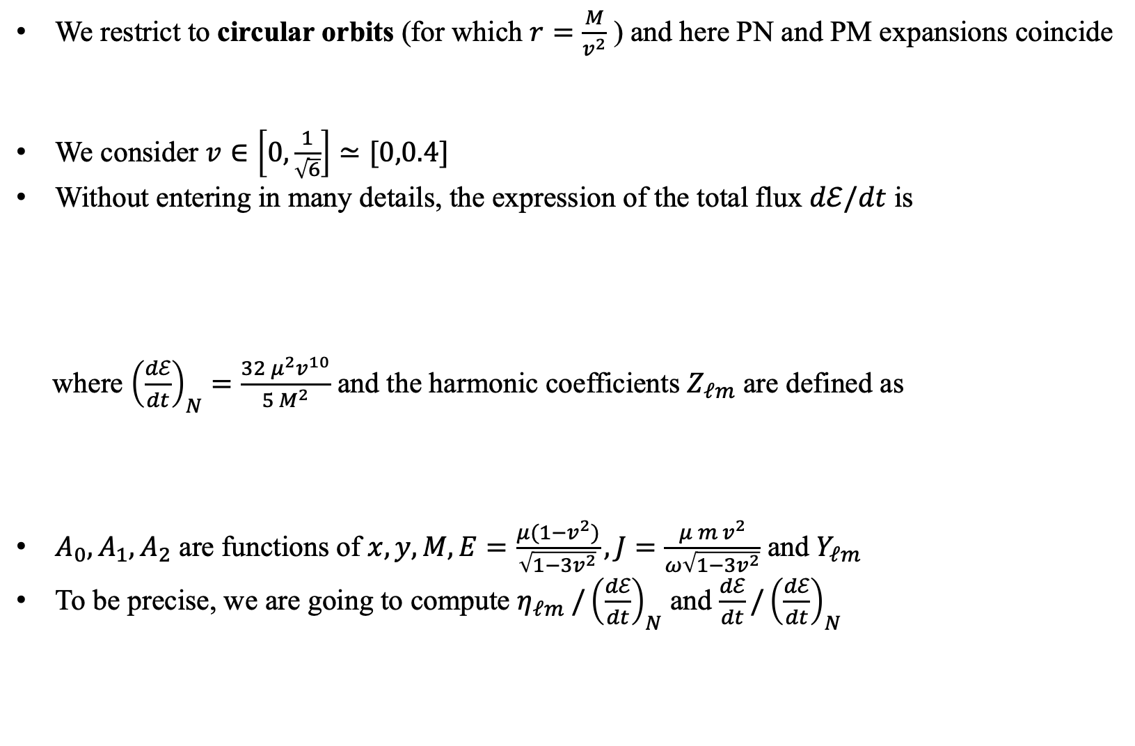
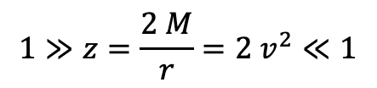
OBSERVABLES: $(ℓ,m)$ HARMONIC MODES AND $dℰ/dt$
We restrict to circular orbits (for which $r=\frac{M}{v^{2}}$ ) and here PN and PM expansions coincide
We consider $v∈\left[0,\frac{1}{\sqrt{6}}\right]≃[0,0.4]$
Without entering in many details, the expression of the total flux $dℰ/dt$ is
where ${\left(\frac{dℰ}{dt}\right)}_{N}=\frac{32 μ^{2}v^{10}}{5 M^{2}}$ and the harmonic coefficients $Z_{ℓm}$ are defined as
$A_{0},A_{1},A_{2}$ are functions of $x,y,M,E=\frac{μ(1−v^{2})}{\sqrt{1−3v^{2}}}, J=\frac{μ m v^{2}}{ω\sqrt{1−3v^{2}}}$ and $Y_{ℓm}$
To be precise, we are going to compute $η_{ℓm} /{\left(\frac{dℰ}{dt}\right)}_{N}$ and ${\frac{dℰ}{dt}/\left(\frac{dℰ}{dt}\right)}_{N}$
$$1≫z=\frac{2 M}{r}=2 v^{2}≪1$$
PM
PN
$$Z_{ℓm}=A_{0} ℜ_{in}\left(y\right)+A_{1}∂_{y}ℜ_{in}\left(y\right)+A_{2} ∂_{y}^{2}ℜ_{in}(y)$$

Slide 16
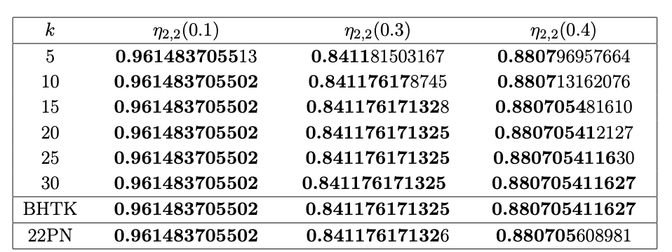
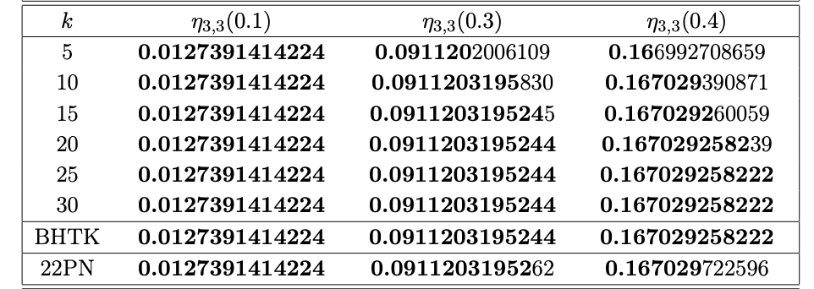



RESULTS FOR SOME $(ℓ,m)$ MODES
Here we show the convergence of the $PM_{k}$ results for $η_{2,2},η_{3,3,} η_{3,2}, η_{10,1}$ normalized with the Newtonian luminosity

Slide 17

RESULTS FOR TOTAL LUMINOSITY
Here we show our 30PN results for the total luminosity $\frac{dℰ}{dt}$against those obtained by BHTK and the 22 PN computation by Fujita

Slide 18




OLD FACTORIZED FORMS FOR THE WAVEFORM
In order to compare our results with the literature, we consider now the modulus of the waveform
The first reference paper wrote the following factorization for the first time and the second one gives a new proposal for the tail part
Damour, Iyer, Nagar, 0811.2069
Ivanov, Li, Parra-Martinez, Zhou, 2504.07862
$$\left|h_{ℓm}^{DIN}\right| =\left|h_{ℓm}^{N} {\hat{S}}_{eff} T_{ℓm}^{DIN} {\left(ρ_{ℓm}^{DIN}\right)}^{ℓ}\right|$$
$$\left|h_{ℓm}^{ILPZ}\right| =\left|h_{ℓm}^{N} {\hat{S}}_{eff} T_{ℓm}^{ILPZ} {\left(ρ_{ℓm}^{ILPZ}\right)}^{ℓ}\right|$$
$h_{ℓm}^{N}$ is the Newtonian multipolar waveform
${\hat{S}}_{eff}$ is the angular momentum if $ℓ+m∈2ℤ+1$,
the EOB Hamiltonian ${\hat{H}}_{eff}$ if $ℓ+m∈2ℤ$
$\left|T_{ℓm}^{DIN}\right|= \frac{|Γ(ℓ+1−2iGℰω)|}{Γ(ℓ+1)} e^{πGℰω}$ is a resummed version
of the tails
${\left(ρ_{ℓm}^{DIN}\right)}^{ℓ}$is the remainder, which is PN expanded
with $\left|T_{ℓm}^{ILPZ}\right|=\frac{|Γ\left(\hat{ν}+1−2iGℰω\right)|}{Γ(\hat{ν}+1)}e^{πGℰω} {\left(r_{orb} ω\right)}^{\hat{ν}−ℓ}$ is a
a new resummed version of the tails, in particular:
$\hat{ν}=a\left(ℓ\right)+\frac{1}{2}$;
$r_{orb} ω$ is a term coming from the EFT scenario employed
in this work ($r_{orb}$ is the orbital scale)
${\left(ρ_{ℓm}^{ILPZ}\right)}^{ℓ}$is the remainder, which is expanded up to 4PN

Slide 19






FACTORIZED FORM USING THE NEW METHOD
In this context, we want to frame our new results.
Let us recall the structure of $ℜ_{in}$
Passing to take the derivatives w.r.t y of this function in order to arrive to the waveform (which plays, in this setup, the role of $η_{ℓm}$ seen above), the same structure remains
$ρ_{ℓm}^{New}$ and ${\tilde{ρ}}_{ℓm}^{New}$ are PN expanded, so they are polynomials
where $R_{±}\left(y\right)=y^{\frac{3}{2}∓a} {\hat{R}}_{±}\left(y\right)$, in
such a way we factor out all tail
contributions and so ${\hat{R}}_{±}\left(y\right)$ contain only the hypergeometric part (notice that $a=a(x)$)!
$$ℜ_{in}= \frac{x^{\frac{x}{2}}}{B_{−−}(1−x^{2a} γ_{inst}\left(x\right)\frac{F_{−+} B_{+−}}{F_{++} B_{−−}})} y^{\frac{3}{2}+a} \left[{\hat{R}}_{−}\left(y\right)−γ_{inst} \frac{F_{−+}}{F_{++}} {\left(\frac{x}{y}\right)}^{2 a} {\hat{R}}_{+}(y)\right]$$
$$C_{in}$$
$$\left|h_{ℓm}^{New}\right| =\left|h_{ℓm}^{N} {\hat{S}}_{eff} \right|\left|T_{ℓm}^{New}\right| \left|{\left(ρ_{ℓm}^{New}\right)}^{ℓ}\right|\left|1+{\tilde{T}}_{ℓm}^{New} {\tilde{ρ}}_{ℓm}^{New} \right|$$
coming from
coming from
${\hat{R}}_{−}(y)$ and
derivatives
coming from
coming from ratio of ${\hat{R}}_{+}(y)$ and derivatives with ${\hat{R}}_{−}(y)$ and derivatives

Slide 20







COMPARISON BETWEEN THE THREE FACTORIZATIONS
We expand all $ρ$ and $\tilde{ρ}$ functions at 8PN and 10PN and we sum all the modes up to $ℓ=8$ (now called $F$)
In the horizontal axes of the two plots, we have $x=v^{2}$
The result coming from our prescription gives the lowest errors. In particular, at LSO we gain
If we leave the entire hypergeometric functions instead their PN expansions, the error gets incredibly reduced. For example, for $k=20$, we obtain
$${\left|δF_{New}^{8PN}\right|}_{LSO}=1.6⋅{10}^{−4} {\left|δF_{New}^{10PN}\right|}_{LSO}=5.7⋅{10}^{−6} {\left|δF_{DIN+Fuj}\right|}_{LSO}=3.9⋅{10}^{−4}$$
$${\left|δF_{ILPZ}\right|}_{LSO}=2.3⋅{10}^{−3}$$
$${\left|δF_{Hyp,New}^{k=20}\right|}_{LSO}=5.7⋅{10}^{−7}$$

Slide 21



EXTENSION OF RESULTS TO COMPARABLE-MASS
Up to now we have considered the test-mass regime, $\frac{μ}{M}≪1$, but we want to go beyond it
So we denote the two comparable masses as $m_{1}$ and $m_{2}$ and we define the parameter $ν=\frac{m_{1} m_{2}}{{\left(m_{1}+m_{2}\right)}^{2}}$
We focus on $\left|h_{22}\right|$. Starting from its 4PN expansion known in literature, we factor out from it our new tail $T_{ℓm}^{New}$, getting in this way the 4PN expansion of the remainder $ρ_{ℓm}^{New}$ with terms dependent from $ν$
At this point we pass to compute $\left|h_{22}\right|$ with our tail and the last remainder and then we compare it with the result obtained by A. Nagar and its collaborators in Damour, Iyer, Nagar, 0811.2069
and Nagar, Chiaramello et al. 2407.04762. We set $ν=0.25$ (equal masses)

Slide 22
CONCLUSIONS AND GOALS
The novel hypergeometric representation of the solutions of Heun equation gives very good results for the waveform (as seen by the comparisons shown above)
The reasons of it mainly are:
our formulae resum the infinite tower of logarithmic divergent terms into exponentials and Gamma functions;
this parametrization provides a simple proof of Heun connection formulae;
it is very practical, thanks to the recursive scheme we depicted at the beginning
Future outlooks:
application of the same kind of extension to comparable-mass also for higher modes, naturally uplifting in this way the total mass from the test-mass regime to the latter one;
application of the same representation also to study Kerr BH (AC, A. Nagar, F. Fucito, J.F. Morales, Work in progress)
application of the same representation also to systems governed by Heun equation

Slide 23
THANK YOU SO MUCH FOR YOUR
ATTENTION!

Slide 24




DERIVATION OF $Z_{ℓm}$ COEFFICIENTS FROM THE DYNAMICS
We consider the perturbations of the metric of spin $s=−2$, defined as
where $C_{μνσρ}$ is the Weyl tensor perturbation, $f\left(r\right)=1−\frac{2M}{r}, x^{μ}=(t,r,θ,φ)$ (they will describe the particle’s trajectory)
The Einstein equations for $ψ$ can be separated at linear order into a radial and an angular part via the ansatz
where $X=(T,R,Θ,Φ)$ are the coordinates of the observer
As already said, the radial function $R_{ℓm}(r)$ satisfies the Teukolsky equation
$$ψ=r^{4} ψ_{4}=r^{4}C_{μνσρ} n^{μ}{\overline{m}}^{ν}n^{σ}{\overline{m}}^{ρ}$$
with $n^{β}=\frac{1}{2}\left(1,−f\left(r\right),0,0\right), {\overline{m}}^{β}=\frac{1}{\sqrt{2} r}(0,0,1,−\frac{i}{sin\left(θ\right)})$
$$ψ(X)=\int{\frac{dω}{2 π} \sum_{ℓ,m}{e^{−iωT}} R_{ℓm}\left(R\right) Y_{−2}^{ℓm}(Θ,Φ)}$$
$$r^{4} f{\left(r\right)}^{2}\frac{d}{dr}\left[\frac{R_{ℓm}^{′}(r)}{r^{2} f(r)}\right]+\left(\frac{ω^{2}r^{2}+4iω\left(r−M\right)}{f\left(r\right)}−8iωr−\left(ℓ+2\right)\left(ℓ−1\right)\right)R_{ℓm}\left(r\right)=G T_{ℓm}(r)$$

Slide 25



DERIVATION OF $Z_{ℓm}$ COEFFICIENTS FROM THE DYNAMICS
$T_{ℓm}(r)$ are the coefficients of the harmonic decomposition of the stress energy source and they are defined as
where $S_{ℓm}\left(θ\right)=Y_{−2}^{ℓm}(θ,0)$
$𝒯$(x) is given by the following expression
where all the ingredients that appear are defined as
The solution of the homogeneous equation of above can be obtained with the Green function method and written in the form
$$T_{ℓm}\left(r\right)=π\int{dθ dφ dt sin\left(θ\right) S_{ℓm}\left(θ\right) e^{−imφ+i ωt}} 𝒯(x)$$
$$𝒯\text{(}\text{x}\text{)}=2 r^{4} L_{−1} L_{0}𝒯_{nn}+\sqrt{2} r^{3} f^{2} J_{+}\left(\frac{r^{2}}{f} L_{−1} 𝒯_{\overline{m}n}\right)+\sqrt{2} r f^{2} J_{+}\left(\frac{r^{4}}{f} L_{−1} 𝒯_{\overline{m}n}\right)+f^{2}r J_{+}\left[r^{4} J_{+}\left(r 𝒯_{\overline{m}\overline{m}}\right)\right]$$
$𝒯_{nn}=𝒯_{μν} n^{μ}n^{ν}$ , $𝒯_{\overline{m}n}=𝒯_{μν} n^{μ}{\overline{m}}^{ν}$ , $𝒯_{\overline{m}\overline{m}}=𝒯_{μν} {\overline{m}}^{μ}{\overline{m}}^{ν}$ , $J_{±}=∂_{r}±\frac{iω}{f}$ , $L_{s}=∂_{θ}+\frac{m}{sin\left(θ\right)}+s cotθ$
$$R_{ℓm}\left(R\right)=ℜ_{up,ℓ}\left(R\right) Z_{ℓm}(ω)$$

Slide 26





DERIVATION OF $Z_{ℓm}$ COEFFICIENTS FROM THE DYNAMICS
$Z_{ℓm}(ω)$are defined as
These are called harmonic coefficients of the waveform because they enter in the harmonic decomposition of it
Indeed the waveform measured by a far away observer admits the following harmonic decomposition
After some algebra, we arrive at the following expression for these coefficients
$$Z_{ℓm}\left(ω\right)= \int_{2M}^{∞}{ℜ_{in,ℓ}\left(r′\right) \frac{T_{ℓm}(r^{′})}{{\left(r^{′}\right)}^{4} f{\left(r^{′}\right)}^{2}} dr′}$$
$$h\left(X\right)≈−\frac{4G}{R} \int{\frac{dω}{2π} \sum_{ℓ,m}{e^{−iω(T−R_{∗})}} \frac{Z_{ℓm}(ω)}{2{\left(iω\right)}^{2}} Y_{−2}^{ℓm}(Θ,Φ)}$$
$$R→∞$$
$$Z_{ℓm}\left(ω\right)=\int{dt} e^{−imφ\left(t\right)+iωt} \frac{1}{r{\left(t\right)}^{2}}\sum_{i=0}^{2}{b_{ℓm}^{i} ℒ^{i}\left[ℜ_{in,ℓ}\left(r(t)\right)\right]}$$

Slide 27




DERIVATION OF $Z_{ℓm}$ COEFFICIENTS FROM THE DYNAMICS
where:
In case of a circular orbit, $r\left(t\right)≡r_{0}→\dot{r}=0$, the integral in t becomes trivial (since $φ\left(t\right)=Ω t$ and the orbital frequency $Ω$ is related to the wavefrequency through the relation $ω=m Ω$)
Using the expressions developed during the presentation, we get the following final expression of these coefficients, from which we can find the functions $A_{0},A_{1},A_{2}$
$$Z_{ℓm}\left(ω\right)=\int{dt} e^{−imφ\left(t\right)+iωt} \frac{1}{r{\left(t\right)}^{2}}\sum_{i=0}^{2}{b_{ℓm}^{i} ℒ^{i}\left[ℜ_{in,ℓ}\left(r(t)\right)\right]}$$
$ℒ^{0}=\frac{E}{f}{\left(1+\frac{\dot{r}}{f}\right)}^{2}$ , $ℒ^{1}=\frac{i J}{r}\left(1+\frac{\dot{r}}{f}\right)\left(2−r ∂_{r}+\frac{iωr}{f}\right)$ ,
$ℒ^{2}=\frac{J^{2}}{E}\frac{f}{r^{2}}\left[f^{−2}\left(−iωr+\frac{1}{2}ω^{2}r^{2}+iωM\right)+\left(1+\frac{iωr}{f}\right)r ∂_{r}−\frac{1}{2}r^{2}∂_{r}^{2} \right]$ , $b_{ℓm}^{0}=\frac{π}{2}\sqrt{\left(ℓ−1\right)ℓ(ℓ+1)(ℓ+2)}Y_{0}^{ℓm}\left(\frac{π}{2},0\right)$, $b_{ℓm}^{1}=π\sqrt{\left(ℓ−1\right) (ℓ+2)}Y_{−1}^{ℓm}\left(\frac{π}{2},0\right)$ , $b_{ℓm}^{2}=π Y_{−2}^{ℓm}\left(\frac{π}{2},0\right)$

Slide 28




$ρ_{22}$ FUNCTIONS IN COMPARABLE-MASS REGIME
Starting from the following PN expansion of $|h_{22}|$ at 4PN known in literature
and factorizing out from it the two expressions of the tails $T_{ℓm}^{DIN}$ and $T_{ℓm}^{New}$, we get the two following
expressions of the remainder functions $ρ_{22}^{DIN}$ and $ρ_{22}^{New}$

Slide 29






MORE ON THE COMPUTATION OF $a$ FUNCTION
Remembering the relation
since now we know all the coefficients $u_{i}(a)$, we can invert this series in order to find $a(u)$, where
we set $u={\left(ℓ+\frac{1}{2}\right)}^{2}+\frac{5}{2}x+\frac{x^{2}}{4}$, as obtained from the dictionary
Inverting this series at high PM order can be time consuming for Mathematica, hence we use an alternative to find $a(u)$ that, once again, exploits the SW correspondence for this quantity
We start by writing the SW curve for $𝒩=2$ SYM theory with gauge group $SU(2)$ and $N_{f}=3$ hypermultiplets transforming in the fundamental representation of the gauge group with masses $m_{i}$ in flat space (hence the curve is classical)
$$u\left(a\right)=a^{2}+\sum_{i=0}^{∞}{u_{i}\left(a\right) x^{i}}$$
$$Λ^{2} y^{2}P_{L}\left(x\right)+y P_{0}\left(x\right)+P_{R}(x)=0$$
where
$P_{R}\left(x\right)=\left(x−m_{1}\right)\left(x−m_{2}\right)$ $P_{L}\left(x\right)=x−m_{3}$
$$Λ=e^{2πiτ}$$
$$P_{0}(x)=x^{2}−u+Λ\left(x+\frac{1}{2}−m_{1}−m_{2}−m_{3}\right)$$

Slide 30

MORE ON THE COMPUTATION OF $a$ FUNCTION
This gauge theory can be understood in terms of the following brane configurations (Hanany-Witten setup)
The QFT lives on a stack of D4-branes stretched between two NS5-branes (vector multiplet content) or between an NS5 brane and infinity (hypermultiplet content), positioned both to the left and right
The locations of the zeros of $P_{L,R}(x)$ and $P_{0}(x)$ determine the positions of the D4-branes in these three regions, serving as parameters for the three masses. Hence in this scenario we have $N_{f}=(1,2)$
non dynamical NS5-brane
non dynamical NS5-brane
D4-flavour-brane
D4-colour-branes
D4-flavour-branes

Slide 31




MORE ON THE COMPUTATION OF $a$ FUNCTION
When we deform our spacetime by the presence of the so called $Ω$ background with parameters $ε_{1}=1, ε_{2}=0$ (in units of $ℏ$), the dynamics of the gauge theory is described by a quantum curve obtained from the classical one after replacing $x$ and $y$ by operators $\hat{x}$ and $\hat{y}$ satisfying the following commutation rule
In this way the quantum SW curve follows from the classical one and it is a differential equation
In order to arrive at the determination of the quantity $a$ (which is one of the two periods of the elliptic curve), it is convenient to rewrite this equation in the $x$-plane, i.e. setting $\hat{y}=e^{−∂_{x}}, \hat{x}=x 𝟙$
If we start from the gauge theory with $N_{f}=(1,2)$, as in the case we are treating, this differential equation is of the Confluent Heun type
$$\left[\hat{x},\hat{y}\right]=\hat{y}$$
$$\left[Λ {\hat{y}}^{\frac{1}{2}} P_{L}\left(\hat{x}\right){\hat{y}}^{\frac{1}{2}}+P_{0}\left(\hat{x}\right)+{\hat{y}}^{− \frac{1}{2}} P_{R}\left(\hat{x}\right){\hat{y}}^{− \frac{1}{2}}\right]f=0$$
$$\left[Λ P_{L}\left(x−\frac{1}{2}\right)\hat{y}+P_{0}\left(x\right)+P_{R}\left(x+\frac{1}{2}\right){\hat{y}}^{−1}\right]\tilde{f}(x)=0$$

Slide 32





MORE ON THE COMPUTATION OF $a$ FUNCTION
Within all this scenario, it can be demonstrated that the quantum period $a$ satisfies the following continuous fraction equation
where, using the dictionary of our gravity scenario
The previous equation can be solved for $a(ℓ)$ order by order in $x$. For example, for $ℓ=2,3$ one finds
$$\frac{x M(a+1)}{P\left(a+1\right)−\frac{x M(a+2)}{P\left(a+2\right)−…}}+\frac{x M(a)}{P\left(a−1\right)−\frac{x M(a−1)}{P\left(a−2\right)−…}}−P\left(a\right)=0$$
$$P\left(a\right)=a^{2}+a x+2 x−\frac{3}{4}x^{2}−{\left(ℓ+\frac{1}{2}\right)}^{2}$$
$$M\left(a\right)=\left(a−\frac{x}{2}−\frac{1}{2}\right)\left(a−\frac{x}{2}+\frac{3}{2}\right)\left(a+\frac{x}{2}+\frac{3}{2}\right)$$

