Slide 1
Next steps
Intensity → Energy Frontier
David Neuffer
Fermilab graduate (2024)
July 2025

Slide 2
Over view
Future
  ~Fermilab-centric perspective ?
    Post Tevatron Energy Frontier
      LHC is energy frontier now
2014 P-5 US HEP focus on Intensity frontier
    Energy frontier is too expensive
Intensity frontier
  g-2, Mu2e
  Neutrinos
  PIP-2 → DUNE
    FCC-ee
Energy Frontier
  Muon Collider -IMCC
  FCC-hh

Slide 3
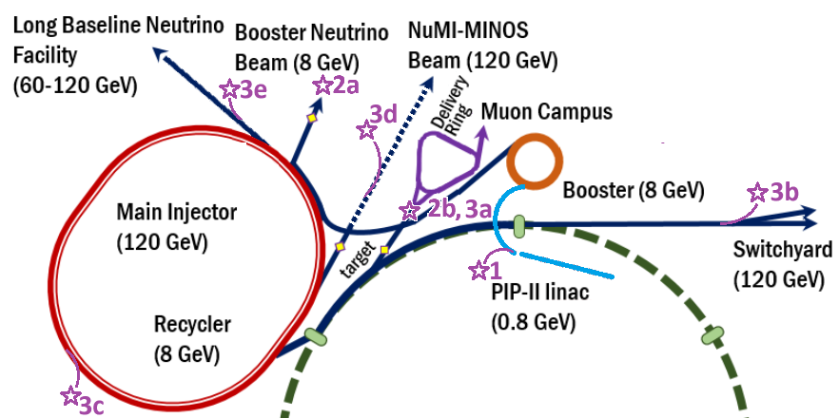
Intensity Frontier at Fermilab
Proton beams
  Booster
    8 GeV – up to ~ 100 kW
  Main Injector
    120 GeV – up to 1MW
Neutrino beams
  NuMI
    Measurements of neutrino properties
  BNB
    Search for “sterile neutrinos”
  Muon beams
    g-2
    Mu2e

Slide 4
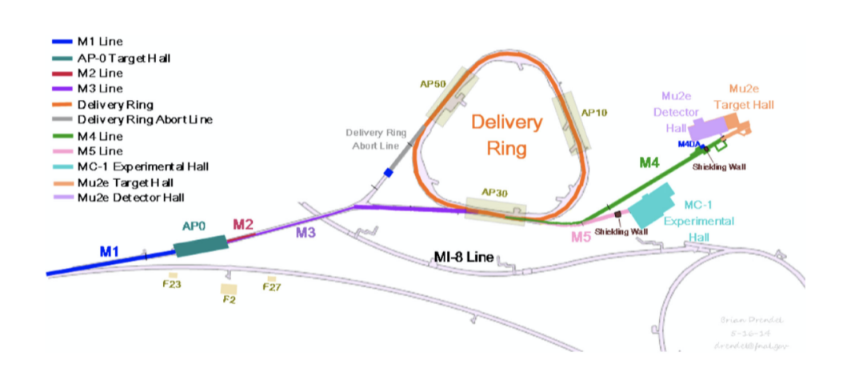
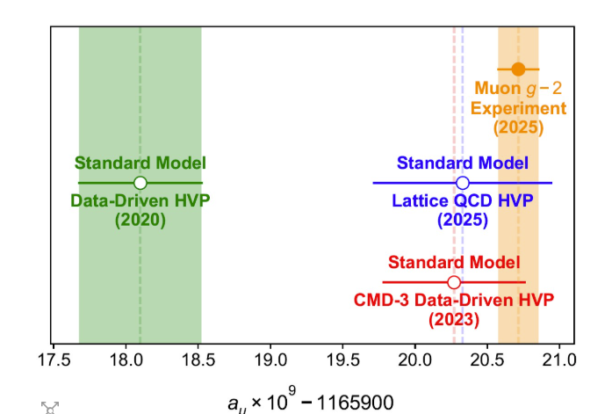
Current Muon Beams at Fermilab
g-2 Experiment
  Uses Tevatron production target to produce π→ µ
  3.1 GeV μ ~10¹² μ
  Measured g-2
      Resolved (?) g-2 anomaly
Mu2e experiment
  ~ 10¹⁸ μ

Slide 5
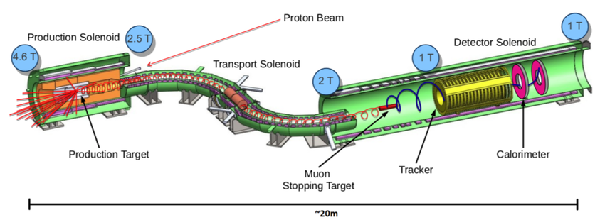
Mu2e experiment
P→π→μ in 4.5 T solenoid
  Backward capture of low-E μ
    0→0.1 GeV
    > ~10⁻³ stopped μ/p 10¹⁸ μ⁻
  Complementary to PSI, J-Parc, etc. experiments

Slide 6
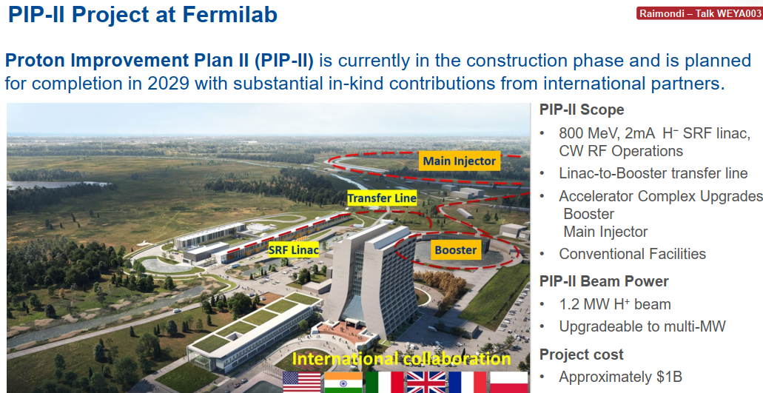
PIP-II Linac upgrade
1MW + at ~1 GeV
  > 200 kW from Booster 8 GeV
  > 2 MW 60-120 GeV for DUNE, …

Slide 7
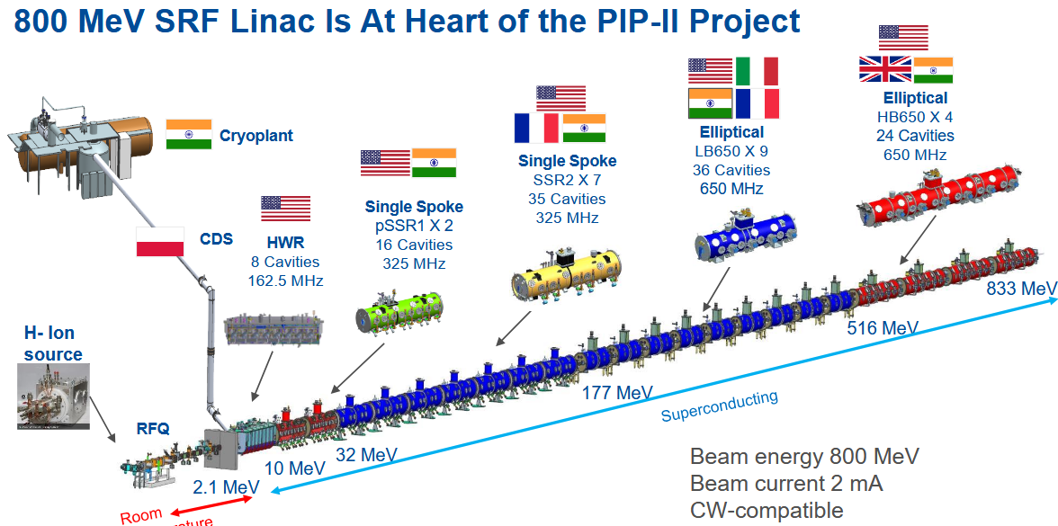
SRF Linac 162.5 →325→650 MHz

Slide 8
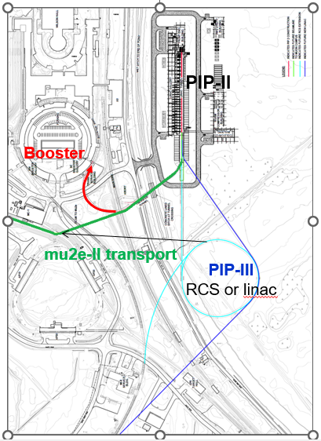
PIP-II → new beam possibilites
Up to ~1 MW, ~1 GeV p
  Only need ~20 kW for DUNE
π, μ, ν beams
  lepton number conservation
      μ→e , μ→ 3e, μ→ eγ
  μSR, π, μ low E physics
  Eventually, “Booster replacement”
    ~8 GeV RCS/Linac

Slide 9
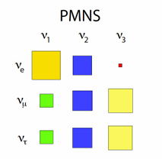
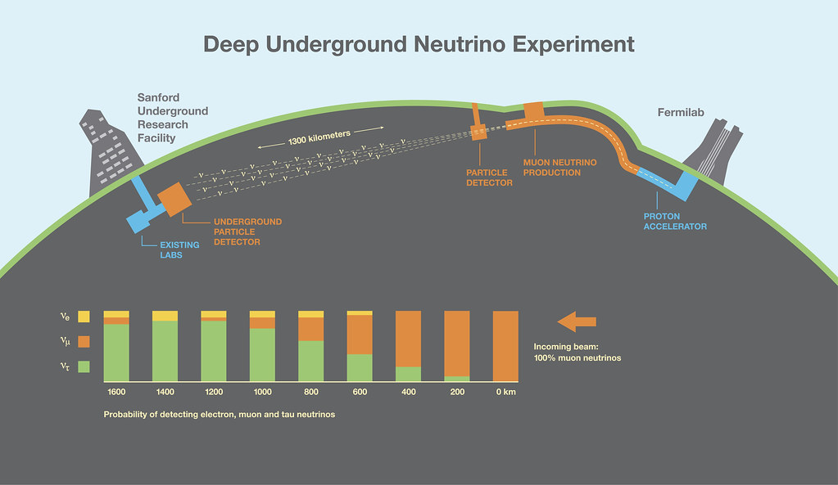
Physics program (~2030—2040)
Neutrino Physics at DUNE
  Intensity 1→2.5 MW 120 GeV p
    Measure SM neutrino parameters
    PMNS matrix
    Mass-order, CP phase
  Other physics ?
    Mu2e(-II)

Slide 10
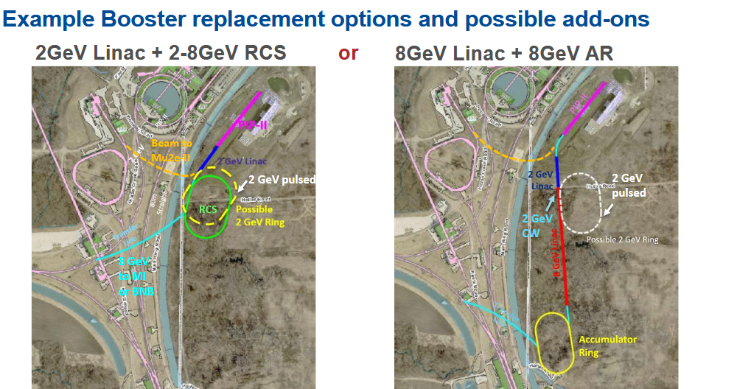
After PIP-II, upgrade Booster
~2 MW at ~8 GeV
  2-4 MW at 60—120 GeV

Slide 11
Energy Frontier or Intensity Frontier??
LHC ~14 TeV (since ~2010)
  Intensity upgrades
“Higgs Factory”
  250 GeV ee
    Intensity Frontier
Higher- Energy ??
    European strategy/ US P5
  100 km ring to 100TeV?
  Muon Collider →
    MAP → International Muon Collider Collaboration

Slide 12
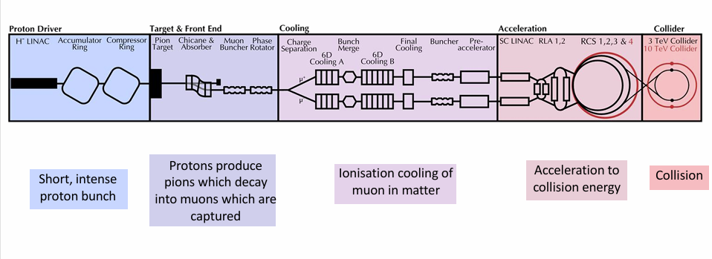
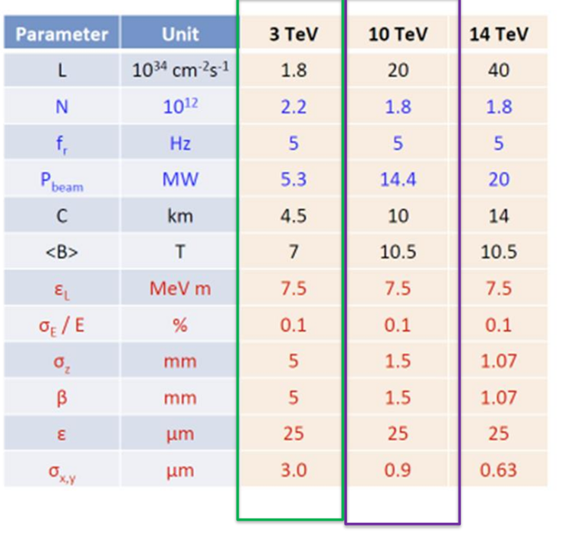

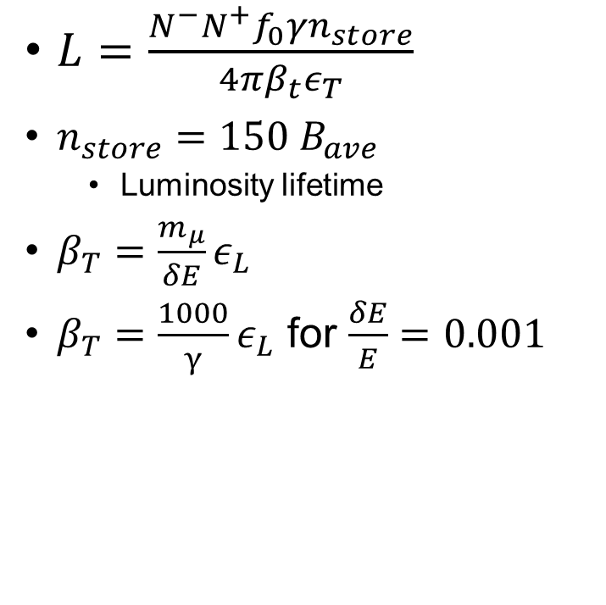
$L=\frac{N^{−}N^{+}f_{0}{γn}_{store}}{4πβ_{t}ε_{T}}$
$n_{store}=150 B_{ave}$
  Luminosity lifetime
$β_{T}={\frac{m_{μ}}{δE}ε}_{L}$
$β_{T}={\frac{1000}{γ}ε}_{L}$ for $\frac{δE}{E}=0.001$

Slide 13
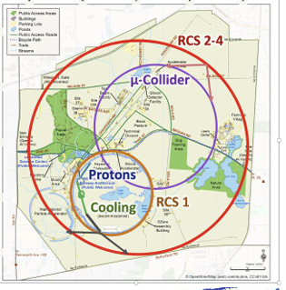
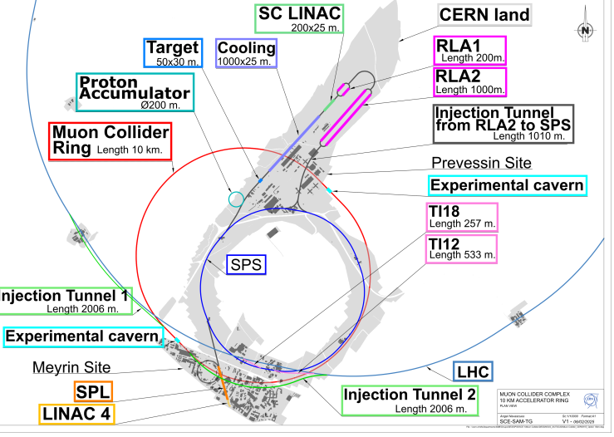
Muon Collider Layouts
~3—10 TeV

Slide 14
IMCC Scenario (2025)
Demos needed
  Ionization cooling
    Can components be built?
      Rf within B-fields and with beam
    Cool by large factor? >2?
  Target
    Can be built?
    Target production/heating ?
    π/μ capture?
  Acceleration
    Rf/magnets can be built?
    Operate in desired mode?
Demos needed
  Final Cooling
    B=40?T, low-frequency rf ?
    Operate with beam ?
    Wedge alternative ?
  Front End
    Optimize, demonstrate ???
  Magnets
    Build, test, operate
    High field,
      RCS ramp ?

Slide 15
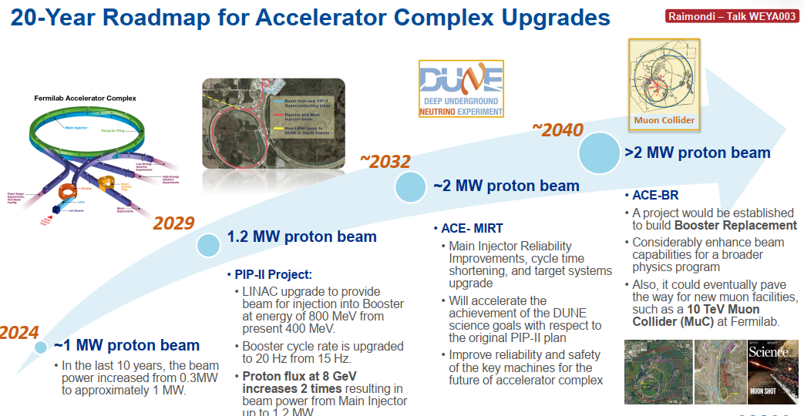
Intensity upgrade PIP-II → ???

Slide 16
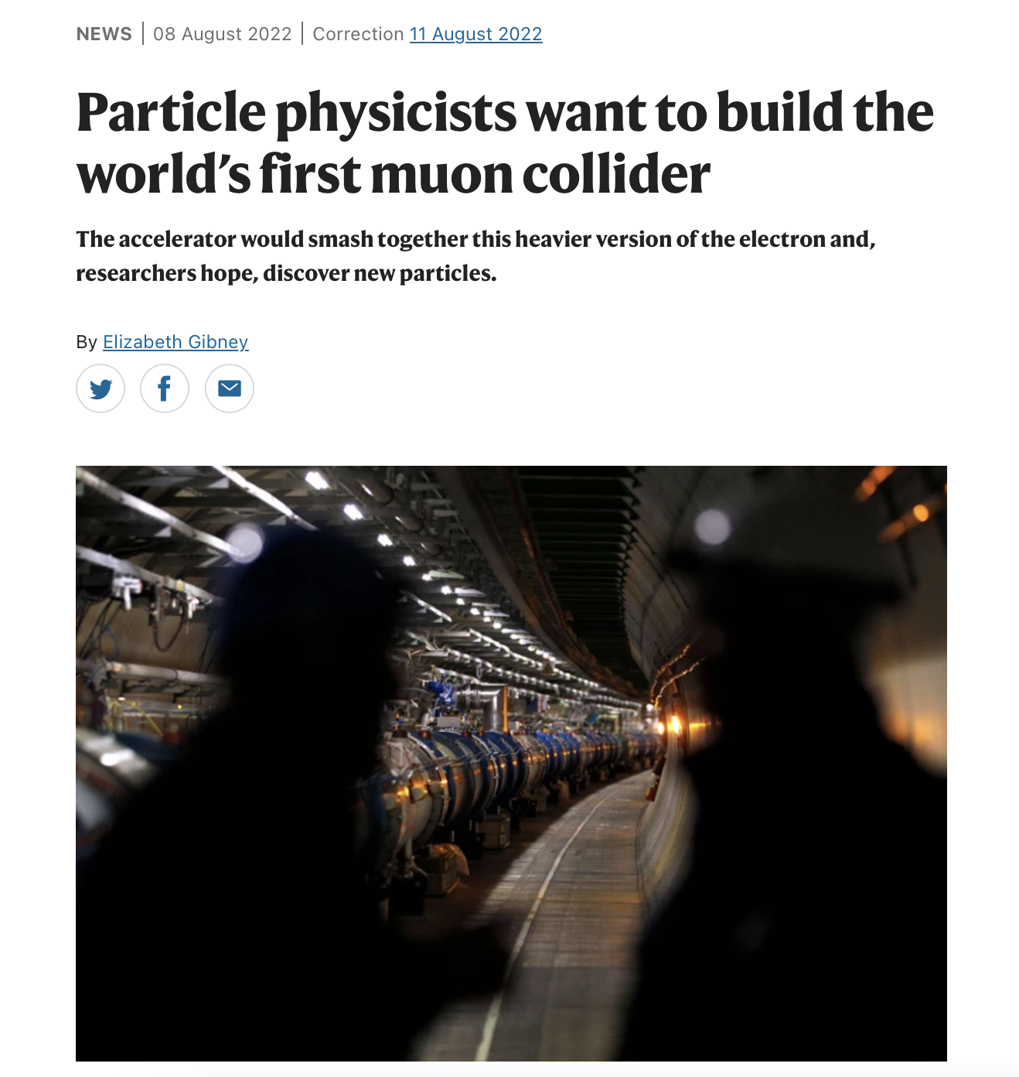
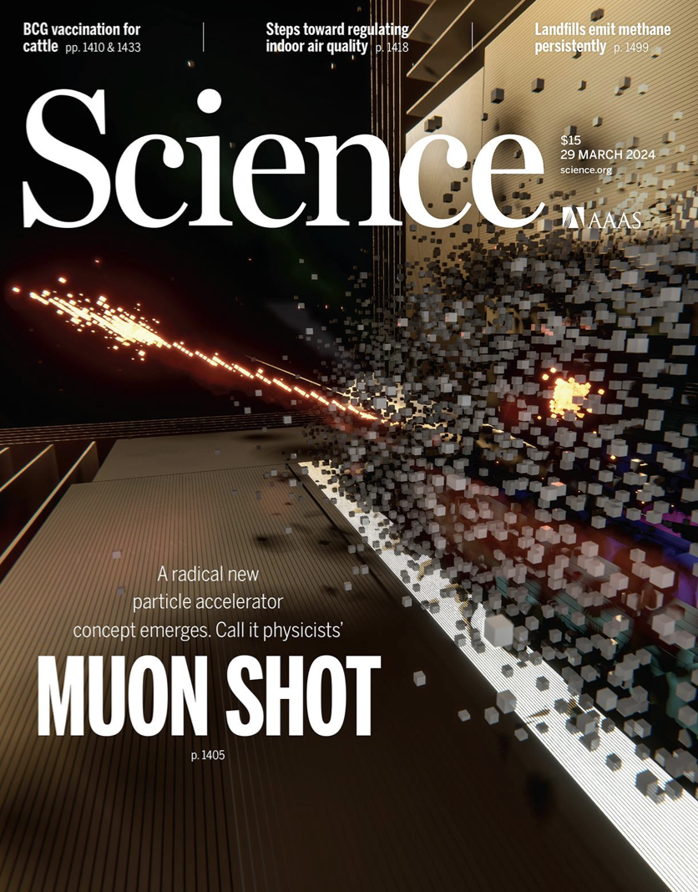

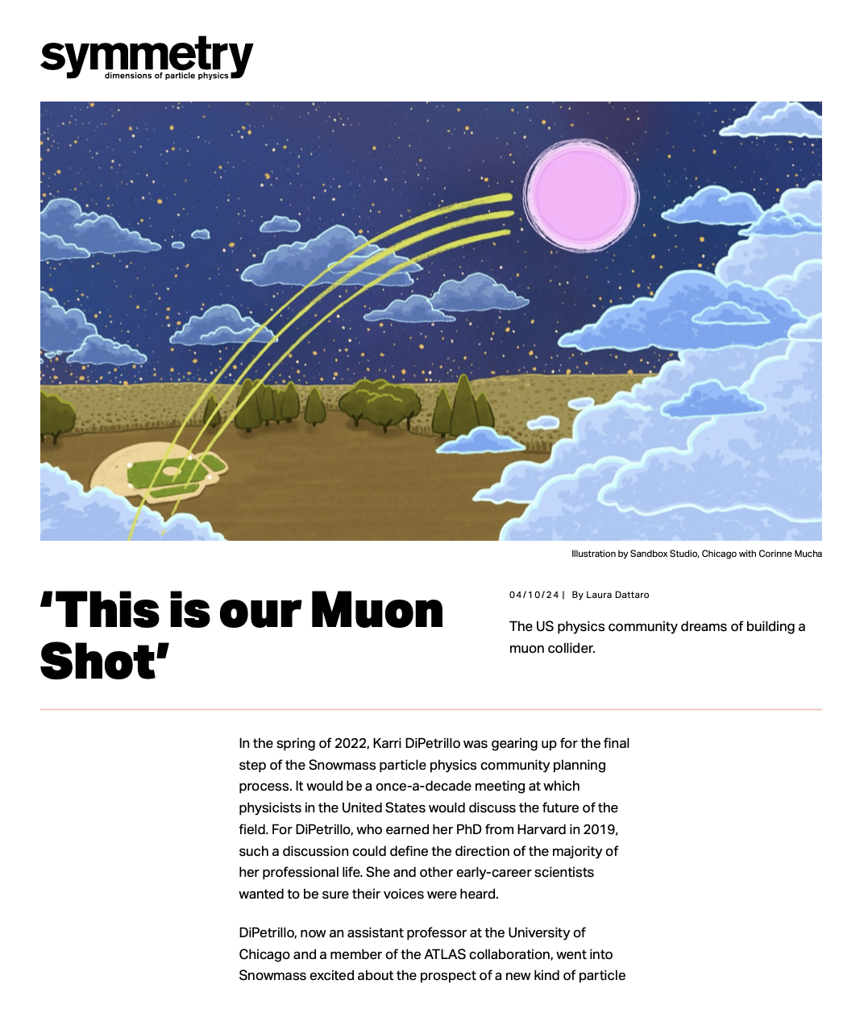
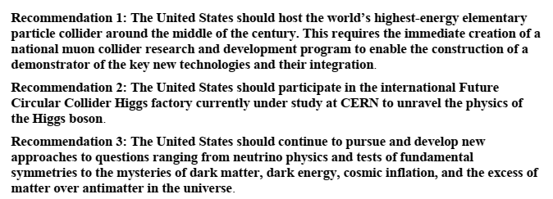
2023 P5 Report – 2025 NAS recommendation
Muon Fever ?

Slide 17
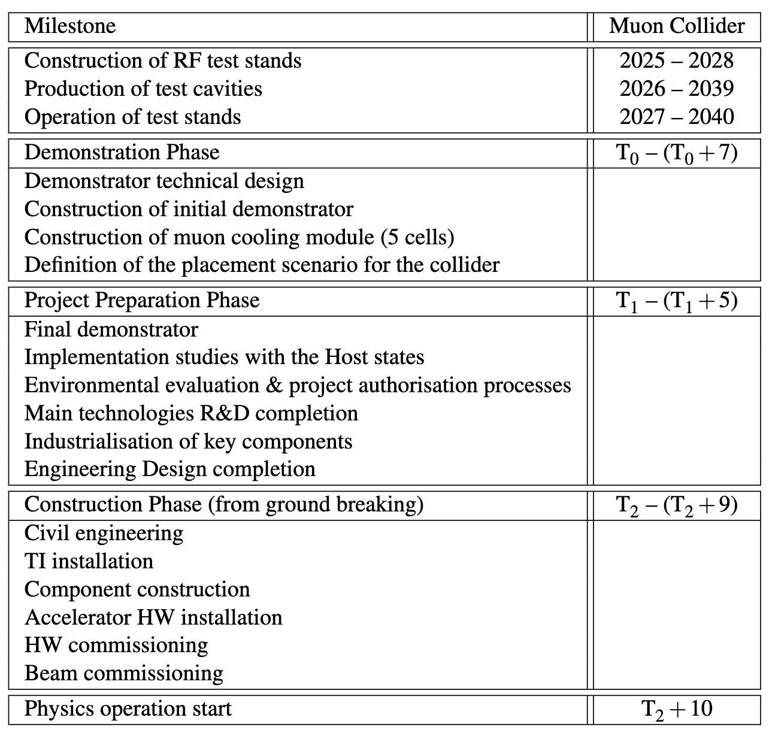
Timeline and R&D Programme Proposal
IMCC plans/ time lines
D. Schulte
Decision on demonstrator T₀
Initial final demonstrator
Timeline is driven by R&D
Most ambitious example to define R&D programme priorities
Assumes firm commitment to enable the muon collider
    as next flagship after HL-LHC
R&D is fully successful
No delays due to decision making
Other options
In Europe after a higgs factory
In the US to become leader at the energy frontier
https://indico.cern.ch/event/1439855/contributions/6542430/

Slide 18
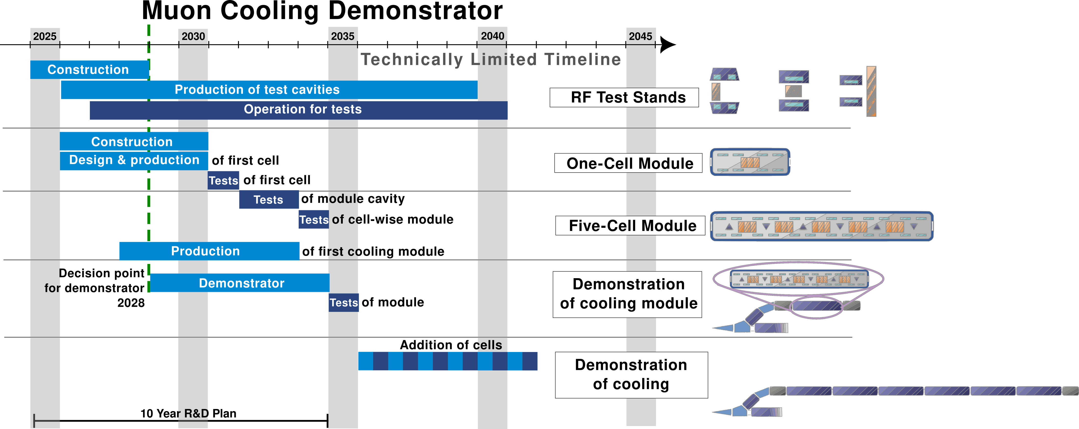
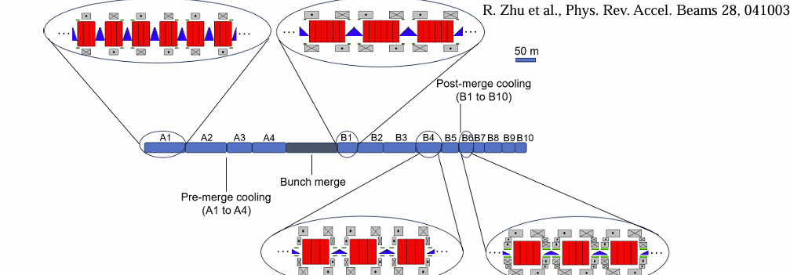
Cooling Demonstrator timeline
Cooling Linac

Slide 19

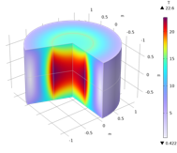
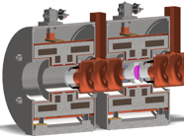
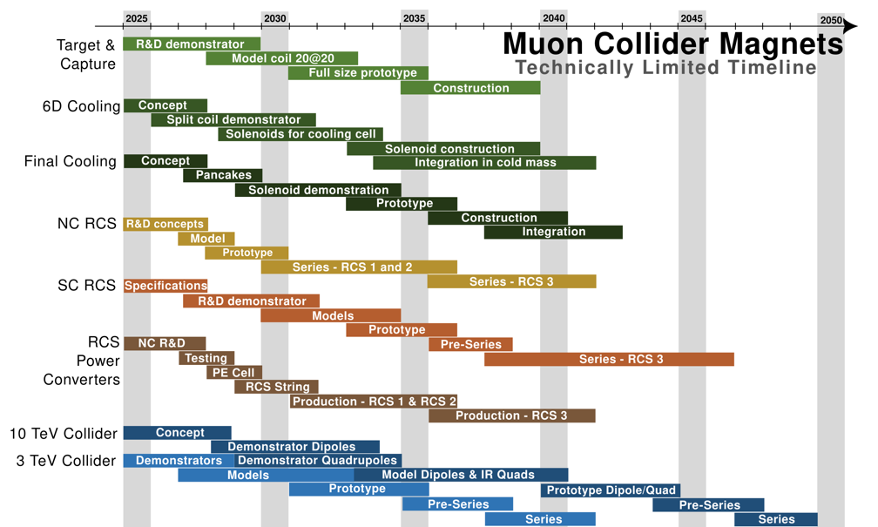
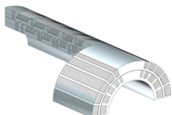

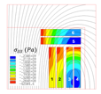
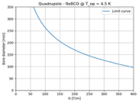
Technology Demonstrators-
Magnets
Target solenoid model coil (20@20)
Objectives: Generate a bore field of 20 T,
and operating at a temperature of 20 K.
Time: 2033
Prototypes and Industrialization
Technology R&D
Demonstrators
Production
Split Solenoid integration for 6D cooling cell (SOLID)
Objectives: Demonstrator of HTS split solenoid
representative of a 6D cooling cell.
Time: 2032
Final cooling UHF solenoid (UHF-Demo)
Objectives: HTS final cooling solenoid,
40 T in a 50 mm bore, 150 mm length.
Time: 2034
Wide-aperture, DC Nb₃Sn dipole (MBHY)
Objectives: Demonstrate wide-ap. LTS dipole
Time: 2036
Wide-aperture DC HTS dipole (MBHTSY)
Objectives: Demonstrate wide-ap. HTS dipole
Time: (2045)
Wide aperture HTS IR quadrupole (MQHTSY)
Objectives: Demonstrate wide-ap. HTS
quadrupole for the collider IR.
Time: (2045)
B. Auchmann

Slide 20
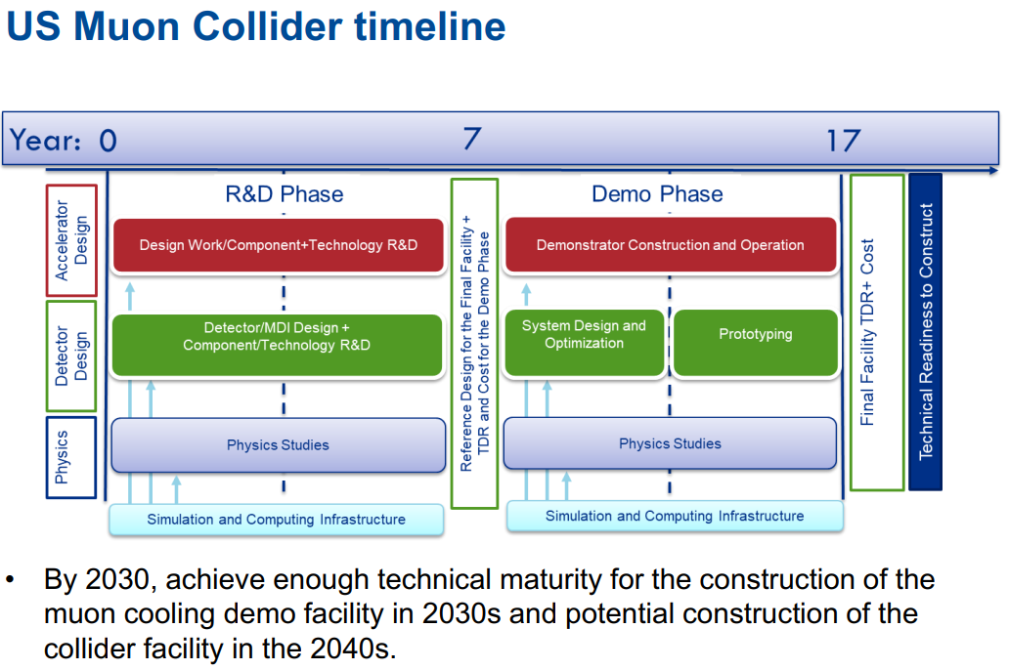
US MCC collaboration

Slide 21
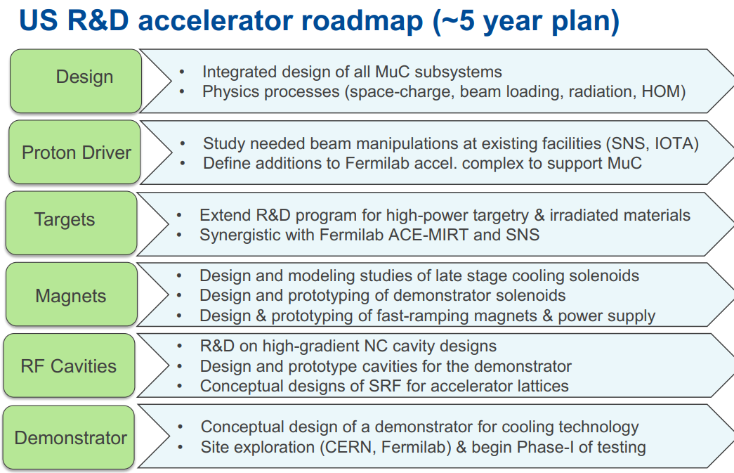
Initial R&D research

Slide 22
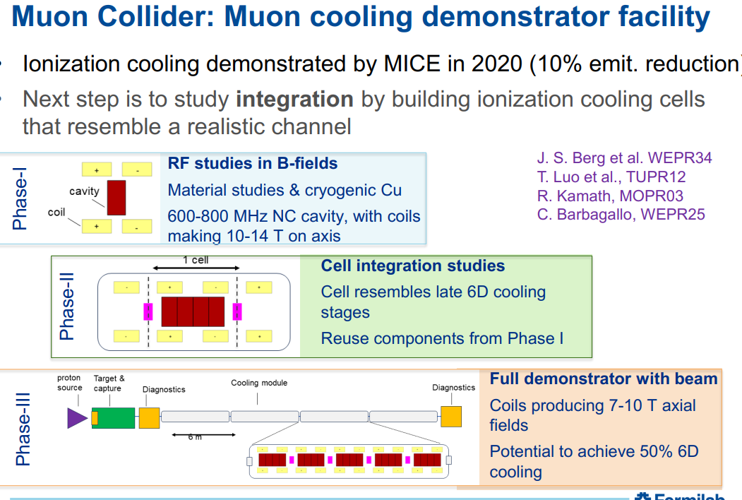

Slide 23
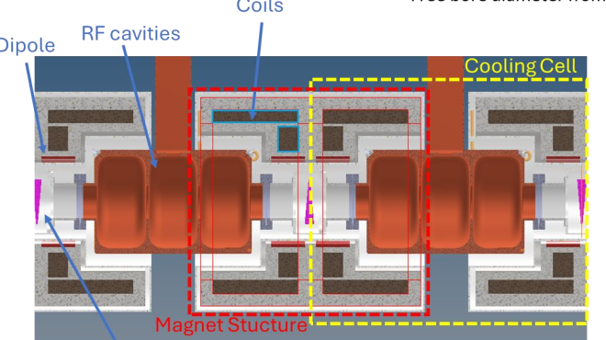
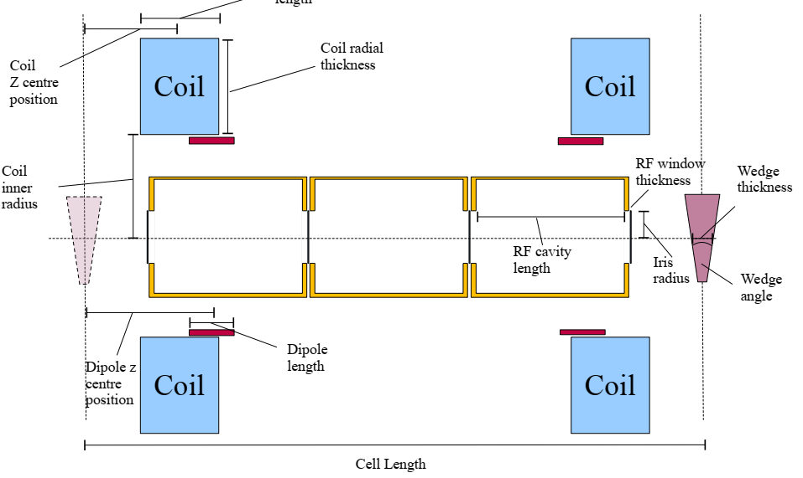
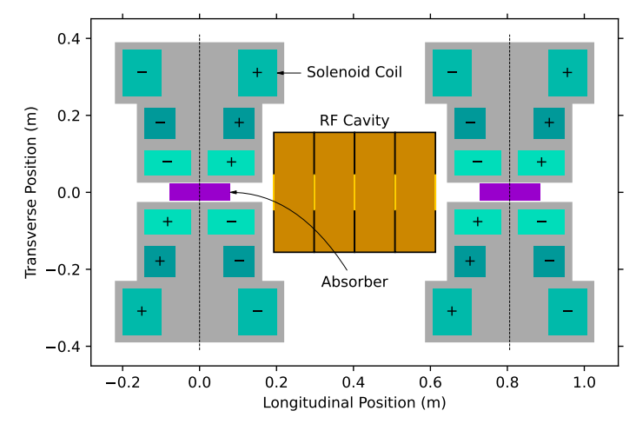
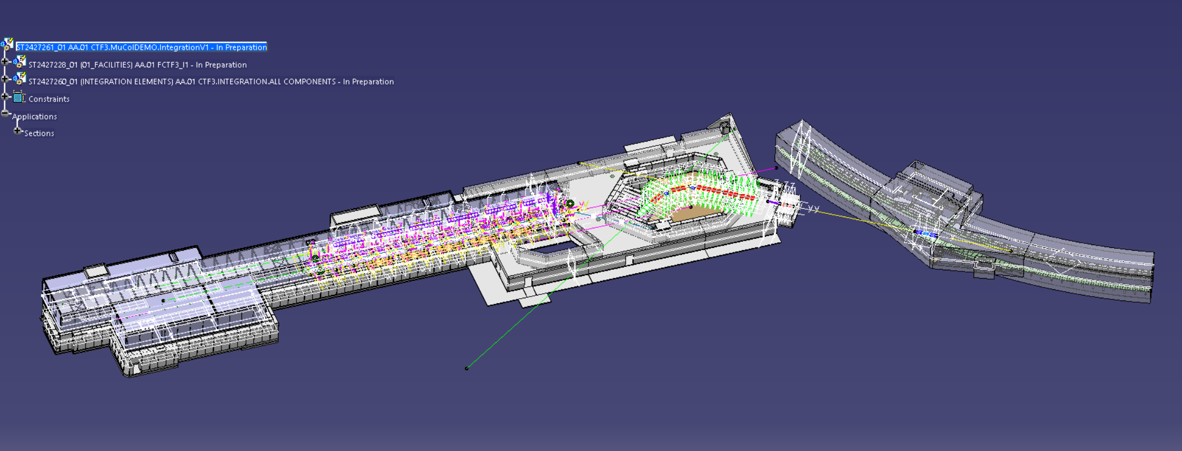
Demonstrator Design (CERN)
CT3 Facility could demonstrate cooling in a Multicell/multicavity scenario (~ 50 m)

Slide 24
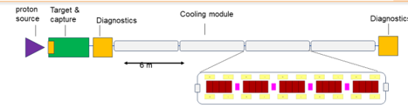
A demo idea
Scaled-back version of MC Front end
  8 GeV p, use BNB line
    Or M1-AP0 line
  FE – 5 → 1 T , C target
  Buncher to shape beam
  Cooling device to be tested
    Cooling section from scenario(325 MHz ?
    Example: inject into cooling ring ??
      Example: stopping target for low-energy πµν
  neutrino beams?

Slide 25
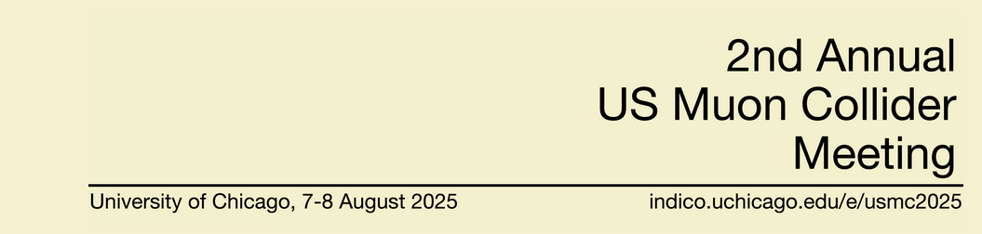
Next Event:
  US Muon Collider collaboration meeting
    August 7—8 (U of Chicago)

