Slide 1
Recent Developments in γγ Collider Concepts
from 125 GeV to 100 TeV
Physics At The Highest Energies With Colliders
Tim Barklow
SLAC National Accelerator Laboratory
July 29, 2025
Outline
γγ Collider Introduction
γγ Collider Higgs Factories
Higgs Self Coupling Measurement at 280/380 GeV
Accelerator and MDI
Major Technical Challenges
Multi-TeV γγ Colliders

Slide 2
Introduction

Slide 3
Layout of laser , e⁻ beams near interaction point of γγ collider -- x=1000, XFEL Higgs Factory Example
All of this is simulated by CAIN MC
>
>
Primary IP
2 mrad? 20 mrad?
Compton IP’s
>
>
1 KeV XFEL γ
62.6 GeV e⁻
62.5 GeV γ + spectrum of e⁻ , e⁺ , γ

Slide 4


Slide 5
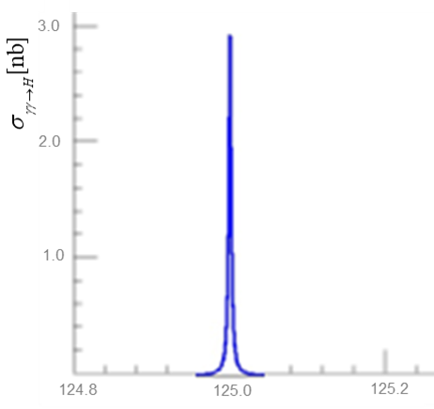
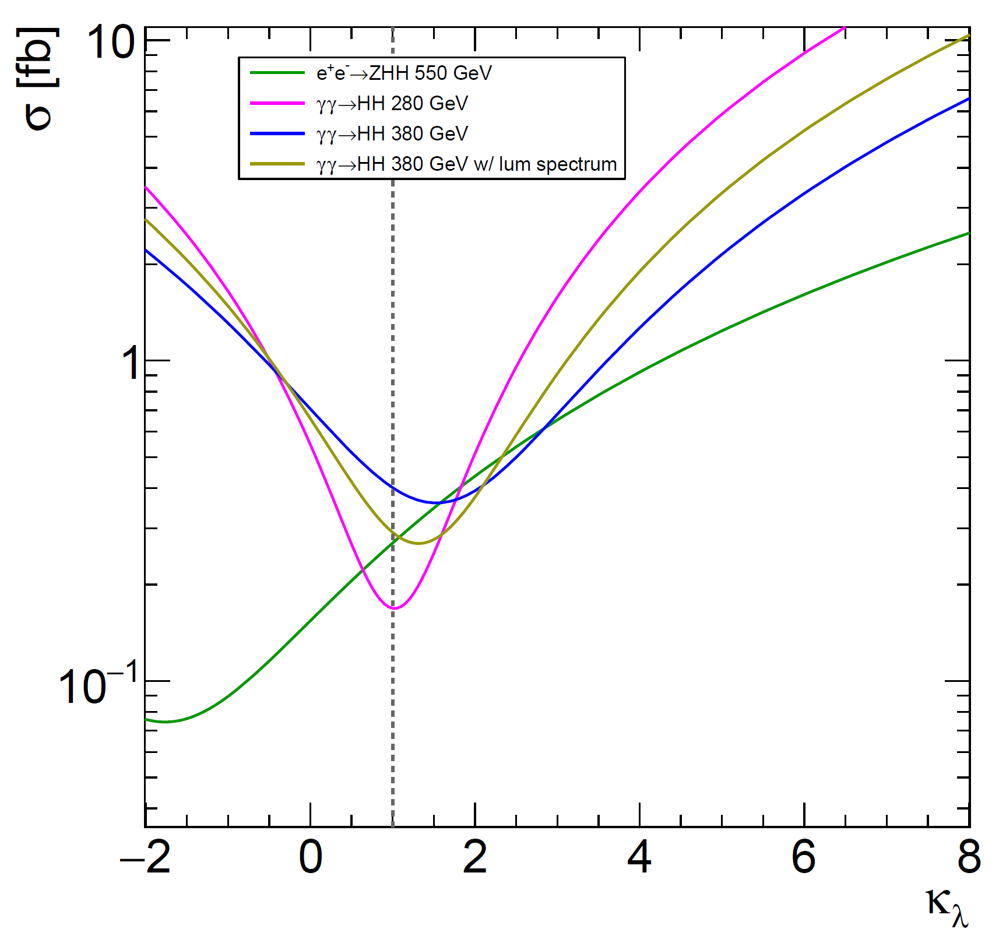

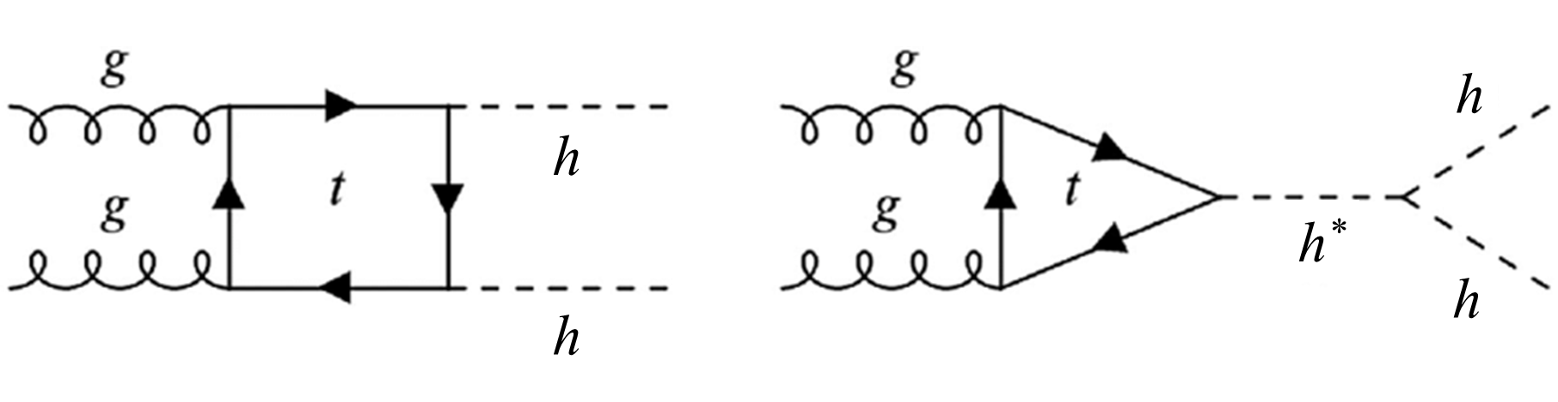
γγ
LHC

Slide 6
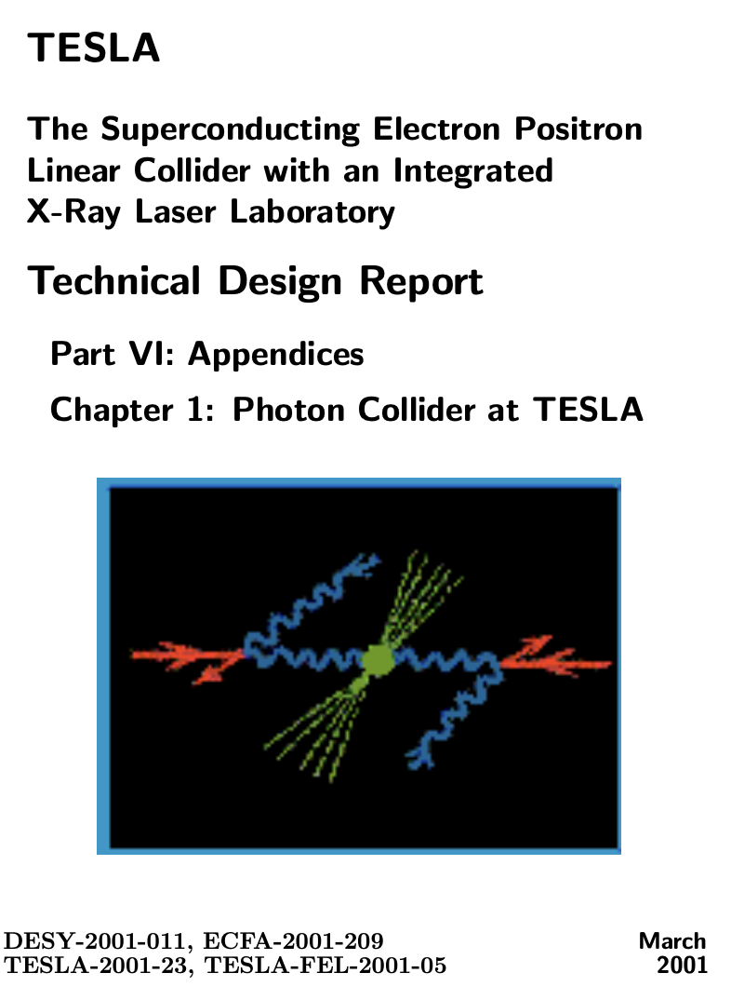
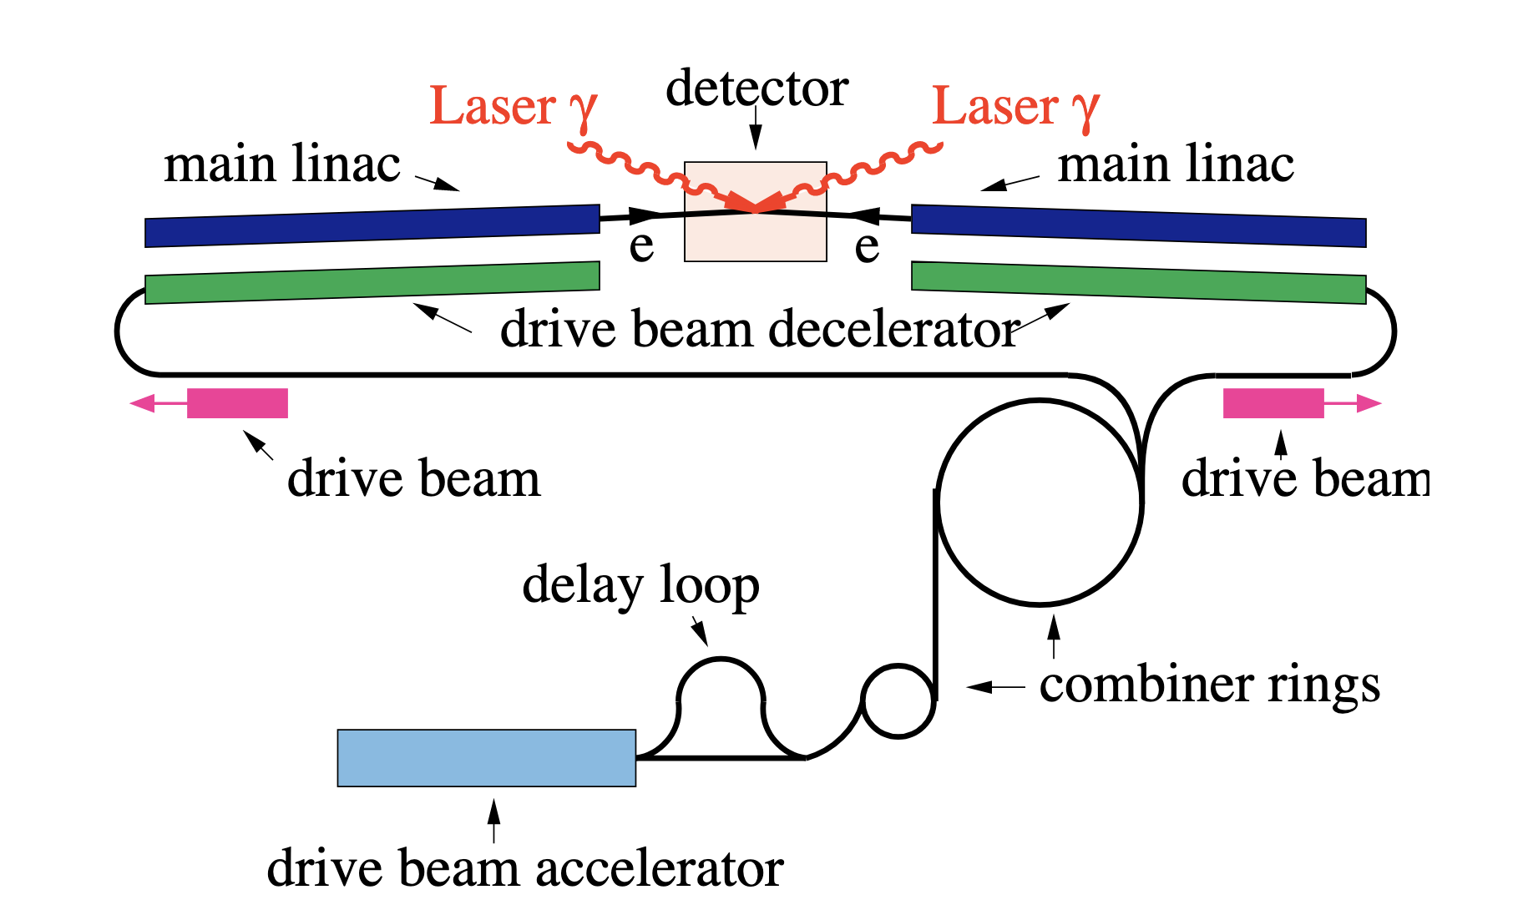
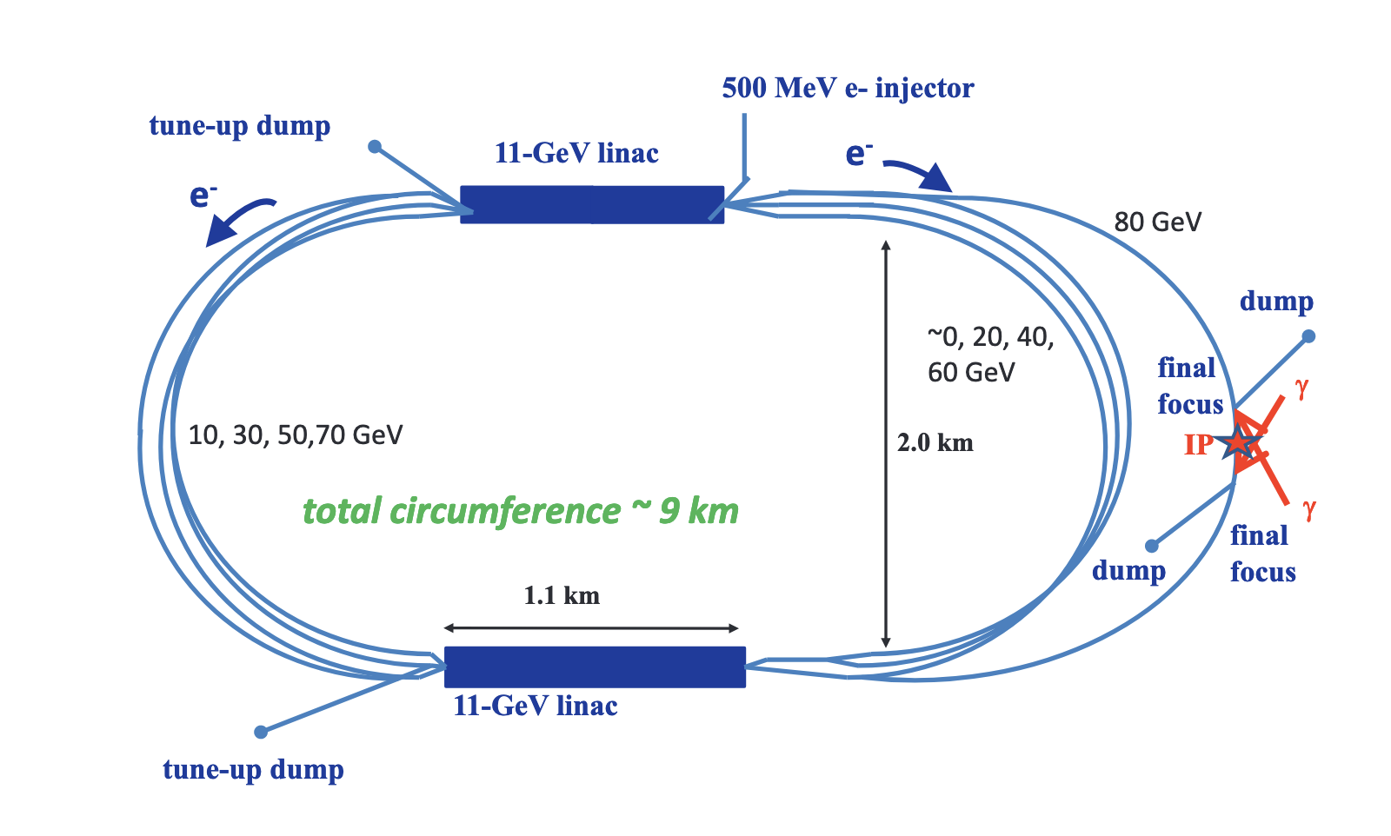
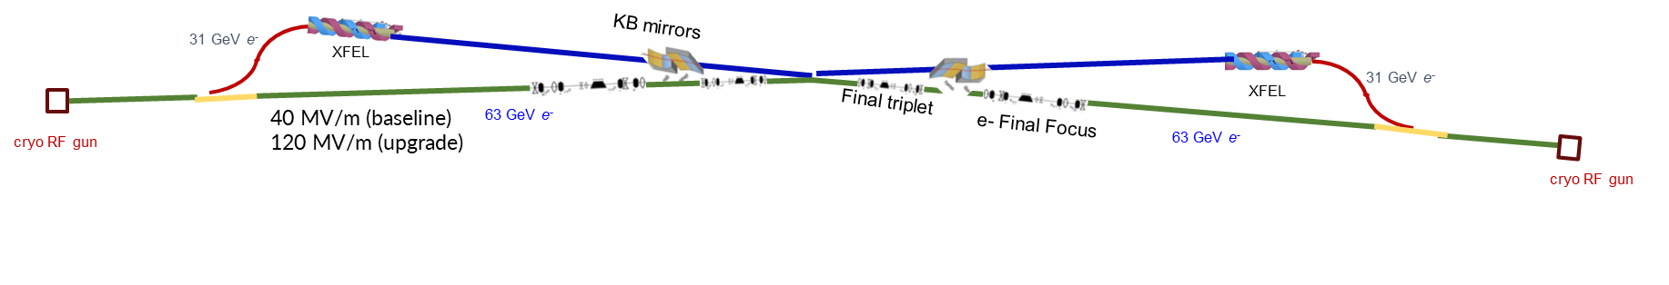
Photon Collider Concepts
Optical photon colliders concepts developed in the 2000’s can produce similar number of Higgs bosons per year than e⁺e⁻, but with higher backgrounds
Recent innovation in photon science, particularly in XFELs can lead to enhanced capabilities
CLICHE
SAPPHiRE
XFEL Compton Collider XCC

Slide 7
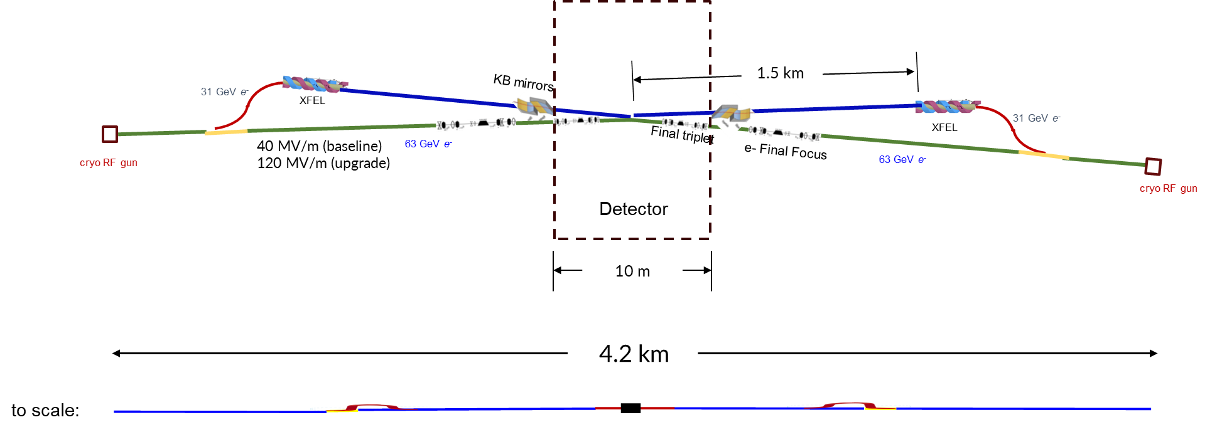
XFEL Compton Collider (XCC) Schematic

Slide 8
Choice of XCC Design Parameters - what value of x ?

Slide 9
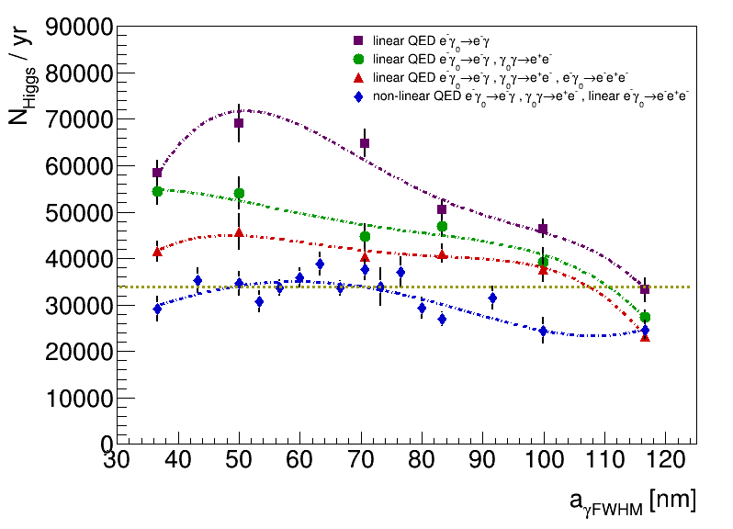
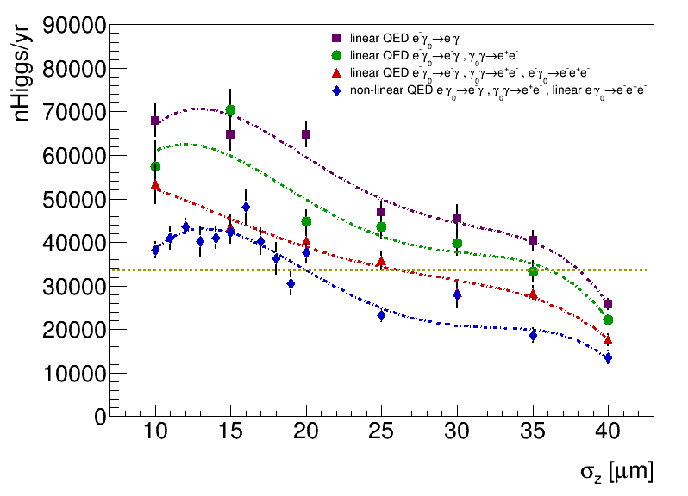
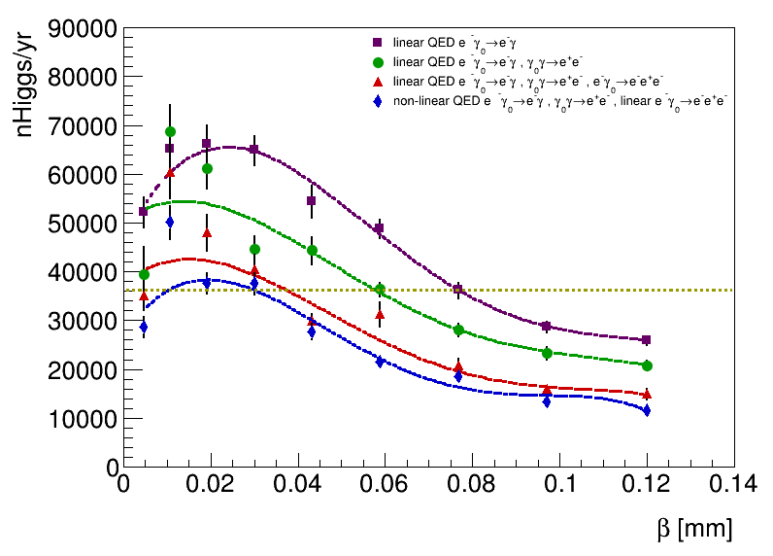
Choice of XCC Design Parameters - laser waist, bunch length , β*, …

Slide 10
XCC Design Parameters, Full Cain Simulation
x=1000, ω₀ =1 keV
Analytical calculation
CAIN MC simulation
beamstrahlung γγ luminosity

Slide 13
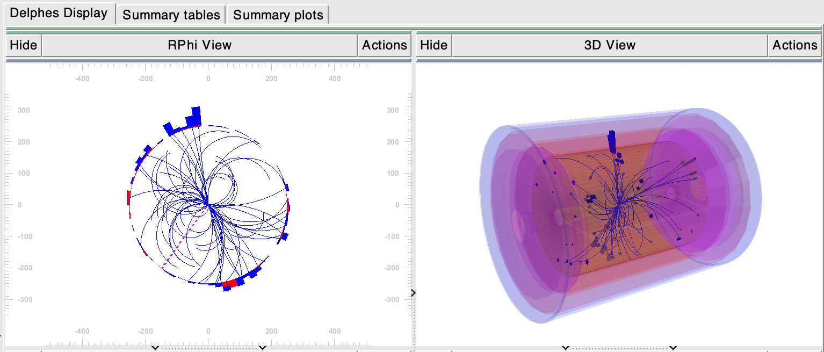
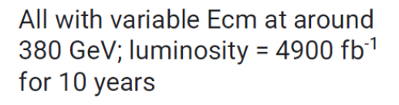
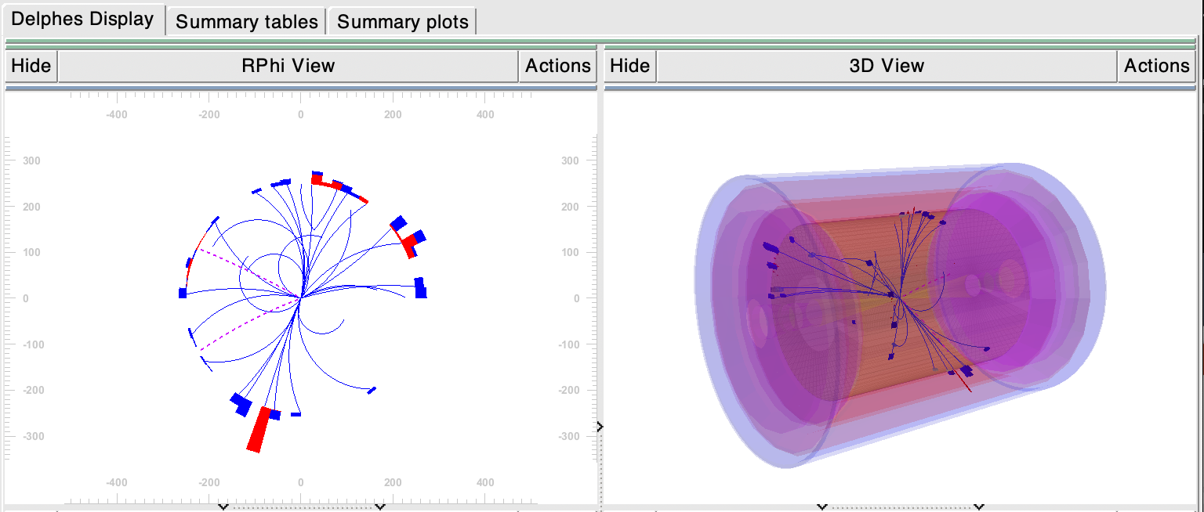

Slide 14
Before NN cuts
After NN cuts
q0
S. Ampudia Castelazo
10.8%
8.5σ

Slide 16
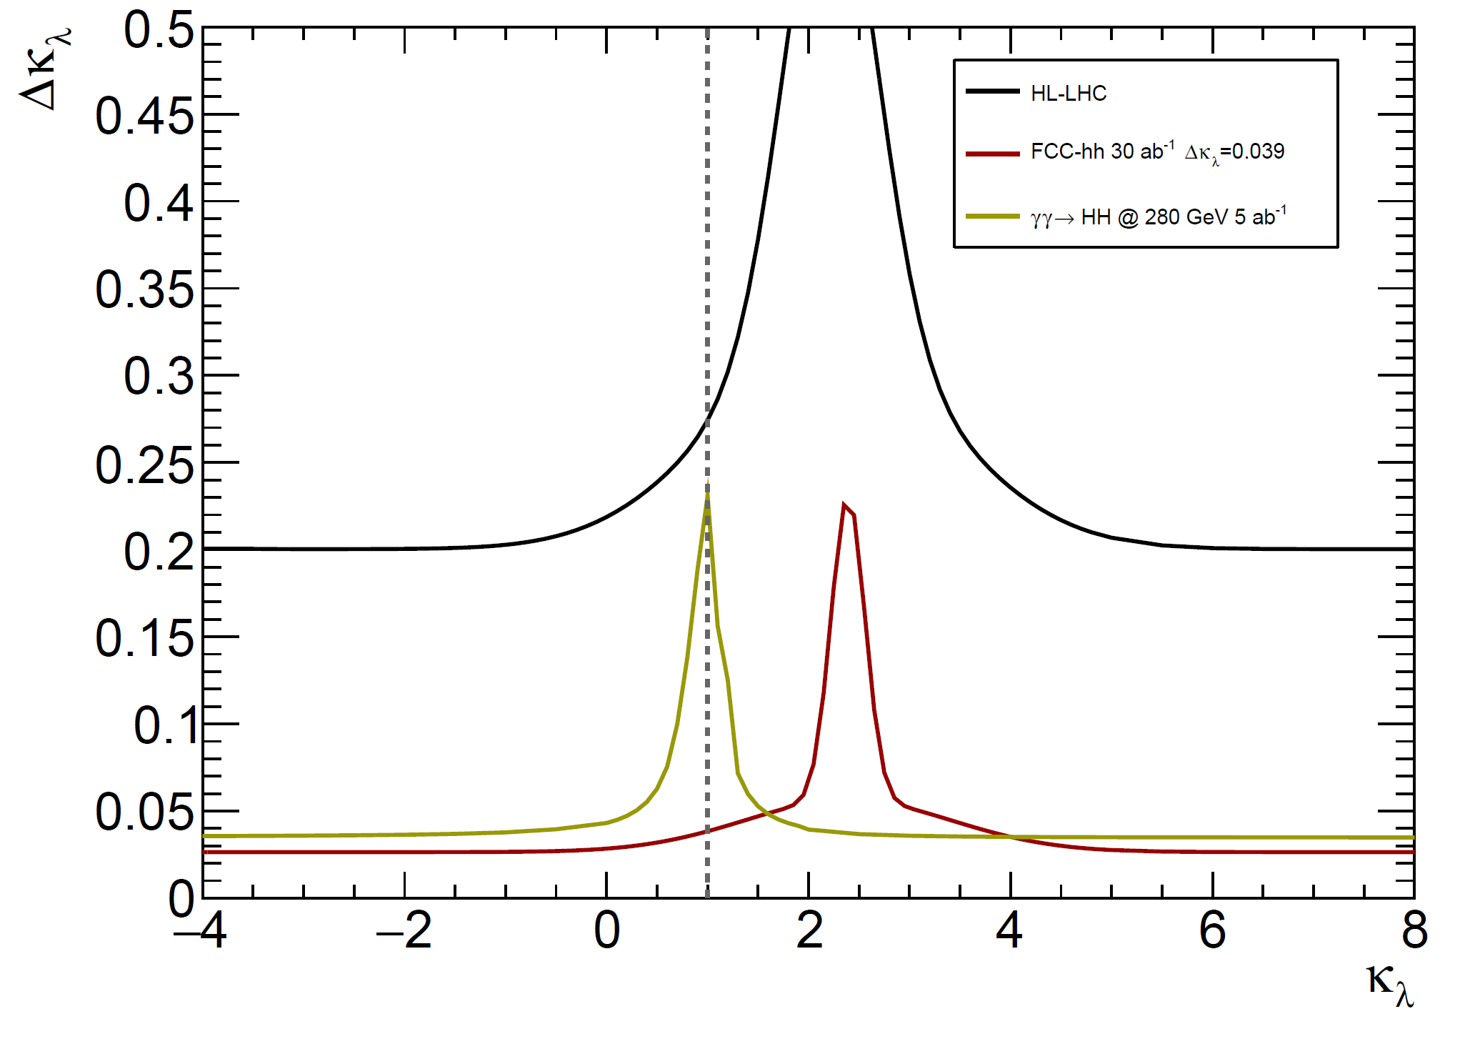

Slide 19
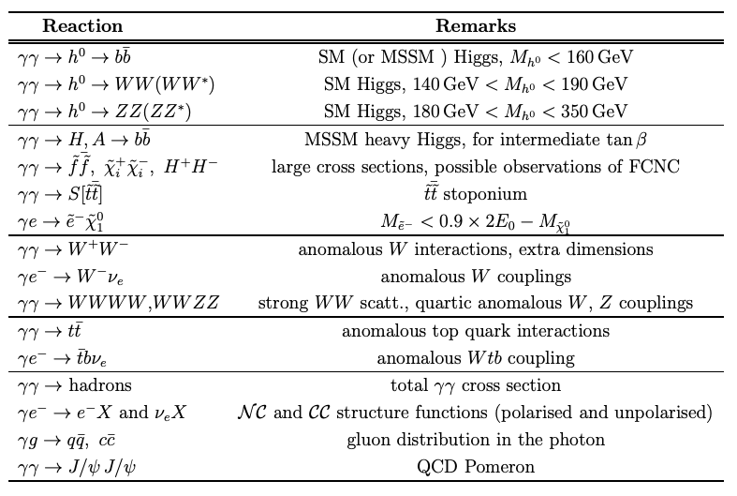
Ability to control the photon polarizations provides a powerful tool for the exploration of CP properties of any single neutral Higgs boson
  The J_{z}=0 ɣɣ initial state can form a CP-even or a CP-odd state using linear polarizations of the laser beams
  CP-even Higgs bosons (h⁰, H⁰) couple to linearly polarized photons with maximum strength for parallel polarisation vectors
  CP-odd Higgs boson (A⁰) couple to linearly polarized photons with perpendicular polarization vectors

Slide 20
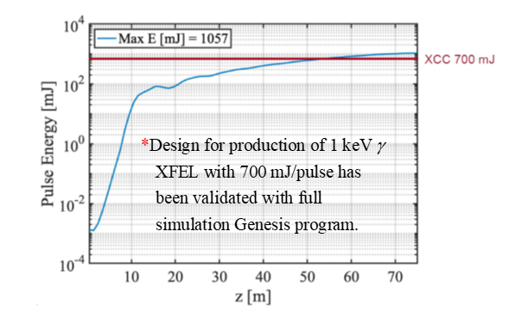
Z. Huang
C. Emma
Aggressive emittance, β* , bunch length
Round beam FF distinct from usual flat FF
And the e- beam must be 80 to 90% pol.
SASE followed by self-seeded section
Helical permanent magnet undulator
Negligible quantum diffusion

Slide 21
Even more aggressive emittance, β* , bunch length.
Unattainable now, but assume can be reached
once 125 GeV design is realized, in spirit of an upgrade
0.5 keV instead of 1 keV photons
1.0 Joule instead of 0.7 Joule
No design yet

Slide 22
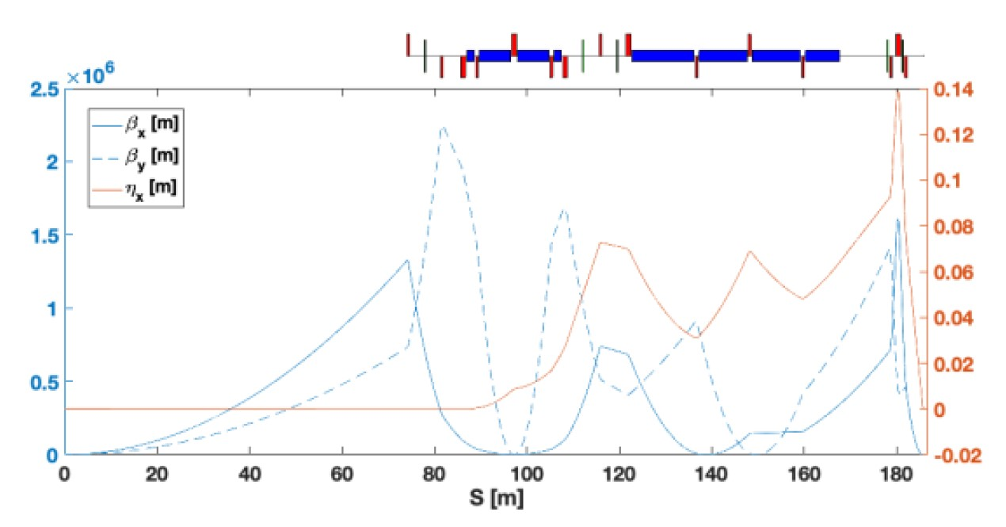
2 x 5 m KB mirrors go here
Photon and e- beampipes merge after last bend magnet
First attempt at XCC round beam FF design
G. White

Slide 23
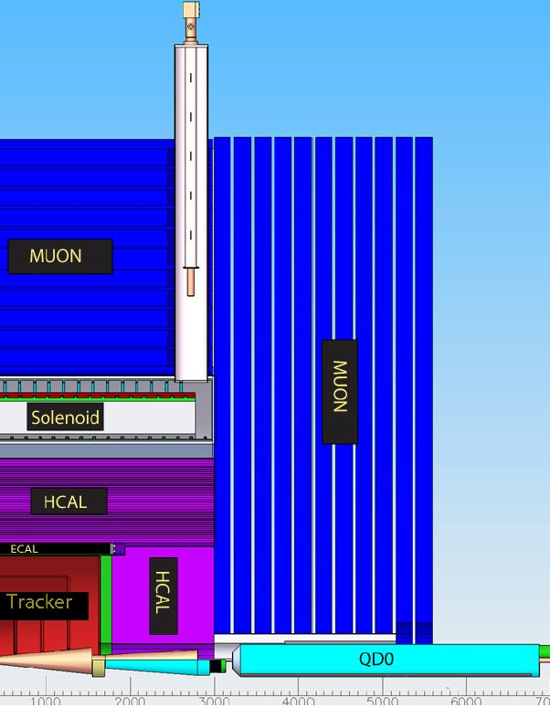
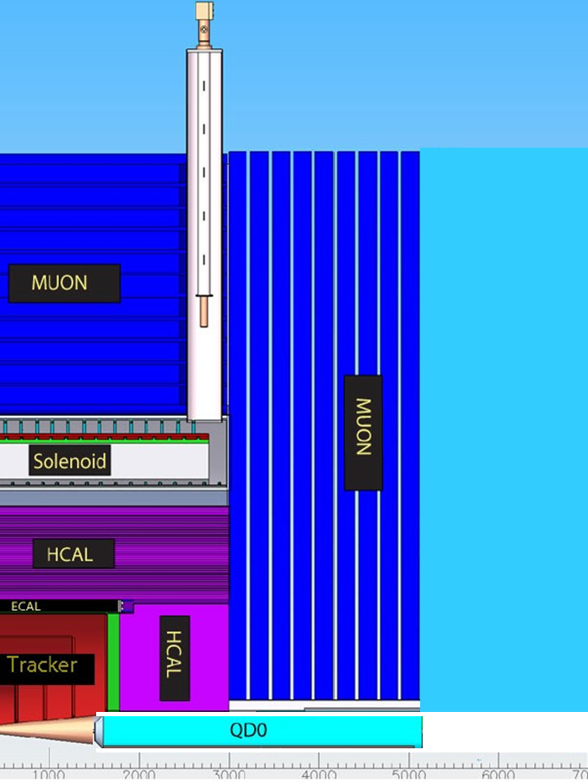
Example beam layout of KB mirror and electron beam final triplet QD0.
This KB mirror example consists of two 5 m long mirrors (one
horiz and one vertical). Mirrors are contained in the KB mirror vacuum chamber with movers and cooling. Electron beam must pass through this chamber(?)
L*=1.5 m + 3.5 m QD0 => 5 m
QD0
KB Mirrors
SX8
23

Slide 24
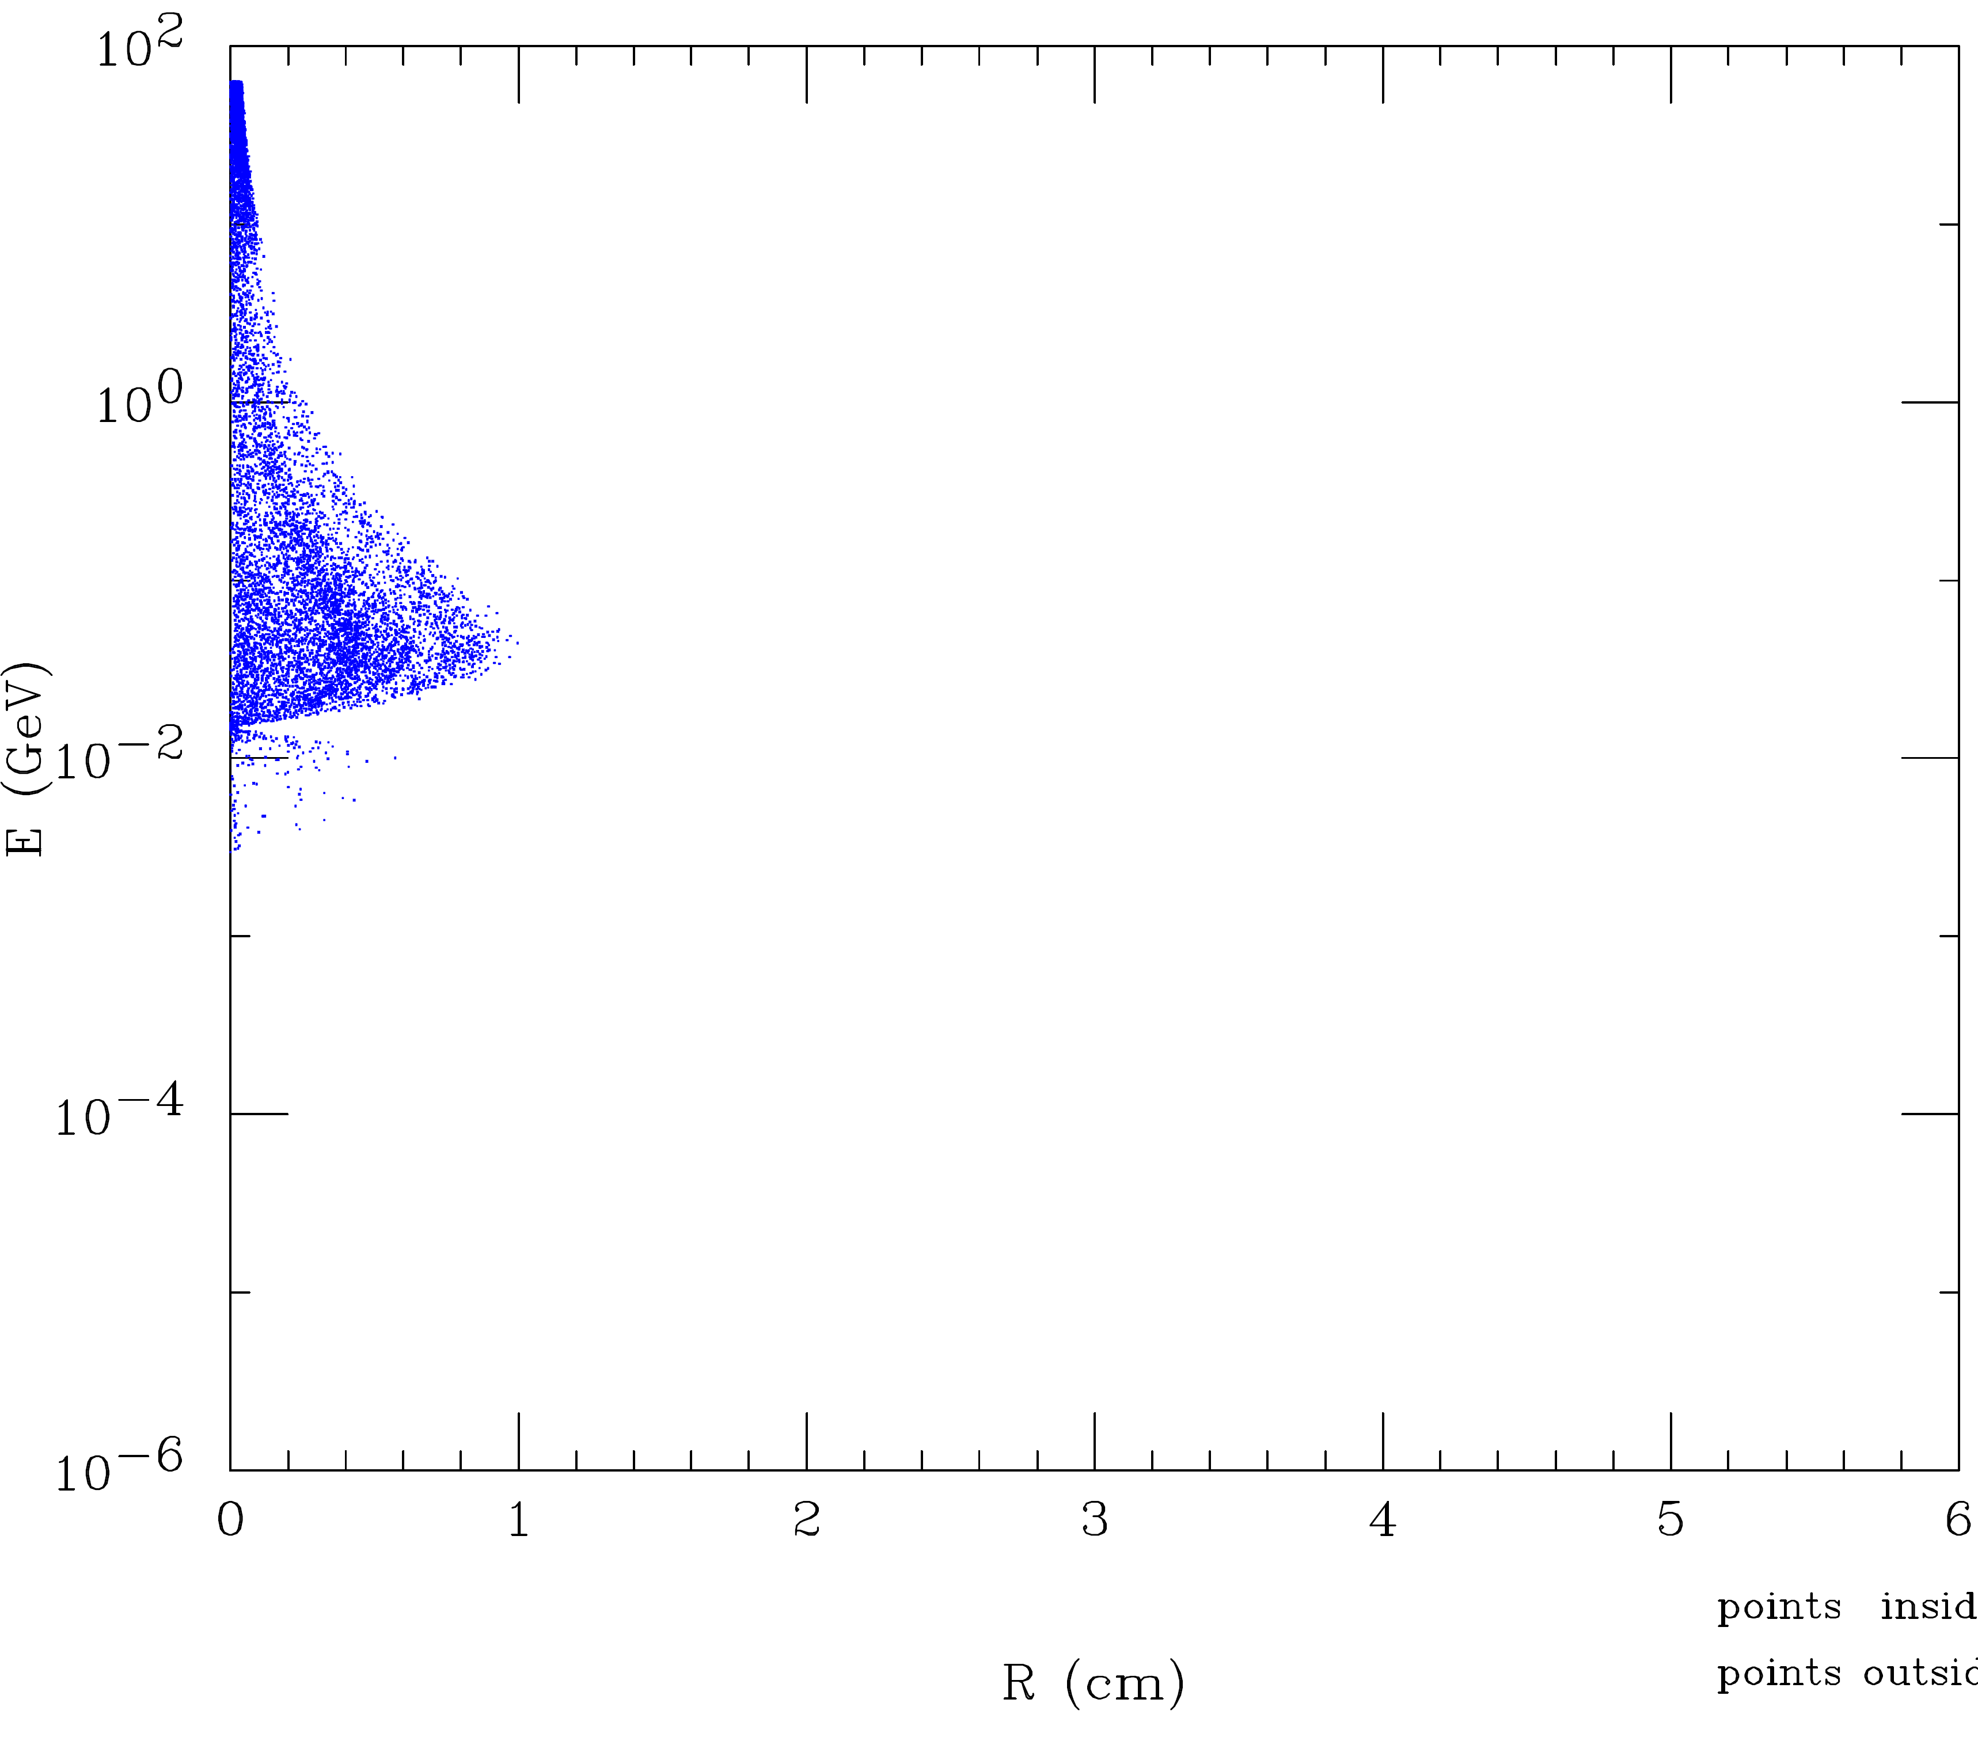
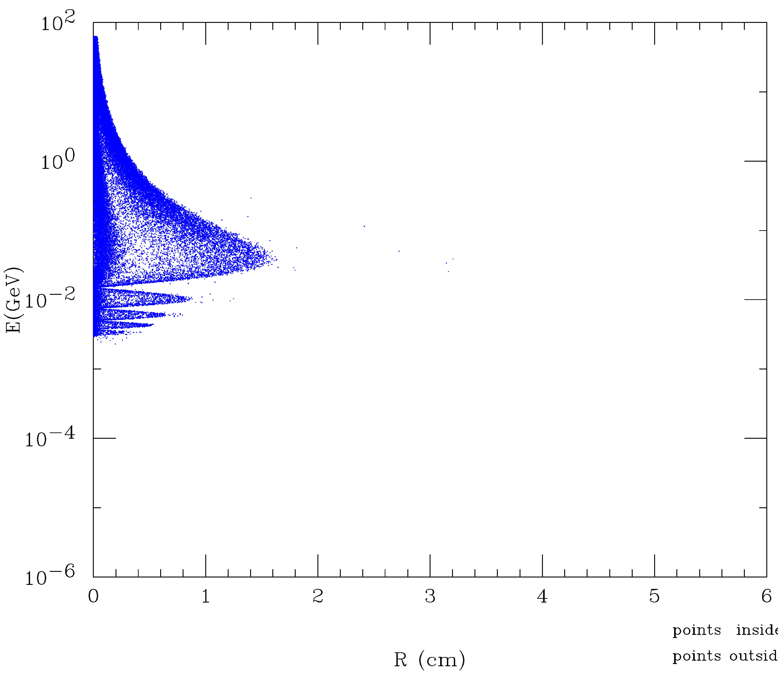
R(cm)
R(cm)
R(cm)
SiD Vtx Inner Rad=1.5 cm
XCC Vtx Inner Rad=1.9 cm
should be OK
R(cm)
R(cm)

Slide 27
XCC Accelerator Challenges
undulator
Table of XCC KB mirror parameters

Slide 28
Mirror Damage Limit (single pulse)
Boron carbide is the highest damage threshold coating and is used for this calculation
Assumes the incident fwhm beam size is ½ the substrate length
No safety factor is included in these calculations – 5-10x below this value should be planned for
Calculation is weakly dependent on incident angle below the mirror cutoff (0.3 deg AOI used)
A large mirror (> 1 m) is needed to survive ~ 1 J pulse energies

Slide 29
Mirror Reflectivity

Slide 30
X-ray Focusing summary following initial study
Large mirrors (> 1 m) are needed for 1 J per pulse energy
  1 m FEL quality substrates produced today
  1.5 m substrates produced for synchrotrons
  > 1 m FEL quality substrates would require development with industry but not R&D
> 1 km source to KB optic distance is desirable
FEL average power is a new regime (6.5 kW)
  This requires an engineering study
  Very grazing angles help since the most straight forward approach is to absorb less in the substrate
  Another reason to consider beyond state-of-the-art substrates sizes (e.g. 2 m or beyond)

Slide 31
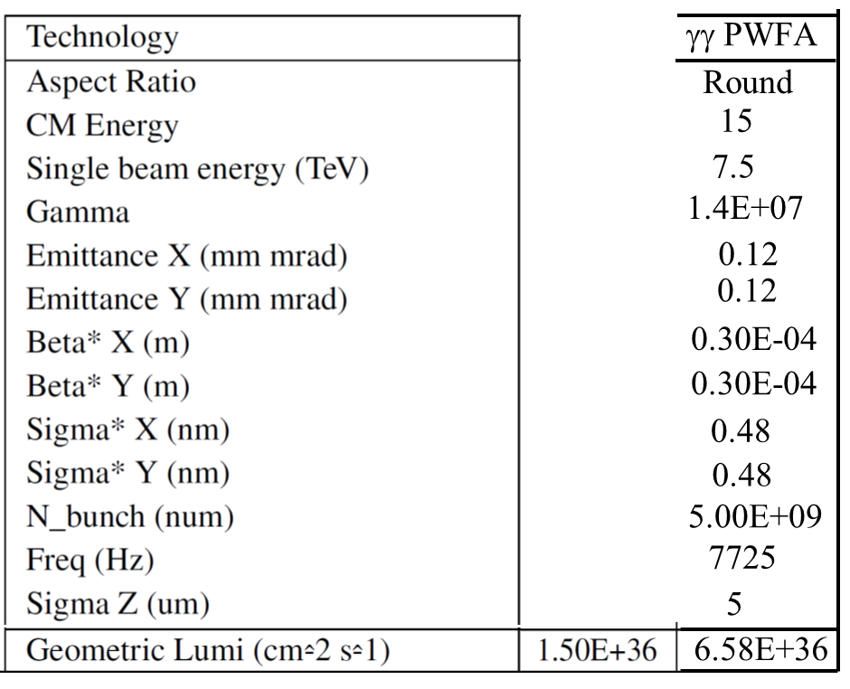
Replace 62.5 GeV e- beam w/ 5000 GeV WFA e- beam and simulate γγ Collisions using CAIN MC
PWFA parameters & β*=0.030 mm
LWFA parameters & β*=0.100 mm
10.0
5.0
1.0E+07
0.61
0.61
Note: a lot of the discussion that follows uses examples with Ecm=15 TeV

Slide 32
x=4.8 adjust parameters to get ~ 100 % conversion w/ linear QED
Start with β* = 0.030 mm parameter set

Slide 33
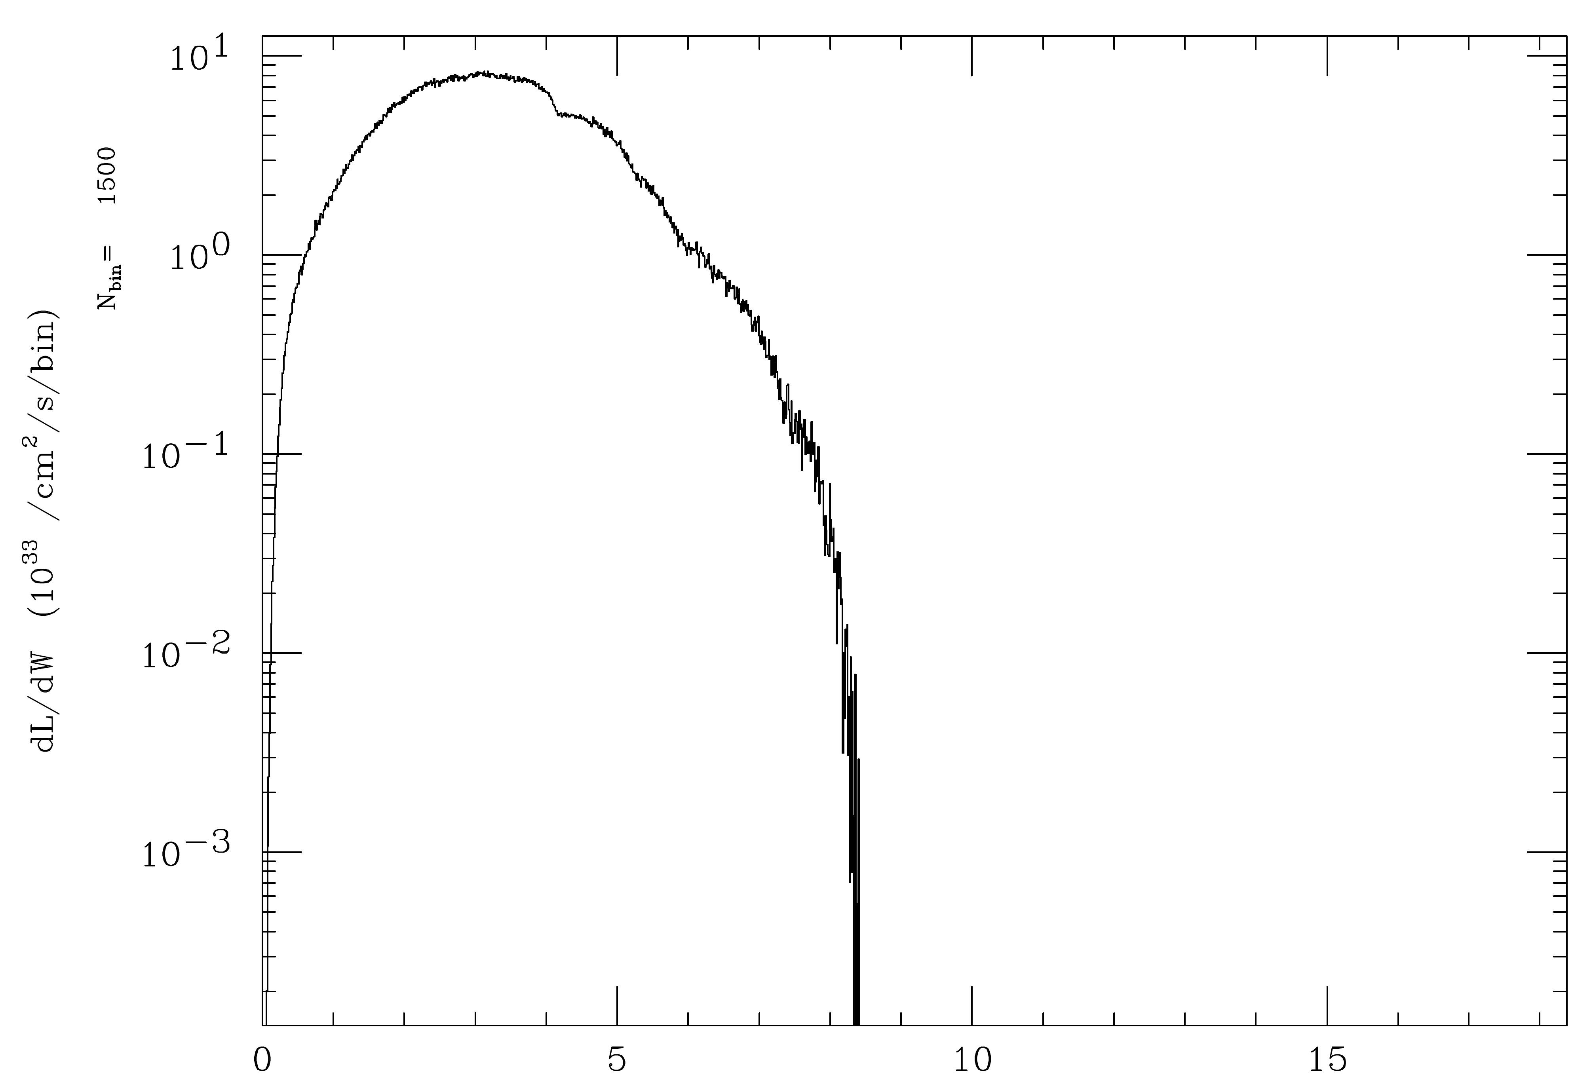
x=4.8 , parameters with ~ 100 % conversion w/ linear QED
E_{γγ} (TeV)
E_{γγ} (TeV)

Slide 34
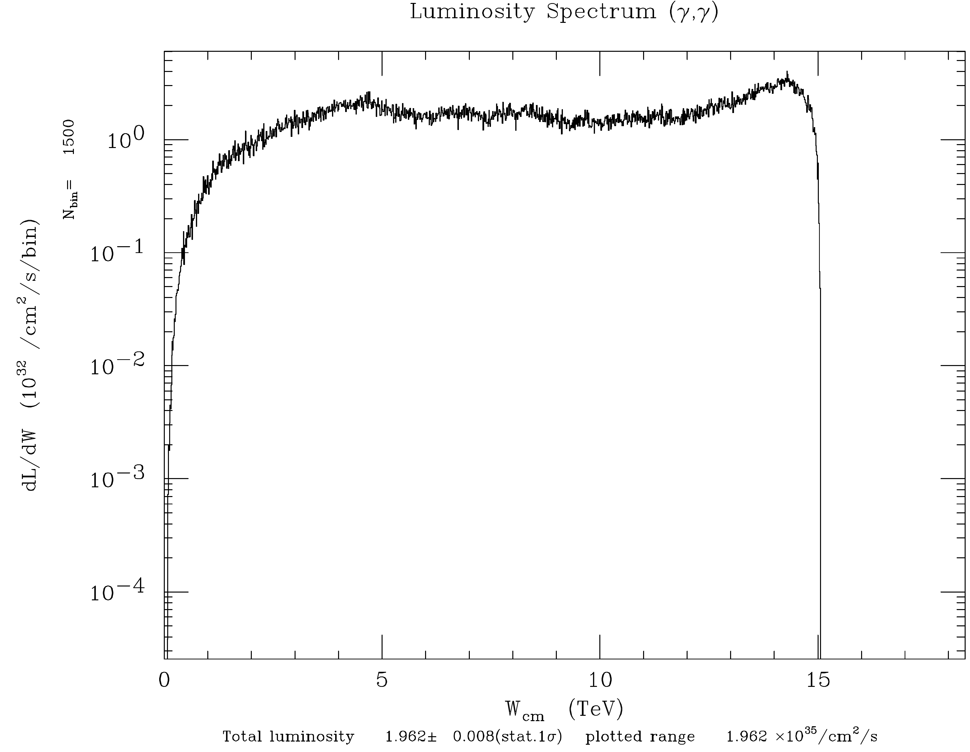
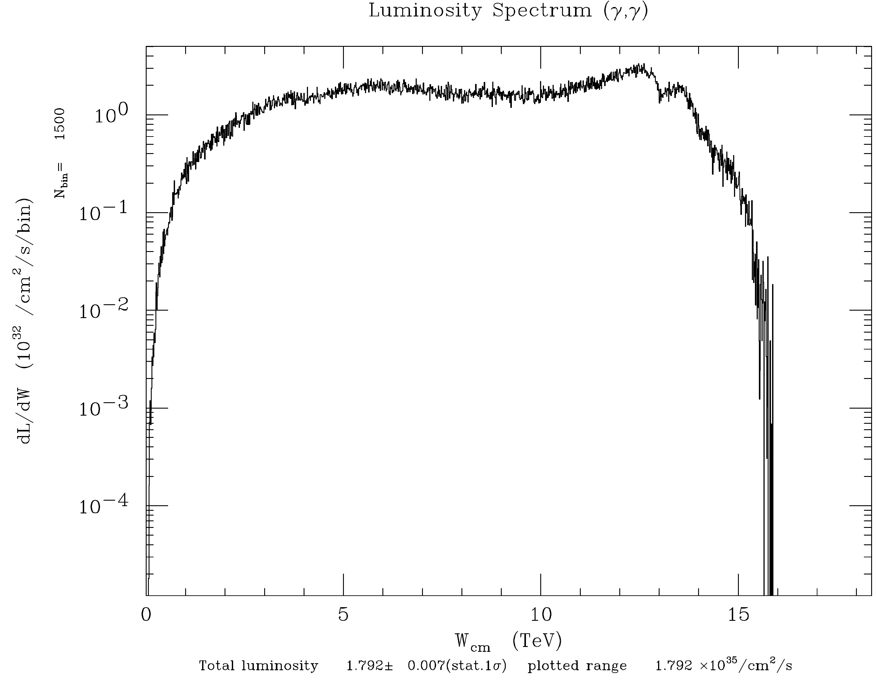
x=4.8 dial back E_{pulse} to get ξ² < 1
E_{γγ} (TeV)
E_{γγ} (TeV)

Slide 35
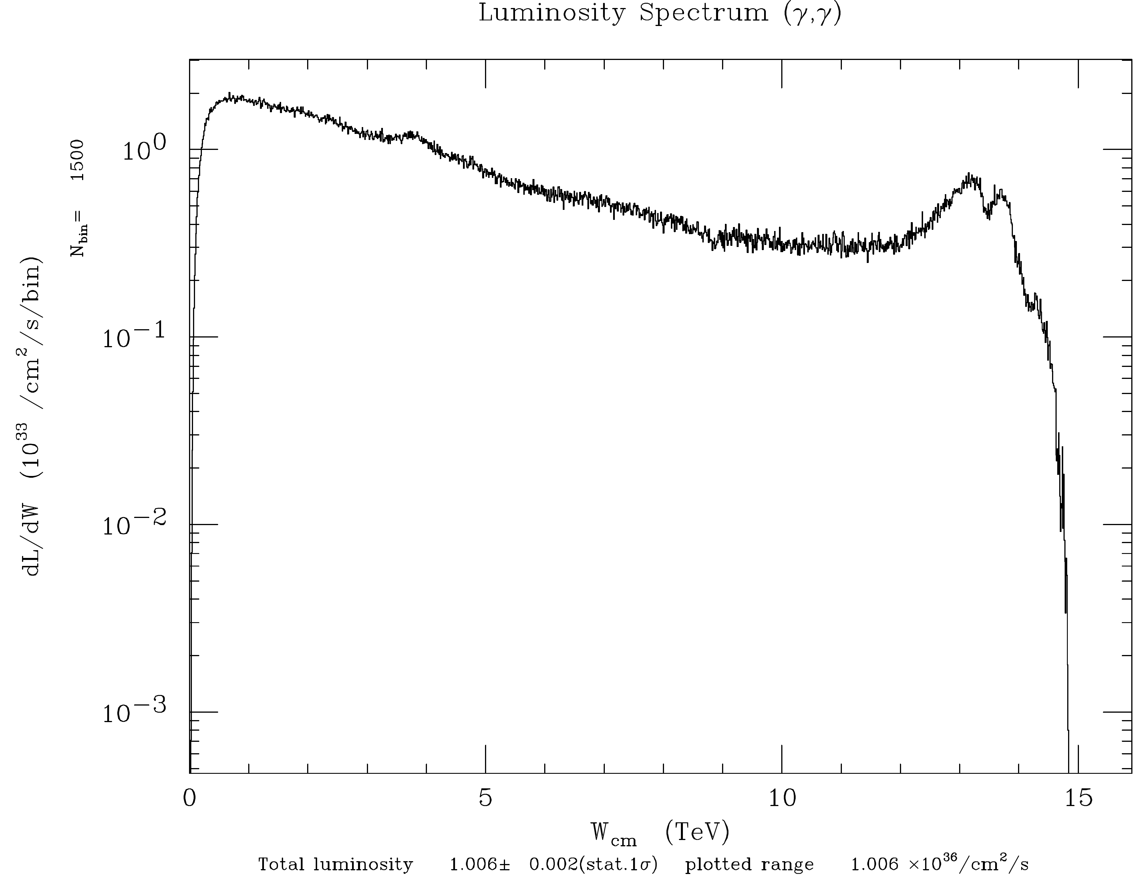
Try x=40 to get more of a peak in the spectrum
v05617
E_{γγ} (TeV)
E_{γγ} (TeV)

Slide 36
15 TeV and x=40 Turn on coherent processes
Halfway through the collision CAIN complains:
(SUBR.COHPAR) Algorithm of coherent pair generation wrong.
Call the programmer prob,pmaxco= 8.309E-01 8.000E-01
Solution:
number of macro particles produced per coherent beamstrahlung photon = 1 → 0.01
number of pairs of macro particles produced per coherent e+e- pair = 1 → 0.0001
number of macro particles produced per incoherent particle = 1 → 0.01

Slide 37
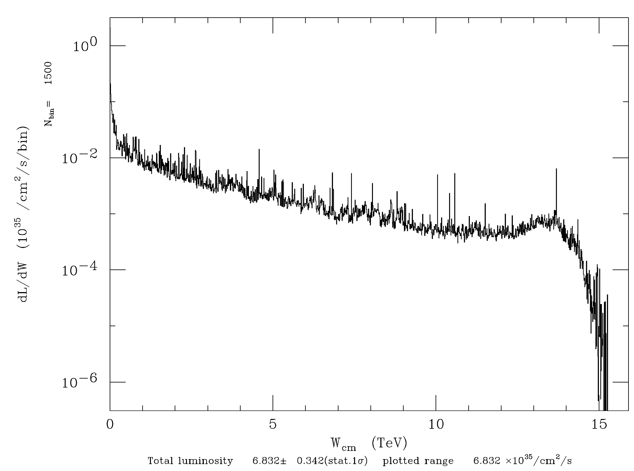
15 TeV and x=40 Turn on coherent processes
v05617
v05706
E_{γγ} (TeV)
E_{γγ} (TeV)
Coherent pair production eats up the 7.5 TeV photons and produces many e+ that pinch the e- beam leading to higher fields and even more coherent pair production.

Slide 38
e⁻ γ collisions at E_{eγ}=140 GeV I.P. geometric e⁻ σ_{x},σ_{y}=5.1 nm
N_{e-} in 3.3 μm slice
N_{e-} in 3.3 μm slice
N_{e+} in 3.3 μm slice
N_{e+} in 3.3 μm slice

Slide 39
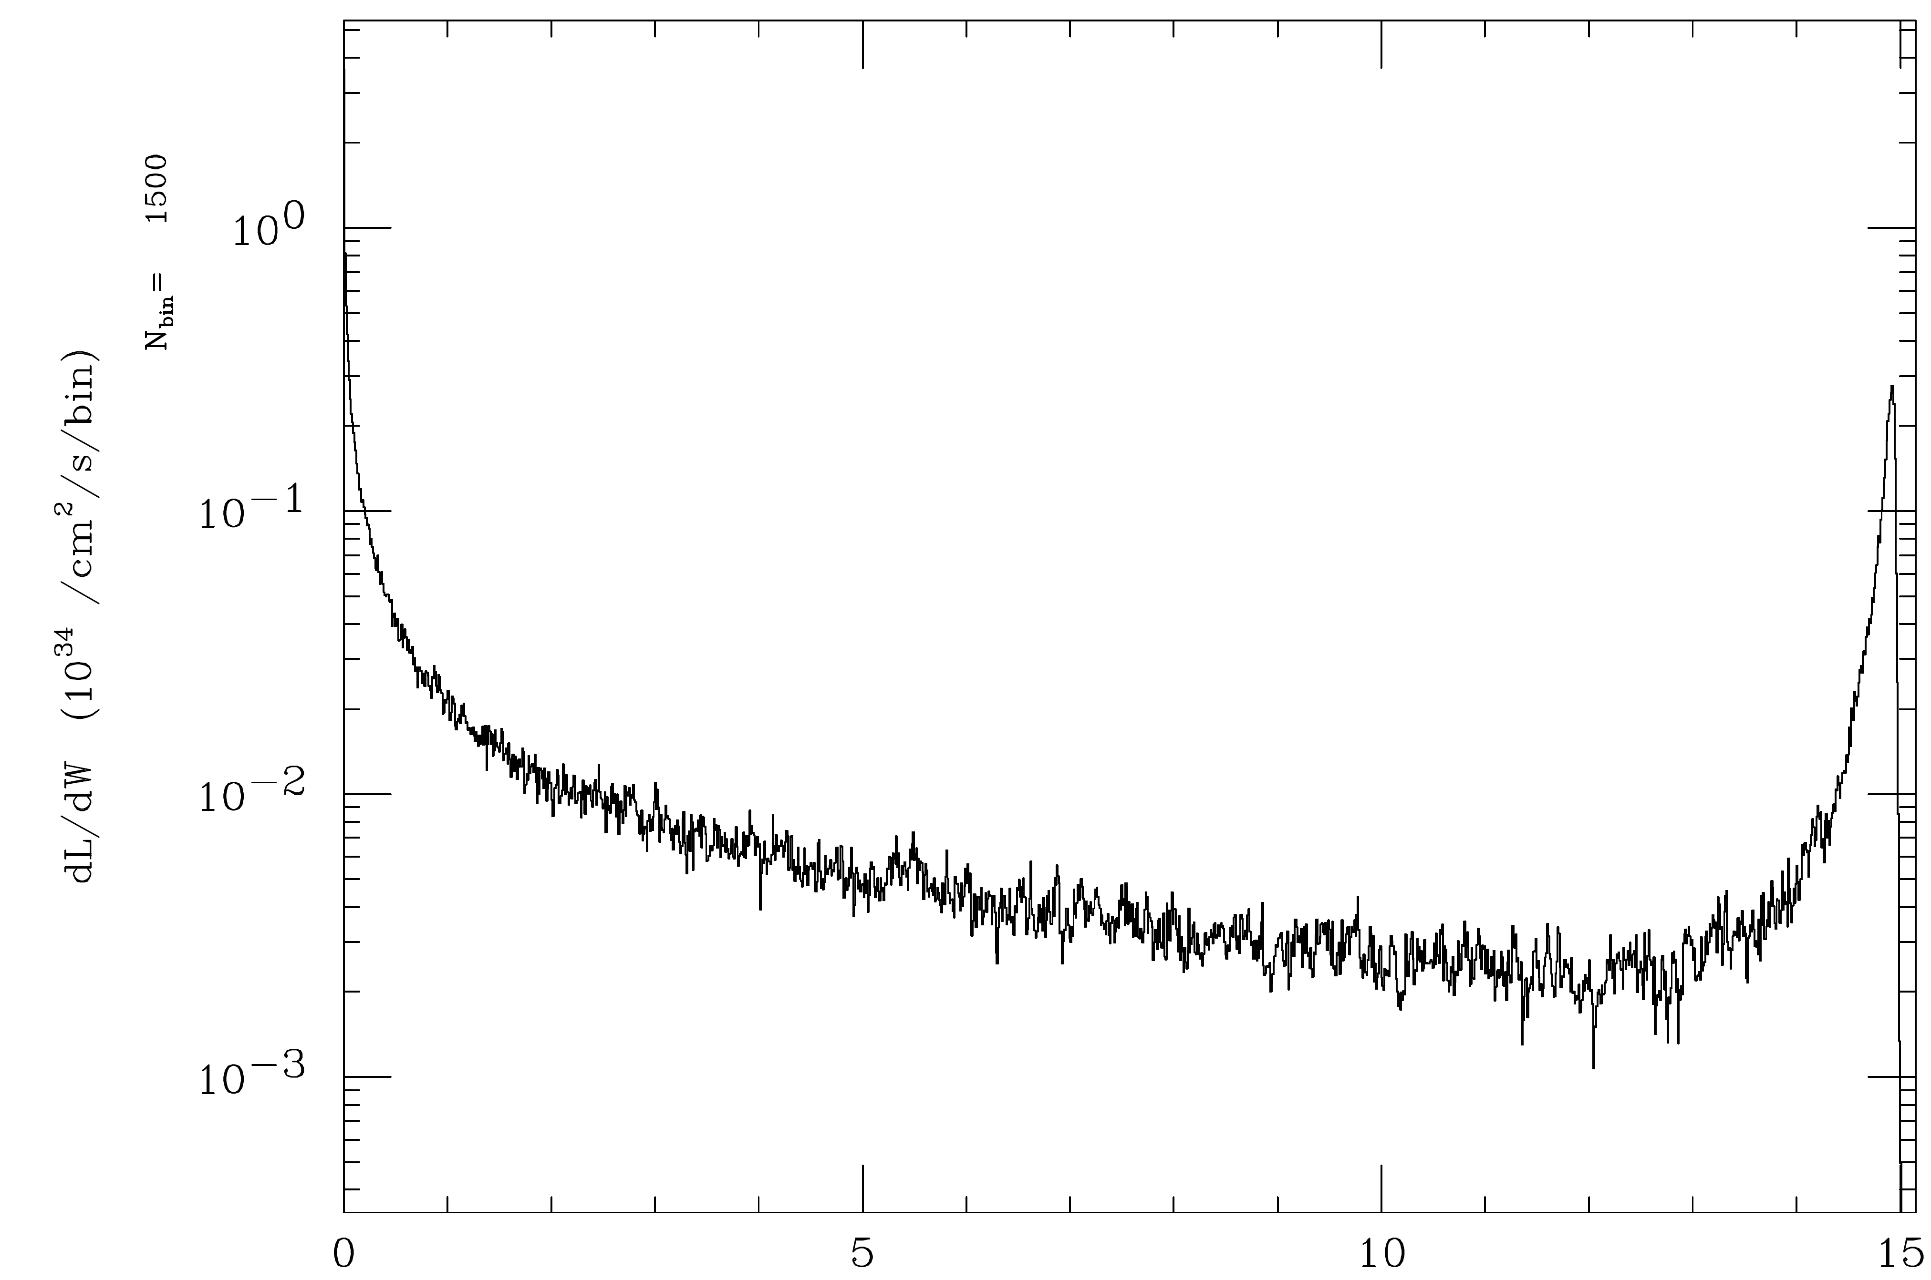
x=1.2x10⁵ (1 keV γ) not affected as much by coherent processes
v06311
v05706
E_{γγ} (TeV)
E_{γγ} (TeV)

Slide 40
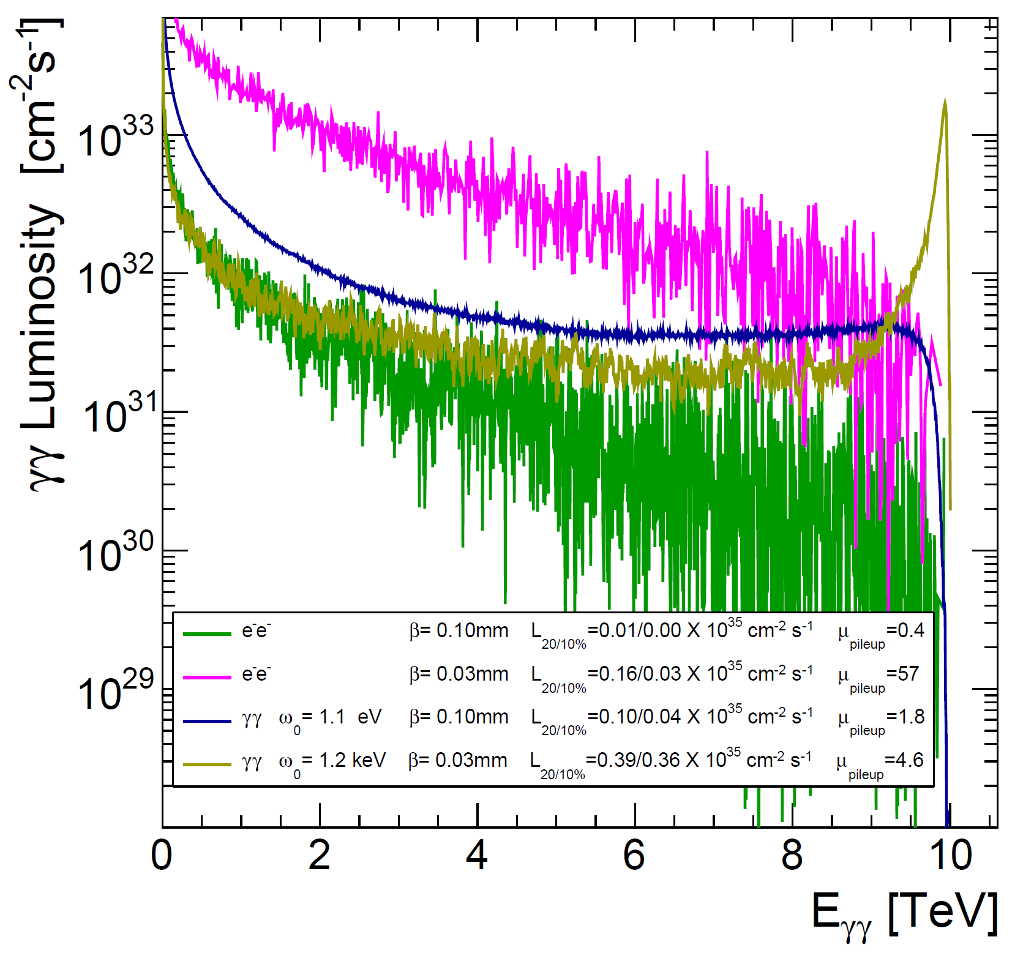

Slide 41
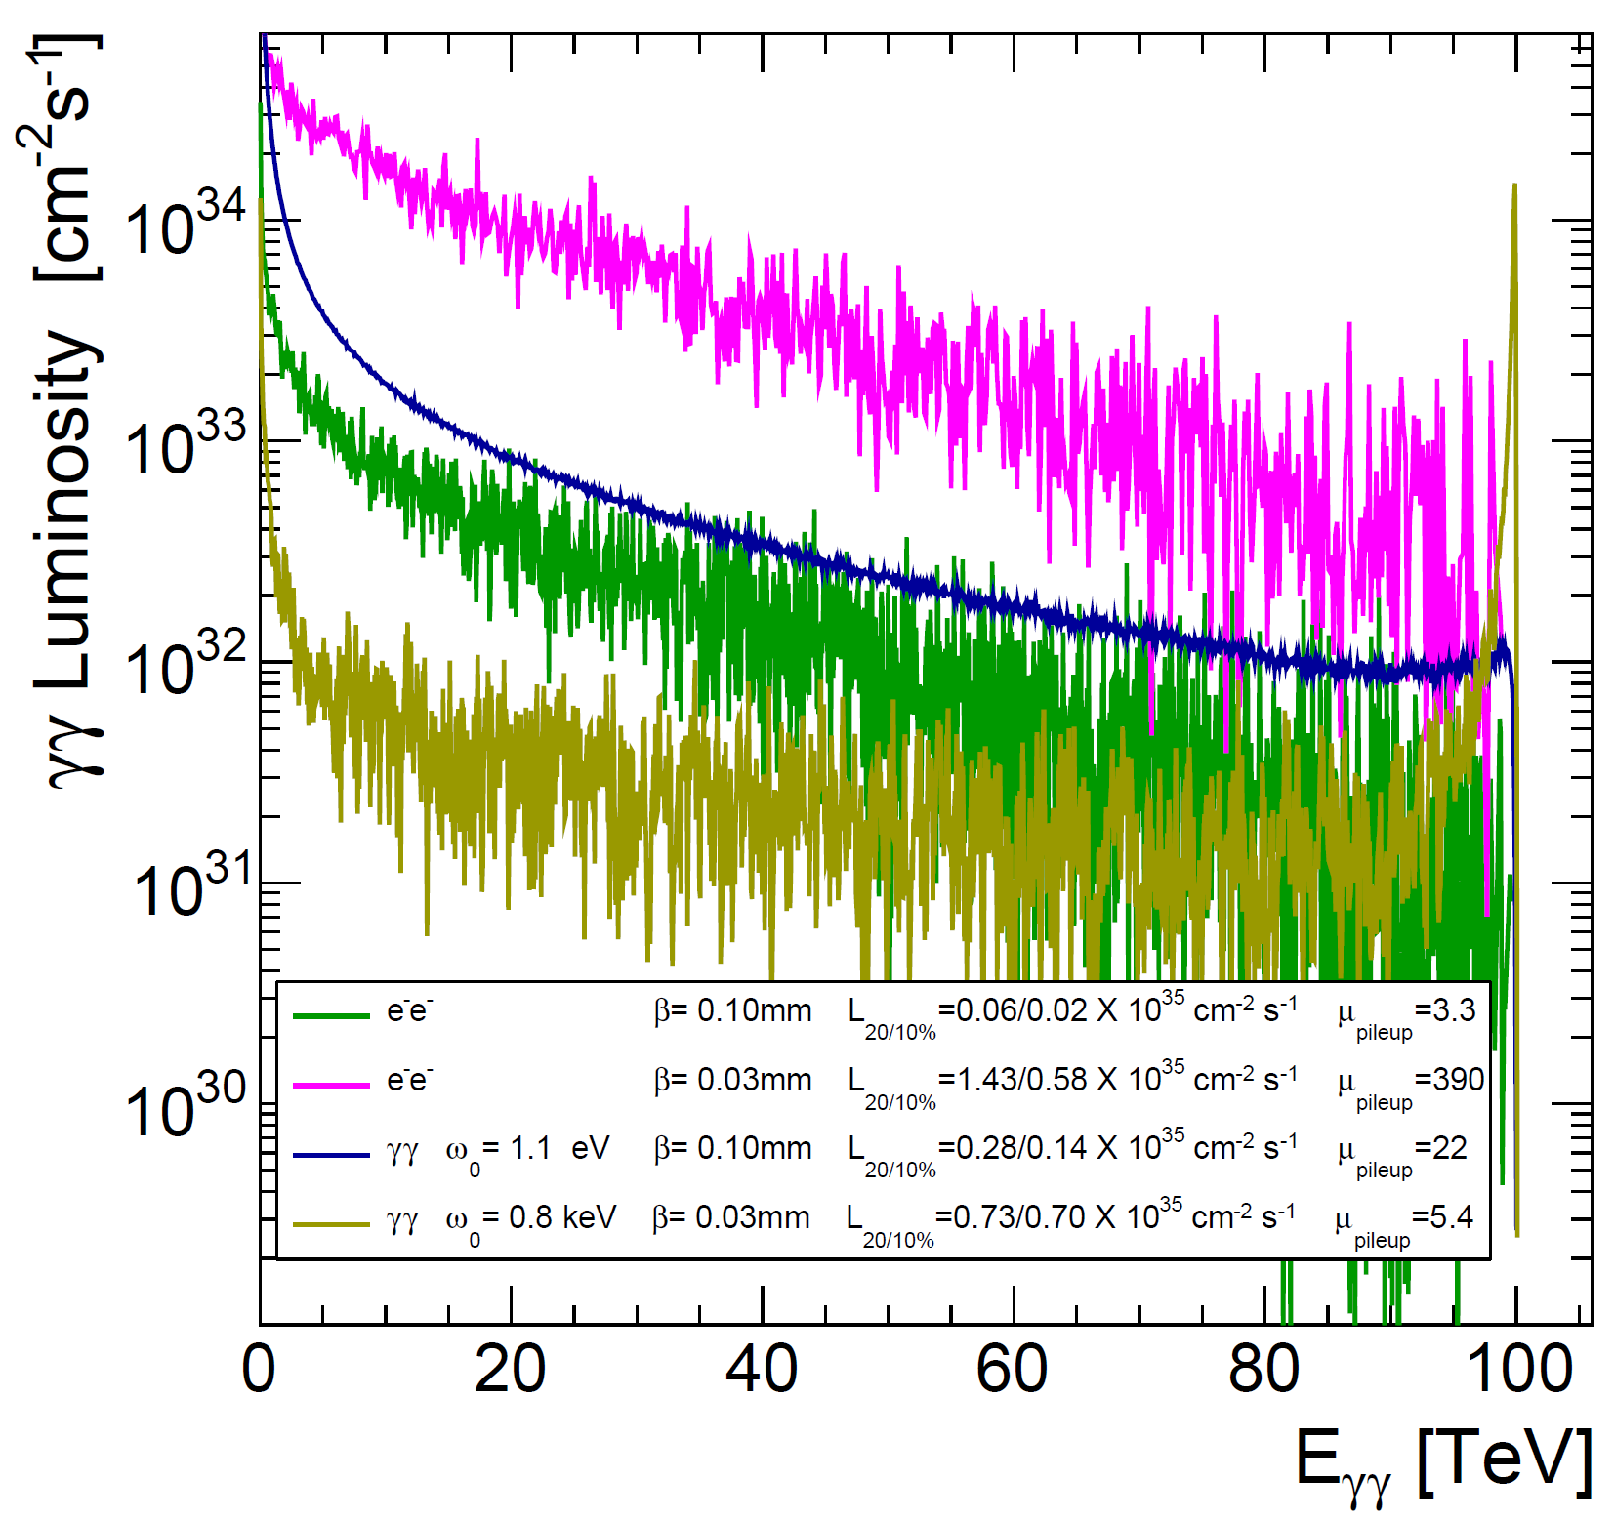

Slide 42
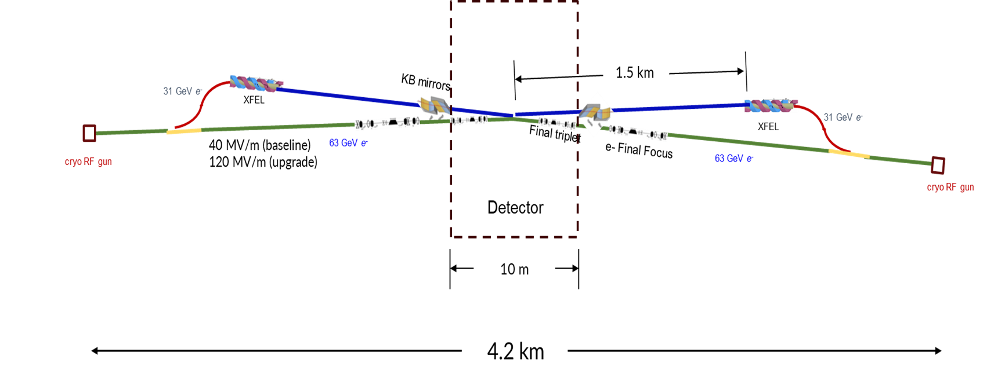
Summary

Slide 43
ɣɣ-Collider Path
Complete Higgs Factory Program, Comparable to ILC, LCF
125 GeV
280/380 GeV
10 TeV
Standalone project (XCC)
Second interaction region of a linear collider facility at CERN (LCVISION proposal to European Strategy)
Future 10 TeV plasma wakefield collider

Slide 44
Backup

Slide 45
v06311
E_{γγ} (TeV)

Slide 47
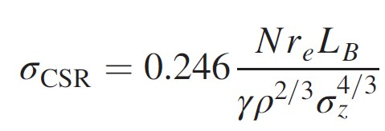
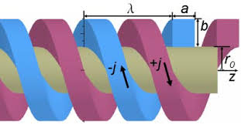
Trombone-like configuration for extraction line
Should also check incoherent
synchrotron radiation
CV
CV
CV
CV
CV
1.4 km
KB mirrors
ξ
CV
Y
ρ
Final triplet
2 mrad
e- Final Focus
L
k
k = Gap in Linac
L = distance from end of Linac Gap to start of undulator
(projected onto Linac axis)
Detector
10 m
Phys. Rev. Accel. Beams 24.8 (2021), p. 080701.

Slide 48
TESLA TDR, Part VI, Chapter 1: The Photon Collider at TESLA

Slide 49
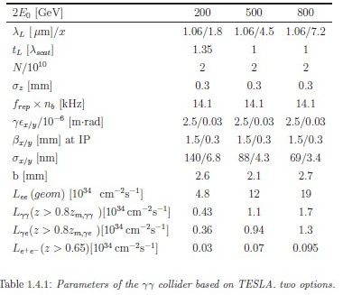
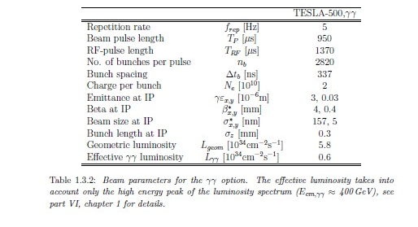
Let’s check this with CAIN. Calculate energy incident on 6 cm dia. cryostat at L*=3m.
Assume 6 cm dia cryostat

Slide 50
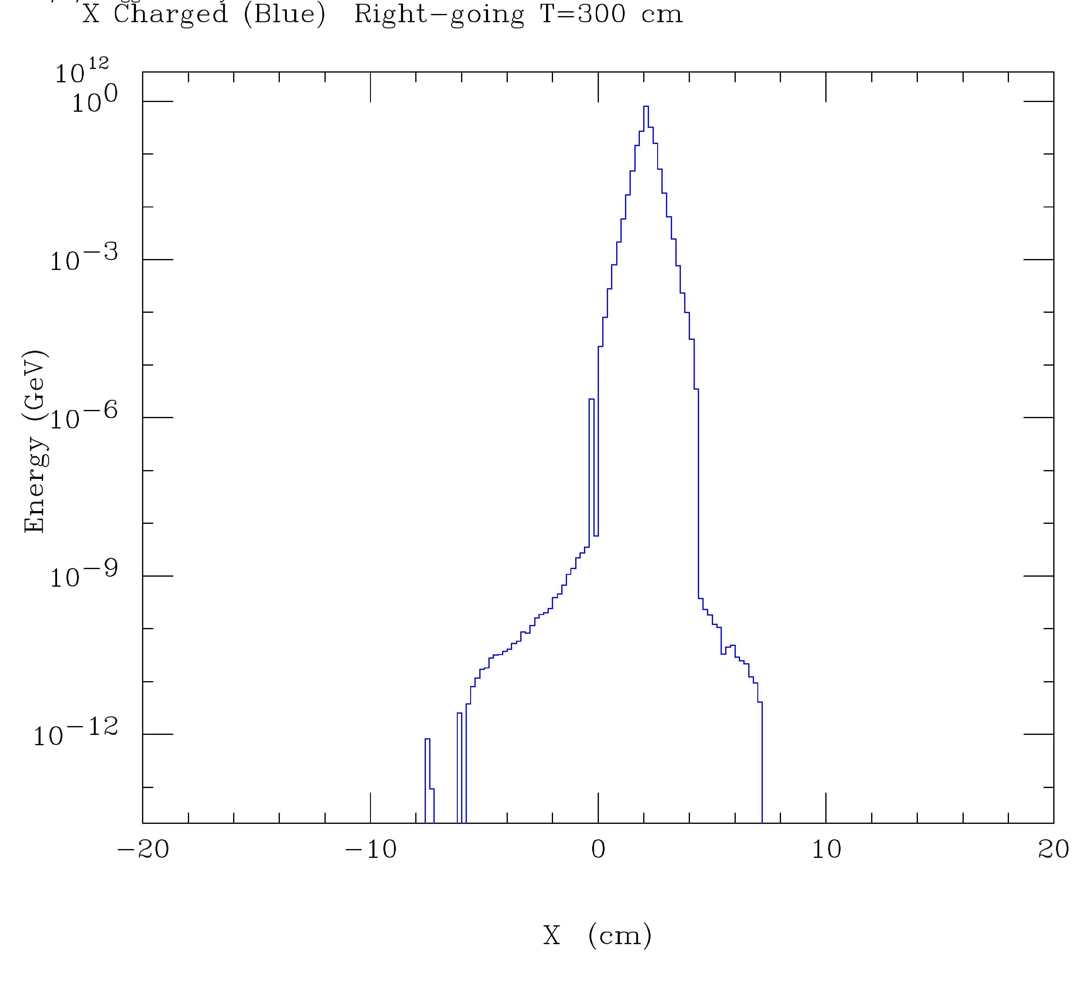
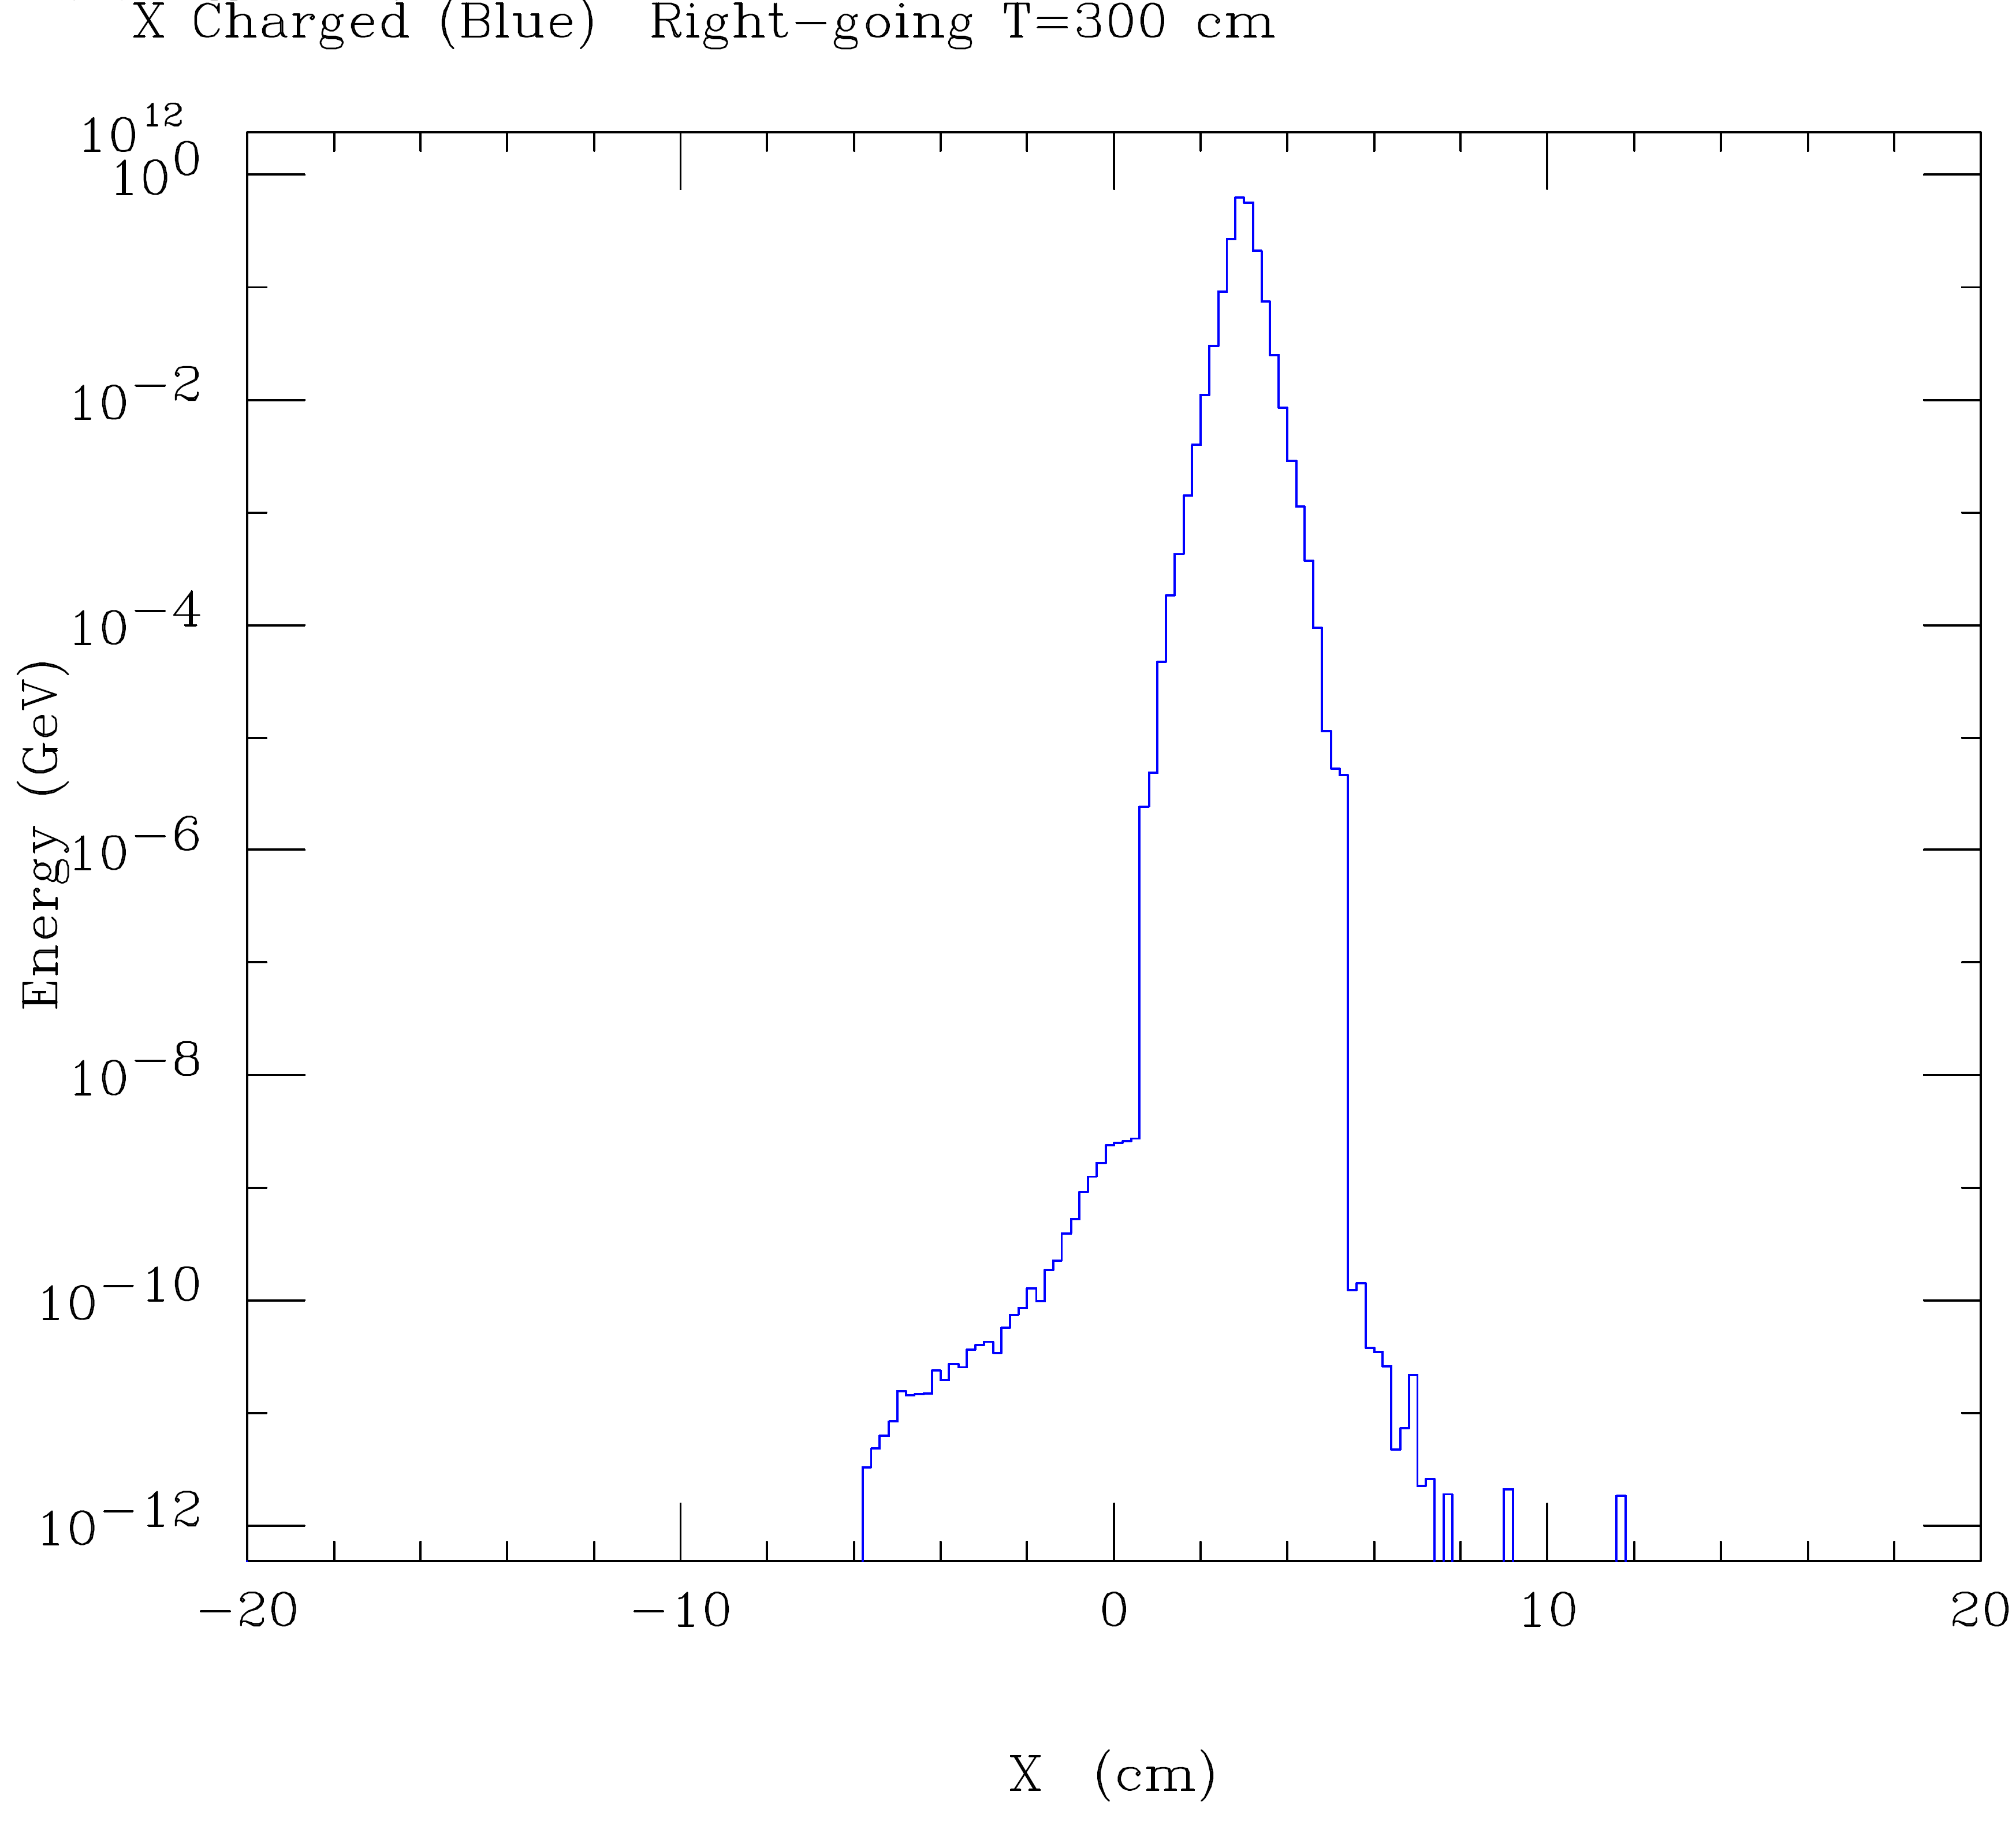
v06801
v06804
Assuming only few Watts on QD0 is tolerable, we conclude that 14 mrad is insufficient and 20 mrad is the minimum crossing angle.

Slide 51
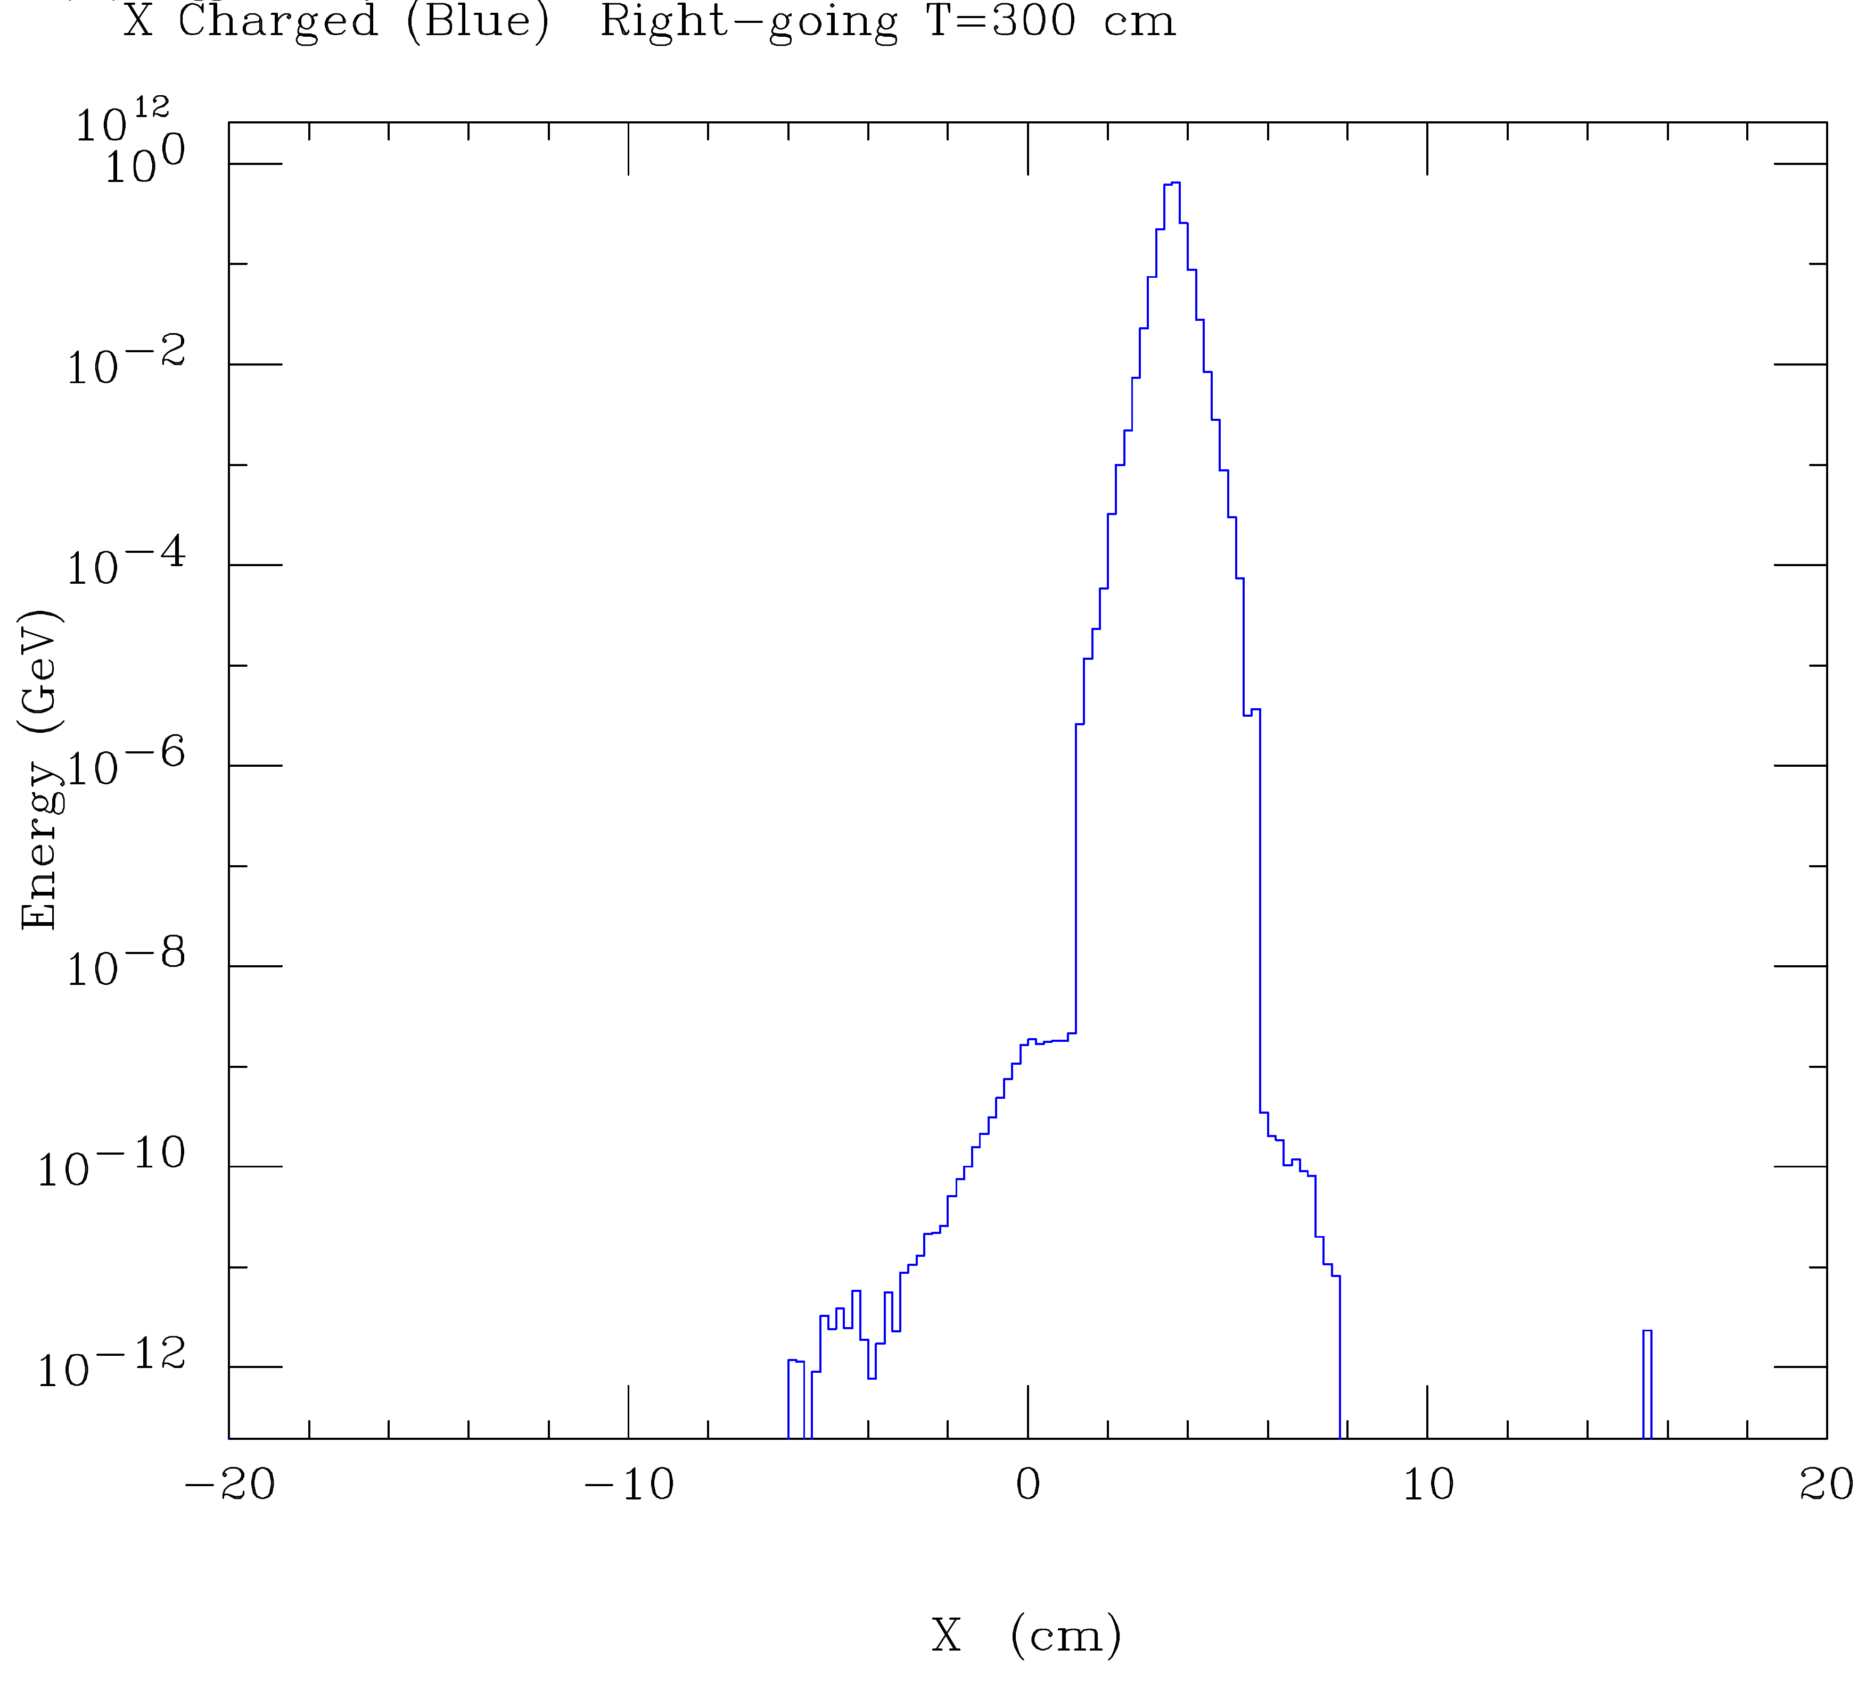
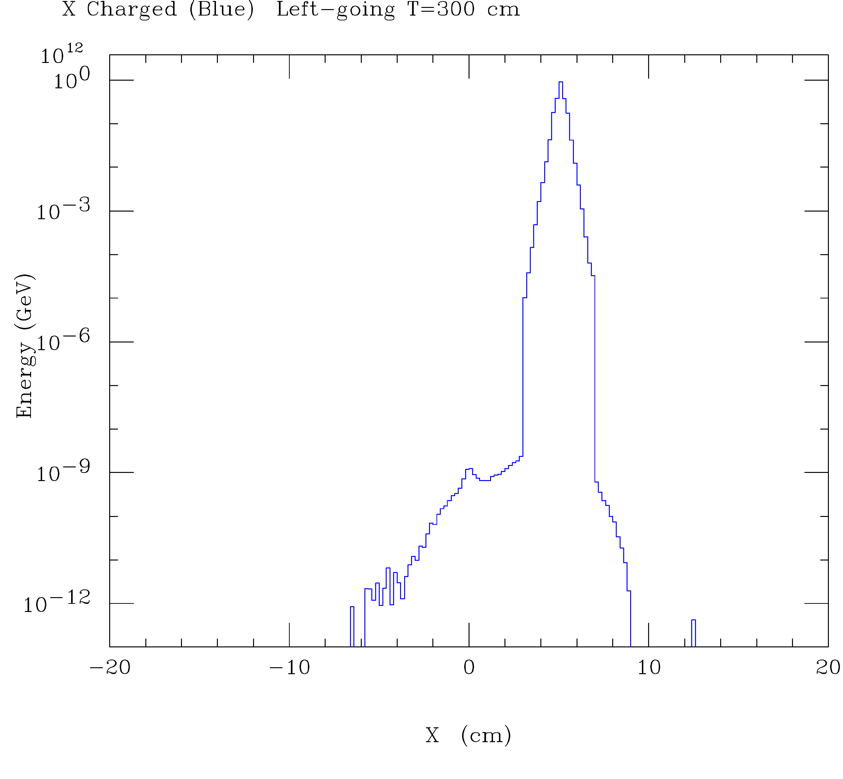
v06802
v06803
Conclude from CAIN that 24 mrad is more comfortable than 20 mrad and 34 mrad is overkill

Slide 52
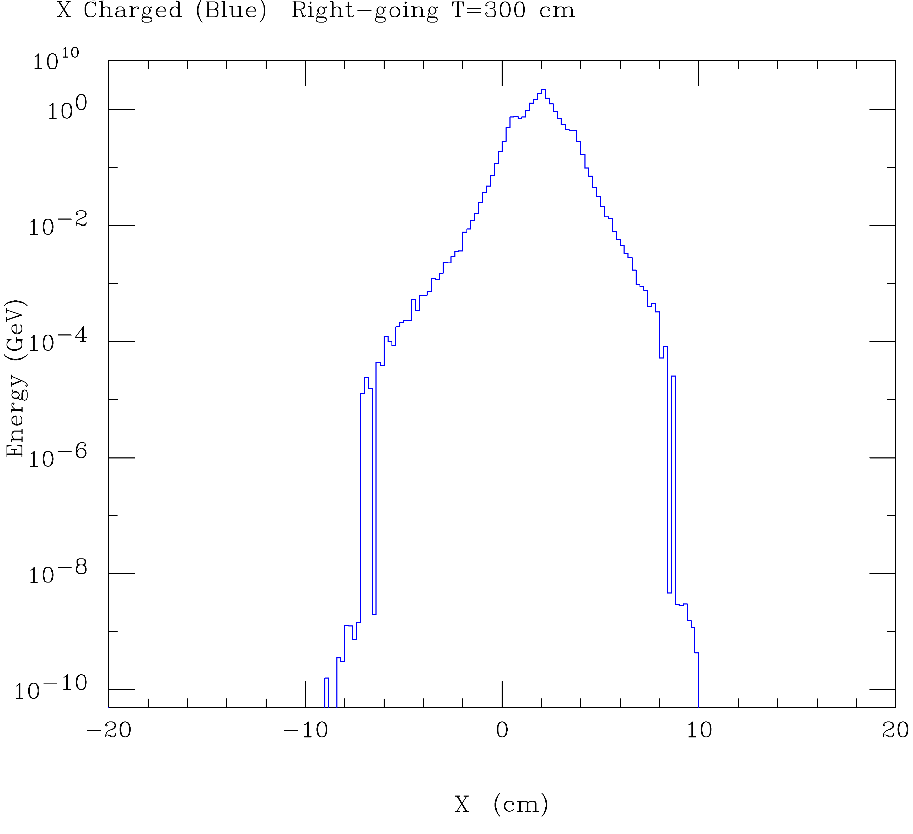
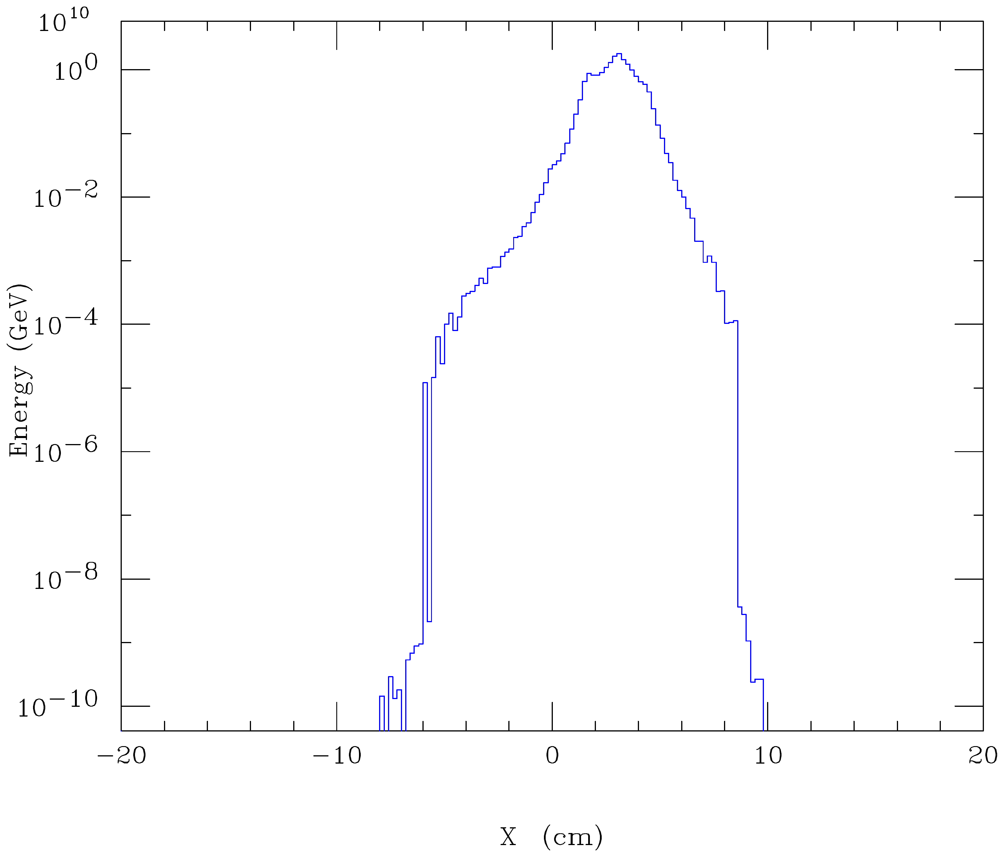
v06781
v06792
20 mrad will work if collimators are installed to protect QD0; must study size of collimator backscatter into detector

Slide 53
Solution requires large aperture HL-LHC-like final triplet. Significant departure from usual e+e- collider design

