Slide 1
ULTIMATE COLLIDERS
(A Look into the Future)
Vladimir SHILTSEV
Galileo Galilei Institute · July 29, 2025 · Firenze, Italy
Exploring the Energy Frontier with Muon Beams

Slide 2
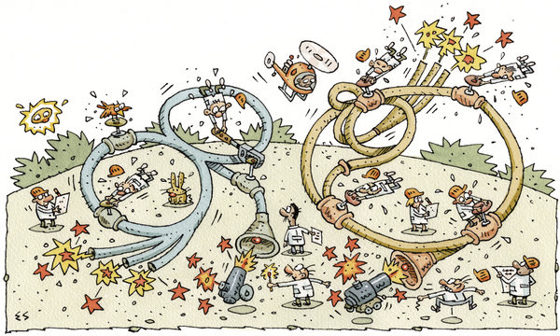


2011
Le Roy mort,
Vive le Roy!

Slide 3
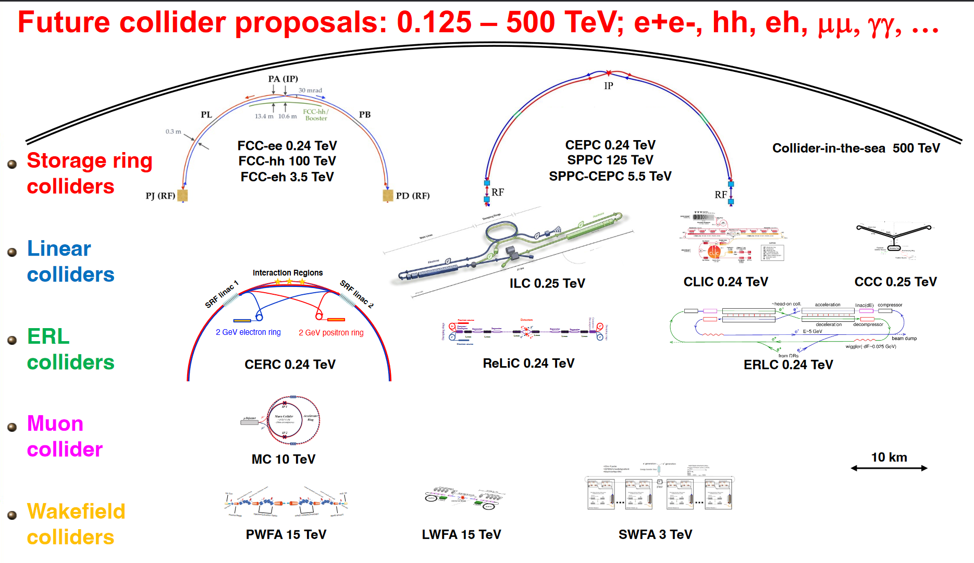


Thomas Roser et al 2023 JINST 18 P05018

Slide 4

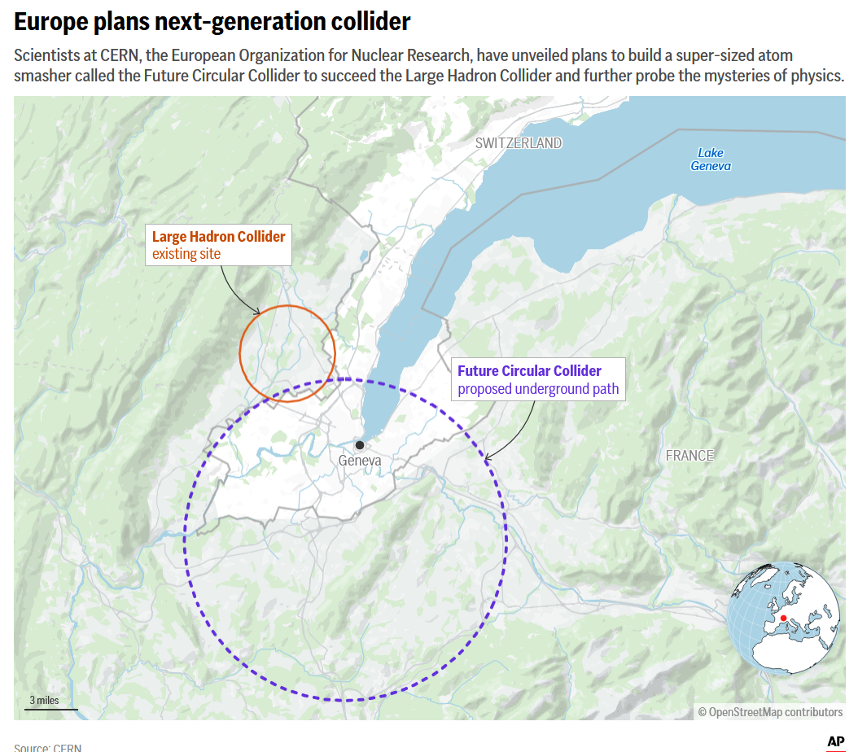




2025

Slide 5


Slide 6
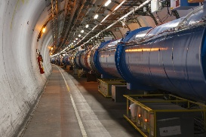
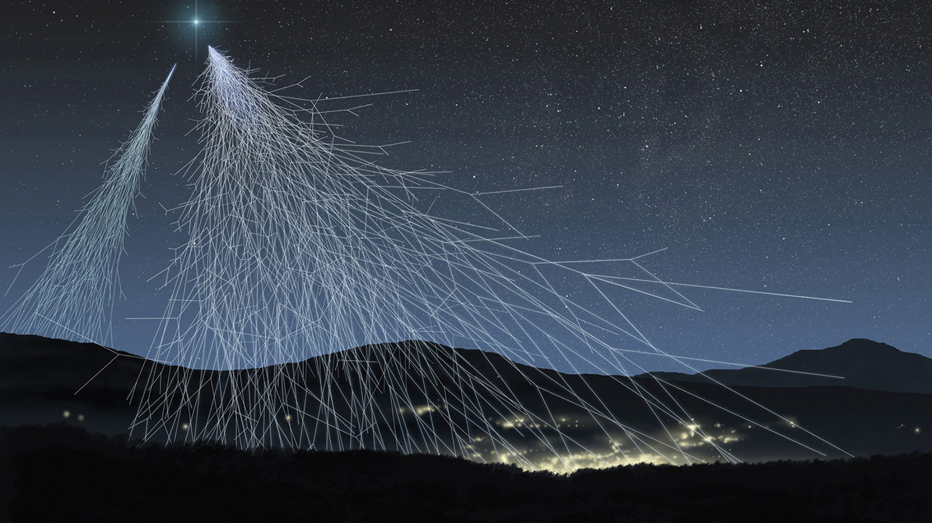
ENERGY: ACCELERATORS vs COSMOS
10 ⁴⁰
~8 orders of magnitude in energy
LHC
10 ³⁰
10 ²⁰
~45 orders of
magnitude in flux
Flux (m² sr s GeV)⁻¹
10 ¹⁰
1
10 ⁻¹⁰
10 ⁻²⁰
“Oh-My-God Particle”
(1991, Utah)
1
10 ³
10 ⁶
10 ⁹
10 ¹²
Energy (GeV)
6

Slide 7
ENERGY: Three Great Ideas
#1 Colliders
#2 [Muon Colliders – to be explored]
#3 [Plasma Colliders – to be explored]

Slide 8
Trick #1: Colliders
E=γmc²
E=γmc²
Center-of-mass energy (c.m.e. - available for transformative particle physics reactions)
gain about x120 for LHC
E_{CM}=2E
Compare with c.m.e. of a fixed target collisions:
E_{CM}=SQRT(2Emc²)
31 colliders built

Slide 9
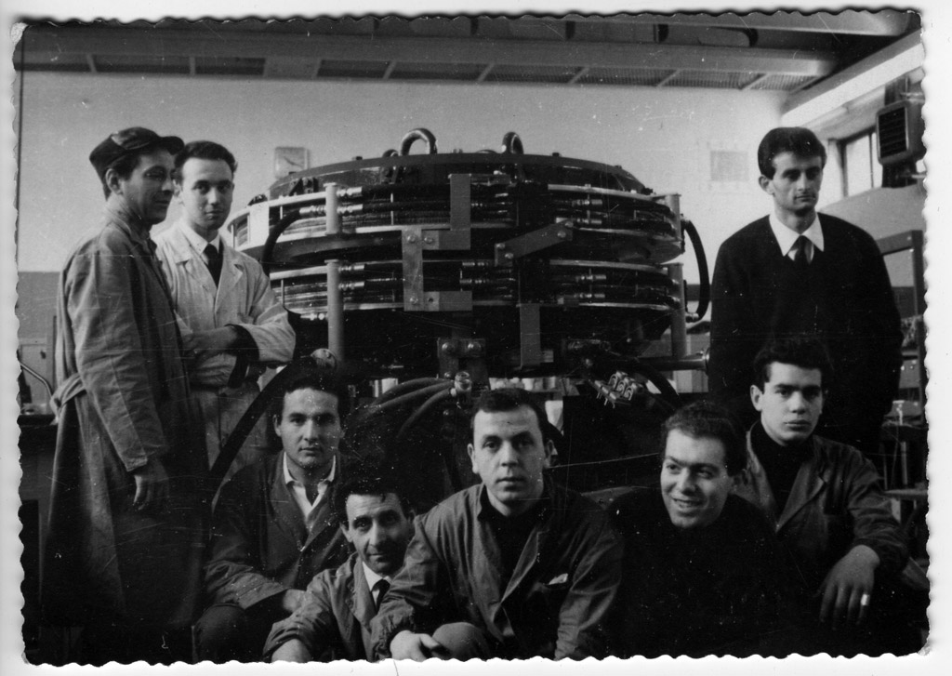
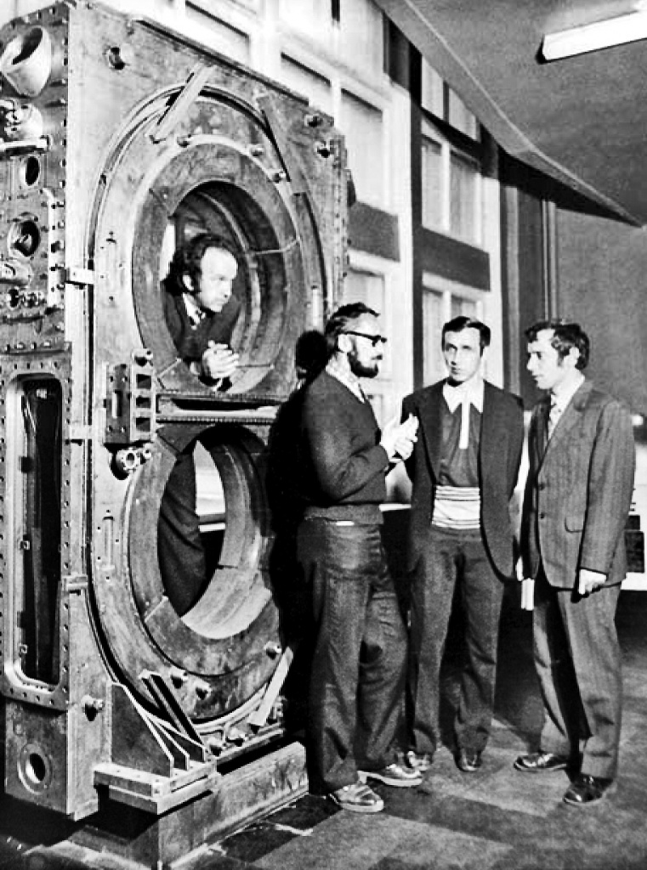
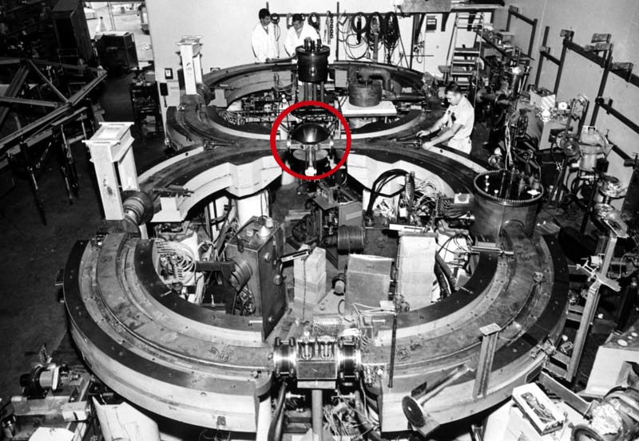
First Colliders – 60! (1964 - 65)
VEP-1 (Novosibirsk)
e-e- E_{cm}=0.32 GeV
CBX (Stanford/Princeton)
e-e- E_{cm}=1.0 GeV
constr. start: 1959
collisions: March 1965
AdA (Frascati/Orsay)
e+e- E_{cm}=0.5 GeV
constr. start: 1960
collisions: mid-1964
constr. start: 1959
collisions: May 1964

Slide 10
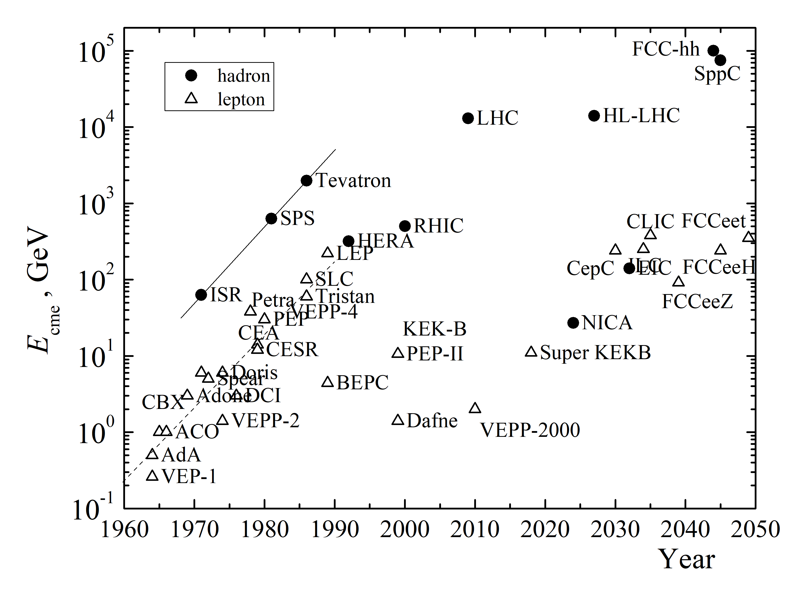
Energy of Colliders (aka Livingston Plot)
5 orders of magnitude in E_{CM} in 6 decades (0.2 GeV → 14 TeV)
hadron
lepton
V. Shiltsev, F. Zimmermann, Rev. Mod. Phys. 93, 015006 (2021)
V. Shiltsev, Phys. Usp. 55, 965 (2012)
10

Slide 11
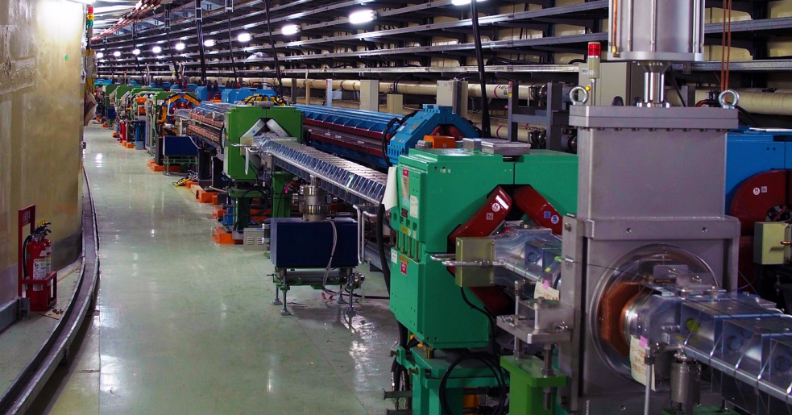
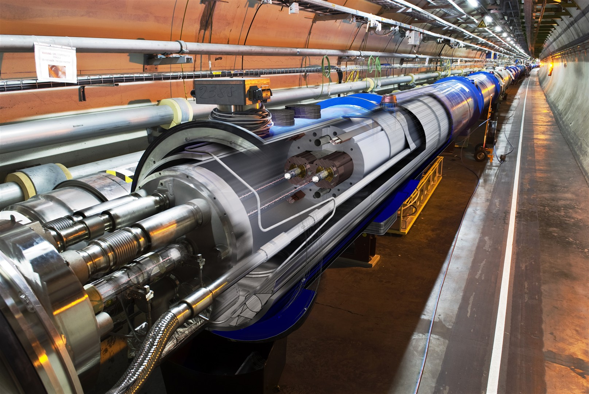
Colliders Now (7 Ops, 2 Constr.)
VEPP-4M, BEPC, DAFNE, RHIC, LHC, VEPP-2000, Super-KEKB, NICA (2025), EIC (2032)
leptons hadrons
Super-KEKB (KEK, Japan):
LHC (CERN):
7 GeV e- + 4 GeV e+
3.0 km tunnel, 1 detector
Normal-conducting magnets, SC RF
Record Lumi 5.1e34 cm⁻²s⁻¹ ( →60 )
6.8 TeV protons + 6.8 TeV protons
26.7 km tunnel, 4 detectors
Superconducting magnets, SC RF
Record Lumi 2.6e34 cm⁻²s⁻¹ (HL-LHC→5)
*cost of construction: 3.6 BCHF (CERN), ~10B$ (US*)

Slide 12
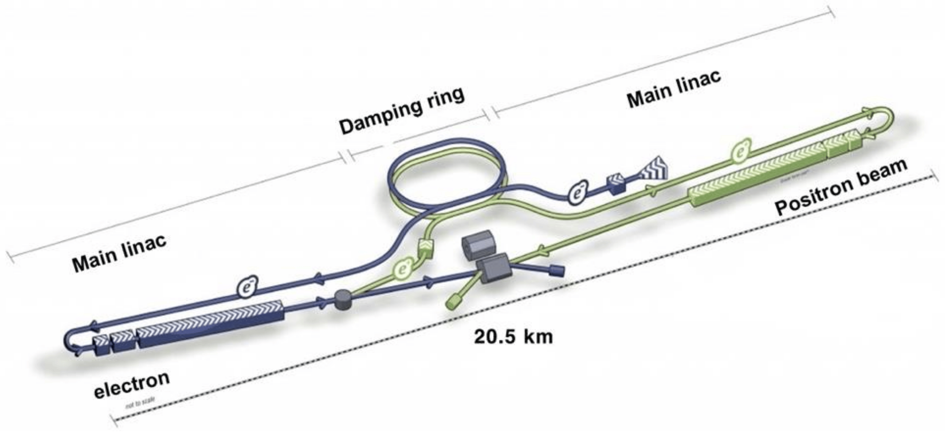
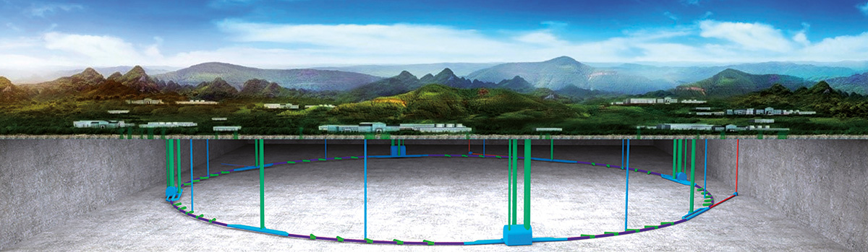
Future Colliders in Asia - Aspirations
ILC (Japan) e+e-
~21 km, E_{cm} =250(500) GeV
31.5 MV/m 1.3 GHz SRF
TDR (2013): cost ~8.1B$* +10kFTEs
CEPC/SPPC (China) e+e-/pp
100 km, E_{cm} =91…360 GeV
NC magnets and 60MW SRF
TDR (Dec’2023): 36BCNY(5.2B$)*
*2024: not incl. labor, contingency and escalation
*no labor, escalation, R&D, spares / w. contingency

Slide 13
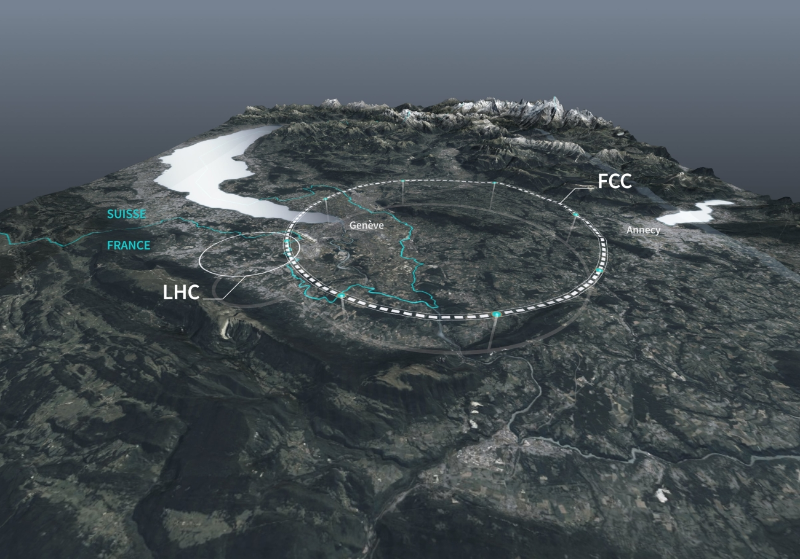
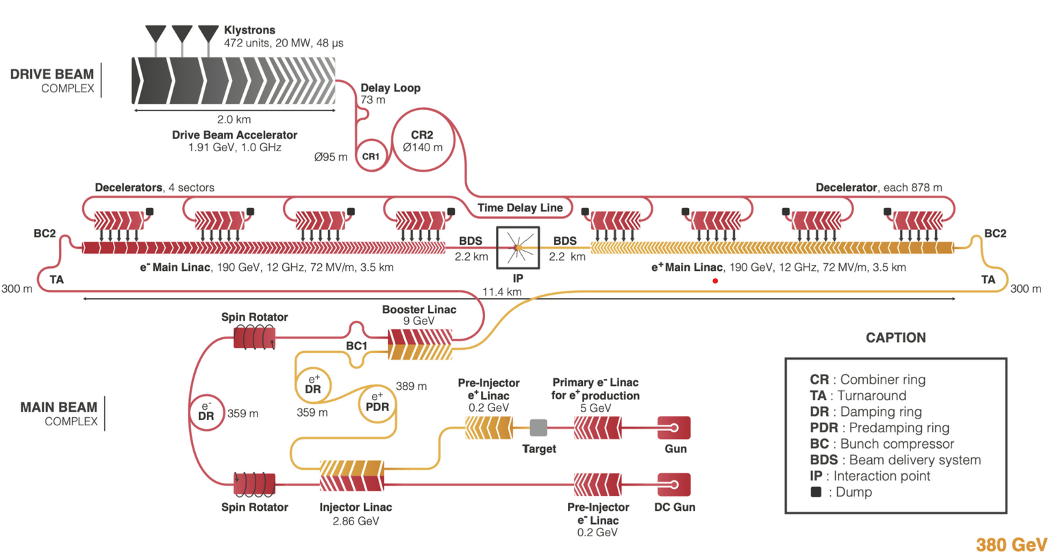
Future Colliders in Europe - Aspirations
FCC-ee
FCCee [→hh] (CERN) e+e-
91 km, E_{cm} =91…365 GeV
NC magnets and 100MW SRF
FSR (2025): cost ~14BCHF *
CLIC (CERN) e+e-
11 km, E_{cm} =380 GeV [3 TeV]
2-beam NC RF 70-100 MV/m
CDR (2018): cost 7.3 BCHF *
*no 15kFTE of labor, escalation, or contingency
*no 11,5kFTEs of labor, no escalation, no contingency

Slide 14
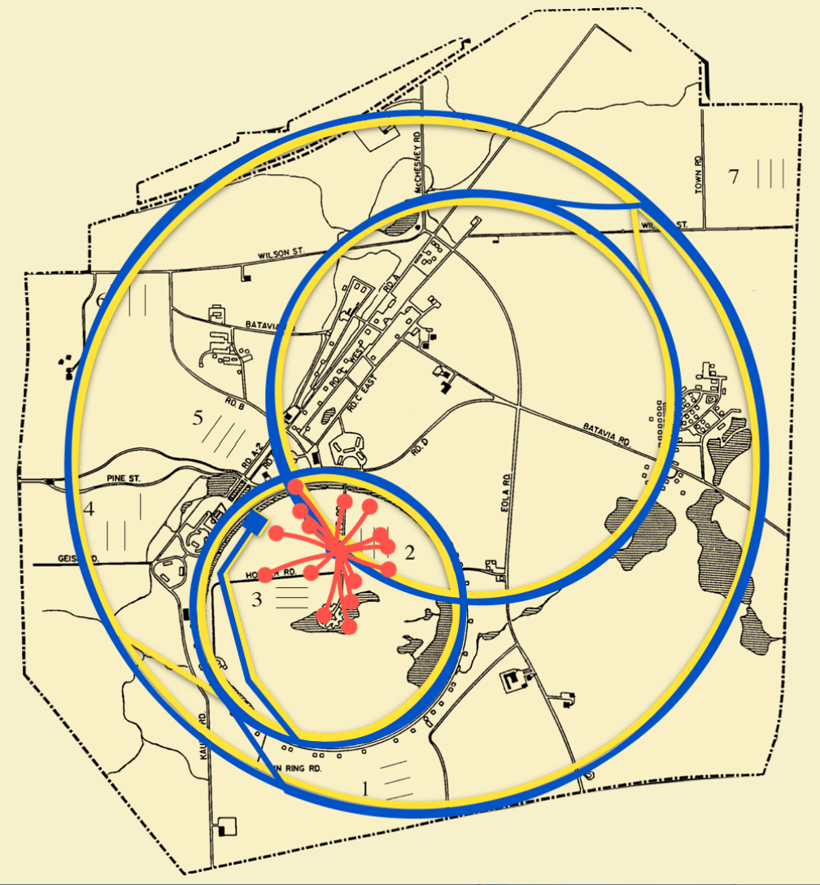
Future Muon Collider in the US
circular
compact
low(er)cost
low(est) power consumption
Muons decay quickly 2.2μs×γ
→ Fast production, cooling (size reduction)& acceleration
Muon Collider eg at FNAL μ+μ-
Circumference ~10 km, E_{cm} =3…10 TeV
NC+SC magnets and SRF
Cost ~12-18 B$* (ITF, 2021; 17±4 BCHF IMCC’25)
20 yrs of R&D
Fermilab site: about 3 x 4 miles, 6,800 acres
*no labor, escalation, or contingency

Slide 15
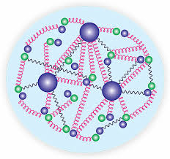
Our Trick #2: Leptons vs Hadrons
Protons
E=γmc²
E=γmc²
E_{CM partons}≈ 2E × 0.1
Leptons
e+
μ+
τ+
e-
μ-
τ-
E_{CM leptons}=2E

Slide 16
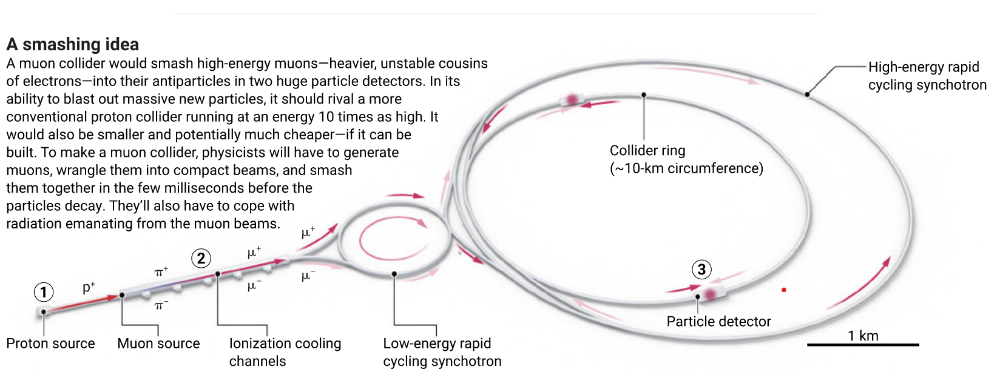
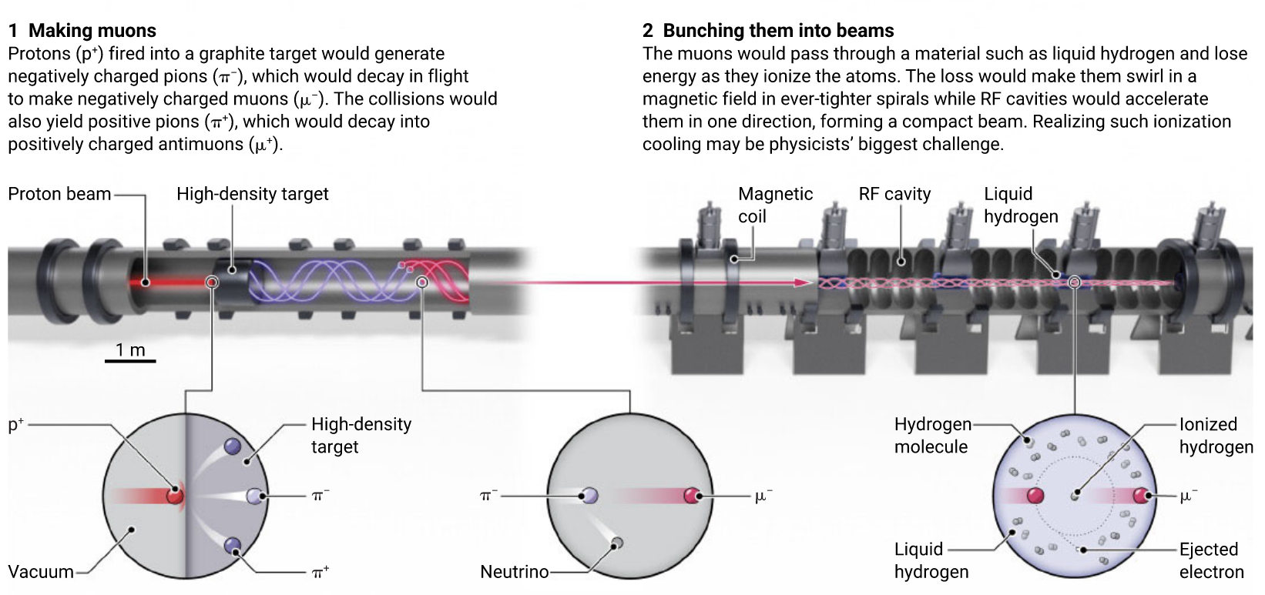
Muon Collider Challenges and R&D Topics
R&D re: Energy Reach/Cost
Fast magnets for the accelerator rings (~few ms, ~20 km)
Economical high-gradient pulsed SRF (~few ms, ~20-40 GeV)
Collider ring 12-16 T superconducting magnets (DC, ~10 km)
Civil construction (~40 km)
Power infrastructure (~360 MW)
“…no showstopper, but very complicated…” Requires a (Convincing)
Demonstrator Test Facility
R&D re: Luminosity Goals
Proton driver: 1-4 MW at 5-20 GeV; accumulate bunches with up to 10^14 particle, compress to few ns; deliver at 5-10 Hz rate
Targets and cooling: DPAs, ~15 T SC solenoid with ~2 m aperture; high-gradient NC RF in 2-14 T SC solenoids of the ionization cooling channel
Challenging MDI due to muon decays; neutrino flux dilution

Slide 17
10+ TeV pCM Colliders - Summary
 | CME (TeV) | Lumi per IP (10^34) | Years, pre-project R&D | Years to 1st physics | Cost range (2021 B$) | Electric Power (MW)
MuColl-FNAL μ⁺μ⁻ | 6-10 | 20 | >10 | 19-24 | 12-18 | O(300)
Plasma WFA e⁺e⁻ | 15 | 20 | >10 | >25 | 18-50 | O(600)
FCChh-100 SPPC pp | 100 125 | 30 13 | >10 | >25 | 30-50 30-80 | ~560 ~400
From the Snowmass’21 Implementation Task Force report - T.Roser et al 2023 JINST 18 P05018

Slide 18
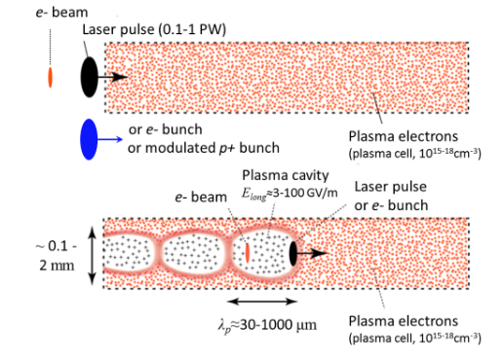
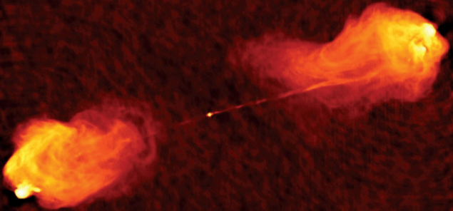
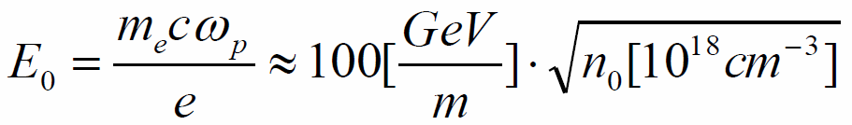
“Trick #3”: Ultra-High Gradients in Plasma
From 0.1 GV/m (in traditional RF accelerators) to 10-100 GV/m in plasma
Three ways to excite plasma (drivers)
laser dE ~ 10 GeV (~3∙10¹⁷ cm⁻³ 0.1-0.3 m)
e- bunch dE ~ 9 GeV (~10¹⁷ cm⁻³ 1.3 m)
p+ bunch dE ~ 2 GeV (~10¹⁵ cm⁻³ 10 m)
Impressive proof-of-principle demos!
In principle, plasma PeV μ+μ- colliders could be feasible…staging, cost and power of such TBD
UHECRs from EM shock waves in the ultra-dense jets of accreting magnetized black holes
Zetta eV (10²¹) particles

Slide 19

On Ultimate Colliders
V.Shiltsev, “Ultimate Colliders” (Oxford Encyclopedia, 2023); https://arxiv.org/abs/2309.15960

Slide 20
Factors and Limits
Main factors to consider feasibility of future colliders used to be
  Feasibility of Energy
  Feasibility of Luminosity
  Feasibility of Cost
The European Strategy (2019, 2025) and Snowmass’21 (2020-2023) discussions revealed additional limits:
  Time to construct and commission
  Societal limits: # of experts, size of facility, radiation, etc
  Environmental impacts: power consumption, carbon footprints, scarcity of resources (He, Nb, W, etc), excavated materials, etc
Here we will only briefly touch some important points

Slide 21



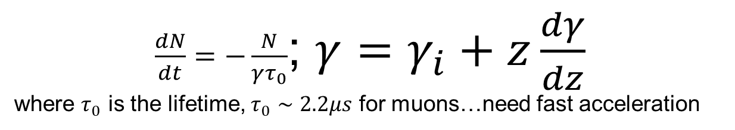
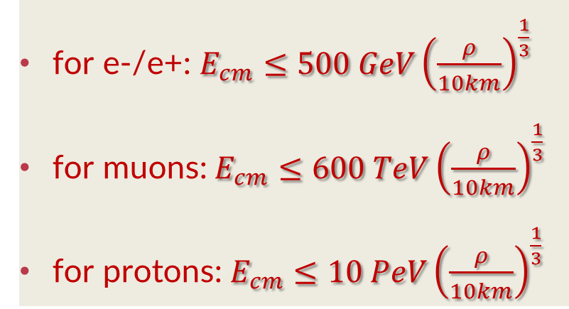
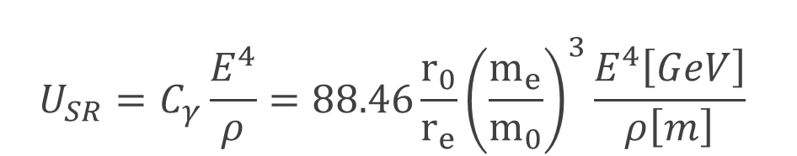
Limits on Energy
for e-/e+: $E_{cm}≤500 GeV{\left(\frac{ρ}{10km}\right)}^{\frac{1}{3}}$
for muons: $E_{cm}≤600 TeV{\left(\frac{ρ}{10km}\right)}^{\frac{1}{3}}$
for protons: $E_{cm}≤10 PeV{\left(\frac{ρ}{10km}\right)}^{\frac{1}{3}}$
Synchrotron radiation defines linear vs circular if U_{SR} < E
$$U_{SR}=C_{γ}\frac{E^{4}}{ρ}=88.46\frac{r_{0}}{r_{e}}{\left(\frac{m_{e}}{m_{0}}\right)}^{3}\frac{E^{4}\left[GeV\right]}{ρ\left[m\right]}$$
Production and survival: unstable particles such as muons
$\frac{dN}{dt}=−\frac{N}{γτ_{0}}$; $γ=γ_{i}+z\frac{dγ}{dz}$
where $τ_{0}$ is the lifetime, $τ_{0}∼2.2μs$ for muons…need fast acceleration
for muons
for τ-leptons
Staging efficiency (losses) per stage for M stages ≥
  Circumference 100 km , B<16 T , E <50 TeV
  Circumference 40,000 km, B=1 T, E <1.3 PeV
  Length 50 km , G<0.1 GV/m, E <5 TeV
  Length 10 km, G<1 TV/m, E <10 PeV
Reach vs technology within limited space /area:

Slide 22





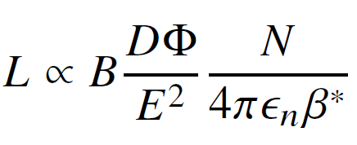

Limits on Luminosity
General Equation
  sheer beam power
  e/p SR rad. power
  μ→ν radiation dose
  LC power, BS, jitter
flux dilution factor

Slide 23
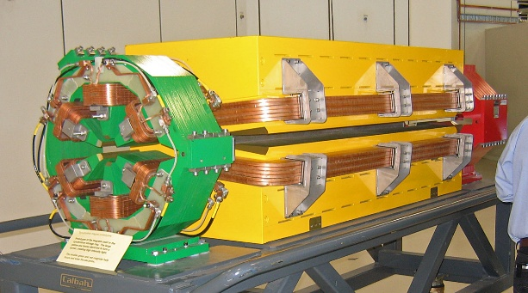
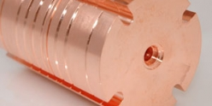
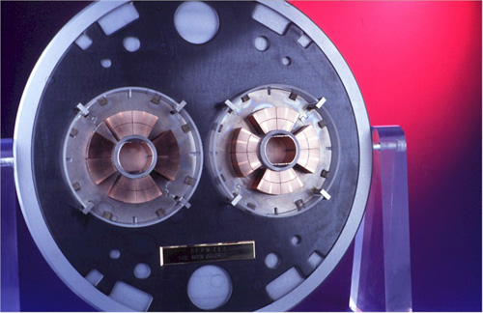
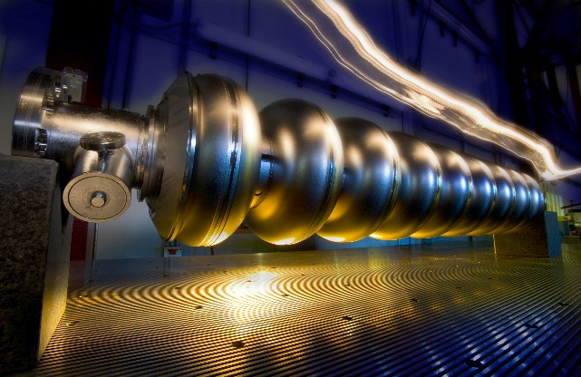
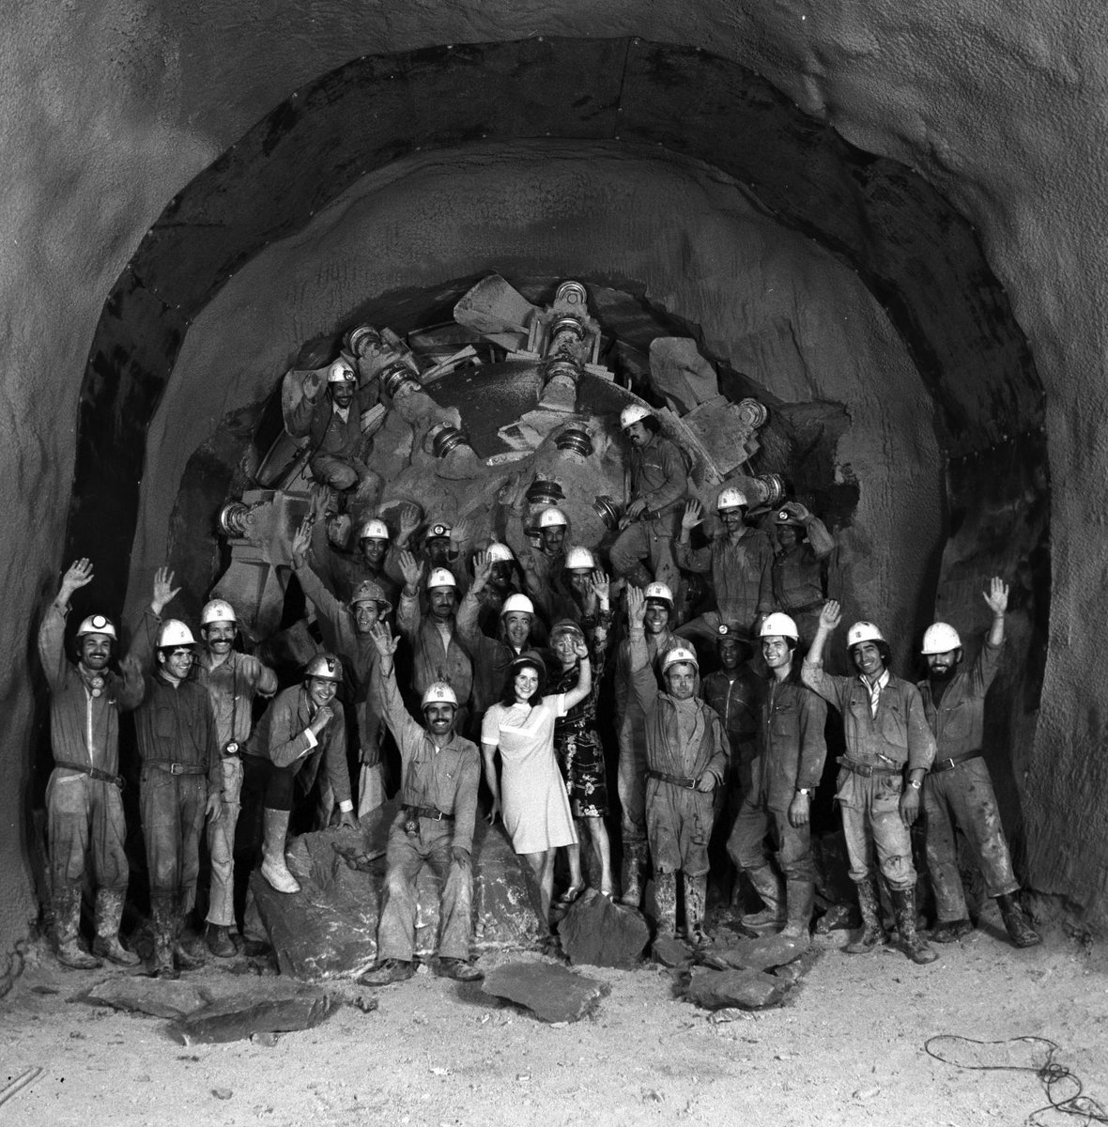
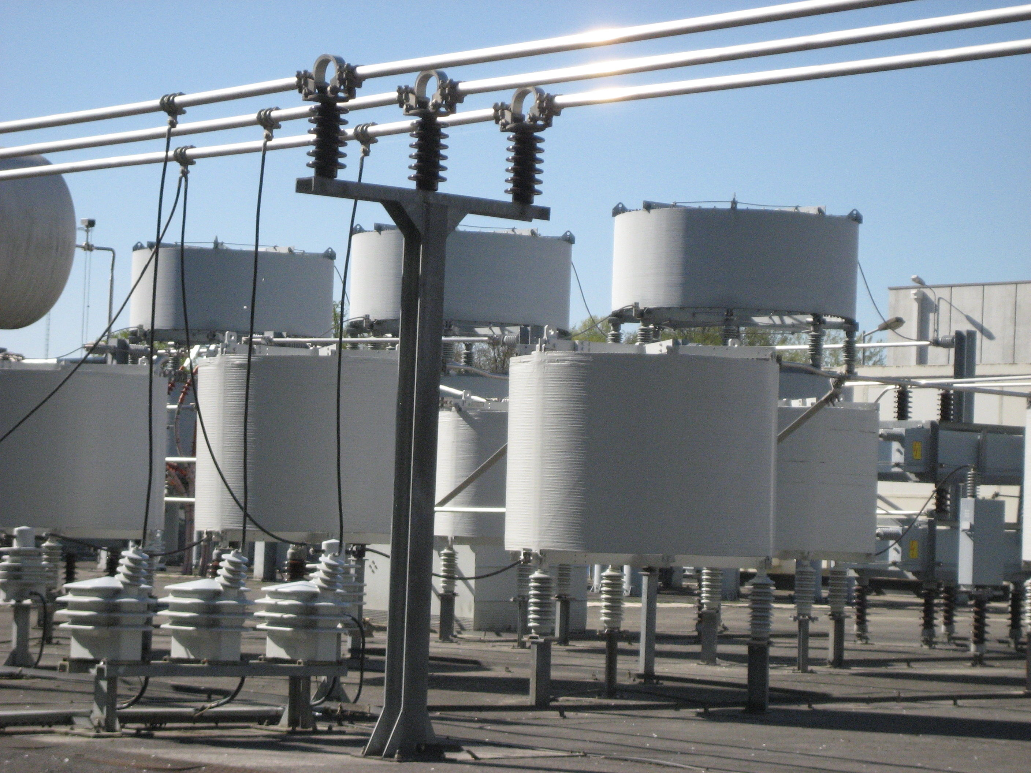
Cost is set by the Scale (energy, length, power) and Technology
  Accelerator technology (magnets NC and SC, RF and SCRF, etc)
  Civil construction technology
  Power production, delivery and distribution technology
Normal Conducting Magnets
Normal Conducting RF
~50±10 %
~35±15 %
~15±10 %
SC RF
SC magnets

Slide 24
Rough Cost Estimates of Large Accelerators
Higher energy E → usually bigger size L, more power P → higher costs:
  Where is the societal limit on the cost of colliders?
  Cost ranges estimates – detailed vs parametric models
The αβγ cost model:
Cost(TPC)= α L^{1/2} + β E^{1/2} + γ P^{1/2}
α≈ 2B$/sqrt(L/10 km) for tunnel/civil
β ≈ 10B$/sqrt(E/TeV) for SC/NC RF
β ≈ 2B$ /sqrt(E/TeV) for SC magnets
β ≈ 1B$ /sqrt(E/TeV) for NC magnets
γ≈ 2B$/sqrt(P/100 MW) for site power
V.Shiltsev, “A phenomenological cost model for high energy particle accelerators”, JINST 9 T07002 (2014)

Slide 25

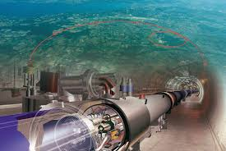



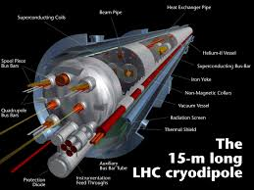
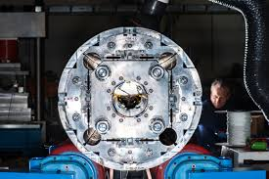
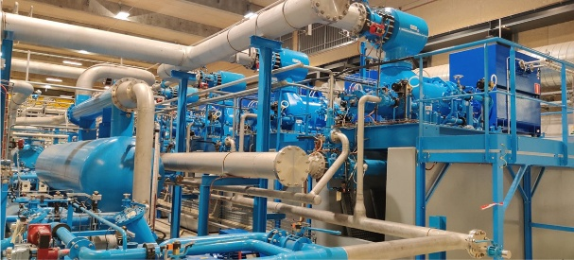
An Example – Large Hadron Collider:
αβγ – Model:
  40 km of tunnels
  14 TeV c.o.m SC magnets
  ~150 MW of site power
TOTAL PROJECT COST (est.) : 14B$ ± 4.5B$
ITF T.Roser talk @ PLUB-II Workshop (USD 2021):
  existing injector complex 4.6 B$
  new accelerator systems 4.06 B$
  new infrastructure and civil 2.75 B$
  explicit labor ~1.4 B$
  Total: 12.8B$

Slide 26
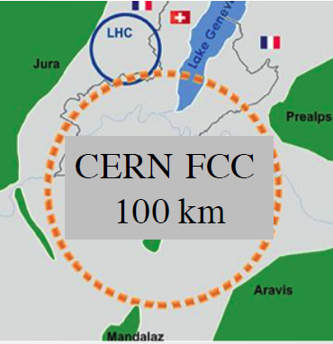
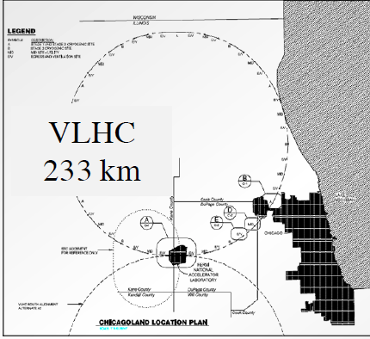
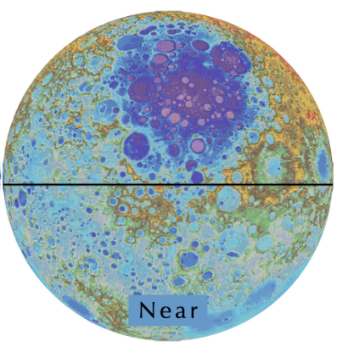
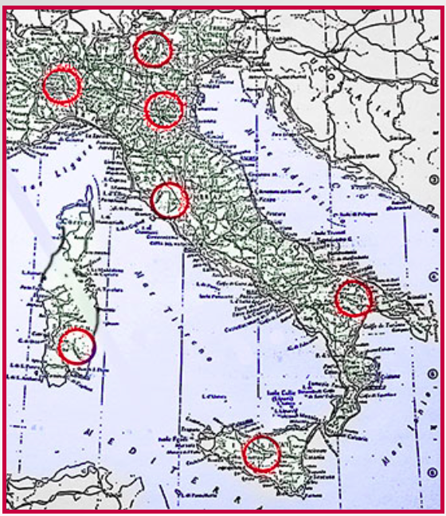
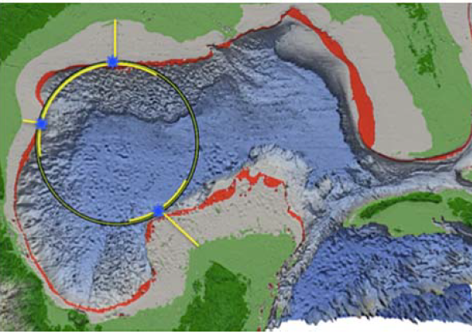
Circular pp Colliders
0.1 PeV
Known technology (magnets)
Major limitations:
  Size (magnetic field B), power, cost
  Synchrotron radiation → Lumi ~R/E³
  Beam-beam, burn-off, pileup, instabilities
0.175 PeV
Luna-tron
Collider-in-the-Sea
0.3 PeV
300km
Eloisatron
0.5 PeV
1900km
14 PeV,11000km

Slide 27
pp Colliders: Lumi, Power, Cost vs Energy
  Circular pp
B=10T, 300 km
P=2-3 TWh
Cost=3-5 LHCU
B=16T, 100 km, P=2.5-3 TWh
Cost=3-5 LHCU
10 ab⁻¹/yr
B=3.2T, 1900 km P=>5 TWh
Cost>8 LHCU
FCC
ELN
1 ab⁻¹/yr
Sea
B=20T, 1600 km, P=10? TWh
Cost > 6 LHCU
LHC
UELN
VLHC
0.1 ab⁻¹/yr
B=8 T, 27 km, P=1.1 TWh
Cost=1 LHCU
Globe
B=1T, 40000 km, P> 30 TWh
Cost> 30 LHCU
B=10T, 233 km, P=1.5-3 TWh
Cost= 3.8? LHCU
0.01 ab⁻¹/yr
Collider on Moon
Tevatron
B=20T, 11000 km, P> >10 TWh
Cost> 40 LHCU
1 fb⁻¹/yr
B=4.5 T, 6 km, P=0.3 TWh
Cost=~0.5 LHCU
7 TeV
70 TeV
700 TeV
7 PeV
70 PeV

Slide 28

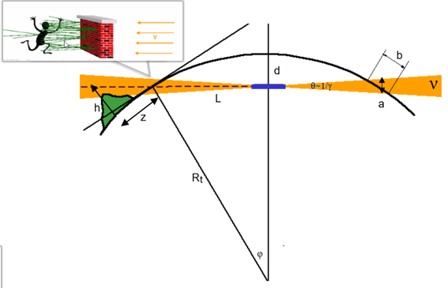
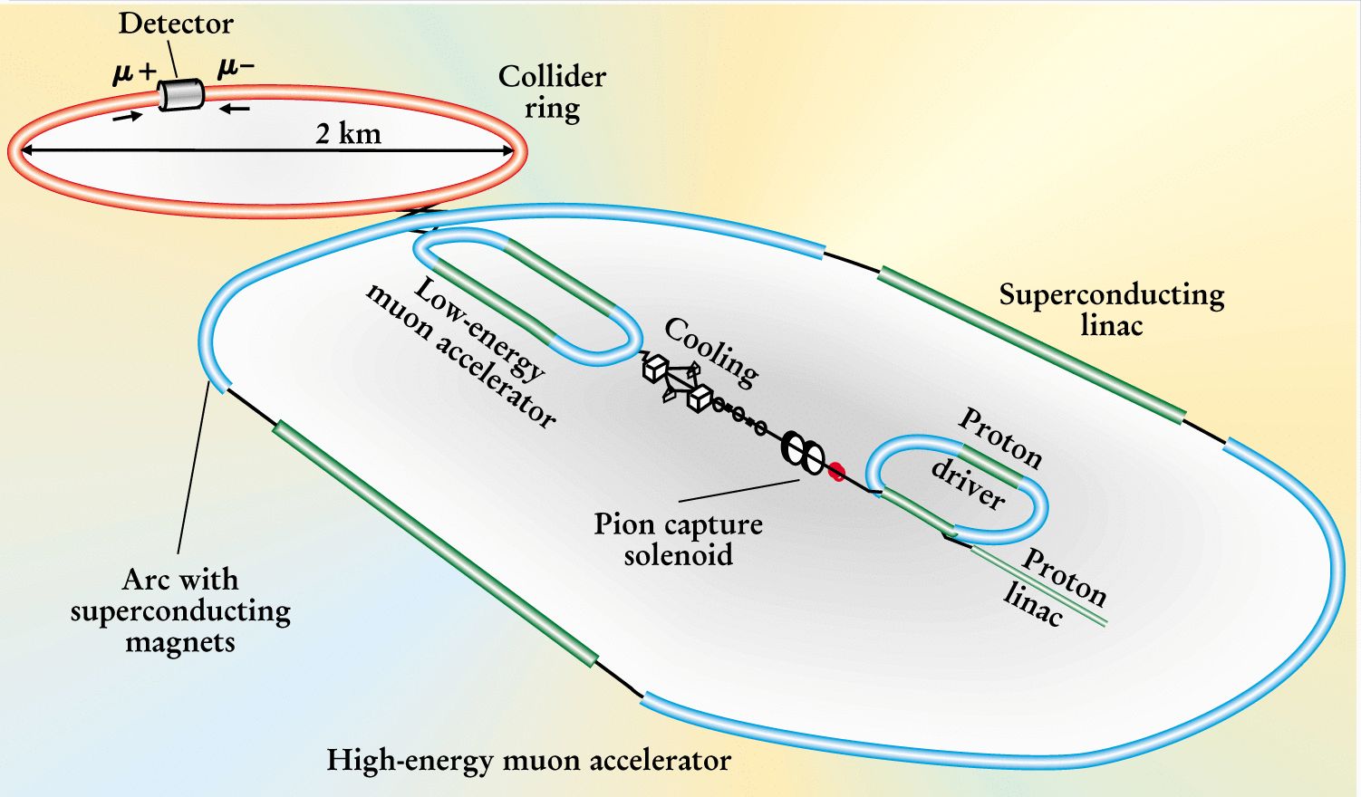
Circular μ+μ- Colliders
10 TeV
~10 km
Known technology (magnets, RF)
Major limitations:
  Size (magnetic field B), power, cost
  Ionization cooling of muons
  SR energy loss @ 50-100 TeV
  Neutrino flux → Lumi ~Ф/E²
μμ
0.1 PeV
1 PeV
1000 km

Slide 29
MuColl: Lumi and Cost vs Energy
  Circular μμ
B=10 T, Ф=1
27(14) km
P=1.5-2TWh
Cost=1-2 LHCU
B=10 T, Ф=10
27 km
P=2 TWh
Cost=1.6-2.5 LHCU
10 ab⁻¹/yr
MC-14
MC-6
B=10 T, Ф=100
100 km
P=3.5? TWh
Cost=3-5 LHCU
1 ab⁻¹/yr
B=10 T
6 km, Ф=1
P=1.3 TWh
Cost=0.7-1 LHCU
MC-1.5
0.1 ab⁻¹/yr
B=10 T, 2.5 km, Ф=1
P=1 TWh
Cost=0.5 LHCU
B=10 T, Ф=100
300 km
P=5 ? TWh
Cost=>5 LHCU
0.01 ab⁻¹/yr
B=10 T, Ф=100
1000 km
P=9 ?TWh
Cost=>8 LHCU
1 fb⁻¹/yr
1 TeV
10 TeV
100 TeV
1 PeV
10 PeV

Slide 30
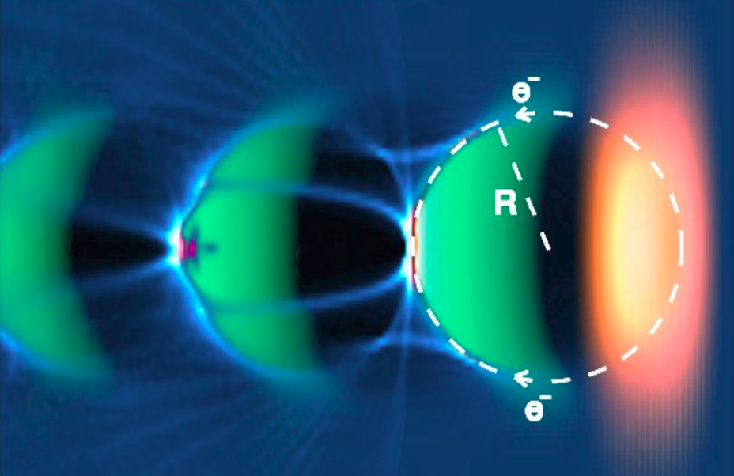
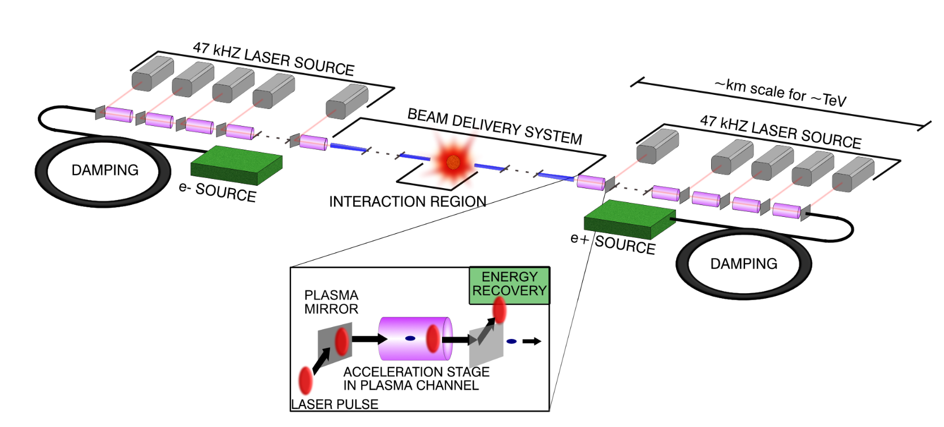
Linear e+e- Colliders
15 TeV e+e-
100+ km
10-15 km
Either RF acceleration (50-200 MeV/m) or
wake-field acceleration in plasma (2-5 GeV/m)
Major limitations:
  100% energy spread at IP (beamstrahlung)
  One-time collisions ineffective → Lumi ~P/(Eσ)
  Very long/complex Final Focus to get nm IP size
  Extreme sensitivity to nm jitters of linac elements
  In plasma – ultra-strong focusing hurts staging,
  impossible(?) to accelerate positrons
Plasma sustains high fields
Takes about 1 GW of electric power even for 15 TeV

Slide 31
Linear RF and Plasma: Lumi and Cost vs Energy
  Linear ee/γγ
20-50 km
P=6-15? TWh
Cost=4-8 LHCU
18 km
P=3-4 TWh
Cost=2-5 LHCU
LWFA-30
10 ab⁻¹/yr
DLA-30
ILC-1
CLIC-3
PWFA-10
1 ab⁻¹/yr
30-100 km
P=2.5 TWh
Cost=5-10 LHCU
40 km
P=1.5 TWh
Cost=1.5-2 LHCU
Ult.Plasma-0.1
0.1 ab⁻¹/yr
50 km
P=3 TWh
Cost=2-3 LHCU
Ult.Plasma-1
0.01 ab⁻¹/yr
~200-500 km
P=2.5 TWh
Cost=15-30 LHCU
1 fb⁻¹/yr
1 TeV
10 TeV
100 TeV
1 PeV
10 PeV

Slide 32

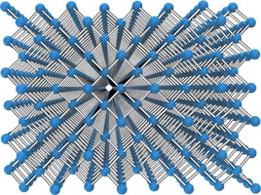
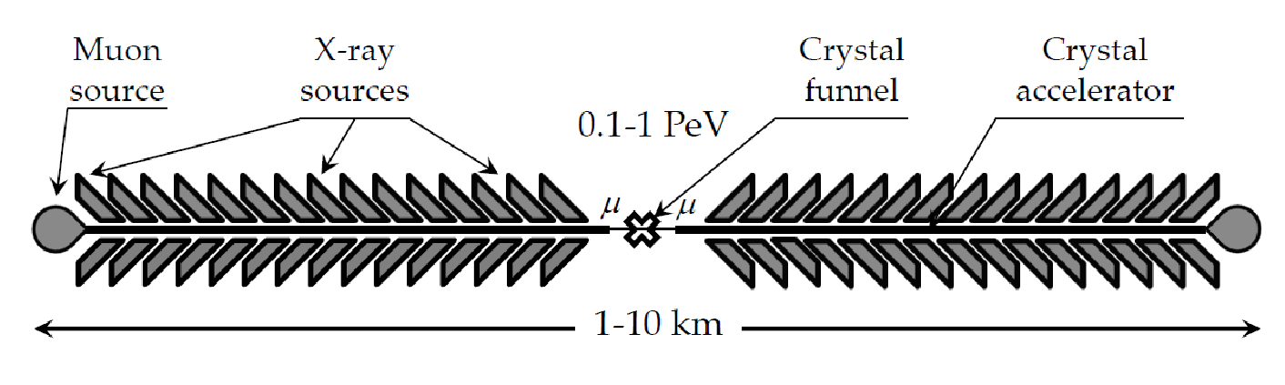
Exotic Colliders
Plasma-wakefield acceleration and channeling in structured media, eg CNTs or crystals ( only muons!!! )
Major advantages:
  solid density → 1-10 TV/m gradients
  continuous focusing and acceleration (no cells, one long channel, particles get strongly cooled betatron radiation)
  small size promises low cost
Lumi ~1/E² …totally unproven yet concept:
  proof-of-principle experiment E336 @ SLAC FACET-II
1980’s-1990’s T.Tajima/R.Cavenago
1990’s-2000’s P.Chen/R.Noble
2010’s-2020’s V.Shiltsev, S.Corde

Slide 33
Xtal Colliders: Lumi and Cost vs Energy
  Linear Xtal μμ
10 ab⁻¹/yr
1 ab⁻¹/yr
XC-0.1
G=1-10 TV/m
0.1-1 km
P=< 1TWh
Cost=<3 LHCU?
0.1 ab⁻¹/yr
G=1 TV/m
0.1-1 km
P=< 1TWh
Cost=<1 LHCU?
XC-1
0.01 ab⁻¹/yr
G=1-10 TV/m
1-10 km
P=< 2TWh
Cost=<10 LHCU?
1 fb⁻¹/yr
XC-10
1 TeV
10 TeV
100 TeV
1 PeV
10 PeV

Slide 34
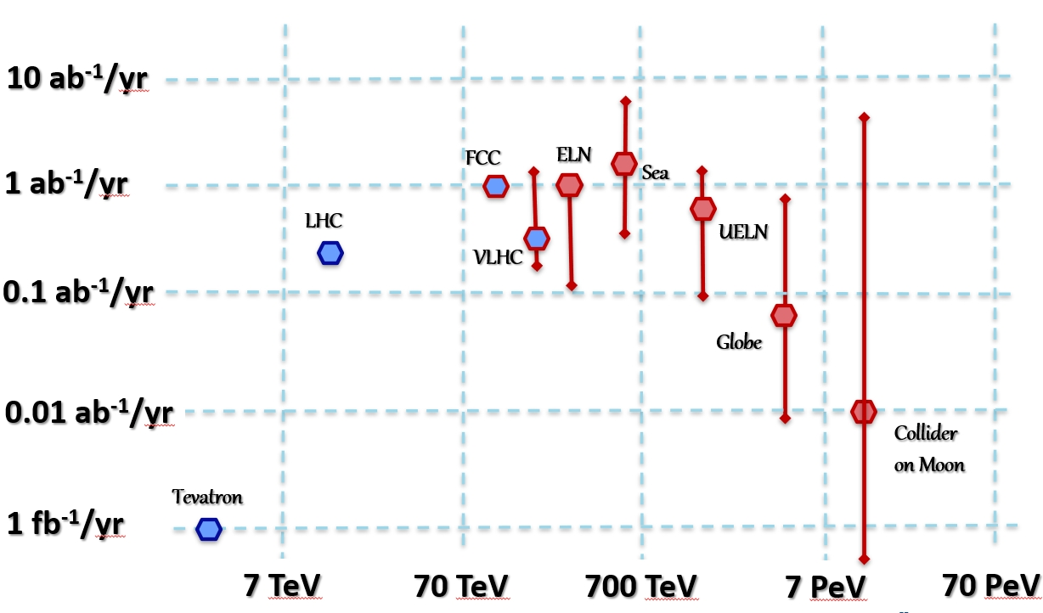
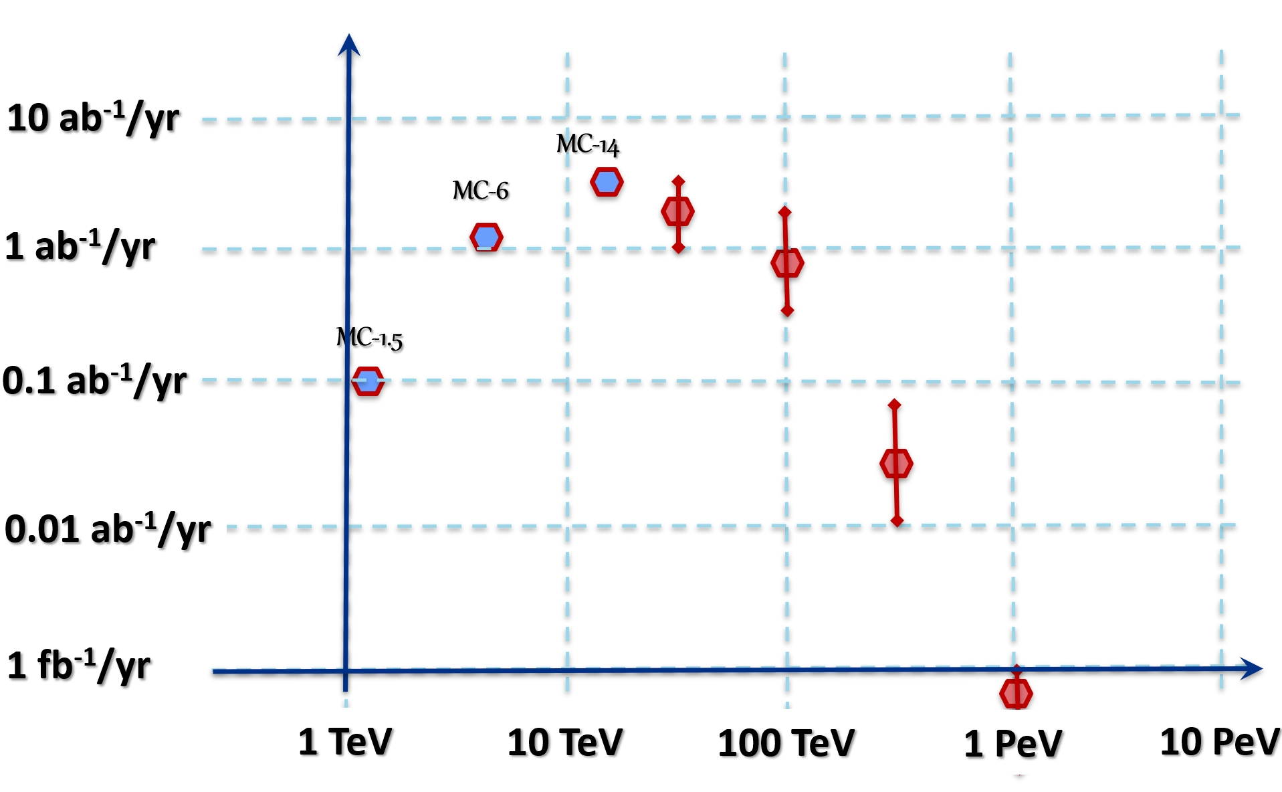
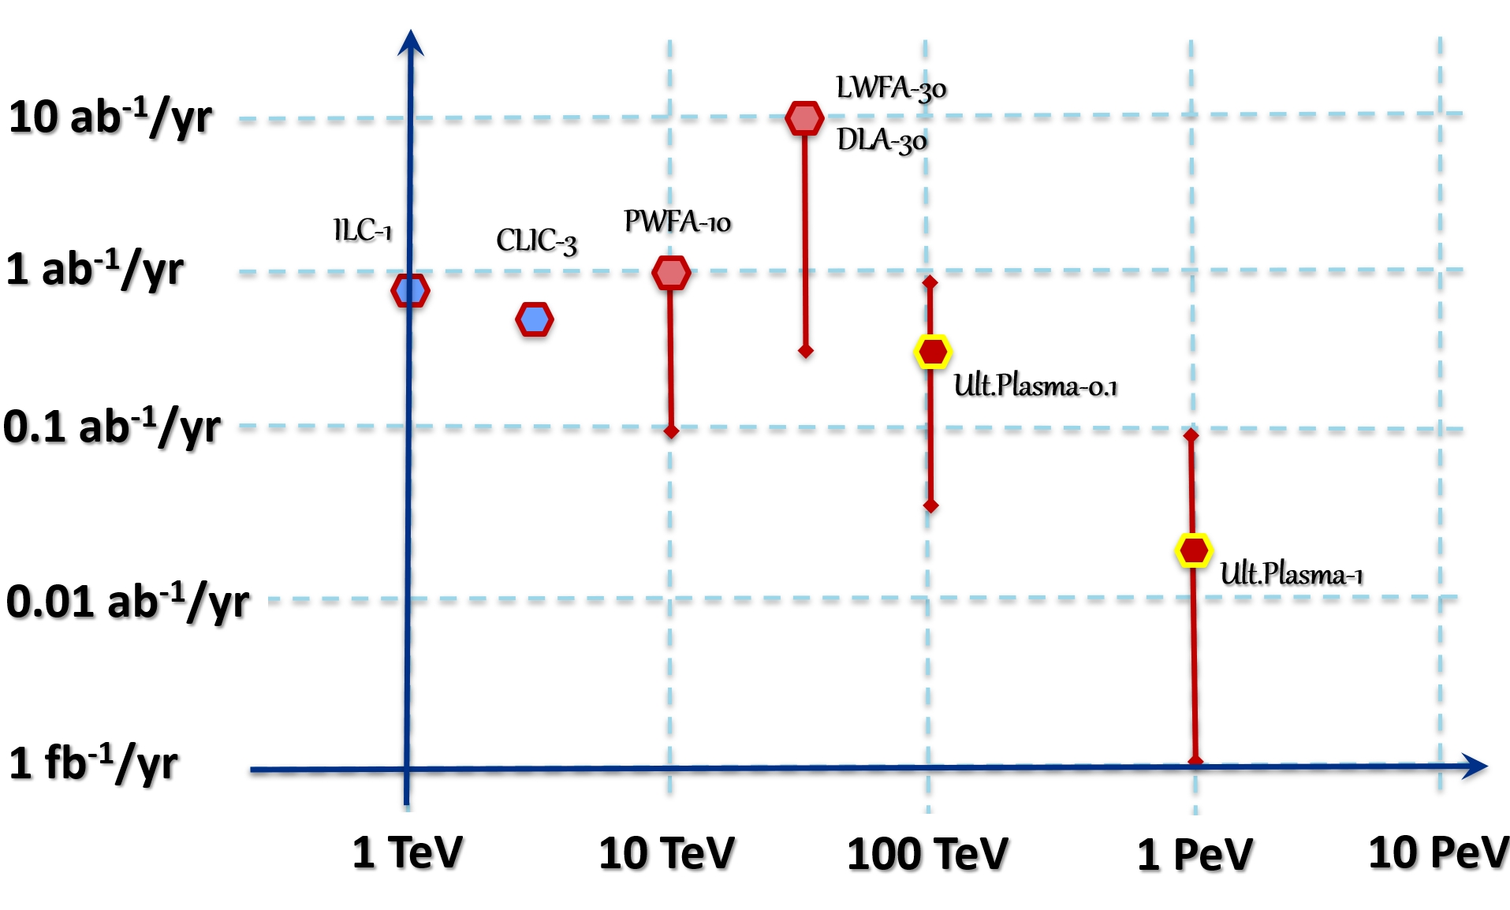

Limits (Electric Power and Cost)
Circular pp
Circular μμ
Power > 2x LHC
Power > 2x LHC
Cost >3x LHC
Cost >3x LHC
Linear e+e-
Linear crystal μμ
P> 2x LHC
Power > 2x LHC
C>3x LHC
Cost >3x LHC

Slide 35
Ultimate Colliders Luminosity vs Energy
10 ab⁻¹/yr
μ⁺μ⁻ Circular
1 ab⁻¹/yr
pp Circular
0.1 ab⁻¹/yr
e⁺e,⁻μ⁺μ⁻ Linear
Main Limits:
Power… 3 TWh/yr
Cost….. 3 xLHC
0.01 ab⁻¹/yr
1 fb⁻¹/yr
1 TeV
10 TeV
100 TeV
1 PeV
10 PeV
Parton CME
V.Shiltsev, “Ultimate Colliders” (Oxford Encyclopedia, 2023); DOI: 10.1093/acrefore/9780190871994.013.118

Slide 36


“…Muons seem to be the particles of choice for future ultimate HEP colliders.” V.Shiltsev, “Ultimate Colliders” (2023)
DOI: 10.1093/acrefore/9780190871994.013.118
also in arXiv: https://arxiv.org/abs/2309.15960

Slide 37
Summary
Colliders were a great success – now celebrate 60 years!
31 built, 7 operate now, 2 under construction (NICA, EIC for Nuclear Physics)
There are HEP collider plans in Europe, Asia and in the US (recent European Strategy, Snowmass’21 and P5)
HEP priorities for the next 2 decades:
  Construction of Higgs Factory(ies)
  R&D on 10+ TeV pCM colliders (pp, μμ,…)
Ultimate colliders can be very high energy but low luminosity

Slide 38
More On Ultimate Colliders (1)
For ultimate high energy colliders:
  Major thrust is Energy
  Major concern/limit is Cost
  Main focus is Luminosity and Power
Cost:
  Critically dependent on core acceleration technology
  Existing injectors and infrastructure greatly help
High Energy means low Luminosity :
  Don’t expect more than 0.1-1 ab⁻¹/yr at 30TeV - 1 PeV
  Assume Power limited to 1-3 TWh/yr (1-3 x LHC)

Slide 39
More on Ultimate Colliders (2):
For considered collider types:
  Circular pp – limit is close or below 100 TeV (~14 TeV pcm)
  Circular ee – limit is ~0.4-0.5 TeV
  Circular μμ – limit is between 30 and 50 TeV
  Linear RF ee/γγ – limit is between 3 and 10 TeV
  Plasma ee/γγ
  Exotic crystal μμ – promise of 0.1-1 PeV, low Luminosity
Muons are the particles of the future
  Helpful/cited references (next slide)

Slide 40
(Some) References:
αβγ model – V.Shiltsev, JINST 9 T07002 (2014).
RMP Colliders – V.Shiltsev, F.Zimmermann, Rev.Mod.Phys. (2021); see also arxiv
NatPhys MC – K.Long, et al, Nature Physics (2021), see also arxiv
Eloisatron – W.Barletta, in AIP Conference Proceedings, vol. 351, no. 1, pp. 56-67(1996).
Xtal collider – V.Shiltsev, Physics Uspekhi, v.55 (10), p.1033 (2012)
F.Zimmermann – NIMA 909 (2018): 33-37; see also ARIES Workshops summary
T.Raubenheimer - Phys. Rev. ST Accel. Beams 3, 121002 (2000)
D.Schulte Plasma Colliders – Rev.Accel.Sci.Tech. 9 (2016): 209-233.
Granada ALEGRO – Input to EPPSU, #007a (Granada, 2019)
Modern Muon Physics: Selected Issues, I.Strakovsky, et al (Nova, 2020)
2019 Crystal Workshop - eds. T.Tajima et al Beam Acceleration in Crystals and Nanostructures (World Scientific, 2020)
CPT-theorem – V.Shiltsev Mod. Phys. Lett. A, vol. 26, No. 11 (2011) pp. 761-772
Cheap magnets – V.Kashikhin, Fermilab beams-doc-8948 (2021)

Slide 41

Grazie per l'attenzione!
Questions?

Slide 42

Scale of Numbers
World’s Total GDP ~106,000 B$
World’s Total R&D ~2,800 B$
  that is ~2.7% of the above
World’s Basic Sciences ~400 B$
  that is ~14% of the above
World’s Particle Physics ~4.5 B$
  that is ~1.2% of the above
  Very generous for ~16,000 researchers
  (about 0.2% of ~8 million in the R&D sector)

Slide 43
“Really Big” Accelerator
Even in the most successful scenatrio
  fully international project
  construction over 10 years
  30% all resources (1.5B$/yr)
Key cost drivers are
  Length of the tunnel
  Cost of the accelerating elements
  Total accelerator site electric power
~20 B$

Slide 44
Defining the “Phase-Space”
We want “Interesting Physics”
  Physics ∝ log(Energy)
  100-1000+ TeV (10-100 × LHC)
  decent luminosity
… but we should “live within means”:
  < 10 B$
  < 10 km
  < 10 MW (beam power, ~100MW total)

Slide 45


An Example of “Over the Limit”
“globaltron”
  40,000 km
  >> 1000 B$
E.Fermi

Slide 46



Another “Too Big of a Machine”
VLHC or “pipetron”
  233 km , >10 B$
G.W.Foster

Slide 47

Excitation of Plasma Waves
Idea- Tajima & Dawson, Phys. Rev. Lett. (1979)
Plasma wave: electron density perturbation
Laser/beam pulse ~ λ_{p}/c
Option A:
Short intense e-/e+/p bunch
10¹⁸cm⁻³, 100 GV/m, λ_{p}~30μm
Option B:
Short intense laser pulse
~10¹⁷cm⁻³, 30 GV/m, λ_{p}~100μm

Slide 48

Laser Plasma e+e- Linear Collider
Leemans & Esarey, Physics Today (March 2009)

Slide 49


Laser-plasma: First Results
LBNL
Serious issues are seen:
  speed of light in plasma <c
  need many stages of acceleration
  Very high cost of laser power
  hard to accelerate e+
  e- and e+ radiate too much if E>1-3 TeV (even in linear channel)
Achieved ~30 GV/m (Berkeley)
  1 GeV over 3 cm with 40 TW laser
  2 J laser → 0.03 J beam (η=1.5%)

Slide 50

Luminosity of Super-high E Colliders
High energy particle reactions are rare
  cross sections of QED reactions drop with energy as ~ 1/ E^2
  correspondingly, we tried to increase the luminosity
But there is a limit on beam power
  P=f eN E - must be less than 10 MW alternative – to reduce beam size at the IP – beam cross section A

Slide 51

Paradigm Shift Needed

Slide 52



Yet Another Option : Crystals
P.Chen
R.Noble
R.Ruth
10²² cm⁻³ → 10 TV/m, λ_{p}~ 1A
T980 experiment at Tevatron
Strong inter-planar electric fields ~10V/A=1GV/cm
Very stable, can be used for
  deflection/bending (works)
  focusing (works )
  acceleration (if excited)

Slide 53

Crystal Excitation by X-Rays
Tajima,Cavenago, Phys. Rev. Lett. 59 (1987), 1440
Muons preferred
  No bremstrahlung, no nucl.
μ+ rad length 10^9 cm
  total energy~10^9 GeV
Need 40keV high peak power x-rays
  now available from SASE FELs like LCLS
Gradients >1GV/cm

Slide 54

Linear μ+μ- Crystal X-ray Collider
1 PeV = 1000 TeV
n_{μ} ~1000
n_{B} ~100
f_{rep} ~10⁶
L ~10³⁰⁻³²
V.Shiltsev, Fermilab-Pub-2012-100 (2012)

Slide 55
Comparison of Future Options
 | Dielectric based | Plasma based | Crystal channeling
Accelerating media | micro-structures | ionized plasma | solid crystals
Energy source: option 1 option 2 | optical laser e⁻ bunch | e⁻ bunch optical laser | x-ray laser
Preferred particles | any stable | e⁻, μ⁻ | μ⁺, p⁺
Max accelerating gradient | 1-3 GV/m | 30-100 GV/m | 0.1-10 TV/m
c.m. energy reach in 10 km | 3-10 TeV | 3-50 TeV | 10³-10⁵ TeV
# stages/10 km: option 1 option 2 | 10⁵-10⁶ 10⁴-10⁵ | ~100 10³-10⁴ | ~1

Slide 56




Compare with Cosmic Rays
LHC
Xtal
Collider

Slide 57
ITF Higgs Factories Summary Table
 | CME* (TeV) | Lumi per IP (10^34) | Years, pre-project R&D | Years to 1st physics | Cost range (2021 B$) | Electric Power (MW)
FCCee e⁺e⁻ | 0.24 | 7.7 | 0-2 | 13-18 | 12-18 | 290
CEPC e⁺e⁻ | 0.24 | 8.3 | 0-2 | 13-18 | 12-18 | 340
ILC e⁺e⁻ | 0.25 | 2.7 | 0-2 | <12 | 7-12 | 140
CLIC e⁺e⁻ | 0.38 | 2.3 | 0-2 | 13-18 | 7-12 | 110
CCC e⁺e⁻ | 0.25 | 1.3 | 3-5 | 13-18 | 7-12 | 150
CERC e⁺e⁻ | 0.24 | 78 | 5-10 | 19-24 | 12-30 | 90
ReLiC e⁺e⁻ | 0.24 | 165 | 5-10 | >25 | 7-18 | 315
ERLC e⁺e⁻ | 0.24 | 90 | 5-10 | >25 | 12-18 | 250
XCC γγ | 0.125 | 0.1 | 5-10 | 19-24 | 4-7 | 90
MC μ⁺μ⁻ | 0.13 | 0.01 | >10 | 19-24 | 4-7 | 200
*luminosity and electric power values are given for one energy

Slide 59

ITF: HF Cost
Estimates
ITF used: a) various models to estimate the cost (e.g. 5- and 31-parameters) ; b) known costs of existing installations and reasonably expected cost of novel equipment; c) for future technologies, the cost estimate is quite conservative, and one should expect cost reductions from pre-project R&D.
Horizontal scale is approx. logarithmic for the project total cost in 2021 B$ without contingency and escalation.
Black horizontal bars with smeared ends indicate the cost est. range for each machine.

