Slide 1
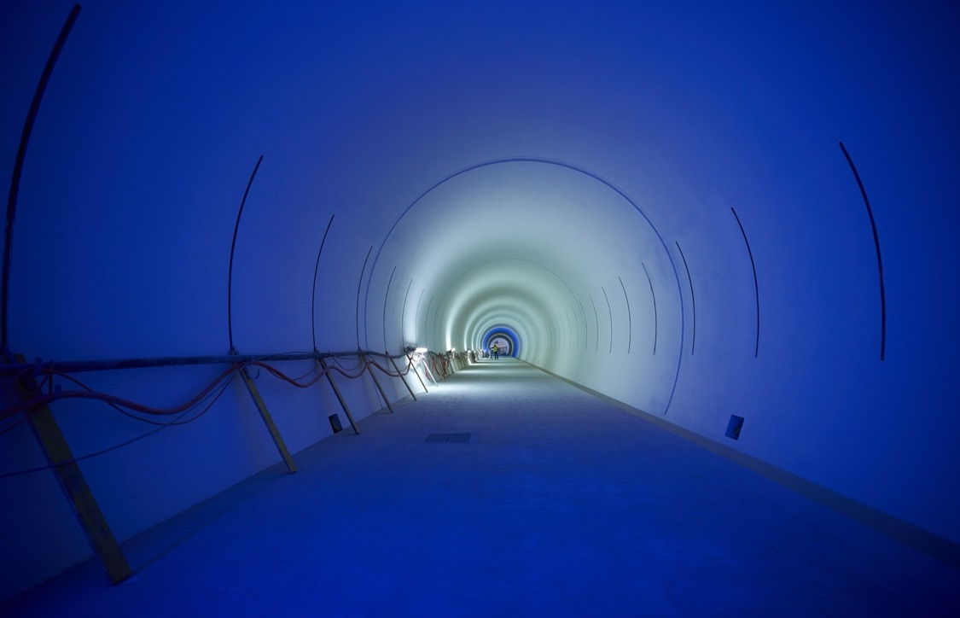
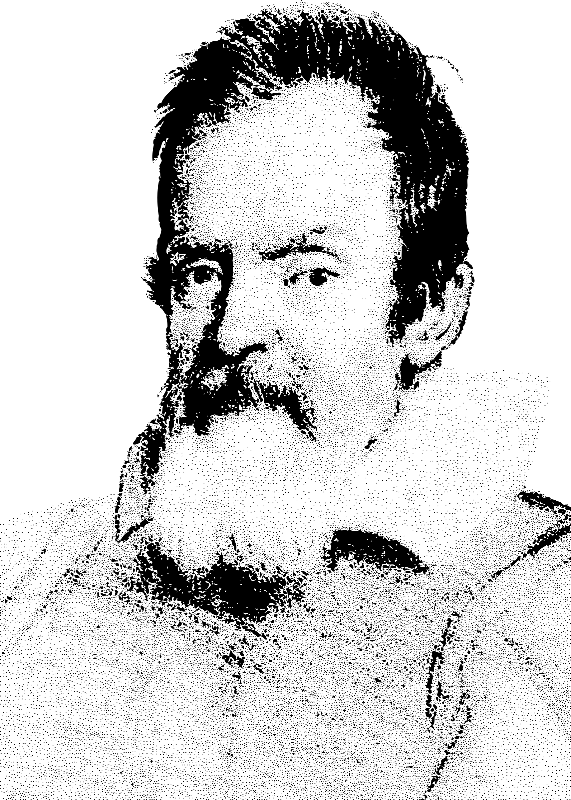

Lessons from HL-LHC to realise further big projects
Physics At The Highest Energies With Colliders
B. Di Girolamo, on behalf of the HL-LHC Project
Arcetri – July 28th 2025

Slide 2
Outline
Very short introduction LHC
HL-LHC ➔ key project goals and challenges
Specific points of attention
Lessons learned for future projects

Slide 3

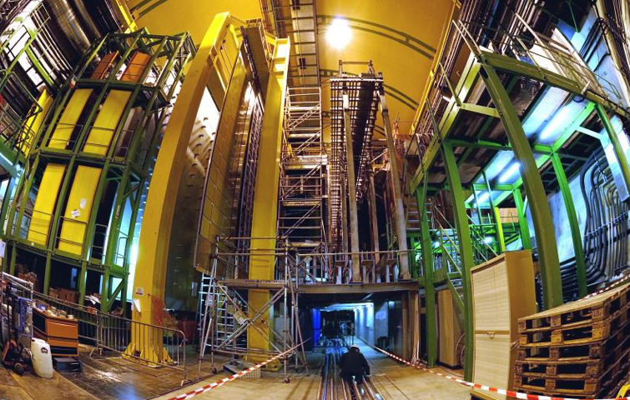


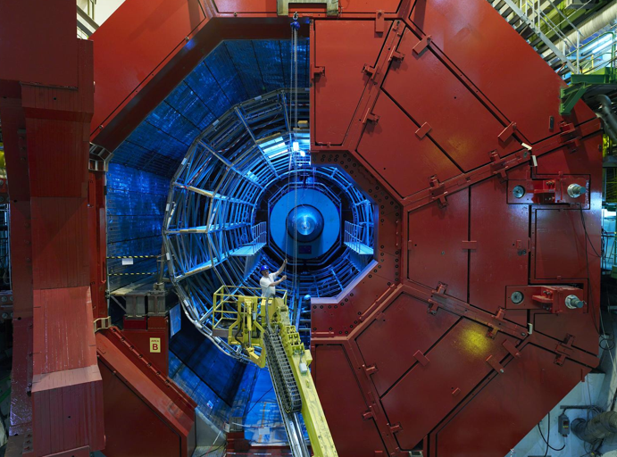

LHC in the Geneva Basin and its Experiments
LHCb
CMS
ATLAS
Features proton-proton and Lead-Lead and Lead-proton collisions!
[plus other ion species]
LHC ring:
27 km circumference
ALICE
22 km arcs with
Super Conducting Magnets

Slide 4
LHC Performance Goals
Collision energy: Higgs discovery requires E_{CM} > 1 TeV
p collisions E_{beam} > 5 TeV LHC: E = 7 TeV
[3.5/4TeV; 6.5TeV; 6.8TeV]
Instantaneous luminosity: rate of events in detector
rare events L > 10³³cm⁻²sec⁻¹ L = 10³⁴cm⁻²sec⁻¹
[2×10³⁴cm⁻²sec⁻¹]
Integrated luminosity: total number of events L
300 fb⁻¹ with 1barn = 10⁻²⁸m² and femto = 10⁻¹⁵
[389 fb⁻¹] -> [500 fb⁻¹]
depends on the beam lifetime, the LHC cycle and
‘turn around’ time and overall accelerator efficiency

Slide 5
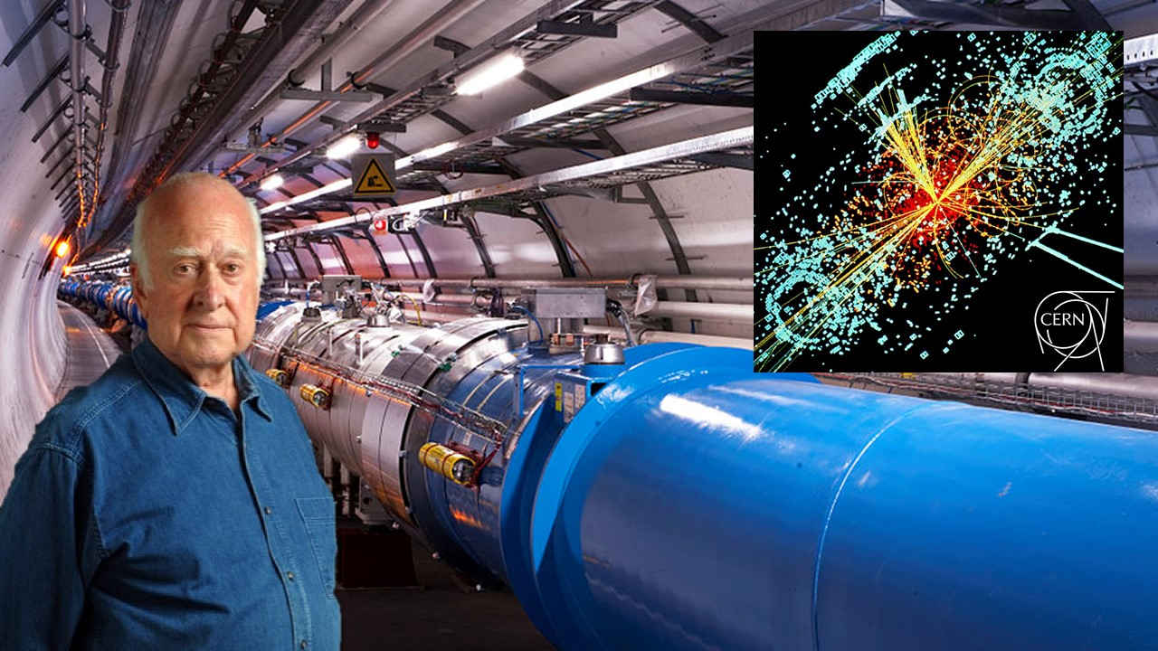
We found a new particle

Slide 6
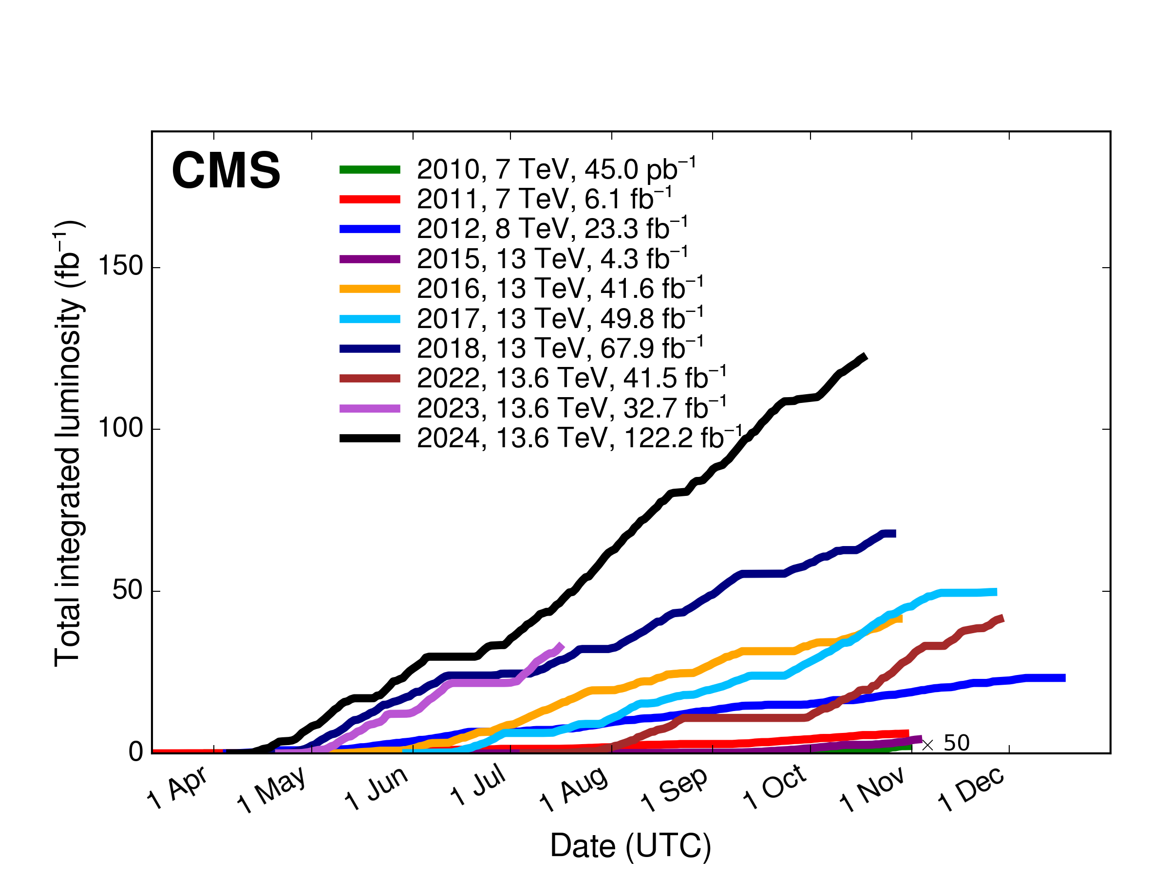
LHC Performance
Higgs discovery in 2012! ➔ But many questions remain and the search continues!!!
Higgs properties [coupling]
More than one Higgs?
BSM Physics? Dark Matter & Dark Energy?
Need for more Data and Statistics!!
➔ Over 389fb⁻¹ at 13 TeV so far during first 10 years of operation with
Higgs Discovery in 2012!
> 100fb⁻¹ / year at hand!!!
over 500fb⁻¹ by the end of LHC Run3 by mid 2026!!!
Doubling the statistical accuracy for the experiments implies 4 times the data volume!!!
over 20 Years of operation with current peak performance
Operation until 2055 with long shutdowns every 4 years!!!
So Why do we need an Upgrade?
HL-LHC goal: 10 times the LHC data Volume within 10 years
➔ operation from mid 2030 until 2041

Slide 7
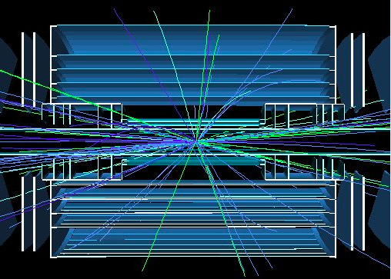
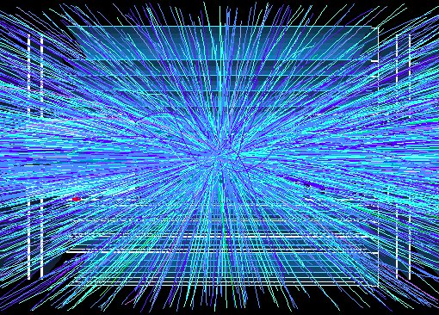
LHC Lifetime Limitation:
Debris from the IP & Radiation damage to magnets!
Implies overcoming several limitations in the existing LHC!!!
Cryo cooling of triplet magnets & radiation damage in triplet magnets & machine efficiency!
But also for the experiments!!
➔ Need for an Upgrade!
End of the LHC triplet lifetime by End Run3 in 2026
[over 500fb⁻¹]
Cold bore insulation
≈ 35 MGy
Q2
27 MGy
MCBX3 20 MGy
Need to replace triplets in the LHC after 2026 to keep the machine operational
➔ replace with design for higher performance!!!
HL-LHC goal: 10 times the LHC data Volume ➔ requires radiation hard magnets
that can tolerate over 3ab⁻¹!!!
7

Slide 8
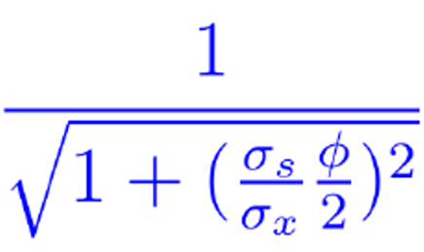


Higher Intensity
Increase bunch population
Increase F
Crossing angle reduction factor
Shorter bunches, smaller crossing angle, crab cavities
$$ℒ=\frac{N^{2}f_{rev}k_{c}}{4πβ^{∗}ε_{xy}}F$$
Smaller $β^{∗}$
Reduced emittance
Smaller beam size at IP

Slide 9
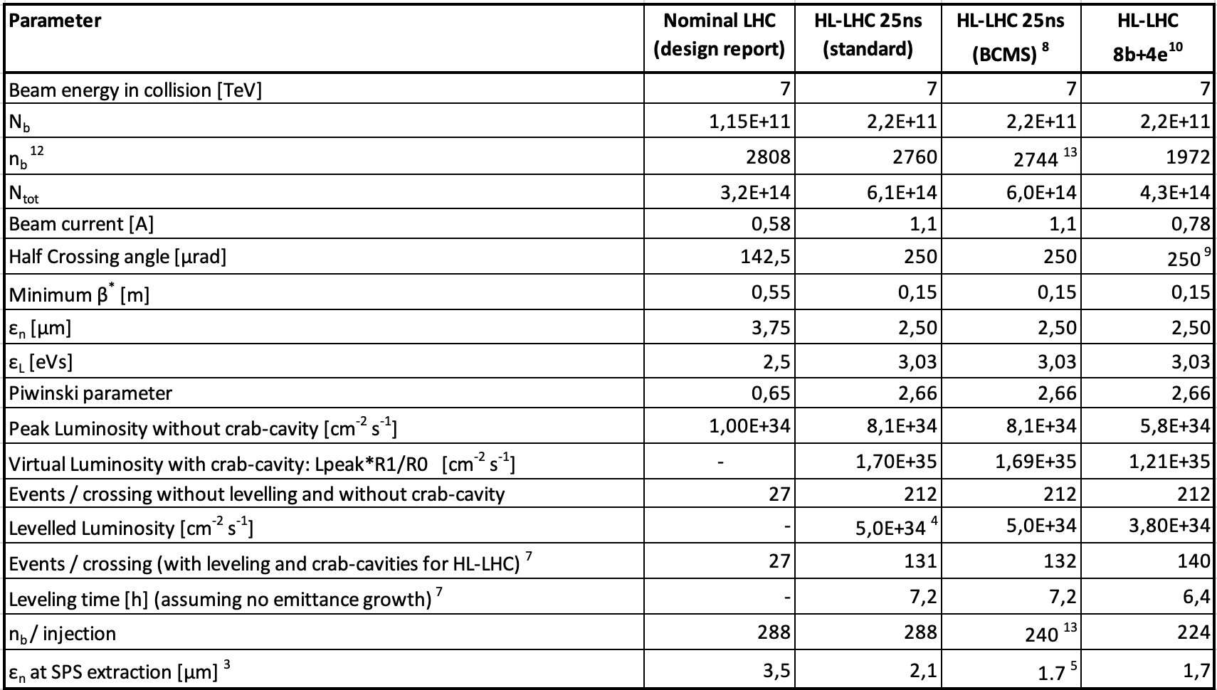
HL-LHC Design Parameters
LHC Magnet system
LHC injector complex
HL-LHC triplet magnets
HL-LHC crab cavities
Machine operation &
availability
LHC injector complex

Slide 10
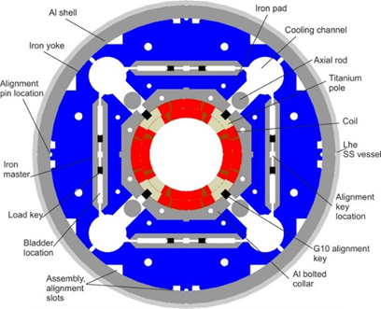
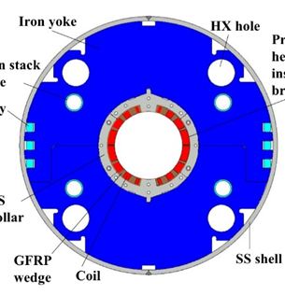
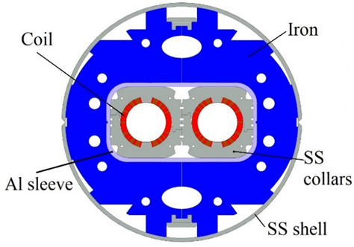
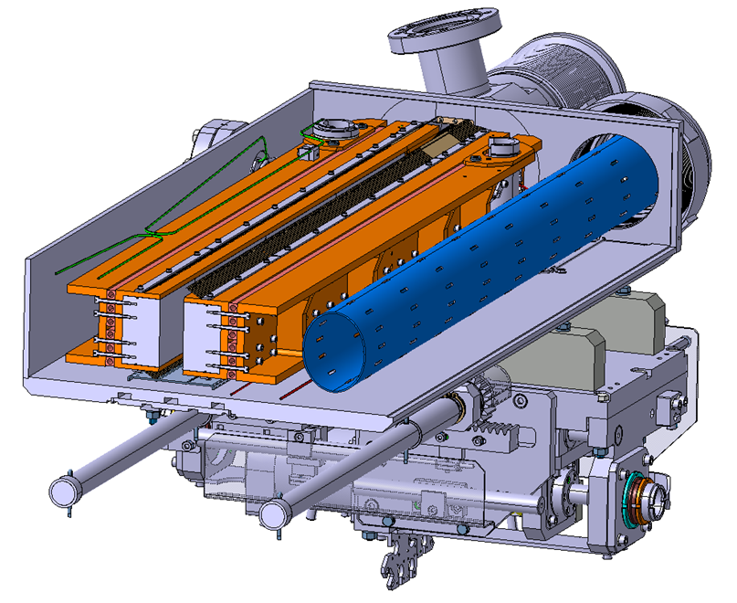
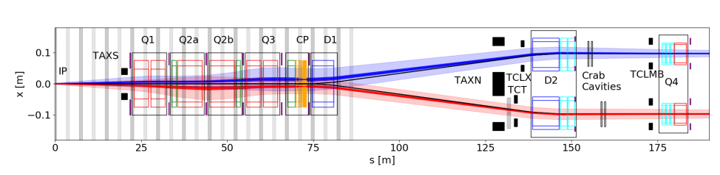
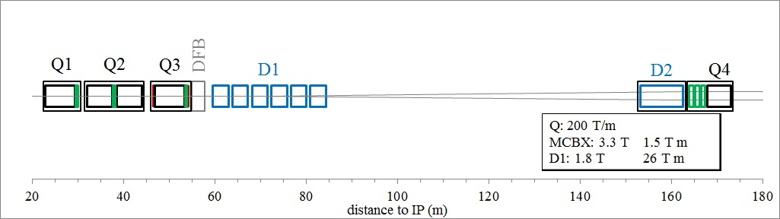
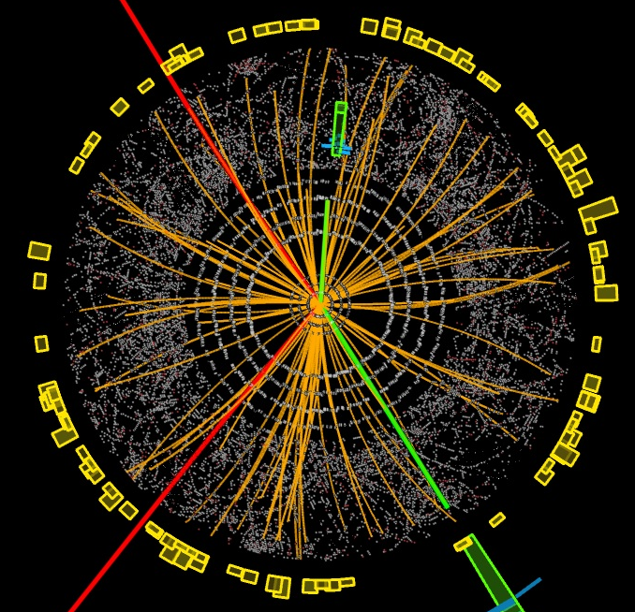
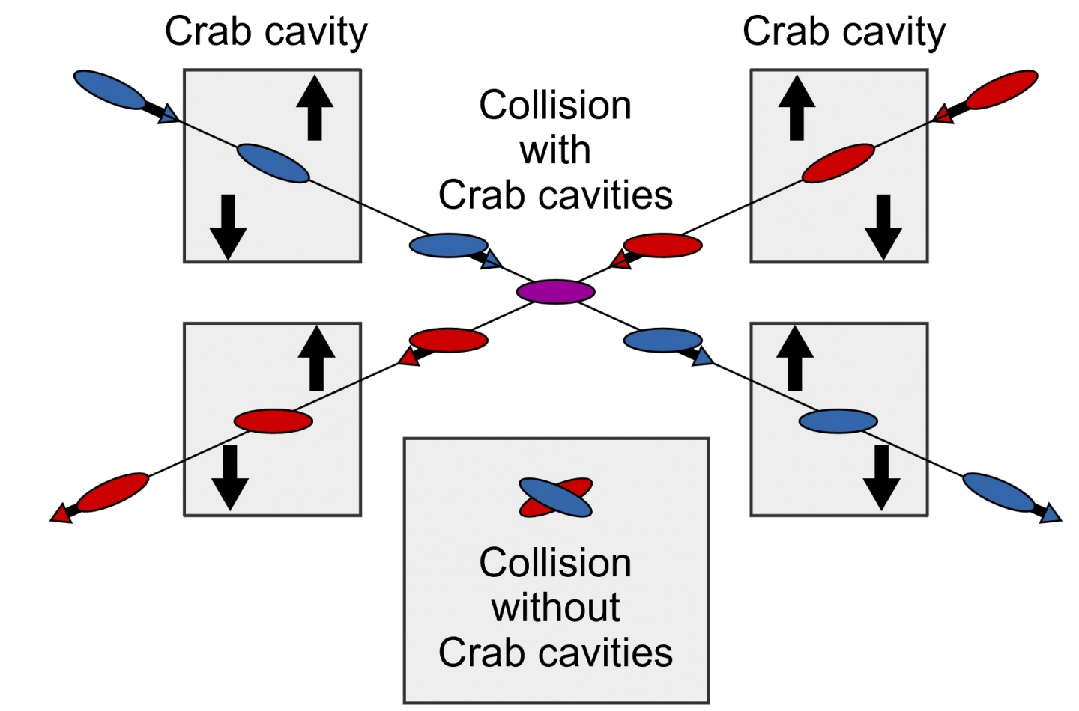
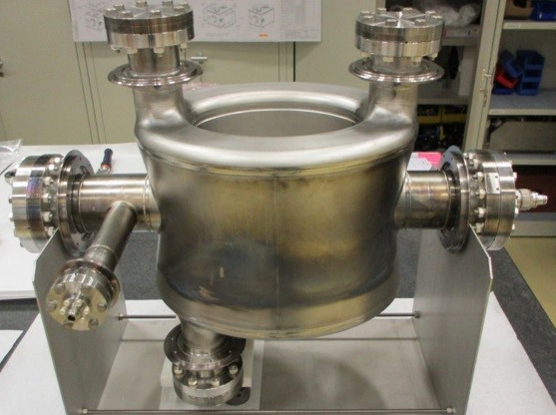
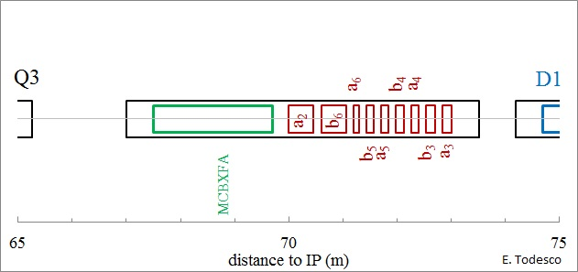
Scope
LHC TODAY
Peak luminosity L_{peak} = 2×10³⁴ cm⁻²s⁻¹
Integrated luminosity in 10 years 300-350 fb⁻¹
HL-LHC
LHC TOMORROW
Ultimate peak luminosity 7.5×10³⁴ cm⁻²s⁻¹
Integrated luminosity in 12 years L_{int} = 4000 fb⁻¹
Recombination dipole
Collimators
Inner triplet Nb₃Sn focusing Quadrupoles, handle more intense beam, withstand higher radiation, are longer to improve beam stability
Separation dipole with correctors, for smooth transition btw arc dipoles and final focusing
Q1/Q3, Q2
D1
D2
Interaction region HL layout
TAXN, TAXS target absorbers
Corrector package (orbit and multipole)
crab cavities

Slide 11
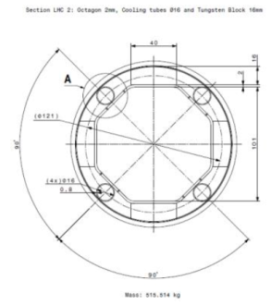
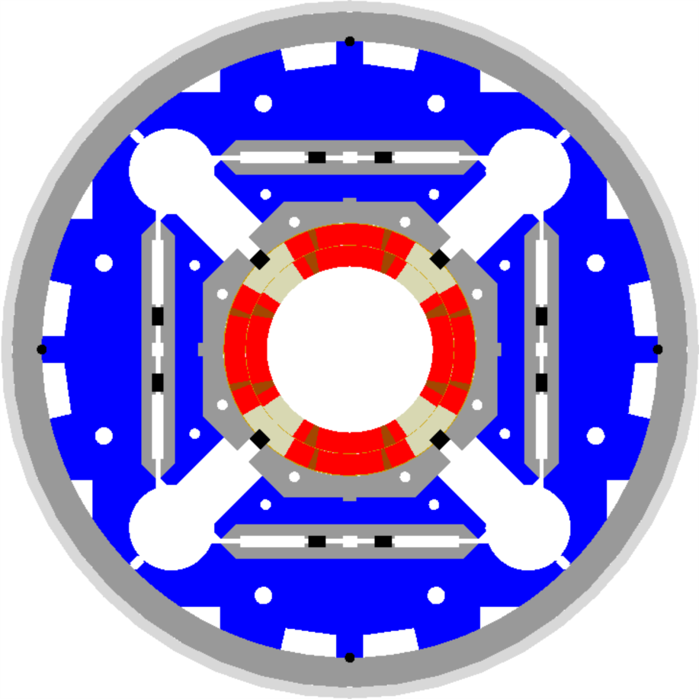
HL-LHC technical bottleneck:
Radiation damage to triplet magnets
Tungsten blocks
Need to replace existing triplet magnets with radiation hard system such that the new magnet coils receive a similar radiation dose @ 10 times higher integrated luminosity!!!!! ➔ Shielding!
US-LARP MQXF magnet design
Based on Nb₃Sn
technology
Requires larger aperture!
70mm at 210 T/m ➔150mm diameter 140 T/m
8T peak field at coils ➔ 12T field at coils (Nb₃Sn)!!!
➔ New magnet technology!
➔ New, brittle superconductor!
Capillaries
➔ Longer magnets
➔ New Superconductor

Slide 12
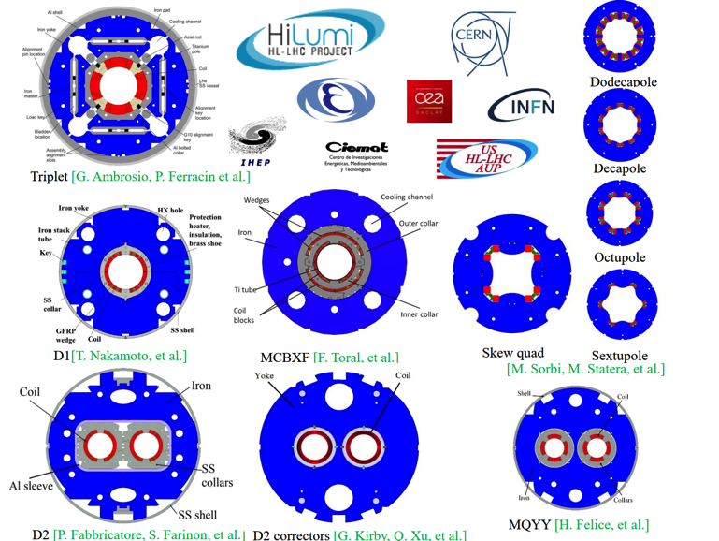
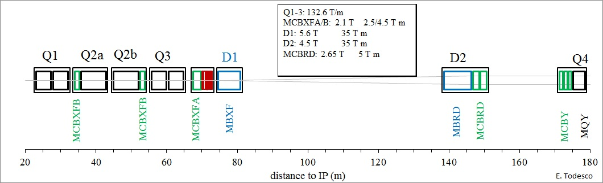
WP3 Magnet Scope
Design, engineering, construction, test and installation the Insertion Region (IR) magnets of IR1 and IR5 for the HL-LHC upgrade.
  Q1/Q3 cryomagnets: from AUP (US)
  Q2: from CERN
  MCBXF nested corrector magnets: from CIEMAT (Spain)
  HO corrector magnets: from INFN-LASA (Italy) [completed]
  D1 cold masses: from KEK (Japan)
  D2 magnets: from INFN-Ge (Italy)
  D2 corrector magnets: from IHEP (China)
  DCM: from CERN

Slide 13
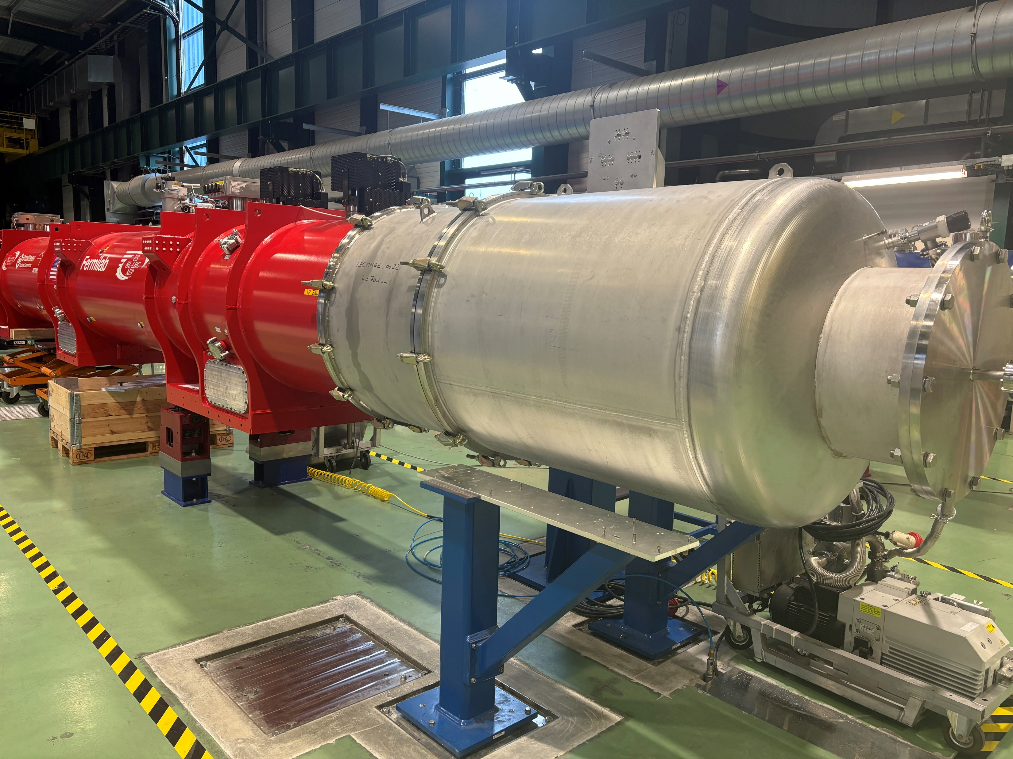
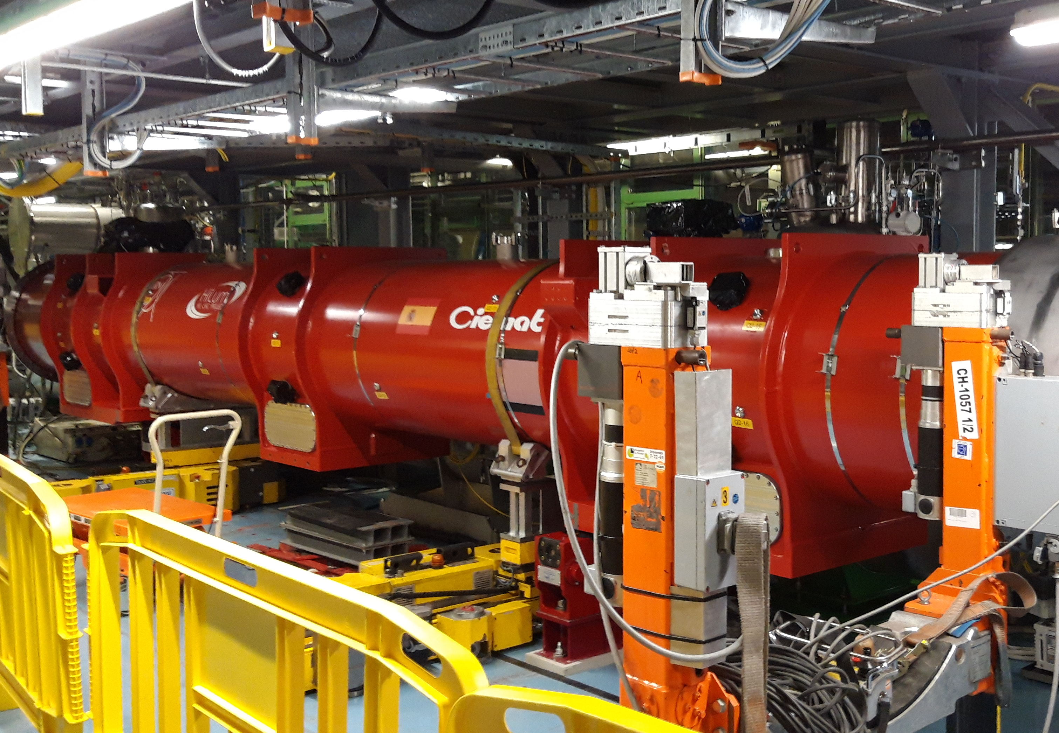
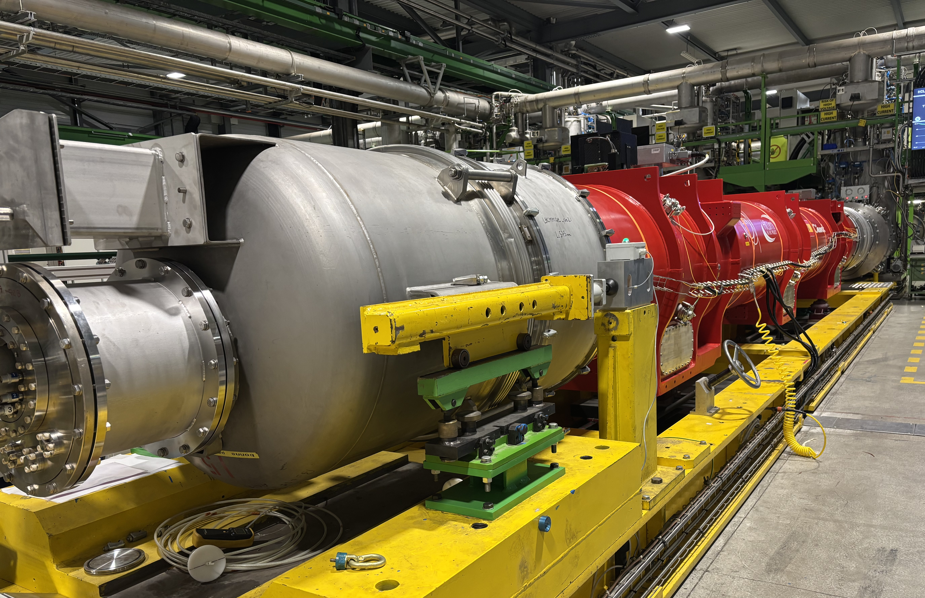
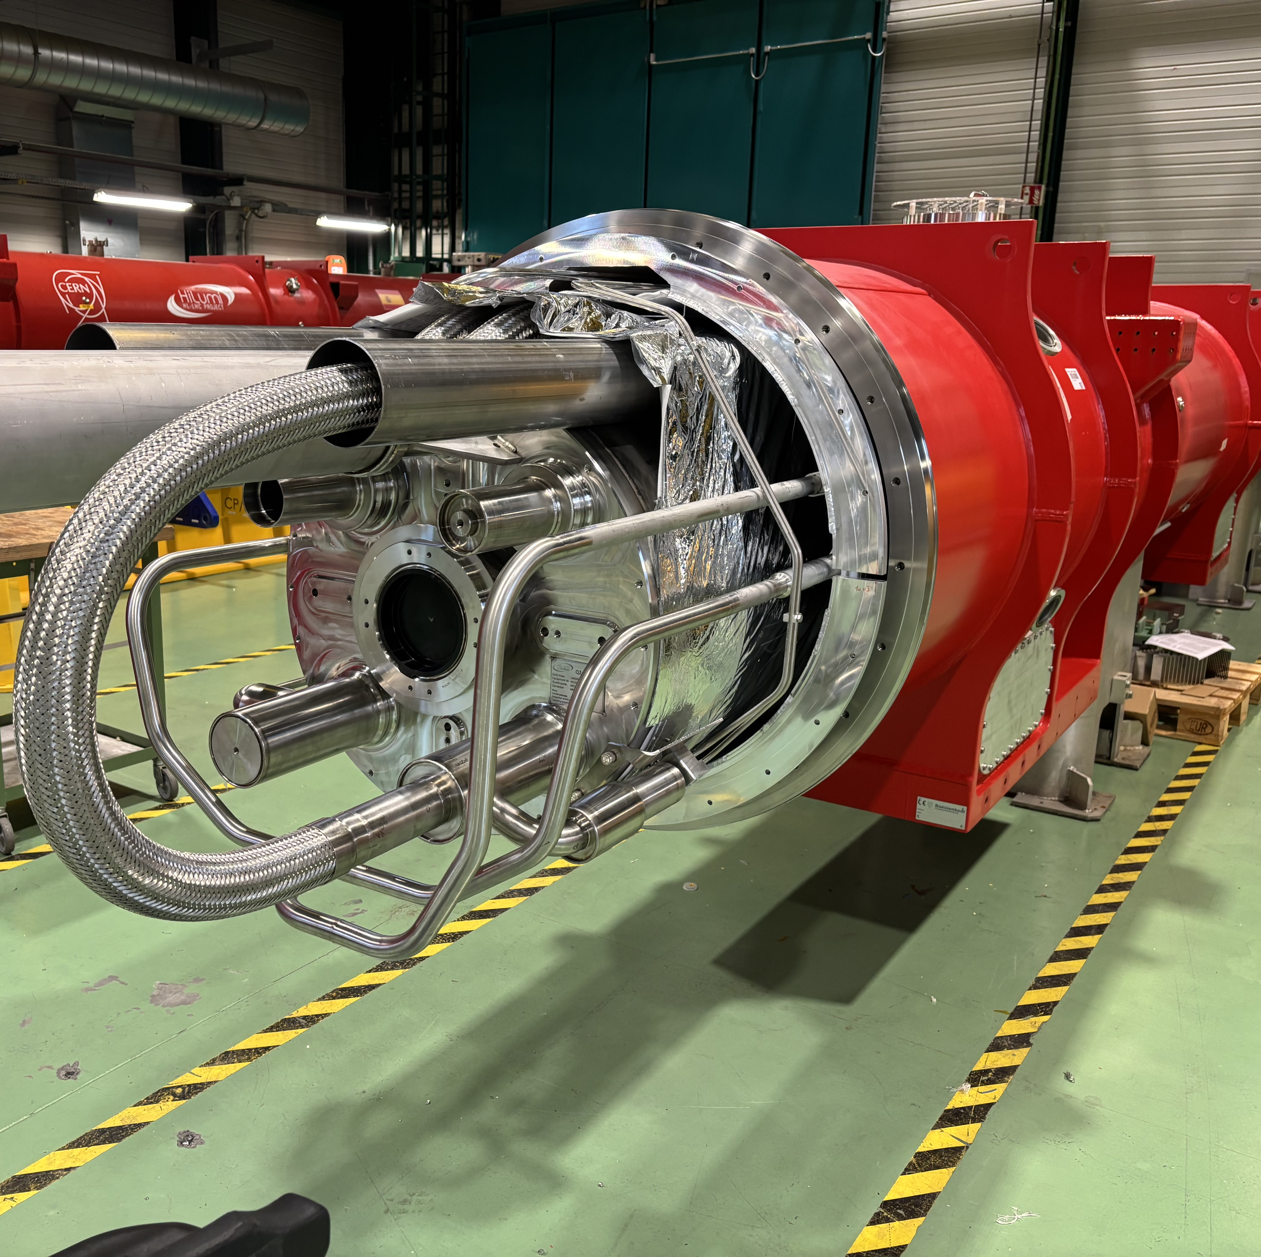
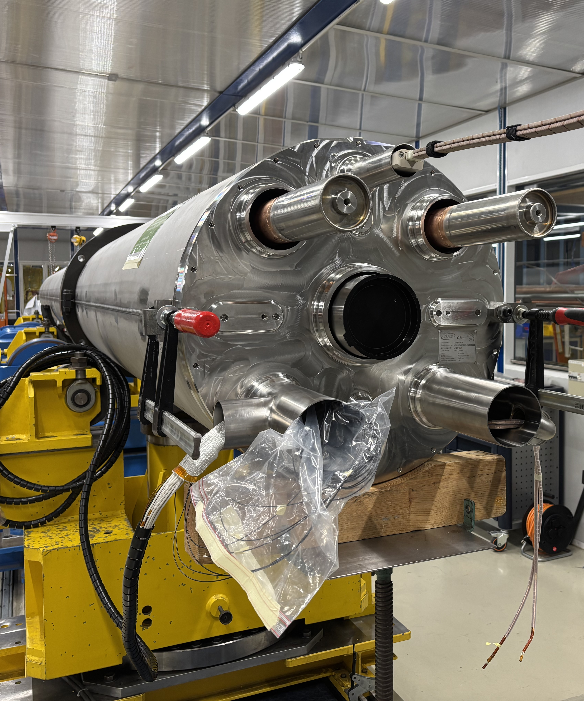
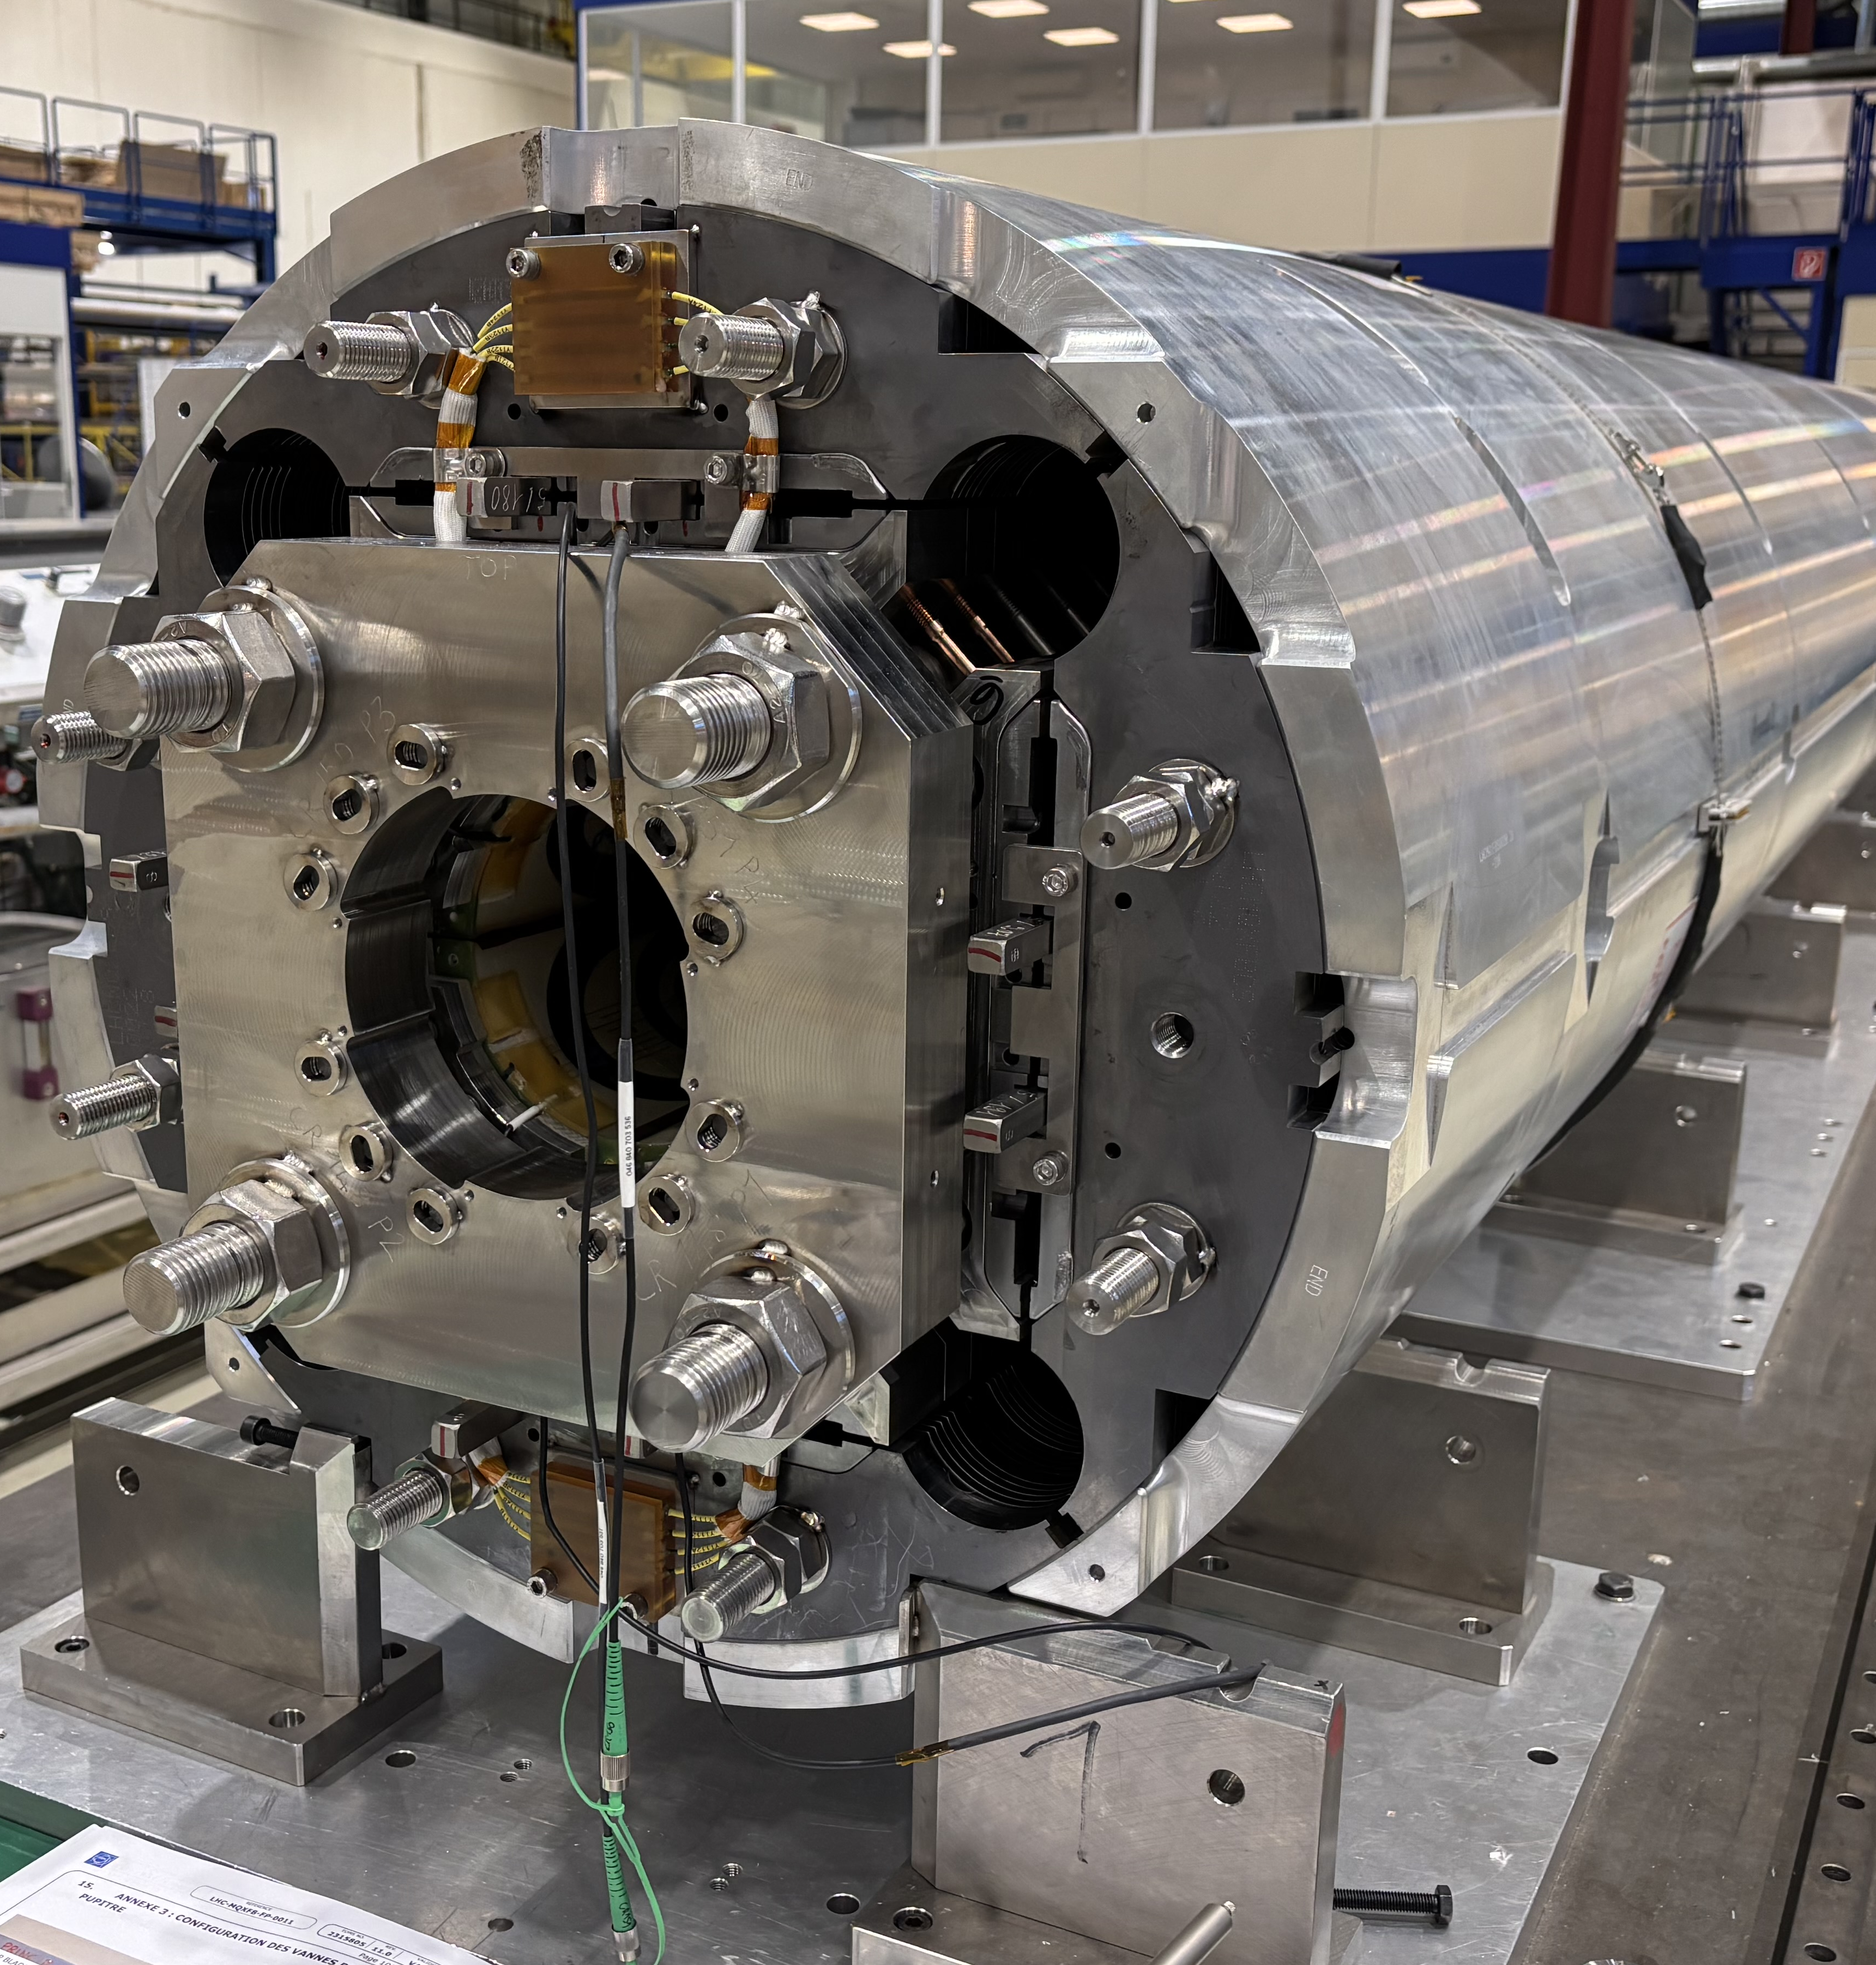
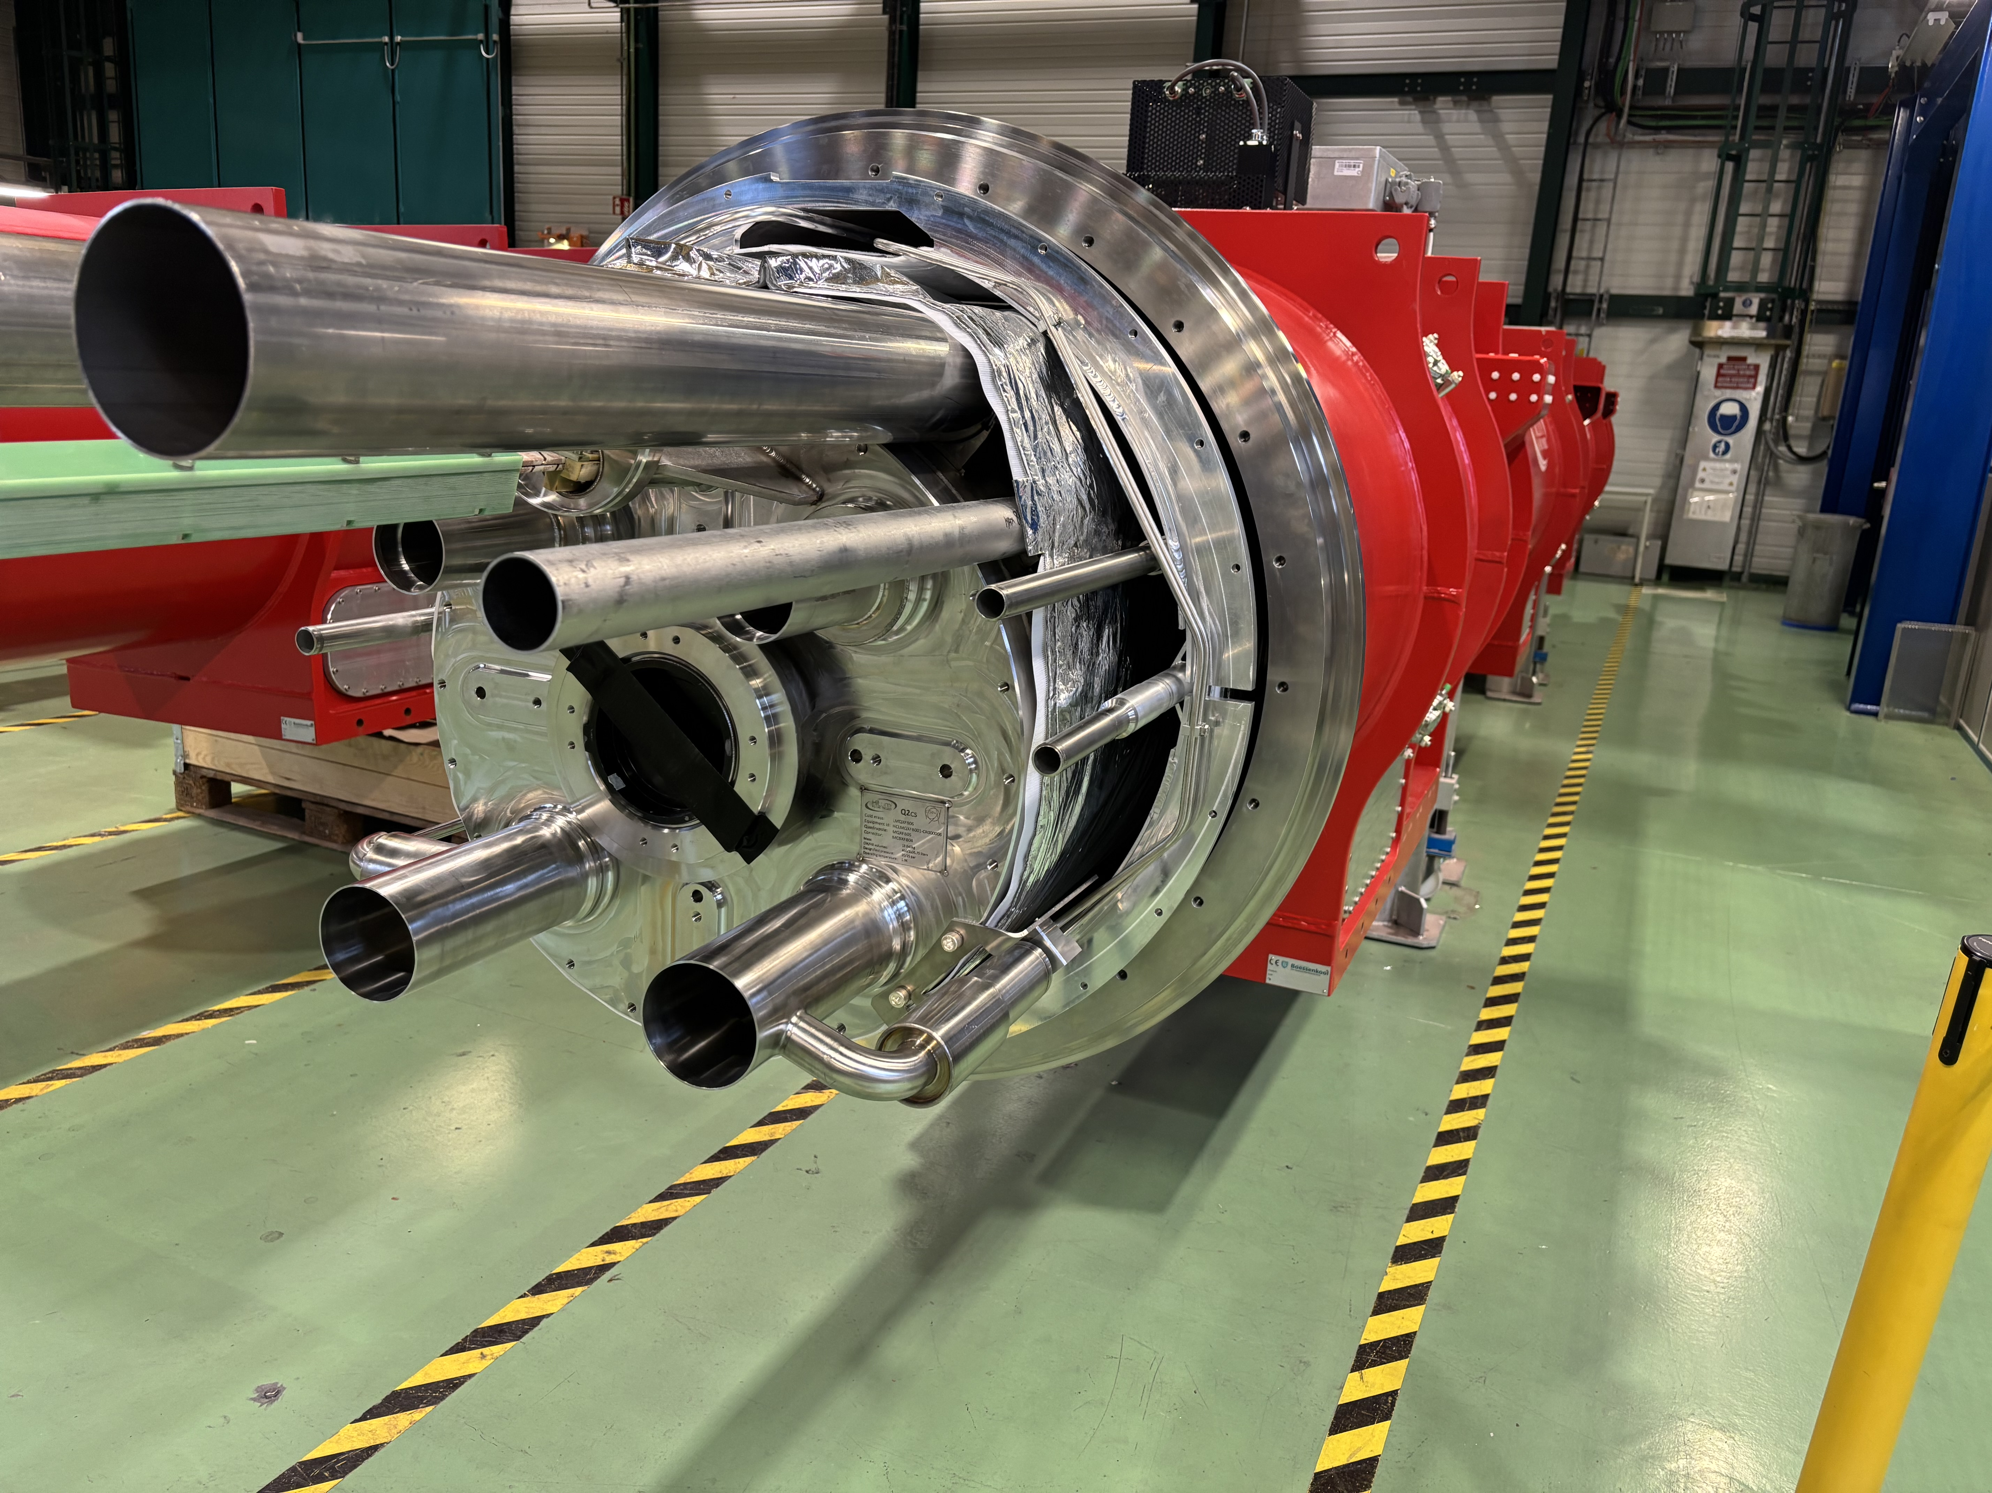
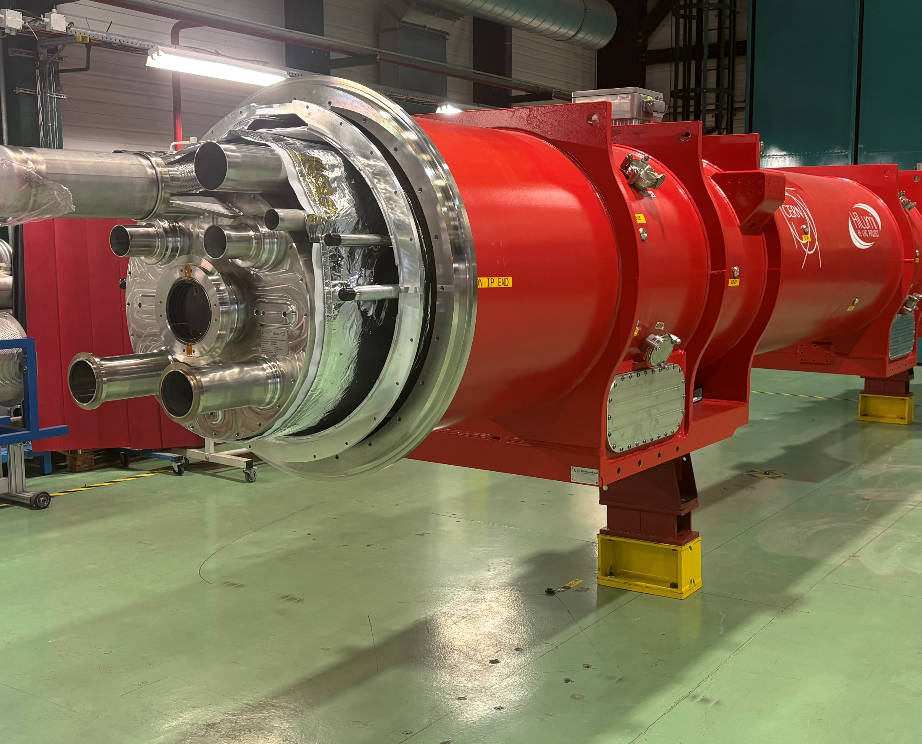
Q2 – Overall status
At full production speed! Ca. 50% of Cold-Mass-Assemblies done
MQXFBP2: being prepared for the HL-LHC string
MQXFBP3: in the HL-LHC string
MQXFB03: test ongoing
MQXFB04: fully qualified for HL-LHC ✓
MQXFB05: fully qualified for HL-LHC ✓
MQXFB06: cryostating ongoing
MQXFB07: cold mass finishing
MQXFB08: magnet assembled
3 more magnets to build (B10-B12)

Slide 14
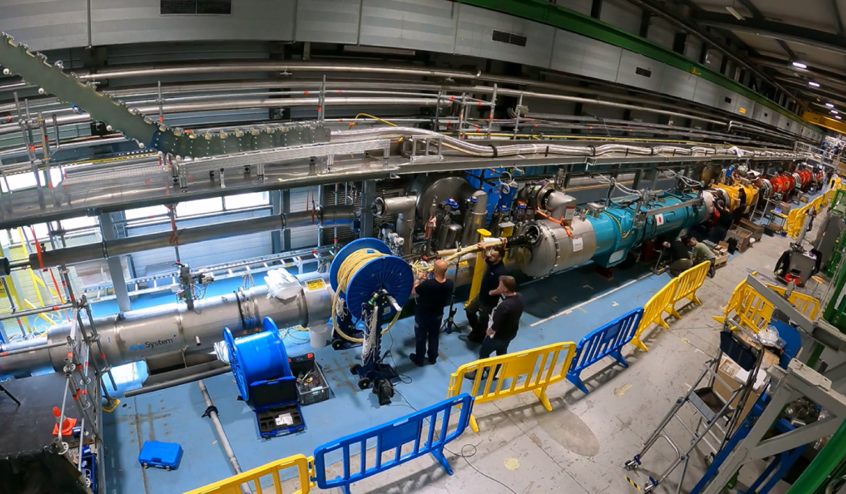
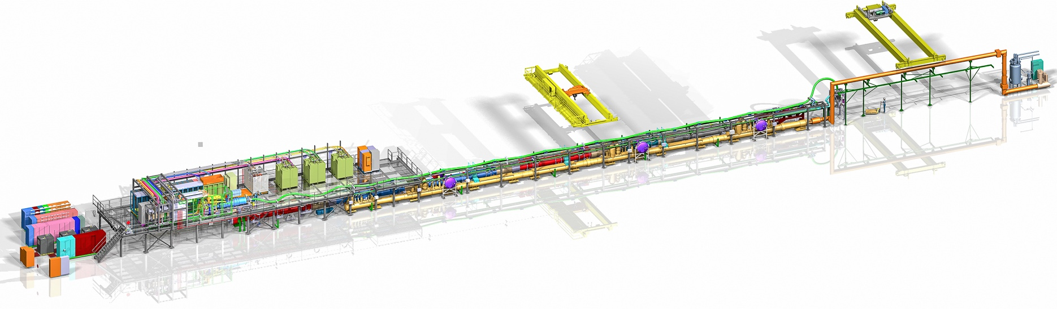
The IT STRING Scope
The scope of the IT STRING is to represent, as best as reasonably achievable in a surface building, the various operation modes to STUDY and VALIDATE the COLLECTIVE BEHAVIOUR of the different systems of the HL-LHC’s IT zone (magnets, magnet protection, cryogenics of the magnets and of the superconducting link, magnet powering, vacuum, alignment, interconnections between magnets, and the superconducting link itself).
To reality!
Installation of IT-String is now completed.
Cooldown expected after summer, Hardware Commissioning to start in October 2025
The IT STRING will deliver the first complete experience of installing and operating the IT zone

Slide 15
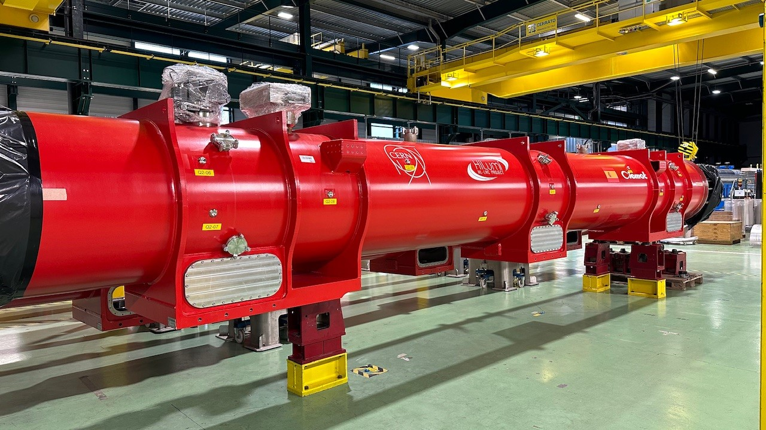
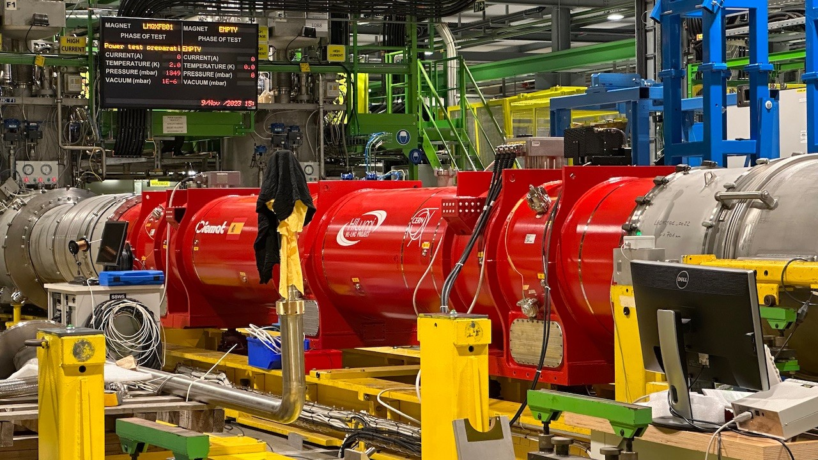
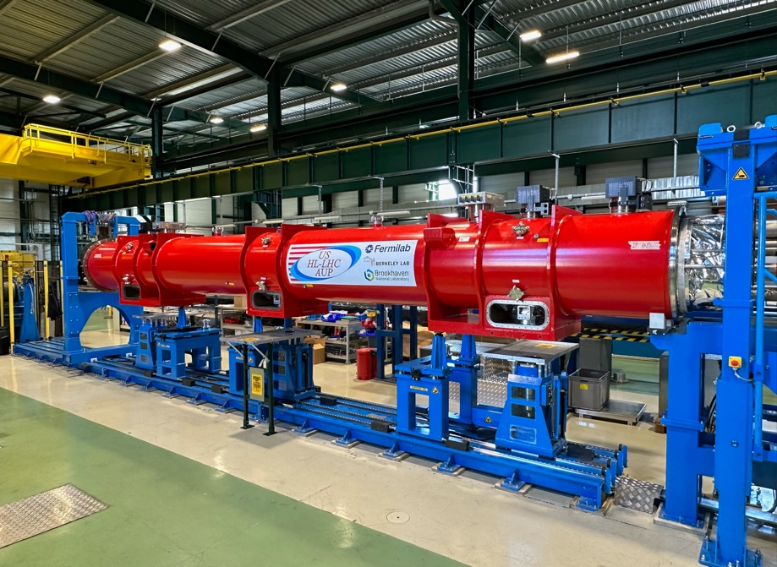
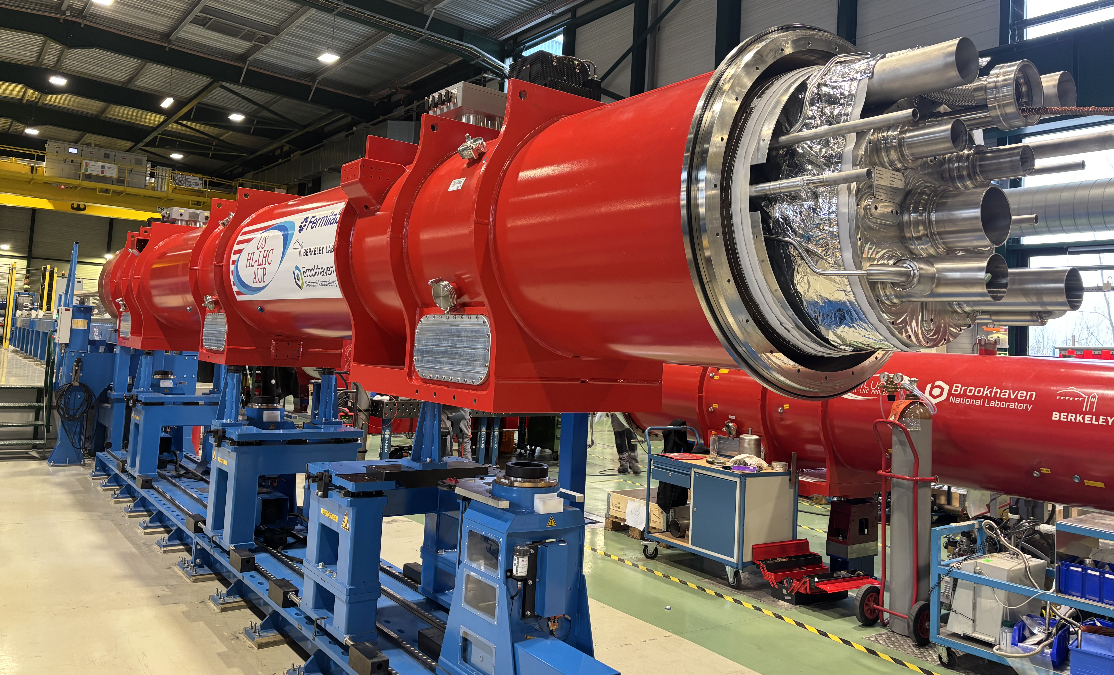
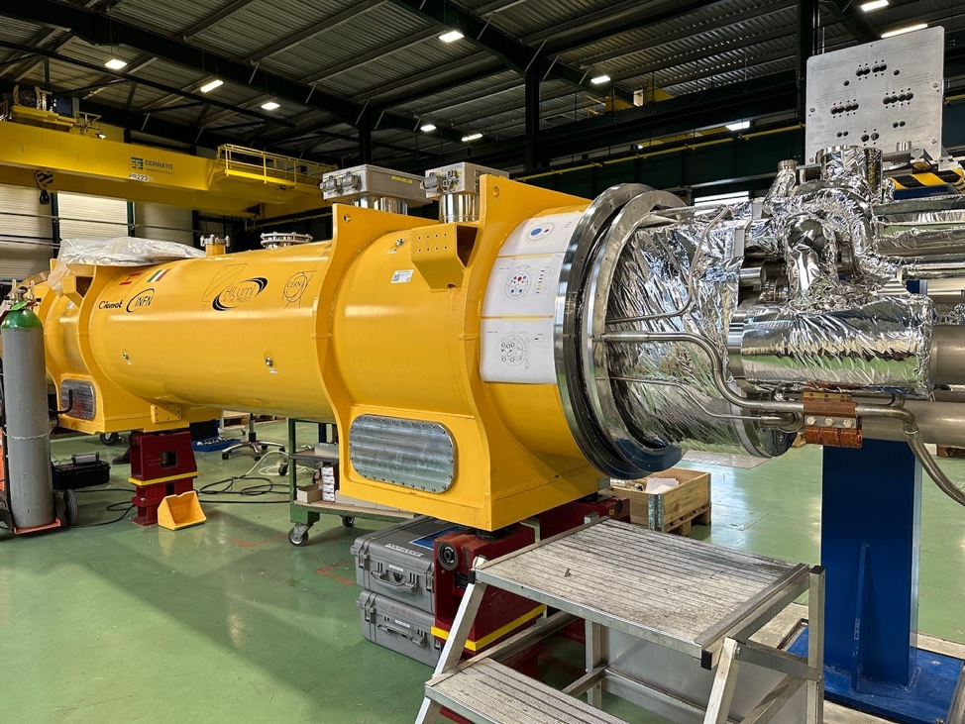
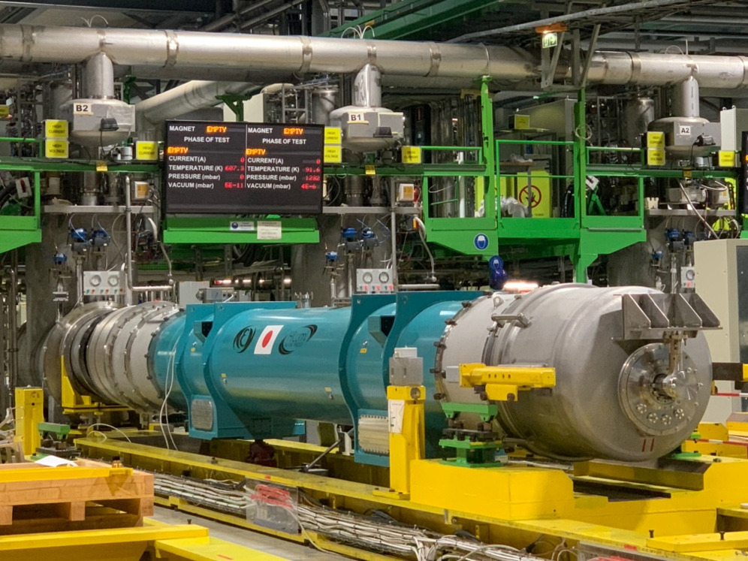
Magnet Validation for IT-String

Slide 16
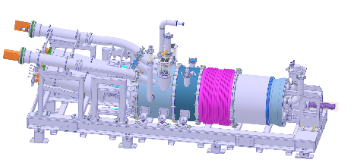
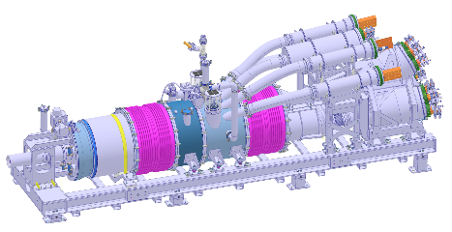
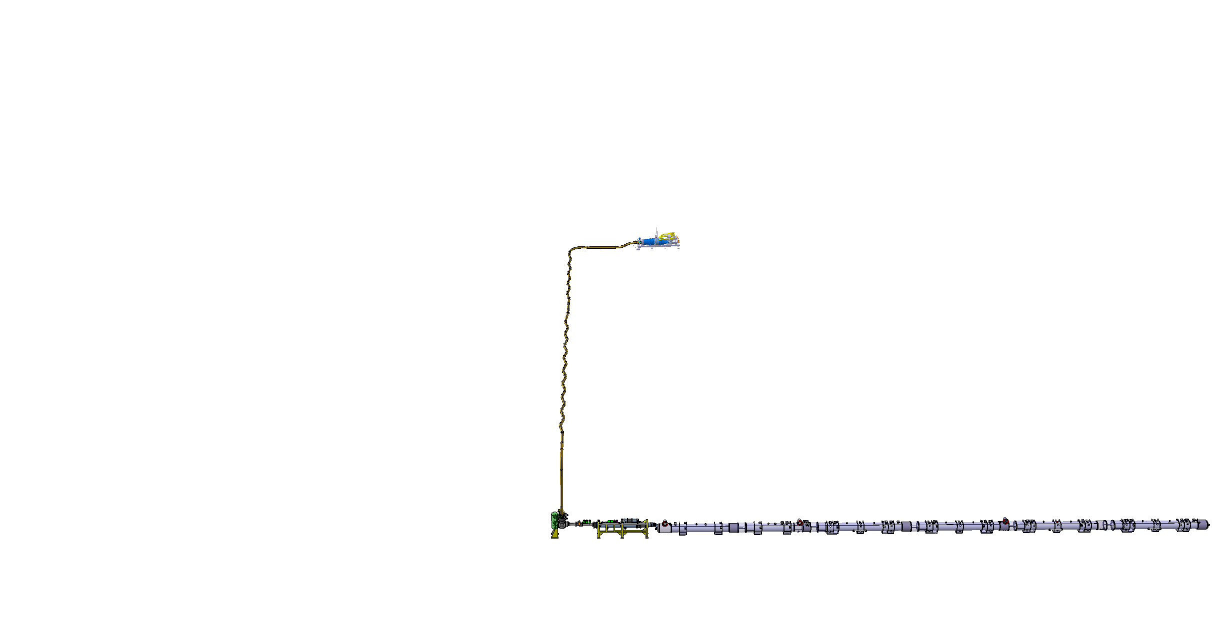
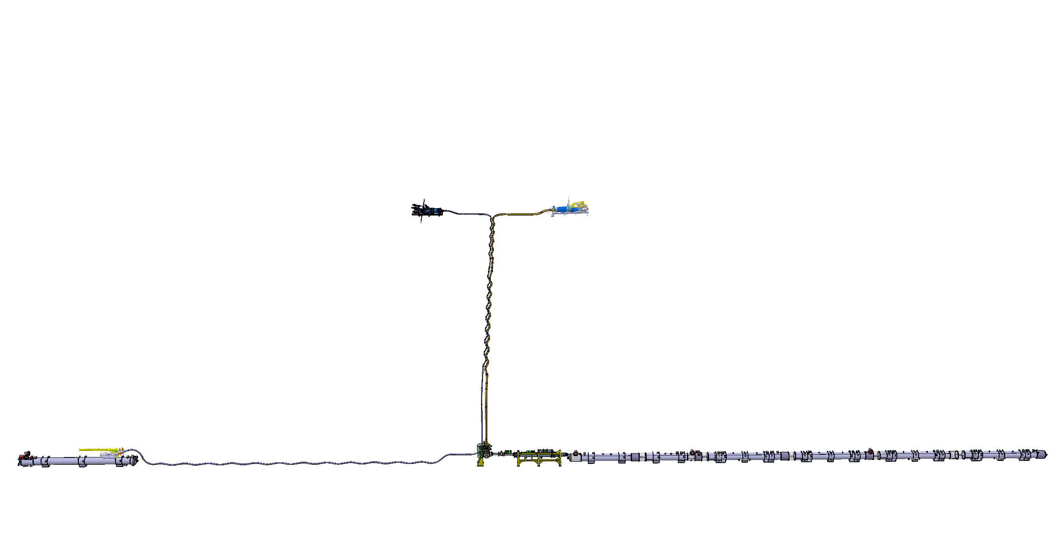
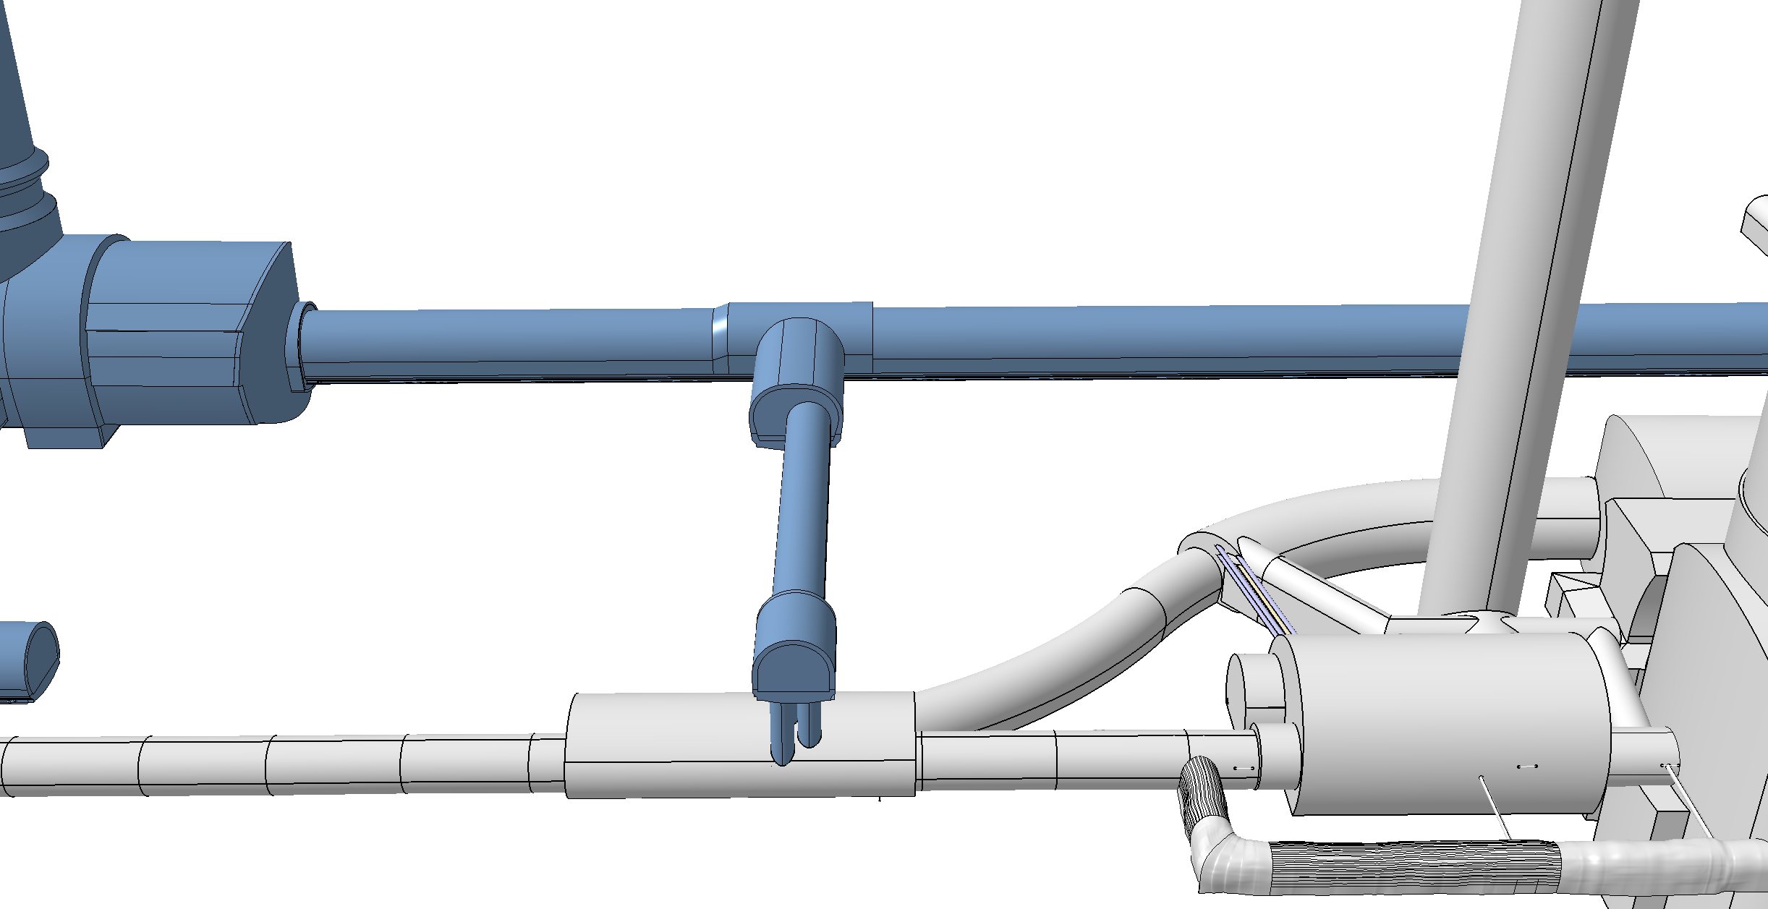
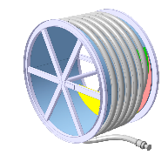
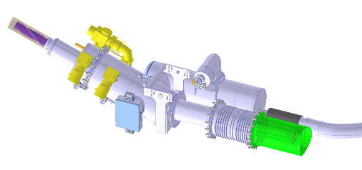
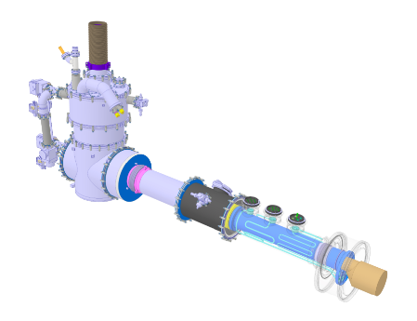
Cold Powering System
Superconducting link to minimize thermal losses when transporting over 100kA over 100m!
High Temperature Superconductor, MgB₂ operating at ca. 20K to 30K
Cooling with gaseous He from liquid He boil off
DFHM
DFHX
Power converters: (18, 0.6) kA
Power converters: (18, 7, 2) kA
DSHM
DSHX
140 m
89.5 m
Power converters: (60, 120, 200) A
D2
DCM
D1
CP
Q3
Q2B
Q2A
Q1
DFM
DFX

Slide 17
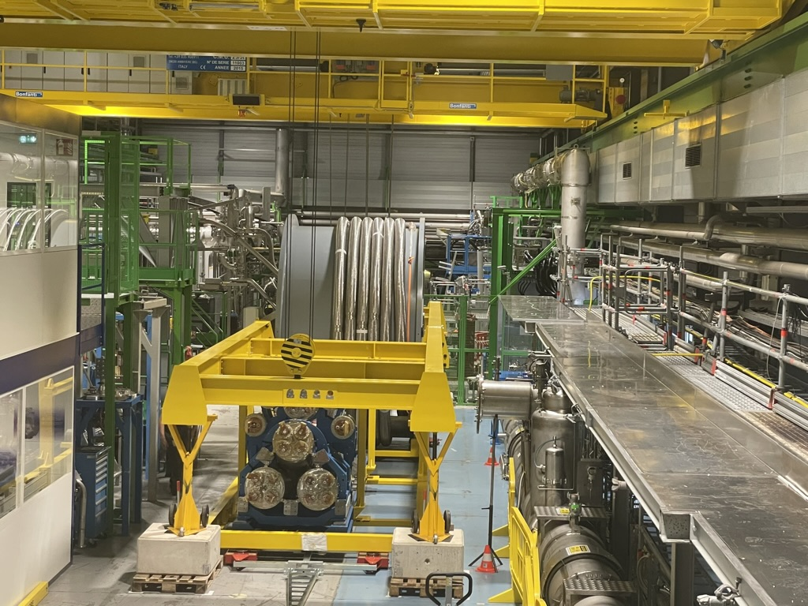
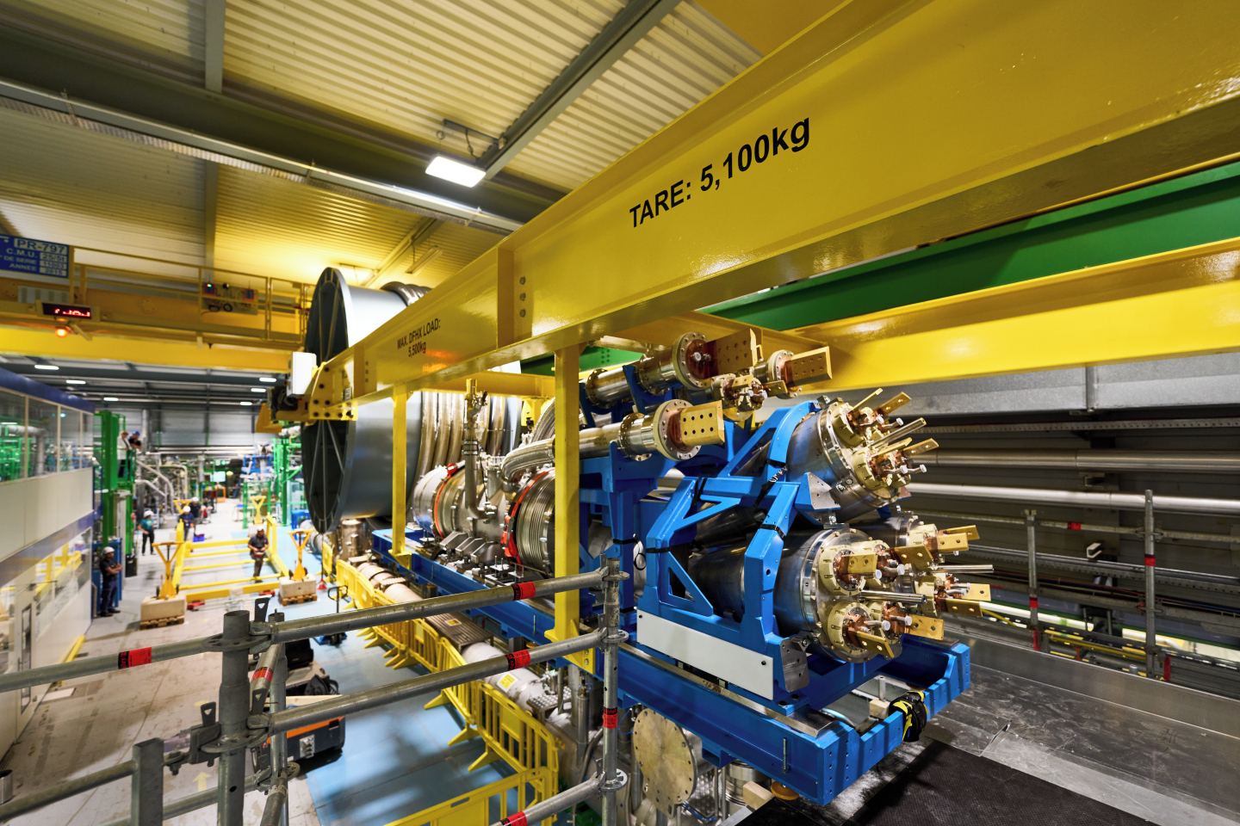



Sc Link INSTALLATION IN THE IT STRING

Slide 18

HL-LHC Upgrade Ingredients: Crab Cavities
Geometric Luminosity
Reduction Factor:
Crab Cavities:
Reduces the effect of geometrical reduction factor
Independent for each IP
Noise from cavities to beam
➔ Beam size; losses and
phase control!!!
Challenging space constraints:
➔ requires novel compact
cavity design
effective cross section
nom HL-LHC
nom LHC
early LHC

Slide 19



HL-LHC cavity designs
RF Dipole: Waveguide or
waveguide-coax couplers
2 Designs with
Different Coupler concepts and
for crossings in the vertical and
horizontal planes
Double ¼-wave: Coaxial couplers with
hook-type antenna
Present baseline: 4 cavities / IP / side ➔ 16 total
Present baseline: 2 cavities within one common cryostat ➔ need 4 cryo-modules per CC type

Slide 20






DQW Crab cavity cryo-module for installation in the SPS
20

Slide 21

First proton crabbing ever!
Beam TEST in SPS ongoing between 2018-2023
Study and R&D
has been very useful to obtain this result

Slide 22

New underground galleries and surface buildings for technical infrastructure finished!
➔ Installation of services ongoing

Slide 23




Completion of CE on January 20th 2023
Notes:
To be updated with latest plans for Ceremony

Slide 24



Technology
Landmarks
Series production started
in Industry
First series magnets delivered to CERN
Nb-Ti Technology
Separation / Recombination
dipole magnets: D1 & D2
Finished in 2023
New Civil Engineering
~ 1 km of LHC modified
Finished in 2023
Fully validated in 2023 and first magnets ready for installation
Complete Prototype System validated in 2024
Prototype validated by CERN &
Half of series [3/6] completed
½ system already installed for Run3
Successfully deployed in 2023 Pb-Pb run

Slide 25


HL-LHC physics production
Ions physics run recently approved in 2031-2041
Expected target reduced from 3000 fb⁻¹ to 2771 fb⁻¹
How could 3000 fb⁻¹ could be recovered?
Machine could provide higher pile-up to compensate, if requested by experiments
Limit considering engineering margins PU = 200

Slide 26
Physics opportunities at HL-LHC
Both experiments and theorists are systematically exploring the physics potential of the HL-LHC, identifying new opportunities and achievable goals while assessing potential limitations
The HL-LHC offers several key advantages
  A vastly larger dataset
  Reduced statistical uncertainties
  Lower experimental systematic uncertainties, thanks to larger calibration datasets
  Decreased background uncertainties, achieved through precise high-statistics control measurements
  Enhanced detector capabilities, such as forward tracking and improved timing
A wide program is planned for HL-LHC!
  Precise characterization of the Higgs boson (precise measurements of its properties and search for sign of BSM physics)
  Detailed exploration of electroweak SM and top sectors (precise measurements and rare signature observations)
  Dedicated searches for BSM physics (long-lived particles, DM, heavy resonances)
  QCD (and high-density QCD) measurements
  Flavour Physics program

Slide 27


Higgs factory (~180 million Higgs)
Just an example
ggH can be measured at ~2%
WH can be measured at ~6%
Gauge boson decays can reach ~3% precision
Fermion decays (bb,ττ) can reach ~3-4%
μμ can be observed with ~8%
In several cases the uncertainties will be dominated by theory
arXiv:1902.00134

Slide 28
Lessons learned from a 1.2 BCHF CtC project

Slide 29
The obvious recipe
It takes time and it needs money
It needs a sustained international interest and support of the scope
It needs international collaborations
It needs a careful Project Management, a robust Quality Plan, a rigorous and flexible Budget and Schedule

Slide 30
TIME MANAGEMENT

Slide 31

EU funded HiLumi
Design Study
Approval of
HL-LHC Project
We are here
HL-LHC Operation
Run3 operation
~1 year until start of Long Shutdown 3
> 80% of the project budget of ~1.2 BCHF already committed
The project is ready for installation start in mid 2026!

Slide 32

High Field SC Magnets
Magnet development requires substantial R&D effort!!!
Transition from NbTi to Nb₃Sn:
HL-LH lead the R&D for 11-15T magnets based on Nb₃Sn technology:
➔15-20 years R&D program
Transition to HTS:
Assume R&D period of similar siz
e ➔ 2035?
HLHL
Ca. 30 years of NbTi magnet R&D leading up to the LHC dipole magnets!
FCC-hh
Transition from NbTi to Nb₃Sn: requires similar length of R&D!
HL-LHC led the R&D for 11-15T magnets based on Nb₃Sn technology:
Started in early 2000
➔15-20 years R&D program
➔ Ready for installation in 2028
HL-LHC magnet
Installation from
2028 to 2029
32

Slide 33
SCHEDULE Management
We work with 2 different schedules
Equipment readiness schedule
Long shutdown 3 schedule
Float:
Time lag btw READY and NEEDED for installation

Slide 34


Equipment readiness Schedule: Bottom-up
Each WP manages its In-work schedule
Data are exchanged with Monitoring & Control Office
The HL-MCO manages:
Schedule baseline
Isochrone line
Schedule change
Interlinked deliverables
Project master schedule
Critical/ sub-critical path
Schedule margins via installation plan
EVM provides complementary monitoring

Slide 35




Master Schedule – LS3 shift
Impact of LS3 shift
YETS 2025-26
LS3 LHC start shifted to 2026 and extended
Start delayed to the 29th of June 2026 for the LHC
Duration beam to beam in the LHC: 47 months (+4.5 months wrt long term revision 4.0)
Long Term Schedule v.4.1 Engineering Check (ACC-PM-MS-0004)
still 4.5 months to be gain
development
specifications
Master Schedule In Work CSR2024
fabrication
assembly
test
installation
commissioning
upgrade

Slide 36

Long shutdown Installation schedule
zone
LSS dismantling after cryo lockout
  Beam vacuum, magnets, collimators, QRL dismantling and transport
Warm-up and related tests
Cabling and CV dismantling
  Optical fibre duct cut and displaced, de-cabling and EN-EL infrastructure dismantling
  Piping dismantling
LSS dismantling and transport after
cryo lockout
Cabling and CV dismantling
Core excavation
  Core excavation and Minor Civil Engineering work
Cabling and CV installation
  Power cable infrastructure installation (from core excavation to QXL installation)
  Piping installation
Cabling and CV installation
LSS installation, including transport
LSS installation, including transport – QXL and SC link
  QXL installation + Cold test
  SC link(DSHX/M) unspooling (after first QXL installation)
Cabling installation
  Optical fibre installation, re-cabling, pulling/blowing cables and test
Cool-down, related test & HWC
LSS installation, including transport –accelerator elements
  Beam vacuum, magnet, Crab cavities, collimators, TAXN, DFX/M, …

Slide 37
BUDGET MANAGEMENT

Slide 38



Budget figures
108.9
Budget At Completion | 1,178
CERN funds | 1,069
In-kind | 94.4
External funds | 14.5
MCHF
Procurement of the scope financed by cash contribution is managed by CERN
~9%
1,069.0+14.5
=1,083.5
1178.0

Slide 39


Resources
Industrial support contracts, not appearing as workforce, but as CHF (labour hours)
Long Shutdown
  1,790
  2,230
= 4,020 FTE
Per WP
Per year

Slide 40

BAC evolution
kCHF
Indexation, insourcings, LS3 shift cost
Cryogenic contracts
Russian
in-sourcing
Russian
in-kinds
CSR | MCHF | Delta
2015 | 1033
2018 | 1041 | +0.9%
2019 | 1088 | +4.5%
2021 | 1102 | +1.3%
2023 | 1141 | +3.4%
2024 | 1157 | +1.4%
2025 | 1178 | +1.8%
TOTAL |  | +14%
Scope reduction compensates infrastructures cost
Covid & cost changes
Infrastructures reevaluation

Slide 41

Financing HiLumi
2000 | 2002 | 2004 | 2006 | 2008 | 2010 | 2012 | 2014 | 2016 | 2018 | 2020 | 2022 | 2024 | 2026 | 2028 | 2030 | 2032 | 2034
LHC
HL-LHC
Cumulative Budget Deficit
[MCHF]
CERN works with constant annual contribution by its Member States.
To reabsorb the Cumulative Budget Deficit due to HL-LHC, no other major project may be financed before ~2032.

Slide 42
PROJECT MANAGEMENT

Slide 43

Interplay work packages and project management
THE WP’s…
Manage the technical issues and decisions
Manage schedule and budget of the WP
Report to the Project
Request cost/schedule changes
THE Project…
Dictates Templates and Quality
Manages change
Manages interlinking deliverables
Identifies & follows critical path
Manages buffer budget
Manages integration, installation
Manages Make or Buy Plan
Manages Risk
Reports to Management
Strong PM delegation to WPs

Slide 44
MONITORING

Slide 45


Earned Value Management
Planned Value
Earned Value
Actual Cost
Work is detailed, scheduled, budget estimated, to lowest level of detail
The project engineer reports progress on each task (work-unit), on monthly basis
BUDGET CODE
The accounting system computes the real cost for the activity
, via Budget Codes
BC used for: Financial planning, purchasing, accounting, EVM
BAC
94012 WP03 – Q2 – Cold tests
92261 WP17.3 – Cooling – SF Cooling Towers
SM18 test bench reconfiguration
SM18 powering
Shuffling modules
Magnet protection
SM18 DAQ
SF Cooling towers point 1
SF Cooling towers point 5
Cost Variance
Schedule Variance
Incremental cost increases are understood: →Schedule delays vs overspending
Key to transparent reporting to stakeholders and trust of management
today
Time

Slide 46
PROCESSES: Committees and meetings

Slide 47
organization
Finance Committee
CERN Council
Scientific Policy Committee
advisory
Governance
project
Director general
CERN Machine Advisory Committee
Links the HLLHC machine and the experiments upgrade
Accelerators director
Cost & Schedule Reviewer’s panel
HL-LHC Executive board
HLLHC project and ATS resource providers (departm’s)
HL-LHC
ATS-HL meeting
HL Machine & exp. coordination
HL Coordination group
PL & coordinators
Management
HL Project office Mgt Meetings
HL Collaboration board
All In-kind institutes
WP Monitoring Cost & Schedule
CONFIGURATION
Collaboration Steering Committees
WP Project Steering Meetings
Technical Coordination Committee
IN-KIND single collaboration agreement management
Single WP audit
→ next slide
Project-wide Configuration management meeting

Slide 48
PROCESSES
TCC: Technical Coordination Committee, weekly, all WPs
PSM: Project Steering Meeting, 3mestral, per WP
CSR: HL Cost & Schedule Review
MTP: CERN Medium Term plan, N-1/ N+5
Baseline: Technical Design Report
Chamonix yearly LHC performance workshop
TCC
TCC
TCC
TCC
TCC
Engineering Change Request
Engineering Change Request
CONFIGURATION
Approval by
WPLs, PL, DPL, BSO, DH, GL
CMAC
Configuration review
Decision Management Report
Decision Management Report
Decision Management Report
NEW Cost & Schedule BASELINE
HL yearly Cost
& Schedule
Review
CERN Medium Term Plan
PSM-WPx
PSM-WPx
PSM-WPx
CERN arbitration
BUDGET & SCHEDULE
Budget CR
Approval by
WPLs, PL, DPL, BSO, DH, GL
CSR Panel recommends strategy
to ATS head
Schedule Change Request
ATS presents strategy to DG+ FD
DG presents strategy to Council
Council approves
Budget CR
Baseline budget & schedule
In-work budget & schedule
9 months

Slide 49
Quality Assurance

Slide 50
Pragmatic approach to Quality Assurance
External contributors are governed by the quality management plans of their home institute, however all HL-LHC deliverables shall be compatible with the HL-LHC Quality plan
Hardware baseline documentation stored in EDMS (primary tool for documentation at CERN)
Fabrication records in MTF (Asset management tool)
Project technical information accessible to all “Hilumiers”
Corporate image when representing the project

Slide 51
Points specific to International Collaborations
(my specialty)

Slide 52











International Collaboration:
The Insertion Region (up to Q4)
Connection to LHC (UL)
Service gallery (UR)
UA Gallery
Service cavern
SC Links
Q4
Collimators
D2
Crab cavities
D1
CP
Q3
TAXN
DFM
DFX
Q2b
Q2a
Q1
TAXS
HL-LHC Introduction and LHC overview

Slide 53




Collaborating Institutes
Not anymore valid

Slide 54













Interleaved in-kind & CERN deliverables
The example of the WP4 crab cavities
Multiplication of schedule risk from one collaborating partner to the next
Components (FPC, beam screen, RF lines, …)
Components
5 DQW cryomodules (Europe) | 5 RFD cryomodules (North America) | 20 RF Systems (Asia, CERN)
Cavities + processing + helium vessels by Research Instruments (DE) & CERN Cold magnetic shields by UK HOM couplers + antennas by CERN 4 CM by UK (STFC) & 1 CM at CERN with some components from CERN All cavities & CM cold validation tests at CERN (and a back up at Uppsala-Sweden) | Bare cavities by Zanon (IT) under US-AUP Processing + cold magnetic shield + helium vessel + HOM couplers + antennas + cold tests by US-AUP/CERN 5 CM by TRIUMF-Canada with some components by CERN CM cold validation tests at CERN | High power amplifiers (IOT) CERN, financed KEK High power RF lines, circulators, loads by CERN, financed KEK $μ$TCA platform for LLRF by CERN
( )

Slide 55
Core value and In-Kind value
This defines in-kind value
CORE VALUE
=
Equivalent cost for CERN to execute the full extent of the scope
CERN
-funded
part
CORE VALUE
=
Equivalent cost for CERN to execute the full extent of the scope
IN-KIND CORE VALUE
In-kind core value is what remains from the core value estimate, when we subtract what CERN funds
*Proportion for illustration purpose only
General rule
CERN/Member States = 50/50
CERN/Non-Member States = 0/100

Slide 56
Lessons learned

Slide 57
Lessons learned from collaborations
Differences betweek CERN accounting and Collaborators accounting
The HL-LHC CORE cost
  The CERN CORE costs includes material and labor for construction, Quality and construction documentation.
  It does not include conceptual design and construction follow-up or supervision, the cost of CERN Staff, the cost of infrastructures that might be needed to execute the work
The effective or declared cost for the Institutes can be significantly higher depending on the effort on infrastructure and on the accounting model that may take into account the full manpower cost and overheads
This can create issues with funding agencies: recognition of value vs. paid value

Slide 58
Lesson from “It takes time and it needs money”
The timeline of the big projects span decades
  If new projects pop up (FCC, MuonCollider, etc.) the hardware builders get distracted – almost as if “production is boring”
    Effect: less attention to production – non-conformities – crisis – more time to resolve and more money spent
  In a chain of integration, delays happen and this might create clashes
    Example an item produced in Country A and to be integrated with other items by Country B, is delayed by X months and other priorities kick-in and Country B has to reduce manpower to finish the integration
    New projects and national strategies while production not yet finished
  Technical experts in companies changing with small overlap
  Companies love large productions: an upgrade triggers small productions
Some countries value money more than scope and schedule
  Remaining within cost is the main parameter of success

Slide 59
Lesson from “It takes time and it needs money”
Crises happen
  COVID hit every country: extra costs
  Wars didn’t help: lost a substantial contribution promised earlier
  Detectors or accelerator items not ready: schedule shift, additional manpower needed, contracts for installations moved and penalties
Some institutes, for budget reasons, have split procurement contracts (for example for series and spares)
  Number of items for the project is low and industry, after the first contracts, understands they have little profit and on the second contract they want to recover…bad idea

Slide 60
Misalignment of fiscal years and rigidity
Expenditures within a fiscal year can be interpreted rigidly
  Item can be ready in advance, but not delivered because its delivery and transfer of liability was foreseen in next fiscal year

Slide 61
Lessons from consortia of institutes
Funding agencies might favor to have a single institute managing the funds for deliverables of multiple institutes
  Multi-parties agreements or single agreement to be signed by all
  Management of liabilities towards a single end point
  Multiple legal services, each with a different approach or policy
It takes time to go through legal aspects, while the technical aspects are instead very clear and would allow start of work very quickly

Slide 62
Lesson: The High Cost of Schedule Drift
Challenge: The critical LS3 installation phase has been repeatedly delayed, now at its "hard limit".
The Cost:
  Estimated at
  ~1 MCHF per month of delay.
Lesson: Schedule delays have significant and compounding financial consequences. Proactive management of the critical path and schedule float is paramount.

Slide 63
Lesson: Managing Without a Formal Contingency
Challenge: The project budget was approved with no formal contingency for risks.
The Solution: A Dynamic "Buffering Reserve"
  The Project Office maintains a central reserve.
  It's funded by capturing savings and descoped items from Work Packages.
  Funds are re-allocated to cover overruns or new scope.
Lesson: This model offers flexibility and strong central control but makes the budget highly sensitive to risks, leading to an implicit tolerance for cost drift.

Slide 64
Lesson: In-Kind Collaborations (and Industrial contracts)
Challenge: Managing dozens of international partners providing critical components ("in-kind") is a source of risk.
The Impact:
  Delays from one partner can cascade through the project schedule.
  It may happen that CERN needs to internalise items to minimise delays
Lesson: While essential for funding, the in-kind model requires extremely robust governance, clear interfaces, and proactive risk management to mitigate inevitable delays. CERN can help and this needs an effort in keeping knowledge and strength over decades

Slide 65
Lesson: A Flexible PM Model in a Matrix Organization
The Model: lightweight, flexible, distributed
  Strong delegation of PM to technical Work Package leaders.
  Relies on a dense network of review meetings (TCC, PSM) for coordination and control.
The Outcome:
  Pros: Adapts well to CERN's scientific and matrix culture.
  Cons: Matrix and top-down management priorities (project vs. operation) can contribute to schedule overruns and recurring cost pressure.
Lesson: A tailored PM approach is necessary, but it must be balanced with strong central oversight to enforce discipline and contain drift.

Slide 66
Lesson: The Power of Transparent Monitoring
Challenge: How do you track progress and justify costs to stakeholders in a project this complex?
Key Tools:
  Earned Value Management (EVM): Essential for identifying schedule vs. cost variance.
  Schedule Float Analysis: Comparing the "equipment ready" date with the "needed for installation" date provides a clear, forward-looking risk indicator.
Lesson: Consistent, data-driven monitoring builds stakeholder trust and provides the evidence needed for difficult decisions regarding cost, schedule, and scope changes.

Slide 67
Lesson: Key Takeaways for Future Projects
The HL-LHC experience highlights four pillars for managing similar large scientific projects:
  Adaptability: Be prepared to change scope, schedule, and plans. Rigid, long-term plans are unrealistic.
  Robust Governance: A clear, multi-layered governance and meeting structure is non-negotiable for managing international collaborations and complex interfaces.
  Transparent Monitoring: Use tools like EVM and float analysis to provide clear, honest, and data-driven status reports to all stakeholders.
  Continuous Improvement: Acknowledge weaknesses in the project management model and actively work to strengthen processes, tools, and culture.
AND do not forget to plan for costs for decommissiong and dismantling

Slide 68


More about HL-LHC
Published in 2024 and available as
Open Access Publication
https://doi.org/10.1142/13487
ISBN: 978-981-127-894-5

Slide 69





PM workshop at CERN: AcceleratePM
Date (provisional)
Contacted institutes
Early dec 2025
Themes
GSI/FAIR, ESS, DESY, PSI, INFN…
Cost, Schedule, Risk, Requirements Management, Change Management, Test, Model Based System Engineering.
Networking, cross fertilisation, synergies.
Investigation axes
Contact @CERN
Methodologies, implementation strategies, software, return of experience.
Giovanna.Vandoni@cern.ch
Michele.Battistin@cern.ch
Format
Presentations
Round tables

Slide 70
THANK YOU!
…and thanks to:
The invaluable sources
O.Brüning, H.Garcia Gavela, G. Vandoni, M.Zerlauth
…and the full HL-LHC Project!

Slide 71
Backup slides

Slide 72


LHC Challenges: Crossing Angle at Interaction Points
Insertion Layout:
ca.130m ➔ 150m
ca.50m
Parasitic bunch encounters:
Operation with ca. 2800 bunches @ 25ns spacing ➔ approximately 30 unwanted collisions per
Interaction Region (IR) in the LHC
➔ even more for HL-LHC!
➔ Operation requires crossing angle
non-linear fields from long-range beam-beam interaction:
efficient operation requires large beam separation at unwanted collision points ➔ Separation of 10 -12 σ ➔ large magnet apertures next to the experiments!!
➔ at the limit of magnet technology!!!

Slide 73


EVM at CSR 24 - baseline 8
 | [MCHF]
Budget At Completion | 1157.0
BAC CERN funds | 1050.1
BAC in-cash | 12.5
BAC CERN + in-cash | 1062.6
BAC In-kind | 94.4
Planned Value | 800
Earned Value | 767
Actual Cost | 749
Uncommitted, CERN + in-cash | 210
All HL-LHC, including in-kind
-94.4M

Slide 74

Baselines comparison
Strong inflection of PV slope pushed forward
PV also determined by labor cost, shows strong labor effort in LS3
Linear EV eats up schedule float
Expenditure capacity depending on workforce and business model:
250kCHF/(FTE · year)
Heavy in-house procurement via fabrication workshops and service groups

Slide 75
QA – Mandate
Support the members of the project (CERN and Collaborations) on the fulfillment of the HL Quality plan*.
Definition of requirements (Configuration, Baseline Change Requests)
Control of requirements (Technical reviews, Deviations, Nonconformities)
Traceability of requirements (Documents and records)
Continuous improvement (Corrective & preventive actions and audits)
* Based on the ISO 9001:2015

Slide 76
The need of a Quality Plan for the Project
HL-LHC is an upgrade of an existing machine (LHC). Therefore, there were existing rules and procedures to be respected
A Quality Plan was prepared for the LHC Project. This document was still in use when the project was approved, but it became obsolete on many aspects. With the advent of the HL-LHC Project, it was necessary that an updated Quality Plan was released to fulfil both the HL-LHC Project and the LHC machine in operation
CERN is not ISO-9001 certified and there is not a common approach in all Departments/Groups concerning quality matters (even within the same Group)
Safety rules at CERN are to be respected (documentation to be approved by HSE for safety compliance) but we are not an INB (no external Control by Authorities)
Requirements (documentation, control, safety aspects, etc) are different than decades ago (continuous improvement on quality aspects)

Slide 77
Procurement & Risk

Slide 78

Make or Buy Plan
what
when
How much
Bottom-up approach identifies what can be produced with industrial partners, what must be insourced
Breakdown of Contracts included in the HL-LHC Procurement Plan

Slide 79

Qualitative risk analysis
HL has no contingency for risk in budget
Risk quantified only in relation to procurement: Cost risk only
Risk qualitatively analysed for all other aspects : RISK Intelligence Map
Risk analysis is used to
  Identify threats & opportunities, decrease uncertainty
  Provide evidence-based information for decision taking
  Increase resilience by anticipating adverse events
  Prioritize risk treatment where impact and vulnerability are highest.
  Risk register, annually renewed, continuously updated via PSMs

Slide 80

Work packages

Slide 81


Slide 82
Interleaved in-kind & CERN deliverables
The example of the magnets
Design, engineering, construction, test and installation the Insertion Region (IR) magnets of IR1 and IR5 for the HL-LHC upgrade.
  Q1/Q3 cryomagnets: from AUP (US)
  Q2: from CERN
  MCBXF nested corrector magnets: from CIEMAT (Spain)
  HO corrector magnets: from INFN-LASA (Italy) [completed]
  D1 cold masses: from KEK (Japan)
  D2 magnets: from INFN-Ge (Italy)
  D2 corrector magnets: from IHEP (China)
  DCM: from CERN
No chain in-kind →in-kind →CERN, but several deliverables integrated together at CERN

Slide 83



Run 3
]

