Slide 1

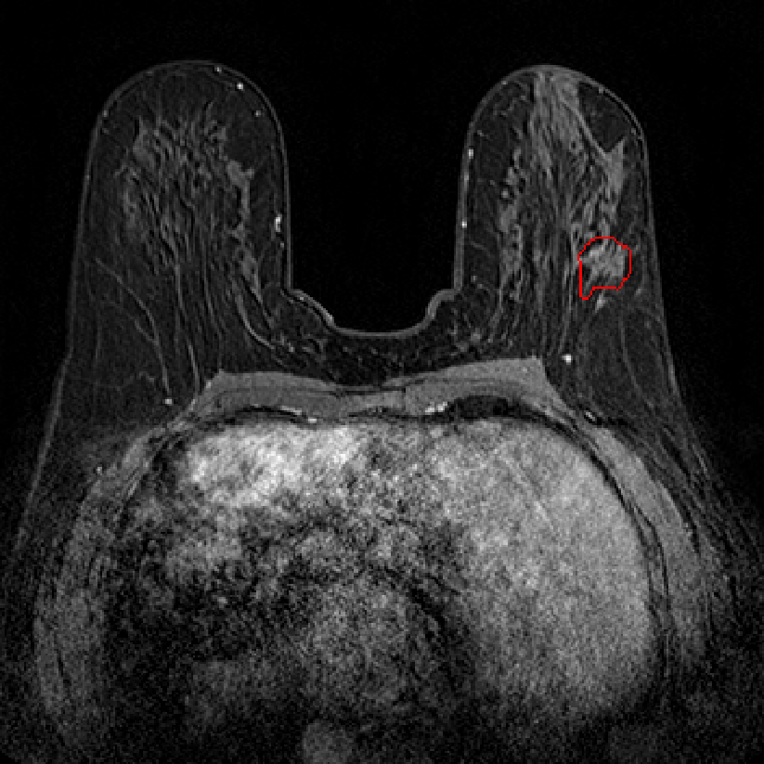
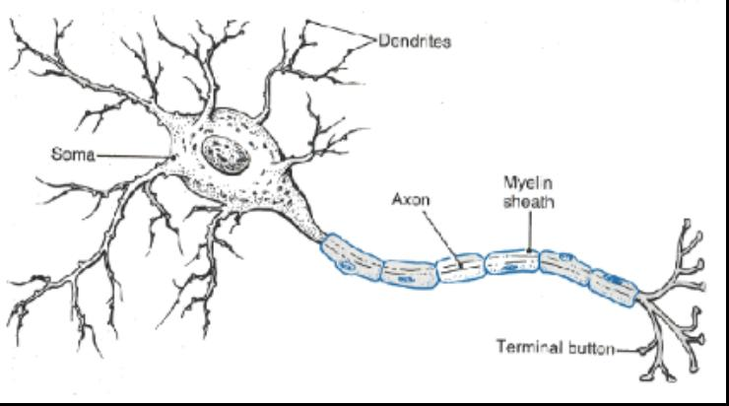

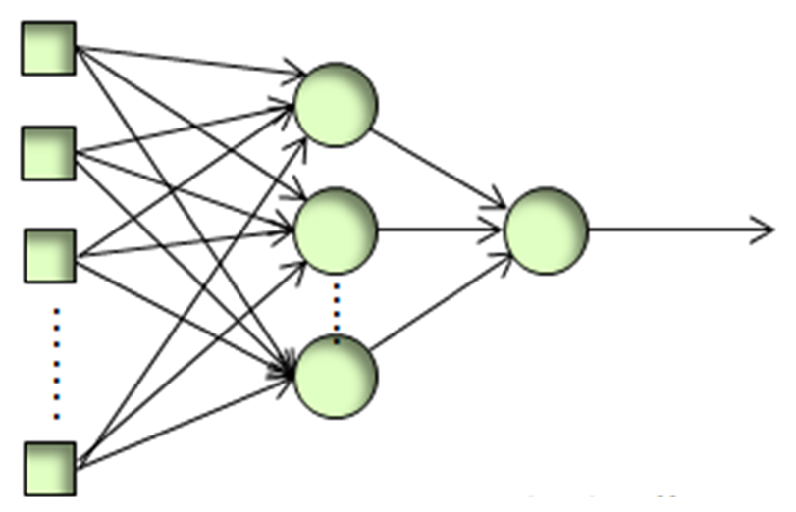

Radiomics and Machine Learning approaches for breast MRI data interpretation
Breast Cancer
Luana Conte
Department of Physics and Chemistry,
University of Palermo, Italy
luana.conte@unipa.it

Slide 2


Radiomics and Machine Learning for Preoperative Differentiation of in Situ and Invasive Breast Cancer Using Dynamic Contrast-Enhanced Magnetic Resonance Imaging (DCE–MRI)
Radiomics and AI for the Pre-Operative Detection of Triple Negative Breast Cancer in Multiparametric MRI, in the context of
Federated Learning

Slide 3
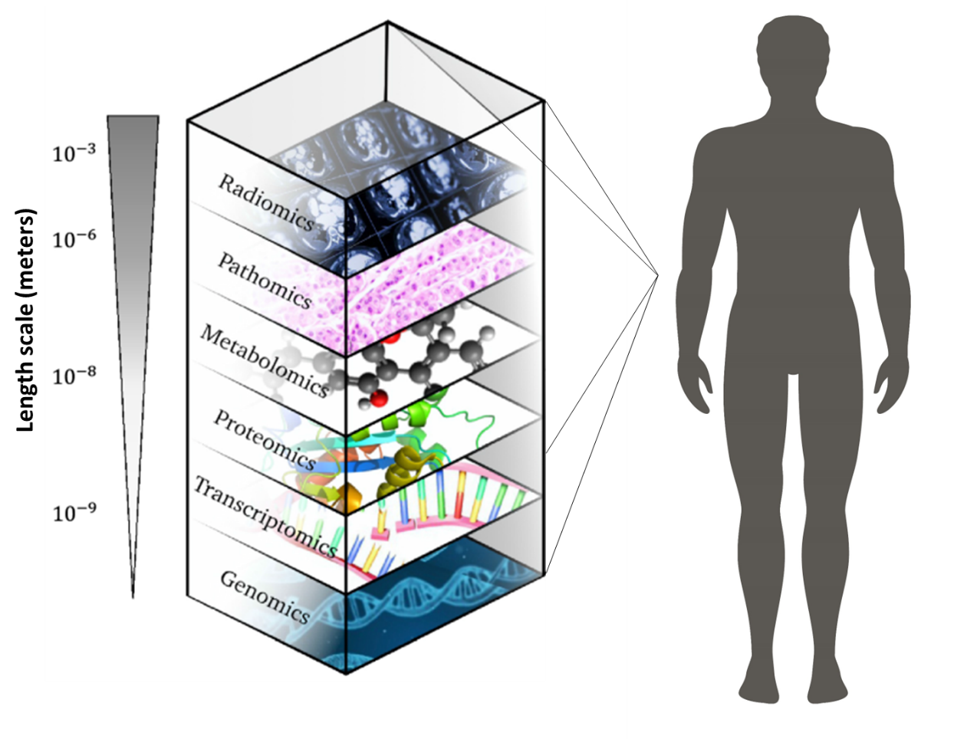
Background
What is Radiomics?
MULTIOMICS MEDICINE
Modified from Lafata KJ et al. Abdon Radiol 2021

Slide 4
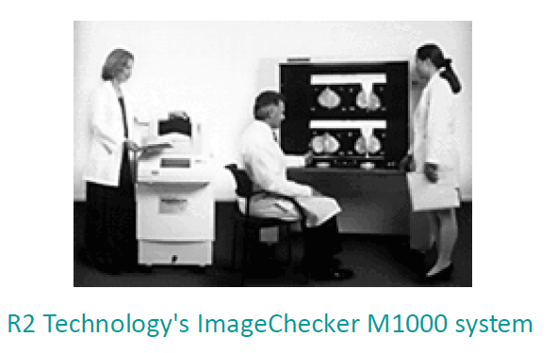
Background
The first commercial automated mammogram analyzer
1998

Slide 5
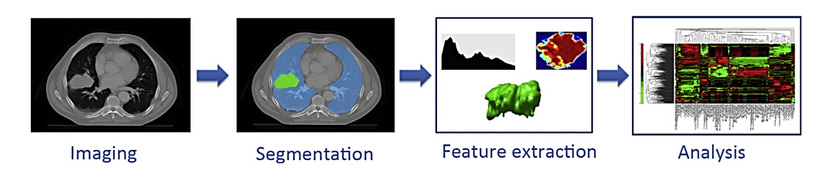
Background
Traditional Radiomics Workflow
Preprocessing
Lambin, P., et al. Europ jour of cancer 2012

Slide 6
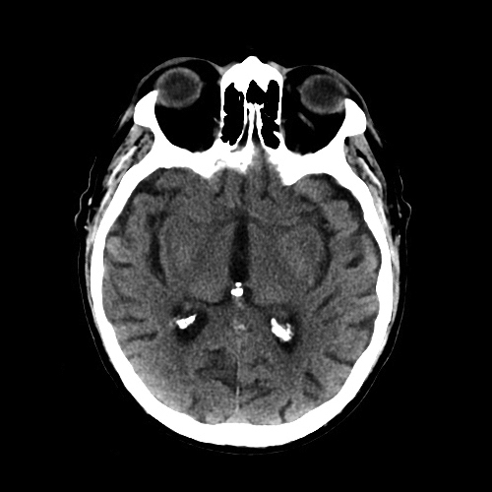
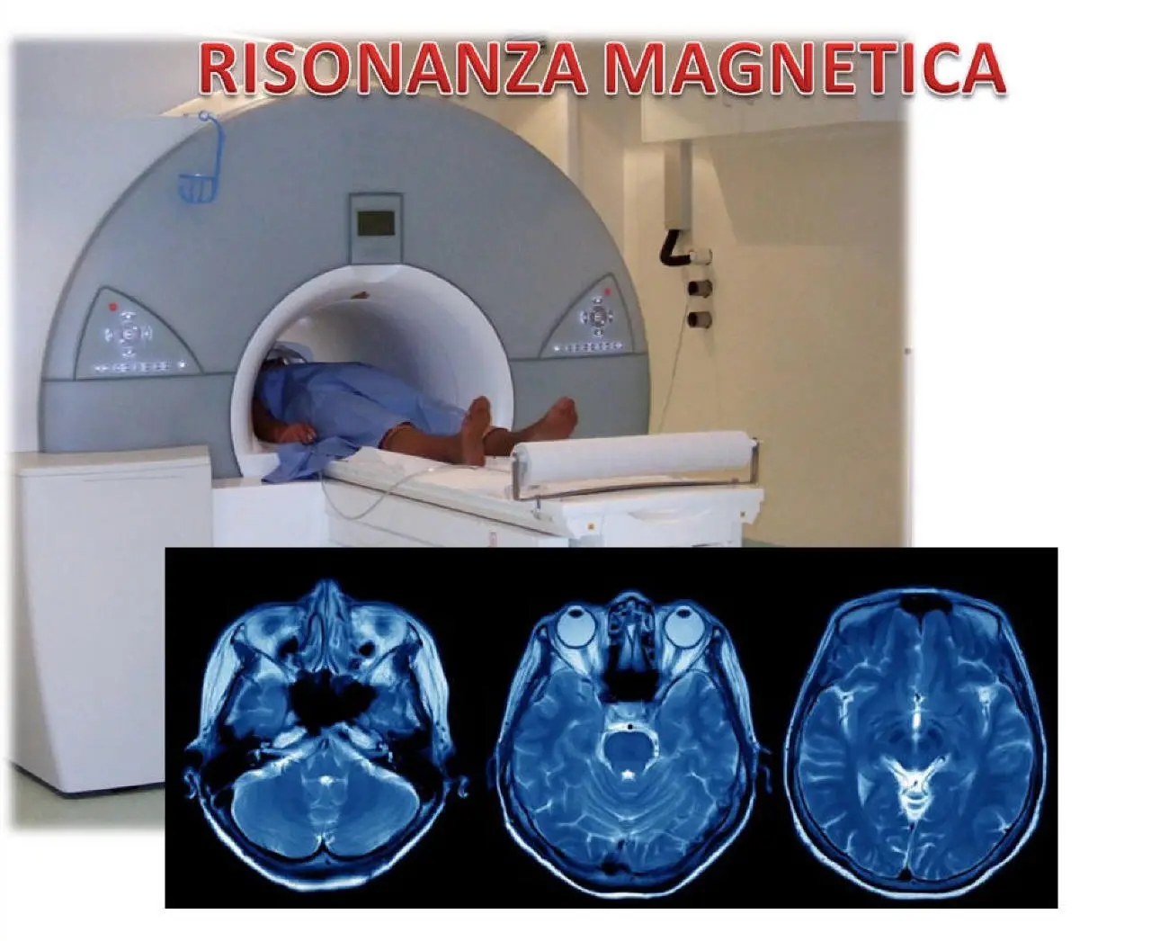
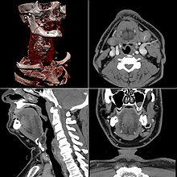
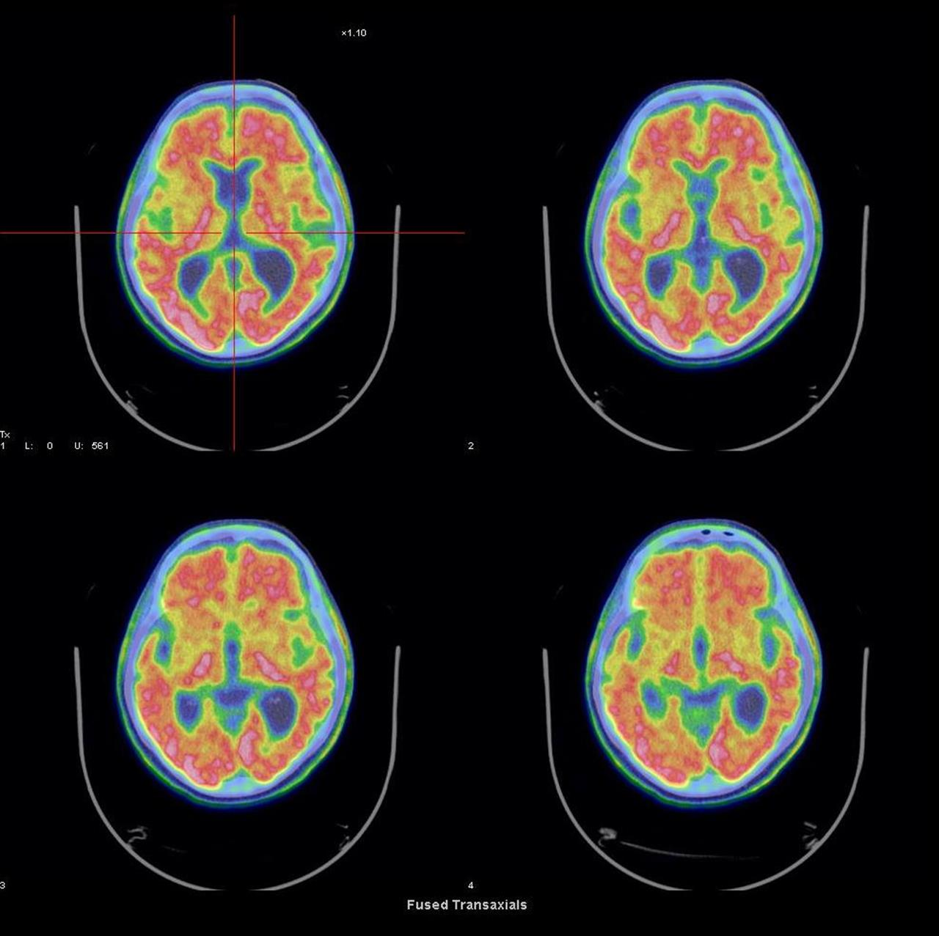
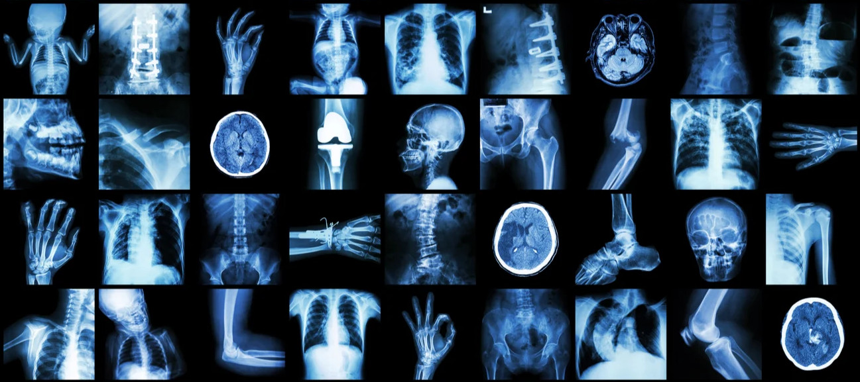

Background
IMAGING

Slide 7
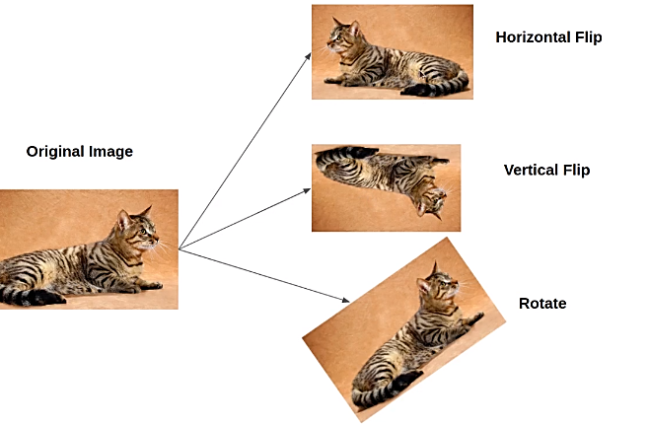
Data Augmentation

Slide 8
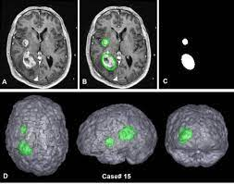
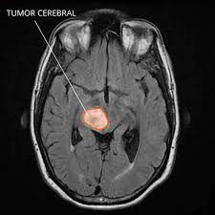
Background
SEGMENTATION
Lambin, P., et al. Europ jour of cancer 2012

Slide 9
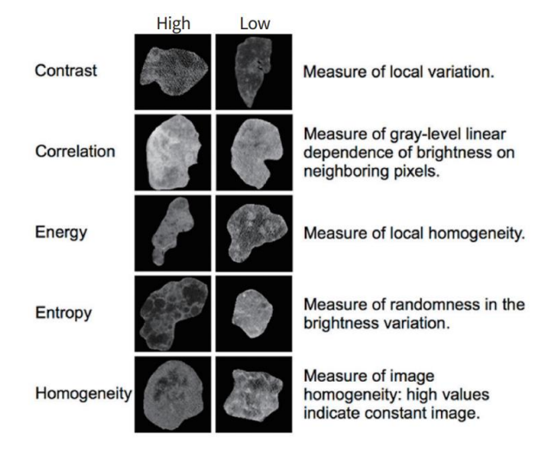
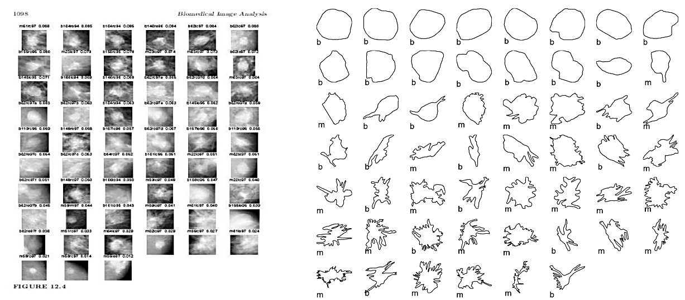
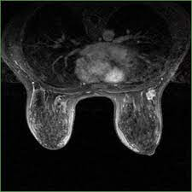
Background
FEATURE EXTRACTION
Feature 1 | Feature 2 | Feature 3 | Feature 4
0,322 | 0,256 | 1,522 | 65351
0,366 | 0,355 | 2,651 | 65655
0,255 | 0,235 | 1,652 | 65856
Lee, G., et al. Precision and Future Medicine 2017

Slide 10
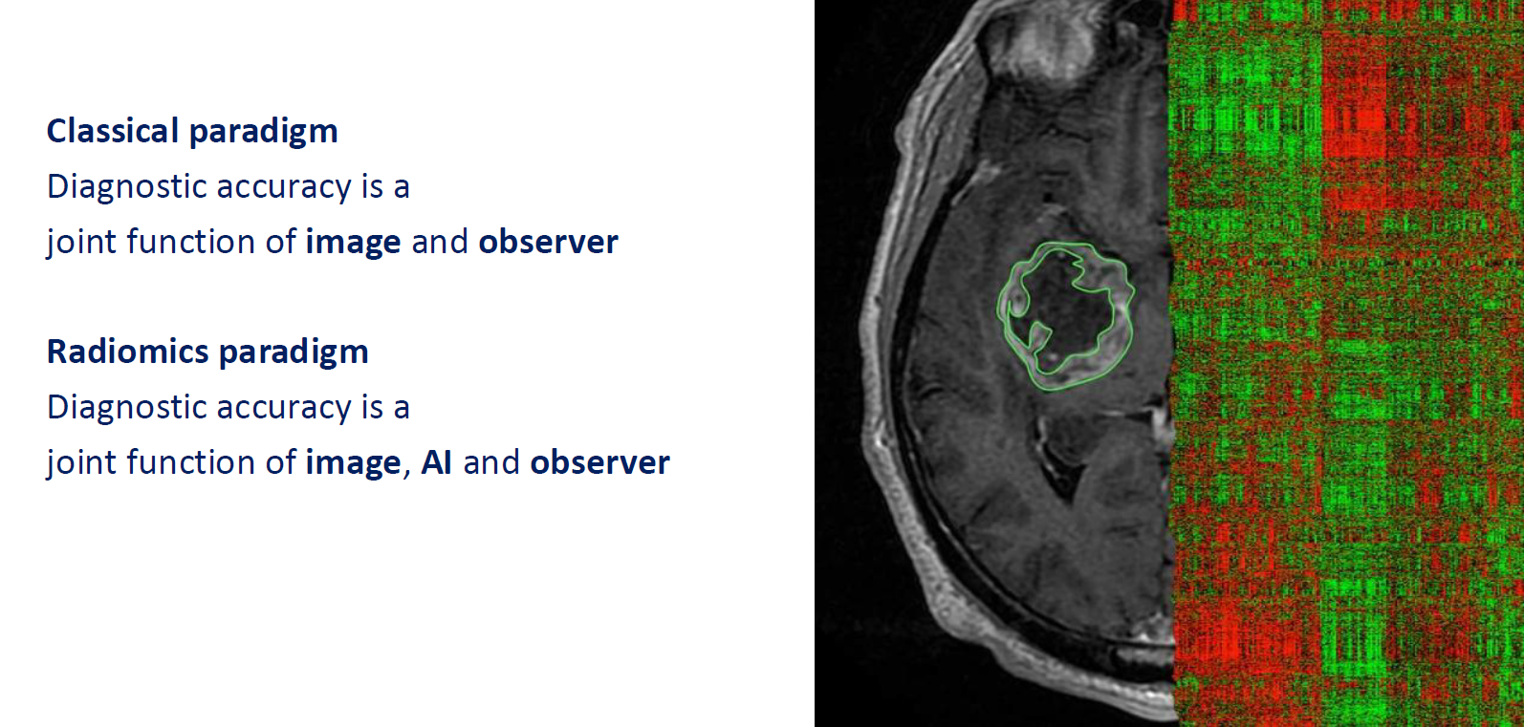
Fryback DG and Thornbury JR. Medical Decision Making 1991

Slide 11
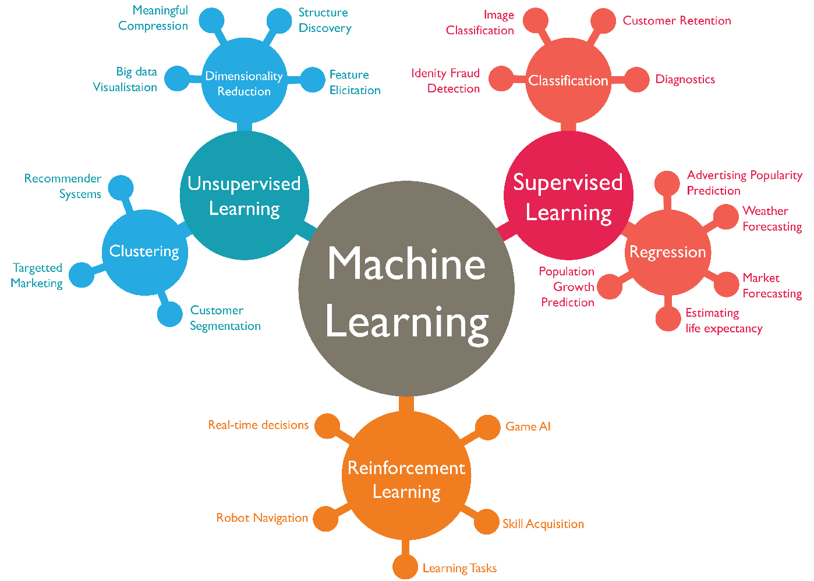

Slide 12
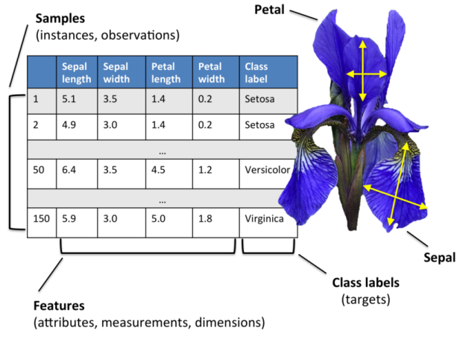
How does supervised machine learning work?
Dataset Iris:
A multivariate dataset introduced by Ronald Fisher in 1936. It includes 150 flower samples, each classified into one of three Iris species: Iris setosa, Iris virginica, and Iris versicolor. For each flower, four measurements are provided: sepal length, sepal width, petal length, and petal width.
These features were used to train a supervised machine learning algorithm to recognize patterns and accurately classify the species of new, unseen samples.

Slide 13
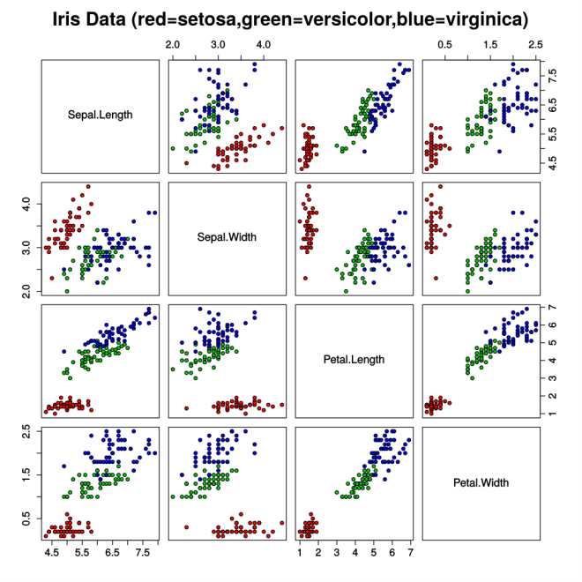
How does supervised machine learning work?
The classifier in a machine learning system calculates the position of separation lines between the data points in the learning set.
Once the space is partitioned, a new flower will be classified based on the position it occupies in this graph (with a margin of error!).

Slide 14
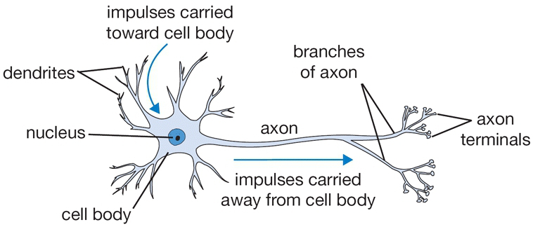
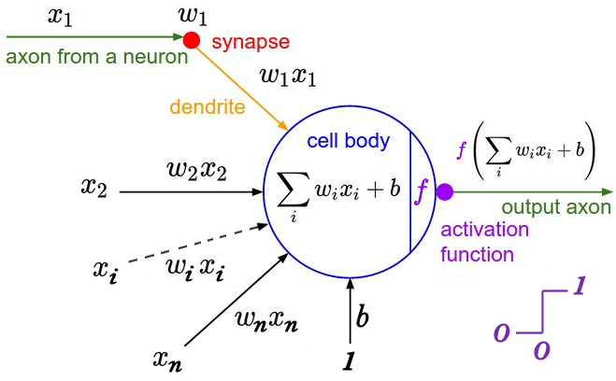
From the biological neuron to the artificial neural network

Slide 15
Radiomics and Machine Learning for Preoperative Differentiation of in Situ and Invasive Breast Cancer Using Dynamic Contrast-Enhanced Magnetic Resonance Imaging (DCE–MRI)
Luana Conte
Department of Physics and Chemistry,
University of Palermo, Italy
luana.conte@unipa.it
Appl. Sci. 2025, 15, https://doi.org/10.3390/xxxxx

Slide 16
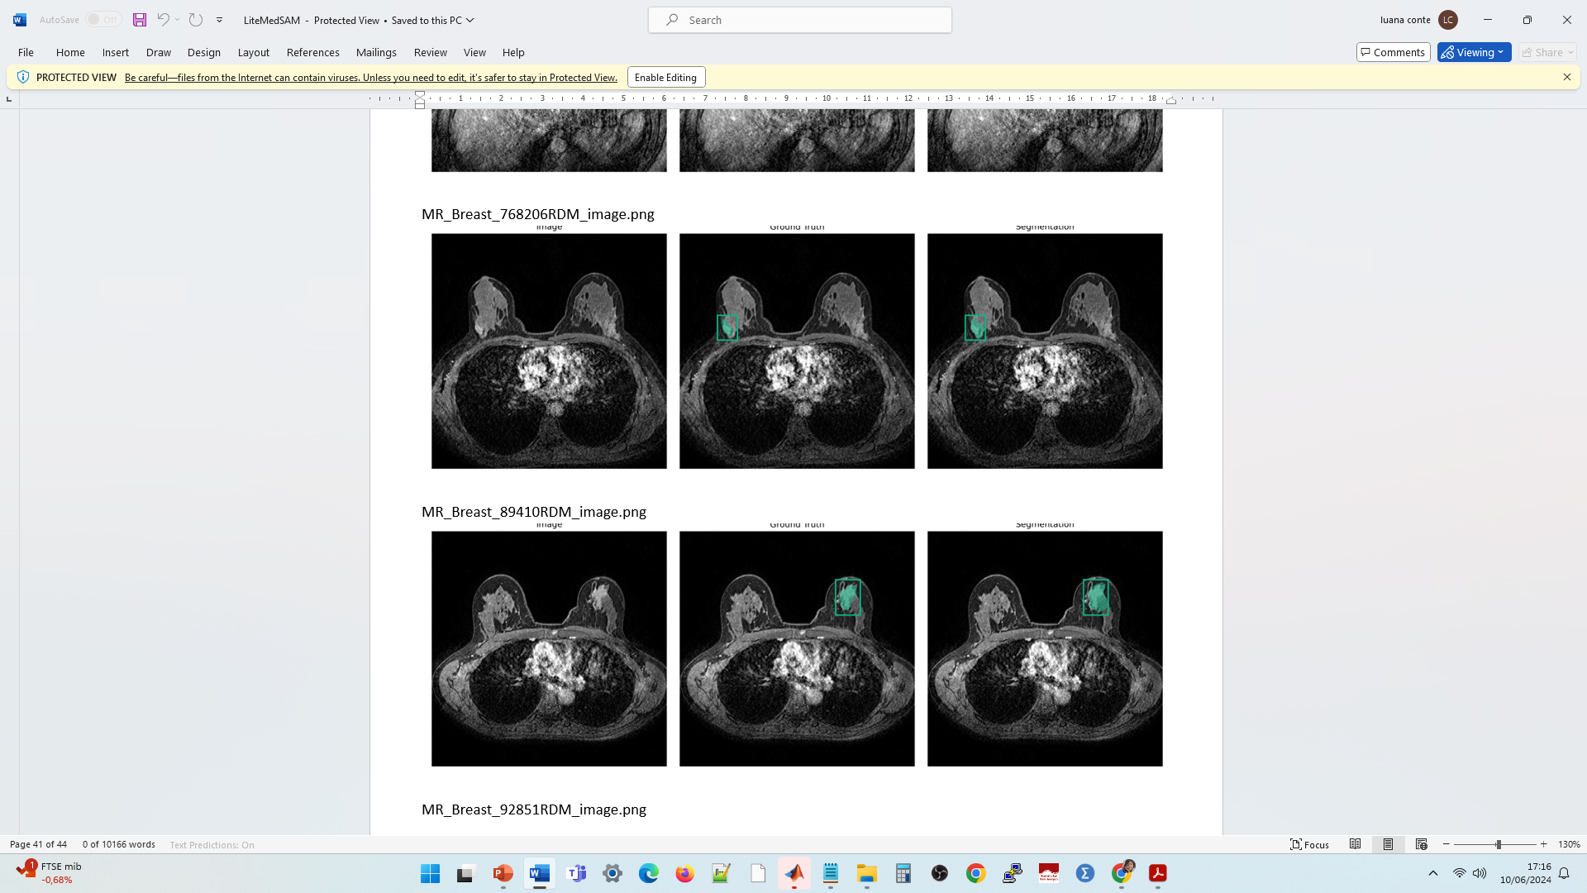
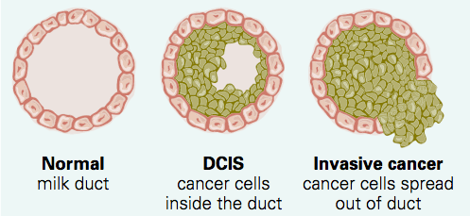
Background & Clinical Need
Breast cancer: 53,686 new cases and 15,500 deaths in Italy in 2024 [1]
In situ (DCIS/LCIS) vs. invasive (IDC/ILC)
In situ: malignant cells confined within basement membrane
Invasive: breach membrane → stromal infiltration, metastasis risk
Different surgical and adjuvant pathways
Importance of accurate pre-op classification
Sentinel-node biopsy indicated only in invasive cases
1. AIOM-AIRTUM-Siapec-Iap I Numeri Del Cancro in Italia 2024

Slide 17
Study Objective
To evaluate ML classifiers trained on DCE–MRI radiomic features (+ basic clinical data) to distinguish in situ vs. invasive BC lesions preoperatively.

Slide 18
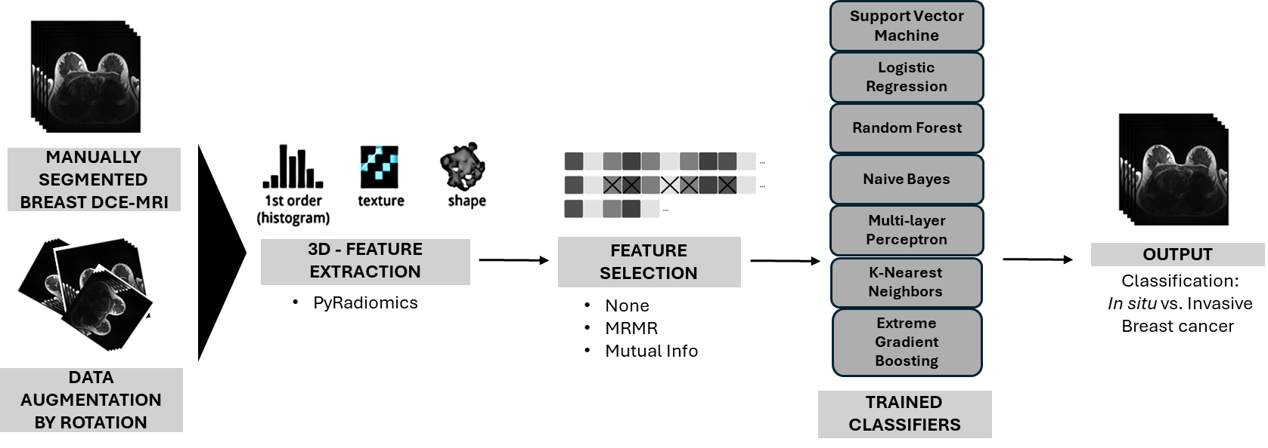
Methods

Slide 19
DATASET
71 post-contrast DCE–MRI scans: 24 in situ (DCIS/LCIS), 47 invasive (IDC)
Scanner: Philips Achieva 1.5 T, isotropic resampled to 1 mm³
Manual ROI segmentation by two expert radiologists
FEATURE EXTRACTION
Radiomic features (n=107) via PyRadiomics: Shape (e.g. Elongation, Flatness), First-order stats, Texture (GLCM, GLRLM, GLSZM, GLDM)
Clinical features: age, laterality
FEATURE SELECTION
Mutual Information ranking (mutual_info_classif)
MRMR (Min Redundancy Max Relevance) (mrmr_classif)
No selection

Slide 20
DATA AUGMENTATION
2D rotations in the axial plane: ±10°, ±20°, ±30°
Increased sample variability → rotation-invariant learning
CLASSIFICATION ALGORITMS
Algorithms tested: KNN, SVM, RF, XGBoost, NB, LR, MLP
Class imbalance handled via class_weight / scale_pos_weight
LOOCV for robust small-sample evaluation
Metrics: AUC, accuracy, precision, recall, F1

Slide 21
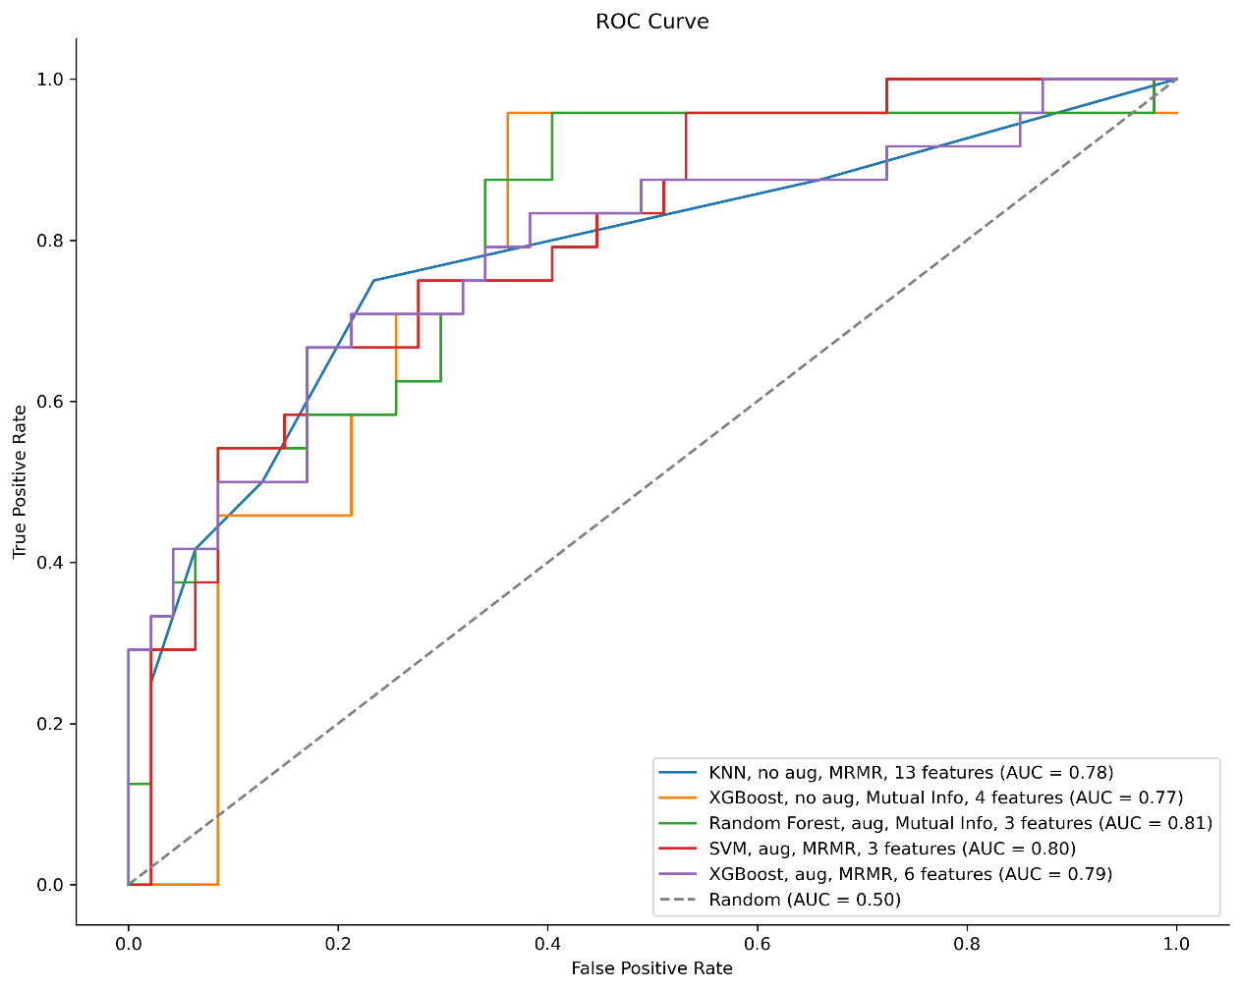
Results
Model | Augmentation | Feature Selection | Number of selected Features | AUC | Best Accuracy (%) | Precision (%) | Recall (%) | F1-score (%)
KNN | No | MRMR | 13 | 0.78 | 0.76 | 0.77 | 0.42 | 0.54
XGBoost | No | Mutual Info | 4 | 0.77 | 0.76 | 0.73 | 0.46 | 0.56
RF | Yes | Mutual Info | 3 | 0.81 | 0.79 | 0.76 | 0.54 | 0.63
SVM | Yes | MRMR | 3 | 0.80 | 0.79 | 0.76 | 0.54 | 0.63
XGBoost | Yes | MRMR | 6 | 0.79 | 0.77 | 0.67 | 0.67 | 0.67

Slide 22
Discussion
RF on augmented data provided highest discrimination
Shape descriptors most informative for tree-based models
Texture + shape combination effective for SVM/KNN
Performance comparable to literature despite small n
Limitations
Small, imbalanced dataset (n=71)
Manual ROI segmentation introduces operator dependency
Single imaging modality (post-contrast DCE only)
Need for external validation on larger cohorts

Slide 23
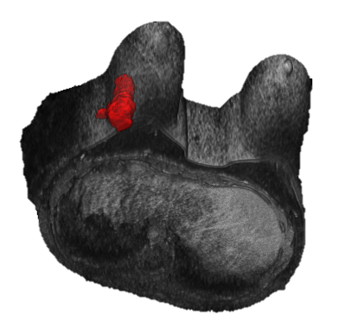
Conclusions & Future Directions
Radiomics + ML can differentiate in situ vs. invasive BC preoperatively
Approach robust on limited data via augmentation & feature selection
RF and SVM were top performers
Validate on multicenter, larger datasets
Integrate multi-parametric MRI & other modalities (DWI, mammography)
Explore automated segmentation
Combine radiomics with genomics/clinical variables

Slide 24




Luana Conte
Rocco Rizzo
Alessandra Sallustio
Eleonora Maggiulli
Mariangela Capodieci
Francesco Tramacere
Alessandra Castelluccia
Giuseppe Raso
Ugo De Giorgi
Raffaella Massafra
Maurizio Portaluri
Giorgio De Nunzio Donato Cascio
Luana Conte^{1,2}, Ilaria Amodeo³, Giorgio De Nunzio^{1,2*}, Genny Raffaeli^{3,4,}, Irene Borzani⁵, Nicola Persico^{4,6}, Alice Griggio⁷, Giuseppe Como³, Donato Cascio⁸, Mariarosa Colnaghi³, Fabio Mosca^{3,4}, Giacomo Cavallaro³

Slide 25
Breast Cancer
Radiomics and AI for the Pre-Operative Detection of Triple Negative Breast Cancer (TNBC) in Multiparametric MRI, in the context of
Federated Learning (FL)

Slide 26
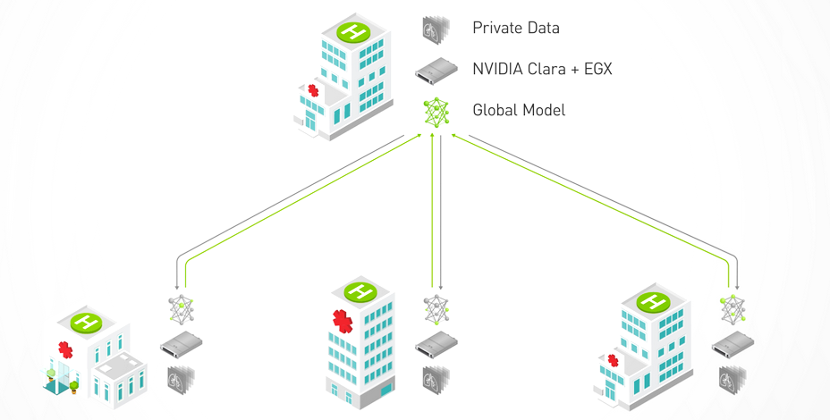
Background
Background

Slide 27
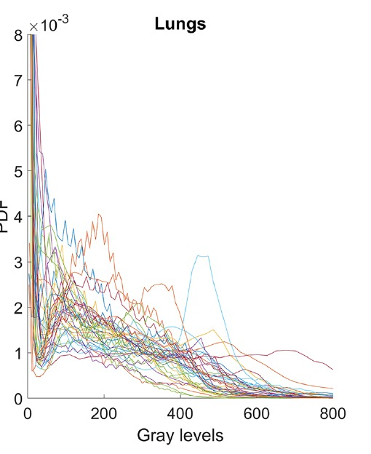
MRI intensity standardization
Grey-level intensities vary across scanners and protocols
This variability hinders: segmentation, radiomics, classification
→ STANDARDIZATION CAN BE ESSENTIAL

Slide 28
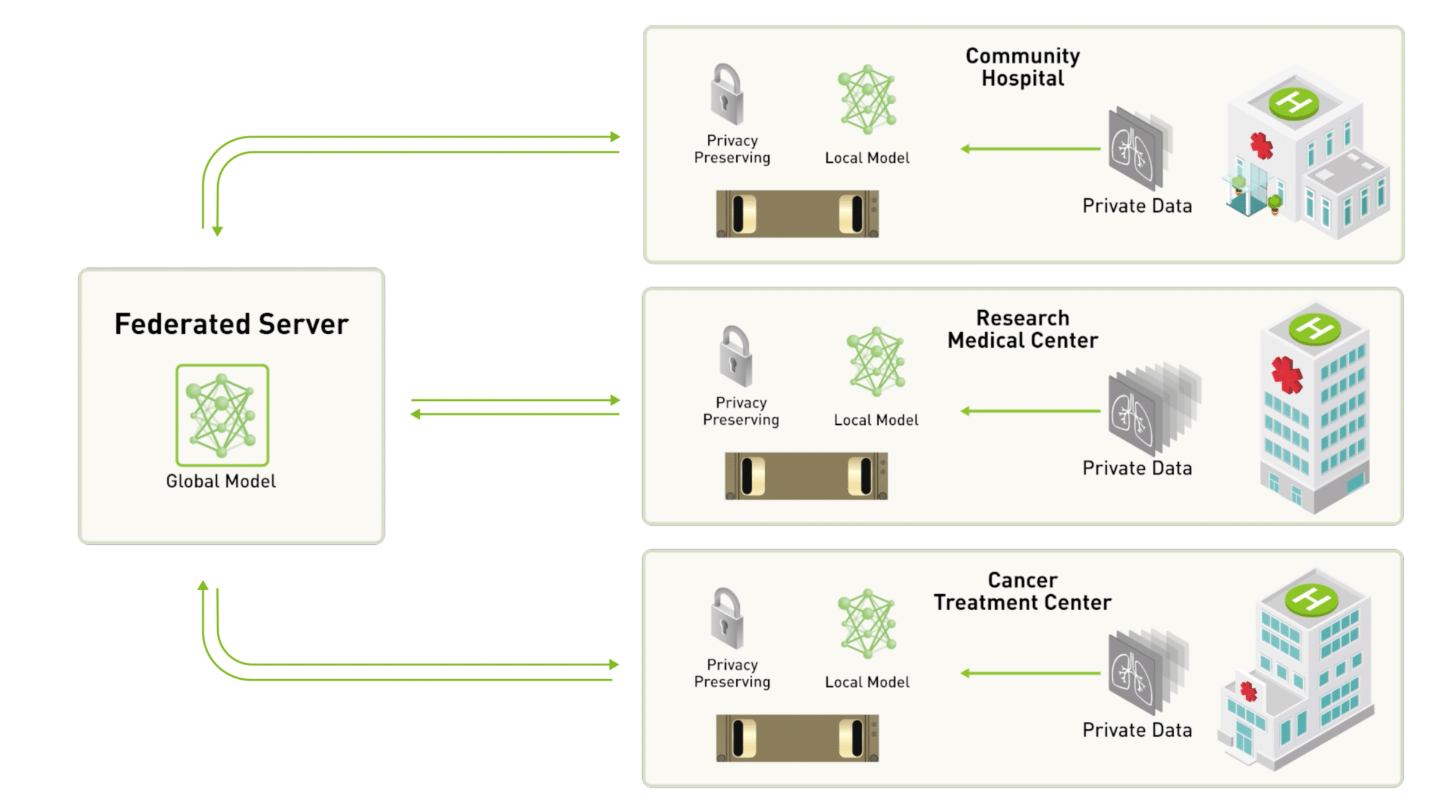
Background

Slide 29


FL scenario: several hospitals sharing ML model training without sharing data.
FEDERATED LEARNING STRUCTURE
SERVER

Slide 30
Background and Clinical Challenge
Triple-Negative Breast Cancer (TNBC):
Lacks:
ER (estrogen receptor),
PR (progesterone receptor), and
HER2 (human epidermal growth factor receptor 2 )
→ limited treatment options
Aggressive, early-onset tumor
Early diagnosis is essential
Mammography: low sensitivity for TNBC
Ultrasound: low specificity
MRI: high sensitivity but many false positives

Slide 31
Study Objectives
To evaluate ML classifiers trained on DCE–MRI radiomic features (+ basic clinical data) to classify TNBC (triple negative breast cancer)
... In a Federated Learning context
... with and w/out gray level intensity standardization with various approaches
... with multi-center, multi-modal datasets (inter-center variability limits AI applicability)
FEDERATED LEARNING STRUCTURE
SERVER

Slide 32
MRI intensity standardization
Standardization Techniques:
Bias field correction (e.g., N4)
Histogram Matching (Nyúl et al., De Nunzio et al.: a set of “standard” histogram landmarks are learned from a set of MRI images)
Z-score, Min-Max normalization
White Stripe: brain-specific, limited generalization
Percentile-based normalization: rescaling voxel intensities between the 1st and 99th percentile of each image, thus mitigating the influence of extreme values and improving inter-scan comparability.

Slide 33
FL and Standardization Strategy
FL: data remains local → preprocessing must be local
Intra-center: identical preprocessing rules (e.g., z-score, N4)
Inter-center: global, shared histogram landmarks sent by server to clients for harmonization

Slide 34
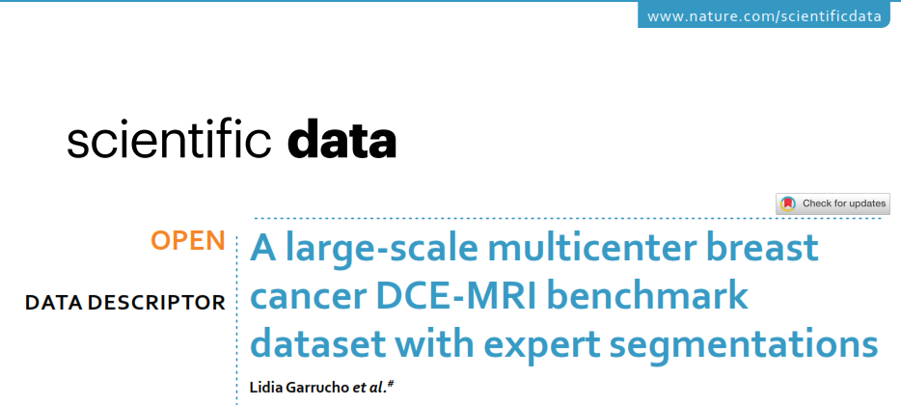
The MAMA-MIA Dataset
Methods
1,506 cases from 4 public datasets (Duke, ISPY1/2, NACT)
Includes DCE-MRI, segmentations, and clinical variables
Ideal for FL: scanner heterogeneity, consistent structure, variable histograms
https://github.com/LidiaGarrucho/MAMA-MIA
https://www.ub.edu/mama-mia/
https://www.ub.edu/mama-mia/wp-content/uploads/2025/03/mamamia_dataset_paper.pdf
https://arxiv.org/abs/2406.13844

Slide 35
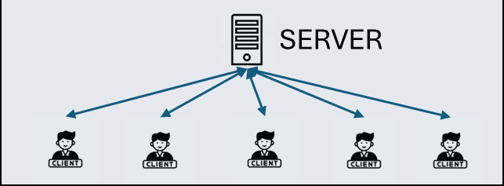
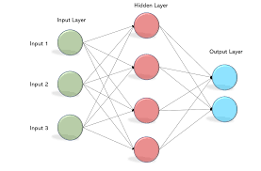
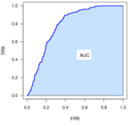
Methods
Classification on FL
SERVER
Shares initial MLP parameters to...
Dataset
Public project: MAMA-MIA
https://github.com/LidiaGarrucho/MAMA-MIA
1271 patients from DUKE and ISPY2 datasets
Axial DCE-MRI T1 scans
3 to 6 DCE-MRI acquisitions per patient
(including one pre-contrast and multiple post-contrast images)
Image Pre-processing
Resampling applied to all images to obtain isotropic voxel spacing of (1.0 × 1.0 × 1.0 mm)
Federated Data Partitioning
A test set of 100 patients was reserved for the central server
65 from Class 0 (non-TNBC)
35 from Class 1 (TNBC)
The remaining 1171 patients were split into 5 non-overlapping groups,
each assigned to a different federated client for decentralized training
each client performs hold-out cv (70/30 split) for 100 epochs and shares the parameters with…
Target
Class 0: Non-TNBC patients (65%)
Class 1: TNBC patients (35%)
Modality Selection
For each patient:
Pre-contrast DCE-MRI
Last post-contrast DCE-MRI (based on acquisition time)
SERVER
Pre-processing: Resampling + Normalization
Resampling to isotropic voxel spacing (1.0 × 1.0 × 1.0 mm)
Gray-level normalization to range [0, 255] using percentiles
Parameters computed on the 70% training portion of each client’s dataset
Final normalization parameters are the average of the 5 clients’ values
Feature Extraction (PyRadiomics)
214 features
The server averages the MLP parameters received from the clients
It performs classification on the test set
Then, it shares the averaged parameters back to the clients
The clients repeat the hold-out cross-validation using the updated parameters, 10 rounds (with fixed 70/30 split)
The 10x100 macro-procedure is repeated 5-10 times, each time using a random 70/30 train-val split, to assess mean accuracy and evaluate its variance.

Slide 36
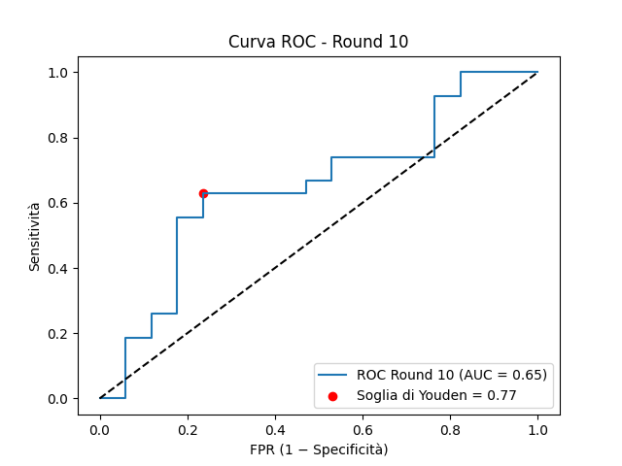
Results
Models without normalization perform poorly (low AUC)
Normalization significantly improve performance
Non-normalized data
AUC = 0.60±0.02
Normalized data
AUC = 0.66±0.02

Slide 37
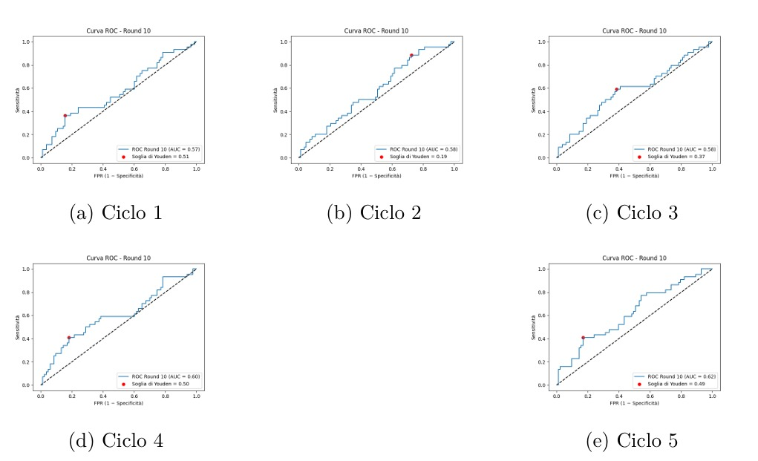
ROC curves of the final round from the five cycles
e
e
e
e
e
e

Slide 38
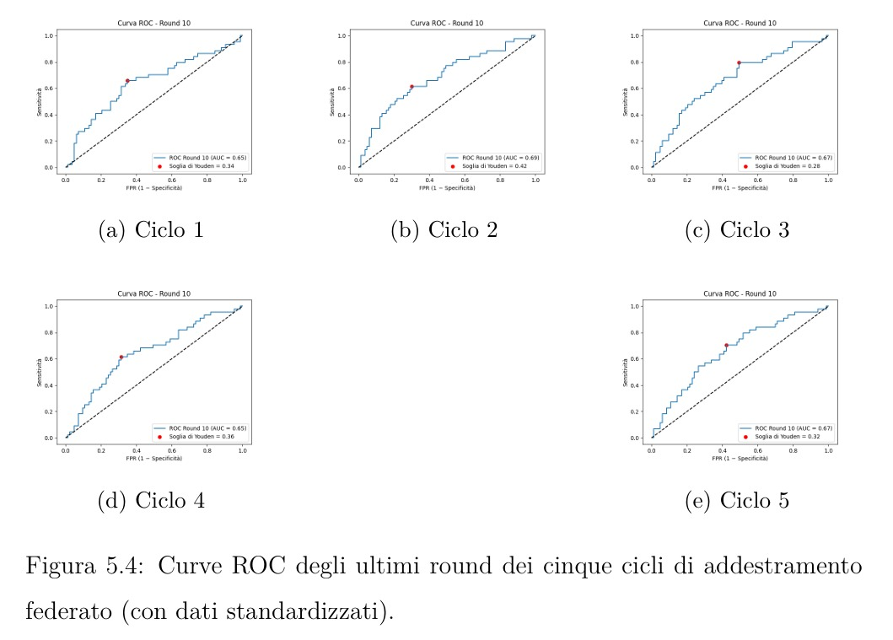
ROC curves of the final round from the five cycles WITH STANDARDIZAZION
e
e
e
e
e

Slide 39
SUMMARY of Results
Federated Learning enables privacy-preserving collaboration across institutions
Knowledge is shared across sites without sharing sensitive data
Image standardization significantly improves model performance

Slide 40
Discussion & Future Perspectives
Evaluate and compare multiple standardization strategies
Shift to CNNs to reduce the need for intensity normalization and manual feature extraction
Explore the impact of classical and advanced data augmentation
Redefine clients based on internal similarity (image clustering) instead of random split
Local test set on each client to compute independent ROC curves
Compare FL model with classical ML pipelines

Slide 41
Conclusions
Federated Learning is knowledge sharing that empowers local sites.
It shifts the focus from a central server to the client,
allowing each institution to benefit from others
without ever sharing sensitive data.
Clients learn together, while keeping their data private.

Slide 42
Luana Conte
Rocco Rizzo
Alessandro Crisci
Giovanni V. Donatiello
Aimen Chaib
Donato Cascio
Giorgio De Nunzio
Luana Conte^{1,2}, Ilaria Amodeo³, Giorgio De Nunzio^{1,2*}, Genny Raffaeli^{3,4,}, Irene Borzani⁵, Nicola Persico^{4,6}, Alice Griggio⁷, Giuseppe Como³, Donato Cascio⁸, Mariarosa Colnaghi³, Fabio Mosca^{3,4}, Giacomo Cavallaro³

Slide 43
Thank you!
Luana Conte
Department of Physics and Chemistry
University of Palermo, Italy
luana.conte@unipa.it

