Slide 1
Detector R&D: 4D tracking - LGAD (DRD3)
Marco Ferrero
INFN Torino

Slide 2
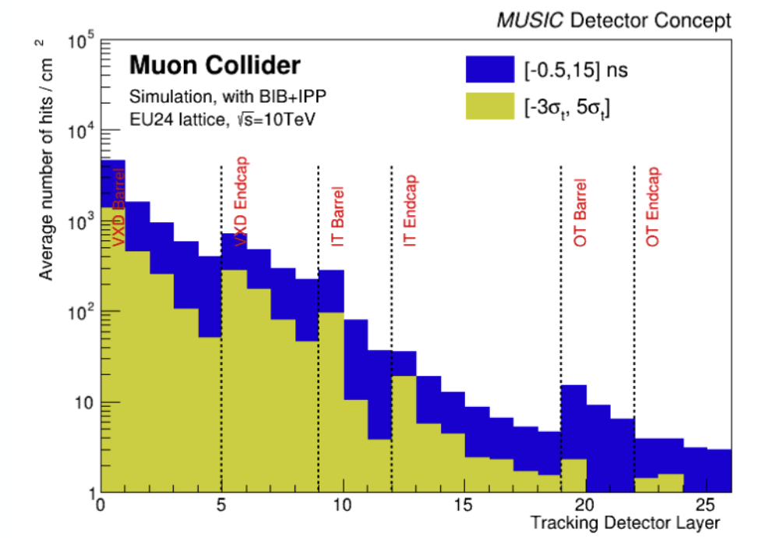
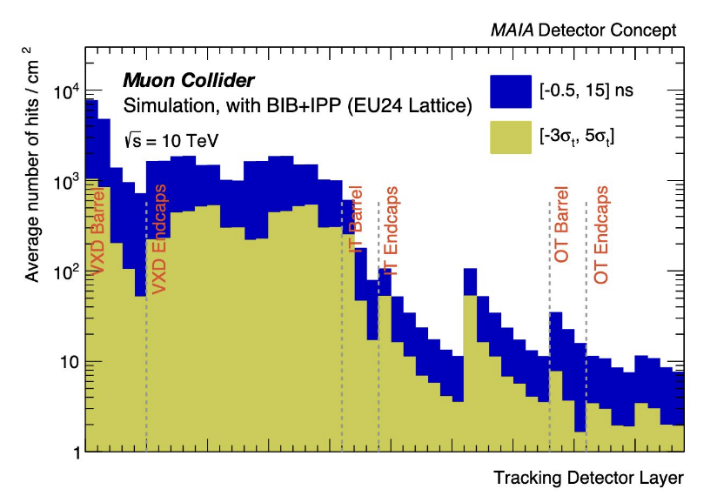
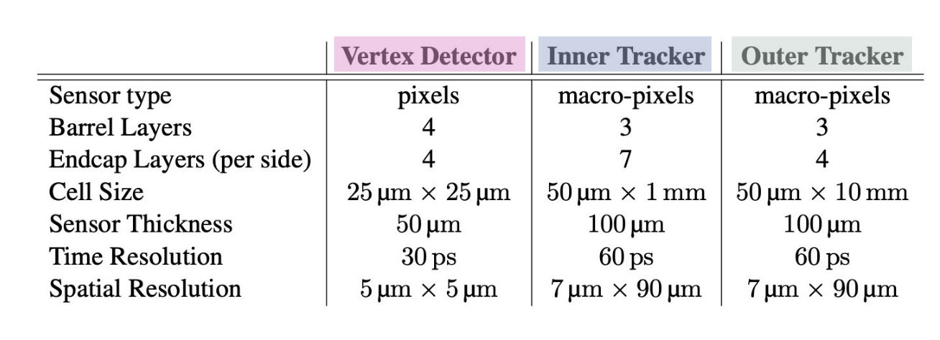
Tracker design
sensors requirements – Space-Time tracking
Sensor requirements for spatial and temporal tracking in a 10 TeV Detector
Occupancy plots in tracking detectors
MUSIC tracking Detector
MAIA tracking Detector
MuCol annual meeting 2025
MuCol annual meeting 2025
MuCol annual meeting 2025
Occupancy in the tracking system is partially reduced by timing requirements
(30 ps and 60 ps time resolutions are assumed in Vertex and IT+OT respectively)

Slide 3
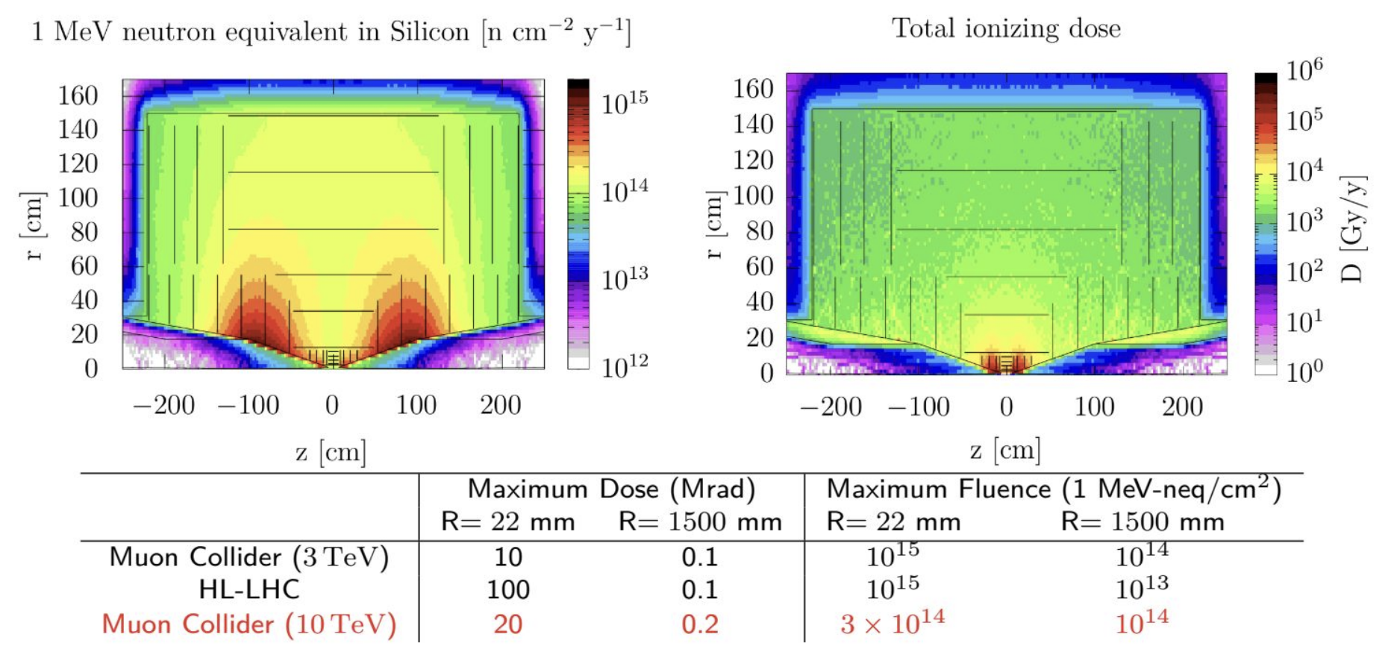
Tracker design
sensors requirements – Radiation Damage
Sensor requirements for spatial and temporal tracking in a 10 TeV Detector
Radiation hardness requirements @ 10 TeV comparable to HL-LHC level
MuCol annual meeting 2025
MuCol annual meeting 2025

Slide 4
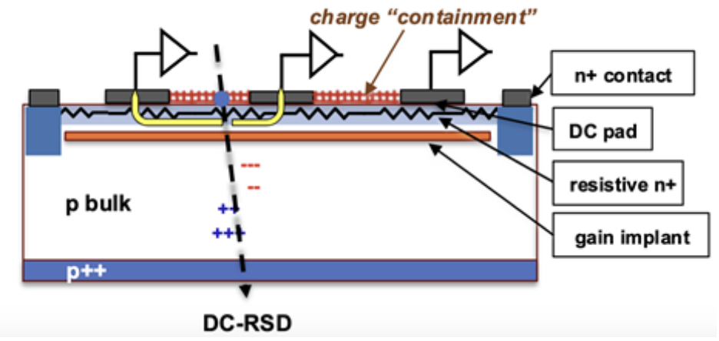
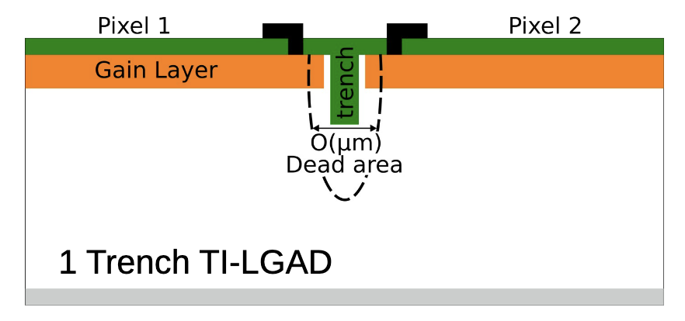
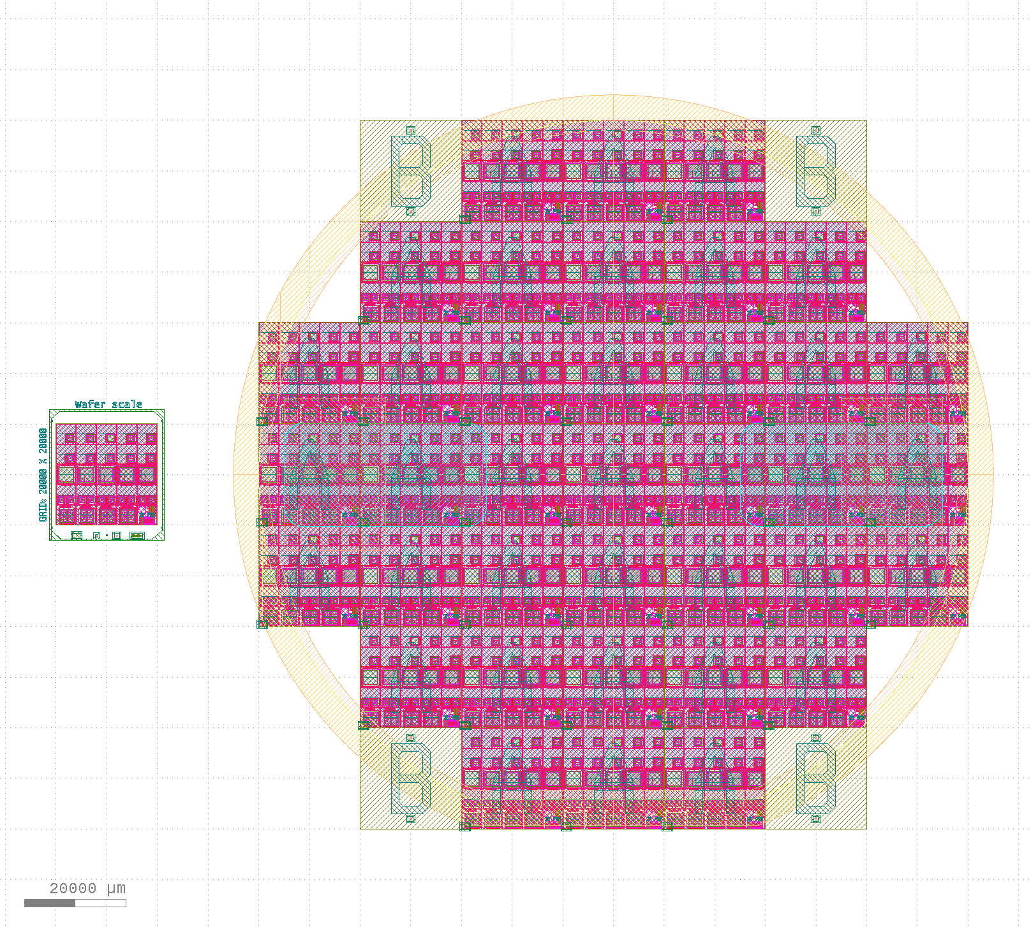
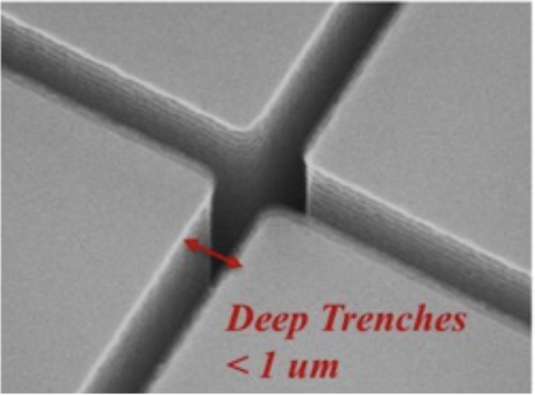
Low Gain Avalanche Diode (LGAD) developments -
Contributions on Turin
Resistive silicon detector (AC- or DC-RSD)
One of the candidate technology for the major part of the tracker
Radiation hardness and Extreme fluence
The operation principle is based on signal sharing between read-out electrodes, through a resistive read-out
Fill factor close to 100%
Space resolution: ~ 3-5% of the pitch
Timing resolution of 30-40 ps
RSD is a technology suitable for:
low density, low power read-out architectures (approximately x100 fewer channels than standard pixel sensors)
Environment with low-medium event rate
Compensated-LGAD
Improvement of the multiplication layer design to cope with fluences exceeding 10¹⁶ n_{eq}/cm²
p-in-n LGAD
Study of donor removal mechanism. Propaedeutic for Compensated-LGADs
Trench-isolated LGADs (TI-LGADs)
The traditional JTE and p-stop are replaced by trench etched into the silicon sensor
Smaller dead area: trench width ~1µm
Small pixels (down to 50 µm) with high fill factor
R&D ongoing in DRD3 collaboration
Wafer layout
Batch is releasing in September

Slide 5
Projects
Projects oriented to improve the radiation hardness of LGAD technology
eXFlu-Innova (AIDAinnova project from 2022 to 2025) and ComonSens (PRIN2022 - from 2023 to 2025):
→ Funding p-in-n LGAD, propaedeutic to the design of compensated-LGAD
→ p-in-n LGAD is releasing in September
CompleX (ERC - from 2024 to 2029):
→ Funding of 3 productions of Compensated LGAD for extreme fluences
→ First batch of compensated LGAD will be released in 2026
Partial Activated Boron LGAD (PAB-LGAD) (RD50/DRD3 common project - from 2024)
Projects involved RSD technology development:
4D_Share (INFN CSN5 project 2023 to 2025) and 4D_Share (PRIN2022 - from 2023 to February 2026):
→ Funding 2 productions of DC-RSD sensors
→ The second production of DC-RSD is scheduled for the end/beginning of 2025/2026
RadHard AC-LGAD (RD50/DRD3 common project - from 2024):
→ An AC-LGAD production with the purpose of investigating and extending the radiation hardness of the RSD technology
FAST3-Amplifier (RD50/DRD3 common project - from 2024):
→ Development of a multichannel amplification boards based on FAST3 ASIC, optimized to readout multi-channel LGAD prototypes (suitable for sensor R&D in laboratory and test beam activities).

Slide 6
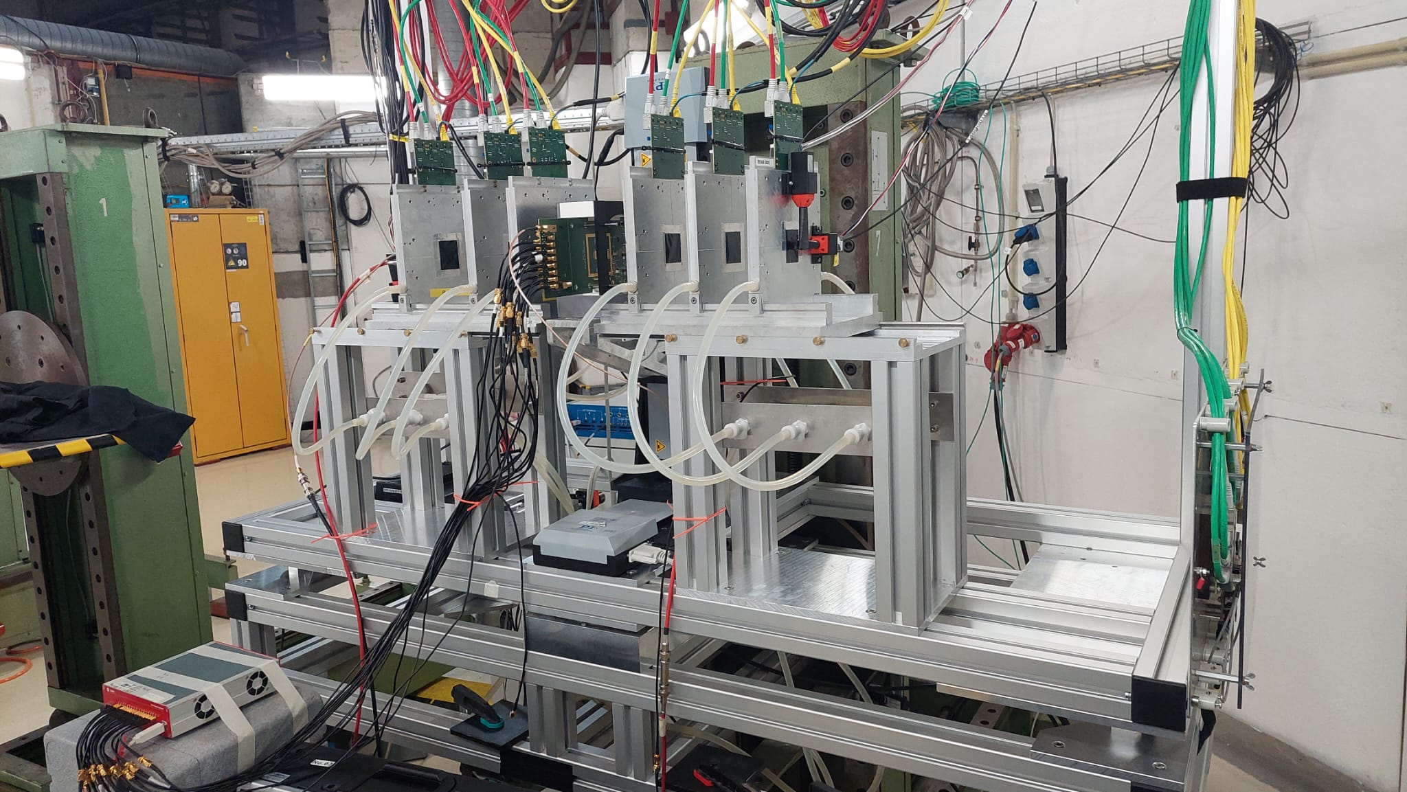
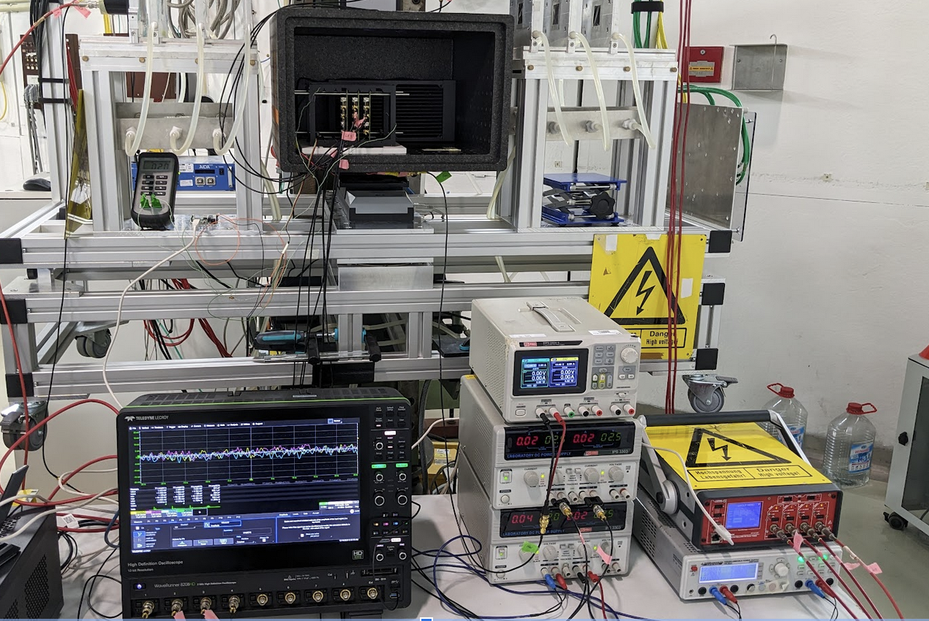
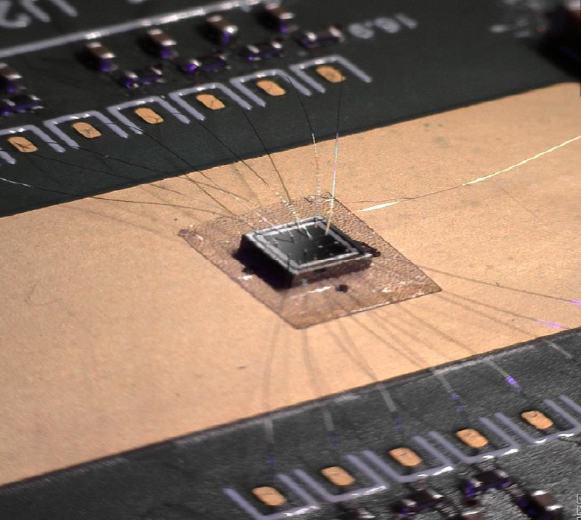
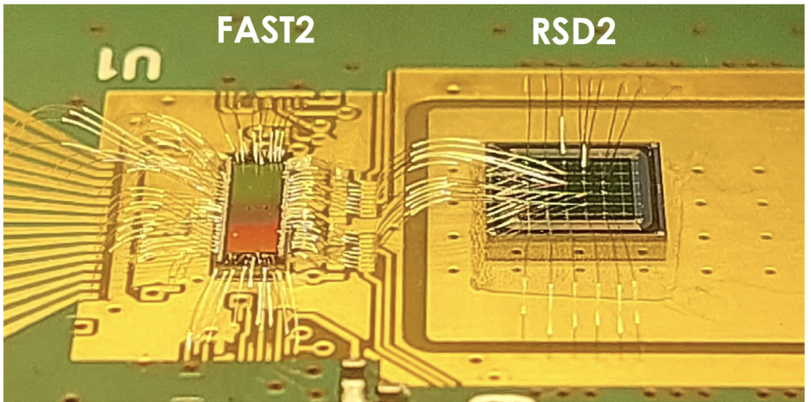
Beam test activities ad funding request
Beam tests activities are crucial in order to evaluate the performance of devices
Beam test on DC and AC-RSD
Beam test on thin LGAD
DESY beam line
DESY beam line
Funding request:
Beam test: 10 k€
Single channel Read-out (optimal for timing): 5 k€

Slide 7
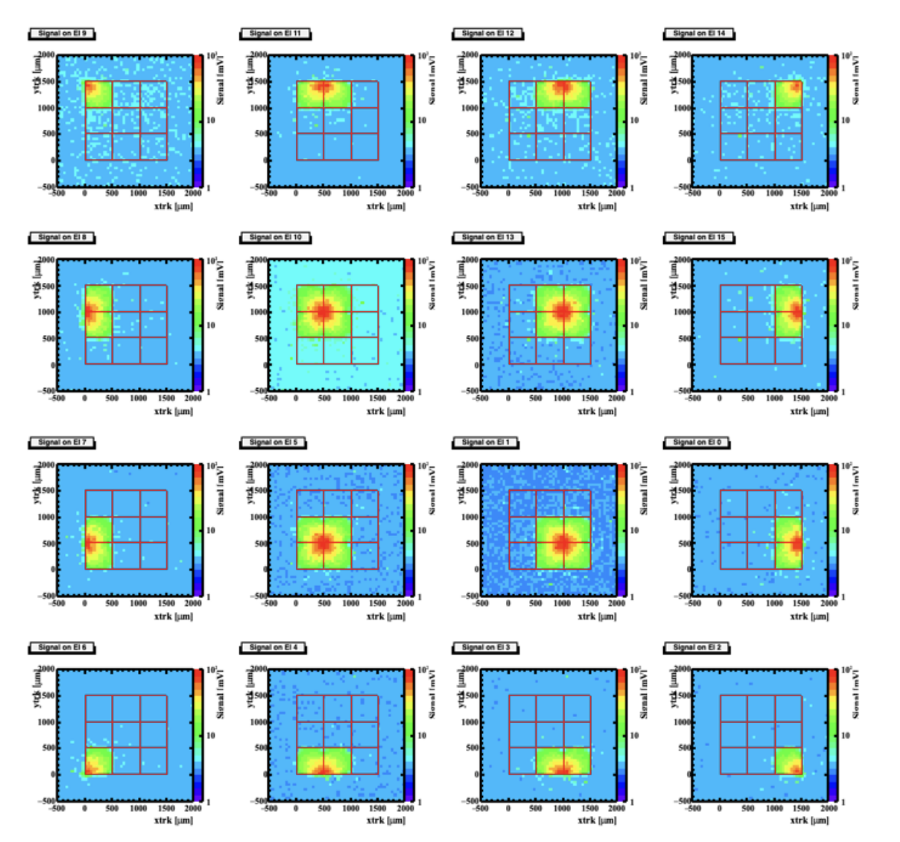
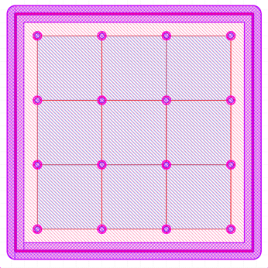
State of the art of LGAD for space tracking
LGAD based on resistive readout (DC-RSD)
Average signal amplitude seen by each electrode as a function of the (X,Y)_{TRACKER}
Data acquired during beam test

Slide 8
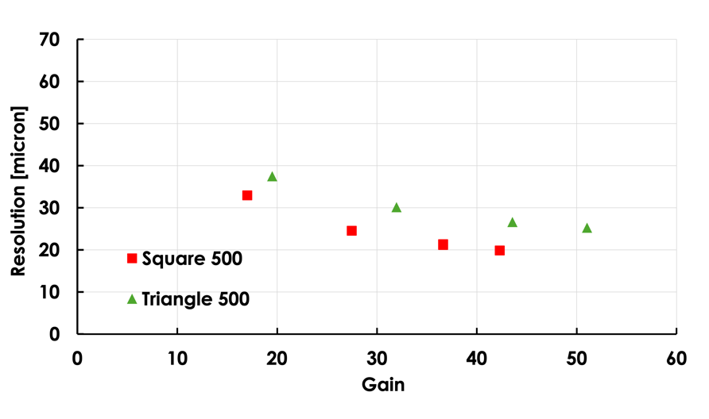
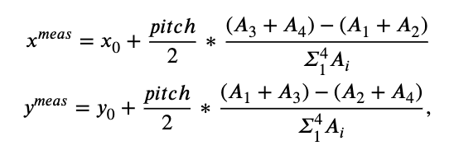
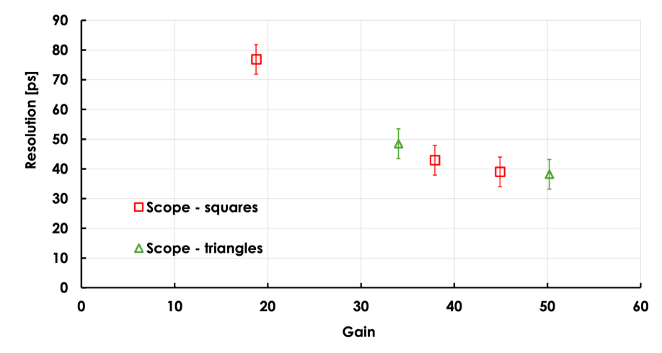
State of the art of LGAD for space tracking
LGAD based on resistive readout (DC-RSD)
Position resolution (X, Y)_{DC-RSD} - (X, Y)_{Tracker}
Square and triangular pixel 500-µm pitch
Time resolution for the 500-μm pitch squared and triangular pixel matrix
Charge imbalance as reconstruction method
Tracker resolution of ~8 µm has been subtracted
25 µm
20 µm
All sensors achieve a space resolution below 5% of the pitch
Square pixels yield a slightly better spatial resolution

Slide 9
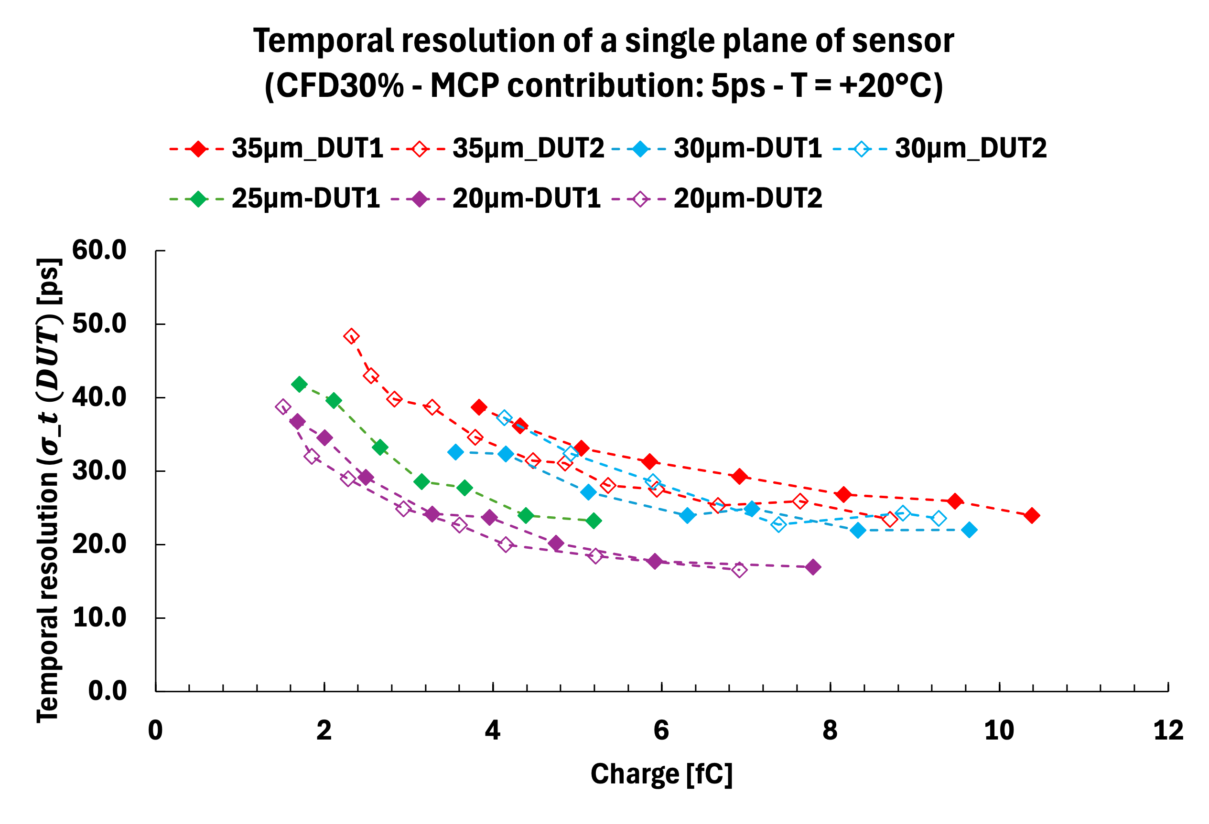
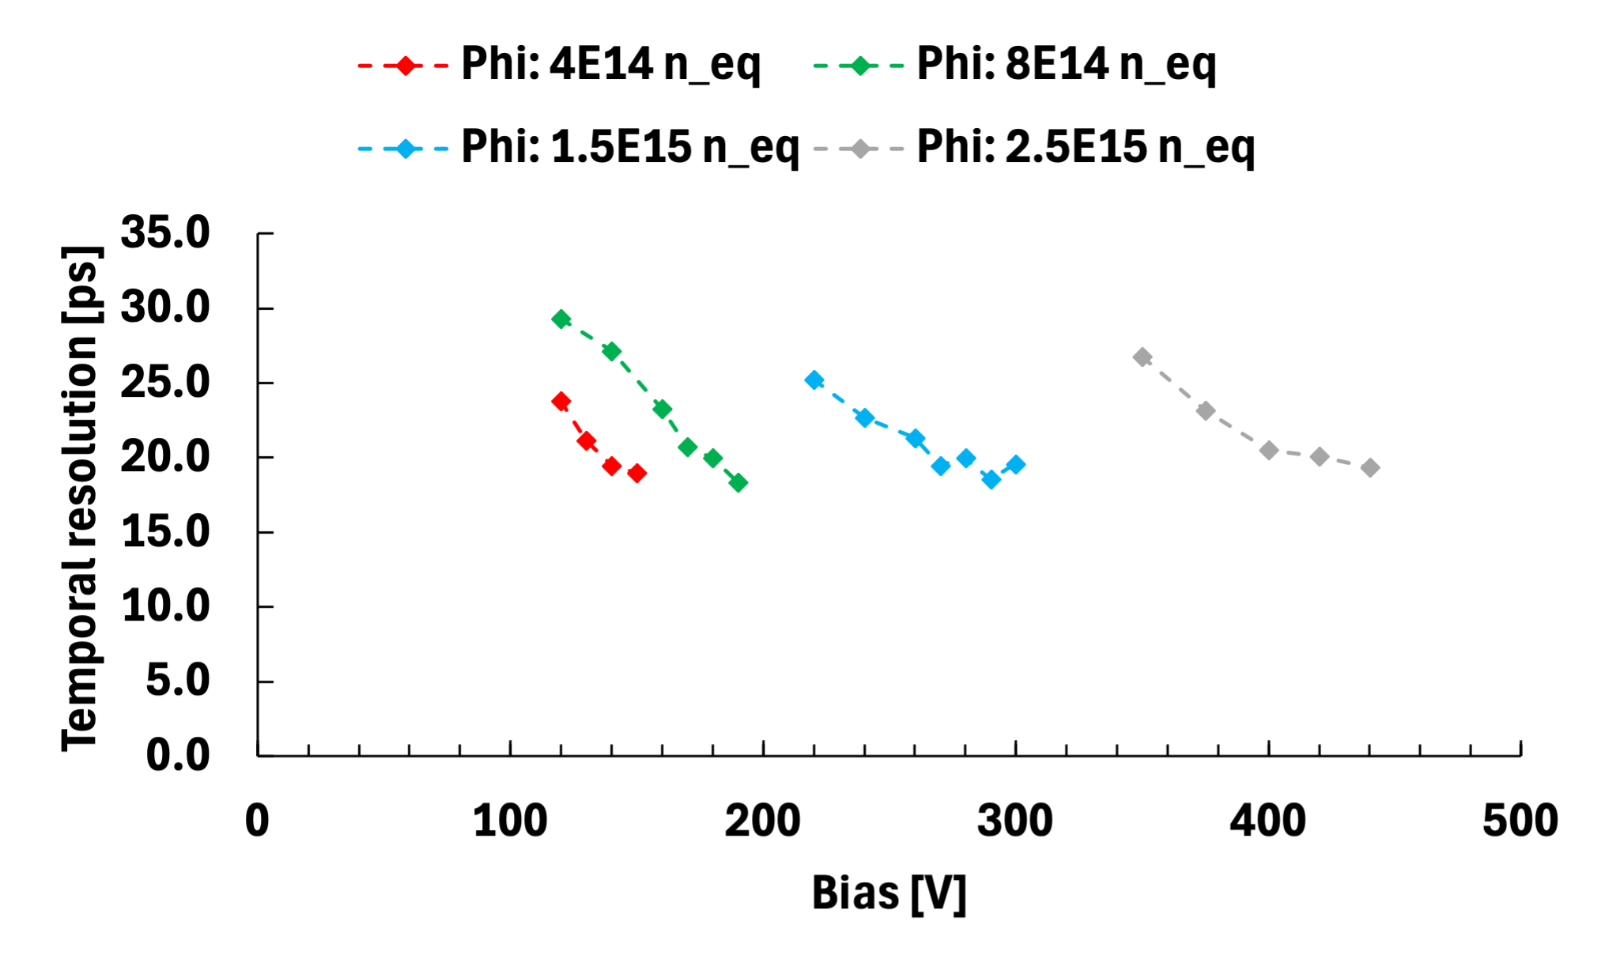
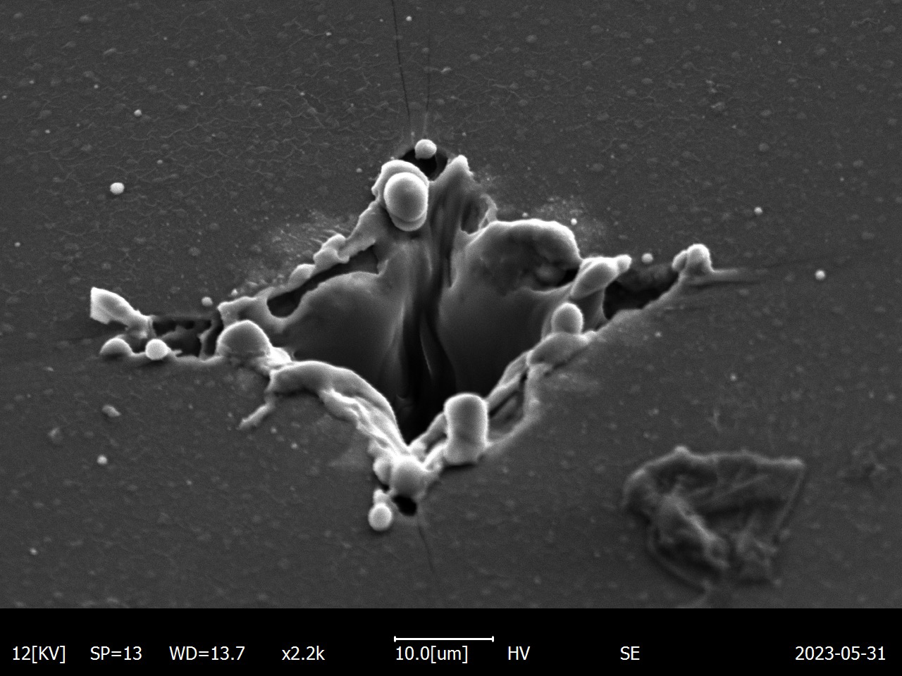
State of the art of LGAD for time tracking
Single Event Burnout (SEB) damage
24 ps
20 ps
SEB region
16 ps
Time resolution between 16 ps and 24 ps measure with 20-35µm thick LGAD UnIrradiated
Time resolution of 20 ps achieved by 30 µm-thick LGAD irradiated up to 2.5$∙$10¹⁵ n_{eq}/cm²

Slide 10
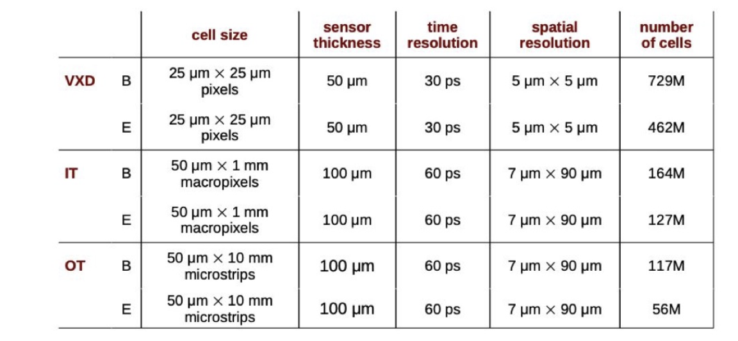
Matching LGAD capabilities to muColl request
LGAD
technology
Vertex Detector
TI-LGAD
High occupancy and radiation level
R&D in radiation hardness will cover the radiation requirements
Inner tracker Detector
RSD
Low occupancy and radiation level
Pixel size, spatial and temporal resolution are a perfect fit for present RSD technology
RSD will strongly reduce the number of pixels
RSD macro pads are probably better than strips in term of spatial and temporal resolution
Outer tracker Detector
RSD

Slide 11
Backup

Slide 12
A completely new tracker based on RSD (AC or DC couple)
One of the candidate technology for the major part of the tracker
M. Ferrero , INFN Torino, MuCol -25 July 2024
Standard tracker
RSD-based tracker
The design of a tracker based on RSD is truly innovative:
It delivers ~ 20 -30 ps temporal resolution
For the same spatial resolution, the number of pixel is reduced by 50-100
The electronic circuitry can be easily accomodated
The power consumption is much lower, it might even be air cooled (~ 0.1-0.2 W/cm²)
The sensors can be really thin

Slide 13
Occupancy
Effective area for read out of a single hit is 3x3 pixels
Hit pixel
M. Ferrero , INFN Torino, MuCol -25 July 2024
Busy pixels
Traditional trench-isolated LGADs could be more suitable mere suitable for VTX
Low Occupancy must be ensured to avoid pile-up effects
50x50 µm pads would be sufficient for most of the VTX

