Slide 1





RD_MUCOL 2025-2026
Dario Giove
Riunione Referee
July 2025

Slide 4
Muon Cooling and its challenges
Activities in charge to INFN Milano
High magnetic field superconducting solenoids
High electric field normal conducting RF cavities

Slide 5
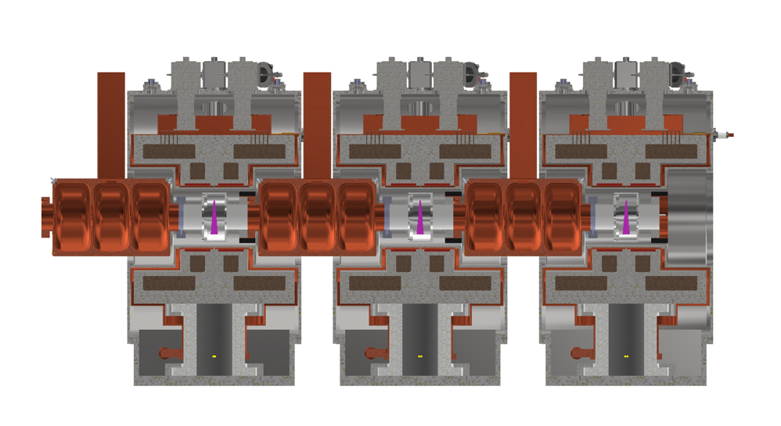
Cooling Cell Integration study: first concept

Slide 6
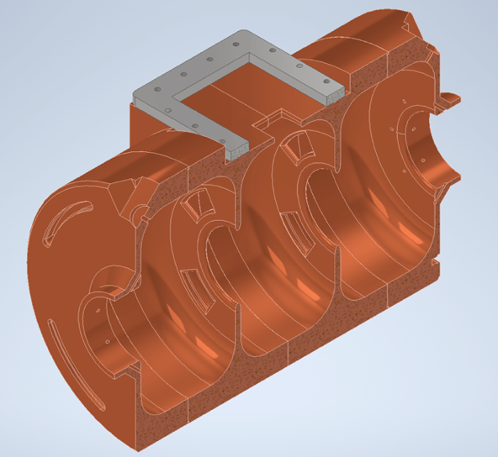
RF 3 cells 704 MHz: first concept

Slide 8
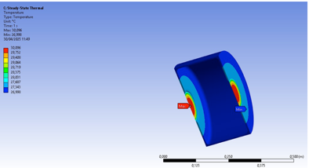
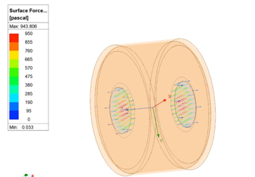
Test facilities: high electric fields in magnets and RF laminas
The RF cavities design foresees the presence of thin (100 micron) metallic windows at the cells iris.
This will simplify the RF e.m. design but introduces a challenging element related to the mechanical design, the soldering procedures and the capability to sustain RF pressures and thermal stresses.

Slide 9
Test facilities: Shape Memory Alloy and Pillow Seal Systems

Slide 10
Richieste finanziarie 2026
Totale FTE:
Ric. Tecnologi: 3.2
Tecnici: 1.4
Magneti: 200 kE
RF NC: 125 kE

