Slide 1

Recent cases of Plasma Electrolytic Polishing (PEP) of AM parts executed at INFN Legnaro Laboratories
AM4Linacs
Improving the Surface Quality of Additively Manufactured Parts Through Innovative PEP Technology.
Ezeaba Tochukwu Emmanuel
INFN, Legnaro 01/08/2025

Slide 2
AM4Linacs
Presentation Overview
1
Introduction:
2
Plasma Electrolytic Polishing (PEP) Overview:
What PEP is, how it works, and its unique advantages for AM
3
Experimental Workflow:
From part design to final part surface finishing - PEP
4
5
6
Challenges in post-processing AM parts and need for improved surface quality.
Case Studies: PEP effects on 5 AM parts
Process description & Results of PEPed parts
Comparative Summary of Results:
Quantitative Before & After Metrics across all parts
Conclusions:
Key Takeaways, Scalability of PEP, and Future Directions
Ezeaba Tochukwu Emmanuel
INFN, Legnaro 01/08/2025

Slide 3
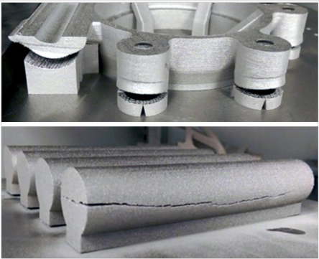
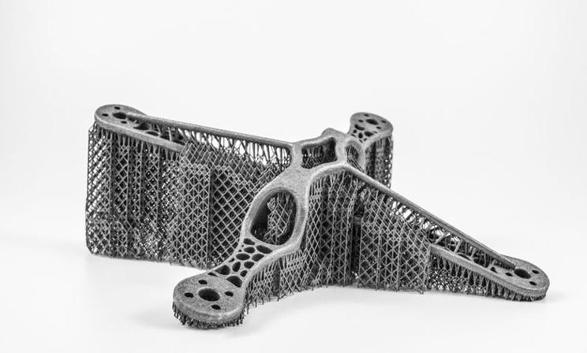
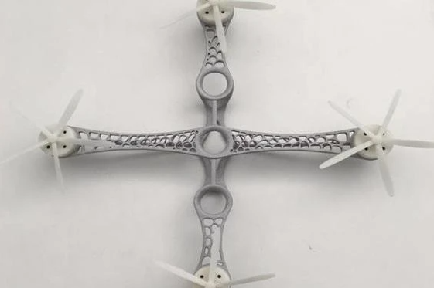
AM4Linacs
Specific Challenges
Surface Roughness
Defects
Impact on Performance
Fatique Life
Dimensional Accuracy
Addressing the Challenges
Process Optimization
Residual Stresses
Material Limitations
Size & Geometry Limitations
Post-processing Requirements
Wear Resistance
Corossion Resistance
Post-processing
Hybrid Manufacturing
Material Development
Challenges with AM
Probable Solutions
https://www.materialise.com/en/inspiration/cases/volum-e-reduces-metal-support-removal-e-stage
Ezeaba Tochukwu Emmanuel
INFN, Legnaro 01/08/2025

Slide 4
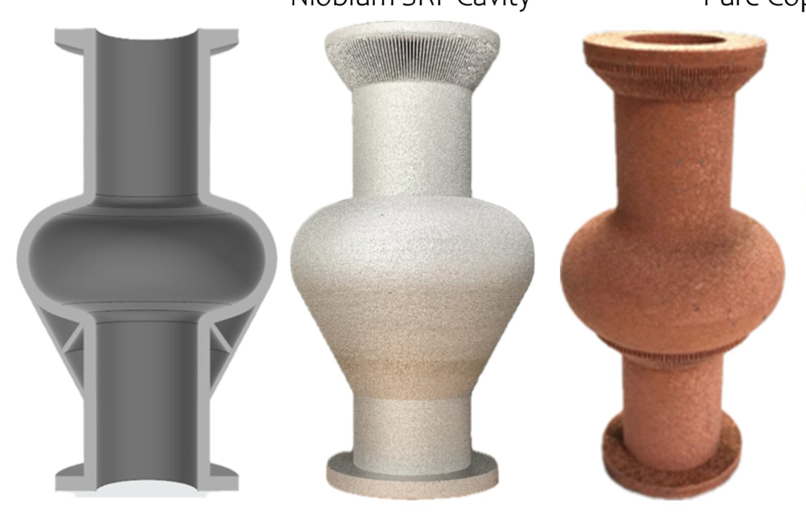
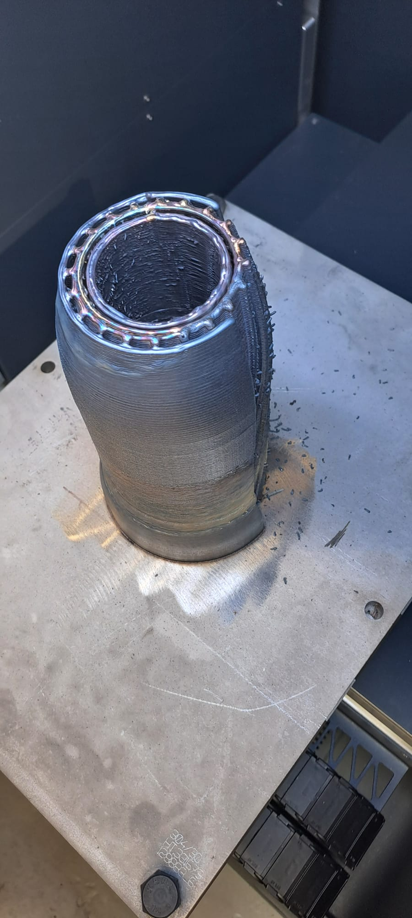
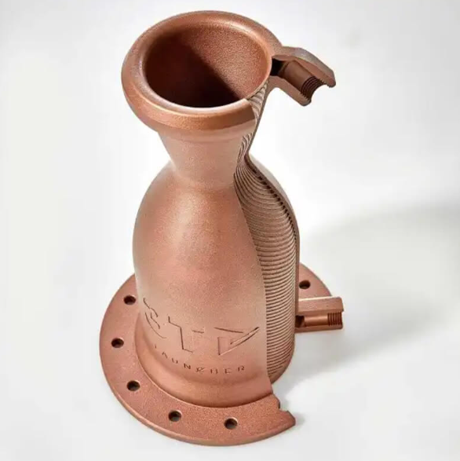
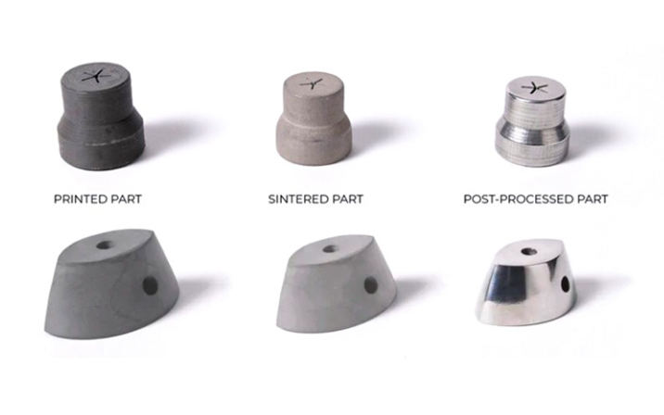
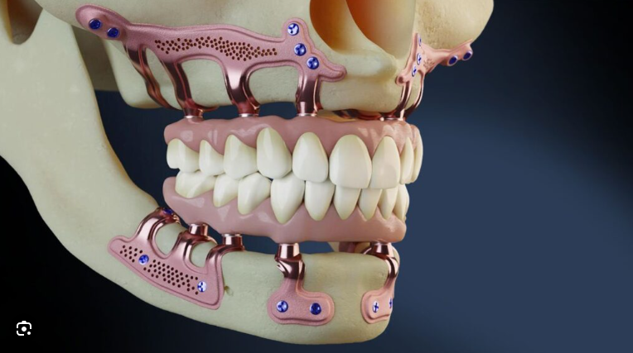
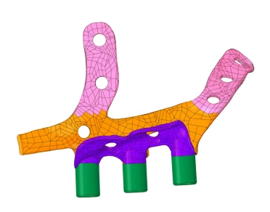
AM4Linacs
Why is post-processing critical?
Enhancing Functionality
Improving Aesthetics/Surface Quality
Addressing Inherent Manufacturing Limitations
Enabling Creative Expression
Challenges with AM
https://altair.com/blog/articles/how-additive-manufacturing-became-a-game-changer-in-the-rocket-propulsion-industry
Ezeaba Tochukwu Emmanuel
INFN, Legnaro 01/08/2025

Slide 5
AM4Linacs
Surface finishing techniques used in the post-processing of AM part
Mechanical Methods
Abrasive Flow Machinig (AFM)
CNC-based Milling / Polishing
Thermal Methods
Laser Polishing (Remelting)
Electron Beam Melting (Remelting)
Additive / Coating-based Finishing
Thermal Spraying / Cols Spraying
PVD / CVD Coatings
Chemical & Electrochemical Methods
Blasting (Sand, Bead, Shot, etc.)
Centrifugal / Vibratory Finishing
Electrical Discharge Machining (EDM)
Chemical Etching / Chemical Polishing
Electropolishing
Plasma Electrolytic Polishing (PEP)
Challenges with AM
Ezeaba Tochukwu Emmanuel
INFN, Legnaro 01/08/2025

Slide 6
What is PEP?
Plasma- assisted EP?
Melting or Welding?
AM4Linacs
Challenges with AM
Ezeaba Tochukwu Emmanuel
INFN, Legnaro 01/08/2025

Slide 7
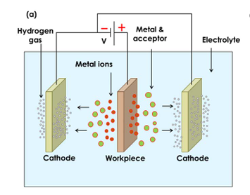
AM4Linacs
Consensus so far:
Electrochemical Anodic Material Removal Process
Operates at higher voltages than traditional EP
Involves localized discharge activity (Plasma/Microarcs)
Causes selective Material Removal, especially at high peaks
Uses eco-friendly, non-toxic salt-based electrolytes
Results in surface deburring, smoothing, and gloss enhancement of metallic parts
Challenges with AM
Ezeaba Tochukwu Emmanuel
INFN, Legnaro 01/08/2025

Slide 8
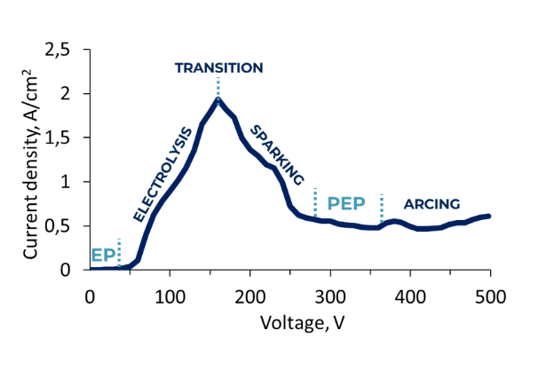
AM4Linacs
Consensus so far:
Electrochemical Anodic Material Removal Process
Operates at higher voltages than traditional EP
Involves localized discharge activity (Plasma/Microarcs)
Causes selective Material Removal, especially at high peaks
Uses eco-friendly, non-toxic salt-based electrolytes
Results in surface deburring, smoothing, and gloss enhancement of metallic parts
Challenges with AM
Ezeaba Tochukwu Emmanuel
INFN, Legnaro 01/08/2025

Slide 9
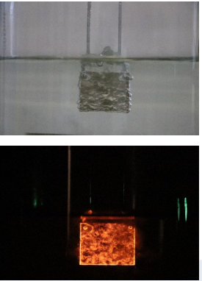
AM4Linacs
Consensus so far:
Electrochemical Anodic Material Removal Process
Operates at higher voltages than traditional EP
Involves localized discharge activity (Plasma/Microarcs)
Causes selective Material Removal, especially at high peaks
Uses eco-friendly, non-toxic salt-based electrolytes
Results in surface deburring, smoothing, and gloss enhancement of metallic parts
Challenges with AM
Ezeaba Tochukwu Emmanuel
INFN, Legnaro 01/08/2025

Slide 10
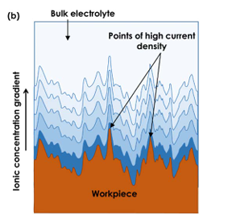
AM4Linacs
Consensus so far:
Electrochemical Anodic Material Removal Process
Operates at higher voltages than traditional EP
Involves localized discharge activity (Plasma/Microarcs)
Causes selective Material Removal, especially at high peaks
Uses eco-friendly, non-toxic salt-based electrolytes
Results in surface deburring, smoothing, and gloss enhancement of metallic parts
Challenges with AM
Ezeaba Tochukwu Emmanuel
INFN, Legnaro 01/08/2025

Slide 11
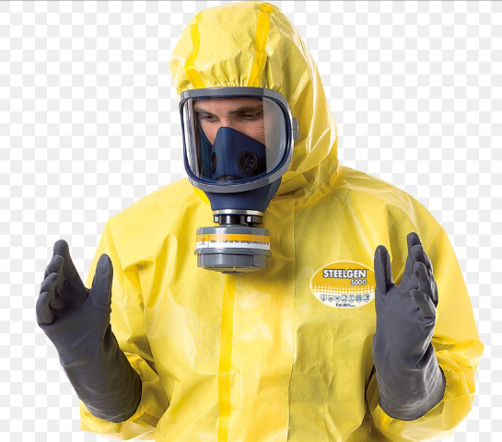
AM4Linacs
Consensus so far:
Electrochemical Anodic Material Removal Process
Operates at higher voltages than traditional EP
Involves localized discharge activity (Plasma/Microarcs)
Causes selective Material Removal, especially at high peaks
Uses eco-friendly, non-toxic salt-based electrolytes
Results in surface deburring, smoothing, and gloss enhancement of metallic parts
Challenges with AM
Ezeaba Tochukwu Emmanuel
INFN, Legnaro 01/08/2025

Slide 12
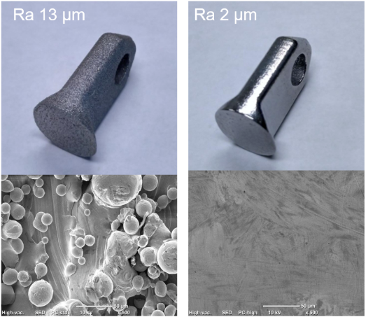
AM4Linacs
Consensus so far:
Electrochemical Anodic Material Removal Process
Operates at higher voltages than traditional EP
Involves localized discharge activity (Plasma/Microarcs)
Causes selective Material Removal, especially at high peaks
Uses eco-friendly, non-toxic salt-based electrolytes
Results in surface deburring, smoothing, and gloss enhancement of metallic parts
Challenges with AM
https://gpplasma.com/plasma-electrolytic-processing
Ezeaba Tochukwu Emmanuel
INFN, Legnaro 01/08/2025

Slide 13
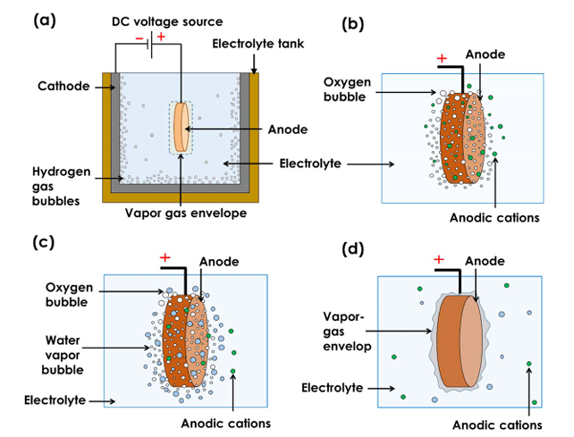
AM4Linacs
PEP Process Mechanism
(a)
Structural electrochemical cell setup
(b)
Formation of oxygen gas bubbles and oxidation of anode
(c)
Formation of water vapour bubbles along with the oxygen gas bubbles and the oxidation of the anode
(d)
Merger of the water vapour and the oxygen gas bubbles to form the VGE around the anode
Challenges with AM
K. Sushil et al 2024 J. Electrochem. Soc. 171 063508
Ezeaba Tochukwu Emmanuel
INFN, Legnaro 01/08/2025

Slide 14
AM4Linacs
Benefits of PEP
Low or no need for pre-treatment or sample preparation
No strict electrodes dimensional requirement
Capable of polishing complex geometries
High quality surface finish achievable (Sa ≈ 8 nm – depending on initial conditions)
Short processing time (MRR ≥ 50µm/min possible)
Improved Surface Gloss (effective at low MRR ≤ 5µm/min)
Low concentration, non-toxic, environmentally friendly electrolyte
Leaves no adsorbate on the surface layer
Challenges of PEP
Requires tailored electrolyte/alloy compatibility
For very high roughness, PEP is not suitable for one step polishing
Only applicable to electrically conductive materials
Difficult to polish deep internal cavities or high-aspect-ratio features
Maximum part size and power supply capacity dependency
Lack of industrial standardization
Challenges with AM
Ezeaba Tochukwu Emmanuel
INFN, Legnaro 01/08/2025

Slide 15
AM4Linacs
Our Standard PEP Workflow for AM parts
Part Production/Reception
Pre-characterization
Sample Preparation
Plasma Electrolytic Polishing (PEP)
Passivation
Rinsing and Drying
Post-characterization
Final Evaluation & Feedback
DIAM Group
External Collaborators
Weight
Surface Roughness
Confocal Microscopic Imaging
Application of screws, lids, thermo-shrinking material
Protected of selected surface
Ensuring good electrical contact points
Core polishing process
Surface stabilization and corrosion prevention
Removal of electrolyte residue
Drying with non-reactive gas
Weight
Roughness
Confocal Microscopy
MRR Calculation
Challenges with AM
Ezeaba Tochukwu Emmanuel
INFN, Legnaro 01/08/2025

Slide 16
AM4Linacs
Case Studies of AM parts polished with PEP
Material: Niobium (Nb)
Application: Accelerator
Material: Stainless steel
AM Technology: PBF - LB/M
Material: Copper
AM Technology: PBF - LB/M
Material: Copper
Material: Copper
AM technique: PBF - LB/M
Application: Particle Accelerators
Application: I.FAST Project
AM Technology: Cold Spray
Application:
AM Technology: PBF - LB/M
Application:
Challenges with AM
Ezeaba Tochukwu Emmanuel
INFN, Legnaro 01/08/2025

Slide 17
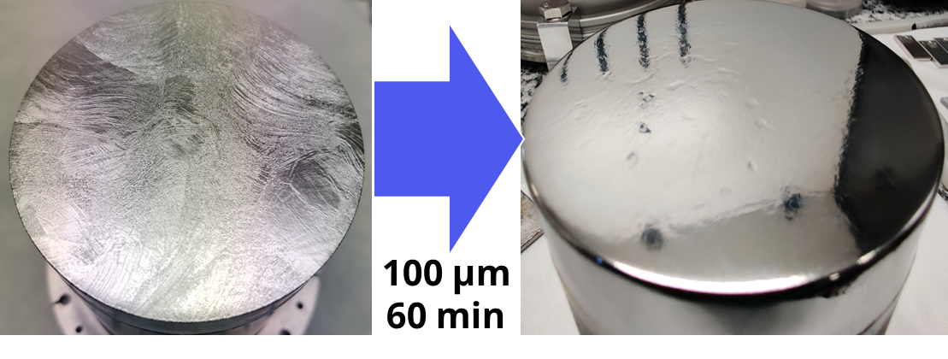
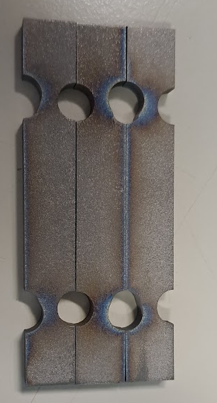
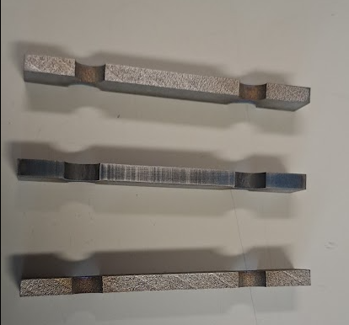
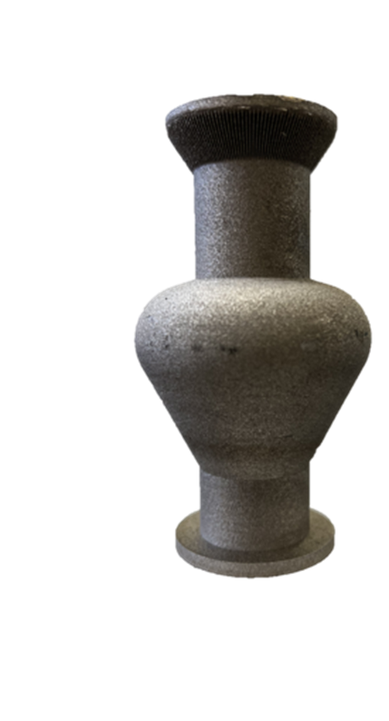
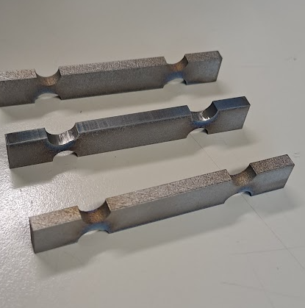
AM4Linacs
Case Study 1
Name: R&D Sample
Material: Nb
AM Technology: PBF - LB/M
PEP Details
Electrolyte: AMF_SF31*
Voltage: 300V
Temperature: 73°C
Total Time: 30 mins.
Workpiece
Challenges with AM
Patent WO2023218390A1, Nov. 16, 2023
Ezeaba Tochukwu Emmanuel
INFN, Legnaro 01/08/2025

Slide 18
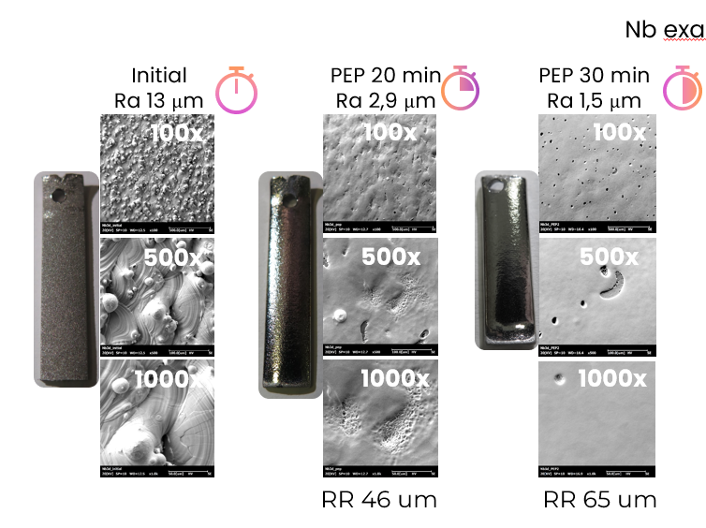

AM4Linacs
Challenges with AM
Treatment showed improvement in the surface quality
Next step: 6GHz cavity
Ezeaba Tochukwu Emmanuel
INFN, Legnaro 01/08/2025

Slide 19
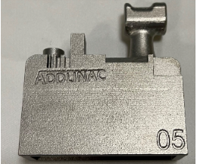
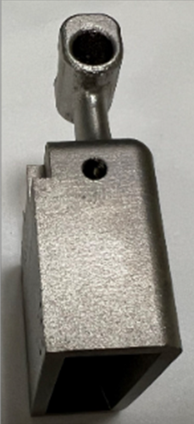
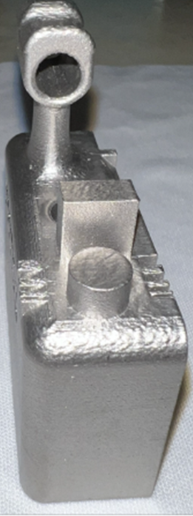
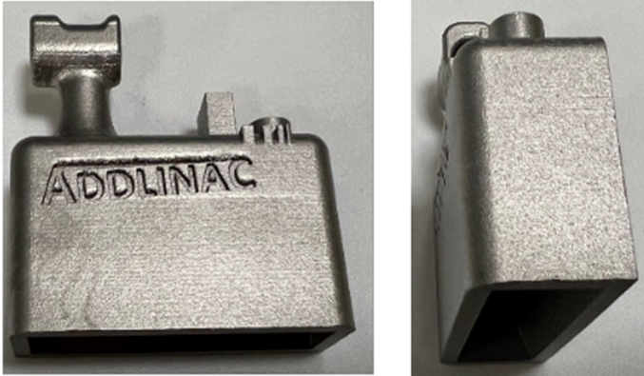
AM4Linacs
Case Study 2
Name: Benchmark Sample
Material: SS 1440
AM Technology: PBF-LB/M
PEP Details
Electrolyte: (NH₄)₂SO₄
Voltage: 300V
Temperature: 90°C
Total Time: 125 mins.
Workpiece
Challenges with AM
https://doi.org/10.18429/JACoW-LINAC2024-TUPB020
Ezeaba Tochukwu Emmanuel
INFN, Legnaro 01/08/2025

Slide 20


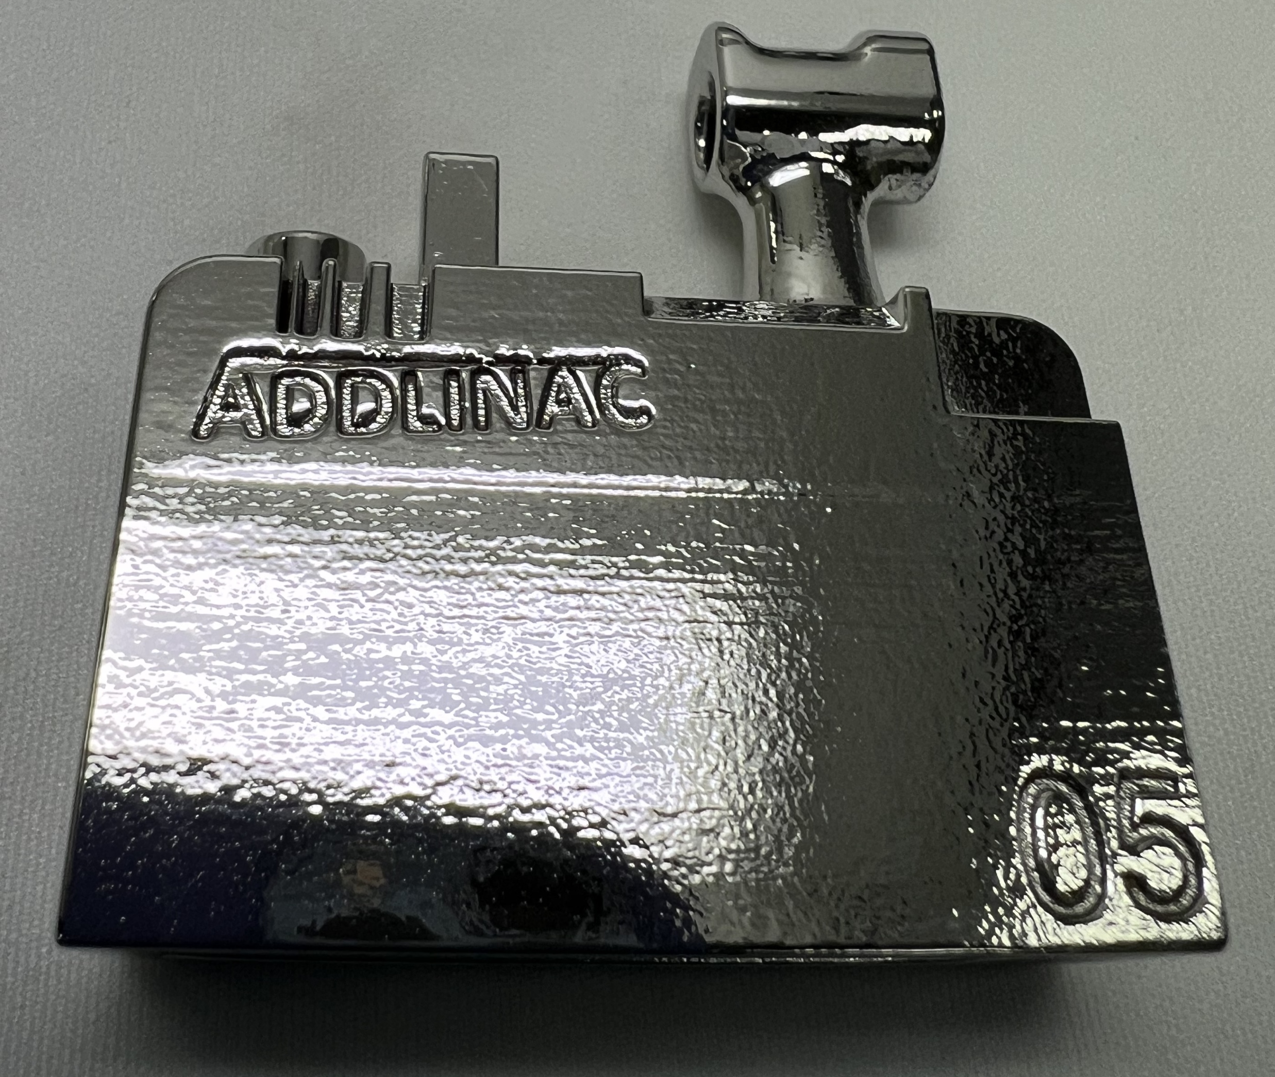
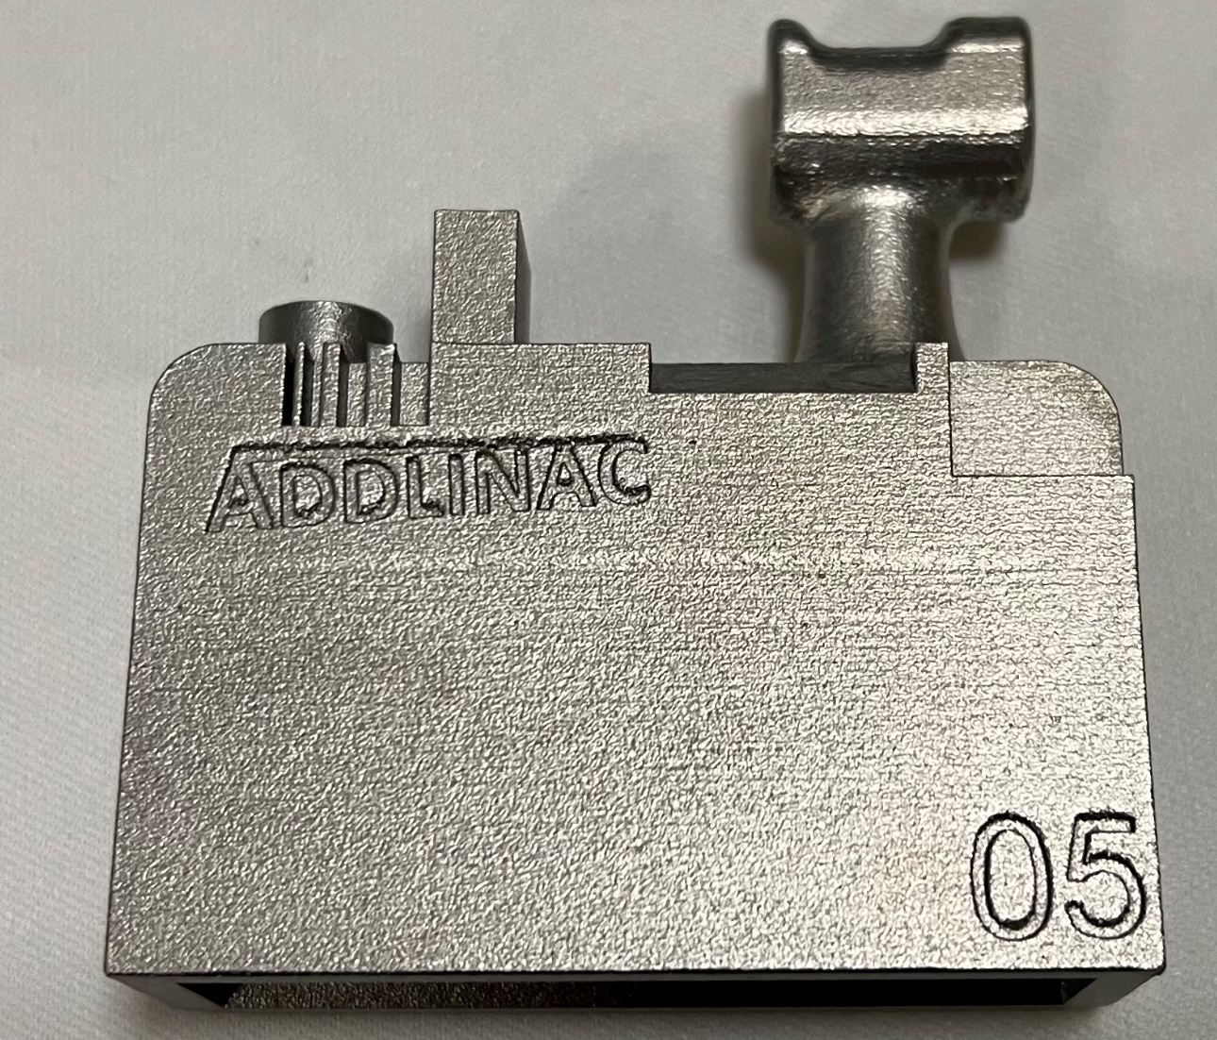
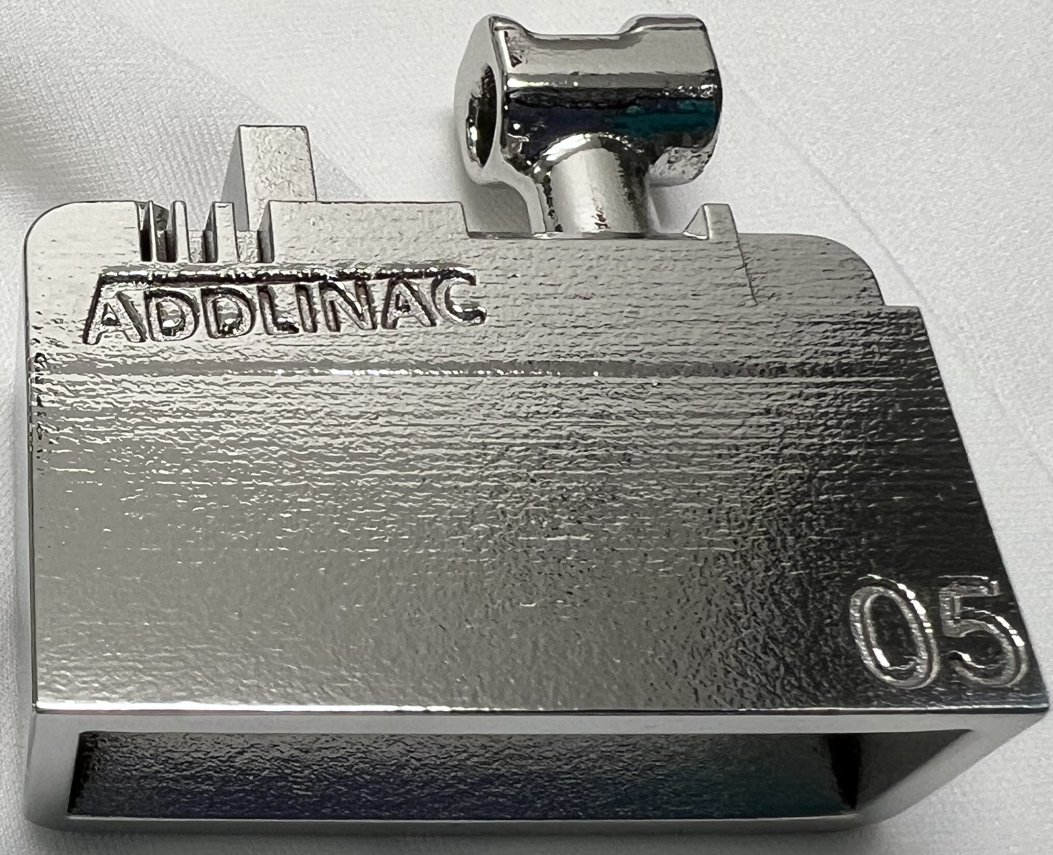
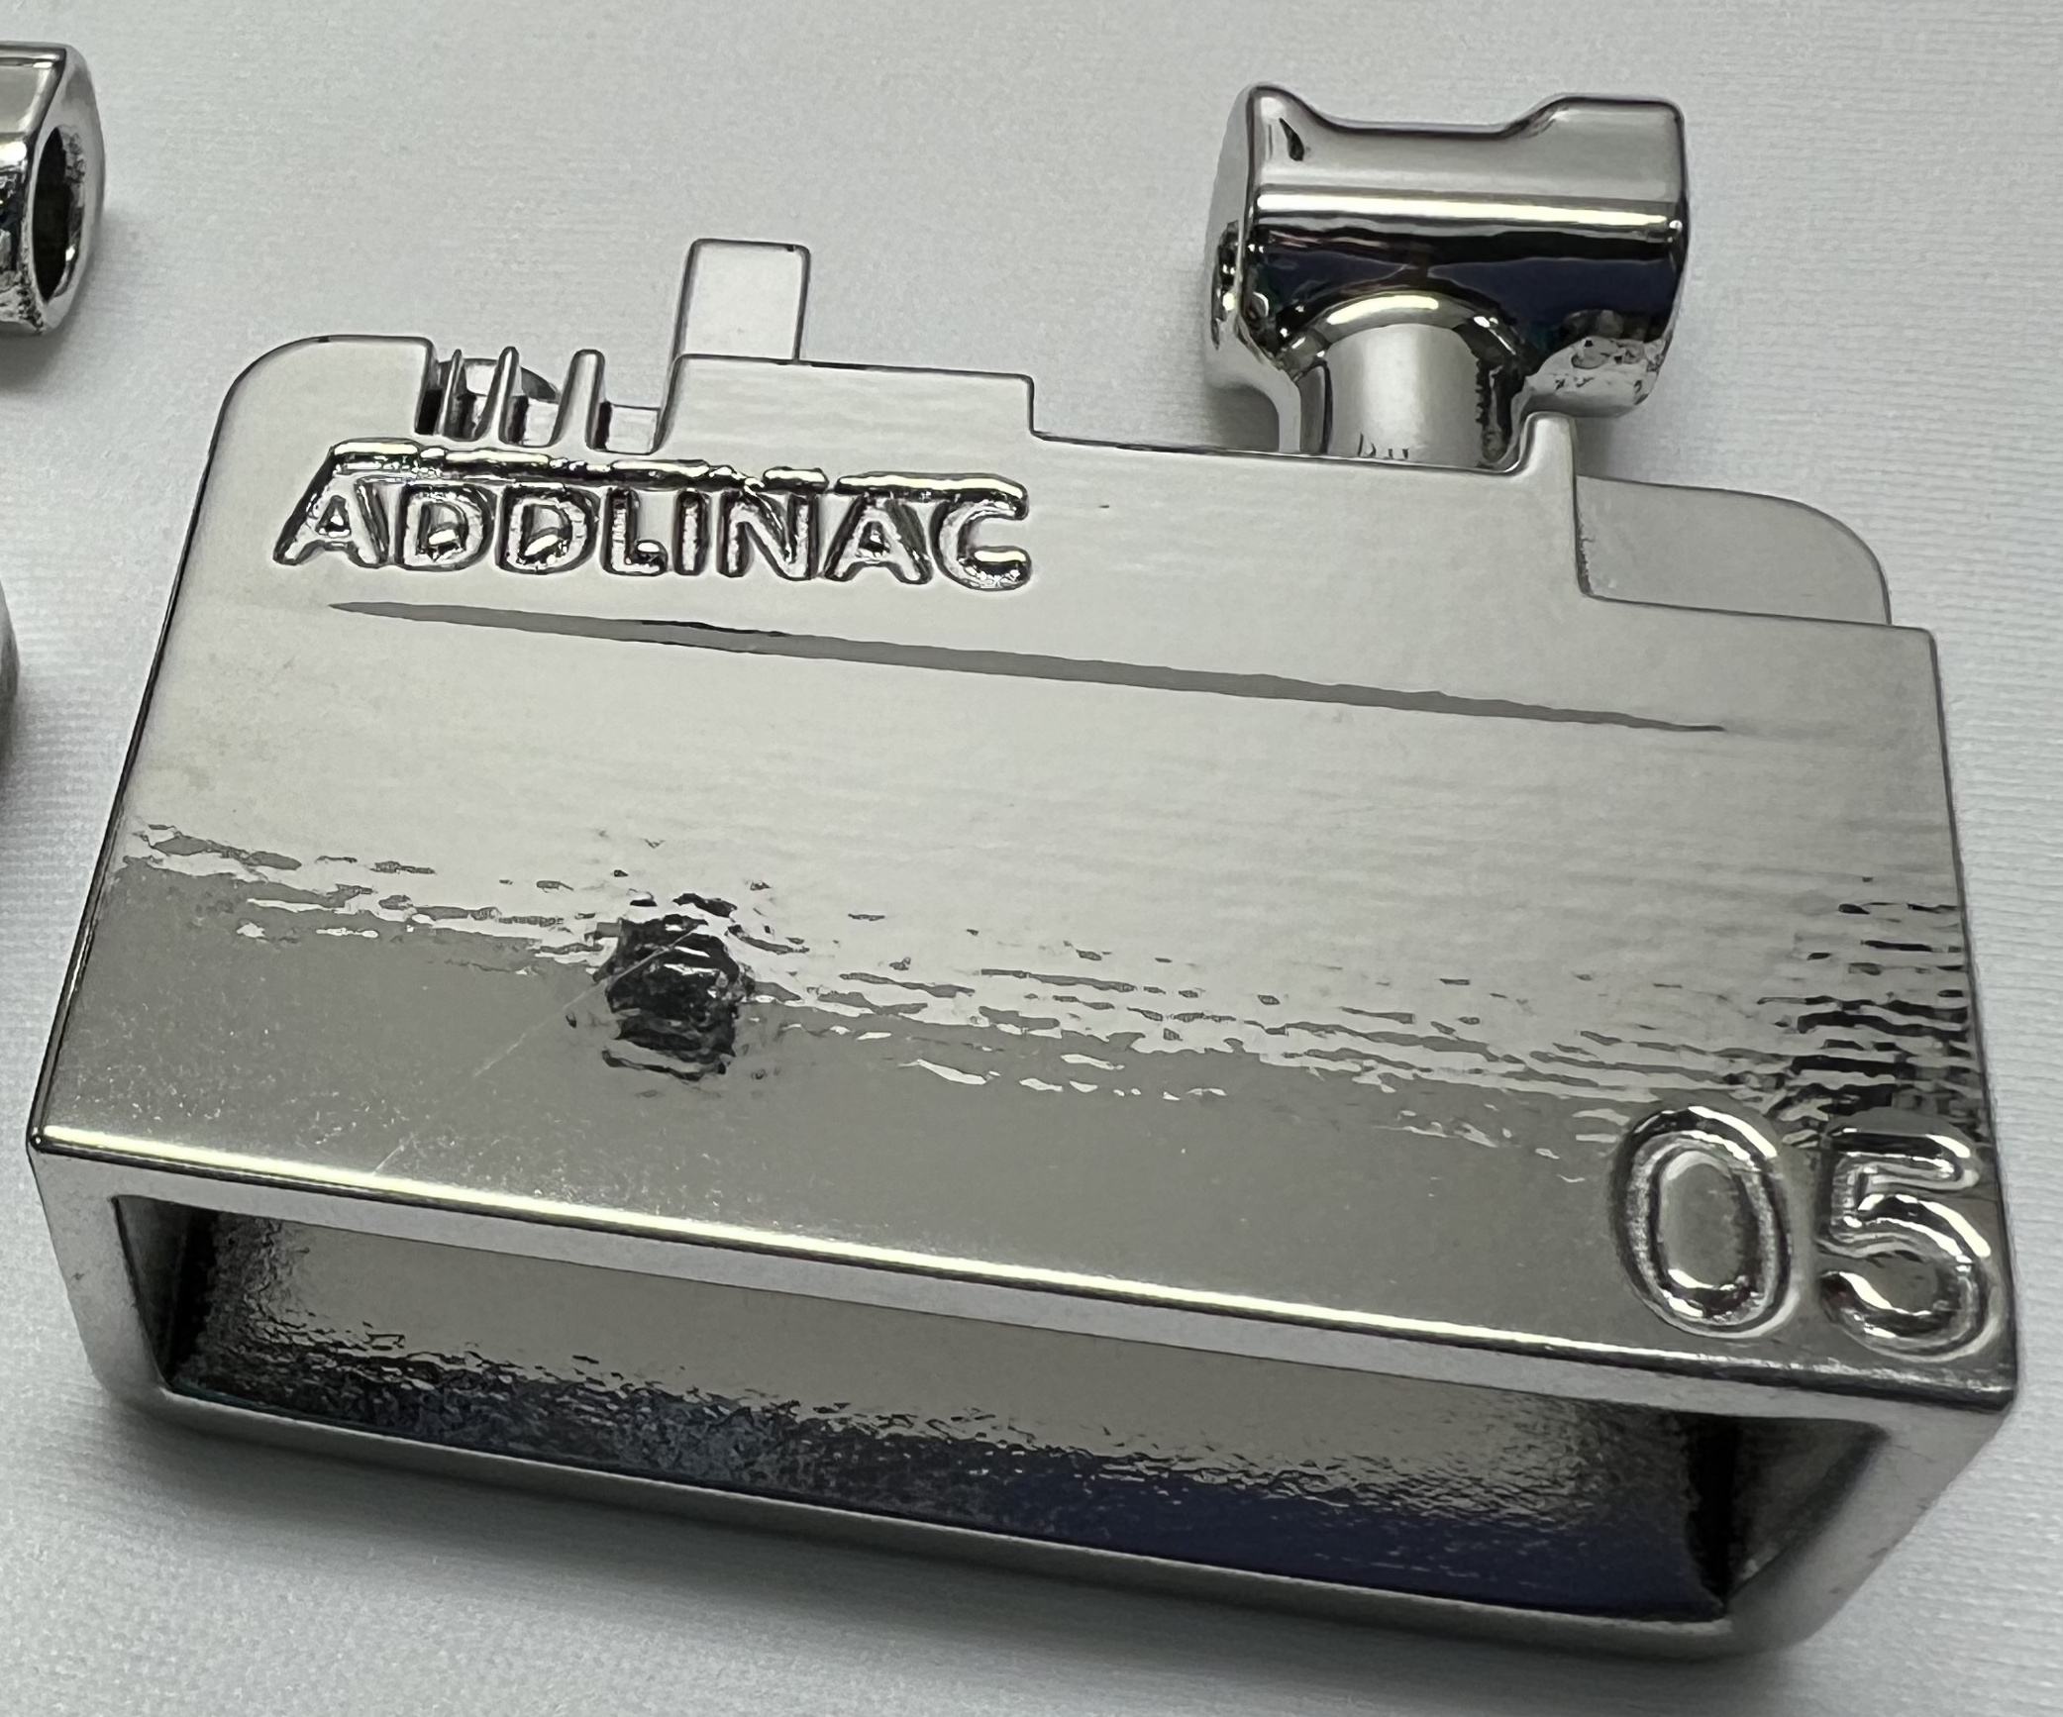
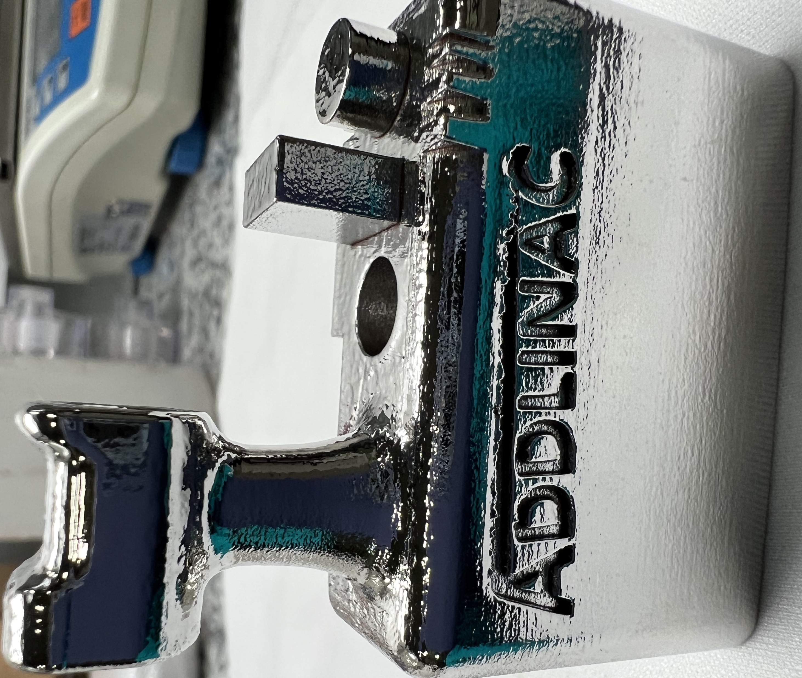
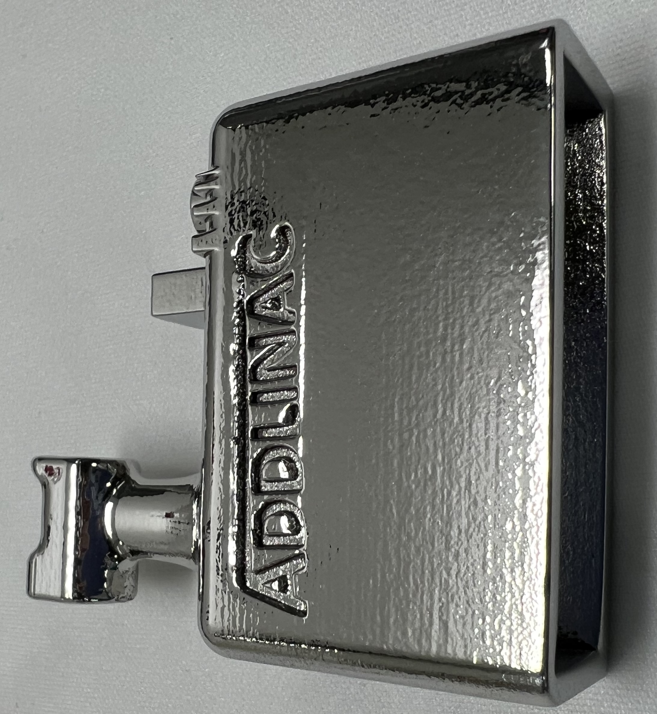
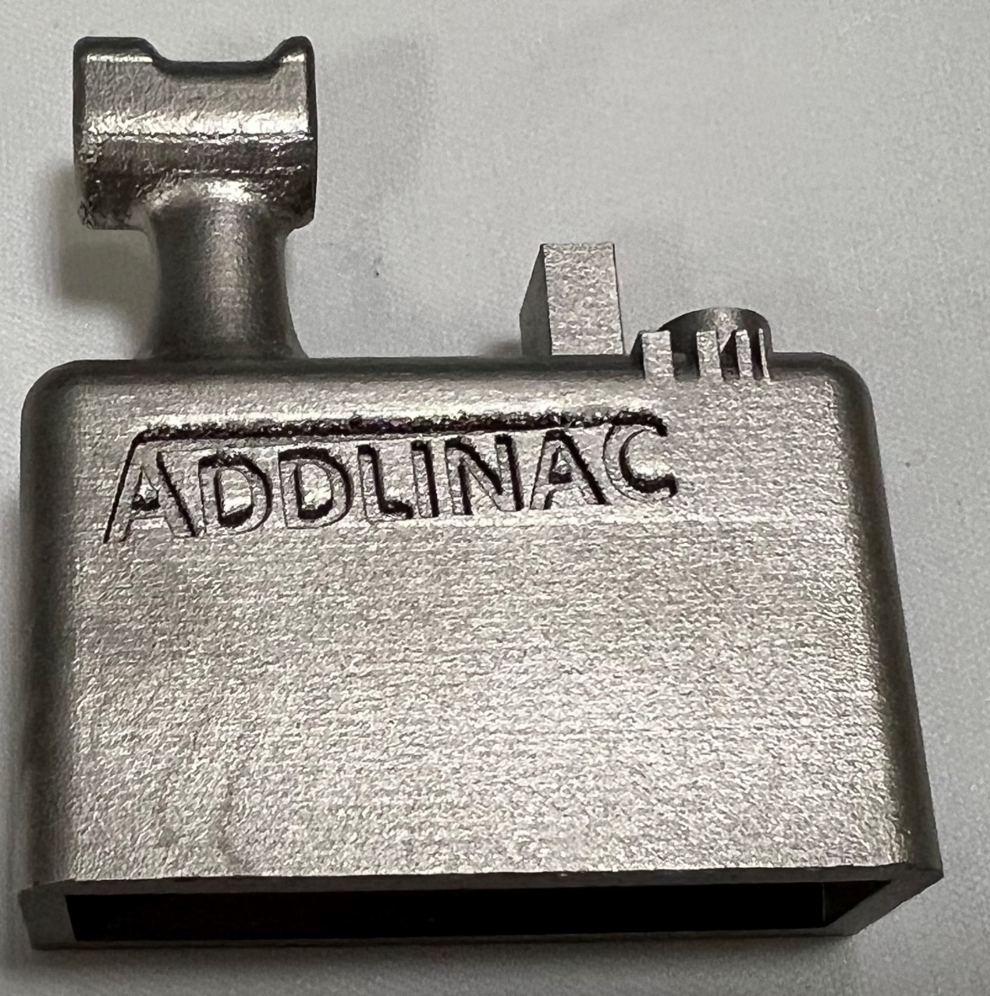
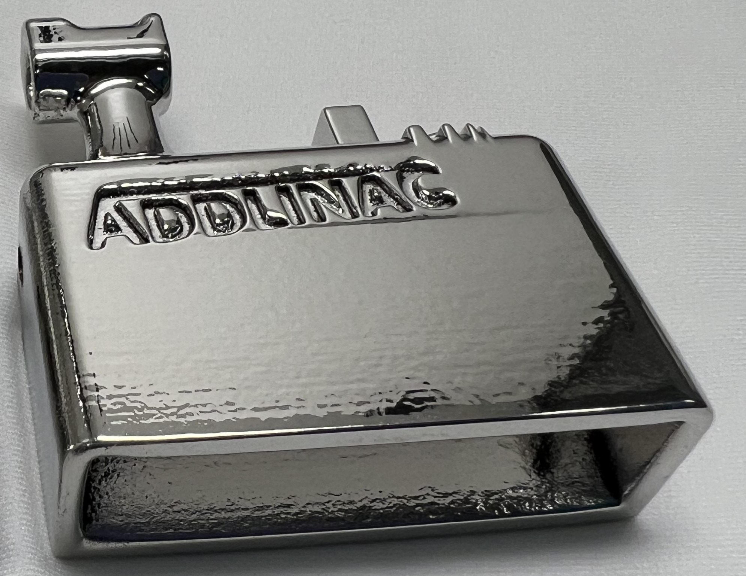
AM4Linacs
Comparison
Average thickness removed 150 μm
Sa 0,37 μm
Sand-Blasted
Challenges with AM
Sa 4,54 μm
Non-
Sand-Blasted
Sa 0,40 μm
Sa 8,80 μm
PEP1_37min
PEP2_65min
PEP3_125min
Ezeaba Tochukwu Emmanuel
INFN, Legnaro 01/08/2025

Slide 21
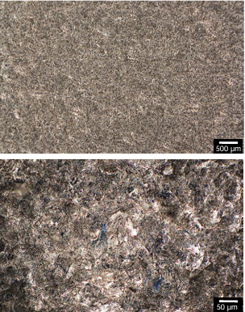
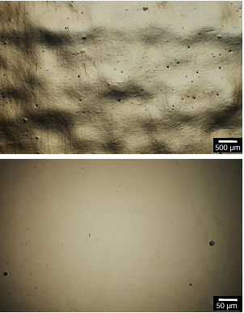


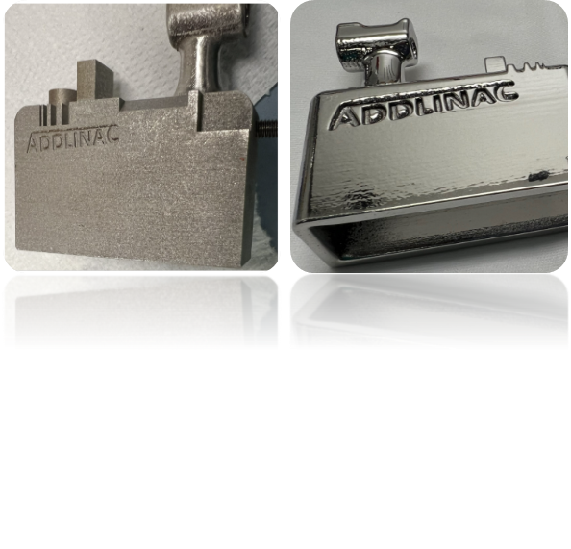
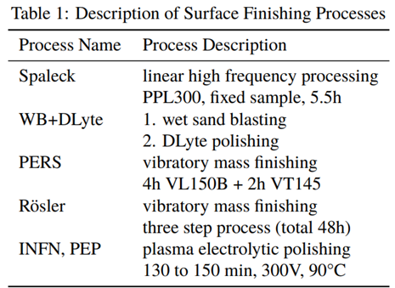
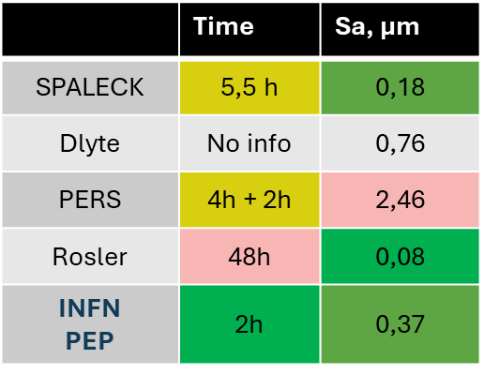
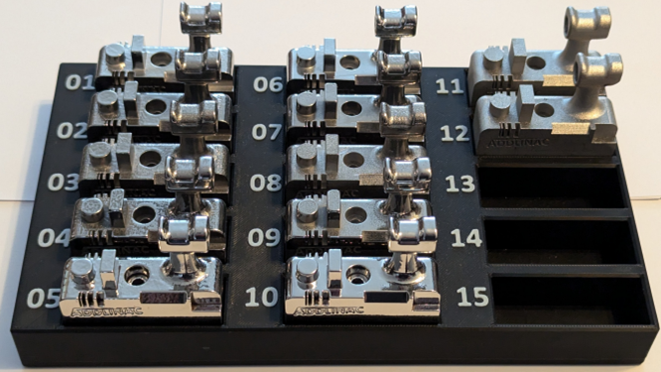
AM4Linacs
WP10
Summary of Results
Challenges with AM
Measurements by Rosler
https://doi.org/10.18429/JACoW-LINAC2024-TUPB020
Ezeaba Tochukwu Emmanuel
INFN, Legnaro 01/08/2025

Slide 22
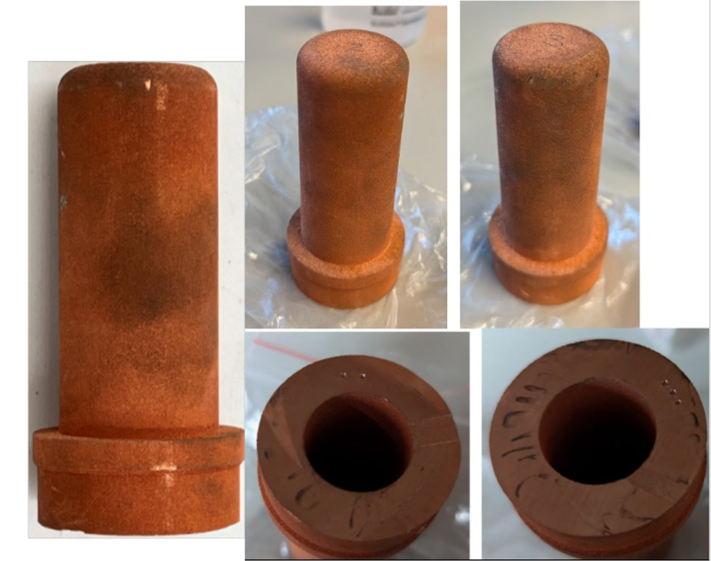
AM4Linacs
Case Study 3
Name: Inner Conductor
Material: Cu
AM Technology: LPBF/M
Initial Weight: 492.20g
PEP Details
Electrolyte: SUBU_5/MCS_4
Voltage: 300V
Temperature: 90°C
Total Time: 63 mins.
Workpiece
Challenges with AM
Ezeaba Tochukwu Emmanuel
INFN, Legnaro 01/08/2025

Slide 23

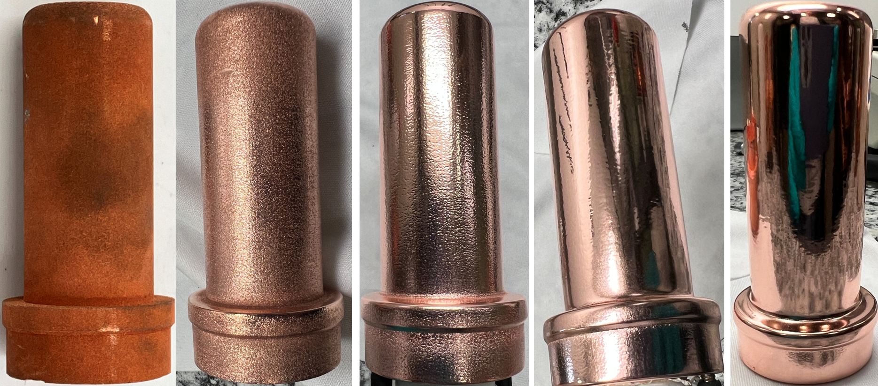


Comparison
AM4Linacs
Challenges with AM
Ezeaba Tochukwu Emmanuel
INFN, Legnaro 01/08/2025

Slide 24

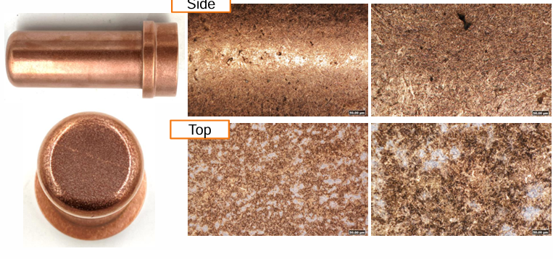

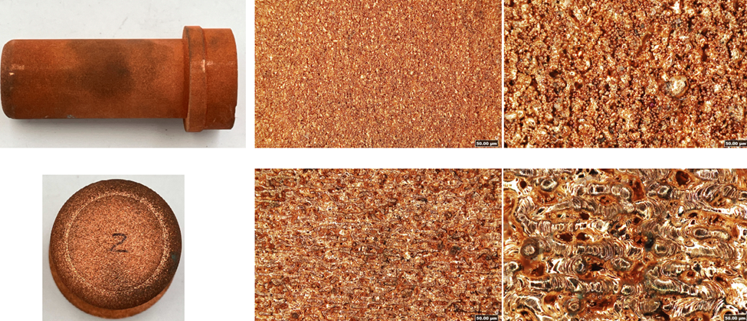
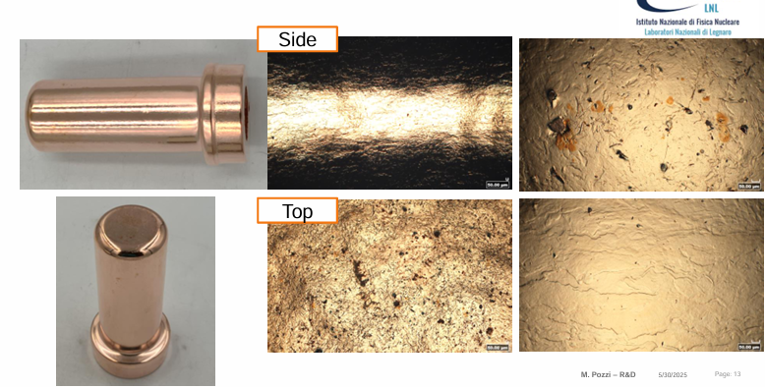
WP10
AM4Linacs
Summary of Results
19.31 µm
Challenges with AM
31.48 µm
Process
CMP+Mass Finishing
PEP
Sa µm (Side)
0.76
0.70
Time
7 hrs.
63 min
Sa µm (Top)
0.71
2.22
Ezeaba Tochukwu Emmanuel
INFN, Legnaro 01/08/2025

Slide 25
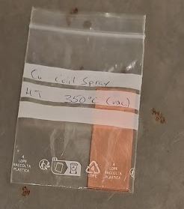
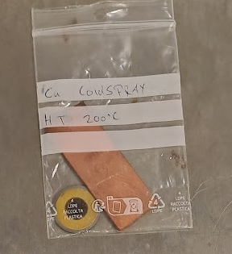
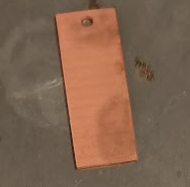
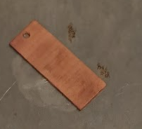
AM4Linacs
Case Study 4
Name: CEA Samples
Material: Cu
AM Technology: Cold Spray
PEP Details
Electrolyte1: SUBU_5
Voltage: 300V
Temperature: 75° - 95°C
Workpiece
Electrolyte2: MCS_4
Application: R&D
Post-processed: HT (200&350°C)
Challenges with AM
Ezeaba Tochukwu Emmanuel
INFN, Legnaro 01/08/2025

Slide 26
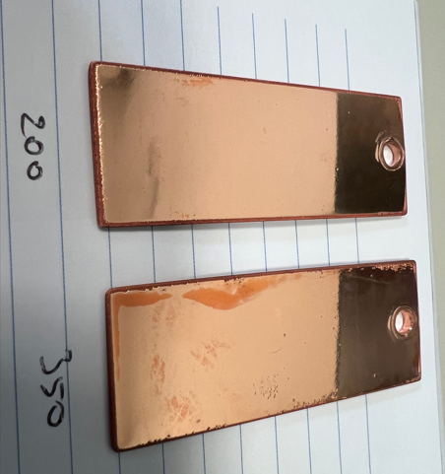





AM4Linacs
PEP1
PEP2
PEP3
PEP2:
Electrolyte: MCS_4
Time: 20 min.
PEP3:
Electrolyte: SUBU_5
Time: 5min
PEP1:
Electrolyte: SUBU_5
Time:10 min
Smoothened
As-sprayed
Left: 200°C
Right: 350°C
Ezeaba Tochukwu Emmanuel
INFN, Legnaro 01/08/2025

Slide 27








AM4Linacs
Initial
Final
Smoothened
Sa = 1.142µm
Sa = 1.003µm
Sa = 0.077µm
Sa = 0.095µm
As-sprayed
Sa = 6.317µm
Sa = 6.893µm
Sa = 0.074µm
Sa = 0.094µm
200°C
350°C
200°C
350°C
Ezeaba Tochukwu Emmanuel
INFN, Legnaro 01/08/2025

Slide 28




AM4Linacs
Case Study 5
Name: Drift-tubes
Material: Cu
AM Technology: PBF-LB/M
PEP Details
Electrolyte1: SUBU_5 *
Voltage: 300V
Temperature: 75° - 95°C
Workpiece
Electrolyte2: MCS_4
Application: IH-type Linac
Challenges with AM
DT3
DT2
*Patent WO2024184764A1,Sep. 12, 2024
Ezeaba Tochukwu Emmanuel
INFN, Legnaro 01/08/2025

Slide 29






AM4Linacs
Drift-tube 3
Highly turbulent process
Polishing Time: 15min
Electrolyte: SUBU_5 (Higher current density)
Temperature: 73°C
Ezeaba Tochukwu Emmanuel
INFN, Legnaro 01/08/2025

Slide 30






AM4Linacs
Drift-tube 2
Highly turbulent process .
Electrolyte: MCS_4 (Moderate current density)
Temperature: 95°C
Time: 30 minutes
Ezeaba Tochukwu Emmanuel
INFN, Legnaro 01/08/2025

Slide 31





AM4Linacs
Comparison
Need to study electrolyte/AM specifics dependency
Polishing result not identical
Stability could be achieved with temp. adjustment
Ezeaba Tochukwu Emmanuel
INFN, Legnaro 01/08/2025

Slide 32





AM4Linacs
Optical Micrographs
A1
A1
 | As-built |  | After PEP
 | Sa (µm) | Sz (µm) | Sa (µm) | Sz(µm)
DT3 | 1.216 | 21.521 | 0.079 | 2.585
DT2 | 1.242 | 17.093 | 0.099 | 1.889
Roughness Standard: ISO 25178-2:2012
DT3
20X
DT2
20X
Ezeaba Tochukwu Emmanuel
INFN, Legnaro 01/08/2025

Slide 33














Metal Injection Molding
AM4Linacs
Ezeaba Tochukwu Emmanuel
INFN, Legnaro 01/08/2025
CuCr1Zr (X-Band RF Cavity)
Binder Jetting

Slide 34
AM4Linacs
Plasma Electrolytic Polishing (PEP) has emerged as a highly promising alternative to conventional surface finishing methods, especially for additively manufactured (AM) parts.
PEP enables significant surface roughness reduction with excellent gloss enhancement. Roughness values as low as 8 nm and below are possible.
In certain cases, AM build strategies (e.g., scanning or hatching patterns) could be traceable after PEP, offering insight into underlying microstructures.
PEP tends to open existing surface pores and do not concealing them. This, however, may serve as a benefit for applications requiring pore visibility or inspection.
Prolonged treatment time can lead to dimensional changes (edge rounding) or deterioration of optically sensitive surfaces.
Our group is currently studying the relationship between printing parameters and PEP. Also, exploring scaling up PEP applications to SRF cavities (6 GHz, 1.3 GHz, 400 MHz), with niobium (Nb) and copper (Cu) as primary material candidates.
CONCLUSION
Ezeaba Tochukwu Emmanuel
INFN, Legnaro 01/08/2025

