Slide 1

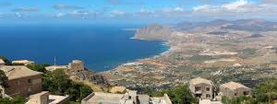

ERICE INTERNATIONAL SCHOOL OF PARTICLE ACCELERATORS
«KJELL JOHNSEN, GUSTAV VOSS AND EDMUND WILSON» School directors: Lucio Rossi, Thomas Taylor
Higgs factories for the post-HiLumi era
Place : ERICE Dates : 26 Nov- 1 Dec 2025
5th Course Directors : Massimo Ferrario, INFN-LNF, Lucio Rossi, Università di Milan and INFN-MI-LASA,
F. Zimmermann, CERN
Scientific Secretary: Stefano Sorti, University of Milano and INFN-LASA https://agenda.infn.it/event/47080/

Slide 2
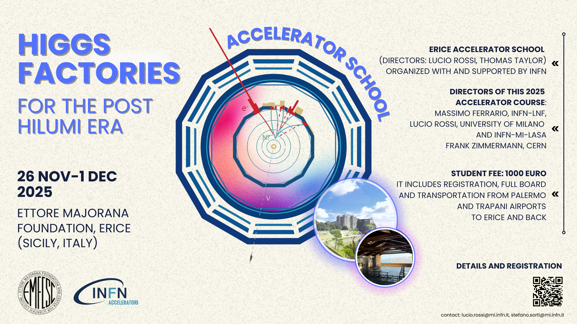

Slide 3
Join the INFN Accelerator School – Shaping the Future of Particle Physics!
Particle physics is at an exciting crossroads! As the Large Hadron Collider (LHC) nears the end of its standard configuration run, it is preparing to transition into the High-Luminosity LHC (HiLumi LHC), boosting its luminosity tenfold in the quest for new physics beyond the Standard Model.
At the same time, the global particle physics community is engaged in defining the future of accelerators, with the Update of the European Strategy for Particle Physics taking place throughout 2025 and into spring 2026. The big question: What comes after the HiLumi LHC?
Several groundbreaking options are on the table:
🔹 A next-generation circular hadron collider with cutting-edge high-temperature superconductor (HTS) magnets? Either following the FCC-ee Higgs/electroweak/top factory, as envisaged by present CERN plan, or as direct bold step into the future.
🔹 A linear lepton collider leveraging plasma acceleration for a revolutionary compact design?
🔹 The resurgence of the Muon Collider, re-emerging as a bold alternative?
With so many competing concepts, how can we compare their beam dynamics, technological challenges, and scientific potential? How do cost, feasibility, and physics priorities shape the decision-making process?

Slide 4
💡 This Accelerator School is your opportunity to explore these questions firsthand! Designed for students, young researchers, and even experienced scientists, the school offers a comprehensive, comparative perspective on the next frontier of accelerator physics.
📌 What to Expect?
✅ Top-tier lecturers – leading scientists, chief technologists, and project directors
✅ A deep dive into all major accelerator proposals, with decision-makers
✅ Fact-based insights to help you form your own informed opinion
🚀 Don't miss this chance to be at the heart of the debate on the future of high-energy physics!
Student fee: 1000 Euro. It includes registration, full board and transportation from Palermo and Trapani airports top Erice and back.

Slide 5
2025 | Wednesday, 26 November | Thursday, 27 November | Friday, 28 November | Saturday, 29 November | Sunday, 30 November
08:30 | Arrival | Introduction to accelerators - III - Longitudinal dynamics | FCCee dynamic aperture optimization | Linear collider as Higgs factory | Plasma acceleration and limitations
 |  | Davide Alesini (LNF) | Rogelio Tomas Garcia (CERN) | Roberto Corsini (CERN) | Massimo Ferrario (INFN-LNF)
09:30 |  | Technical infrastructure of large facilities | FCC-ee MDI | Positron sources | Plasma specific issues and ideas for Higgs factory (CEPC injector)
 |  | Jean Paul Burnet (CERN) | Manuela Boscolo (LNF) | Iryna Chaikovska (IJC Lab) | Massimo Ferrario (INFN-LNF)
10:30 |  | Coffee
11:00 |  | Why a Higgs factory is so crucial? | FCC-ee radiation and vacuum issues | Final Focus and luminosity at colliders (lessons from ATF2& SuperKEKB) | Free (Holy mass/shopping/site exploring)
 |  | Guy Wilkinson (CERN) | Marton Ady (CERN) | Rogelio Tomas Garcia (CERN)
12:00 |  | Comparing and ranking Higgs factories: the ESPP point of view | FCC-ee collective effects | Instabilities at IP (both linear colliders and FCC)
 |  | Karl Jakobs (Univ. of Freiburg) | Mauro Migliorati (UniRoma1) | Daniel Schulte (CERN)
13:00 | Lunch
15:00 | Arrival | Magnet technology and limitations | FCC-ee Injector | ILC specific challenges (SRF) | HALHF: Hybrid Asymmetric Linear Higgs Factory
 |  | Attilio Milanese (CERN) | Paolo Craievich (PSI) | Caterina Vernieri (SLAC) | Brian Foster (Oxford)
16:00 |  | Rf technology and limitations | FCC-hh design | CCC challenges and prototypes | Muon Collider as Higgs factory
 |  | Franck Peauger (CERN) | Massimo Giovannozzi (CERN) | Caterina Vernieri (SLAC) | Daniel Schulte (CERN)
17:00 | Coffee
17:30 | Introduction to the school & students' self presentation | FCC Intro and general concepts | FCC - Magnets | CLIC challenges | Cost estimation of large projects
 | Lucio Rossi (Univ. of Milan) | Frank Zimmermann (CERN) | Attilio Milanese (CERN) | Roberto Corsini (CERN) | Norbert Holtkamp (SLAC)
18:30 | Introduction to accelerators - I - Transverse dynamics | FCC-ee optics -I | FCC - SRF | Other options: LHeC, LEP3, gamma-gamma and ERL based | Higgs factory: the view of ICFA
 | Tatiana Pieloni (EPFL) | Katsunobu Oide (KEK/CERN) | Franck Peauger (CERN) | Frank Zimmermann (CERN) | Pierluigi Campana (INFN-LNF)
19:30 | Introduction to accelerators - II - Transverse Dynamics | FCC-ee optics-II | Sustainability of large accelerator research infrastructures | The development of SRF : the lesson from XFEL, SNS, LCLS2 | Q&A - wrap up of the school
 | Tatiana Pieloni (EPFL) | Katsunobu Oide (KEK/CERN) | Denise Volker (Desy) | Norbert Holtkamp (SLAC) | Ferrario, Rossi, Zimmermann
20:30 | Dinner

Slide 6
Category comparison
14 general interest talks
11 lecture on FCC and technology
7 lectures on LCs and technology
3 Plasma based and HALHF acc.
1 Muon C.
1 on other options (LEP3, LHeC, ERL, γ-γ)
37 Lectures in total
25 Lecturers

