Slide 1
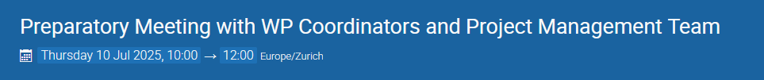

MEETINGS
https://indico.cern.ch/event/1561674/
https://indico.cern.ch/event/1569704/

Slide 2
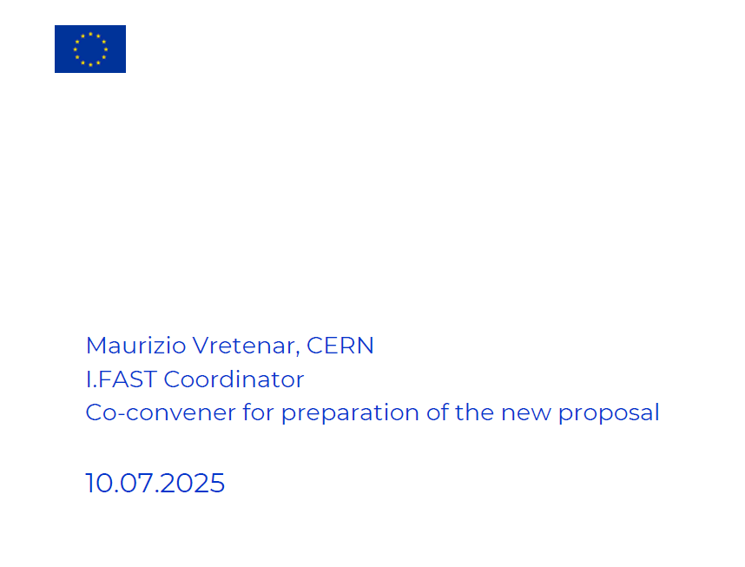
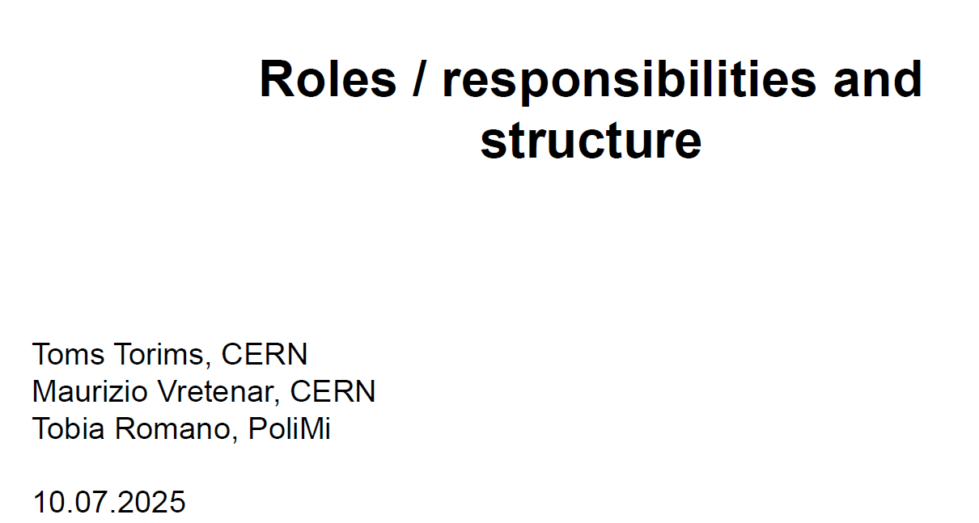

Slide 3
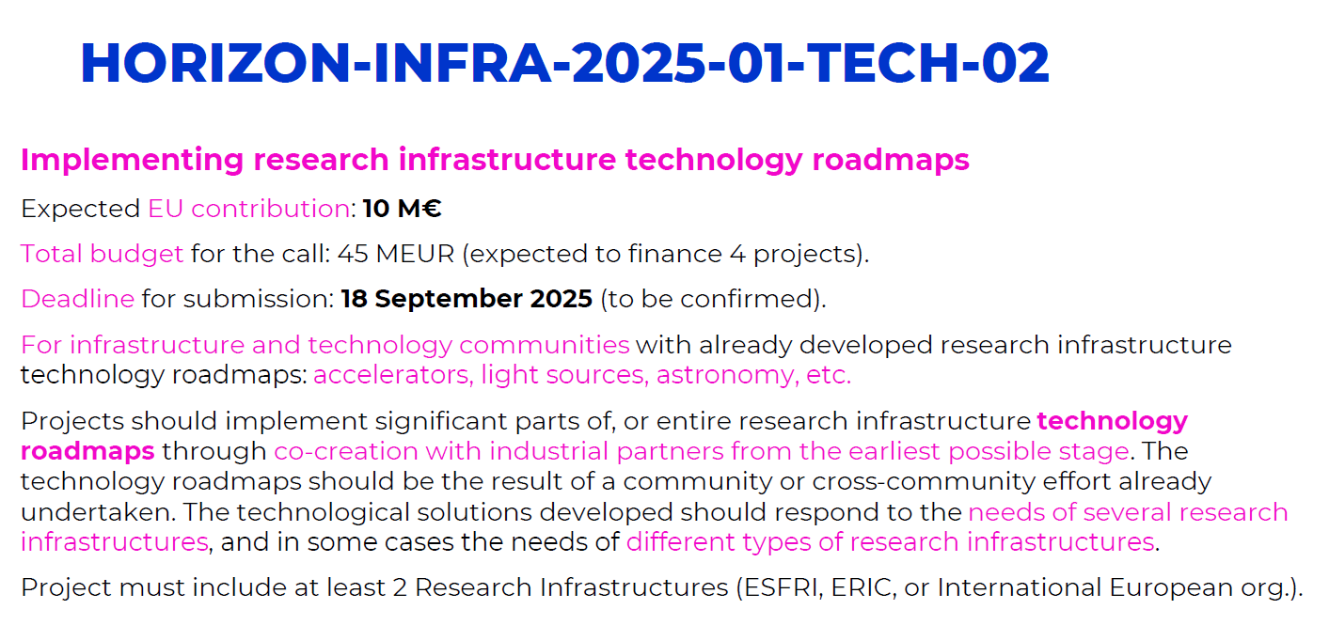

Slide 4
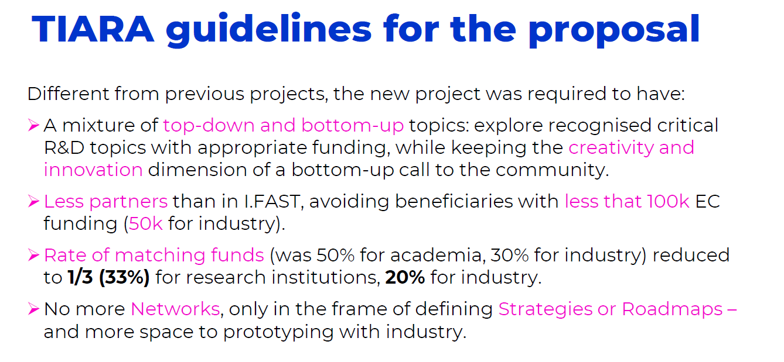

Slide 5
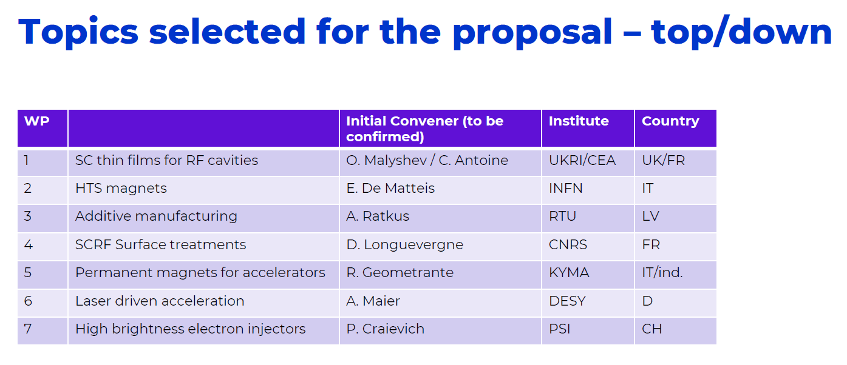

Slide 6
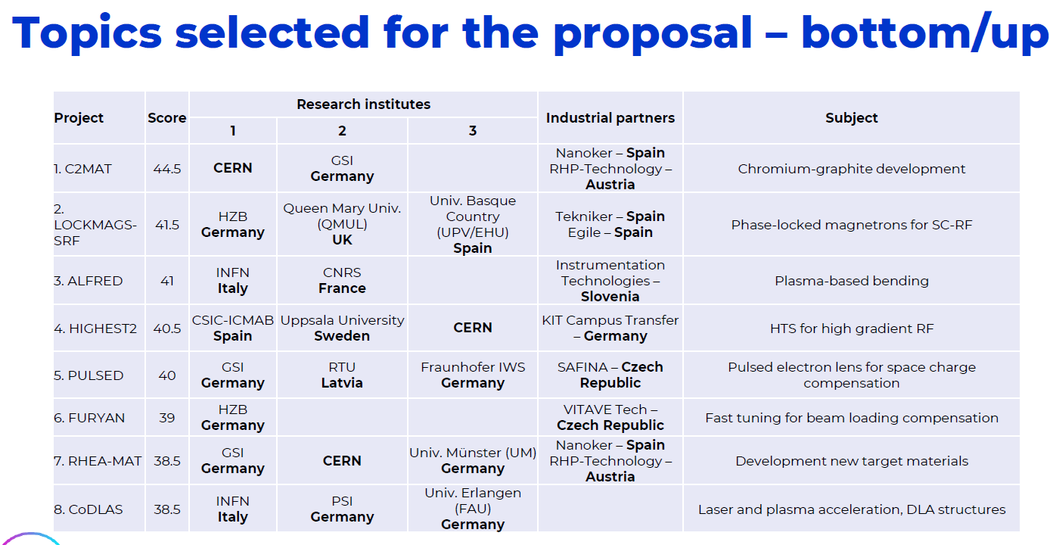

Slide 7
IFAST2 ⇒EPITA
Enabling Technology (prima istituzione in parentesi indica il coordinatore europeo)
Ernesto De Matteis (INFN Milano): Superconducting HTS magnets (INFN, CEA, CIEMAT, CERN, GSI, IEE-SAS, Arquimea, SUBRA)
Cristian Pira (LNL): Superconducting Thin Films coated RF cavities (STFC, CEA, IEE-SAS, INFN, HZB, ZANON)
David Alesini (LNF): High brightness electron injectors (PSI, INFN, COMEB, VDL)
Daniele Sertore (MI_LASA): Surface treatments for SCRF cavities (CNRS, CEA, DESY, INFN, ESS, Zanon)
Pietro Rebesan (INFN-PD): Additive Manufacturing for Accelerators (RTU, PoliMi, GUF, CERN, INFN, AIDIMME, EOS, ROSLER, IWS, BINC)
Emerging Technologies
Riccardo Pompili (LNF): Active pLasma FoR bEnDing (ALFRED) (INFN, CNRS, Instrumentation Technologies)
Giuseppe Torrisi (LNS): CoDLAS: Co-Propagating Dielectric Laser Accelerator Structures (INFN, PSI, FAU, SENSI, THALES)
Coordinatore nazionale: David Alesini, LNF

Slide 8
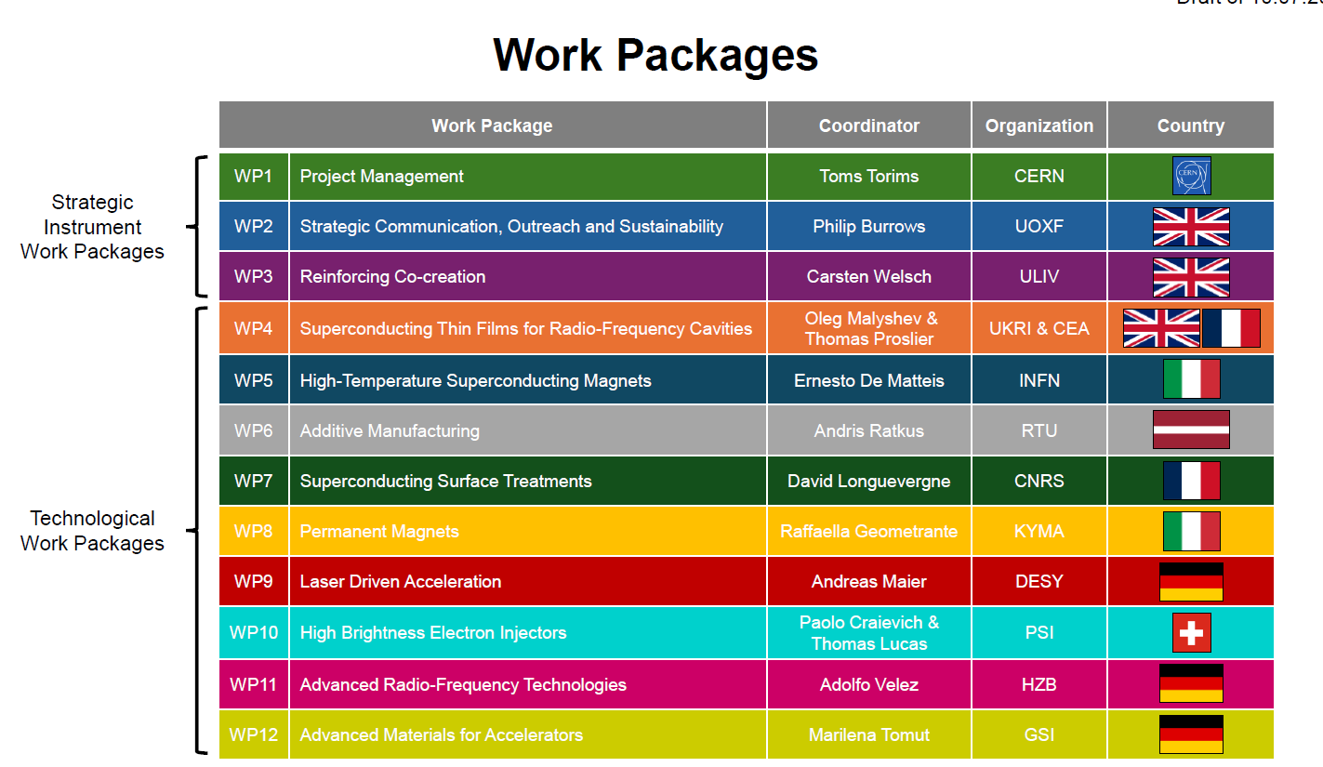

Slide 9
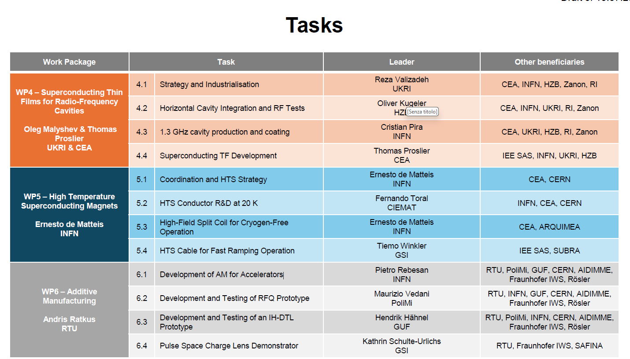

Slide 10
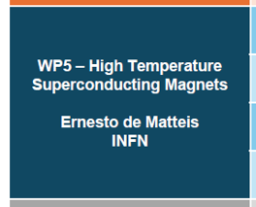
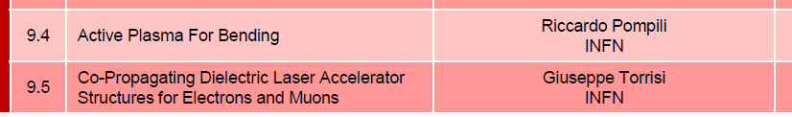
PROGETTI INFN NEI WORK TASK

Slide 11
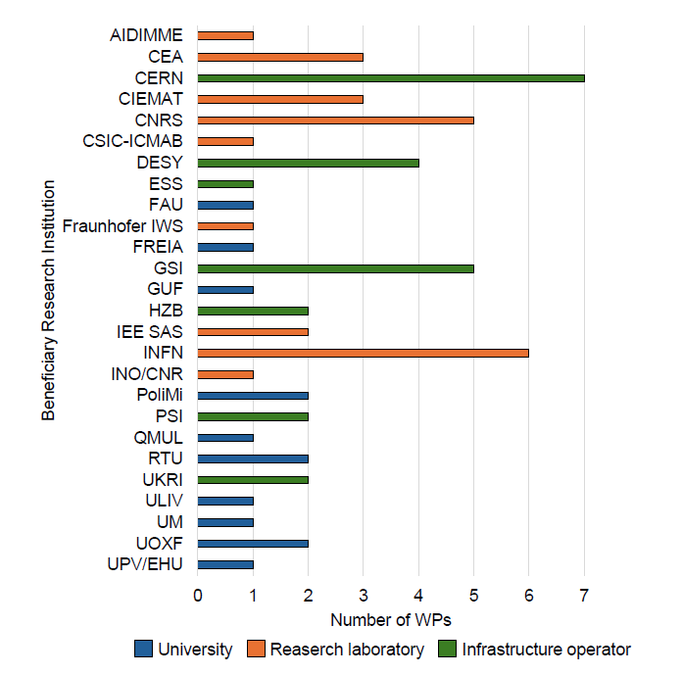

Slide 12
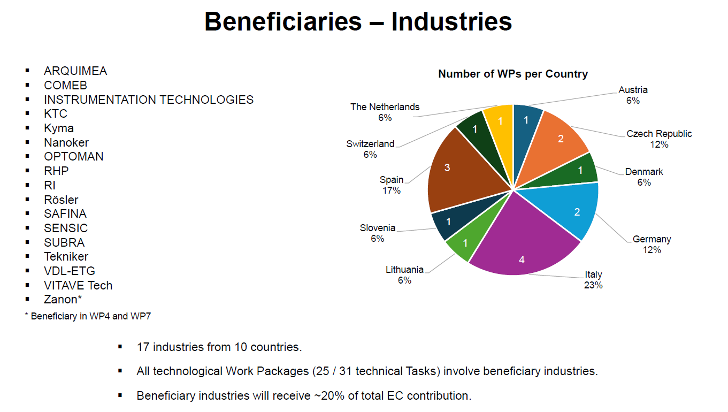

Slide 13
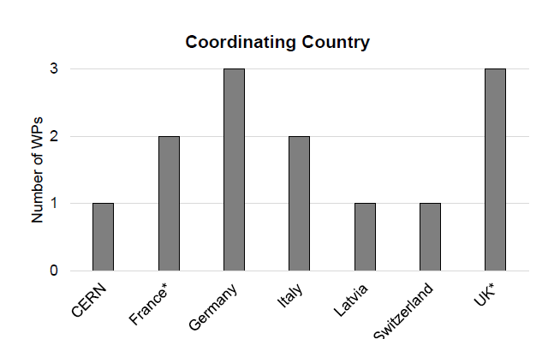
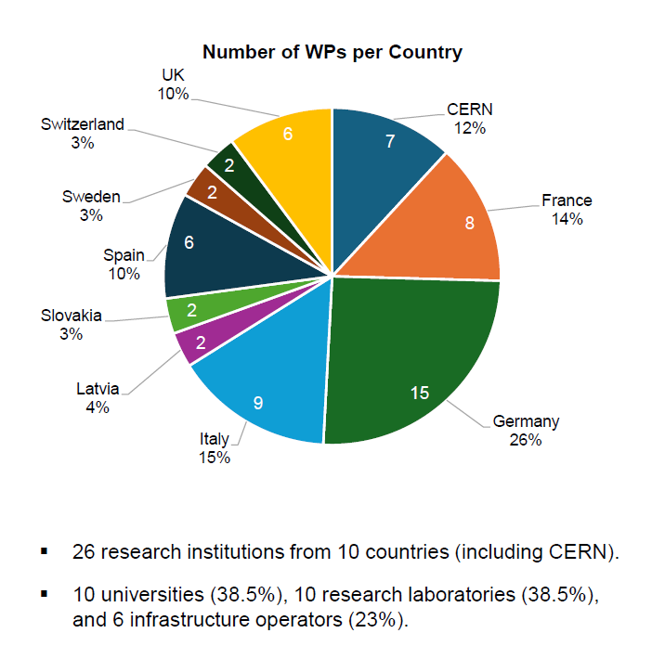

Slide 14
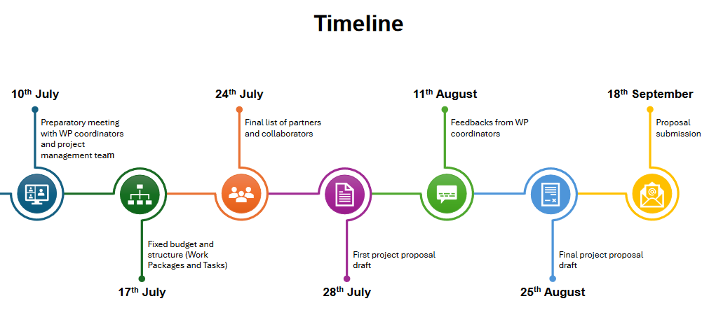

Slide 15
