Slide 1
TOFpRad update
15/07/2025

Slide 2
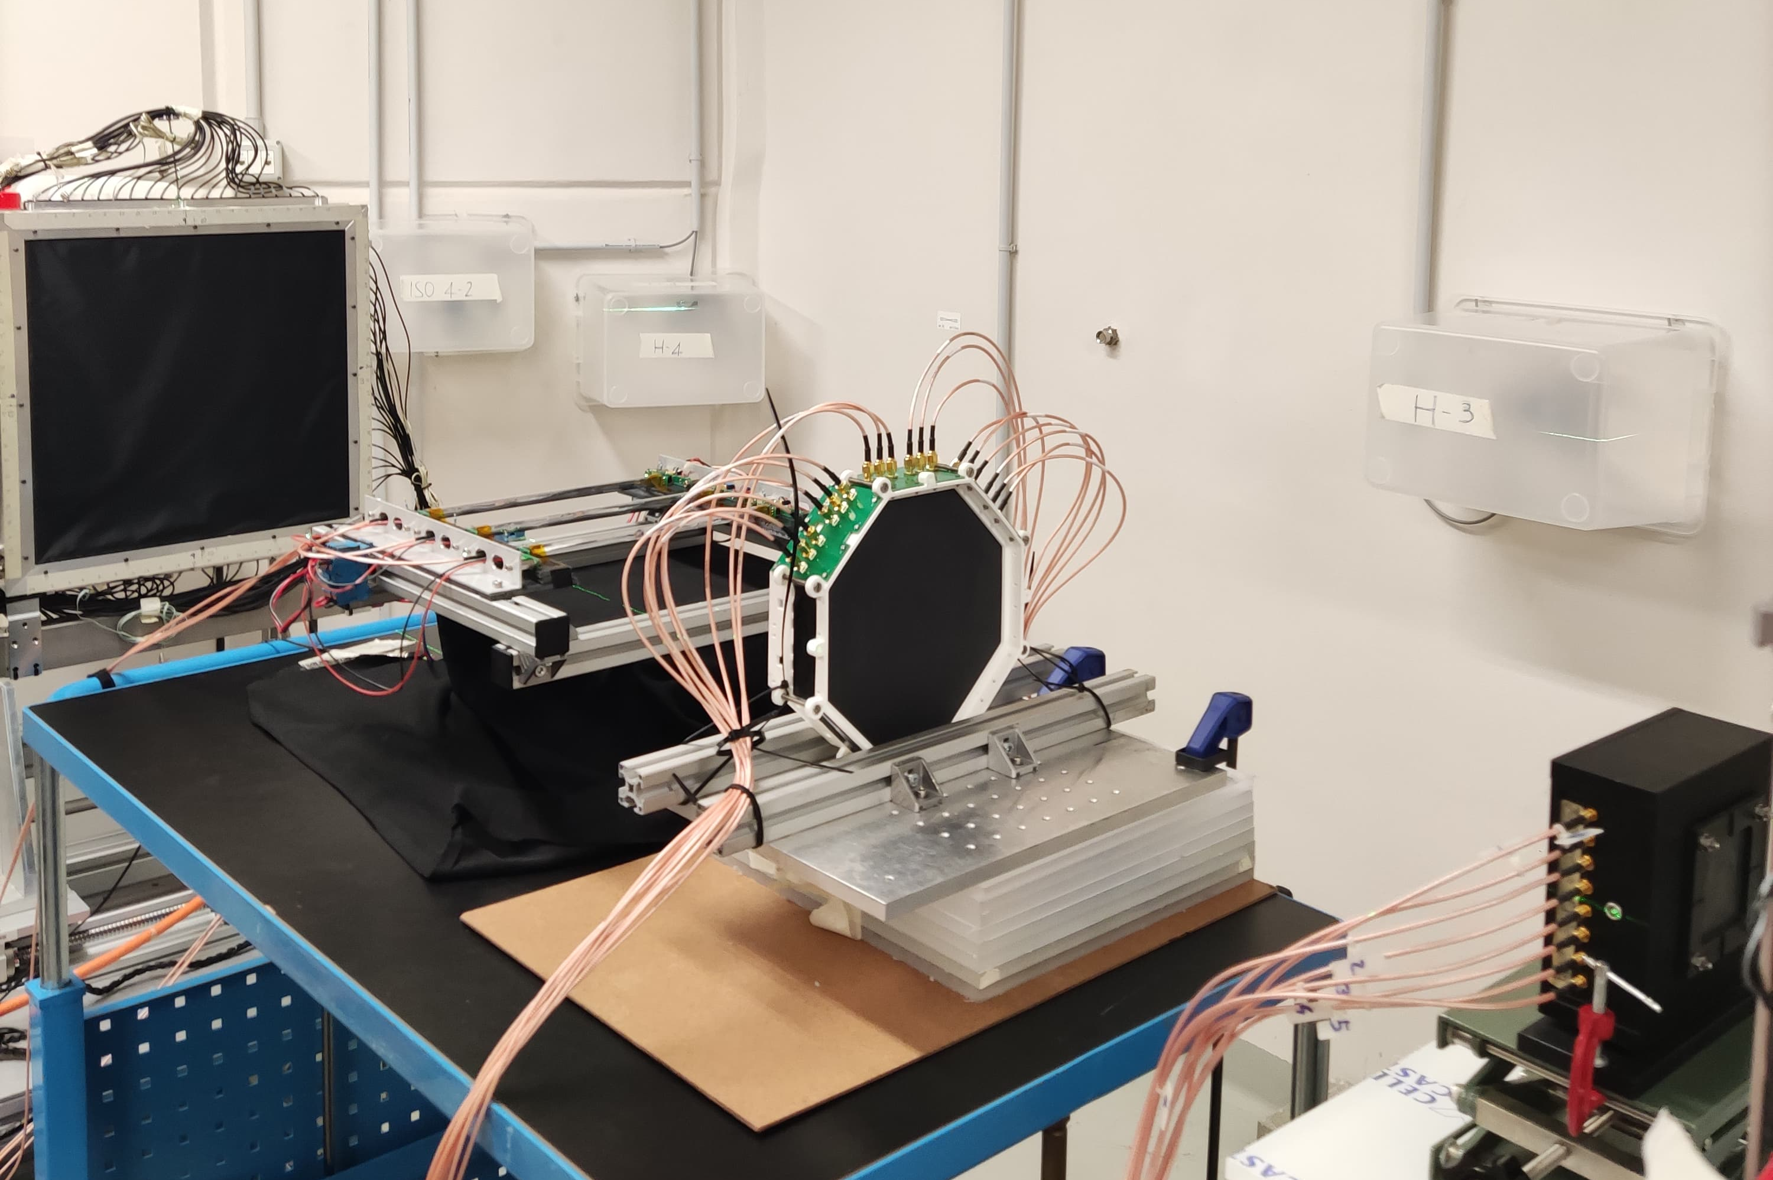
Last data taking
New demonstrator of detectors tested on the beam!
Tested different configurations of HV, PZ, beam energies
Irradiations of the detectors at different positions
Repeated some of the measurements that were already performed in 2024, with a different synchronization of the beam monitor.
As always, everything is at CNAO yet, but we will find the way…

Slide 3
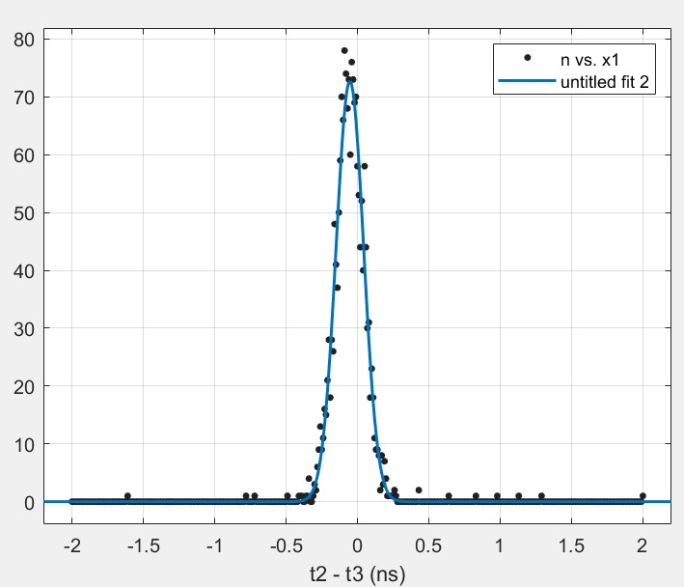
New TW bars results… preliminary
Due to a design mistake, it was not possible to bias the SiPMs with the WaveDAQ. The signal acquired at the WaveDAQ exhibited ha high level of noise, which compromised the time resolution performance.
We decided to send few board signals directly at the oscilloscope.
With the oscilloscope we obtained a standard deviation of 97 ps between two single channels of two different bars.
Time resolution of a single bar below 50 ps!

Slide 4
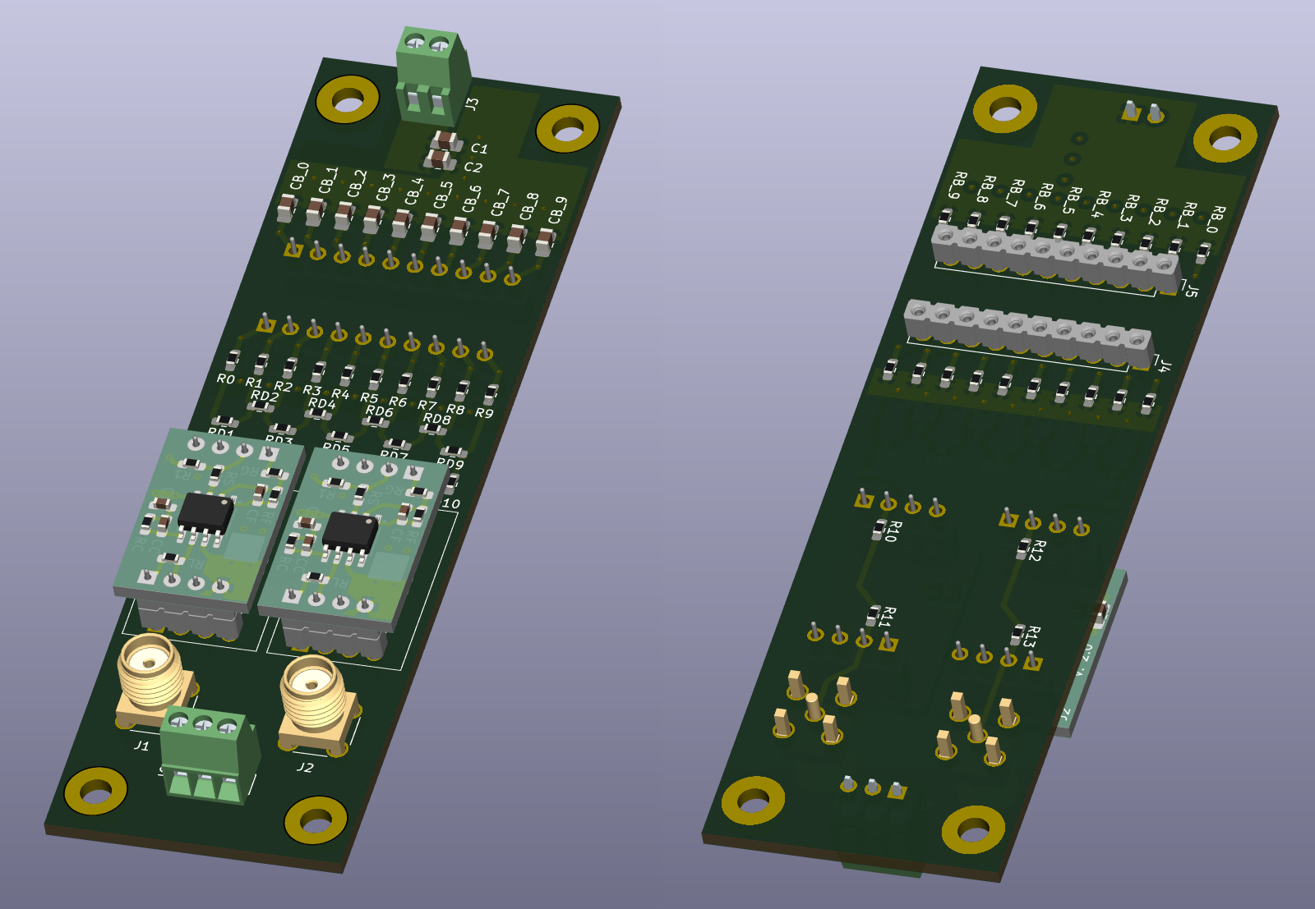
Further developments… Tracker board
New version of the board ready to be sent to construction
Two amplifiers (up to 20 V/V) connected to the two ends of the resistor divider.
Simplified version of the divider circuit tested with Spice simulations
Each board cover a 30 mm lateral side.
→ 2 chs / 30 mm coverage
- No chance to set the HV with the WaveDAQ system

Slide 5
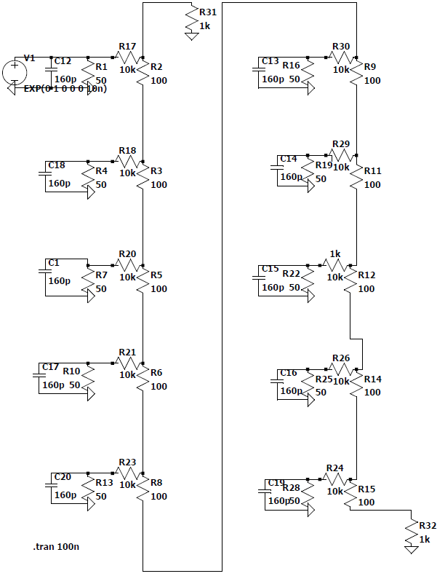
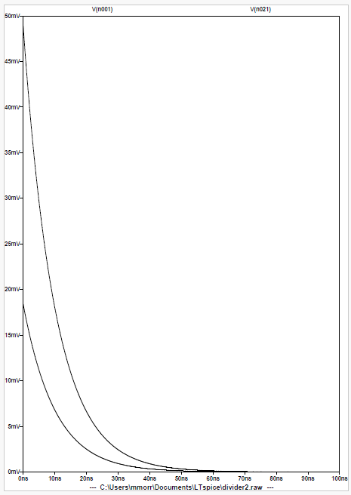
Further developments… Tracker board
Basic Spice simulation to optimize the values in the divider circuit
Further test will be done in lab before sending the board in production

Slide 6
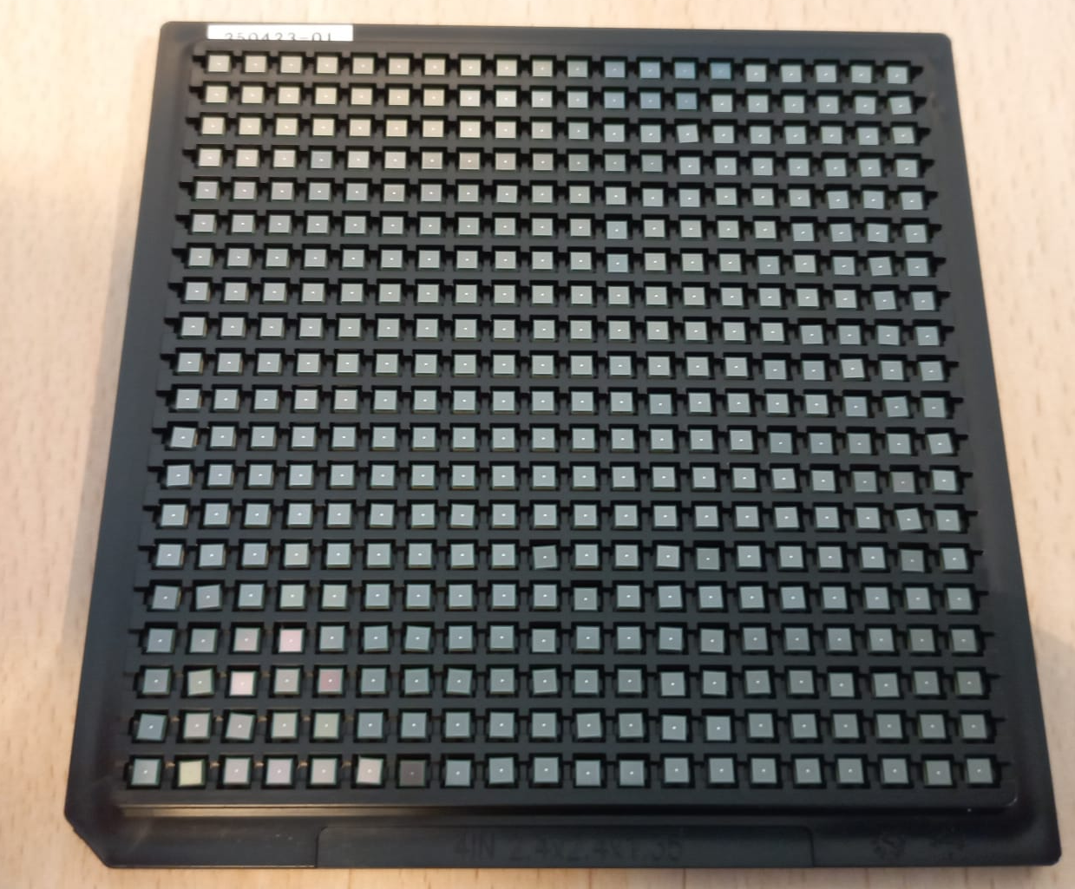
Further developments… Tracker board
We have enough material for the production of 40 boards (120 cm fiber coverage)
→ 2 X-Y pairs with double side readout, ~12x12 cm² FOV
System for automatic IV verification of the 10 SiPM on each board.
First SiPM board assembled, once verified that everything is ok, we can continue with the glueing of the others.

Slide 7
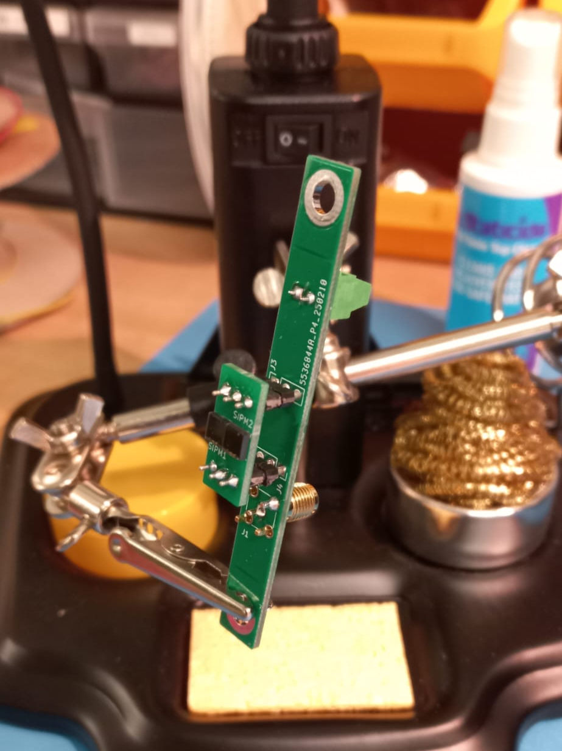
New Stop detector
We received the material for the mechanical frame
All the required detector have been assembled on the boards.
The readout board needs some minor changes to allow the bias with the WaveDAQ system (reverse the orientation of the SiPM)
The new boards will be send in production with all the other ones.

Slide 8
Timeline
DET | PHASE | Sept (I half) | Sept (II half) | Oct (I half) | Oct (II half) | Nov (I half) | Nov (II half) | Dec (I half) | Dec (II half) | Jan
TRCK | Board fab.
TRCK | Board test
TRCK | SiPM assembly
TRCK | Assembly
TRCK | Lab test
TW | Board fab.
TW | Board test
TW | SiPM assembly
TW | Assembly
TW | Lab test

