Slide 1
Experimental verification of the vertex detector Air Cooling System
^{Gherardo Ammirabile}
Filippo Bosi, Maurizio Massa , Andrea Moggi, Gabriele Balestri,
^{Fabrizio Palla}
INFN Pisa
Pisa, FCC-ee vertex detector R&D workshop
31/10/2025

Slide 2

FCC-ee vertex detector R&D workshop, Pisa 31/10/25
Gherardo Ammirabile, INFN Pisa
INTRODUCTION
Requirements of the vertex detector
Current vertex layout
Inner vertex
Mockup of the vertex detector
  Experimental setup: compressed air system
      First test results
      Timeline for next steps
      Conclusions

Slide 3
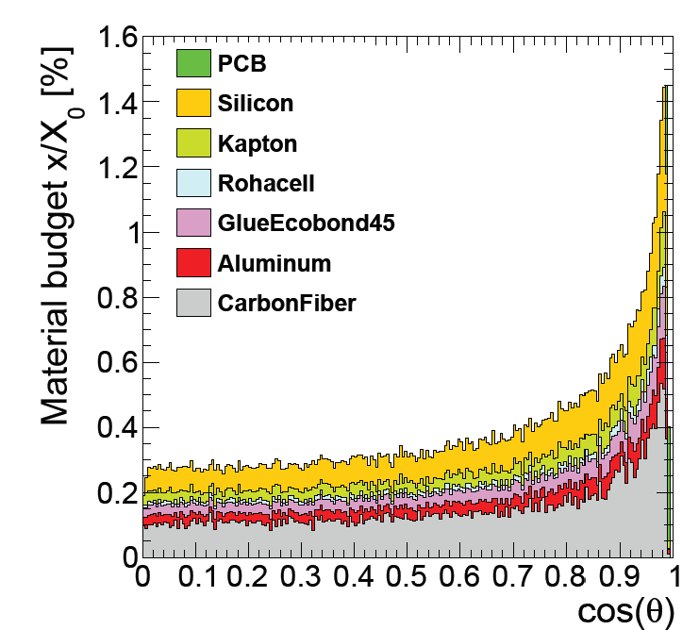
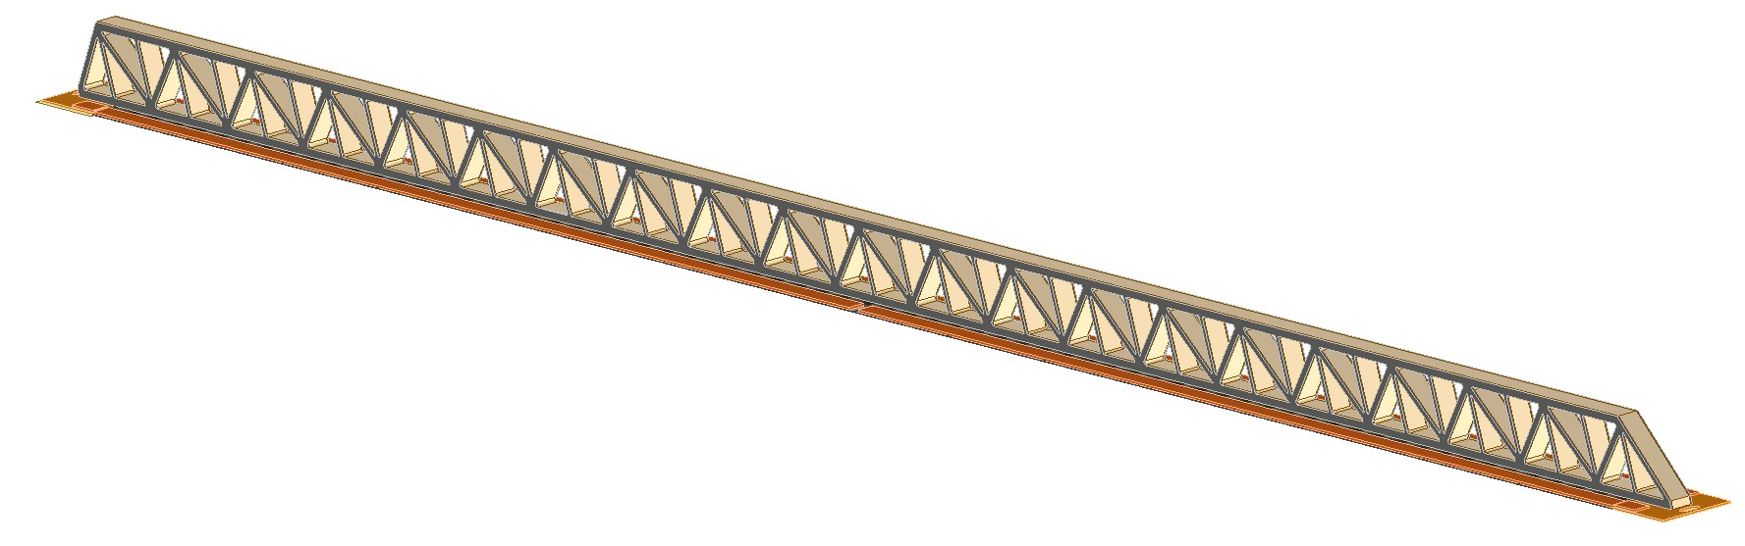
FCC-ee vertex detector R&D workshop, Pisa 31/10/25
Gherardo Ammirabile, INFN Pisa
Requirements of the vertex detector
In general:
Minimize the effect of material in front of the LumiCal (below 130 mrad)
Facilitate assembly, opening and maintenance operations
P h y s y c s
E n g i n e e r i n g
Lightweight but rigid
Structure
Low
material budget
Fluids
Effective cooling system
see Armin Ilg talk

Slide 4
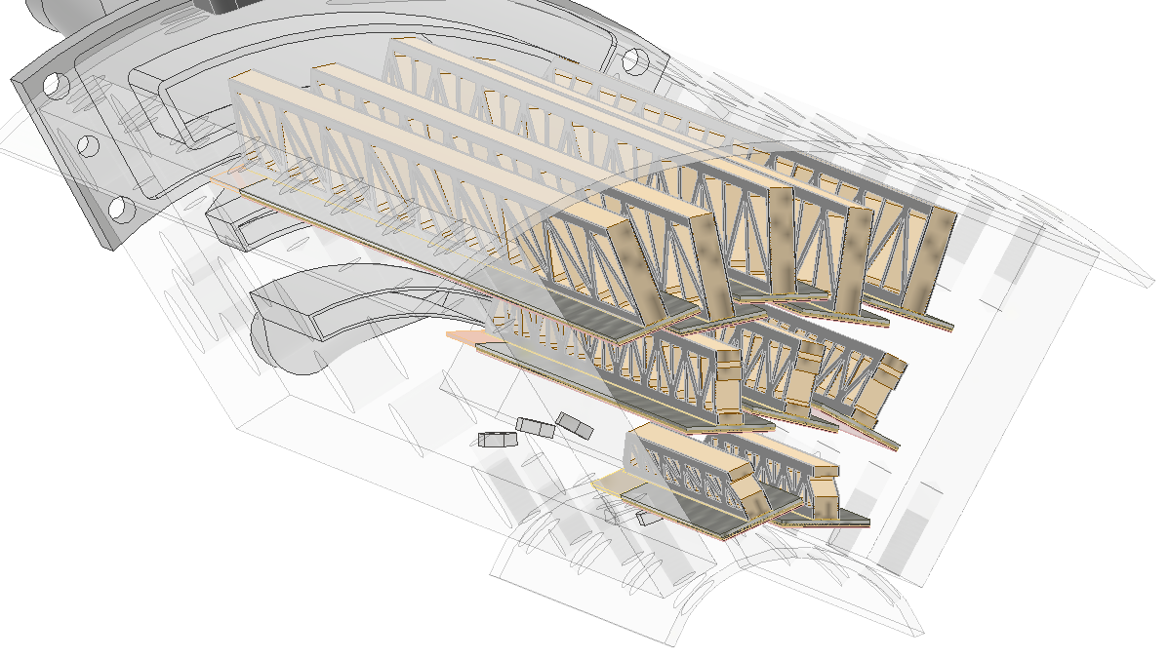
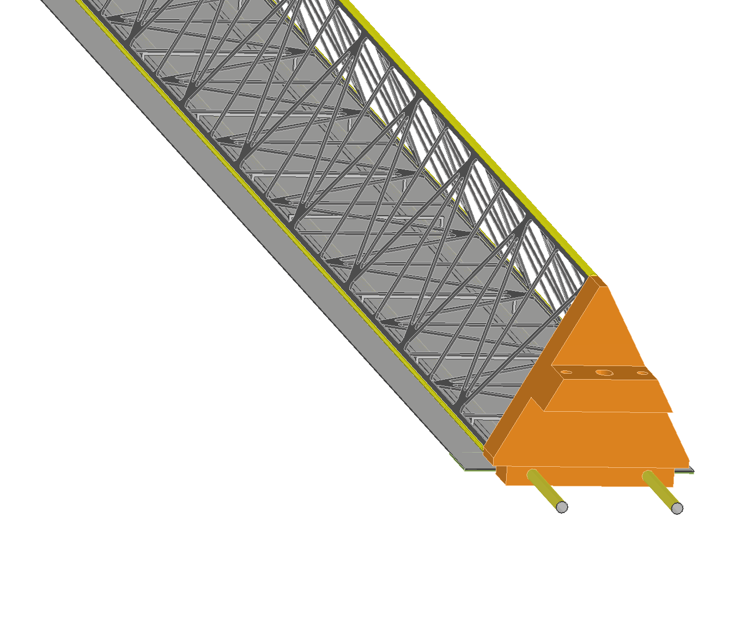
FCC-ee vertex detector R&D workshop, Pisa 31/10/25
Gherardo Ammirabile, INFN Pisa
Fluids
Choice is based on:
Sensors completely immersed in the fluid
Heat load from the sensors:
  Inner Vertex (ARCADIA based): 50 mW/cm²
  Outer vertex and disks (ATLASPIX3 based): 100 mW/cm²
AIR
AIR
Radiation length:
  Density of the fluid
  Pipes material
  Distance from IP
WATER
WATER

Slide 5
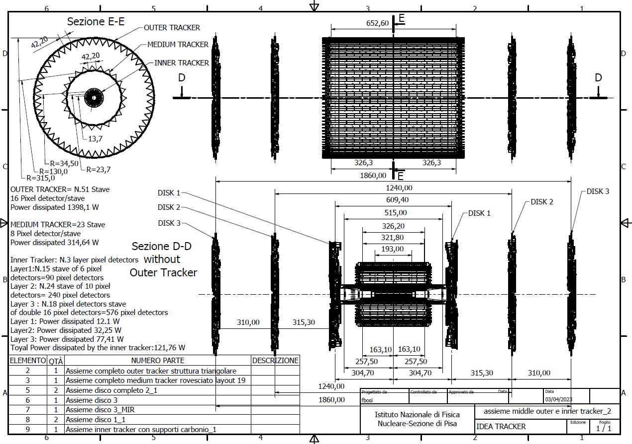
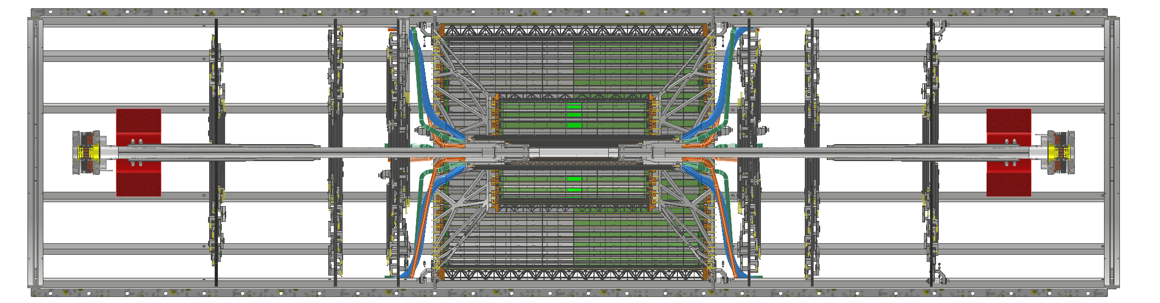
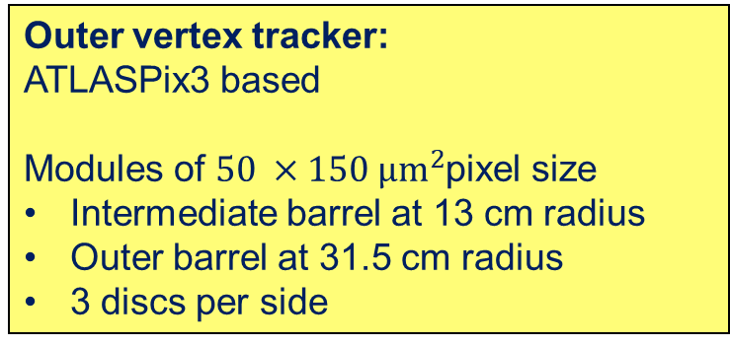
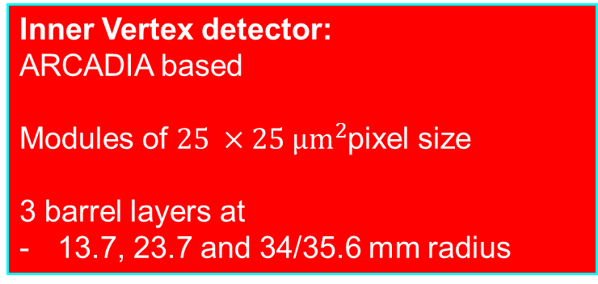
FCC-ee vertex detector R&D workshop, Pisa 31/10/25
Gherardo Ammirabile, INFN Pisa
Current vertex layout
Outer vertex tracker:
ATLASPix3 based
Modules of $50 ×150 µm^{2}$pixel size
Intermediate barrel at 13 cm radius
Outer barrel at 31.5 cm radius
3 discs per side
Inner Vertex detector:
ARCADIA based
Modules of $25 ×25 µm^{2}$pixel size
3 barrel layers at
13.7, 23.7 and 34/35.6 mm radius

Slide 6
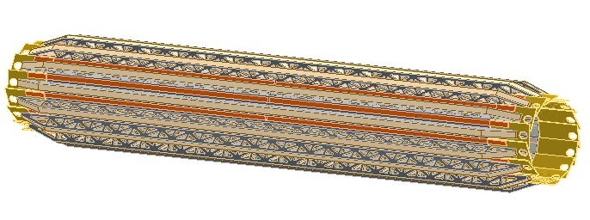
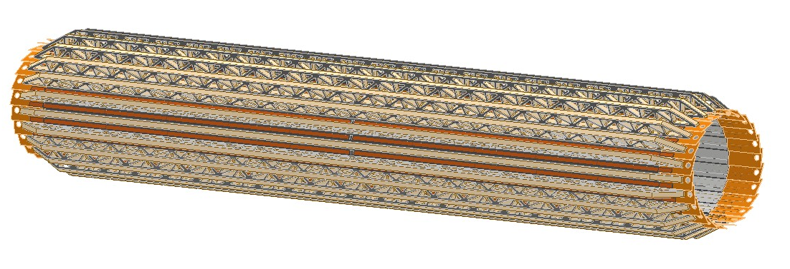
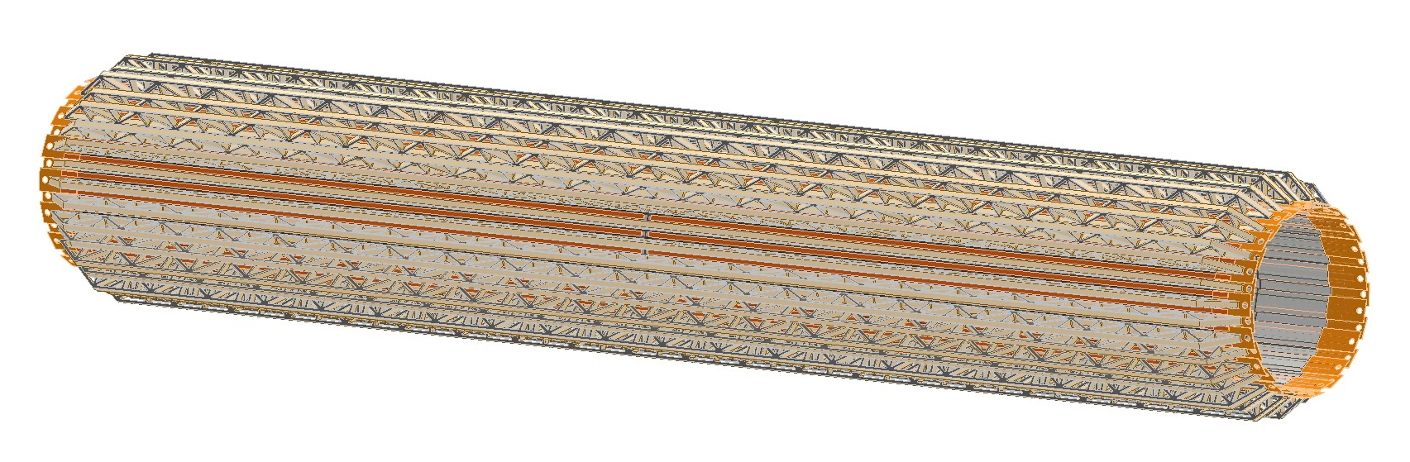
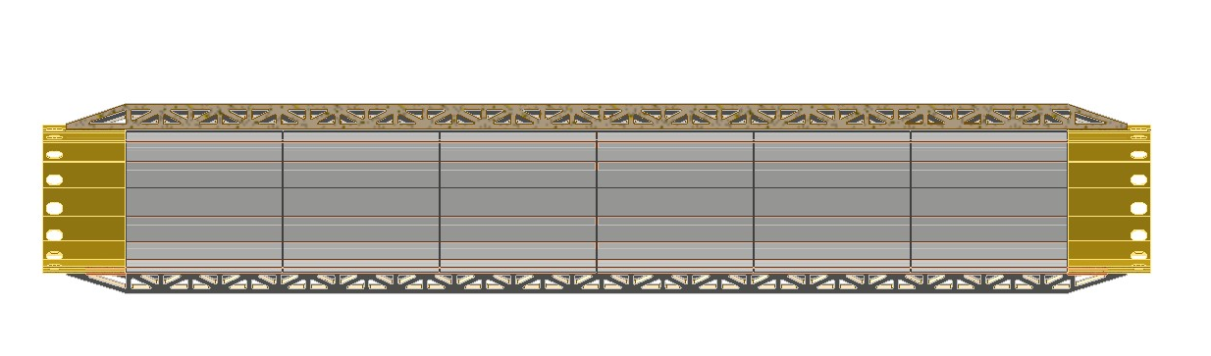
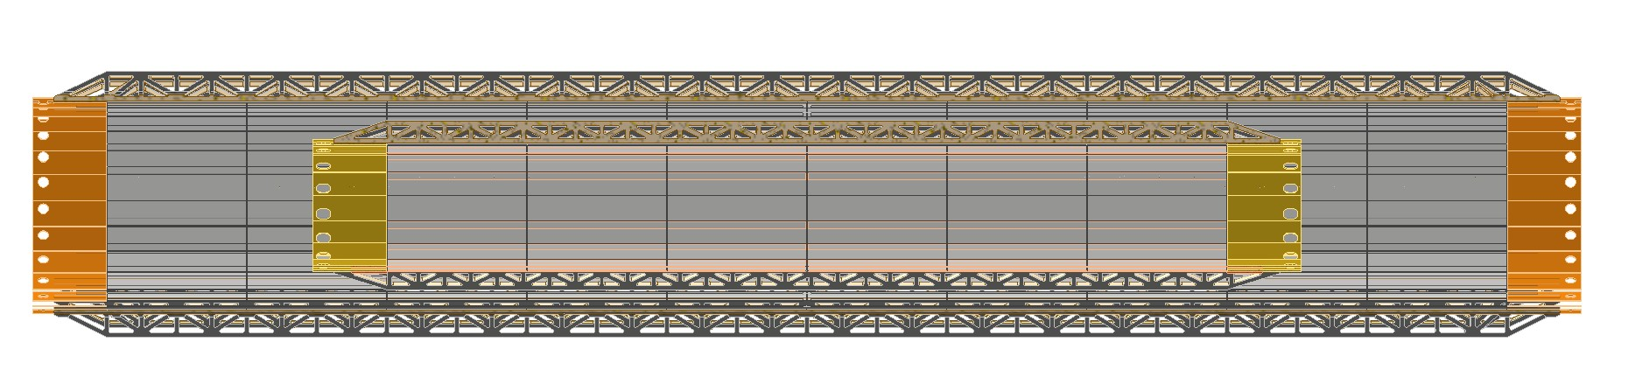
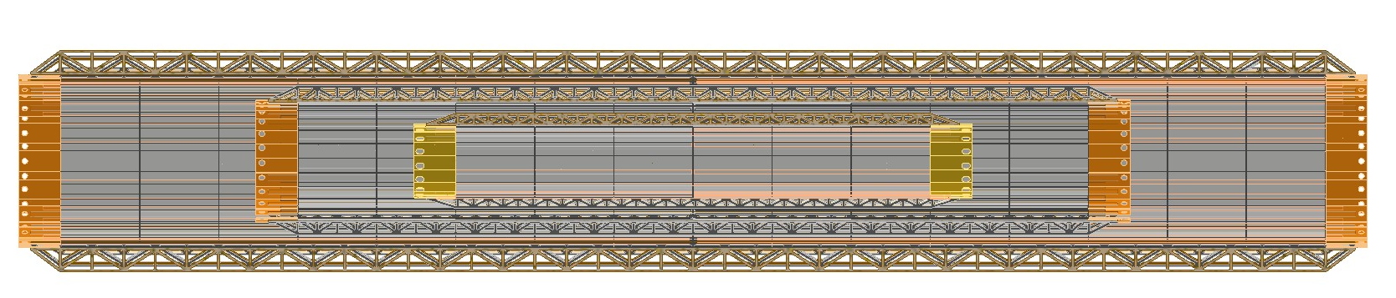
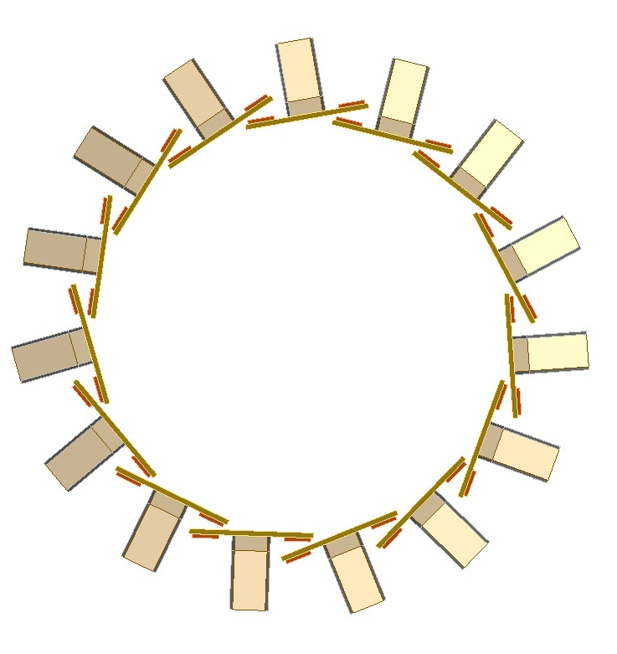
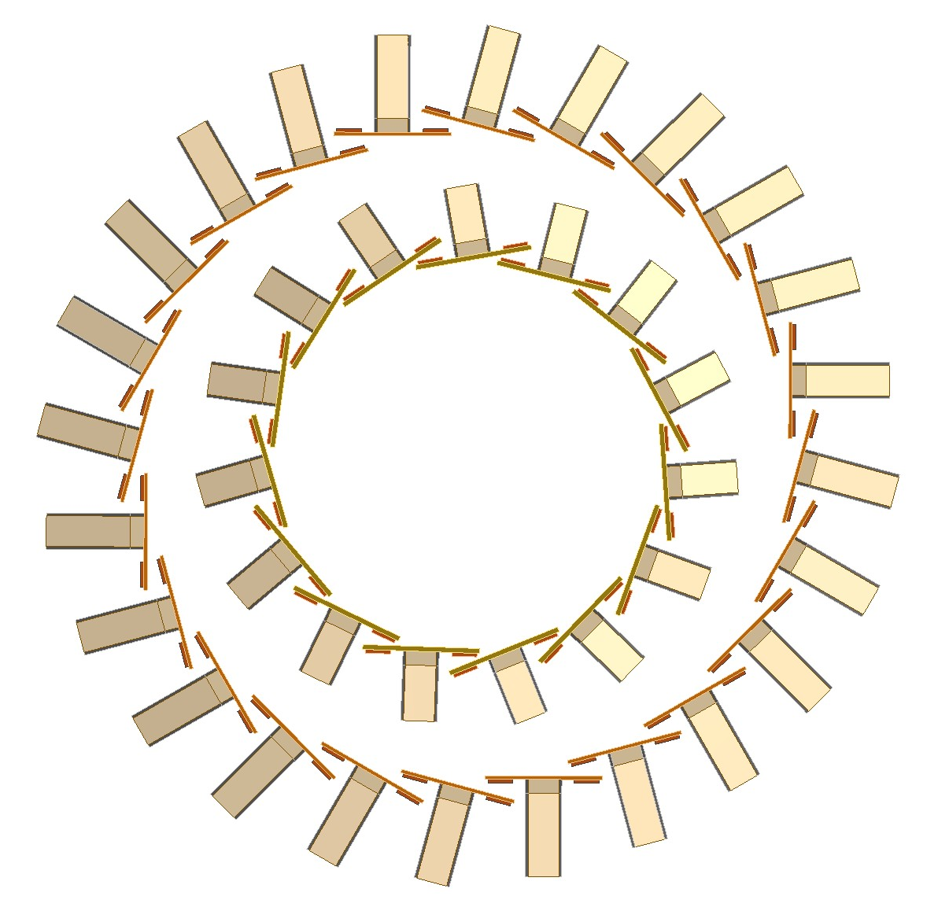
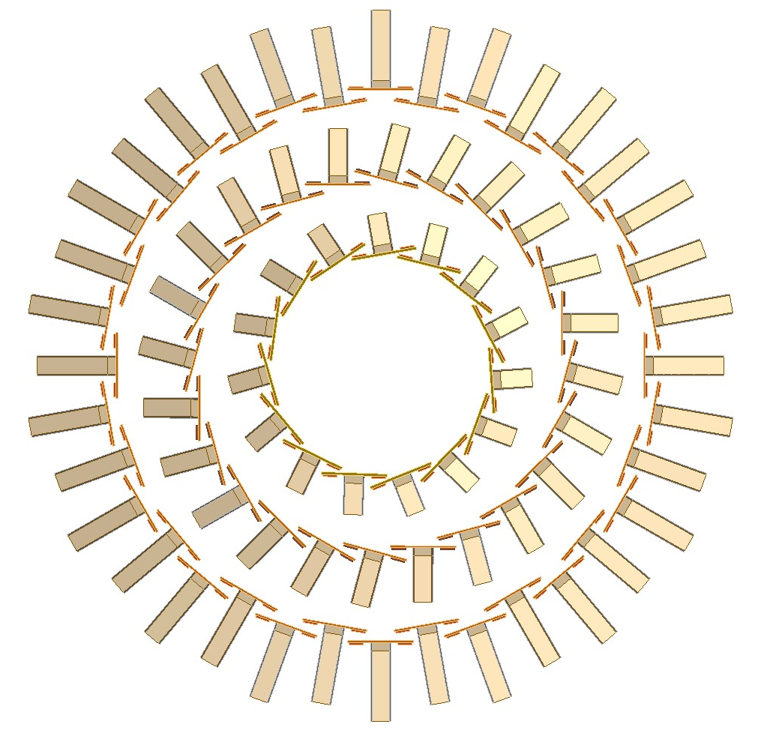
FCC-ee vertex detector R&D workshop, Pisa 31/10/25
Gherardo Ammirabile, INFN Pisa
Inner vertex
Layer 1:
15 staves of 6 modules each
Power budget ≈ 12 W
Layer 2:
24 staves of 10 modules each
Power budget ≈ 32 W
Layer 3:
36 staves of 16 modules each
Power budget ≈ 77 W
227.4 mm
356.2 mm
549.4 mm
13.7
23.7
35.6
Reticular lightweight support to provide stiffness:
Thin carbon fiber walls interleaved with Rohacell
2 buses (data and power) 1.8 mm wide and 250 μm thick

Slide 7
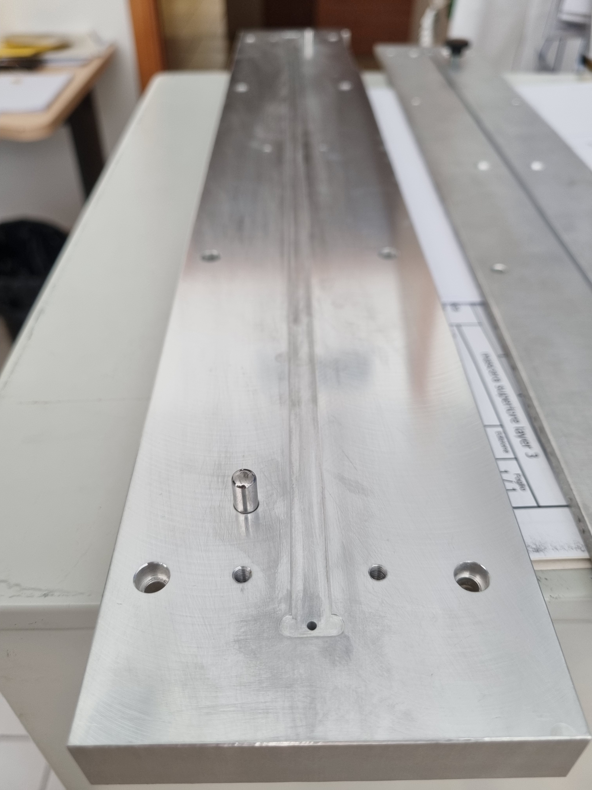
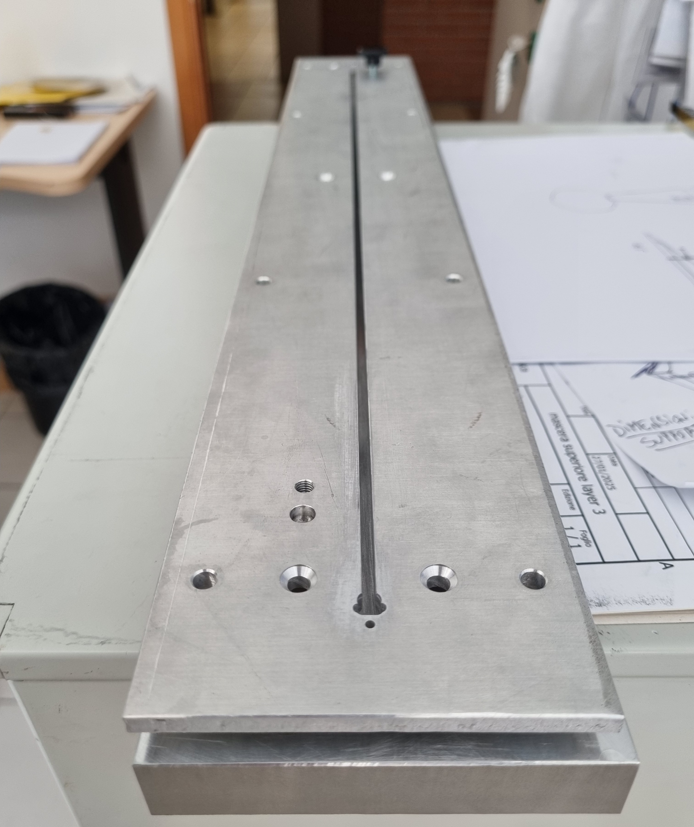
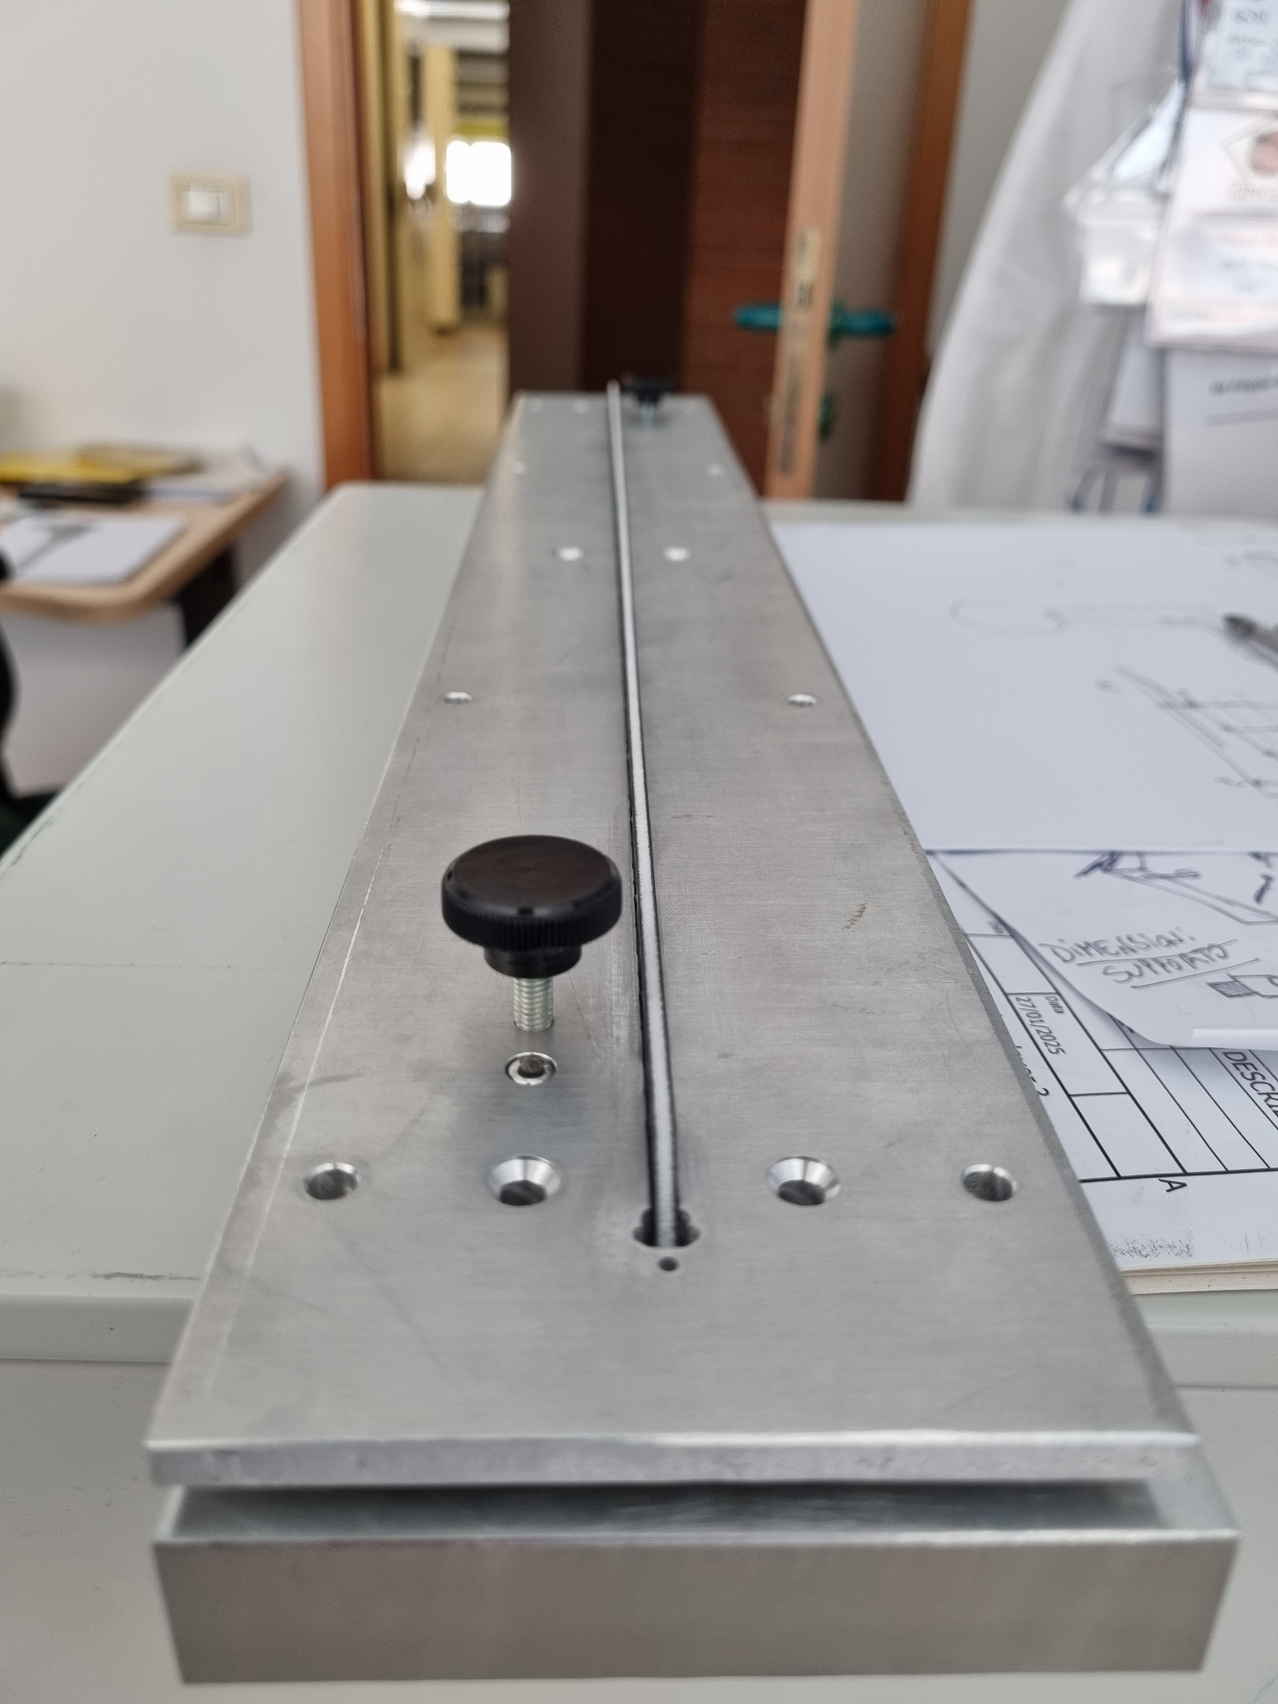
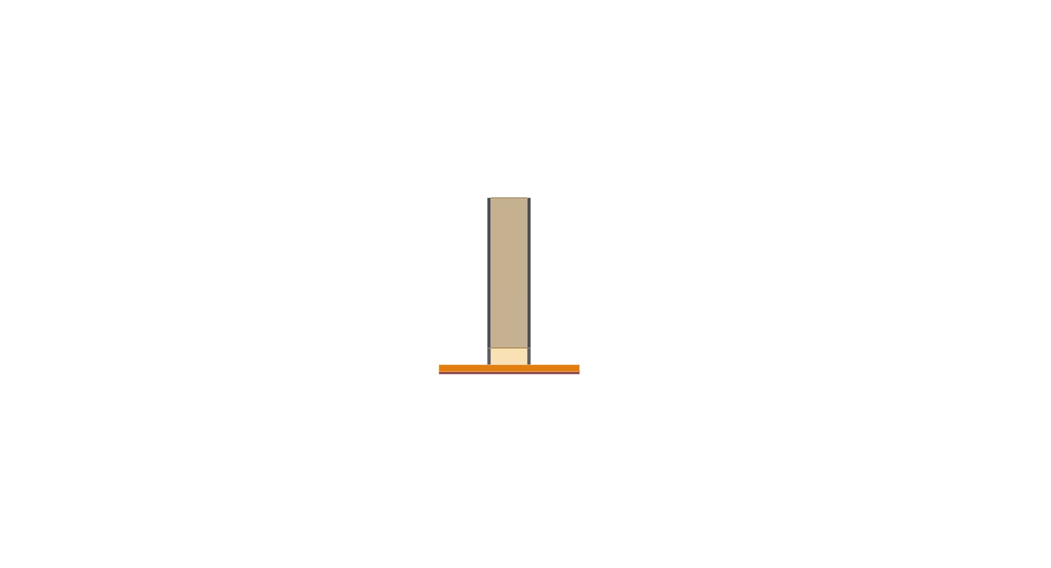
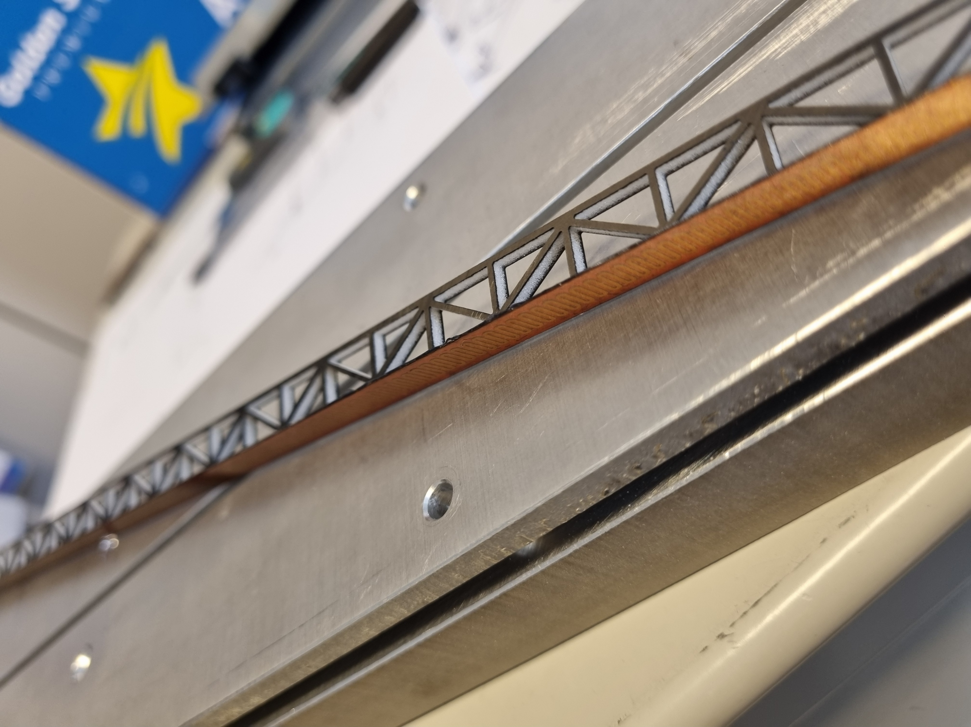
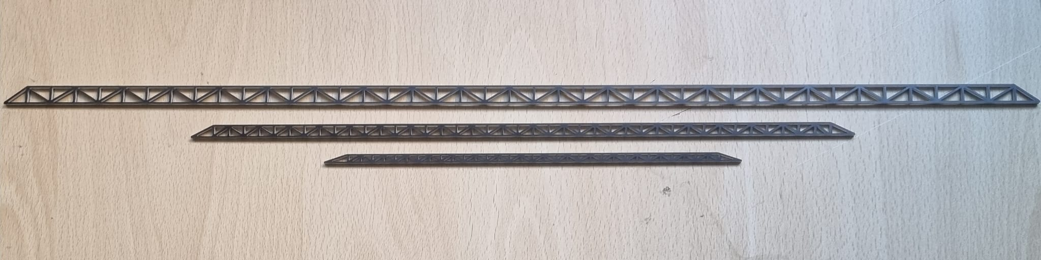
FCC-ee vertex detector R&D workshop, Pisa 31/10/25
Gherardo Ammirabile, INFN Pisa
Mockup of the vertex detector
Bonding tool
Silicon modules replaced by a brass strip with the same thickness = 50 μm
Thermal load created by a bonded heater
W
Lower
Upper
With stave
H
CF strip = 360 μm
Glue ~ 90 μm
R
E
S
U
L
T
Brass strip = 50 μm
Heater = 150 μm
Shape to be optimized with Aeroelastic studies
Stave dimensions (mm)
 | H | W
Design | 10.5 | 1.4
Real | 10.8 | 2.6*
* increase in thickness of Rohacell (best compromise between cost & manufacturing)

Slide 8
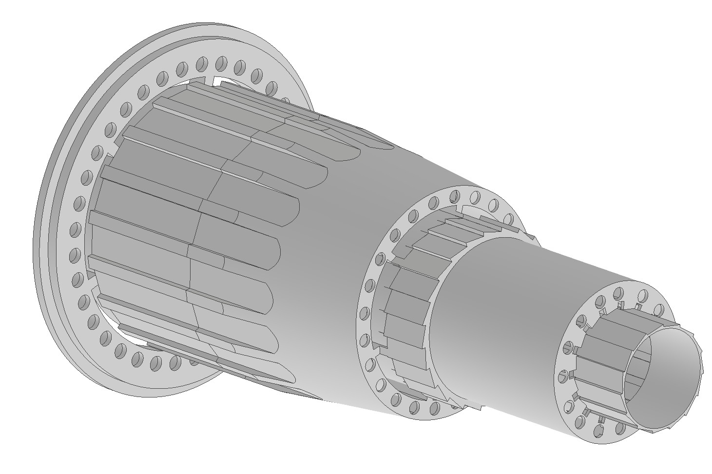
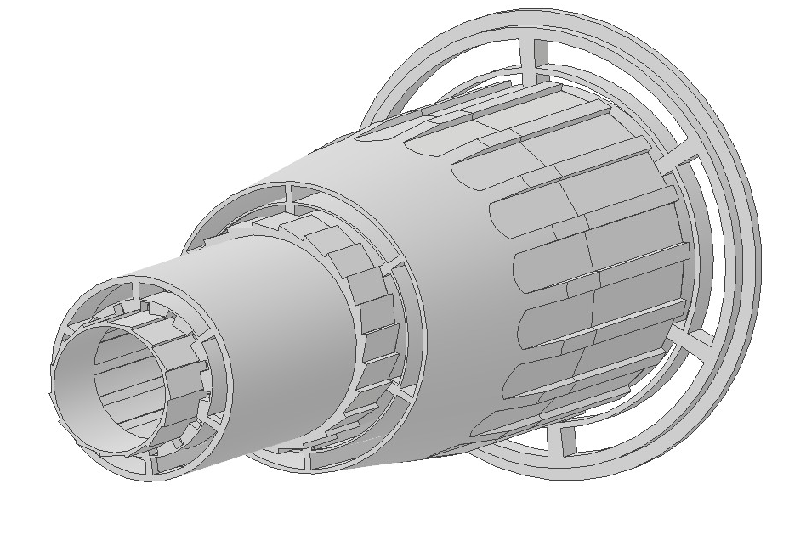
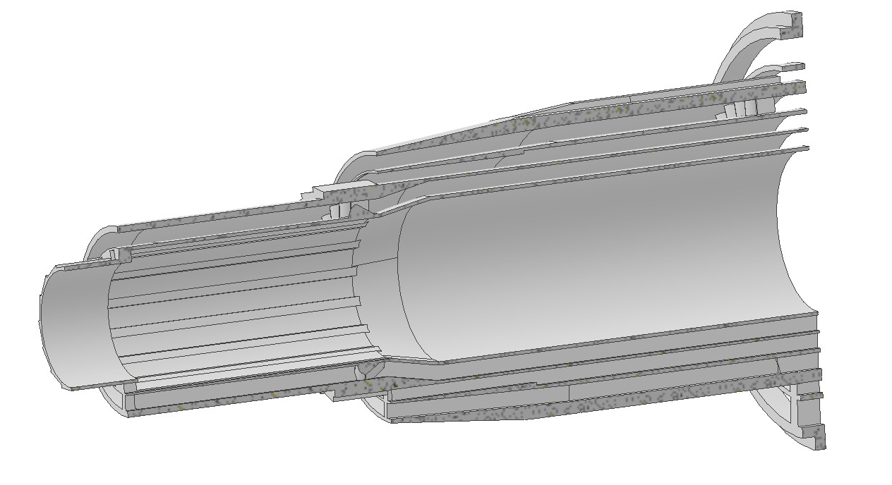
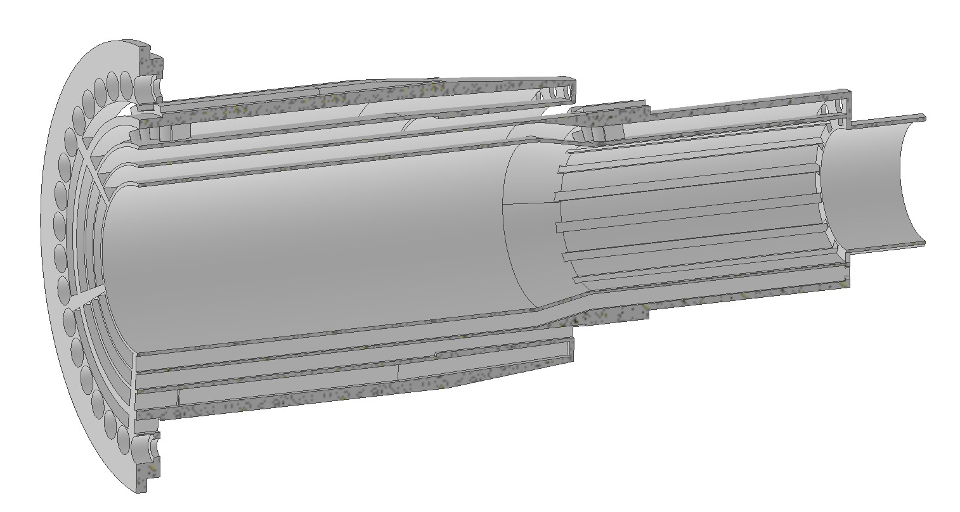
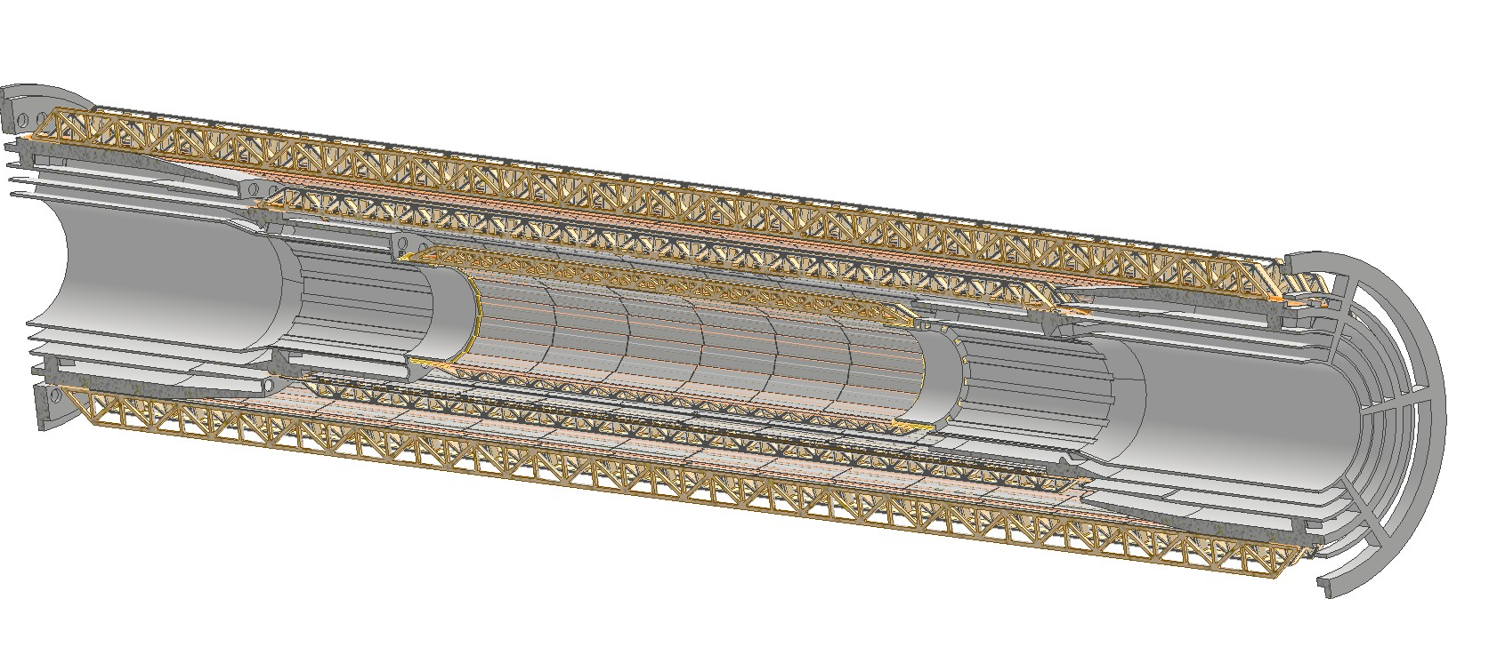
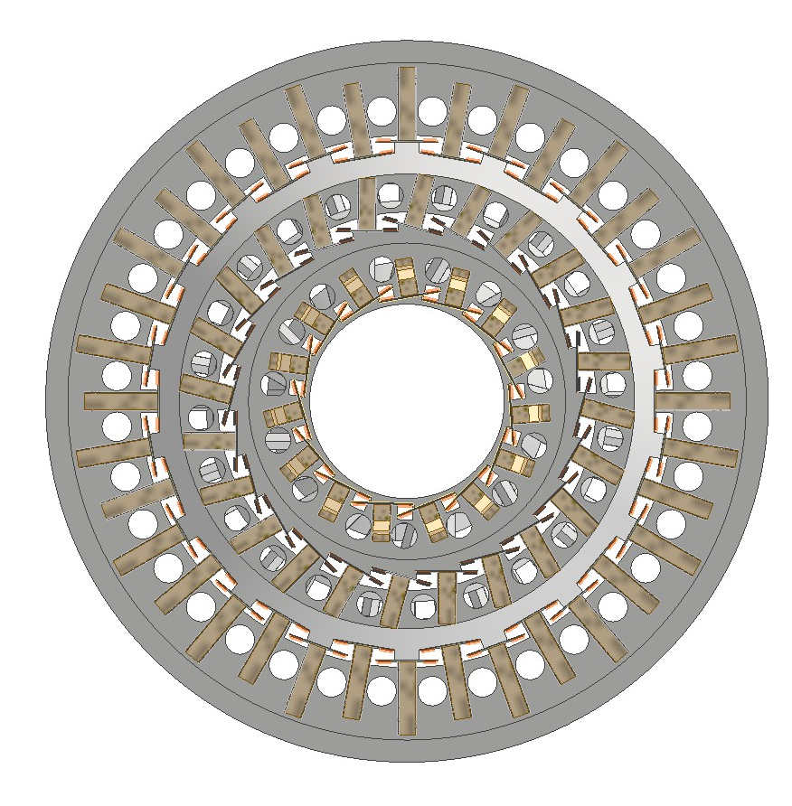
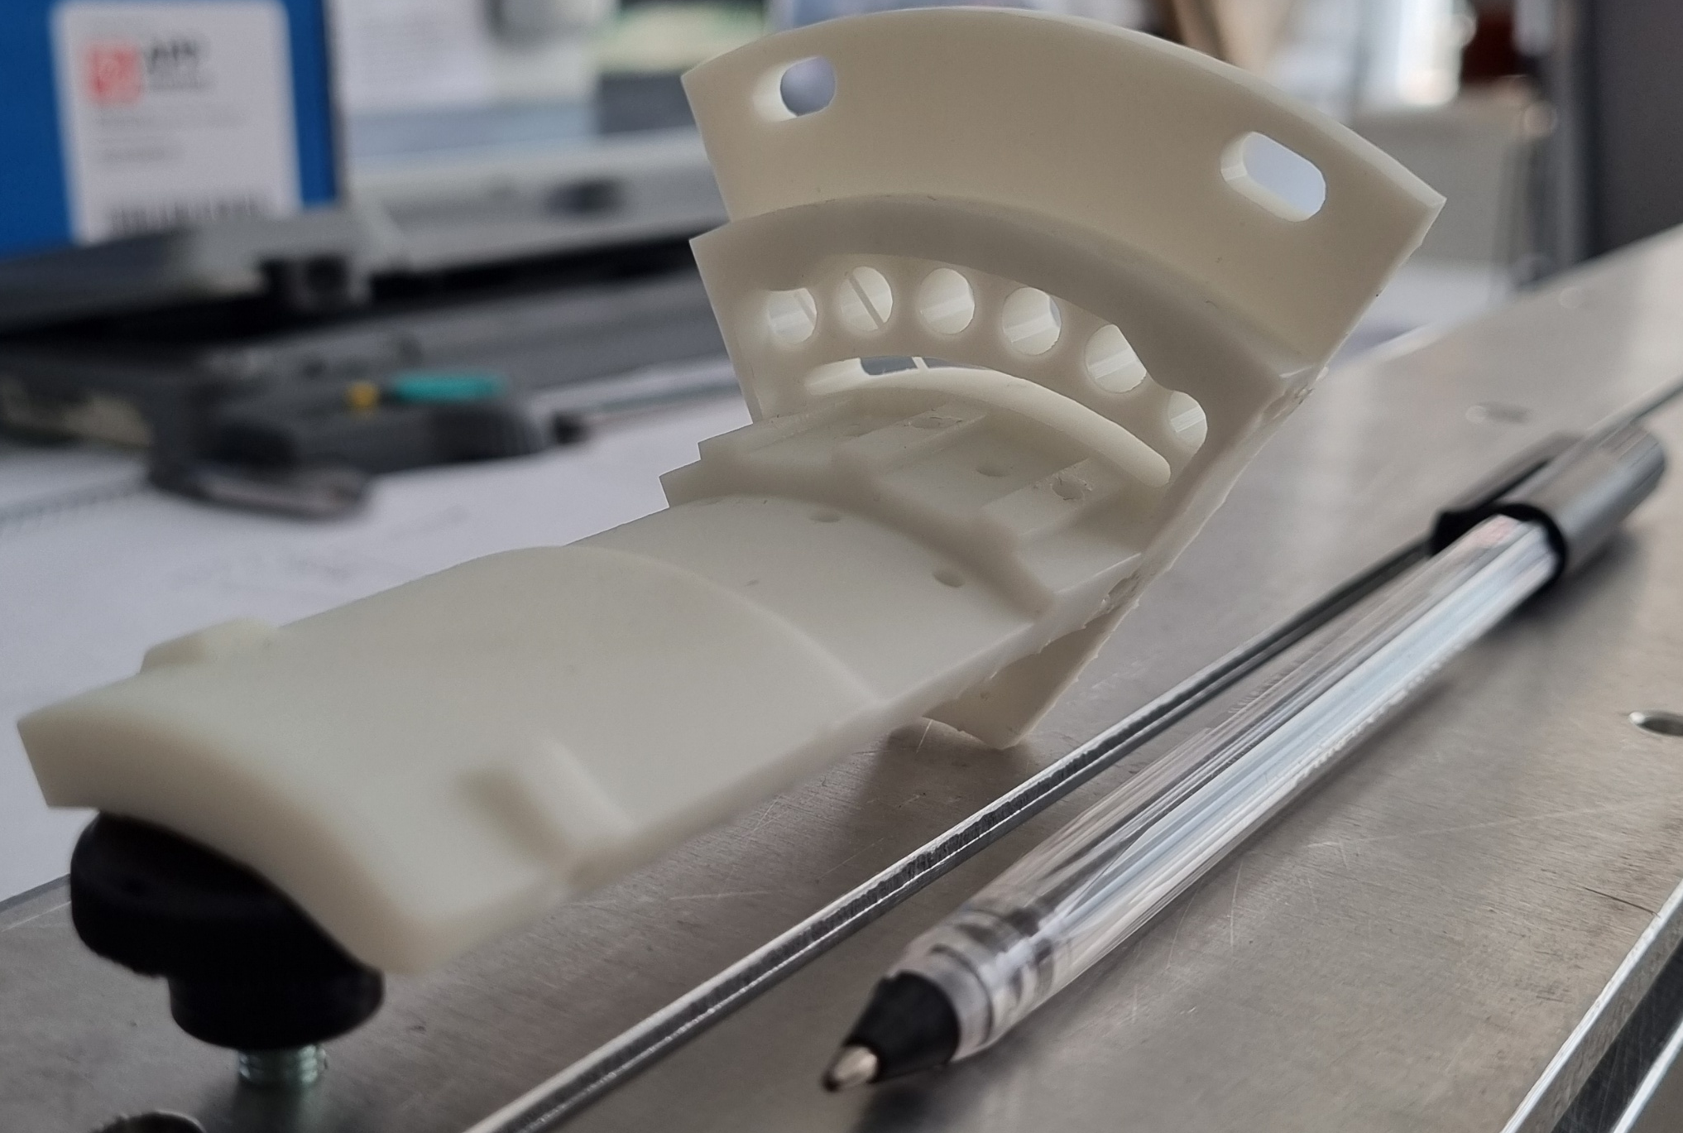
FCC-ee vertex detector R&D workshop, Pisa 31/10/25
Gherardo Ammirabile, INFN Pisa
AIR
INLET
SUPPORT
Support of the staves
AIR
OUTLET
SUPPORT
Target: support & cool the silicon detectors
Result: 3D printed support with integrated air ducts
(High Temp Resin)
Layer 3
Layer 2
Layer 1
Bus
Bus
1st test
3 separated ducts one for each of the layers
Split support for assembly
Air ducts
Cables ducts
60°

Slide 9
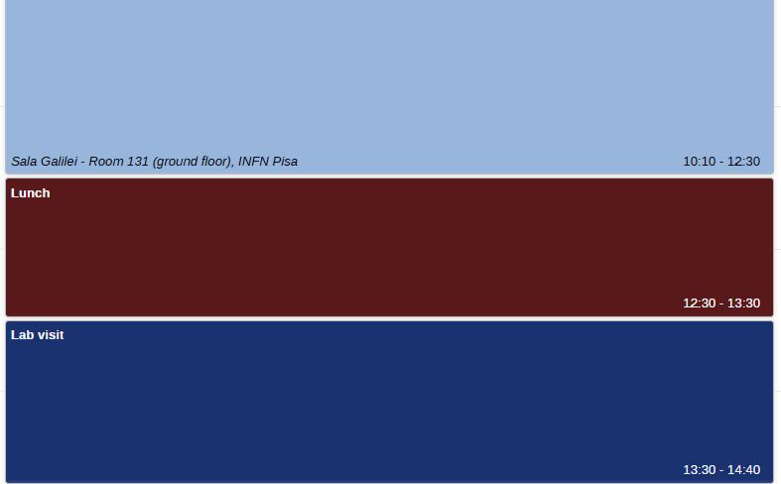
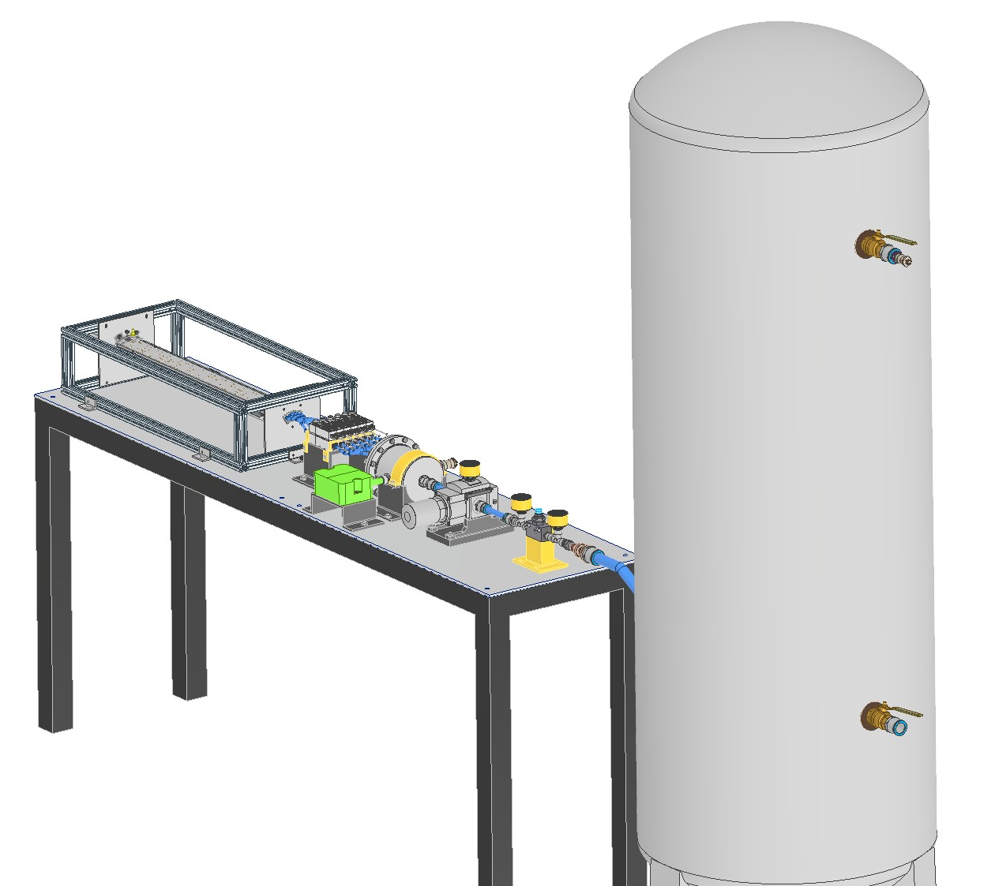
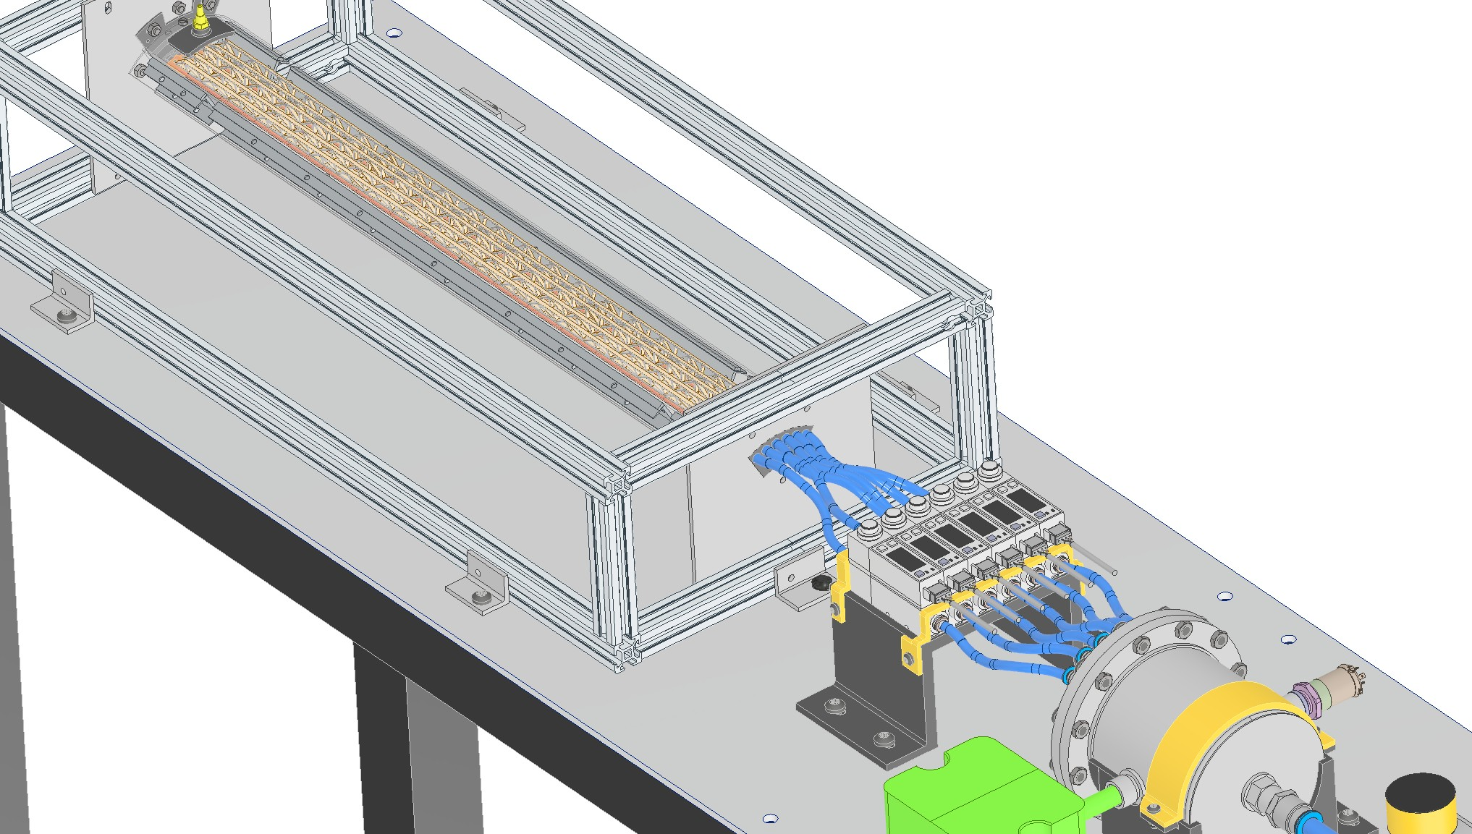
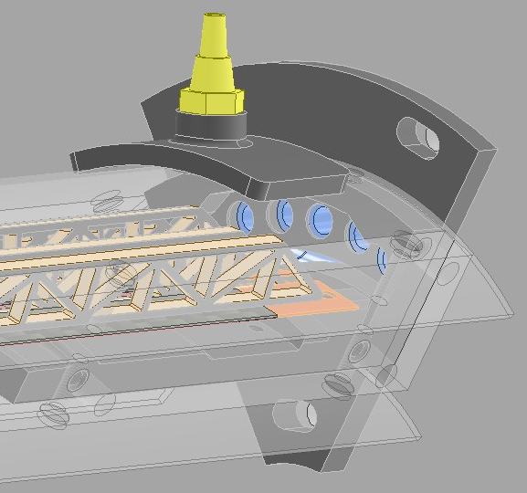
FCC-ee vertex detector R&D workshop, Pisa 31/10/25
Gherardo Ammirabile, INFN Pisa
Experimental setup to evaluate the effectiveness of air cooling
First test on a 60° circular sector of layer 3 including five staves
Next test on the same circular sector with all three layers
Compressed air system to define:
Flow rate needed to cool the detectors
Pressure drop in the central region
Temperature increase between inlet and outlet

Slide 10
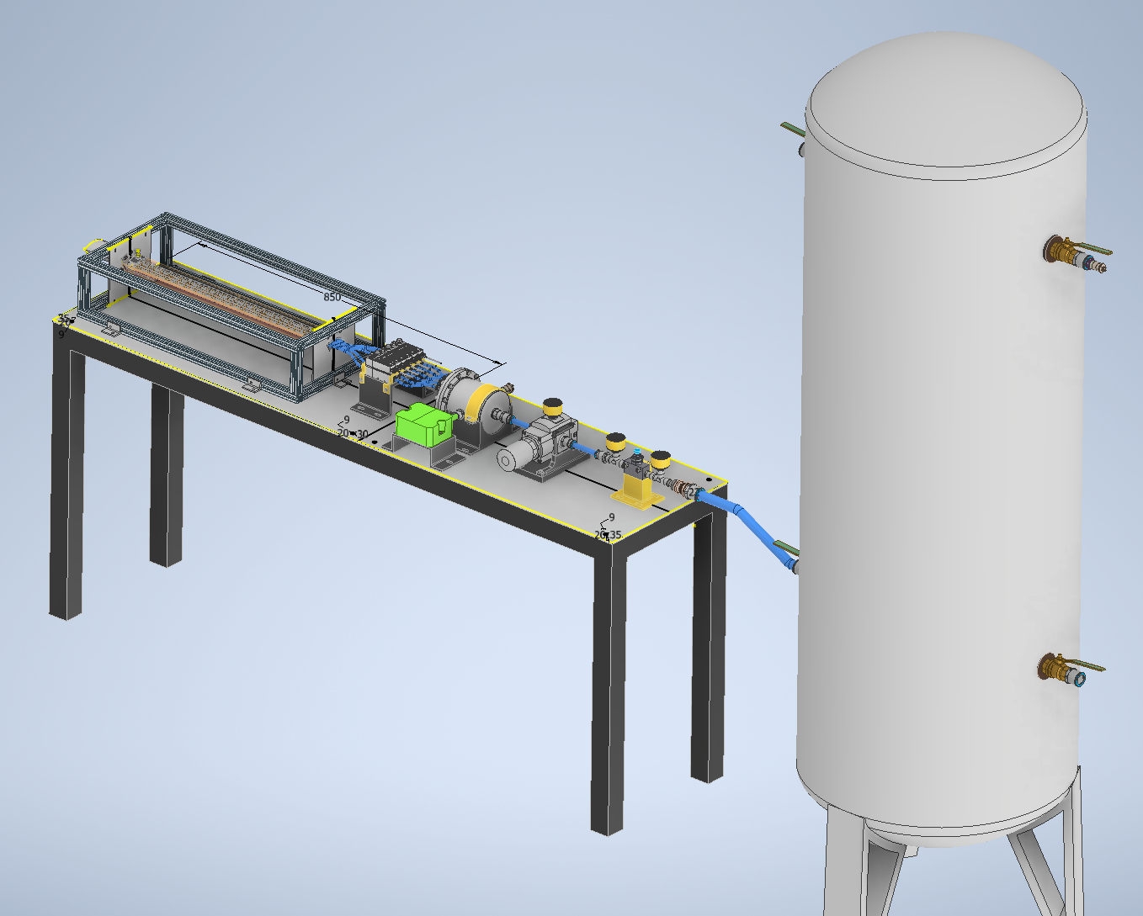
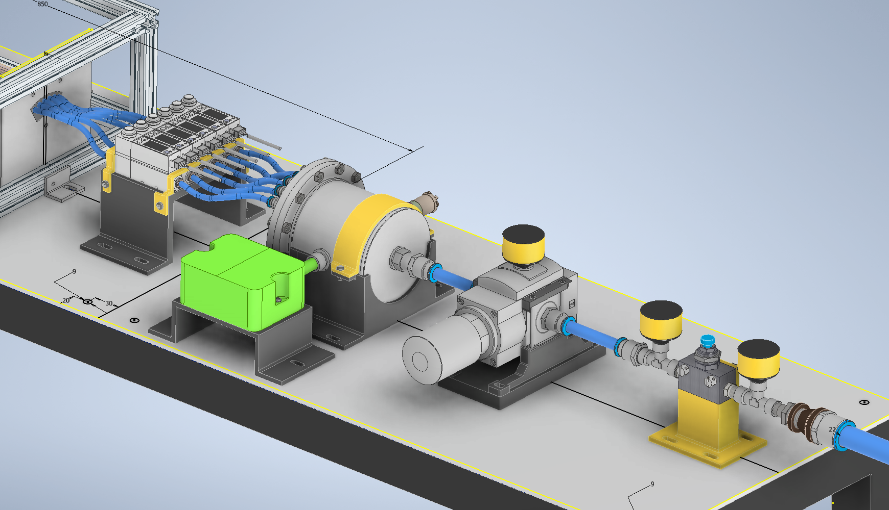
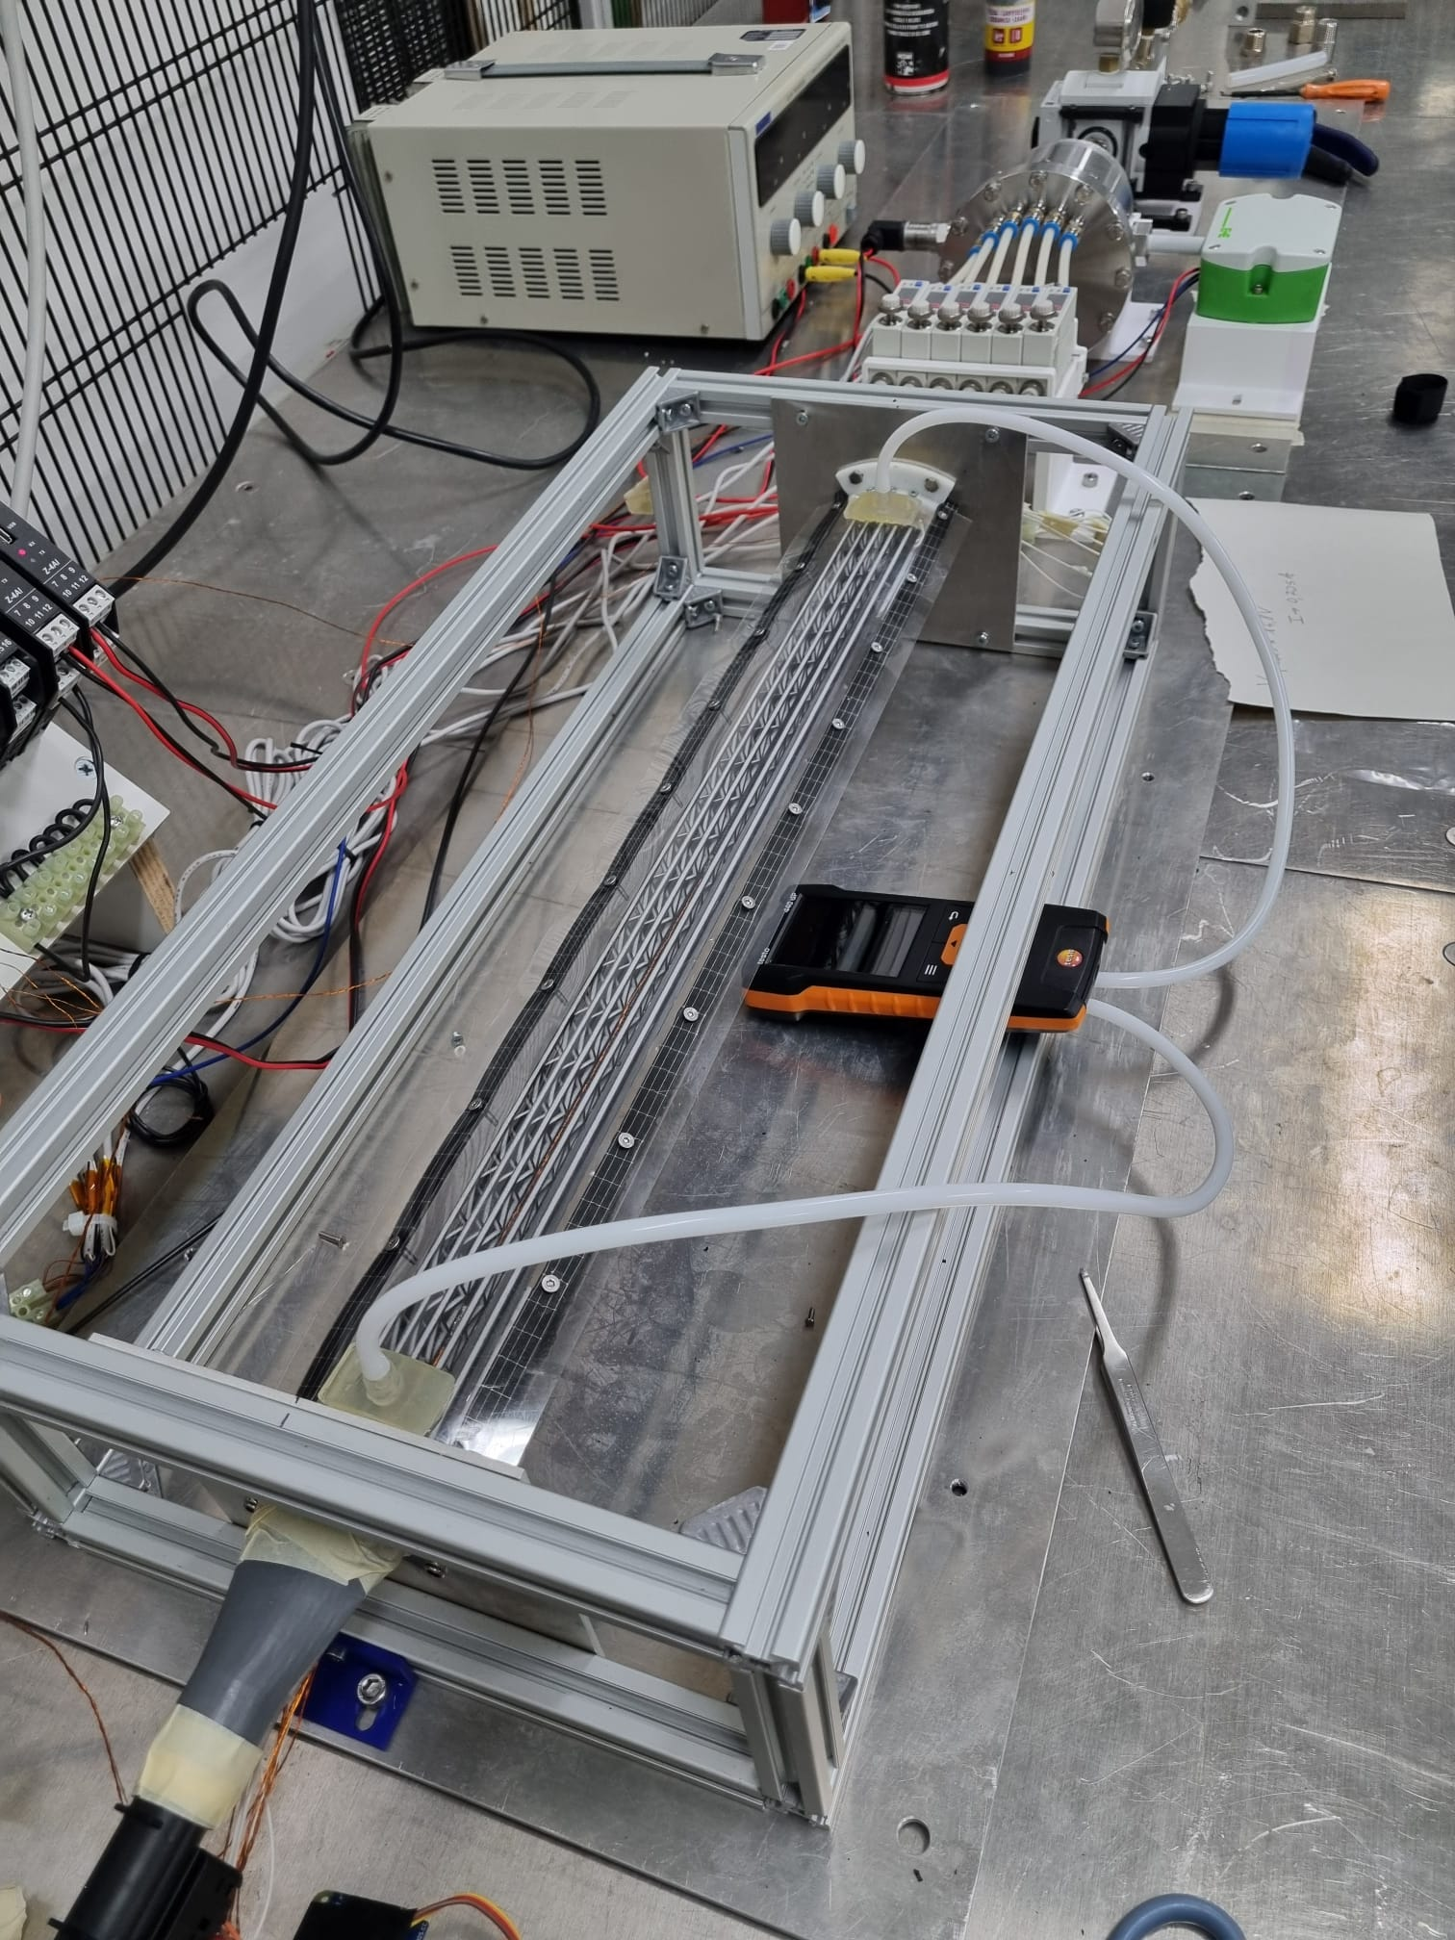
FCC-ee vertex detector R&D workshop, Pisa 31/10/25
Gherardo Ammirabile, INFN Pisa
Flowmeters
Serbatoio
H
E
A
T Exch
6 bar
0.5 m³
Absolute Pressure sensor
Diffuser
Test section
Settling chamber
Drier
Temperature/Humidity sensor
Valve group
RTD
380 mm
Test section
1600 mm
Designed to:
Be adaptable
Be controlled
Allow CFD result verification

Slide 11
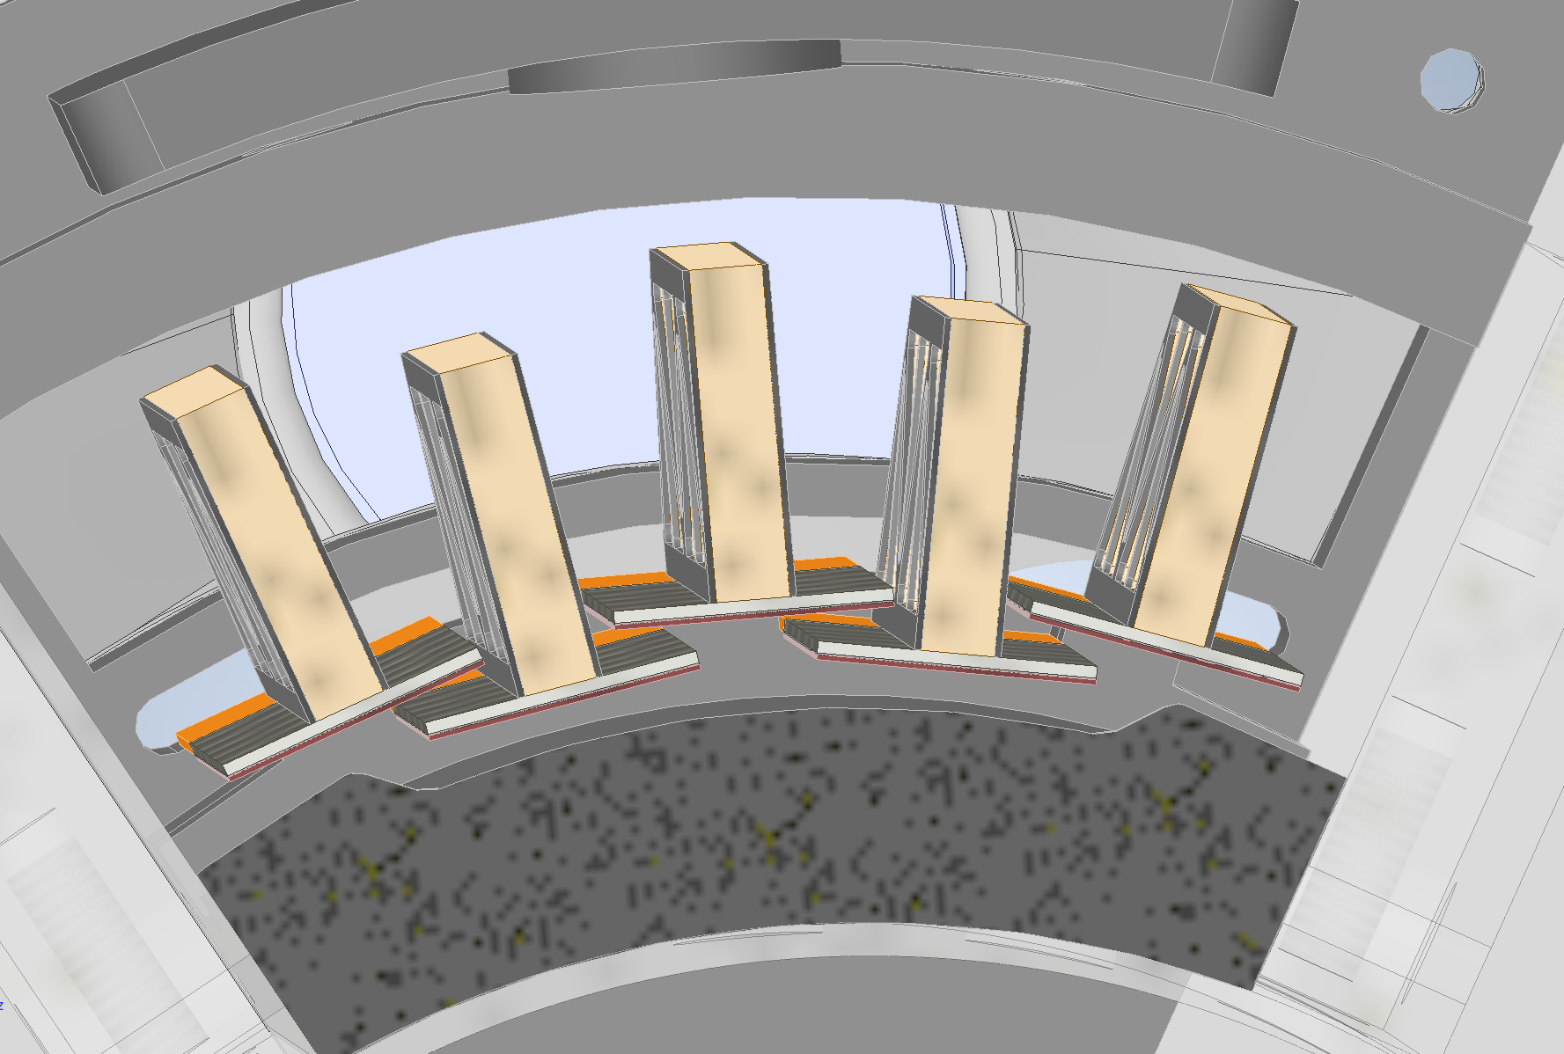
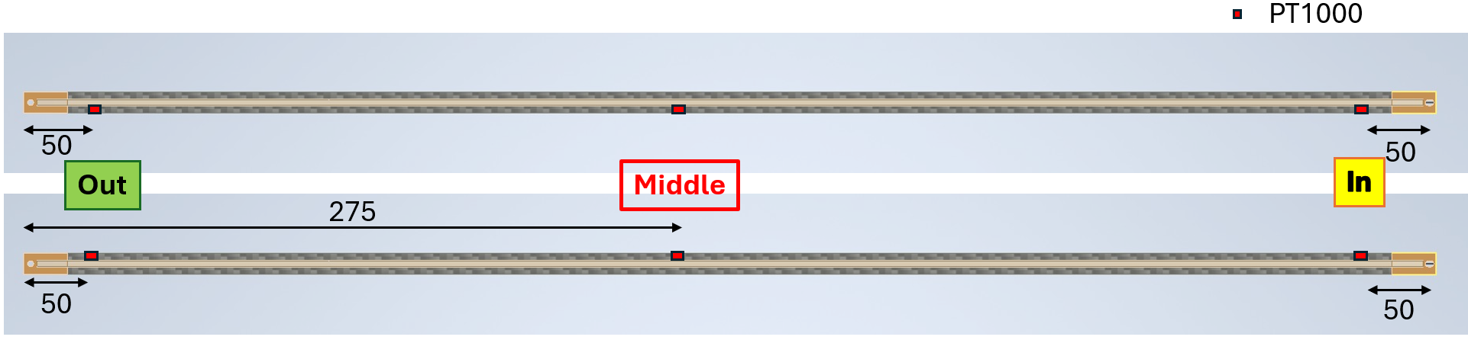
FCC-ee vertex detector R&D workshop, Pisa 31/10/25
Gherardo Ammirabile, INFN Pisa
First test: 60° angular sector of only layer 3
Stave 5
5
6
Stave 6
Staves under thermal testing
Top view
ΔT~ 6 – 7 °C
Power density (sensor) = 50 mW/cm²
Total power (each stave) = 2.2 W
The Middle section has the highest temperature
(heat exchange at the ends with the support)
Without cooling > 65°C
With cooling < 40°C

Slide 12
FCC-ee vertex detector R&D workshop, Pisa 31/10/25
Gherardo Ammirabile, INFN Pisa
The air cooling system appears to be effective for the case of study but we need to:
Upgrade hydraulic tightness to decouple air flow paths from cable entry/exit routes
Evaluate the vibrations of the structure connected to the air flow
Consistent with the allowed ΔT values between sensors, it would be advisable to maintain low flow rates to avoid significant aeroelastic issues
(simulations in progress with INFN Perugia)
ΔT~ 6 – 7 °C
Air velocity inlet ~ 20-25 m/s
Air velocity middle (average) ~ 2-2.5 m/s
Air velocity outlet ~ 5-7 m/s

Slide 13
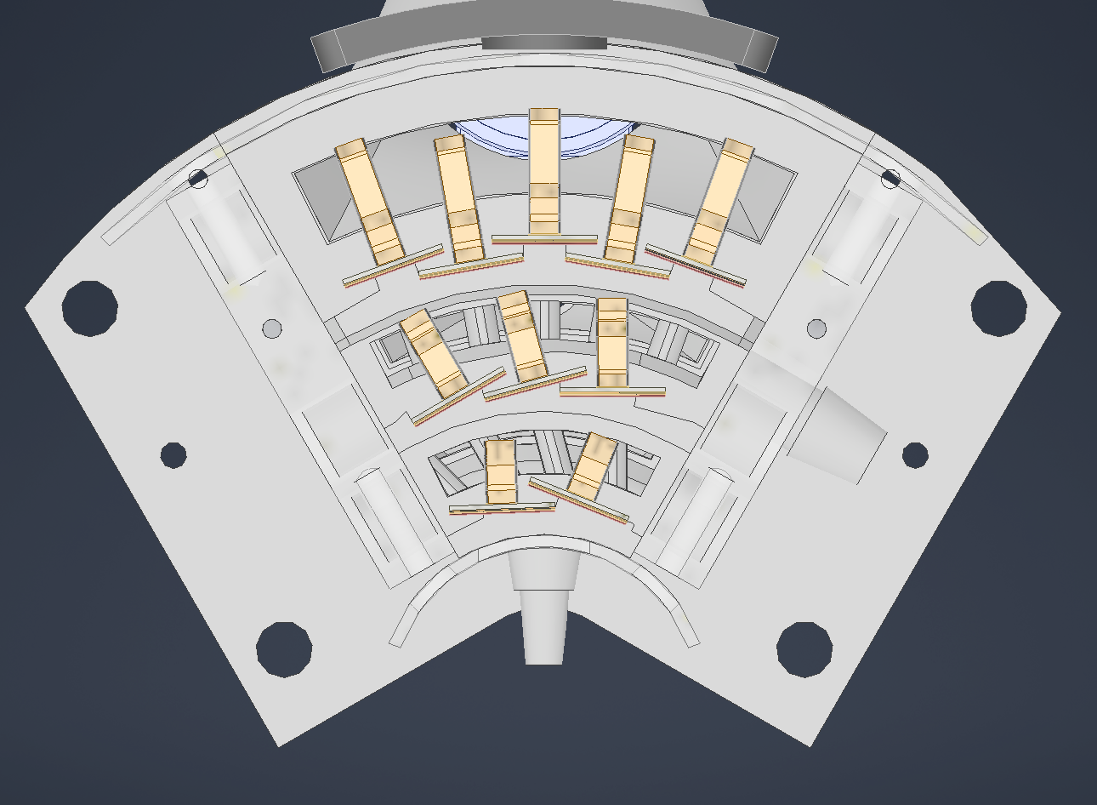
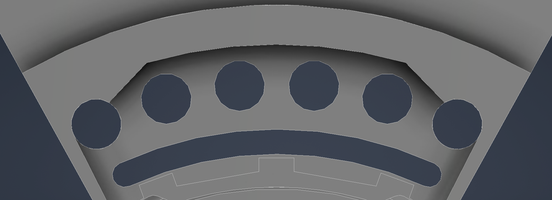
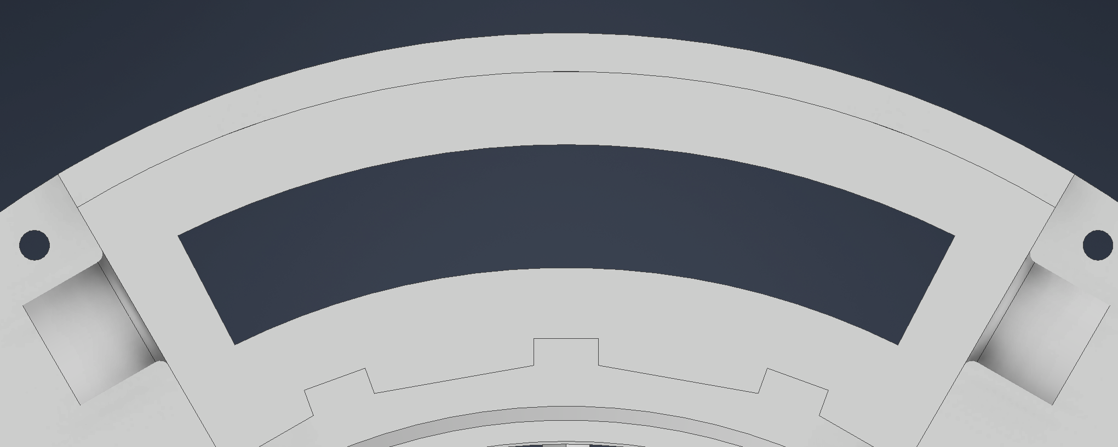
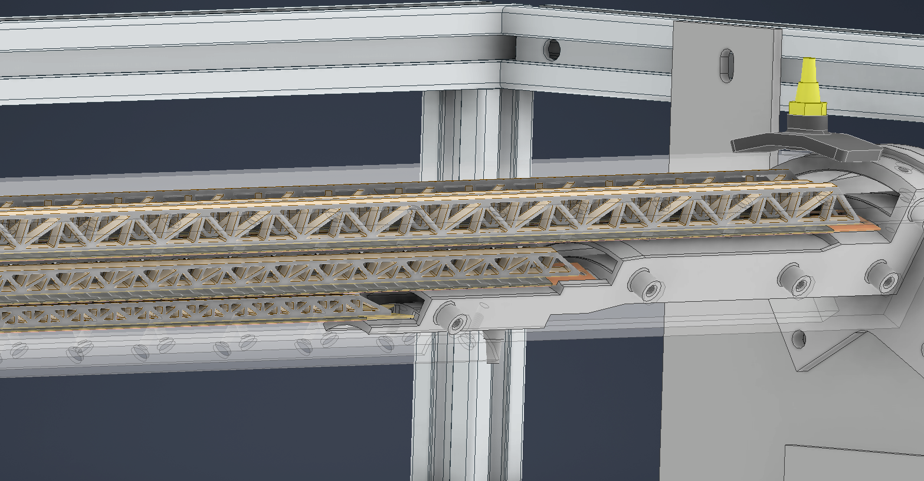
FCC-ee vertex detector R&D workshop, Pisa 31/10/25
Gherardo Ammirabile, INFN Pisa
Staves:
5 for Layer 3
3 for Layer 2
2 for Layer 1
Timeline for next steps:
Assembly on the same 60°angular sector of the staves of Layer 2 and Layer 1
Details to study:
Air induced vibrations with optical instrument
Inlet shape:
Circular Slotted
60°
Targets:
Flow rate to cool each layer
Pressure drop
Thermal connection between them
Expected results: by the end of the year
Advantage:
The compressed air system offers versatility, enabling specific testing for single and multi layer solution

Slide 14
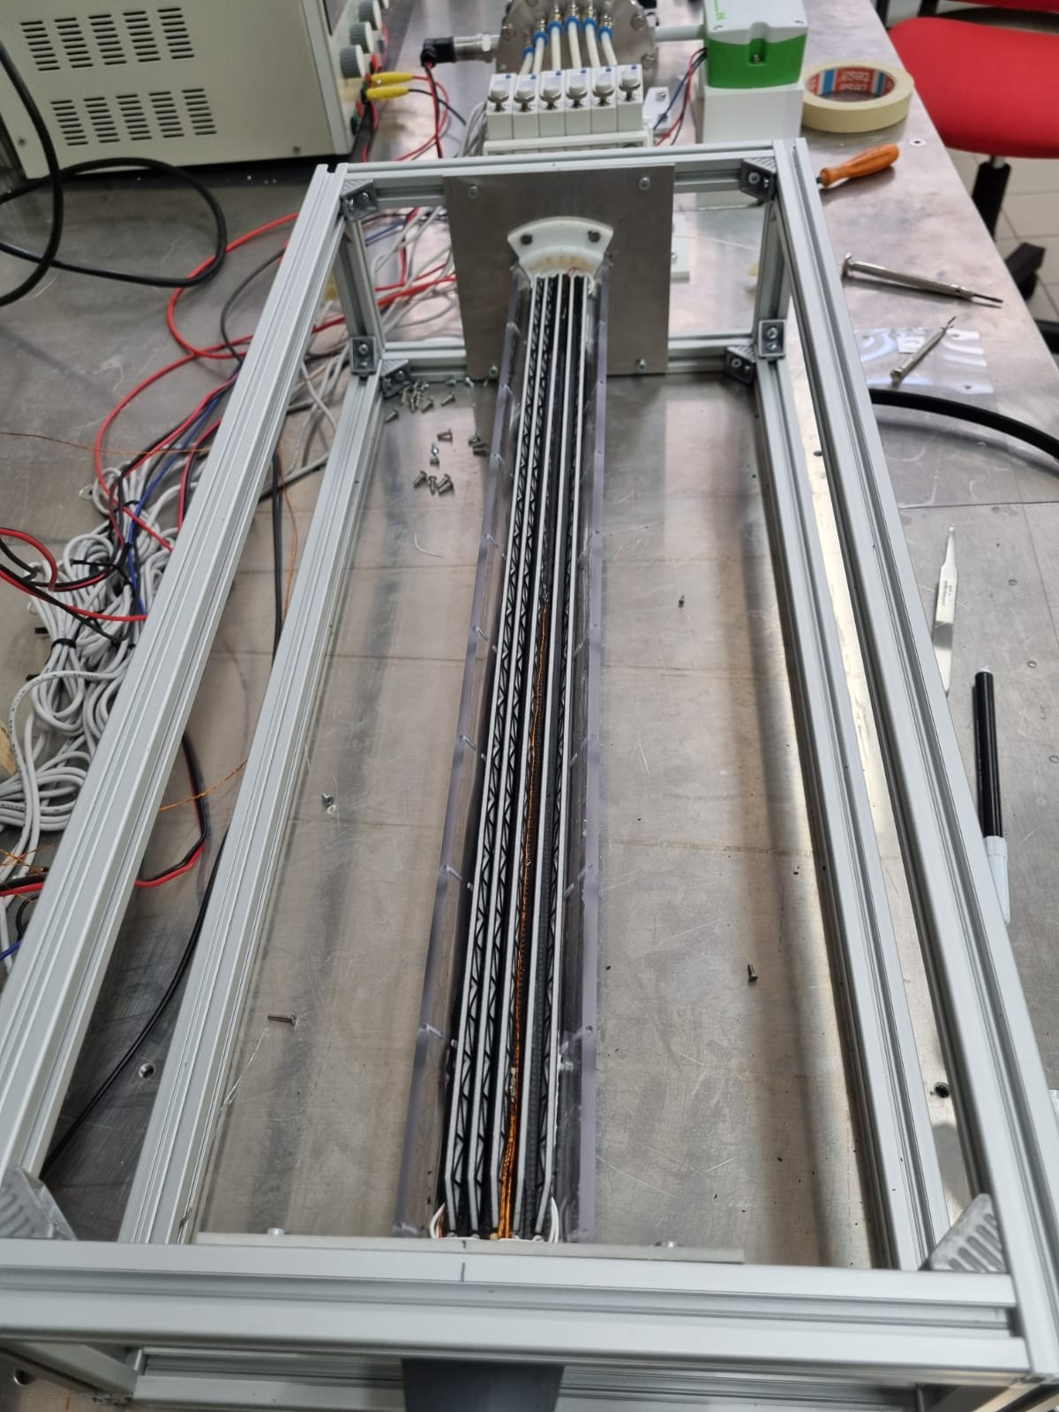
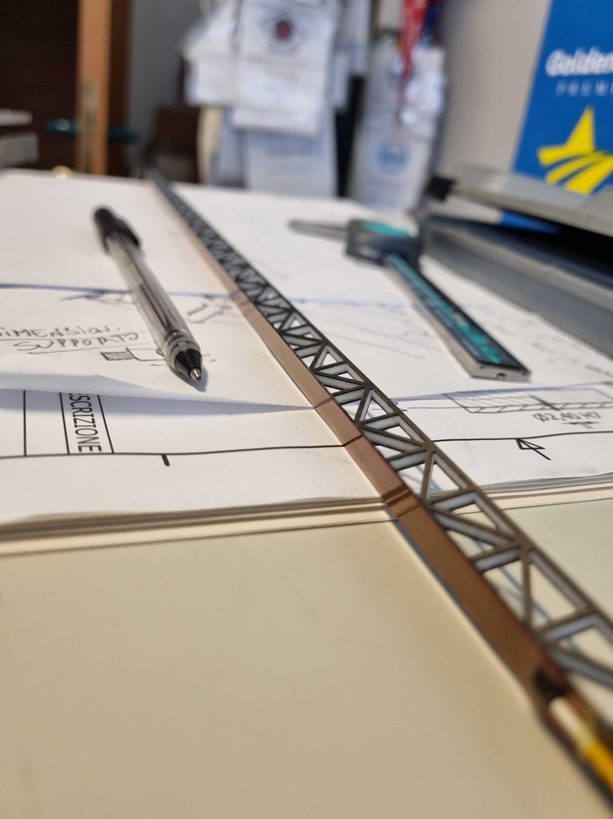
FCC-ee vertex detector R&D workshop, Pisa 31/10/25
Gherardo Ammirabile, INFN Pisa
CONCLUSIONS:
The air cooling system seems to be
adequate for the case study
The compressed air system is stable and dynamic, allowing continuous testing for different solutions
It’s possible to control and monitor the properties of the air being introduced into the test section in terms of:
- Flow rate (Pressure)
- Humidity
- Temperature
The maximum flow rate required for cooling is determined by the vibration allowed by the structure

Slide 15
Thank you for your attention!

