Slide 1


FCC-SEED
Vertex detector project
Toward curved Mimosis
Jeremy Andrea, Franck Agnèse, Auguste Besson, Gilles Clauss, Olivier Clausse, Ziad El-Bitar, Mathieu Goffe, Kimmo Jaaskelainen, Marc Krauth, Jean-Sebastien Pelle, Cédric Schwab, Serhyi Senyukov, Titouan Sommen, Matthieu Specht, Christophe Wabtniz.
(IPHC, CPPM, IP2I, LPNHE)

Slide 2
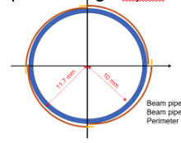
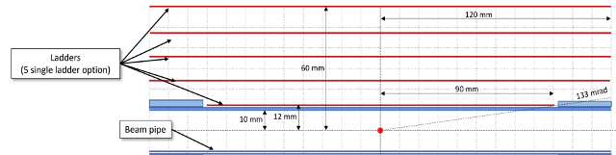
Introduction
Development of a vertex detector concept for FCCee, based on curved sensor.
Main concept :
  Have curved “ladders” (a la ALICE),
  Bend wafer “slice”, have bonding along the Z-axis,
  Overlap to avoid holes in the acceptance,
  Barrel+endcaps.
Pros :
  Bonding on a “flat” surface,
  Improved acceptance,
  Options without stitching possible.
Cons:
  Extra material budget in bands along Z,
  Design of the mechanical structure and of the flex challenging,
  Assembly and integration procedure challenging.
See Armin’s talk

Slide 3
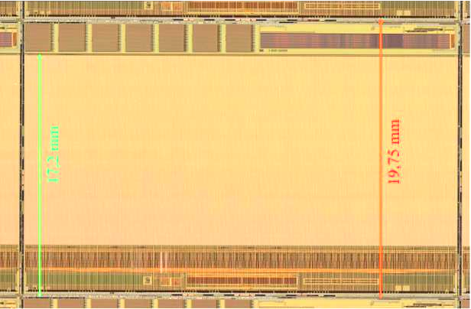
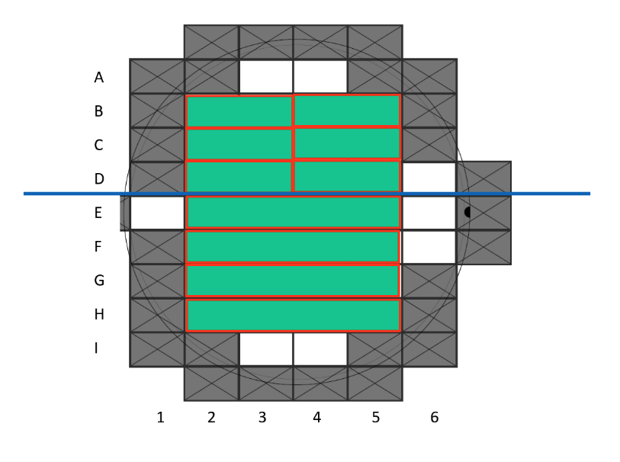
Toward curved Mimosis ladder
Designs of FCC-SEED requires a gain of expertise in curved sensors. Many aspects to investigate, questions to answer.
  To what minimal inner radius can we bend sensors ?
  And for what sensors thickness ?
  Does the bending change the chip performances ? Silicon properties ?
  How to curve the sensors, and maintain the curvature ?
  How to glue sensors on mechanical structure ?
  How to make the bonding with curved sensors?
  Etc… etc…
Strategy/working plan.
  Use existing and available chips : Mimosis prototype versions,
  Setup and practice sensors bending (different radii and different thicknesses), using sacrificial sensors,
  Bend single functional Mimosis, and tests them (lab, source, beam). Required flex and running DAQ,
  Bend a Mimosis ladder, integrated on simplified mechanical structure, tests,
  Design and realise a demonstrator/mock-up for the first FCC-SEED layer.
MIMOSIS-2.1
Cutting of Mimosis wafer
M.Goff

Slide 4
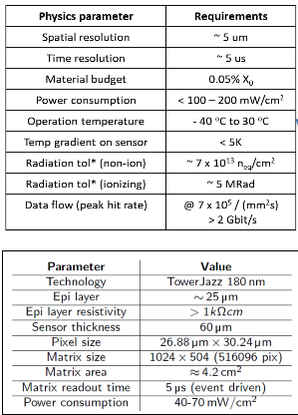
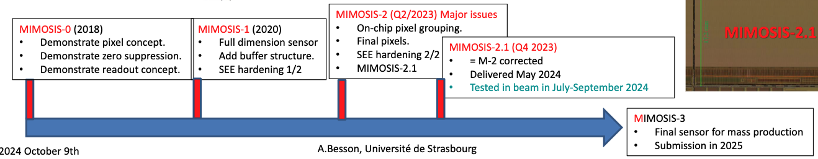
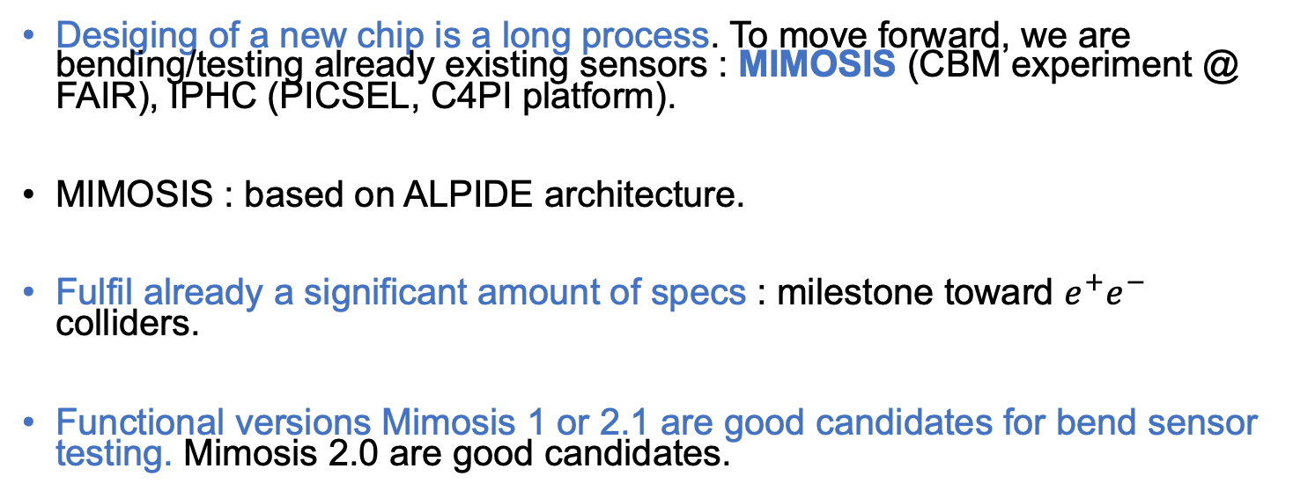
MIMOSIS
Desiging of a new chip is a long process. To move forward, we are bending/testing already existing sensors : MIMOSIS (CBM experiment @ FAIR), IPHC (PICSEL, C4PI platform).
MIMOSIS : based on ALPIDE architecture.
Fulfil already a significant amount of specs : milestone toward $e^{+}e^{−}$ colliders.
Functional versions Mimosis 1 or 2.1 are good candidates for bend sensor testing. Mimosis 2.0 are good candidates.

Slide 5
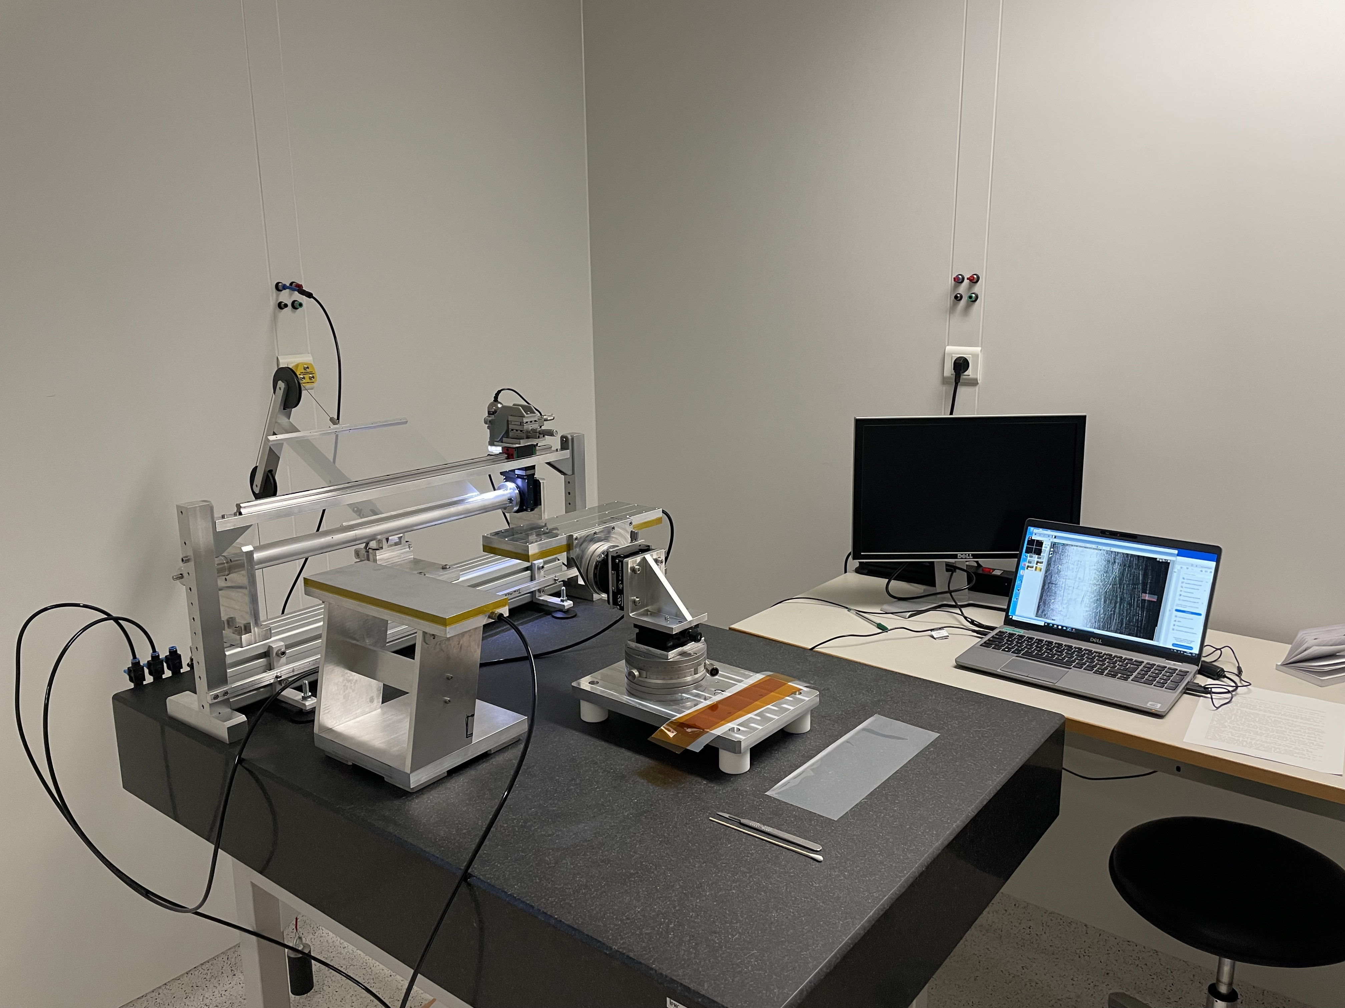
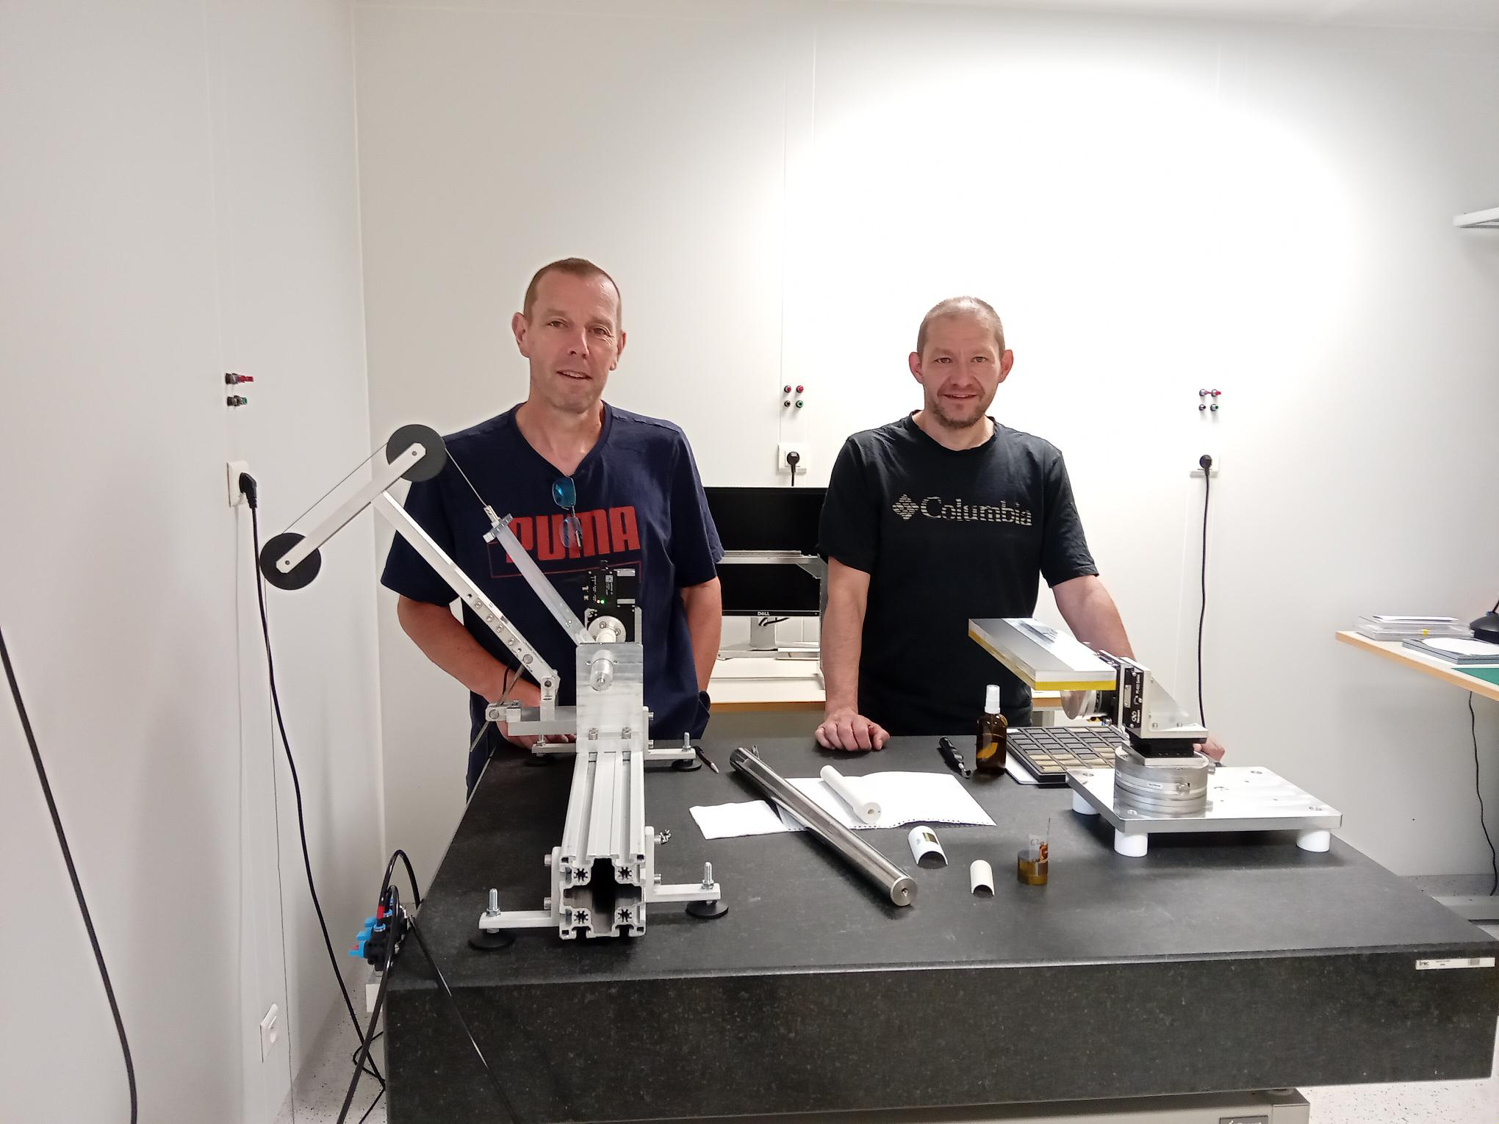
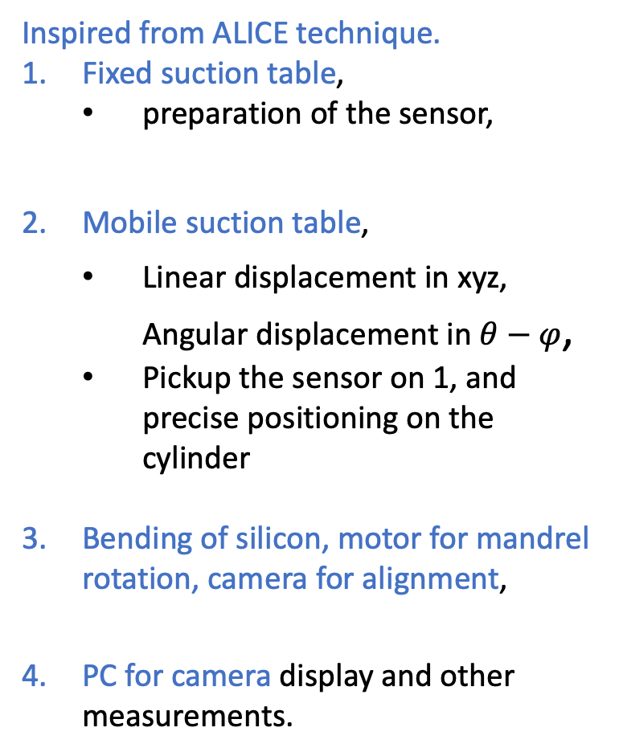
Bending bench setup
O.Clausse, F.Agnèse
Inspired from ALICE technique.
Fixed suction table,
  preparation of the sensor,
Mobile suction table,
  Linear displacement in xyz, Angular displacement in $θ−φ$,
  Pickup the sensor on 1, and precise positioning on the cylinder
Bending of silicon, motor for mandrel rotation, camera for alignment,
PC for camera display and other measurements.
3
2
4
1

Slide 6
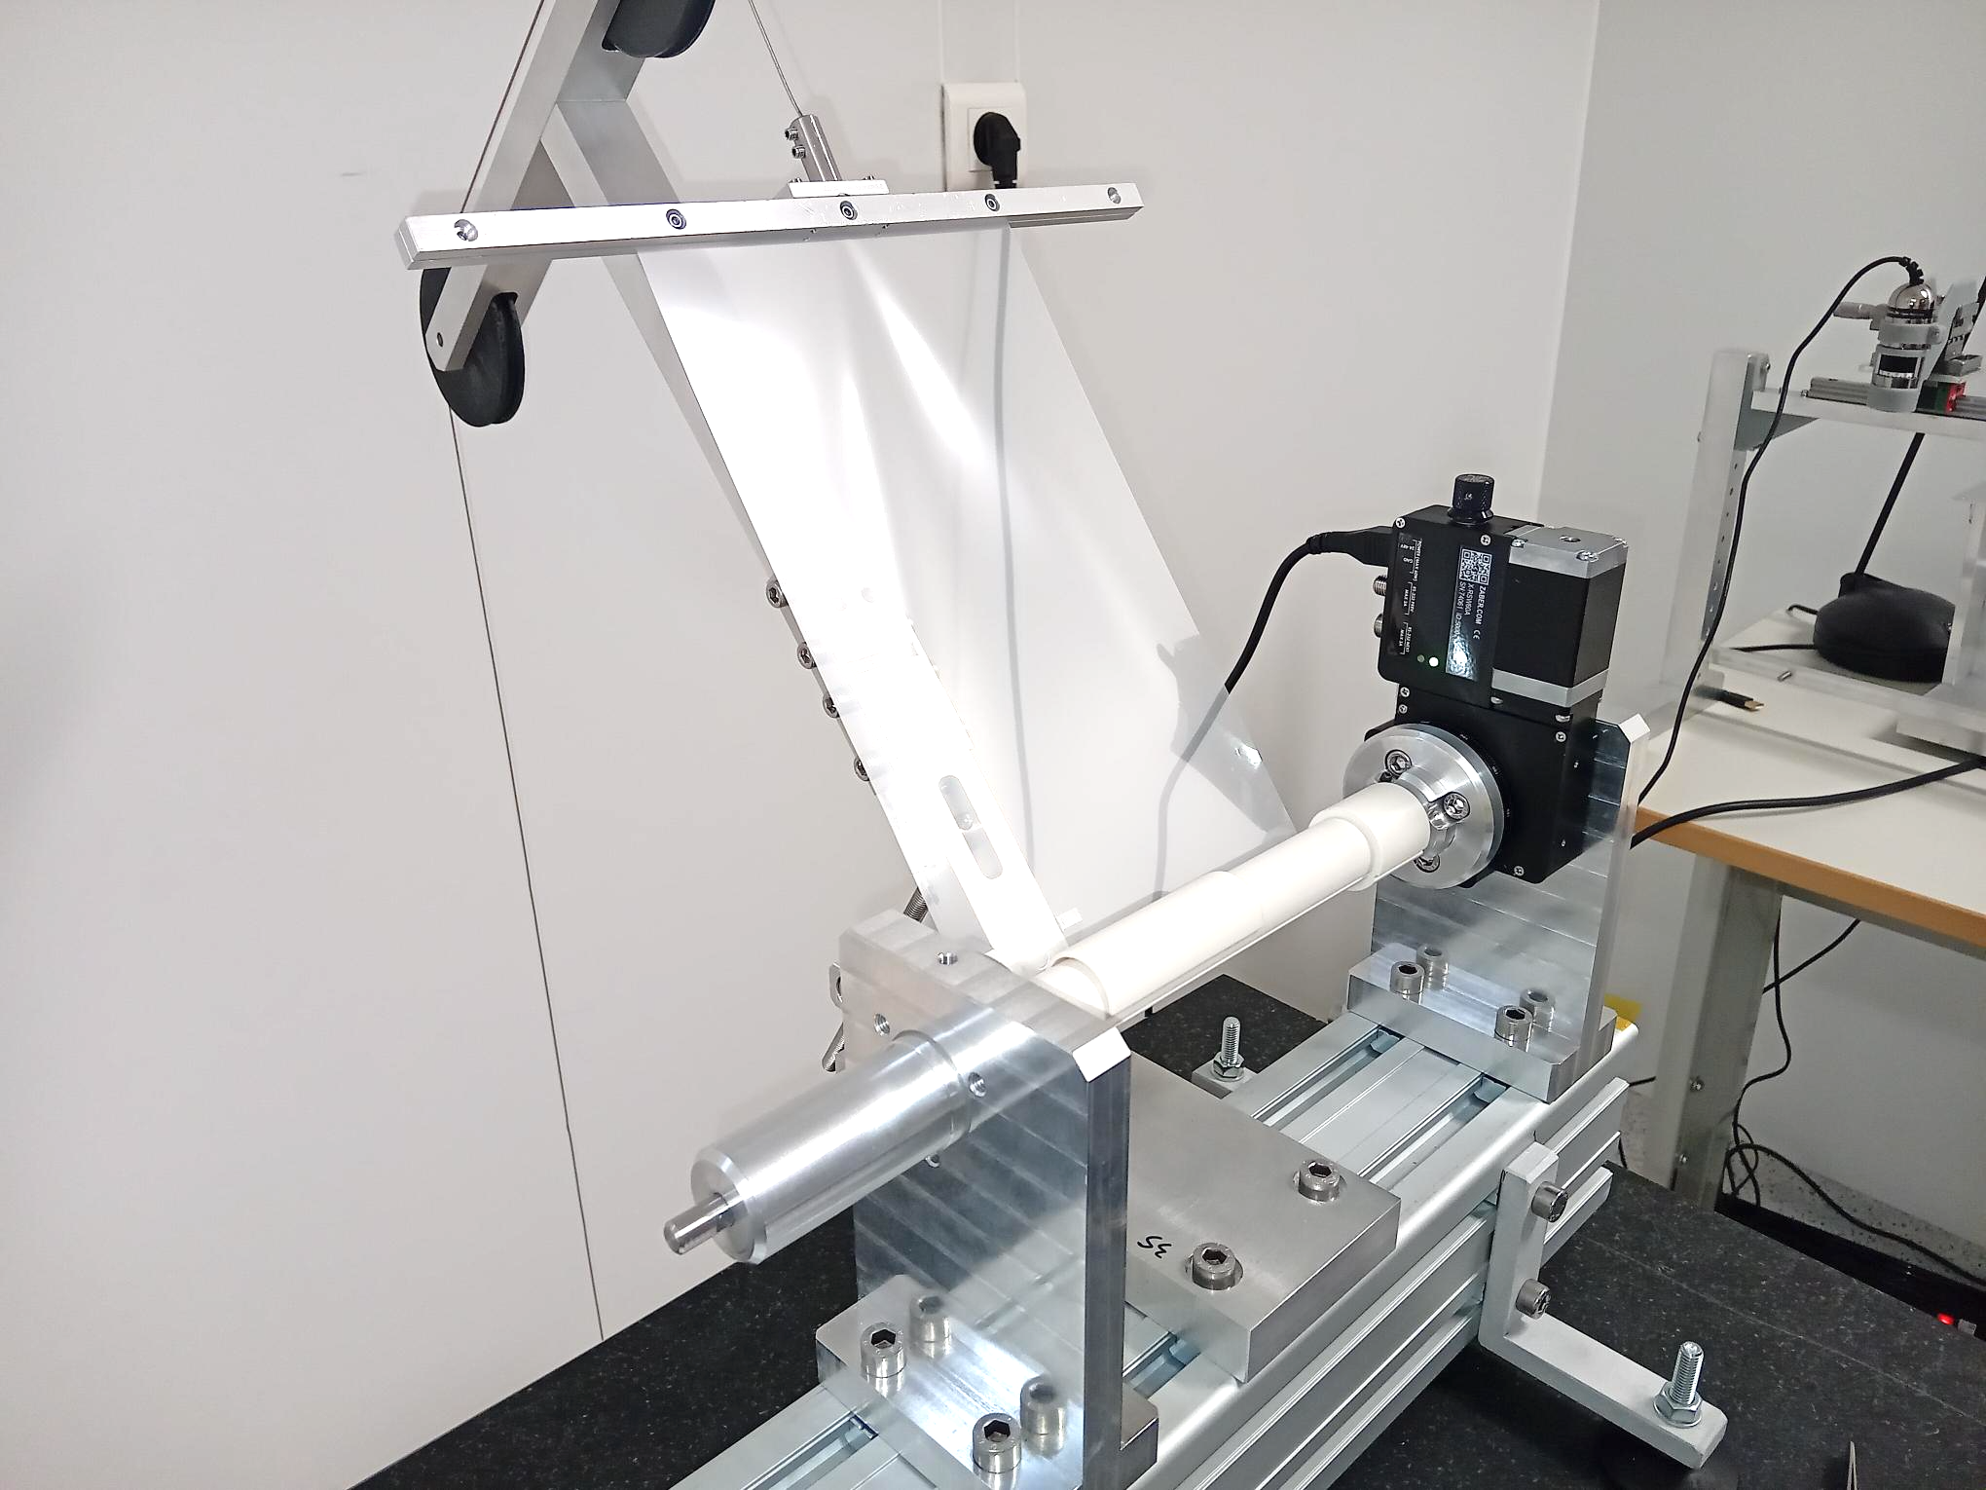
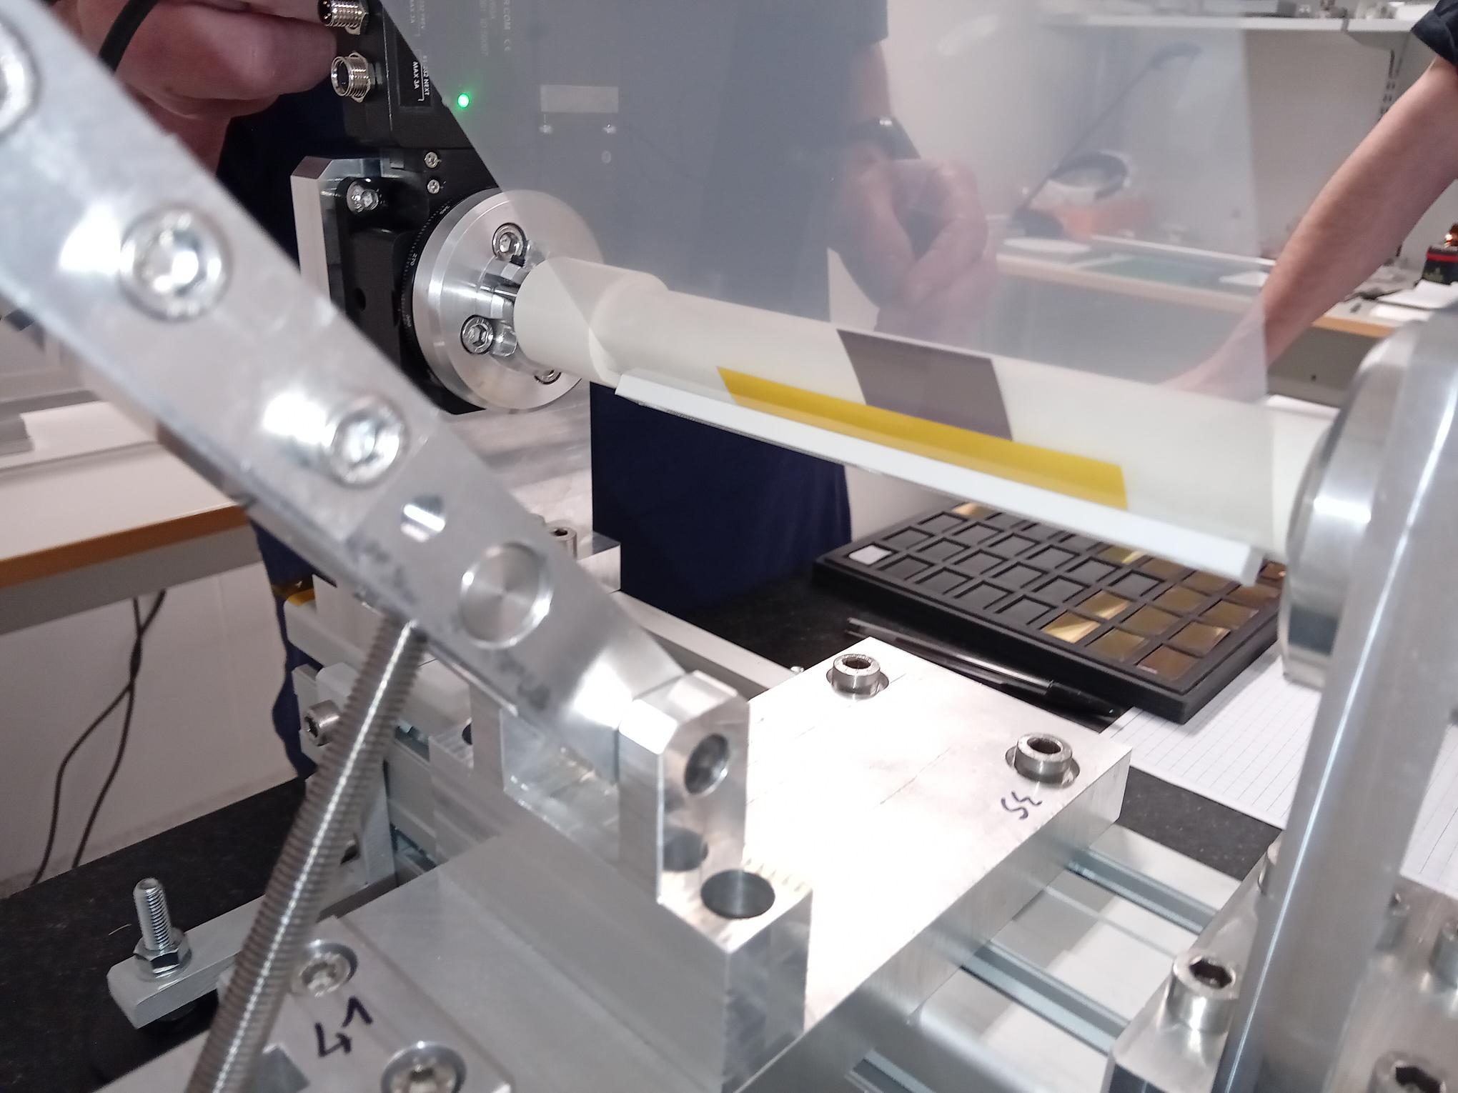
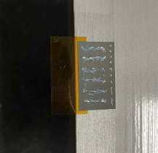

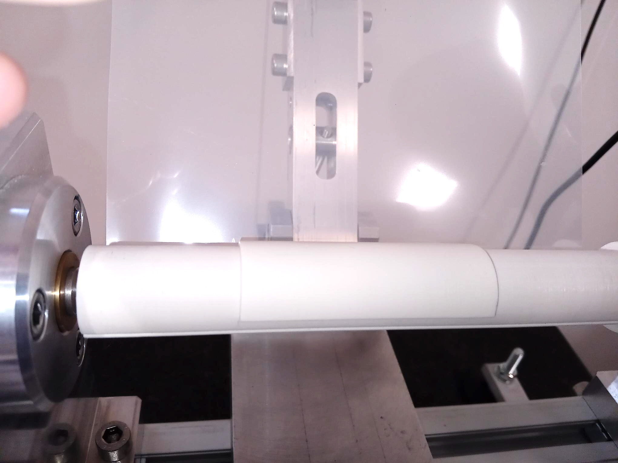
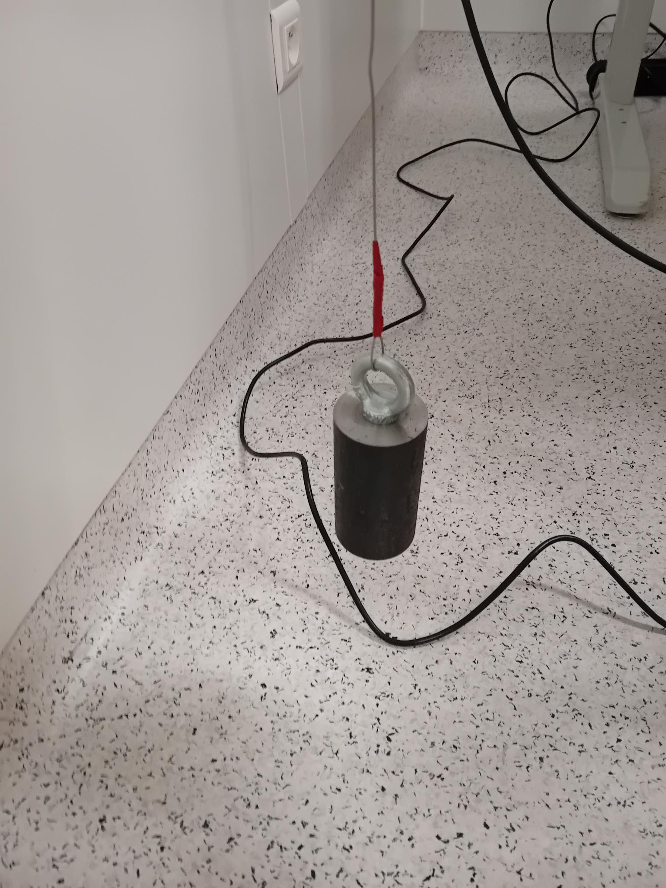
Sensor Bending
Millar foil
Sensor
Sensor support
Mandrell
counterweight

Slide 7
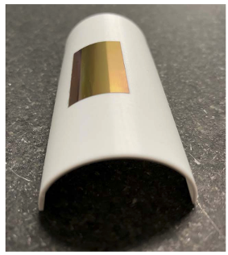
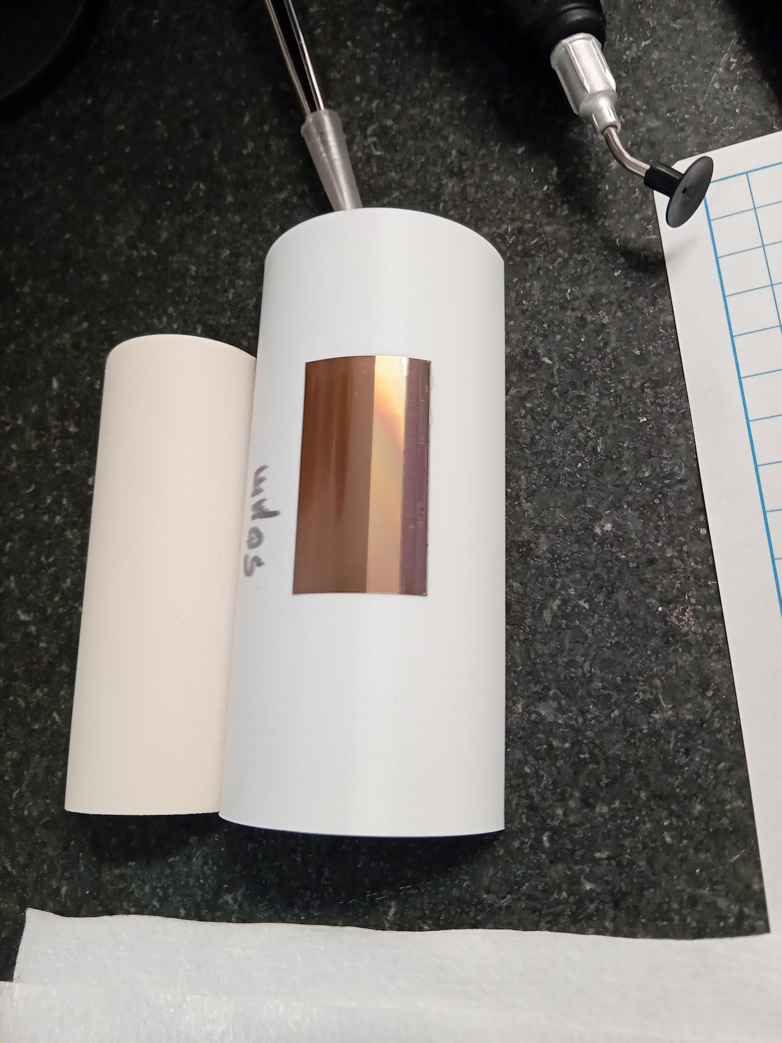
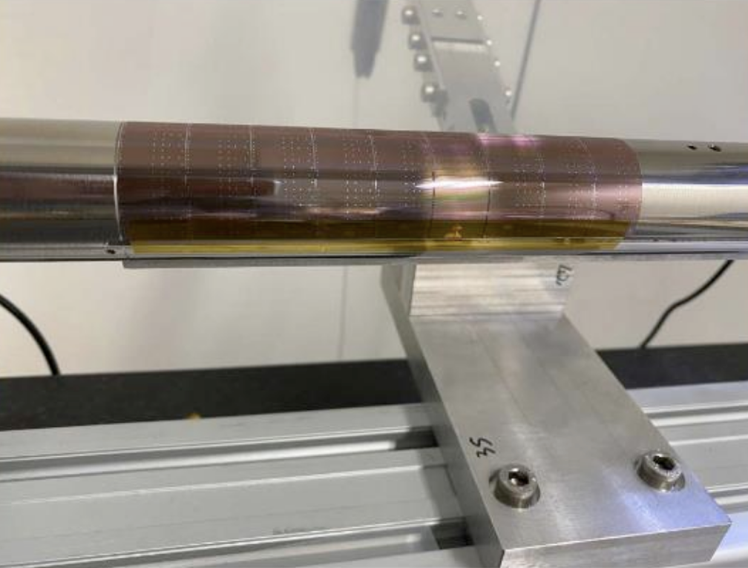
After bending
Several tests performed, on non-operational silicon pads or chips.
Half-cylinder 3D printed supports placed on mandrel 3D printed => large flexibility for performing tests.
Conclusion of the bending feasibility:
  Large size silicon pieces bended successfully,
  Bending at R=18mm successful with 50-60 microns thickness,
  No issues observed with 3D printed cylinder and support.
Further plan:
  Tests bending at R=18, 15 and 12 mm,
  With sensor thickness of 50, 40 and 30 microns (30 microns might not be feasible with Mimosis),
  Move to metallic mandrel for the bending of final functional sensors.

Slide 8
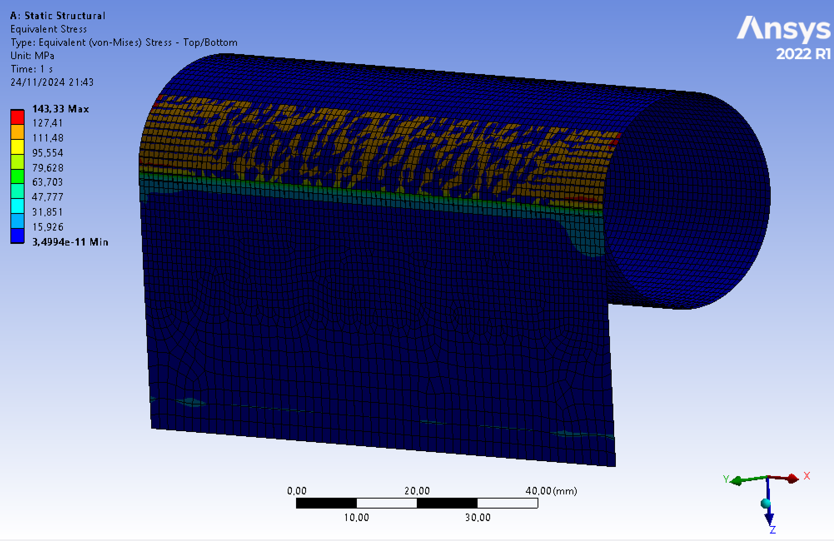
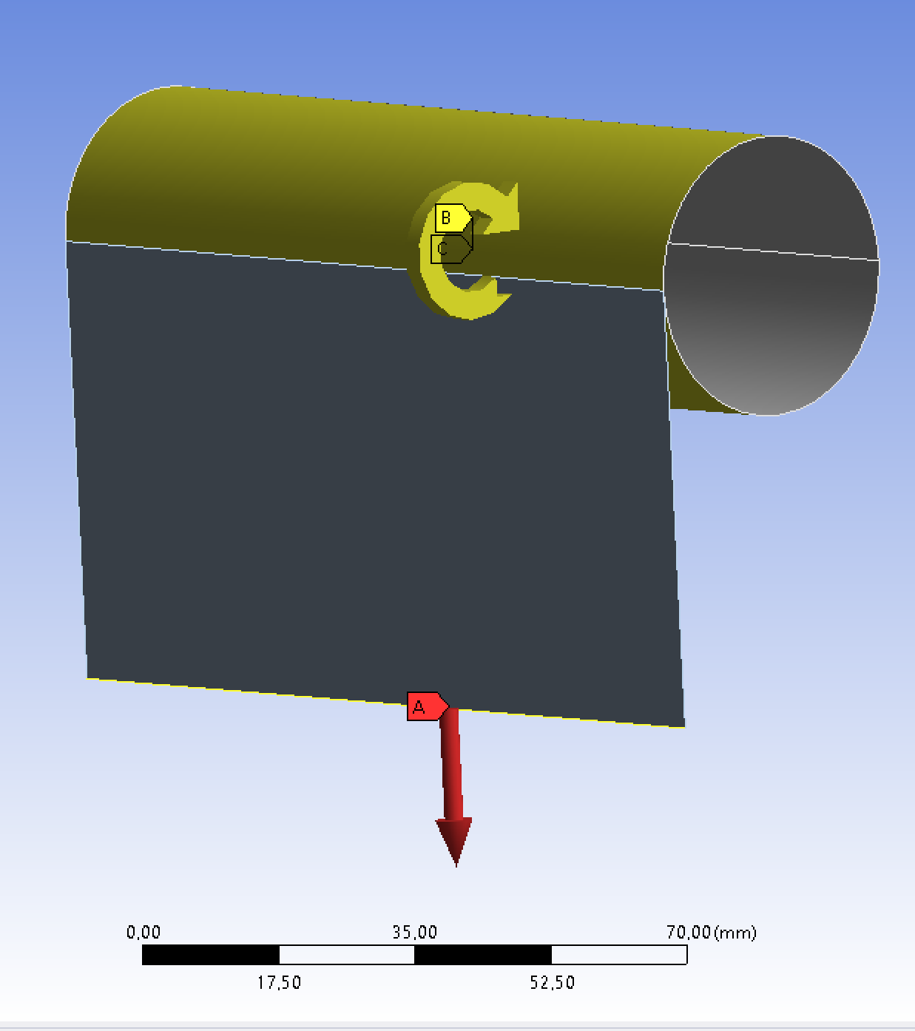
Mecanical simulations
M.Krauth, T.Sommen
Preliminary
Goal : simulate the bending of a silicon sensor, to determine the breaking points vs thickness and inner radius.
Start with the modelling of a simple leaf of silicon, but mechanical characteristics of chips might be different :
  Simulation of a complete chips might be difficult,
  Considering measuring the mechanical characteristic of Mimosis and feed the simulation with the results.
Preliminary studies with ANSYS being performed, but much more work is needed.
More simulations (thermo-fluidic) related to thermal aspects are also required.
Preliminary

Slide 9
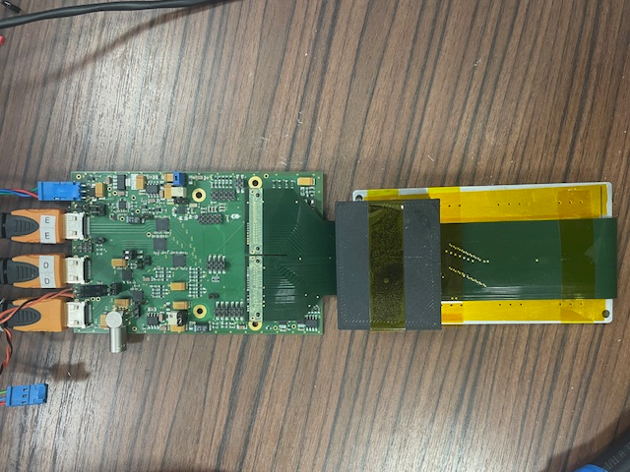
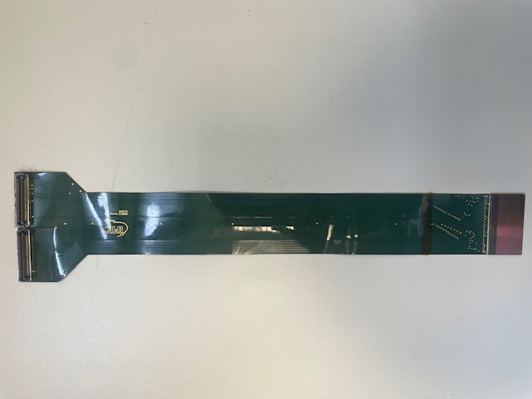
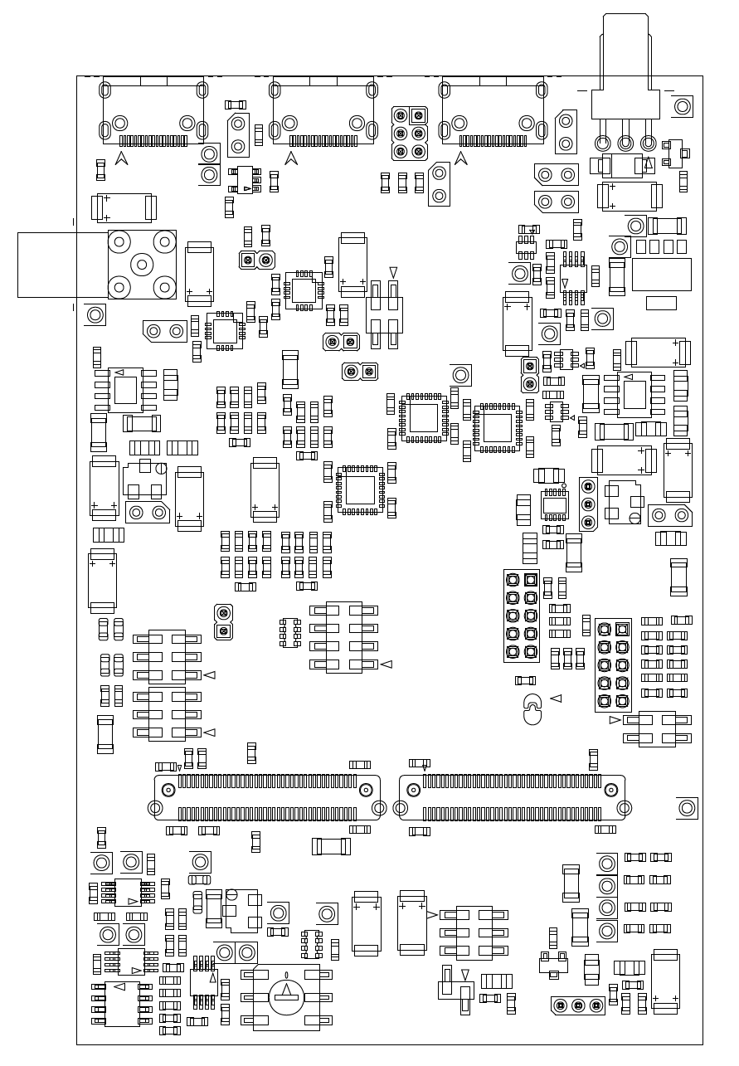
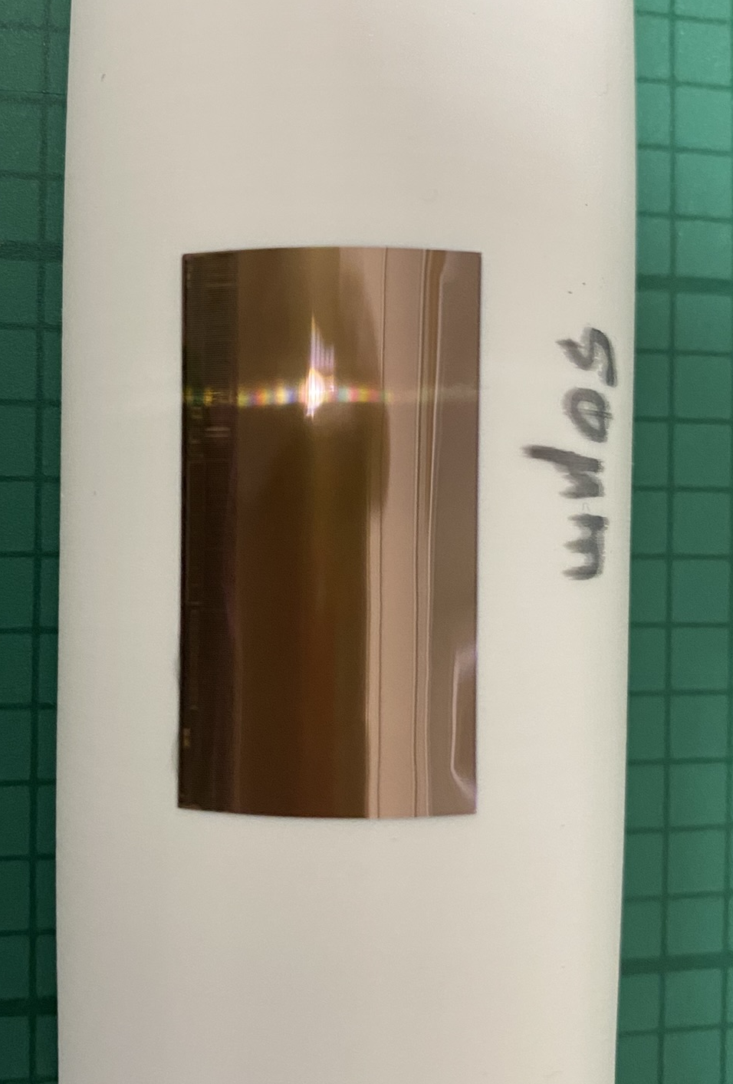
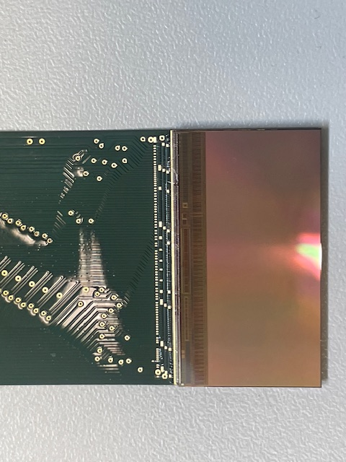
Design of a flex cable and board for curved Mimosis testing
Test board and flex for tests :
  Design and fabrication done,
  First tests performed,
  Flex and board validated, but improved version being produced,
  To be tested first on a flat sensor, then with curved sensors
First tests to be performed on MIMOSIS vs curved-MIMOSIS :
  A/D power consumption,
  Noise and s-curves,
  Test with source and beam (CYRCé then DESY).
Carte Msis_prox
For the final detector, the flex design is a key element.
  Should allow for a robust and easy bonding,
  Should be well integrated within the mechanics,
  Should be as small and as light as possible.

Slide 10
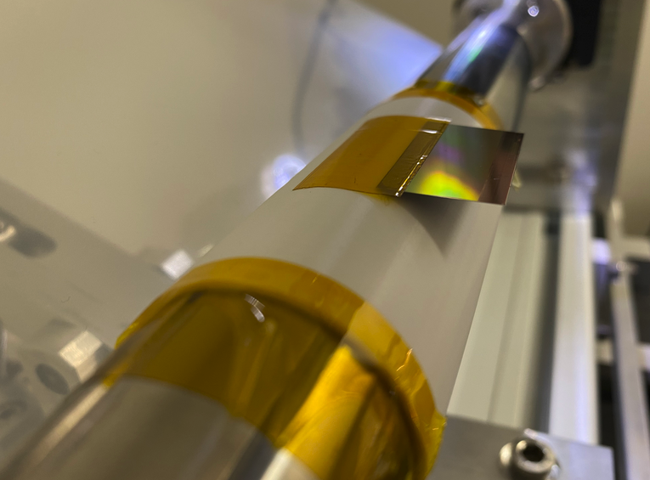
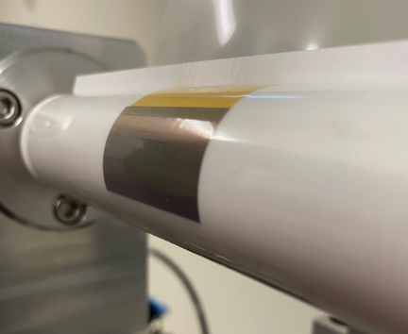
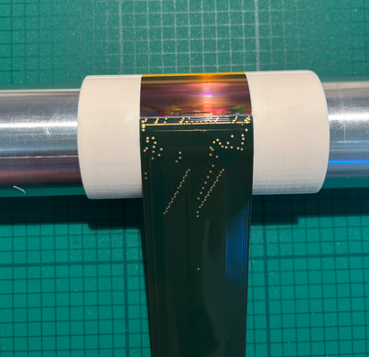
Toward functional bend Mimosis
Observed difficulties while performing bonding.
Glue was flowing out of the silicon surface and contaminated the bonding pads.
Several tests were performed, with different glue viscosities and glue doses.
Solution found.
  Optimise the quantity of glue,
  Bend the sensors while covered with a Kapton foil and demoulding agent,
  Allows for wire bonding. Procedure still to be optimised.
Sensor covered with Kapton foil,
after rolling the Millar foil
Curved sensor glued on it support, ready for bonding
Sensor taping on the mandrel

Slide 11
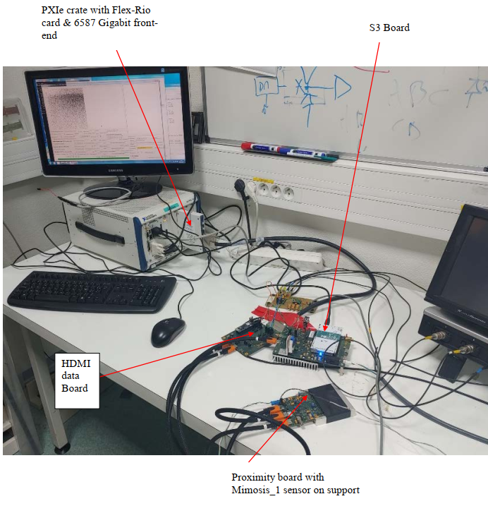
G.Claus, M.Goffe, J.S.Pelle, M. Specht, K.Jaaskelainen
Test bench for Mimosis testing
Le slow control & DAQ
  NI PXIe crate
  CPU + DAQ board FlexRio (FPGA)
  SW under Windows 7 Pro
  DAQ : GUI executable (C++ Builder)
  SC : GUI Python Q
DATA board transmission links to Mimosis / DAQ, 8 links at 320 Mb/s.
S3 board (Slow control Steering Synchro)
provides slow control I2C and clock to Mimosis
Mimosis is mounted on a “Proximity board”
Possibility to have a DAQ based on cheaper FPGA under study. Software being made more user friendly

Slide 12
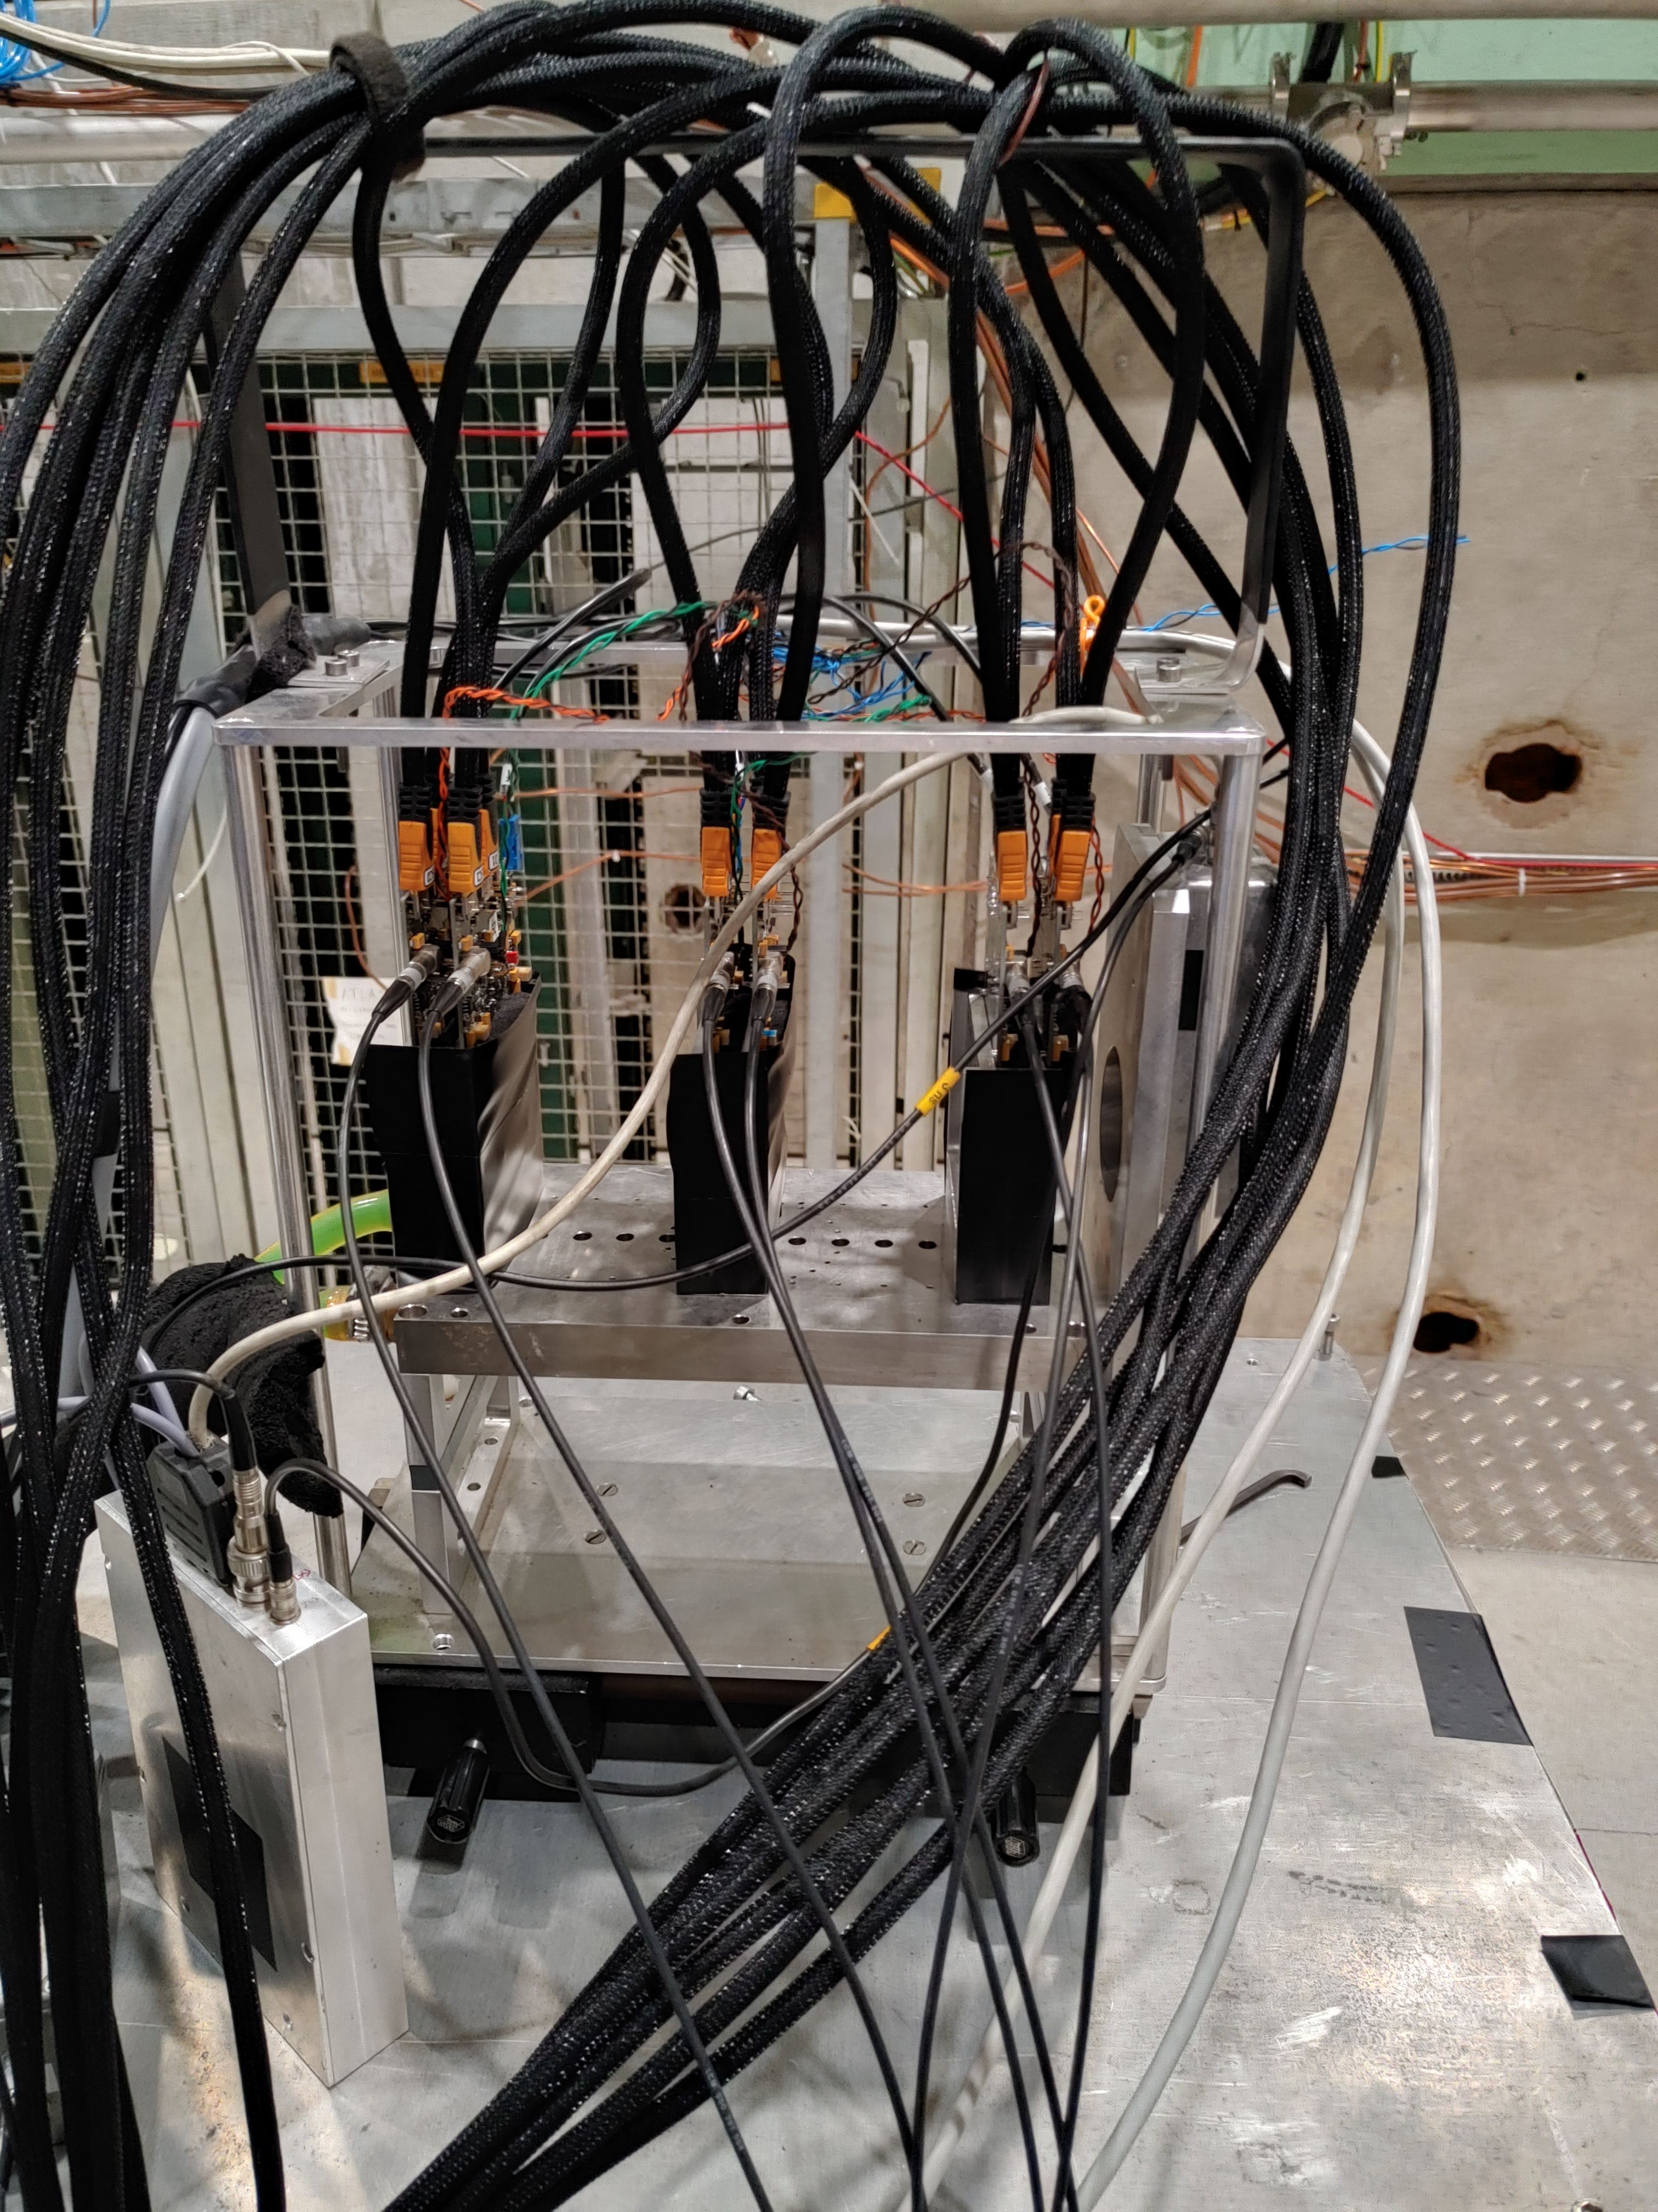
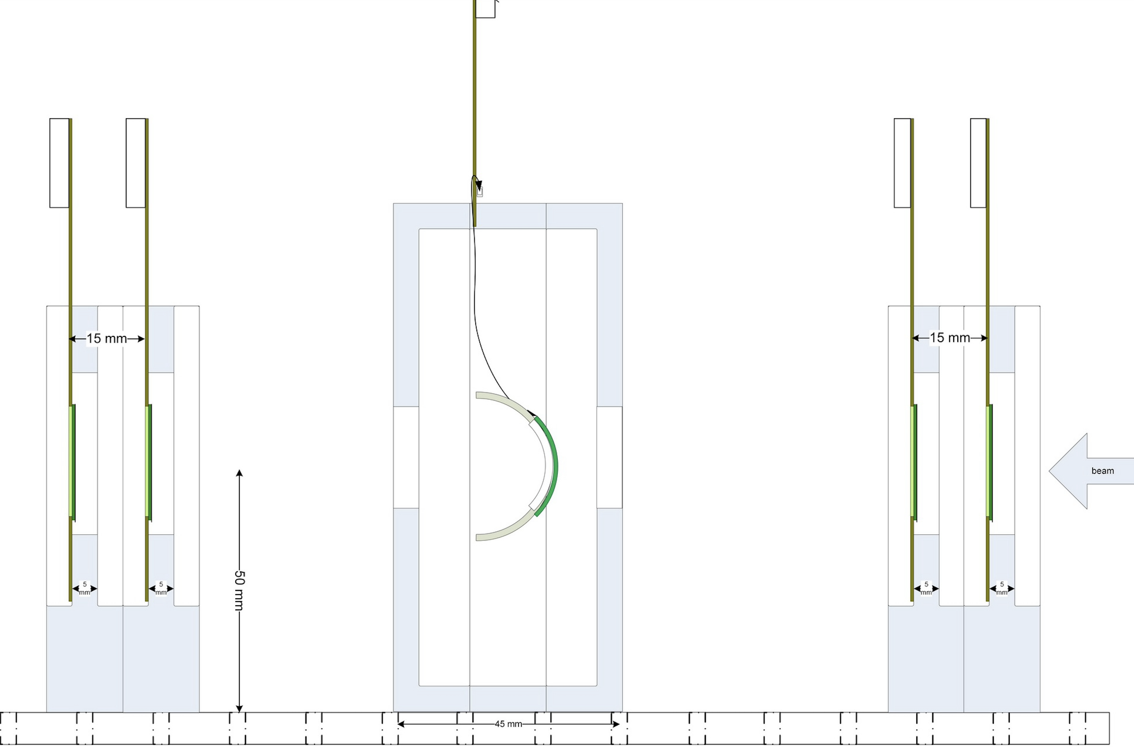
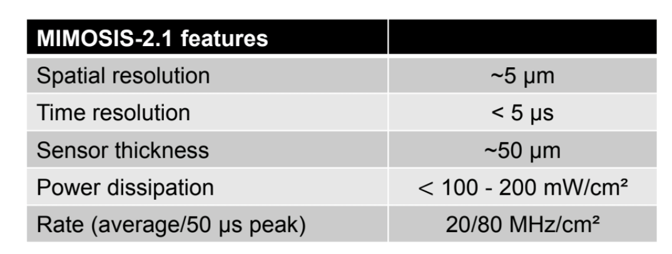
Beam test preparation
M.Goffe, M. Specht
Reference planes
2 Mimosis per layer
Testing with beams to be performed with a Mimosis-based telescope.
Two layers with two Mimosis sensors each, sandwiching the Detector Under Test (DUT).
Synchronisation “for free”, uses same DAQ and software.
Prior to test at DESY, testing of the sensors and telescope at the local IPHC cyclotron.
scintillator
Location of the DUT

Slide 13
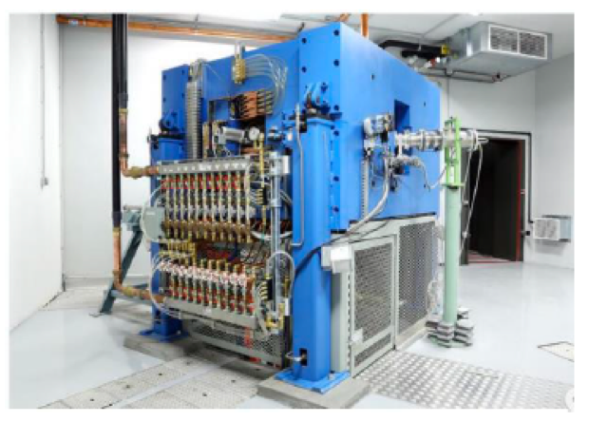
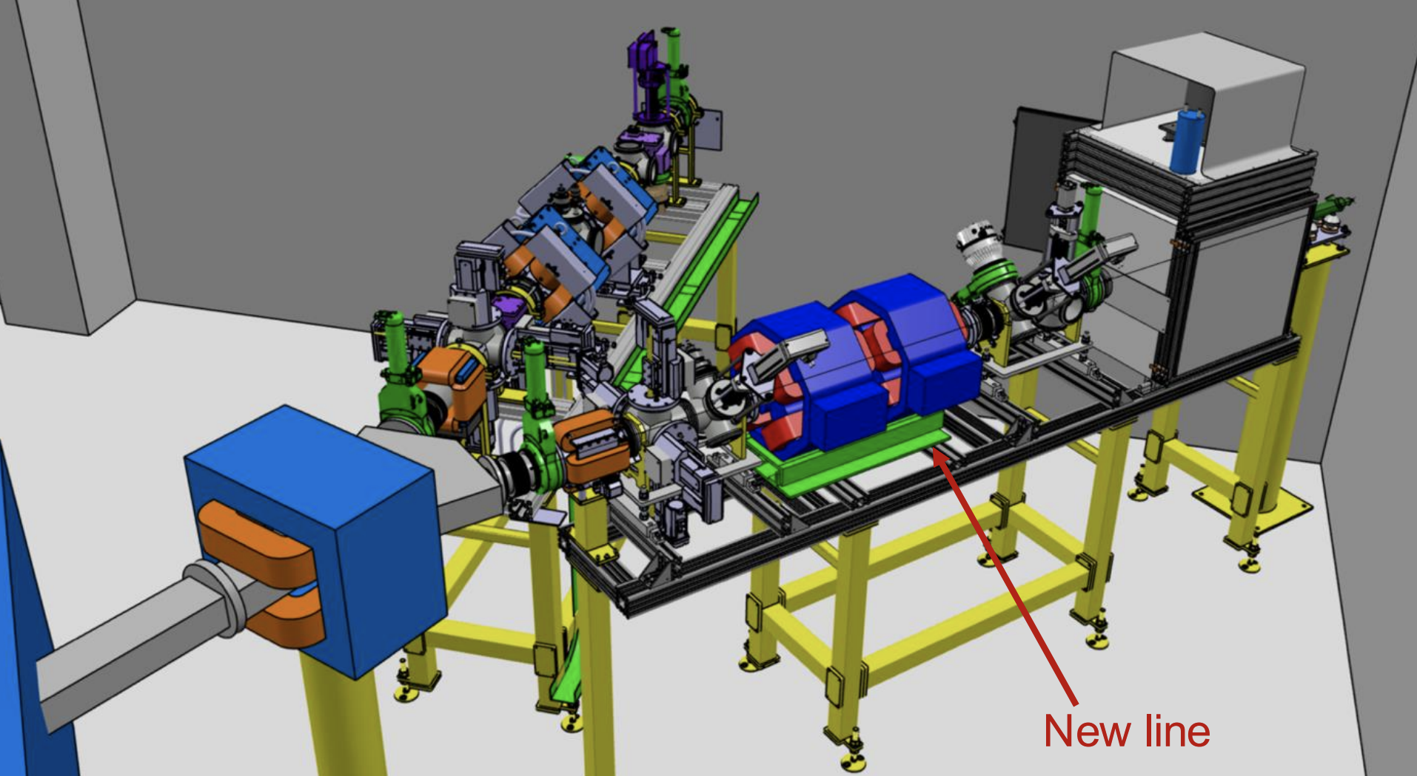
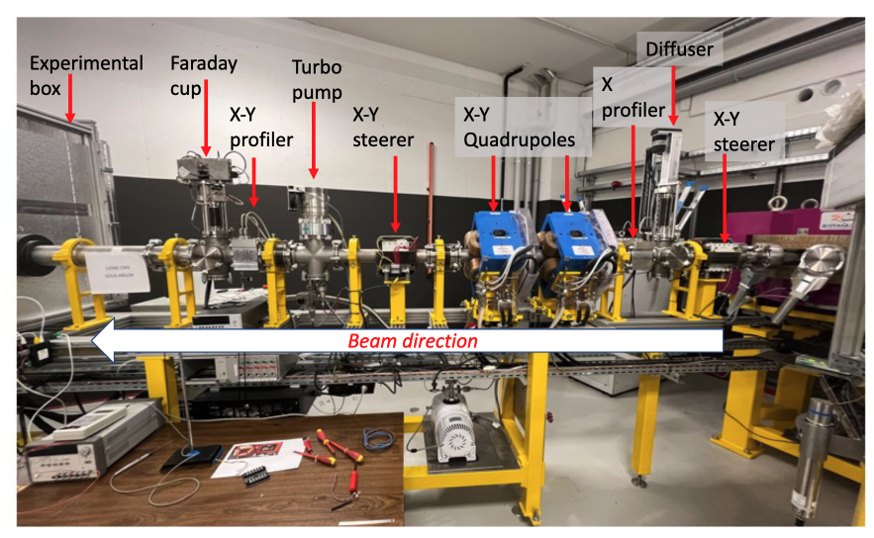
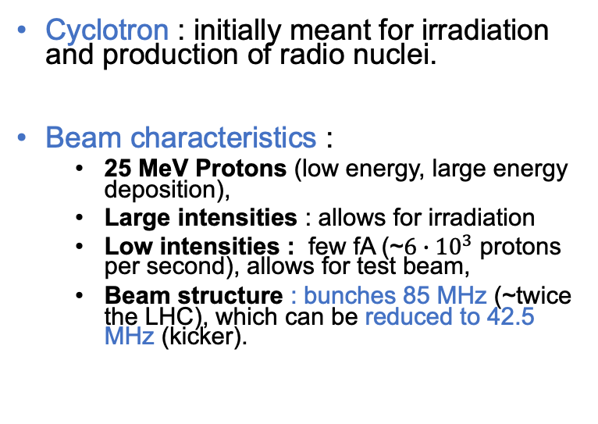
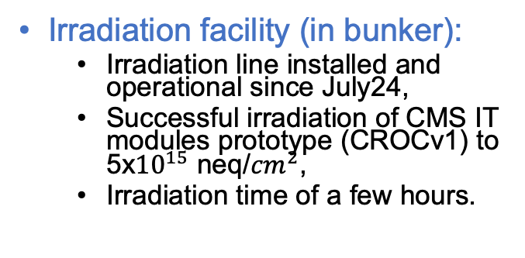
Beam test and irradiation facility : CYRCé@IPHC
Cyclotron : initially meant for irradiation and production of radio nuclei.
Beam characteristics :
  25 MeV Protons (low energy, large energy deposition),
  Large intensities : allows for irradiation
  Low intensities : few fA (~$6∙{10}^{3}$ protons per second), allows for test beam,
  Beam structure : bunches 85 MHz (~twice the LHC), which can be reduced to 42.5 MHz (kicker).
Test facility (in exp. area):
  Operational since 2020,
  Well suited for rate studies and efficiencies measurements,
  Limited precision due to multiple-scattering,
  Preparation for test beam campaign at DESY or CERN.
Irradiation facility (in bunker):
  Irradiation line installed and operational since July24,
  Successful irradiation of CMS IT modules prototype (CROCv1) to 5x${10}^{15}$ neq/${cm}^{2}$,
  Irradiation time of a few hours.

Slide 14
Summary and next steps
Goal : gain expertise and deep understanding of curved sensors, before designing a Vertex detector for FCCee.
R&D program on curves sensor ongoing.
  Uses ALICE bending techniques to bend single Mimosis chips,
  Bending at different radius with different thickness, using non functional chips. So far, tests seems conclusive,
  Bend sensor testing.
Next short term plan : finalising a functional bent Mimosis, perform lab testing, and then beam testing @CYRCé before going to DESY (or CERN).
Longer term :
  have samples of bend Mimosis, for testing, with different radius and different thickness,
  Bend and test a Mimosis wafer “slice”.
Starting parallel activity : mechanical studies in view of designing supports for Mimosis ladders, and vertex detector.
  Interaction with MDI to be discussed in depth (background, acceptance, supports),
  Optimize geometry based on physics benchmark,
  Integration and services location,
  Assembly, cooling,
  Etc… etc…
Room for collaborations !

Slide 15
Backups

Slide 16
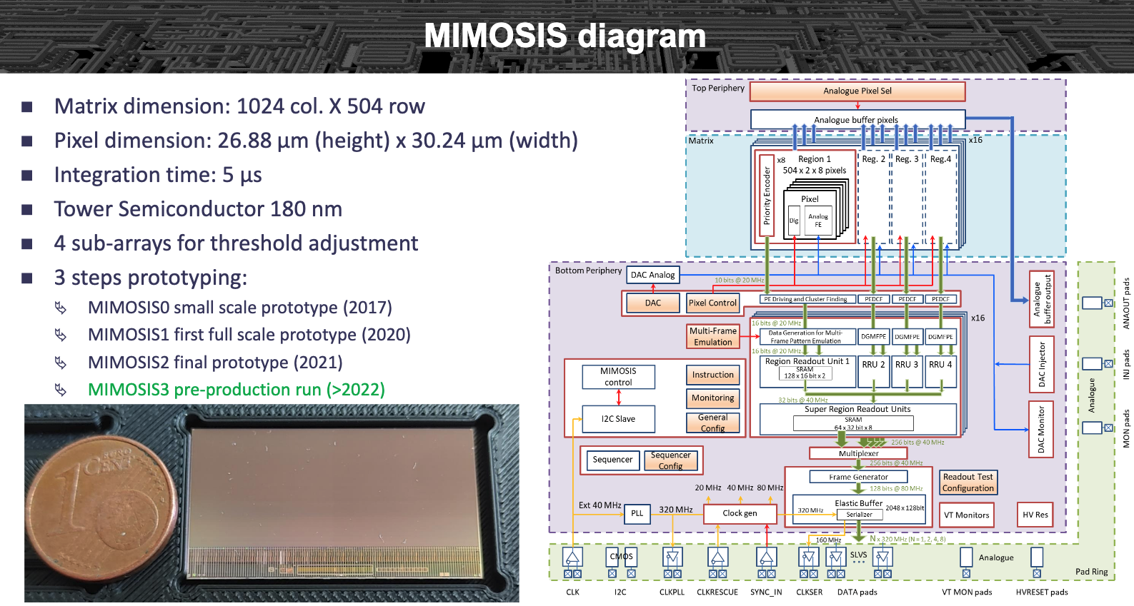
Mimosis
F.Morel, link

Slide 17
FCC-SEED : geometry concept first thoughts
z
y
Flex
Mechanical supports.
Include the flex?
Wire bonding on the side
Might make the stitching not needed,
No dead region in phi,
Makes the design of the mechanics and the flex quite challenging.
Wire bond
Wire bond
x
Beam pipe
Bend sensor
R=12mm
Assembly of quarters (hemi) of cylinders : assemble individual frames together around the beam pipe

Slide 18
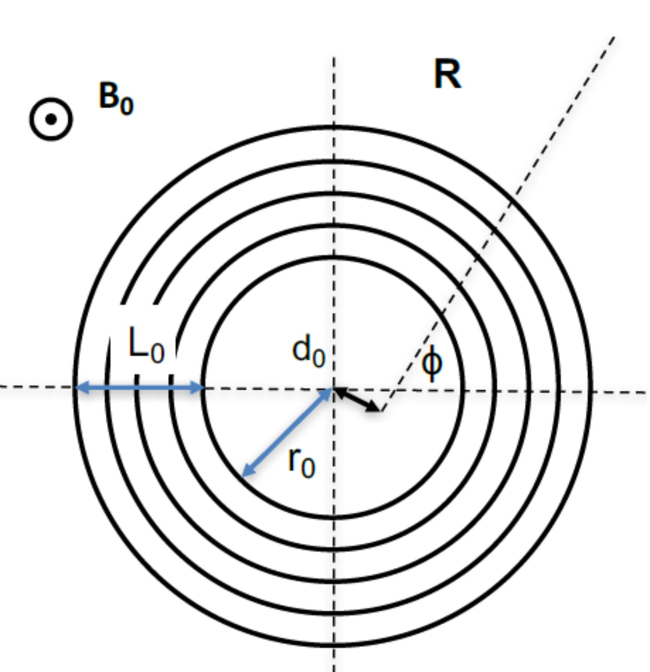
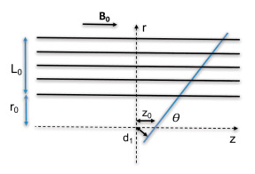




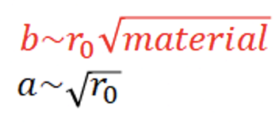





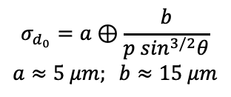
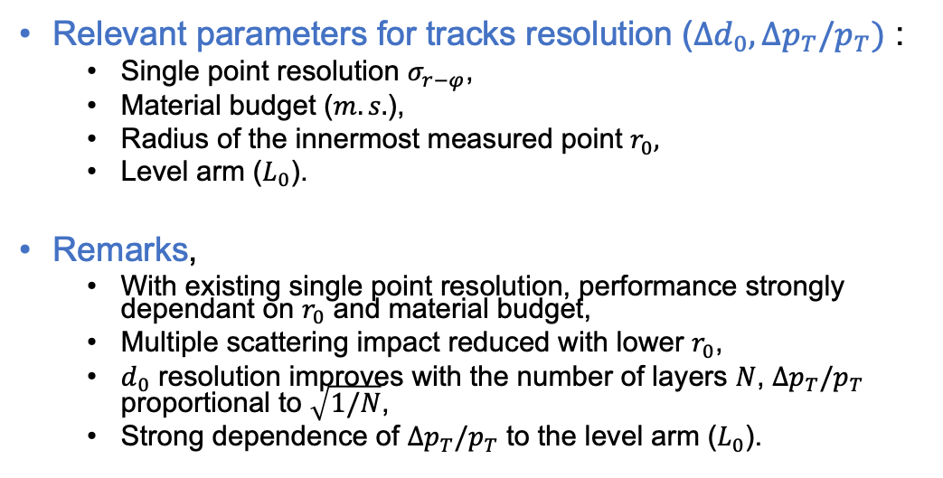
Main parameters of tracks resolution
Relevant parameters for tracks resolution ($Δd_{0}, Δp_{T}/p_{T})$ :
  Single point resolution $σ_{r−φ}$,
  Material budget ($m.s.$),
  Radius of the innermost measured point $r_{0},$
  Level arm ($L_{0}$).
Remarks,
  With existing single point resolution, performance strongly dependant on $r_{0}$ and material budget,
  Multiple scattering impact reduced with lower $r_{0}$,
  $d_{0}$ resolution improves with the number of layers $N$, $Δp_{T}/p_{T}$ proportional to $\sqrt{1/N}$,
  Strong dependence of $Δp_{T}/p_{T}$ to the level arm ($L_{0}$).
FCCee
$$σ_{d_{0}}=a⊕\frac{b}{p \sin^{3/2}θ}$$
$$a≈5 μm; b≈15 μm$$
ALICE ITS2
Material budget is a key parameter !

Slide 19
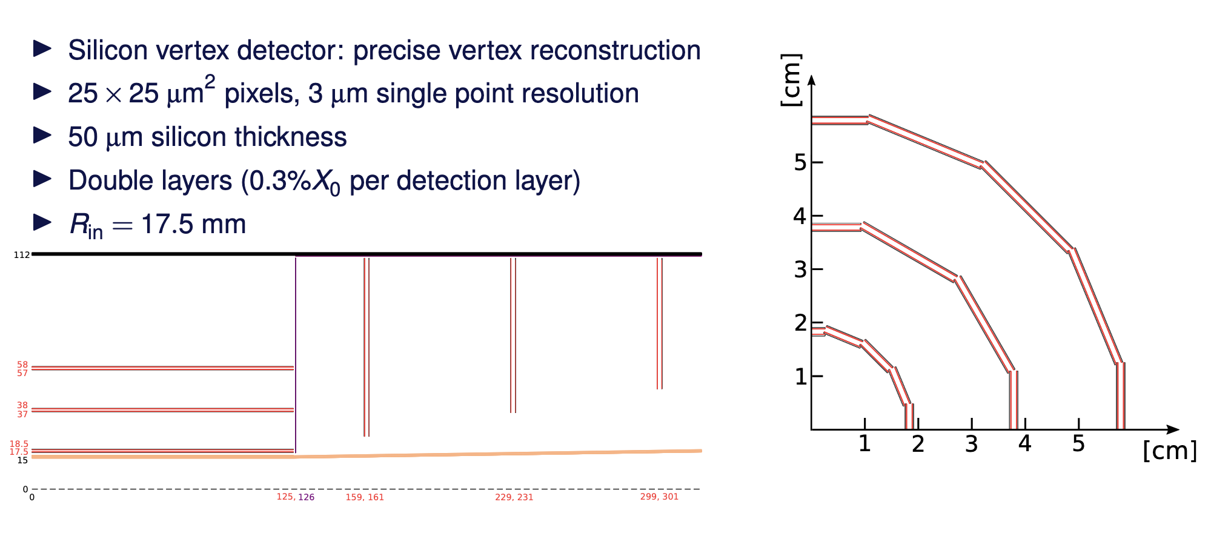

CLD vertexing
A.Sailer, link.
y
$$θ$$
x

Slide 20
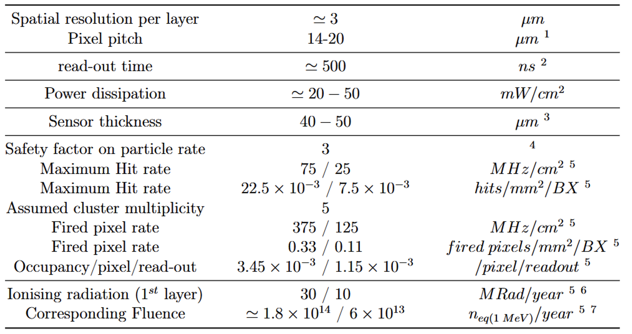
Vertex sensor specifications
Depends on charge shareing and encoding
Balance between power dissipation and particle rate
To be compatible with air cooling
Reduced material budget, allows for bending
Related to max particle rates at the Z energy
Expected max fluence per year

Slide 21
FCC-SEED concept
Chip design
Pitch
Size/geometry
digitization
Readout speed/timing
Cables/flex
Integration
Assembly procedure
Mechanics
Geometry
Material budget
Material
Services supports
Cooling power
Cooling
Cooling type

Slide 22
FCC-SEED concept
Chip Design, Mechanics, Integration and Cooling are strongly inter-connected
Main FCC-SEED approach : develop things in coherent manner
Chip design
Pitch
Size/geometry
digitization
Readout speed/timing
Cables/flex
Integration
Assembly procedure
Mechanics
Geometry
Material budget
Material
Services supports
Cooling power
Cooling
Cooling type

Slide 23
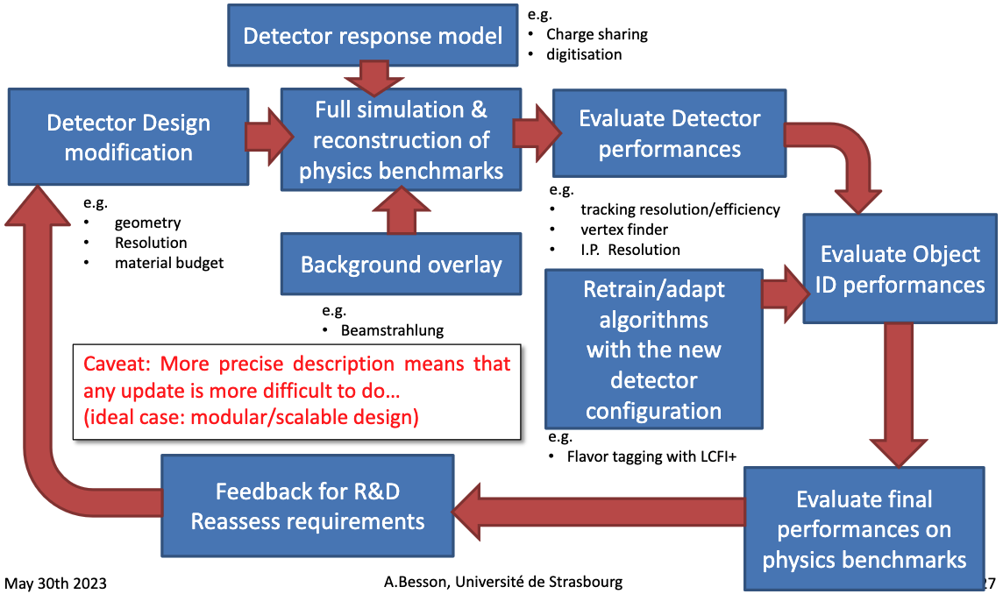
FCC-SEED : setting up the program
Goals for mechanics and integration: work toward a robust vertex concepts for FCCee (or other e+e- colliders) in the coming ~5 years.
Mains topics to worked on :
  Master curved sensor fabrication and testing,
  Explore mechanical options, type of material, stress and colling, etc…
  Design a full mechanical geometry, to be tested in full simulation,
Iterative process !
A.Besson

