Slide 1
DPDF Meeting
July 10

Slide 2
Steering File Setup and Validation for Diffractive DIS Generation
Objective:
Prepare validated RAPGAP steering files for diffractive DIS event generation with and without QED radiative corrections, using the base configuration.
Reference Files Reviewed:
Base file: steer-ep-diff (diffractive DIS, no QED radiation)
Jung’s file: steer-ep-qedrad-dis (inclusive DIS with QED radiation)
No-rad reference: steer-ep-no-qedrad-dis
Parameters Identified for QED Radiation:
INT3, LPIN, IFPS (initial/final state radiation, leptonic radiation, parton showering)

Slide 3
Two New Steering Files Created:
steer-ep-diff-qedrad: Enabled QED ISR/FSR using Jung’s settings
INT3 = 1 0 5
LPIN = 4 0 1
IFPS = 1 0 3
steer-ep-diff-noqedrad: Ensured QED radiation is off, consistent with no-QED file
INT3 = 2 0 5
LPIN = 4 0 0
IFPS = 1 0 0

Slide 4
Proton Dissociation Control
Investigated Proton Dissociation Control:
Key finding:
Found the responsible steering variable: NFRA
NFRA = 0: only elastic scattering (no dissociation)
NFRA = 1: allows proton dissociation
Current samples use NFRA = 0 → purely exclusive diffraction

Slide 5
Diagnosis of the xP∼1 Peak in RAPGAP Events
Initial inspection of the xP distribution showed an unexpected peak near 1.
Such large values are not consistent with diffractive kinematics.
Parsed events from truth-level RAPGAP output with 4-momenta.
Computed: xP, ∣t∣
Observed that many events with xP>0.8 had abnormally large ∣t∣values:
Some with ∣t∣>100 GeV2, even >500 GeV2
These events are not truly diffractive. Likely originate from proton dissociation or misidentified forward baryons. Applying a physics-motivated cut of ∣t∣<1 GeV2 removes the peak entirely, confirming the hypothesis.

Slide 6
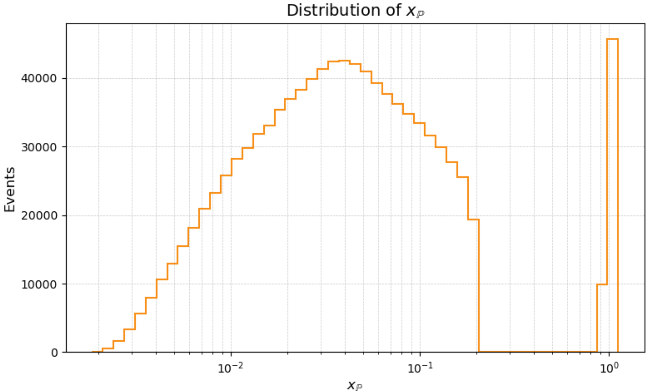
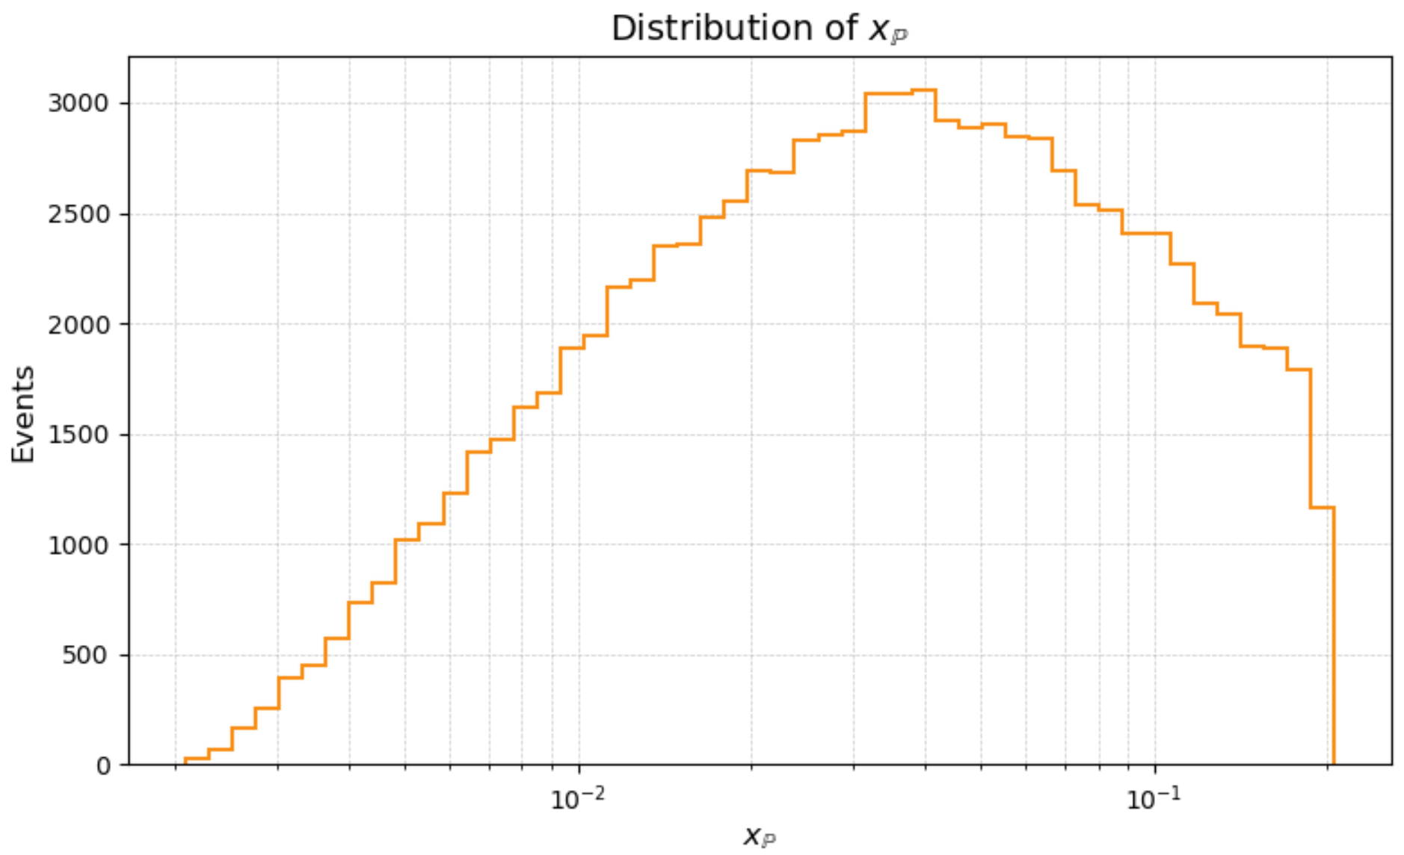
Before |t| cut after |t| <1.0 cut

Slide 7
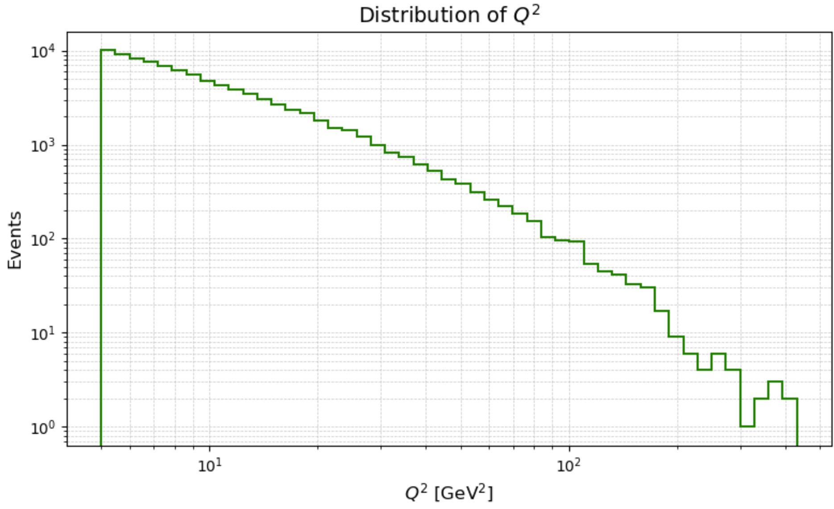
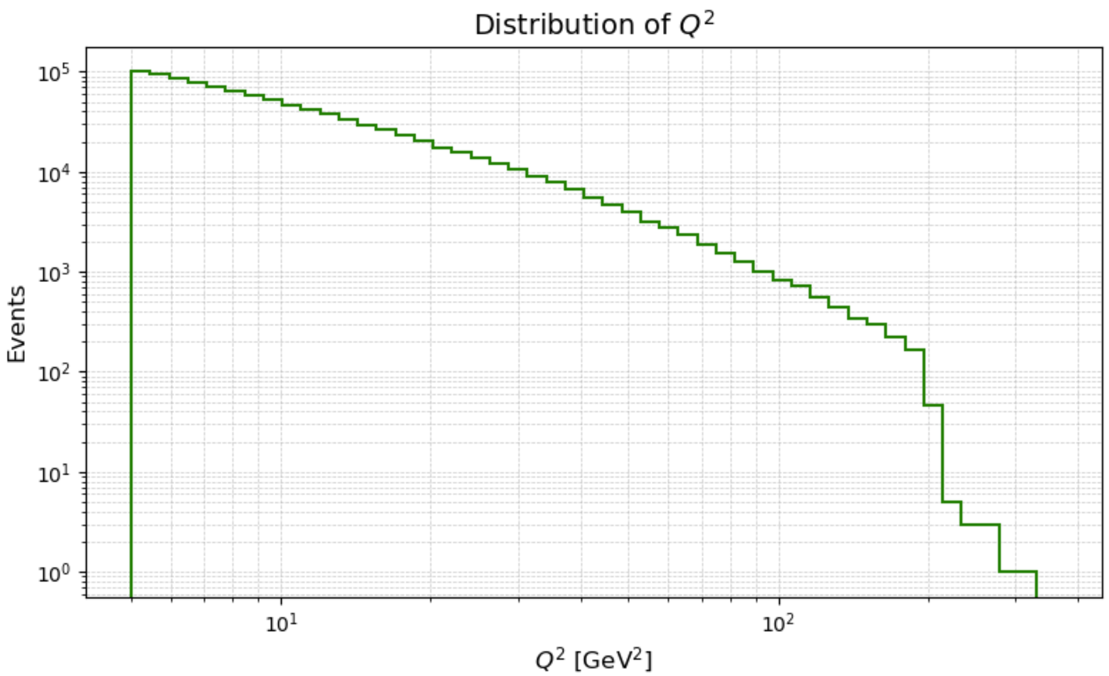
Before |t| cut after |t| <1.0 cut

Slide 8
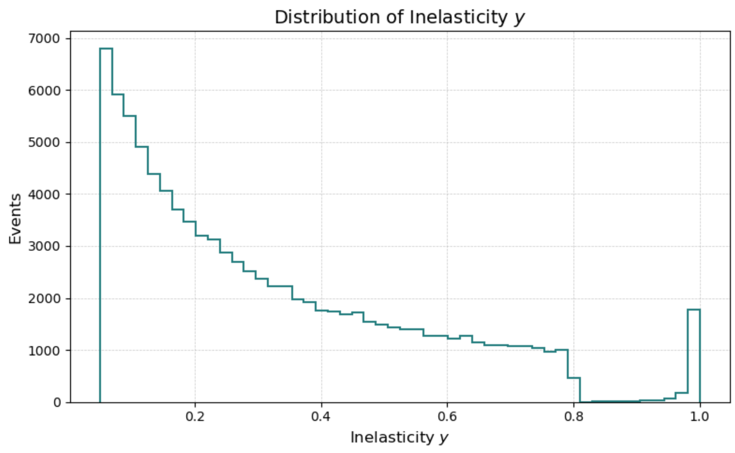
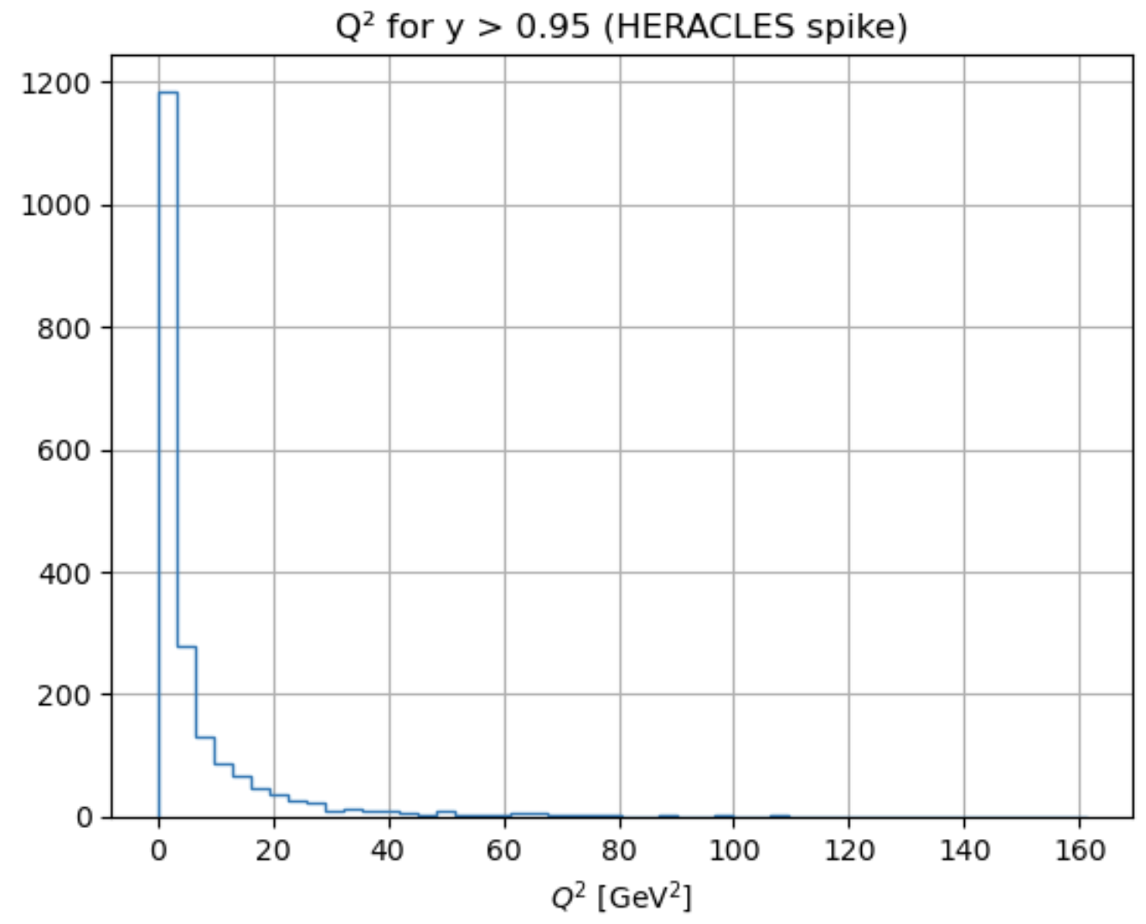
QMAX and YMAX
From comments in the steering file when using HERACLES QMAX should not be used.
the steering file comment warns: Do not apply YMAX when using HERACLES. Still though

Slide 9
YMAX
Most events have very low Q2 — sharply peaked at Q2≲2 GeV2
This is a sign pointing to radiative events, where:
The electron radiates a photon and is left with little energy and The resulting virtual photon is nearly real (soft interaction)
So maybe these are related to ISR parameter. Didn’t test this, but if we cut y<0.95
This solves this issue but also something else happens

Slide 10
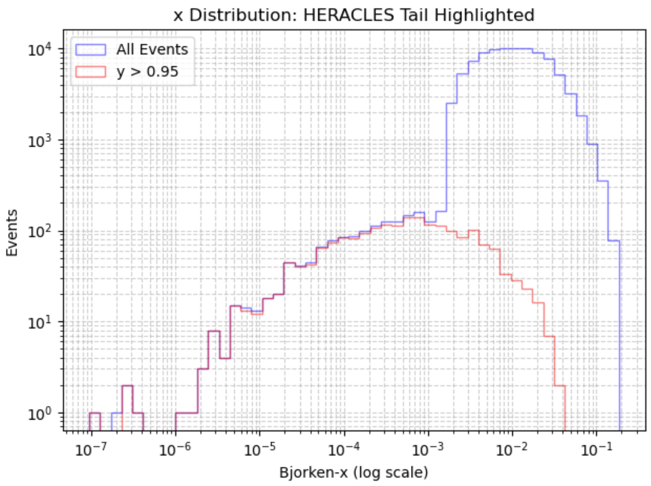
Low xB tail
So with y<0.95 cut basically all of the tail is gone.

Slide 11
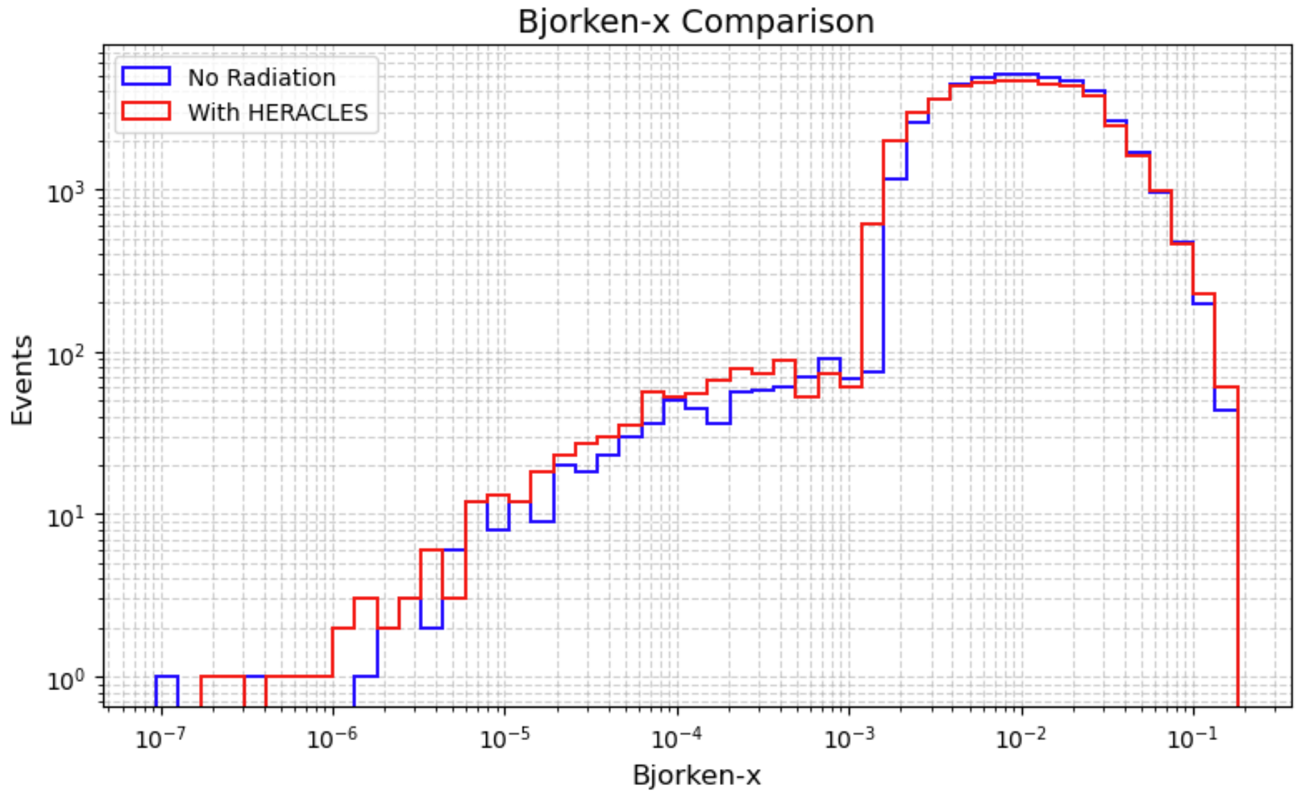
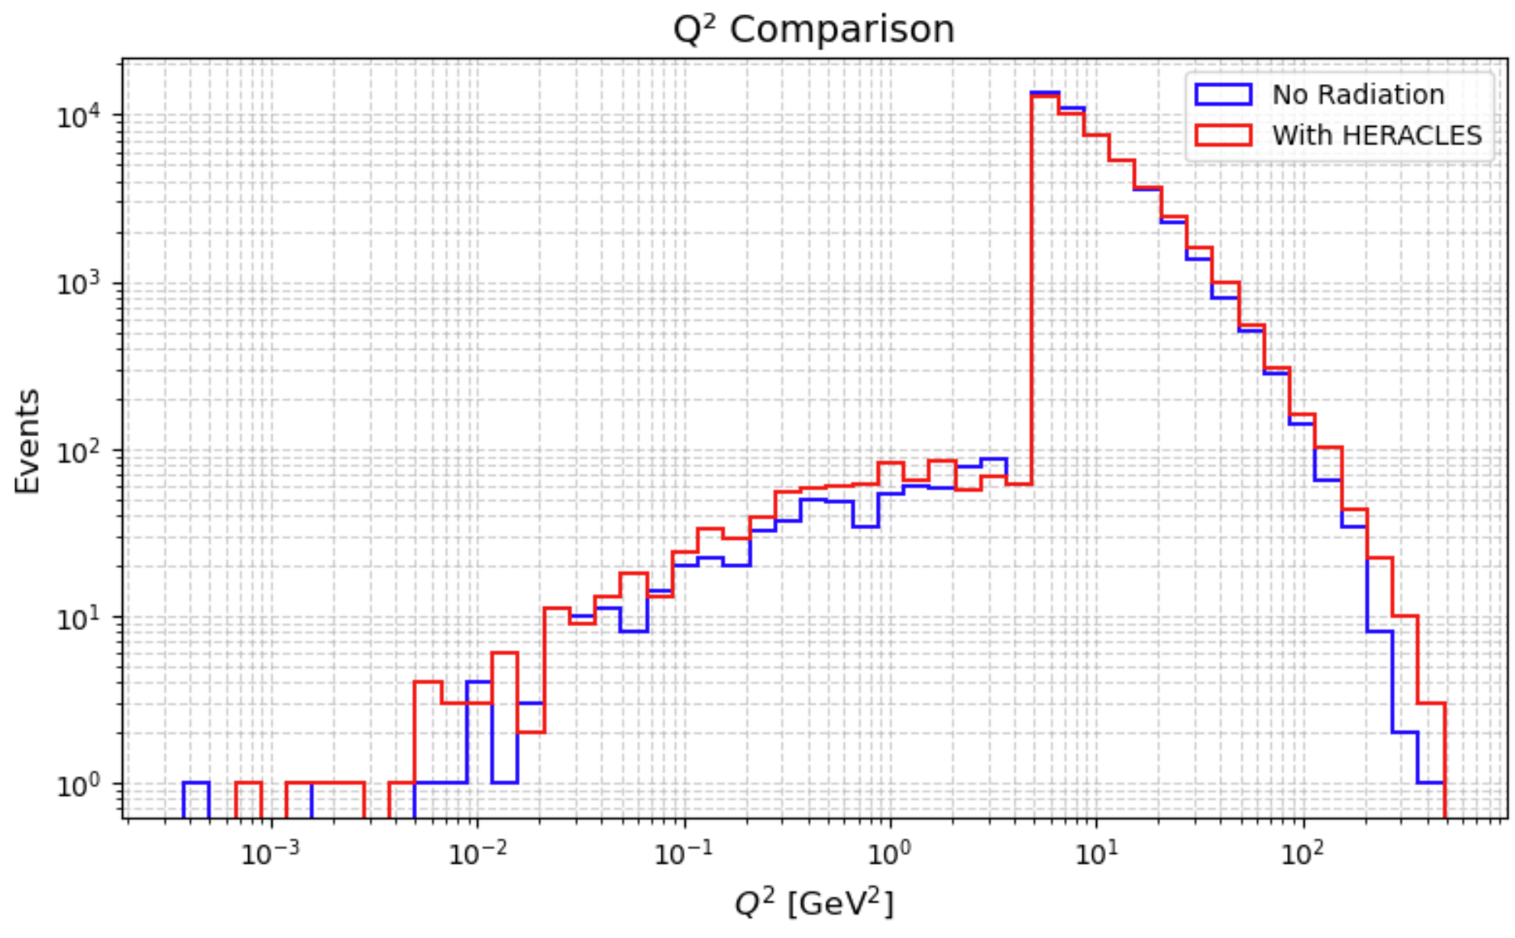
Results comparing QED rad vs w/o rad

Slide 12
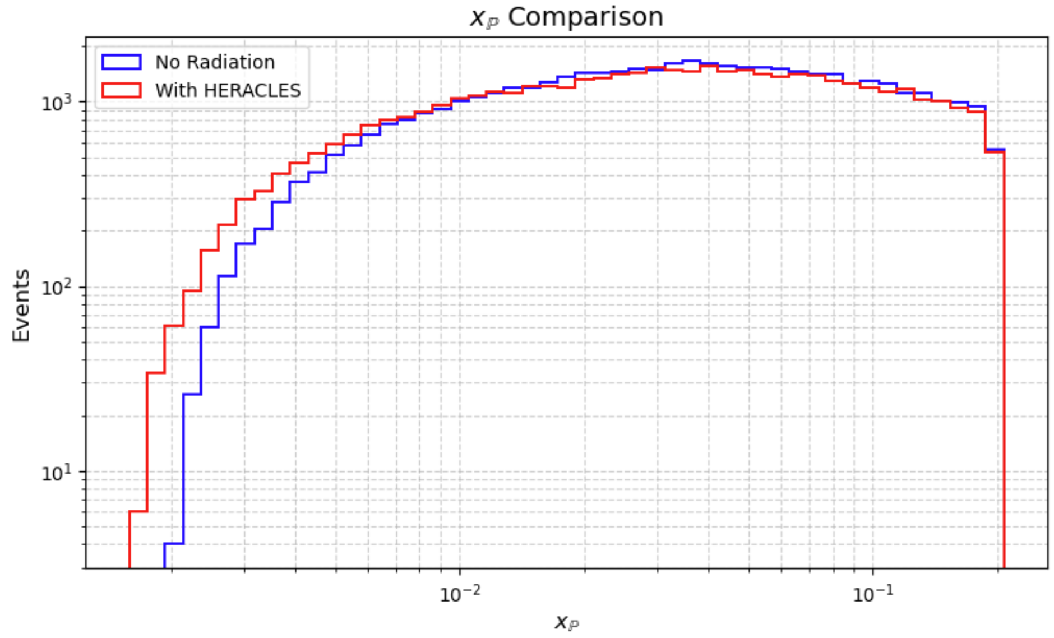
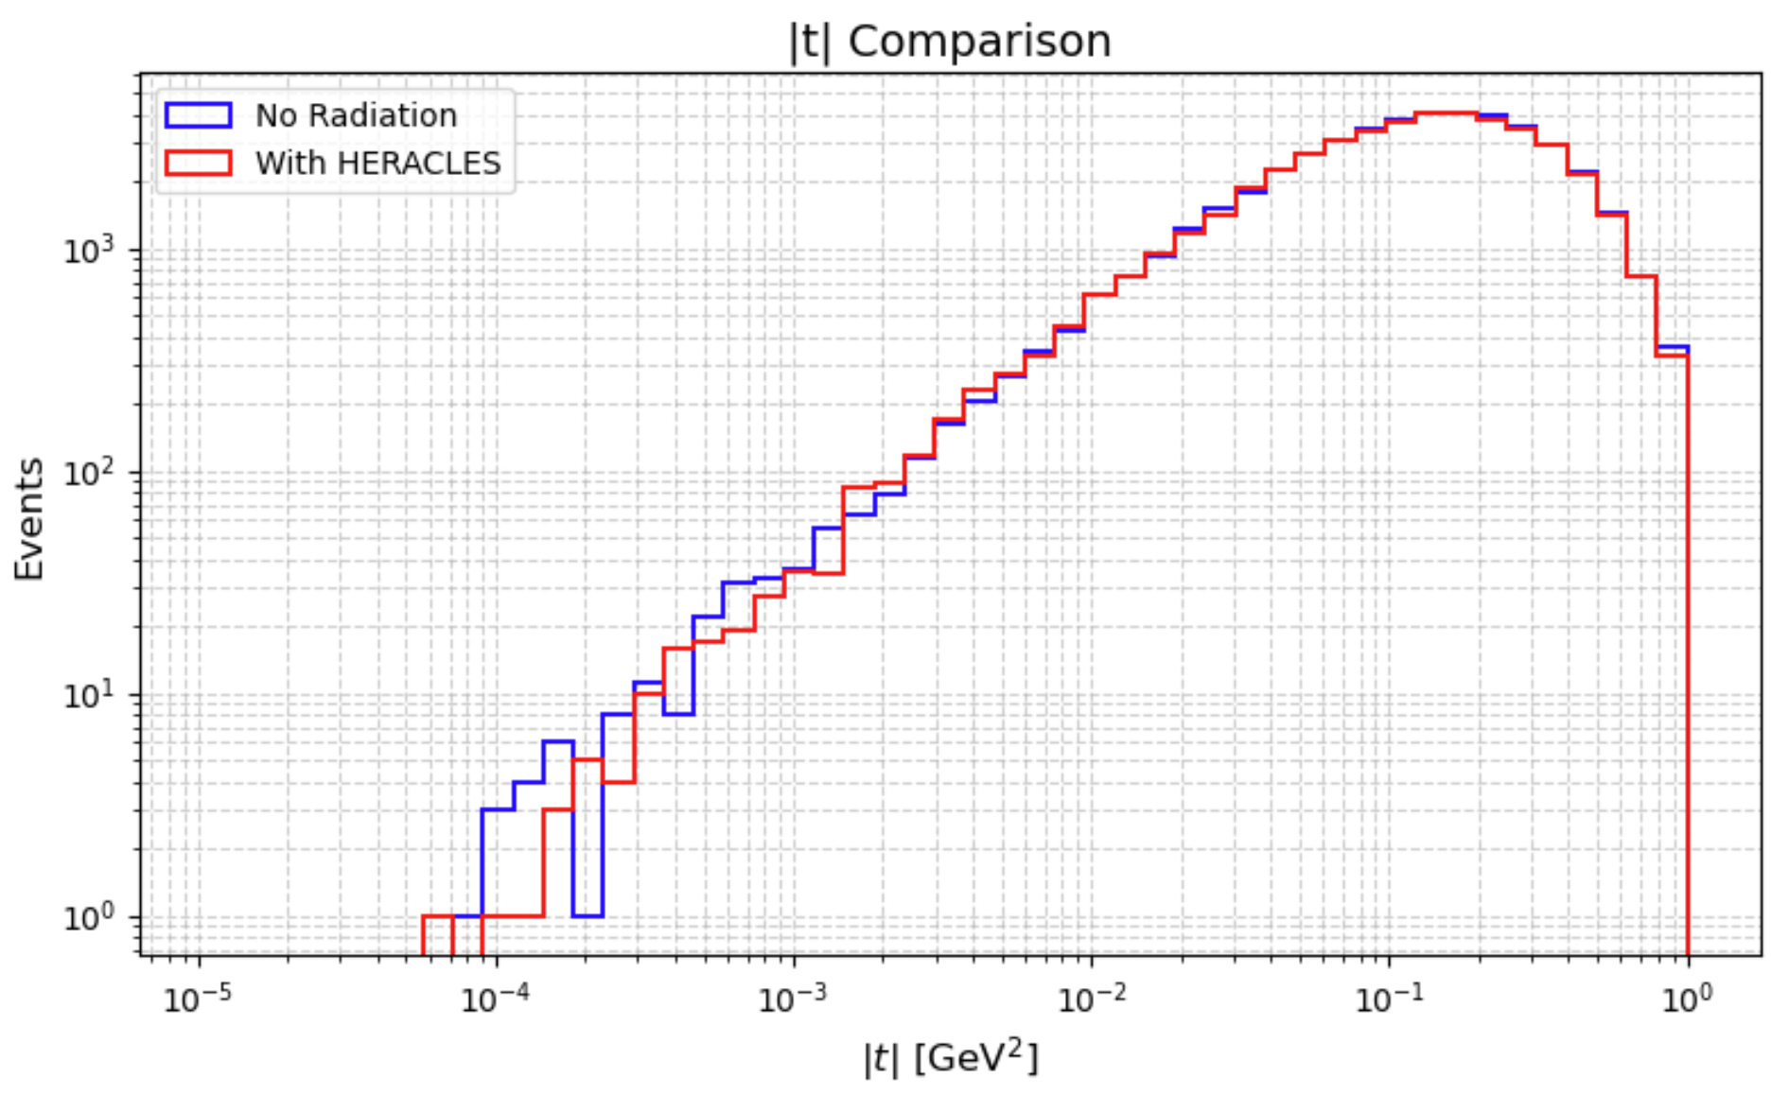

Slide 13
