Slide 1

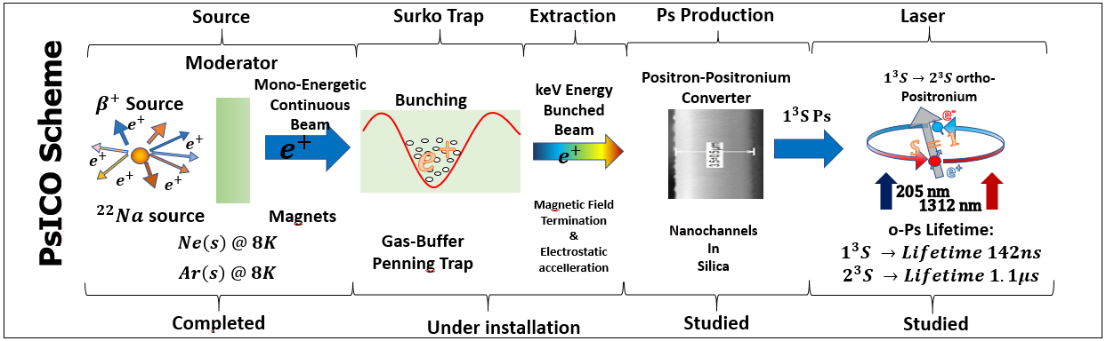
PsICO goals
production of a positronium (Ps) beam excited to the long-lived 2³S state for:
entanglement measurements of the 3γ coming from the annihilation of Ps prepared in selected quantum states
ii) inertial sensing measurements with the purely leptonic system
Both experiments requires:
1) continuous positron beam (based on the use of a radioactive source and a moderator);
2) positron Surko trap for e⁺ cooling and trapping for the production of e⁺ bunches;
3) extraction buncher to compress e⁺ in time (2 ns) and accelerate e⁺ up to several keV
4) high efficiency e⁺/Ps converter placed in the free field region;
5) a laser system to excite the metastable 2³S level (lifetime 1142 ns)

Slide 2
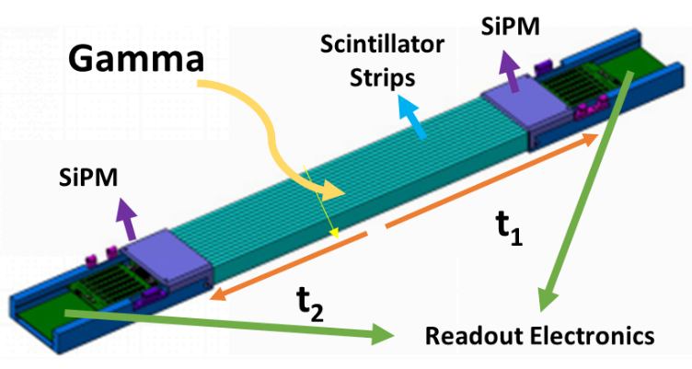
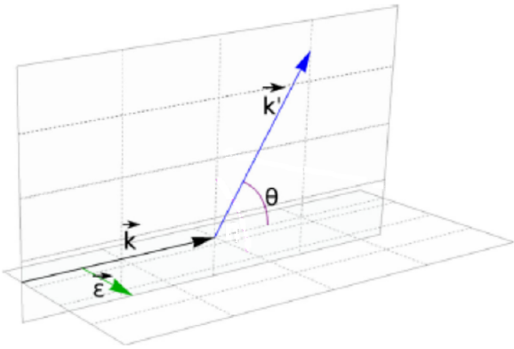
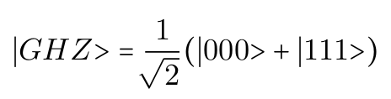
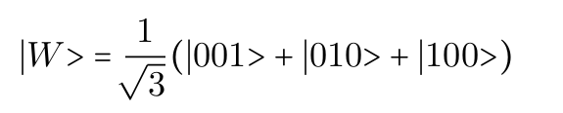
entanglement measurements of the 3γ coming from the annihilation of Ps prepared in selected quantum states
6) Selection of the magnetic quantum number m via 1³S-3³P-2³S two-step laser excitation with polarized laser pulses
7) Simultaneous detection of the 3 primary gamma rays and 3 scattered Compton (the polarization is expected to be perpendicular to the scattering plane)
M. Antonello et al. (AEgIS Collaboration),
Phys. Rev. A 100, 063414 (2019)
?
S.D. Bass, S. Mariazzi, P. Moskal, and E. Stepien, Rev. Mod. Phys. 95, 021002 (2023)
? … or other?
Sharma, S., Povolo L., Mariazzi, S….Brusa, R.S. …
Nucl. Instr. And Meth. A 1062, 169192 (2024)

Slide 3
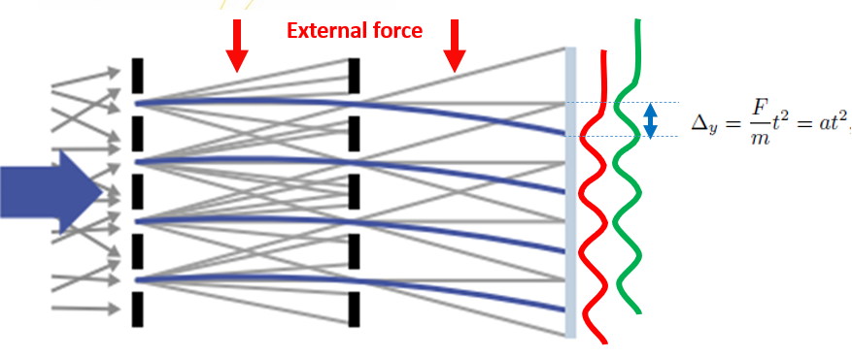
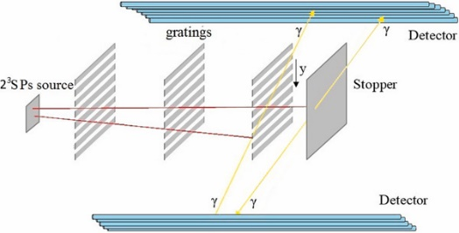
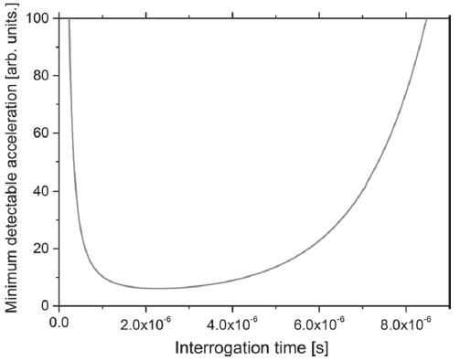

ii) inertial sensing measurements with the purely leptonic system
6) Interferometer for the formation of the fringe pattern
7) a spatial-sensitive detector for the measurement of the displacement of the fringe pattern induced by the external force
d
For 2³S Ps (1.142 μs)
For 2³S level
g → Δy < 0.3 nm
10⁵ g → Δy < 30 μm
S. Mariazzi, R. Caravita, M. Doser, G. Nebbia, and R.S. Brusa, Eur. Phys. J. D 74, 79 (2020)

Slide 4
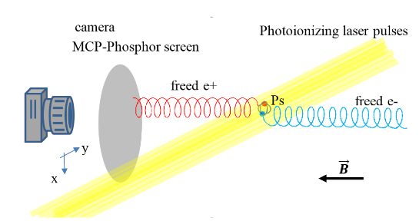
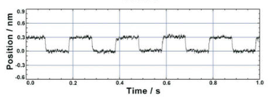
ii) inertial sensing measurements with the purely leptonic system
Fringe pattern detector
Option 1: spatial sensitive detector
Option 2: scan of the fringe pattern
Ps photoionization in a strong magnetic field and imaging of the photopositrons (thanks to the field they keep memory of the Ps position)
Probing the fringe pattern with a third material grating with a detector counting Ps annihilations on the grid and crossing the grid
Resolution given by the one of the grating movement. Commercially available piezo-actuators have 0.3 nm of resolution
Spatial resolution of (88±5) μm (MCP+phosphor screen)
Amsler C et al (AEgIS collaboration) NIMB 457, 44 (2019)
Spatial resolution of ~12 μm (Timepix)
Glogger L et al (AEgIS collaboration) Meas Sci and Tech 33, 115105 (2022)
Expected spatial resolution of ~3 μm (with commercially available proper MCP)

Slide 5
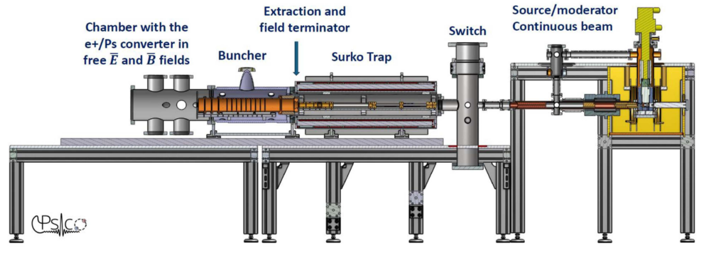
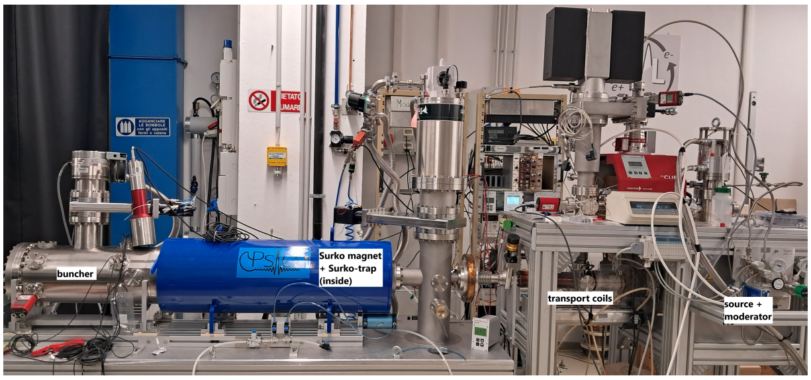
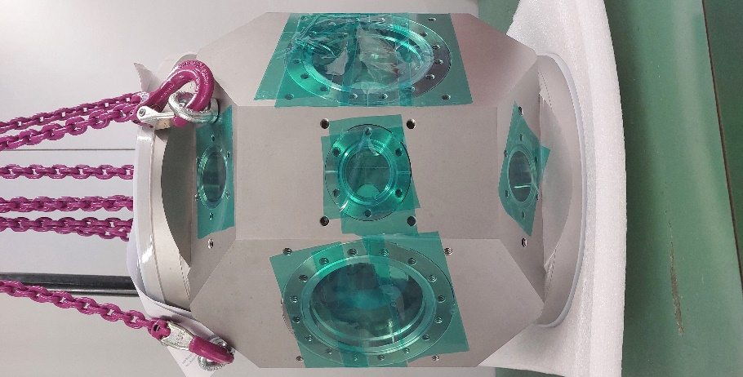
PsICO apparatus
Delivered in May
Under test
Tested

Slide 6
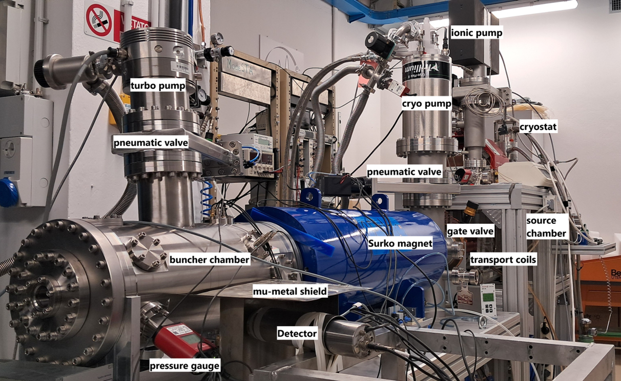
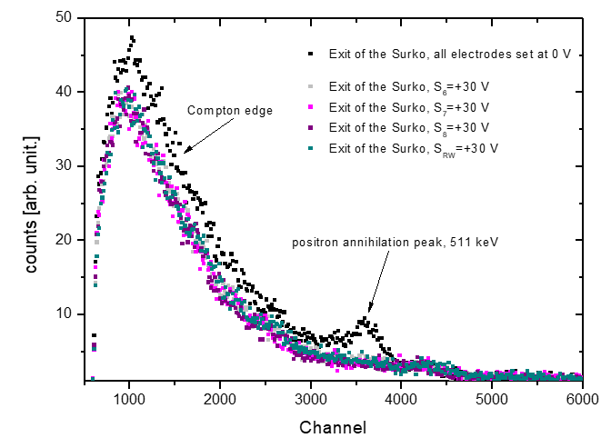
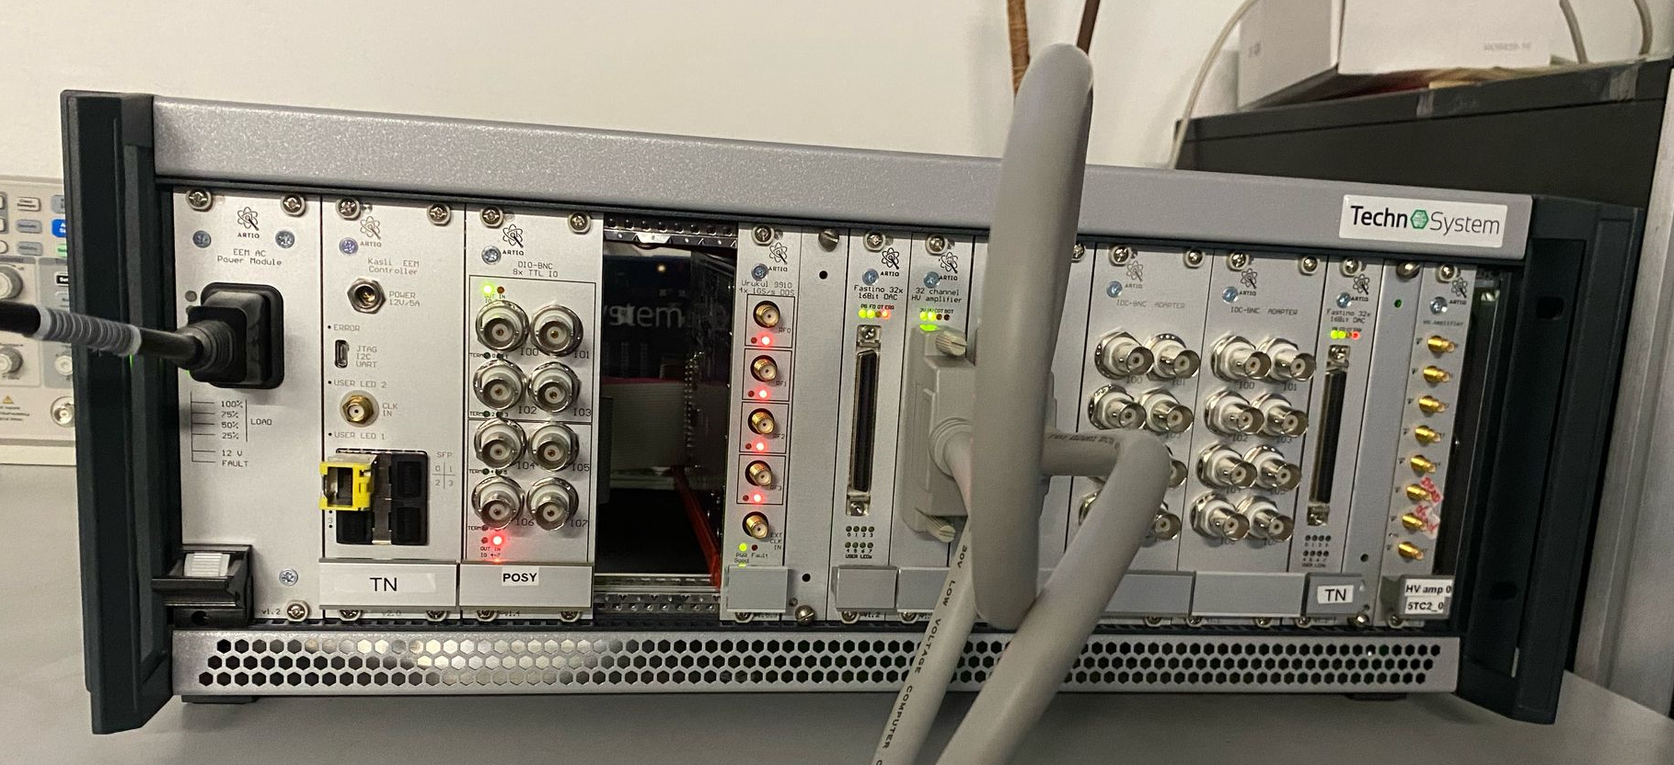
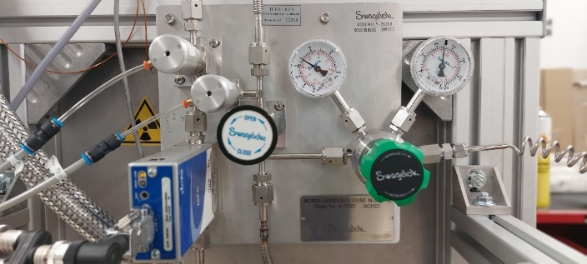
Results 2024/beginning 2025
Continuous transport of positron to the exit of the Surko trap
Test completed
Test of electronics for Surko-trap electrodes (including RW)
Installation of the Surko-trap buffer gas lines
Tests of e⁺ trapping, storing, and bunching are planned in the next few months

Slide 7

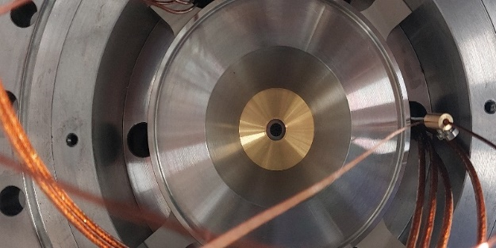
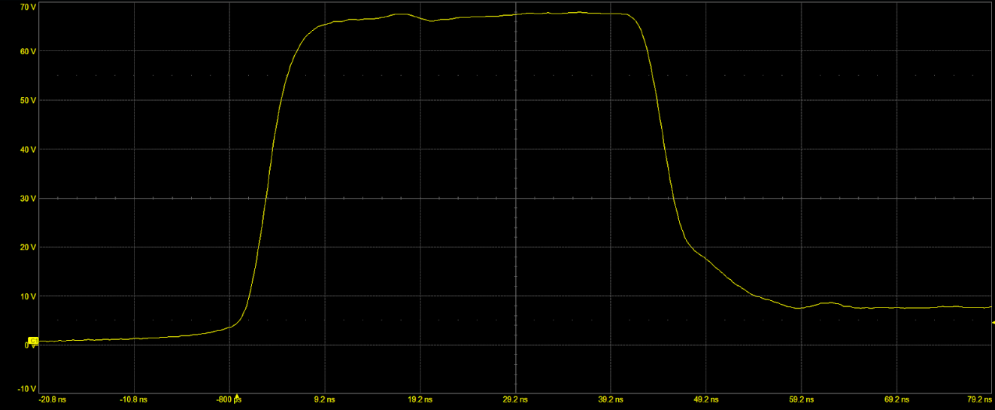
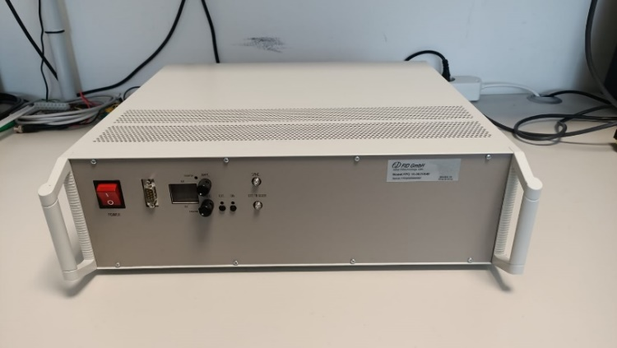
Results 2024/beginning 2025
Installation of spider field terminator
Tests of e⁺ extraction planned in the next few months
Tests of the pulser of the buncher
(rise time <5ns at 10 kV)
Tests of the buncher planned in the next few months

Slide 8
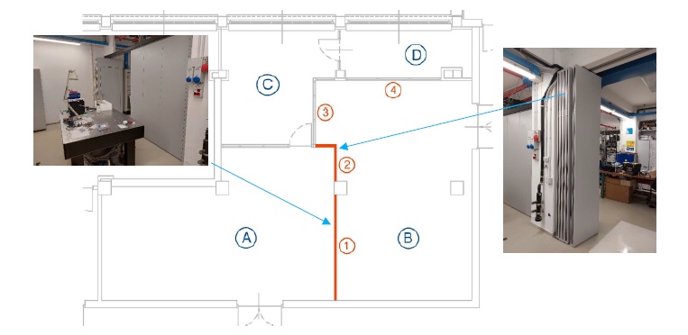
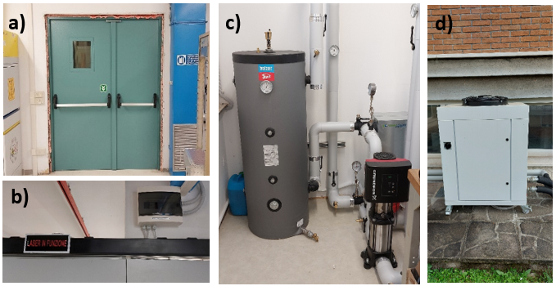
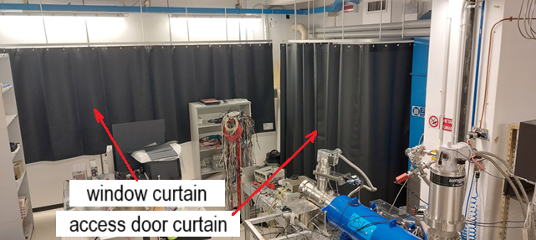
Results 2024/beginning 2025
Completion of the infrastructures for laser+positron beam installation

Slide 9
Milestones
La milestone del 2024 prevedeva l’installazione della camera per la conversione di positroni in positronio.
Tale sistema è costituito da un vessel per l'alloggiamento del campione, dal supporto dedicato, dal sistema di pompaggio, dalla connessione al buncher, dalle flange per la chiusura del vuoto, le view ports per l’accesso del laser ed il manipolatore per l’inserimento del convertitore di positroni in positronio. Tutti gli elementi sono attualmente disponibili nel laboratorio. L’ultimo pezzo ad essere stato consegnato è l’alloggiamento del campione che è stato ordinato a giugno 2024 da una compagnia extra UE. La ditta è stata scelta per il prezzo molto competitivo ma questo ha allungato l’iter burocratico ed è stato consegnato a fine Maggio 2025.
Al momento la milestone è stata completata al 90% e sarà ultimata a breve ora che tutti gli elementi sono disponibili.
2024 Installation e⁺/Ps experimental chamber 90%
2025 Production of Ps clouds 31/12 70% estimation 100%
2025 Tests of Ps laser excitation to 2^3S 31/12 70% estimation 100%
2026 Commissioning of the Ps entanglement apparatus 31/12
Publications 2024-2025
New Bunched Positron Beam at the AntiMatter Laboratory in Trento: Planned Quantum Experiments with Positronium
Mariazzi, S., Caravita, R….Brusa, R.S.
Acta Phys. Pol. A 146, 5 (2024)
Systematic characterization of a Ne, Ar, Kr rare-gas moderated positron beam and spin polarization measurements
Povolo, L., Mariazzi, S….Brusa, R.S.
Nucl. Instr. And Meth. B 552, 165376 (2024)
Feasibility studies for imaging e⁺-e⁻ annihilation with modular multi-strip detectors
Sharma, S., Povolo L., Mariazzi, S….Brusa, R.S. …
Nucl. Instr. And Meth. A 1062, 169192 (2024)

Slide 10
Conferences 2024-2025
Preliminary tests of positronium gathering in microcavities connected to nanochannels
International Conference on Positron Annhilation 2025, Takamatsu, Japan 30/6-6/7/2025
S. Mariazzi invited talk
Metastable positronium clouds production for fundamental experiments
110 Congresso nazionale SIF, Bologna, Italy, 9-13 September 2024
S. Mariazzi talk
Fundamental experiments with positronium confined in micro-cavities and emitted into the vacuumwith the new bunched positron beam at the AntiMatter Lab of Trento
Positron Studies of Defects 2024, Como 1-6/9/2024
S. Mariazzi invited talk
Preliminary tests of positronium gathering in microcavities connected to nanochannels
International Conference on Positron Annhilation 2025, Como 30/6-6/7/2025
S. Mariazzi invited talk
Master thesis 2024-2025
S. Salandini “Installation and preliminary tests of a Surko-trap for a new bunched positron beam”
Master’s Degree Thesis in Physics, University of Trento, 20/3/2025
E. Socal “Characterization of targets for positronium collection in microcavities”
Master’s Degree Thesis in Physics, University of Trento, 20/3/2025

Slide 11
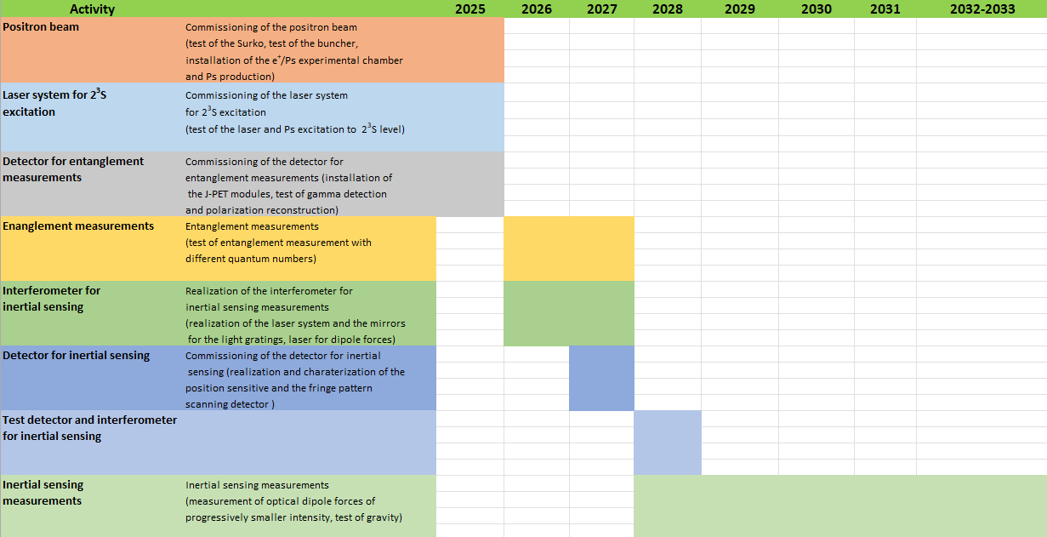
Gantt CDR
Detector for entanglement measurements: four-year long project financed by Polish National Science Centre (NCN) with 565 k€ (of which around 160 k€ for instrumentation) in the call Sonata bis 13 whose PI is Sushil Sharma

Slide 12
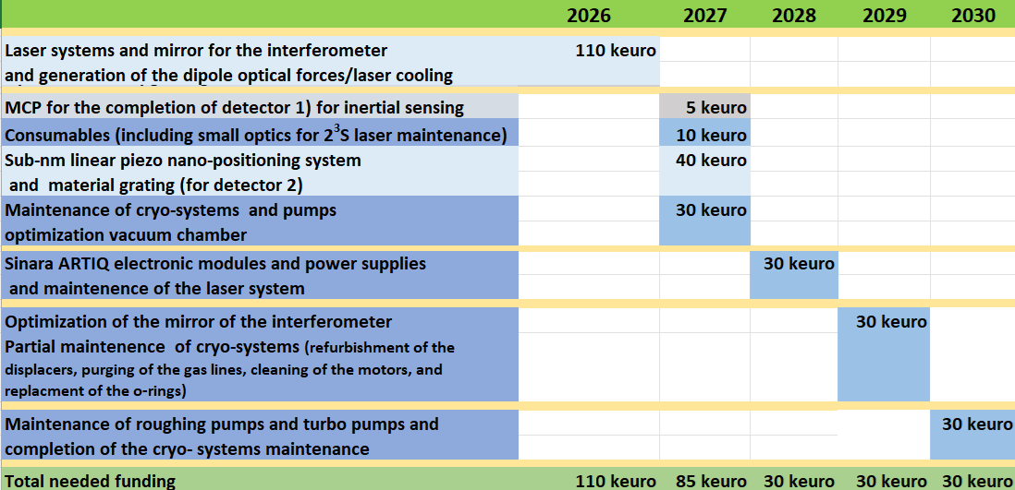
Financial needs
105
105 keuro
Missioni 2.5 keuro synergy with AEgIS for operation of the laser system
1 alexandride laser rod, 1 dedicated power supply, 1 HV switch for intracavity pulse chopping, 1 flashlamp, 1 control system, 1 chiller,
1 mirror with high degree of optical planarity
second alexandride laser rod, dedicated power supply, HV switch for intracavity pulse chopping, and flashlamp

Slide 13
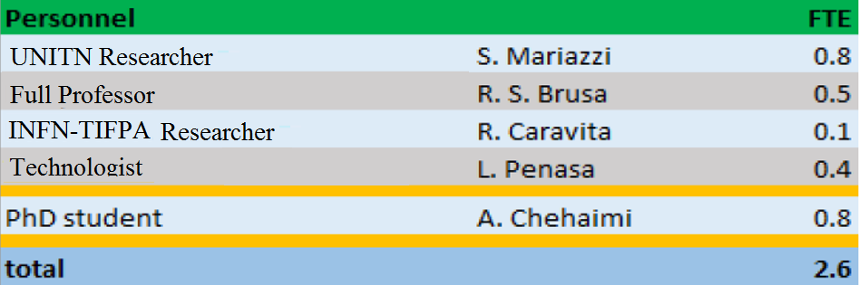
People
Design of the experiments, development of the experimental bunched positron system and the laser system for Ps excitation to long-lived states
-Department of Physics, University of Trento- TIFPA/INFN Trento
-Department of Physics “Aldo Pontremoli”, Università degli Studi di Milano
-Department of Aerospace Science and Technology, Politecnico di Milano
7 researchers 2.6 FTE
+ new PhD
Other Institutes:
CERN
University of Oslo (Norway),
Norwegian University of Science and Technology (Norway),
University of Liverpool (United Kingdom),
Jagiellonian University of Krakow (Poland),
Fondazione Bruno Kesler (FBK) (Italy)
Development of theoretical models and simulations of Ps atomic structure
+ new PhD (0.8)
Responsible for the detector of gamma polarization
In 2025, A. Chehaimi spent several month in AEgIS to get familiar with the AEgIS laser system. Missioni 2025: 2.5 keuro non assegnati.

Slide 14
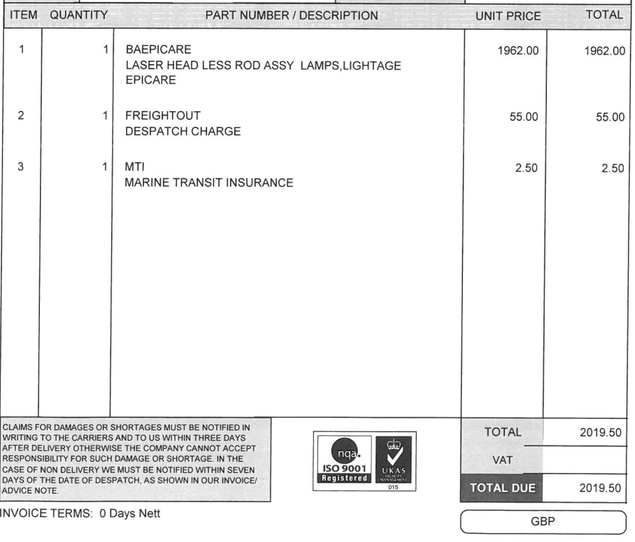
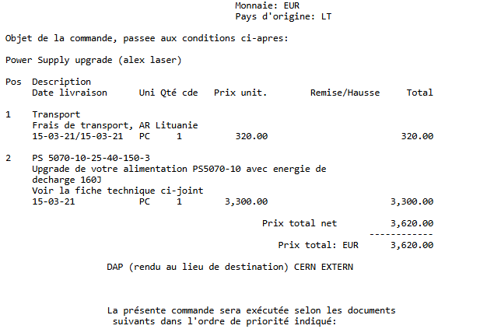
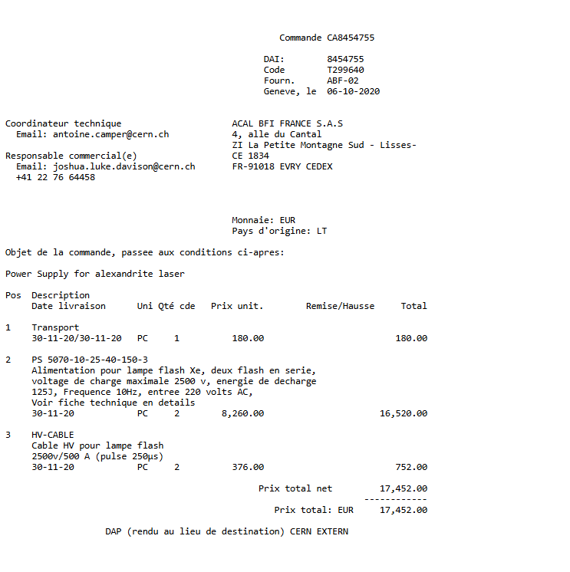
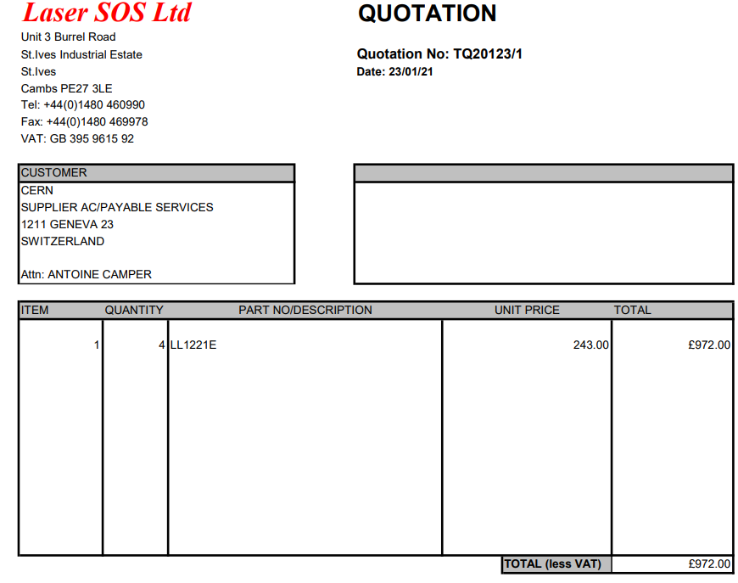
Alexandrite
2 alexandride laser rod and housing,
2 dedicated power supply,
2 HV switch for intracavity pulse chopping (home made HV connectors, C,
housing…),
2 flashlamp,
1 control system (crate+FPGA 8ch),
1 chiller
2 x 2500 euro (housing)
2 x 3000 euro (rod)
500 euro
22000 euro
1200 euro

Slide 15
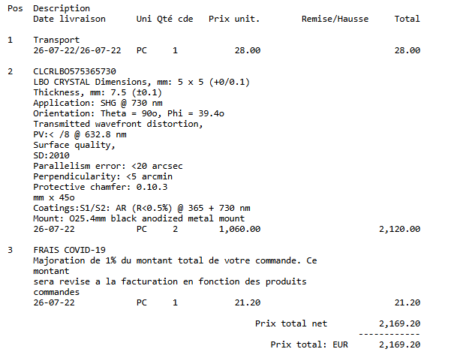
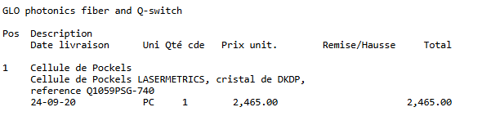
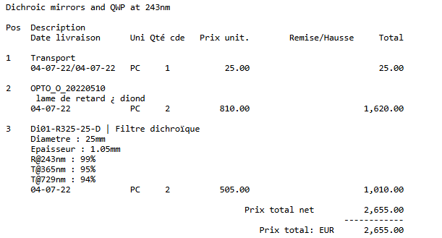
Alexandrite
non-linear crystals,
their mount with heating and associated motorized stages,
volume Bragg grating,
Q-switch crystal,
polarizer,
mirrors for the cavity,
half wave plate,
rotative mount for wavelength selection inside the cavity
2500 euro
2200 euro
2700 euro

